Slide 1
Operating Systems:
Principles and Practice
Original slides by: Tom Anderson
https://homes.cs.washington.edu/~tom/Slides/slides.html

Slide 2
Further reading
https://d3s.mff.cuni.cz/files/teaching/nswi004/text.pdf
https://d3s.mff.cuni.cz/teaching/nswi004/
https://homes.cs.washington.edu/~tom/Slides/slides.html

Slide 3
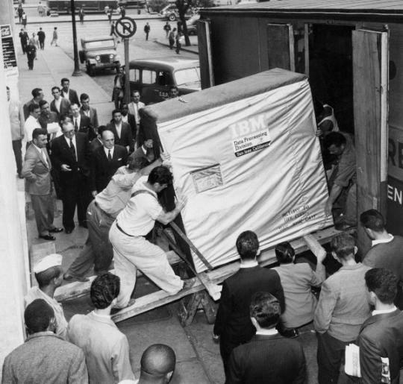
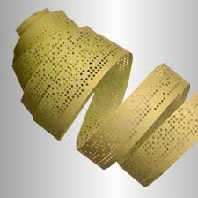
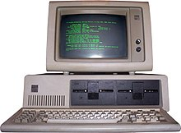
Why OS?
1950’
1970’
1980’

Slide 4
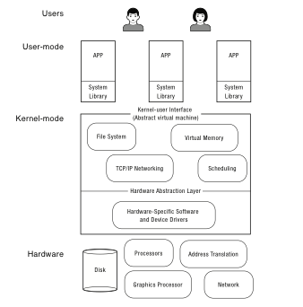
What is an operating system?
Software to manage a computer’s resources for its users and applications
Notes:
In some sense, OS is just a software engineering problem: how do you convert what the hardware gives you into something that the application programmers want?
For any OS area (file systems, virtual memory, networking, CPU scheduling), begin by asking two questions:
what’s the hardware interface? (the physical reality)
what’s the application interface? (the nicer abstraction)
We’ve broken it down a bit: we have users and their applications. You probably already know about libraries – that applications can be linked with code that helps them do their job, e.g., like the C library, with malloc and free and string operations.
But when you write an app, you write it as if it has the entire machine – you don’t need to worry about the fact that there are multiple other apps running at the same time. It doesn’t crash just because one of those other apps has a bug. This interface is an abstract virtual machine – an abstraction that allows programmers to ignore the OS.
Much of the OS runs in “kernel mode” – we’ll describe that in the next lecture. That code provides applications the abstraction of their own dedicated hardware. And under all of that is another abstraction, that allows the OS to run on a variety of different hardware – this is the HAL. That way, you can change the underlying hardware, without changing (much of) the OS.
Need to have the various layers coordinate – library makes calls into the kernel to do things, like write file data to the disk, or get a network packet. But they run in separate domains.
As you look at the code in OS/161, or if you look inside Linux (or any other OS you might find), you’ll see these three categories.
Kern – kernel code
Userland – system libraries
Kern/arch – machine dependent routines, specific to each different type of CPU
One of the first questions you’ll see in assignment 0 is: how does a system call work? Where do you find the code to read from a file in userland? Where do you find the code to read from a file in the kernel? Where do you find the machine-specific code to read from the physical disk?

Slide 5
Operating System Roles
Referee:
  Resource allocation among users, applications
  Isolation of different users, applications from each other
  Communication between users, applications
Illusionist
  Each application appears to have the entire machine to itself
  Infinite number of processors, (near) infinite amount of memory, reliable storage, reliable network transport
Glue
  Libraries, user interface widgets, …
Notes:
Each of these points is pretty complex! But we’ll see a lot of examples.
90% of the code in an OS is in the glue – but its mostly easy to understand, so we won’t spend any time on it.
Consider the illusion though – you buy a new computer, with more processors than the last one. But you don’t have to get all new software – the OS is the same, the apps are the same, but the system runs faster. How does it do that? You buy more memory – you don’t change the OS, you don’t change the apps, but the system runs faster. How does it do that?
Part of the answer is that the OS serves as the referee between applications. How much memory should everyone have? How much of the CPU?
The OS also has to isolate the different applications and users from each other – if one app crashes, you don’t want it to require a system reboot. If one user writes a buggy app on attu, you don’t want it to crash the system for everyone else. How is that even possible?

Slide 6
Example: File Systems
Referee
  Prevent users from accessing each other’s files without permission
  Even after a file is deleting and its space re-used
Illusionist
  Files can grow (nearly) arbitrarily large
  Files persist even when the machine crashes in the middle of a save
Glue
  Named directories, printf, …
Notes:
Ask: Examples of OS as referee?
Examples of OS as illusionist?

Slide 7
  Question
What (hardware, software) do you need to be able to run an untrustworthy application?
  Memory protection
  Interrupt running application
  Privileged mode (OS)
Notes:
Ask audience for ideas – they’ve taken machine structures.
Answer: need memory protection, but also ability to interrupt a running job. And to have a privileged mode – capable of changing the memory proection.

Slide 8
Question
How should an operating system allocate processing time between competing uses?
  Give the CPU to the first to arrive?
  To the one that needs the least resources to complete? To the one that needs the most resources?

Slide 9
OS Challenges
Reliability
  Does the system do what it was designed to do?
Availability
  What portion of the time is the system working?
  Mean Time To Failure (MTTF), Mean Time to Repair
Security
  Can the system be compromised by an attacker?
Privacy
  Data is accessible only to authorized users
Notes:
An excuse to define some terms!

Slide 10
OS Challenges
Portability
  For programs:
    Application programming interface (API)
    Abstract virtual machine (AVM)
  For the operating system
    Hardware abstraction layer

Slide 11
OS Challenges
Performance
  Latency/response time
    How long does an operation take to complete?
  Throughput
    How many operations can be done per unit of time?
  Overhead
    How much extra work is done by the OS?
  Fairness
    How equal is the performance received by different users?
  Predictability
    How consistent is the performance over time?

Slide 12
Early Operating Systems:
Computers Very Expensive
One application at a time
  Had complete control of hardware
  OS was runtime library
  Users would stand in line to use the computer
Batch systems
  Keep CPU busy by having a queue of jobs
  OS would load next job while current one runs
  Users would submit jobs, and wait, and wait, and
Notes:
And wait…

Slide 13
Time-Sharing Operating Systems:
Computers and People Expensive
Multiple users on computer at same time
  Multiprogramming: run multiple programs at same time
  Interactive performance: try to complete everyone’s tasks quickly
  As computers became cheaper, more important to optimize for user time, not computer time

Slide 14
The Kernel Abstraction

Slide 15
Challenge: Protection
How do we execute code with restricted privileges?
  Either because the code is buggy or if it might be malicious
Some examples:
  A script running in a web browser
  A program you just downloaded off the Internet
  A program you just wrote that you haven’t tested yet
Notes:
Not just about OS’es; not just bugs

Slide 16
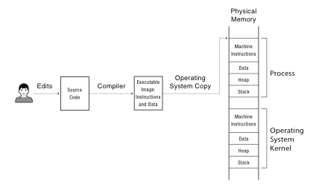
A Problem
Notes:
OK, so you compile your program into an executable image with instructions and data.
Which of these is the program? How does it start running? Well, if its Javascript – no compilation step! Just interprets the source code.
If its Android, then its compiled into a byte code that is interpreted in software – well, actually, interpreted into short snippets of instructions, with jumps back into the interpreter when done.
If it’s attu, then compiled into x86 instructions.
What’s to keep the process from overwriting the OS kernel? Or some other process running at the same time?
What’s to keep it from overwriting the disk? From reading someone else’s files that are stored on disk?

Slide 17
Main Points
Process concept
  A process is the OS abstraction for executing a program with limited privileges
Dual-mode operation: user vs. kernel
  Kernel-mode: execute with complete privileges
  User-mode: execute with fewer privileges
Safe control transfer
  How do we switch from one mode to the other?

Slide 18
Process Abstraction
Process: an instance of a program, running with limited rights
  Thread: a sequence of instructions within a process
    Potentially many threads per process (for now 1:1)
  Address space: set of rights of a process
    Memory that the process can access
    Other permissions the process has (e.g., which system calls it can make, what files it can access)

Slide 19
Thought Experiment
How can we implement execution with limited privilege?
  Execute each program instruction in a simulator
  If the instruction is permitted, do the instruction
  Otherwise, stop the process
  Basic model in Javascript and other interpreted languages
How do we go faster?
  Run the unprivileged code directly on the CPU!
Notes:
Upsides? Downsides to this approach? Essentially what you do in Javascript in a browser – simulate the execution of the script, one line at a time.

Slide 20
Hardware Support:
Dual-Mode Operation
Kernel mode
  Execution with the full privileges of the hardware
  Read/write to any memory, access any I/O device, read/write any disk sector, send/read any packet
User mode
  Limited privileges
  Only those granted by the operating system kernel
On the x86, mode stored in EFLAGS register
On the MIPS, mode in the status register
Notes:
Obviously, you need the part that has full rights to be really reliable!

Slide 21
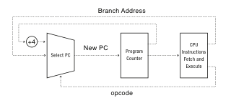
A Model of a CPU

Slide 22
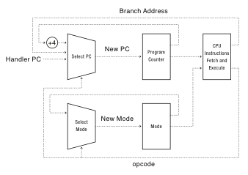
A CPU with Dual-Mode Operation
Notes:
Where do interrupts fit in?

Slide 23
Hardware Support:
Dual-Mode Operation
Privileged instructions
  Available to kernel
  Not available to user code
Limits on memory accesses
  To prevent user code from overwriting the kernel
Timer
  To regain control from a user program in a loop
Safe way to switch from user mode to kernel mode, and vice versa

Slide 24
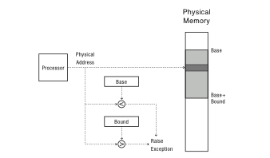
Simple Memory Protection
Notes:
Second thing

Slide 25
Privileged instructions
Examples?
  Change mode bit in EFLAGs register!
  Change which memory locations a user program can access
  Send commands to I/O devices
  Read data from/write data to I/O devices
  Jump into kernel code
Notes:
Change mode bit in EFLAGs register!
Change which memory locations a user program can access
Send commands to I/O devices
Read data from/write data to I/O devices
Jump into kernel code
…

Slide 26
Mode Switch
From user mode to kernel mode
  Interrupts
    Triggered by timer and I/O devices
  Exceptions
    Triggered by unexpected program behavior
    Or malicious behavior!
  System calls (aka protected procedure call)
    Request by program for kernel to do some operation on its behalf
    Only limited # of very carefully coded entry points
Notes:
Might work better starting with interrupts!

Slide 27
Device Interrupts
OS kernel needs to communicate with physical devices
Devices operate asynchronously from the CPU
  Polling: Kernel waits until I/O is done
  Interrupts: Kernel can do other work in the meantime
Device access to memory
  Programmed I/O: CPU reads and writes to device
  Direct memory access (DMA) by device
  Buffer descriptor: sequence of DMA’s
    E.g., packet header and packet body
  Queue of buffer descriptors
    Buffer descriptor itself is DMA’ed
Notes:
OK, a quick tour of I/O. Without I/O, can’t do much of anything!

Slide 28
System Calls
Creating and managing processes
  fork, exec, wait
Performing I/O
  open, read, write, close
Communicating between processes
  pipe, dup, select, connect

Slide 29
Mode Switch
From kernel mode to user mode
  New process/new thread start
    Jump to first instruction in program/thread
  Return from interrupt, exception, system call
    Resume suspended execution
  Process/thread context switch
    Resume some other process
  User-level upcall (UNIX signal)
    Asynchronous notification to user program

Slide 30
How do we take interrupts safely?
Interrupt vector
  Limited number of entry points into kernel
Atomic transfer of control
  Single instruction to change:
    Program counter
    Stack pointer
    Memory protection
    Kernel/user mode
Transparent restartable execution
  User program does not know interrupt occurred

Slide 31
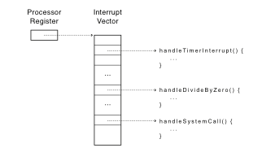
Interrupt Vector
Table set up by OS kernel; pointers to code to run on different events
Notes:
Note: by “processor register” I do not mean %eax. Rather – these are special purpose registers.

Slide 32
Concurrency

Slide 33
Motivation
Operating systems (and application programs) often need to be able to handle multiple things happening at the same time
  Process execution, interrupts, background tasks, system maintenance
Humans are not very good at keeping track of multiple things happening simultaneously
Threads are an abstraction to help bridge this gap

Slide 34
Definitions
A thread is a single execution sequence that represents a separately schedulable task
  Single execution sequence: familiar programming model
  Separately schedulable: OS can run or suspend a thread at any time
Protection is an orthogonal concept
  Can have one or many threads per protection domain

Slide 35
How?
Queue of threads ready to execute
  Schedueler select one of them and let it run on processor for a certain time, then switch another
  Which one to select? Good question:-)
    Responsiveness, throughput, efficiency requirements
    Requirements may differ (realtime / batch / interactive)
    Priorities (static / dynamic)
    Fair share, shortest job first, Round robin,…

Slide 36
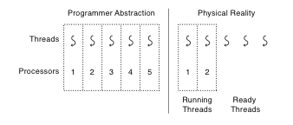
Thread Abstraction
Infinite number of processors
Threads execute with variable speed
  Programs must be designed to work with any schedule
Notes:
Execution model: each thread runs on a dedicated virtual processor with unpredictable and variable speed.

Slide 37
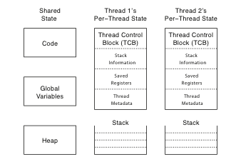
Thread Data Structures

Slide 38
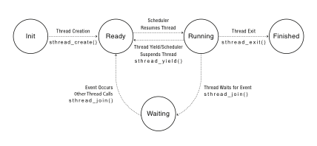
Thread Lifecycle
Notes:
Labels should be thread_create() not sthread_create, etc.

Slide 39
Synchronization
Notes:
NOTE to instructors: it is helpful to walk through an example such as readers/writers locks for illustrating the use of condition variables. I haven’t included it in these slides, as I usually take a class to do that example on the board – showing what happens as multiple threads stop at various points during the execution and other threads run.

Slide 40
Synchronization Motivation
When threads concurrently read/write shared memory, program behavior is undefined
  Two threads write to the same variable; which one should win?
Thread schedule is non-deterministic
  Behavior changes when re-run program
Compiler/hardware instruction reordering
Multi-word operations are not atomic
Notes:
To solve any of these, you need synchronization.
You want program behavior to be a specific function of input – not of the sequence of who went first.
You want the behavior to be deterministic – not to vary from run to run
Even if you ignore those, the compiler will mess you up bad (compared to what you think will happen)
And even If you ignore that, the hardware will mess you up bad.

Slide 41
Too Much Milk Example
 | Person A | Person B
12:30 | Look in fridge. Out of milk.
12:35 | Leave for store.
12:40 | Arrive at store. | Look in fridge. Out of milk.
12:45 | Buy milk. | Leave for store.
12:50 | Arrive home, put milk away. | Arrive at store.
12:55 |  | Buy milk.
1:00 |  | Arrive home, put milk away. Oh no!

Slide 42
Definitions
Race condition: output of a concurrent program depends on the order of operations between threads
Mutual exclusion: only one thread does a particular thing at a time
  Critical section: piece of code that only one thread can execute at once
Lock: prevent someone from doing something
  Lock before entering critical section, before accessing shared data
  Unlock when leaving, after done accessing shared data
  Wait if locked (all synchronization involves waiting!)

Slide 43
Too Much Milk, Try #1
Correctness property
  Someone buys if needed (liveness)
  At most one person buys (safety)
Try #1: leave a note
  if (!note)
  if (!milk) {
  leave note
  buy milk
  remove note
  }
Notes:
What can go wrong?
Thread A, Thread B

Slide 44
Too Much Milk, Try #2
Thread A
leave note A
if (!note B) {
if (!milk)
buy milk
}
remove note A
Thread B
leave note B
if (!noteA) {
if (!milk)
buy milk
}
remove note B
Notes:
What can go wrong? Starvation

Slide 45
Lessons
Solution is complicated
  “obvious” code often has bugs
Peterson Algorithm
// Indicate the intent to enter the critical section
bIWantToEnter = true;
// Be polite and act as if it is not our
// turn to enter the critical section
iWhoseTurn = HIS_TURN;
// Wait until the other process either does not
// intend to enter the critical section or
// acts as if its our turn to enter
while (bHeWantsToEnter && (iWhoseTurn != MY_TURN)) { }
// Code of critical section comes here ...
bIWantToEnter = false;

Slide 46
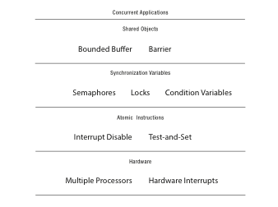
Roadmap

Slide 47
Locks
Lock::acquire
  wait until lock is free, then take it
Lock::release
  release lock, waking up anyone waiting for it
At most one lock holder at a time (safety)
If no one holding, acquire gets lock (progress)
If all lock holders finish and no higher priority waiters, waiter eventually gets lock (progress)
Notes:
Bounded waiting

Slide 48
Too Much Milk, #4
Locks allow concurrent code to be much simpler:
  lock.acquire();
  if (!milk)
  buy milk
  lock.release();

Slide 49
Virtual Memory

Slide 50
Simple Memory Protection
Base and Bounds
Notes:
Second thing

Slide 51
Towards Virtual Addresses
Problems with base and bounds?
  Expandable heap?
  Expandable stack?
  Memory sharing between processes?
  Non-relative addresses – hard to move memory around
  Memory fragmentation
How to get more memmory than currently available?

Slide 52
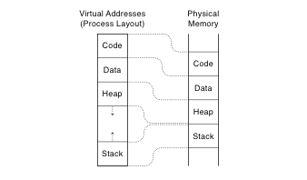
Virtual Addresses
Translation done in hardware, using a table
Table set up by operating system kernel
Notes:
On every instruction!
Table of instructions set up by the kernel: similar idea to buffer descriptor queue for I/O

Slide 53
Main Points
Address Translation Concept
  How do we convert a virtual address to a physical address?
Flexible Address Translation
  Base and bound
  Segmentation
  Paging
  Multilevel translation
Efficient Address Translation
  Translation Lookaside Buffers
  Virtually and physically addressed caches

Slide 54
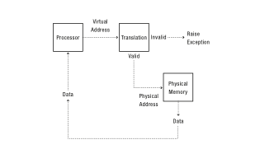
Address Translation Concept

Slide 55
Address Translation Goals
Memory protection
Memory sharing
  Shared libraries, interprocess communication
Sparse addresses
  Multiple regions of dynamic allocation (heaps/stacks)
Efficiency
  Memory placement
  Runtime lookup
  Compact translation tables
Portability

Slide 56
Paged Translation
Manage memory in fixed size units, or pages
Finding a free page is easy
  Bitmap allocation: 0011111100000001100
  Each bit represents one physical page frame
Each process has its own page table
  Stored in physical memory
  Hardware registers
    pointer to page table start
    page table length
Notes:
Simpler, because allows use of a bitmap. What's a bitmap?
001111100000001100
Each bit represents one page of physical memory -- 1 means allocated, 0 means unallocated. Lots simpler than base&bounds or segmentation

Slide 57
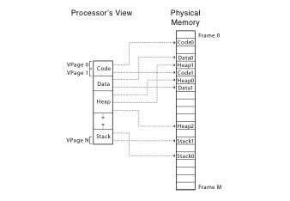
Paged Translation (Abstract)

Slide 58
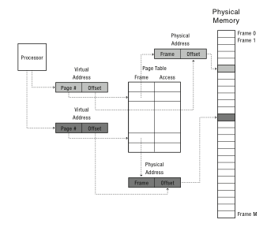
Paged Translation (Implementation)

Slide 59
Paging Questions
Can we share memory between processes?
  Set entries in both page tables to point to same page frames
  Need core map of page frames to track which processes are pointing to which page frames (e.g., reference count)
What if page size is very small?
What if page size is very large?
  Internal fragmentation: if we don’t need all of the space inside a fixed size chunk
Notes:
Means lots of space taken up with page table entries.

Slide 60
Segmentation
Segment is a contiguous region of virtual memory
Each process has a segment table (in hardware)
  Entry in table = segment
Segment can be located anywhere in physical memory
  Each segment has: start, length, access permission
Processes can share segments
  Same start, length, same/different access permissions

Slide 61
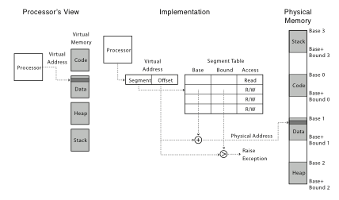
Segmentation
Notes:
This should seem a bit strange: the virtual address space has gaps in it! Each segment gets mapped to contiguous locations in physical memory, but may be gaps between segments.
This is a little like walking around in the dark, and there are huge pits in the ground where you die if you step in the pit.
But! of course, a correct program will never step off into a pit, so ok.
A correct program will never address gaps; if it does, trap to kernel and then core dump. Minor exception: stack, heap can grow. In UNIX, sbrk() increases size of heap segment. For stack, just take fault, system automatically increases size of stack.
Detail: Protection mode in segmentation table entries. For example, code segment would be read-only (only execution and loads are allowed). Data and stack segment would be read-write (stores allowed).
What must be saved/restored on context switch? Typically, segment table stored in CPU, not in memory, because it’s small.
Contents must be saved/restored.

Slide 62
Segmentation
Pros?
  Can share code/data segments between processes
  Can protect code segment from being overwritten
  Can transparently grow stack/heap as needed
  Can detect if need to copy-on-write
Cons?
  Complex memory management
    Need to find chunk of a particular size
  May need to rearrange memory from time to time to make room for new segment or growing segment
    External fragmentation: wasted space between chunks

Slide 63
Paged Segmentation
Process memory is segmented
Segment table entry:
  Pointer to page table
  Page table length (# of pages in segment)
  Access permissions
Page table entry:
  Page frame
  Access permissions
Share/protection at either page or segment-level

Slide 64
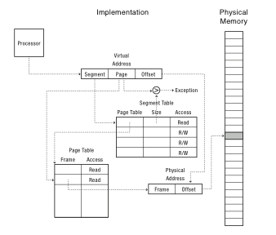
Paged Segmentation (Implementation)

Slide 65
A Preview: MIPS Address Translation
Software-Loaded Translation lookaside buffer (TLB)
  Cache of virtual page -> physical page translations
  If TLB hit, physical address
  If TLB miss, trap to kernel
  Kernel fills TLB with translation and resumes execution
Kernel can implement any page translation
  Page tables
  Multi-level page tables
  Inverted page tables
  …

Slide 66
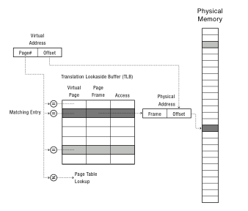
A Preview: MIPS Lookup

Slide 67
Page/Cache Replacement Policy
On a page/cache miss, how do we choose which entry to replace?
  Assuming the new entry is more likely to be used in the near future
  In direct mapped caches, not an issue!
Policy goal: reduce cache misses
  Improve expected case performance
  Also: reduce likelihood of very poor performance

Slide 68
A Simple Policy
Random?
  Replace a random entry
FIFO?
  Replace the entry that has been in the cache the longest time
  What could go wrong?

Slide 69
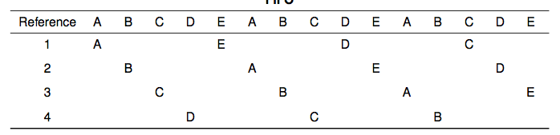
FIFO in Action
Worst case for FIFO is if program strides through memory that is larger than the cache

Slide 70
MIN, LRU, LFU
MIN
  Replace the cache entry that will not be used for the longest time into the future
  Optimality proof based on exchange: if evict an entry used sooner, that will trigger an earlier cache miss
Least Recently Used (LRU)
  Replace the cache entry that has not been used for the longest time in the past
  Approximation of MIN
Least Frequently Used (LFU)
  Replace the cache entry used the least often (in the recent past)

Slide 71
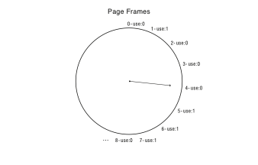
Clock Algorithm: Estimating LRU
Periodically, sweep through all pages
If page is unused, reclaim
If page is used, mark as unused

Slide 72
Nth Chance: Not Recently Used
Instead of one bit per page, keep an integer
  notInUseSince: number of sweeps since last use
Periodically sweep through all page frames
if (page is used) {
notInUseSince = 0;
} else if (notInUseSince < N) {
notInUseSince++;
} else {
reclaim page;
}

Slide 73
Implementation Note
Clock and Nth Chance can run synchronously
  In page fault handler, run algorithm to find next page to evict
  Might require writing changes back to disk first
Or asynchronously
  Create a thread to maintain a pool of recently unused, clean pages
  Find recently unused dirty pages, write mods back to disk
  Find recently unused clean pages, mark as invalid and move to pool
  On page fault, check if requested page is in pool!
  If not, evict that page

