Slide 1
NSWI178: Principles of Computers for Bioinformatics
Ladislav Peška
Department of Software Engineering,
Charles University, Prague,
Czech Republic
Ladislav.peska@matfyz.cuni.cz, S208
https://www.ksi.mff.cuni.cz/~peska/vyuka/nswi178

Slide 2
Introduction
How computers work from the inside?
  Why/what is (it) important for a bioinformatics?
Introduction into several rather complex topics
  Computer architecture
  Operating systems
  Compilers
  Data formats & performance
  Parallel & distributed programming
Details (if interested) in separate courses

Slide 3
Introduction
How computers work from the inside?
  Why/what is (it) important for a bioinformatics?
Only the basics covered
  Intended for first year bachelor students
  ... might be too trivial for more experienced students...
  ... but nobody will force you to leave – your choice ☺

Slide 4
Organization
1/0, lectures every other Thursday from 12:20
  6 lectures in total, roughly in the following order:
Computer architecture, processor, instructions
Low-level number representations, conversions, precision, basic text representations, encoding
Compilers, compiled vs. Interpreted languages, temporal complexity
Operating systems, processes
Parallel & distributed computing, concurrency & shared data
Selected data formats (CSV, JSON, XML, picture representations, sparse matrices, trained representations & deep learning, common formats in bioinformatics), efficiency
  Written exam, questions based on „to-remember“ notes
  Slides are available from https://www.ksi.mff.cuni.cz/~peska/vyuka/nswi178/
  Video recordings: https://youtube.com/playlist?list=PLTYzSYF3EX3BURNB3gMwspsDbeexE6x51

Slide 5
Disclaimer

Slide 6
Computer architecture
  Literature: Computer Organization and Design By David A. Patterson and John L. Hennessy
  Most examples in slides are from this book
  Surprisingly enjoyable reading
http://home.ustc.edu.cn/~louwenqi/reference_books_tools/Computer%20Organization%20and%20Design%20RISC-V%20edition.pdf

Slide 7
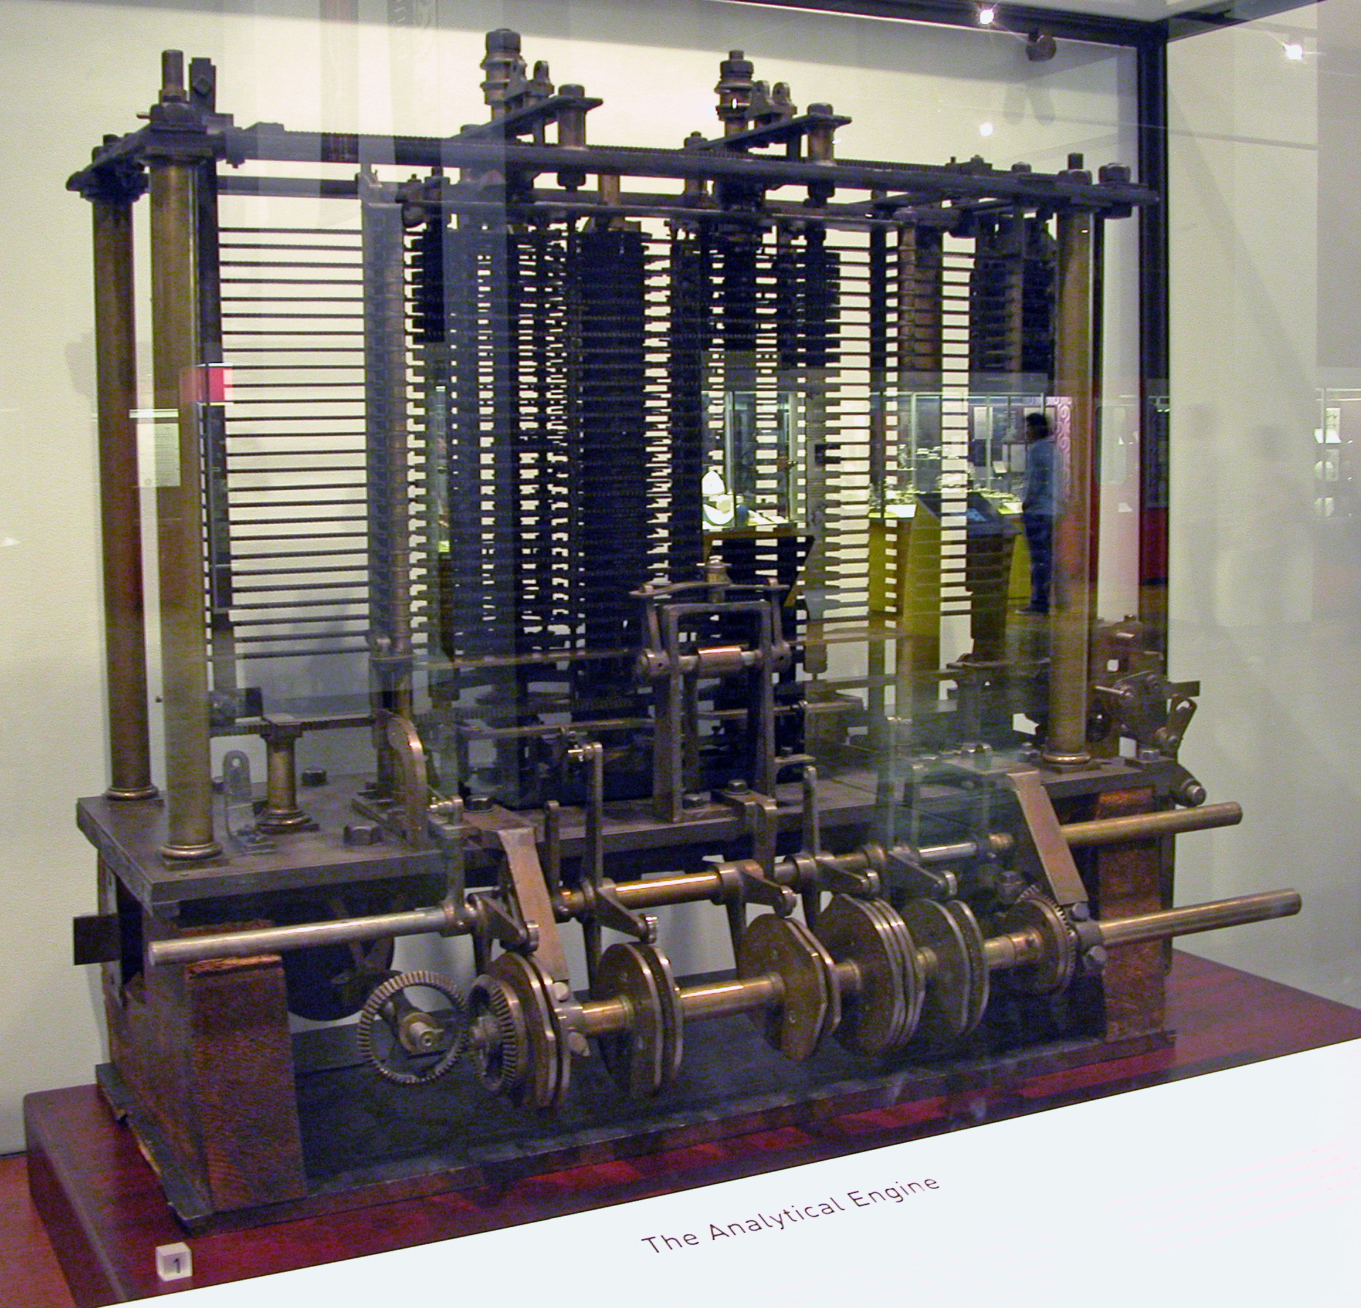
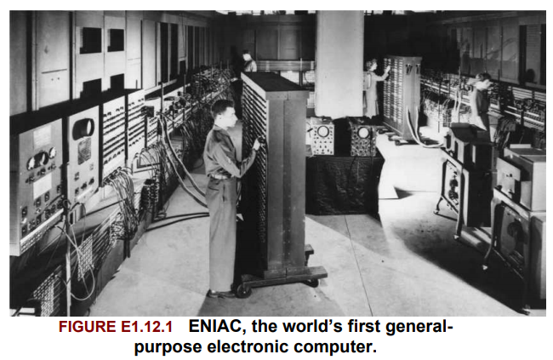
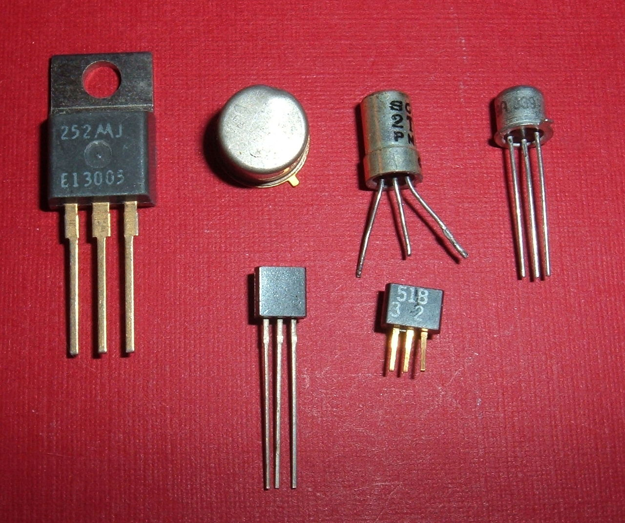
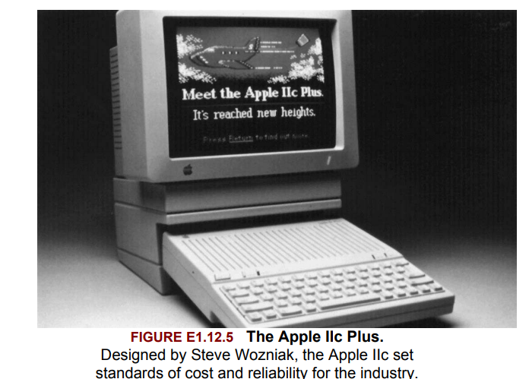
Computer architecture
What is computer?
  Google: an electronic device for storing and processing data, typically in binary form, according to instructions given to it in a variable program.
  Lets skip a history lesson (at least for now)
    But it is really interesting – find out by yourselves

Slide 8
Computer architecture
What is computer?
  Google: an electronic device for storing and processing data, typically in binary form, according to instructions given to it in a variable program.
  Data in binary form: bit (true/false,1/0, high/low voltage...) => sequence of bits
    How to work with data in binary format... See later

Slide 9
Computer architecture
What is computer?
  Google: an electronic device for storing and processing data, typically in binary form, according to instructions given to it in a variable program.
  Processing data: perform various arithmetic or logic operations
    +,-,*,/,... AND, OR, NOT, bit shifts...
  Instruction: a computer-understandable command describing what should be done (usually quite simple, such as „multiply A and B and store the result into C“)
  Program: a sequence of instructions

Slide 10
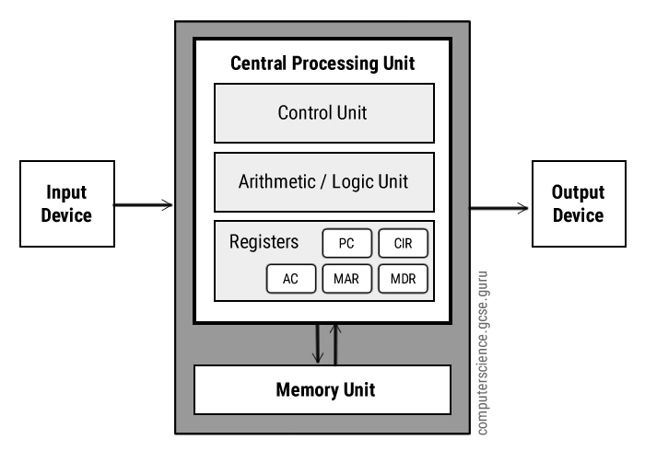
Computer architecture
Von Neumann architecture, 1945

Slide 11
Computer architecture
Von Neumann architecture, 1945
  Input & output: devices to communicate (monitor, HDD, mouse,...)
  ALU (datapath): hardware that enables operations on numbers
  Controll unit: decides what should be performed based on the current instruction
  Registers: memory units directly accessible by CPU
    Some with specific purpose
  (several layers) of „distant“ memory

Slide 12
Computer architecture
Where are DATA?
Where are INSTRUCTIONS?
Where is PROGRAM?

Slide 13
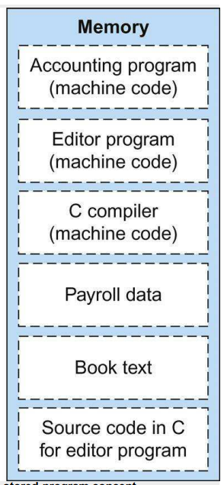
Computer architecture
Where are DATA?
Where are INSTRUCTIONS?
Both data and instructions reside in memory
(revolutionary idea back then)
  Memory is a linearly adressable space (0, ..., |memory|) for storing information
  You can access both data and instructions via specific load/store instructions by supplying correct memory address
  Instructions are typically stored as a sequence in memory (i.e., you are able to find the next instruction upon the completion of the previous one)
    One of the registers (program counter) hold address of the current instruction, you can use ALU to modify it to the address of the next instruction (program counter +4... Why +4?)
    Branches and jumps allow to break the sequence for conditions, subprocedures etc.

Slide 14
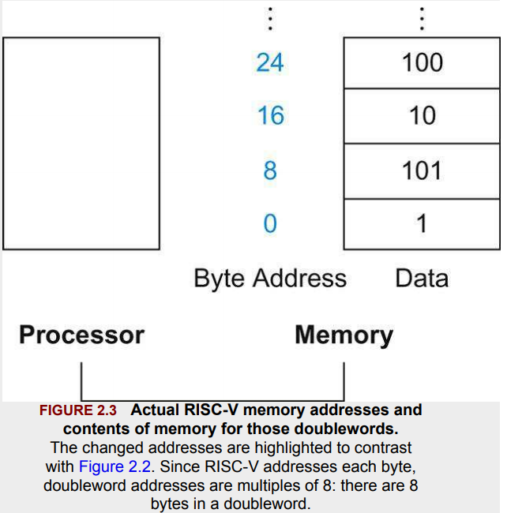
What is Data?
Units of information (binary numbers) stored in memory
bit / byte (8 bits) / word (32 bits) / doubleword (64 bits)...
Low-level organization & meaning depends on hardware
  Usually bytes are addressed
  Different data types, many with fixed representation length (int32, float64,...)
    Why fixed representation length?
    How to get a 20th element of an array of int64s?
    What if the array has only 19 elements?
      Index exceeds array size (or... your problem)

Slide 15
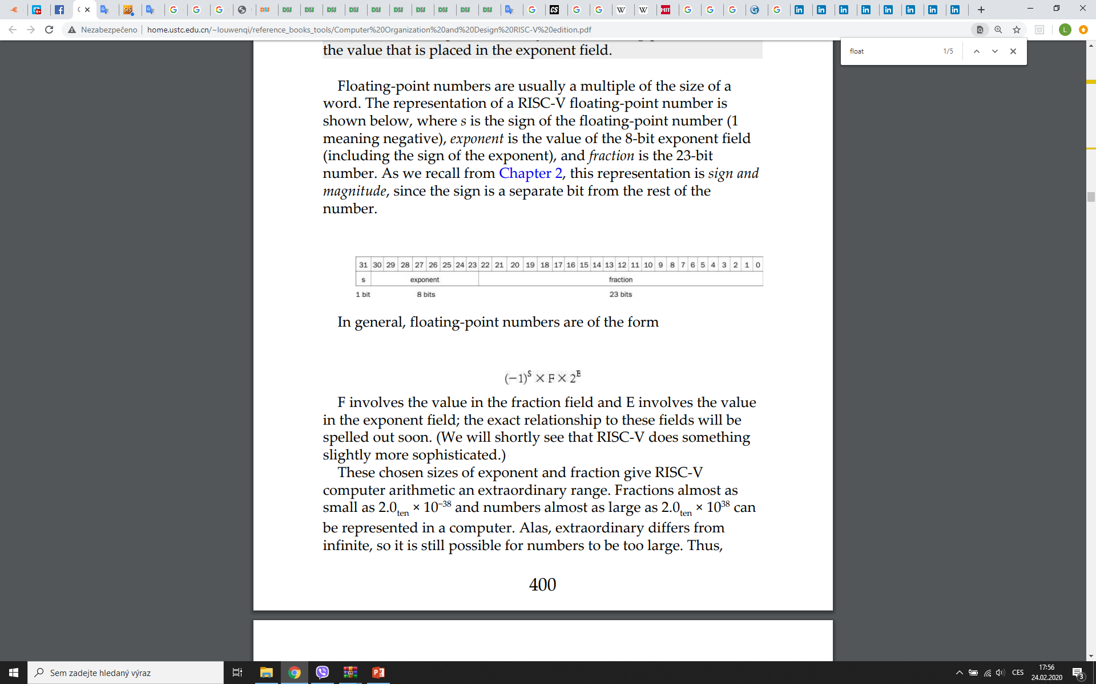
What is Data?
Common data types
Integers
  Several options of fixed length => different range to represent, overflow
  Why not variable length?
  unsigned / signed, several representations of signed integers with various pros/cons
Floats
  Floating point number representations
  Sign, exponent, fraction
  Overflow / underflow
  Limited precision, lack of associativity
Characters
  Dictionary of numeric value => character;
  Various encodings (dictionaries)

Slide 16
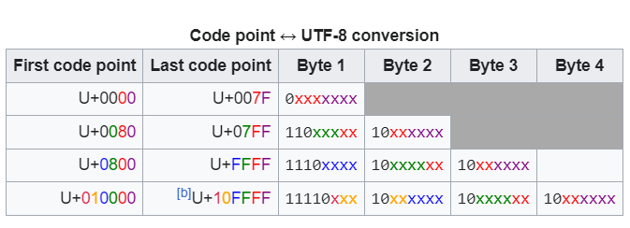
What is Data?
Common data types
Characters
  Dictionary of numeric value => character;
  Various encodings (dictionaries):
    ASCII (fixed length, 256 values)
    UTF-8 (variable length, range from the first byte denote the length of the code)

Slide 17
What is Data?
Common data types
Pointers
  Links to some address in the memory (Python lists)
Complex or specific data types
Lists, arrays, dictionary, objects...
Depends on individual languages

Slide 18
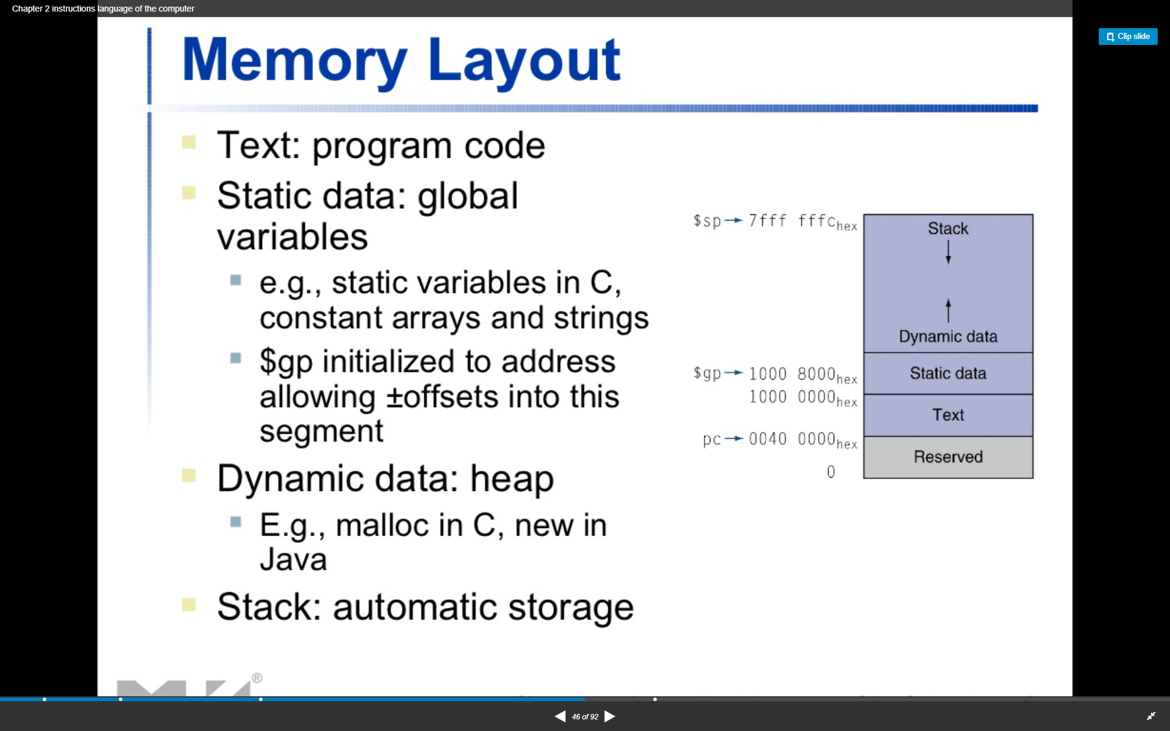
What is Data?
How to store data
Depends on type of allocation
  Stack, heap, static
  Pointers to location
  Stack: subprocedure calls etc.

Slide 19
What is Instruction?
Command understandable by the processor
In binary format (same as data), stored in memory
Usually, human readable interpretation
Contains
Encoded instruction name (what to do)
Operands of the instruction (register ids or numbers)
Destination for the returned value
Interpreted by a controll unit
ALU is executed in parallel („just“ electric wires and transistors)
Controll unit decides which part of the ALU is actually used
Key components are decoder and multiplexor
  Pages 1145+ in Computer Organization and Design

Slide 20
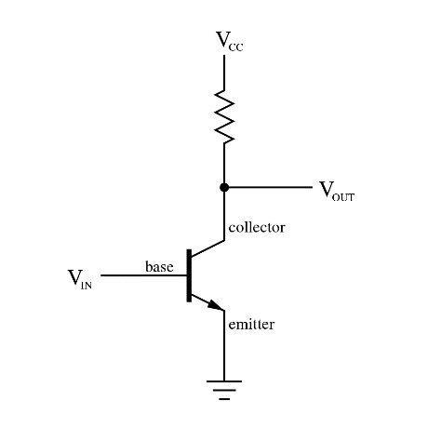
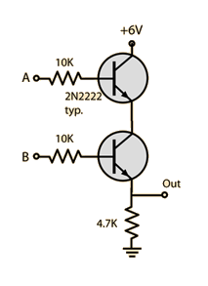
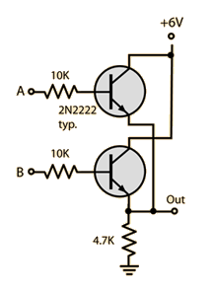
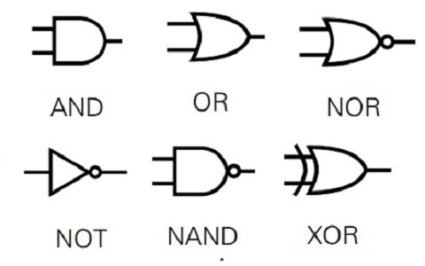
Interpreted by a controll unit...
Small detour: transistors & logical gates
A voltage or current applied to one pair of the transistor's terminals controls the current through another pair of terminals.
Because the controlled (output) power can be higher than the controlling (input) power, a transistor can amplify a signal.
Transistor AND gate
Transistor OR gate
Symbols for basic logic gates
http://hyperphysics.phy-astr.gsu.edu/hbase/Electronic/trangate.html

Slide 21
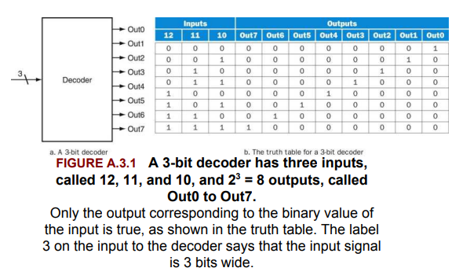
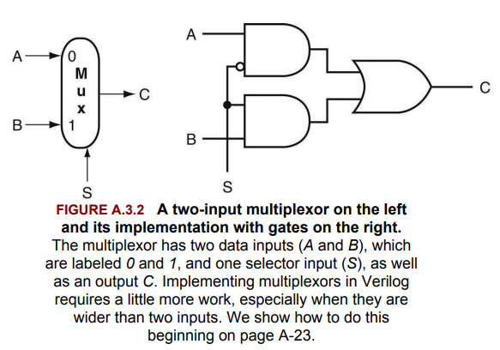

What is Instruction?
Interpreted by a controll unit
Decoder
  N-bits of input => $2^{N}$ outputs
  E.g. If number 7 (${111}_{2}$) is on the input,
  only the 7-th output will have positive output,
  others will be zero
Multiplexor
  A.k.a. Selector of input
  Based on the value of „selector“ input S, it selects
  one of two (or more) inputs

Slide 22
What is Instruction?
Each machine has its own instruction set, so details may differ
Basic types of instructions (RISC-V: reduced instructions set)
Arithmetic and logic operations (ADD x9, x22, x21)
Store and load operations (LD x9. 40(x5) )
Conditional branches (BEQ x5, x6, 100)
Jumps (JAL x1, 100)
Several dozens in total

Slide 23
What is Instruction?
Basic types of instructions (RISC-V: reduced instructions set)
Arithmetic and logic operations (ADD x9, x22, x21)
Store and load operations (LD x9. 40(x5) )
Conditional branches (BEQ x5, x6, 100)
Jumps (JAL x0, 2000)
Several dozens in total
Why can I write JAL x0, 2000 instead of 01111101000000000000000001101111?

Slide 24
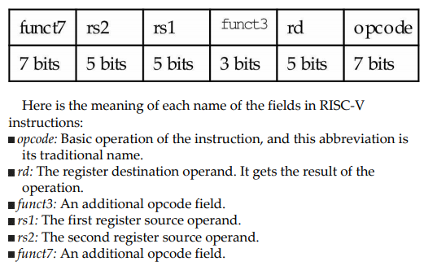
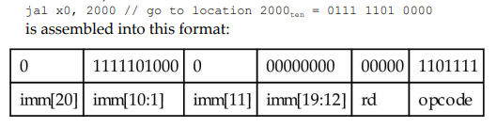
What is Instruction?
Why can I write JAL x0, 2000 instead of 01111101000000000000000001101111?
I know how to translate one to the other
For RISC-V, all instructions are 32 bits long (make common case fast principle)
Each bit has its meaning depending on the type of the instruction

Slide 25
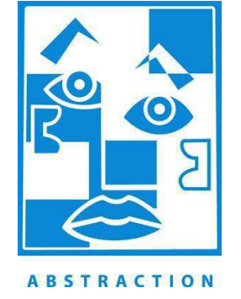
What is Instruction?
Abstraction
One of the key principle in computer design
Translate lower-level representation from/to higher level representation
Remove unnecessary details of the low-level representation
Basic types of instructions (RISC-V: reduced instructions set)
Arithmetic and logic operations (ADD x9, x22, x21)
Store and load operations (LD x9. 40(x5) )
Conditional branches (BEQ x5, x6, 100)
Jumps (JAL x0, 2000)
Several dozens in total
Why can I write JAL x0, 2000 instead of 01111101000000000000000001101111?
Machine code <= Textual instructions <= Higher-level languages
Hardware
Assembler
Compiler

Slide 26
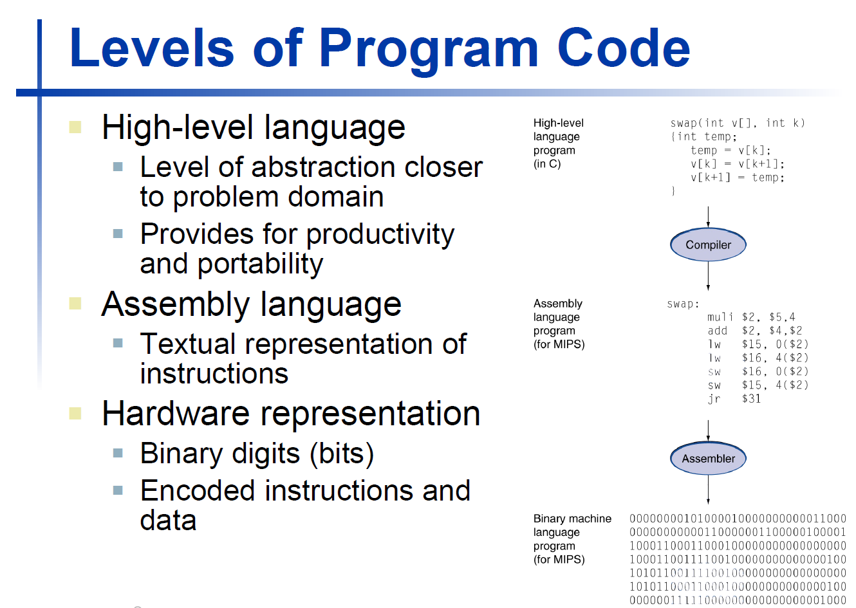
What is Instruction?
Hardware
Assembler
Compiler

Slide 27
What is Instruction?
Is this nice enough?
Hardware
Assembler
Compiler

Slide 28
Levels of Abstraction
Usually, you sacrifice some speed while going from low-level to high-level
  Depends on the quality of the compiler & high-level representations
Also high-level languages differ in the level of abstraction
  Usually, less work for programmer => more work for computer
    Memory alloc / free vs. Garbage collection
    Dynamic vs. Static typing
    You need to set a good balance between both
  There are some clever hacks to this rule
Usually, the older language the lower level of abstraction
  Some newer languages focus more on team work & sustainability / reusability
    Object oriented / service oriented...

Slide 29
Where is Python in all... This?
High-level language, perhaps few steps „higher“ than C or C++
  But how to measure it? Code writing time, Mental burden, Complex things written easily?
Compiled vs. Interpreted languages
Compiled languages are converted directly into machine code that the processor can execute. They give the developer more control over hardware aspects, like memory management and CPU usage. Compiled languages need a “build” step - they need to be manually compiled first. You need to “rebuild” the program every time you need to make a change.
Interpreters will run through a program line by line and execute each command. (Interpret is itself compiled, but the program code is remained as it was written). Programs compiled into native code at compile time usually tend to be faster than those translated at run time, due to the overhead of the translation process. An Interpreted language gives some additional flexibility over compiled languages. Because interpreters execute the source program code themselves, the code itself is platform independent. Also it can be executed interactively (Jupyter notebook, R, Matlab etc.). Other features include dynamic typing, and smaller executable program size.

Slide 30
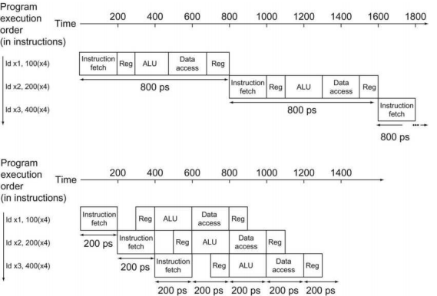
More into instructions
Instruction execution process:
Fetch instruction
Decode instruction
Execute
Store results
Govern by the clock signal
Instruction pipeline (while decoding first instruction, I can already fetch second)
SIMD (single instruction multiple data),VLIW (very long instruction word)
Instruction-level parallelism

Slide 31
Number representations & operations

Slide 32
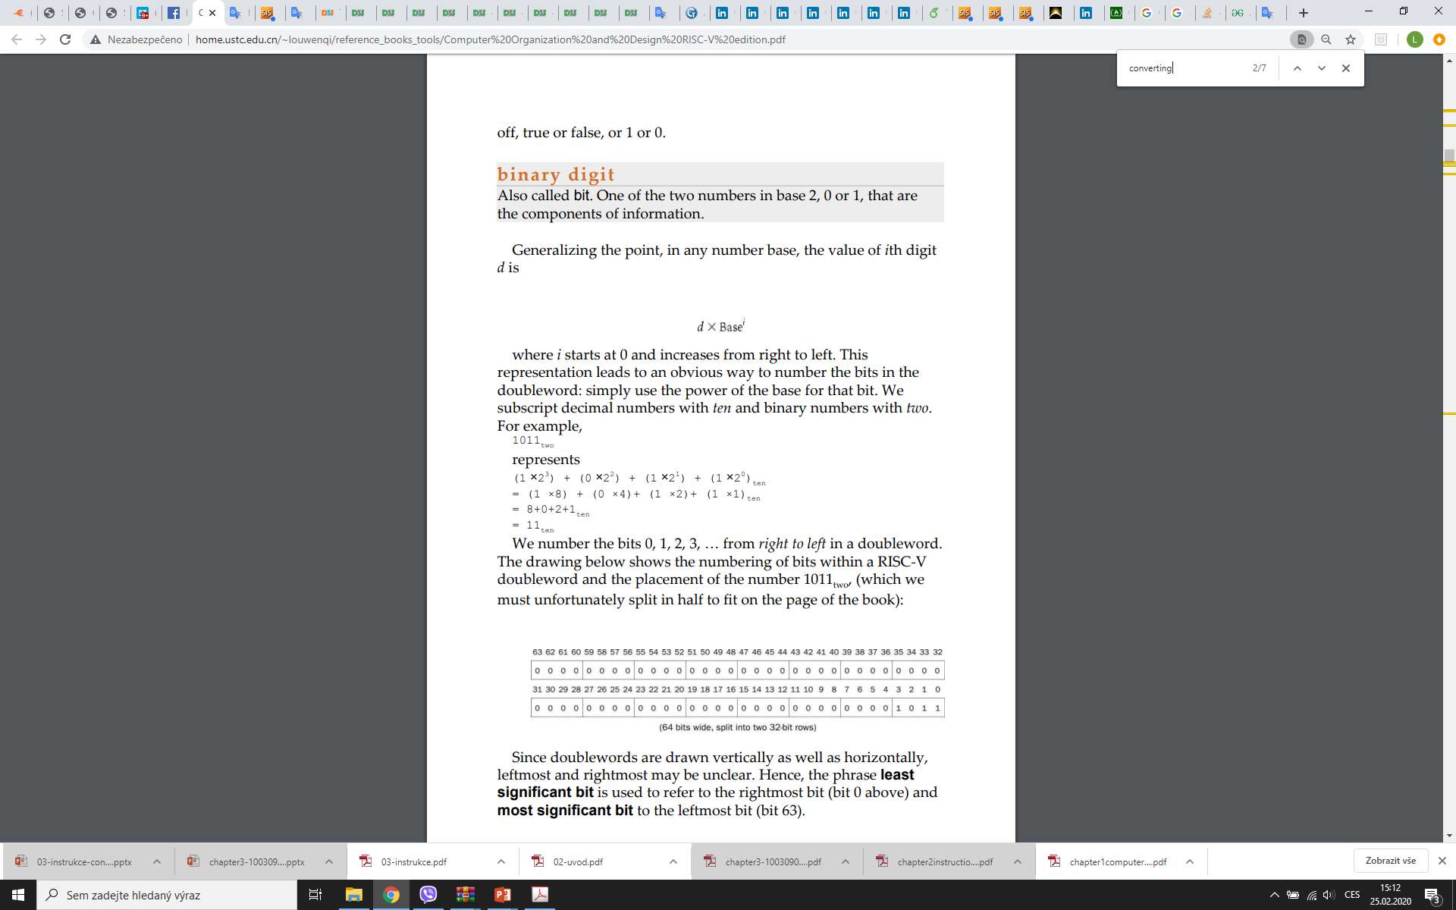
Binary numbers
Humans: 10 fingers => decimal representation 0,...,9
Computers: two levels of voltage => binary representation 0,1 (bit)
How to convert decimal from/to binary?
For any base and digit on i-th position, the result is:
Normally, 32 or 64 bits are used in computers
Decimal to binary: through division and remainder

Slide 33
Binary numbers
Why not decimal arithmetics?
Internally, 4 bits for each decimal digit => ineffective, complex arithmetics
I/O operations fast, but not frequent enough
Why not represent numbers as text?
Same problem, 8bits per digit => extremely ineffective for larger data
In contrast: unlimited precision, Natural for humans to explore / update it
Do you still get „unlimited precision“ calculator homework for introductory programming courses?

Slide 34
Binary numbers
What can be represented?
64 bit „doubleword“ can represent 2⁶⁴ different combinations.
  Unsigned integer: represent numbers 0, ..., 2⁶⁴ -1 (natural case)
  What if we need negative numbers?
    Sign bit (difficult arithmetics, two zeros)
    One-complement (flip bits)
    Two-complement (flip bits and add one)
    Bias (add „bias“ to the number)
See the fairytale

Slide 35
Binary numbers
What can be represented?
64 bit „doubleword“ can represent 2⁶⁴ different numbers.
  Unsigned integer: represent numbers 0, ..., 2⁶⁴ -1 (natural case)
  What if we need larger numbers?
    OVERFLOW!!!
    Overflow can be detected
      e.g. for unsigned integer if C=A+B, then C >=A and C>=B
      For signed integer, if A and B are negative, A+B is also negative; if A and B are positive, A+B is also positive...
    Floating point numbers
      Larger range, precision up to the fixed amount of (binary) digits
      More complex, more „risky“ arithmetics (loss of precision in the past went to serious problems)

Slide 36
Hexa-decimal numbers
0-9,A-F (F=15, A=10...)
Two hexadecimal digits can represent one byte nicely
Utilized e.g. in color descriptions #FFFF00 in RGB = yellow
Common form of displaying binary data

Slide 37
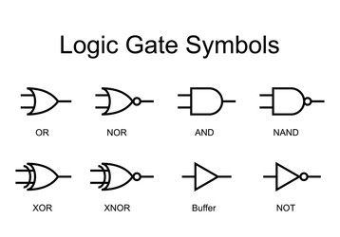
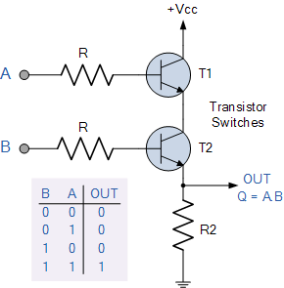
Logical operations
AND, OR, NOT (XOR, NOR, NAND)
Bit shift left (equal to multiplying by 2), bit shift right
AND gate (one bit)
Propagation delay typically refers to the rise time or fall time in logic gates. This is the time it takes for a logic gate to change its output state based on a change in the input state. It occurs due to inherent capacitance in the logic gate.

Slide 38
Logical Operations
§2.6 Logical Operations
Instructions for bitwise manipulation
Operation | C | Java | MIPS
Shift left | << | << | sll
Shift right | >> | >>> | srl
Bitwise AND | & | & | and, andi
Bitwise OR | | | | | or, ori
Bitwise NOT | ~ | ~ | nor
■
Useful for extracting and inserting groups of bits in a word

Slide 39
Shift Operations
op | rs | rt | rd | shamt | funct
6 bits 5 bits 5 bits 5 bits 5 bits 6 bits
Shamt(shift amout) how many positions to shift
Shift left logical
■
■
Shift left and fill with 0 bits
sll by i bits multiplies by 2^{i}
01001101 -> sll(2) ->00110100
■
Shift right logical
Shift right and fill with 0 bits
srl by i bits divides by 2^{i} (unsigned only)
■

Slide 40
AND Operations
Useful to mask bits in a word
  Select same bits, clear others to 0
and $t0, $t1, $t2
$t2
$t1
$t0
0000 0000 0000 0000 00 | 00 11 | 01 1100 0000
0000 0000 0000 0000 00 | 11 11 | 00 0000 0000
0000 0000 0000 0000 00 | 00 11 | 00 0000 0000

Slide 41
OR Operations
Useful to include bits in a word
  Set some bits to 1, leave others unchanged
or $t0, $t1, $t2
$t2
$t1
$t0
0000 0000 0000 0000 00 | 00 11 | 01 1100 0000
0000 0000 0000 0000 00 | 11 11 | 00 0000 0000
0000 0000 0000 0000 00 | 11 11 | 01 1100 0000

Slide 42
NOT Operations
Useful to invert bits in a word
  Change 0 to 1, and 1 to 0
MIPS has NOR 3-operand instruction
  a NOR b == NOT ( a OR b )
nor $t0, $t1, $zero
Register 0: always read as zero
$t1
0000 0000 0000 0000 0011 1100 0000 0000
$t0
1111 1111 1111 1111 1100 0011 1111 1111

