Slide 1
Parallel computing
Original slides by Jakub Yaghob
https://www.ksi.mff.cuni.cz/teaching/nprg042-web/#@tab_lectures
Extensions towards distributed systems:
https://www.ksi.mff.cuni.cz/teaching/nswi035-web/
GPU basics by Martin Krulis:
https://www.youtube.com/watch?v=n8Dhhx69eJY&feature=youtu.be

Slide 2
Parallel programming
Why?
  Solve problem in less time
  Solve bigger problem than would be possible on a single CPU
Bioinformatics often incorporate large problems
Some portions of problems may be effectively distributed

Slide 3
Simple use-cases
Machine learning
  K-nearest neighbors classification model
    K is a hyperparameter: what is the best value of K?
    Select plausible values (e.g., K \in {1,3,5,10,15,20})
    (Train) & evaluate each variant on validation data
      This operation may take long time
    Select the one that performs the best
  More complex models have several hyperparameters => tens or hundreds of combinations to evaluate

Slide 4
Simple use-cases
Matrix multiplication
  Have a (very) large matrix (MxN)
  You need to multiply it with a vector (Nx1)
  You can calculate the output in a for-cycle (cell by cell), but this may take a long time

Slide 5
Parallel programming
Why?
  Solve problem in less time
  Solve bigger problem than would be possible on a single CPU
Programmer’s task
  Identify the concurrency in the problem
  Structure the algorithm so that this concurrency can be exploited
  Implement the solution using a suitable programming environment

Slide 6
Flynn’s taxonomy
Single Instruction, Single Data (SISD)
  von Neumann
Single Instruction, Multiple Data (SIMD)
  Vector processors (mentioned before)
Multiple Instruction, Single Data (MISD)
  No well-known systems
Multiple Instruction, Multiple Data (MIMD)
  All modern parallel systems

Slide 7
A further breakdown of MIMD – shared memory
CPU
CPU
CPU
CPU
Shared memory
  Symmetric multiprocessors (SMP)
    Easiest to program
    Do not scale well, small number of CPUs
  Nonuniform memory access (NUMA)
    Uniformly addressable from all CPUs
    Some memory blocks may be physically more closely, the access time significantly varies
    Each CPU has a cache, it mitigates the effect of NUMA – cache coherent NUMA (ccNUMA), nearly as SMP (locality issues, cache effects)
memory

Slide 8
A further breakdown of MIMD – NUMA
CPU
CPU
CPU
CPU
CPU
CPU
CPU
CPU
memory
memory
memory
memory
CPU
CPU
CPU
CPU
CPU
CPU
CPU
CPU

Slide 9
A further breakdown of MIMD – distributed memory
Distributed memory
  Own address space, message passing
  Explicitly program the communication, the distribution of data
  Massively parallel processors (MPP)
    CPUs and network tightly coupled
  Cluster
    Composed of off-the-shelf computers connected by an off-the-shelf network

Slide 10
The jargon
Task
  Sequence of instructions that operate together as a group
  Logical part of an algorithm
Unit of execution (UE)
  Process or thread
  Tasks are mapped to UEs
Processing element (PE)
  HW element that executes a stream of instructions

Slide 11
The jargon
Load balancing
  How well the work is distributed among PEs
Synchronization
  Enforcing necessary ordering constraints (i.e., task X cannot start before task Y is completed)
Synchronous x asynchronous
  Coupling two events in time
Race condition
  Outcome of a program depends on on the scheduling of UEs
Deadlock

Slide 12
Performance modeling
Total running time on one PE
Total running time on P PEs
Speedup
Additional overhead

Slide 13
Performance modeling
Efficiency
Perfect linear speedup: S(P)=P
Serial fraction
Rewrite total running time for P PEs

Slide 14
Amdahl’s law
Very large number of CPUs
I.e. are the tasks left for serial computation really short enough?

Slide 15
Finding concurrency
Starting point for design of a parallel solution
Dependency analysis
Decomposition
Group Tasks
Task Decomposition
Design Evaluation
Order Tasks
Data Decomposition
Data Sharing

Slide 16
Finding concurrency
Before starting to work:
  Is the problem large enough?
  Are the results significant enough?
Understanding key features and data elements
Understanding, which parts of the problem are most computationally intensive
  Focus the effort here

Slide 17
Finding concurrency
Decomposition patterns
  Decompose the problem into pieces that can execute concurrently
Dependency Analysis patterns
  Group tasks and analyze the dependencies among them
  Theoretically, patterns should be used in order
  Practically, work back and forth between them, possible even revisit decomposition
Design Evaluation pattern
  Final pattern, checkpoint before moving to the Algorithm Structure design space
  Best design not found on the first attempt

Slide 18
Using decomposition patterns
Decomposition occurring in two dimensions
  Task-decomposition
    Problem is a stream of instructions that can be broken into sequences called tasks that can execute simultaneously
    To be efficient, the operations from one task should be largely independent from other tasks
  Data-decomposition
    Focuses on the data required by the tasks
    How can it be decomposed into distinct chunks?
    The computation associated with the data chunk must be relatively independent

Slide 19
Simple use-cases
ML: task decomposition (evaluations w.r.t. single hyperparameter settings)
Seq.: wait for all results & select the best one
Matrix Data: evaluate each row separately
Seq.: place individual results into correct positions of the result vector

Slide 20
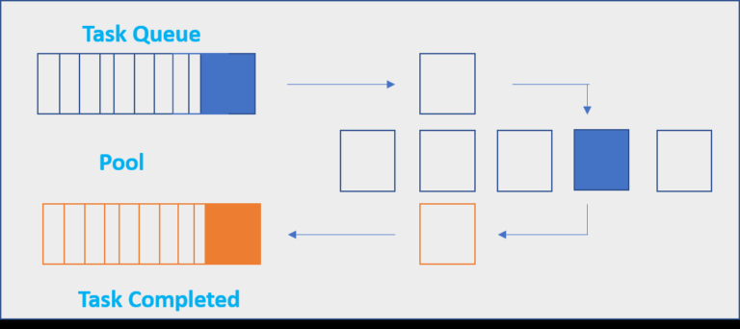
Python Examples
Multiprocessing
https://docs.python.org/3/library/multiprocessing.html
  Pool object: paralellized execution of a function across multiple input values. Predefined worker processes
    Handles results synchronization for you
    Simple interface & good enough for small-scale paralelization
  Processes, messaging, synchronization,…

Slide 21
Python Examples
Multiprocessing.Pool
from multiprocessing import Pool
def knn_eval(k, data):
#evaluation code goes here
k_vals = [1,3,5,10,15]
data = ...
with Pool(5) as p: #number of processes
results = p.map(knn_eval, k_vals)
#now we have results for all k variants
Wait, but how to give data object to the worker processes?

Slide 22
Python Examples
Functools.partial (partially filled functions)
from multiprocessing import Pool
from functools import partial
def knn_eval(k, data):
#evaluation code goes here
k_vals = [1,3,5,10,15]
data = ...
knn_eval_with_data(knn_eval, data=data)
with Pool(5) as p:
results = p.map(knn_eval_with_data, k_vals)
#now we have results for all k variants

Slide 23
Python Examples
Joblib.Parallel
https://joblib.readthedocs.io/en/latest/
  Similar to multiprocessing Pools, high-level API
  Nicely fits together with NumPy
  Simple way to work with shared memmory
from joblib import Parallel, delayed
def knn_eval(k, data):
#evaluation code goes here
k_vals = [1,3,5,10,15]
data = ...
results = Parallel(n_jobs=3)(delayed(knn_eval)(k, data) for k in k_vals)
#now we have results for all k variants

