Slide 1
Compiler principles
Compiler
Slides by Jakub Yaghob
https://www.ksi.mff.cuni.cz/teaching/nswi098-web/#@tab_lectures

Slide 2
Literature and slides
The Dragon Book
  Aho, Sethi, Ullman: Compilers - Principles, Techniques and Tools, Addison-Wesley 1986
  Aho, Lam, Sethi, Ullman: Compilers - Principles, Techniques and Tools (2nd edition), Addison-Wesley 2006
Advanced compiler techniques
  Muchnick S.S.: Advanced compiler design and implementation, Morgan Kaufman Publishers 1997
Slides
  http://www.ksi.mff.cuni.cz/lectures/NSWI098/html/index.html
Notes:
Slajdy NEJSOU učební text! Opakuji, slajdy NEJSOU učební text!

Slide 3
What is a compiler?
Naïve concept
  A black-box compiling a source code to a target code
Compiler
Source
code
Target
code
Error
messages

Slide 4
What is a compiler? More formally
Let’s have an input language L_{in} generated by a grammar G_{in}
Let’s have an output language L_{out} generated by a grammar G_{out} or accepted by an automaton A_{out}
The compiler is a mapping L_{in}→L_{out}, where ∀ w_{in}∈L_{in} ∃ w_{out}∈L_{out}. The mapping does not exist for w_{in}∉L_{in}

Slide 5
Program translation
Interface
Source
code
Preprocessor
.pp
Compiler
Libraries
Objects
.asm
Executable
code
Linker/Loader
.obj
Assembler

Slide 6
Phases of a compiler
front end
Tables
back end
Source
code
Lexical
analysis
Syntax
analysis
Semantic
analysis
Intermediate
code gen
Intermediate
code opt
Code
generation
Target
code
Syntax-directed
translation
Error
handling
Compiler
passes

Slide 7
Lexical analysis
Reads input characters and produces a sequence of tokens
Simpler design
  Separation of lexical analysis from syntax analysis
Specialization
  Speedup
Enhanced portability
  Moving a compiler to other platform requires changes only in lexical analysis (EBCDIC)
„Increasing“ grammar look-ahead
  LR(1) does not mean look-ahead for 1 character
Support for macros usually in lexical analysis
Get next token
Source
code
Lexical
analysis
Syntax
analysis
Stream of tokens
Symbol
tables

Slide 8
Examples
Token | Lexical element | Regular expression
while | while | while
relop | <,<=,=,<>,>,>= | \<|\<=|=|\<>|>|>=
uint | 0, 123 | [0-9]+
 | /* comment */ | \/\* → cmt, <cmt>., <cmt>\*\/

Slide 9
Lexical analysis background
Patterns using regular expressions → regular languages → accepted by finite automata
Restarting the automaton after each recognized/accepted token
Finite automaton for an integer in C:
[1-9]
Whole decimal integer (SINT)
[0-9]
[0-9A-Fa-f]
0
[0-9A-Fa-f]
[xX]
Whole hexadecimal integer (UINT)
[0-7]
Whole decimal integer (SINT)
[1-7]
Whole octal integer (UINT)

Slide 10
Token attributes
More patterns recognized as a token or the token is a literal
Usually one attribute specifying more precisely a token or a literal value
  Token=relop, specification=‘<=’
  Token=uint, specification=‘123’

Slide 11
Syntax analysis
The main task
  Decide, whether an input word is a word from an input language
Other important tasks
  Syntax-directed translation is the main loop of the compiler
  Build the derivation tree
Automaton type
  We are talking about (deterministic) context-free grammars, therefore we are using (deterministic) pushdown automata
Get next
token
Derivation
tree
Source
code
Lexical
analysis
Syntax
analysis
The rest of
front-end
Token
Intermediate
code
Symbol
tables

Slide 12
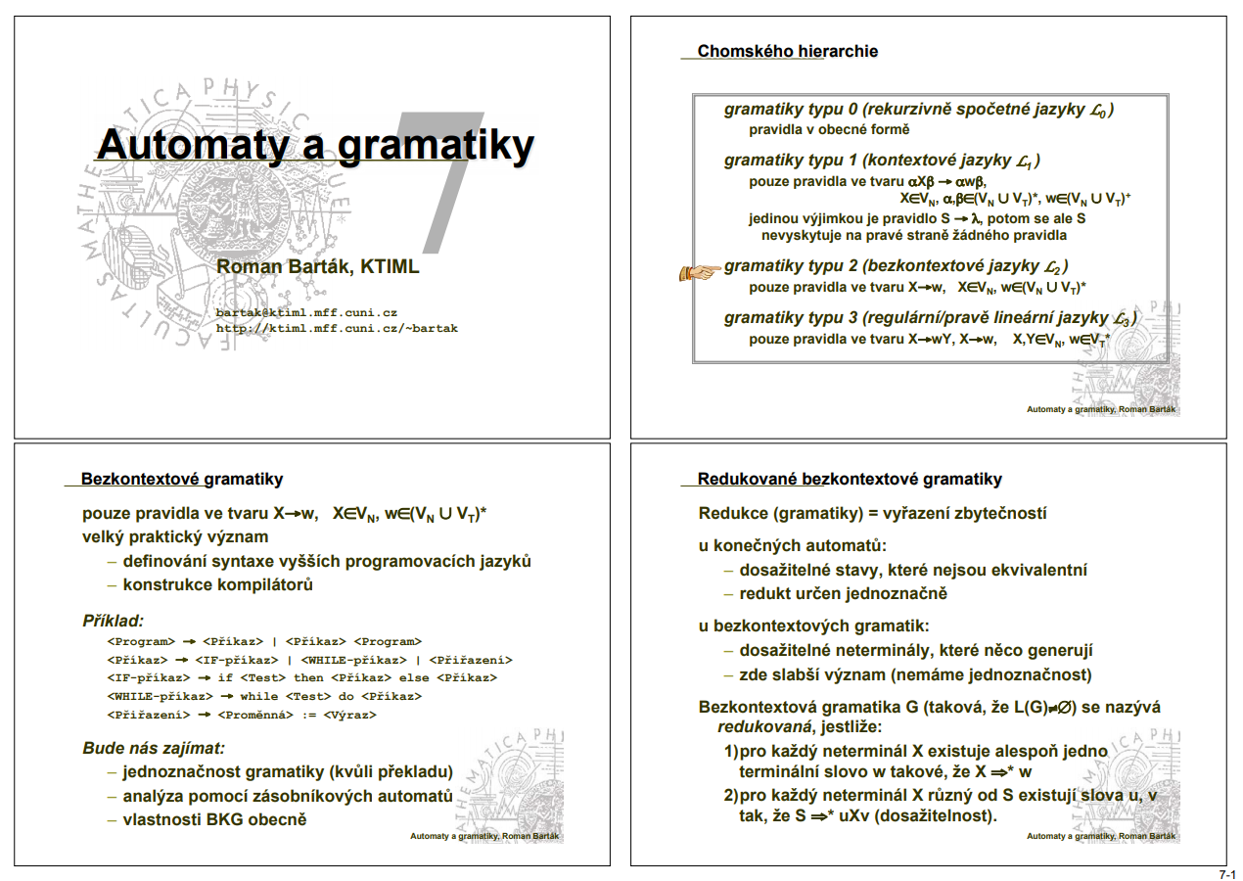
http://ktiml.mff.cuni.cz/~marta/automataAll.pdf
http://ktiml.mff.cuni.cz/~bartak/automaty/

Slide 13
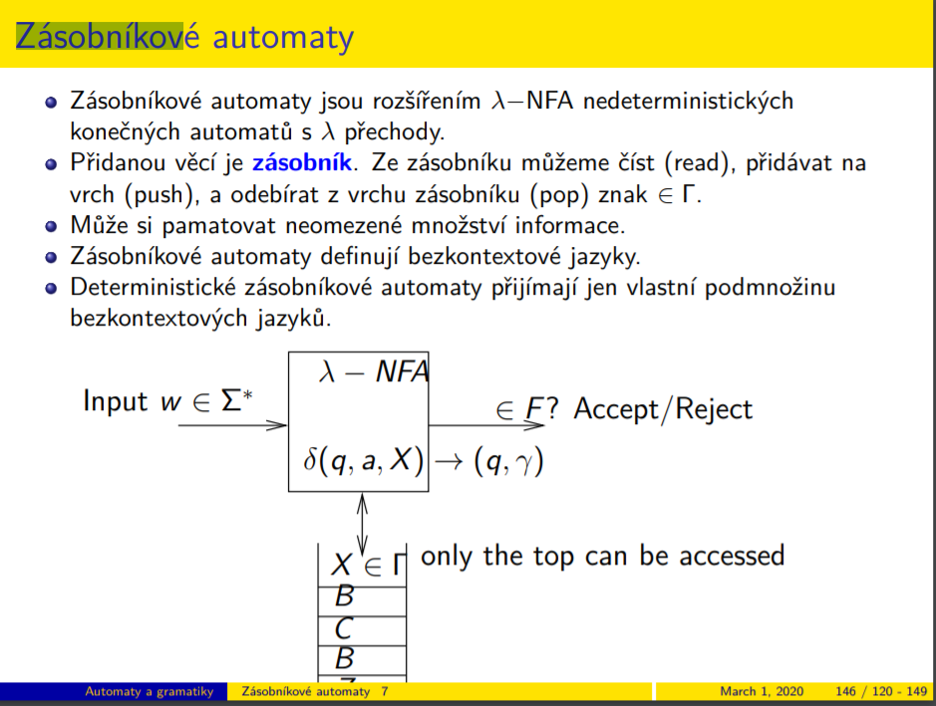
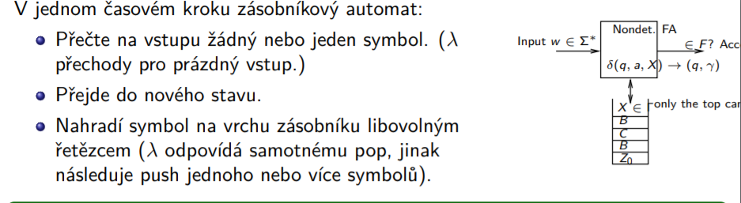

Slide 14
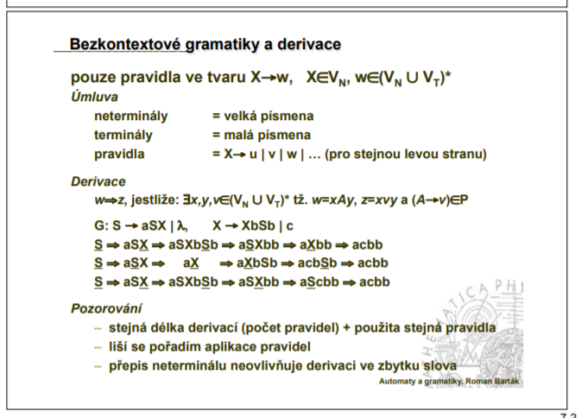
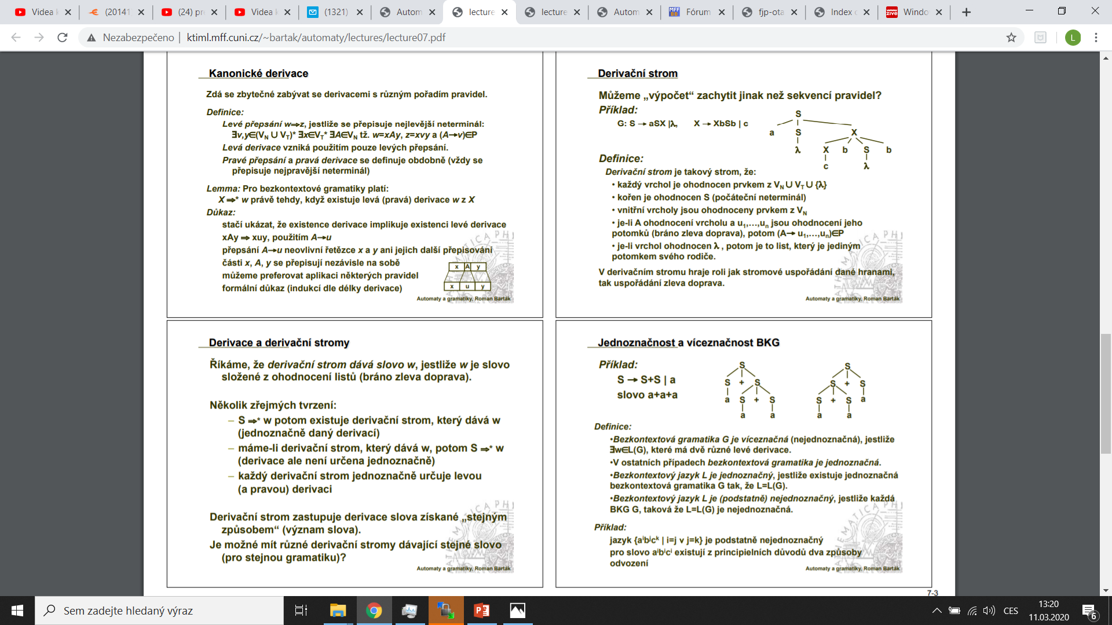

Slide 15
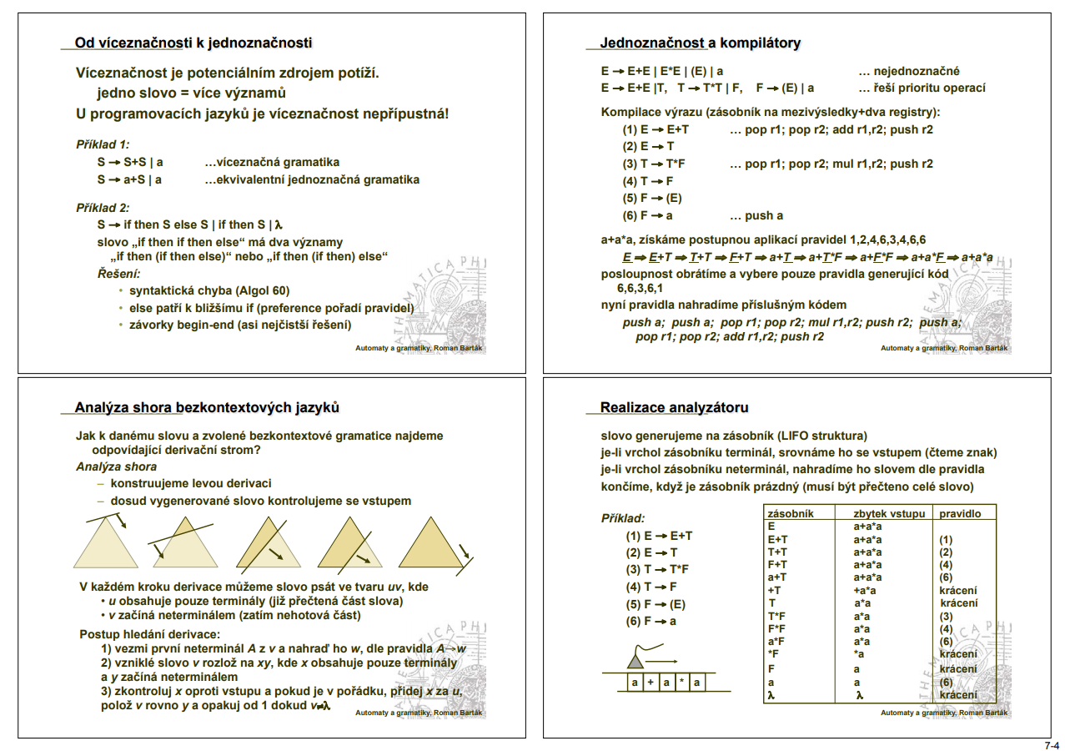

Slide 16
Our grammar
E → E + T
E → T
T → T * F
T → F
F → ( E )
F → id
Sčítání a odčítání s prioritou operací

Slide 17
Derivation (parse, syntax) tree
Graphical representation of derivations using trees
  Vertices are both non-terminals and terminals
  Edges from inner vertex representing a non-terminal on the left side of a production rule to all symbols from the right side of a production rule
E ⇒① E+T ⇒② T+T ⇒④ F+T ⇒⑥ id+T ⇒③ id+T*F ⇒④ id+F*F ⇒⑥ id+id*F ⇒⑥ id+id*id

Slide 18
Example
E
⇒①
E
⇒②
E
⇒④
E
⇒⑥
E
⇒③
E
+
T
E
+
T
E
+
T
E
+
T
T
T
T
F
F
id
E
⇒④
E
⇒⑥
E
⇒⑥
E
E
+
T
E
+
T
E
+
T
E
+
T
T
T
*
F
T
T
*
F
T
T
*
F
T
T
*
F
F
F
F
F
F
F
F
id
id
id
id
id
id
id

Slide 19
Ambiguous grammar
We can construct distinct derivation trees for the same input word
Real-life example (dangling else):
  stmt → if expr then stmt
  | if expr then stmt else stmt
  | while expr do stmt
  | goto num
  Input word: if E₁ then if E₂ then S₁ else S₂
stmt
stmt
if
E1
then
stmt
if
E1
then
stmt
else
S2
if
E2
then
S1
else
S2
if
E2
then
S1

Slide 20
Left recursion elimination
A grammar is a left-recursive grammar, when there is a non-terminal A for which it is true that A⇒⁺Aα for a string α
It is a problem for top-down parsing
A simple solution for βα^{m}:
  A → Aα
  A → β
  A → βA’
  A’ → αA’
  A’ → Λ

Slide 21
Removing left recursion from our grammar
E → E + T
E → T
T → T * F
T → F
F → ( E )
F → id
E → TE’
E’ → + TE’
E’ → Λ
T → FT’
T’ → * FT’
T’ → Λ
F → ( E )
F → id

Slide 22
Non-context-free language constructions
L₁={ wcw | w=(a|b)* }
  Check, whether an identifier w is declared before using
L₂={ a^{n}b^{m}c^{n}d^{m} | n≥1, m≥1 }
  Check, whether number of parameters in function call confirms to the function declaration
Solved during semantic analysis

Slide 23
Operators FIRST and FOLLOW – definitions
If α is any string of grammar symbols, let FIRST(α) be the set of terminals that begin the strings derived from α. If α can be derived to Λ, then Λ is also in FIRST(α)
Define FOLLOW(A), for nonterminal A, to be the set of terminals that can appear immediately to the right of A in some string, where exists a derivation of the form S ⇒* αAaβ for some α and β. If A can be the rightmost symbol in some sentential form, then $ is in FOLLOW(A).

Slide 24
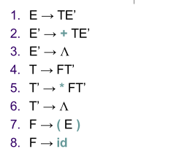
FIRST and FOLLOW – an example for our grammar
FIRST(E)={ (, id }
FIRST(T)={ (, id }
FIRST(F)={ (, id }
FIRST(E’)={ +, Λ }
FIRST(T’)={ *, Λ }
FOLLOW(E)={ ), $ }
FOLLOW(E’)={ ), $ }
FOLLOW(T)={ +,), $ }
FOLLOW(T’)={ +,), $ }
FOLLOW(F)={ +, *, ), $ }

Slide 25
LL(1) grammar
Context-free grammar G=(T,N,S,P) is a LL(1) grammar, if and only if whenever A→α, A→β ∈ P are two distinct (α≠β) productions of G and we have any left sentential forms uAγ, vAδ, where u,v∈T* and γ,δ∈(T∪N)*, the following condition holds:
  FIRST(αγ) ∩ FIRST(βδ) = ∅
Simplified detection: no ambiguous or left-recursive grammar can be LL(1)

Slide 26
Top-down parsing
An attempt to find a leftmost derivation for an input string
An attempt to construct a parse tree for the input starting from the root and creating the nodes of the tree in preorder
Recursive-descent parsing
  Recursive descent using procedures
Nonrecursive predictive parsing
  An automaton with an explicit stack
Both solutions have a problem with left recursion in a grammar
Many current parser generators use top-down parsing
  ANTLR, CocoR – LL(1) grammars with conflict resolution using dynamic look-ahead expansion to LL(k)

Slide 27
Nonrecursive predictive parsing
input
a
+
b
$
stack
X
Automaton
Y
output
Z
$
Parsing
table M
Parsing table M[A, a], where A is nonterminal and a is terminal
The stack contains grammar symbols

Slide 28
LL(1) automaton behavior
Initial configuration
  Input pointer points to the first terminal in the input string
  The stack contains the start symbol of the grammar on top of $
In each step, the automaton decides, what to do, using a symbol X on top of the stack and a terminal a, pointed by input pointer
  If X=a=$, the parser halts, parsing finished successfully
  If X=a≠$, the parser pops X from the stack and advances the input pointer to the next input symbol
  If X≠a and X∈T, the parser reports error
  If X is a nonterminal, the parser uses entry M[X, a]. If this entry is a production, the parser replaces X on top of the stack by the right side (leftmost symbol on top of the stack). At the same time, the parser generates an output about using the production. If the entry is error, the parser informs about a syntax error.

Slide 29
Construction of predictive parsing tables
For each production A→α do following steps
  For ∀ a∈FIRST(α) add A→α to M[A, a]
  If Λ∈FIRST(α), add A→α to M [A, b]
  ∀ b∈FOLLOW(A). Moreover, if $∈FOLLOW(A), add A→α to M[A, $]
Mark each empty entry in M as error

Slide 30
Example of table construction for our grammar
 | id | + | * | ( | ) | $
E | E→TE’ |  |  | E→TE’
E’ |  | E’→+TE’ |  |  | E’→Λ | E’→Λ
T | T→FT’ |  |  | T→FT’
T’ |  | T’→Λ | T’→*FT’ |  | T’→Λ | T’→Λ
F | F→id |  |  | F→(E)

Slide 31
Example of parser behavior for our grammar
Stack | Input | Output
$E | id+id*id$
$E’T | id+id*id$ | E→TE’
$E’T’F | id+id*id$ | T→FT’
$E’T’id | id+id*id$ | F→id
$E’T’ | +id*id$
$E’ | +id*id$ | T’→Λ
$E’T+ | +id*id$ | E’→+TE’
$E’T | id*id$
$E’T’F | id*id$ | T→FT’
Stack | Input | Output
$E’T’id | id*id$ | F→id
$E’T’ | *id$
$E’T’F* | *id$ | T’→*FT’
$E’T’F | id$
$E’T’id | id$ | F→id
$E’T’ | $
$E’ | $ | T’→Λ
$ | $ | E’→Λ

