Slide 1
NSWI178 - lecture 2
Arithmetic for Computers
Original slides from:
https://www.slideshare.net/ececourse/chapter-3-3372943

Slide 2
Arithmetic for Computers
§3.1 Introduction
Operations on integers
Addition and subtraction Multiplication and division Dealing with overflow
■
■
Floating-point real numbers
Representation and operations
■

Slide 3
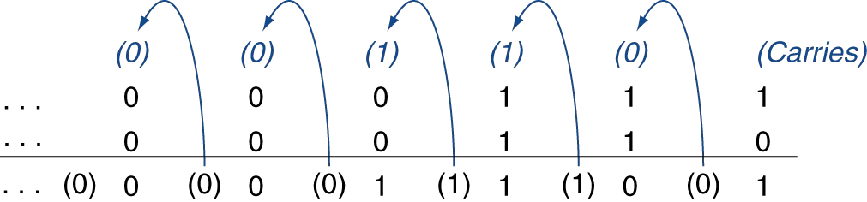
Integer Addition
§3.2 Addition and Subtraction
Example: 7 + 6
■
Overflow if result out of range
Adding +ve and –ve operands, no overflow
Adding two +ve operands
  Overflow if result sign is 1
Adding two –ve operands
  Overflow if result sign is 0
Faster variant: book page 1197

Slide 4
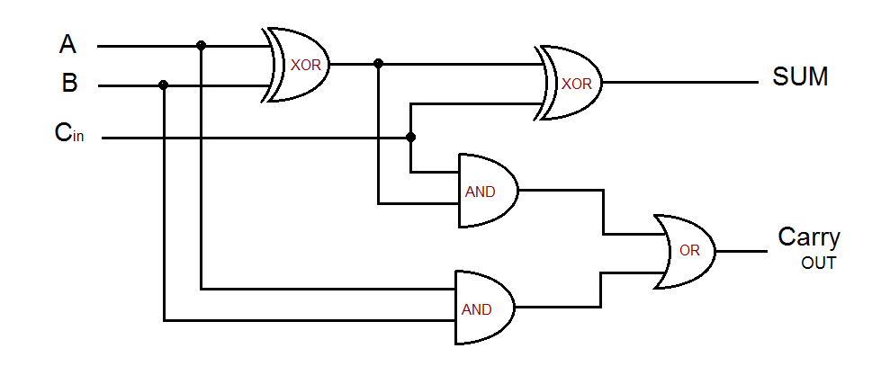
Integer Addition
§3.2 Addition and Subtraction
■

Slide 5
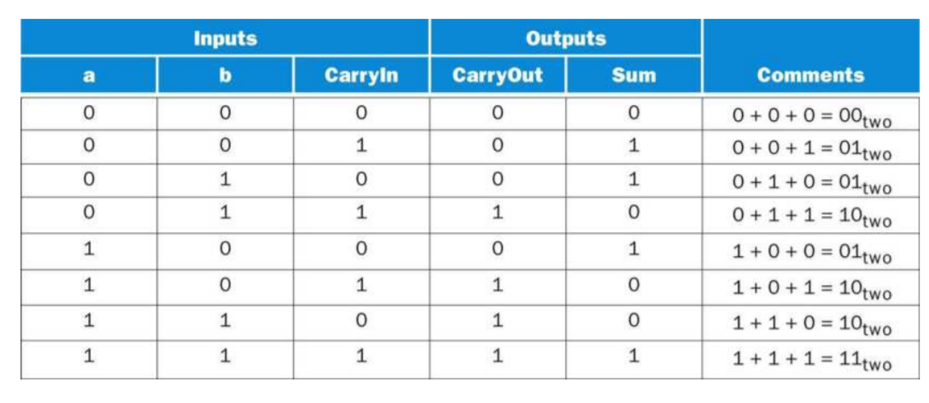
Integer Addition
§3.2 Addition and Subtraction
One-bit variant:
Faster variant: book page 1197

Slide 6
Integer Subtraction
Add negation of second operand
Example: 7 – 6 = 7 + (–6)
+7:
–6:
+1:
0000 0000 … 0000 0111
1111 1111 … 1111 1010
0000 0000 … 0000 0001
■
Overflow if result out of range
Subtracting two +ve or two –ve operands, no overflow Subtracting +ve from –ve operand
■
Overflow if result sign is 0
Subtracting –ve from +ve operand
Overflow if result sign is 1
■

Slide 7
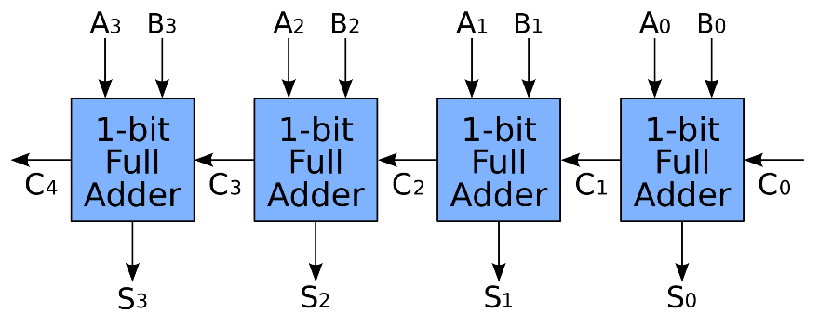
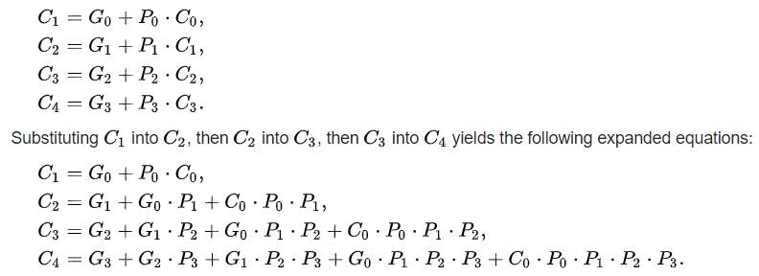
Why is all this too slow?
Carry-in bit takes long time to set (propagation delay)
  In the worst case propagates all the way from least significant bits
  Depth is the enemy => lets do it wide
What if we look ahead whether
there will be a carry-in?
  Generate or Propagate carry
  (A and B) will generate, (A or B) will propagate
  Can be determined for several bits ahead, and sent forward quickly

Slide 8
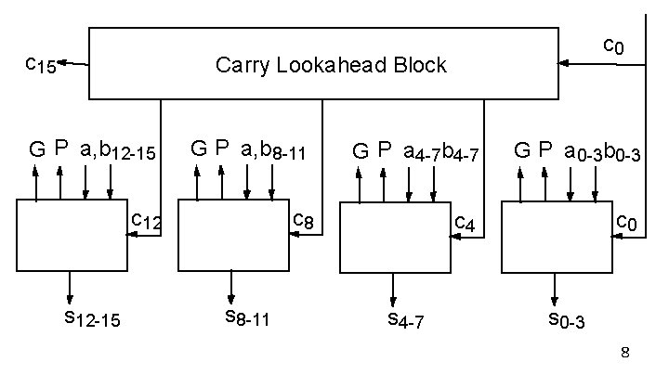
Why is all this too slow?
Carry lookahead
  Can be determined for several bits ahead, and sent forward quickly
  C4 only needs to get through one AND gate to get C8 -> quite fast
  Can be done hierarchically

Slide 9
Arithmetic for Multimedia
Graphics and media processing operates on vectors of 8-bit and 16-bit data
  Use 64-bit adder, with partitioned carry chain
    Operate on 8×8-bit, 4×16-bit, or 2×32-bit vectors
  SIMD (single-instruction, multiple-data)
Saturating operations
  On overflow, result is largest representable value
    c.f. 2s-complement modulo arithmetic
  E.g., clipping in audio, saturation in video

Slide 10
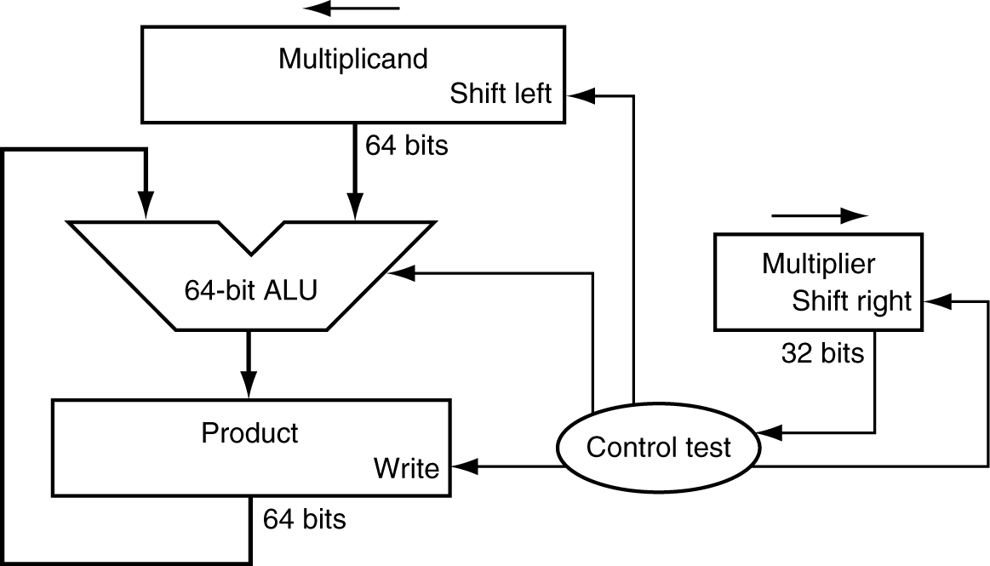

Multiplication
§3.3 Multiplication
Start with long-multiplication approach
multiplicand
1000
× 1001
1000
0000
0000
1000
1001000
multiplier
product
Length of product is the sum of operand lengths

Slide 11
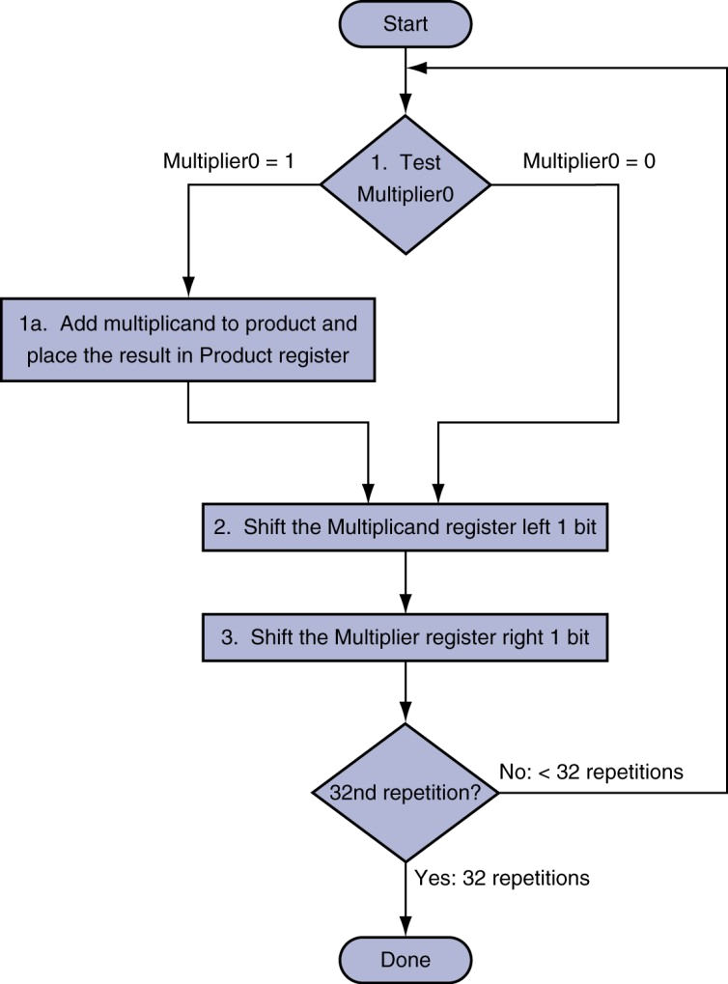
Multiplication Hardware
Initially 0

Slide 12
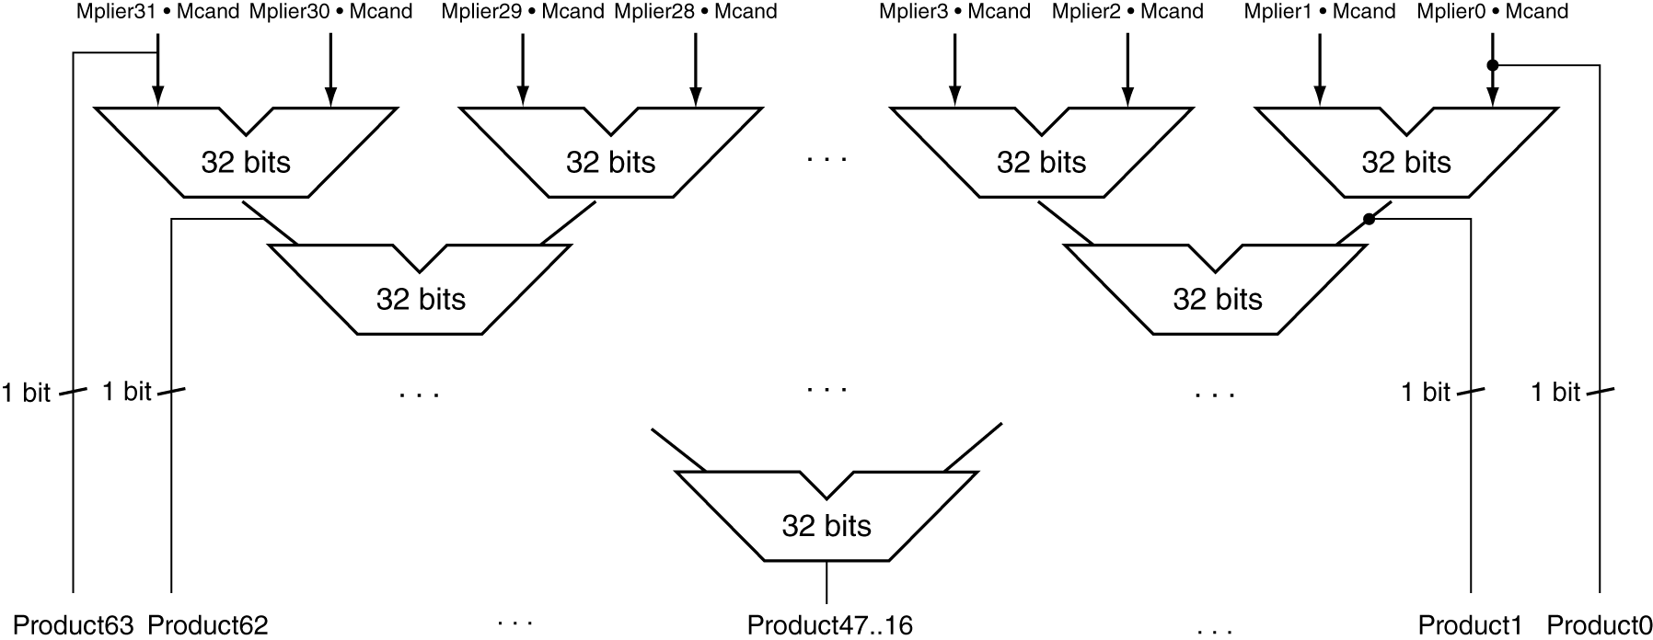
Faster Multiplier
Uses multiple adders
  Cost/performance tradeoff
Can be pipelined
Several multiplication performed in parallel
■

Slide 13
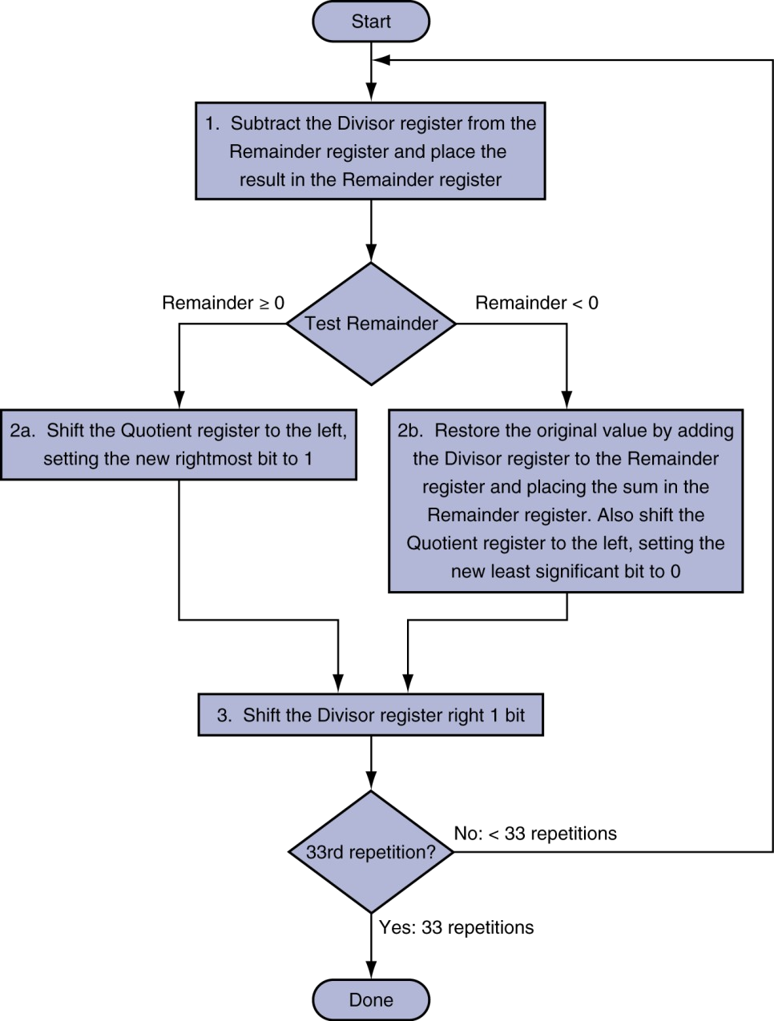
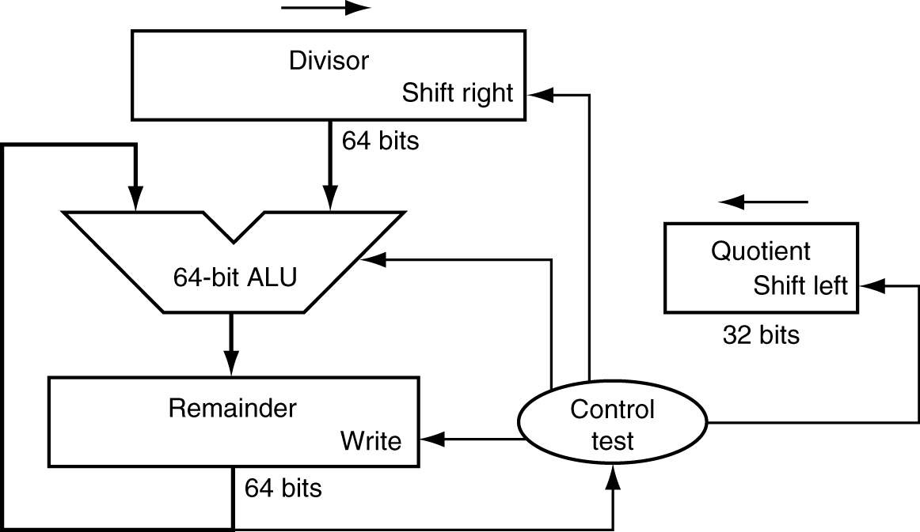
Division Hardware
Initially divisor in left half
Initially dividend

Slide 14
Floating Point
§3.5 Floating Point
Representation for non-integral numbers
  Including very small and very large numbers
Like scientific notation
–2.34 × 10⁵⁶
+0.002 × 10^{–4}
+987.02 × 10⁹
normalized
■
not normalized
■
In binary
±1.xxxxxxx₂ × 2^{yyyy}
■
■
Types float and double in C

Slide 15
Floating Point Standard
Defined by IEEE Std 754-1985
Developed in response to divergence of representations
Portability issues for scientific code Now almost universally adopted Two representations
■
■
Single precision (32-bit)
Double precision (64-bit)

Slide 16
IEEE Floating-Point Format
single: 8 bits
double: 11 bits
single: 23 bits
double: 52 bits
S | Exponent | Fraction
x = (−1)^{S} ×(1+Fraction)× 2^{(Exponent−Bias)}
■
■
S: sign bit (0 ⇒ non-negative, 1 ⇒ negative) Normalize significand: 1.0 ≤ |significand| < 2.0
■
Always has a leading pre-binary-point 1 bit, so no need to represent it explicitly (hidden bit)
Significand is Fraction with the “1.” restored
■
■
Exponent: excess representation: actual exponent + Bias
■
Ensures exponent is unsigned
Single: Bias = 127; Double: Bias = 1203
■

Slide 17
Single-Precision Range
Exponents 00000000 and 11111111 reserved
Smallest value
Exponent: 00000001
⇒ actual exponent = 1 – 127 = –126 (biased repr.)
Fraction: 000…00 ⇒ significand = 1.0
±1.0 × 2^{–126} ≈ ±1.2 × 10^{–38}
■
■
■
Largest value
exponent: 11111110
⇒ actual exponent = 254 – 127 = +127
Fraction: 111…11 ⇒ significand ≈ 2.0
±2.0 × 2⁺¹²⁷ ≈ ±3.4 × 10⁺³⁸
■
■

Slide 18
Double-Precision Range
Exponents 0000…00 and 1111…11 reserved
Smallest value
Exponent: 00000000001
⇒ actual exponent = 1 – 1023 = –1022
Fraction: 000…00 ⇒ significand = 1.0
±1.0 × 2^{–1022} ≈ ±2.2 × 10^{–308}
■
■
■
Largest value
Exponent: 11111111110
⇒ actual exponent = 2046 – 1023 = +1023
Fraction: 111…11 ⇒ significand ≈ 2.0
±2.0 × 2⁺¹⁰²³ ≈ ±1.8 × 10⁺³⁰⁸
■
■

Slide 19
Floating-Point Precision
Relative precision
  all fraction bits are significant
  Single: approx 2^{–23}
Equivalent to 23 × log₁₀2 ≈ 23 × 0.3 ≈ 6 decimal digits of precision
Double: approx 2^{–52}
■
■
Equivalent to 52 × log₁₀2 ≈ 52 × 0.3 ≈ 16 decimal digits of precision

Slide 20
Floating-Point Example
Represent –0.75
–0.75 = (–1)¹ × 1.1₂ × 2^{–1}
S = 1
Fraction = 1000…00₂
Exponent = –1 + Bias
■
■
■
Single: –1 + 127 = 126 = 01111110₂
Double: –1 + 1023 = 1022 = 01111111110₂
■
Single: 1011111101000…00 Double: 1011111111101000…00
■
■

Slide 21
Floating-Point Example
What number is represented by the single- precision float
11000000101000…00
S = 1
Fraction = 01000…00₂
Exponent = 10000001₂ = 129
■
■
x = (–1)¹ × (1 + .01₂) × 2^{(129 – 127)}
= (–1) × 1.25 × 2²
= –5.0
■

Slide 22
Denormal Numbers
Exponent = 000...0 ⇒ hidden bit is 0
x = (−1)^{S} ×(0 +Fraction)× 2^{−Bias}
Smaller than normal numbers
  allow for gradual underflow, with diminishing precision
Denormal with fraction = 000...0
x = (−1)^{S} ×(0 + 0)× 2^{−Bias} = ±0.0
Two representations of 0.0!

Slide 23
Infinities and NaNs
Exponent = 111...1, Fraction = 000...0
  ±Infinity
  Can be used in subsequent calculations, avoiding need for overflow check
■
Exponent = 111...1, Fraction ≠ 000...0
Not-a-Number (NaN)
Indicates illegal or undefined result
  e.g., 0.0 / 0.0
Can be used in subsequent calculations

Slide 24
Floating-Point Addition
Consider a 4-digit decimal example
  9.999 × 10¹ + 1.610 × 10^{–1}
1. Align decimal points
  Shift number with smaller exponent
  9.999 × 10¹ + 0.016 × 10¹
■
Add significands
  9.999 × 10¹ + 0.016 × 10¹ = 10.015 × 10¹
Normalize result & check for over/underflow
  1.0015 × 10²
Round and renormalize if necessary
  1.002 × 10²
■
■

Slide 25
Floating-Point Addition
Now consider a 4-digit binary example
  1.000₂ × 2^{–1} + –1.110₂ × 2^{–2} (0.5 + –0.4375)
1. Align binary points
  Shift number with smaller exponent
  1.000₂ × 2^{–1} + –0.111₂ × 2^{–1}
■
Add significands
  1.000₂ × 2^{–1} + –0.111₂ × 2^{–1} = 0.001₂ × 2^{–1}
Normalize result & check for over/underflow
  1.000₂ × 2^{–4}, with no over/underflow
Round and renormalize if necessary
  1.000₂ × 2^{–4} (no change) = 0.0625
■
■

Slide 26
FP Adder Hardware
Much more complex than integer adder
Doing it in one clock cycle would take too long
  Much longer than integer operations
  Slower clock would penalize all instructions
FP adder usually takes several cycles
Can be pipelined
■

Slide 27
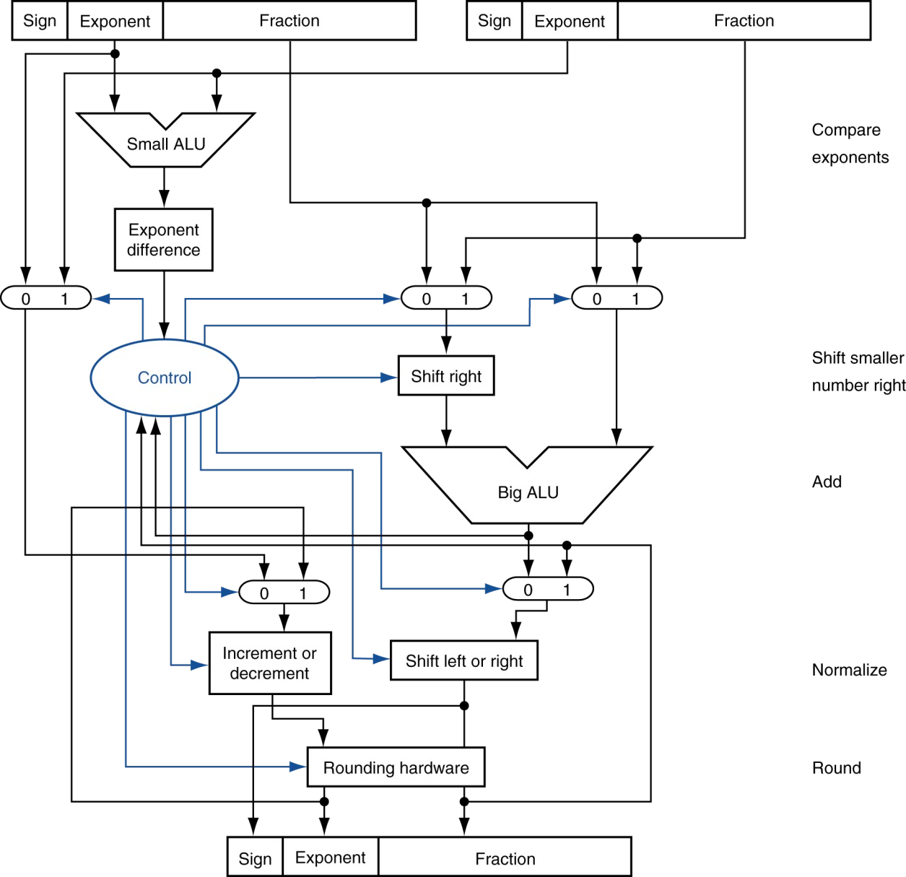
FP Adder Hardware
Step 1
Step 2
Step 3
Step 4

Slide 28
Floating-Point Multiplication
Consider a 4-digit decimal example
■
1.110 × 10¹⁰ × 9.200 × 10^{–5}
■
1. Add exponents
■
For biased exponents, subtract bias from sum New exponent = 10 + –5 = 5
■
■
2. Multiply significands
■
1.110 × 9.200 = 10.212 ⇒ 10.212 × 10⁵
■
3. Normalize result & check for over/underflow
■
1.0212 × 10⁶
■
4. Round and renormalize if necessary
■
1.021 × 10⁶
■
5. Determine sign of result from signs of operands
■
+1.021 × 10⁶

Slide 29
Floating-Point Multiplication
Now consider a 4-digit binary example
■
1.000₂ × 2^{–1} × –1.110₂ × 2^{–2} (0.5 × –0.4375)
■
1. Add exponents
■
Unbiased: –1 + –2 = –3
Biased: (–1 + 127) + (–2 + 127) = –3 + 254 – 127 = –3 + 127
■
■
2. Multiply significands
■
1.000₂ × 1.110₂ = 1.1102 ⇒ 1.110₂ × 2^{–3}
■
3. Normalize result & check for over/underflow
■
1.110₂ × 2^{–3} (no change) with no over/underflow
■
4. Round and renormalize if necessary
■
1.110₂ × 2^{–3} (no change)
■
5. Determine sign: +ve × –ve ⇒ –ve
■
–1.110₂ × 2^{–3} = –0.21875

Slide 30
FP Arithmetic Hardware
FP multiplier is of similar complexity to FP adder
But uses a multiplier for significands instead of an adder
FP arithmetic hardware usually does
■
■
Addition, subtraction, multiplication, division, reciprocal, square-root
FP ↔ integer conversion
■
■
Operations usually takes several cycles
Can be pipelined

Slide 31
FP Instructions in MIPS
FP hardware is coprocessor 1
  Adjunct processor that extends the ISA
■
Separate FP registers
32 single-precision: $f0, $f1, … $f31
Paired for double-precision: $f0/$f1, $f2/$f3, …
■
Release 2 of MIPs ISA supports 32 × 64-bit FP reg’s
■
FP instructions operate only on FP registers
Programs generally don’t do integer ops on FP data, or vice versa
More registers with minimal code-size impact
■
■
FP load and store instructions
lwc1, ldc1, swc1, sdc1
  e.g., ldc1 $f8, 32($sp)

Slide 32
FP Instructions in MIPS
Single-precision arithmetic
  add.s, sub.s, mul.s, div.s
    e.g., add.s $f0, $f1, $f6
■
Double-precision arithmetic
add.d, sub.d, mul.d, div.d
  e.g., mul.d $f4, $f4, $f6
■
Single- and double-precision comparison
c.xx.s, c.xx.d (xx is eq, lt, le, …) Sets or clears FP condition-code bit
■
e.g. c.lt.s $f3, $f4
■
Branch on FP condition code true or false
bc1t, bc1f
  e.g., bc1t TargetLabel

Slide 33
Interpretation of Data
The BIG Picture
Bits have no inherent meaning
Interpretation depends on the instructions applied
Computer representations of numbers
■
■
Finite range and precision
Need to account for this in programs
(a+b)+c = a+(b+c)

Slide 34
Associativity
§3.6 Parallelism and Computer Arithmetic: Associativity
Parallel programs may interleave operations in unexpected orders
  Assumptions of associativity may fail
 |  | (x+y)+z | x+(y+z)
x | -1.50E+38 | 0.00E+00 | -1.50E+38
y | 1.50E+38 |  | 1.50E+38
z | 1.0 | 1.0
 |  | 1.00E+00 | 0.00E+00
■
Need to validate parallel programs under varying degrees of parallelism

Slide 35
Streaming SIMD Extension 2 (SSE2)
Adds 4 × 128-bit registers
  Extended to 8 registers in AMD64/EM64T
Can be used for multiple FP operands
2 × 64-bit double precision 4 × 32-bit double precision
Instructions operate on them simultaneously
■
■
Single-Instruction Multiple-Data

Slide 36
Right Shift and Division
§3.8 Fallacies and Pitfalls
Left shift by i places multiplies an integer by 2^{i}
Right shift divides by 2^{i}?
■
Only for unsigned integers
For signed integers
■
Arithmetic right shift: replicate the sign bit e.g., –5 / 4
■
11111011₂ >> 2 = 11111110₂ = –2
Rounds toward –∞
■
■
c.f. 11111011₂ >>> 2 = 00111110₂ = +62

