Slide 1
TensorFlow Tutorial
Based on slides by Bharath Ramsundar

Slide 2
What is TensorFlow?
TensorFlow is a deep learning library recently open-sourced by Google.
But what does it actually do?
TensorFlow provides primitives for
defining functions on tensors and automatically computing their derivatives.

Slide 3
But what’s a Tensor?
Formally, tensors are multilinear maps from vector spaces to the real numbers ( vector space, and dual space)
A scalar is a tensor (
A vector is a tensor (
A matrix is a tensor (
Common to have fixed basis, so a tensor can be
represented as a multidimensional array of numbers.
)
)
)

Slide 4
TensorFlow vs. Numpy
Few people make this comparison, but TensorFlow and Numpy are quite similar. (Both are N-d array libraries!)
Numpy has Ndarray support, but doesn’t offer methods to create tensor functions and automatically compute derivatives (+ no GPU support).
VS

Slide 5
Simple Numpy Recap
I n [ 23 ]: import numpy as np
I n [ 24 ]: a = np. zeros(( 2 , 2 ) ) ; b = np. ones(( 2 , 2 )) I n
[ 25 ]: np.sum(b, axis=1) Out[ 25]: a r r a y([ 2. , 2. ])
I n [ 26 ]: a.shape
Out[ 26]: ( 2 , 2)
I n [ 27 ]: np.reshape(a, ( 1 , 4 ))
Out[ 27] : array([ [ 0 . , 0 . , 0 . ,
0 .]])

Slide 6
Repeat in TensorFlow
More on Session soon
More on . e v a l () in a few slides
I n [ 31 ]: import tensorflow as tf
I n [ 32 ]: tf . Interacti ve Sessi on ()
I n [ 33 ]: a = tf . z e r o s (( 2 , 2 ) ) ; b = tf . o n e s (( 2 , 2 ))
I n [ 34 ]: tf.reduce_sum(b, reduction_ indices= 1 ). eval() Out[ 34 ]: a r r a y([ 2. , 2. ], dtype=float32)
TensorShape behaves
like a python tuple.
I n [ 35 ]: a.get_shape()
Out[ 35 ]: TensorShape([Dimension(2), Dimension(2)])
I n [ 36 ]: tf . reshape( a, ( 1 , 4 )). e v a l ()
Out[ 36 ]: a r r a y ( [ [ 0. , 0. , 0. , 0. ] ] , dtype=float32)

Slide 7
Numpy to TensorFlow Dictionary
Numpy | TensorFlow
a = np. zeros(( 2 , 2 ) ) ; b = np. ones(( 2 , 2 )) | a = tf . z e r o s (( 2 , 2 ) ) , b = tf . o n e s (( 2 , 2 ))
np.sum(b, axis=1) | tf. reduce_sum( a, reduction_indices=[ 1])
a.shape | a.get_shape()
np.reshape(a, ( 1 , 4 )) | tf . reshape( a, ( 1 , 4 ))
b * 5 + 1 | b * 5 + 1
np. dot( a, b) | tf . matmul( a, b)
a [ 0 , 0 ] , a [:, 0 ], a [ 0 ,:] | a [ 0 , 0 ] , a [:, 0 ], a [ 0 ,:]

Slide 8
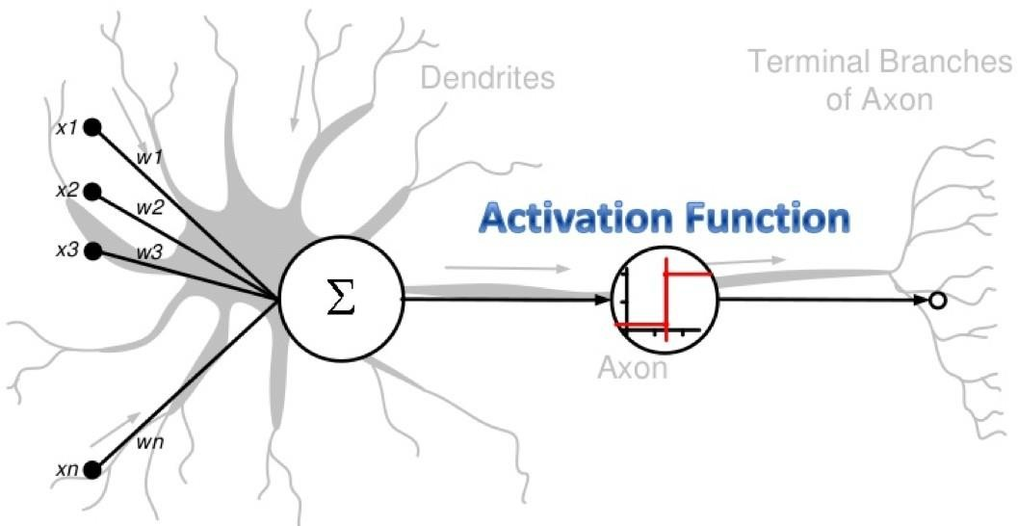
Neural Model

Slide 9
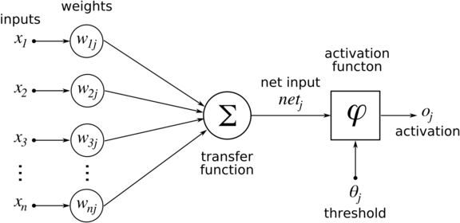
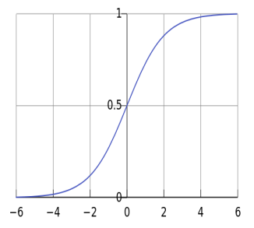
Neuron a.k.a. Unit

Slide 10
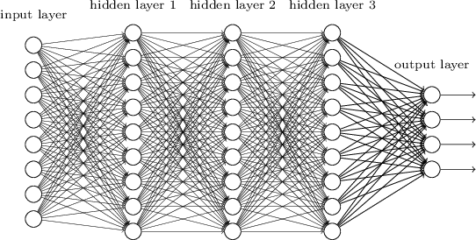
Multilayered Network

Slide 11
Stochastic Gradient Descent
Generalization of (Stochastic) Gradient Descent

Slide 12
TensorFlow Variables (1)
“When you train a model you use variables to hold and update parameters. Variables are in-memory buffers containing tensors” - TensorFlow Docs.
All tensors we’ve used previously have been constant
tensors, not variables.

Slide 13
TensorFlow Variables (2)
...
def fcLayer(self, i: int, o: int, x: tf.Tensor, f: Callable[[tf.Tensor], tf.Tensor]) -> tf.Tensor:
self.w = tf.Variable(tf.random.normal([i, o]))
self.b = tf.Variable(tf.random.normal([i, o]))
self.f = f
if callable(self.f): #ReLU, Sigmoid, or other activations
return self.f(tf.add(tf.matmul(x, self.w), self.b))
else:
return tf.add(tf.matmul(x, self.w), self.b)

Slide 14
Inputting Data
All previous examples have manually defined tensors. How can we input external data into TensorFlow?
Simple solution: Import from Numpy:
I n [ 93 ]: a = np. zeros(( 3 , 3 ))
I n [ 94 ]: t a = tf . convert_ to_ tensor( a)
....:
[[ | 0. | 0. | 0 . ]
[ | 0. | 0. | 0 . ]
[ | 0. | 0. | 0. ]]

Slide 15
Placeholders and Feed Dictionaries (1)
Inputting data with tf . convert_ to_ tensor () is convenient, but doesn’t scale.
TF 1.x: Use tf . placeholder variables (dummy nodes that provide entry points for data to computational graph).
TF 2.x: keras Input has similar characteristics

Slide 16
High-level API
So far, low level API considered
Sure, you can do everything with it, but it is tedious
High level API oriented on neural networks: Keras
simple ways to define networks, its input data, training and utilization

Slide 17
High-level API
Basics: https://www.tensorflow.org/tutorials/quickstart/beginner

Slide 18
But what about paralellization?
So far, only some layers and variables.
Not a single word about parallel implementation
Your code is evaluated in parallel either on CPU or GPU based on TF’s internal logic & available resources
You dont have to care ☺
Nowadays, installing TF with GPU support starts to be quite simple
Some adjustments for multi-GPU support

Slide 19
Further reading
https://docs.anaconda.com/anaconda/user-guide/tasks/tensorflow/
Recommended installation variant
https://www.tensorflow.org/guide/migrate
Some notes & solutions on TF 1.x and 2.x compatibility issues

Slide 20
Further reading
https://www.tensorflow.org/tutorials/customization/basics
How to work with GPUs explicitely & much more
https://www.youtube.com/watch?v=5ECD8J3dvDQ
Slightly „propaganda“ talk, but quite informative if you skip all „I love this feature“ stuff
At 29:40, there are some extensions on TF and parallelization

