Slide 1
Parallel computing
Original slides by Jakub Yaghob
https://www.ksi.mff.cuni.cz/teaching/nprg042-web/#@tab_lectures
Extensions towards distributed systems:
https://www.ksi.mff.cuni.cz/teaching/nswi035-web/

Slide 2
Parallel programming
Why?
Solve problem in less time
Solve bigger problem than would be possible on a single CPU
Bioinformatics often incorporate large problems
Some portions of problems may be effectively distributed

Slide 3
Simple use-cases
Machine learning
K-nearest neighbors classification model
K is a hyperparameter: what is the best value of K?
Select plausible values (e.g., K \in {1,3,5,10,15,20})
(Train) & evaluate each variant on validation data
This operation may take long time
Select the one that performs the best
More complex models have several hyperparameters => tens or hundreds of combinations to evaluate

Slide 4
Simple use-cases
Matrix multiplication
Have a (very) large matrix (MxN)
You need to multiply it with a vector (Nx1)
You can calculate the output in a for-cycle (cell by cell), but this may take a long time

Slide 5
Parallel programming
Why?
Solve problem in less time
Solve bigger problem than would be possible on a single CPU
Programmer’s task
Identify the concurrency in the problem
Structure the algorithm so that this concurrency can be exploited
Implement the solution using a suitable programming environment

Slide 6
Flynn’s taxonomy
Single Instruction, Single Data (SISD)
von Neumann
Single Instruction, Multiple Data (SIMD)
Vector processors (mentioned before)
Multiple Instruction, Single Data (MISD)
No well-known systems
Multiple Instruction, Multiple Data (MIMD)
All modern parallel systems

Slide 7
A further breakdown of MIMD – shared memory
CPU
CPU
CPU
CPU
Shared memory
Symmetric multiprocessors (SMP)
Easiest to program
Do not scale well, small number of CPUs
Nonuniform memory access (NUMA)
Uniformly addressable from all CPUs
Some memory blocks may be physically more closely, the access time significantly varies
Each CPU has a cache, it mitigates the effect of NUMA – cache coherent NUMA (ccNUMA), nearly as SMP (locality issues, cache effects)
memory

Slide 8
A further breakdown of MIMD – NUMA
CPU
CPU
CPU
CPU
CPU
CPU
CPU
CPU
memory
memory
memory
memory
CPU
CPU
CPU
CPU
CPU
CPU
CPU
CPU

Slide 9
A further breakdown of MIMD – distributed memory
Distributed memory
Own address space, message passing
Explicitly program the communication, the distribution of data
Massively parallel processors (MPP)
CPUs and network tightly coupled
Cluster
Composed of off-the-shelf computers connected by an off-the-shelf network

Slide 10
The jargon
Task
Sequence of instructions that operate together as a group
Logical part of an algorithm
Unit of execution (UE)
Process or thread
Tasks are mapped to UEs
Processing element (PE)
HW element that executes a stream of instructions

Slide 11
The jargon
Load balancing
How well the work is distributed among PEs
Synchronization
Enforcing necessary ordering constraints (i.e., task X cannot start before task Y is completed)
Synchronous x asynchronous
Coupling two events in time
Race condition
Outcome of a program depends on on the scheduling of UEs
Deadlock

Slide 12
Performance modeling
Total running time on one PE
Total running time on P PEs
Speedup
Additional overhead

Slide 13
Performance modeling
Efficiency
Perfect linear speedup: S(P)=P
Serial fraction
Rewrite total running time for P PEs

Slide 14
Amdahl’s law
Very large number of CPUs
I.e. are the tasks left for serial computation really short enough?

Slide 15
Finding concurrency
Starting point for design of a parallel solution
Dependency analysis
Decomposition
Group Tasks
Task Decomposition
Design Evaluation
Order Tasks
Data Decomposition
Data Sharing

Slide 16
Finding concurrency
Before starting to work:
Is the problem large enough?
Are the results significant enough?
Understanding key features and data elements
Understanding, which parts of the problem are most computationally intensive
Focus the effort here

Slide 17
Finding concurrency
Decomposition patterns
Decompose the problem into pieces that can execute concurrently
Dependency Analysis patterns
Group tasks and analyze the dependencies among them
Theoretically, patterns should be used in order
Practically, work back and forth between them, possible even revisit decomposition
Design Evaluation pattern
Final pattern, checkpoint before moving to the Algorithm Structure design space
Best design not found on the first attempt

Slide 18
Using decomposition patterns
Decomposition occurring in two dimensions
Task-decomposition
Problem is a stream of instructions that can be broken into sequences called tasks that can execute simultaneously
To be efficient, the operations from one task should be largely independent from other tasks
Data-decomposition
Focuses on the data required by the tasks
How can it be decomposed into distinct chunks?
The computation associated with the data chunk must be relatively independent

Slide 19
Simple use-cases
ML: task decomposition (evaluations w.r.t. single hyperparameter settings)
Seq.: wait for all results & select the best one
Matrix Data: evaluate each row separately
Seq.: place individual results into correct positions of the result vector

Slide 20
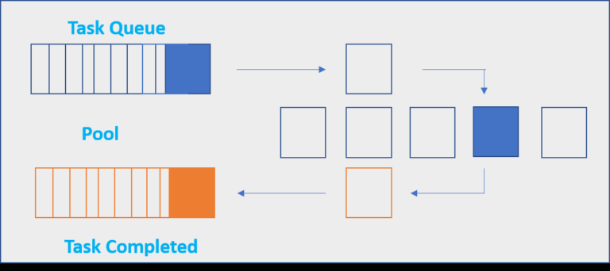
Python Examples
Multiprocessing
https://docs.python.org/3/library/multiprocessing.html
Pool object: paralellized execution of a function across multiple input values. Predefined worker processes
Handles results synchronization for you
Simple interface & good enough for small-scale paralelization
Processes, messaging, synchronization,…

Slide 21
Python Examples
Multiprocessing.Pool
from multiprocessing import Pool
def knn_eval(k, data):
#evaluation code goes here
k_vals = [1,3,5,10,15]
data = ...
with Pool(5) as p: #number of processes
results = p.map(knn_eval, k_vals)
#now we have results for all k variants
Wait, but how to give data object to the worker processes?

Slide 22
Python Examples
Functools.partial (partially filled functions)
from multiprocessing import Pool
from functools import partial
def knn_eval(k, data):
#evaluation code goes here
k_vals = [1,3,5,10,15]
data = ...
knn_eval_with_data(knn_eval, data=data)
with Pool(5) as p:
results = p.map(knn_eval_with_data, k_vals)
#now we have results for all k variants

Slide 23
Python Examples
Joblib.Parallel
https://joblib.readthedocs.io/en/latest/
Similar to multiprocessing Pools, high-level API
Nicely fits together with NumPy
Simple way to work with shared memmory
from joblib import Parallel, delayed
def knn_eval(k, data):
#evaluation code goes here
k_vals = [1,3,5,10,15]
data = ...
results = Parallel(n_jobs=3)(delayed(knn_eval)(k, data) for k in k_vals)
#now we have results for all k variants

Slide 24
KSI Laboratory – overview
Two SLURM clusters
parlab – parallel and distributed computing
gpulab – parallel and GPU computing, Docker
Common homes
NFS array mounted on /mnt/home
Available software
Centos 7.x
gcc/g++ 8.x/9.x
UDSS
Charliecloud
Info
https://gitlab.mff.cuni.cz/ksi/clusters

Slide 25
Parlab
Internet
FDR Infiniband switch
FC16 SAN
Blade chassis
parlab
10G Ethernet switch
phi[01-02]
w[201-208]
w[401-404]

Slide 26
Gpulab
Internet
Blade chassis
gpulab
10G Ethernet switch
volta[01-05]
dw[01-05]
varjag

Slide 27
SLURM – crash course
Resource manager
Commands from any node
Acquire resources before use
Cluster nodes divided to partitions
Important commands
srun – acquire resources and immediately run a command, creates a job
sbatch – acquire resources and run a shell script , creates a job
scancel – cancel a job
sinfo – get info about partitions, nodes, …
squeue – get info about job queue

