Slide 1
Evaluating Recommender Systems
If You want to double your success rate, you should double your failure rate.

Slide 2
Evaluating Recommender Systems
A myriad of techniques has been proposed, but
  Which one is the best in a given application domain?
  What are the success factors of different techniques?
  Comparative analysis based on an optimality criterion?
Research questions are:
  Is a RS efficient with respect to a specific criteria like accuracy, user satisfaction, response time, serendipity, online conversion, ramp-up efforts, ….
  Do customers like/buy recommended items?
  Do customers buy items they otherwise would have not?
  Are they satisfied with a recommendation after purchase?
  (Can we assure that this improvement was caused by the RS? )

Slide 3
Empirical research
Characterizing dimensions:
  Who is the subject that is in the focus of research?
  What research methods are applied?
  In which setting does the research take place?
Subject | Online customers, students, historical online sessions, computers, …
Research method | Experiments, quasi-experiments, non-experimental research
Setting | Lab, real-world scenarios, off-line (data) study

Slide 4
Evaluation settings
Off-line evaluation
  Based on historical data
  Aiming to predict hidden part of the data
Lab studies
  Expressly created for the purpose of the study
  Extraneous variables can be controlled more easy by selecting study participants
    Possibility to get more feedback
  But doubts may exist about participants motivated by money or prizes
  Participants should behave as they would in a real-world enviroment
Field studies (On-line, A/B testing)
  Conducted in an preexisting real-world enviroment
  Users are intrinsically motivated to use a system

Slide 5
Varianty Evaluace
Online
Offline
Na běžícím serveru
Těžko se opakuje
Náročné (časově i finančně)
Pouze několik metod
Skutečné metriky (CTR, konverze…)
Lze měřit i změny GUI atp.
Datová simulace
Snadno se opakuje
Výsledky (poměrně) rychle
Umělé metriky (RMSE, nDCG, diversity…)
Dovedeme pouze porovnávat schopnost predikce minulého chování uživatele
Success in offline do not imply success in online…
…ale pokud metoda neuspěje v offline, obvykle nemá cenu jí zkoušet online.

Slide 6
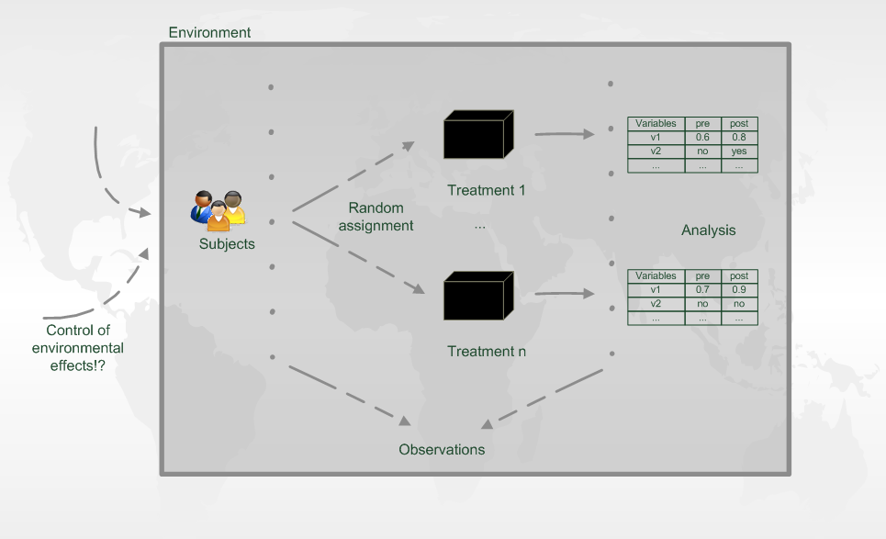
Experiment designs – Online Evaluation, A/B testing

Slide 7
Evaluation of Online studies
A/B testing
  Evaluate metric as close to the actual target variable as possible
  Retailer’s target variable is profit
    i.e. Netflix’s target variable is monthly subscribes
    Usually, larger overal consumption increase profit
  Broadcaster’s target variable may be influenceness / total mass of readers
The direct effect on target variables may be too small
  How much does one small parameter change affect retention of users?
The target variables may be hard to measure directly
  E.g. has long-term effect only / cannot extrapolate all external variables
Proxy variables
  Loyalty of user, Conversions rate, Basket size / value, Click through rate, Shares / Follows /…

Slide 8
Common on-line evaluation metrics – E-commerce
Always design evaluation metrics with respect to your target variable
  However select something, where the effect is measurable
  Cascade of evaluation metrics
    From high to low detectability of changes
    From low to high impact on your true target

Slide 9
Common on-line evaluation metrics – E-commerce
Higher potential impact
Recommending correctness
  Visit (once) recommended object (i.e. ignore page layout)
Click-through rate
  Click on recommended item / Click and do something (do not leave imediatelly)
Conversions rate
  Buy recommended item / Recommend -> Click -> Purchase
  Share / follow / like / ask about... recommended item
Cross-sale increase
  Add to cart -> Recommend -> Add another (recommended) to cart
Better proxy of target variable

Slide 10
Common on-line evaluation metrics – Broadcaster/News/Info
Higher potential impact
Recommending correctness
  Visit (once) recommended object (i.e. ignore page layout)
Click-through rate
  Click on recommended item / Click and do something (do not leave imediatelly)
„Conversions“ rate
  Share / follow / like / comment... recommended item
Value per user
  Total time / number of visited objects / displayed adds…
  per user or per session
  Returning rate of users / user loyalty
Better proxy of target variable

Slide 11
Common on-line evaluation metrics – Technical
!!Response time!!
Train / re-train time
Memory / CPU consumption
  How large can we grow with current infrastructure?
Recall on objects
  Is portion of your objects ignored? Are there too many low-profit bestsellers?
Ability to predict
  Can you calculate recommendations for all users?
  For which groups of users are we better than baseline?

Slide 12
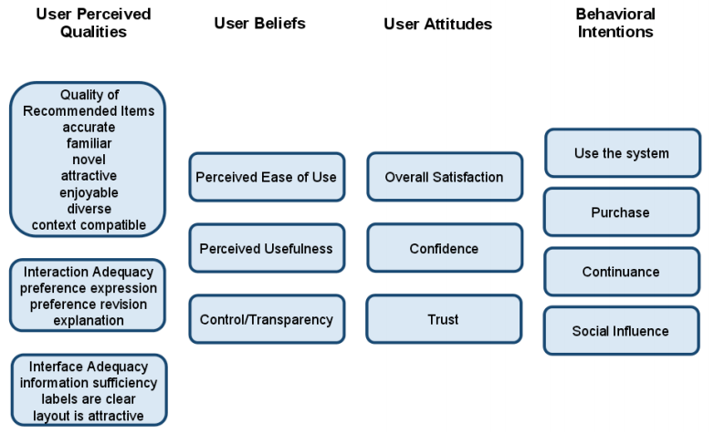
Evaluation in Lab studies
Same as on-line experiments
Questionnaire
  Features otherwise harder to detect directly
  Helpfulness / Ease of use / Relevance
  Trust
  Novelty to the user etc.
Physiological response
  Eye tracking etc.
Key criterion in lab studies is that subjects should well approximate behavior of your real users
  This may be harder than it seems

Slide 13
Evaluation of Off-line experiments
Simulation on existing dataset
  Train / Validation / Test split
    Random (bootstrap) – only in case of very large datasets
    Cross-validation variants
    Temporal splits – better than CV for RecSys (causality problems), however lower support in non-recsys audience
    Event-based simulation – the best option from causality perspective, most expensive
Prediction of „correct“ objects
  According to some metic / metrics

Slide 14
Evaluation of Off-line experiments
Simulation on existing dataset
  Correct evaluation protocol:
  For each method and set of parameters:
    Learn model on TRAIN set
    Evaluate prediction on VALIDATION set
  Select best parameters for each method
  For each method:
    Learn model on TRAIN + VALIDATION set
    Evaluate prediction on TEST set
  Compare results
Never use any knowledge of the test set data
  E.g. For mean ratings, object similarities etc.

Slide 15
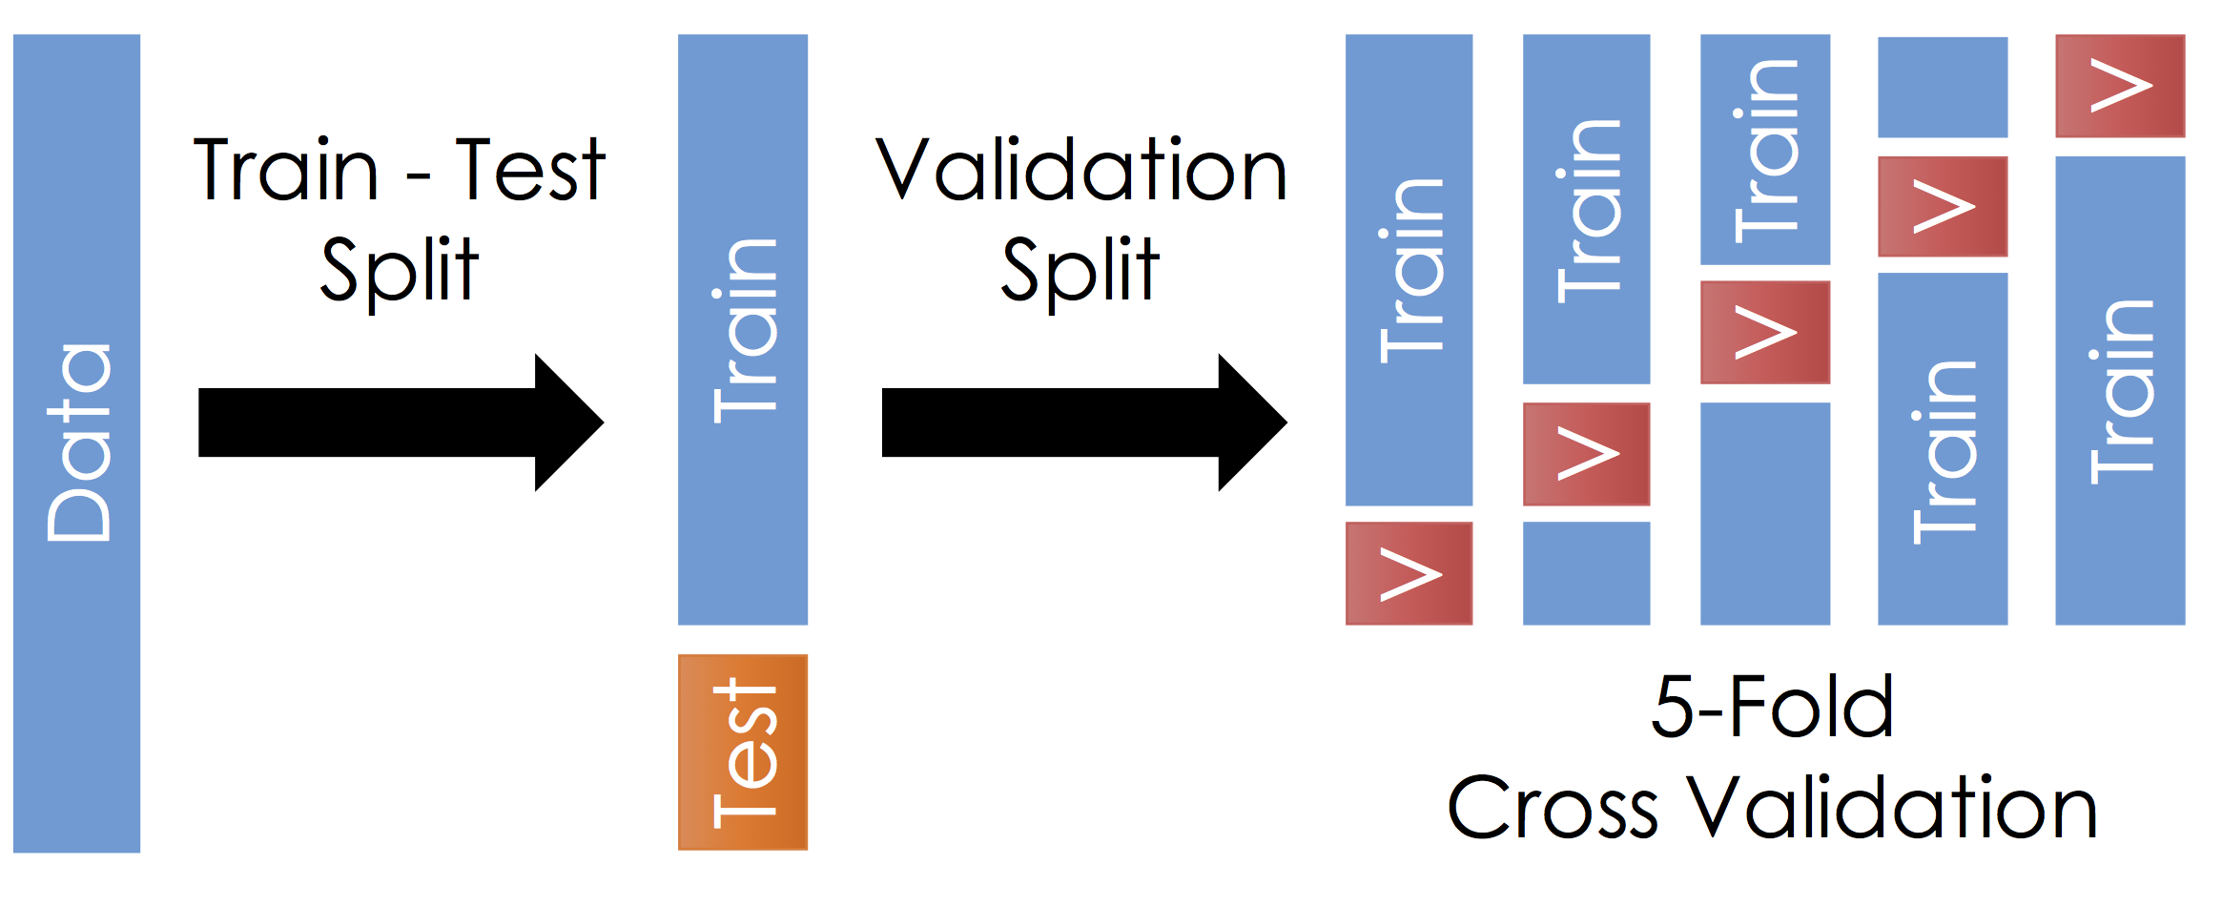
Evaluation of Off-line experiments
Simulation on existing dataset: cross-validation
Istead of Train – Test split, you may use additional „outer“
cross-validation
  Get results from all parts of the dataset
Never use any knowledge of the test set data
  E.g. For mean ratings, object similarities etc
Aggregate results

Slide 16
Off-line Evaluation Metrics
Relevance of the recommended objects / Ranking metrics
  User visited / rated / purchased… the objects, which the method recommends
  nDCG, MAP, Precision, Precision@top-k, Recall, Liftindex, RankingScore,…
Rating error metrics
  User rated some objects, how large is the prediction error on those?
  MAE, RMSE,…
Novelty
  Does the user already know / visited recommended objects?
  This may be both positive and negative depending on task
    However it is always trivial
    No need of complex system to recommend previously visited objects
Diversity
  Are all the recommendations similar to each other?
  Relevance vs. Diversity tradeoff
  Intra-List Diversity

Slide 17
Off-line Evaluation Metrics
Novelty
  Items known (has feedback) by the user
  Well known items (blockbusters in movies/books), based on overal consumption
  Items that are new (have been added recently)
Diversity
  Intra-List Diversity
    Average similarity of all pairs of recommended items
    Both content-based and collaborative variants are plausible

Slide 18
Evaluation in information retrieval (IR)
Historical Cranfield collection (late 1950s)
  1,398 journal article abstracts
  225 queries
  Exhaustive relevance judgements (over 300K)
Ground truth established by human domain experts
 |  | Reality
 |  | Actually Good | Actually Bad
Prediction | Rated Good | True Positive (tp) | False Positive (fp)
 | Rated Bad | False Negative (fn) | True Negative (tn)
All recommended items
All good items

Slide 19

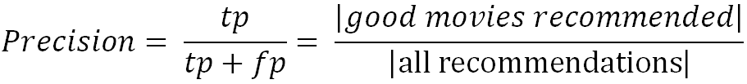
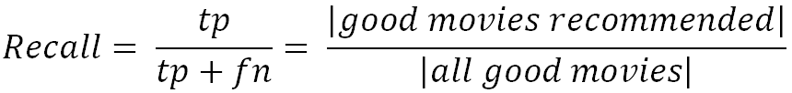
Metrics: Precision and Recall
Recommendation is viewed as information retrieval task:
  Retrieve (recommend) all items which are predicted to be “good”.
Precision: a measure of exactness, determines the fraction of relevant items retrieved out of all items retrieved
  E.g. the proportion of recommended movies that are actually good
Recall: a measure of completeness, determines the fraction of relevant items retrieved out of all relevant items
  E.g. the proportion of all good movies recommended

Slide 20
Precision vs. Recall
E.g. typically when a recommender system is tuned to increase precision, recall decreases as a result (or vice versa)
AUPR
Area under
Prec. vs. Recall
AUC:
Area under ROC
(TP vs. FP)

Slide 21
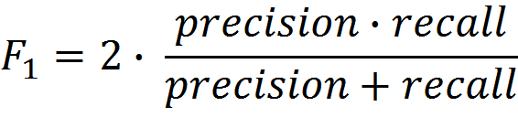
F₁ Metric
The F₁ Metric attempts to combine Precision and Recall into a single value for comparison purposes.
  May be used to gain a more balanced view of performance
The F₁ Metric gives equal weight to precision and recall
  Other F_{β} metrics weight recall with a factor of β.

Slide 22
Precision and Recall in Recommender Systems
Limit on top-k
  Precision@top-k
  Recall@top-k
Position within top-k does not matter
  The list is short enough that user observe it all
  With increasing k, this becames less applicable

Slide 23
Metrics: Rank position matters
For a user:
Actually good
Item 237
Item 899
Recommended (predicted as good)
Item 345
Item 237
Item 187
hit
Rank metrics extend recall and precision to take the positions of correct items in a ranked list into account
  Relevant items are more useful when they appear earlier in the recommendation list
  Particularly important in recommender systems as lower ranked items may be overlooked by users

Slide 24
Metrics: Rank Score
Rank Score extends the recall metric to take the positions of correct items in a ranked list into account
  Particularly important in recommender systems as lower ranked items may be overlooked by users
Rank Score is defined as the ratio of the Rank Score of the correct items to best theoretical Rank Score achievable for the user, i.e.
Where:
h is the set of correctly recommended items, i.e. hits
rank returns the position (rank) of an item
T is the set of all items of interest
α is the ranking half life, i.e. an exponential reduction factor

Slide 25
Metrics: Liftindex
Assumes that ranked list is divided into 10 equal deciles S_{i}, where
  Linear reduction factor
Liftindex:
              h is the set of correct hits

Slide 26
Metrics: Normalized Discounted Cumulative Gain
Discounted cumulative gain (DCG)
  Logarithmic reduction factor
Idealized discounted cumulative gain (IDCG)
  Assumption that items are ordered by decreasing relevance
Normalized discounted cumulative gain (nDCG)
  Normalized to the interval [0..1]
Where:
pos denotes the position up to which relevance is accumulated
rel_{i} returns the relevance of recommendation at position i

Slide 27
Example
Assumptions:
  |T| = 3
  Ranking half life (alpha) = 2
Rank | Hit?
1
2 | X
3 | X
4 | X
5

Slide 28
Example cont.
Reducing the ranking half life (alpha) = 1
Rankscore (exponential reduction) < Liftscore (linear red.) < NDCG (log. red.)
Rank | Hit?
1
2 | X
3 | X
4 | X
5

Slide 29
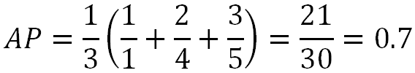

Average Precision
Mean Average Precision (MAP) is a ranked precision metric that places emphasis on highly ranked correct predictions (hits)
Essentially it is the average of precision values determined after each successful prediction, i.e.
Rank | Hit?
1
2 | X
3 | X
4 | X
5
Rank | Hit?
1 | X
2
3
4 | X
5 | X

Slide 30
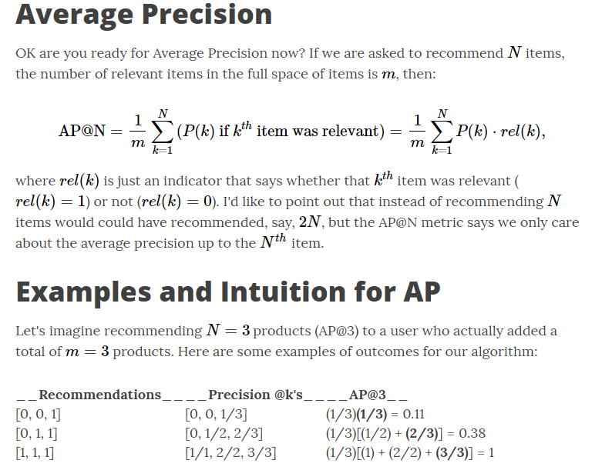
Metrics: Mean average precision

Slide 31
Evaluation in RS – rating based
Datasets with items rated by users
  MovieLens datasets 100K-10M ratings
  Netflix 100M ratings
Historic user ratings constitute ground truth
Metrics measure error rate
  Mean Absolute Error (MAE) computes the deviation between predicted ratings and actual ratings
  Root Mean Square Error (RMSE) is similar to MAE, but places more emphasis on larger deviation

Slide 32
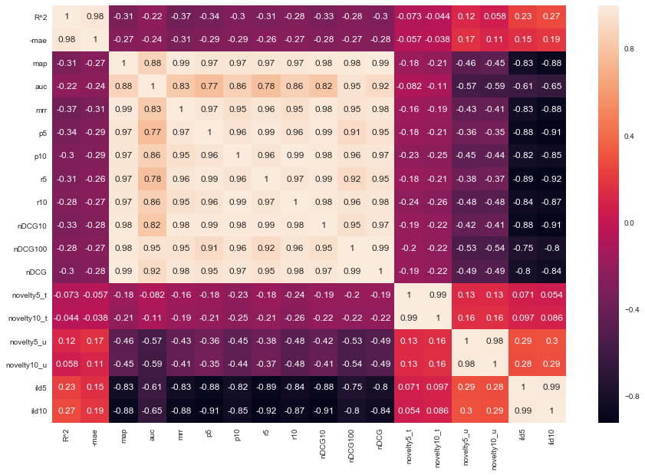
Metrics: Comparison

Slide 33
Dilemma of establishing ground truth
IR measures are frequently applied, however:
Offline experimentation | Online experimentation
Ratings, transactions | Ratings, feedback
Historic session (not all recommended items are rated) | Live interaction (all recommended items are rated)
Ratings of unrated items unknown, but interpreted as “bad” (default assumption, user tend to rate only good items) | “Good/bad” ratings of not recommended items are unknown
If default assumption does not hold: True positives may be too small False negatives may be too small | False/true negatives cannot be determined
Precision may increase Recall may vary | Precision ok Recall questionable
  Results from offline experimentation have limited predictive power for
  online user behavior.

Slide 34
Offline experimentation
Netflix competition 2004 – 2007?
  Web-based movie rental
  Prize of $1,000,000 for accuracy improvement (RMSE) of 10% compared to own Cinematch system.
Historical dataset
  ~480K users rated ~18K movies on a scale of 1 to 5
  ~100M ratings
  Last 9 ratings/user withheld
    Probe set – for teams for evaluation
    Quiz set – evaluates teams’ submissions for leaderboard
    Test set – used by Netflix to determine winner

Slide 35
Methodology
Setting to ensure internal validity:
  One randomly selected share of known ratings (training set) used as input to train the algorithm and build the model
  Model allows the system to compute recommendations at runtime
  Remaining share of withheld ratings (testing set) required as ground truth to evaluate the model’s quality
  To ensure the reliability of measurements the random split, model building and evaluation steps are repeated several times
N-fold cross validation is a stratified random selection procedure
  N disjunct fractions of known ratings with equal size (1/N) are determined
  N repetitions of the model building and evaluation steps, where each fraction is used exactly once as a testing set while the other fractions are used for training
  Setting N to 5 or 10 is popular

Slide 36
Analysis of results
Are observed differences statistically meaningful or due to chance?
  Standard procedure for testing the statistical significance of two deviating metrics is the pairwise analysis of variance (ANOVA)
  Null hypothesis H₀: observed differences have been due to chance
  If outcome of test statistics rejects H₀, significance of findings can be reported
Practical importance of differences?
  Size of the effect and its practical impact
  External validity or generalizability of the observed effects

Slide 37
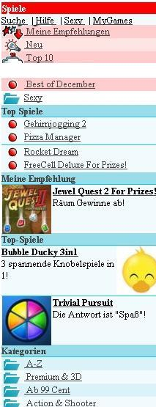
Online experimentation
Effectiveness of different algorithms for recommending cell phone games
[Jannach, Hegelich 09]
Involved 150,000 users on a commercial mobile internet portal
Comparison of recommender methods
Random assignment of users to a specific method

Slide 38
Experimental Design
A representative sample 155,000 customers were extracted from visitors to site during the evaluation period
  These were split into 6 groups of approximately 22,300 customers
  Care was taken to ensure that customer profiles contained enough information (ratings) for all variants to make a recommendation
  Groups were chosen to represent similar customer segments
A catalog of 1,000 games was offered
A five-point ratings scale ranging from -2 to +2 was used to rate items
  Due to the low number of explicit ratings, a click on the “details” link for a game was interpreted as an implicit “0” rating and a purchase as a “1” rating
Hypotheses on personalized vs. non-personalized recommendation techniques and their potential to
  Increase conversion rate (i.e. the share of users who become buyers)
  Stimulate additional purchases (i.e. increase the average shopping basket size)

Slide 39
Non-experimental research
Quasi-experiments
  Lack random assignments of units to different treatments
Non-experimental / observational research
  Surveys / Questionnaires
  Longitudinal research
    Observations over long period of time
    E.g. customer life-time value, returning customers
  Case studies
    Focus on answering research questions about how and why
    E.g. answer questions like: How recommendation technology contributed to Amazon.com‘s becomes the world‘s largest book retailer?
  Focus group
    Interviews
    Think aloud protocols

Slide 40
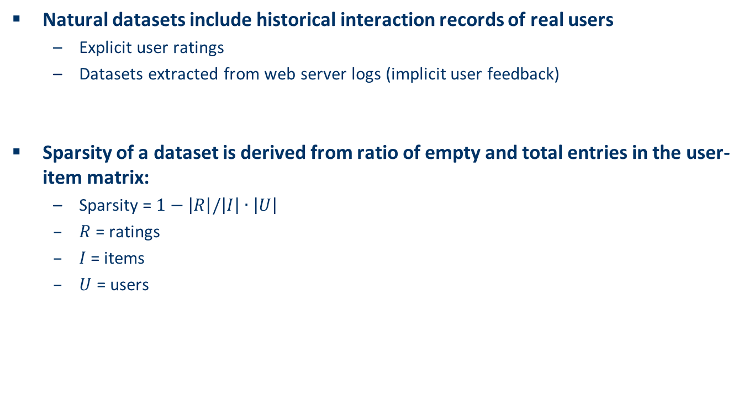
Data sparsity
Natural datasets include historical interaction records of real users
  Explicit user ratings
  Datasets extracted from web server logs (implicit user feedback)
Sparsity of a dataset is derived from ratio of empty and total entries in the user-item matrix:
  Sparsity = $1−\left|R\right|/\left|I\right|∙\left|U\right|$
  $R$ = ratings
  $I$= items
  $U$ = users

Slide 41
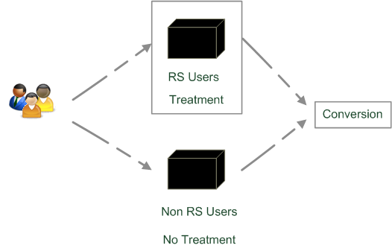
Quasi-experimental
SkiMatcher Resort Finder introduced by Ski-Europe.com to provide users with recommendations based on their preferences
Conversational RS
  question and answer dialog
  matching of user preferences with knowledge base
Delgado and Davidson evaluated the
effectiveness of the recommender over a
4 month period in 2001
  Classified as a quasi-experiment
  as users decide for themselves if they
  want to use the recommender or not

Slide 42
SkiMatcher Results
 | July | August | September | October
Unique Visitors | 10,714 | 15,560 | 18,317 | 24,416
SkiMatcher Users | 1,027 | 1,673 | 1,878 | 2,558
Non-SkiMatcher Users | 9,687 | 13,887 | 16,439 | 21,858
Requests for Proposals | 272 | 506 | 445 | 641
SkiMatcher Users | 75 | 143 | 161 | 229
Non-SkiMatcher Users | 197 | 363 | 284 | 412
Conversion | 2.54% | 3.25% | 2.43% | 2.63%
SkiMatcher Users | 7.30% | 8.55% | 8.57% | 8.95%
Non-SkiMatcher Users | 2.03% | 2.61% | 1.73% | 1.88%
Increase in Conversion | 359% | 327% | 496% | 475%
[Delgado and Davidson, ENTER 2002]

Slide 43
Interpreting the Results
The nature of this research design means that questions of causality cannot be answered (lack of random assignments), such as
  Are users of the recommender systems more likely convert?
  Does the recommender system itself cause users to convert?
  Some hidden exogenous variable might influence the choice of using RS as well as conversion.
However, significant correlation between using the recommender system and making a request for a proposal
Size of effect has been replicated in other domains
  Tourism
  Electronic consumer products

Slide 44
What is popular?
Evaluations on historical datasets measuring accuracy
Most popular datasets
  Movies (MovieLens, EachMovie, Netflix)
  Web 2.0 platforms (tags, music, papers, …)
Most popular measures for accuracy
  Precision/Recall
    Items are classified as good or bad
  MAE (Mean Absolute Error), RMSE (Root Mean Squared Error)
    Items are rated on a given scale
Availability of data heavily biases what is done
  Tenor at RecSys conferences to foster live experiments
  Public infrastructures to enable A/B tests

Slide 45
What is popular? cont.
Quantitative survey in the literature
  High ranked journal on IS and IR
  ACM Transactions on Information Systems
Evaluation designs ACM TOIS 2004-2010
  In total 15 articles on RS
  Nearly 50% movie domain
  80% offline experimentation
  2 user experiments under lab conditions
  1 qualitative research

Slide 46
Discussion & summary
General principles of empirical research an current state of practice in evaluating recommendation techniques were presented
Focus on how to perform empirical evaluations on historical datasets
Discussion about different methodologies and metrics for measuring the accuracy or coverage of recommendations.
Overview of which research designs are commonly used in practice.
From a technical point of view, measuring the accuracy of predictions is a well accepted evaluation goal
  but other aspects that may potentially impact the overall effectiveness of a recommendation system remain largely under developed.

