Slide 1
Content-based recommendation

Slide 2
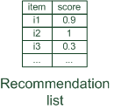
Content-based recommendation
While CF – methods do not require any information about the items,
it might be reasonable to exploit such information; and
recommend fantasy novels to people who liked fantasy novels in the past
What do we need:
some information about the available items such as the genre ("content")
some sort of user profile describing what the user likes (the preferences)
The task:
learn user preferences
locate/recommend items that are "similar" to the user preferences
"show me more of the same what I've liked"

Slide 3
What is the "content"?
Most CB-recommendation techniques were applied to recommending text documents.
Like web pages or newsgroup messages for example.
Now also multimedia content (fashion, music) or e-commerce
Content of items can also be represented as text documents.
With textual descriptions of their basic characteristics.
Structured: Each item is described by the same set of attributes
Unstructured: free-text description.
Title | Genre | Author | Type | Price | Keywords
The Night of the Gun | Memoir | David Carr | Paperback | 29.90 | Press and journalism, drug addiction, personal memoirs, New York
The Lace Reader | Fiction, Mystery | Brunonia Barry | Hardcover | 49.90 | American contemporary fiction, detective, historical
Into the Fire | Romance, Suspense | Suzanne Brockmann | Hardcover | 45.90 | American fiction, murder, neo-Nazism

Slide 4
Content representation and item similarities
Item representation
Title | Genre | Author | Type | Price | Keywords
The Night of the Gun | Memoir | David Carr | Paperback | 29.90 | Press and journalism, drug addiction, personal memoirs, New York
The Lace Reader | Fiction, Mystery | Brunonia Barry | Hardcover | 49.90 | American contemporary fiction, detective, historical
Into the Fire | Romance, Suspense | Suzanne Brockmann | Hardcover | 45.90 | American fiction, murder, neo-Nazism
User profile
$keywords\left(b_{j}\right)$ describes Book $b_{j}$ with a set of keywords
Title | Genre | Author | Type | Price | Keywords
… | Fiction | Brunonia, Barry, Ken Follett | Paperback | 25.65 | Detective, murder, New York
Simple approach
Compute the similarity of an unseen item with the user profile based on the keyword overlap (e.g. using the Dice coefficient)
Or use and combine multiple metrics
$$\frac{2 × \left|keywords\left(\left.b_{i}\right)\right.∩keywords\left(b_{j}\right)\right|}{\left|keywords\left(\left.b_{i}\right)\right.\right|+\left|keywords\left(\left.b_{j}\right)\right.\right|}$$

Slide 5
Term-Frequency - Inverse Document Frequency ($TF−IDF$)
Simple keyword representation has its problems
in particular when automatically extracted as
not every word has similar importance
longer documents have a higher chance to have an overlap with the user profile
Standard measure: TF-IDF
Encodes text documents in multi-dimensional Euclidian space
weighted term vector
TF: Measures, how often a term appears (density in a document)
assuming that important terms appear more often
normalization has to be done in order to take document length into account
IDF: Aims to reduce the weight of terms that appear in all documents
May not be relevant in some cases (e.g. Male vs. Female attribute on dating sites)

Slide 6
TF-IDF II
Given a keyword $i$ and a document $j$
$TF\left(i,j\right)$
term frequency of keyword $i$ in document $j$
$IDF(i)$
inverse document frequency calculated as $IDF\left(i\right)=log\frac{N}{n(i)}$
$N$ : number of all recommendable documents
$n(i)$: number of documents from $N$ in which keyword $i$ appears
$TF−IDF$
is calculated as: $TF$-$IDF\left(i,j\right)=TF\left(i,j\right)∗IDF\left(i\right)$

Slide 7
Example TF-IDF representation
Term frequency:
Each document is a count vector in $ℕ^{\left|v\right|}$
 | Antony and Cleopatra | Julius Caesar | The Tempest | Hamlet | Othello | Macbeth
Antony | 157 | 73 | 0 | 0 | 0 | 0
Brutus | 4 | 157 | 0 | 1 | 0 | 0
Caesar | 232 | 227 | 0 | 2 | 1 | 1
Calpurnia | 0 | 10 | 0 | 0 | 0 | 0
Cleopatra | 57 | 0 | 0 | 0 | 0 | 0
mercy | 1.51 | 0 | 3 | 5 | 5 | 1
worser | 1.37 | 0 | 1 | 1 | 1 | 0
Vector $v$with dimension $\left|v\right|=7$
Example taken from http://informationretrieval.org

Slide 8
Example TF-IDF representation
Combined TF-IDF weights
Each document is now represented by a real-valued vector of $TF$-$IDF$weights $∈ℝ^{\left|v\right|}$
 | Antony and Cleopatra | Julius Caesar | The Tempest | Hamlet | Othello | Macbeth
Antony | 157 | 73 | 0 | 0 | 0 | 0
Brutus | 4 | 157 | 0 | 1 | 0 | 0
Caesar | 232 | 227 | 0 | 2 | 1 | 1
Calpurnia | 0 | 10 | 0 | 0 | 0 | 0
Cleopatra | 57 | 0 | 0 | 0 | 0 | 0
mercy | 1.51 | 0 | 3 | 5 | 5 | 1
worser | 1.37 | 0 | 1 | 1 | 1 | 0
 | Antony and Cleopatra | Julius Caesar | The Tempest | Hamlet | Othello | Macbeth
Antony | 5.25 | 3.18 | 0 | 0 | 0 | 0.35
Brutus | 1.21 | 6.1 | 0 | 1 | 0 | 0
Caesar | 8.59 | 2.54 | 0 | 1.51 | 0.25 | 0
Calpurnia | 0 | 1.54 | 0 | 0 | 0 | 0
Cleopatra | 2.85 | 0 | 0 | 0 | 0 | 0
mercy | 1.51 | 0 | 1.9 | 0.12 | 5.25 | 0.88
worser | 1.37 | 0 | 0.11 | 4.15 | 0.25 | 1.95
Example taken from http://informationretrieval.org

Slide 9
Improving the vector space model
Vectors are usually long and sparse
remove stop words
They will appear in nearly all documents.
e.g. "a", "the", "on", …
use stemming
Aims to replace variants of words by their common stem
e.g. "went" "go", "stemming" "stem", …
size cut-offs
only use top n most representative words to remove "noise" from data
e.g. use top 100 words

Slide 10
Improving the vector space model II
Use lexical knowledge, use more elaborate methods for feature selection
Remove words that are not relevant in the domain
Detection of phrases as terms
More descriptive for a text than single words
e.g. "United Nations"
Limitations
semantic meaning remains unknown
example: usage of a word in a negative context
"there is nothing on the menu that a vegetarian would like.."
The word "vegetarian" will receive a higher weight then desired
an unintended match with a user interested in vegetarian restaurants

Slide 11
Cosine similarity
Usual similarity metric to compare vectors: Cosine similarity (angle)
Cosine similarity is calculated based on the angle between the vectors
$sim\left(\vec{a},\vec{b} \right)=\frac{\vec{a}∙\vec{b}}{\left|\vec{a}\right|∗\left|\vec{b}\right|}$

Slide 12
Recommending items
Simple method: nearest neighbors
May be relevant for item-based recommendations
Most similar items to the currently viewed one

Slide 13
Query-based retrieval: Rocchio's method
Originally for „conversational“ query retrieval systems
Query-based retrieval: Rocchio's method
The SMART System: Users are allowed to rate (relevant/irrelevant) retrieved documents (feedback)
The system then learns a prototype of relevant/irrelevant documents
Queries are then automatically extended with additional terms/weight of relevant documents
The paradigm fits well also for recommender systems

Slide 14
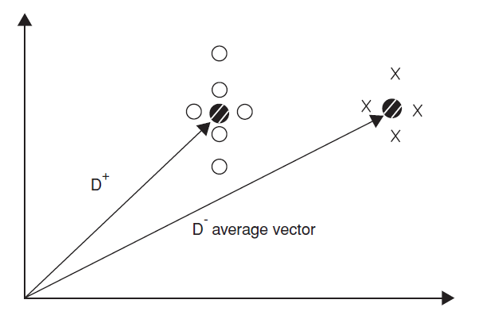
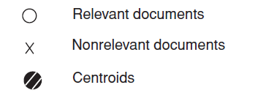
Rocchio details
Document collections D⁺ (liked) and D⁻ (disliked)
Calculate prototype vector for these categories.
Computing modified query Qi+1 from current query Qi with:
α, β, γ used to fine-tune the feedback
α weight for original query
β weight for positive feedback
γ weight for negative feedback
$$Q_{i+1}= α ∗ Q_{i}+ β\left(\frac{1}{\left|D^{+}\right|} \sum_{d^{+}∈D^{+}}{d^{+}}\right)− γ\left(\frac{1}{\left|D^{−}\right|}\sum_{d^{−}∈D^{−}}{d^{−}}\right)$$
Often only positive feedback is used
More valuable than negative feedback

Slide 15
Practical challenges of Rocchio's method
Certain number of item ratings needed to build reasonable user model
Can be automated by trying to capture user ratings implicitly (click on document)
Pseudorelevance Feedback: Assume that the first$n$documents match the query best. The set $D^{−}$ is not used until explicit negative feedback exists.
User interaction required during retrieval phase
Interactive query refinement opens new opportunities for gathering information and
Helps user to learn which vocabulary should be used to receive the information he needs

Slide 16
Explicit decision models
Decision tree for recommendation problems
inner nodes labeled with item features (keywords)
used to partition the test examples
existence or non existence of a keyword
in basic setting only two classes appear at leaf nodes
interesting or not interesting
decision tree can automatically be constructed from training data
works best with small number of features
use meta features like author name, genre, ... instead of TF-IDF representation.

Slide 17
Explicit decision models II
Rule induction
built on RIPPER algorithm
good performance compared with other classification methods
eloborate postpruning techniques of RIPPER
extension for e-mail classification
takes document structure into account
main advantages of these decision models:
inferred decision rules serve as basis for generating explanations for recommendation
existing domain knowledge can be incorporated in models

Slide 18
On feature selection
process of choosing a subset of available terms
different strategies exist for deciding which features to use
feature selection based on domain knowledge and lexical information from WordNet (Pazzani and Billsus 1997)
frequency-based feature selection to remove words appearing "too rare" or "too often" (Chakrabarti 2002)
Not appropriate for larger text corpora
Better to
evaluate value of individual features (keywords) independently and
construct a ranked list of "good" keywords.
Typical measure for determining utility of keywords: e.g. $X^{2}$, mutual information measure or Fisher's discrimination index

Slide 19
Limitations of content-based recommendation methods
Keywords alone may not be sufficient to judge quality/relevance of a document or web page
up-to-date-ness, usability, aesthetics, writing style
content may also be limited / too short
content may not be automatically extractable (multimedia)
Ramp-up phase required
Some training data is still required
Web 2.0: Use other sources to learn the user preferences
Overspecialization
Algorithms tend to propose "more of the same"
Or: too similar news items
Multicriterial optimization (diversity, novelty)

Slide 20
Discussion & summary
In contrast to collaborative approaches, content-based techniques do not require user community in order to work
Presented approaches aim to learn a model of user's interest preferences based on explicit or implicit feedback
Deriving implicit feedback from user behavior can be problematic
Evaluations show that a good recommendation accuracy can be achieved with help of machine learning techniques
These techniques do not require a user community
Danger exists that recommendation lists contain too many similar items
All learning techniques require a certain amount of training data
Some learning methods tend to overfit the training data
Pure content-based systems are rarely found in commercial environments

Slide 21
Knowledge-based recommendation

Slide 22
Basic I/O Relationship
Knowledge-based: "Tell me what fits based on my needs"

Slide 23
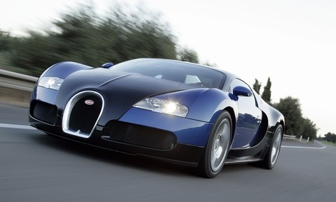
Why do we need knowledge-based recommendation?
Products with low number of available ratings
Time span plays an important role
five-year-old ratings for computers
user lifestyle or family situation changes
Customers want to define their requirements explicitly
"the color of the car should be black"

Slide 24
Knowledge-based recommender systems
Constraint-based
based on explicitly defined set of recommendation rules
(partially) fulfill recommendation rules
Case-based
Item-based: give me similar items, however with larger display
Both approaches are similar in their conversational recommendation proces (edge of query retrieval and recommender systems)
users specify the requirements
systems try to identify solutions
if no solution can be found, users change requirements
Not always, we may learn knowledge RS rules from collaborative data

Slide 25
Constraint-based recommender systems
Knowledge base
usually mediates between user model and item properties
variables
user model features (requirements), Item features (catalogue)
set of constraints
logical implications (IF user requires A THEN proposed item should possess feature B)
hard and soft/weighted constraints
solution preferences
Derive a set of recommendable items
fulfilling set of applicable constraints
applicability of constraints depends on current user model
explanations – transparent line of reasoning

Slide 26
Constraint-based recommendation tasks
Find a set of user requirements such that a subset of items fulfills all constraints
ask user which requirements should be relaxed/modified such that some items exist that do not violate any constraint
Find a subset of items that satisfy the maximum set of weighted constraints
similar to find a maximally succeeding subquery (XSS)
all proposed items have to fulfill the same set of constraints
compute relaxations based on predetermined weights
Rank items according to weights of satisfied soft constraints
rank items based on the ratio of fulfilled constraints
does not require additional ranking scheme

Slide 27
Ranking the items
Multi-attribute utility theory
each item is evaluated according to a predefined set of dimensions that provide an aggregated view on the basic item properties
E.g. quality and economy are dimensions in the domain of digital cameras
id | value | quality | economy
price | ≤250 >250 | 5 10 | 10 5
mpix | ≤8 >8 | 4 10 | 10 6
opt-zoom | ≤9 >9 | 6 10 | 9 6
LCD-size | ≤2.7 >2.7 | 6 9 | 10 5
movies | Yes no | 10 3 | 7 10
sound | Yes no | 10 7 | 8 10
waterproof | Yes no | 10 8 | 6 10

Slide 28
Item utility for customers
Customer specific interest
Calculation of Utility
Customer | quality | economy
Cu₁ | 80% | 20%
Cu₂ | 40% | 60%
quality | economy | cu₁ | cu₂
P₁ Σ(5,4,6,6,3,7,10) = 41 | Σ (10,10,9,10,10,10,6) = 65 | 45.8 [8] | 55.4 [6]
P₂ Σ(5,4,6,6,10,10,8) = 49 | Σ (10,10,9,10,7,8,10) = 64 | 52.0 [7] | 58.0 [1]
P₃ Σ(5,4,10,6,10,10,8) = 53 | Σ (10,10,6,10,7,8,10) = 61 | 54.6 [5] | 57.8 [2]
P₄ Σ(5,10,10,6,10,7,10) = 58 | Σ (10,6,6,10,7,10,6) = 55 | 57.4 [4] | 56.2 [4]
P₅ Σ(5,4,6,10,10,10,8) = 53 | Σ (10,10,9,6,7,8,10) = 60 | 54.4 [6] | 57.2 [3]
P₆ Σ(5,10,6,9,10,10,8) = 58 | Σ (10,6,9,5,7,8,10) = 55 | 57.4 [3] | 56.2 [5]
P₇ Σ(10,10,6,9,10,10,8) = 63 | Σ (5,6,9,5,7,8,10) = 50 | 60.4 [2] | 55.2 [7]
P₈ Σ(10,10,10,9,10,10,10) = 69 | Σ (5,6,6,5,7,8,6) = 43 | 63.8 [1] | 53.4 [8]

Slide 29
Case-based recommender systems
Items are retrieved using similarity measures
Distance similarity
Def.
sim (p, r) expresses for each item attribute value φr (p) its distance to the customer requirement r ∈ REQ.
wr is the importance weight for requirement r
In real world, customer would like to
maximize certain properties. i.e. resolution of a camera, "more is better"(MIB)
minimize certain properties. i.e. price of a camera, "less is better"(LIB)
Target within some values, e.g. Price between x,y

Slide 30
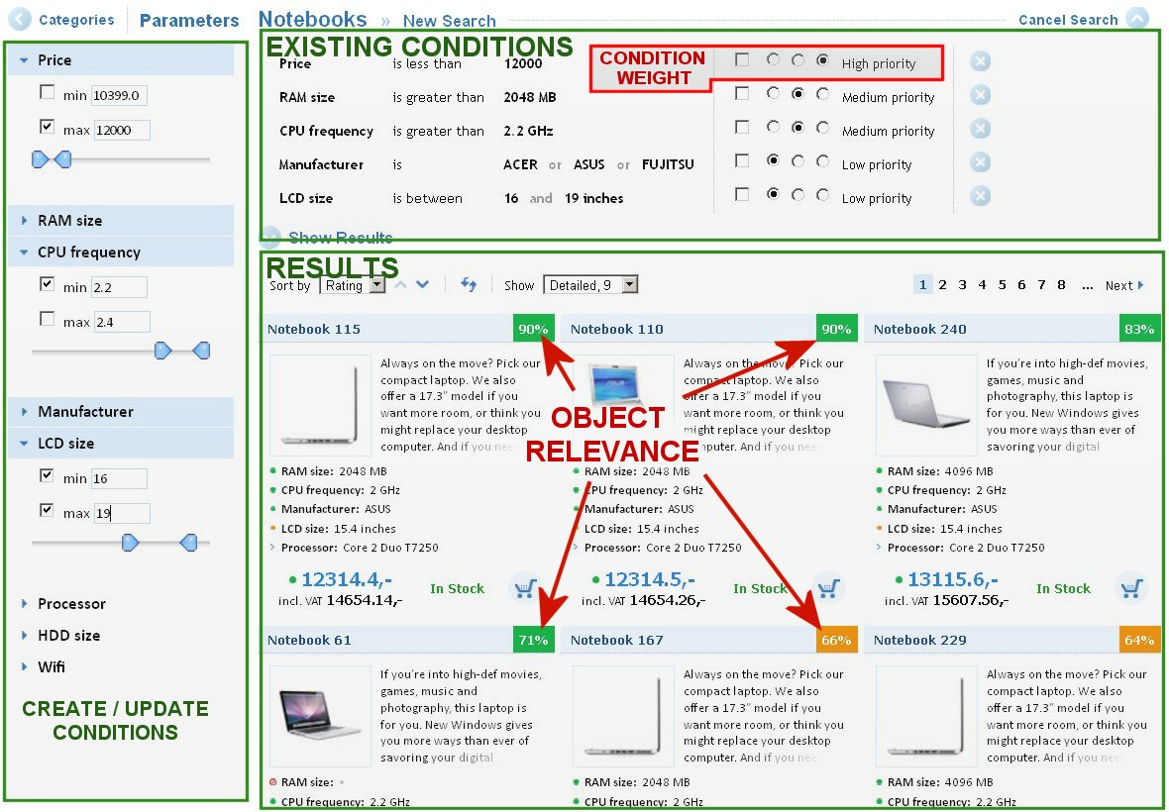
Constraint-based recommendation tasks

Slide 31
Knowledge-based recommender systems
Transform known rating on items into
Rating (preference regression) of item features
Learning combination of item feature´s ratings
Based on goodness of fit on features
Evaluate the learned rating function on all other objects
Recommend better instead of similar objects

Slide 32
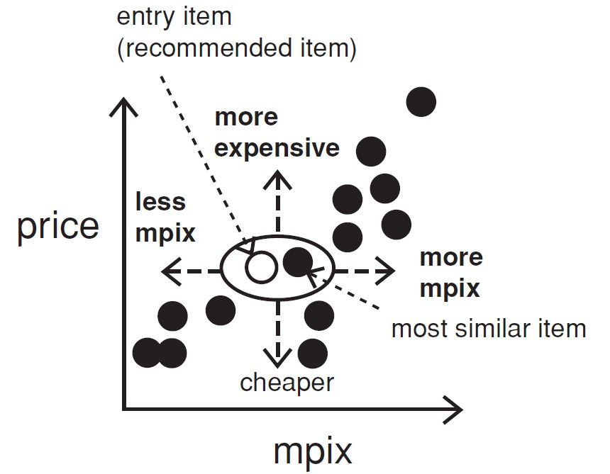
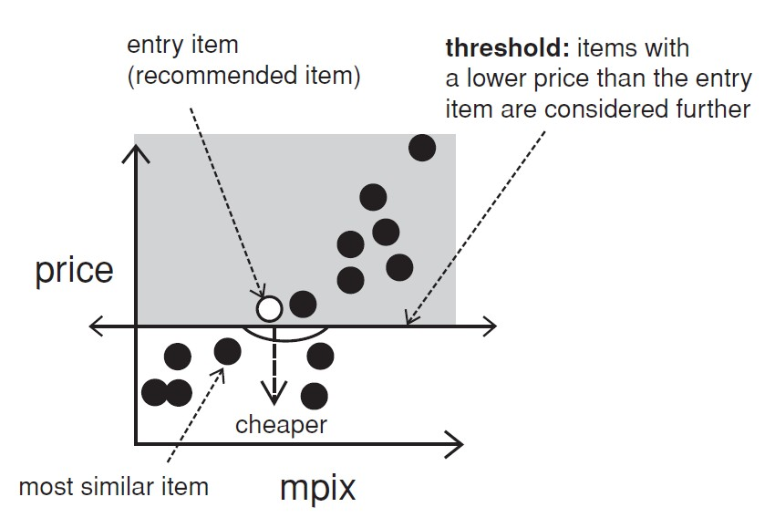
Interacting with case-based recommenders
Customers maybe not know what they are seeking
Critiquing is an effective way to support such navigations
Customers specify their change requests (price or mpix) that are not satisfied by the current item (entry item)
Critique on price

Slide 33
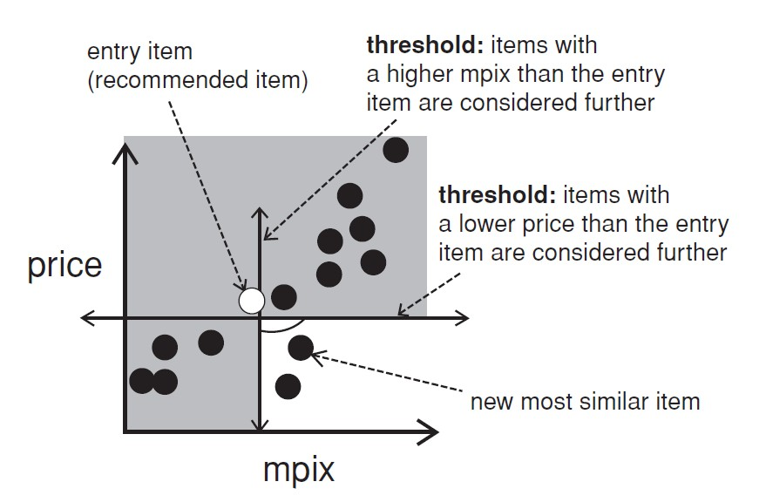
Compound critiques
Operate over multiple properties can improve the efficiency of recommendation dialogs

Slide 34
Summary
Knowledge-based recommender systems
Move from recommending similar to recommending better objects
Limitations
cost of knowledge acquisition
from domain experts
from users
from web resources
accuracy of preference models
very fine granular preference models require many interaction cycles
collaborative filtering models preference implicitly
independence assumption can be challenged
preferences are not always independent from each other

