Slide 1
Deep Learning for Recommender Systems
Alexandros Karatzoglou (Scientific Director @ Telefonica Research) alexk@tid.es, @alexk_z
Balázs Hidasi (Head of Research @ Gravity R&D) balazs.hidasi@gravityrd.com, @balazshidasi
RecSys’17, 29 August 2017, Como

Slide 2
Why Deep Learning?
ImageNet challenge error rates (red line = human performance)

Slide 3
Why Deep Learning?

Slide 4
Complex Architectures

Slide 5
Neural Networks are Universal Function Approximators
Depending on dataset size, traditional ML may make sense

Slide 6
Inspiration for Neural Learning

Slide 7
Neural Model

Slide 8
Neuron a.k.a. Unit

Slide 9
Feedforward Multilayered Network

Slide 10
Learning

Slide 11
Stochastic Gradient Descent
Generalization of (Stochastic) Gradient Descent

Slide 12
Stochastic Gradient Descent

Slide 13
Backpropagation

Slide 14
Backpropagation
Does not work well in plain a normal” multilayer deep network
Vanishing Gradients
Slow Learning
SVM’s easier to train
2nd Neural Winter

Slide 15
Modern Deep Networks
Ingredients:
Rectified Linear Activation function a.k.a. ReLu

Slide 16
Modern Deep Networks
Ingredients:
Dropout:
Prevent overfitting by redundancy
Dropout verteces changes over iterations

Slide 17
Modern Deep Networks
Ingredients:
Mini-batches:
Stochastic Gradient Descent
Compute gradient over many (50 -100) data points (minibatch) and update.

Slide 18
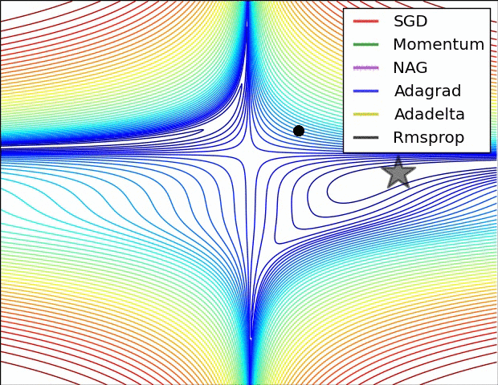
Modern Feedforward Networks
Ingredients:
Adagrad a.k.a. adaptive learning rates
Decrease step size over time
In a factor-wise fashion
https://ruder.io/optimizing-gradient-descent/

Slide 19
Deep Learning for RecSys
Feature extraction directly from the content
Image, text, audio, etc.
Instead of metadata
For hybrid algorithms
Heterogenous data handled easily
CB + CF + context + …
Sequential behaviour modeling (RNNs/Transformers)
Beyond RecSys paradigms
RecSys + LLM / conversational RecSys
RecSys is a complex domain
Deep learning worked well in other complex domains
Worth a try

Slide 20
Research directions in DL-RecSys
As of 2017 summer, main topics:
Learning item embeddings
Deep collaborative filtering
Feature extraction directly from content
Session-based recommendations with RNN
And their combinations

Slide 21
Best practices
Start simple
Add improvements later
Optimize code
GPU/CPU optimizations may differ
Scalability is key
Opensource code
Experiment (also) on public datasets
Don’t use very small datasets
Don’t work on irrelevant tasks, e.g. rating prediction

Slide 22
Item embeddings & 2vec models

Slide 23
Embeddings
Embedding: a (learned) real value vector representing an entity
Also known as:
Latent feature vector
(Latent) representation
Similar entities’ embeddings are similar
Use in recommenders:
Initialization of item representation in more advanced algorithms
Item-to-item recommendations

Slide 24
Matrix factorization as learning embeddings
MF: user & item embedding learning
Similar feature vectors
Two items are similar
Two users are similar
User prefers item
MF representation as a simplictic neural network
Input: one-hot encoded user ID
Input to hidden weights: user feature matrix
Hidden layer: user feature vector
Hidden to output weights: item feature matrix
Output: preference (of the user) over the items
„Matrix factorization“ in EasyStudy is implemented like this…
R ≈
U
I
^{𝑟}u,1^{, 𝑟}u,2^{, … , 𝑟}u,m
𝑊_{I}
u
𝑊_{U}
0,0,...,0,1,0,0,...0

Slide 25
Word2Vec
[Mikolov et. al, 2013a]
Representation learning of words
Shallow model
Data: (target) word + context pairs
Sliding window on the document
Context = words near the target
In sliding window
1-5 words in both directions
Two models
Continous Bag of Words (CBOW)
Skip-gram (pairwise relevance)

Slide 26
Word2Vec - CBOW
Continuous Bag of Words
Maximalizes the probability of the target word given the context
Model
„Fake“ Prediction
Input: one-hot encoded words
Input to hidden weights
Embedding matrix of words
– Hidden layer
Sum of the embeddings of the words in the context
Hidden to output weights
Softmax transformation
Smooth approximation of the max operator
Highlights the highest value
– Output: likelihood of words of the corpus given the context
Embeddings are taken from the input to hidden matrix
– Hidden to output matrix also has item representations (but not used)
Our TRUE target - embedings
Learning

Slide 27
Word2Vec – Skip-gram
Maximalizes the probability of the context, given the target word
Model
Input: one-hot encoded word
Input to hidden matrix: embeddings
Hidden state
Item embedding of target
Softmax transformation
Output: likelihood of context words (given the input word)
„Fake“ Prediction
Learning pairwise prediction
Shared input/output weights for the same words

Slide 28
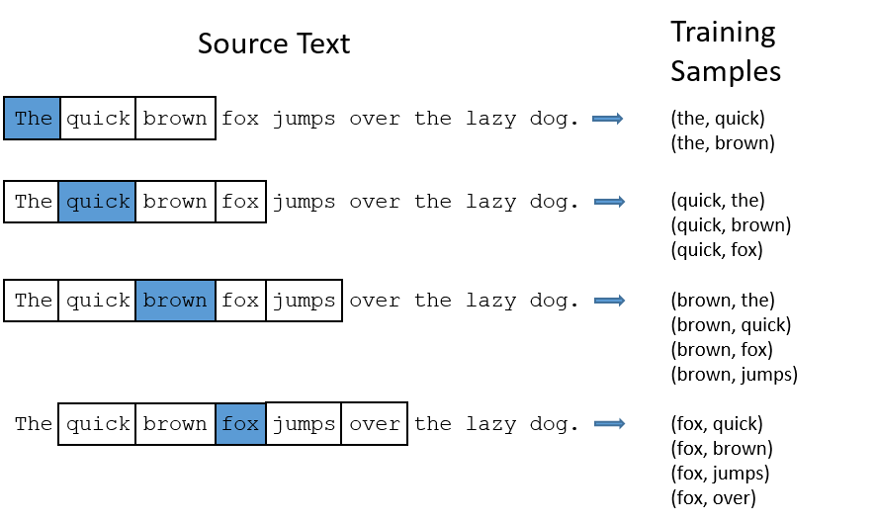
Word2Vec – Skip-gram
http://mccormickml.com/2016/04/19/word2vec-tutorial-the-skip-gram-model/

Slide 29
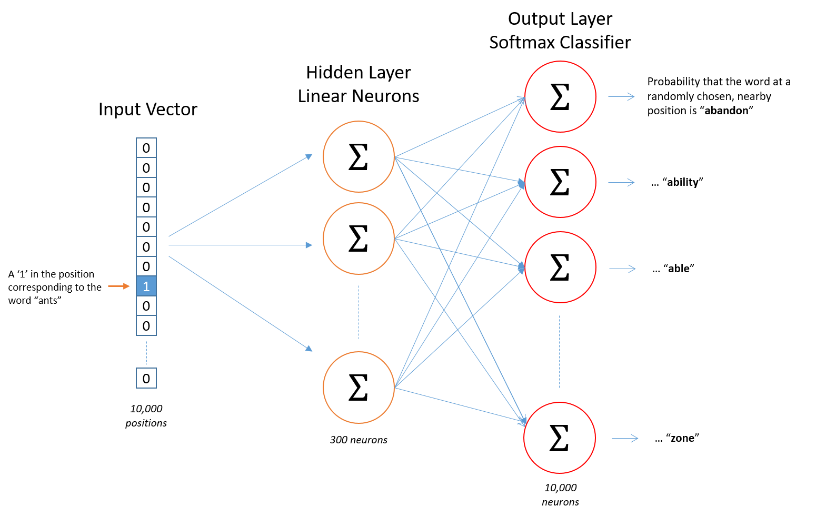
Word2Vec – Skip-gram

Slide 30
Word2Vec – Skip-gram
Shared weights for the same input and output word
Afterwards, apply softmax to get a probability distribution
Still, too many weights -> sample negative elements to be updated
Negative sampling, http://mccormickml.com/2017/01/11/word2vec-tutorial-part-2-negative-sampling/
http://mccormickml.com/2016/04/19/word2vec-tutorial-the-skip-gram-model/

Slide 31
Paragraph2vec, doc2vec
[Le & Mikolov, 2014]
Learns representation of paragraph/document
Based on CBOW model
Paragraph/document embedding added to the model as global context

Slide 32
...2vec for Recommendations
Replace words with items in a session/user profile

Slide 33
Prod2Vec
[Grbovic et. al, 2015]
Skip-gram model on products
Input: i-th product purchased by the user
Context: the other purchases of the user
Bagged prod2vec model
Input: products purchased in one basket by the user
Basket: sum of product embeddings
Context: other baskets of the user
Learning user representation
Follows paragraph2vec
User embedding added as global context
Input: user + products purchased except for the i-th
Target: i-th product purchased by the user
[Barkan & Koenigstein, 2016] proposed the same model later as item2vec
Skip-gram with Negative Sampling (SGNS) is applied to event data

Slide 34
Prod2Vec
[Grbovic et. al, 2015]
pro2vec skip-gram model on products

Slide 35
Bagged Prod2Vec
[Grbovic et. al, 2015]
bagged-prod2vec model updates

Slide 36
User-Prod2Vec
[Grbovic et. al, 2015]
User embeddings for user to product predictions

Slide 37
Utilizing more information
Meta-Prod2vec [Vasile et. al, 2016]
Based on the prod2vec model
Uses item metadata
Embedded metadata
meta(t-1)
item(t-1)
item(t)
meta(t+1)
item(t+2)
Classifier
Classifier
Classifier
Classifier
Classifier
Added to both the input and the context
Losses between: target/context item/metadata
Final loss is the combination of 5 of these losses
Content2vec [Nedelec et. al, 2017]
𝑖_{t}
𝑚_{t}
Separate modules for multimodel information
CF: Prod2vec
Image: AlexNet (a type of CNN)
Text: Word2Vec and TextCNN
Learns pairwise similarities
Likelihood of two items being bought together
I
M
item(t)
meta(t)

Slide 38
Follow-up Development
Usually, 1-2 years after a new network is adopted for NPL, it is tested in RecSys domain
https://github.com/NVIDIA-Merlin/Transformers4Rec

Slide 39
Feature extraction from content
Deep learning is capable of direct feature extraction
Work with content directly
Instead (or beside) metadata
Images
E.g.: product pictures, video thumbnails/frames
Extraction: convolutional networks
Applications (e.g.):
Fashion
Video
Text
E.g.: product description, content of the product, reviews
Extraction
RNNs
1D convolution networks
Weighted word embeddings
Paragraph vectors
BERT, CLIP, LLMs
Applications (e.g.):
News
Books
Publications
Music/audio
Extraction: convolutional networks (or RNNs)

Slide 40
Images in recommenders
Whole new fashion RecSys research area emerged after this. E.g. Finding outfits (i.e. Products matching together)
Visual BPR [He & McAuley, 2016]
Model composed of
Bias terms
MF model
Visual part
Pretrained CNN features
Dimension reduction through „embedding”
The product of this visual item feature and a learned user feature vector is used in the model
Visual bias
Product of the pretrained CNN features and a global bias vector over its features
BPR loss
Tested on clothing datasets (9-25% improvement)

Slide 41
Music representations
[Oord et. al, 2013]
Extends iALS/WMF with audio features
To overcome cold-start
Music feature extraction
Time-frequency representation
Applied CNN on 3 second samples
Latent factor of the clip: average predictions on consecutive windows of the clip
Integration with MF
(a) Minimize distance between music features and the MF’s feature vectors
(b) Replace the item features with the music features (minimize original loss)

Slide 42
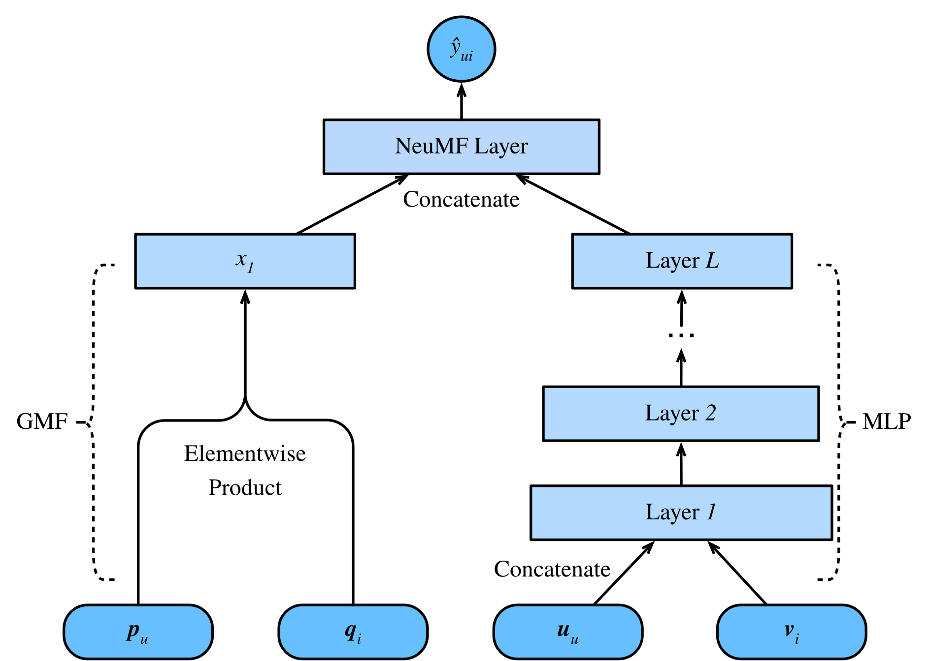
Neural Collaborative Filtering
NeuMF (He et al., 2017)
Instead of a simple dot product, try MLP
Theoretically, learn more complex dependencies
Reported improvements, but…

Slide 43
Neural Collaborative Filtering
NeuMF (He et al., 2017)
Instead of a simple dot product, try MLP
Reported improvements, but…

Slide 44
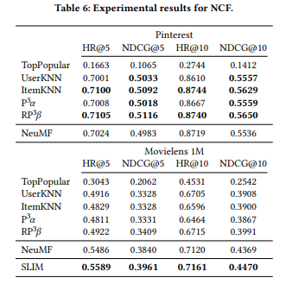
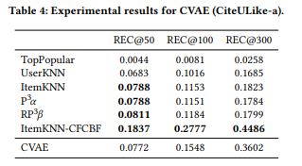
Neural Collaborative Filtering
NeuMF / NCF (He et al., 2017)
Instead of a simple dot product, try MLP
Reported improvements, but…
… w.r.t. under-optimized baselines
Often, simple KNN approaches wins if tuned properly

Slide 45
Session-based Recommendations with RNNs

Slide 46
Recurrent Neural Networks
Input: sequential information ( 𝑥_{𝑡} ^{𝑇} )
𝑡=1
Hidden state (ℎ_{𝑡}):
representation of the sequence so far
influenced by every element of the sequence up to t
ℎ_{𝑡} = 𝑓 𝑊𝑥_{𝑡} + 𝑈ℎ_{𝑡;1} + 𝑏

Slide 47
RNN-based machine learning
Sequence to value
Encoding, labeling
E.g.: time series classification
Value to sequence
– Decoding, generation
– E.g.: sequence generation
Sequence to sequence
Simultaneous
E.g.: next-click prediction
Encoder-decoder architecture
𝑦
ℎ₁
ℎ₂
ℎ₃
𝑦₁
𝑦₂
𝑦₃
𝑥₁
𝑥₂
𝑥₃
ℎ₁
ℎ₂
ℎ₃
𝑦₁
𝑦₂
𝑦₃
𝑥
ℎ₁
ℎ₂
ℎ₃
E.g.: machine translation
Two RNNs (encoder & decoder)
𝑥₁
𝑥₂
𝑥₃
𝑦₁
𝑦₂
𝑦₃
– Encoder produces a vector describing the sequence
» Last hidden state
» Combination of hidden states (e.g. mean pooling)
» Learned combination of hidden states
– Decoder receives the summary and generates a new sequence
» The generated symbol is usually fed back to the decoder
» The summary vector can be used to initialize the decoder
_{ℎ}𝑑
_{ℎ}𝑑 _{ℎ}𝑑
1
2
3
𝑠
0
𝑠
𝑦₁
𝑠
𝑦₂
ℎ^{𝑒} ℎ^{𝑒} ℎ^{𝑒}
𝑠
» Or can be given as a global context
Attention mechanism (optionally)
1
2
3
𝑥₁
𝑥₂
𝑥₃

Slide 48
Exploding/Vanishing gradients
ℎ_{𝑡} = 𝑓 𝑊𝑥_{𝑡} + 𝑈ℎ_{𝑡−1} + 𝑏
Gradient of ℎ_{𝑡} wrt. 𝑥₁
Simplification: linear activations
In reality: bounded
– 𝛛ℎ_{𝑡 =} 𝛛ℎ_{𝑡} 𝛛ℎ_{𝑡−1 ⋯} 𝛛ℎ₂ 𝛛ℎ_{1 = 𝑈𝑡−1𝑊}
𝛛𝑥₁ 𝛛ℎ₁ 𝛛𝑥₁
^{𝛛ℎ}𝑡−1 ^{𝛛ℎ}𝑡−2
𝑈 ₂ < 1 → vanishing gradients
– The effect of values further in the past is neglected
– The network forgets
𝑈 ₂ > 1 → exploding gradients
– Gradients become very large on longer sequences
– The network becomes unstable

Slide 49
Handling exploding gradients
Gradient clipping
– If the gradient is larger than a threshold, scale it back to the threshold
Updates are not accurate
– Vanishing gradients are not solved
Enforce 𝑈 ₂ = 1
Unitary RNN
Unable to forget
Gated networks
Long-Short Term Memory (LSTM)
Gated Recurrent Unit (GRU)
(and a some other variants)

Slide 50
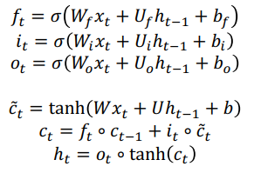
Long-Short Term Memory (LSTM)
[Hochreiter & Schmidhuber, 1999]
Instead of rewriting the hidden state during update, add a delta
– 𝑠_{𝑡} = 𝑠_{𝑡−1} + Δ𝑠_{𝑡}
– Keeps the contribution of earlier inputs relevant
Information flow is controlled by gates
Gates depend on input and the hidden state
Between 0 and 1
Forget gate (f): 0/1 → reset/keep hidden state
Input gate (i): 0/1 → don’t/do consider the contribution of the input
Output gate (o): how much of the memory is written to the hidden state
Hidden state is separated into two (read before you write)
+
i
f
𝐶
+
IN
– Memory cell (c): internal state of the LSTM cell
– Hidden state (h): influences gates, updated from the memory cell
o
ℎ
OUT

Slide 51
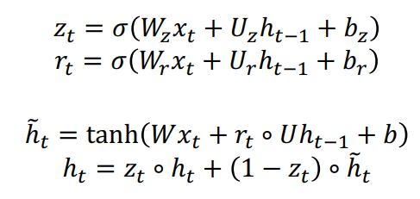
Gated Recurrent Unit (GRU)
[Cho et. al, 2014]
Simplified information flow
Single hidden state
– Input and forget gate merged →
update gate (z)
No output gate
Reset gate (r) to break information flow from previous hidden state
Similar performance to LSTM
z
r
ℎ
+
IN
OUT

Slide 52
Session-based recommendations
Sequence of events
User identification problem
Disjoint sessions (instead of consistent user history)
Tasks
Next click prediction
Predicting intent
Classic algorithms can’t cope with it well
Item-to-item recommendations as approximation in live systems
Area revitalized by RNNs

Slide 53
GRU4Rec
[Hidasi et. al, 2015]
Network structure
Input: one hot encoded item ID
Optional embedding layer
GRU layer(s)
Output: scores over all items
Target: the next item in the session
Adapting GRU to session-based recommendations
– Sessions of (very) different length & lots of short sessions: session-parallel mini-batching
Lots of items (inputs, outputs): sampling on the output
The goal is ranking: listwise loss functions on pointwise/pairwise scores
ItemID (next)
One-hot vector
Scores on items
f()
Weighted output
GRU layer
One-hot vector
ItemID

Slide 54
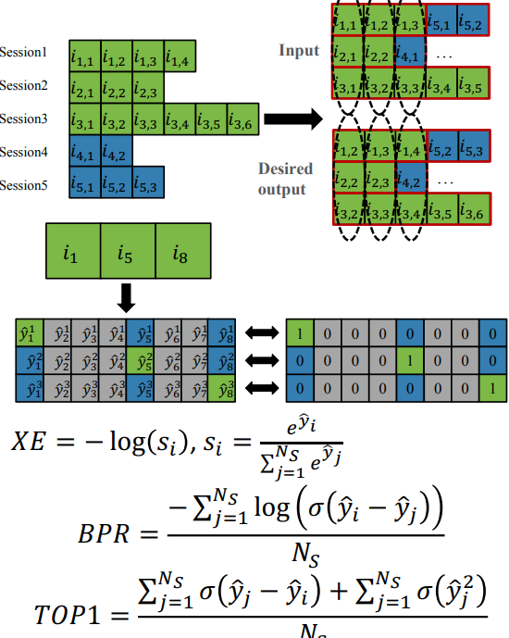
GRU4Rec
Session-parallel mini-batches
Mini-batch is defined over sessions
Update with one step BPTT
Lots of sessions are very short
2D mini-batching, updating on longer sequences (with or without padding) didn’t improve accuracy
Output sampling
– Computing scores for all items (100K – 1M) in every step is slow
– One positive item (target) + several samples
Fast solution: scores on mini-batch targets
Items of the other mini-batch are negative samples for the current mini-batch
Loss functions
– Cross-entropy + softmax
– Average of BPR scores
– TOP1 score (average of ranking error + regularization over score values)

Slide 55
GRU4Rec
Observations
Similar accuracy with/without embedding
– Multiple layers rarely help
Sometimes slight improvement with 2 layers
Sessions span over short time, no need for multiple time scales
– Quick conversion: only small changes after 5-10 epochs
Upper bound for model capacity
No improvement when adding additional units after a certain threshold
This threshold can be lowered with some techniques
Results
– 20-30% improvement over item-to-item recommendations… BUT

Slide 56
GRU4Rec
Observations
Similar accuracy with/without embedding
– Multiple layers rarely help
Sometimes slight improvement with 2 layers
Sessions span over short time, no need for multiple time scales
– Quick conversion: only small changes after 5-10 epochs
Upper bound for model capacity
No improvement when adding additional units after a certain threshold
This threshold can be lowered with some techniques
Results
– 20-30% improvement over item-to-item recommendations

Slide 57
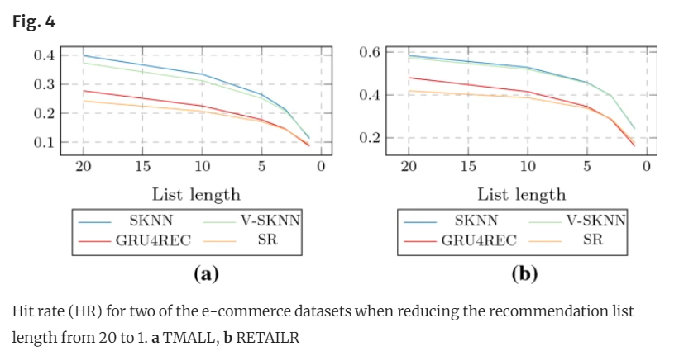
GRU4Rec
Observations
Similar accuracy with/without embedding
– Multiple layers rarely help
Sometimes slight improvement with 2 layers
Sessions span over short time, no need for multiple time scales
– Quick conversion: only small changes after 5-10 epochs
Upper bound for model capacity
No improvement when adding additional units after a certain threshold
This threshold can be lowered with some techniques
Results
– 20-30% improvement over item-to-item recommendations
Session KNN variants may outperform deep learning approaches

Slide 58
References
[Barkan & Koenigstein, 2016] O. Barkan, N. Koenigstein: ITEM2VEC: Neural item embedding for collaborative filtering. IEEE 26th International Workshop on Machine Learning for Signal Processing (MLSP 2016).
[Grbovic et. al, 2015] M. Grbovic, V. Radosavljevic, N. Djuric, N. Bhamidipati, J. Savla, V. Bhagwan, D. Sharp: E-commerce in Your Inbox: Product Recommendations at Scale. 21th ACM SIGKDD International Conference on Knowledge Discovery and Data Mining (KDD’15).
[Le & Mikolov, 2014] Q. Le, T. Mikolov: Distributed Representations of Sentences and Documents. 31st International Conference on Machine Learning (ICML 2014).
[Mikolov et. al, 2013a] T. Mikolov, K. Chen, G. Corrado, J. Dean: Efficient Estimation of Word Representations in Vector Space. ICLR 2013 Workshop.
[Mikolov et. al, 2013b] T. Mikolov, I. Sutskever, K. Chen, G. Corrado, J. Dean: Distributed Representations of Words and Phrases and Their Compositionality. 26th Advances in Neural Information Processing Systems (NIPS 2013).
[Morin & Bengio, 2005] F. Morin, Y. Bengio: Hierarchical probabilistic neural network language model. International workshop on artificial intelligence and statistics, 2005.
[Nedelec et. al, 2017] T. Nedelec, E. Smirnova, F. Vasile: Specializing Joint Representations for the task of Product Recommendation. 2nd Workshop on Deep Learning for Recommendations (DLRS 2017).
[Vasile et. al, 2016] F. Vasile, E. Smirnova, A. Conneau: Meta-Prod2Vec – Product Embeddings Using Side-Information for Recommendations. 10th ACM Conference on Recommender Systems (RecSys’16).

Slide 59
Additional topics
Context-awareness
Explanations and interface
Multi-stakeholder and multi-objective
Fairness and biases

Slide 60
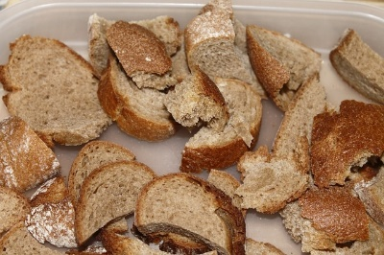
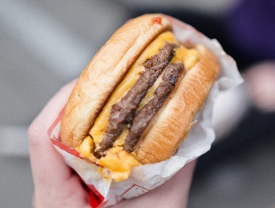
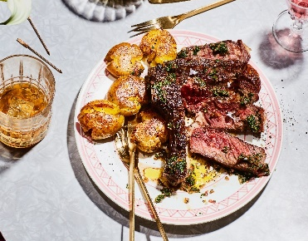
Context-aware RecSys
Context-awareness
Eating alone vs. With friends vs. On a conference
Usual tase vs. The end of December
While in homepage vs. in headset category

Slide 61
RecSys: Context-aware
Key design choice: which contextual axes and values / granularity to consider?
Context-awareness
Simple method for context incorporation into matrix factorization
Nowadays, more convenient to model through DL

Slide 62
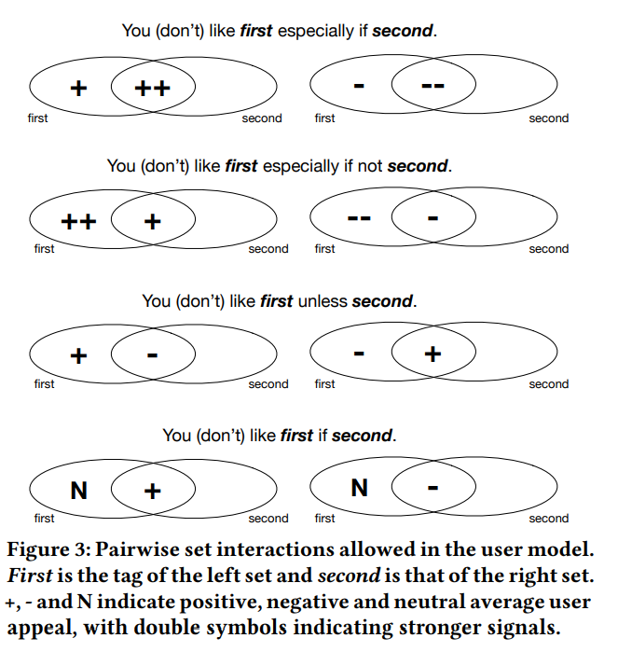
Explanations in RecSys
This item was recommended to you because…
Improve Transparency / Validity checking / Trust in the system / Persuasiveness / Simplify decision-making / Understand domain,…
Many different strategies, interfaces, use-cases and source data tried so far

Slide 63
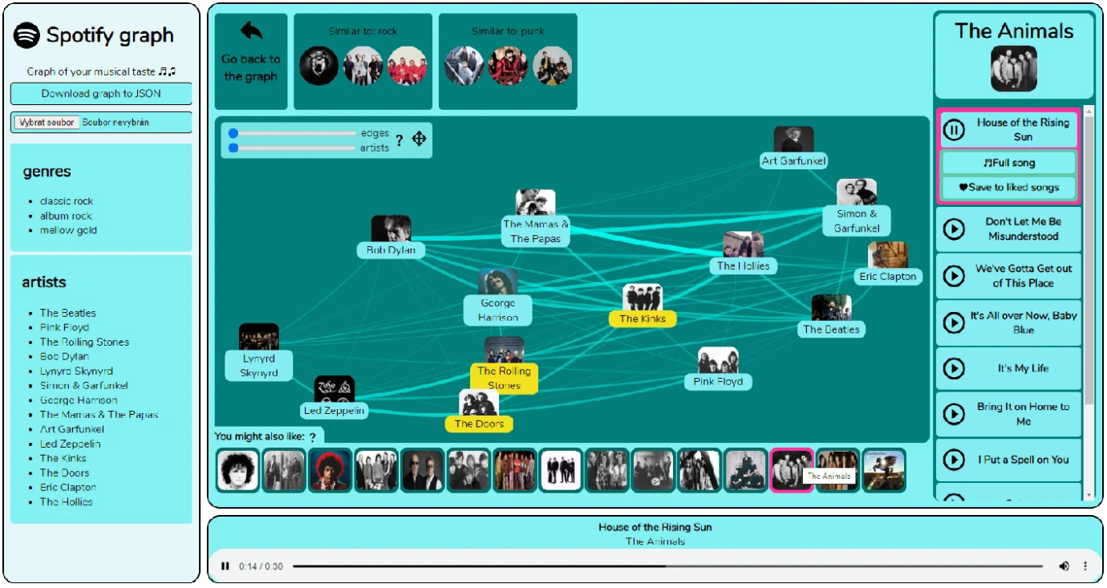
Explanations in RecSys

Slide 64
Multi-stakeholder RecSys Multi-objective RecSys
You are not alone in the system, others have their needs too
You may have multiple needs hard to sum into a single objective

Slide 65
Multi-Stakeholder RecSys
Why we need MOO in this context
– The end user is not the only stakeholder
– RecSys should be built by considering the item utility
from the perspective of different stakeholders

Slide 66
Multi-Stakeholder RecSys
Objective definitions
It varies from domains to domains
For each stakeholder, there’s at least one objective
E-Commerce or Marketplace
Buyer: user preferences on items, budget
Seller: profits
Platform: commission fees
Delivery company: costs and profits
Job seeking
Job seeker: user preferences
Recruiter: talent requirements
50

Slide 67
Fairness in Recommender Systems
Bias and Fairness Issues
Tutorial from: https://fairness-tutorial.github.io/

Slide 68
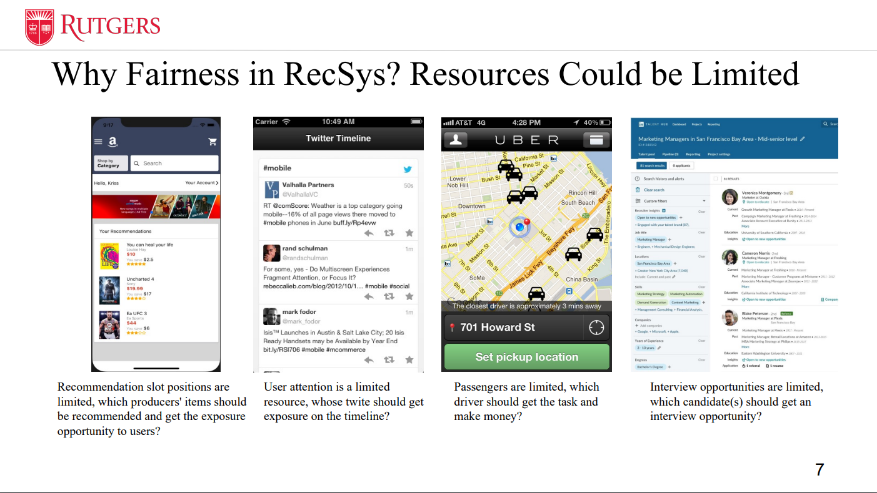
Fairness Issues

Slide 69
Fairness Issues

Slide 70
Fairness Issues

Slide 71
Fairness Issues

Slide 72
Cascade of Biases

Slide 73
Selection Bias
Definition: Selection bias happens in explicit feedback data as users are free to choose which items to rate, so that the observed ratings are not a representative sample of all ratings.
Selection bias
p_{T} (u, i) ≠ p_{D} (u, i)
3 | 4 | 2 | 5
1 | 3 | 2 | 5
2 | 3 | 4 | 4
3 | 4 |  | 5
 | 3 |  | 5
 | 3 | 4 | 4
Tobias Schnabel, Adith Swaminathan, Ashudeep Singh, Navin Chandak, and Thorsten Joachims. 2016. Recommendations as Treatments: Debiasing Learning and Evaluation. In ICML.
B. M. Marlin, R. S. Zemel, S. Roweis, and M. Slaney, “Collaborative filtering and the missing at random
assumption,” in UAI, 2007
17

Slide 74
Exposure Bias
Definition: Exposure bias happens in implicit feedback data as users are only exposed to a part of specific items.
Explanation: A user generates behaviors on exposed items, making the observed user‐item distribution deviate from the ideal one p_{D} (u, i) .
1 | 1 | 0 | 1
0 | 1 | 0 | 1
0 | 1 | 1 | 1
Exposure bias
p_{T} (u, i) ≠ p_{D} (u, i)
1 | 1
0 |  | 0
0 | 1 | 1 | 1
18

Slide 75
Exposure Bias
Unware
Dislike Implicit feedback
p_{T} (u, i | r = 0) = 0
1 | 1 | 0 | 1
0 | 1 | 0 | 1
0 | 1 | 1 | 1
1 | 1
0 |  | 0
0 | 1 | 1 | 1
1
1
Exposure bias
p_{T} (u, i) ≠ p_{D} (u, i)
1
1
1
Exposure
User
Background
Item
Popularity
Policy of RS
19

Slide 76
Conformity Bias
Definition: Conformity bias happens as users tend to behave similarly to the others in a group, even if doing so goes against their own judgment.
Conformity bias
p_{T} (r|u, i) ≠ p_{D} (r | u, i)
3 | 4 |  | 5
 | 3 |  | 4
 | 3 | 4 | 3
3 | 4 |  | 5
 | 3 |  | 5
 | 3 | 3 | 4
3 | 4 | 3 | 5
Public opinions
20

Slide 77
Position Bias (Presentation Bias more generally)
Definition: Position bias happens as users tend to interact with items in higher position of the recommendation list.
Position bias
1 | 1 | 0 | 1
0 | 1 | 0 | 1
0 | 1 | 1 | 1
1 | 1 | 1
 |  | 1
 |  | 1 | 1
p_{T} (u, i) ≠ p_{D} (u, i)
User exposure will be affected by the position
p_{T} (r | u, i) ≠ p_{D} (r | u, i)
User judgments also will be affected by the position
21

Slide 78
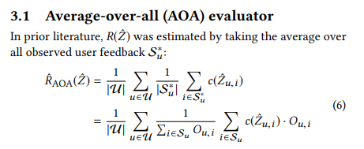
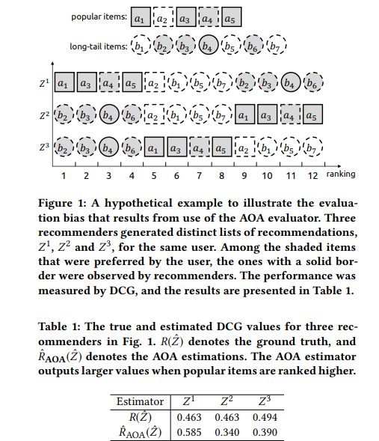
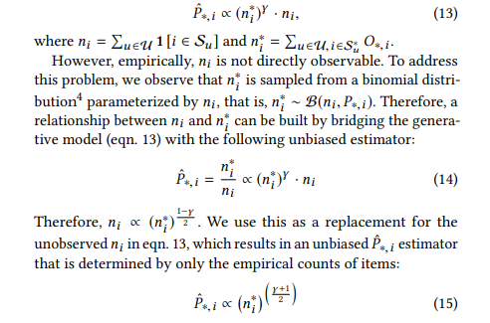
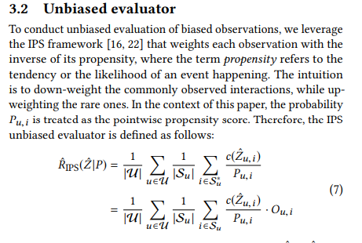
De-biasing Off-line Evaluation
https://dl.acm.org/doi/pdf/10.1145/3240323.3240355
nDCG, AUC, MAP,...
Propensity score

Slide 79
Outlook
More complex task-specific architectures (bit boring)
Scalability issues (sparse EASE variants)
User controll + Large Language Models (Conversational RecSys)
Evaluation issues (evergreen)
System -> Ecosystem (normal in industry, not so much in papers)

