Slide 1
NSWI166 Introduction to recommender systems and user preferences
Peter Vojtáš, KSI MFF UK
7/12 Querying - top-k

Slide 2
Repetition, addition of extras
D₂
Preference model of user u_{f,t} on data cube
Function R^{f,t}: ΠD_{i} →[0,1] R^{f,t}(a₁, …, a_{m}) = t ([f_{i} (a_{i}) : i = 1, …, m])
Ordering on data cube(a₁, …, a_{m}) ≥^{f,t} (b₁, …, b_{m}) iff R^{f,t}(a₁, …, a_{m}) ≥ R^{f,t}(b₁, …, b_{m}) Odering can be vizualized as contour lines on ΠD_{i}
For better understanding are different contour lines (of same t) in colors
User u_{f,t} , preference of user u_{f,t} , R^{f,t}: ΠD_{i} →[0,1]
R^{f,t}(a₁, …, a_{m}) = t ([f_{i} (a_{i}) : i = 1, …, m])
(a) ≥^{f,t} (b) iff R^{f,t}(a) ≥R^{f,t}(b)
C
E
D
ideal
b₂
B
f₂^{u}
x₂
D₁
1
b₁^{u}
0
b₁
C^{u}
0
E^{u}
D^{u}
f₁^{u}
B^{u}
b₁^{u}
1
ideal
x₁

Slide 3
D₂
Let us insert into previous slide the preference cube diagonal and depict it in DC. Does it preserve preference degree?
We have now mappings from DC→PC and from PC→DC – what are properties?
DC→PC is injective, PC→DC need not
Both mappings preserve line segments ( maybe in quadrants , see quadrant in yellow)
Mapping of areas, e.g. quadrilaterals can be more complicated
C
E
D
ideal
b₂
B
f₂^{u}
x₂
D₁
1
b₁^{u}
0
b₁
C^{u}
0
E^{u}
D^{u}
f₁^{u}
B^{u}
b₁^{u}
1
ideal
x₁

Slide 4
D₂
ideal
Let us insert into previous slide the preference cube diagonal and depict it in DC. Does it preserve preference degree?
We have now mappings from DC→PC and from PC→DC – what are properties?
DC→PC is injective, PC→DC need not
Both mappings preserve line segments (maybe in quadrants)
Mapping of areas, e.g. quadrilaterals can be more complicated
C
E
D
B
f₂^{u}
x₂
D₁
1
0
ideal
0
C^{u}
E^{u}
D^{u}
f₁^{u}
B^{u}
1
ideal
x₁

Slide 5
ideal
D₂
Let us insert into previous slide the preference cube diagonal and depict it in DC. Does it preserve preference degree?
We have now mappings from DC→PC and from PC→DC – what are properties?
DC→PC is injective, PC→DC need not
Both mappings preserve line segments (maybe in quadrants)
Mapping of areas, e.g. quadrilaterals can be more complicated
C
E
D
B
f₂^{u}
x₂
D₁
ideal
1
0
B^{u}
0
D^{u}
C^{u}
f₁^{u}
E^{u}
1
ideal
x₁

Slide 6
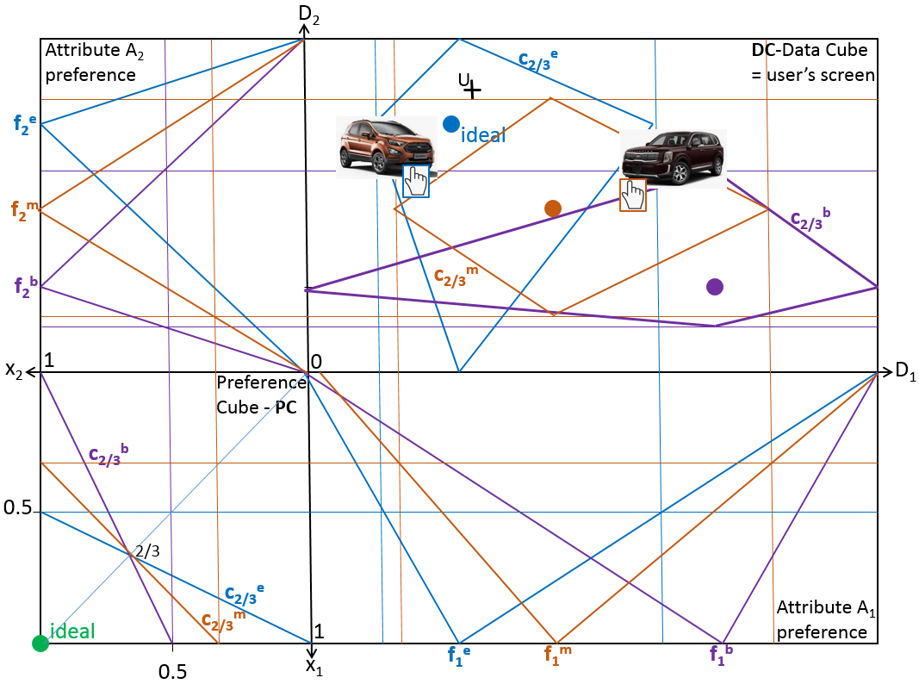

Slide 7
Outline of this lecture
  Web service motivation
  FLN=Fagin-Lotem-Naor class of data model
  FLN data model – viewed as LMPM
  FLN TA=threshold algorithm for top-k
  FLN TA seen geometrically (illustrative 2D in LMPM)
  FLN TA heuristics
  FLN data model and W3C RDF (web Resources Description Model)

Slide 8
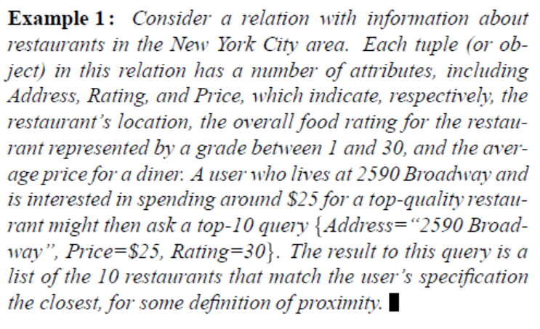
Motivation – new aspects
so far from “no match” to “close”, multicriterial
  Ideal values separately for attributes – conflicts
new aspect – attributes distributed/external sources
  N. Bruno, L. Gravano, A. Marian. Evaluating Top-k Queries over Web-Accessible Databases, ICDE 2002 - San Jose,

Slide 9
Web services – access mode – data types
MapQuest returns the distance between two addresses.
NYTimes Review gives the price range of a restaurant.
Zagat gives a food rating to the restaurant.
We follow paper [FLN] R. Fagin, A. Lotem, M. Naor, Optimal aggregation algorithms for middleware. Journal of Computer and System Sciences 66 (2003) 614–656 JCSS2003
  Access mode – sorted, direct (random), stateless, …
  From multimedia middleware (IBM Almaden Garlic project) top-k optimal querying to our multiuser LMPM

Slide 10
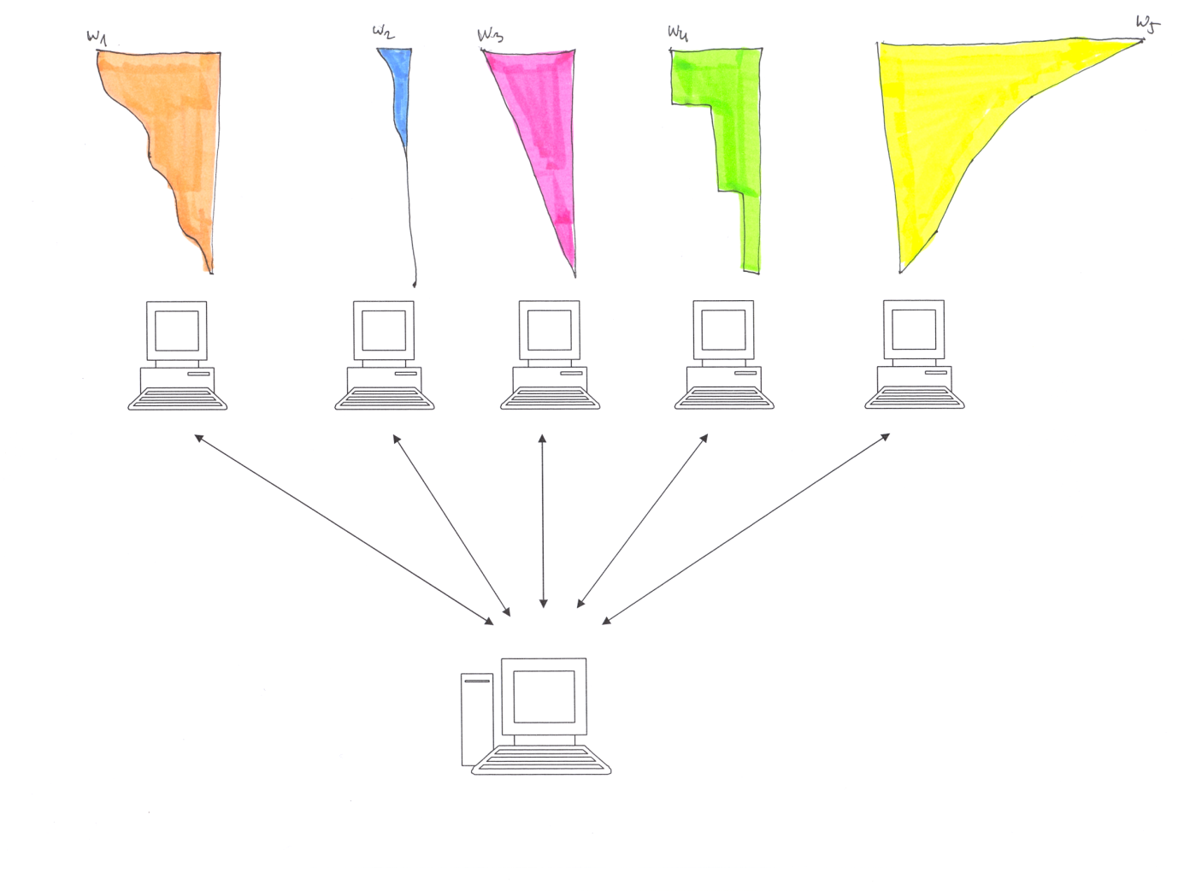
Data model Fagin – Lotem - Naor
Top-k
We need method/prototype/algorithm for top-k queries
Possibly without scanning whole data ? “order-by” ?
Notes:
Ako urobit aby som tieto poznamky videl a na obrazovke neboli

Slide 11
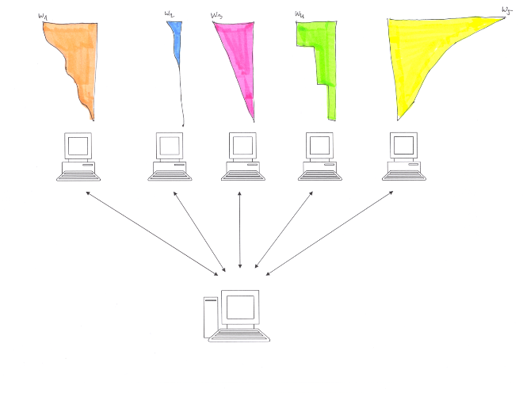
Data model Fagin-Lotem-Naor-FLN
Objects {R_{i} : i ≤ N}, m attributes
R has scores x₁^{R}, ..., x_{m}^{R} ∈ [0, 1]
Data in m ordered lists L₁, ..., L_{m}
record in L_{i} looks like (R, x_{i}^{R}), is sorted in descending order by
the x_{i}^{R} value
Data access:
- sequential – price c_{S}
- Direct (random) , knowing id. R) – price c_{R}
overall price s*c_{S} + r*c_{R}
Combination function t:[0,1]^{m} → [0,1], monotone, i.e.
x_{i} ≤ y_{i} implies t(x₁, ..., x_{m}) ≤ t(y₁, ..., y_{m})
We follow paper [FLN] R. Fagin, A. Lotem, M. Naor, Optimal aggregation algorithms
for middleware. Journal of Computer and System Sciences 66 (2003) 614–656

Slide 12
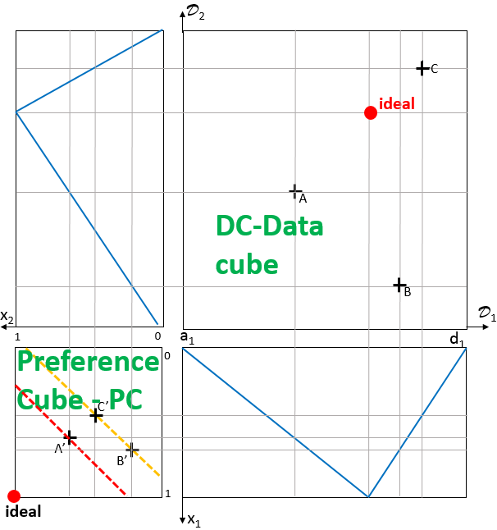

FLN data model – viewed as LMPM

Slide 13
FLN data model – viewed as LMPM
In LMPM object globally ordered by
r_{f,t}(oid) = t(f₁(oid.A₁),…, f_{j}(oid.A_{j}),…, f_{m}(oid.A_{m}))
In FLN Objects {R_{i} : i ≤ N}, m attributes - R_{i} iff oid=i
R has scores x₁^{R}, ..., x_{m}^{R} ∈ [0, 1] - x_{j}^{R} = f_{j}(oid.A_{j})
Ordered by t(R) = t(x₁^{R}, ..., x_{m}^{R}) = r_{f,t}(oid) – so far same …
Differences:
FLN do not restrict to linear f_{j} and t
FLN assumes data in m ordered lists L₁, ..., L_{m} (indexes) or
mode of access on the server side
Data access – sequential, direct (random),
price c_{S}, price c_{R}, overall price s*c_{S} + r*c_{R}
We will add more - our model is multiuser – formally is FLN
single user, Garlic Almaden has a graphical query interface

Slide 14
FLN threshold algorithm TA
1. Do sorted access in parallel to each of the m sorted lists L_{i}.
As an object R is seen under sorted access in some list, do
random access to the other lists to find the grade x_{j}^{R} of object R
in every list L_{j} . Then compute the grade t(R) = t(x₁^{R}, ..., x_{m}^{R}) of
object R.
If this grade is one of the k highest we have seen, then
remember object R and its grade t(R) (ties are broken arbitrarily,
so that only k objects and their grades need to be remembered
at any time).
(It may seem wasteful to do random access to find a grade that
was already determined earlier. As we discuss later, this is done
in order to avoid unbounded buffers)

Slide 15
τ
Threshold algorithm TA
2. For each list L_{i}, let x_{i} be the grade of the last object seen
under sorted access. Define the threshold value τ to be
τ = t(x₁, ..., x_{m})
As soon as at least k objects have been seen whose grade is
at least equal to τ; then halt. Else go to 1.
3. Let Y be a set containing the k objects that have been seen
with the highest grades. The output is then the graded set
{(R, t(R))| R ∈ Y} (ordered by t(R)).

Slide 16
TA algorithm - illustration
I am looking for a hotel close to beach, cheap, good
close
H1 |  | 0,9
H2 |  | 0,8
H3 |  | 0,5
H4 |  | 0,4
cheap
H3 |  | 0,9
H2 |  | 0,8
H4 |  | 0,5
H1 |  | 0,3
quality
H2 |  | 0,9
H3 |  | 0,8
H1 |  | 0,5
H4 |  | 0,3
stack c₁
H2 |  | 0,8
H3 |  | 0,68
H1 |  | 0,63
stack c₂
H2 |  | 0,8
H3 |  | 0,68
H1 |  | 0,63
…
Threshold τ₁
Threshold τ₂
Threshold τ₃
So far I do not know the best
0,8≥0,8 … H2 is the best
= 0.5, hotel H4 has overall preference degree 0.416…
Notes:
Ako urobit aby som tieto poznamky videl a na obrazovke neboli

Slide 17
Threshold algorithm is incremental in top-k
threshold
Found versus confirmed = In which step
was the object above threshold, e.g., Sebrle
in the step 3
Objects seen in first second third step
Notes:
Ako urobit aby som tieto poznamky videl a na obrazovke neboli

Slide 18
TA algorithm geometrically
User’s screen?
D₂
We would like to keep our model
intuitive
self explanatory
We would like to visualize also methods / prototypes / algorithms
both
Top-k querying
and
Learning user’s preferences
We start at preference cube
C
E
D
ideal
b₂
B
f₂^{u}
x₂
D₁
1
b₁^{u}
0
b₁
C^{u}
0
E^{u}
D^{u}
f₁^{u}
B^{u}
b₁^{u}
1
ideal
x₁
FLN-TA-runs here

Slide 19
FLN-TA graphically (2D)
Objects {R_{i} : i ≤ N}, R have m-many score x₁^{R}, ..., x_{m}^{R}
Data in m ordered lists L₁, ..., L_{m} , record in L_{i} looks like (R, x_{i}^{R}), is sorted in descending order by the x_{i}^{R} value
Combination function
t:[0,1]^{m} → [0,1], monotone wrt Pareto ord
User u is fixed, task is to compute top-k as efficiently as possible, f_{i}^{u} gave x_{i}^{R}
Preference cube with images of data pts A,…,G on x₁, x₂ axes (lists L₁, L₂)
at middleware is not seen … with aggregation given by one contour line.
D₂
e ₂
d ₂
f ₂
g ₂
b ₂
c ₂
a ₂
D₁
1
0
x₂
0
contour line
exemplar
e ₁
f ₁
d ₁
c ₁
g ₁
b ₁
a₁
1
x₁

Slide 20
FLN-TA graphically (2D)
cycle counter c:=1
Step 1
Part “Do sorted access ”
aggregation given by ex. contour line.
Axes x₁, x₂ can be viewed as lists, in this case we see only (by sequential access)
L₁ = {(A,a₁)}
L₂ = {(E,e₂)}
Nevertheless we know object ID’s and so we can go to part 2
Rest of the list
L₂ we do not see
e₂ from the list L₂ we know (E, e₂)
D₂
e ₂
d ₂
f ₂
g ₂
b ₂
c ₂
a ₂
D₁
1
0
x₂
0
contour line
exemplar
e ₁
f ₁
d ₁
Rest of the list
L₁ we do not see
c ₁
g ₁
b ₁
a₁ from the list L₁ we know (A, a₁)
1
x₁

Slide 21
FLN-TA graphically (2D)
cycle counter c:=1
Step 1
Part “DO random access ”
this gives a₁,e₂,
Axes x₁, x₂ viewed as lists, in this case
L₁ = {(A,a₁), (E,e₁)}
L₂ = {(E,e₂), (A,a₂)}
We have PC images A^{u} = (a₁,a₂), E^{u} = (e₁,e₂)
Part “compute t(R) ”
gives t(A), t(E)
Part “in stack Y¹ we have”
Y¹ = {(A, t(A)), (E, t(E))}
Step 2 gives
x₁¹ = a₁ , x₂¹ = e₂,
T¹= (a₁ , e₂), and it’s contour line intersects diagonal at τ¹
a₂ from the list L₂ we know (A, a₂)
D₂
e ₂
d ₂
f ₂
g ₂
b ₂
c ₂
a ₂
D₁
1
0
x₂
0
contour line
exemplar
E^{u}
e ₁ from the list L₁ we know (E, e₁)
f ₁
d ₁
t(E)
c ₁
t(A)
g ₁
b ₁
T¹
A^{u}
a₁
τ¹
1
x₁

Slide 22
FLN-TA graphically (2D)
cycle counter c:=1
Step 2
Part “compare Y¹ and τ¹”
ELSE c:= c+1 = 2
and GO TO 1
applies
D₂
e ₂
d ₂
f ₂
g ₂
b ₂
c ₂
a ₂
D₁
1
0
x₂
0
contour line
exemplar
E^{u}
e ₁
f ₁
d ₁
t(E)
c ₁
t(A)
g ₁
b ₁
T¹
A^{u}
a₁
τ¹
1
x₁

Slide 23
FLN-TA graphically (2D)
cycle counter c:=2
Step 1
Part “Do sorted access ”
Axes x₁, x₂ and/or lists we see (by sequential access)
L₁ ={(A,a₁),(B,b₁),…(E, e₁)}
L₂ ={(E,e₂),(D,d₂),…(A,a₂)}
Nevertheless we know object ID’s and so we can go to part 2
D₂
e ₂
d ₂
f ₂
g ₂
b ₂
c ₂
a ₂
D₁
1
0
x₂
0
contour line
exemplar
E^{u}
e ₁
f ₁
d ₁
t(E)
c ₁
t(A)
g ₁
b ₁
T¹
A^{u}
a₁
τ¹
1
x₁

Slide 24
FLN-TA graphically (2D)
cycle counter c:=2
Step 1
Part “DO random access ”
this gives d₁,b₂,
We have PC images B^{u}, D^{u}
Part “compute t(R) ”
gives t(B), t(D)
Part “in stack Y² we have” an ordered stack
Y² = {(B, t(B)), (A, t(A)), (D, t(D)), (E, t(E))}
Step 2 gives
x₁² = b₁ , x₂² = d₂,
T²= (b₁ , d₂), and it’s contour line intersects diagonal at τ²
Part “compare Y² and τ²”
gives c:= 3 and GO TO 1
D₂
e ₂
d ₂
f ₂
g ₂
b ₂
c ₂
a ₂
D₁
1
0
x₂
0
contour line
exemplar
E^{u}
e ₁
D^{u}
f ₁
d ₁
t(D)
t(E)
c ₁
t(B)
t(A)
g ₁
T²
B^{u}
b ₁
T¹
τ²
A^{u}
a₁
τ¹
1
x₁

Slide 25
FLN-TA graphically (2D)
cycle counter c:=3
Step 1, part … 2, part …
Colors can help us to distinguish cycles …
Anyway, it is a mess in this small dimension
In future we omit depicting
data cube part
attribute preferences
We enlarge preference cube and solutions will be coded by colors and notation as here
D₂
e ₂
d ₂
f ₂
g ₂
b ₂
c ₂
a ₂
D₁
1
0
x₂
0
contour line
exemplar
E^{u}
e ₁
D^{u}
f ₁
d ₁
t(D)
t(E)
c ₁
t(B)
t(A)
g ₁
T²
B^{u}
b ₁
T¹
τ²
A^{u}
a₁
τ¹
1
x₁

Slide 26
FLN-TA graphically (2D)
e ₂
d ₂
f ₂
g ₂
b ₂
c ₂
a ₂
Big picture
In this case we need 4 steps to decide the winner
Certified order of items so far is B, A, G, D (for F, C, E we have to wait)
It seems that number of steps needed to decide the winner is at most n/2 + 1 where n is the # of items (⎣n/2⎦ + 1)
?can we find data distribution such that TA ends (decides winner / decides all) in arbitrary number of steps
s ≤ (⎣n/2⎦ + 1) ?
In 3-D, 4-D, …?
contour line
exemplar
E^{u}
e ₁
F^{u}
f ₁
D^{u}
d ₁
T⁴
C^{u}
c ₁
τ⁴
T³
G^{u}
g ₁
τ³
T²
B^{u}
b ₁
τ²
T¹
A^{u}
a₁
τ¹

Slide 27
FLN-TA graphically (2D)
Lab/homework 1
a ₂
b ₂
c ₂
d ₂
e ₂
f ₂
g ₂
h ₂
Run threshold algorithm
Use notation as in previous slide
Use colors to denote steps/cycles of TA
a₁
b ₁
c ₁
d ₁
e ₁
f ₁
g ₁
h ₁

Slide 28
FLN-TA graphically (2D)
Lab/homework 2
a ₂
b ₂
c ₂
d ₂
e ₂
f ₂
g ₂
h ₂
Run threshold algorithm
Use notation as in previous slide
Use colors to denote steps/cycles of TA
a₁
b ₁
c ₁
d ₁
e ₁
f ₁
g ₁
h ₁

Slide 29
FLN-TA graphically (2D)
Lab/homework 3
a ₂
b ₂
c ₂
d ₂
e ₂
f ₂
g ₂
h ₂
Run threshold algorithm
Use notation as in previous slide
Use colors to denote steps/cycles of TA
Lists are same, how does aggregation influence run of TA?
Is there a neighborhood
of contour line with same TA run and outcome?
a₁
b ₁
c ₁
d ₁
e ₁
f ₁
g ₁
h ₁

Slide 30
FLN-TA graphically (2D)
Lab/homework 4
Experiment with mutual influence of data and aggregation distribution.
Is the hypothesis
?can we find data distribution such that TA ends (decides winner / decides all) in arbitrary number of steps
s ≤ (⎣n/2⎦ + 1) ? true ?
Check it in higher dimensions in PC, 4-D, 5-D, …
Try randomly generated data and threshold
Run threshold algorithm
With notation, colors, etc. same as in previous

Slide 31
TA algorithm is correct
FLN – theorem 4.1. If the aggregation function t is monotone,
then TA correctly finds the top k answers (ties are ordered
arbitrarily).
Proof. Let Y be as in Step 3 of TA. We need only show that
every member of Y has at least as high a grade as every object
z not in Y.
By definition of Y; z∉Y, either it’s grade was not one of the k
highest or z has not been seen in running TA. So assume that
z was not seen. Assume that the fields of z are x₁^{z} , …, x_{m}^{z} .
Therefore, x_{i}^{z} ≤ x_{i} for every i: Hence, t(x₁^{z}, ..., x_{m}^{z})≤τ=t(x₁, ..., x_{m});
where the inequality follows by monotonicity of t.
But by definition of Y; for every y in Y, t(y) ≥ τ. Therefore, for
every y in Y we have t(y) ≥ τ ≥ t(z) as desired.

Slide 32
Threshold algorithm TA - wording as in FLN and small changes, additional notation (cycle counter)
Given k > 0 (can work incrementally then put k=0), data in
ordered lists L_{j}, sequential/random access, cycle counter c:=1
Do sorted access in parallel to each of the m sorted lists L_{i},
either the service is stateless (get c’s element) or not (server
“knows c” → next)
As an object R is seen under sorted access in some list,
DO random access to the other lists to find the grade x_{j}^{R}
of object R in every list L_{j}
THEN compute the grade of R, t(R) = t(x₁^{R}, ..., x_{m}^{R})
IF this grade is one of the k highest we have seen,
THEN remember in Y^{c} object R and its grade t(R) (ties
are broken arbitrarily, can work incrementally)
GO TO 2
Notes:
Ako urobit aby som tieto poznamky videl a na obrazovke neboli

Slide 33
Threshold algorithm TA - wording as in FLN and small changes, additional notation (cycle counter) - cont'd
2. For each list L_{i}, let x_{i}^{c} be the grade of the last object seen
under c’s sorted access. Put T^{c} =(x₁^{c}, ..., x_{m}^{c})
Define the threshold value τ^{c} to be
τ^{c} = t(x₁^{c}, ..., x_{m}^{c})
If k>0 and AS SOON AS at least k objects in Y^{c} have been seen
whose grade is at least equal to τ^{c} (incremental variant: elements
of Y^{c} above τ^{c} are confirmed)
THEN GOTO 3 ELSE IF N=c THEN GOTO 3 ELSE c:= c+1
and GO TO 1
3. Let Y^{c} be a set containing the k objects that have been seen
with the highest grades. The output is then the graded set
{(R, t(R))| R ∈ Y} (ordered by t(R)).
Notes:
Ako urobit aby som tieto poznamky videl a na obrazovke neboli

Slide 34
TA is optimal
Theorem FLN 6.1. Assume that the aggregation function t is
monotone. Let D be the class of all databases. Let A be the class
of all algorithms that correctly find the top k answers for t for every
database and that do not make wild guesses. Then TA is optimal.
Proof. Let A ∈ A and D ∈ D. Result is Y_{A} and in each list L_{i} the
algorithm A made d_{i} sequential accesses. Last seen score is x_{i}
and threshold is τ_{A}. A has seen in total a many objects and price
c_{A} is at least a*c_{S} (as A does not make wild guesses).
Put d = maxd_{i}, we know that d ≤ a.
As A does not make wild guesses, then TA running on same
data has seen after d*m steps all objects seen by A and τ_{TA} ≤ τ_{A} .
As A correctly finds the top we have Y_{TA} =* Y_{A} .

Slide 35
TA is optimal
We claim that for each R ∈ Y_{A}
we have t(R) ≥ τ_{A} . Assume not
and R₀ ∈ Y_{A} has t(R₀) < τ_{A} .
Let us consider data D’ such that
on place d_{i}+1 we insert record
(V, x_{i}) in each list L_{i}. As far as A
does not make wild guesses, it
runs on D’ same way as it was
running on D. Object V was not
seen and the out put is same.
As t(V) = τ_{A} > t(R₀), V should be in
top-k. Contradiction.
(R₁,x₁)
(V,x₁)
(R₂,x₂)
(R_{m},x_{m})
d
(V,x_{m})
(V,x₂)
Having τ_{TA} ≤ τ_{A} ≤ t(R) also TA ends not later than in step d.

Slide 36
TA is optimal
Price of the computation of TA is
d*m*c_{S} + d*m*(m-1)*c_{R}
Comparison of TA with A
How many times is TA price worse than price of A , i.e.
priceTA/price A ≤
using d/a ≤ 1 we see that this is bounded by a constant.
- Is there some/any asymptotic? Over all A ∈ A and D ∈ D?
- For which heuristics H is A_{H}∈ A? What does this theorem say
about multiuser case, domain knowledge expert, change scenario
What if Y_{A} =* Y_{TA} (* ties) is changed? E.g. |Y_{A} ∩ Y_{TA} | ≥ 1,
Probability P(|Y_{A} ∩ Y_{TA}|/|Y_{TA}| ≥ 0.1)>1-ε,
Kendal ordering similarity… ?
□

Slide 37
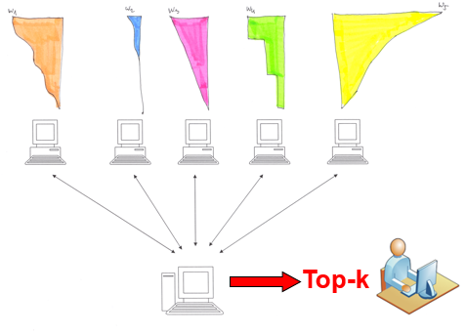
Discussion on TA optimality, scenario change
Do we have real data for c_{R}/c_{S}. Is there an auction system for
setting prices. Try “gsp generalized second price auction”, Google
calculation, more, what if c_{R}/c_{S} is time (user, …) dependent ?
For 5 attributes is coefficient m(m-1) = 20 … so there is
sufficient place for improvements
Consider limitations of sequential access – variant of TA,
no random access (or too expensive), more in [FLN] …
What are real cases, used scenario?
  Server, cost and profit, offer and demand
    Protocols, metrics,
  Middleware, cost-profit, offer-demand
    Sometimes missing, man-in-the-middle
  Client , cost and profit, offer and demand
    Use case, process, behavior, …
Is TA still optimal wrt. these cases?

Slide 38
Alternatives
Various server responses
  No random access (some servers have both, some only one type of access, ... )
  Answer is an ordered (step-by-step) list od object ID’s (preference degree computation hidden – probably depending on user’s behavior)
  Answer is an ordered (step-by-step) list od object ID’s and attribute values (preference degree computation hidden – probably depending on user’s behavior)
It is about data integration
  preference degree computation on server side hidden – probably depending on user’s behavior
  preference degree computation on middleware side – our task?
In house data?
  Is TA useful at all?

Slide 39
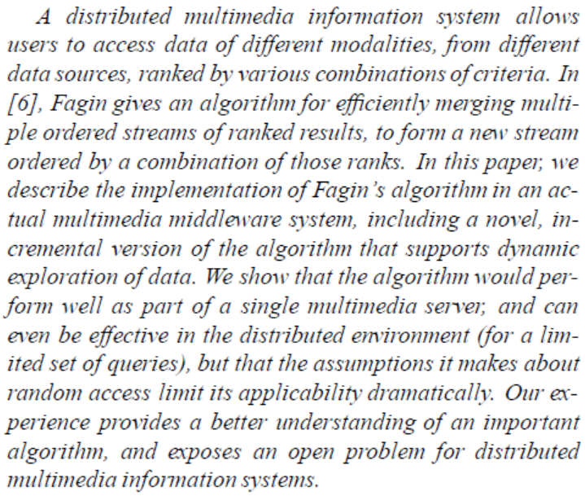
Using Fagin’s Algorithm for Merging Ranked Results in Multimedia Middleware
Wimmers, Haas, ... IBM Almaden Research Center San Jose,

Slide 40
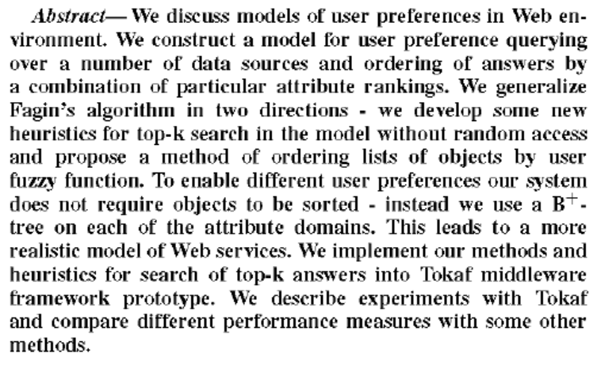
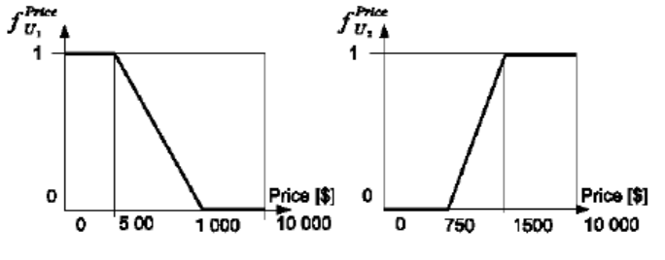
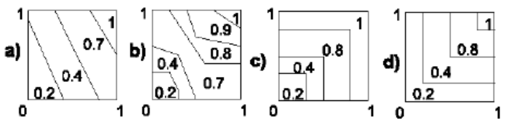
A system
recommending
top-k objects
for multiple
users preferences
A. Eckhardt,
J. Pokorny,
P. Vojtas,
2007 FuzzIEEE

Slide 41
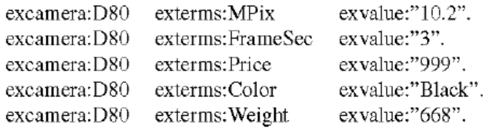
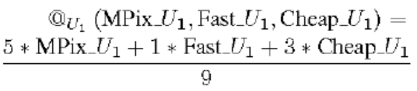
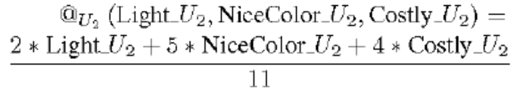
A system recommending top-k objects for multiple users preferences
A. Eckhardt, J. Pokorny, P. Vojtas, 2007 FuzzIEEE continued

Slide 42
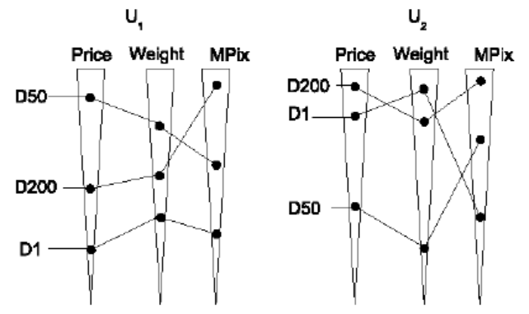
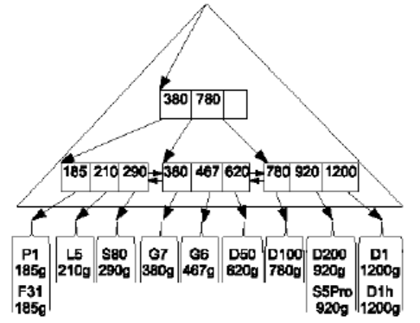
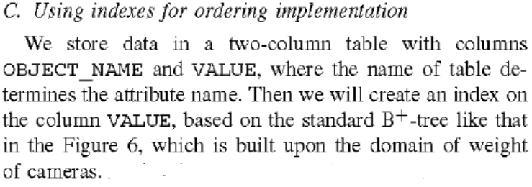

Slide 43
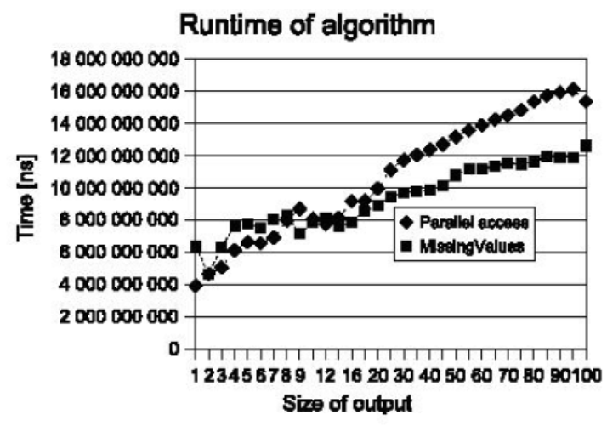
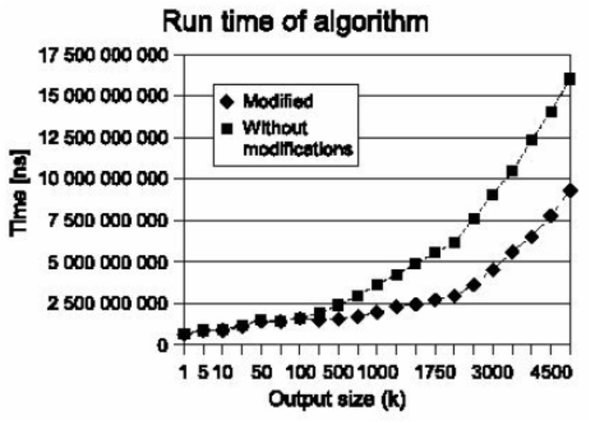
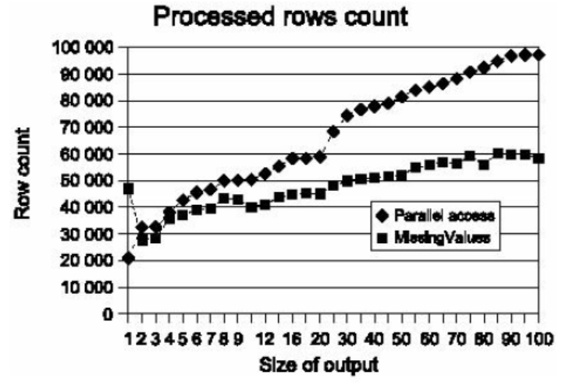
Experiments
Several improvements
No comparison with
others

Slide 44
Found versus confirmed in TA
Assume – data structure is given – computed offline (NlogN)^{m}
We can not influence found; we can try to influence confirmed
Number of
steps TA needs
Athlete

Slide 45
Found versus confirmed - heuristics
Confirm TA as early as possible, if t(R) bigger, τ smaller
t(R) ≥ τ = t(x₁, ..., x_{m})
Heuristics can use
∂t/x_{i}
– if it is our first access to services in L_{i} , …
If we know from previous access some estimation of distribution of grades (attribute values when f_{i} is known) then
Heuristics can use
estimationOf(j^{th} element of L _{i})*∂t/x_{i}
Test heuristics on data (maybe it is domain dependent – e.g., Reuters collection has exponential distribution of lists)
Can we predict found? What is the probability that at step c(k) the list is already fixed?

Slide 46
Design experiments!
Server
  Create lists for u_{i}
  Which data accessed
  by different users?
middleware
  Change aggregation
  Measure influence
client
  Incremental run, when found, when confirmed
  Step-by-step execution, measure top-k, 1-hit,
Separate middleware server
Like IBM, Google, …
Maybe an e-shop
Maybe a “smart” app client
middleware

Slide 47
Visualizing TA – price ≈ time
Some objects are confirmed earlier
threshold
Top-k
buffer
Time, price, …
t_{found}
t_{confirmed}

Slide 48
Speed up ideas …
      Guntzer, Balke, Kießling VLDB 2000
      With P. Gurský
threshold
Top-k
buffer
t_{confirmed2}
Time, price, …
t_{found2}
t_{found}
t_{confirmed}

Slide 49
Heuristics GBK, PG, …
Increase frequency and depth of sequential
access
t(R) ≥ τ
Where x_{i}*∂t(x₁,…,x_{i} ,..., x_{m})/∂x_{i} decrease most
Where x_{i}*∂t(x₁,…,x_{i} ,..., x_{m})/∂x_{i} decrease least
Discrete ∂t(x₁^{H(j)}, ..., x_{m}^{H(j)})/∂x_{i}*(x_{i}^{H(j)} - x_{i}^{H(j)+p})
See PG page 18-20

Slide 50
Restricting sorted access
Let Z be the set of indices i of those lists L_{i} that can be accessed under sorted access. We assume |Z| ≥ 1. We take m’ to be the cardinality of Z (and as before, take m to be the total number of sorted lists).
Define TA_{Z} to be the following natural modification of TA,
Do sorted access in parallel to each of the m’ sorted lists L_{i} with i∈Z: As an object R is seen under sorted access in some list, do random access as needed to the other lists to find the grade x_{i} of object R in every list L_{i}: Then compute the grade t(R) =
t(x₁, …,x_{m}) of object R: If this grade is one of the k highest we have seen, then remember object R and its grade t(R) (ties are broken arbitrarily, so that only k objects and their grades need to be remembered at any time).
2. For eachlist L_{i} with i∈Z; let x_{i} be the grade of the last object seen under sorted access. For each list L_{i} with i∉Z; let x_{i} = 1. Define the threshold value τ to be
t(x₁, …,x_{m}) . As soon as at least k objects have been seen whose grade is at least equal to τ ; then halt. *
3. Let Y be a set containing the k objects that have been seen with the highest grades. The output is then the graded set {(R, t(R)): R ∈ Y}
* after seeing the grade of every object in every list, and thus having done sorted access to every object in every list L_{i} with i∈Z; there are not at least k objects with a grade that is at least equal to the final threshold value t: In this situation, we say that TA_{Z} halts after it has seen the grade of every object in every list.
□
Notes:
Ako urobit aby som tieto poznamky videl a na obrazovke neboli

Slide 51
Restricting sorted access
Theorem 7.1. Assume that the aggregation function t is monotone. Let D be the class of all databases. Let A be the class of all algorithms that correctly find the top k answers for t for every database and that do not make wild guesses, where the only lists that may be accessed under sorted access are those lists L_{i} with i∈Z: Then TA_{Z} is instance optimal over A and D.
The ratio is similar to the one in TA
‘
‘
‘
‘
Notes:
Ako urobit aby som tieto poznamky videl a na obrazovke neboli

Slide 52
Minimizing random access
For each object R there is a subset S(R)={i₁,…,i_{l}} ⊆ {1,…,m}
l≤m of the fields of R where the algorithm has determined the values x_{i1},…,x_{il} . We define functions that are lower and upper bounds on the value t(R) can obtain.
Lower bound W_{S}(R)=t(x₁,…x_{l}, 0,…,0) “worst”
Upper bound in position z = (x₁,…,x_{m})
B_{S}(R)=t(x₁,…x_{l}, x_{l+1},…,x_{m}) “best”
W_{S}(R) ≤ t(R) ≤ B_{S}(R)
Can be used also when there are
Servers without random access
R
z
(R₁,x₁)
(R₂,x₂)
(R_{m},x_{m})
Notes:
Ako urobit aby som tieto poznamky videl a na obrazovke neboli

Slide 53
Model FLN – no direct/random access
R, we know S(R)={i1,…,i_{l}} ⊆ {1,…,m}
l≤m
W_{S}(R)=t(x₁,…x_{l}, 0,…,0) “worst”
in position z = (x₁,…,x_{m})
B_{S}(R)=t(x₁,…x_{l}, x_{l+1},…,x_{m}) “best”
W_{S}(R) ≤ t(R) ≤ B_{S}(R)
W_{S}(R) during computation eventually
increases
B_{S}(R) during computation eventually
decreases
Can be used also when there are
Servers without random access
R
z
(R₁,x₁)
(R₂,x₂)
(R_{m},x_{m})
Notes:
Ako urobit aby som tieto poznamky videl a na obrazovke neboli

Slide 54
Further notes
Important is the position z
S(R) depends on z, so a better notation is S_{z}(R)
Instead of B_{S}(R) it is better to denote B_{z}(R)
notation (R_{m},x_{m}) z = (x₁,…,x_{m}) is probably incomplete
Better is z = ((R₁,x₁),…, (R_{m},x_{m}), even this need not be exact
Because there can be ties, same list of objects with preferences
Can be represented differently with respect to ties
z_{L} = ((R₁,x₁),…, (R_{m},x_{m}), where L=(L₁,…,L_{m})
(timely) ordering z1 < z2 depends on position in the list
□
Notes:
Ako urobit aby som tieto poznamky videl a na obrazovke neboli

Slide 55
Algorithm NRA (No Random/direct Access)
We access each list L_{i}. In depth d we calculate x₁^{d}, ..., x_{m}^{d}
for each item R, we calculate S^{d}(R), W_{S}^{d}(R) and B_{S}^{d}(R).
T_{k}^{d} is the list of objects with k best values W^{d}(R) (ties are
ordered wrt. B^{d}(R), by equality of B^{d}(R) arbitrary).
M_{k}^{d} is minimum from values W^{d}(R) with R ∈ T_{k}^{d}.
2. An object R is called viable if B_{S}^{d}(R) > M_{k}^{d}.
End if
a) T_{k}^{d} contains at least k objects
and at the same time
b) no object outside of T_{k}^{d} is considered as an candidate
else go to 1.
3. Output is the set T_{k}^{d} (without ordering (we do not know the
ordering)).
Notes:
Ako urobit aby som tieto poznamky videl a na obrazovke neboli

Slide 56
Correctness of NRA algorithm
Theorem. Assume the aggregation function t is monotone, then
NRA correctly finds top-k objects (ties are ordered arbitrarily.
Proof. Let T_{k}^{d} = {R₁, …, R_{k}}. Then each object R ∉ T_{k}^{d} has
B_{S}^{d}(R) ≤ M_{k}^{d}, and hence for every i ≤ n
t(R) ≤ B_{S}(R) ≤ M_{k}^{d} ≤ W_{S}(R_{i}) ≤ t(R_{i})
□
Notes:
Ako urobit aby som tieto poznamky videl a na obrazovke neboli

Slide 57
NRA is optimal
For the proof, please consult FLN paper
[FLN] R. Fagin, A. Lotem, M. Naor, Optimal aggregation algorithms for middleware. Journal of Computer and System Sciences 66 (2003) 614–656
https://researcher.watson.ibm.com/researcher/files/us-fagin/jcss03.pdf
Pages 639-640
We give here a brief copy of it.
Notes:
Ako urobit aby som tieto poznamky videl a na obrazovke neboli

Slide 58
NRA is optimal
Theorem. NRA is optimal wrt all algorithms A which correctly
find top-k (for a given monotone aggregation function) without
direct/random access over all instances of database D.
Proof. Let A ∈ A, D are data on which NRA saw at least k distinct
objects by depth d-1 (or earlier) and finished in depth d (else k distinct objects were sawn first time in the finishing step, k objects were seen also by A , hence ratio of NRA is ≤ m).
We claim, A had to reach depth d in at least one list.
Let R be object viable in step d-1 for NRA , and not in T_{k}^{d-1}.
Then B^{d-1}(R)>M_{k}^{d-1} a W^{d-1}(R)≤ M_{k}^{d-1}.
From tie rule we know, that if W^{d-1}(R)=M_{k}^{d-1}, then
For all R_{i}∈T_{k}^{d-1}, with M_{k}^{d-1}=W^{d-1}(R_{i}), it should be
B^{d-1}(R)≤B^{d-1}(R_{i}).
Now the proof splits into two cases depending on R ∈ T_{k}^{A} or not.
Notes:
Ako urobit aby som tieto poznamky videl a na obrazovke neboli

Slide 59
NRA is optimal
By contradiction, assume A did not get to depth d in any of lists.
Case 1. Let R ∈ T_{k}^{A} . Then let us construct a database D’ as D up to depth d-1. Missing R_{i} values will be completed with value x_{i}, missing R values will be completed with value 0. Then
t(R) = W^{d-1}(R) ≤ M_{k}^{d-1} ,
M_{k}^{d-1} ≤ W^{d-1}(R_{i}) ≤ B^{d-1}(R_{i}) = t(R_{i}).
As,
M_{k}^{d-1} < B^{d-1}(R)≤B^{d-1}(R_{i})
we have
t(R) < t(R_{i}), ∀i<k
Contradiction with R ∈ T_{k}^{A} □
1
t(R_{i})
=
B^{d-1}(R)
B^{d-1}(R_{i})
W^{d-1}(R)
M_{k}^{d-1}=W^{d-1}(R_{i})
=
t(R)
0
Notes:
Ako urobit aby som tieto poznamky videl a na obrazovke neboli

Slide 60
NRA is optimal
Case 2. Let R ∉ T_{k}^{A} . Then let us construct database D’’ jako D up to depth d-1. missing R_{i} values fill with 0, missing R values fill with x_{i}. Then
t(R) = B^{d-1}(R) > M_{k}^{d-1} ,
And at least one R_{i}, for which
M_{k}^{d-1} = W^{d-1}(R_{i})
we have W^{d-1}(R_{i}) = t(R_{i}) and hence
t(R) > r(R_{i}).
Contradiction with R ∉ T_{k}^{A} □
All contradictions follow from assumption that A went only to depth
d-1. Hence A attained depth d in at least one list. □
1
t(R)
=
B^{d-1}(R)
B^{d-1}(R_{i})
W^{d-1}(R)
M_{k}^{d-1}=W^{d-1}(R_{i})
=
t(R_{i})
0
Notes:
Ako urobit aby som tieto poznamky videl a na obrazovke neboli

Slide 61
FLN Model– viewed as LMPM-RDF data, for web services + multiuser, …
In LMPM object globally ordered by r_{f,t}(oid) = t(f₁(oid.A₁),…)
In FLN Objects {R_{i} : i ≤ N}, (attributes are hidden, R_{i} = oid_{i})
R has scores x₁^{R}, ..., x_{m}^{R} ∈ [0, 1] - x_{j}^{R} = f_{j}(oid.A_{j})
Ordered by t(R) = t(x₁^{R}, ..., x_{m}^{R}) = r_{f,t}(oid) – so far same …
FLN do not restrict to linear f_{j} and t
FLN assumes data in m ordered lists L₁, ..., L_{m} (indexes) or mode of access on the server side
Lists are in fact RDF data, as (R, x_{i}^{R}) can be seen as a triple R x_{i}^{R}
Data access – sequential, direct (random), price c_{S}, price c_{R}, overall price s*c_{S} + r*c_{R}
We will add more - our model is multiuser – FLN is single user + we consider learning user models, measure quality of models, …
A_{i} preference
Notes:
Ako urobit aby som tieto poznamky videl a na obrazovke neboli

Slide 62
End of lecture
Questions?
Comments?

