Slide 1
NSWI166 Introduction to recommender systems and user preferences
Peter Vojtáš, KSI MFF UK
6/12 Linear Monotone Preference Model

Slide 2
Outline of this lecture
  User requirements – conflicting, multicriterial
  Ordering – human, intuitive, (self) explainable
  Decathlon
  Customer model – ideal values, choice
  Linear Monotone Preference Model
  Data cube, Preference cube, contour lines, top-k, …
  Examples, Conclusions

Slide 3

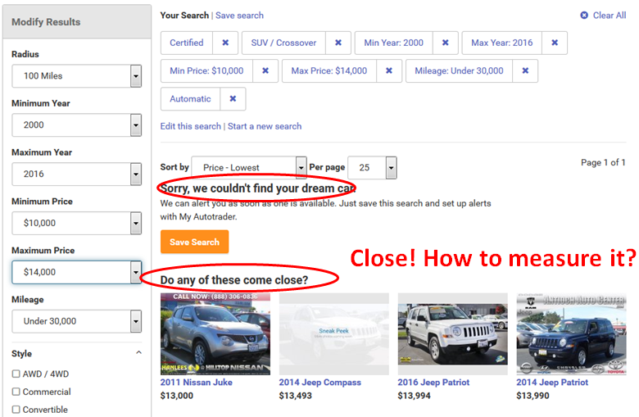
Conflicting requirements –
No such product
Do any of these come close?

Slide 4
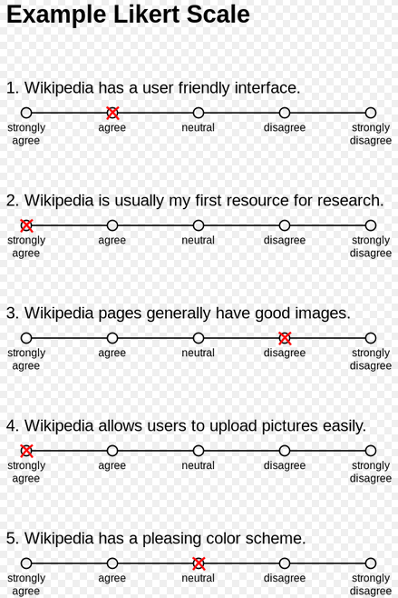

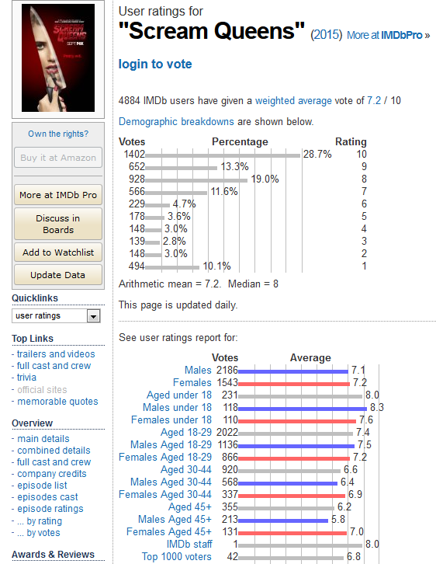


Ordering – human, intuitive, …scaled
… Self explainable - Information technology - more and more about the people and for the people
Ordering – in the language, Likert’s scale https://en.wikipedia.org/wiki/Likert_scale , …

Slide 5
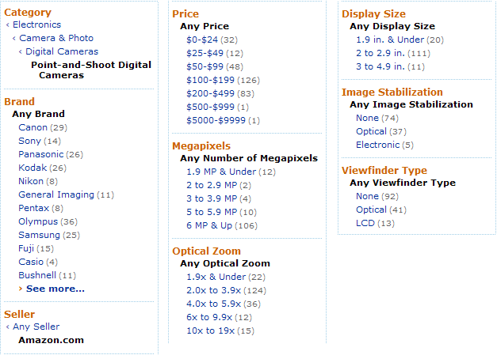

User preference – scaled + ideal values
In competitions it is clear who is better = winner
On e-shop it is not clear – users differ
Producers know this - Marketing Segmentation
„Faceted browsing“ – specifying „ideal values“
Too many items, conflicting requirements

Slide 6
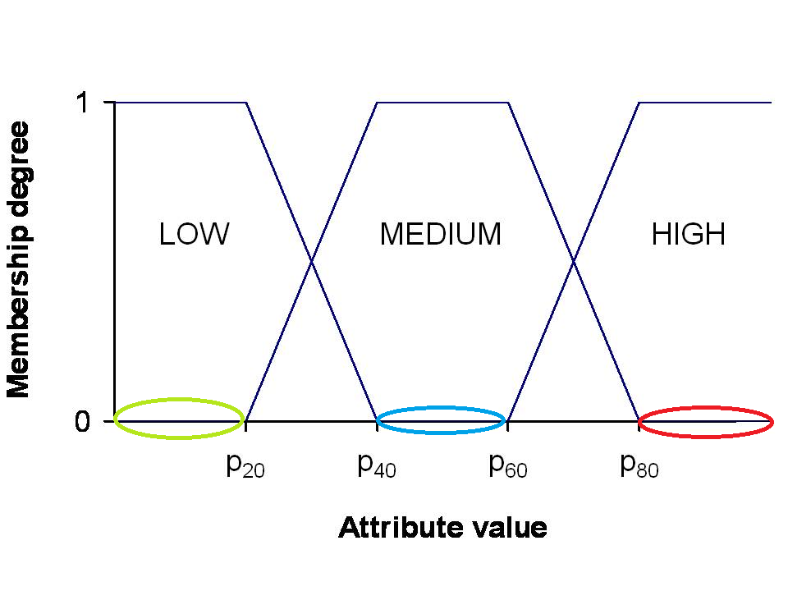
Preferential sets
Preferential sets are variants of fuzzy sets
  Fuzzy sets intended to model linguistic vagueness
  Preferential sets model human’s linear preferences
Price - fully cheap, reasonable, expensive
Linearly ordered domain low, medium, high
Linguistic input is very rare – we usually have
  Preference scale, e.g. [0, 1]

Slide 7
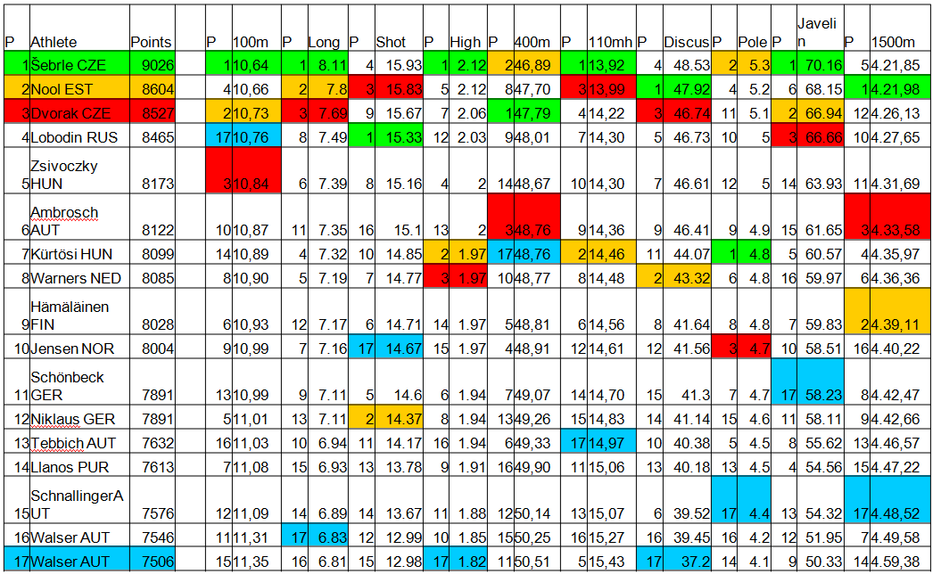
Decathlon data – scale-points, multicriterial

Slide 8
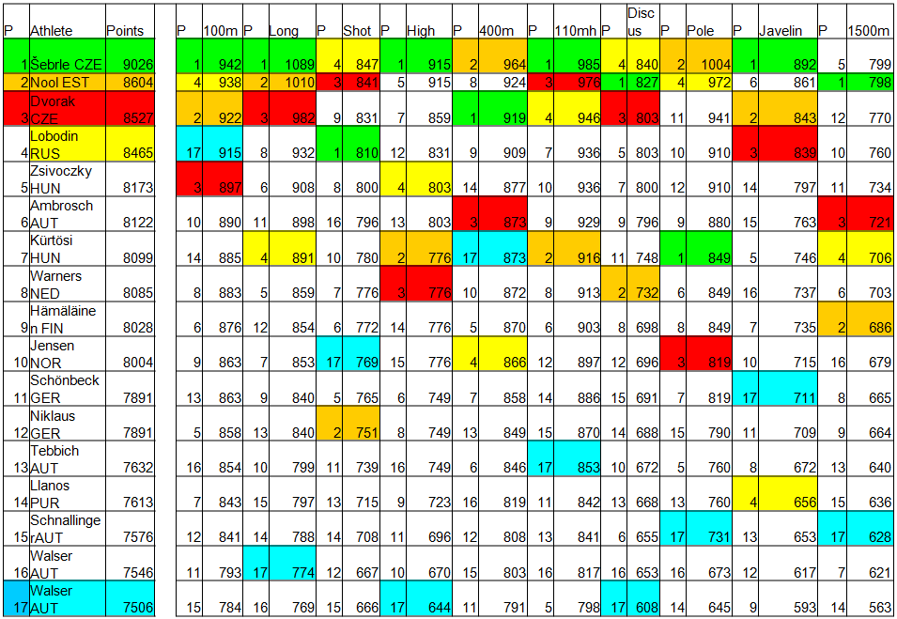
Decathlon points-commeasurable

Slide 9
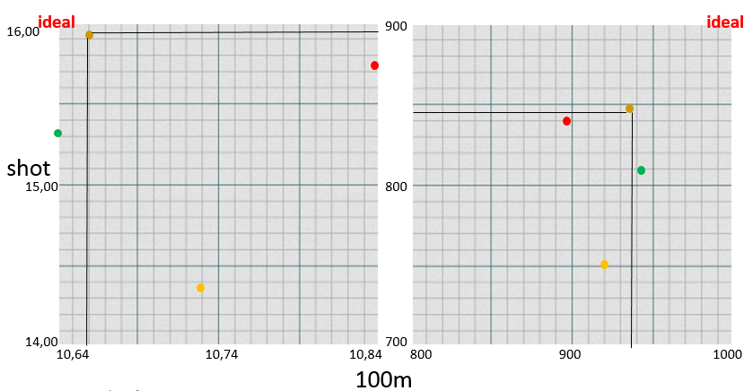
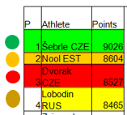
Better is rephrased by dominance
Intuitively better (dominating) means better in all disciplines = Pareto ordering – it is a partial ordering! We need the winner!
Lobodin dominates both Nool and Dvorak . and are incomparable (restricted to 100m x shot data and points)

Slide 10
Better is rephrased by dominance
Intuitively better (dominating) means better in all disciplines = Pareto ordering – it is a partial ordering! We need the winner!
Lobodin dominates both Nool and Dvorak . and are incomparable (restricted to 100m x shot data and points)
data
cube
Preference
(Pareto) cube

Slide 11
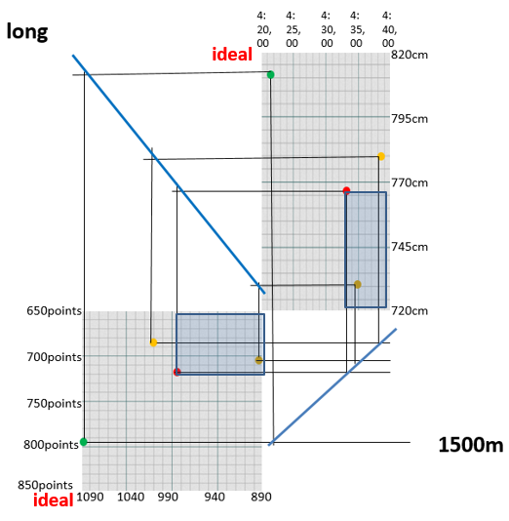
Sum of points makes Decathlon linear
Data cube (upper right) – point function transforms achievements to preference cube (lower left)
dominates
and are incomparable
Sum (aggregation) of points
in these two events
= 1703 points
= 1696 points
PC contour line connects
points with same result
in Pareto cube
Contour line can be
propagated to data cube

Slide 12
Sum of points makes Decathlon linear
Data cube (upper right) – point function transforms achievements to preference cube (lower left)
dominates
and are incomparable
Sum (aggregation) of points
in these two events
= 1703 points
= 1696 points
PC contour line connects
points with same result
in Pareto cube
Contour line can be
propagated to data cube
data
cube
Preference
(Pareto) cube

Slide 13
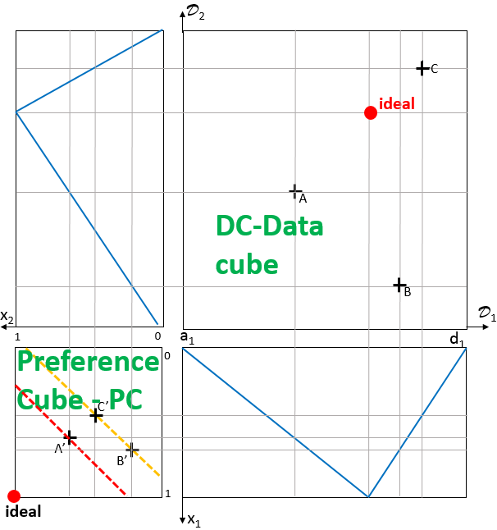
Decathlon like preference model for information ordering in web e-shops
DC-Athletes → items , Ordering made linear by sum → aggregation
Preference scale linear point system → [0,1] preference degree
Single authority decides winner → each user separately has/can have own preferences
PC-Multicriterial Pareto partial ordering of preference degree vectors
Decathlon like preference model – all parts linear – linear monotone preference model - LMPM
data
cube
Preference
cube
13

Slide 14
Linear Monotone Preference Model-LMPM
Decathlon – “single user” IAAF rules order athletes
  Disciplines A₁,…, A₁₀; domains D₁,…, D₁₀; ideal (field / track)
  A_{i} point function f_{i} : D_{i} → N makes results commeasurable
  Winner - overall IAAF achievement is obtained via sum Σ{f_{i} (athleteID . A_{i}): i = 1, …, 10}
Retail, e-shop – set of users U, LMPM^{u} orders items
  Attributes A₁,…, A_{m}; domains D₁,…, D_{m}; ideal points can be for each user different
  Degree of preference for A_{i} and user u∈U f_{i}^{u}: D_{i} → [0, 1] – hardly made commeasurable in response time
  Winner, top-k, overall degree of preference - aggregation r^{f,t}(objectID) = t^{u}{f_{i}^{u} (objectID . A_{i}): i = 1, …, m}
  Here t^{u}: [0, 1]^{m} → [0, 1], t^{u}(0,…,0) = 0, t^{u}(1,…,1) = 1, t^{u} monotone(linear) - preserves Pareto ordering,

Slide 15
D₂
Let us build LMPM step by step
Data model: attributes A₁, A₂; domains D₁, D₂; only 2-dimensional – makes paper drawing easier
triangular degree of preference of A_{j} , a value from D_{j} (local preference) is given by an ideal point i_{j} and function f_{j}
f_{j} (x_{j}) = 0 , x_{j} = min D_{j}
f_{j} (x) = (x- x_{j})/(i_{j} - x_{j}) if x_{j} ≤ x ≤ i_{j}
f_{j} (i_{j}) = 1
f_{j} (x) = (y_{j} -x)/(y_{j} - i_{j}) if i_{j} ≤ x ≤ y_{j}
f_{j} (y_{j}) = 0 , y_{j} = max D_{i},
C
E
D
i₂
ideal
B
f₂
x₂
D₁
1
0
i₁
0
f₁
1
x₁

Slide 16
D₂
Similarly
trapezoidal degree of preference of A_{j} , a value from D_{j} (local preference) is given by an ideal interval [i_{j}^{l} , i_{j}^{r} ] and analogically defined functions f_{j}
C
E
i₂^{r}
i₂^{r}
D
ideal
B
f₂
x₂
D₁
1
0
a₁
i₁^{l} i₁^{r}
d₁
0
f₁
1
ideal
x₁

Slide 17
D₂
degree of preference of A_{j} , a value from D_{j} (local preference) can have different shapes depending on position of ideal points / intervals
C
E
f₂
D
i₂
B
x₂
ideal
D₁
1
0
i₁
0
f₁
1
x₁

Slide 18
D₂
degree of preference of A_{j} , a value from D_{j} (local preference) can have different shapes depending on position of ideal points / intervals
(and all possible combinations)
C
E
D
B
f₂
x₂
D₁
1
0
0
f₁
1
x₁

Slide 19
D₂
Let us describe steps leading to calculation of preference degree of item B (for user u), we first describe mapping DC-data cube to PC-preference cube
Assume degree of preference f_{i}^{u}: D_{i} → [0, 1] (for an user u∈U),
Object with objectID = B has attribute values B.A₁ = b₁ and B.A₂ = b₂, sometimes we write B=(b₁, b₂).
Attribute preference degrees f_{j}^{u}(B.A_{j}) = b_{j}^{u} and corresponding point in preference cube is B^{u} = (b₁^{u}, b₂^{u})
other points analogically
C
E
D
b₂
B
f₂^{u}
x₂
D₁
1
b₂^{u}
0
b₁
0
f₁^{u}
B^{u}
b₁^{u}
1
x₁

Slide 20
D₂
Note, that point B^{u} has 4 coimages B, B’, B’’, B’’’
Degree of preference for user u∈U are given by f₁^{u} and f₂^{u} .
Object with objectID = B has attribute values B.A₁ = b₁ and B.A₂ = b₂, sometimes we write B=(b₁, b₂).
For B, D, E attribute preference degrees the corresponding points in preference cube are B^{u}, D^{u}, E^{u},
Note that B^{u} and D^{u} are incomparable in Pareto order and E^{u} is dominated by both B^{u} and D^{u},
C
E
B’’
B’’’
D
b₂
B’
B
f₂^{u}
x₂
D₁
1
b₁^{u}
0
b₁
0
E^{u}
D^{u}
f₁^{u}
B^{u}
b₁^{u}
1
x₁

Slide 21
Pareto ordering of pref. cube (x) <_{Pareto} (y) iff (for each i) x_{i} ≤ y_{i} & (∃i) x_{i} < y_{i}
Assume A, B, C, D, E, F, G are images of respective items under some attribute preference
We say that item B dominates item G in <_{Pareto} (G is dominated by B), in fact B dominates whole red area
F is dominated by whole green area
<_{Pareto} is not linear, e.g. B and C are not comparable
D₂
x₂
0
D₁
1
0
F
E
G
D
C
B
A
Ideal, top
1
x₁

Slide 22
Pareto ordering of pref. cube (x) <_{Pareto} (y) iff (for each i) x_{i} ≤ y_{i} & (∃i) x_{i} < y_{i}
Assume A, B, C, D, E, F, G are images of respective items under some attribute preference
Repeat, that item B dominates whole red area and is dominated by whole green area
<_{Pareto} is not linear, e.g. B and C are not comparable
All item images in white areas are incomparable with B
D₂
x₂
0
D₁
1
0
F
E
G
D
C
B
A
Ideal, top
1
x₁

Slide 23
Visualization of Pareto partial order
1
x₂
0
0
F
G
F
E
G
A
D
E
D
C
B
C
B
A
Ideal, top
1
x₁
Ideal, top

Slide 24
Difference between preference degree-matters?
1
x₂
0
0
F
G
F
E
G
A
D
E
D
C
B
C
B
A
Ideal, top
1
x₁
Ideal, top

Slide 25

Difference between preference degree-matters?
G
F
A
F
E
G
E
C
B
D
D
C
B
A
Ideal, top
Ideal, top

Slide 26
Several preference model-how to aggregate results?
G
F
G
F
A
A
E
C
B
E
D
C
B
D
Ideal, top
Ideal, top

Slide 27
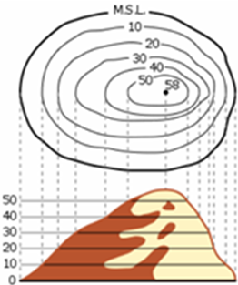
To get global preference degree of items we need aggregation functions. It is a function [0,1]²→[0,1]
t(x₁, x₂) = w₁*x₁ + w₂*x₂ , where w₁, w₂ ≥ 0 are attribute weights with w₁+ w₂ =1
Graph of t is a 3D object. Intuition behind display of aggregation function are contour lines (e.g. cl_{1/3} , cl_{2/3}) for users u, resp. u
Note, that on the preference cube diagonal corresponding contour line of preference degree y∈[0,1] intersect the diagonal at point (y, y) , because
w₁*x + w₂*x = y gives
x*(w₁ + w₂)= y, i.e. x = y
D₂
x₂
½
0
D₁
1
0
cl_{1/3}
¹/₃
½
½
²/₃
cl_{2/3}
Ideal, top
1
x₁

Slide 28
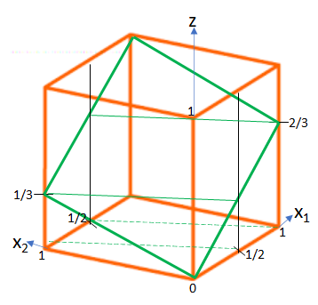
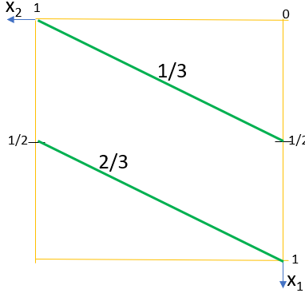
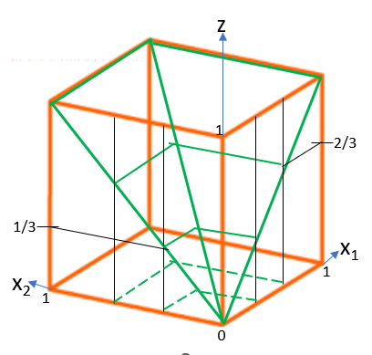
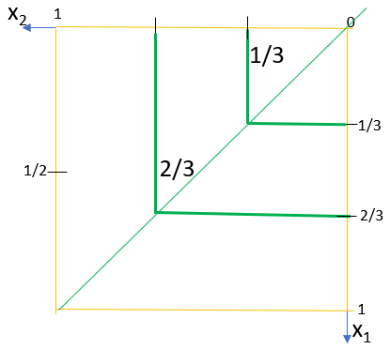

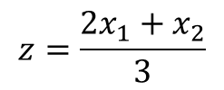
Representing preference cube surfaces in 2D by contour lines
$$z=\frac{2x_{1}+x_{2}}{3}$$
$$z=\max_{ }{(x_{1},x_{2})}$$

Slide 29
To get global preference degree of items we need to aggregate them. First is weighted average
t(x₁, x₂) = w₁*x₁ + w₂*x₂ , where w₁, w₂ ≥ 0 are attribute weights with w₁+ w₂ =1
Graph of t is a 3D object. Intuition behind display of aggregation function are contour lines (e.g. cl_{1/3} , cl_{2/3}) for users u, resp. u
Only NW to SE
Ordering is compliant with Pareto order
On the preference cube diagonal corresponding contour line of preference degree y∈[0,1] intersect the diagonal at point (y, y)
(2x₁+x₂)/3 B is better than A
(x₁+2x₂)/3 A is better than B
Only x₂ matters
1
x₂
½
0
0
cl_{1/3}
A
Only x₁ matters
¹/₃
½
B
½
²/₃
cl_{2/3}
Ideal, top
1
x₁

Slide 30
Assume, we have users u, and u. Red are item image using u‘s preference, green that of u.
Notice e.g. t^{u}(A) = 0.54
B and C are not <_{Pareto} comparable, aggregation makes C more preferable for user u than B (w₁ is sufficiently bigger than w₂)
E is best for u
Can C be better than E?
Can B be better than C?
If two PC cube points are Pareto incomparable, then any ordering of these is possible – prove or disprove!
D₂
x₂
0
D₁
1
0
F
E
G
0.54
D
cl_{0.54}
C = C
cl_{0.76}
B
A
Ideal, top
1
x₁

Slide 31
D₂
How does it work together?
Vector of attribute preferences f=[f₁, …, f_{m}] and aggregation t define a user u_{f,t} = u
Overall preference of user u_{f,t} is given by r^{f,t}:O→[0,1] , for object oid given by r^{f,t}(oid) =
t ([f_{i} (oid.A_{i}) : i = 1, …, m])
Depict contour line (i.e. items of same preference degree) in DC-data cube is a little bit trickier (depending on position of ideal points and/or intervals)
C
E
A
D
b₂
B
f₂^{u}
x₂
D₁
1
b₂^{u}
0
b₁
C^{u}
0
E^{u}
D^{u}
r^{f,t}(E)
f₁^{u}
B^{u}
b₁^{u}
1
x₁

Slide 32
D₂
Preference model of user u_{f,t} on data cube
Function R^{f,t}: ΠD_{i} →[0,1] R^{f,t}(a₁, …, a_{m}) = t ([f_{i} (a_{i}) : i = 1, …, m])
Ordering on data cube(a₁, …, a_{m}) ≥^{f,t} (b₁, …, b_{m}) iff R^{f,t}(a₁, …, a_{m}) ≥ R^{f,t}(b₁, …, b_{m}) Odering can be vizualized as contour lines on ΠD_{i}
For better understanding are different contour lines (of same t) in colors
User u_{f,t} , preference of user u_{f,t} , R^{f,t}: ΠD_{i} →[0,1]
R^{f,t}(a₁, …, a_{m}) = t ([f_{i} (a_{i}) : i = 1, …, m])
(a) ≥^{f,t} (b) iff R^{f,t}(a) ≥R^{f,t}(b)
C
E
D
ideal
b₂
B
f₂^{u}
x₂
D₁
1
b₁^{u}
0
b₁
C^{u}
0
E^{u}
D^{u}
f₁^{u}
B^{u}
b₁^{u}
1
ideal
x₁

Slide 33
D₂
Let us insert into previous slide the preference cube diagonal and depict it in DC. Does it preserve preference degree?
We have now mappings from DC→PC and from PC→DC – what are properties?
DC→PC is injective, PC→DC need not
Both mappings preserve line segments ( maybe in quadrants , see quadrant in yellow)
Mapping of areas, e.g. quadrilaterals can be more complicated
C
E
D
ideal
b₂
B
f₂^{u}
x₂
D₁
1
b₁^{u}
0
b₁
C^{u}
0
E^{u}
D^{u}
f₁^{u}
B^{u}
b₁^{u}
1
ideal
x₁

Slide 34
Dynamical model – three sessions – moving ideal points (aggregations remain same)
Simulation of development in time
Starting vector of attribute preferences f⁰ and aggregation t⁰ define an user u⁰_{f,t} = u⁰ in time 0. Depict contour line in DC-data cube.
Assume user clicks on third item. In time 1, t⁰ = t¹ , ideal is clicked item (triangular max-min shape remains).
In time 1 user clicks on second item – this becomes ideal in time 2.
Describe order in time 2. Use copy of DC, PC in pptx.
Time 0
D₂
C
E
A
D
b₂
B
f₂^{u}
x₂
D₁
1
b₂^{u}
0
b₁
C^{u}
0
E^{u}
D^{u}
f₁^{u}
B^{u}
b₁^{u}
1
x₁
A^{u}

Slide 35
Dynamical model – three sessions – moving ideal points (aggregations remain same)
Simulation of development in time
Starting vector of attribute preferences f⁰ and aggregation t⁰ define an user u⁰_{f,t} = u⁰ in time 0. Depict contour line in DC-data cube.
Assume user clicks on third item. In time 1, t⁰ = t¹ , ideal is clicked item (triangular max-min shape remains).
In time 1 user clicks on second item – this becomes ideal in time 2.
Describe order in time 2. Use copy of DC, PC in pptx.
Time 1
D₂
C
E
A
D
b₂
B
f₂^{u}
x₂
D₁
1
b₂^{u}
0
b₁
0
f₁^{u}
b₁^{u}
1
x₁
C^{u}
E^{u}
D^{u}
B^{u}
A^{u}

Slide 36
Dynamical model – three sessions – moving ideal points (aggregations remain same)
Simulation of development in time
Starting vector of attribute preferences f⁰ and aggregation t⁰ define an user u⁰_{f,t} = u⁰ in time 0. Depict contour line in DC-data cube.
Assume user clicks on third item. In time 1, t⁰ = t¹ , ideal is clicked item (triangular max-min shape remains).
In time 1 user clicks on second item – this becomes ideal in time 2.
Describe order in time 2. Use copy of DC, PC in pptx.
Time 2
D₂
C
E
A
D
b₂
B
f₂^{u}
x₂
D₁
1
b₂^{u}
0
b₁
0
f₁^{u}
b₁^{u}
1
x₁
C^{u}
E^{u}
D^{u}
B^{u}
A^{u}

Slide 37
Dynamical model – three sessions – moving ideal points and moving aggregation
Simulation of development in time
Starting vector of attribute preferences f⁰ and aggregation t⁰ define an user u⁰_{f,t} = u⁰ in time 0. Depict contour line in DC-data cube.
Assume user clicks on third item. In time 1, t⁰ = t¹ , ideal is clicked item (triangular max-min shape remains).
In time 1 user clicks on second item – this becomes ideal in time 2.
Describe order in time 2. Use copy of DC, PC in pptx.
D₂
C
E
A
D
b₂
B
f₂^{u}
x₂
D₁
1
b₂^{u}
0
b₁
C^{u}
0
E^{u}
D^{u}
f₁^{u}
B^{u}
b₁^{u}
1
x₁

Slide 38
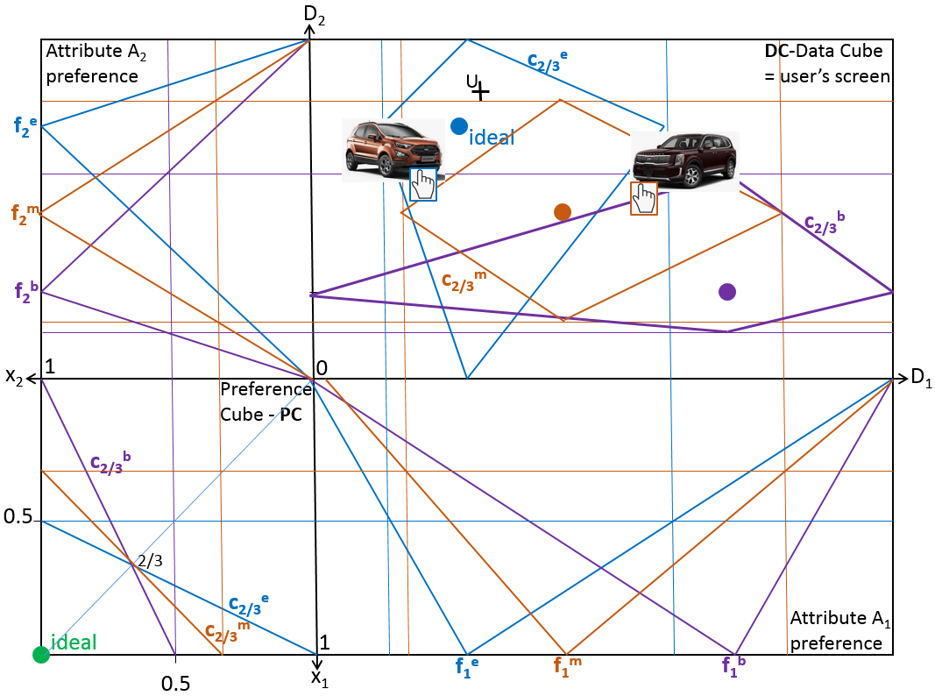

Slide 39
D₂
Two users u and u
Preference scale L = [0, 1]
C
ideal
E
Data
cube
A
D
ideal
B
x₂
D₁
1
0
a₁
d₁
0
Preference
cube
1
ideal
x₁

Slide 40
D₂
Data model: attributes A₁, A₂; domains D₁, D₂;
Ideal points can be for each user different, we consider users u and u.
Degree of preference f_{i}^{u}: D_{i} → [0, 1] (for an user u∈U), so we have f_{i}^{u} and f_{i}^{u} .
Object with objectID = B has attribute values B.A₁ = b₁ and B.A₂ = b₂, sometimes we write B=(b₁, b₂).
Attribute preference degrees f_{i}^{u}(B.A_{i}) = b_{i}^{u} and corresponsing point in preference cube is B^{u} = (b₁^{u}, b₂^{u})
Find both images of C, …
f₂^{u}
C
E
A
D
b₂
B
f₂^{u}
x₂
D₁
1
b₂^{u}
b₂^{u}
0
b₁
0
B^{u}
b₁^{u}
f₁^{u}
f₁^{u}
B^{u}
b₁^{u}
1
x₁

Slide 41
D₂
Data model: attributes A₁, A₂; domains D₁, D₂;
Ideal points can be for each user different, we consider users u and u. Both have same aggregation average AVG
As before we have f_{i}^{u}: D_{i} → [0, 1] (for an user u∈U), so we have f_{i}^{u} and f_{i}^{u} .
Object with objectID = B has attribute values B.A₁ = b₁ and B.A₂ = b₂, sometimes we write B=(b₁, b₂) has two images in preference cube B^{u} and B^{u} .
Let us depict ½ contour line in DC, interpret result, discuss intuitiveness
f₂^{u}
C
E
A
D
b₂
B
f₂^{u}
x₂
D₁
1
b₂^{u}
b₂^{u}
0
b₁
0
B^{u}
b₁^{u}
f₁^{u}
f₁^{u}
B^{u}
b₁^{u}
1
x₁

Slide 42
D₂
Data model: attributes A₁, A₂; domains D₁, D₂;
Ideal points can be for each user different, we consider users u and u. Both have same aggregation average AVG
As before we have f_{i}^{u}: D_{i} → [0, 1] (for an user u∈U), so we have f_{i}^{u} and f_{i}^{u} .
Object with objectID = B has attribute values B.A₁ = b₁ and B.A₂ = b₂, sometimes we write B=(b₁, b₂) has two images in preference cube B^{u} and B^{u} .
Let us depict ¾ contour line in DC, interpret result, discuss intuitiveness
f₂^{u}
C
E
A
D
b₂
B
f₂^{u}
x₂
D₁
1
b₂^{u}
b₂^{u}
0
b₁
0
B^{u}
b₁^{u}
f₁^{u}
f₁^{u}
B^{u}
b₁^{u}
1
x₁

Slide 43
D₂
Previous two slides in one.
Observe ½ and ¾ contour lines in DC.
It seems that there is some parallelism.
Formulate statement, prove or disprove.
Interpret result, discuss intuitiveness
f₂^{u}
C
C
E
E
A
D
D
B
b₂
B
f₂^{u}
x₂
D₁
1
b₂^{u}
b₂^{u}
0
b₁
0
B^{u}
b₁^{u}
f₁^{u}
f₁^{u}
B^{u}
b₁^{u}
1
x₁

Slide 44
D₂
Discuss all possible combinations for two users:
Different attribute preferences same aggregation
Same attribute preferences and different aggregations
All is different, both attribute preferences and aggregations
?All possible shapes of f_{j}^{u}
Interpret result, discuss intuitiveness
Some comments on market segmentation
f₂^{u}
C
E
A
D
b₂
B
f₂^{u}
x₂
D₁
1
b₂^{u}
b₂^{u}
0
b₁
0
B^{u}
b₁^{u}
f₁^{u}
f₁^{u}
B^{u}
b₁^{u}
1
x₁

Slide 45
D₂
Similarly
trapezoidal degree of preference of A_{j} , a value from D_{j} (local preference) is given by an ideal interval [i_{j}^{l} , i_{j}^{r} ] and analogically defined functions f_{j}
Instead of minimum/max of domains D_{j} we can/have to consider the possibility that trapezoid is based on some interval [a_{j}, d_{j}]
Depicting contour lines continues on blackboard
d₂
C
E
i₂^{r}
i₂^{r}
D
ideal
B
f₂
a₂
x₂
D₁
1
0
a₁
i₁^{l} i₁^{r}
d₁
0
f₁
1
ideal
x₁

Slide 46
D₂
Contour lines for general trapezoidal case
Please, notice construction
Image ungrouped for further constructions
0
t(1,0)
0
t(0,1)
1
t(0,1)
f₂
0
t(1,0)
0
x₂
D₁
1
0
0
1
f₁
x₁

Slide 47
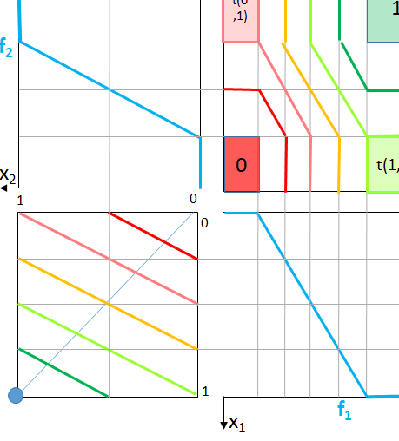
Four corners versus one corner - Makes your solutions faster
Illustration for “one quarter” construction
Saves time
Only illustration, must be constructed

Slide 48
D₂
Contour lines for general trapezoidal case
Consider different combination of “hill” “valley” shaped attribute preferences
Illustration for “one quarter” construction …
f₂
x₂
D₁
1
0
0
1
f₁
x₁

Slide 49
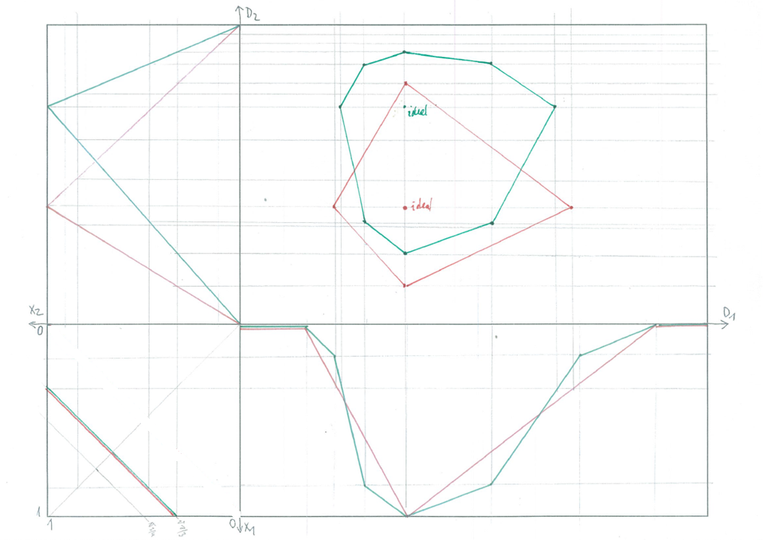
Partially linear approximations of preferences
f₂^{u}
We proceed similarly
as before from PC to
DC, just – we must
be considering each
linear part of f₁^{u}
separately
f₁^{u}

Slide 50
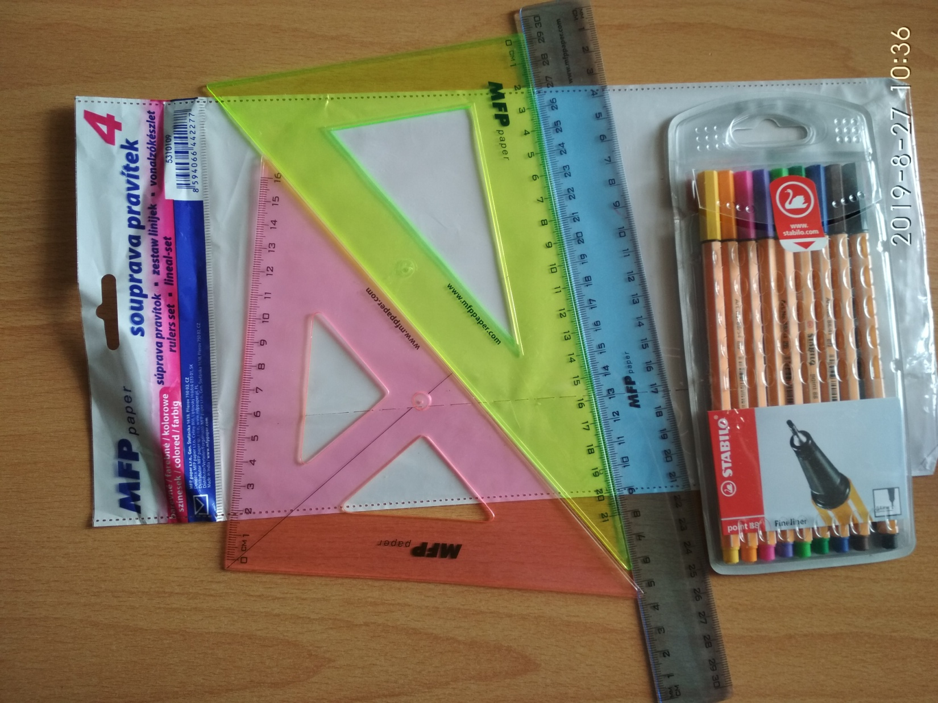
No coding, simulation using drawing tools

Slide 51

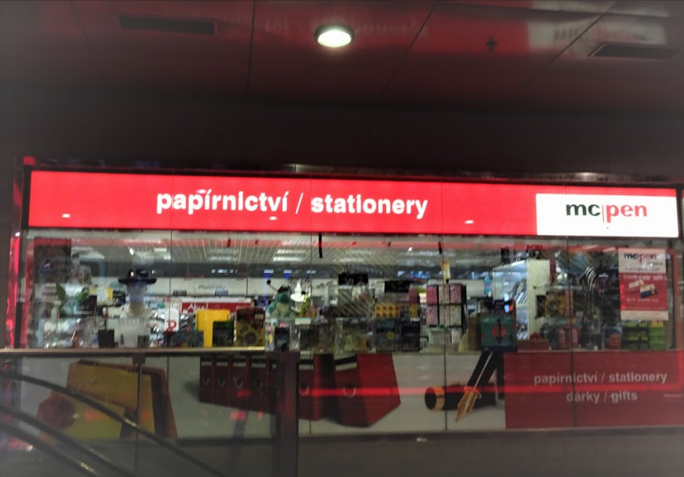
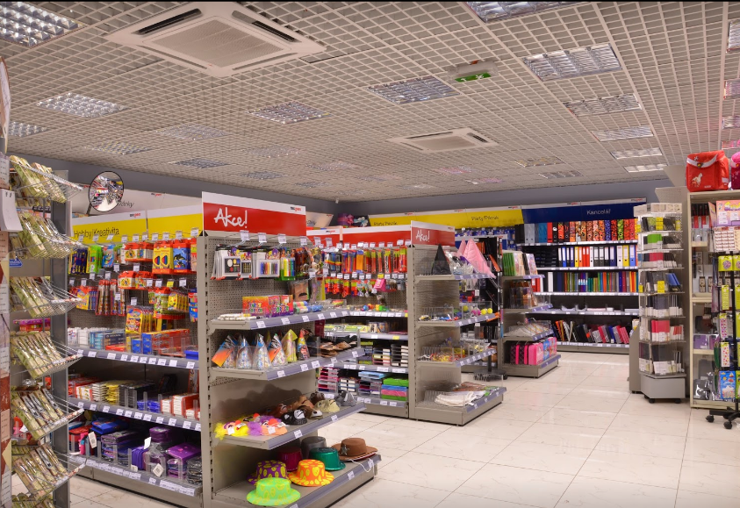
Main Railway station, southern wing

Slide 52
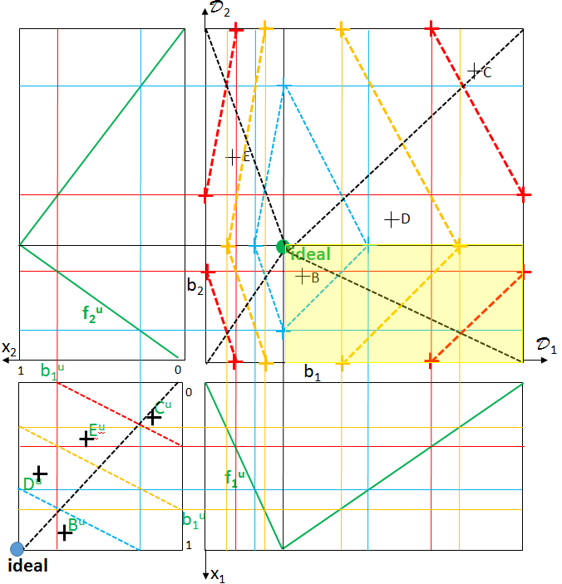
Our solutions will look like …

Slide 53
Possible extensions: assume we know the convex hull of data (as depicted in DC), find the best object, calculate it’s preference degree x, find objects with preference degree 0.9*x
Discuss all possible solution strategies, which is/can be most intuitive for an untrained user?
Consider variants of this task, e.g. with trapezoidal attribute preferences; with ideal point in max/min of domains,
Consider f_{i}^{u} and t variable, formulate tasks …
D₂
f₂^{u}
x₂
D₁
1
0
0
f₁^{u}
b₁^{u}
1
x₁
Same? in SQL, domain calculi, logic

Slide 54
Possible extensions: assume we know the convex hull of data (as depicted in DC), find the best object, calculate it’s preference degree x, find objects with preference degree 0.9*x
Discuss all possible solution strategies, which is/can be most intuitive for an untrained user?
Consider variants of this task, e.g. with trapezoidal attribute preferences; with ideal point in max/min of domains,
Consider f_{i}^{u} and t variable, formulate tasks …
D₂
f₂^{u}
x₂
D₁
1
0
0
f₁^{u}
b₁^{u}
1
x₁
Same? in SQL, domain calculi, logic

Slide 55
Possible extensions: assume we know the convex hull of data each product group separately (as depicted in DC), find the best object, calculate it’s preference degree x, find objects with preference degree 0.9*x
Discuss all possible solution strategies, which is/can be most intuitive for an untrained user?
Consider variants of this task, e.g. with trapezoidal attribute preferences; with ideal point in max/min of domains,
Consider f_{i}^{u} and t variable, formulate tasks …
D₂
f₂^{u}
x₂
D₁
1
0
0
f₁^{u}
b₁^{u}
1
x₁
Same? in SQL, domain calculi, logic

Slide 56
D₂
Possible extensions:
Vector of attribute preferences f=[f₁, …, f_{m}] and aggregation t define an user u_{f,t} = u
Overall preference of user u_{f,t} is given by r^{f,t}:O→[0,1] , for object oid given by r^{f,t}(oid) =
t ([f_{i} (oid.A_{i}) : i = 1, …, m])
Depict contour line (i.e. items of same preference degree) in DC-data cube is a little bit trickier (depending on position of ideal points and/or intervals)
C
E
A
D
b₂
B
f₂^{u}
x₂
D₁
1
b₂^{u}
0
b₁
C^{u}
0
E^{u}
D^{u}
f₁^{u}
B^{u}
b₁^{u}
1
x₁

Slide 57
D₂
Possible extensions:
Vector of attribute preferences f=[f₁, …, f_{m}] and aggregation t define an user u_{f,t} = u
Overall preference of user u_{f,t} is given by r^{f,t}:O→[0,1] , for object oid given by r^{f,t}(oid) =
t ([f_{i} (oid.A_{i}) : i = 1, …, m])
Depict contour line (i.e. items of same preference degree) in DC-data cube is a little bit trickier (depending on position of ideal points and/or intervals)
C
E
A
D
b₂
B
f₂^{u}
x₂
D₁
1
b₂^{u}
0
b₁
C^{u}
0
E^{u}
D^{u}
f₁^{u}
B^{u}
b₁^{u}
1
x₁

Slide 58
D₂
Possible extensions:
Vector of attribute preferences f=[f₁, …, f_{m}] and aggregation t define an user u_{f,t} = u
Overall preference of user u_{f,t} is given by r^{f,t}:O→[0,1] , for object oid given by r^{f,t}(oid) =
t ([f_{i} (oid.A_{i}) : i = 1, …, m])
Depict contour line (i.e. items of same preference degree) in DC-data cube is a little bit trickier (depending on position of ideal points and/or intervals)
C
E
A
D
b₂
B
f₂^{u}
x₂
D₁
1
b₂^{u}
0
b₁
C^{u}
0
E^{u}
D^{u}
f₁^{u}
B^{u}
b₁^{u}
1
x₁

Slide 59
D₂
Possible extensions:
Two users u and u
Preference scale L = [0, 1]
C
E
A
D
B
x₂
D₁
1
0
a₁
d₁
0
1
ideal
x₁

Slide 60
D₂
Possible extensions:
assume a cluster of item segments
Assume a cluster of possible ideal points of users
Assume a cluster of their aggregations
Discuss the situation
f₂^{u}
x₂
D₁
1
0
0
f₁^{u}
b₁^{u}
1
x₁
Same? in SQL, domain calculi, logic

Slide 61
Questions?
Comments?

