Slide 1


NSWI166 – Introduction to Recommender Systems and User Preferences
Ladislav Peska & Peter Vojtas
Ladislav.peska@matfyz.cuni.cz, S208
https://www.ksi.mff.cuni.cz/~peska/vyuka/NSWI166
Lecture: Wed 9:00 S5 (:-/)
Labs: Wed 10:40 S6 (every two weeks)
2/1, ZK+Z, 4 credits
https://www.ksi.mff.cuni.cz/

Slide 2
Organization
Active reading #1 results
  Amazon Item-Item KNN: 20 submissions
  EASE (shallow autoencoder): 12 submissions
  Time-aware MF: 1 submission
Overall, good job
  Do not forget to add your own perspective
  Do not forget to add weaknesses
  Structure the output

Slide 3
Organization
Amazon Item-Item KNN
  Old (but recently won „Test of the Time“ award IEEE Internet Computing, 2017)
  Lack of details in algorithm (common for many industry papers, unfortunately)
  No handling of temporality (true; persistent issue; often only short-span of data for training)
  No evaluation details (common for many industry papers, unfortunately)
  Opportunity for hybrid similarity using CB data
  In industry, this is often THE algorithm to start with
EASE (Embarassingly Shallow Autoencoders)
  Surprising Simplicity vs. Performance tradeoff (general trend of not incorporating NLP stuff blindly)
    Sparsity vs. Quantity tradeoff (effect of matrix inversion)
    Actually, the volume of parameters is rather high (despite the structure is simple)
    Minimal effect of L2 hyperparam (diag=0 is the main thing that prevents overfitting)
  Evaluation issues (pre-processing time, fit into memory)
    Problems arise with the number of items (good for NetFlix, bad for large e-commerce)
  For me personally, this is THE algorithm to start with if you do not have too many items

Slide 4
Organization
Temporal MF
  Importance of feature engineering
  Periodicity bias (not a suitable dataset for this feature)
Funny notes:
  Too good to be true (true☺)
  If there would be a weakness, the paper would not be published ☺

Slide 5
Active reading
#2: Hybrid RS (choose one of the following)
Knowledge Graph Convolutional Networks for Recommender Systems [Using knowledge graphs]
  https://dl.acm.org/doi/abs/10.1145/3308558.3313417
VBPR: Visual Bayesian Personalized Ranking from Implicit Feedback [Incorporate raw content]
  https://cseweb.ucsd.edu/~jmcauley/pdfs/aaai16.pdf
Ensemble Recommendations via Thompson Sampling: … [Intelligent switching hybrid]
  https://dl.acm.org/doi/abs/10.1145/3172944.3172967
Deadline: 31.3.2024
At most 1 page of text CZ/SK/EN (normal font and margins - be brief but thorough)
Submit through Study Group Roaster in SIS
Q1. Your name and Paper’s title
Q2. What is this paper about, and what contributions does it make? Q3. What main new insights you received from the paper?
Q4. Does the paper has any notable weaknesses?

Slide 6

Questions?

Slide 7

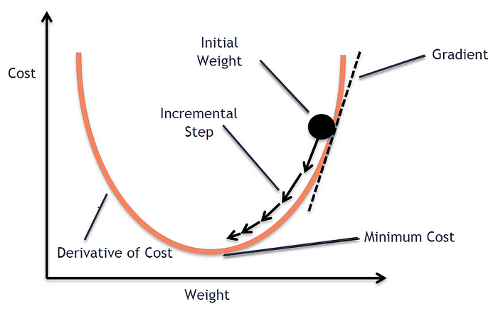
Recap
What matrix factorization aims to do?
How stochastic gradient descend works?

Slide 8
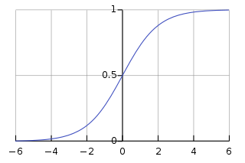
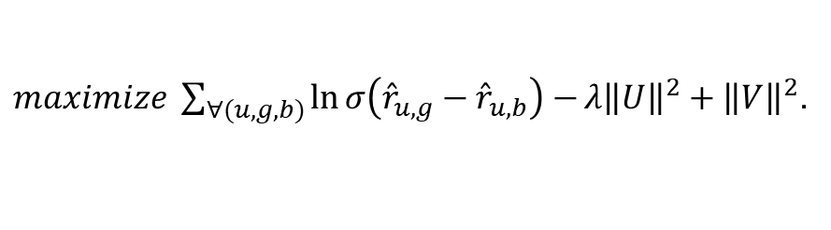
Recap
How BPR differs from „standard“ MF (FunkSVD)?
Ranking correctness
$maximize \sum_{∀(u,g,b)}{\ln{σ\left({\hat{r}}_{u,g}−{\hat{r}}_{u,b}\right)}−}{λ\left\|U\right\|}^{2}+{\left\|V\right\|}^{2}$.
Regularization
Train set
Why do we need user/item baseline predictors?

Slide 9
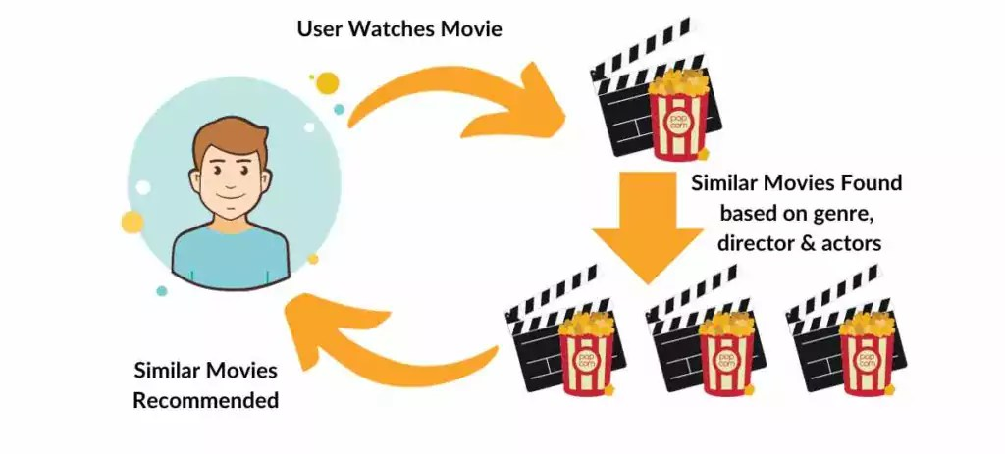
Content-based recommendation

Slide 10



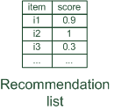

Content-based recommendation
While CF – methods do not require any information about the items,
    it might be reasonable to exploit such information; and
    recommend fantasy novels to people who liked fantasy novels in the past
What do we need:
    some information about the available items such as the genre ("content")
    some sort of user profile describing what the user likes (the preferences)
The task:
    learn user preferences
    locate/recommend items that are "similar" to the user preferences
"show me more of the same what I've liked"

Slide 11

What is the "content"?
Most CB-recommendation techniques were applied to recommending text documents.
  Like web pages or newsgroup messages for example.
  Now also multimedia content (fashion, music) or e-commerce
Content of items can also be represented as text documents.
  With textual descriptions of their basic characteristics.
  Structured: Each item is described by the same set of attributes
  Unstructured: free-text description.
Title | Genre | Author | Type | Price | Keywords
The Night of the Gun | Memoir | David Carr | Paperback | 29.90 | Press and journalism, drug addiction, personal memoirs, New York
The Lace Reader | Fiction, Mystery | Brunonia Barry | Hardcover | 49.90 | American contemporary fiction, detective, historical
Into the Fire | Romance, Suspense | Suzanne Brockmann | Hardcover | 45.90 | American fiction, murder, neo-Nazism

Slide 12
What is the "content"?
Most CB-recommendation techniques were applied to recommending text documents.
  Like web pages or newsgroup messages for example.
  Now also multimedia content (fashion, music) or e-commerce
Content of items can also be represented as text documents.
  With textual descriptions of their basic characteristics.
  Structured: Each item is described by the same set of attributes
  Unstructured: free-text description.
Described method is outdated... But worth to know
(baseline & simple yet working approach)
Title | Genre | Author | Type | Price | Keywords
The Night of the Gun | Memoir | David Carr | Paperback | 29.90 | Press and journalism, drug addiction, personal memoirs, New York
The Lace Reader | Fiction, Mystery | Brunonia Barry | Hardcover | 49.90 | American contemporary fiction, detective, historical
Into the Fire | Romance, Suspense | Suzanne Brockmann | Hardcover | 45.90 | American fiction, murder, neo-Nazism

Slide 13
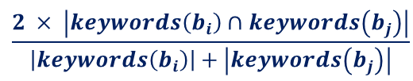
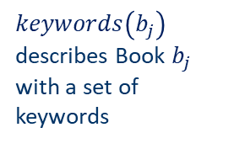
Content representation and item similarities
Item representation
Title | Genre | Author | Type | Price | Keywords
The Night of the Gun | Memoir | David Carr | Paperback | 29.90 | Press and journalism, drug addiction, personal memoirs, New York
The Lace Reader | Fiction, Mystery | Brunonia Barry | Hardcover | 49.90 | American contemporary fiction, detective, historical
Into the Fire | Romance, Suspense | Suzanne Brockmann | Hardcover | 45.90 | American fiction, murder, neo-Nazism
User profile
$keywords\left(b_{j}\right)$ describes Book $b_{j}$ with a set of keywords
Title | Genre | Author | Type | Price | Keywords
… | Fiction | Brunonia, Barry, Ken Follett | Paperback | 25.65 | Detective, murder, New York
Simple approach
  Compute the similarity of an unseen item with the user profile based on the keyword overlap
  (e.g. using the Dice coefficient)
  Or use and combine multiple metrics
$$\frac{2 × \left|keywords\left(\left.b_{i}\right)\right.∩keywords\left(b_{j}\right)\right|}{\left|keywords\left(\left.b_{i}\right)\right.\right|+\left|keywords\left(\left.b_{j}\right)\right.\right|}$$
Jaccard similarity

Slide 14

Term-Frequency - Inverse Document Frequency ($TF−IDF$)
Simple keyword representation has its problems
  in particular when automatically extracted as
    not every word has similar importance
    longer documents have a higher chance to have an overlap with the user profile
Standard measure: TF-IDF
  Encodes text documents in multi-dimensional Euclidian space
    weighted term vector
  TF: Measures, how often a term appears (density in a document)
    assuming that important terms appear more often
    normalization has to be done in order to take document length into account
  IDF: Aims to reduce the weight of terms that appear in all documents
    May not be relevant in some cases (e.g. Male vs. Female attribute on dating sites)

Slide 15
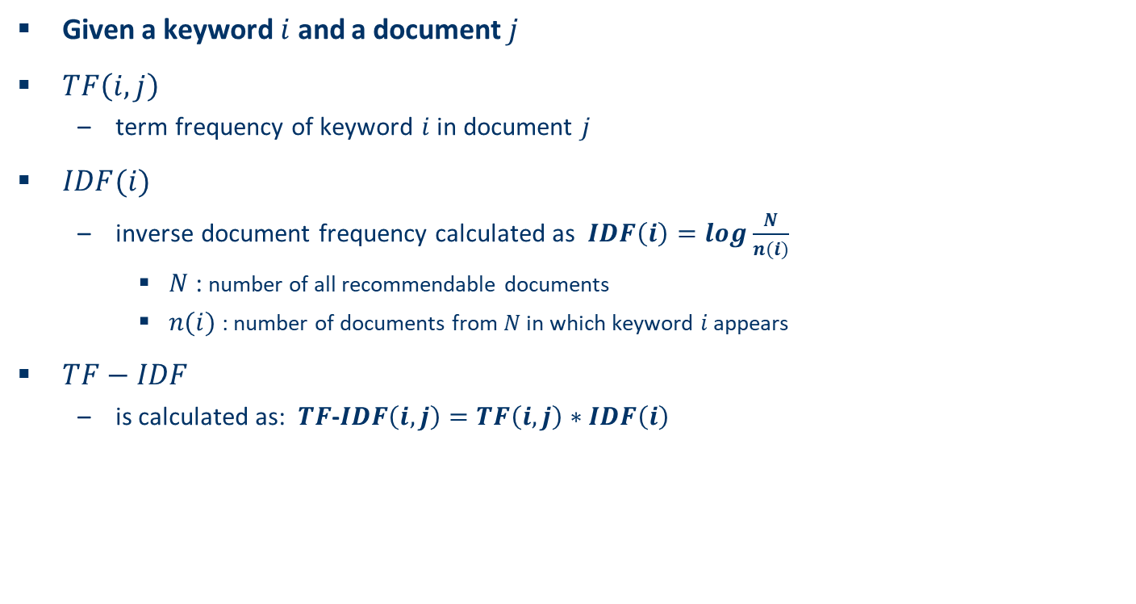
TF-IDF II
Given a keyword $i$ and a document $j$
$TF\left(i,j\right)$
  term frequency of keyword $i$ in document $j$
$IDF(i)$
  inverse document frequency calculated as $IDF\left(i\right)=log\frac{N}{n(i)}$
    $N$ : number of all recommendable documents
    $n(i)$: number of documents from $N$ in which keyword $i$ appears
$TF−IDF$
  is calculated as: $TF$-$IDF\left(i,j\right)=TF\left(i,j\right)∗IDF\left(i\right)$

Slide 16
Example TF-IDF representation
Term frequency:
  Each document is a count vector in $ℕ^{\left|v\right|}$
 | Antony and Cleopatra | Julius Caesar | The Tempest | Hamlet | Othello | Macbeth
Antony | 157 | 73 | 0 | 0 | 0 | 0
Brutus | 4 | 157 | 0 | 1 | 0 | 0
Caesar | 232 | 227 | 0 | 2 | 1 | 1
Calpurnia | 0 | 10 | 0 | 0 | 0 | 0
Cleopatra | 57 | 0 | 0 | 0 | 0 | 0
mercy | 1.51 | 0 | 3 | 5 | 5 | 1
worser | 1.37 | 0 | 1 | 1 | 1 | 0
  Vector $v$with dimension $\left|v\right|=7$
Example taken from http://informationretrieval.org

Slide 17

Example TF-IDF representation
Combined TF-IDF weights
  Each document is now represented by a real-valued vector of $TF$-$IDF$weights $∈ℝ^{\left|v\right|}$
 | Antony and Cleopatra | Julius Caesar | The Tempest | Hamlet | Othello | Macbeth
Antony | 157 | 73 | 0 | 0 | 0 | 0
Brutus | 4 | 157 | 0 | 1 | 0 | 0
Caesar | 232 | 227 | 0 | 2 | 1 | 1
Calpurnia | 0 | 10 | 0 | 0 | 0 | 0
Cleopatra | 57 | 0 | 0 | 0 | 0 | 0
mercy | 1.51 | 0 | 3 | 5 | 5 | 1
worser | 1.37 | 0 | 1 | 1 | 1 | 0
 | Antony and Cleopatra | Julius Caesar | The Tempest | Hamlet | Othello | Macbeth
Antony | 5.25 | 3.18 | 0 | 0 | 0 | 0.35
Brutus | 1.21 | 6.1 | 0 | 1 | 0 | 0
Caesar | 8.59 | 2.54 | 0 | 1.51 | 0.25 | 0
Calpurnia | 0 | 1.54 | 0 | 0 | 0 | 0
Cleopatra | 2.85 | 0 | 0 | 0 | 0 | 0
mercy | 1.51 | 0 | 1.9 | 0.12 | 5.25 | 0.88
worser | 1.37 | 0 | 0.11 | 4.15 | 0.25 | 1.95
Example taken from http://informationretrieval.org

Slide 18
Improving the vector space model
Computational linguistics machinery
Vectors are usually long and sparse
remove stop words
  They will appear in nearly all documents.
  e.g. "a", "the", "on", …
use stemming
  Aims to replace variants of words by their common stem
  e.g. "went" "go", "stemming" "stem", …
size cut-offs
  only use top n most representative words to remove "noise" from data
  e.g. use top 100 words

Slide 19
Improving the vector space model II
Use lexical knowledge, use more elaborate methods for feature selection
  Remove words that are not relevant in the domain
  Remove features that are not relevant for a particular task
Detection of phrases as terms
  More descriptive for a text than single words
  e.g. "United Nations„
  Named entity recognition (use e.g. Wikipedia)
Limitations
  semantic meaning remains unknown
  example: usage of a word in a negative context
    "there is nothing on the menu that a vegetarian would like.."
    The word "vegetarian" will receive a higher weight then desired
    an unintended match with a user interested in vegetarian restaurants
Replaced by 2vec, BERT, CLIP or similar nowadays

Slide 20
Content-based RS
What about other modality than text?
  Numeric and nominal (cathegorical) attributes
  Multimedia (e.g., images)
Attributes
  Serialize into vectors & utilize the same approaches as for text
    Nominal attributes are quite natural
    Numeric attributes -> binning (multiple options), or leave them as is (normalization issues)
    Usage of fixed weighting such as TF-IDF is questionable
      (e.g. Gender or Age attributes on dating sites: high importance, but low IDF)
      State-of-the-art: probably attention layer
Multimedia
  Embeddings (probably some deep convolutional neural networks or similar architecture)
    Semantically similar items should have similar embeddings
    Networks may be either trained to have this feature, or pre-trained models from similar tasks are used

Slide 21
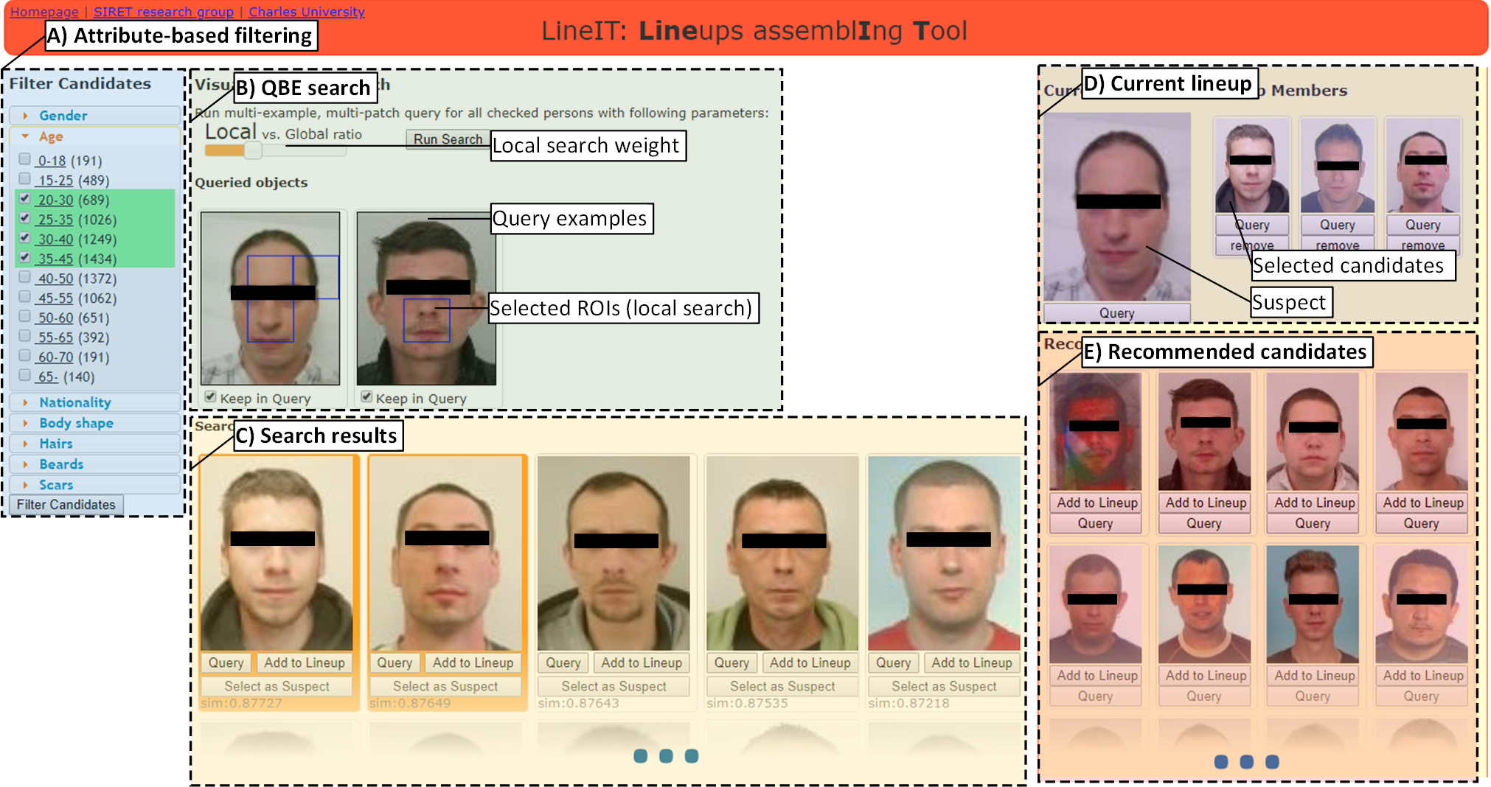
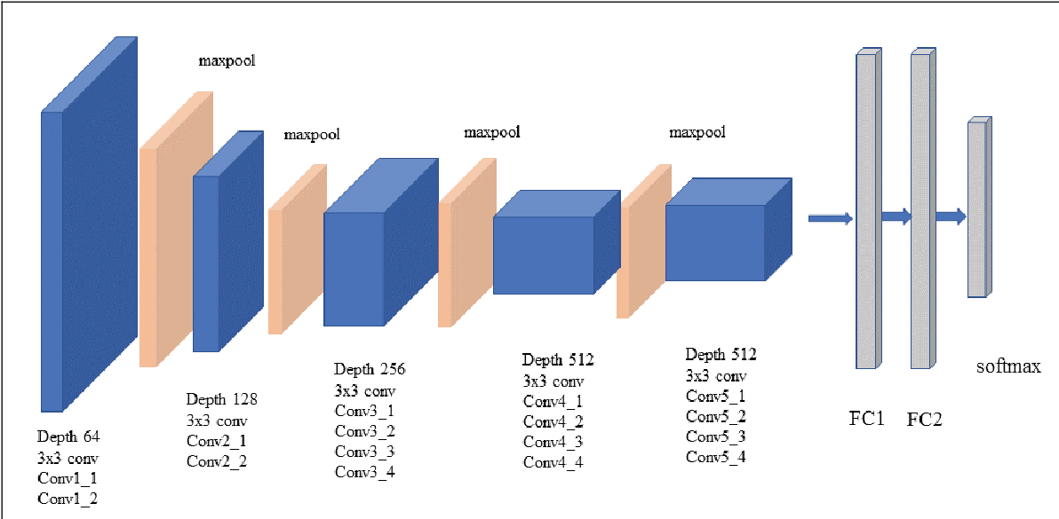
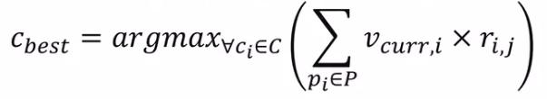

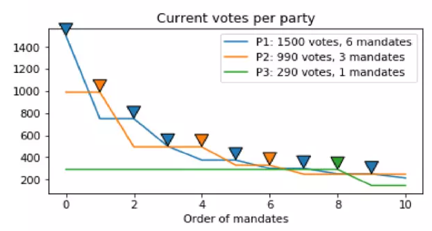
Content-based RS: Multimedia+attribute data, LineIT example
Fuzzy D’Hondt
Recommend based on an aggregation of attribute-based and visual similarity
Combine similarities towards both the suspect and already selected candidates (i.e., lineup uniformity)
For attribute-based similarity, employ users long-term preference on individual attributes
Combine both recommenders using Fuzzy interpretation of D’Hondt mandate allocation algorithm

Slide 22
Recommending items
Simple method: nearest neighbors
May be relevant for item-based recommendations
  Most similar items to the currently viewed one
  Still used in smaller e-commerce (either based on content or collaborative similarity)
Other options?
  Any aggregation of user’s preferences?

Slide 23
Query-based retrieval: Rocchio's method (Vector Space Model)
Originally for „conversational“ (interactive/iterative) query retrieval systems
Query-based retrieval: Rocchio's method
  The SMART System: Users are allowed to rate (relevant/irrelevant) retrieved documents (feedback)
  The system then learns a prototype of relevant/irrelevant documents
  Queries are then automatically extended with additional terms/weight of relevant documents
The paradigm fits well also for recommender systems
Some modern loss functions are based on a similar principles (e.g. Contrastive loss for siamese networks)

Slide 24
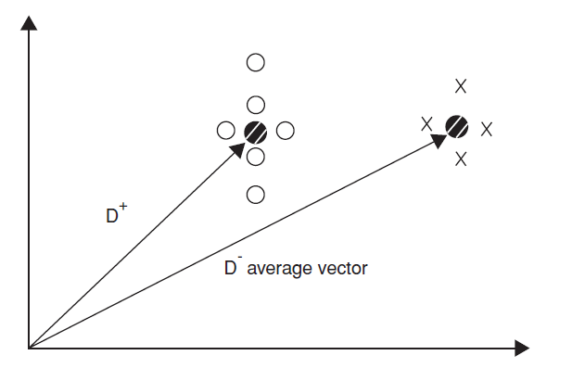
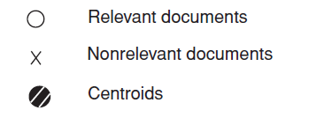

Rocchio details
Document collections D⁺ (liked) and D⁻ (disliked)
  Calculate prototype vector for these categories.
Computing modified query Qi+1 from
current query Qi with:
α, β, γ used to fine-tune the feedback
  α weight for original query
  β weight for positive feedback
  γ weight for negative feedback
$$Q_{i+1}= α ∗ Q_{i}+ β\left(\frac{1}{\left|D^{+}\right|} \sum_{d^{+}∈D^{+}}{d^{+}}\right)− γ\left(\frac{1}{\left|D^{−}\right|}\sum_{d^{−}∈D^{−}}{d^{−}}\right)$$
Often only positive feedback is used
  More valuable than negative feedback

Slide 25
Rocchio details
Document collections D⁺ (liked) and D⁻ (disliked)
  Calculate prototype vector for these categories.
Computing modified query Qi+1 from
current query Qi with:
This intuition paritally stops working in high dimensions
But should be fine e.g. for attribute-based or low-dim representations
Clustering for diverse interests, margin from negative instead of distance
α, β, γ used to fine-tune the feedback
  α weight for original query
  β weight for positive feedback
  γ weight for negative feedback
$$Q_{i+1}= α ∗ Q_{i}+ β\left(\frac{1}{\left|D^{+}\right|} \sum_{d^{+}∈D^{+}}{d^{+}}\right)− γ\left(\frac{1}{\left|D^{−}\right|}\sum_{d^{−}∈D^{−}}{d^{−}}\right)$$
Often only positive feedback is used
  More valuable than negative feedback

Slide 26
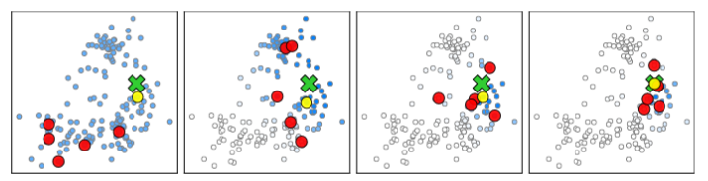
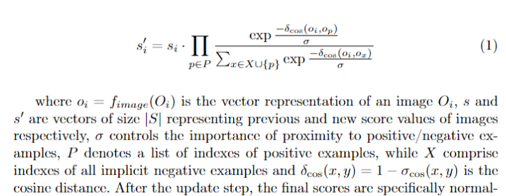
Bayesian relevance feedback
Slight modification: Instead of query prototype evaluate suitability of all points in the solutions space
  Counting distances to each positive example separately
  Exponential transformation (amplify highly similar objects)
https://dl.acm.org/doi/10.1007/s11042-022-14046-w

Slide 27
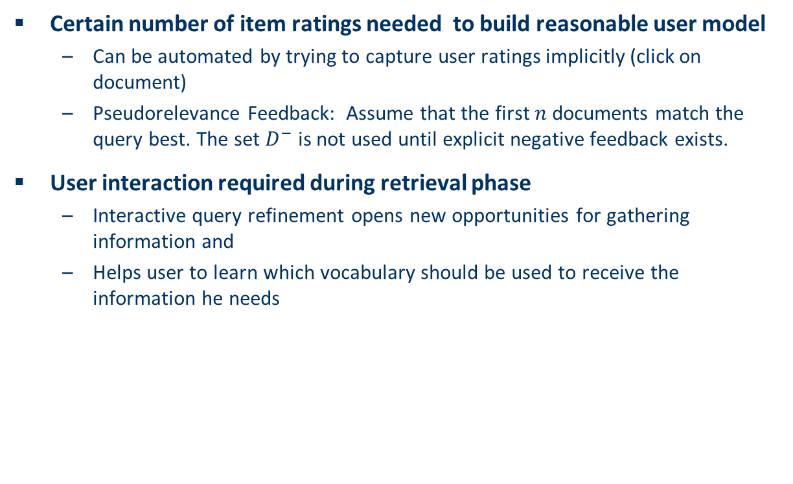
Practical challenges of Rocchio's method
Certain number of item ratings needed to build reasonable user model
  Can be automated by trying to capture user ratings implicitly (click on document)
  Pseudorelevance Feedback: Assume that the first$n$documents match the query best. The set $D^{−}$ is not used until explicit negative feedback exists.
User interaction required during retrieval phase
  Interactive query refinement opens new opportunities for gathering information and
  Helps user to learn which vocabulary should be used to receive the information he needs

Slide 28
Explicit decision models
Decision tree for recommendation problems
  inner nodes labeled with item features (keywords)
  used to partition the test examples
    existence or non existence of a keyword
  in basic setting only two classes appear at leaf nodes
    interesting or not interesting
  decision tree can automatically be constructed from training data
  works best with small number of features
  use meta features like author name, genre, ... instead of TF-IDF representation.
Never saw them really working...

Slide 29
Explicit decision models II
Rule induction
  built on RIPPER algorithm
  good performance compared with other classification methods
    eloborate postpruning techniques of RIPPER
    extension for e-mail classification
      takes document structure into account
main advantages of these decision models:
  inferred decision rules serve as basis for generating explanations for recommendation
  existing domain knowledge can be incorporated in models
Never saw them really working...
But may be fine for possible results pre-processing

Slide 30
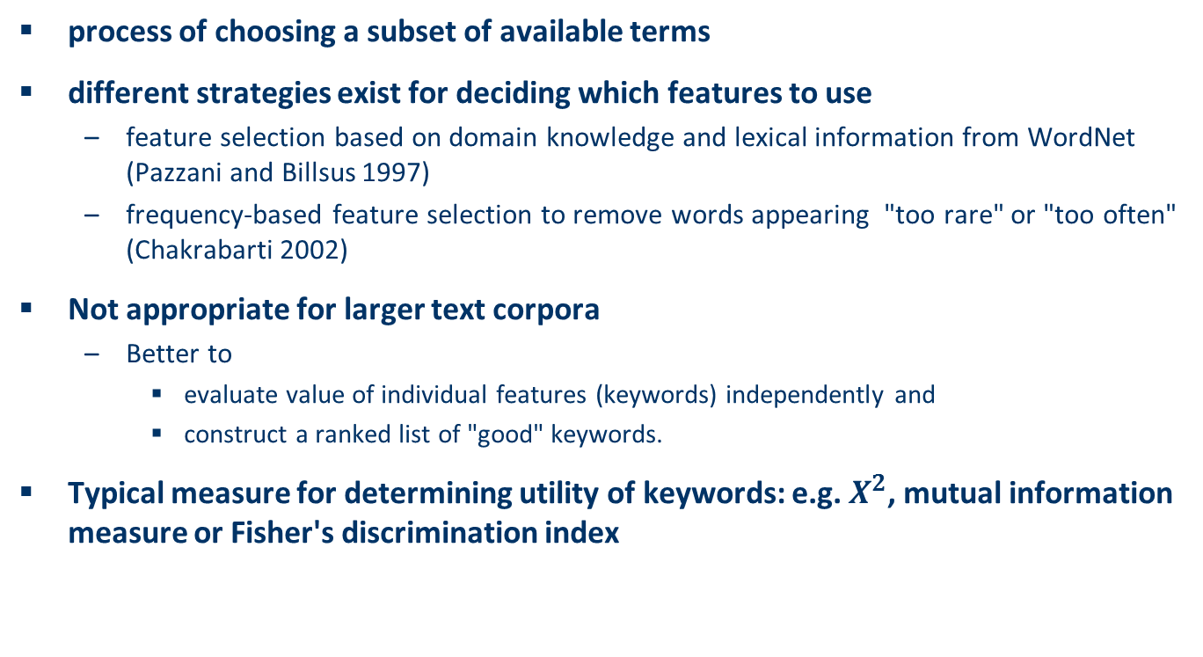
On feature selection
process of choosing a subset of available terms
different strategies exist for deciding which features to use
  feature selection based on domain knowledge and lexical information from WordNet (Pazzani and Billsus 1997)
  frequency-based feature selection to remove words appearing "too rare" or "too often" (Chakrabarti 2002)
Not appropriate for larger text corpora
  Better to
    evaluate value of individual features (keywords) independently and
    construct a ranked list of "good" keywords.
Typical measure for determining utility of keywords: e.g. $X^{2}$, mutual information measure or Fisher's discrimination index
Still important even today (less garbage to crawl for deep learning models)
- Think on the meta-level: can user preference be based on this feature?

Slide 31
Limitations of content-based recommendation methods
Keywords alone may not be sufficient to judge quality/relevance of a document or web page
    up-to-date-ness, usability, aesthetics, writing style
    content may also be limited / too short
    content may not be automatically extractable (multimedia)
      Not so big issue today
Ramp-up phase required
    Some training data is still required
    Web 2.0: Use other sources to learn the user preferences
Overspecialization
    Algorithms tend to propose "more of the same"
    Or: too similar news items
    Multicriterial optimization (diversity, novelty), fairness-aware approaches

Slide 32

Overspecialization
Recommended reading:
What is wrong here?

Slide 33
Overspecialization
Recommended reading:
Possibly lacking:
Novelty (w.r.t. user’s currently known interests)
Diversity (of recommended items from each other)
Serendipity (i.e. combination of relevance & surprise for the user)

Slide 34
Overspecialization
Recommended reading:
Simple diversity re-ranking: maximal marginal relevance
Select first item by relevance
Select next item by max(alpha*relevance – (1-alpha)*max(similarity to already selected item))
Not good for too long lists (iterative calculations over increasingly large sets)
– or have similarity matrix ready (might be too large to store)
https://www.cs.cmu.edu/~jgc/publication/The_Use_MMR_Diversity_Based_LTMIR_1998.pdf (2-page paper, 3500 citations☺)

Slide 35
Discussion & summary
In contrast to collaborative approaches, content-based techniques do not require user community in order to work
Presented approaches aim to learn a model of user's interest preferences based on explicit or implicit feedback
  Deriving implicit feedback from user behavior can be problematic
Evaluations show that a good recommendation accuracy can be achieved with help of machine learning techniques
  These techniques do not require a user community
Danger exists that recommendation lists contain too many similar items
  All learning techniques require a certain amount of training data
  Some learning methods tend to overfit the training data
Pure content-based systems are rarely found in commercial environments
  Well, for small-scale projects (cold-start) they’ll do…
  Better than building collaborative systems without any users so far

Slide 36
Knowledge-based recommendation

Slide 37


Basic I/O Relationship
Knowledge-based: "Tell me what fits based on my needs"
„Bigger HDD is better“
„Schwarzenegger is similar to Stalone“
But who will say that?
And how? Is it uniform?

Slide 38

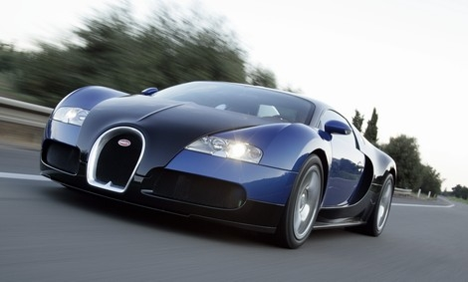
Why do we need knowledge-based recommendation?
Products with low number of available ratings
Time span plays an important role
  five-year-old ratings for computers
  user lifestyle or family situation changes
Customers want to define their requirements explicitly
  "the color of the car should be black"

Slide 39
Knowledge-based recommender systems
Constraint-based
  based on explicitly defined set of recommendation rules
  (partially) fulfill recommendation rules
Case-based (critiquing)
  Item-based: give me similar items, however with larger display
Both approaches are similar in their conversational recommendation proces (edge of query retrieval and recommender systems)
  users specify the requirements
  systems try to identify solutions
  if no solution can be found, users change requirements (or partial solution is given)
  Not always, we may learn knowledge RS rules from collaborative data

Slide 40
Constraint-based recommender systems
Knowledge base
  usually mediates between user model and item properties
  variables
    user model features (requirements), Item features (catalogue)
  set of constraints
    logical implications (IF user requires A THEN proposed item should possess feature B)
    hard and soft/weighted constraints
    solution preferences
Derive a set of recommendable items
  fulfilling set of applicable constraints
  applicability of constraints depends on current user model
  explanations – transparent line of reasoning

Slide 41
Constraint-based recommendation tasks
Find a set of user requirements such that a subset of items fulfills all constraints
  ask user which requirements should be relaxed/modified such that some items exist that do not violate any constraint
Find a subset of items that satisfy the maximum set of weighted constraints
  similar to find a maximally succeeding subquery (XSS)
  all proposed items have to fulfill the same set of constraints
  compute relaxations based on predetermined weights
Rank items according to weights of satisfied soft constraints
  rank items based on the ratio of fulfilled constraints
  does not require additional ranking scheme

Slide 42
Ranking the items
Multi-attribute utility theory
  each item is evaluated according to a predefined set of dimensions that provide an aggregated view on the basic item properties
E.g. quality and economy are dimensions in the domain of digital cameras
id | value | quality | economy
price | ≤250 >250 | 5 10 | 10 5
mpix | ≤8 >8 | 4 10 | 10 6
opt-zoom | ≤9 >9 | 6 10 | 9 6
LCD-size | ≤2.7 >2.7 | 6 9 | 10 5
movies | Yes no | 10 3 | 7 10
sound | Yes no | 10 7 | 8 10
waterproof | Yes no | 10 8 | 6 10

Slide 43
Item utility for customers
Customer specific interest
Calculation of Utility
Customer | quality | economy
Cu₁ | 80% | 20%
Cu₂ | 40% | 60%
quality | economy | cu₁ | cu₂
P₁ Σ(5,4,6,6,3,7,10) = 41 | Σ (10,10,9,10,10,10,6) = 65 | 45.8 [8] | 55.4 [6]
P₂ Σ(5,4,6,6,10,10,8) = 49 | Σ (10,10,9,10,7,8,10) = 64 | 52.0 [7] | 58.0 [1]
P₃ Σ(5,4,10,6,10,10,8) = 53 | Σ (10,10,6,10,7,8,10) = 61 | 54.6 [5] | 57.8 [2]
P₄ Σ(5,10,10,6,10,7,10) = 58 | Σ (10,6,6,10,7,10,6) = 55 | 57.4 [4] | 56.2 [4]
P₅ Σ(5,4,6,10,10,10,8) = 53 | Σ (10,10,9,6,7,8,10) = 60 | 54.4 [6] | 57.2 [3]
P₆ Σ(5,10,6,9,10,10,8) = 58 | Σ (10,6,9,5,7,8,10) = 55 | 57.4 [3] | 56.2 [5]
P₇ Σ(10,10,6,9,10,10,8) = 63 | Σ (5,6,9,5,7,8,10) = 50 | 60.4 [2] | 55.2 [7]
P₈ Σ(10,10,10,9,10,10,10) = 69 | Σ (5,6,6,5,7,8,6) = 43 | 63.8 [1] | 53.4 [8]

Slide 44
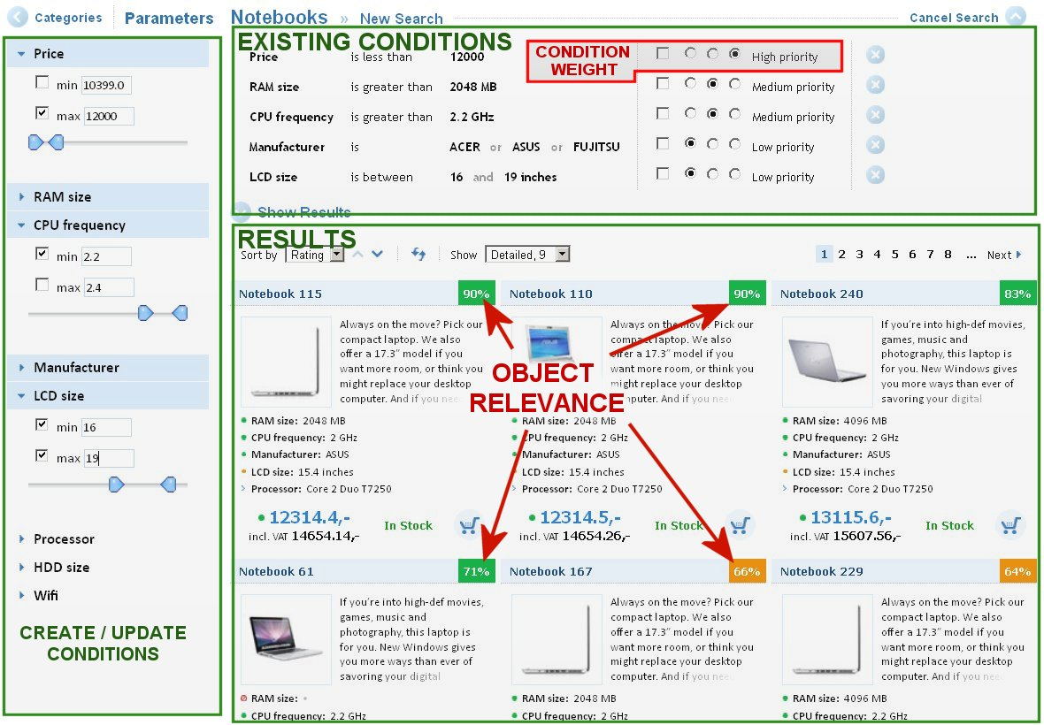
Explicit constraint-based GUI (Bronislav Vaclav, Master thesis 2011)

Slide 45
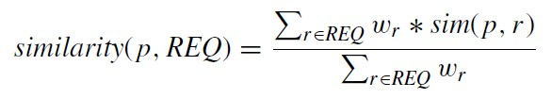

Case-based recommender systems
Items are retrieved using similarity measures
Distance similarity
Def.
  sim (p, r) expresses for each item attribute value φr (p) its distance to the customer requirement r ∈ REQ.
  wr is the importance weight for requirement r
In real world, customer would like to
  maximize certain properties. i.e. resolution of a camera, "more is better"(MIB)
  minimize certain properties. i.e. price of a camera, "less is better"(LIB)
  Target within some values, e.g. Price between x,y

Slide 46
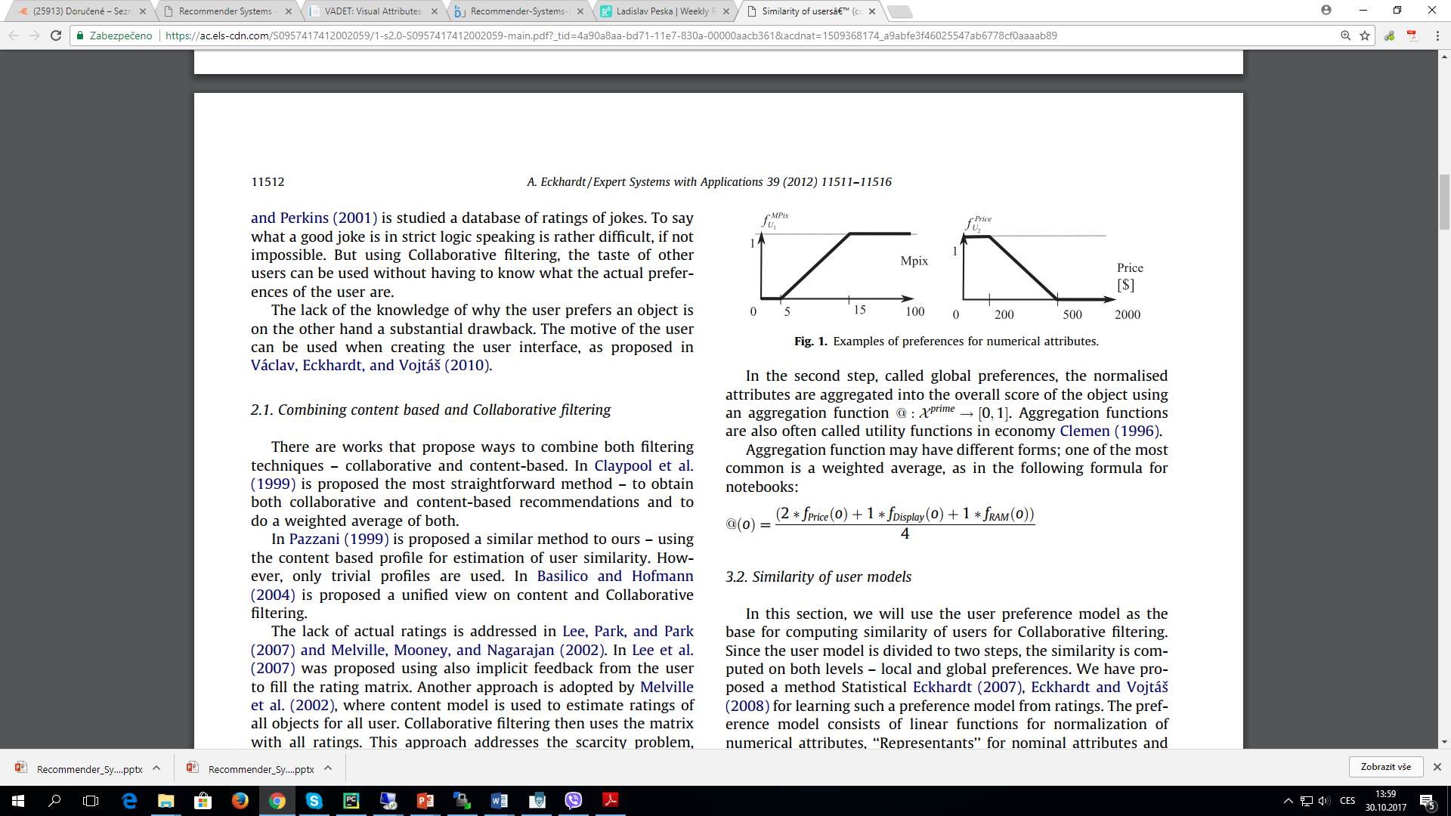
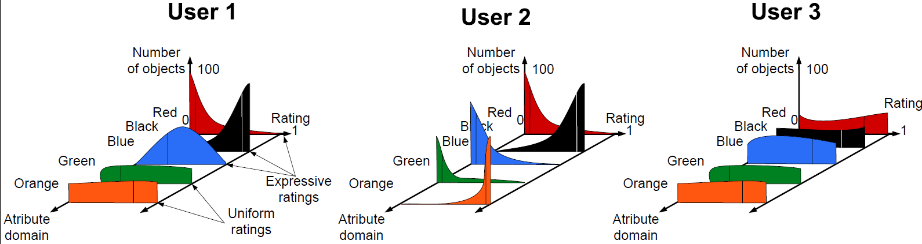
Knowledge-based recommender systems (work of Alan Eckhardt circa 2008-2014)
Transform known rating on items into
  Rating (preference regression) of item features
  Learning combination of item feature´s ratings
    Based on goodness of fit on features
Evaluate the learned rating function on all other objects
  Recommend better instead of similar objects

Slide 47
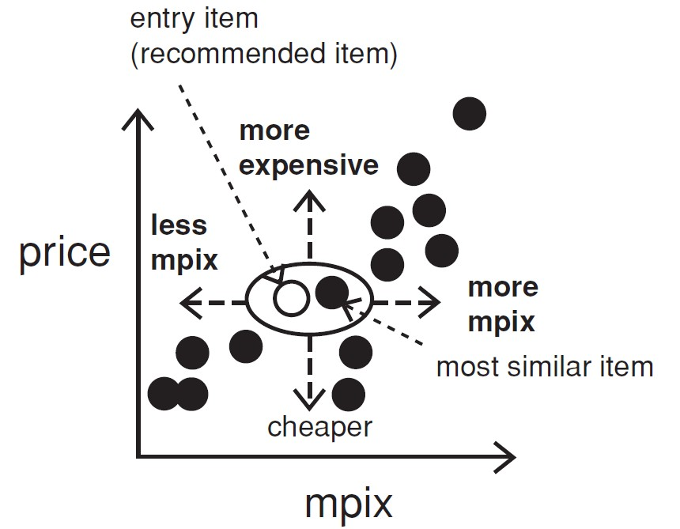
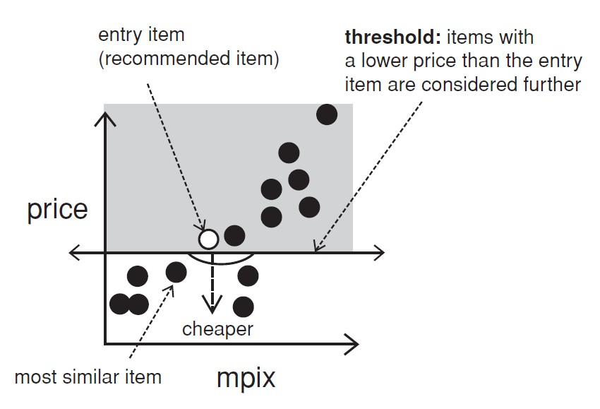
Interacting with case-based recommenders (perhaps the key thing to remember)
Customers maybe not know what they are seeking
Critiquing is an effective way to support such navigations
Customers specify their change requests (price or mpix) that are not satisfied by the current item (entry item)
Critique on price

Slide 48
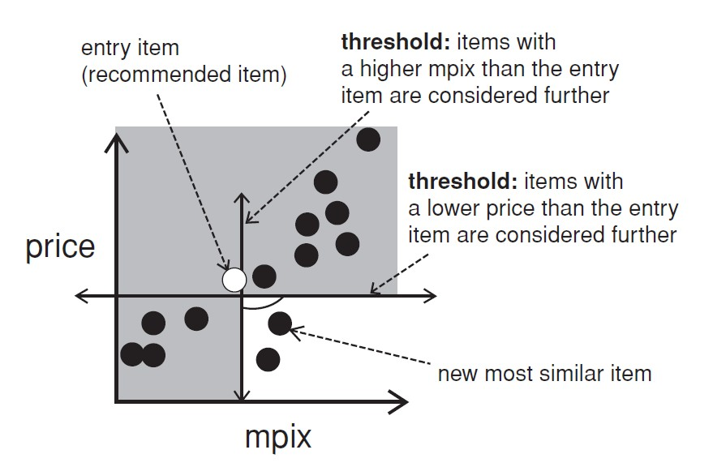
Compound critiques
Operate over multiple properties can improve the efficiency of recommendation dialogs
  You can try to learn attribute-level preferences from the interaction data (if you have them), or apply general policies (item A is better than item B for most settings)

Slide 49
Summary
Knowledge-based recommender systems
  Move from recommending similar to recommending better objects
Limitations
  cost of knowledge acquisition
    from domain experts / users / external resources
  accuracy of preference models
    very fine granular preference models require many interaction cycles
    collaborative filtering models preference implicitly
  independence assumption can be challenged
    preferences are not always independent from each other
  No known commercial usage
    Experiments with LLM + text input goes in this direction
    The generic concept of price per value with optional personalization is viable

