Slide 1


NSWI166 – Introduction to Recommender Systems and User Preferences – Lecture #2
Ladislav Peska & Peter Vojtas
Ladislav.peska@matfyz.cuni.cz, S208
https://www.ksi.mff.cuni.cz/~peska/vyuka/NSWI166
Lecture: Wed 9:00 S5 (:-/)
Labs: Wed 10:40 S6 (every two weeks)
2/1, ZK+Z, 4 credits
https://www.ksi.mff.cuni.cz/

Slide 2
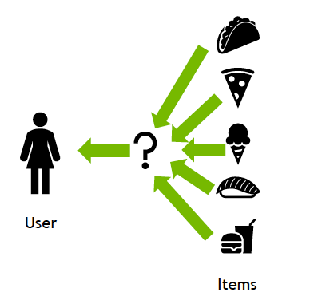
Recap: what should RS do?

Slide 3



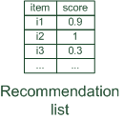




Recap: what data can RS use?

Slide 4
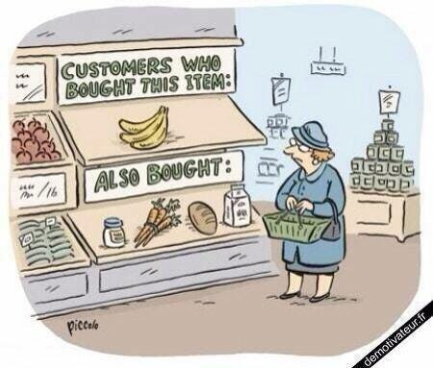
Non-personalized

Slide 5
Paradigms of recommender systems

Slide 6

Non-personalized RS
Editors selection (think about news)

Slide 7
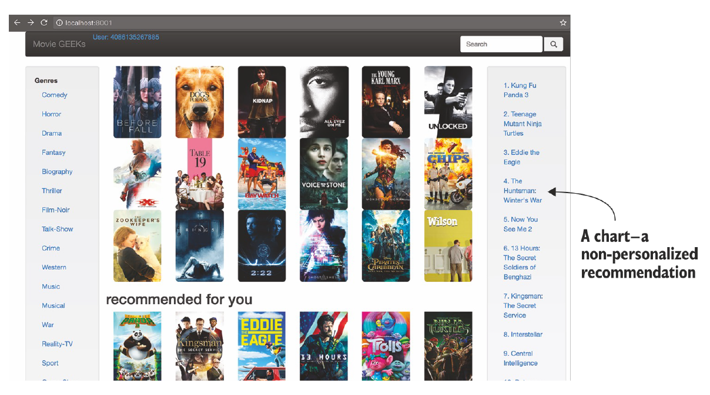
Non-personalized RS
Popularity-based algorithms

Slide 8
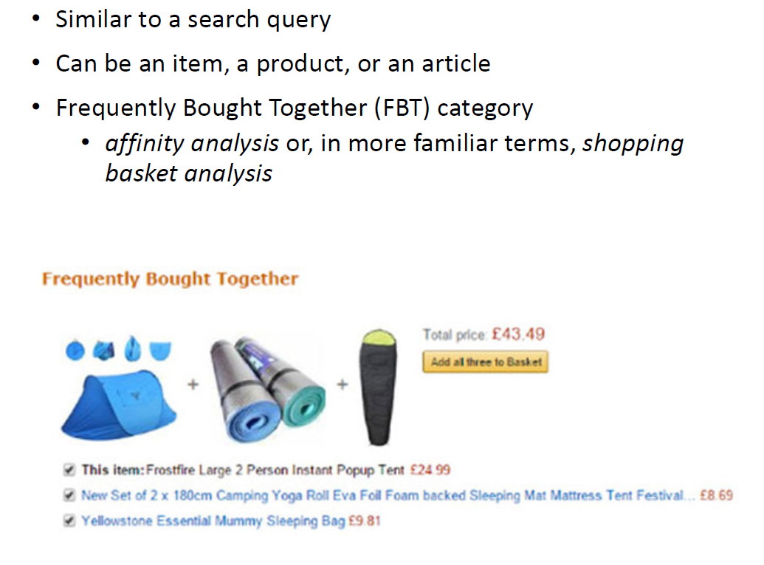
Non-personalized RS
Seeded / item-based recommendations

Slide 9
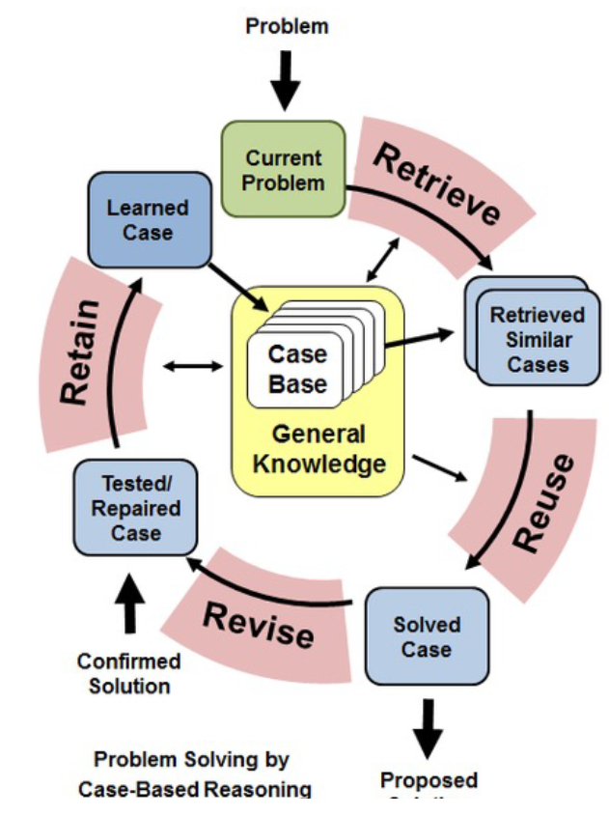
Non-personalized RS
Case-based / Business rules / Stereotypes
  Age as a proxy to music profile
  If you are abroad, we should not supply you local news
  After buying fruit, recommend vegetable on sale

Slide 10
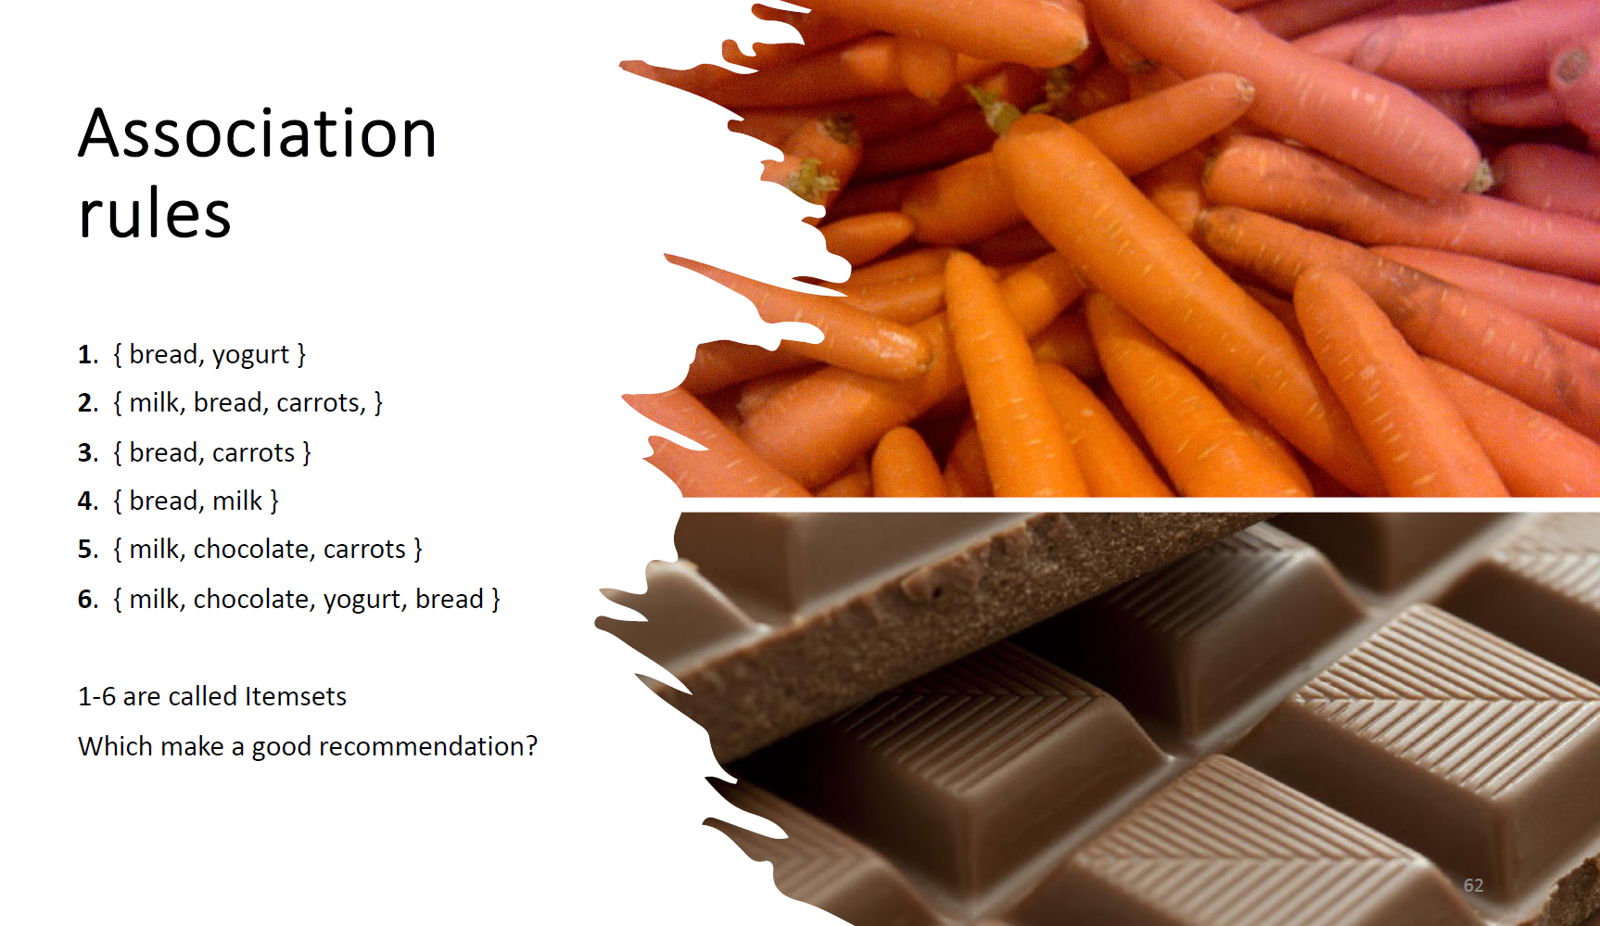
Non-personalized RS

Slide 11
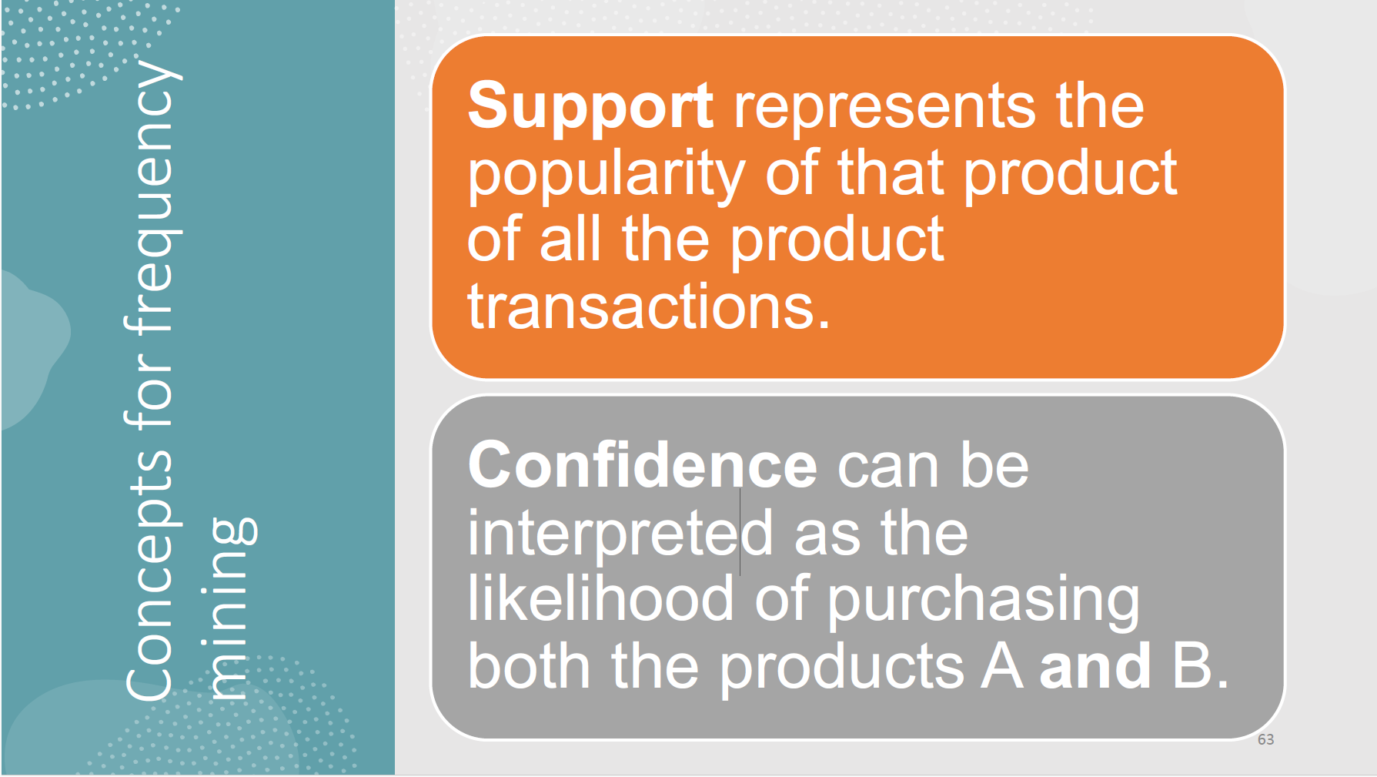
Non-personalized RS

Slide 12
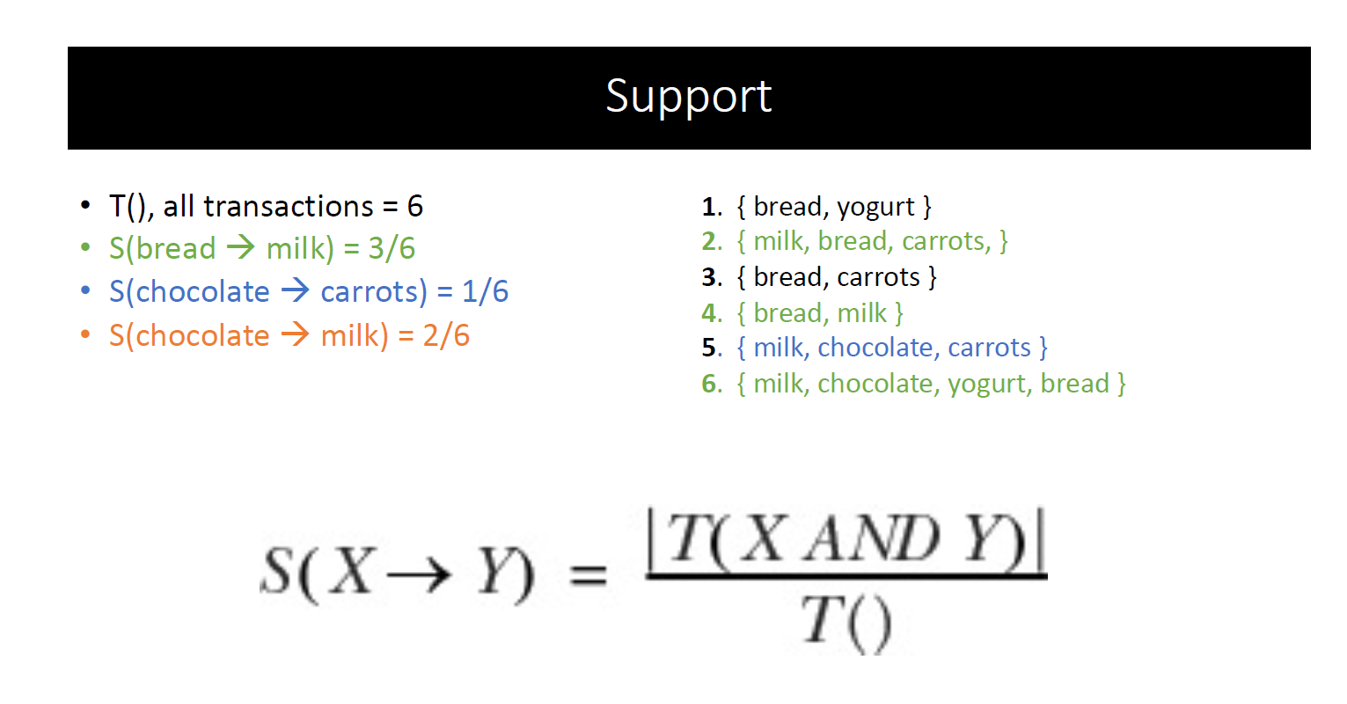
Non-personalized RS

Slide 13
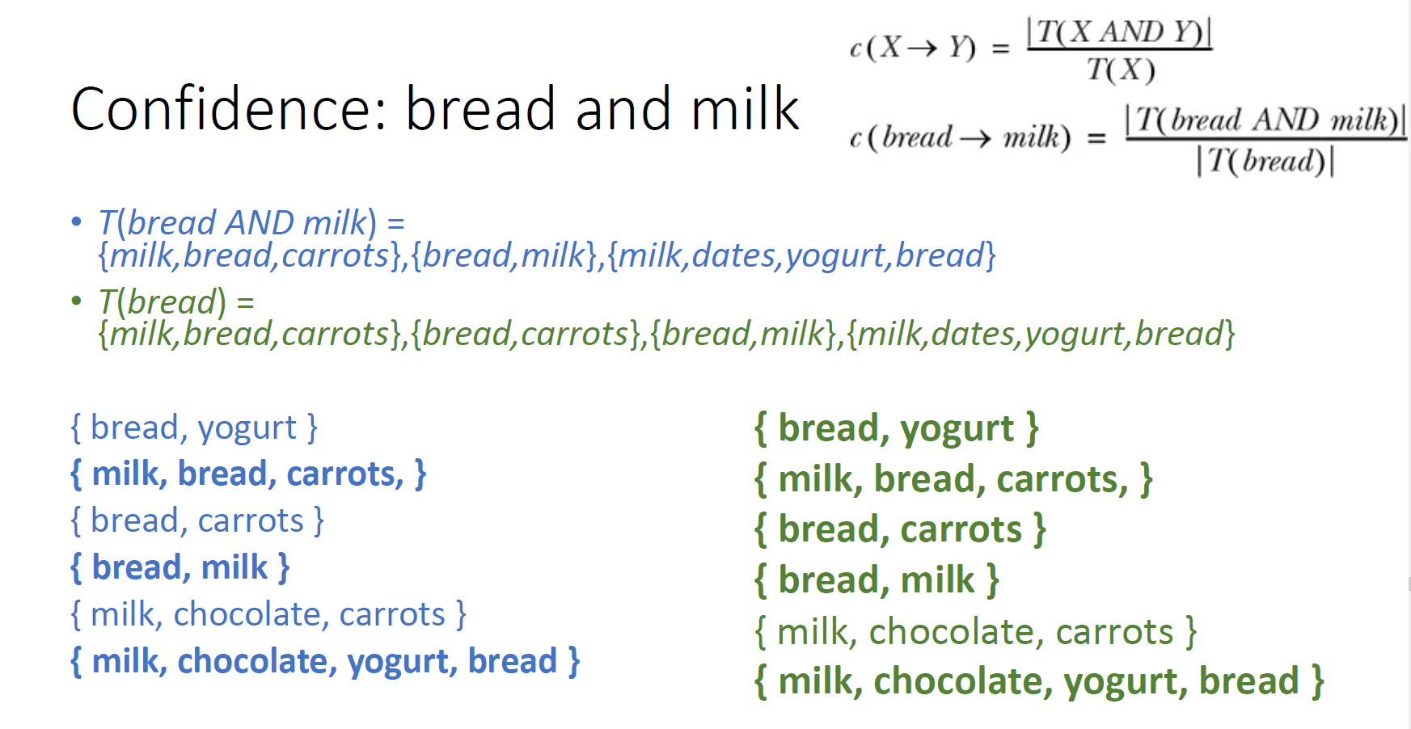
Non-personalized RS

Slide 14
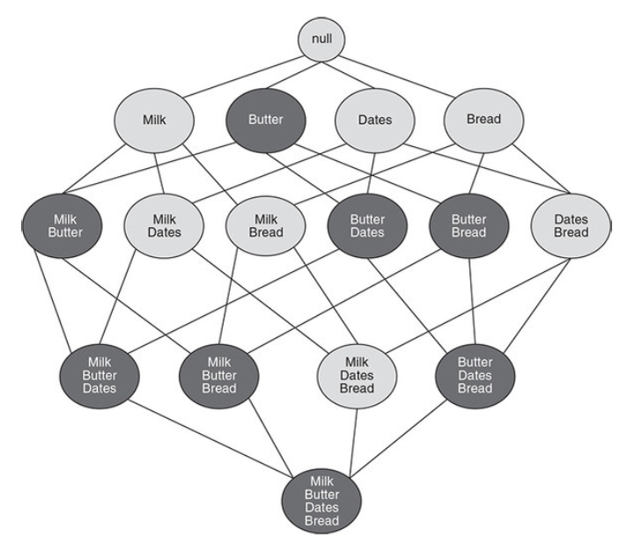
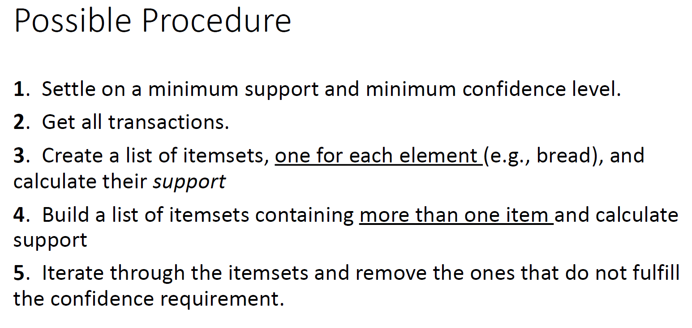
Non-personalized RS

Slide 15
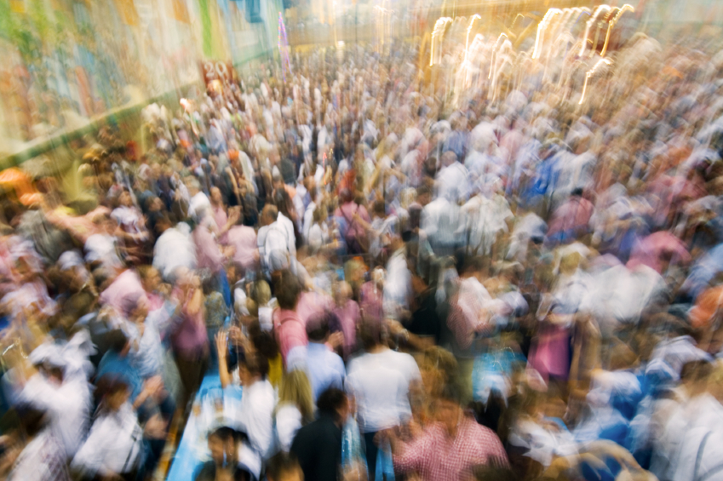
Collaborative Filtering

Slide 16
Paradigms of recommender systems

Slide 17
Agenda
Collaborative Filtering (CF)
  What & why
  User-based nearest-neighbor
  Item-based nearest-neighbor
  Input data types
  Data sparsity problems
  Matrix factorization techniques

Slide 18
Collaborative Filtering (CF)
(used to be) The most prominent approach to generate recommendations
  used by large, commercial e-commerce sites
  well-understood, various algorithms and variations exist
  applicable in many domains (book, movies, DVDs, ..)
Approach
  use the "wisdom of the crowd" to recommend items
Basic assumption and idea
  Users give ratings to catalog items (implicitly or explicitly)
  Customers who had similar tastes in the past, will have similar tastes in the future

Slide 19
Pure CF Approaches
Input
  Only a matrix of given user–item ratings
Output types
  A (numerical) prediction indicating to what degree the current user will like or dislike a certain item
    Less relevant nowadays
    Shown somewhere in the product description
  A top-N list of recommended items
    This is what you need in the end anyway

Slide 20
Pure CF Approaches
Input
  Only a matrix of given user–item ratings
Output types
  A (numerical) prediction indicating to what degree the current user will like or dislike a certain item
    Less relevant nowadays
    Shown somewhere in the product description
  A top-N list of recommended items
    This is what you need in the end anyway

Slide 21


User-based nearest-neighbor collaborative filtering [Rating Prediction variant]
The basic technique
  Given an "active user" (Alice) and an item $i$ not yet seen by Alice
    find a set of users (peers/nearest neighbors) who liked the same items as Alice in the past and who have rated item $i$ [this is the difference from RecSys HelloWorld from last lecture]
    use, e.g. the average of their ratings to predict, if Alice will like item $i$
    do this for all items Alice has not seen and recommend the best-rated
Basic assumption and idea
  If users had similar tastes in the past they will have similar tastes in the future
  User preferences remain stable and consistent over time

Slide 22
User-based nearest-neighbor collaborative filtering [Rating Prediction variant]
The basic technique
  Given an "active user" (Alice) and an item $i$ not yet seen by Alice
    find a set of users (peers/nearest neighbors) who liked the same items as Alice in the past and who have rated item $i$ [this is the difference from RecSys HelloWorld from last lecture]
    use, e.g. the average of their ratings to predict, if Alice will like item $i$
    do this for all items Alice has not seen and recommend the best-rated
Basic assumption and idea
  If users had similar tastes in the past they will have similar tastes in the future
  User preferences remain stable and consistent over time

Slide 23
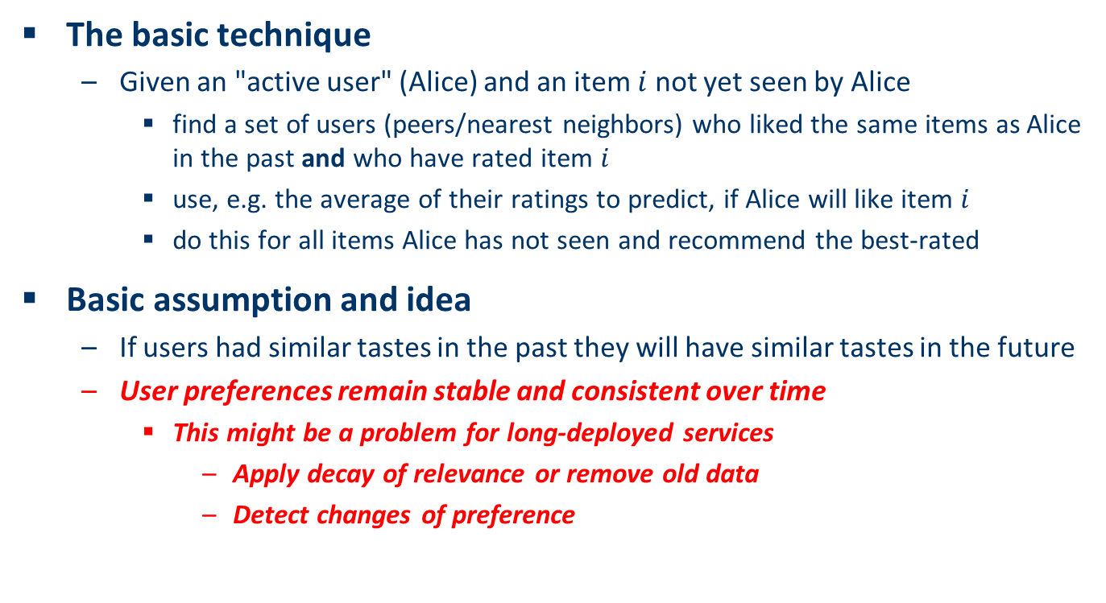
User-based nearest-neighbor collaborative filtering [Rating Prediction variant]
The basic technique
  Given an "active user" (Alice) and an item $i$ not yet seen by Alice
    find a set of users (peers/nearest neighbors) who liked the same items as Alice in the past and who have rated item $i$
    use, e.g. the average of their ratings to predict, if Alice will like item $i$
    do this for all items Alice has not seen and recommend the best-rated
Basic assumption and idea
  If users had similar tastes in the past they will have similar tastes in the future
  User preferences remain stable and consistent over time
    This might be a problem for long-deployed services
      Apply decay of relevance or remove old data
      Detect changes of preference

Slide 24
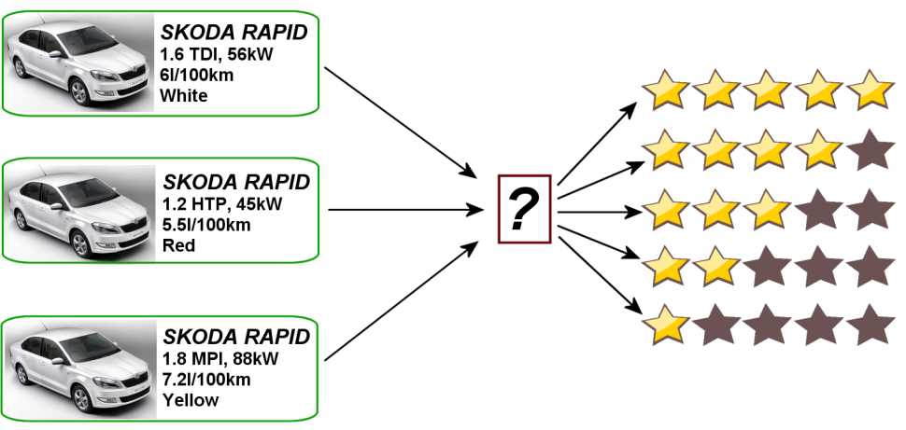
User-based nearest-neighbor collaborative filtering (2)
Example
  A database of ratings of the current user, Alice, and some other users is given:
  Determine whether Alice will like or dislike Item5, which Alice has not yet rated or seen
  Underlying assumption: user provides explicit rating
 | Item1 | Item2 | Item3 | Item4 | Item5
Alice | 5 | 3 | 4 | 4 | ?
User1 | 3 | 1 | 2 | 3 | 3
User2 | 4 | 3 | 4 | 3 | 5
User3 | 3 | 3 | 1 | 5 | 4
User4 | 1 | 5 | 5 | 2 | 1

Slide 25
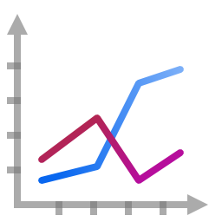
User-based nearest-neighbor collaborative filtering (3)
Some first questions
  How do we measure similarity?
  How many neighbors should we consider?
  How do we generate a prediction from the neighbors' ratings?
 | Item1 | Item2 | Item3 | Item4 | Item5
Alice | 5 | 3 | 4 | 4 | ?
User1 | 3 | 1 | 2 | 3 | 3
User2 | 4 | 3 | 4 | 3 | 5
User3 | 3 | 3 | 1 | 5 | 4
User4 | 1 | 5 | 5 | 2 | 1

Slide 26
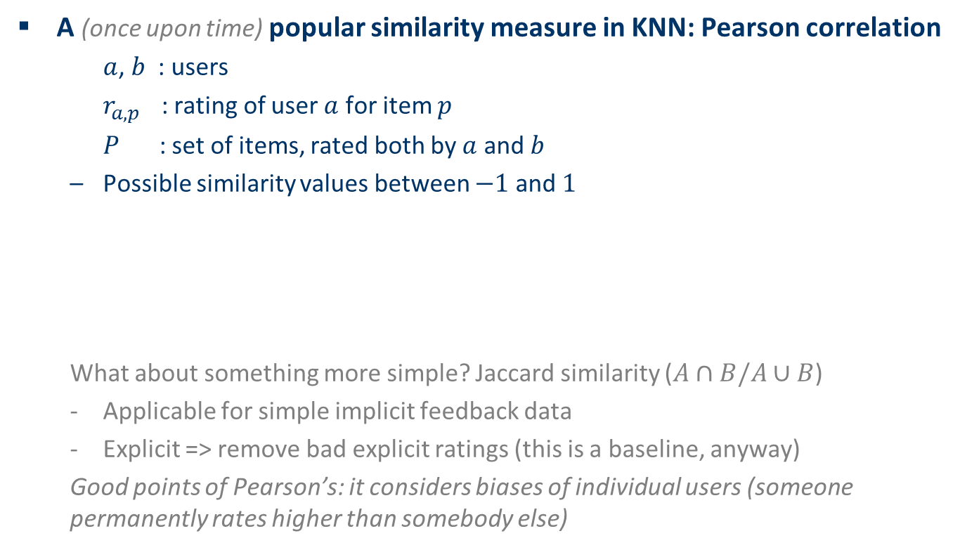
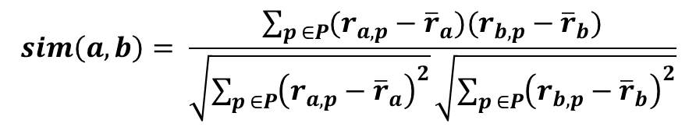
Measuring user similarity (1)
A (once upon time) popular similarity measure in KNN: Pearson correlation
  $a$, $b$ : users
  $r_{a,p}$ : rating of user $a$ for item $p$
  $P$ : set of items, rated both by $a$ and $b$
  Possible similarity values between $−1$ and $1$
  What about something more simple? Jaccard similarity ($A∩B/A∪B$)
  Applicable for simple implicit feedback data
  Explicit => remove bad explicit ratings (this is a baseline, anyway)
  Good points of Pearson’s: it considers biases of individual users (someone permanently rates higher than somebody else)
$$sim\left(a,b\right)= \frac{\sum_{p ∈P}{(r_{a,p}−{\overline{r}}_{a})(r_{b,p}−{\overline{r}}_{b})}}{\sqrt{\sum_{p ∈P}{{\left(r_{a,p}−{\overline{r}}_{a}\right)}^{2}}}\sqrt{\sum_{p ∈P}{{\left(r_{b,p}−{\overline{r}}_{b}\right)}^{2}}}}$$

Slide 27
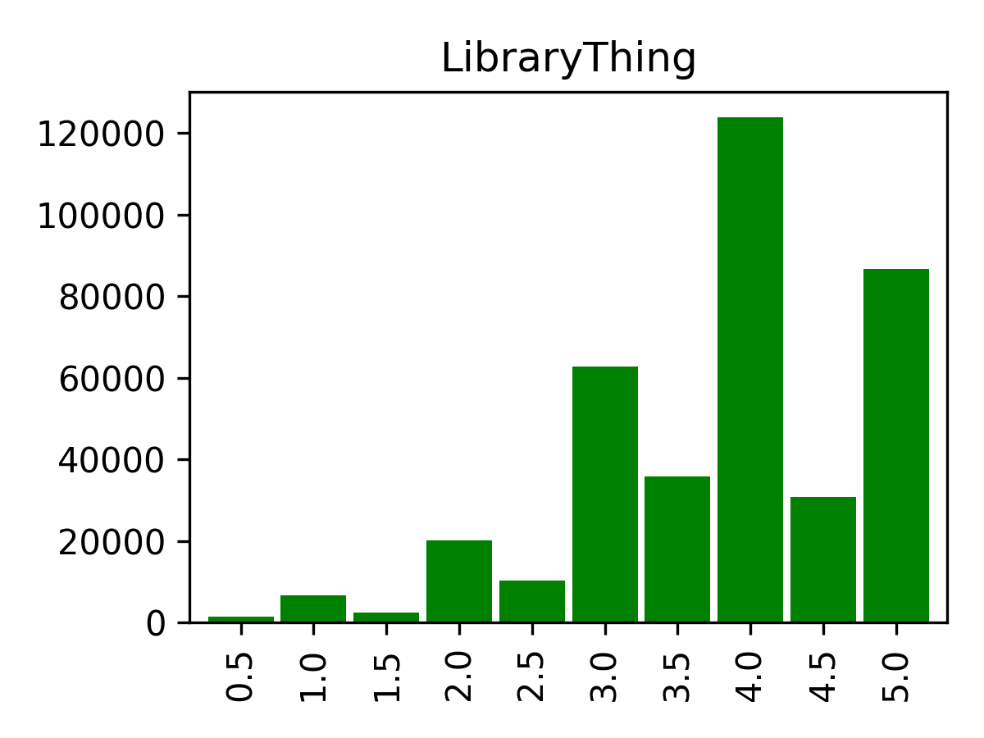
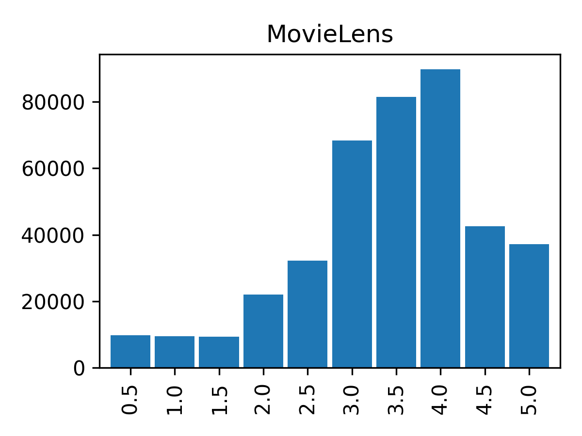
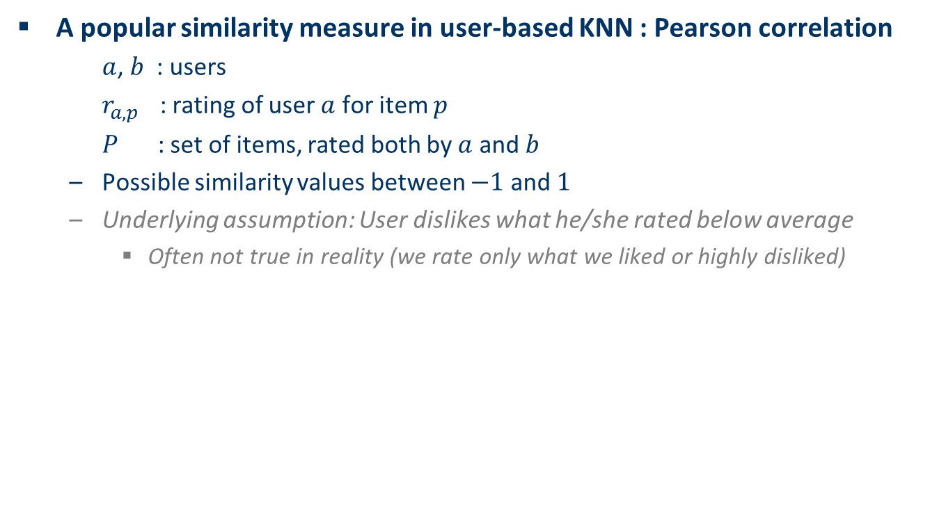
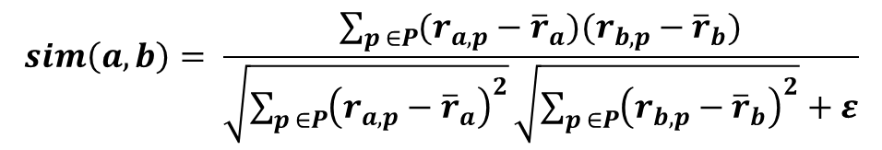
Measuring user similarity (1)
A popular similarity measure in user-based KNN : Pearson correlation
  $a$, $b$ : users
  $r_{a,p}$ : rating of user $a$ for item $p$
  $P$ : set of items, rated both by $a$ and $b$
  Possible similarity values between $−1$ and $1$
  Underlying assumption: User dislikes what he/she rated below average
    Often not true in reality (we rate only what we liked or highly disliked)
Deviation from average rating on shared items
$$sim\left(a,b\right)= \frac{\sum_{p ∈P}{(r_{a,p}−{\overline{r}}_{a})(r_{b,p}−{\overline{r}}_{b})}}{\sqrt{\sum_{p ∈P}{{\left(r_{a,p}−{\overline{r}}_{a}\right)}^{2}}}\sqrt{\sum_{p ∈P}{{\left(r_{b,p}−{\overline{r}}_{b}\right)}^{2}}}+ε}$$
!!! Will be zero in case of uniform rating !!!

Slide 28

Measuring user similarity (2)
A popular similarity measure in user-based KNN : Pearson correlation
  $a$, $b$ : users
  $r_{a,p}$ : rating of user $a$ for item $p$
  $P$ : set of items, rated both by $a$ and $b$
  Possible similarity values between $−1$ and $1$
 | Item1 | Item2 | Item3 | Item4 | Item5
Alice | 5 | 3 | 4 | 4 | ?
User1 | 3 | 1 | 2 | 3 | 3
User2 | 4 | 3 | 4 | 3 | 5
User3 | 3 | 3 | 1 | 5 | 4
User4 | 1 | 5 | 5 | 2 | 1
sim = 0,85
sim = 0,00
sim = 0,70
sim = -0,79

Slide 29
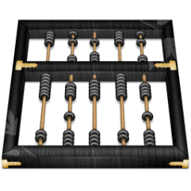
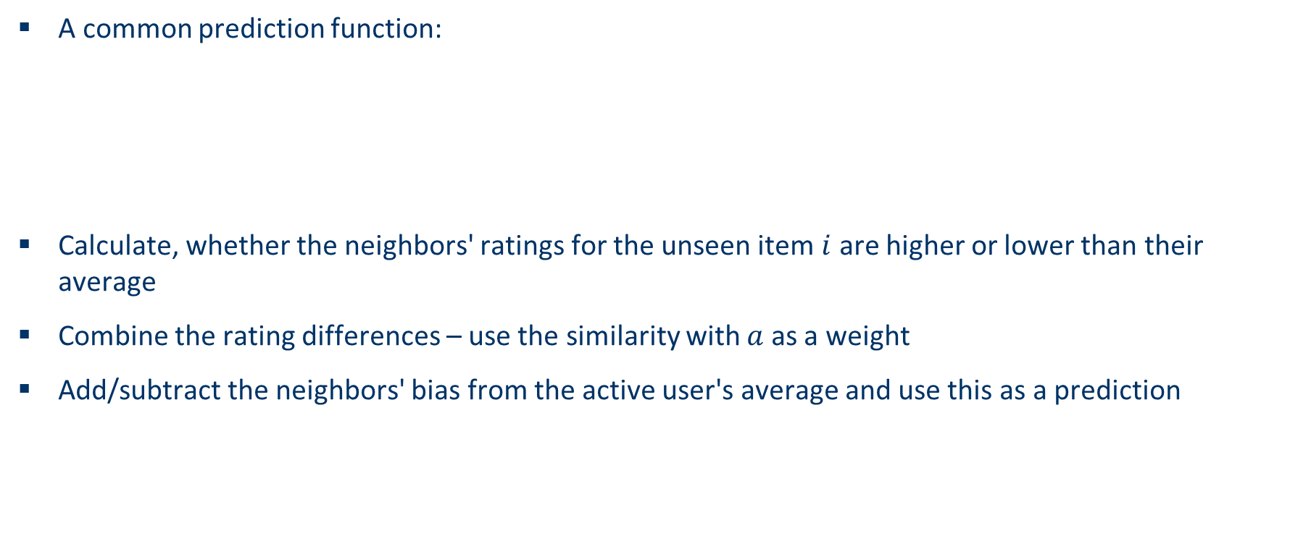
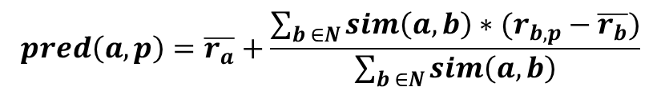
Making predictions
A common prediction function:
Calculate, whether the neighbors' ratings for the unseen item $i$ are higher or lower than their average
Combine the rating differences – use the similarity with $a$ as a weight
Add/subtract the neighbors' bias from the active user's average and use this as a prediction
$$pred\left(a,p\right)=\overline{r_{a}}+\frac{\sum_{b ∈N}{sim\left(a,b\right)∗(r_{b,p}−\overline{r_{b}})}}{\sum_{b ∈N}{sim\left(a,b\right)}}$$

Slide 30

Making predictions
Only matters for rating prediction (not ranking)
Similarity-weighting optional, but mostly works
A common prediction function:
Calculate, whether the neighbors' ratings for the unseen item $i$ are higher or lower than their average
Combine the rating differences – use the similarity with $a$ as a weight
Add/subtract the neighbors' bias from the active user's average and use this as a prediction
$$pred\left(a,p\right)=\overline{r_{a}}+\frac{\sum_{b ∈N}{sim\left(a,b\right)∗(r_{b,p}−\overline{r_{b}})}}{\sum_{b ∈N}{sim\left(a,b\right)}}$$

Slide 31
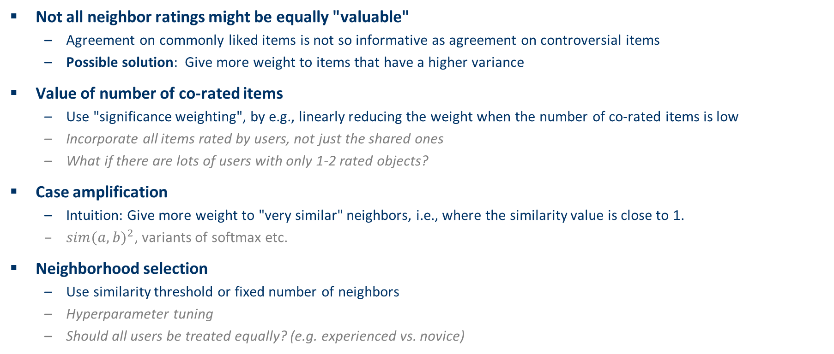
Improving the metrics / prediction function
Not all neighbor ratings might be equally "valuable"
  Agreement on commonly liked items is not so informative as agreement on controversial items
  Possible solution: Give more weight to items that have a higher variance
Value of number of co-rated items
  Use "significance weighting", by e.g., linearly reducing the weight when the number of co-rated items is low
  Incorporate all items rated by users, not just the shared ones
  What if there are lots of users with only 1-2 rated objects?
Case amplification
  Intuition: Give more weight to "very similar" neighbors, i.e., where the similarity value is close to 1.
  ${sim(a,b)}^{2}$, variants of softmax etc.
Neighborhood selection
  Use similarity threshold or fixed number of neighbors
  Hyperparameter tuning
  Should all users be treated equally? (e.g. experienced vs. novice)

Slide 32
Memory-based and model-based approaches
User-based KNN is said to be "memory-based"
  the rating matrix is directly used to find neighbors / make predictions
    Everything is calculated at the time of the request
  does not scale for most real-world scenarios (how much can you calculate within 50-100ms?)
  large e-commerce sites / social networks have tens of millions of customers and millions of items
Model-based approaches
  based on an offline pre-processing or "model-learning" phase
    Represent users and/or items as a set of features, which are easy to operate with
  at run-time, only the learned model is used to make predictions
  models are updated / re-trained periodically
  large variety of techniques used
  model-building and updating can be computationally expensive
  item-based KNN is an example for model-based approaches

Slide 33
Item-based collaborative filtering
Basic idea:
  Use the similarity between items (and not users) to make predictions
    Tends to be a bit more stable
Example:
  Look for items that are similar to Item5 w.r.t. Ratings given by other users
  Take Alice's ratings for these items to predict the rating for Item5
 | Item1 | Item2 | Item3 | Item4 | Item5
Alice | 5 | 3 | 4 | 4 | ?
User1 | 3 | 1 | 2 | 3 | 3
User2 | 4 | 3 | 4 | 3 | 5
User3 | 3 | 3 | 1 | 5 | 4
User4 | 1 | 5 | 5 | 2 | 1

Slide 34
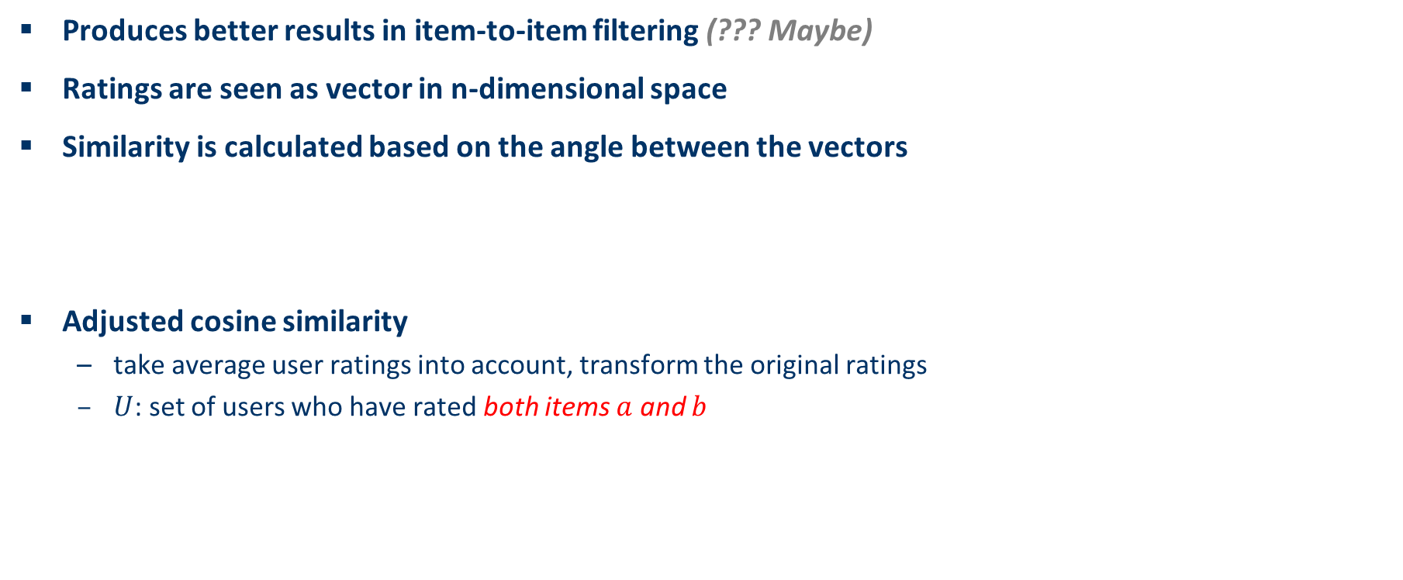
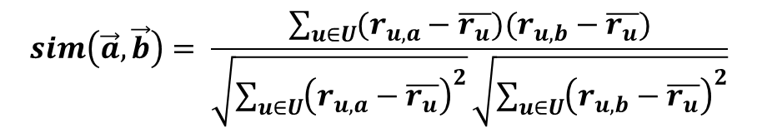

The cosine similarity measure
Produces better results in item-to-item filtering (??? Maybe)
Ratings are seen as vector in n-dimensional space
Similarity is calculated based on the angle between the vectors
Adjusted cosine similarity
  take average user ratings into account, transform the original ratings
  $U$: set of users who have rated both items $a$ and $b$
$$sim\left(\vec{a},\vec{b}\right)=\frac{\vec{a}∙\vec{b}}{\left|\vec{a}\right|∗|\vec{b}|}$$
$$sim\left(\vec{a},\vec{b}\right)= \frac{\sum_{u∈U}{(r_{u,a}−\overline{r_{u}})(r_{u,b}−\overline{r_{u}})}}{\sqrt{\sum_{u∈U}{{\left(r_{u,a}−\overline{r_{u}}\right)}^{2}}}\sqrt{\sum_{u∈U}{{\left(r_{u,b}−\overline{r_{u}}\right)}^{2}}}}$$

Slide 35
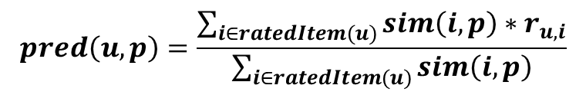
Making predictions
A common prediction function:
Neighborhood size is typically also limited to a specific size
Not all neighbors are taken into account for the prediction
An analysis of the MovieLens dataset indicates that "in most real-world situations, a neighborhood of 20 to 50 neighbors seems reasonable" (Herlocker et al. 2002)
  Outdated, you need to tune hyperparameters yourself
$$pred\left(u,p\right)=\frac{\sum_{i∈ratedItem(u)}{sim\left(i,p\right)∗r_{u,i}}}{\sum_{i∈ratedItem(u)}{sim\left(i,p\right)}}$$

Slide 36
Pre-processing for item-based filtering
Item-based filtering does not solve the scalability problem itself
Pre-processing approach by Amazon.com (in 2003)
  Calculate all pair-wise item similarities in advance
  The neighborhood to be used at run-time is typically rather small, because only items are taken into account which the user has rated
  Item similarities are supposed to be more stable than user similarities
Memory requirements
  Up to N² pair-wise similarities to be memorized (N = number of items) in theory
  In practice, this is significantly lower (items with no co-ratings)
  Further reductions possible
    Minimum threshold for co-ratings
    Limit the neighborhood size (might affect recommendation accuracy)

Slide 37
More on ratings – Explicit ratings
Probably the most precise ratings (ehm... Attribute ratings, reviews, detailed implicit feedback nowadays...)
Most commonly used (1 to 5, 1 to 7 Likert response scales, likes/dislikes)
Research topics
  Optimal granularity of scale; indication that 10-point scale is better accepted in movie dom.
    Different domains addopted other common scales
  Multidimensional ratings (multiple ratings per movie such as ratings for actors and sound)
    Booking.com rating
Main problems
  Users not (always) willing to rate many items
    number of available ratings could be too small → sparse rating matrices → poor recommendation quality
  How to stimulate users to rate more items?
  What else to use?

Slide 38
More on ratings – Implicit ratings
Typically collected by the web shop or application in which the recommender system is embedded
When a customer buys an item, for instance, many recommender systems interpret this behavior as a positive rating
Clicks, page views, time spent on some page, demo downloads …
Implicit ratings can be collected constantly and do not require additional efforts from the side of the user
Main problem
  How to interpret the feedback
    Like vs. consume
  For example, a user might not like all the books he or she has bought; the user also might have bought a book for someone else
Implicit ratings can be used in addition to explicit ones; question of correctness of interpretation

Slide 39

Data sparsity problems
Cold start problem
  How to recommend new items? What to recommend to new users?
Straightforward approaches
  Ask/force users to rate a set of items (they will hate you)
    Recommend new items more often (get feedback quickly)
  Use another method (e.g., content-based, demographic or simply non-personalized) in the initial phase (bias problems, but generally OK)
  Default voting: assign default values to items that only one of the two users to be compared has rated (Breese et al. 1998) (... And the performance is...☺)
Alternatives
  Use better algorithms (beyond nearest-neighbor approaches)
  Simple example:
    Assume "transitivity" of neighborhoods

Slide 40
Data sparsity problems
What is the expected data density?
  How many items do users usually rate?
  How many ratings items usually receive?
  How many items are viewed/consumed?
  What is the lifecycle of users / items?

Slide 41

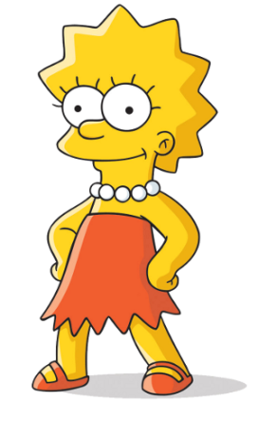

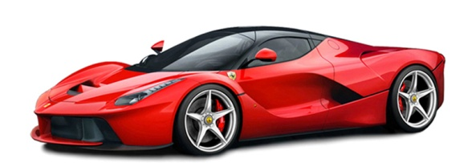


Data sparsity problem for nearest neighbors
Which user is closer to the current one?
Which object is closer to the current one?
  among the rated objects

Slide 42
KNN Models for Sparse Datasets and Ranking Prediction
Calculating estimated rating for each object is time-consuming and unnecessary
  Often, we do not need object’s rating, but only ranking of a top-k objects
For many objects, there are no similar user who rated this object
  No way to reliably estimate rating
 | Item1 | Item2 | Item3 | Item4 | Item5 | Item6 | Item7
Alice | 5 | 3 | ? | 4 | ? | ? | ?
User1 | 5 | 3 | ? | ? | 3 | 2 | ?
User2 | ? | 5 | ? | ? | 5 | 5 | 5
User3 | ? | ? | 1 | ? | ? | 1 | 3
User4 | 1 | ? | 4 | 2 | ? | 4 | ?
Negative similarity
No shared objects

Slide 43
KNN Models for Sparse Datasets and Ranking Prediction
Calculating estimated rating for each object is time-consuming and unnecessary
  Often, we do not need object’s rating, but only ranking of a top-k objects
For many objects, there are no similar user who rated this object
  No way to reliably estimate rating
  => Forget about Item3, we have plenty of other items to recommend
 | Item1 | Item2 | Item3 | Item4 | Item5 | Item6 | Item7
Alice | 5 | 3 | ? | 4 | ? | ? | ?
User1 | 5 | 3 | ? | ? | 3 | 2 | ?
User2 | ? | 5 | ? | ? | 5 | 5 | 5
User3 | ? | ? | 1 | ? | ? | 1 | 3
User4 | 1 | ? | 4 | 2 | ? | 4 | ?
Negative similarity
No shared objects

Slide 44

KNN Models for Sparse Datasets and Ranking Prediction
User-based KNN for ranking:
  Select K closest neighbors, who rated also some other items
  Sum scores for all unknown items rated by the neighbors [other aggregation variants possible]
  Return items with highest scores

Slide 45
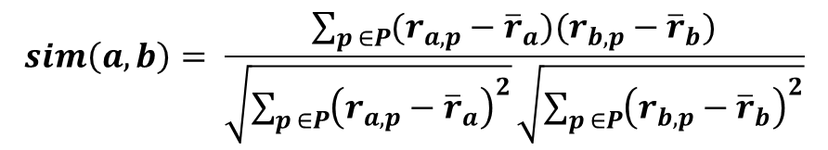
KNN Models for Sparse Datasets and Ranking Prediction
User-based KNN for ranking:
  Select K closest neighbors, who rated also some other item
$$sim\left(a,b\right)= \frac{\sum_{p ∈P}{(r_{a,p}−{\overline{r}}_{a})(r_{b,p}−{\overline{r}}_{b})}}{\sqrt{\sum_{p ∈P}{{\left(r_{a,p}−{\overline{r}}_{a}\right)}^{2}}}\sqrt{\sum_{p ∈P}{{\left(r_{b,p}−{\overline{r}}_{b}\right)}^{2}}}}$$
 | Item1 | Item2 | Item3 | Item4 | Item5 | Item6 | Item7
Alice | 5 | 3 | ? | 4 | ? | ? | ?
User1 | 5 | 3 | ? | ? | 3 | 1 | ?
User2 | ? | 4 | ? | ? | 5 | 5 | 4
User3 | ? | ? | 1 | ? | ? | 1 | 4
User4 | 1 | ? | 4 | 2 | ? | 5 | ?
0.5
0.35
NaN/0
-0.45

Slide 46

KNN Models for Sparse Datasets and Ranking Prediction
User-based KNN for ranking:
  Select K closest neighbors, who rated also some other item
  Sum scores for all unknown items rated by the neighbors
  Return items with highest scores
    Item5, Item6,…
 | Item1 | Item2 | Item3 | Item4 | Item5 | Item6 | Item7
Alice | 5 | 3 | ? | 4 | ? | ? | ?
User1 | 5 | 3 | ? | ? | 3 | 1 | ?
User2 | ? | 4 | ? | ? | 5 | 5 | 4
0.5
0.35
?/0
3.25
2.25
1.4
$$score\left(a,p\right)=\sum_{b ∈N}{sim\left(a,b\right)∗(r_{b,p}−\overline{r_{b}})}$$

Slide 47
Item-based KNN for Ranking Prediction
2003 paper: Amazon.com Recommendations Item-to-Item Collaborative Filtering
  https://dl.acm.org/citation.cfm?id=642471
Recommend items that are similar (based on other user ratings) to the items already liked by Alice
 | Item1 | Item2 | Item3 | Item4 | Item5 | Item6 | Item7
Alice | 5 | 3 | ? | 4 | ? | ? | ?
User1 | 5 | 3 | ? | ? | 3 | 2 | ?
User2 | ? | 5 | ? | ? | 5 | 5 | 5
User3 | ? | ? | 1 | ? | ? | 1 | 3
User4 | 1 | ? | 4 | 2 | ? | 4 | ?

Slide 48
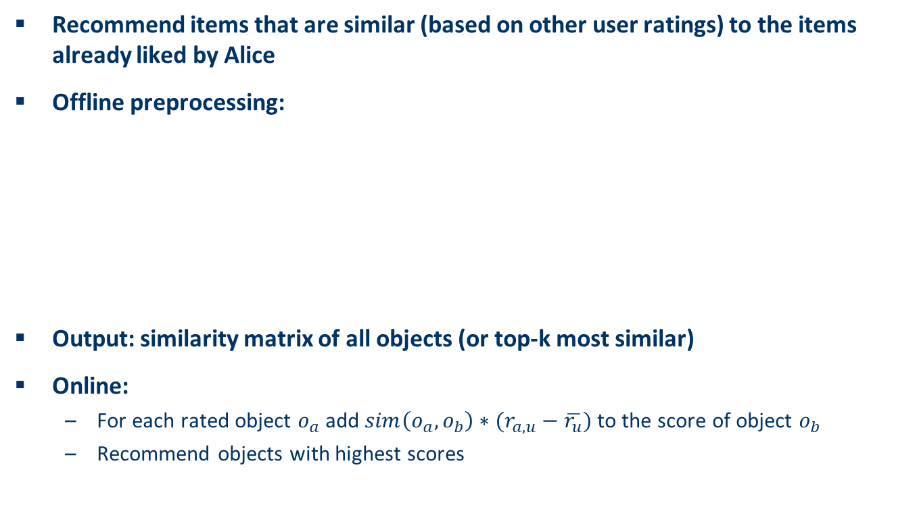
Item-based KNN for Ranking Prediction
Recommend items that are similar (based on other user ratings) to the items already liked by Alice
Offline preprocessing:
Output: similarity matrix of all objects (or top-k most similar)
Online:
  For each rated object $o_{a}$ add $sim\left(o_{a}, o_{b}\right)∗(r_{a,u}−\overline{r_{u}})$ to the score of object $o_{b}$
  Recommend objects with highest scores
For each item in product catalog, I1
For each customer C who purchased I1
For each item I2 purchased by customer C
Record that a customer purchased I1 and I2
For each item I2
Compute the similarity between I1 and I2 (i.e. Jaccard)

Slide 49
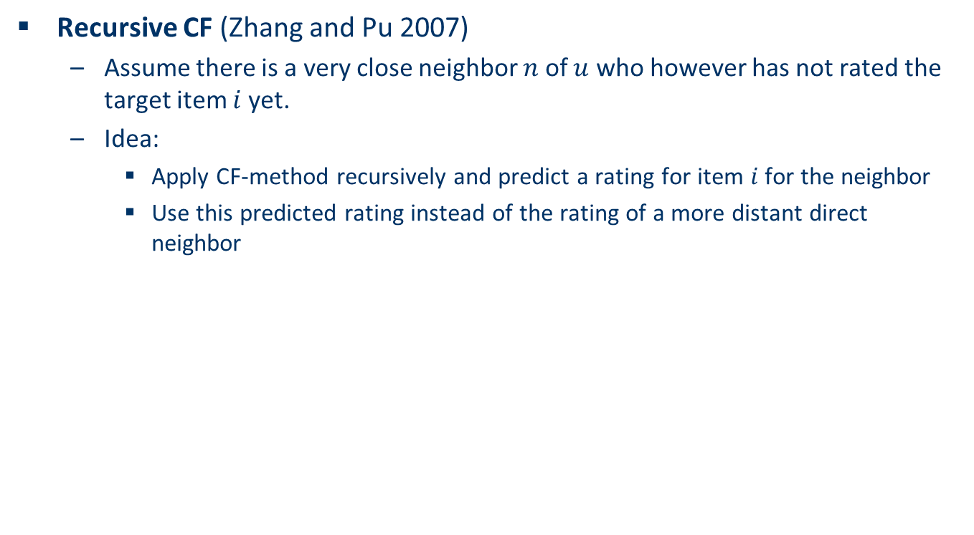
Example algorithms for sparse datasets
Recursive CF (Zhang and Pu 2007)
  Assume there is a very close neighbor $n$ of $u$ who however has not rated the target item $i$ yet.
  Idea:
    Apply CF-method recursively and predict a rating for item $i$ for the neighbor
    Use this predicted rating instead of the rating of a more distant direct neighbor
Never saw in praxis
 | Item1 | Item2 | Item3 | Item4 | Item5
Alice | 5 | 3 | 4 | 4 | ?
User1 | 3 | 1 | 2 | 3 | ?
User2 | 4 | 3 | 4 | 3 | 5
User3 | 3 | 3 | 1 | 5 | 4
User4 | 1 | 5 | 5 | 2 | 1
sim = 0.85
Predict rating for
User1

Slide 50
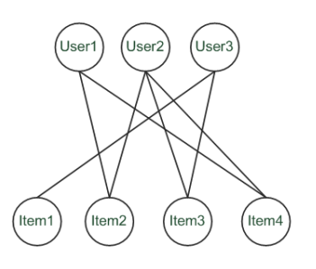
Graph-based methods (1)
"Spreading activation" (Huang et al. 2004)
  Exploit the supposed "transitivity" of customer tastes and thereby augment the matrix with additional information
  Assume that we are looking for a recommendation for User1
  When using a standard CF approach, User2 will be considered a peer for User1 because they both bought Item2 and Item4
  Thus Item3 will be recommended to User1 because the nearest neighbor, User2, also bought or liked it

Slide 51
Graph-based methods (2)
"Spreading activation" (Huang et al. 2004)
  In a standard user-based or item-based CF approach, paths of length 3 will be considered – that is, Item3 is relevant for User1 because there exists a three-step path (User1–Item2–User2–Item3) between them
  Because the number of such paths of length 3 is small in sparse rating databases, the idea is to also consider longer paths (indirect associations) to compute recommendations
  Using path length 5, for instance

Slide 52
Graph-based methods (3)
"Spreading activation" (Huang et al. 2004)
  Idea: Use paths of lengths > 3
  to recommend items
  Length 3: Recommend Item3 to User1
  Length 5: Item1 also recommendable

Slide 53
More model-based approaches
Plethora of different techniques proposed in the last years, e.g.,
  Matrix factorization techniques,
    BPR, Funk SVD, ALS,…
  Association rule mining
    compare: shopping basket analysis
  Probabilistic models
    clustering models, Bayesian networks, probabilistic Latent Semantic Analysis
  Various other machine learning approaches, nowadays mostly deep learning variants
Costs of pre-processing
  Usually not discussed
  Incremental updates possible?
    if not, training should be fast enough

Slide 54


Collaborative Filtering Issues
Pros:
  well-understood, works well in some domains, no knowledge engineering required
Cons:
  requires user community, sparsity problems, no integration of other knowledge sources, no explanation of results
What is the best CF method?
  In which situation and which domain? Inconsistent findings; always the same domains and data sets; differences between methods are often very small (1/100)
How to evaluate the prediction quality? (separate lecture on this – gets even more important nowdays)
  MAE / RMSE: What does an MAE of 0.7 actually mean?
  Serendipity (novelty and surprising effect of recommendations)
    Not yet fully understood (still true)
What about multi-dimensional ratings? not many application domains
  instead, what about implicit feedback?

Slide 55
NSWI166 – Introduction to Recommender Systems and User Preferences – Lecture #3
Ladislav Peska & Peter Vojtas
Ladislav.peska@matfyz.cuni.cz, S208
https://www.ksi.mff.cuni.cz/~peska/vyuka/NSWI166
Lecture: Wed 9:00 S5 (:-/)
Labs: Wed 10:40 S6 (every two weeks)
https://www.ksi.mff.cuni.cz/

Slide 56
Organization
Active reading #1 deadline: 10.3. 2024
  Submit via SIS
Labs #1 deadlines last/next Sunday
  Submit via E-mail (next labs submit via SIS -> Study Group Roaster)
Intermediate results in SIS
Recordings from the lecture #2 are online on YouTube
  https://youtu.be/30q7yKnFKtk
  Note that the audio is very quiet☹
Get to know Pandas / Numpy / Scipy + Scikit-learn
  Not strictly needed to pass, but can greatly simplify your life

Slide 57
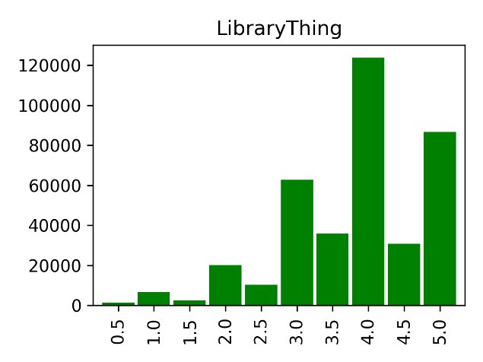
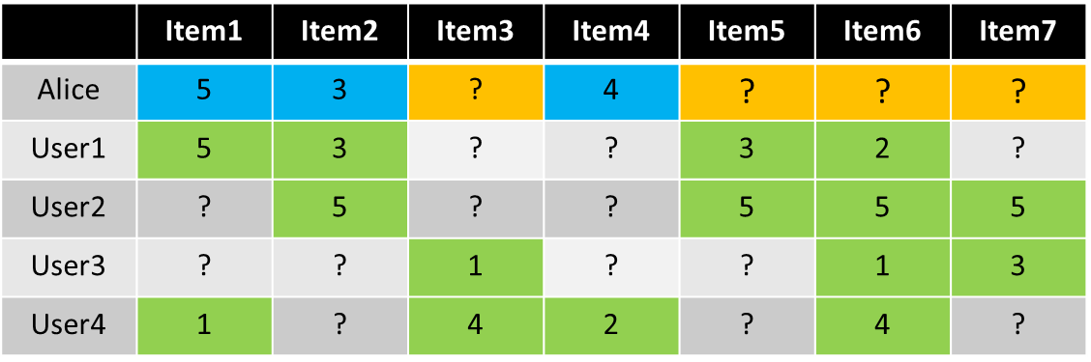
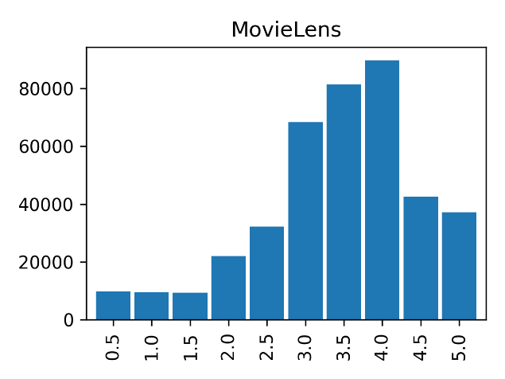
Recap
How are ratings distributed?
Item vs. User KNN?

Slide 58
Recap
What is COLD START?
How Spreading Activation works?

Slide 59
Matrix Completion
(Matrix factorization)

Slide 60
Matrix completion
Given a sparse matrix. We want to fill-in
the unknown values
The values of the matrix are dependent
on each other
Approaches
  Search for similar rows/columns
  (nearest neighbour collaborative filtering)
  Matrix factorization
  Restricted Boltzmann Machines (RBM)
  ...
5 | ? | 1 | ? | ? | ...
? | ? | 5 | ? | 4 | ...
5 | 4 | 2 | ? | ? | ...
? | 3 | ? | 2 | 5 | ...
1 | ? | 5 | ? | 4 | ...
5 | 4 | ? | ? | 2 | ...
... | ... | ... | ... | ... | ...

Slide 61
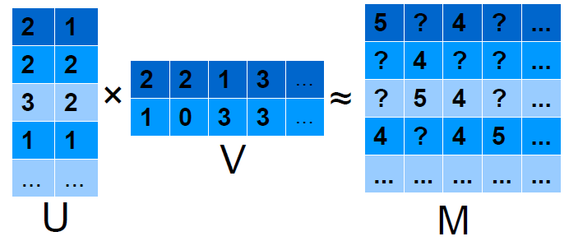
Matrix factorization
We estimate matrix M as the product of two matrices U and V.
Based on the known values of M, we search for U and V so that their product best estimates the (known) values of M

Slide 62
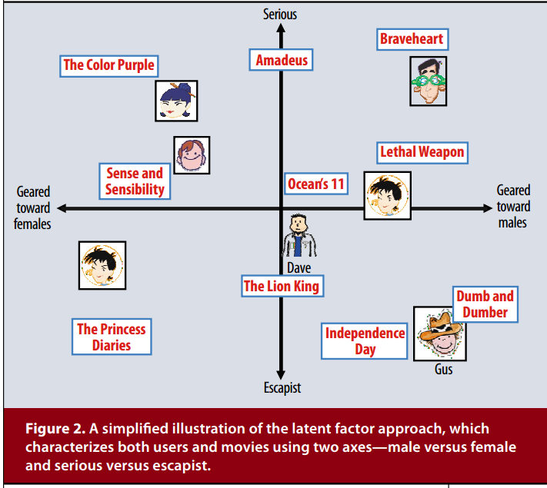
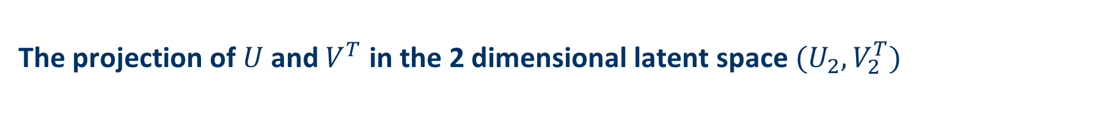
The projection of $U$ and $V^{T}$ in the 2 dimensional latent space $(U_{2},V_{2}^{T})$

Slide 63

Problem formulation
Target function:
sum of squared errors + regularization
where λ is the weight of the regularization term
(i. e., a constant giving the importance of the
regularization term)
Minimization of the above loss function using stochastic gradient descent (or any other incremental optimization algorithms)

Slide 64
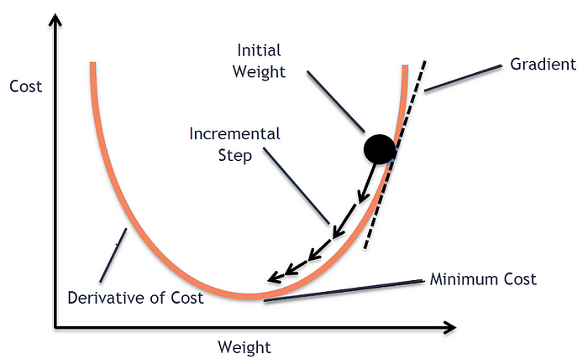
Matrix Factorization Algorithm
# Gradient Descent
def gradient_descent(x, y, theta, alpha, num_iters):
m = len(y)
for i in range(num_iters):
h = np.dot(x, theta)
loss = h - y
gradient = np.dot(x.T, loss) / m
theta = theta - alpha * gradient
return theta
# Stochastic Gradient Descent
def stochastic_gradient_descent(x, y, theta, alpha, num_iters):
m = len(y)
for i in range(num_iters):
for j in range(m):
h = np.dot(x[j], theta)
loss = h - y[j]
gradient = x[j].T * loss
theta = theta - alpha * gradient
return theta

Slide 65
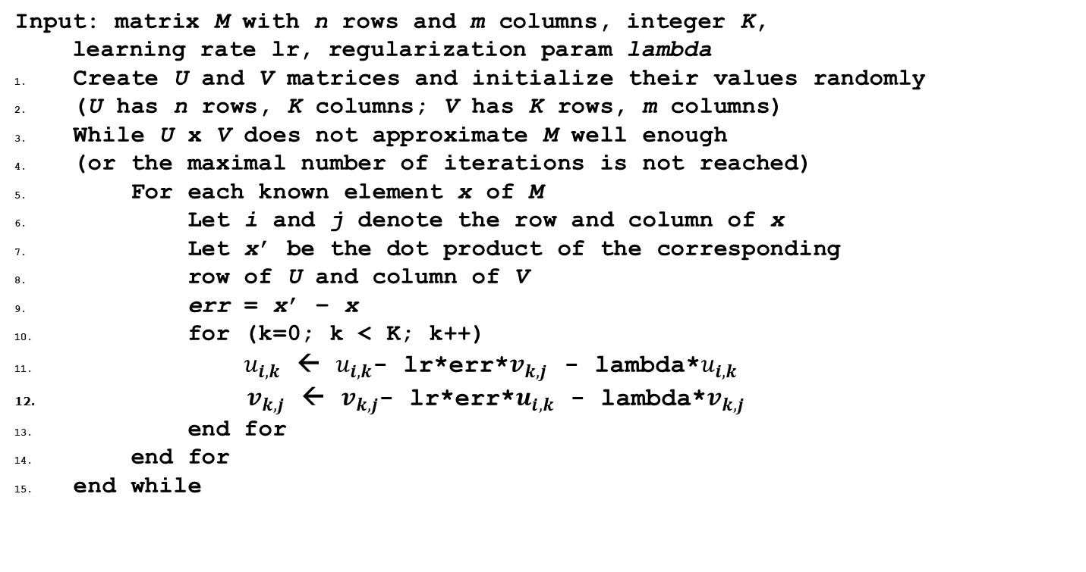
Matrix Factorization Algorithm
Input: matrix M with n rows and m columns, integer K,
learning rate lr, regularization param lambda
Create U and V matrices and initialize their values randomly
(U has n rows, K columns; V has K rows, m columns)
While U x V does not approximate M well enough
(or the maximal number of iterations is not reached)
For each known element x of M
Let i and j denote the row and column of x
Let x’ be the dot product of the corresponding
row of U and column of V
err = x’ – x
for (k=0; k < K; k++)
$u_{i,k}$ ← $u_{i,k}$- lr*err*$v_{k,j}$ - lambda*$u_{i,k}$
$v_{k,j} \text{←} v_{k,j}\text{− }\text{lr}\text{∗}\text{err}\text{∗}u_{i,k}\text{ − }\text{lambda}\text{∗}v_{k,j}$
end for
end for
end while

Slide 66
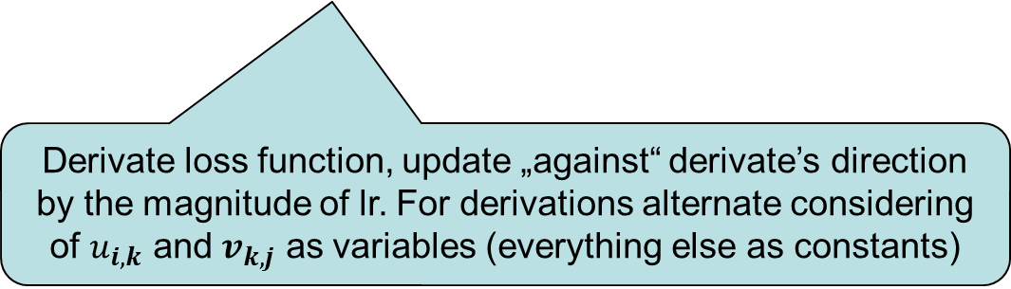
Matrix Factorization Algorithm
Input: matrix M with n rows and m columns, integer K,
learning rate lr, regularization param lambda
Create U and V matrices and initialize their values randomly
(U has n rows, K columns; V has K rows, m columns)
While U x V does not approximate M well enough
(or the maximal number of iterations is not reached)
For each known element x of M
Let i and j denote the row and column of x
Let x’ be the dot product of the corresponding
row of U and column of V
err = x’ – x
for (k=0; k < K; k++)
$u_{i,k}$ ← $u_{i,k}$- lr*err*$v_{k,j}$ - lambda*$u_{i,k}$
$v_{k,j} \text{←} v_{k,j}\text{− }\text{lr}\text{∗}\text{err}\text{∗}u_{i,k}\text{ − }\text{lambda}\text{∗}v_{k,j}$
end for
end for
end while
Iterations
Training examples
For all latent factors
Error on example
Update user and item vectors
Derivate loss function, update „against“ derivate’s direction by the magnitude of lr. For derivations alternate considering of $u_{i,k}$ and $v_{k,j}$ as variables (everything else as constants)

Slide 67
High-level view of matrix factorization algorithm
Random initialization of U and V
While U x V does not approximate the known values of M well enough
  Choose a known value of M, we denote it by x
  Adjust the values of the corresponding row and column of U and V respectively, so that the approximation becomes better

Slide 68
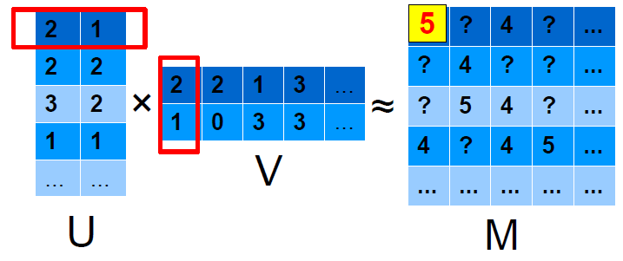
Example for an adjustment step
(2*2)+(1*1) = 5 which equals to the selected value → we do not do anything

Slide 69
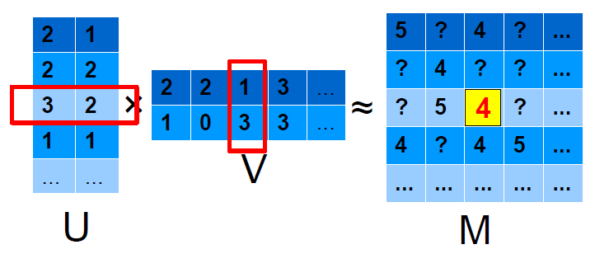
Example for an adjustment step
(3*1)+(2*3) = 9
9 > 4 → we decrease the values of the corresponding rows so that their products will be closer to 4

Slide 70
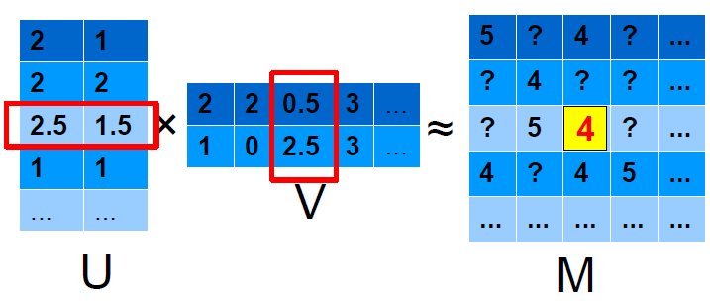
Example for an adjustment step
(3*1)+(2*3) = 9
9 > 4 → we decrease the values of the corresponding rows so that their products will be closer to 4

Slide 71
Why is the algorithm „good”?
1. The adjustment should be proportional to the error → let it be ε-times the error
  In the current example: error = 9 – 4 = 5
  with ε=0.1 we will decrease all the values in the corresponding rows and columns by 0.1*5=0.5
(3*1)+(2*3) = 9

Slide 72
Why is the algorithm „good”?
2. We should take into account how much each value of the row/column contributes to the error
  For the selected row:
  3 is multiplied by 1 → 3 is adjusted by ε*5*1 = 0.5
  2 is multiplied by 3 → 2 is adjusted by ε*5*3 = 1.5
  For the selected column respectively:
  ε*5*3=1.5 and ε*5*2=1.0

Slide 73
Why is the algorithm „good”?
3. We prefer simpler models (avoid overfitting).
At each adjustment step: subtract additionally
λ-times the value
  For the selected row: subtract additionally
  λ*3 from 3, and λ*2 from 2 .
  For the selected column respectively: λ*1 and λ*3

Slide 74

What are the MF’s Hyperparameters?
- Number of latent factors
- Learning rate
- Amount of regularization
- Stopping criteria (number of iterations + early stopping options)
How to select the right ones?
- Hyperparameter tuning
- Try different configurations and evaluate on validation data
- Select the best performing variant and re-train on all data
- grid search / random search / Bayesian / Evolutionary ...

Slide 75

Questions?

Slide 76
Issues + Disadvantages of classical MF
Static set of items and users (what about new ones?)
  Batch-trained – newest response is never in the models
  Iterative local updates possible, but new users/items are stil a problem
Optimize w.r.t. Irrelevant error (RMSE)
Learning rate vs. Regularization hyperparameters
Local optimum vs. global optimum; convergence speed
  More ellaborated optimizers
  https://ruder.io/optimizing-gradient-descent/
Memory-efficient implementation
  sparse representation of M
  Sparse matrix in scipy.sparse (i,j,value)
Too many items / users to fit into memory
  „Pipeline approaches” pre-filter candidates first via some simple alg. Use more complex alg. For a subset

Slide 77

Learning rate vs. Regularization vs. Num of factors hyperparameters

Slide 78


More ellaborated optimizers
Momentum-like updates (accumulated directions)
Plain SGD
With Momentum
Adaptive learning rates (AdaGrad, AdaDelta, RMSprop)
- smaller updates (i.e. low learning rates) for parameters associated with frequently occurring features,
- larger updates (i.e. high learning rates) for parameters associated with infrequent features
Time-decaying factor / floating window
https://www.ruder.io/optimizing-gradient-descent/

Slide 79


More ellaborated optimizers
https://www.ruder.io/optimizing-gradient-descent/

Slide 80
2008: Factorization meets the neighborhood: a multifaceted collaborative filtering model, Y. Koren, ACM SIGKDD
Merges neighborhood models with latent factor models
Latent factor models
  good to capture weak signals in the overall data
Neighborhood models
  good at detecting strong relationships between close items
Combination in one prediction single function
  Local search method such as stochastic gradient descent to determine parameters
  Add penalty for high values to avoid over-fitting

Slide 81
Optimizing w.r.t. Incorrect metric
True | Pred 1 | Pred 2
3 | 4.1 | 0.05
4 | 3.9 | 1.2
5 | 3.8 | 9.5
What is RMSE of both predictors?
Which one is better + why?

Slide 82
BPR matrix factorization
Instead of rating errors, focus on ranking correctness
Triples of user, good and bad object
For these pairs, good object should be rated higher than the bad one
(unary feedbak originally, but graded possible)

Slide 83



BPR algorithm
Matrix factorization/completion
Ranking-oriented optimization
  Based on BPR MF¹
  Binary implicit feedback
  Train set triples (user, good, bad object)
    Maximize distance in rating of good and bad obj.
    Individual updates for both user, good object and bad object
¹Rendle et al.: BPR: Bayesian Personalized Ranking from Implicit Feedback, UAI 2009
$${\hat{r}}_{i,j}≔u_{i}×o_{j}$$
Ranking correctness
$maximize \sum_{∀(u,g,b)}{\ln{σ\left({\hat{r}}_{u,g}−{\hat{r}}_{u,b}\right)}−}{λ\left\|U\right\|}^{2}+{\left\|V\right\|}^{2}$.
Regularization
Train set

Slide 84
BPR algorithm
What about weak spots of this method?

Slide 85
Questions?

