Slide 1


NSWI166 – Introduction to Recommender Systems and User Preferences
Ladislav Peska & Peter Vojtas
Ladislav.peska@matfyz.cuni.cz, S208
https://www.ksi.mff.cuni.cz/~peska/vyuka/NSWI166
Lecture: Wed 9:00 S5 (:-/)
Labs: Wed 10:40 S6 (every two weeks)
2/1, ZK+Z, 4 credits
- 1 -
https://www.ksi.mff.cuni.cz/

Slide 2

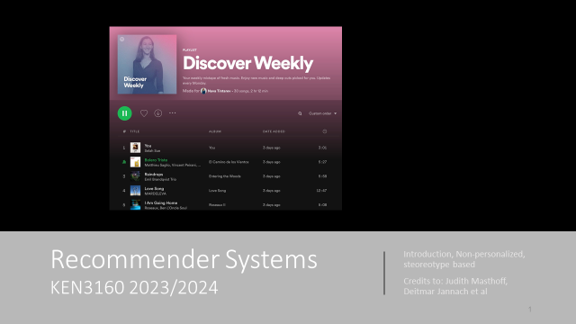
Recommender Systems – An Introduction
Source materials
KEN3160: Recommender Systems
Maastricht University
Ad-hoc papers &tutorials
Dietmar Jannach, Markus Zanker, Alexander Felfernig, Gerhard Friedrich
Cambridge University Press
- Bit outdated, but covers the basics
Nava Tintarev, Francesco Barile
- Borrowed some content
?
- 2 -

Slide 3
Today’s Agenda
Introduction
  Problem domain
  Purpose and success criteria
  Paradigms of recommender systems
    Collaborative Filtering
    Content-based Filtering
    Knowledge-Based Recommendations
    Hybridization Strategies
NSWI166 outline
  Topics to be covered
  Requirements
  Dates
RecSys „Hello Worlds“
  Non-personalized
  User-based KNN
- 3 -

Slide 4


- 4 -

Slide 5
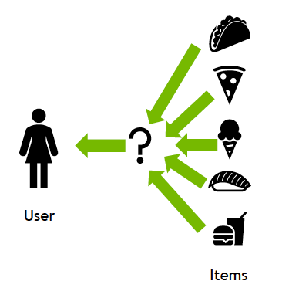
What are Recommender Systems?
RS are software agents that elicit the interests and preferences of individual consumers […] and make recommendations accordingly. They have the potential to support and improve the quality of the decisions consumers make while searching for and selecting products online. (Xiao & Benbasat 2007¹)
https://www.nvidia.com/en-us/glossary/recommendation-system/
[Wikipedia] A recommender system is a subclass of information filtering system that provides suggestions for items that are most pertinent to a particular user. Recommender systems are particularly useful when an individual needs to choose an item from a potentially overwhelming number of items that a service may offer.
[pertinent: relevant or applicable to a particular matter]
[N. Tintarev (KEN3160)] Recommender systems play an important role in helping to mediate many of our everyday decisions and choices….They do this by learning from our past interactions, inferring our interests and documenting our preferences. To make the right suggestions …recommender systems must …understand …our current needs and perhaps our immediate intent.
(1) Xiao and Benbasat, E-commerce product recommendation agents: Use, characteristics, and impact, MIS Quarterly 31 (2007), no. 1, 137–209
- 5 -

Slide 6
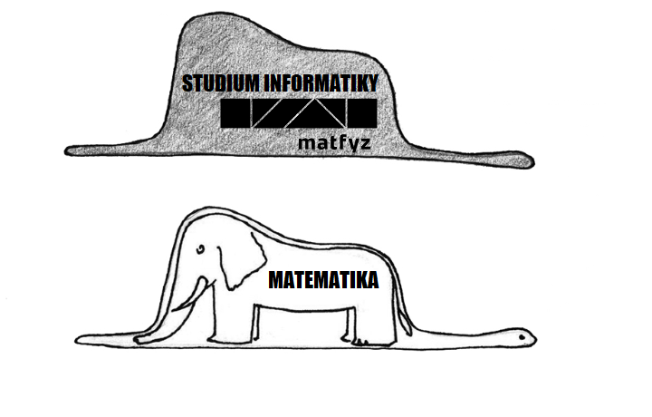



What are Recommender Systems? Meme style
Recommendation systems (RS) help to match users with items
  Ease information overload
  Sales assistance (guidance, advisory, persuasion,…)
RS are software agents that elicit the interests and preferences of individual consumers […] and make recommendations accordingly.
They have the potential to support and improve the quality of the
decisions consumers make while searching for and selecting products online.
» (Xiao & Benbasat 2007¹)
Different system designs / paradigms
  Based on availability of exploitable data
  Implicit and explicit user feedback
  Domain characteristics
(1) Xiao and Benbasat, E-commerce product recommendation agents: Use, characteristics, and impact, MIS Quarterly 31 (2007), no. 1, 137–209
- 6 -

Slide 7
Problem domain
Recommendation systems (RS) help to match users with items
  Ease information overload
  Sales assistance (guidance, advisory, persuasion,…)
RS are software agents that elicit the interests and preferences of individual consumers […] and make recommendations accordingly.
They have the potential to support and improve the quality of the
decisions consumers make while searching for and selecting products online.
» (Xiao & Benbasat 2007¹)
Different system designs / paradigms
  Based on availability of exploitable data
  Implicit and explicit user feedback
  Domain characteristics
(1) Xiao and Benbasat, E-commerce product recommendation agents: Use, characteristics, and impact, MIS Quarterly 31 (2007), no. 1, 137–209
- 7 -

Slide 8
Problem domain
Recommendation systems (RS) help to match users with items
  Ease information overload
  Sales assistance (guidance, advisory, persuasion,…)
RS are software agents that elicit the interests and preferences of individual consumers […] and make recommendations accordingly.
They have the potential to support and improve the quality of the
decisions consumers make while searching for and selecting products online.
» (Xiao & Benbasat 2007¹)
UI/UX, Causality, multi-objective, Beyond-accuracy, Dynamic processes, Impact of RS on society.
Different system designs / paradigms
  Based on availability of exploitable data
  Implicit and explicit user feedback
  Domain characteristics
(1) Xiao and Benbasat, E-commerce product recommendation agents: Use, characteristics, and impact, MIS Quarterly 31 (2007), no. 1, 137–209
- 8 -

Slide 9
Recommending vs. Searching
Search Engines
  Users know in advance what they want (and are able to specify it)
  Explicit query submitted by the user
  Evaluation through known „correct“ answers for the query
Recommender Systems
  Users do not know what they want (or do not know how to ask for it)
  RS tries to understand user’s needs through observed behavior
  (provide suitable results for these needs without being explicitly asked)
  „Implicit query“
  Personalized Adds
  Works extra-site, no prior indication of user’s needs
    Often, the basic principle of RecSys (mutual benefits) is violated
    Although seemingly the same task, the same methods as for RecSys often do not work

Slide 10

Benefits of recommendation
Information overload. Too many: movies, ads, webpages, songs, plumbers, etc.
Strongest need for RS
What’s good, what’s not?
Searching is difficult
10

Slide 11
Benefits of recommendation
Information overload. Too many: movies, ads, webpages, songs, plumbers, etc.
Strongest need for RS
RecSys are everywhere
What’s good, what’s not?
Searching is difficult
11

Slide 12
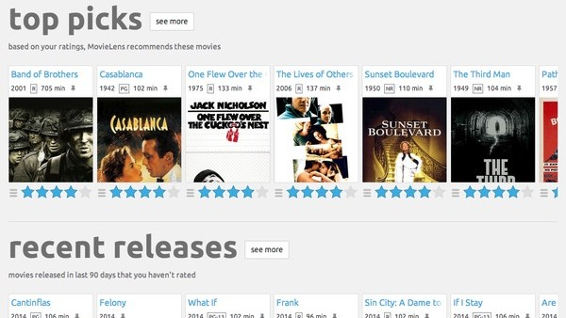
Movies
12

Slide 13
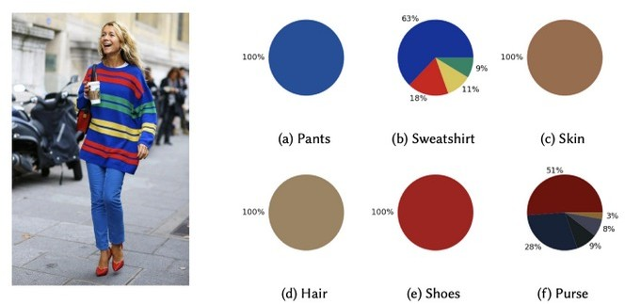


Fashion recommendation
Second Workshop on Recommender Systems for Fashion

Slide 14

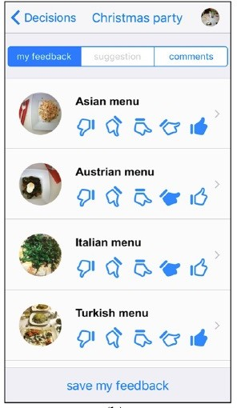
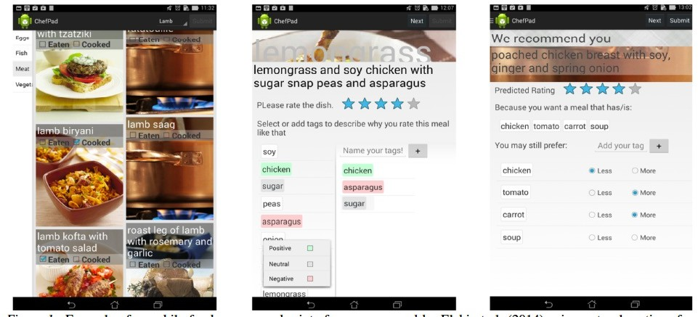
Food recommendations

Slide 15
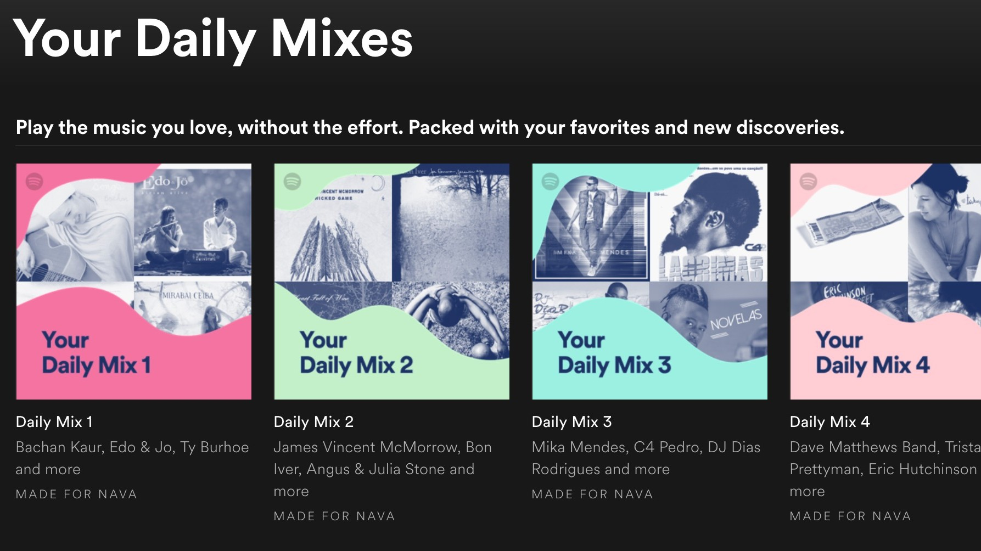
Music

Slide 16
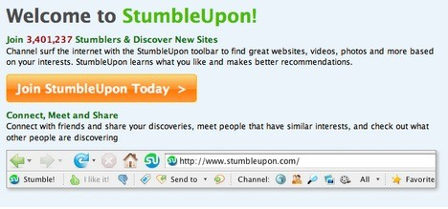
Webpages

Slide 17
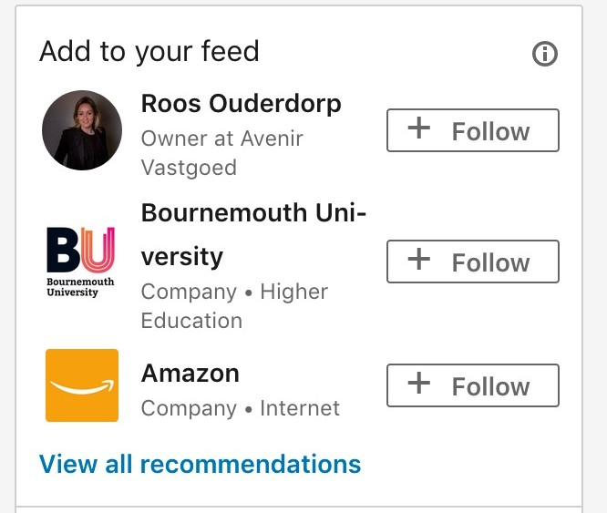
People (LinkedIn)

Slide 18
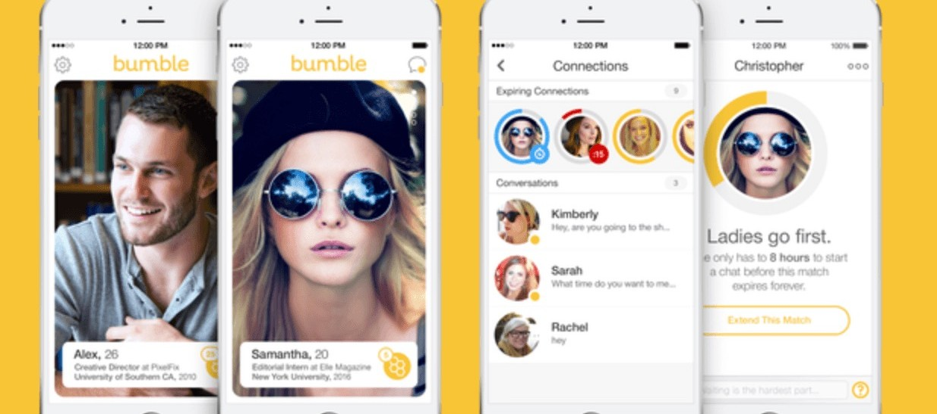
People (Bumble)

Slide 19
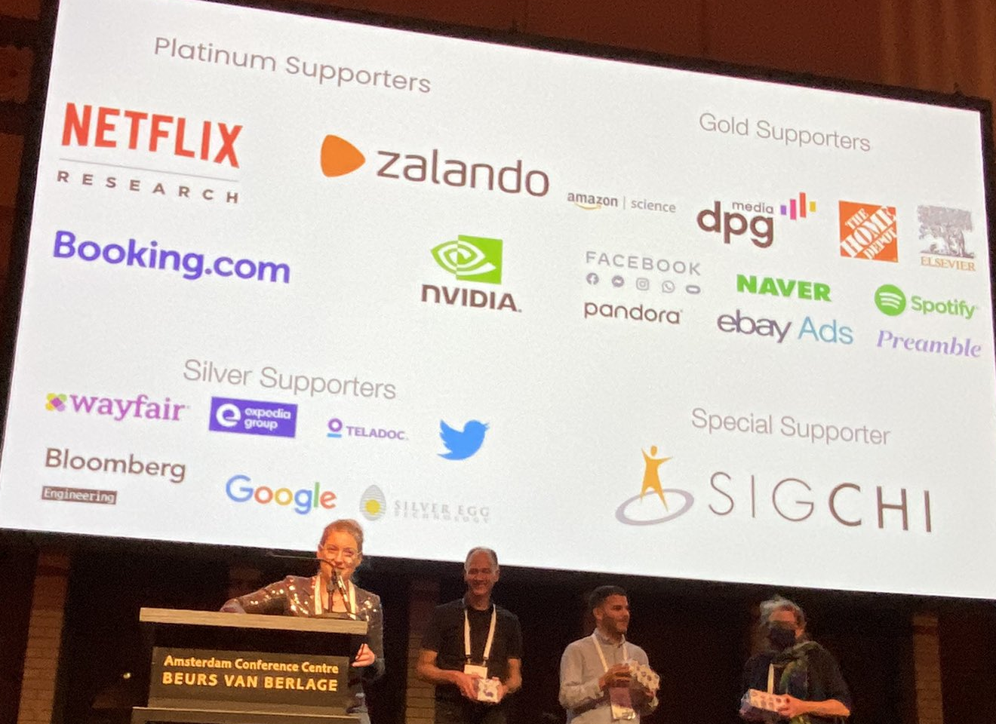
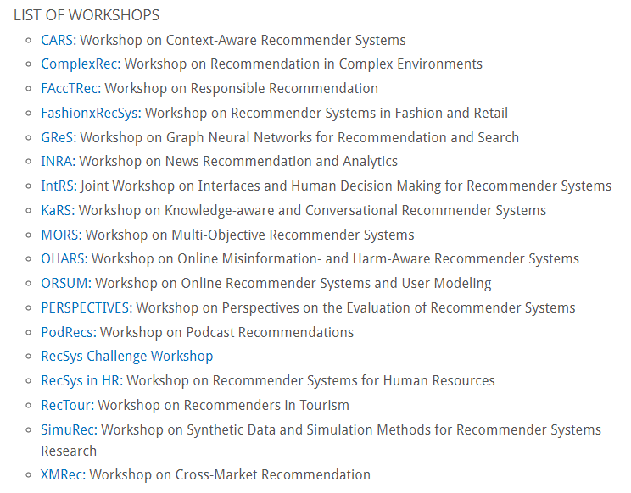
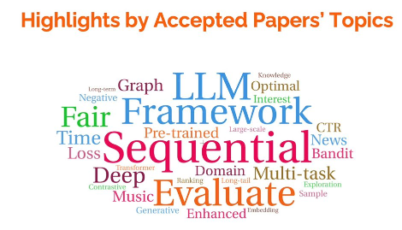
Recommender Systems are intensively researched
RecSys 2021: >1100 attendies, ±50 papers (acceptance <20%)
RecSys 2022: >1200 attendies; RecSys 2023: 1000 attendies,
Large industrial sponsors, lots of industry based research papers
Lots of „We’re hiring“ signs ☺

Slide 20


This can be you ☺
RecSys 2023, Martin Spisak (NSWI166 almuni)

Slide 21
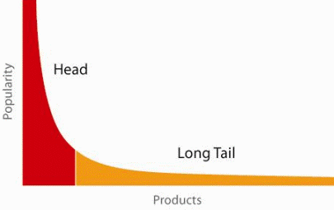
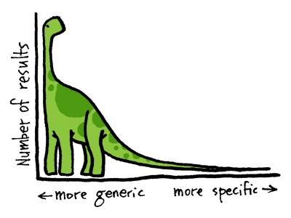
When does a RS do its job well?
"Recommend widely unknown items that users might actually like!"
Recommend items from the long tail
20% of items accumulate 74% of all positive ratings

Slide 22

Retrieval perspective
Reduce search costs
Provide "correct" proposals
Users know in advance what they want
Recommendation perspective
Serendipity – identify items from the Long Tail
Users did not know about existence, but like them
Purpose and success criteria (1)

Slide 23
Prediction perspective
Predict to what degree users like an item
Used to be the most popular evaluation scenario
Interaction perspective
Give users a "good feeling"
Educate users about the product domain
Convince/persuade users - explain
Finally, conversion perspective
Commercial situations
Increase "hit", "clickthrough", "lookers to bookers" rates
Optimize sales margins and profit
Purpose and success criteria (2)

Slide 24
Recommender systems
RS seen as a function
Given:
  User model (e.g. ratings, preferences, demographics, situational context)
  Items (with or without description of item characteristics, relations,…)
Find:
  Items’ relevance score / Ranking of items (short head section is sufficient).
How?
  Based on similarity! (and other stuff… later)
  The true question is, what kind of similarity we assume☺

Slide 25

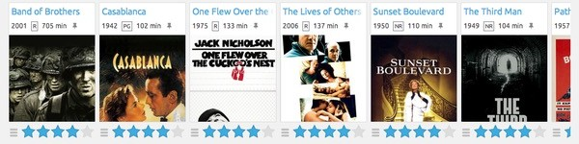
Discuss
How do you think a recommender system works? What could be similar?

Slide 26
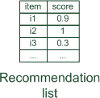
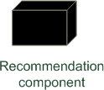
Paradigms of recommender systems
Recommender systems reduce information overload by estimating relevance
Non-personalized, e.g. most popular, manually currated

Slide 27


Paradigms of recommender systems
Personalized recommendations

Slide 28

Paradigms of recommender systems
Collaborative: "Tell me what's popular among my peers"

Slide 29

Paradigms of recommender systems
Content-based: "Show me more of the same what I've liked"

Slide 30


Paradigms of recommender systems
Knowledge-based: "Tell me what fits based on my needs"

Slide 31
Paradigms of recommender systems
Hybrid: combinations of various inputs and/or composition of different mechanism

Slide 32
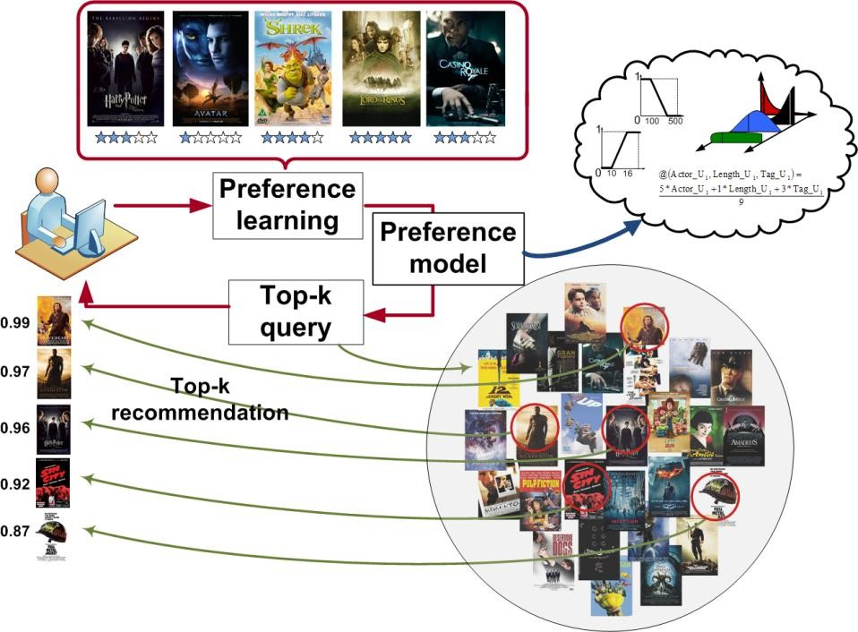
Lifecycle of Recommender Systems
Get User Feedback
Learn internal model
Upon demand, recommend objects
The process is asynchronous by nature
Most recent usually most relevant
Dynamic nature of the process seriously complicate things

Slide 33

Questions?

Slide 34
NSWI166 Lectures Outline
RS Basics
21.2. Intro + RecSys Hello World
28.2. Collaborative Filtering
06.3. Collaborative Filtering (Intro to Content-based RS)
13.3. Content-based and Knowledge-based RS
20.3. Evaluating RS
User preferences (Peter Vojtas)
27.3. Linear monotone preference model
03.4. Threshold algorithms
10.4. Challenge-response framework
(Slightly more) advanced RS
17.4. Hybrid recommending algorithms
24.4. Context-aware & beyond-relevance RS
15.5. Deep Learning in RS and recent trends
22.5. Invited Lecture

Slide 35
NSWI166 Labs
    Lab Content:
    Get practical understanding of user preferences and recommendation concepts
    Development & evaluation of rec. algorithms
    Hands on Libraries / Tools / Frameworks / Datasets
    Time for paper/software presentations etc.
Active reading
Four research papers
Short written reports (strict deadlines)
At least two (accepted) reports to pass; additional/exceptional reports = bonifications for exams
Participation during labs (or at home)
Typically, 1-2 assignments will require to be finalized at home
At least 50% of assignments accepted to pass; additional/exceptional results = bonification for exams
Semestral work (individual or in a group)
Details after the first block
User study to compare recommending algorithms
  Integration of existing recommending frameworks
  Slight results modification (e.g., diversity enhancments)
  Integration to EasyStudy
  Non-trivial domain / integration / algorithms => group work
Alternative pass: more extensive research project (contact me for details)

Slide 36
Active reading
#1: Collaborative RS algorithms (choose one of the following)
Amazon.com Recommendations Item-to-Item Collaborative Filtering:
  https://www.cs.umd.edu/~samir/498/Amazon-Recommendations.pdf
Embarrassingly Shallow Autoencoders for Sparse Data
  https://dl.acm.org/doi/abs/10.1145/3308558.3313710
Collaborative filtering with temporal dynamics
  https://dl.acm.org/doi/abs/10.1145/1557019.1557072
Deadline: 10.3.2024
At most 1 page of text CZ/SK/EN (normal font and margins - be brief but thorough)
Q1. Your name and Paper’s title
Q2. What is this paper about, and what contributions does it make? Q3. What main new insights you received from the paper?
Q4. Does the paper has any notable weaknesses?

Slide 37
Exam
„Semi-oral“ exam (written notes + discussion)
4-5 questions from the theory covered during lectures
Application of knowledge
  Having a particular case where RS is to be introduced, you should be able to recommend sensible first approaches & hypotheses on what could work, what not.

Slide 38
NSWI166 - Literature
Textbooks
  Ricci, F. et al (Eds): Recommender Systems Handbook, Springer, 2011/2015/2022
    https://edyaaleh.files.wordpress.com/2016/02/recommendersystemshandbook.pdf
    Mail me for the most up-to-date book’s PDF
  Kim Falk: Practical Recommender Systems, Manning 2019
Tutorials
  https://www.slideshare.net/balazshidasi (algorithms, deep learning)
  https://www.slideshare.net/usabart (evaluation)
  RecSys 2021+2022+2023 tutorials (let me know if you cannot obtain videos for tutorials)
  NSWI166 slides: http://ksi.mff.cuni.cz/~peska/vyuka/nswi166/
Lecture recordings from last years (in Czech)
  https://www.youtube.com/playlist?list=PLTYzSYF3EX3AO5IouvxraVzeVPRORJTmV
Conferences / Journals / Other sources
  RecSys, UMAP, SIGIR, IUI, CHI, ECIR, FaccT...
  USER MODELING AND USER-ADAPTED INTERACTION (UMUAI journal)
  ACM Transactions on Recommender Systems (ToRS, introduced in 2021)

Slide 39
NSWI166 – Related Courses
NDBI021: User preferences and advanced recommending methods
  More insights on what the user preferences are & how to learn them
  Advanced concepts in Recommender Systems (Biases, multi-objective/multi-stakeholders, Fairness, Domain specific challenges)
  Tuesday from 2PM
  Normally a follow-up, but slightly altered to allow simultaneous passage
Other from Information Retrieval:
NDBI038: Searching the Web, NDBI045: Video Retrieval, NDBI034: Multimedia Retrieval (winter)

Slide 40
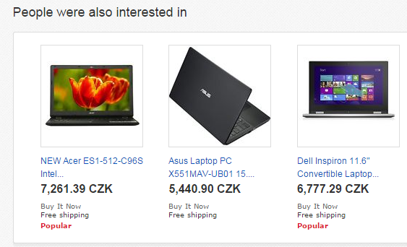
RecSys „Hello worlds“ (if you leave now, please remember...)
Non-personalized
no explicit notion of the current user (i.e., no UID)
recommending based on aggregated data
  and (optionally), current page context (item-based RS)
„Most (recently) popular items (in this category)“
„People who bought this also bought that“
„Similar objects to this one“
…
Select count(*) as num, item_i
from coocurred_items
where item_j = [current_item]
group by item_i
order by num
limit 0, [num_of_displayed]
Caching / periodic evaluation for the sake of speed

Slide 41
RecSys „Hello worlds“ (if you leave now, please remember...)
The simplest personalized recommending algorithm
User-based nearest-neighbor collaborative filtering (UB-kNN)
  Get most similar users to the current one.
    Cosine similarity / Correlation of known ratings per user
  Aggregate their feedback on not-yet-visited items.
    Average / similarity-weighted average…
  Recommend items with best aggregated feedack.
    Top-k items with highest rating

Slide 42
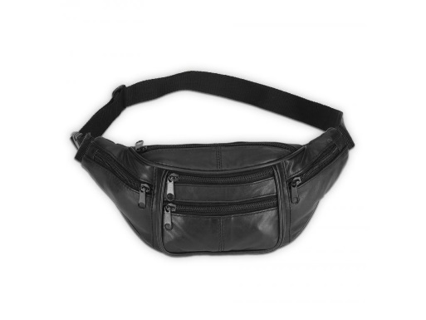
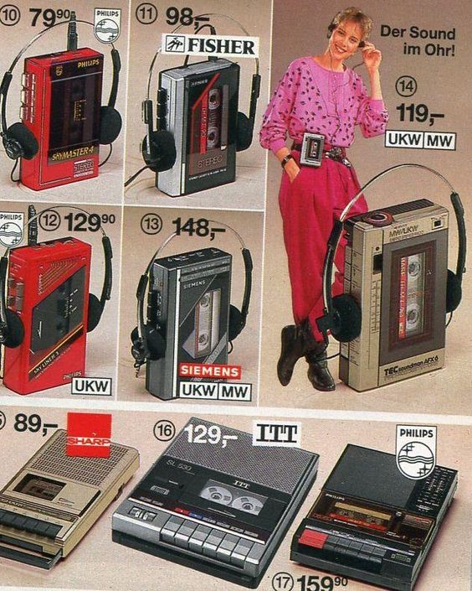
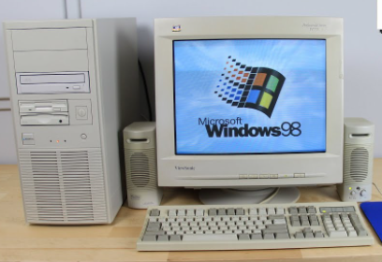
RecSys „Hello worlds“ (if you leave now, please remember...)
Next lecture: 28.2.
  Why not to use User-based KNN
    (no 90s nostalgia tolerated here)
  What are better alternatives?
    Why also do not use these?
    What should I use then?

Slide 43
Guess the title... ☺
?

