Slide 1
NDBI021, Lecture 12
User preferences, 2/1 ZK+Z,
Wed 12:20 – 13:50 S8
Wed 14:00 – 15:30 SW2 (odd weeks)
https://www.ksi.mff.cuni.cz/~peska/vyuka/ndbi021/2022/
https://ksi.mff.cuni.cz

Slide 2
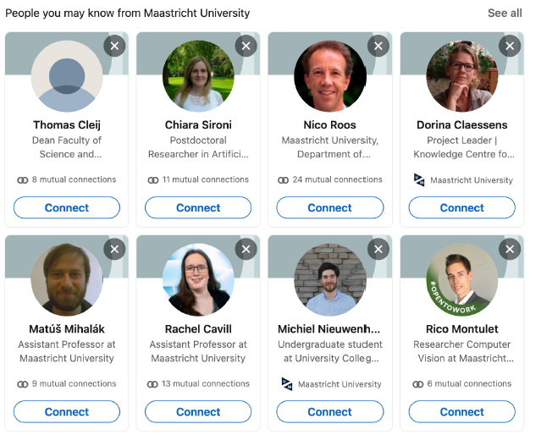
People Recommender Systems
Slides partially based on Maastricht RecSys course by Nava Tintarev and Francesco Barile
https://ksi.mff.cuni.cz

Slide 7
Do you know? Recommending people to invite into your social network
https://www.researchgate.net/publication/221607653_Do_you_know_Recommending_people_to_invite_into_your_social_network

Slide 13
Can lead to FoFoF (friend of a friend of a frined) type recommendations, considering the weak ties (B->A->C)

Slide 15
Recommend courses/mentors to follow…
… or recommend people to team up with

Slide 16
Recommend courses/mentors to follow…
… or recommend people to team up with
Socio-demographic links performed the best

Slide 18
People Recommender Systems: Online Dating
Slides partially based on Maastricht RecSys course by Nava Tintarev and Francesco Barile
https://ksi.mff.cuni.cz

Slide 19
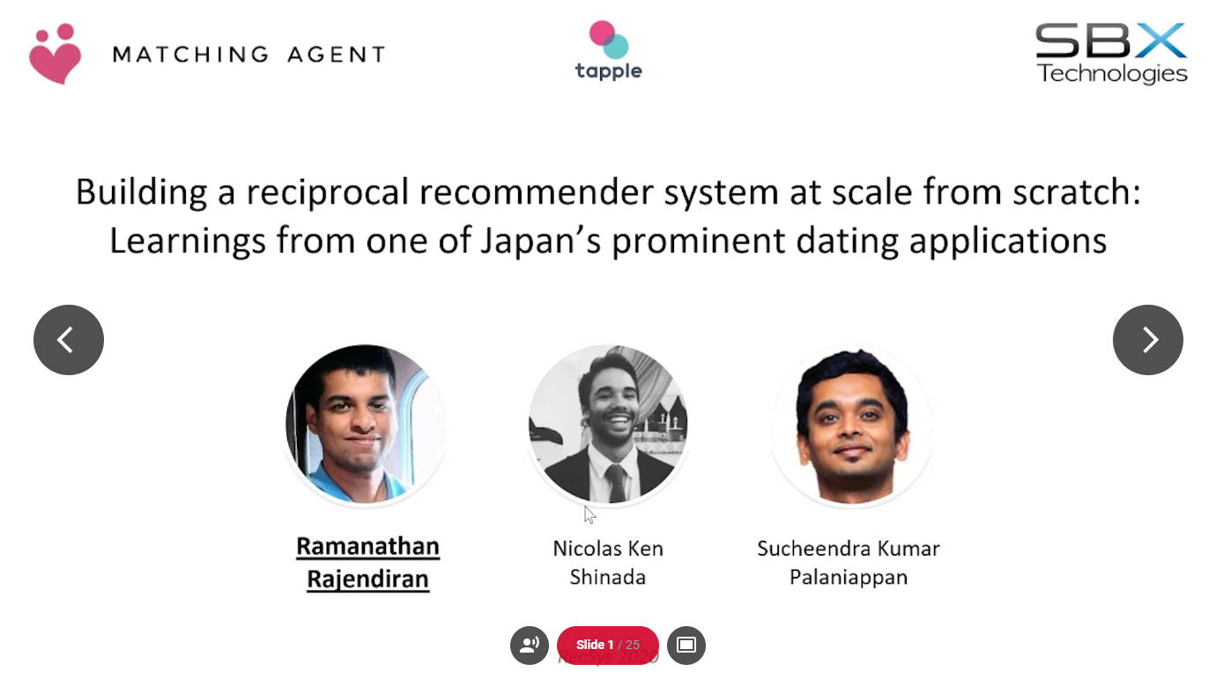
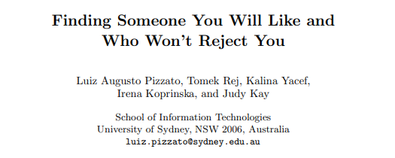
Reciprocal RS in Online Dating

Slide 20
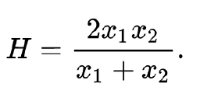
Finding Someone You Will Like and Who Won’t Reject You (UMAP 2011)
Modeling both Likes and Dislikes
Costly „bad“ recommendations – i.e., initiate contact but rejected
Likes: send invitation / response positively
Attribute-oriented CB recommender (it was over a decade ago:-/)
Checking compatibility of „liked“ attributes C_pos(A,B)
Harmonic mean for C_pos(A,B) and C_pos(B,A)
Penalizes high differences in compatibilities
Dislikes: ignoring invite
Otherwise, same approach
Unified model: C(A,B) = (1 + C_pos(A,B) – C_neg(A,B))/2
Finding Someone You Will Like and Who Won’t Reject You, UMAP 2011

Slide 21
Other insights (2016)
Large disballance
Possible CB links to exploit
Design of Reciprocal Recommendation Systems for Online Dating: https://web.cs.ucla.edu/~yzsun/papers/snam2016.pdf

Slide 27
Notes:
Recently active users re-ranking!

Slide 28
Notes:
De-popularization
Recently active users
Recently registered users

Slide 29
Notes:
New users: pseudo embeddings based on similar metadata of other users
Metadata: e.g., location

Slide 30
Notes:
Pre-compute recommendations for faster query-time responses

Slide 31
Notes:
Different treatment of existing (key-value pair storage of precomputed recs) vs. Cold-start users (running inference server)

Slide 35
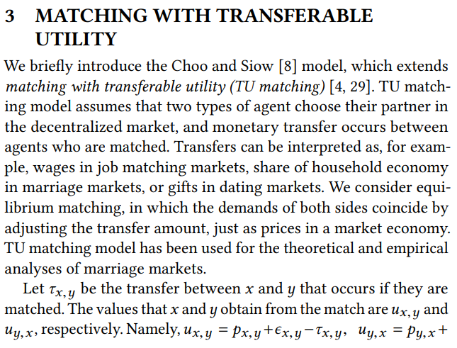
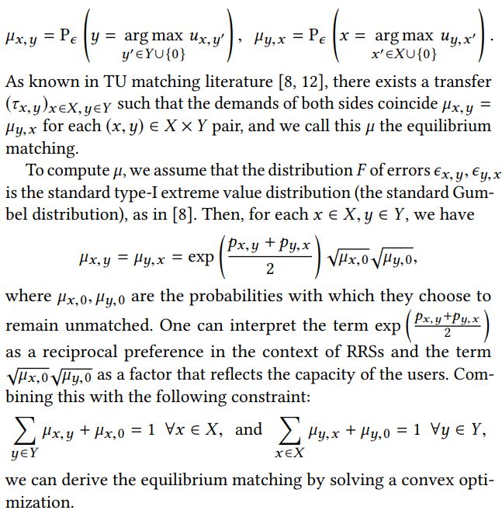
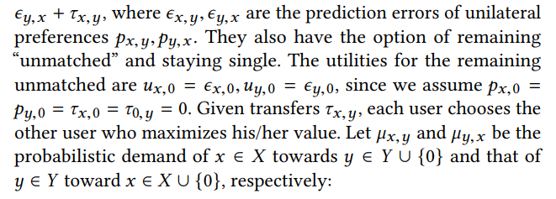
Notes:
TU: sort of a cost one have to pay to receive a match…
Aiming to maximize overal utility of the system
Work on top of probabilistic distributions – I assume hten there is time for sampling
Jointly consider reciprocal preference and the capacity of users

Slide 36
People Recommender Systems: Job Recommender Systems
Slides partially based on Maastricht RecSys course by Nava Tintarev and Francesco Barile
https://ksi.mff.cuni.cz

Slide 37
Job Recommender Systems (RecSys in HR)
RecSys Workshop at 2021 – 24
Overall, challenging topic
Reciprocal RS, but with different stakeholders
Recruiters
Job seekers
Main sources of knowledge
Interactional data (the usual)
CV (content-representation of „users“)
Job description (content-representation of „items“)
Dual task (whom do we recommend to?)
Location importance

Slide 39
Effectiveness of job title based embeddings (2021)
Recommend candidates to jobs
Latent model (users = job postings, items = job seekers), several variants
Represent items as an embedding of ther CV, User as embed of their description
Represent items through historical interaction with users (average embeddings)
Represent users through historical interaction with items (average embeddings)
Embeddings:
Pre-trained Word2Vec
Self-trained Word2Vec
Self-trained Doc2Vec
Data:
Job title only
Job appetizer / resume texts

Slide 40
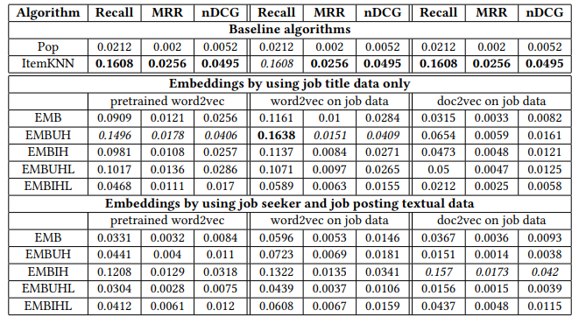
Effectiveness of job title based embeddings (2021)
Results:
If enough interactional data, ItemKNN outperforms all embeddings :-/
But not in cold-start
Job title-based embeds outperformed whole resume-based ones.
Mismatch in writing style?
Self-trained improved over pre-trained

Slide 41
Follow-up: An Exploration of Sentence-Pair Classification for Algorithmic Recruiting (2023)
Maybe, 2vec models are not versatile enough
Different „language style“ of resume and job postings (semantic gap)
What if we use a good language model to learn the properties of this semantic gap?
Use next-sentence-prediction feature of BERT and tune it to map resumes from job postings

Slide 42
An Exploration of Sentence-Pair Classification for Algorithmic Recruiting (2023)
Approaches classification:

Slide 43
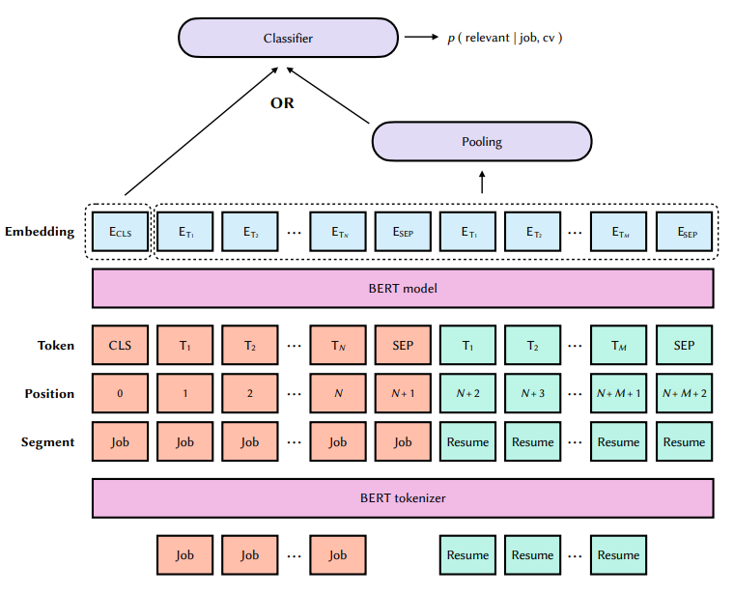
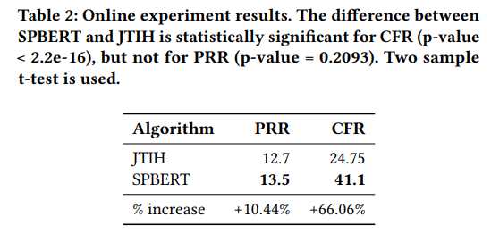
An Exploration of Sentence-Pair Classification for Algorithmic Recruiting (2023)
SPBERT

Slide 45
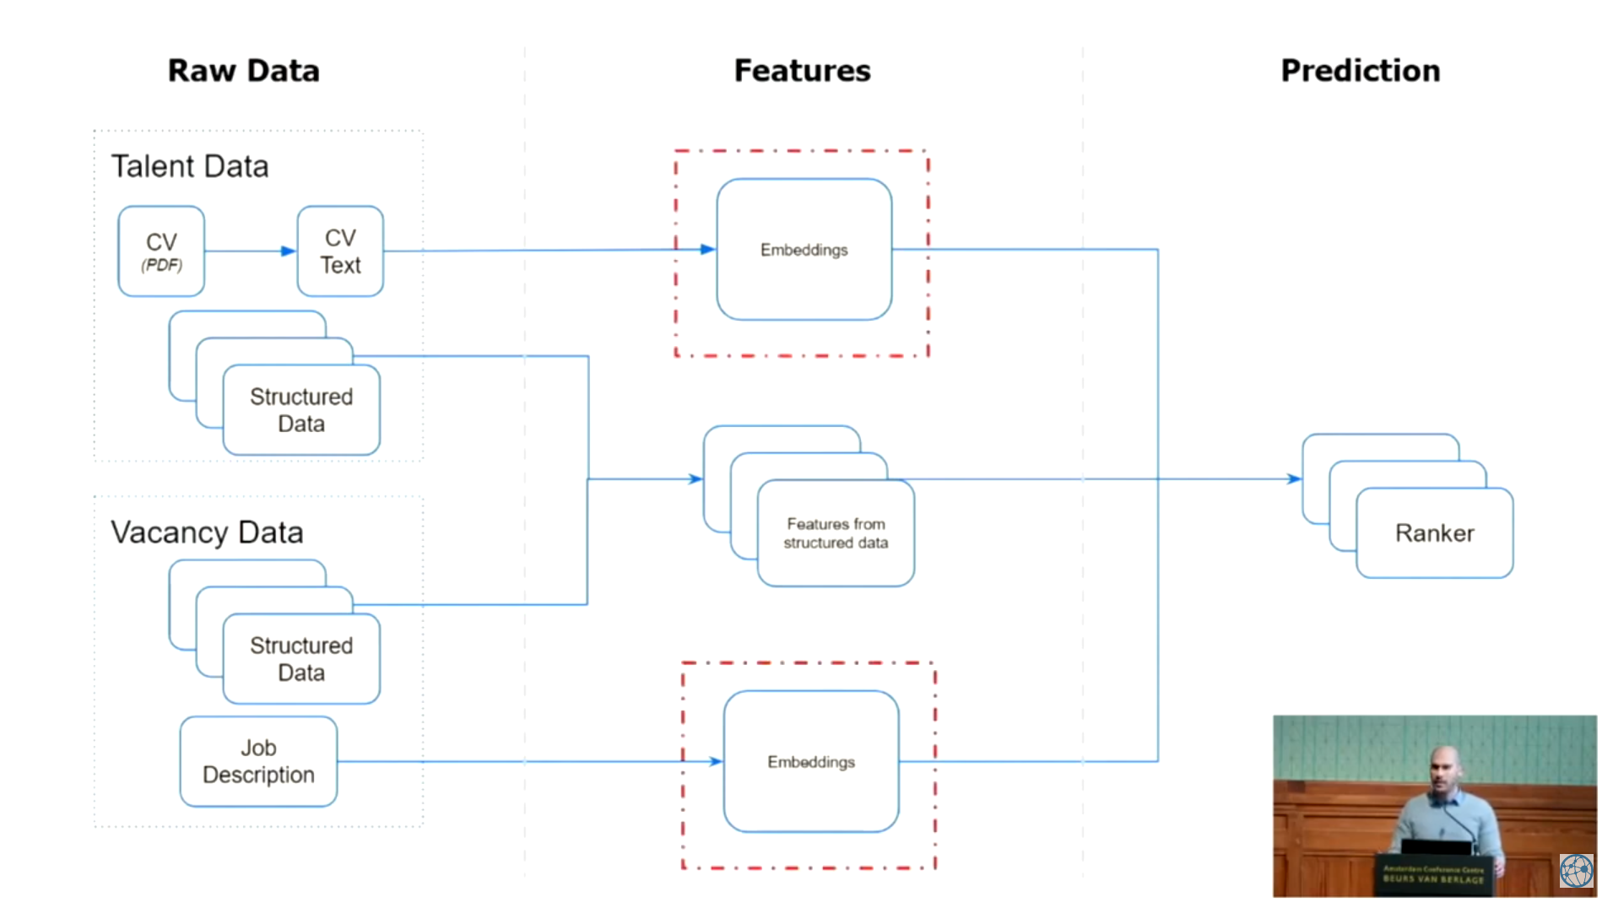

Slide 46
Notes:
CV is noisy, but job description is more consistent
English CV but Dutch job descriptions
Positive signal: any kind of interaction from recruiter to person
Negative: absence of thereof

Slide 47
Notes:
TF-IDF: even larger dimensions did not help
Supervised: feed to random forest

Slide 48
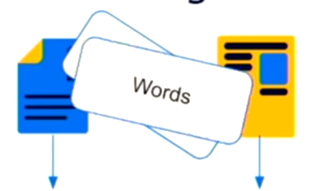
Notes:
Siamese network => pooling layer => cosine similarity

Slide 50
Notes:
Unsupervised distributions basically did not learn anything
Having softmax hurt the performance, but can be remedied by adding random forest

Slide 51
Notes:
Finetuning also help to distinguish different language for descriptions… maybe language agnostic networks next?

Slide 52
Career Path Prediction using Resume Representation Learning and Skill-based Matching (2023)
Provide people with the next career steps at the right time
Career path prediction task:
given a career history: sequence of experiences (𝑒𝑥1 , 𝑒𝑥2 , … , 𝑒𝑥𝑁 −1) each having a title, description and their ESCO occupation labels (𝑜𝑐𝑐1 , 𝑜𝑐𝑐2 , … , 𝑜𝑐𝑐𝑁 −1),
predict the ESCO occupation label 𝑜𝑐𝑐𝑁 of the held-out next experience.
European Skills, Competences, Qualifications and Occupations (ESCO) ontology
Not focus on specific job, but rather a generic job class
Internal job mobility
Research obstacles due to data privacy

Slide 53
Career Path Prediction using Resume Representation Learning and Skill-based Matching (2023)

Slide 54
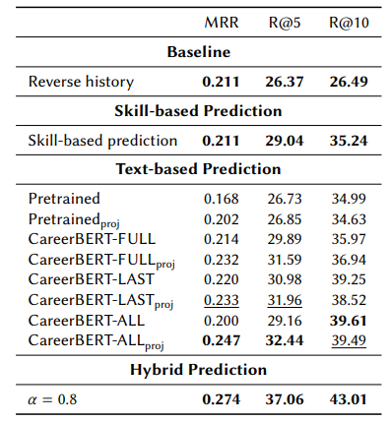
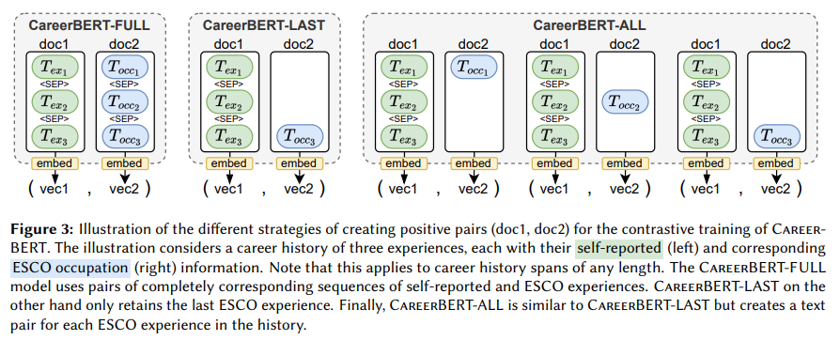
Career Path Prediction using Resume Representation Learning and Skill-based Matching (2023)
Approach:
Skill-based prediction (part of ESCO ontology)
Description-based prediction (embedding + mapping)
Notes:
Contrastive learning
Then, linear transformation between embeddings of previous experience and current job posting

