Slide 1
Rank-sensitive Proportional Aggregations in Dynamic Recommendation Scenarios
Štěpán Balcar, Vít Škrhák and Ladislav Peška
Department of Software Engineering,
Charles University, Prague,
Czech Republic

Slide 2
Task, Motivation
Fair (proportional) representation of multiple recommending algorithms based on their on-line performance and current context of the user
Aggregate multiple lists of recommended items $R_{i}$ corresponding to the recommending strategy ${rs}_{i}$ into a single list of items $R$ based on the current performance of ${rs}_{i}$
Why?
Multiple recommending strategies may be both relevant (up to some extent) and highly diverse
Multiple strategies can be used to model various user’s interests, which should be present in recommendations ^{[Steck 2018]}
Fair aggregation of multiple base recommenders may provide relevant, yet highly diverse recommendations or cover multiple users interests
^{[Steck 2018]} Harald Steck, Calibrated recommendations. RecSys 2018
ORSUM 2019, Copenhagen

Slide 3
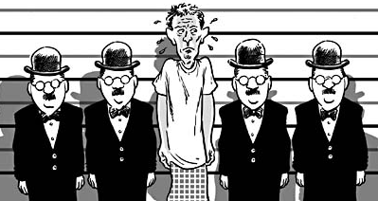
Proportionality Preservation Motivating Example: Assembling Police Photo Lineups
Recommend candidates similar to the suspect, so the lineup is unbiased
Two strategies: CB attribute-based & visual-based (DCNN)
Results:
Visual RS is better (58% vs 37% of selections, but not so good for rare ethnics)
However, very small candidates intersection (1.8% for top-20 candidates)
CB strategy was relevant up to some extent
CB proposed some relevant candidates which Visual could not
Both strategies should be present in final recommendations
Simple weighted aggregation would over-sample visual strategy
Thompson sampling MAB ^{[Broden 2018]} would probably over-sample best method as well
Biased lineup, floridainnocence.org
Reasonably unbiased lineup
(persons artificially generated)
^{[Broden 2018]} Bjorn Broden et al. Ensemble recommendations via thompson sampling: An experimental study within e-commerce. IUI 2018
ORSUM 2019, Copenhagen

Slide 4
Proportionality Preservation Motivating Example: Assembling Police Photo Lineups
Recommend candidates similar to the suspect, so the lineup is unbiased
Two strategies: CB attribute-based & visual-based (DCNN)
Results:
Visual RS is better (58% vs 37% of selections, but not so good for rare ethnics)
However, very small candidates intersection (1.8% for top-20 candidates)
CB strategy was relevant up to some extent
CB proposed some relevant candidates which Visual could not
Both strategies should be present in final recommendations
Simple weighted aggregation would over-sample visual strategy
Thompson sampling MAB ^{[Broden 2018]} would probably over-sample best method as well
Biased lineup, floridainnocence.org
In addition: challenges of dynamic environment (preference changes, current needs/context of user)
Reasonably unbiased lineup
(persons artificially generated)
^{[Broden 2018]} Bjorn Broden et al. Ensemble recommendations via thompson sampling: An experimental study within e-commerce. IUI 2018
ORSUM 2019, Copenhagen

Slide 5
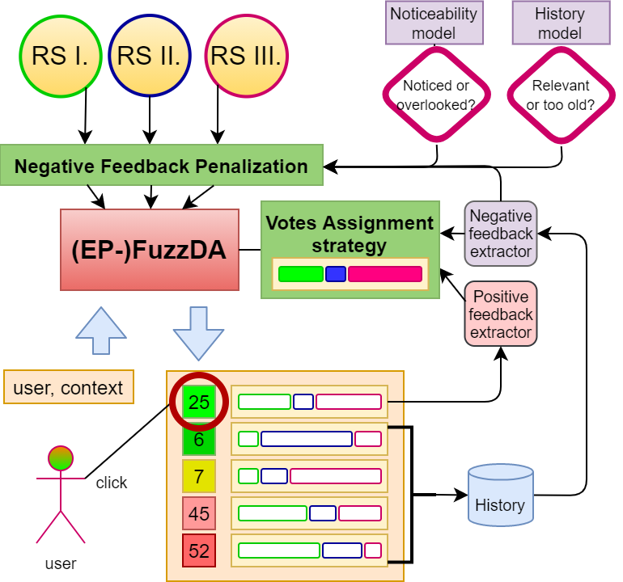
FuzzDA Framework
Fair (proportional) representation of multiple recommending algorithms based on their on-line performance and current context of the user
^{[Steck 2018]} Harald Steck, Calibrated recommendations. RecSys 2018
ORSUM 2019, Copenhagen

Slide 6
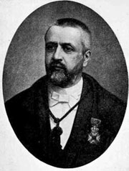
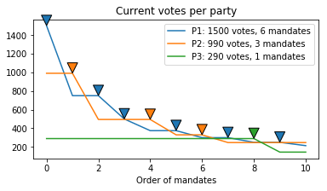
D’Hondts Proportional Mandates Allocation
First idea: What about using something that is tailored to preserve fairness?
Range of algorithms designed to convert votes to mandates in public elections
D’Hondt’s election algorithm ^{[D’Hondt 1882]}
One of the widest-used method in proportional election systems (e.g., 23 countries from Europe)
Core principle:
Greedy selection of next best candidate
Party with the most current votes $v_{curr}$ wins the next candidate, the best candidate of the winning party is selected
Upon a selection of a candidate ($k$-th from this party), the volume of party’s current votes is reduced $v_{curr}=\frac{v_{orig}}{k+1}$
Algorithm outputs an ordered list of „current best“ candidates
Volume of per-party votes corresponds with the volume of per-party candidates
^{[D’Hondt 1882]} Victor D’Hondt, Systeme pratique et raisonne de representation proportionnelle. C.Muquardt, 1882

Slide 7
D’Hondts Proportional Mandates Allocation
First idea: What about using something that is tailored to preserve fairness?
Range of algorithms designed to convert votes to mandates in public elections
D’Hondt’s election algorithm ^{[D’Hondt 1882]}
One of the widest-used method in proportional election systems (e.g., 23 countries from Europe)
Core principle:
Party with the most current votes $v_{curr}$ wins the next candidate, the best candidate of the winning party is selected
Upon a selection of a candidate ($k$-th from this party), the volume of party’s current votes is reduced $v_{curr}=\frac{v_{orig}}{k+1}$
Algorithm outputs an ordered list of „current best“ candidates
Volume of per-party votes corresponds with the volume of per-party candidates
What about graded relevance?
What about items relevant for multiple recommenders?
^{[D’Hondt 1882]} Victor D’Hondt, Systeme pratique et raisonne de representation proportionnelle. C.Muquardt, 1882

Slide 8
Fuzzy D’Hondts Aggregation Algorithm ^{[Peska2019]}
Allows fuzzy membership of candidates to parties
Items can be recommended by multiple recommenders
Per-recommeder ratings of items rather than per-recommender rankings
Modified next item selection procedure
${argmax}_{∀ i∈items}\left(\sum_{∀ j∈recommenders}{currentVotes_{j}∗relevance_{i,j}}\right)$
Modified votes reduction
Consider per-recommender relevance of selected item
^{[Peska2019]} Ladislav Peska and Štěpán Balcar: Fuzzy D’Hondt’s Algorithm for On-line Recommendations Aggregation, ORSUM@RecSys 2019

Slide 9
Fuzzy D’Hondts Aggregation Algorithm ^{[Peska2019]}
Allows fuzzy membership of candidates to parties
Items can be recommended by multiple recommenders
Per-recommeder ratings of items rather than per-recommender rankings
Modified next item selection procedure
${argmax}_{∀ i∈items}\left(\sum_{∀ j∈recommenders}{currentVotes_{j}∗relevance_{i,j}}\right)$
Modified votes reduction
Consider per-recommender relevance of selected item
Where is some guarantee for optimality?
^{[Peska2019]} Ladislav Peska and Štěpán Balcar: Fuzzy D’Hondt’s Algorithm for On-line Recommendations Aggregation, ORSUM@RecSys 2019

Slide 10
Exactly-proportional Fuzzy D’Hondts Aggregation Algorithm: Motivation
Two concepts: relevance and proportionality
Propose the most relevant items w.r.t. all RS
(e.g. $\sum_{∀ j∈recommenders}{relevance_{i,j}}$)
The accumulated per-RS relevance should be proportional to its votes
(e.g. $\sum_{∀ i∈rec. items}{relevance_{i,j}≈votes_{j}}$)
Largely orthogonal concepts
Which set of items is better?
R1
R2
R3
R1
R2
R3
O1 + O2
O3 + O4
Left: more proportional (consider uniform votes)
Right: more relevant for each base RS

Slide 11
Exactly-proportional Fuzzy D’Hondts Aggregation Algorithm: Motivation
Two concepts: relevance and proportionality
Propose the most relevant items w.r.t. all RS
The accumulated per-RS relevance should be proportional to its votes
Largely orthogonal concepts
Counting only the portion of per-RS relevance that is proportional to RS’s votes, we want these to be as high as possible.
Which set of items is better?
R1
R2
R3
R1
R2
R3
O1 + O2
O3 + O4
Each RS gets better relevance, although they are less balanced

Slide 12
Exactly-proportional Fuzzy D’Hondts Aggregation Algorithm (EP-FuzzDA)
Consider overall relevance of items ($\sum_{∀ j∈recommenders}{relevance_{i,j}})$ when selecting next item
But only up to the exactly proportional share of relevances per recommender
${argmax}_{∀ i∈items}\left(\sum_{∀ j∈recommenders}{ min⁡(relevance_{i,j}, max⁡(0,proportional_{j}−current_{j})} )\right)$
If some RS already accumulated more than a proportional share of relevance, its evaluation of the item no longer plays any role
Only the currently under-represented RS has saying in the selection of next item
Rank-sensitive optimality of EP-relevance-sum
recommeded list as well as each its prefix iteratively maximize the exactly proportional sum of relevances

Slide 13
Exactly-proportional Fuzzy D’Hondts Aggregation Algorithm (EP-FuzzDA)
Consider overall relevance of items ($\sum_{∀ j∈recommenders}{relevance_{i,j}})$ when selecting next
But only up to the exactly proportional share of relevances per recommender
${argmax}_{∀ i∈items}\left(\sum_{∀ j∈recommenders}{min⁡(relevance_{i,j}, proportional_{j}−current_{j})}\right)$
If some RS already accumulated more than a proportional share of relevance, its evaluation of the item no longer plays any role
Only the currently under-represented RS has saying in the selection of next item
Rank-sensitive optimality of EP-relevance-sum
recommeded list as well as each its prefix iteratively maximize the exactly proportional sum of relevances
Good, but what are the votes & who will supply them?

Slide 14
Iterative Votes Assignment Strategies
Recommenders which provide better (more selected) candidates should be preferred
Gradient descent ^{[Peska 2019]}
Iteratively maximize the difference of votes for selected and ignored candidates
Thompson Sampling ^{[Broden 2018]}
Select votes from a beta distribution according to recommended vs. selected statistics
Contextualized Votes Assignment (LinUCB) ^{[Li 2010]}
Similar to ↑ but consider context that may affect relevance of individual RS
Linear regression model for numeric context variables
Visited items per user, Item’s categories, type of page on which recommendations are displayed
[Peska2019] Ladislav Peska and Štěpán Balcar: Fuzzy D’Hondt’s Algorithm for On-line Recommendations Aggregation, ORSUM@RecSys 2019
[Broden 2018] Bjorn Broden et al. Ensemble recommendations via thompson sampling: An experimental study within e-commerce. IUI 2018
[Li 2010] Li, L., Chu, W., Langford, J., Schapire, R.E.: A contextual-bandit approach to personalized news article recommendation. WWW ’10

Slide 15
Iterative Votes Assignment Strategies
Recommenders which provide better (more selected) candidates should be preferred
Gradient descent ^{[Peska 2019]}
Iteratively maximize the difference of votes for selected and ignored candidates
Thompson Sampling ^{[Broden 2018]}
Select votes from a beta distribution according to recommended vs. selected statistics
Contextualized Votes Assignment (LinUCB) ^{[Li 2010]}
Similar to ↑ but consider context that may affect relevance of individual RS
Linear regression model for numeric context variables
Visited items per user, Item’s categories, type of page on which recommendations are displayed
Votes changes are gradual & rather slow
Cannot react on just-in-time user needs/context
Consecutive recommendtions are almost identical
[Peska2019] Ladislav Peska and Štěpán Balcar: Fuzzy D’Hondt’s Algorithm for On-line Recommendations Aggregation, ORSUM@RecSys 2019
[Broden 2018] Bjorn Broden et al. Ensemble recommendations via thompson sampling: An experimental study within e-commerce. IUI 2018
[Li 2010] Li, L., Chu, W., Langford, J., Schapire, R.E.: A contextual-bandit approach to personalized news article recommendation. WWW ’10

Slide 16
Implicit Negative Feedbck Incorportion
Repeted ignore behavior can be considered as negative preference on particular item
Ignoring willingly or just not noticing?
What if user’s preference/needs changed from the moment the item was ignored?
Several functions to model the level of user’s preference stability & ignoring vs. not noticing
Static, Linearly decreasing & power-law based probability of noticing an item w.r.t. item’s rank
Linearly increasing chance of preference change
Modeled as independent
Penalty on the relevance of previosly displayed but ignored items
Additive penalty
Probabilistic penalty

Slide 17
Evaluation Procedure
Offline (ML1M + Travel agency) & online (Travel agency)
Sequential offline evaluation
Sliding window of events, next-k prediction
Stochastic noticeability model (object has to be both noticed and relevant to evaluate as click-through)
Repeated requests for recommendation (no new positive feedback) R=1,2,3
=> simulate uncertainty and volatility in human evaluation better
Several base RS: BPR, word2vec, iKNN, SKNN, CB similarity, Most popular
Several baselines: FAI, Random K from top-N, Switching hybrid, WAVG, Bandits
Click through rate (CTR), incremental novelty, several diversity metrics, popularity bias

Slide 18
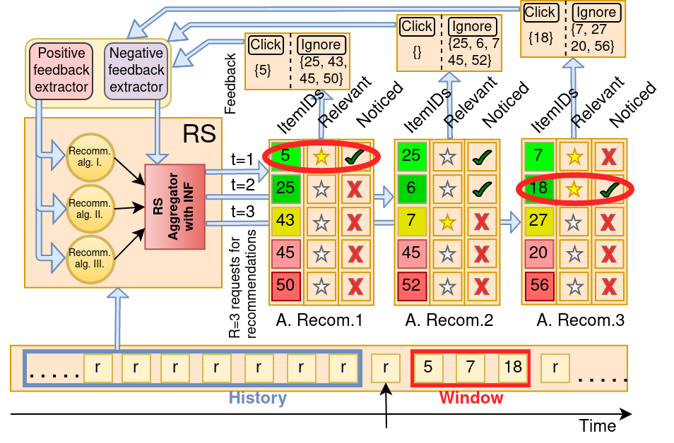
Evaluation Procedure

Slide 19
Results

Slide 20
Results

Slide 21
Results – Novelty vs. CTR interplay
Variants of FuzzDA framework (neg.feedback penalization) gives high variability w.r.t. Incremental novelty
Results tend to be on (close to) Pareto front

Slide 22
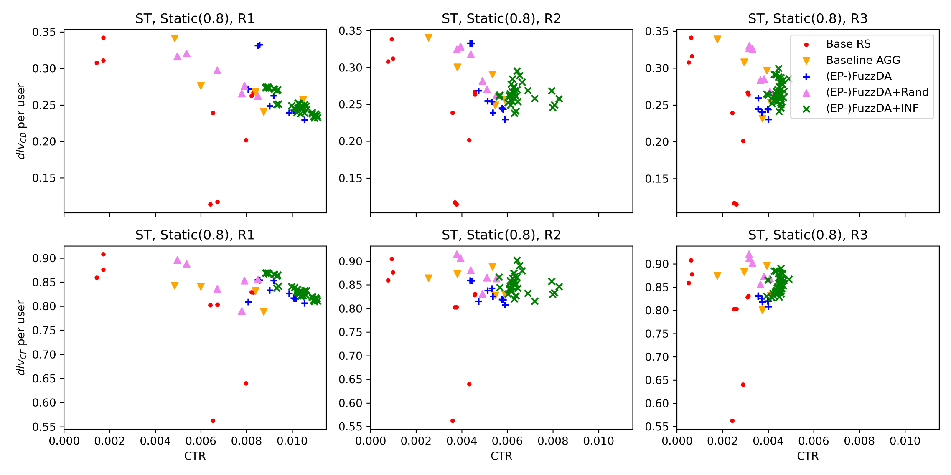
Results – Diversity vs. CTR interplay
Not so good variability, but FuzzDA results are mostly on (close to) Pareto front

Slide 23
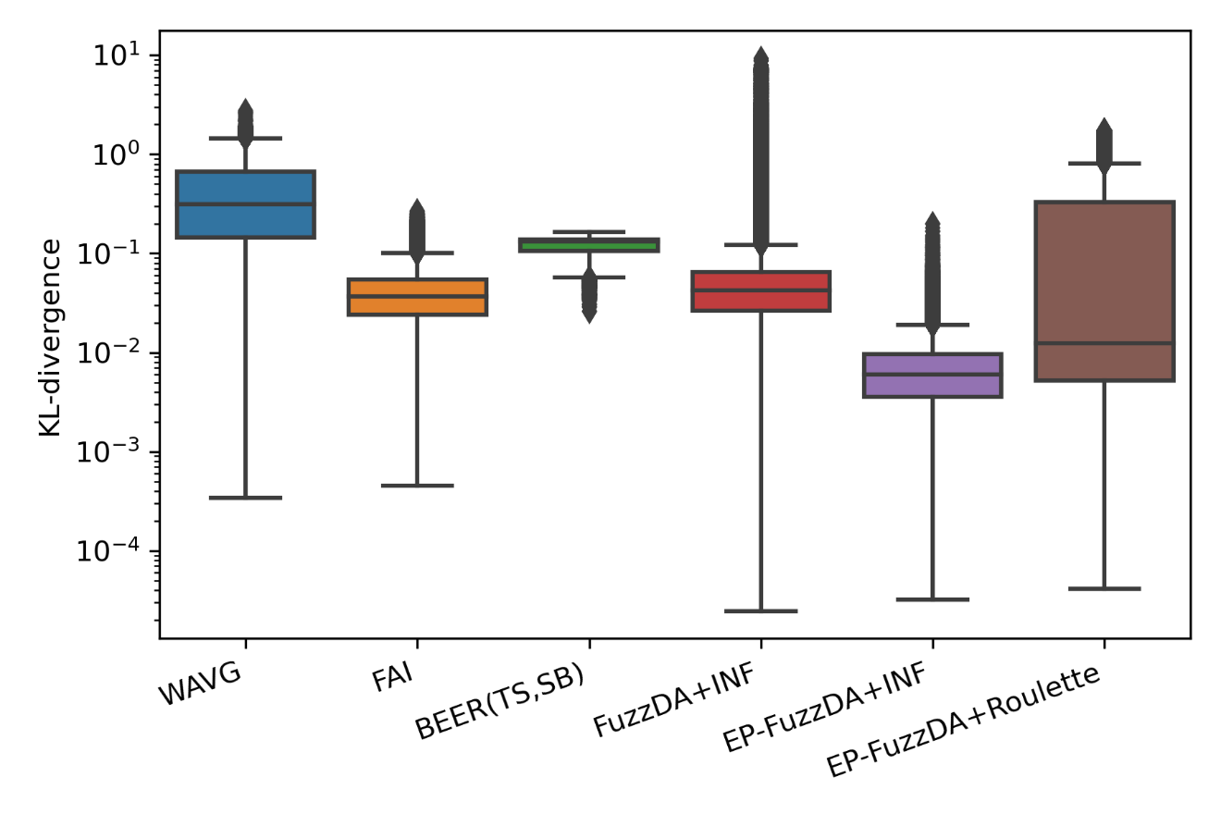
Results – Fairness
EP-FuzzDA in general provides most proportional results w.r.t. weights of base RS

Slide 24
On-line evaluation
Affected by Covid19 (much less trafic than usual)
Not quite stat.sign. w.r.t. CTR, but EP-FuzzDA with contextual votes + multiplicative penalty seemed best
Good results of FuzzDA framework w.r.t. Novelty and diversity (corroborating off-line evaluation)

Slide 25
Conclusions & Outlook
Fuzzy extension of D’Hondt’s election algorithm with iterative votes assignment can be used to aggregate multiple RS strategies w.r.t. the principle of proportionality
Improving noticeability models
Additional observed implicit feedback
Page layout features
Ability of particular item to „catch attention“
Improving off-line simulator
What page the user is currently on?
Biases in data?
Context of currently visited page missing in datasets

Slide 26
Thank you!
Questions, comments?

