Slide 1
NSWI166 Introduction to recommender systems and user preferences
Peter Vojtáš + Ladislav Peška, KSI MFF UK
Visualize and combine user preferences
Linear Monotone Preference Model

Slide 2
Outline of this lecture
User requirements – conflicting, multicriterial
Ordering – human, intuitive, (self) explainable
Decathlon
Customer model – ideal values, choice
Linear Monotone Preference Model
Data cube, Preference cube, contour lines, top-k, …
Examples, Conclusions

Slide 3
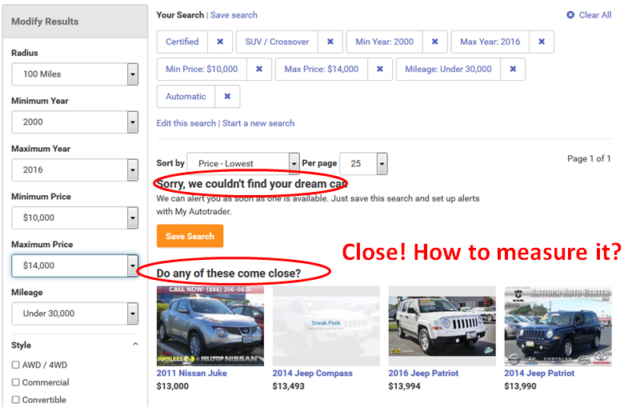
Conflicting requirements –
No such product
Do any of these come close?

Slide 4
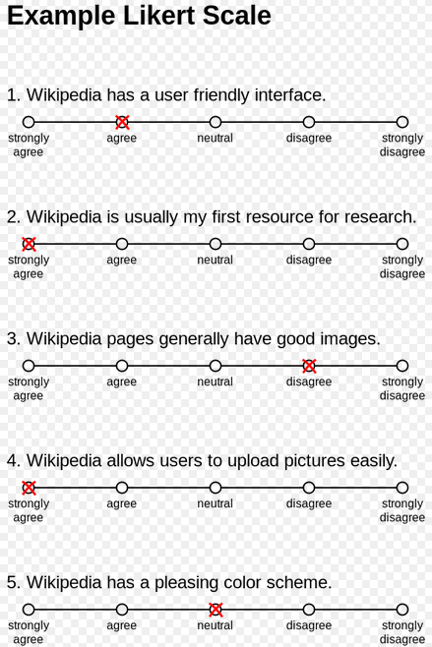
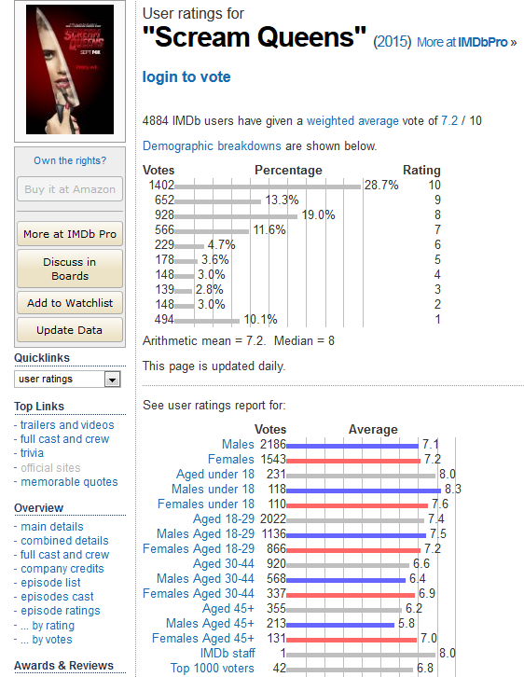
Ordering – human, intuitive, …scaled
… Self explainable - Information technology - more and more about the people and for the people
Ordering – in the language, Likert’s scale https://en.wikipedia.org/wiki/Likert_scale , …

Slide 5
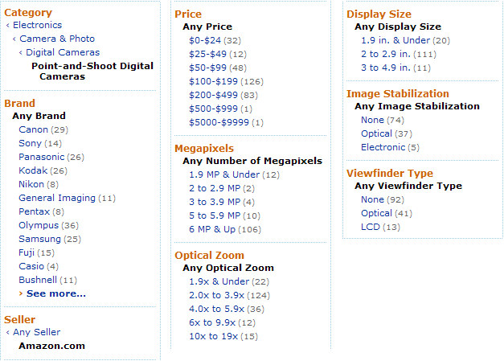
User preference – scaled + ideal values
In competitions it is clear who is better = winner
On e-shop it is not clear – users differ
Producers know this - Marketing Segmentation
„Faceted browsing“ – specifying „ideal values“
Too many items, conflicting requirements

Slide 6
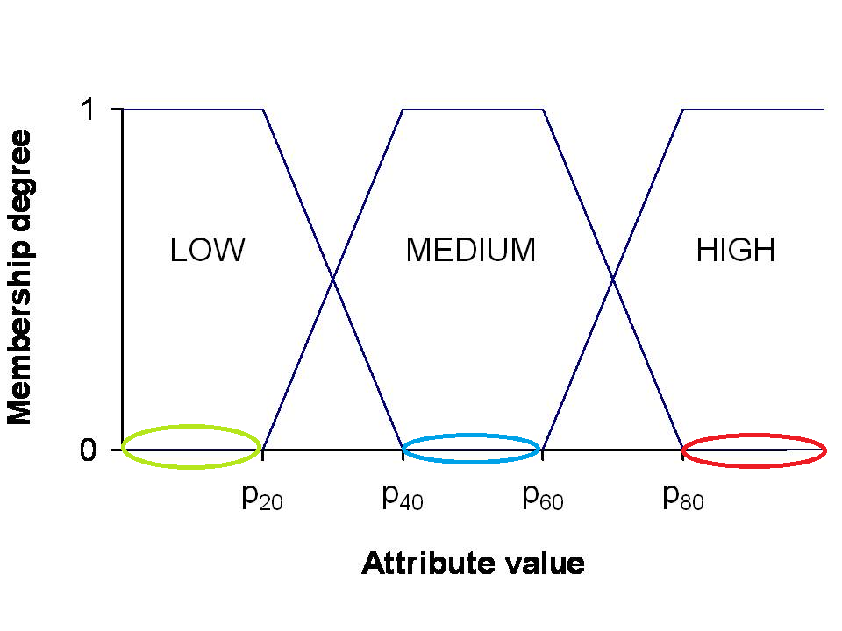
Preferential sets
Preferential sets are variants of fuzzy sets
Fuzzy sets intended to model linguistic vagueness
Preferential sets model human’s linear preferences
Price - fully cheap, reasonable, expensive
Linearly ordered domain low, medium, high
Linguistic input is very rare – we usually have
Preference scale, e.g. [0, 1]

Slide 7
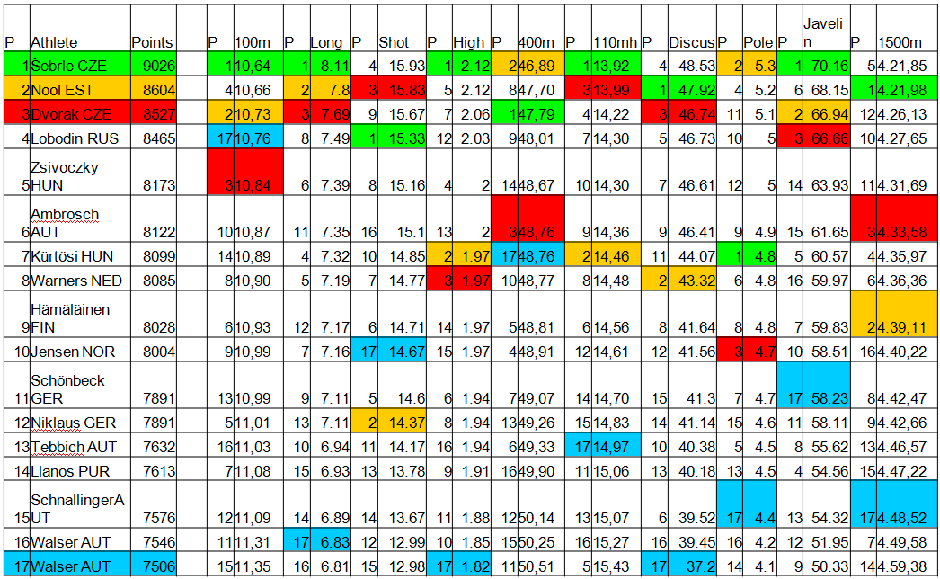
Decathlon data – scale-points, multicriterial

Slide 8
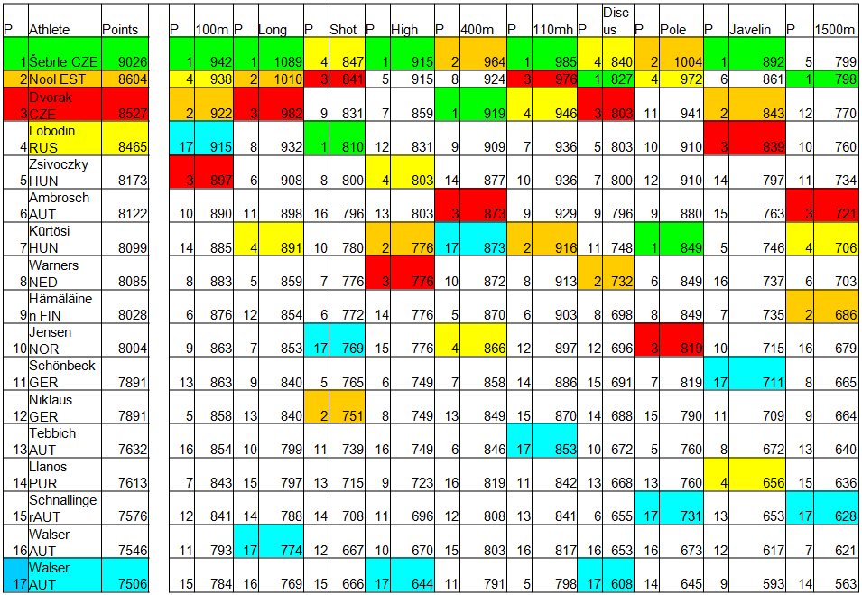
Decathlon points-commeasurable

Slide 9
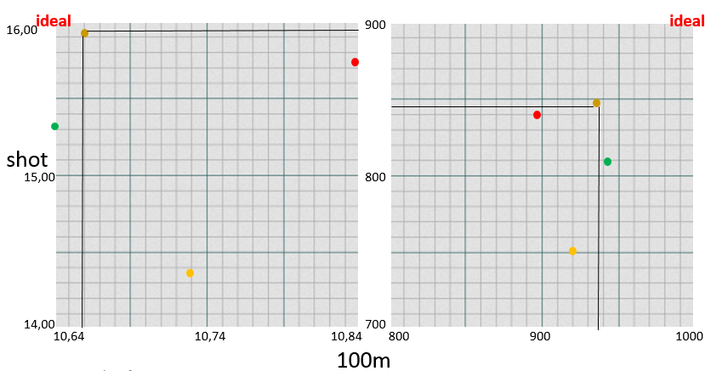
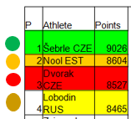
Better is rephrased by dominance
Intuitively better (dominating) means better in all disciplines = Pareto ordering – it is a partial ordering! We need the winner!
Lobodin dominates both Nool and Dvorak . and are incomparable (restricted to 100m x shot data and points)

Slide 10
Better is rephrased by dominance
Intuitively better (dominating) means better in all disciplines = Pareto ordering – it is a partial ordering! We need the winner!
Lobodin dominates both Nool and Dvorak . and are incomparable (restricted to 100m x shot data and points)
data
cube
Preference
(Pareto) cube

Slide 11
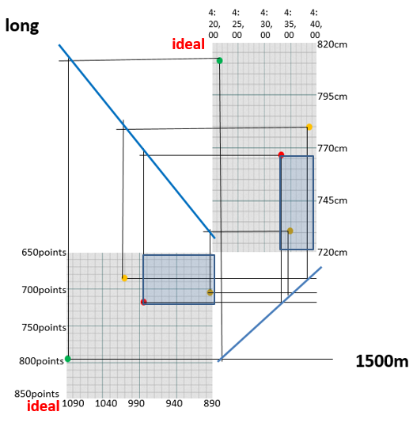
Sum of points makes Decathlon linear
Data cube (upper right) – point function transforms achievements to preference cube (lower left)
dominates
and are incomparable
Sum (aggregation) of points
in these two events
= 1703 points
= 1696 points
PC contour line connects
points with same result
in Pareto cube
Contour line can be
propagated to data cube

Slide 12
Sum of points makes Decathlon linear
Data cube (upper right) – point function transforms achievements to preference cube (lower left)
dominates
and are incomparable
Sum (aggregation) of points
in these two events
= 1703 points
= 1696 points
PC contour line connects
points with same result
in Pareto cube
Contour line can be
propagated to data cube
data
cube
Preference
(Pareto) cube

Slide 13
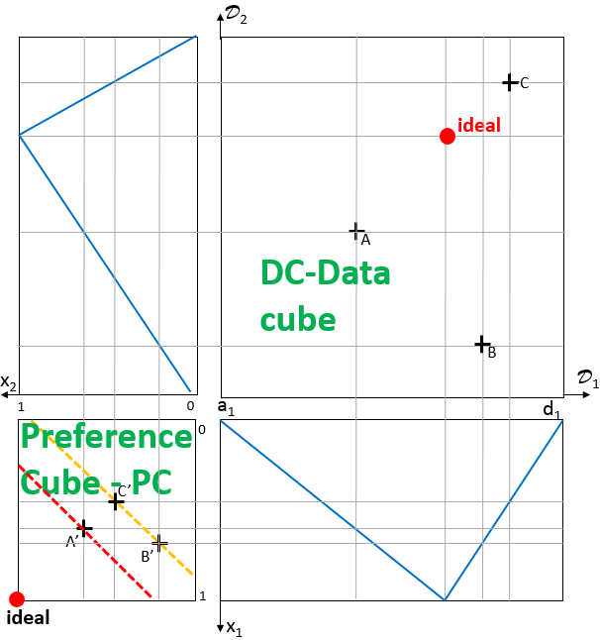
Decathlon like preference model for information ordering in web e-shops
DC-Athletes → items , Ordering made linear by sum → aggregation
Preference scale linear point system → [0,1] preference degree
Single authority decides winner → each user separately has/can have own preferences
PC-Multicriterial Pareto partial ordering of preference degree vectors
Decathlon like preference model – all parts linear – linear monotone preference model - LMPM
data
cube
Preference
cube
13

Slide 14
Linear Monotone Preference Model-LMPM
Decathlon – “single user” IAAF rules order athletes
Disciplines A₁,…, A₁₀; domains D₁,…, D₁₀; ideal (field / track)
A_{i} point function f_{i} : D_{i} → N makes results commeasurable
Winner - overall IAAF achievement is obtained via sum Σ{f_{i} (athleteID . A_{i}): i = 1, …, 10}
Recommenders – set of users U, LMPM^{u} orders items
Attributes A₁,…, A_{m}; domains D₁,…, D_{m}; ideal points can be for each user different
Degree of preference for A_{i} and user u∈U f_{i}^{u}: D_{i} → [0, 1] – hardly made commeasurable in response time
Winner, top-k, overall degree of preference - aggregation r^{f,t}(objectID) = t^{u}{f_{i}^{u} (objectID . A_{i}): i = 1, …, m}
Here t^{u}: [0, 1]^{m} → [0, 1], t^{u}(0,…,0) = 0, t^{u}(1,…,1) = 1, t^{u} monotone(linear) - preserves Pareto ordering,

Slide 15
D₂
Let us build LMPM step by step
Data model: attributes A₁, A₂; domains D₁, D₂; only 2-dimensional – makes paper drawing easier
triangular degree of preference of A_{j} , a value from D_{j} (local preference) is given by an ideal point i_{j} and function f_{j}
f_{j} (x_{j}) = 0 , x_{j} = min D_{j}
f_{j} (x) = (x- x_{j})/(i_{j} - x_{j}) if x_{j} ≤ x ≤ i_{j}
f_{j} (i_{j}) = 1
f_{j} (x) = (y_{j} -x)/(y_{j} - i_{j}) if i_{j} ≤ x ≤ y_{j}
f_{j} (y_{j}) = 0 , y_{j} = max D_{i},
C
E
D
i₂
ideal
B
f₂
x₂
D₁
1
0
i₁
0
f₁
1
x₁

Slide 16
D₂
Similarly
trapezoidal degree of preference of A_{j} , a value from D_{j} (local preference) is given by an ideal interval [i_{j}^{l} , i_{j}^{r} ] and analogically defined functions f_{j}
C
E
i₂^{r}
i₂^{r}
D
ideal
B
f₂
x₂
D₁
1
0
a₁
i₁^{l} i₁^{r}
d₁
0
f₁
1
ideal
x₁

Slide 17
D₂
degree of preference of A_{j} , a value from D_{j} (local preference) can have different shapes depending on position of ideal points / intervals
C
E
f₂
D
i₂
B
x₂
ideal
D₁
1
0
i₁
0
f₁
1
x₁

Slide 18
D₂
Let us describe steps leading to calculation of preference degree of item B (for user u), we first describe mapping DC-data cube to PC-preference cube
Assume degree of preference f_{i}^{u}: D_{i} → [0, 1] (for an user u∈U),
Object with objectID = B has attribute values B.A₁ = b₁ and B.A₂ = b₂, sometimes we write B=(b₁, b₂).
Attribute preference degrees f_{j}^{u}(B.A_{j}) = b_{j}^{u} and corresponding point in preference cube is B^{u} = (b₁^{u}, b₂^{u})
other points analogically
C
E
D
b₂
B
f₂^{u}
x₂
D₁
1
b₂^{u}
0
b₁
0
f₁^{u}
B^{u}
b₁^{u}
1
x₁

Slide 19
D₂
Note, that point B^{u} has 4 coimages B, B’, B’’, B’’’
Degree of preference for user u∈U are given by f₁^{u} and f₂^{u} .
Object with objectID = B has attribute values B.A₁ = b₁ and B.A₂ = b₂, sometimes we write B=(b₁, b₂).
For B, D, E attribute preference degrees the corresponding points in preference cube are B^{u}, D^{u}, E^{u},
Note that B^{u} and D^{u} are incomparable in Pareto order and E^{u} is dominated by both B^{u} and D^{u},
C
E
B’’
B’’’
D
b₂
B’
B
f₂^{u}
x₂
D₁
1
b₁^{u}
0
b₁
0
E^{u}
D^{u}
f₁^{u}
B^{u}
b₁^{u}
1
x₁

Slide 20
Pareto ordering of pref. cube (x) <_{Pareto} (y) iff (for each i) x_{i} ≤ y_{i} & (∃i) x_{i} < y_{i}
Assume A, B, C, D, E, F, G are images of respective items under some attribute preference
We say that item B dominates item G in <_{Pareto} (G is dominated by B), in fact B dominates whole red area
F is dominated by whole green area
<_{Pareto} is not linear, e.g. B and C are not comparable
D₂
x₂
0
D₁
1
0
F
E
G
D
C
B
A
Ideal, top
1
x₁

Slide 21
Pareto ordering of pref. cube (x) <_{Pareto} (y) iff (for each i) x_{i} ≤ y_{i} & (∃i) x_{i} < y_{i}
Assume A, B, C, D, E, F, G are images of respective items under some attribute preference
Repeat, that item B dominates whole red area and is dominated by whole green area
<_{Pareto} is not linear, e.g. B and C are not comparable
All item images in white areas are incomparable with B
D₂
x₂
0
D₁
1
0
F
E
G
D
C
B
A
Ideal, top
1
x₁

Slide 22
Visualization of Pareto partial order
1
x₂
0
0
F
G
F
E
G
A
D
E
D
C
B
C
B
A
Ideal, top
1
x₁
Ideal, top

Slide 23
Difference between preference degree-matters?
1
x₂
0
0
F
G
F
E
G
A
D
E
D
C
B
C
B
A
Ideal, top
1
x₁
Ideal, top

Slide 24
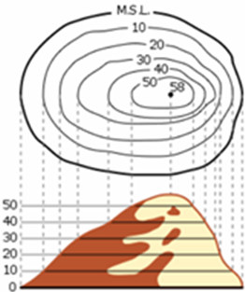
To get global preference degree of items we need aggregation functions. It is a function [0,1]²→[0,1]
t(x₁, x₂) = w₁*x₁ + w₂*x₂ , where w₁, w₂ ≥ 0 are attribute weights with w₁+ w₂ =1
Graph of t is a 3D object. Intuition behind display of aggregation function are contour lines (e.g. cl_{1/3} , cl_{2/3}) for users u, resp. u
Note, that on the preference cube diagonal corresponding contour line of preference degree y∈[0,1] intersect the diagonal at point (y, y) , because
w₁*x + w₂*x = y gives
x*(w₁ + w₂)= y, i.e. x = y
D₂
x₂
½
0
D₁
1
0
cl_{1/3}
¹/₃
½
½
²/₃
cl_{2/3}
Ideal, top
1
x₁

Slide 25
To get global preference degree of items we need to aggregate them. First is weighted average
t(x₁, x₂) = w₁*x₁ + w₂*x₂ , where w₁, w₂ ≥ 0 are attribute weights with w₁+ w₂ =1
Graph of t is a 3D object. Intuition behind display of aggregation function are contour lines (e.g. cl_{1/3} , cl_{2/3}) for users u, resp. u
Only NW to SE
Ordering is compliant with Pareto order
On the preference cube diagonal corresponding contour line of preference degree y∈[0,1] intersect the diagonal at point (y, y)
(2x₁+x₂)/3 B is better than A
(x₁+2x₂)/3 A is better than B
Only x₂ matters
1
x₂
½
0
0
cl_{1/3}
A
Only x₁ matters
¹/₃
½
B
½
²/₃
cl_{2/3}
Ideal, top
1
x₁

Slide 26
Assume, we have users u, and u. Red are item image using u‘s preference, green that of u.
Notice e.g. t^{u}(A) = 0.54
B and C are not <_{Pareto} comparable, aggregation makes C more preferable for user u than B (w₁ is sufficiently bigger than w₂)
E is best for u
Can C be better than E?
Can B be better than C?
If two PC cube points are Pareto incomparable, then any ordering of these is possible – prove or disprove!
D₂
x₂
0
D₁
1
0
F
E
G
0.54
D
cl_{0.54}
C = C
cl_{0.76}
B
A
Ideal, top
1
x₁

Slide 27
D₂
How does it work together?
Vector of attribute preferences f=[f₁, …, f_{m}] and aggregation t define a user u_{f,t} = u
Overall preference of user u_{f,t} is given by r^{f,t}:O→[0,1] , for object oid given by r^{f,t}(oid) =
t ([f_{i} (oid.A_{i}) : i = 1, …, m])
Depict contour line (i.e. items of same preference degree) in DC-data cube is a little bit trickier (depending on position of ideal points and/or intervals)
C
E
A
D
b₂
B
f₂^{u}
x₂
D₁
1
b₂^{u}
0
b₁
C^{u}
0
E^{u}
D^{u}
r^{f,t}(E)
f₁^{u}
B^{u}
b₁^{u}
1
x₁

Slide 28
D₂
Preference model of user u_{f,t} on data cube
Function R^{f,t}: ΠD_{i} →[0,1] R^{f,t}(a₁, …, a_{m}) = t ([f_{i} (a_{i}) : i = 1, …, m])
Ordering on data cube(a₁, …, a_{m}) ≥^{f,t} (b₁, …, b_{m}) iff R^{f,t}(a₁, …, a_{m}) ≥ R^{f,t}(b₁, …, b_{m}) Odering can be vizualized as contour lines on ΠD_{i}
For better understanding are different contour lines (of same t) in colors
User u_{f,t} , preference of user u_{f,t} , R^{f,t}: ΠD_{i} →[0,1]
R^{f,t}(a₁, …, a_{m}) = t ([f_{i} (a_{i}) : i = 1, …, m])
(a) ≥^{f,t} (b) iff R^{f,t}(a) ≥R^{f,t}(b)
C
E
D
ideal
b₂
B
f₂^{u}
x₂
D₁
1
b₁^{u}
0
b₁
C^{u}
0
E^{u}
D^{u}
f₁^{u}
B^{u}
b₁^{u}
1
ideal
x₁

Slide 29
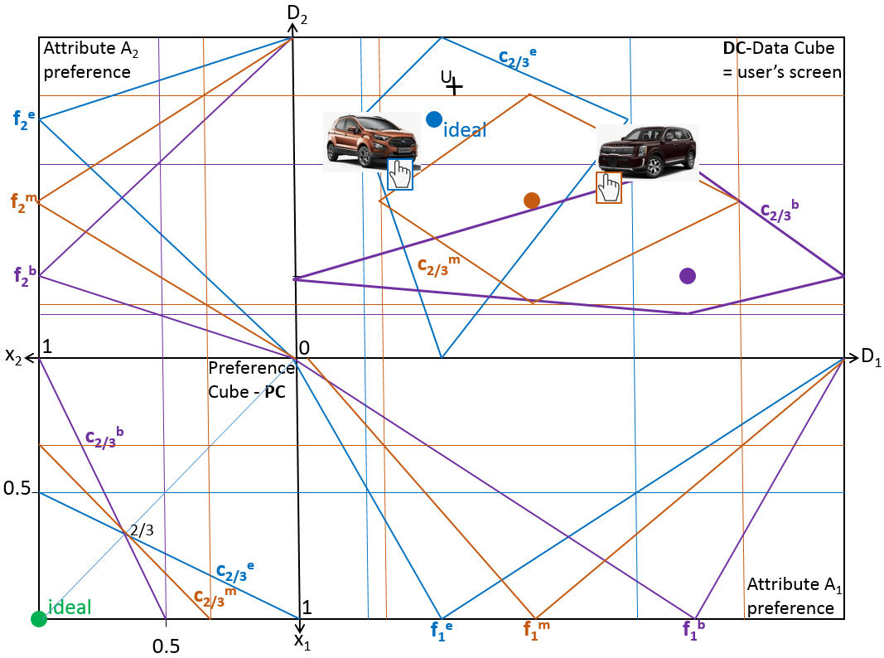

Slide 30
D₂
Two users u and u
Preference scale L = [0, 1]
C
ideal
E
Data
cube
A
D
ideal
B
x₂
D₁
1
0
a₁
d₁
0
Preference
cube
1
ideal
x₁

Slide 31
D₂
Data model: attributes A₁, A₂; domains D₁, D₂;
Ideal points can be for each user different, we consider users u and u.
Degree of preference f_{i}^{u}: D_{i} → [0, 1] (for an user u∈U), so we have f_{i}^{u} and f_{i}^{u} .
Object with objectID = B has attribute values B.A₁ = b₁ and B.A₂ = b₂, sometimes we write B=(b₁, b₂).
Attribute preference degrees f_{i}^{u}(B.A_{i}) = b_{i}^{u} and corresponsing point in preference cube is B^{u} = (b₁^{u}, b₂^{u})
Find both images of C, …
f₂^{u}
C
E
A
D
b₂
B
f₂^{u}
x₂
D₁
1
b₂^{u}
b₂^{u}
0
b₁
0
B^{u}
b₁^{u}
f₁^{u}
f₁^{u}
B^{u}
b₁^{u}
1
x₁

Slide 32
D₂
Data model: attributes A₁, A₂; domains D₁, D₂;
Ideal points can be for each user different, we consider users u and u. Both have same aggregation average AVG
As before we have f_{i}^{u}: D_{i} → [0, 1] (for an user u∈U), so we have f_{i}^{u} and f_{i}^{u} .
Object with objectID = B has attribute values B.A₁ = b₁ and B.A₂ = b₂, sometimes we write B=(b₁, b₂) has two images in preference cube B^{u} and B^{u} .
Let us depict ½ contour line in DC, interpret result, discuss intuitiveness
f₂^{u}
C
E
A
D
b₂
B
f₂^{u}
x₂
D₁
1
b₂^{u}
b₂^{u}
0
b₁
0
B^{u}
b₁^{u}
f₁^{u}
f₁^{u}
B^{u}
b₁^{u}
1
x₁

Slide 33
D₂
Data model: attributes A₁, A₂; domains D₁, D₂;
Ideal points can be for each user different, we consider users u and u. Both have same aggregation average AVG
As before we have f_{i}^{u}: D_{i} → [0, 1] (for an user u∈U), so we have f_{i}^{u} and f_{i}^{u} .
Object with objectID = B has attribute values B.A₁ = b₁ and B.A₂ = b₂, sometimes we write B=(b₁, b₂) has two images in preference cube B^{u} and B^{u} .
Let us depict ¾ contour line in DC, interpret result, discuss intuitiveness
f₂^{u}
C
E
A
D
b₂
B
f₂^{u}
x₂
D₁
1
b₂^{u}
b₂^{u}
0
b₁
0
B^{u}
b₁^{u}
f₁^{u}
f₁^{u}
B^{u}
b₁^{u}
1
x₁

Slide 34
D₂
Previous two slides in one.
Observe ½ and ¾ contour lines in DC.
It seems that there is some parallelism.
Formulate statement, prove or disprove.
Interpret result, discuss intuitiveness
f₂^{u}
C
C
E
E
A
D
D
B
b₂
B
f₂^{u}
x₂
D₁
1
b₂^{u}
b₂^{u}
0
b₁
0
B^{u}
b₁^{u}
f₁^{u}
f₁^{u}
B^{u}
b₁^{u}
1
x₁

Slide 35
D₂
Similarly
trapezoidal degree of preference of A_{j} , a value from D_{j} (local preference) is given by an ideal interval [i_{j}^{l} , i_{j}^{r} ] and analogically defined functions f_{j}
Instead of minimum/max of domains D_{j} we can/have to consider the possibility that trapezoid is based on some interval [a_{j}, d_{j}]
Depicting contour lines continues on blackboard
d₂
C
E
i₂^{r}
i₂^{r}
D
ideal
B
f₂
a₂
x₂
D₁
1
0
a₁
i₁^{l} i₁^{r}
d₁
0
f₁
1
ideal
x₁

Slide 36
D₂
Contour lines for general trapezoidal case
Please, notice construction
Image ungrouped for further constructions
0
t(1,0)
0
t(0,1)
1
t(0,1)
f₂
0
t(1,0)
0
x₂
D₁
1
0
0
1
f₁
x₁

Slide 37
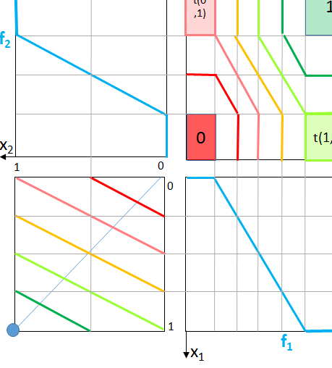
Four corners versus one corner - Makes your solutions faster
Illustration for “one quarter” construction
Saves time
Only illustration, must be constructed

Slide 38
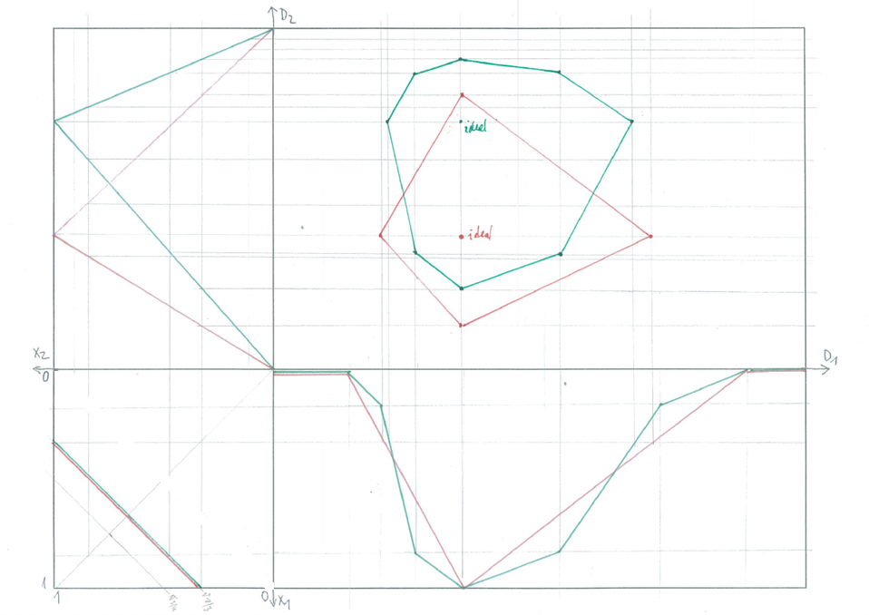
Partially linear approximations of preferences
f₂^{u}
We proceed similarly
as before from PC to
DC, just – we must
be considering each
linear part of f₁^{u}
separately
f₁^{u}

Slide 39
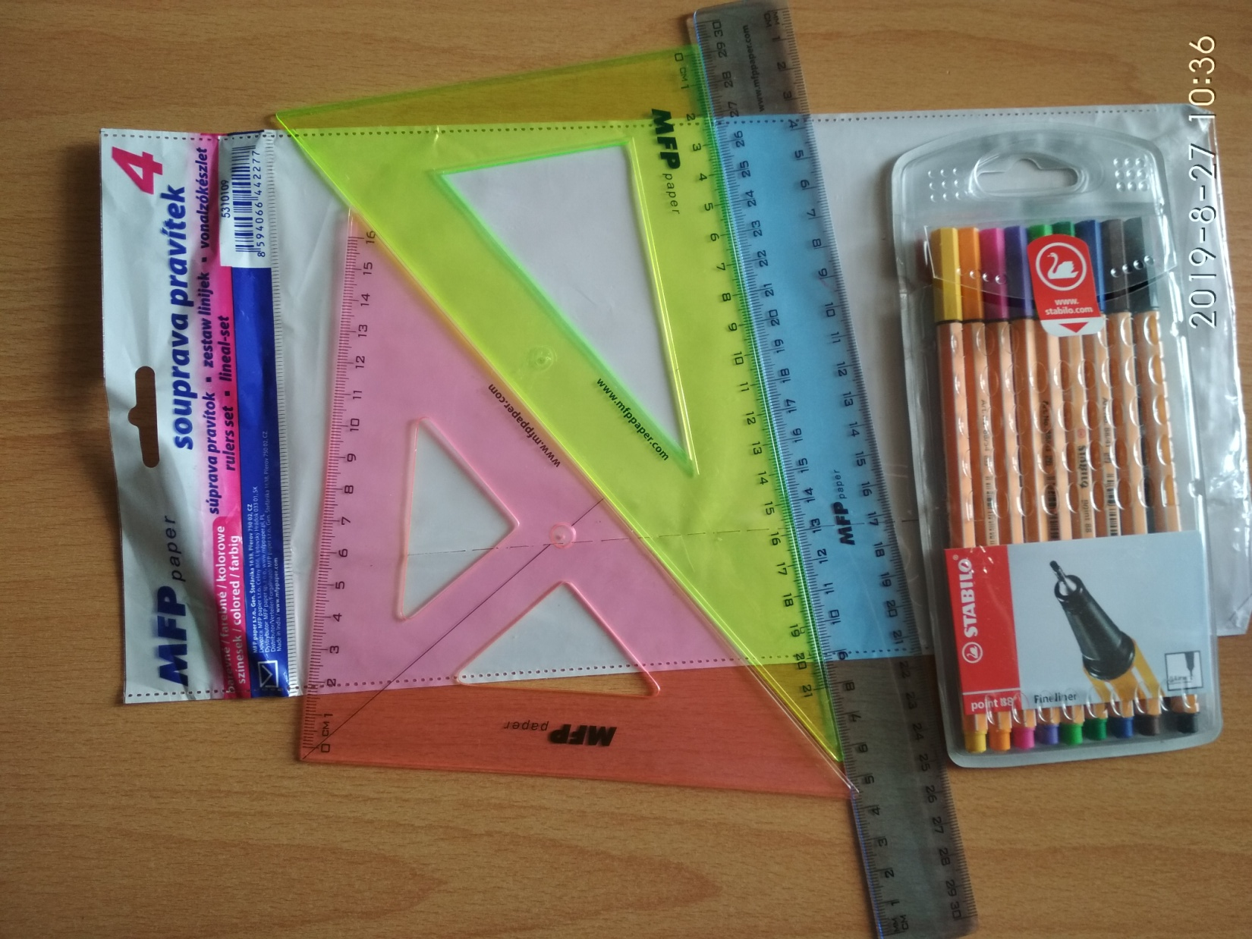
No coding, simulation using drawing tools

Slide 40
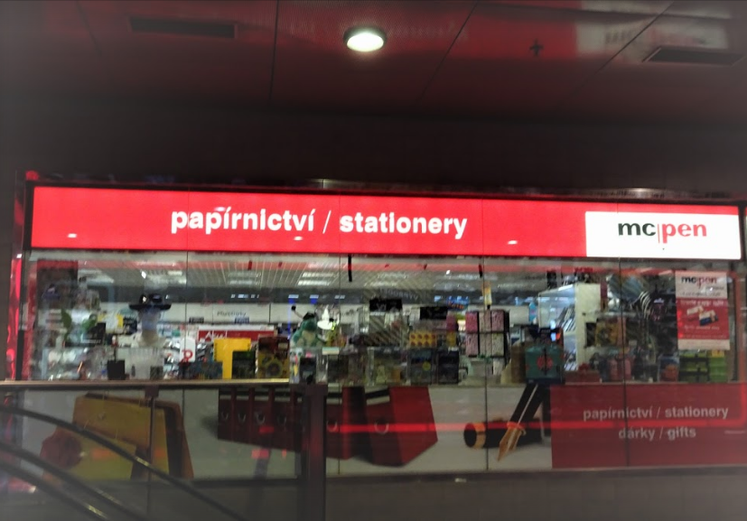
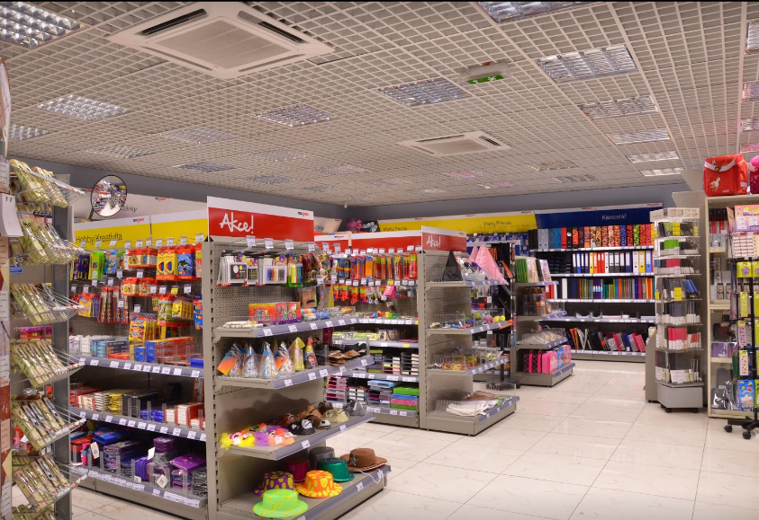
Main Railway station, southern wing

Slide 41
Possible extensions: assume we know the convex hull of data (as depicted in DC), find the best object, calculate it’s preference degree x, find objects with preference degree 0.9*x
Discuss all possible solution strategies, which is/can be most intuitive for an untrained user?
Consider variants of this task, e.g. with trapezoidal attribute preferences; with ideal point in max/min of domains,
Consider f_{i}^{u} and t variable, formulate tasks …
D₂
f₂^{u}
x₂
D₁
1
0
0
f₁^{u}
b₁^{u}
1
x₁
Same? in SQL, domain calculi, logic

Slide 42
Possible extensions: assume we know the convex hull of data (as depicted in DC), find the best object, calculate it’s preference degree x, find objects with preference degree 0.9*x
Discuss all possible solution strategies, which is/can be most intuitive for an untrained user?
Consider variants of this task, e.g. with trapezoidal attribute preferences; with ideal point in max/min of domains,
Consider f_{i}^{u} and t variable, formulate tasks …
D₂
f₂^{u}
x₂
D₁
1
0
0
f₁^{u}
b₁^{u}
1
x₁
Same? in SQL, domain calculi, logic

Slide 43
Questions?
Comments?

