Slide 1
NSWI166 – Introduction to Recommender Systems and User Preferences
Ladislav Peska & Peter Vojtas
peska@ksi.mff.cuni.cz, S208
https://www.ksi.mff.cuni.cz/~peska/vyuka/NSWI166
2/1, ZK+Z, 4 credits
https://www.ksi.mff.cuni.cz/
- 1 -

Slide 2
Hybrid recommendation approaches – I.

Slide 3
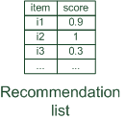
Hybrid recommender systems
Hybrid: combinations of various inputs and/or composition of different mechanism
Collaborative: "Tell me what's popular among my peers"
Content-based: "Show me more of the same what I've liked"
Knowledge-based: "Tell me what fits based on my needs"

Slide 4
Hybrid recommender systems
All three base techniques are naturally incorporated by a good sales assistant (at different stages of the sales act) but have their shortcomings
For instance, cold start problems
Idea of crossing two (or more) species/implementations
hybrida [lat.]: denotes an object made by combining two different elements
Avoid some of the shortcomings
Reach desirable properties not (or only inconsistently) present in parent individuals
Different hybridization designs
Parallel use of several systems
Monolithic exploiting different features
Pipelined invocation of different systems

Slide 5
Monolithic hybridization design
Only a single recommendation component
Hybridization is "virtual" in the sense that
Features/knowledge sources of different paradigms are combined

Slide 6
Parallelized hybridization design
Output of several existing implementations combined
Least invasive design
Some weighting or voting scheme
Weights can be learned dynamically
Extreme case of dynamic weighting is switching
Simple combination using e.g., weighted average
Also suitable for Multiarmed bandits or proportionality preservation algorithms

Slide 7
Pipelined hybridization designs
One recommender system pre-processes some input for the subsequent one
Cascade
Meta-level
Refinement of recommendation lists (cascade)
Learning of model (e.g. collaborative knowledge-based meta-level)
Most common case in industry

Slide 8
Monolithic Hybrids

Slide 9
Monolithic hybridization designs: Feature augmentation
Hybrid RS, monolithic example #1: Content-boosted collaborative filtering [Prem Melville et al. 2002]
Based on content features additional ratings are created
E.g. Alice likes Items 1 and 3 (unary ratings)
Item7 is similar to 1 and 3 by a degree of 0.75
Thus Alice likes Item7 by 0.75
Item matrices become less sparse
Significance weighting and adjustment factors
Peers with more co-rated items are more important
Higher confidence in content-based prediction, if higher number of own ratings
Several more examples on separate slides (Spreading Activation, Hybrid BPR, Visual BPR)

Slide 10
Monolithic hybridization designs
Hybrid RS, monolithic example #2: Visual BPR
Latent factor based approach (similar to matrix factorization)
Portion of the item embedding is static
Based on a pre-trained visual feature extractor
Dimensionality reduction to maintain Collaborative vs. Content-based tradeoff
Trained using BPR loss
https://arxiv.org/abs/1510.01784

Slide 11
Parallelized Hybrids

Slide 12
Parallelized hybridization design: Weighted
Compute weighted sum:
Recommender 1
Item1 | 0.5 | 1
Item2 | 0
Item3 | 0.3 | 2
Item4 | 0.1 | 3
Item5 | 0
Recommender 2
Item1 | 0.8 | 2
Item2 | 0.9 | 1
Item3 | 0.4 | 3
Item4 | 0
Item5 | 0
Recommender weighted(0.5:0.5)
Item1 | 0.65 | 1
Item2 | 0.45 | 2
Item3 | 0.35 | 3
Item4 | 0.05 | 4
Item5 | 0.00

Slide 13
Parallelized hybridization design: Weighted
BUT, how to derive weights?
Estimate, e.g. by empirical bootstrapping
Dynamic adjustment of weights
https://en.wikipedia.org/wiki/Multi-armed_bandit
Empirical bootstrapping
Historic data is needed
Compute different weightings
Decide which one does best
Dynamic adjustment of weights
Start with for instance uniform weight distribution
For each user adapt weights to minimize error of prediction
How rewarding were individual recommenders?
incremental updates / multiarmed bandits

Slide 14
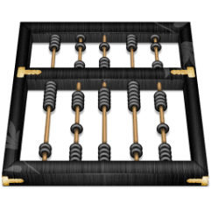
Parallelized hybridization design: Weighted
Let's assume Alice actually bought/clicked on items 1 and 4
Identify weighting that minimizes Mean Absolute Error (MAE)
Absolute errors and MAE
Beta1 | Beta2 |  | rec1 | rec2 | error | MAE
0.1 | 0.9 | Item1 | 0.5 | 0.8 | 0.23 | 0.61
 |  | Item4 | 0.1 | 0.0 | 0.99
0.3 | 0.7 | Item1 | 0.5 | 0.8 | 0.29 | 0.63
 |  | Item4 | 0.1 | 0.0 | 0.97
0.5 | 0.5 | Item1 | 0.5 | 0.8 | 0.35 | 0.65
 |  | Item4 | 0.1 | 0.0 | 0.95
0.7 | 0.3 | Item1 | 0.5 | 0.8 | 0.41 | 0.67
 |  | Item4 | 0.1 | 0.0 | 0.93
0.9 | 0.1 | Item1 | 0.5 | 0.8 | 0.47 | 0.69
 |  | Item4 | 0.1 | 0.0 | 0.91
MAE improves as rec2 is weighted more strongly

Slide 15
Parallelized hybridization design: Weighted
BUT: didn't rec1 actually rank Items 1 and 4 higher?
Be careful when weighting!
Recommenders need to assign comparable scores over all users and items
Some score transformation may be necessary
Stable weights require several user ratings
Recommender 1
Item1 | 0.5 | 1
Item2 | 0
Item3 | 0.3 | 2
Item4 | 0.1 | 3
Item5 | 0
Recommender 2
Item1 | 0.8 | 2
Item2 | 0.9 | 1
Item3 | 0.4 | 3
Item4 | 0
Item5 | 0
!!

Slide 16
Parallelized hybridization design: Switching
Requires an oracle that decides on recommender
Special case of dynamic weights (all except one Beta is 0)
Example:
Ordering on recommenders and switch based on some quality criteria
E.g. if too few ratings in the system use knowledge-based, else collaborative
More complex conditions based on contextual parameters, apply classification techniques

Slide 17
Parallelized hybridization design: Mixed
Combines the results of different recommender systems at the level of user interface
Results of different techniques are presented together
Recommendation result for user $u$ and item $i$ is the set of tuples $<score,k>$ for each of its $n$ constituting recommenders ${rec}_{k}$

Slide 18
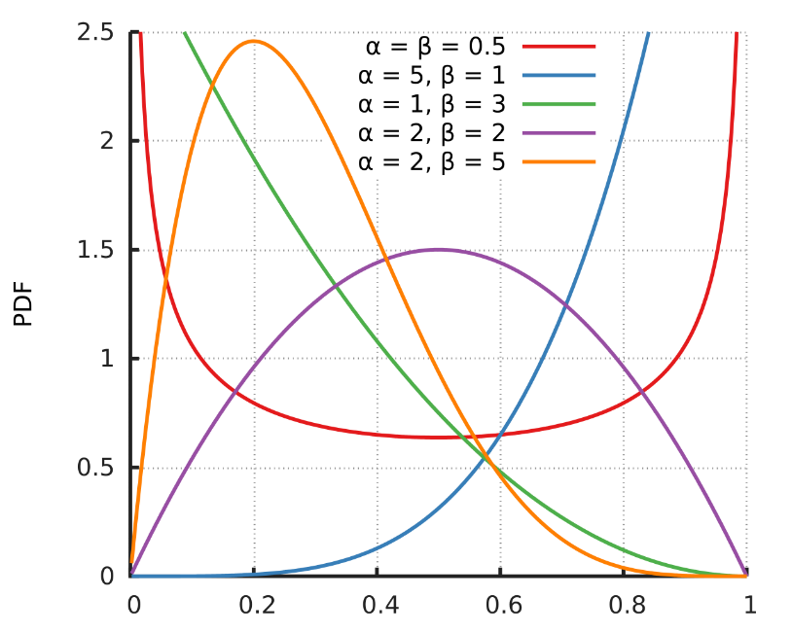
Parallelized hybridization design: Mixed
Broden et al.: Ensemble Recommendations via Thompson Sampling: an Experimental Study within e-Commerce
Pool of several recommenders R1,…,Rk
For each position in the list of recommendations, we first select which Recommender is used and then fill in the position
Some basic filters such as non-repeating of items
The probability to select Recommender corresponds to its performance in the past (how often were their items clicked/purchased/…)
Using multi-armed bandits variant: Thompson Sampling
For each Recommender, we collect number of trials and number of successes
Use this as parameters to the Beta distribution (https://en.wikipedia.org/wiki/Beta_distribution)
Mean value corresponds to the success probablity
Distribution is more compact with more trials
Sample value from this distribution
Use the Recommender with the highest value
One more example on separate slides (fuzzy D’Hondt)

Slide 19
Pipeline Hybrids

Slide 20
Pipelined hybridization designs: Cascade
Successor's recommendations are restricted by predecessor
Where forall k > 1
Subsequent recommender may not introduce additional items
Typical in large-scale scenarios (use simple models to reduce the set of candidates, then refine its ordering)
Thus produces very precise results

Slide 21
Pipelined hybridization designs: Cascade
Recommendation list is continually reduced
First recommender excludes items
Remove absolute no-go items (e.g. knowledge-based)
Second recommender assigns score
Ordering and refinement (e.g. collaborative)
Find acceptable product categories, then select items from within them
Context-awareness may be reasonable for the first-level recs.

Slide 22
Pipelined hybridization designs: Cascade
Recommender 1
Item1 | 0.5 | 1
Item2 | 0
Item3 | 0.3 | 2
Item4 | 0.1 | 3
Item5 | 0
Recommender 2
Item1 | 0.8 | 2
Item2 | 0.9 | 1
Item3 | 0.4 | 3
Item4 | 0
Item5 | 0
Removing no-go items
Ordering and refinement
Recommender 3
Item1 | 0.80 | 1
Item2 | 0.00
Item3 | 0.40 | 2
Item4 | 0.00
Item5 | 0.00

Slide 23
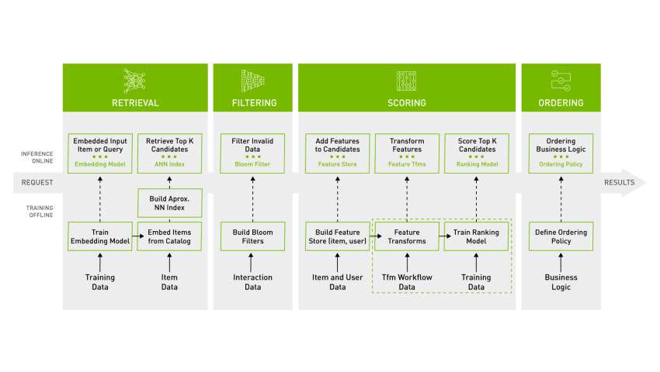
Pipelined hybridization designs: Cascade Industry level

Slide 24
Pipelined hybridization designs: Meta-level
Successor exploits a model delta built by predecessor
Examples:
Fab:
Online news domain
CB recommender builds user models based on weighted term vectors
CF identifies similar peers based on these user models but makes recommendations based on ratings
Collaborative constraint-based meta-level RS
Collaborative filtering learns a constraint base
Knowledge-based RS computes recommendations
E.g., fill-in latent factors in matrix factorization with the help of items’ content similarity

Slide 25
Limitations of hybridization strategies
Only few works that compare strategies from the meta-perspective
Like for instance, [Robin Burke 2002]
Most datasets do not allow to compare different recommendation paradigms
i.e. ratings, requirements, item features, domain knowledge, critiques rarely available in a single dataset
Thus few conclusions that are supported by empirical findings
Monolithic: some preprocessing effort traded-in for more knowledge included
Parallel: requires careful matching of scores from different predictors
Pipelined: works well for two antithetic approaches
Netflix competition – "stacking" recommender systems
Weighted design based on >100 predictors – recommendation functions
Adaptive switching of weights based on user model, context and meta-features

Slide 26
Literature
[Robin Burke 2002] Hybrid recommender systems: Survey and experiments, User Modeling and User-Adapted Interaction 12 (2002), no. 4, 331-370.
[Prem Melville et al. 2002] Content-Boosted Collaborative Filtering for Improved Recommendations, Proceedings of the 18th National Conference on Artificial Intelligence (AAAI) (Edmonton,CAN), American Association for Artificial Intelligence, 2002, pp. 187-192.
[Roberto Torres et al. 2004] Enhancing digital libraries with techlens, International Joint Conference on Digital Libraries (JCDL'04) (Tucson, AZ), 2004, pp. 228-236.
[Chumki Basuet al. 1998] Recommendation as classification: using social and content-based information in recommendation, In Proceedings of the 15th National Conference on Artificial Intelligence (AAAI'98) (Madison, Wisconsin, USA States), American Association for Artificial Intelligence, 1998, pp. 714-720.

