Slide 1
Fuzzy D’Hondt’s Algorithm for On-line Recommendations Aggregation
Ladislav Peška and Štěpán Balcar
Department of Software Engineering,
Charles University, Prague,
Czech Republic

Slide 2
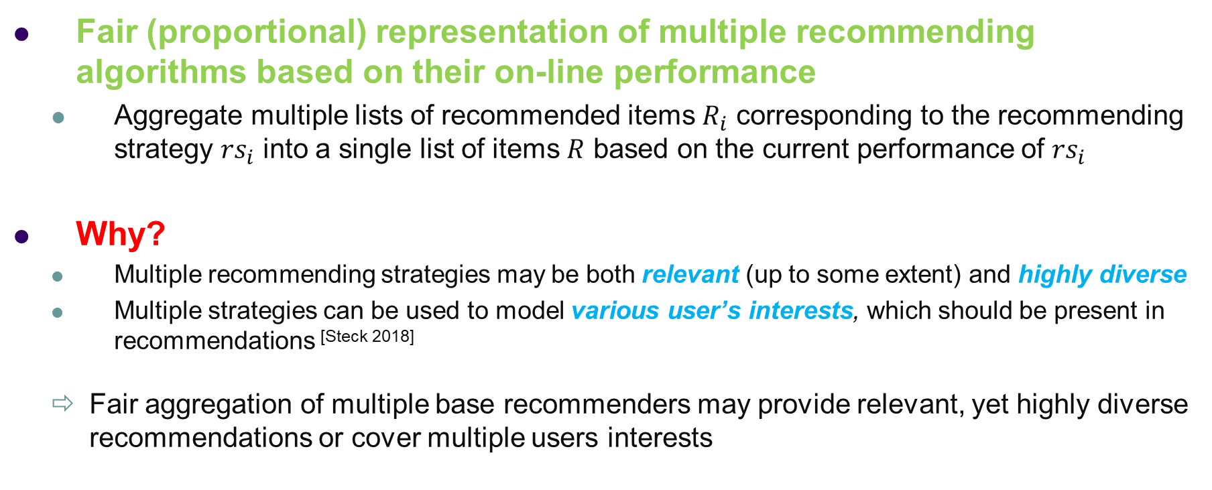
Task, Motivation
Fair (proportional) representation of multiple recommending algorithms based on their on-line performance
  Aggregate multiple lists of recommended items $R_{i}$ corresponding to the recommending strategy ${rs}_{i}$ into a single list of items $R$ based on the current performance of ${rs}_{i}$
Why?
  Multiple recommending strategies may be both relevant (up to some extent) and highly diverse
  Multiple strategies can be used to model various user’s interests, which should be present in recommendations ^{[Steck 2018]}
  Fair aggregation of multiple base recommenders may provide relevant, yet highly diverse recommendations or cover multiple users interests
^{[Steck 2018]} Harald Steck, Calibrated recommendations. RecSys 2018
ORSUM 2019, Copenhagen

Slide 3
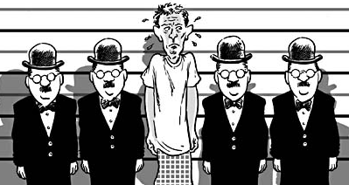
Motivating Example:
Assembling Police Photo Lineups
Recommend candidates similar to the suspect, so the lineup is unbiased
  Two strategies: CB attribute-based & visual-based (DCNN)
Results:
  Visual RS is better (58% vs 37% of selections, not so good for rare ethnics)
  However, very small candidates intersection (1.8% for top-20 candidates)
    CB strategy was relevant up to some extent
    CB proposed some relevant candidates which Visual could not
    Both strategies should be present in final recommendations
    Simple weighted aggregation would over-sample visual strategy
    Thompson sampling MAB ^{[Broden 2018]} would probably over-sample best
    method as well
  What about something that is tailored to preserve fair distribution?
Biased lineup, floridainnocence.org
(Fairly) unbiased lineup
^{[Broden 2018]} Bjorn Broden et al. Ensemble recommendations via thompson sampling: An experimental study within e-commerce. IUI 2018
ORSUM 2019, Copenhagen

Slide 4
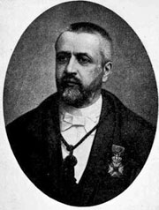
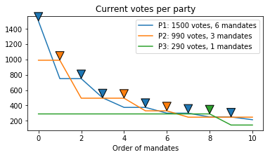
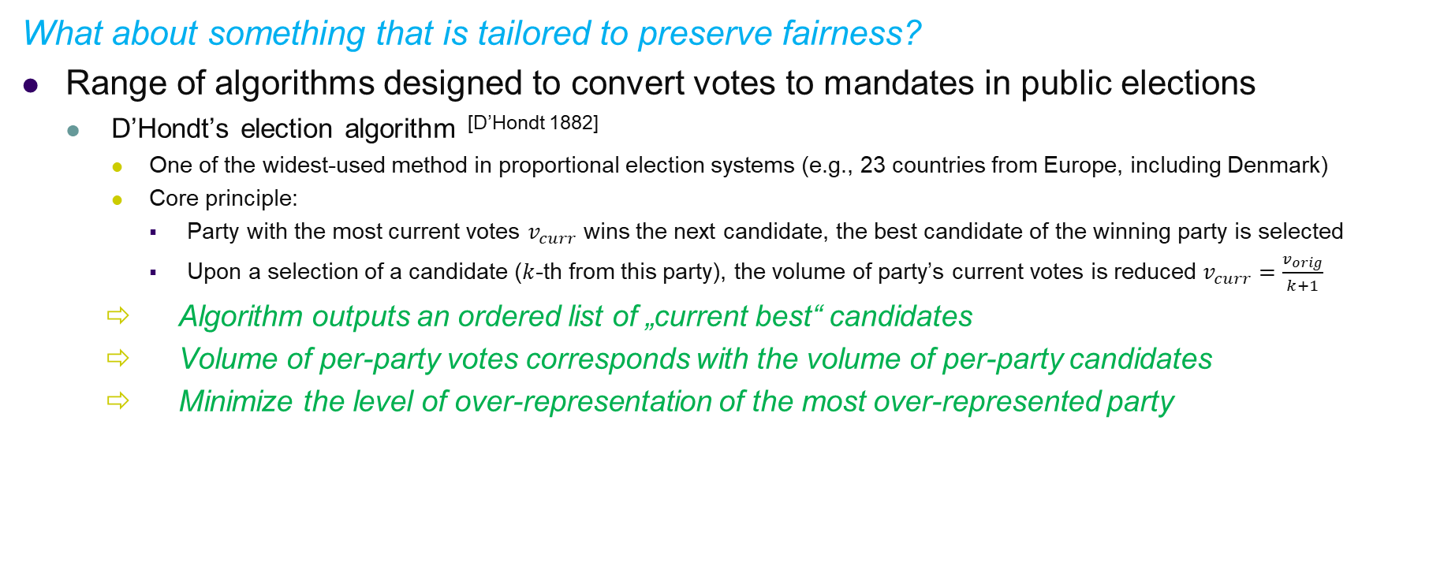
D’Hondts Election Algorithm
What about something that is tailored to preserve fairness?
Range of algorithms designed to convert votes to mandates in public elections
  D’Hondt’s election algorithm ^{[D’Hondt 1882]}
    One of the widest-used method in proportional election systems (e.g., 23 countries from Europe, including Denmark)
    Core principle:
      Party with the most current votes $v_{curr}$ wins the next candidate, the best candidate of the winning party is selected
      Upon a selection of a candidate ($k$-th from this party), the volume of party’s current votes is reduced $v_{curr}=\frac{v_{orig}}{k+1}$
    Algorithm outputs an ordered list of „current best“ candidates
    Volume of per-party votes corresponds with the volume of per-party candidates
    Minimize the level of over-representation of the most over-represented party
^{[D’Hondt 1882]} Victor D’Hondt, Systeme pratique et raisonne de representation proportionnelle. C.Muquardt, 1882

Slide 5
D’Hondts Election Algorithm
What about something that is tailored to preserve fairness?
Range of algorithms designed to convert votes to mandates in public elections
  D’Hondt’s election algorithm ^{[D’Hondt 1882]}
    One of the widest-used method in proportional election systems (e.g., 23 countries from Europe, including Denmark)
    Core principle:
      Party with the most current votes $v_{curr}$ wins the next candidate, the best candidate of the winning party is selected
      Upon a selection of a candidate ($k$-th from this party), the volume of party’s current votes is reduced $v_{curr}=\frac{v_{orig}}{k+1}$
    Algorithm outputs an ordered list of „current best“ candidates
    Volume of per-party votes corresponds with the volume of per-party candidates
    Minimize the level of over-representation of the most over-represented party
Can be considered as parallel hybridization algorithm
^{[D’Hondt 1882]} Victor D’Hondt, Systeme pratique et raisonne de representation proportionnelle. C.Muquardt, 1882

Slide 6
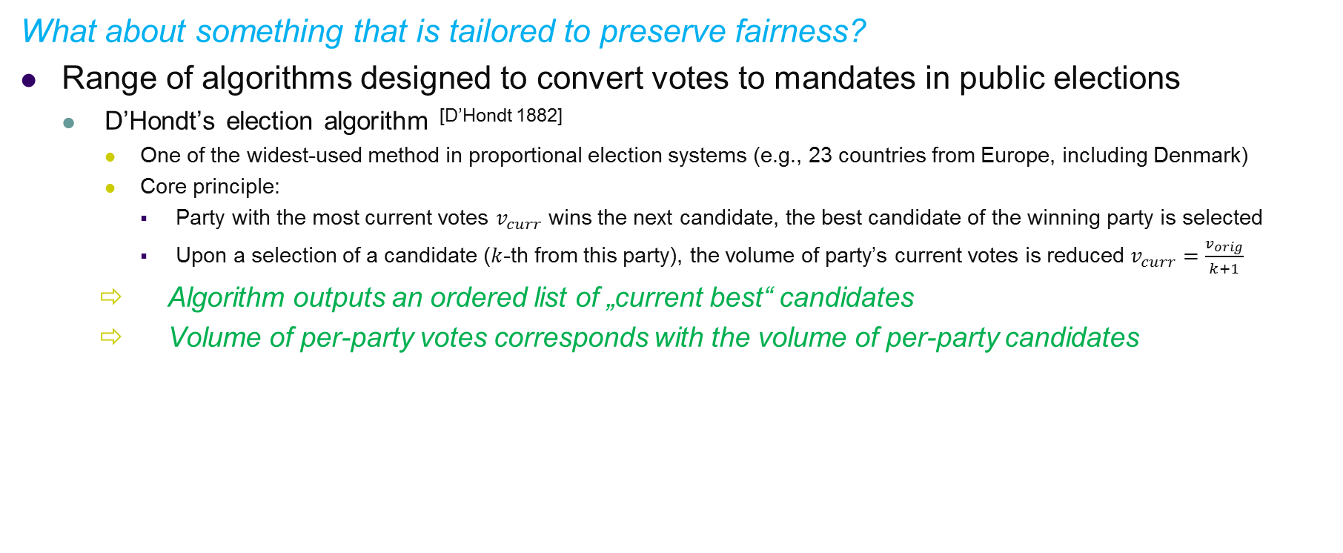
D’Hondts Election Algorithm
What about something that is tailored to preserve fairness?
Range of algorithms designed to convert votes to mandates in public elections
  D’Hondt’s election algorithm ^{[D’Hondt 1882]}
    One of the widest-used method in proportional election systems (e.g., 23 countries from Europe, including Denmark)
    Core principle:
      Party with the most current votes $v_{curr}$ wins the next candidate, the best candidate of the winning party is selected
      Upon a selection of a candidate ($k$-th from this party), the volume of party’s current votes is reduced $v_{curr}=\frac{v_{orig}}{k+1}$
    Algorithm outputs an ordered list of „current best“ candidates
    Volume of per-party votes corresponds with the volume of per-party candidates
Are RS aggregations and Elections the same problem?
^{[D’Hondt 1882]} Victor D’Hondt, Systeme pratique et raisonne de representation proportionnelle. C.Muquardt, 1882

Slide 7


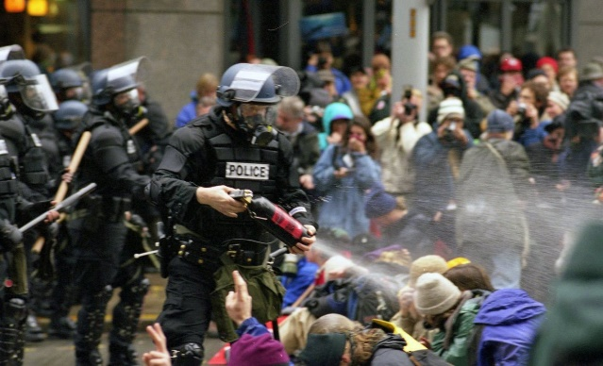
D’Hondts Election Algorithm - Limitations
Politics:
  Can a person join multiple parties simultaneously?
  NOPE
Recommender systems:
  Can be an item recommended by multiple RS strategies?
  Sure, why not
  What about some bonus for items recommended by multiple RS?

Slide 8
D’Hondts Election Algorithm - Limitations
Politics:
  Can a person join multiple parties simultaneously?
  NOPE
Recommender systems:
  Can be an item recommended by multiple RS strategies?
  Sure, why not
  But how large is the intersection?
(Almost) no intersection
Some intersection
(Almost) full intersection
Weighted aggregations should be fine
Fuzzy D’Hondt’s
aggregations
D’Hondt’s is fine

Slide 9
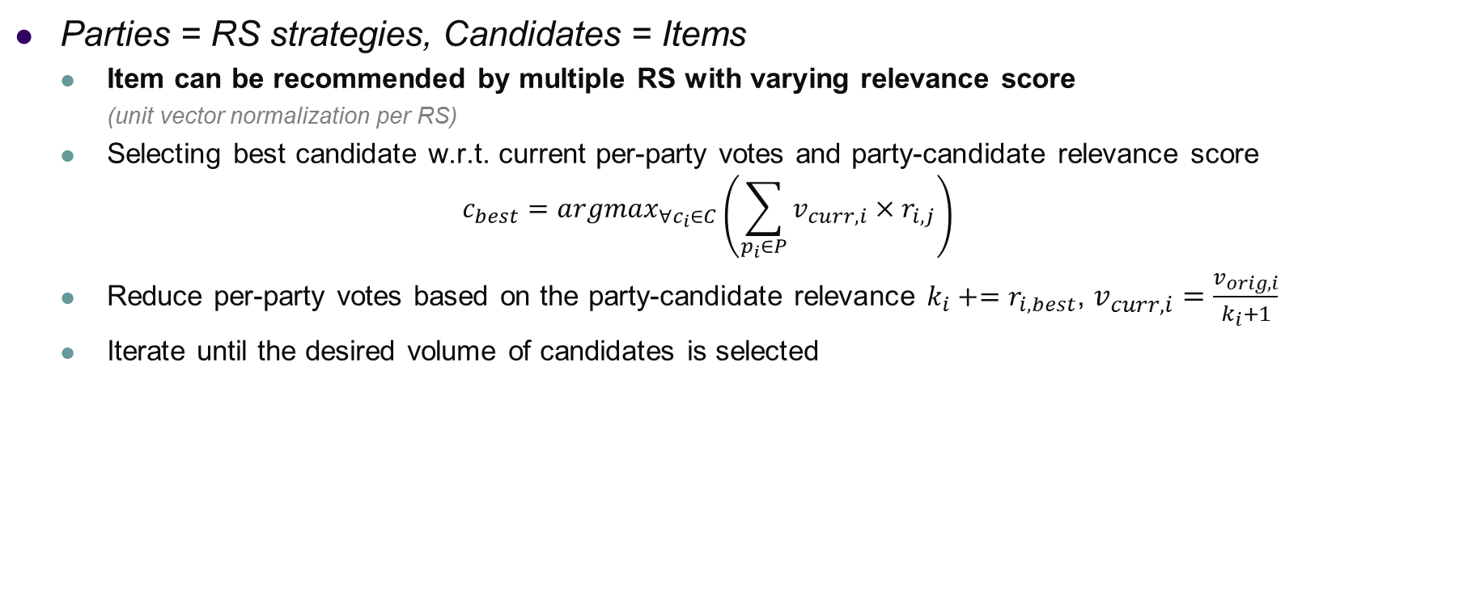

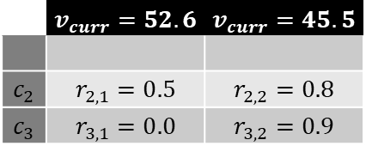

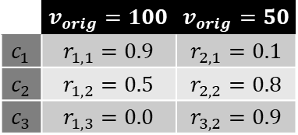
Fuzzy D’Hondt’s RS Aggregations
Parties = RS strategies, Candidates = Items
  Item can be recommended by multiple RS with varying relevance score
    (unit vector normalization per RS)
  Selecting best candidate w.r.t. current per-party votes and party-candidate relevance score
  $$c_{best}={argmax}_{∀c_{i}∈C}\left(\sum_{p_{i}∈P}{v_{curr,i}×r_{i,j}}\right)$$
  Reduce per-party votes based on the party-candidate relevance ${k_{i}+=r}_{i,best}$, $v_{curr, i}=\frac{v_{orig,i}}{k_{i}+1}$
  Iterate until the desired volume of candidates is selected
 | $$v_{orig}=100$$ | $$v_{orig}=50$$
$$c_{1}$$ | $$r_{1,1}=0.9$$ | $$r_{2,1}=0.1$$
$$c_{2}$$ | $$r_{1,2}=0.5$$ | $$r_{2,2}=0.8$$
$$c_{3}$$ | $$r_{1,3}=0.0$$ | $$r_{3,2}=0.9$$
$$95$$
$$90$$
$$45$$
 | $$v_{curr}=52.6$$ | $$v_{curr}=45.5$$
$$c_{2}$$ | $$r_{2,1}=0.5$$ | $$r_{2,2}=0.8$$
$$c_{3}$$ | $$r_{3,1}=0.0$$ | $$r_{3,2}=0.9$$
$$63$$
$$41$$
…

Slide 10
Fuzzy D’Hondt’s Algorithm
Parties = RS strategies, Candidates = Items
  Item can be recommended by multiple RS with varying relevance score
    (unit vector normalization per RS)
  Selecting best candidate w.r.t. current per-party votes and party-candidate relevance score
  $$c_{best}={argmax}_{∀c_{i}∈C}\left(\sum_{p_{i}∈P}{v_{curr,i}×r_{i,j}}\right)$$
  Reduce per-party votes based on the party-candidate relevance ${k_{i}+=r}_{i,best}$, $v_{curr, i}=\frac{v_{orig,i}}{k_{i}+1}$
  Iterate until the desired volume of candidates is selected
But who will assign the votes?

Slide 11
Fuzzy D’Hondt’s Algorithm
Parties = RS strategies, Candidates = Items
  Item can be recommended by multiple RS with varying relevance score
    (unit vector normalization per RS)
  Selecting best candidate w.r.t. current per-party votes and party-candidate relevance score
  $$c_{best}={argmax}_{∀c_{i}∈C}\left(\sum_{p_{i}∈P}{v_{curr,i}×r_{i,j}}\right)$$
  Reduce per-party votes based on the party-candidate relevance ${k_{i}+=r}_{i,best}$, $v_{curr, i}=\frac{v_{orig,i}}{k_{i}+1}$
  Iterate until the desired volume of candidates is selected
This is beyond the hybridization problem... Anyway, we changed the technique recently
Also, where is the „on-line“ from the title?

Slide 12
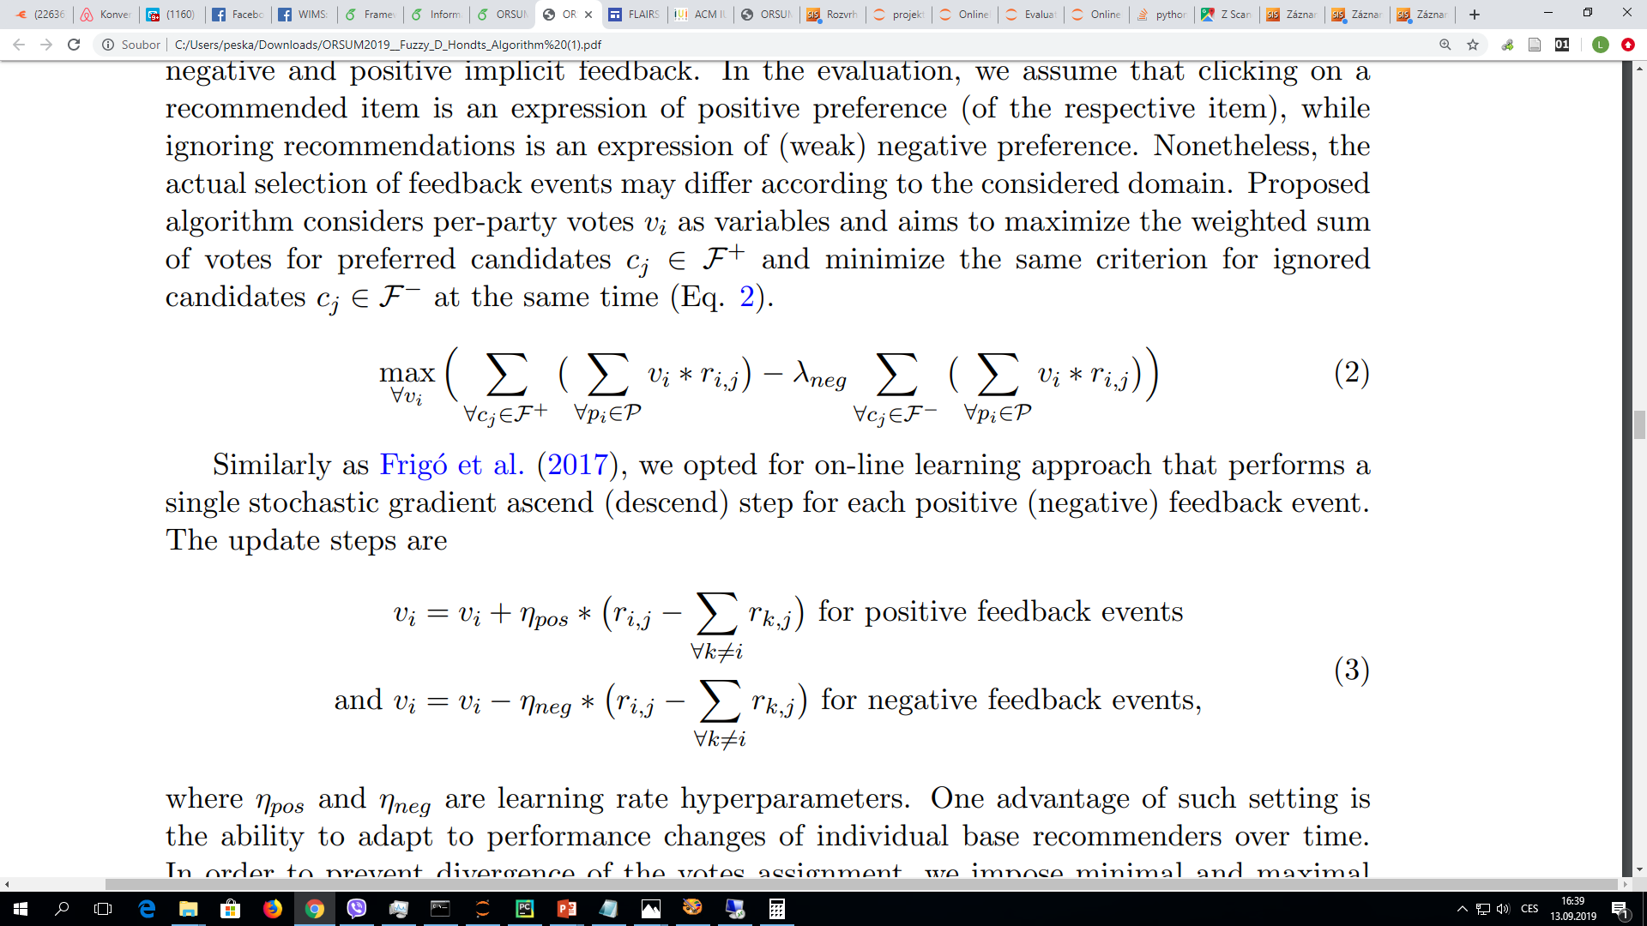
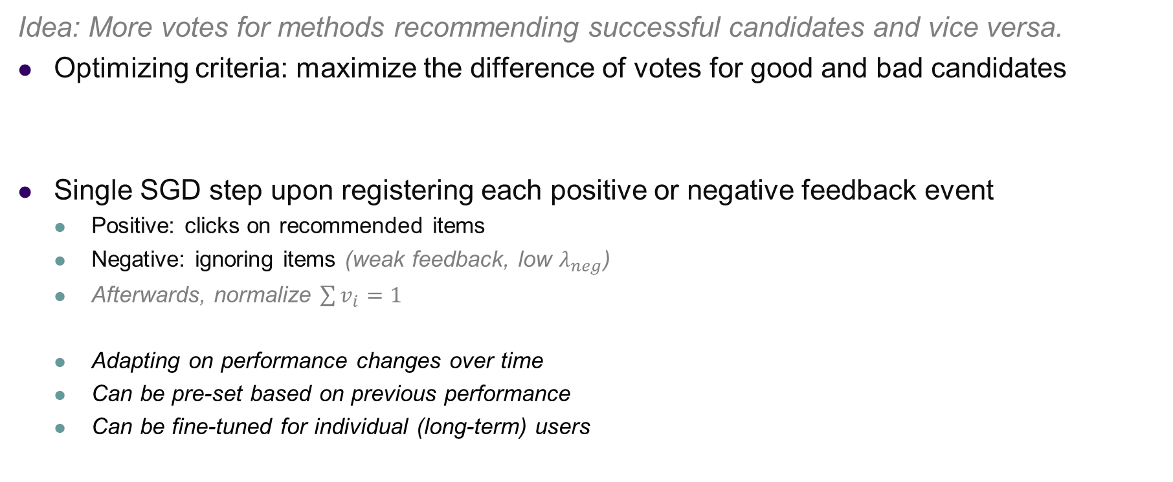
Iterative Votes Assignments
Idea: More votes for methods recommending successful candidates and vice versa.
Optimizing criteria: maximize the difference of votes for good and bad candidates
Single SGD step upon registering each positive or negative feedback event
  Positive: clicks on recommended items
  Negative: ignoring items (weak feedback, low $λ_{neg}$)
  Afterwards, normalize $\sum{v_{i}=1}$
  Adapting on performance changes over time
  Can be pre-set based on previous performance
  Can be fine-tuned for individual (long-term) users

Slide 13


Overview of the Fuzzy D’Hondt’s Aggregations
RS1
C1: 0.8
C2: 0.6
C4: 0.4
...
Iterative Votes Assignment
RS1 ; RS2 ; RS3 ;
Ignored: C1,C2
Clicks: C3
Votes
RS2
C3: 0.9
C4: 0.2
C5: 0.1
...
Recommendations
FUZZY D’HONDT’s AGGREGATION
C1,C3,C2, ...
C1
C3
RS3
C1: 0.7
C5: 0.3
C2: 0.3
...
C2
Per-party votes updates

Slide 14
Evaluation Procedure
Travel agency website, procedure based on our previous work^{[Peska 2018]}
Several RS: doc2vec (tours description), CB attributes similarity and CF word2vec
  Recommendations for short sections of user’s history
  Selecting from previously best-performing algorithms: 4 base RS
On-line A/B testing (one RS strategy per user), July 2019
  Two best-performing individual RS (Cosine CB, word2vec)
  Fuzzy D’Hondt’s Aggregations (4 base RS)
  BEER(TS, SB): multiarmed bandits with Thompson sampling ^{[Broden 2018]} (4 base RS)
Click through rate (CTR), visits after recommendation (VRR)
  Aggregated per recommendation and per user
^{[Broden 2018]} Bjorn Broden et al. Ensemble recommendations via thompson sampling: An experimental study within e-commerce. IUI 2018
^{[Peska 2018]} Peska & Vojtas, Off-line vs. On-line Evaluation of Recommender Systems in Small E-commerce. REVEAL (RecSys) 2018

Slide 15
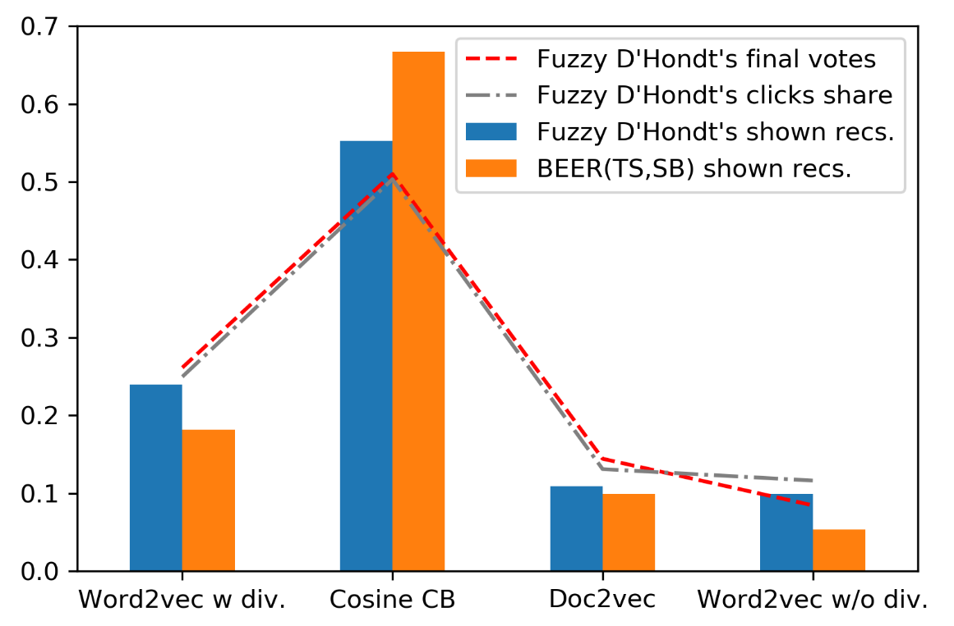
Results
In total 2 299 users, 78 356 recommended objects, 7 663 #VRR, 576 #CTR
Fuzzy D’Hondt’s achieved best scores in VRR and VRR per user
The representation of individual base RS in results seems fair considering their final votes and click-through shares
Fuzzy D’Hondt’s recommendations are rather static
-> lower CTR compared to Bandits?
 | CTR | VRR | CTR_U | VRR_U
Cosine CB | .0086 | 0.089 | 0.262 | 2.707
Word2vec | .0071 | 0.104 | 0.220 | 3.250
BEER(TS,SB) | .0077 | 0.078 | 0.282 | 2.861
Fuzzy D'Hondt's | .0063 | 0.118 | 0.239 | 4.504

Slide 16
Conclusions & Outlook
Fuzzy extension of D’Hondt’s election algorithm with iterative votes assignment can be used to aggregate multiple RS strategies w.r.t. the principle of proportionality
  Only the basic algorithm variant explored
    Better definition (learning?) of positive-negative feedback threshold
    More refined feedback definition (e.g., actions after click, negative only if visible) - depends on domain
    Stochastic candidates selection
    Penalize candidates relevance through time
  More extensive evaluation needed
    Additional domains & baselines
    Analyze domain parameters (RS diversity etc.)

Slide 17
Thank you!
Questions, comments?

