Slide 1


Explicit and Implicit Feedback
How do we know what users like?
https://www.ksi.mff.cuni.cz/

Slide 2
Today’s Content
Organization + Recap
Semestral work definition
Explicit Feedback
  Variants, benefits, issues
Implicit Feedback
  Variants, benefits, issues

Slide 3
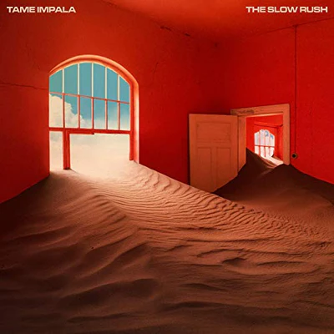


Recap
What is an issue with random train-test splits?
What does „ILD“ stands for?
What metrics of recommendation’s accuracy do you know?

Slide 4
Organization
Active Reading #2
  Knowledge graphs: 8
    KG must exist in particular domain, Tuning and computational complexity
    Unclear hyperparam settings for other methods
    (Everyone’s a Winner paper @RecSys23, https://dl.acm.org/doi/10.1145/3604915.3609488)
    Is 1% improvement „notable“ (overstated conclusions)?
  Visual BPR: 12
    Only handle item cold start, only implicit feedback, only quantitative evaluation
    Lack of visual data importance in certain domains
    Only one image being represented, may be insufficient in some cases
  beeFormer: 4
    Incorporate text-only data (still, text is almost everywhere), possible bias in pre-trained datasets
    Posible bias of LLM-generated descriptions (privacy issues, worked well on real data as well)
    Loss of sequential information
    Ladislav Peska not among the authors while Milan Straka is ☺

Slide 5
Organization
Invited lecture confirmed on 22.5. 2025:
  RecSys team from Seznam.cz
  Practical aspects of Recommender systems
    Research, development and product perspectives
  Do join us on that date ;-)

Slide 6
Organization
Active Reading #3: post-processing algorithms
  Harald Steck, Calibrated Recommendations:
  https://dl.acm.org/doi/10.1145/3240323.3240372
  (how to make recommender systems to follow distributions in the user profiles)
  Rodrygo Santos, Explicit web search result diversification:
  https://dl.acm.org/doi/abs/10.1145/2492189.2492205
  (how to provide diversified recommendations - xQUAD algorithm)
  Parapar & Radlinski, Towards Unified Metrics for Accuracy and Diversity for Recommender Systems:
  https://dl.acm.org/doi/pdf/10.1145/3460231.3474234
  (how to design a unified metric that captures both recommendation accuracy and diversity)
Deadline: April 25

Slide 7
Organization
Active Reading #4: Beyond Algorithms & Impact of RS
  Jannach & Bauer, Escaping the McNamara Fallacy: Toward More Impactful RS Research:
  https://onlinelibrary.wiley.com/doi/10.1609/aimag.v41i4.5312
  (How can we measure the real value of recommender systems?)
  Tomlein et al., An Audit of Misinformation Filter Bubbles on YouTube: Bubble Bursting ...:
  https://dl.acm.org/doi/10.1145/3460231.3474241
  (How is disinformation spread in real-world recommendation services?)
  Sürer et al., Multistakeholder Recommendation with Provider Constraints:
  https://dl.acm.org/doi/pdf/10.1145/3240323.3240350
  (There are other entities the RS should take into account - beyond the end-users)
  Shehzad & Jannach, Everyone’s a Winner! On Hyperparameter Tuning of Recommendation Models:
  https://dl.acm.org/doi/10.1145/3604915.3609488
  (How to mess with experimental evaluation & why not to trust everything stated in papers)
Deadline: May 18

Slide 8
Semestral Work
Use EasyStudy to deploy a user study aiming to measure something of your interest.
  Has to contain some algorithm development (adding new algorithm or some post-processing)
  Has to contain evaluation of results
Workflow:
  A) Define your hypotheses: what you’re looking at and why do you think that should work (get approval)
  B) Implement necessary EasyStudy extensions (added algorithms)
  C) Deploy the study and collect „dummy“ data (2-3 users filling the study)
  D) Evaluate results

Slide 9
Semestral Work - details
Part A:
  Depending on your interests. Has to contain motivation, implementation plan and evaluation plan
Example:
  I would like to explore the amount of popularity bias in collaborative recommenders. I think that EASE recommends highly popular items no matter of user preferences. I would like to mediate this to promote items that are similarly popular to what the user selected during preference elicitation.
  Implementation: I will implement a post-processing to EASE through calibration (Harald Steck’s paper), where instead of generes, items are clustered w.r.t. their popularity into several buckets.
  Evaluation: I will focus on comparing the post-processed EASE with the original EASE implementation, I will evaluate recommendations accuracy and popularity lift w.r.t. all feedback and also w.r.t. user-specific data (from preference elicitation).
Send this to ladislav.peska@matfyz.cuni.cz no later than 30.4.2025 (approval needed)

Slide 10
Semestral Work - details
Part B:
  Try something sufficiently non-trivial that goes beyond what we tackled during the labs
Suggestions for algorithms:
  Higher-order EASE, ELSA, SANSA, MultVAE or similar
    https://dl.acm.org/doi/pdf/10.1145/3460231.3474273, https://dl.acm.org/doi/abs/10.1145/3523227.3551482, https://dl.acm.org/doi/pdf/10.1145/3604915.3608827
  Any reasonable deep-learning based algorithm
    https://arxiv.org/abs/1708.05031
  Any actively de-biasing algorithms
    https://dl.acm.org/doi/10.1145/3109859.3109912, https://proceedings.mlr.press/v48/schnabel16.pdf
  Hybrid recommendations combining CF and CB
    See active reading #2, https://www.researchgate.net/publication/336718297_Fuzzy_D'Hondt's_Algorithm_for_On-line_Recommendations_Aggregation, https://arxiv.org/abs/1210.5631
  Bridge to any reasonable RecSys frameworks (Cormac, RecPack,…)

Slide 11
Semestral Work - details
Part B:
  Try something sufficiently non-trivial that goes beyond what we tackled during the labs
Suggestions for post-processing:
  Novelty and Diversity
    https://dl.acm.org/doi/abs/10.1145/2492189.2492205
    https://papers-gamma.link/static/memory/pdfs/153-Kunaver_Diversity_in_Recommender_Systems_2017.pdf
    https://link.springer.com/chapter/10.1007/978-1-4899-7637-6_26
  Business Value
    Adjustment towards some reasonable requirements of the provider (may utilize artificially created data)
  Exploration (e.g., diversity w.r.t. existing user profile)
  Popularity/novelty (e.g., https://repositorio.uam.es/bitstream/handle/10486/12773/61509_Vargas_Sandoval_Saul.pdf)
  Calibration
    https://dl.acm.org/doi/10.1145/3240323.3240372
  You may also focus on the comparison of the effectivity of different post-processing methods aiming at the same objective

Slide 12
Semestral Work - details
Part D:
  Implement and evaluate such metrics that you can answer your research questions
    Default solution: Jupyter notebook with overal results similar to what we gonna try during labs 4
      Make the notebook such that once enough data is collected, it can provide answers to your questions
      You may add some first impression on how your hypotheses unfolded
    Possible alternative: Display individual results to the user once the study is completed

Slide 13
Semestral Work - details
Timeline and evaluation:
  30.4. 2025: deadline for initial proposal submission
    Possible feedback include „challenging“, „just right“, „minimal-passable-solution“, … „serendipitous“ (i.e., interesting & I did not thought about it).
      If completed successfully, challenging and serendipitous solutions will receive bonus to exams
      Even if completed, minimal-passable-solution studies will result in small penalization during exams
  30.6. 2025 or exam date (whichever is first): deadline for study presentation with bonification
    Have a running instance with you for the exam – we can check it afterwards
    Alternative presentation variants possible if needed
  You can still complete the work after that (until the end of September), but with no bonuses for exams.

Slide 14

Questions?

Slide 15
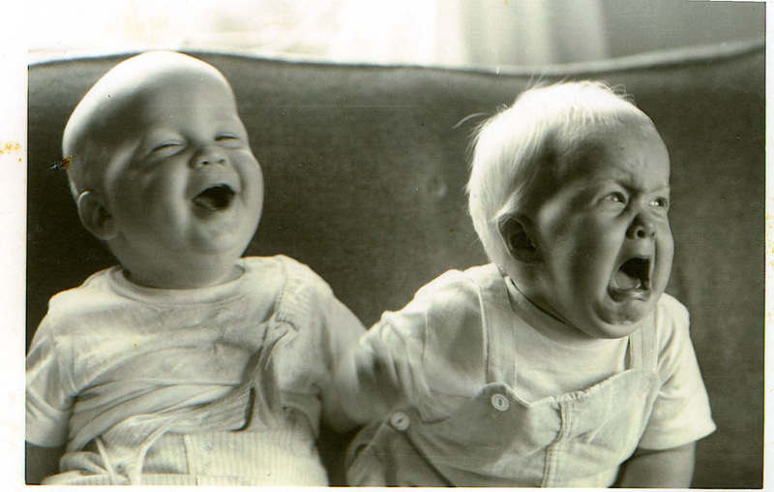
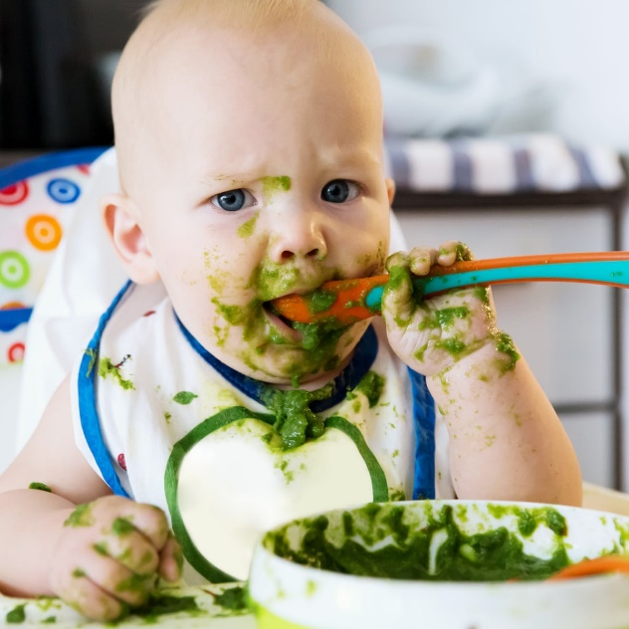

User feedback: tools we have
Explicit feedback
Searching / filtering
Implicit feednack
Why doing user preference research feels like being a parent? ☺
A substantial part of our job is trying to understand our kids/users with only a limited knowledge

Slide 16
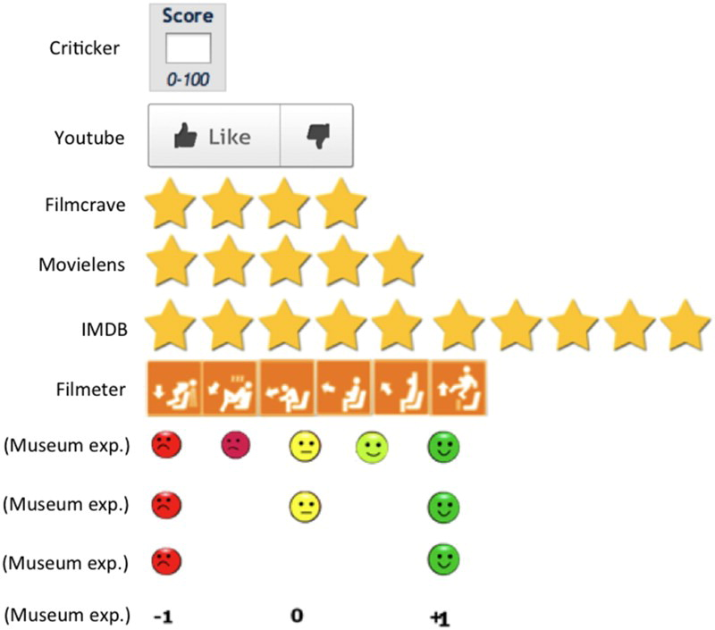
Explicit feedback
Information given consciously by the user to express his/her preference
  Via dedicated GUI
Rating (likert scale) of objects
  N-ary preference (5 / 10 degrees of preference most common)
  Binary preference (likes – dislikes)
  Unary preference (likes only)

Slide 17
Explicit feedback
Common beliefs
  Easier to interpret (direct indication of preference)
  More reliable (free of noises that impact implicit feedback)
  Harder to obtain (willing users needed)
Unknowns & research directions
  Ideal feedback granularity (maximize received volumes & information value)
  Stability of the provided feedback
  How GUI and other presentation features affect received values?
  Should we consider other entities than feedback on whole items?
  Other than numeric feedback? (reviews)

Slide 18
Ideal explicit feedback granularity
What explicit feedback GUIs do you know?
What is their granularity?

Slide 19
Ideal explicit feedback granularity
1-to-5 stars (sometimes more or less)
Likes / dislikes
Loves / likes / dislikes
Likes only
  Different flavors / emoticon reactions
Percentage in reviews

Slide 20
Explicit feedback: does granularity helps?
Common belief:
 Feedback granularity =>  preference understanding =>  recommendations
=>  task complexity =>  feedback volume =>  recommendations
Which phenomenon will have a higher impact?
  Understanding the Temporal Dynamics of Recommendations across Different Rating Scales
  (https://ceur-ws.org/Vol-997/umap2013_lbr_7.pdf)
    Comparing 1-5 star rating scheme with positive-neutral-negative (with explicit conversions)
    Utilizing User kNN algorithm, book dataset, rating prediction task (MAE)
    3-valued feedback result in lower MAE than 5-valued one (surprising)

Slide 21
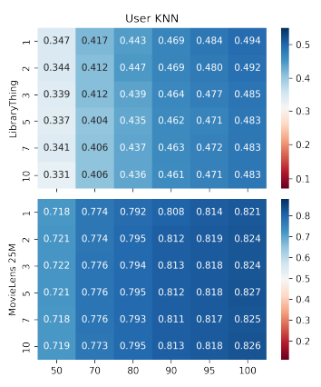
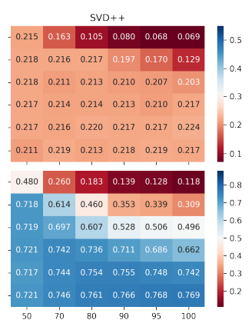
Explicit feedback: does granularity helps?
 Feedback granularity =>  preference understanding =>  recommendations
=>  task complexity =>  feedback volume =>  recommendations
Which phenomenon will have a higher impact?
  The Effect of Feedback Granularity on Recommender Systems
  Performance (https://dl.acm.org/doi/abs/10.1145/3523227.3551479) [our work]
    Movies and books data, more rating granularity (1,2,3,5,7,10) and explicitly model the feedback volume decrease
      More granular data may improve the results of some algorithms – but not all
      Even the slightest decrease in the feedback volume
      has much stronger impact on the results
While some algorithms may benefit from more details,
you should optimize for getting more data
  That is, if the data reliability remain constant
  Nowadays, many algorithms consider binary feedback by design

Slide 22
Explicit feedback: stability
If you positively rated an item a week ago, would you still like it today?
  Are the rating values stable (i.e., can we rely on them?)
  Test-retest scenarios
    https://xamat.github.io/pubs/xamatriain_umap09.pdf
    Netflix dataset, both popular & unpopular movies
    Three trials, 5-scale rating + unseen of 100 movies: 1->2 at least one day apart, 2->3 at least 14 days apart, different ordering of items (random -> popular -> random)
Usually, rating differs just by one point; mediocre movies more unstable

Slide 23
Explicit feedback: stability
If you positively rated an item a week ago, would you still like it today?
  Are the rating values stable (i.e., can we rely on them?)
  Test-retest scenarios
    https://xamat.github.io/pubs/xamatriain_umap09.pdf
    Netflix dataset, both popular & unpopular movies
    Three trials, 5-scale rating + unseen of 100 movies: 1->2 at least one day apart, 2->3 at least 14 days apart, different ordering of items (random -> popular -> random)
Inconsitencies are more frequent in less popular (less known?) items

Slide 24
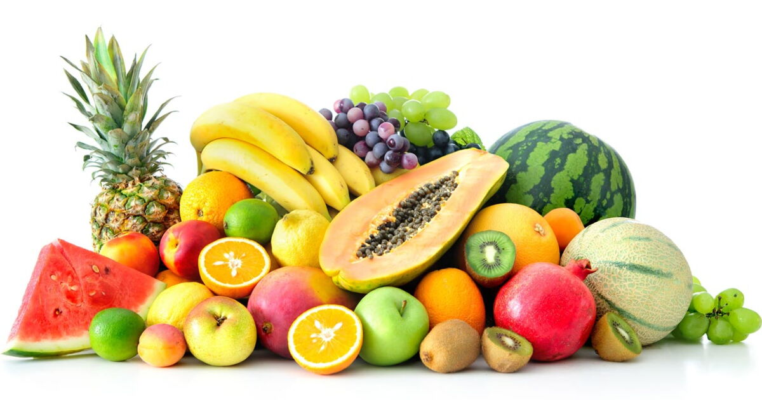
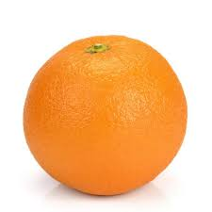
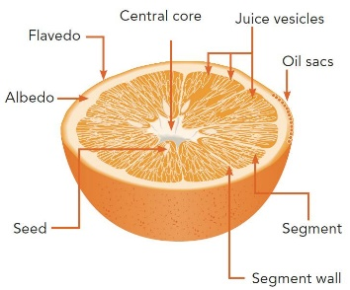
Explicit feedback: target entities
Default: provide one feedback per item
However, there may be well-justified exceptions
  Rating multiple different aspects of the item separately
    Theoretically, this may map 1:1 to some item features.
  Rating a collection of items together
Vs.
Vs.

Slide 25

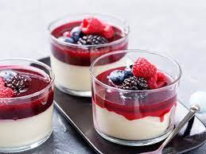
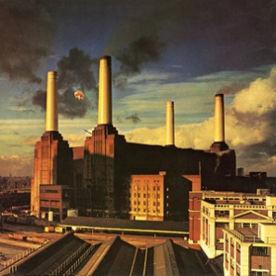
Explicit feedback: target entities
Rating multiple different aspects of the item separately
  Theoretically, this may map 1:1 to some item features.
  But usually, thats not a good idea!
Why do you like Lord of the Rings movie?
What makes panna cotta so delicious?
What is so good on [your favorite artists] songs?

Slide 26
Explicit feedback: target entities
Rating multiple different aspects of the item separately
  Theoretically, this may map 1:1 to some item features.
  But usually, thats not a good idea!
Why do you like Lord of the Rings movie?
What makes Panna cotta so delicious?
What is so good on [your favorite artists] songs?
Is the description discriminative?
  Can it be generalized to all other objects sharing the same feature?
  How much is missing in the picture?
  How much effort did you use? Would you be willing to do it „normally“?
If you mentioned multiple features, what is their interplay?
  And-like / or-like / additive / amplifying…

Slide 27
Explicit feedback: target entities
Rating multiple different aspects of the item separately
  Theoretically, this may map 1:1 to some item features.
  But usually, thats not a good idea!
Why do you like Lord of the Rings movie?
What makes Panna cotta so delicious?
What is so good on [your favorite artists] songs?
Also, are these the actual reasons, or just you justifying your emotions?
  https://start.askwonder.com/insights/want-add-previous-request-made-few-years-ago-want-studies-support-idea-decisions-c22yygpap
  https://en.wikipedia.org/wiki/Motivated_reasoning
  “Ninety percent of human decisions are made based on emotions. Humans use logic to justify their actions to themselves and others“
  "Common emotional decisions may use some logic, but the main driving force is emotion, which either overrides logic or uses a pseudo-logic to support emotional choices (this is extremely common). Another common use of emotion in the decision is to start with logic and then use emotion in the final choice."

Slide 28
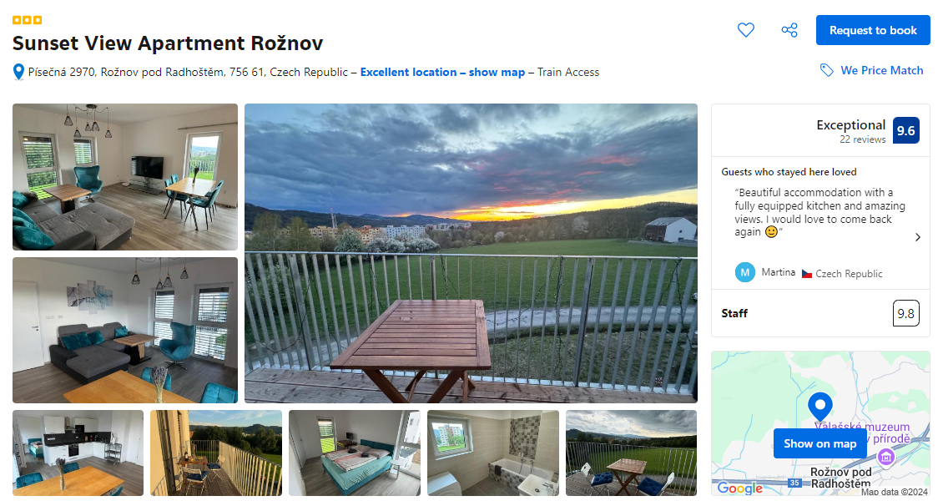
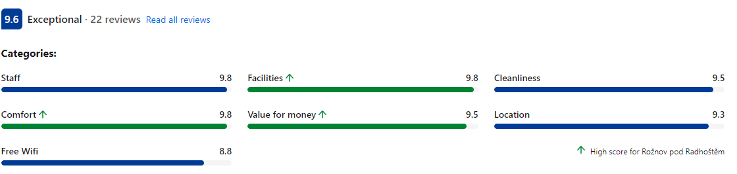
Explicit feedback: target entities
Rating multiple different aspects of the item separately
  In practical situations, some well-defined
  aspects of items may work
    No direct mapping to any meta-data
    Disentangled concepts
    High value for users (paying the depth to society)

Slide 29
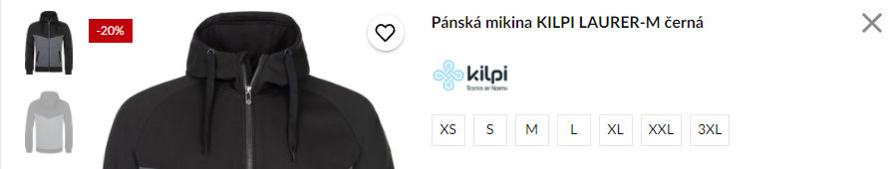
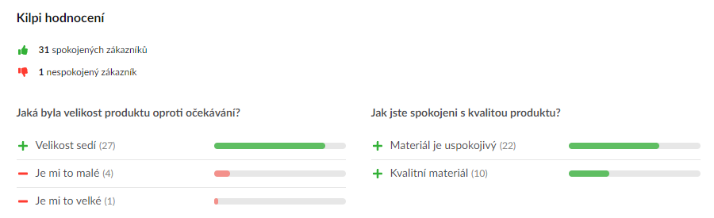


Explicit feedback: target entities
Rating multiple different aspects of the item separately
  In practical situations, some well-defined aspects of items may work
    No direct mapping to any meta-data
    Disentangled concepts
    Focus on concepts beyond what is perceiveable online

Slide 30
Explicit feedback: target entities
How to work with multi-aspect feedback?
  Hard to know, very niche topic, highly domain specific
  No related works to the best of my knowledge :-/
    Maybe, relevance of individual aspects for users and then post-processing?

Slide 31
Explicit feedback: target entities
Rating a collection of items together
  What natural collections of items do you know?

Slide 32
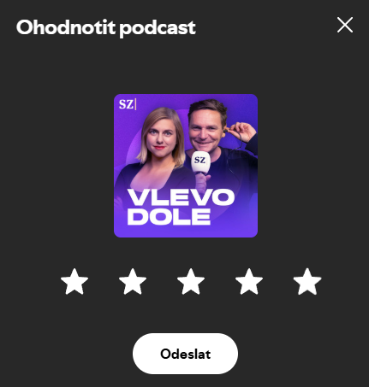
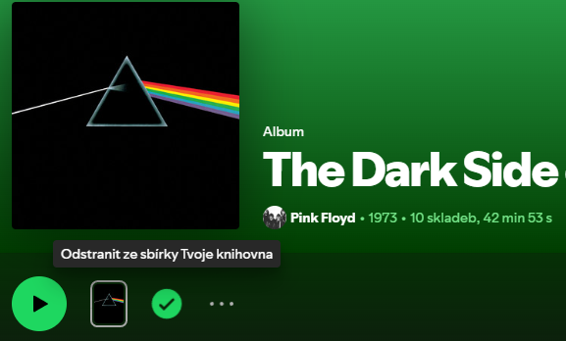
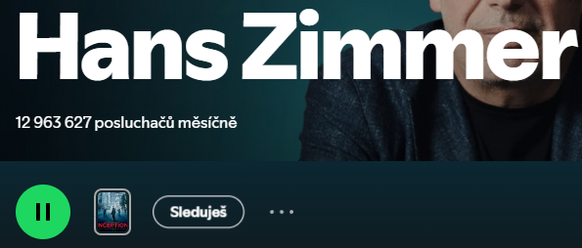
Explicit feedback: target entities
Rating a collection of items together
  What natural collections of items do you know?
  Those that are represented by some independent entity
    Artist
    Album
    Movie/book series
    …
    People are able to express their preference towards that entity

Slide 33
Explicit feedback: target entities
How to process collection-wise feedback?
  Who knows☺ (same issues as with sub-item feedback)
    Option #1: translate to item-level feedback (lower weights)
    Option #2: make the collections recommendable entities
    Option #3: non-linear joint modeling

Slide 34
Questions?

Slide 35
Implicit feedback
Information received unconsciously by simply observing what the user do
  Event triggers either on server-side, or, e.g., on DOM tree (on click, on scroll, on load,…)
Common beliefs
  Often, implicit feedback is considered as unary or binary
  Even binary feedback is rather noisy (accidental clicks etc.)
  It is hard to interpret more refined information
  We can receive it in abundant volumes
    Non-intrusive design

Slide 36
Implicit feedback
If you have to choose between explicit and implicit feedback to power your RS
  What would it be?

Slide 37
Implicit feedback
If you have to choose between explicit and implicit feedback to power your RS
  Implicit feedback!
  Data volume usually wins
    while some events may provide more value, do not forget abhore more-frequent-less-value
    Purchases vs. clicks

Slide 38
Implicit feedback
Research directions
  How to incorporate finer-grained feedback?
  Context of user feedback.
  Biases in feedback data.
  Impressions & their usage in recommendations.

Slide 39
How to incorporate finer-grained feedback?
What to incorporate as feedback?
  Domain specific (how surprising☺)
  Not much guidance from related research
    Tune the algorithms on what is available in the data
    „The decision on what to collect has already been made“
    Not much work done on how to deal with heterogeneous feedback signals
    Industry-based papers often do not offer feedback details (part of know-how)

Slide 40
How to incorporate finer-grained feedback?
What to incorporate as feedback?
  Domain specific (how surprising☺)
  Not much guidance from related research
    Tune the algorithms on what is available in the data
    „The decision on what to collect has already been made“
    Not much work done on how to deal with heterogeneous feedback signals
    Industry-based papers often do not offer feedback details (part of know-how)
  However:
    Time the user spent (doing something productive)
    Activation of relevant GUI elements
    Navigating within the page (e.g., scrolling)

Slide 41
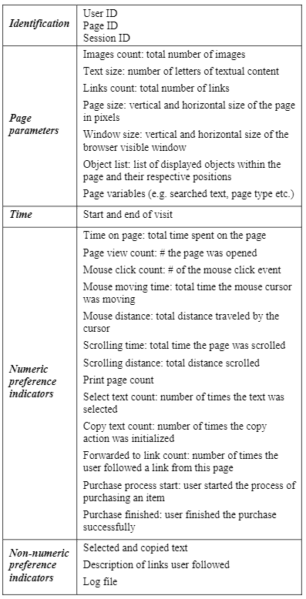
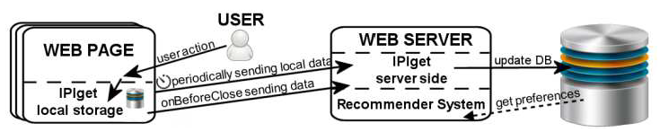
What to Collect as Implicit feedback
Peska, IPIget: The Component for Collecting Implicit User Preference Indicators
https://www.researchgate.net/publication/305495313_IPIget_The_Component_for_Collecting_Implicit_User_Preference_Indicators
Main target: small e-commerce vendors
  Previously mentioned events
  Other aggregated events: print, search, copy, text selection (not much usable)
  Non-numeric data (searched text, selected text,…)
  Context of events
    Scrolling to coordinates
    Mouse position sampling
    Mouse over pre-defined elements
  Basic page statistics
    Volume of text, images, links
    page dimensions, window dimensions
    position of elements
    Page params (e.g. Catalogue -> menswear -> Trousers…)

Slide 42
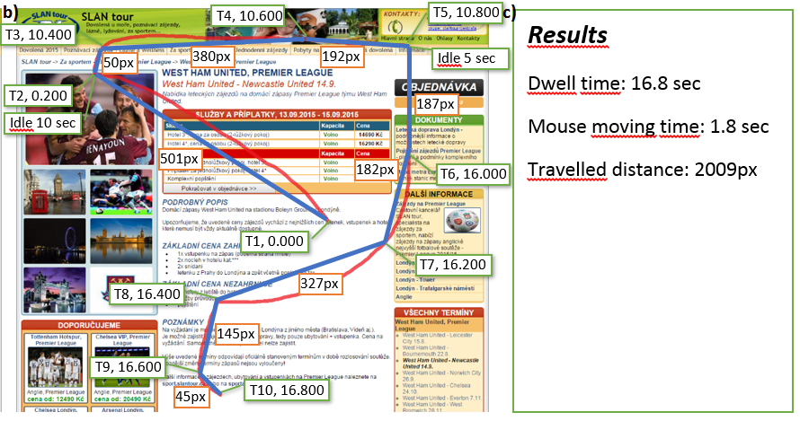
What to Collect as Implicit feedback

Slide 43
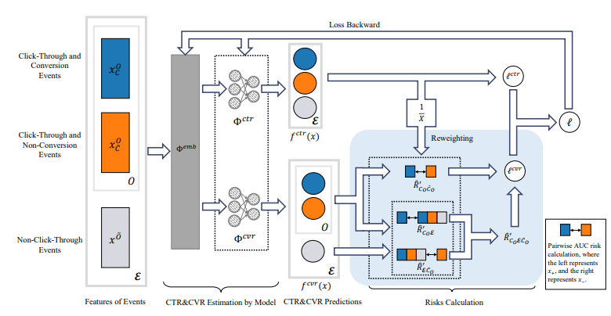

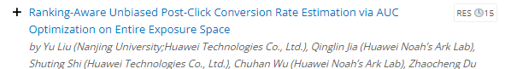
How to interpret numeric implicit feedback?
Assumption: most RS algorithms are tailored to utilize binary/unary feedback
  BPR, EASE, most sequence-aware algorithms…
  Why not to binarize the feedback?
  Downside: we might be loosing too much by relying on coarse-grained + sparse information
Assumption: many algorithms are tailored to utilize explicit numerical feedback
  SVD, variants of KNN,…
  Historically, much higher coverage due to MovieLens and similar datasets
  Translate the multimodal implicit feedback signal to what can be understood as rating. Than use algorithms capable to digest graded feedback.
Assumption: multiple feedback modalities cover different
objective aspects, lets jointly predict them
  Click-through rate & post-click conversion rate
  Two-tower design of the multi-task learning model

Slide 44
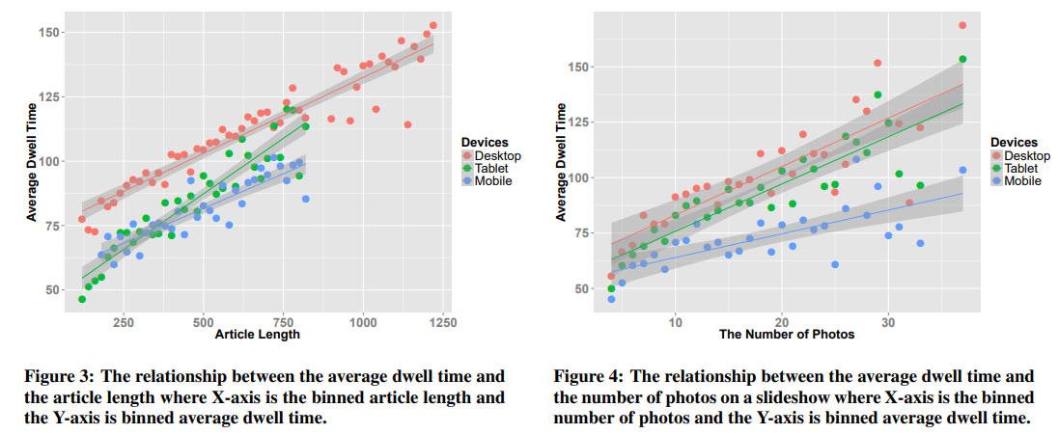
How to interpret implicit feedback: context
Beyond Clicks: Dwell Time for Personalization, https://dl.acm.org/doi/10.1145/2645710.2645724 [RecSys2014 best paper]
Pages may substantially vary in length, amount of content etc.
  This could affect perceived implicit feedback features
  Leveraging context could be important
Consumption statistics may significantly vary also for different device types

Slide 45
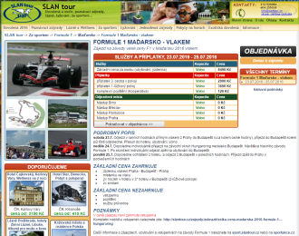

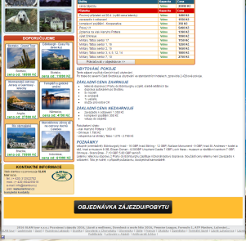
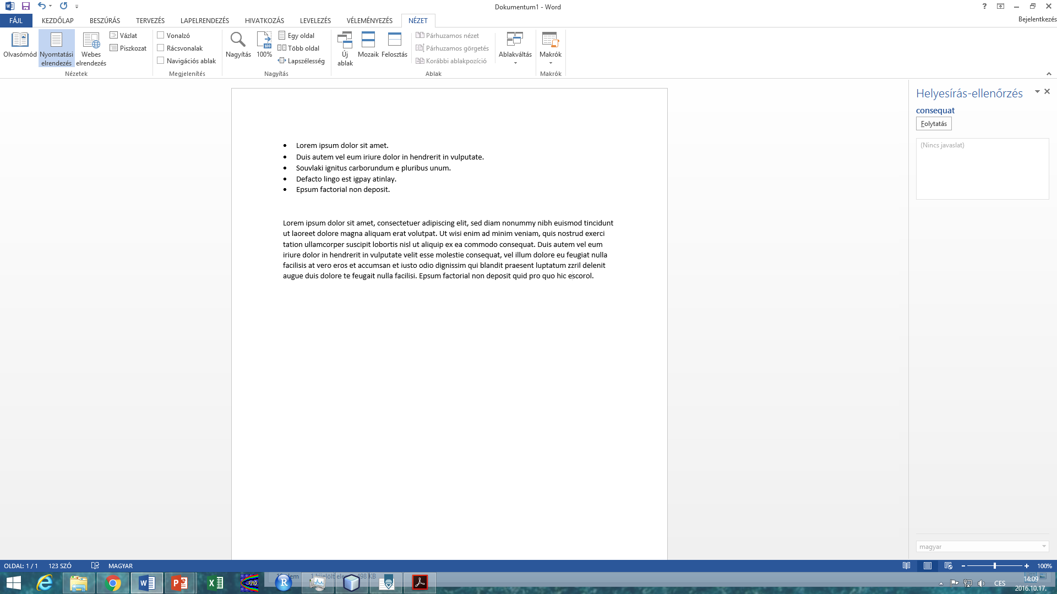
How to interpret implicit feedback: context
Context of device and page
  Page and browser dimensions
  Page complexity (amount of text, links, images,...)
  Device type
  Datetime
  Can affect percieved values of the user feedback
Modeling as additional inputs of the learning worked the best for us
- Explicit feedback normalization also possible
A
B
http://btw2017.informatik.uni-stuttgart.de/slidesandpapers/E3-16/paper_web.pdf

Slide 46
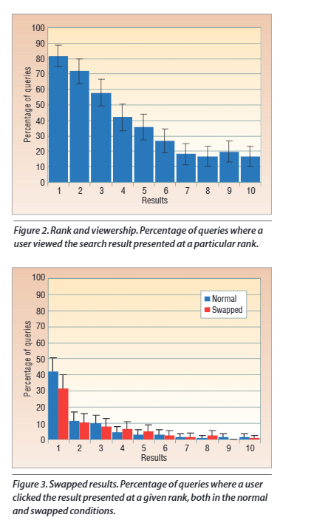
Negative implicit feedback
Most consumption-related information is associated with positive preference
  Why cant we just assume that no data = (weak) negative preference
Biases
  Popularity bias (items are not evenly exposed to users)
  Presentation bias (users tend to interact with items on certain positions)
  …
Positive feedback is missing-not-at-random
  Absence of positive feedback is either because the item is either irrelevant
  or relevant but unseen
  Probability of being unseen varies between different item groups
http://researchgate.net/publication/2961924_Search_Engines_that_Learn_from_Implicit_Feedback

Slide 47
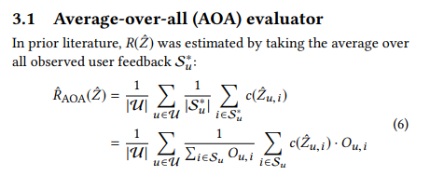
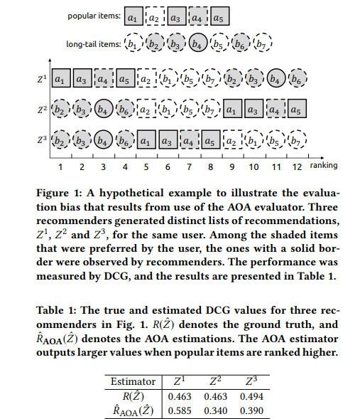
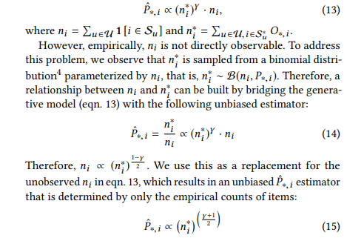
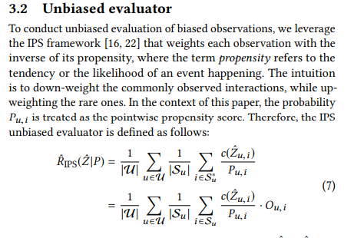
Negative implicit feedback
Different de-biasing strategies exist, e.g., to counter the uneven probability of being unseen. -> Self-normalized inverse propensity score (Popularity bias) https://ylongqi.com/paper/YangCXWBE18.pdf
nDCG, AUC, MAP,...
Propensity score

Slide 48
Negative implicit feedback
Most consumption-related information is associated with positive preference
  We do not have equivalents to negative ratings
  => to get this we need to work with context (i.e., what was recommended, but ignored by the user)
Impressions
  Available information may vary
    Set of items ever displayed to a particular user
    (Ordered) list of items displayed to the user at certain timepoint
    Details on where were the items displayed within the page
      Information on what the user was doing while browsing the page

Slide 49
Negative implicit feedback
If I (repeatedly) ignore an object, I probably dislike it
  How many times do I have to ignore it?
  Could it be that I just did not pay attention for this specific part of the page?
  What is the chance that I changed my mind?
We can consider uniform chance of item being unnoticed
We can consider fixed chance of being unnoticed for certain position
  https://link.springer.com/article/10.1007/s11257-021-09311-w
We can consider that items are evaluated sequentially
  If the item below was clicked, this one is probably observed as well
  https://arxiv.org/abs/1902.08495
We can have detailed feedback with objects’ visibility information
  https://link.springer.com/article/10.1007/s13740-016-0061-8

Slide 50

What to Collect as Implicit feedback
Collect visible area through time
(scrolling position + window dimensions)
Store areas where interesting page segments are located
  Items in category page
  Areas focused on item’s features
Calculate visibility times => noticeability of individual components
Relate minimal noticeability times to how much was needed to get a click on items
https://link.springer.com/article/10.1007/s13740-016-0061-8

Slide 51
Questions?

