Slide 1


Evaluating Recommender Systems
If You want to double your success rate, you should double your failure rate.
https://www.ksi.mff.cuni.cz/

Slide 2
Today’s Content
Organization + Recap
Evaluating RS
  Motivation
    Subjects, Variables, Settings, Design
  Variants
    Online Evaluation
    User/Lab Studies
    Offline Evaluation
  Best practices, evaluation „f**k-ups“

Slide 3

Recap
Basic CB with meta-data?
Vector Space Model (Rocchio’s Method)
What is wrong here?

Slide 4
Organization
Semestral work. Details to be discussed during labs
  Using EasyStudy, construct a new user study with certain extensions of the original framework
    Define research questions and hypotheses (what should work better and why)
    Enhance EasyStudy by
      Adding a new algorithm or a post-processing method (e.g., diversity enhancement)
    Run the study locally (collect dummy data)
    Create basic evaluation scripts / Evaluation screen for users
  Select some of the pre-defined variants, or propose your own
Deadlines:
  By May 15: finalize the proposal of what you plan to do (get approval)
  By May 31 or exam date (whatever is sooner): finish the project if you want to get a bonus for exam
    Later finalization possible (no bonuses)

Slide 5

Evaluating Recommender Systems

Slide 6

Evaluating Recommender Systems
A myriad of techniques has been proposed, but
  Which one is the best in a given application domain?
  What are the success factors of different techniques?
  When/why certain methods do not work?
Possible research questions:
  Is a RS more effective with respect to a specific criteria like accuracy, user satisfaction, response time, serendipity, diversity, online conversion, ramp-up efforts, retention of users ….
  Do customers like/buy recommended items?
  Do customers buy items they otherwise would have not?
  Are they satisfied with a recommendation after purchase?
  Do they keep using our site thanks to the recommendations they’re receiving?
  (Can we assure that the improvements were caused by the RS? )

Slide 7

Background: Requirements on Evaluation in Science
Scientific experiments must ensure reproducibility in order to verify the findings
How an evaluation research is done?
  Thoroughly describing the methodology
  Following a systematic procedure
  Documenting decisions made
Criteria that must be pursued
  Validity (internal and external)
  Reliability
  Sensibility

Slide 8
Evaluation research – Criteria to pursue
Internal validity
  The observed effects are due to the controlled test conditions instead of differences in the set of participants (aka predispositions), or the environment
    I.e., results are better because we applied a better method
External validity
  Results are generalizable to other user groups or situations
  The scenario is representative of a real-world situation
    This works for me & my buddies, vs. this works for everyone
Reliability
  Absence of inconsistence and errors in data and measurements
Sensibility
  Different evaluations of the observed aspects reflect in difference in the
measurements

Slide 9




Evaluation research - Components
Subjects
Settings
Measured Variables
Design

Slide 10
Evaluation research - Settings
Depending on to the conditions in which the data are collected:
Offline studies
  Conducted on real-world data, aiming to predict hidden part of the data
  But analysis is done after the fact…
  A lot of improvements recently towards de-biasing & multi-criterial evaluation
    But still not very reliable
Field studies (Online evaluation)
  Conducted in an preexisting real-world environment (production websites)
  Users are intrinsically motivated to use a system
    But experiments cost you (potentially a lot)
Lab studies (User Studies)
  Expressly created environment for the purpose of the study
    We can get more/better feedback
  Variables can be controlled more easy by selecting study participants
  But doubts may exist about participants motivated by money or prizes
    Do they behave in the same way as your customers?

Slide 11

Evaluation research - Subjects
The subjects of recommender systems research are usually specific subgroups of people
  Online customers, web users, who receive adaptive and personalized recommendations
  Need for balance: ideally, groups of users with the same properties should evaluate each tested condition
    Simple for offline settings, more challenging for field/lab studies

Slide 12
Evaluation research - Measured Variables
Aspects of the users (or subjects) that are relevant in the context of the recommendation system and the research question examined
  Demographics, background check, psychological profiling,...
Independent variables
  Variables that are static throughout the course of the experiment
  E.g., the way how individual items are displayed
Control conditions
  Controlled by the evaluation design (e.g., the recommendation algorithm)
Dependent variables
  Assumed to be influenced by the independent variables and control conditions
  E.g., higher reported satisfaction with certain algorithm / higher nDCG@10 / more conversions...

Slide 13

Evaluation research - Design
Experimental
Quasi-Experimental
Non-Experimental
Cross-Sectional
Case-Studies

Slide 14
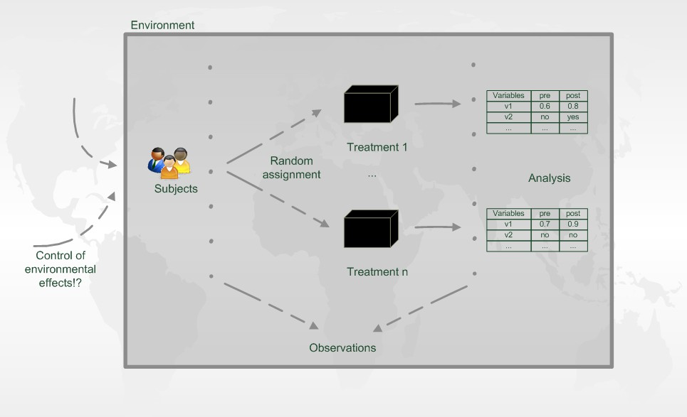
Experimental Research Design
One or more of the independent variables are manipulated to ascertain their impact on the dependent variables
  The most common approach for RecSys research
A/B testing in online settings
  users are randomly directed to recommendations from algorithm A or B

Slide 15
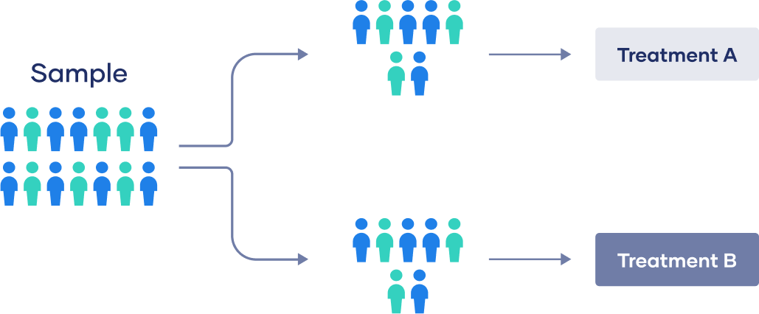
Experimental Research Design
One or more of the independent variables are manipulated to ascertain their impact on the dependent variables
Between-subject design
  Each participant experiences only one treatment
  Simplest variant, suitable also for field studies
  The critical part is to balance the sub-samples well (or make them large enough☺)

Slide 16
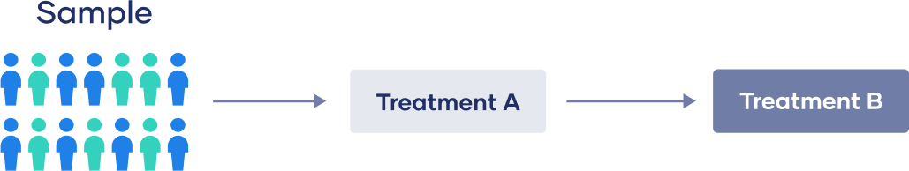
Experimental Research Design
One or more of the independent variables are manipulated to ascertain their impact on the dependent variables
Within-subject design
  Each participant experiences all the treatments, typically in sequential order
    Alternatively, the display provide results of multiple variants
  Sequential design not very suitable for field studies (carry-over effects)
Implicitly, this is what you do for offline evaluation
Mixed designs are also possible (typically when having multiple independent variables)
  Some variables treated as within-subject, others as between-subject

Slide 17



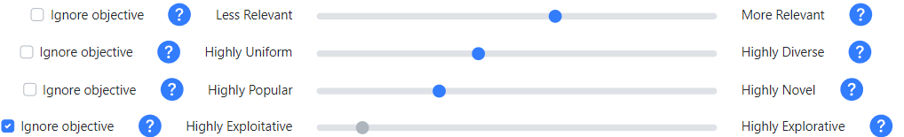
Quasi-Experimental Design
Different from Experimental design from its lacking of random assignments of subjects to different treatments
  Subjects decide on their own about their treatment
Results must be interpreted with utmost circumspection
  Differences between treatment / no treatment groups
Conclusions need to be drawn very carefully
But, may be suitable to test optional parts of design
  e.g., controlling interface

Slide 18

Non-Experimental Design
Quantitative research
  Numerical measurements of different aspects of objects
    For instance, asking users different questions on the perceived utility of the recommendation applications
    Answers usually on a Likert scale
Qualitative research
  Interviews with open-ended questions,
record think-aloud protocols, focus group of discussion
    For instance, to explore user’s motives for using a recommender system
    Understand what features must a good recommendation have
      „What does serendipitous recommendations mean for you?“
Longitudinal research
  The entity under investigation is observed repeatedly over time
    For instance, to evaluate the impact on the long-term of the use of a recommender system

Slide 19


Other Designs
Cross-Sectional design
  Analyze relations among variables that are
  simultaneously measured in different groups
  Allows generalizable findings from different
  application domains to be identified
    Case Studies
      Combine whichever types of quantitative and qualitative methods necessary to investigate contemporary phenomena in their real-life contexts
      Focus on answering research questions about how and why

Slide 20

Questions???

Slide 21
Experimental settings

Slide 22
Evaluation settings
Off-line evaluation
  Based on historical data
  Aiming to predict hidden part of the data
  A lot of improvements recently towards de-biasing & multi-criterial evaluation
Lab studies (User Studies)
  Expressly created for the purpose of the study
  Extraneous variables can be controlled more easily by selecting study participants
    Possibility to get more feedback
  But doubts may exist about participants motivated by money or prizes
  Participants should behave as they would in a real-world enviroment
Field studies (On-line, A/B testing)
  Conducted in an preexisting real-world enviroment
  Users are intrinsically motivated to use a system

Slide 23

Online experiments

Slide 24
Online Experimental Settings
A/B testing
  Evaluate metric as close to the actual target behavior as possible (KPI, key performance indicators)
  Retailer’s target variable is (long-term) profit
    i.e. Netflix’s target variable is monthly subscribes
    Usually, larger overal consumption increase profit (but beware of extreme cases)
  Broadcaster’s target variable may be the overall influence / total mass of readers /… but also maintaining editorial values
The direct effect on KPIs may be too small
  How much does one small parameter change affect retention of users?
The target variables may be hard to measure directly
  E.g. has long-term effect only / cannot extrapolate all external variables
Proxy variables
  Loyalty of user, Conversions rate, Basket size / value, Click through rate, Shares / Follows /…

Slide 25
Rules to live by ☺
Always design evaluation metrics with respect to your target variables
  However select something, where the effect is measurable
In either case, be careful about long term effects
  Cascade of evaluation metrics
    From high to low detectability of changes
    From low to high impact on your true target
  Continuously measure the effectivity of your recommendations
    Even when no experiment is currently running
    Apply automated alerts when some metrics substantially deviate

Slide 26
Common on-line evaluation metrics – E-commerce
Higher potential impact
Recommending correctness
  Visit (once) recommended object (i.e. ignore page layout)
Click-through rate (CTR)
  Recommend -> Click / Click and do sth. (do not leave imediatelly)
Conversions rate (CVR)
  Recommend -> Purchase / Click -> Purchase / Recommend-> Click -> Purchase
  Share / follow / like / ask about... recommended item
Cross-sale increase
  Add to cart -> Recommend -> Add another (recommended) to cart
  Returning buyers, viral effect, market shares…
Better proxy of target variable

Slide 27
Common on-line evaluation metrics – Broadcaster/News/Info
Higher potential impact
Recommending correctness
  Visit (once) recommended object (i.e. ignore page layout)
  Reflecting editorial values (diversity, significance, minority voices...)
Click-through rate
  Recommend -> Click / Click and do sth. (do not leave imediatelly)
  [beware of clickbaits]
„Conversions“ (engagement) rate
  Share / follow / like / comment... recommended item
Value per user
  Total time / number of visited objects / displayed adds…
  per user or per session
  Returning rate of users / user loyalty
  Premium subscription rate
Better proxy of target variables

Slide 28
Beyond performance indicators – Technical metrics
!!Response time!!
Train / re-train / model update time
Memory/CPU/GPU consumption
  How large can we grow with current infrastructure?
Recall on objects
  Is portion of your objects ignored? Are there too many low-profit bestsellers?
Ability to predict
  Can you calculate recommendations for all users?
  For which groups of users are we better than baseline?

Slide 29
Beyond performance indicators – Fairness
Recommender environments have multiple stakeholders
  Consider, e.g., Amazon or Spotify
    Users who consume products
    Providers who supply products
    The platform itself
Provider fairness:
  Products that are similarly good for the user should receive similar attention
  The platform should not discriminate any subgroup of providers (e.g., small local bands)
Consumer fairness:
  The recommendations should be similarly good for all subgroups of users
    Only suggesting the cheapest pubs for anyone from Ostrava is not a good idea☺

Slide 30
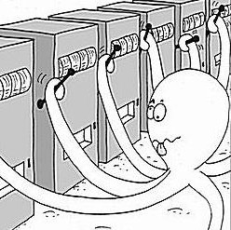
Multiarmed bandits evaluation
Bad side of A/B testing? It costs a fortune
  Organizational requirements (Necessary... Study builder frameworks may help to some extent)
  Users receive sub-optimal recommendations (we can do sth. about that)
Multiarmed bandits
  Alternatives that seems less relevant gradually receives less attention
  Epsilon-greedy, Thompson sampling, upper confidence bounds (UCB)

Slide 31
Multiarmed bandits evaluation
Epsilon-greedy
  Calculate average success (sum of reward / # of trials ) for each arm
    Select the current best arm with the probability of ε, while with (1- ε) probability select at random
    ε may increase in time (supposed cooling effect)
  Simple & somehow works
  But, no optimality guarantees

Slide 32
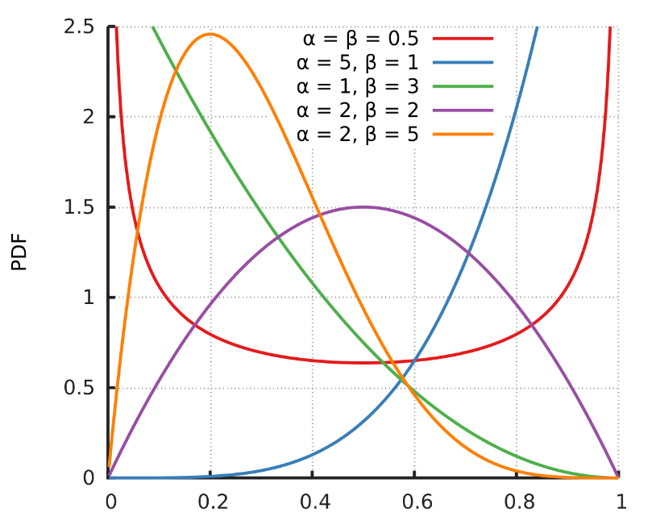
Multiarmed bandits evaluation
Thompson sampling
  Assume Bernoulli (binary) rewards, for each arm keep
    α = number of successes (positive outcomes) + 1
    β = number of failures (negative outcomes) + 1
  Assume that the distribution of rewards follows a Beta(α, β) distribution
    For each arm, sample a value from corresponding Beta distribution
    Select the arm with the highest sampled number
  Update α and β of the selected arm (based on the result of the trial)
  Guarantees to minimize regret under some conditions
  Rather quick convergence (fairly soon, only the best arm is being selected)
    This may be a problem for long-term effects (limit history)

Slide 33
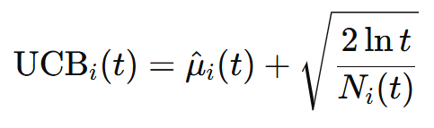
Multiarmed bandits evaluation
Upper Confidence Bound (UCB)
  At each step, select the arm with with the highest upper confidence bound based on the observed rewards.
    UCB = estimated reward + certainty threshold
    Estimation = mean reward
    Certainty threshold determined by the number of trials
  \hat{μ}_​i​ (t) is the estimated average reward of arm i at time t.
  𝑁_𝑖(𝑡) is the number of times arm i has been pulled up to time t.
  ln⁡ 𝑡 is the natural logarithm of time step t
Selects either the arm that is good (and you are fairly certain about it), or the arm, which did not seem so good so far, but you did not sufficiently test it yet.
Time factor increases confidence bounds over time (soft nudge to forget)

Slide 34

Note on multi-criterial RecSys
Wellcome to the DARK SIDE
It is possible to incorporate some providers metrics into the recommendation proces
  i.e. recommend items with higher profit
Do that wisely (or not at all)
  Your credibility is at stake if someone finds out
  User trust is in recommendations is one of the most important features determining the long-term effect of recommender systems
  Do not behave like ALZA a couple years ago...

Slide 35
Evaluating Recommender Systems - II
If You want to double your success rate, you should double your failure rate.
https://www.ksi.mff.cuni.cz/

Slide 36
Recap
Variants of RS Evaluation Settings
Multi-armed bandits
Quasi-experimental design?

Slide 37
Organization
Last couple days to complete Active Reading #2
Active reading #3 to be announced next week
Would you help us with a research?
  Effect of different displays of results in video retrieval
    Your task: search for a particular keyframe in a video collection
  In-person user study: Monday 31.3. from 9am, Rotunda
  Approx 1 hour of your time, modest reward (300CZK)
  Do let me know after the lecture, or write directly to the main organizer:
  Jakub Lokoc, jakub.lokoc@matfyz.cuni.cz

Slide 38
Lab Studies

Slide 39
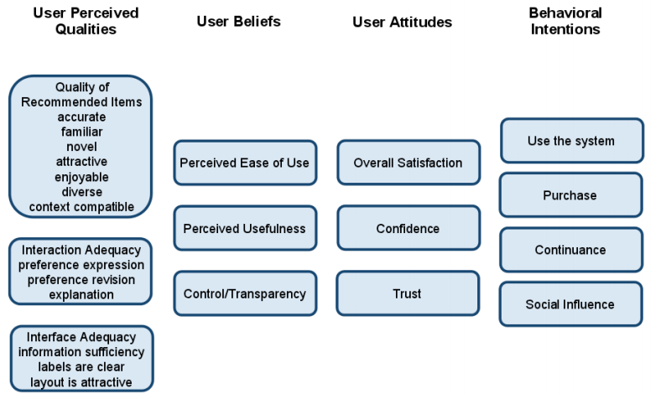
Lab studies settings
Same things possible as in online experiments
  Preference elicitation phase often needed (no history for participants)
  External knowledge for collaborative algorithms needed
In addition to online experiments
  Questionnaire / Interview
    Features otherwise hard to observe
    Helpfulness / Ease of use / Relevance
    Trust, Novelty to the user etc.
    Reasoning behind actions/inaction
  Physiological response
    Eye tracking, facial expression detection etc.
Key criterion in lab studies is that subjects should well approximate behavior of your real users
  This may be harder than it seems (questionable external validity)
  Carefully consider what tasks to give them and then re-think it once more☺
ResQue framework,
https://dl.acm.org/doi/10.1145/2043932.2043962

Slide 40
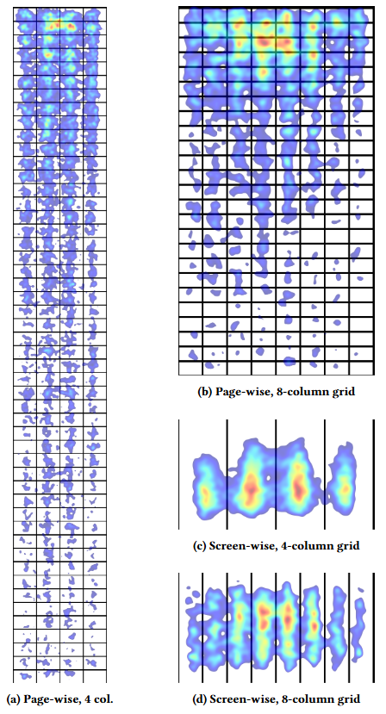
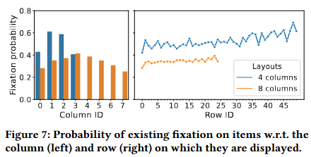
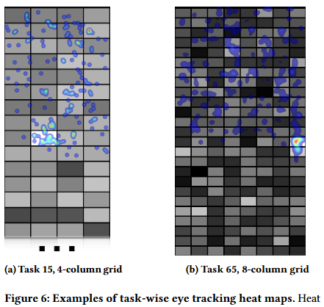
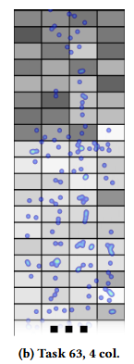
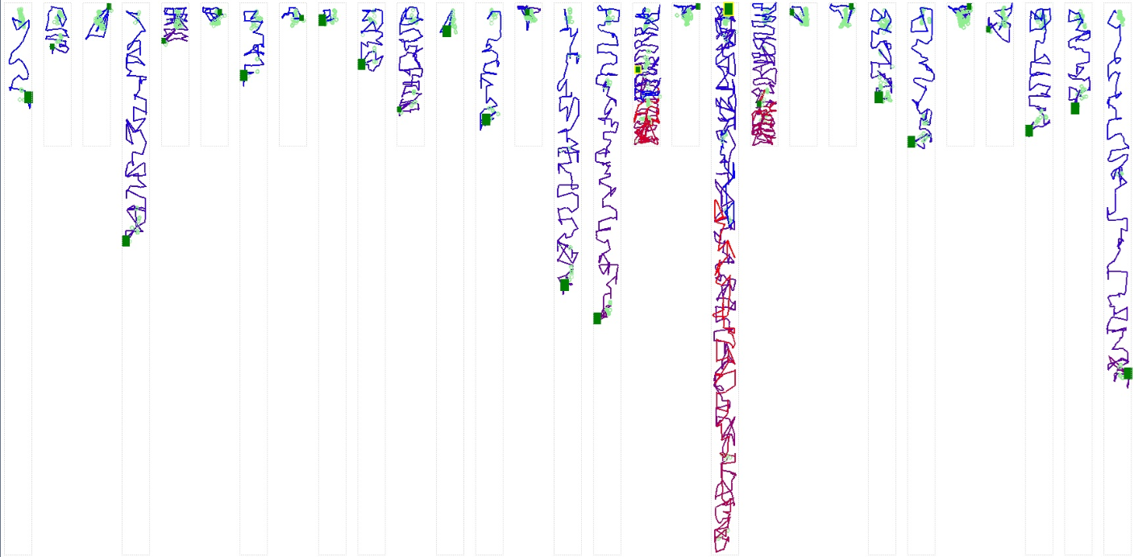
Lab studies example: Known-Item Search in Video: An Eye Tracking-Based Study
https://dl.acm.org/doi/10.1145/3652583.3658119

Slide 41
Offline evaluation
Test | Train
Train | Test | Train

Slide 42
Offline evaluation settings
Largely used in experimental evaluations for recommender systems
  Cheap to conduct, Easy to scale/parallelize, Easy to replicate
  No need to have an access to real-world services
  No need to contract human users of the system
Common working principle:
  Existence of some „correct“ (gold truth) but hidden data (e.g., a portion of users ratings)
  RS aim to predict such hidden data (e.g., recommend items user did rate positively)
Ingredients needed:
  Dataset
  Methodology (e.g., data splits)
  Metrics to evaluate

Slide 43

Datasets
Collection of synthetic or historical user interaction data
  Ratings, purchase transactions, clicks, impressions
  May also contain other data (e.g., item meta-data, item external identifiers etc.)
Synthetic datasets ensure certain properties (distribution, size, sparsity)
  Risk that such datasets are biased toward the design of a specific algorithm and that they may treat other algorithms unfairly
Natural datasets include historical interactions record from real users
Worth to analyse
  Dataset size and sparsity
  Dataset domain
  Available information
    CB data, impressions, feedback granularity,...

Slide 44
Datasets
Dataset | Domain | Feedback | Size
Netflix Prize Dataset | Movies | Ratings | 17770 movies, 480189 users
Movielens 20m | Movies | Ratings | 27278 movies, 138493 users
DePaul Movie | Movies | Ratings + Contextual information | 79 movies, 97 users
LDOS-CoMoDa | Movies | Ratings + Contextual information | 4000 movies, 200 users
MillionSongs Dataset | Music | Listening history | > 1M users
The Million Playlist Dataset | Music | Listening history | 1M playlists, over 2M unique tracks from Spotify users
Kgrec Music Dataset | Music | User’s interactions | 8,640 items, 5,199 users, 751,531 interactions
South Tyrol Suggests | Tourism | Ratings | Not specified
Job Recommendation Challenge Dataset | Job Recommendations | User's applications and work history | Not specified
https://github.com/RUCAIBox/RecSysDatasets
https://github.com/caserec/Datasets-for-Recommender-Systems
https://github.com/otto-de/recsys-dataset
RecSys Challenges (https://recsys.acm.org/recsys24/challenge/)

Slide 45

Methodology
Define how the data available in the dataset are used to train the system and to evaluate its performances
Usually splitted into two sets:
Training set
  Data used to train a machine learning (ML) model
  We use the feedback contained in this subset of data to determine the model
in order to fit the data
Testing set
  Data used to evaluate the model
  We use the trained model to predict the expected feedbacks
  We compare the predictions with the real data to assess the performances

Slide 46

How can we split our data into training and testing sets to increase the reliability of our results?

Slide 47
Holdout
A random set of ratings is withheld from user-item matrix, and it is used as test set (x%)
The remaining ratings are used as training set (100-x%)
20/80 holdout
Risk of overfitting
  tested users are not totally unknown to the model
  Strong generalization (only brand new users in test)
Sometime Stratified
  For instance, we want to ensure that for each user we have data in both training and test set

Slide 48
N-fold cross-validation
Users in the user rating matrix are divided into N partitions
  Normally 5 / 10, common splits 8-2 or 9-1 (80/20, 90/10%)
    Other alternatives, e.g. Monte-Carlo CV
  N-1 partitions are used for the training
  the remaining partition is used for the test
  average of all splits produce the result

Slide 49
N-fold cross-validation
Users in the user rating matrix are divided into N partitions
  Normally 10, common splits 8-2 or 9-1 (80/20, 90/10%)
  N-1 partitions are used for the training
  the remaining partition is used for the test
  average of several ways of splitting the data
Test | Train

Slide 50
N-fold cross-validation
Users in the user rating matrix are divided into N partitions
  Normally 10, common splits 8-2 or 9-1 (80/20, 90/10%)
  N-1 partitions are used for the training
  the remaining partition is used for the test
  average of several ways of splitting the data
Test | Train
Train | Test | Train
…

Slide 51
N-fold cross-validation
Users in the user rating matrix are divided into N partitions
  Normally 10, common splits 8-2 or 9-1 (80/20, 90/10%)
  N-1 partitions are used for the training
  the remaining partition is used for the test
  average of several ways of splitting the data
Test | Train
Train | Test | Train
…
Train | Test

Slide 52
Leave-P-out validation
Usually leave-1-out
During testing, for each user, test one rated item at a time for the test set
Leave-p-out: test predicted ratings for p items
For session-based RS: leave last interaction out and try to predict that one
 |  | ?
 |  | ?
 |  | ?
 |  | ?
 |  | ?
 |  | ? |  | ?
 |  | ? |  | ?
 |  | ? |  | ?
 |  | ? |  | ?
 |  | ? |  | ?

Slide 53
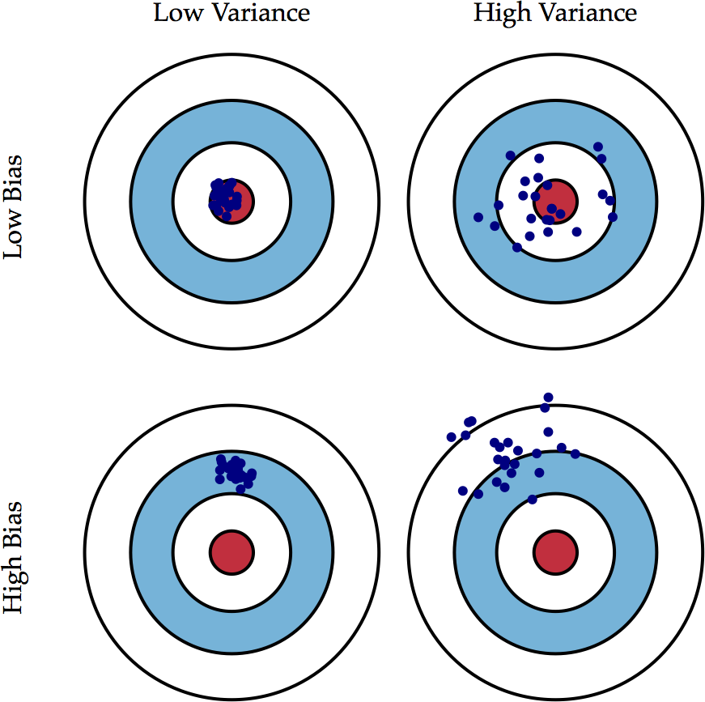
Variance and Bias
Remember, your analysis is only as good as your data.
If your data has high variance or bias, your evaluation will be affected.
Read more here:
https://scott.fortmann-roe.com/docs/BiasVariance.html

Slide 54
Hyperparameters fine-tuning
The trained model behavior depends on its hyperparameters
  KNN – Number N of selected neighbors
  Decision Tree – maximum height of the tree
  EASE – Regularization
  Matrix Factorization– Learning rate, #factors, regularization, stopping criteria
How to find the “best hyperparameters”?
  We try several possibilities during the training using a part of the training set
  Once we find the best hyperparameters, we train the model on the whole training set
Train | Validation | Test
Train | Test

Slide 55
Hyperparameters fine-tuning
The trained model behavior depends on its hyperparameters
  KNN – Number N of selected neighbors
  Linear SVM – C specifying “width of margins” of the decision boundary
  Decision Tree – maximum height of the tree
  Random Forest – Number of trees
  User-based CF – number of similar users
How to find the “best hyperparameters”?
  We try several possibilities during the training using a part of the training set
  Once we find the best hyperparameters, we train the model on the whole training set
Is this good enough?
Train | Validation | Test
Train | Test

Slide 56



Offline evaluation settings
Tame Impala
Beware of causality and biases
  Having A->B->C, predicting C from A may be more difficult than predicting A from C (user-wise causality)
  When did people started liking the item? (dataset-wide causality)
  How were the impressed items selected (dataset biases, e.g., Popularity bias)
Mittigation strategies
  Use temporal data splits, or simulation-style evaluation
  In your data: record impressions and work with them during evaluations
  In 3rd party data: apply appropriate debiasing strategies (e.g. popularity debiasing)

Slide 57
Evaluation of Offline experiments
Temporal splits
  Older data as train set, newer as test set
    Per-user splits
    Global splits
    Multiple temporal splits
Train | Test
Time
Train | Test | Train
Void
Train | Test | Train
Void
…
Train | Test

Slide 58
Evaluation of Offline experiments
Simulation-style evaluation
  Keep the stream of events as it was in the original data (recommendation prompts included)
    Try to re-play what recommendations would the new policy give
    Probably most precise, but rather costly
Biases
  Algorithm biases:
    Users are less likely (often not at all likely) to provide feedback on items that were not recommended
    Limit predictions on impressed data only (or, impressed plus some random subset)
    Use some well-known properties of algorithms (e.g., popularity amplification)
  More subtle issues:
    Previous algorithm was able to gain richer user profiles. Current algorithm is better at utilizing it (exploitation), but inferior in gaining it (exploration)
    Difficult even for online evaluation... Train data sampling w.r.t. Target algorithm distribution?

Slide 59
How we measure the results?

Slide 60

Offline Evaluation Metrics
Metrics selection depend on our research questions and hypotheses we want to test
Relevance of the recommended objects / Ranking metrics
  User visited / rated / purchased… the objects, which the method recommends
  nDCG, MAP, Precision, Precision@top-k, Recall, Liftindex, RankingScore,…
Rating error metrics
  MAE, RMSE,… Not very relevant nowadays
Novelty
  Was the object new for the user? (May be both positive and negative depending on the task)
    However, recommending previously known items is rather trivial
  Several views: novel w.r.t. creation time, novel w.r.t. volume of interactions (= long tail items)
Diversity
  Are all the recommendations similar to each other? (Harry Potter issue)
  Generic Intra-List Diversity (pairwise diversity of items)
  Can be expressed w.r.t. both content-based and collaborative features
Coverage, Serendipity, popularity amplification...

Slide 61
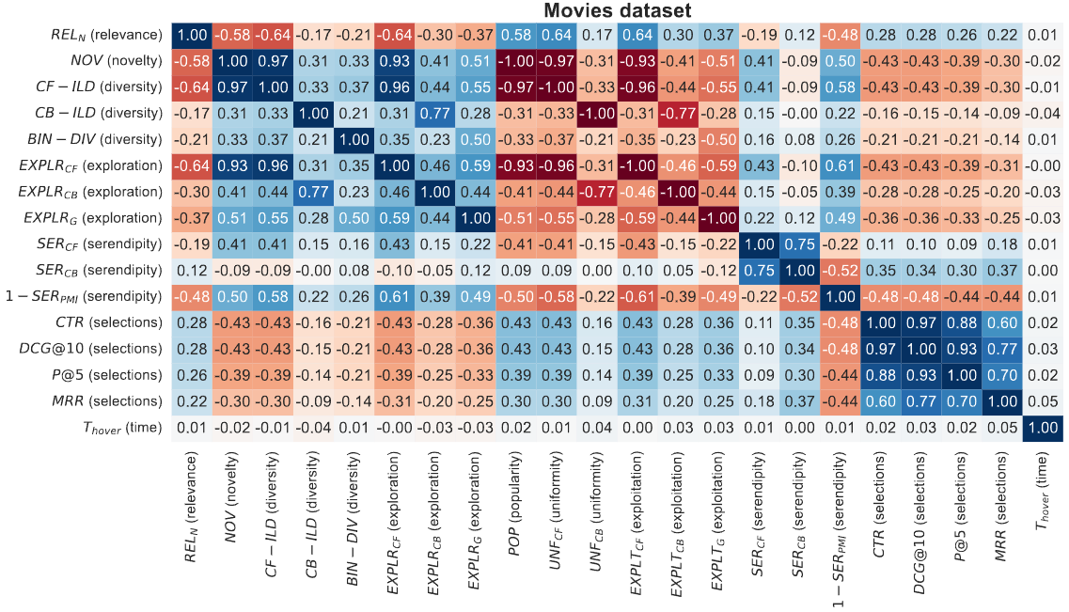
Metrics: Comparison

Slide 62

Beyond-accuracy / beyond-relevance metrics

Slide 63
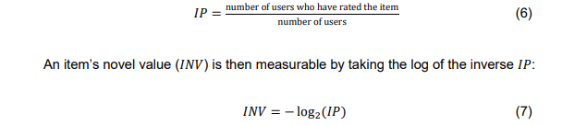
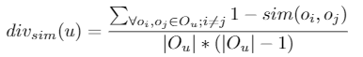
Off-line Evaluation Metrics
Novelty
  Items not known (does not have feedback / were not recommended) by the user
  Not much known (niche) items, based on overal consumption
  Items that are new (have been added recently)
Diversity
  Intra-List Diversity
    Average similarity of all pairs of recommended items
    Both content-based and collaborative variants are plausible
  Subtopics recall, redundancy penalization, intent-aware metrics...
  http://www.mavir.net/docs/tfm-vargas-sandoval.pdf
https://medium.com/mlearning-ai/automatic-evaluation-of-recommendation-systems-coverage-novelty-and-diversity-cc140330d3e7

Slide 64
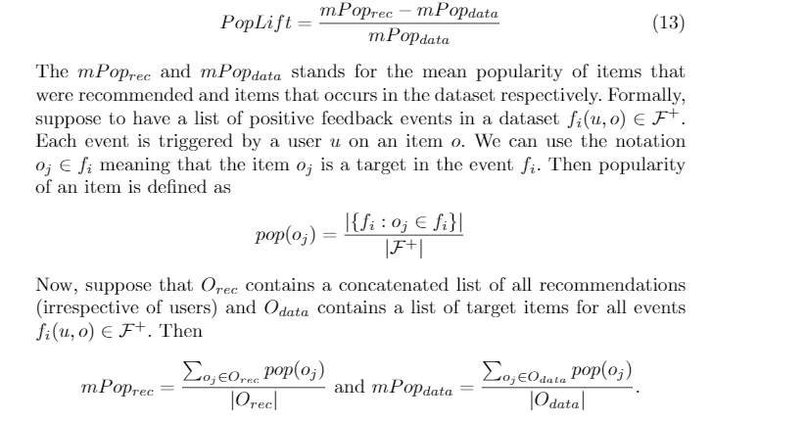
Off-line Evaluation Metrics
Coverage
  Number of unique items recommended at least once / Total volume of items
  Coverage on item categories in user profile (profile broadness)
Popularity amplification / popularity lift
  A.k.a. Novelty of the whole recommendation process
    Normalized by the distribution of feedback among items

Slide 65
Enhancing novelty / diversity
Serendipity
  A.k.a. items that represent pleasant surprise
  Typically modeled as items that are both relevant and unexpected
    relevance is typically the predicted RS relevance (or actuall presence in test data)
    unexpectedness evaluated as diversity to the w.r.t. current user profile
    Serendipity = relevance * unexpectedness

Slide 66
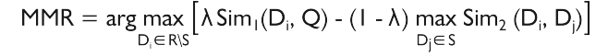
Enhancing novelty / diversity
Novelty, coverage
  Evaluated on individual items => simple weighted models will do
  argmax \alpha * relevance + (1- \alpha ) * novelty
Diversity
  Diversity is a feature of the list
  Maximal Marginal Relevance, xQUAD,...
    Reduce relevance of the next item by its similarity to the closest already selected item
Estimated relevance in our case
https://medium.com/tech-that-works/maximal-marginal-relevance-to-rerank-results-in-unsupervised-keyphrase-extraction-22d95015c7c5
https://www.cs.cmu.edu/~jgc/publication/The_Use_MMR_Diversity_Based_LTMIR_1998.pdf

Slide 67

Accuracy / relevance metrics

Slide 68
Evaluation in information retrieval (IR)
Historical Cranfield collection (late 1950s)
  1,398 journal article abstracts
  225 queries
  Exhaustive relevance judgements (over 300K)
Ground truth established by human domain experts
 |  | Reality
 |  | Actually Good | Actually Bad
Prediction | Rated Good | True Positive (tp) | False Positive (fp)
 | Rated Bad | False Negative (fn) | True Negative (tn)
All recommended items
All good items

Slide 69

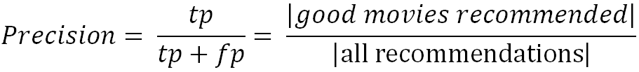
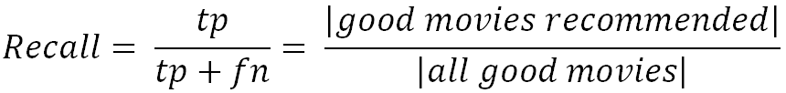
Metrics: Precision and Recall
Recommendation is viewed as information retrieval task:
  Retrieve (recommend) all items which are predicted to be “good”.
Precision: a measure of exactness, determines the fraction of relevant items retrieved out of all items retrieved
  E.g. the proportion of recommended movies that are actually good
Recall: a measure of completeness, determines the fraction of relevant items retrieved out of all relevant items
  E.g. the proportion of all good movies recommended

Slide 70
Precision vs. Recall
E.g. typically when a recommender system is tuned to increase precision, recall decreases as a result (or vice versa)
AUPR
Area under
Prec. vs. Recall
AUC:
Area under ROC
(TP vs. FP)

Slide 71
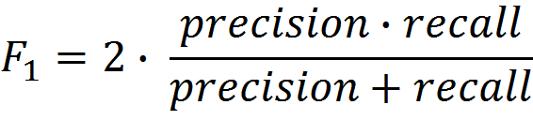
F₁ Metric
The F₁ Metric attempts to combine Precision and Recall into a single value for comparison purposes.
  May be used to gain a more balanced view of performance
The F₁ Metric gives equal weight to precision and recall
  Other F_{β} metrics weight recall with a factor of β.

Slide 72
Precision and Recall in Recommender Systems
Limit on top-k displayed items (i.e., no longer a classification, but rather a ranking problem)
  Hits@top-k
  Precision@top-k
  Recall@top-k
  How to treat recall if only limited items are shown
    E.g., shown: 20, relevant shown: 20, total relevant: 200 => recall@20 = 0.1 or 1.0?
    Unbounded/Bounded recall variants (hard to distinguish in papers or frameworks)
Position within top-k does not matter
  The list is short enough that user observe it all
  With increasing k, this became less applicable
  This assumption may be challenged

Slide 73
Metrics: Rank position matters
For a user:
Actually good
Item 237
Item 899
Recommended (predicted as good)
Item 345
Item 237
Item 187
hit
Rank metrics
  Relevant items are more useful when they appear earlier in the recommendation list
    This might be partially violated e.g. in 2D settings
  Particularly important in recommender systems as lower ranked items may be overlooked by users

Slide 74
Metrics: Rank Score (rarely used)
Rank Score extends the recall metric to take the positions of correct items in a ranked list into account
  Particularly important in recommender systems as lower ranked items may be overlooked by users
Rank Score is defined as the ratio of the Rank Score of the correct items to best theoretical Rank Score achievable for the user, i.e.
Where:
h is the set of correctly recommended items, i.e. hits
rank returns the position (rank) of an item
T is the set of all items of interest
α is the ranking half life, i.e. an exponential reduction factor

Slide 75
Metrics: Liftindex (rarely used)
Assumes that ranked list is divided into 10 equal deciles S_{i}, where
  Linear reduction factor
Liftindex:
              h is the set of correct hits

Slide 76
Metrics: Normalized Discounted Cumulative Gain
Discounted cumulative gain (DCG)
  Logarithmic reduction factor
Idealized discounted cumulative gain (IDCG)
  Assumption that items are ordered by decreasing relevance
Normalized discounted cumulative gain (nDCG)
  Normalized to the interval [0..1]
Where:
pos denotes the position up to which relevance is accumulated
rel_{i} returns the relevance of recommendation at position i

Slide 77
Example
Assumptions:
  |T| = 3
  Ranking half life (alpha) = 2
Rank | Hit?
1
2 | X
3 | X
4 | X
5

Slide 78
Example cont.
Reducing the ranking half life (alpha) = 1
Rankscore (exponential reduction) < Liftscore (linear red.) < NDCG (log. red.)
Rank | Hit?
1
2 | X
3 | X
4 | X
5

Slide 79


Average Precision
Mean Average Precision (MAP) is a ranked precision metric that places emphasis on highly ranked correct predictions (hits)
Essentially it is the average of precision values determined after each successful prediction, i.e.
Rank | Hit?
1
2 | X
3 | X
4 | X
5
Rank | Hit?
1 | X
2
3
4 | X
5 | X
All relevant items (not just all present in the list

Slide 80
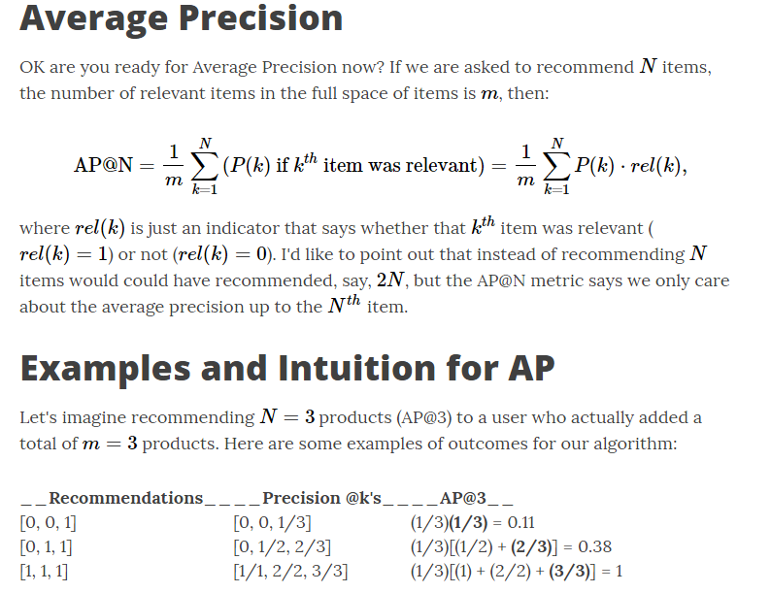
Metrics: Mean average precision

Slide 81

Questions?

Slide 82
Evaluation in RS – rating based
Datasets with items rated by users
  MovieLens datasets 100K-10M ratings
  Netflix 100M ratings
Historic user ratings constitute ground truth
Metrics measure error rate
  Mean Absolute Error (MAE) computes the deviation between predicted ratings and actual ratings
  Root Mean Square Error (RMSE) is similar to MAE, but places more emphasis on larger deviation

Slide 83
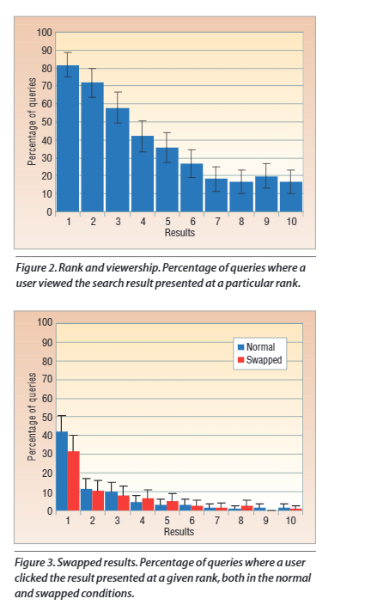
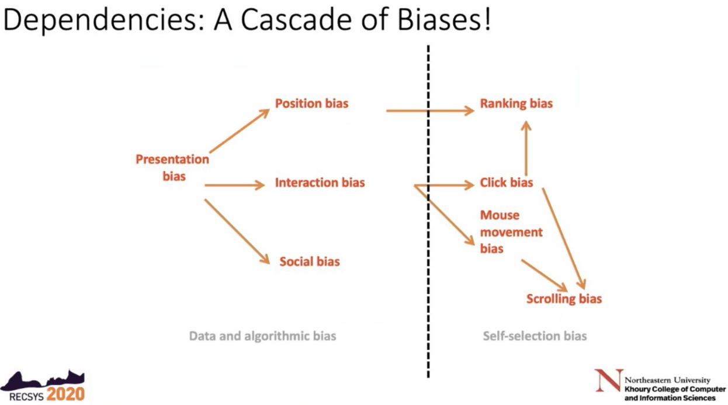
De-biasing Off-line Evaluation
What are the biases in our data?
  Presentation bias
  researchgate.net/publication/2961924_Search_Engines_that_Learn_from_Implicit_Feedback
  ... https://www.youtube.com/watch?v=brr8cZHf2ec (RecSys 2020 keynote)

Slide 84
De-biasing Off-line Evaluation
Presentation bias
  What (where) was shown to the user affects what feedback we received
  How to evaluate novel RS that would recommend something else
    Than what users received & evaluated
    Hard question in general, intensive research topic
      Off-policy evaluation or counterfactual evaluation (what would be the results, if policy B was applied)
      Part of the feedback received on random(ized) data
      https://arxiv.org/pdf/1003.0146.pdf (Section 4: evaluation, assuming independence of events)

Slide 85
De-biasing Off-line Evaluation
Missing not at random for Implicit feedback
  Classical off-line evaluation expects Missing at random data
  absence of (positive) feedback is either because the item is unknown positive or irrelevant
    For aggregational statistics to be valid, it is important that the chance of being unknown positive or irrelevant is the same for all data with no feedback
    Not true in real-world for some cases
    Probability that the item is known by the user => propensity
    Well-known movies may have higher propensity (users ignore them willingly)
      MISSING NOT AT RANDOM
      Evaluation should be de-biased accordingly (we need to estimate the propensity)
      Thorsten Joachims et al. https://arxiv.org/pdf/1608.04468.pdf; https://ylongqi.com/paper/YangCXWBE18.pdf

Slide 86
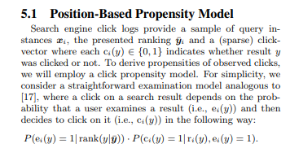
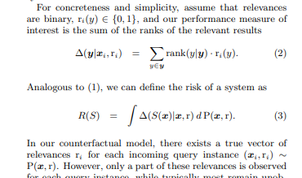
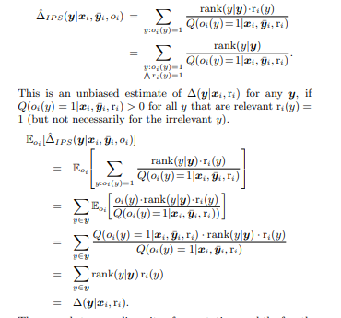

De-biasing Off-line Evaluation
https://arxiv.org/pdf/1608.04468.pdf

Slide 87
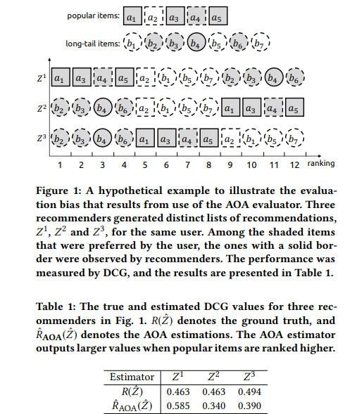
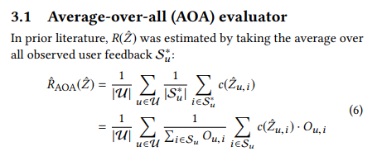
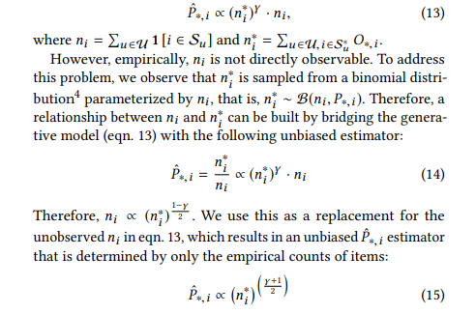
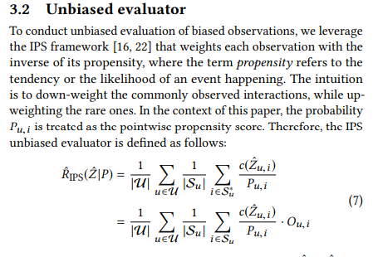
De-biasing Off-line Evaluation
https://ylongqi.com/paper/YangCXWBE18.pdf
nDCG, AUC, MAP,...
Propensity score

Slide 88
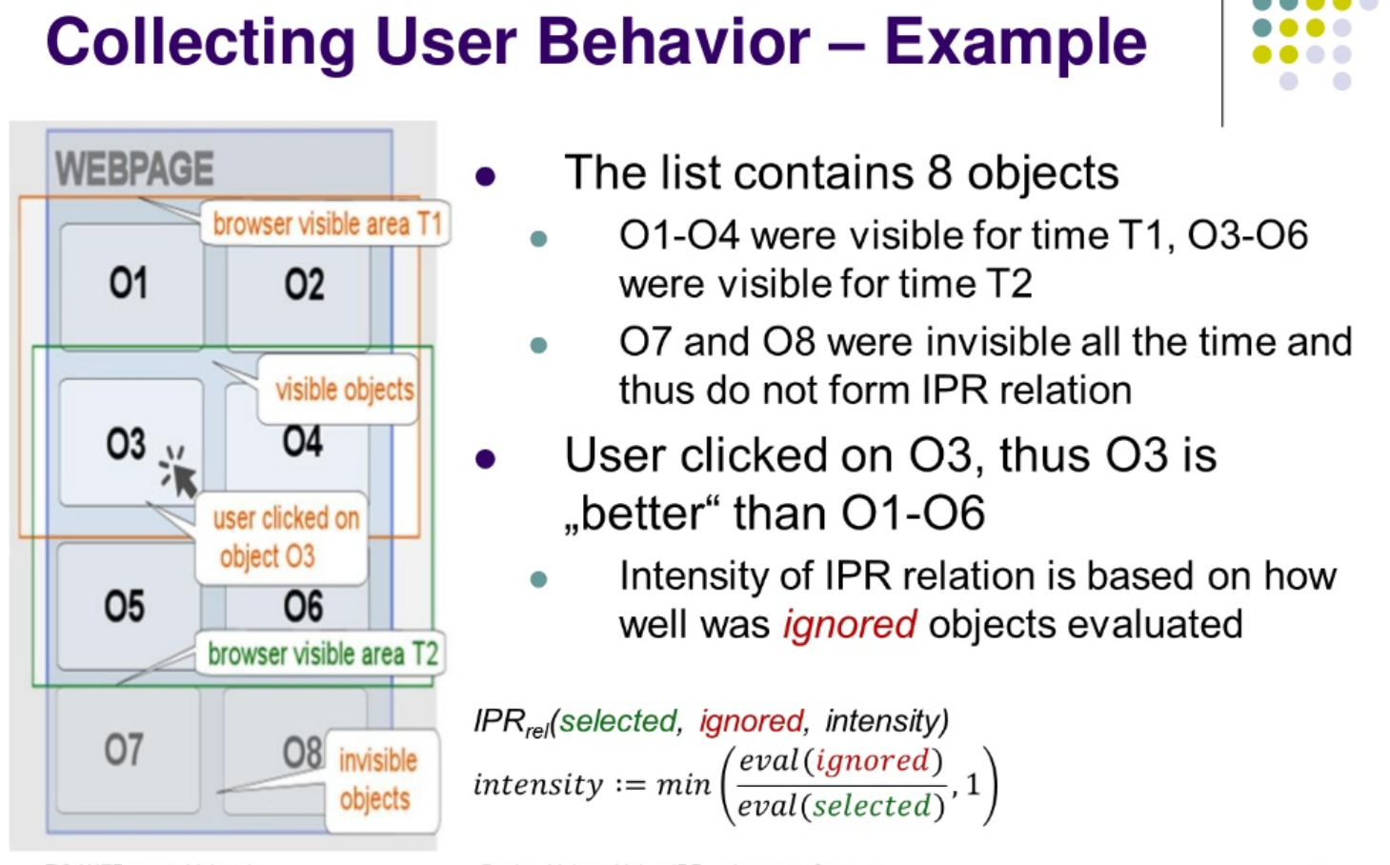
De-biasing Off-line Evaluation (more thorough implicit feedback data)
https://www.researchgate.net/publication/294139826_Using_Implicit_Preference_Relations_to_Improve_Recommender_Systems
Used for pairwise relevance relations, but suitable for propensity scores as well

Slide 89
Additional Slides

Slide 90
Offline experimentation
Netflix competition 2004 – 2007?
  Web-based movie rental
  Prize of $1,000,000 for accuracy improvement (RMSE) of 10% compared to own Cinematch system.
Historical dataset
  ~480K users rated ~18K movies on a scale of 1 to 5
  ~100M ratings
  Last 9 ratings/user withheld
    Probe set – for teams for evaluation
    Quiz set – evaluates teams’ submissions for leaderboard
    Test set – used by Netflix to determine winner

Slide 91
Methodology
Setting to ensure internal validity:
  One randomly selected share of known ratings (training set) used as input to train the algorithm and build the model
  Model allows the system to compute recommendations at runtime
  Remaining share of withheld ratings (testing set) required as ground truth to evaluate the model’s quality
  To ensure the reliability of measurements the random split, model building and evaluation steps are repeated several times
N-fold cross validation is a stratified random selection procedure
  N disjunct fractions of known ratings with equal size (1/N) are determined
  N repetitions of the model building and evaluation steps, where each fraction is used exactly once as a testing set while the other fractions are used for training
  Setting N to 5 or 10 is popular

Slide 92
Analysis of results
Are observed differences statistically meaningful or due to chance?
  Standard procedure for testing the statistical significance of two deviating metrics is the pairwise analysis of variance (ANOVA)
  Null hypothesis H₀: observed differences have been due to chance
  If outcome of test statistics rejects H₀, significance of findings can be reported
Practical importance of differences?
  Size of the effect and its practical impact
  External validity or generalizability of the observed effects

Slide 93
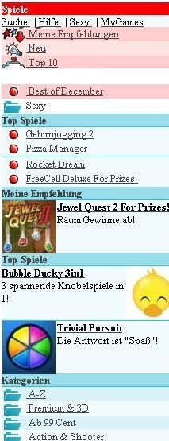
Online experimentation
Effectiveness of different algorithms for recommending cell phone games
[Jannach, Hegelich 09]
Involved 150,000 users on a commercial mobile internet portal
Comparison of recommender methods
Random assignment of users to a specific method

Slide 94
Experimental Design
A representative sample 155,000 customers were extracted from visitors to site during the evaluation period
  These were split into 6 groups of approximately 22,300 customers
  Care was taken to ensure that customer profiles contained enough information (ratings) for all variants to make a recommendation
  Groups were chosen to represent similar customer segments
A catalog of 1,000 games was offered
A five-point ratings scale ranging from -2 to +2 was used to rate items
  Due to the low number of explicit ratings, a click on the “details” link for a game was interpreted as an implicit “0” rating and a purchase as a “1” rating
Hypotheses on personalized vs. non-personalized recommendation techniques and their potential to
  Increase conversion rate (i.e. the share of users who become buyers)
  Stimulate additional purchases (i.e. increase the average shopping basket size)

Slide 95
Non-experimental research
Quasi-experiments
  Lack random assignments of units to different treatments
Non-experimental / observational research
  Surveys / Questionnaires
  Longitudinal research
    Observations over long period of time
    E.g. customer life-time value, returning customers
  Case studies
    Focus on answering research questions about how and why
    E.g. answer questions like: How recommendation technology contributed to Amazon.com‘s becomes the world‘s largest book retailer?
  Focus group
    Interviews
    Think aloud protocols

Slide 96
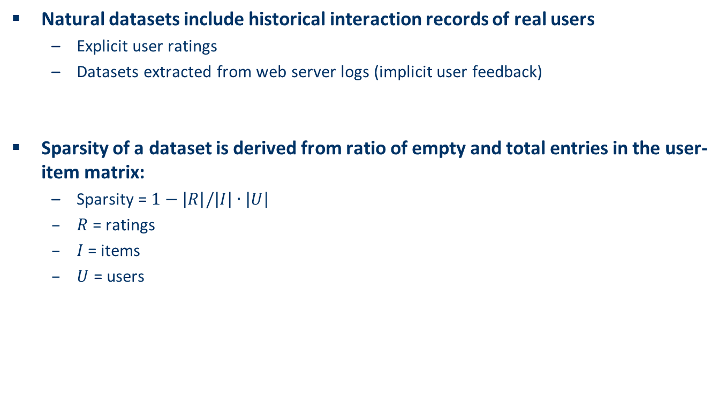
Data sparsity
Natural datasets include historical interaction records of real users
  Explicit user ratings
  Datasets extracted from web server logs (implicit user feedback)
Sparsity of a dataset is derived from ratio of empty and total entries in the user-item matrix:
  Sparsity = $1−\left|R\right|/\left|I\right|∙\left|U\right|$
  $R$ = ratings
  $I$= items
  $U$ = users

Slide 97
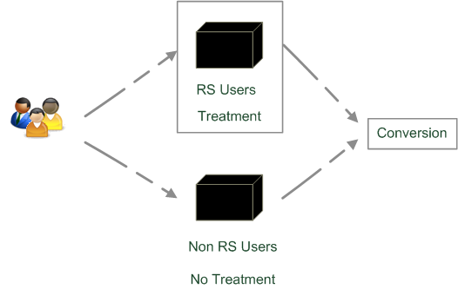
Quasi-experimental
SkiMatcher Resort Finder introduced by Ski-Europe.com to provide users with recommendations based on their preferences
Conversational RS
  question and answer dialog
  matching of user preferences with knowledge base
Delgado and Davidson evaluated the
effectiveness of the recommender over a
4 month period in 2001
  Classified as a quasi-experiment
  as users decide for themselves if they
  want to use the recommender or not

Slide 98
SkiMatcher Results
 | July | August | September | October
Unique Visitors | 10,714 | 15,560 | 18,317 | 24,416
SkiMatcher Users | 1,027 | 1,673 | 1,878 | 2,558
Non-SkiMatcher Users | 9,687 | 13,887 | 16,439 | 21,858
Requests for Proposals | 272 | 506 | 445 | 641
SkiMatcher Users | 75 | 143 | 161 | 229
Non-SkiMatcher Users | 197 | 363 | 284 | 412
Conversion | 2.54% | 3.25% | 2.43% | 2.63%
SkiMatcher Users | 7.30% | 8.55% | 8.57% | 8.95%
Non-SkiMatcher Users | 2.03% | 2.61% | 1.73% | 1.88%
Increase in Conversion | 359% | 327% | 496% | 475%
[Delgado and Davidson, ENTER 2002]

Slide 99
Interpreting the Results
The nature of this research design means that questions of causality cannot be answered (lack of random assignments), such as
  Are users of the recommender systems more likely convert?
  Does the recommender system itself cause users to convert?
  Some hidden exogenous variable might influence the choice of using RS as well as conversion.
However, significant correlation between using the recommender system and making a request for a proposal
Size of effect has been replicated in other domains
  Tourism
  Electronic consumer products

Slide 100
What is popular?
Evaluations on historical datasets measuring accuracy
Most popular datasets
  Movies (MovieLens, EachMovie, Netflix)
  Web 2.0 platforms (tags, music, papers, …)
Most popular measures for accuracy
  Precision/Recall
    Items are classified as good or bad
  MAE (Mean Absolute Error), RMSE (Root Mean Squared Error)
    Items are rated on a given scale
Availability of data heavily biases what is done
  Tenor at RecSys conferences to foster live experiments
  Public infrastructures to enable A/B tests

Slide 101
What is popular? cont.
Quantitative survey in the literature
  High ranked journal on IS and IR
  ACM Transactions on Information Systems
Evaluation designs ACM TOIS 2004-2010
  In total 15 articles on RS
  Nearly 50% movie domain
  80% offline experimentation
  2 user experiments under lab conditions
  1 qualitative research

Slide 102
Discussion & summary
General principles of empirical research an current state of practice in evaluating recommendation techniques were presented
Focus on how to perform empirical evaluations on historical datasets
Discussion about different methodologies and metrics for measuring the accuracy or coverage of recommendations.
Overview of which research designs are commonly used in practice.
From a technical point of view, measuring the accuracy of predictions is a well accepted evaluation goal
  but other aspects that may potentially impact the overall effectiveness of a recommendation system remain largely under developed.

