Slide 1
NSWI166
Labs #5: linear monotone preference model
If to be completed at home, print the assignment, fill in, and upload photos of the drawn solutions

Slide 2
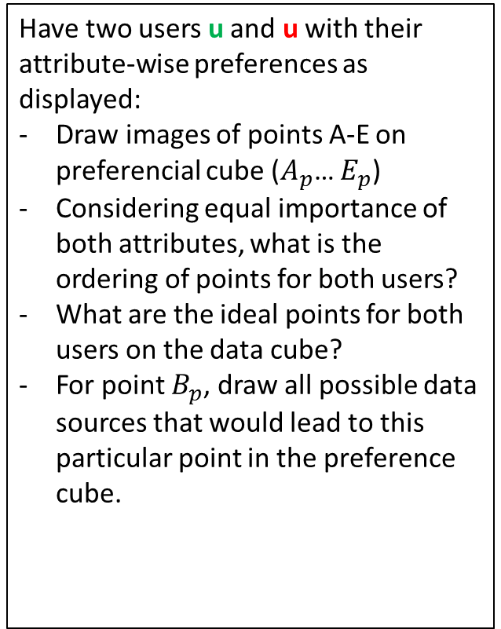
D₂
Have two users u and u with their attribute-wise preferences as displayed:
Draw images of points A-E on preferencial cube ($A_{p}$… $E_{p}$)
Considering equal importance of both attributes, what is the ordering of points for both users?
What are the ideal points for both users on the data cube?
For point $B_{p}$, draw all possible data sources that would lead to this particular point in the preference cube.
C
E
A
D
B
x₂
D₁
1
0
a₁
d₁
0
1
ideal
x₁

Slide 3
D₂
Have two users u and u with their attribute-wise preferences as displayed:
Considering the equal importance of both attributes, draw the subspace on the data cube corresponding to 0.5 and 0.75 preference levels of both users
What data points are within those preferential sets? Are there any intersections?
f₂^{u}
C
E
A
D
B
f₂^{u}
x₂
D₁
1
0
0
f₁^{u}
f₁^{u}
1
x₁

Slide 4
D₂
Having slightly more comples preference functions and different aggregations for both users:
Draw the subspaces for the corresponding contur lines on the data cube for both users
Draw the ideal point(s) for both users
C
f₂^{u}
E
A
f₂^{u}
D
b₂
B
x₂
D₁
1
0
b₁
0
f₁^{u}
f₁^{u}
1
x₁

