Slide 1
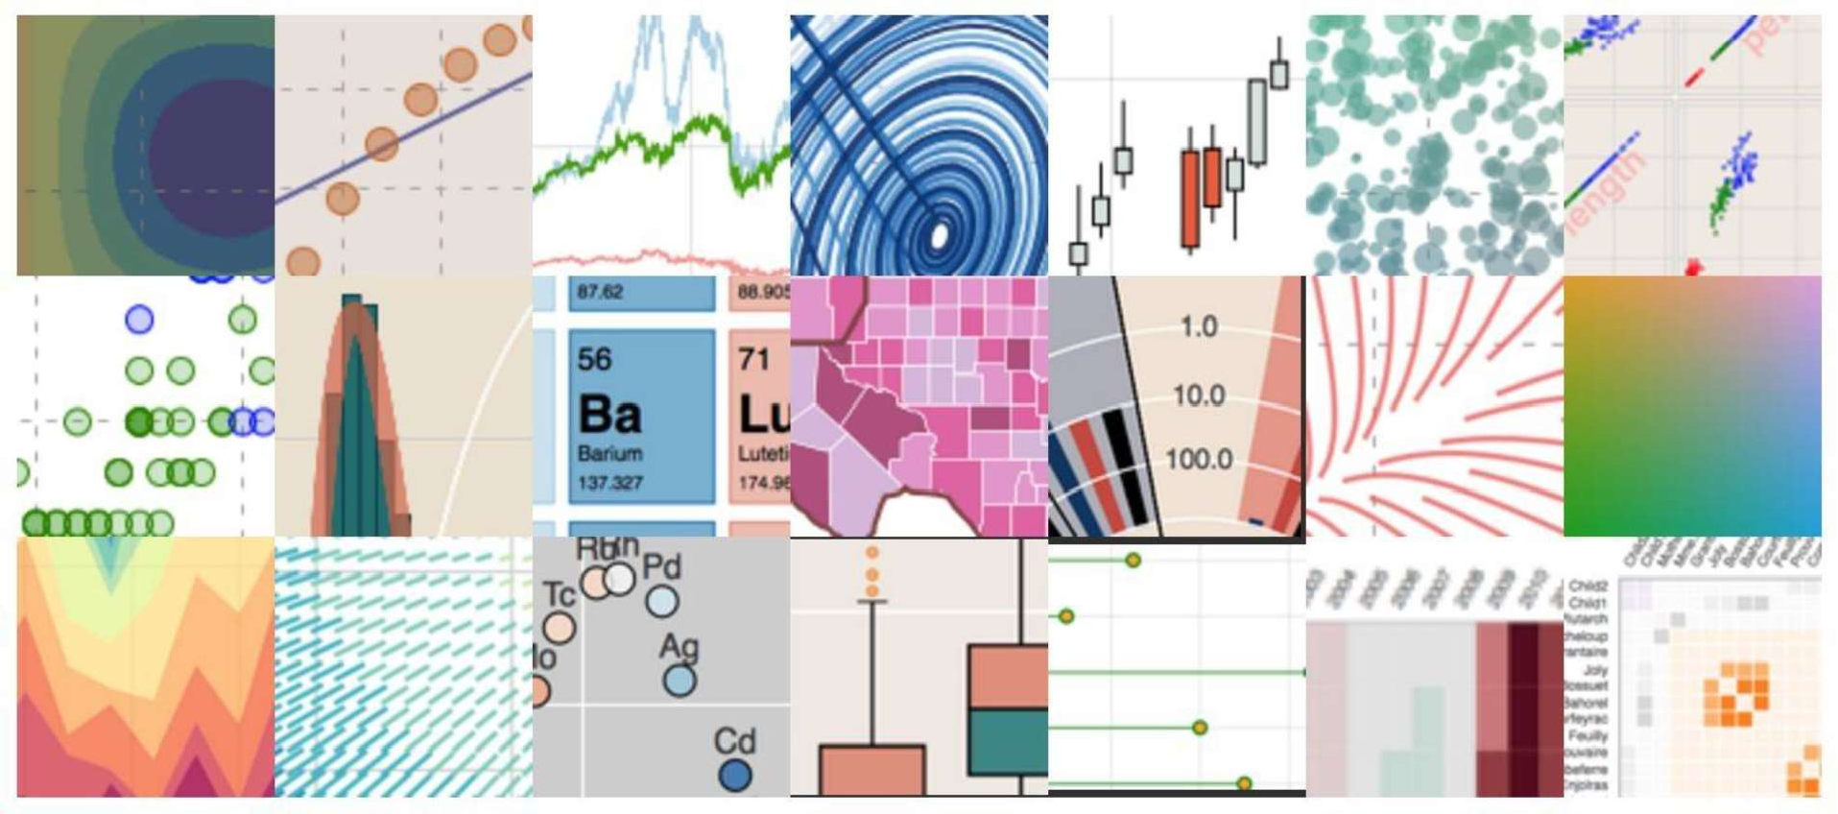





Introduction to plotting in
Python for Data Science
Workshop 2016-01-07
Thanks to:
@bzamecnik

Slide 2
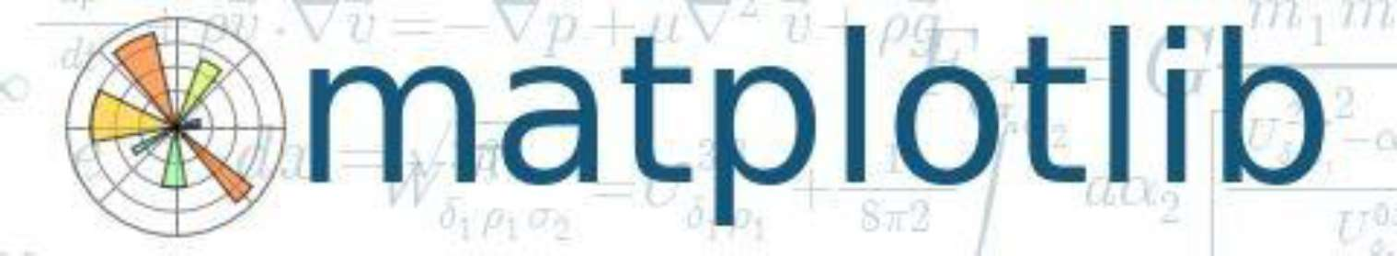
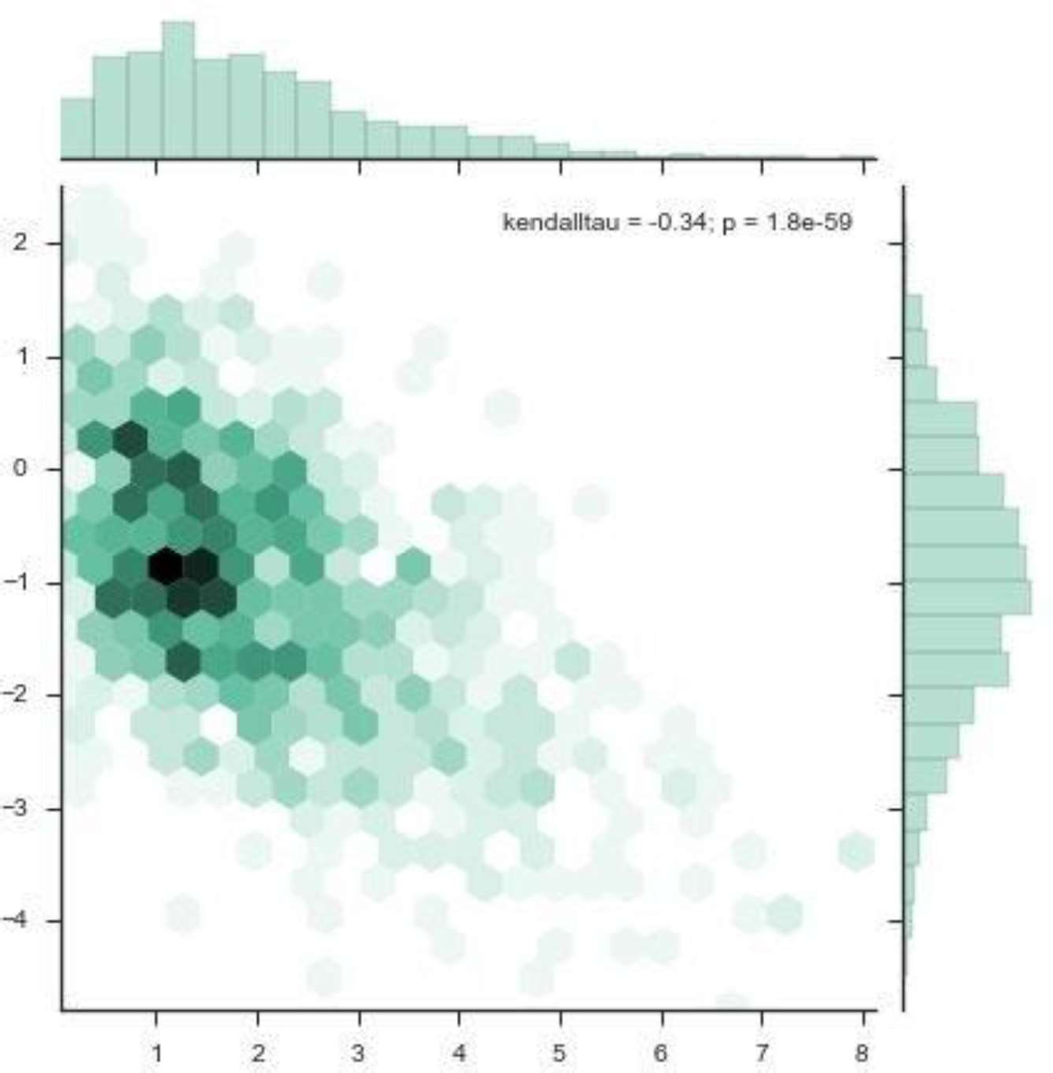






What is
?
Python package for 2D plotting publication quality & interactive plots very powerful very popular many extensions
http://stanford.edu/~mwaskom/software/seaborn/examples/hexbin_marginals.html

Slide 3
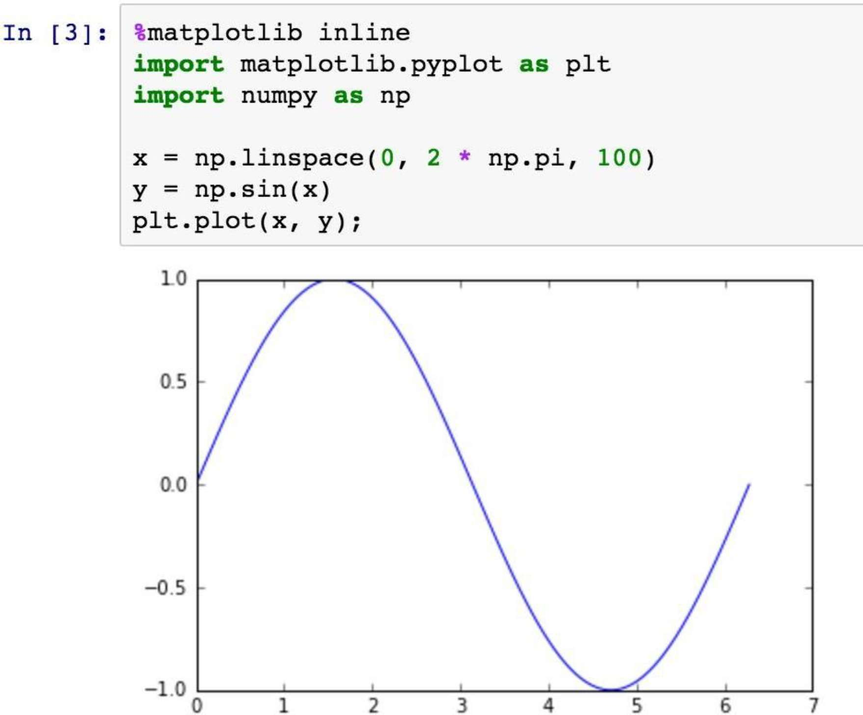
Hello, world!
in matplotlib
Motto:
"Make easy things easy
and hard things possible."

Slide 4
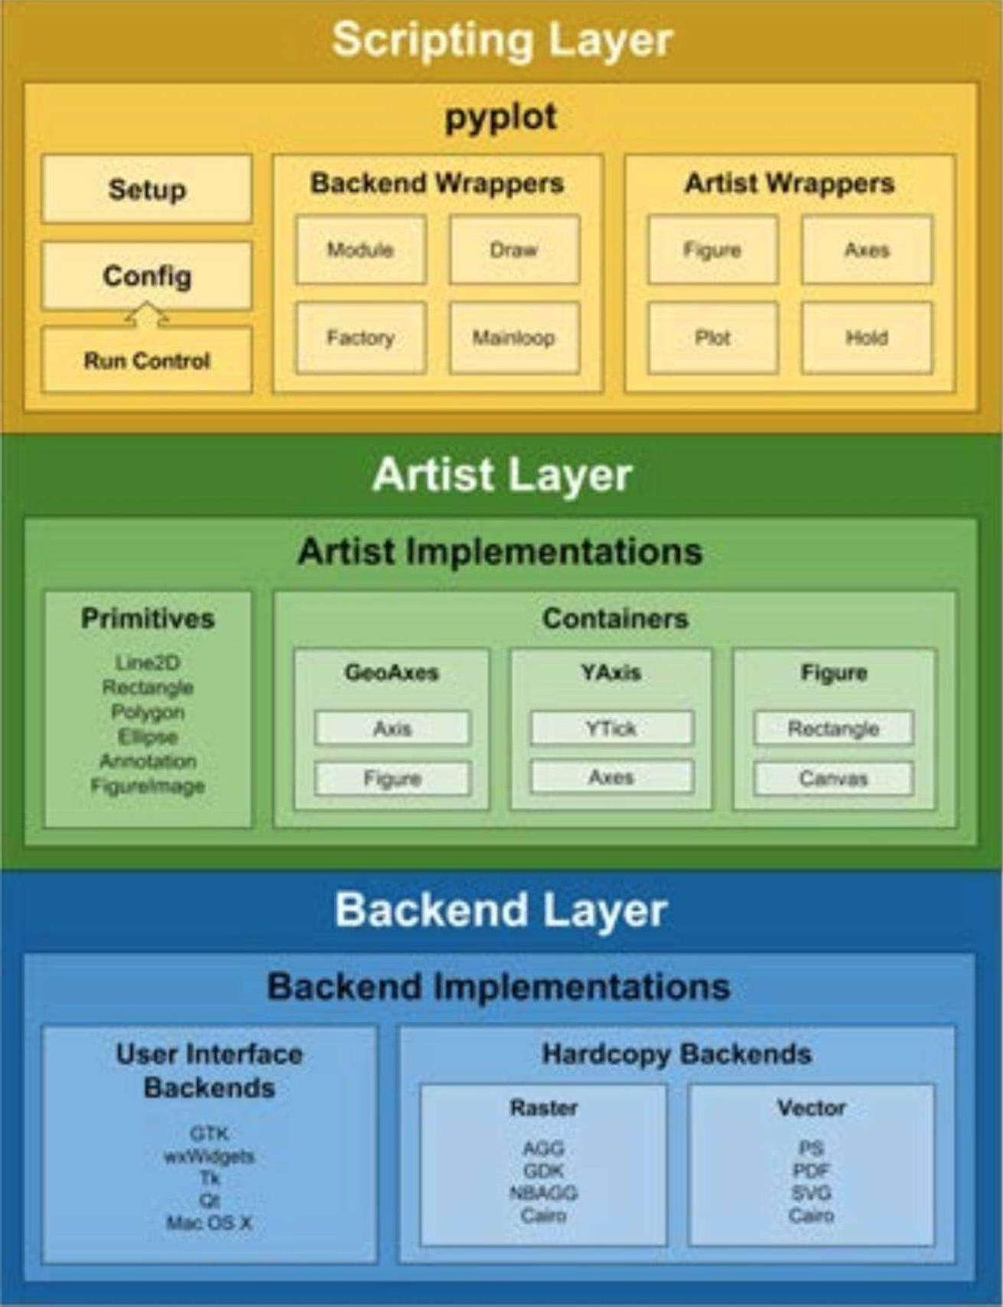
Architecture
scripting layer artist layer backend layer
from book:
Mastering matplotlib by Duncan M. McGreggor Packt Publishing, 2015

Slide 5
Scripting layer
pyplot
syntax sugar stateful API
high-level object API
you typically use this
pylab
compatibility with MATLAB deprecated

Slide 6
Artist layer
what should be rendered? parts of the plot
object-oriented API
primitives - Line2D, Rectangle, Text, Image containers
Figure - full plot Axes - single subplot Axis - one axis

Slide 7
Backend layer
how it should be rendered? interactive
Tk, GTK, Qt, OS X, WX
hardcopy
raster
vector
AGG, GDK, NBAGG, Cairo
PS, PDF, SVG, Cairo
FigureCanvas - area where Figure is drawn Renderer - knows how to draw

Slide 8
Matplotlib - basics
https://gist.github.com/bzamecnik/b58579e319287abcb3ca
%matplotlib inline
Plt.subplots(1,1) is a convenient way to get figure object

Slide 9















plot types
Matplotlib
https://matplotlib.org/3.1.1/tutorials/introductory/sample_plots.html

Slide 10




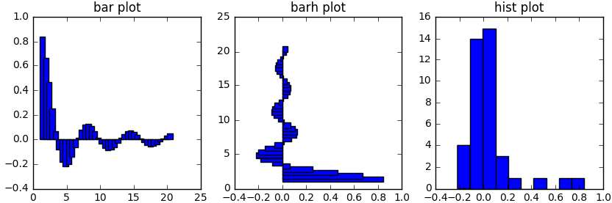









plot types
Matplotlib

Slide 11


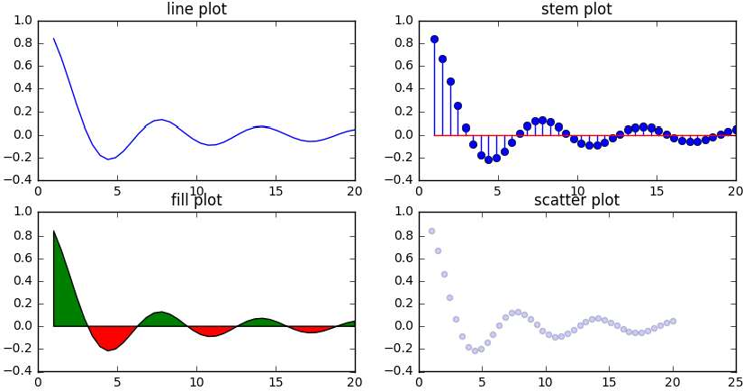










plot types
Matplotlib

Slide 12

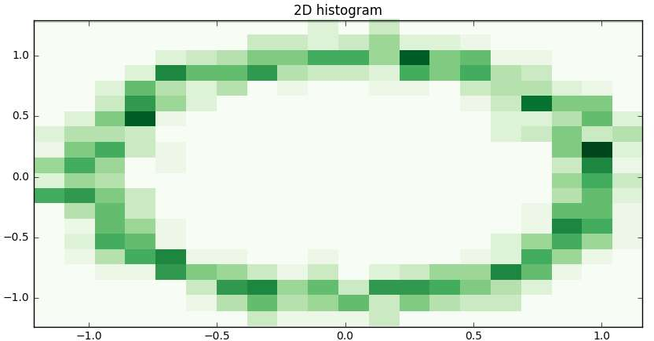














plot types
Matplotlib

Slide 13











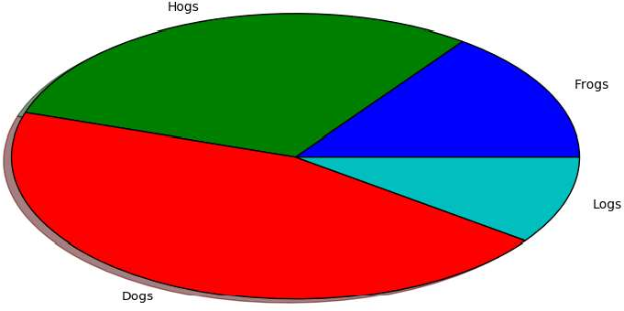
plot types
Matplotlib

Slide 14













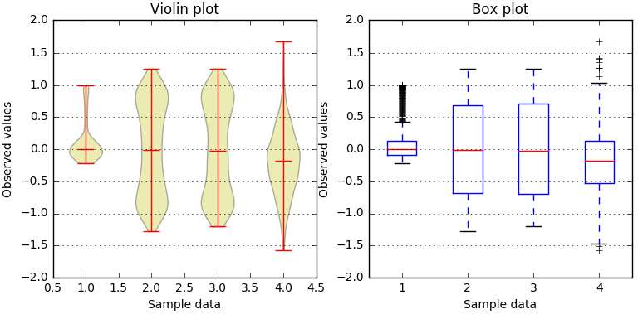





plot types
Matplotlib

Slide 15




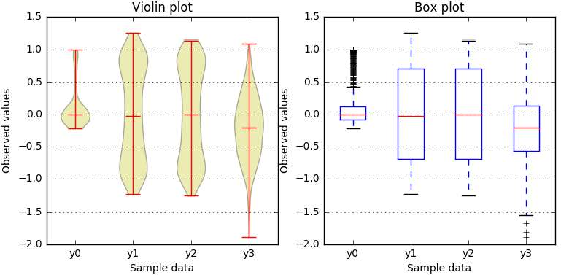
plot types
Matplotlib

Slide 16
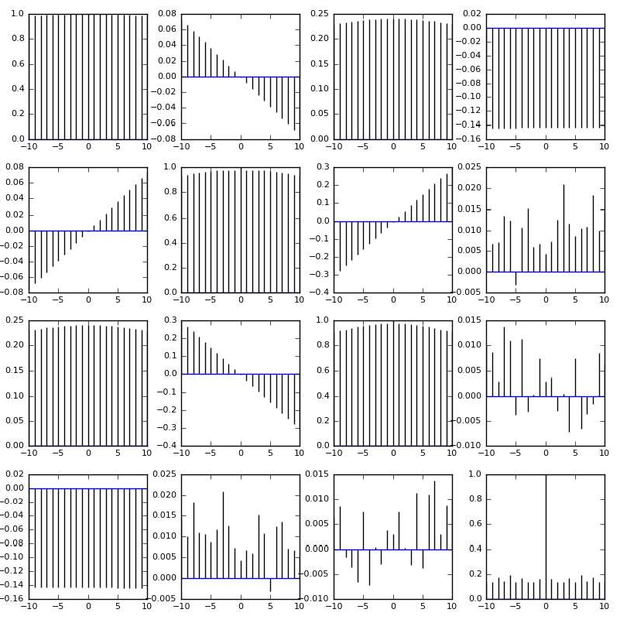









Matplo
tlib plot types

Slide 17
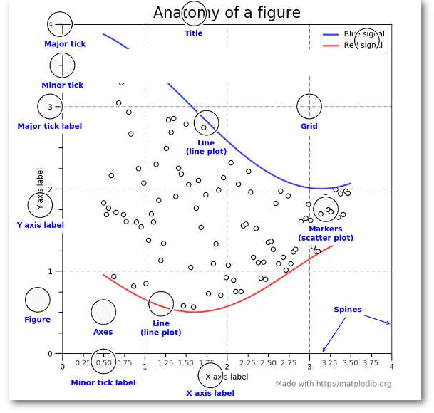










b - b s
Matplotli
asic

Slide 18
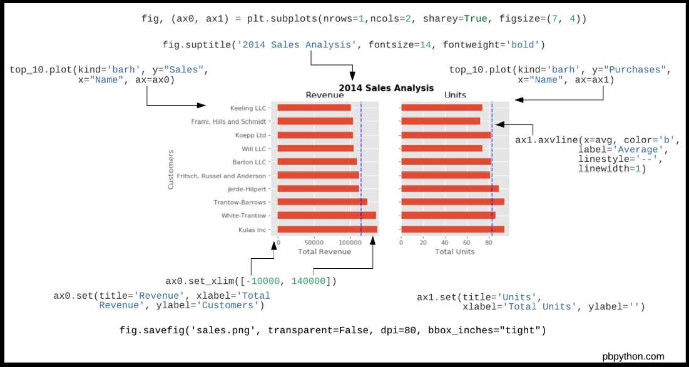
Matplotlib - basics

Slide 19
Extensions & other packages
plot.ly
seaborn
bokeh
ggplot

Slide 20
matplotlib drawbacks
quite old
too focused on server-side too cross-platform
not awesomely beautiful by default

Slide 21
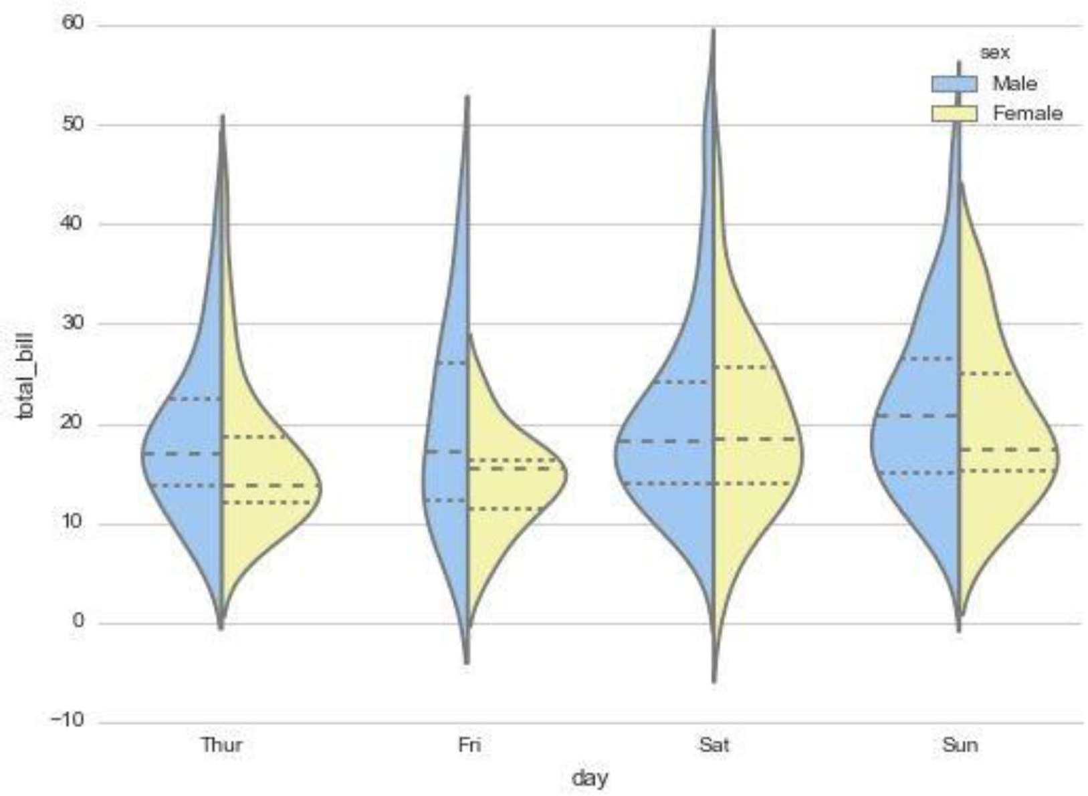
Seaborn: statistical data visualization
matplotlib extension beautiful theme statistical plots
distribution
hexbin, violin plot, etc.
scatterplot
pairwise correlations
http://stanford.edu/~mwaskom/software/seaborn/examples/grouped_violinplots.html
https://www.slideshare.net/SourabhSahu/python-seaborn-data-visualization
https://www.slideshare.net/nishantupadhyaysbi/python-seaborn-cheatsheet

Slide 22
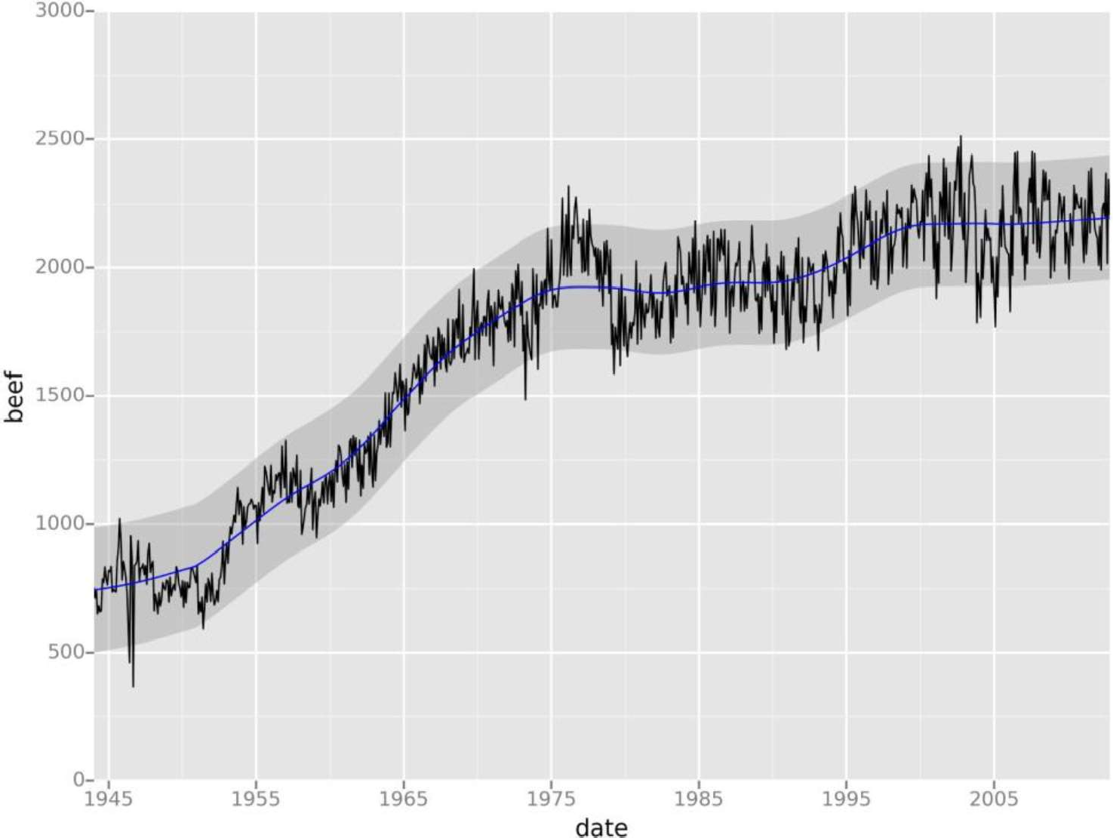
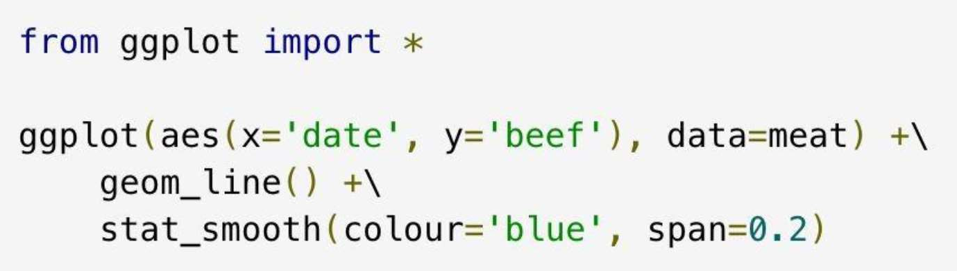
ggplot from hat
based on
Grammar of Graphics ggplot2 from R
http://ggplot.yhathq.com/

Slide 23

based on D3.js client-side interactive
beautiful
high-performance
Bokeh
http://bokeh.pydata.org/

Slide 24
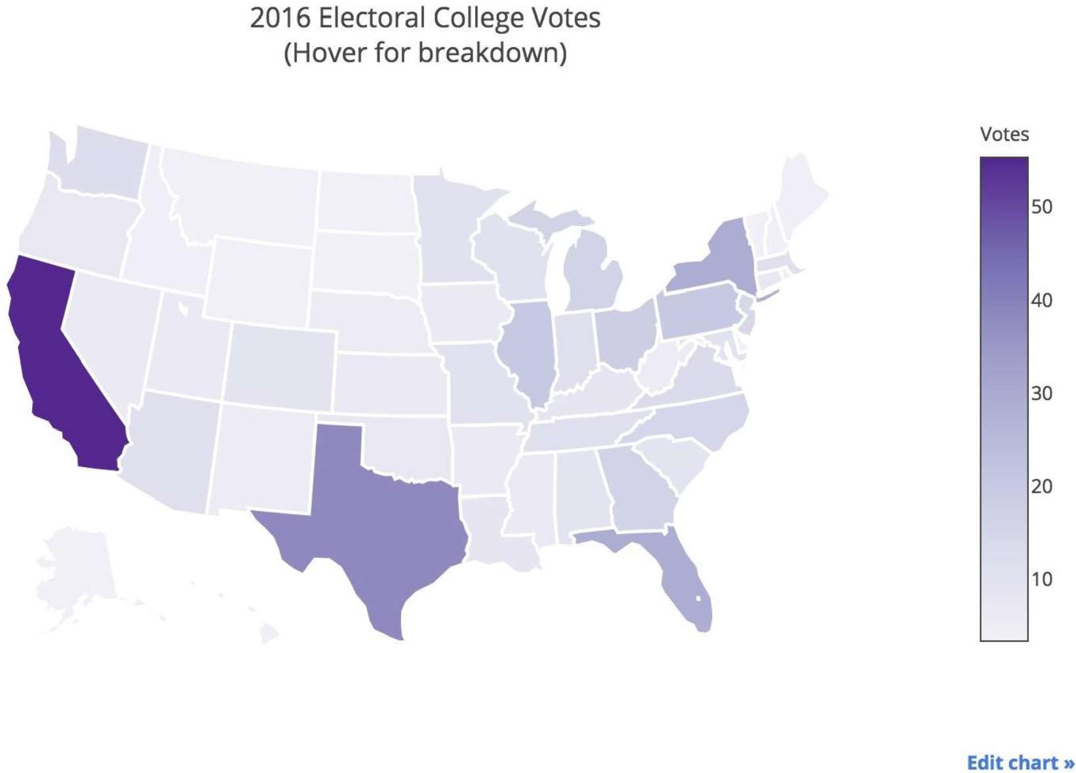
Plot.ly
cloud service can publish plots
free for public plots
API & Python library interactive, beautiful good for dashboards
https://plot.ly/python/choropleth-maps/

Slide 25
Summary
plotting in Python is nice & powerful sometimes a bit overwhelming
it is worth learning it!
Wish you nice plots!

