Slide 1

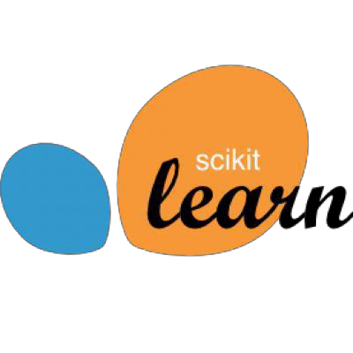
Introduction to Machine Learning with Scikit-Learn

Slide 2
Types of Algorithms by Output
Input training data to fit a model which is then used to predict incoming inputs into ...
Type of Output | Algorithm Category
Output is one or more discrete classes | Classification (supervised)
Output is continuous | Regression (supervised)
Output is membership in a similar group | Clustering (unsupervised)
Output is the distribution of inputs | Density Estimation
Output is simplified from higher dimensions | Dimensionality Reduction

Slide 3
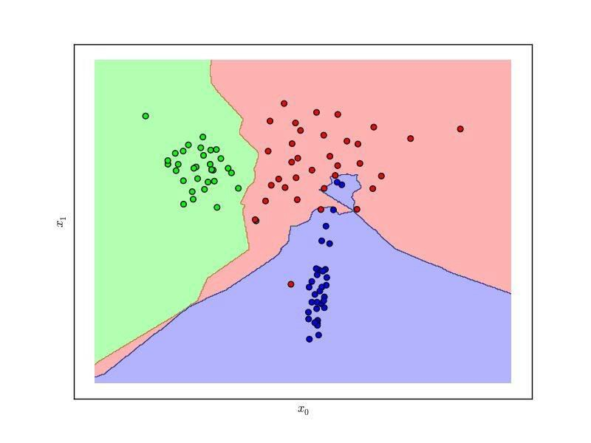
Classification
Given labeled input data (with two or more labels), fit a function that can determine for any input, what the label is.

Slide 4
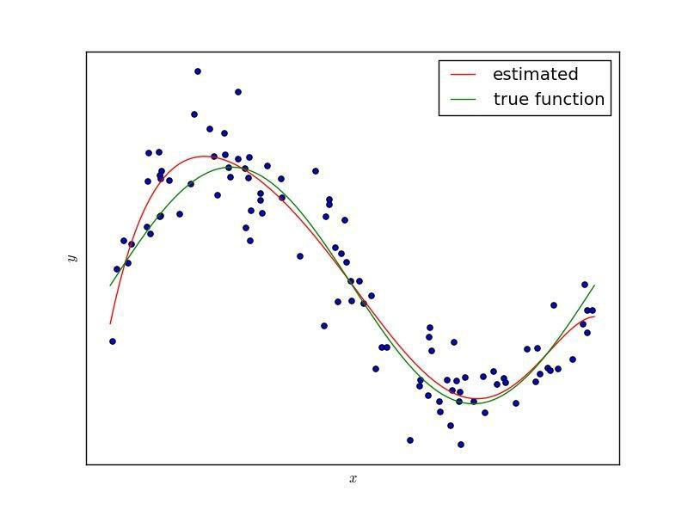
Regression
Given continuous input data fit a function that is able to predict the continuous value of input given other data.

Slide 5
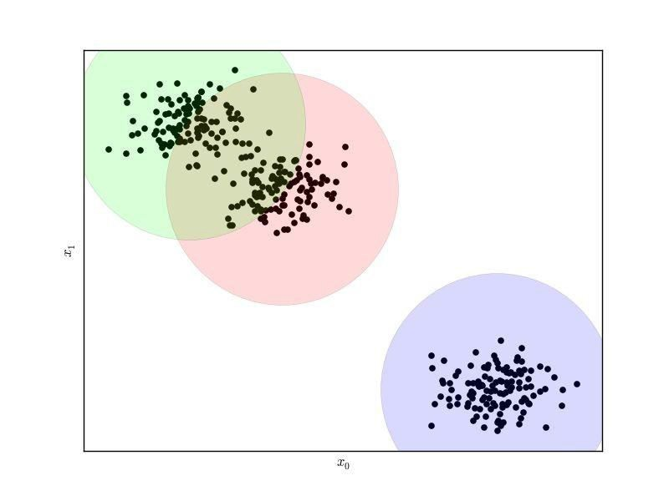
Clustering
Given data, determine a pattern of associated data points or clusters via their similarity or distance from one another.

Slide 6

Hadley Wickham (2015)
“Model” is an overloaded term.
•Model family describes, at the broadest possible level, the connection between the variables of interest.
•Model form specifies exactly how the variables of interest are connected within the framework of the model family.
•A fitted model is a concrete instance of the model form where all parameters have been estimated from data, and the model can be used to generate predictions.
http://had.co.nz/stat645/model-vis.pdf

Slide 7
Dimensions and Features
In order to do machine learning you need a data set containing instances (examples) that are composed of features from which you compose dimensions.
Instance: a single data point or example composed of fields
Feature: a quantity describing an instance
Dimension: one or more attributes that describe a property
from sklearn.datasets import load_ digits d i g i t s = l oad_ d i g i t s ( )
X= d i g i t s . d a t a
y = d i g i t s . t a r g e t
# X.shape == (n_samples, n_features)
# y.shape == (n_samples,)

Slide 8
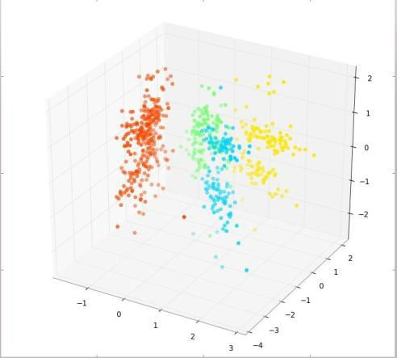
Feature Space
Feature space refers to the n-dimensions where your variables live (not including a target variable or class). The term is used often in ML literature because in ML all variables are features (usually) and feature extraction is the art of creating a space with decision boundaries.
Target
1. Y ≡ Thickness of car tires after some testing period
Variables
X₁ ≡ distance travelled in test
X₂ ≡ time duration of test
X₃ ≡ amount of chemical C in tires
The feature space is R³, or more accurately, the positive quadrant in R³ as all
the X variables can only be positive quantities.
http://stats.stackexchange.com/questions/46425/what-is-feature-space

Slide 9
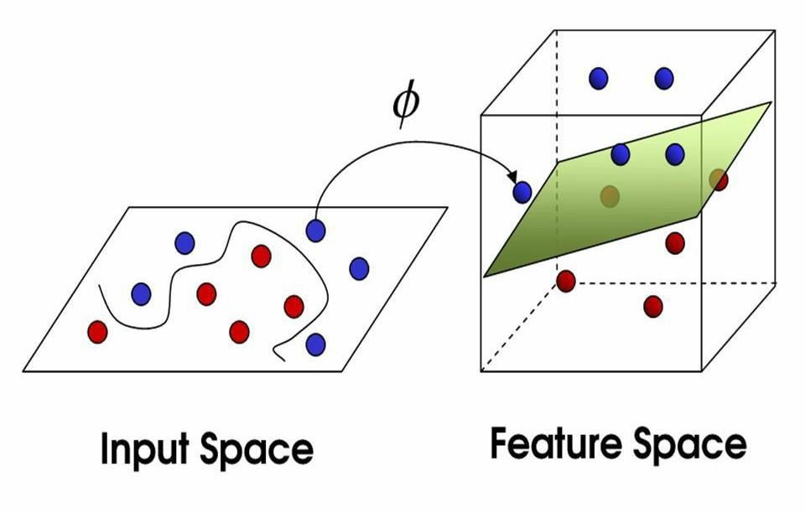
Mappings
Domain knowledge about tires might suggest that the speed the vehicle was moving at is important, hence we generate another variable, X₄ (this is the feature extraction part):
X₄ = X₁*X₂ ≡ the speed of the vehicle during testing.
This extends our old feature space into a new one, the positive part of R⁴.
A mapping is a function, ϕ,from R³ to R⁴:
ϕ(x₁,x₂,x₃) = (x₁,x₂,x₃,x₁x₂)
http://stats.stackexchange.com/questions/46425/what-is-feature-space

Slide 10
Your Task
Given a data set of instances of size N, create a model that is fit from the data (built) by extracting features and dimensions. Then use that model to predict outcomes …
Data Wrangling (normalization, standardization, imputing)
Feature Analysis/Extraction
Model Selection/Building
Model Evaluation
Operationalize Model

Slide 11
A Tour of Machine Learning
Algorithms

Slide 12
Models: Instance Methods
Compare instances in data set with a similarity measure to find best matches.
Suffers from curse of dimensionality.
Focus on feature representation and similarity metrics between instances
k-Nearest Neighbors (kNN)
Self-Organizing Maps (SOM)
Learning Vector Quantization (LVQ)

Slide 13
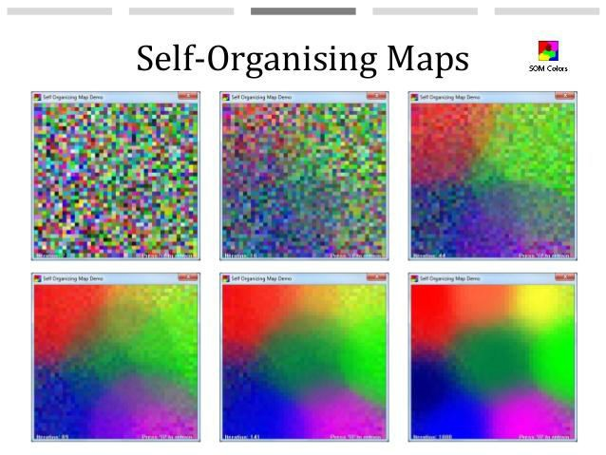
Self-Organizing Maps

Slide 14
Models: Regression
Model relationship of independent variables, X to dependent variable Y by iteratively optimizing error made in predictions.
Ordinary Least Squares
Logistic Regression
Stepwise Regression
Multivariate Adaptive Regression Splines (MARS)
Locally Estimated Scatterplot Smoothing (LOESS)

Slide 15
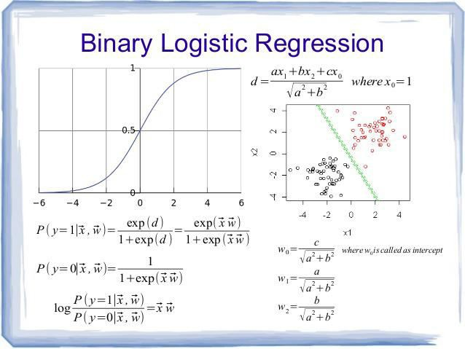
Logistic Regression

Slide 16
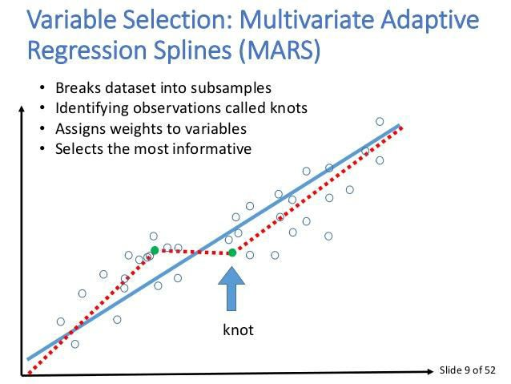
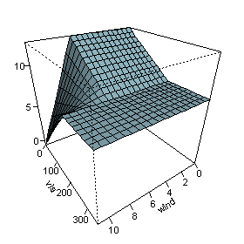
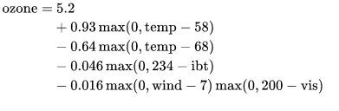
Multivariate Adaptive Regression Splines (MARS)

Slide 17
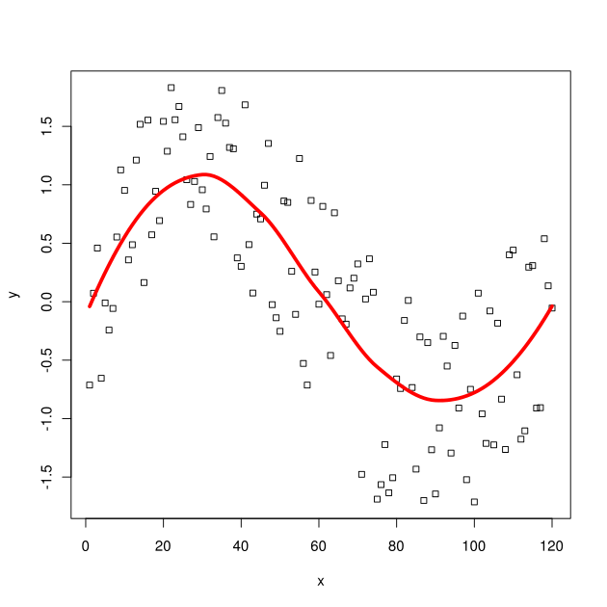
Locally Estimated Scatterplot Smoothing (LOESS)
Combine multiple regression models in a k-nearest-neighbor-based meta- model
Fits a low-degree polynomial to a subset of the data close to the current point
Requires fairly large, densely sampled data sets in order to produce good models.

Slide 18
Models: Regularization Methods
Extend another method (usually regression), penalizing complexity (minimize overfit)
simple, popular, powerful
better at generalization
Ridge Regression
LASSO (Least Absolute Shrinkage & Selection Operator)
Elastic Net

Slide 19
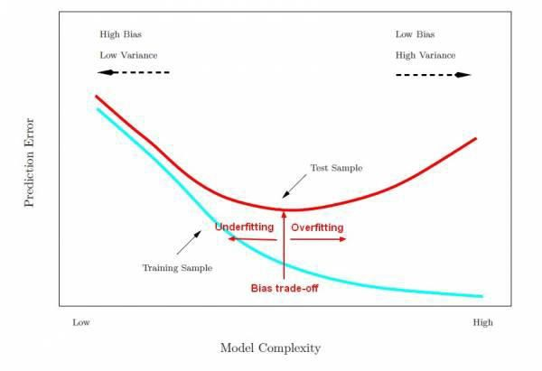
Models: Regularization Methods

Slide 20

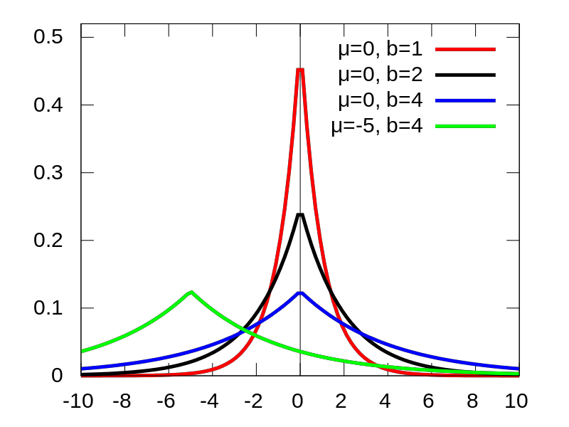
LASSO
Limits total weight of parameters
Can be interpreted as a prior distribution on parameters
Ridge regression: quadratic penalty
•
Elastic Net combines both
Laplace prior distributions

Slide 21
Models: Decision Trees
Model of decisions based on data attributes. Predictions are made by following forks in a tree structure until a decision is made. Used for classification & regression.
Classification and Regression Tree (CART)
Decision Stump
Random Forest
Multivariate Adaptive Regression Splines (MARS)
Gradient Boosting Machines (GBM)

Slide 22
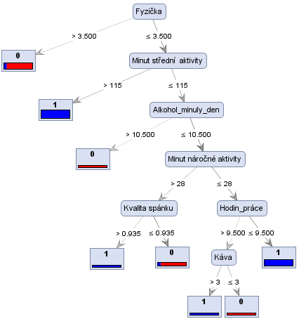
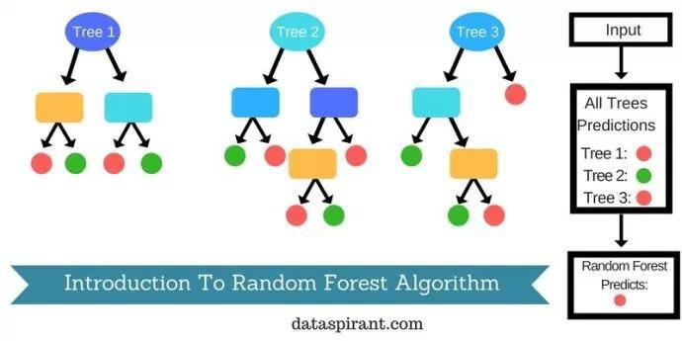
Models: Decision Trees
http://www.saedsayad.com/decision_tree.htm

Slide 23
Models: Bayesian
Explicitly apply Bayes’ Theorem for classification and regression tasks. Usually by fitting a probability function constructed via the chain rule and a naive simplification of Bayes.
Naive Bayes
Averaged One-Dependence Estimators (AODE)
Bayesian Belief Network (BBN)

Slide 24


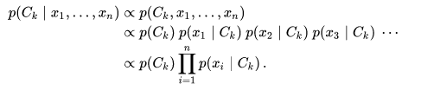
Naive Bayes
Text retrieval 1960s
Independence of feature values (given class)
Bayesian theorem
Probability distribution:
- Voting for max. posterior probability (MAP)

Slide 25
Models: Kernel Methods
Map input data into higher dimensional vector space where the problem is easier to model.
Named after the “kernel trick” which computes
the inner product of images of pairs of data.
Support Vector Machines (SVM)
Radial Basis Function (RBF)
Linear Discriminant Analysis (LDA)

Slide 26
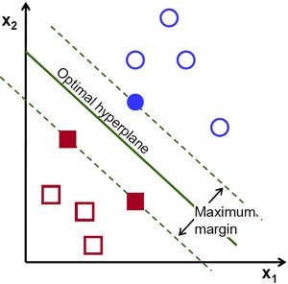
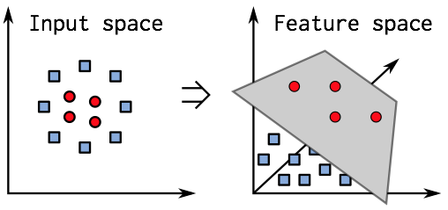
SVM

Slide 27
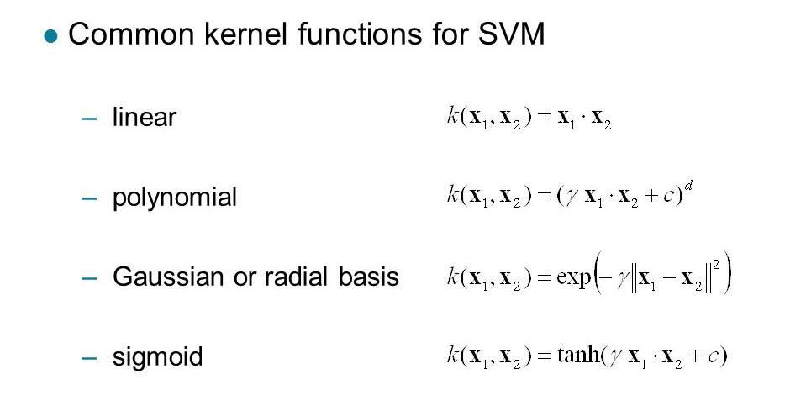
SVM

Slide 28
Models: Clustering Methods
Organize data into into groups whose members share maximum similarity (defined usually by a distance metric). Two main approaches: centroids and hierarchical clustering.
k-Means
Affinity Propegation
OPTICS (Ordering Points to Identify Cluster Structure)
Agglomerative Clustering

Slide 29
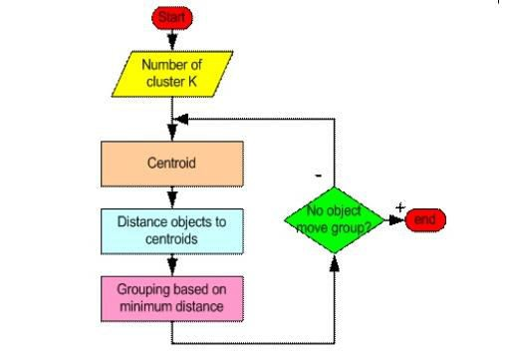
K-means clustering

Slide 30
Models: Artificial Neural Networks
Inspired by biological neural networks, ANNs are nonlinear function approximators that estimate functions with a large number of inputs.
System of interconnected neurons that activate
Deep learning extends simple networks recursively
Restricted Boltzmann Machine (RBM)
Convolutional Neural Networks (CNN)
Recurrent Neural Networks (RNN)
Word2Vec models

Slide 31
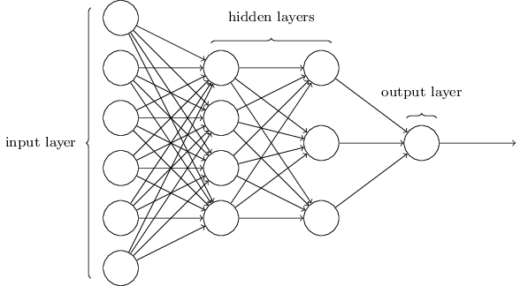
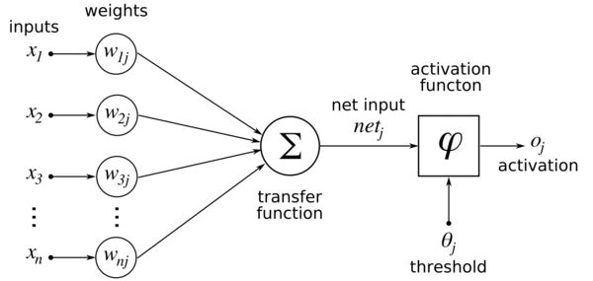
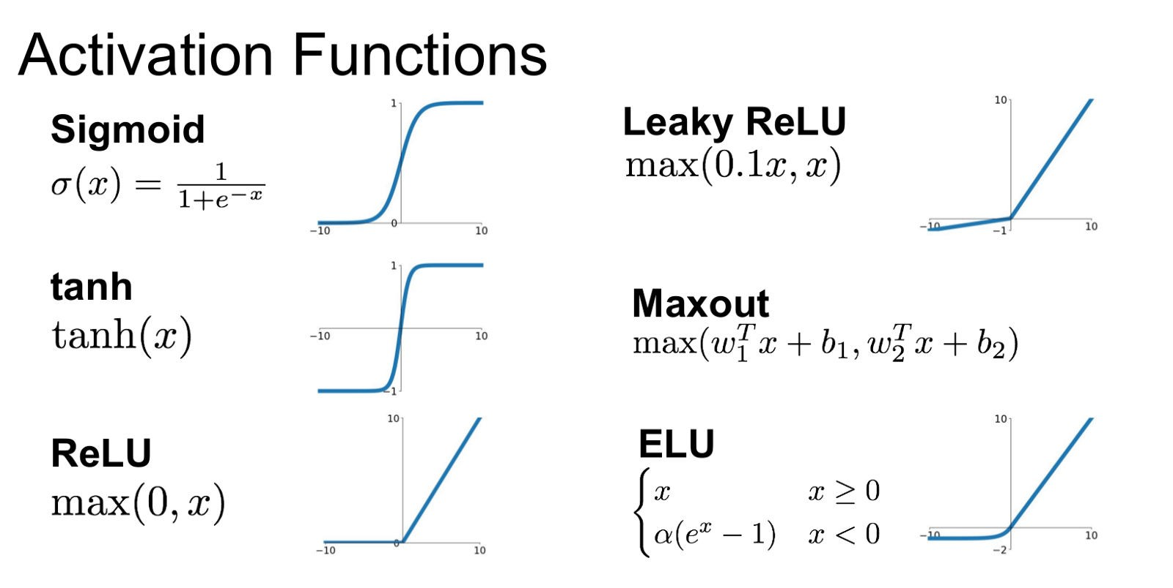
Models: Artificial Neural Networks

Slide 32
Models: Ensembles
Models composed of multiple weak models that are trained independently and whose outputs are combined to make an overall prediction.
Boosting
Bootstrapped Aggregation (Bagging)
AdaBoost
Stacked Generalization (blending)
Gradient Boosting Machines (GBM)
Random Forest

Slide 33
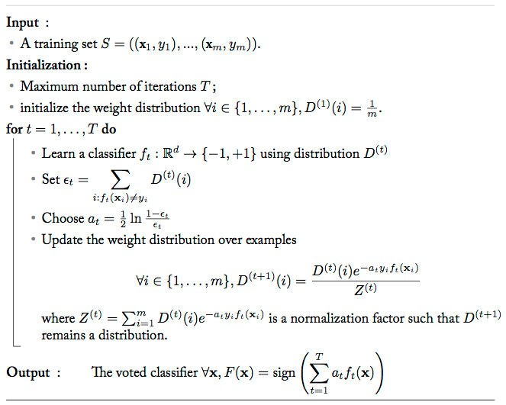
AdaBoost

Slide 34
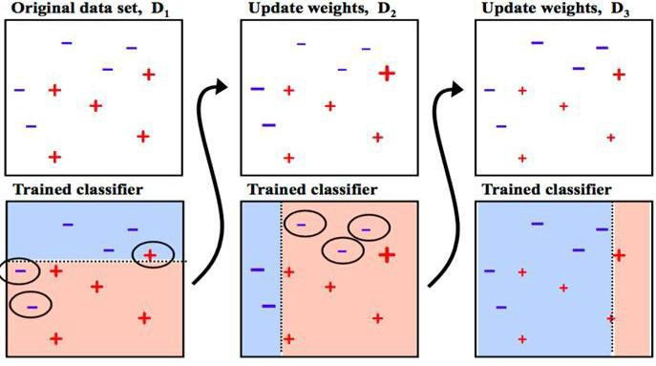
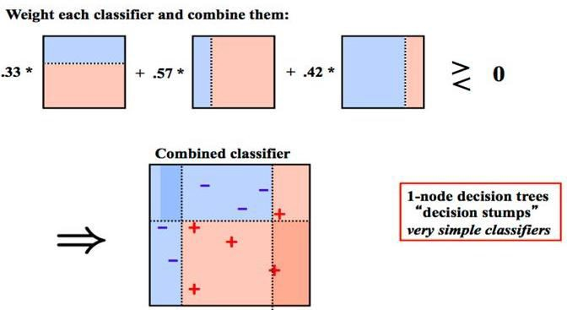
AdaBoost

Slide 35
Models: Other
The list before was not comprehensive, other algorithm and model classes include:
Conditional Random Fields (CRF)
Markovian Models (HMMs)
Dimensionality Reduction (PCA, PLS)
Rule Learning (Apriori, Brill)
More ...

Slide 36
What is Scikit-Learn?
Extensions to SciPy (Scientific Python) are called SciKits. SciKit-Learn provides machine learning algorithms.
Algorithms for supervised & unsupervised learning
Built on SciPy and Numpy
Standard Python API interface
Sits on top of c libraries, LAPACK, LibSVM, and Cython
Open Source: BSD License (part of Linux)
Probably the best general ML framework out there.

Slide 37
Primary Features
Generalized Linear Models
SVMs, kNN, Bayes, Decision Trees, Ensembles
Clustering and Density algorithms
Cross Validation
Grid Search
Pipelining
Model Evaluations
Dataset Transformations
Dataset Loading

Slide 38
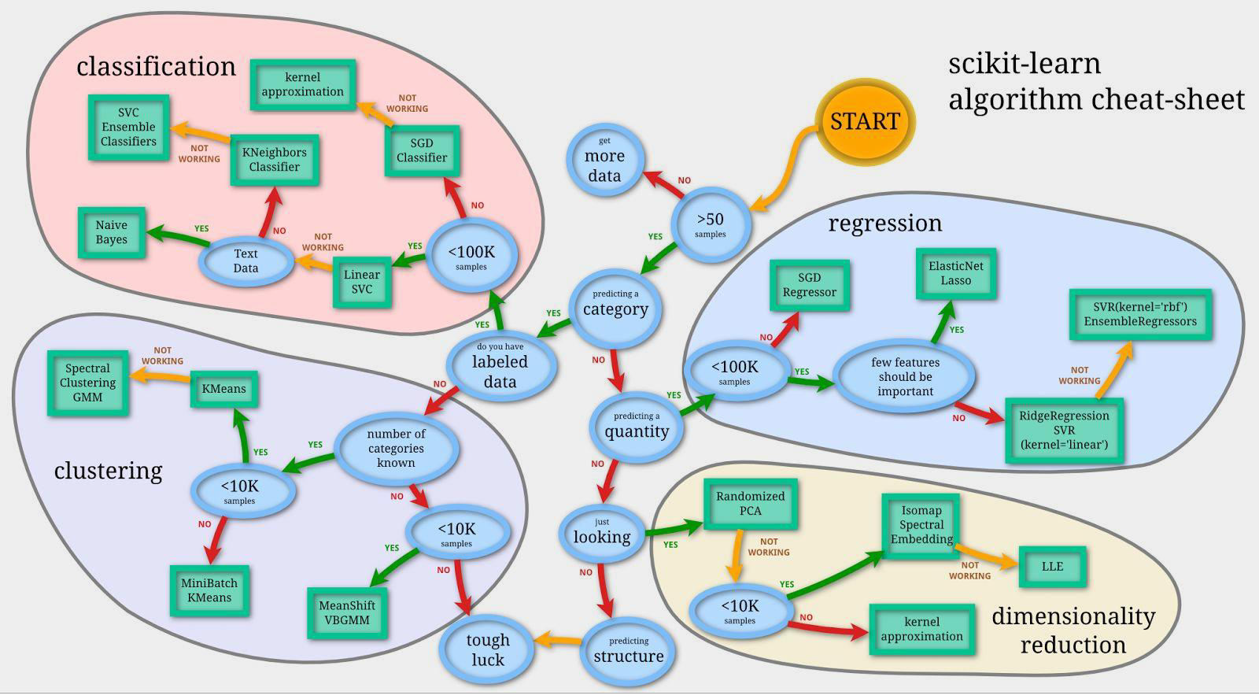
A Guide to Scikit-Learn

Slide 39
Scikit-Learn API
Object-oriented interface centered around the concept of an Estimator:
“An estimator is any object that learns from data; it may be a classification, regression or clustering algorithm or a transformer that extracts/filters useful features from raw data.”
- Scikit-Learn Tutorial

Slide 40
class
Estimator ( object):
def f i t ( s e l f , X, y=None):
" " " F i t s estimator to data. """
# set state of ` ` s e l f ` `
returns e l f
def p r e d i c t ( s e l f , X):
" " " Predictresponse
o f` ` X ` ` . """
# compute predictions
` ` pred``
return pred
The Scikit-Learn Estimator API

Slide 41
Estimators
f i t ( X , y ) sets the state of the estimator.
Xis usually a 2D numpy array of shape (num_samples, num_features).
- y is a 1D array with shape (n_samples,)
-
-
predict( X) returns the class or value
predict_ proba() returns a 2D array of
shape (n_samples, n_classes)

Slide 42
from sklearn import svm
estimator = svm. SVC(gamma=0.001) e s t i m a t o r . f i t ( X , y )
estimator. predict( x)
Basic methodology

Slide 43
Wrapping fit and predict
We’ve already discussed a broad workflow, the following is a development workflow:
Raw Data
Extraction
Evaluation
Evaluate Model
Transform Data
Build Model

