Slide 1
Introduction to Numpy
3/18/13 8:11 AM
Introduction to NumPy
Bryan Van de Ven
Page 1 of 39

Slide 2
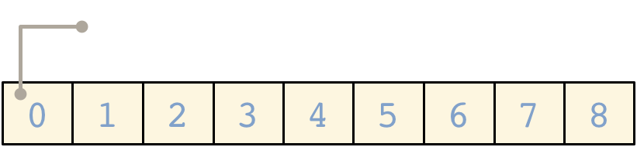
What is NumPy
Introduction to Numpy
3/18/13 8:11 AM
NumPy is a Python C extension library for array-oriented computing Efficient
In-memory
Contiguous (or Strided)
Homogeneous (but types can be algebraic)
NumPy is suited to many applications Image processing
Signal processing Linear algebra
A plethora of others
Page 2 of 39

Slide 3
Arrays – Numerical Python (Numpy)
Lists ok for storing small amounts of one-dimensional data
>>> a = [1,3,5,7,9]
>>> print(a[2:4])
[5, 7]
>>> b = [[1, 3, 5, 7, 9], [2, 4, 6, 8, 10]]
>>> print(b[0])
[1, 3, 5, 7, 9]
>>> print(b[1][2:4])
[6, 8]
>>> a = [1,3,5,7,9]
>>> b = [3,5,6,7,9]
>>> c = a + b
>>> print c
[1, 3, 5, 7, 9, 3, 5, 6, 7, 9]
But, can’t use directly with arithmetical operators (+, -, *, /, …)
Need efﬁcient arrays with arithmetic and better multidimensional tools
Numpy
Similar to lists, but much more capable, except ﬁxed size
>>> import numpy (as np)

Slide 4
NumPy is the foundation of the python scientific stack
Introduction to Numpy
3/18/13 8:11 AM
Page 4 of 39

Slide 5
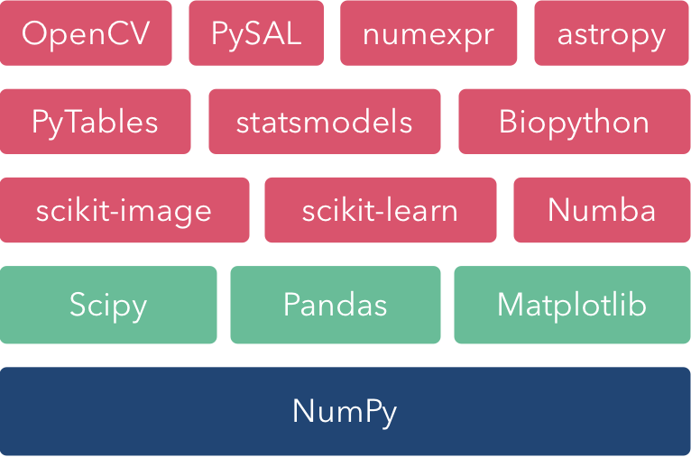
NumPy Ecosystem
Introduction to Numpy
3/18/13 8:11 AM
Page 5 of 39

Slide 6
Numpy – Creating vectors
From lists
  numpy.array
# as vectors from lists
>>> a = numpy.array([1,3,5,7,9])
>>> b = numpy.array([3,5,6,7,9])
>>> c = a + b # common operations element-wise (more later)
>>> print c
[4, 8, 11, 14, 18]
>>> type(c)
(<type 'numpy.ndarray'>)
>>> c.shape
(5,)

Slide 7
Numpy – Creating Arrays
>>> l = [[1, 2, 3], [3, 6, 9], [2, 4, 6]] # create a list
>>> a = numpy.array(l) # convert a list to an array
>>>print(a)
[[1 2 3]
[3 6 9]
[2 4 6]]
>>> a.shape
(3, 3)
>>> print(a.dtype) # get type of an array
int64
# or directly as matrix
>>> M = array([[1, 2], [3, 4]])
>>> M.shape
(2,2)
>>> M.dtype
dtype('int64')
#only one type
>>> M[0,0] = "hello"
Traceback (most recent call last):
File "<stdin>", line 1, in <module>
ValueError: invalid literal for long() with base 10: 'hello‘
>>> M = numpy.array([[1, 2], [3, 4]], dtype=complex)
>>> M
array([[ 1.+0.j, 2.+0.j],
[ 3.+0.j, 4.+0.j]])

Slide 8
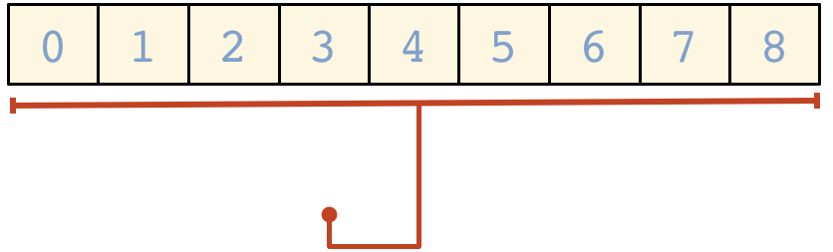
Array Shape
Introduction to Numpy
3/18/13 8:11 AM
One dimensional arrays have a 1-tuple for their shape
Page 6 of 39

Slide 9
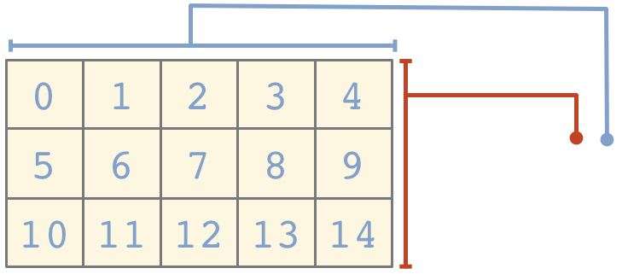
...Two dimensional arrays have a 2-tuple
Introduction to Numpy
3/18/13 8:11 AM
Shape must be maintained
A = np.array([[1,2,3], [4,5], [6]])
A.shape #(3,)
A.dtype #object
A = np.array([[1,2,3], [4,5,6], [6,7,8]])
A.shape #(3,3)
A.dtype #int32
Page 7 of 39

Slide 10
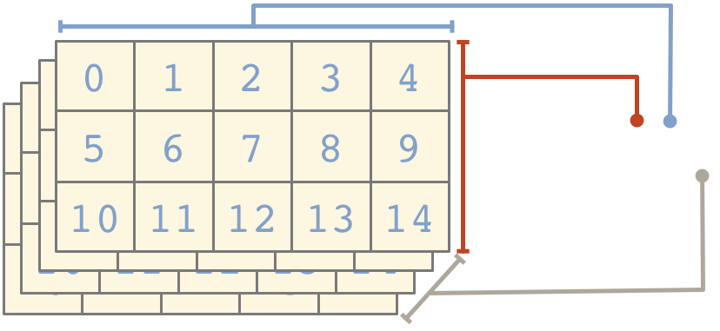
...And so on
Introduction to Numpy
3/18/13 8:11 AM
Page 8 of 39

Slide 11
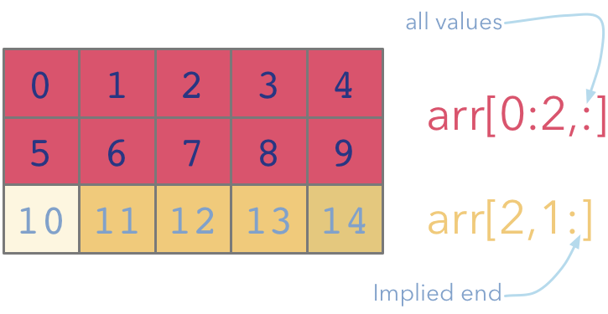
Indexing and Slicing
Introduction to Numpy
3/18/13 8:11 AM

Slide 12
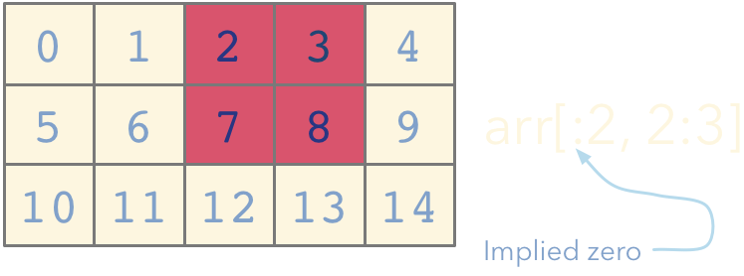
Introduction to Numpy
3/18/13 8:11 AM

Slide 13
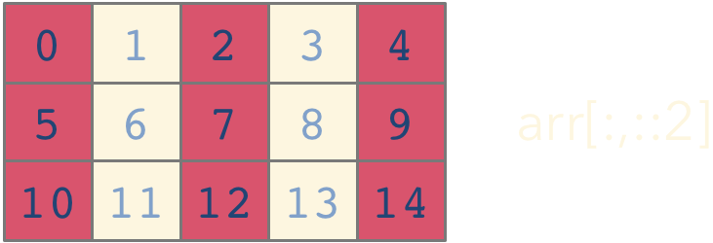
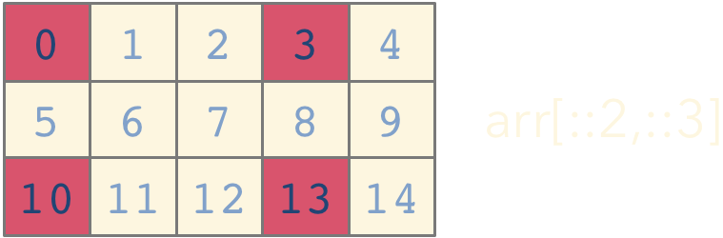
Introduction to Numpy
3/18/13 8:11 AM
NumPy array indices can also take an optional stride

Slide 14

Array Views
Introduction to Numpy
3/18/13 8:11 AM
Simple assigments do not make copies of arrays (same semantics as Python). Slicing operations do not make copies either; they return
views on the original array.
In [2]: a = np.arange(10) In [3]: b = a[3:7]
In [4]: b
Out[4]: array([3, 4, 5, 6])
In [5]: b[:] = 0
In [6]: a
Out[6]: array([0, 1, 3, 0, 0, 0, 0, 7, 8, 9])
In [7]: b.flags.owndata Out[7]: False
Array views contain a pointer to the original data, but may have
different shape or stride values. Views always have flags.owndata
equal to False,

Slide 15
Numpy – Creating arrays
Generation functions
>>> x = numpy.arange(0, 10, 1) # arguments: start, stop, step
>>> x
array([0, 1, 2, 3, 4, 5, 6, 7, 8, 9])
>>> numpy.linspace(0, 10, 25)
array([ 0. , 0.41666667, 0.83333333, 1.25 ,
1.66666667, 2.08333333, 2.5 , 2.91666667,
3.33333333, 3.75 , 4.16666667, 4.58333333,
5. , 5.41666667, 5.83333333, 6.25 ,
6.66666667, 7.08333333, 7.5 , 7.91666667,
8.33333333, 8.75 , 9.16666667, 9.58333333, 10. ])
>>> numpy.logspace(0, 10, 10, base=numpy.e)
array([ 1.00000000e+00, 3.03773178e+00, 9.22781435e+00,
2.80316249e+01, 8.51525577e+01, 2.58670631e+02,
7.85771994e+02, 2.38696456e+03, 7.25095809e+03,
2.20264658e+04])

Slide 16
Numpy – Creating arrays
# a diagonal matrix
>>> numpy.diag([1,2,3])
array([[1, 0, 0],
[0, 2, 0],
[0, 0, 3]])
>>> b = numpy.zeros(5)
>>> print(b)
[ 0. 0. 0. 0. 0.]
>>> b.dtype
dtype(‘float64’)
>>> n = 1000
>>> my_int_array = numpy.zeros(n, dtype=numpy.int)
>>> my_int_array.dtype
dtype(‘int32’)
>>> c = numpy.ones((3,3))
>>> c
array([[ 1., 1., 1.],
[ 1., 1., 1.],
[ 1., 1., 1.]])

Slide 17
Numpy – array creation and use
>>> d = numpy.arange(5) # just like range()
>>> print(d)
[0 1 2 3 4]
>>> d[1] = 9.7
>>> print(d) # arrays keep their type even if elements changed
[0 9 2 3 4]
>>> print(d*0.4) # operations create a new array, with new type
[ 0. 3.6 0.8 1.2 1.6]
>>> d = numpy.arange(5, dtype=numpy.float)
>>> print(d)
[ 0. 1. 2. 3. 4.]
>>> numpy.arange(3, 7, 0.5) # arbitrary start, stop and step
array([ 3. , 3.5, 4. , 4.5, 5. , 5.5, 6. , 6.5])

Slide 18
Numpy – array creation and use
>>> x, y = numpy.mgrid[0:5, 0:5] # similar to meshgrid in MATLAB
>>> x
array([[0, 0, 0, 0, 0],
[1, 1, 1, 1, 1],
[2, 2, 2, 2, 2],
[3, 3, 3, 3, 3],
[4, 4, 4, 4, 4]])
# random data
>>> numpy.random.rand(5,5)
array([[ 0.51531133, 0.74085206, 0.99570623, 0.97064334, 0.5819413 ],
[ 0.2105685 , 0.86289893, 0.13404438, 0.77967281, 0.78480563],
[ 0.62687607, 0.51112285, 0.18374991, 0.2582663 , 0.58475672],
[ 0.72768256, 0.08885194, 0.69519174, 0.16049876, 0.34557215],
[ 0.93724333, 0.17407127, 0.1237831 , 0.96840203, 0.52790012]])
https://docs.scipy.org/doc/numpy/user/basics.creation.html
https://docs.scipy.org/doc/numpy/reference/routines.array-creation.html#routines-array-creation

Slide 19
Numpy – Creating arrays
File I/O
>>> os.system('head DeBilt.txt')
"Stn", "Datum", "Tg", "qTg", "Tn", "qTn", "Tx", "qTx"
001, 19010101, -49, 00, -68, 00, -22, 40
001, 19010102, -21, 00, -36, 30, -13, 30
001, 19010103, -28, 00, -79, 30, -5, 20
001, 19010104, -64, 00, -91, 20, -10, 00
001, 19010105, -59, 00, -84, 30, -18, 00
001, 19010106, -99, 00, -115, 30, -78, 30
001, 19010107, -91, 00, -122, 00, -66, 00
001, 19010108, -49, 00, -94, 00, -6, 00
001, 19010109, 11, 00, -27, 40, 42, 00
>>> data = numpy.genfromtxt('DeBilt.txt‘, delimiter=',‘, skip_header=1)
>>> data.shape
(25568, 8)
>>> numpy.savetxt('datasaved.txt', data)
>>> os.system('head datasaved.txt')
1.000000000000000000e+00 1.901010100000000000e+07 -4.900000000000000000e+01 0.000000000000000000e+00 -6.800000000000000000e+01 0.000000000000000000e+00 -2.200000000000000000e+01 4.000000000000000000e+01

Slide 20
Numpy – Creating arrays
>>> M = numpy.random.rand(3,3)
>>> M
array([[ 0.84188778, 0.70928643, 0.87321035],
[ 0.81885553, 0.92208501, 0.873464 ],
[ 0.27111984, 0.82213106, 0.55987325]])
>>>
>>> numpy.save('saved-matrix.npy', M)
>>> numpy.load('saved-matrix.npy')
array([[ 0.84188778, 0.70928643, 0.87321035],
[ 0.81885553, 0.92208501, 0.873464 ],
[ 0.27111984, 0.82213106, 0.55987325]])
>>>
>>> os.system('head saved-matrix.npy')
NUMPYF{'descr': '<f8', 'fortran_order': False, 'shape': (3, 3), }
Ï<
£¾ðê?­sy²æ?$÷ÒVñë?Ù4ê?%dn¸í?Ã[Äjóë?Ä,ZÑ?Ç
ÎåNê?ó7L{êá?0
>>>
https://docs.scipy.org/doc/numpy/user/basics.io.html
https://docs.scipy.org/doc/numpy/reference/routines.io.html

Slide 21
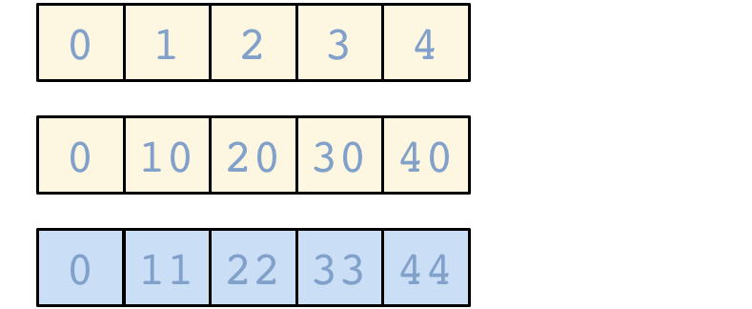
Universal Functions (ufuncs)
NumPy ufuncs are functions that operate element-wise on one or more arrays
Introduction to Numpy
3/18/13 8:11 AM
ufuncs dispatch to optimized C inner-loops based on array dtype

Slide 22
NumPy has many built-in ufuncs
Introduction to Numpy
3/18/13 8:11 AM
comparison: <, <=, ==, !=, >=, >
arithmetic: +, -, *, /, reciprocal, square
exponential: exp, expm1, exp2, log, log10, log1p, log2, power, sqrt
trigonometric: sin, cos, hyperbolic: sinh, cosh, bitwise operations: &, |,
tan, acsin, arccos, atctan tanh, acsinh, arccosh, atctanh
~, ^, left_shift, right_shift
logical operations: and, logical_xor, not, or
predicates: isfinite, isinf, isnan, signbit
other: abs, ceil, floor, mod, modf, round, sinc, sign, trunc

Slide 23
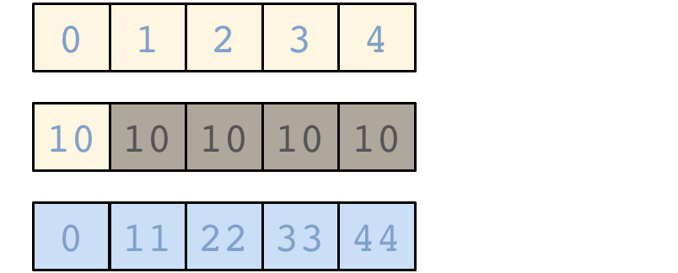
Broadcasting
A key feature of NumPy is broadcasting, where arrays with different, but compatible shapes can be used as arguments to ufuncs
Introduction to Numpy
3/18/13 8:11 AM
In this case an array scalar is broadcast to an array with shape (5, )

Slide 24
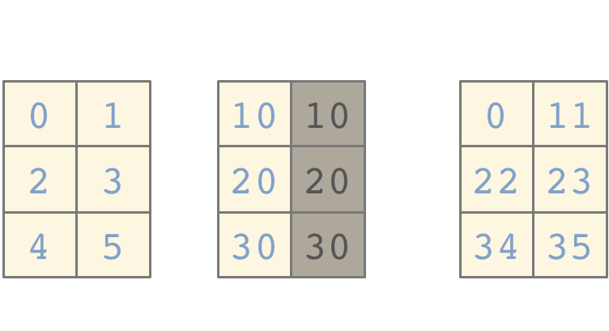
Introduction to Numpy
3/18/13 8:11 AM
A slightly more involved broadcasting example in two dimensions
Here an array of shape (3, 1) is broadcast to an array with shape
(3, 2)

Slide 25

Broadcasting Rules
Introduction to Numpy
3/18/13 8:11 AM
In order for an operation to broadcast, the size of all the trailing dimensions for both arrays must either:
be equal OR be one
A | (1d | array): |  |  |  |  |  |  | 3
B | (2d | array): |  |  |  |  | 2 | x | 3
Result | (2d | array): |  |  |  |  | 2 | x | 3
A | (2d | array): |  |  |  |  | 6 | x | 1
B | (3d | array): |  |  | 1 | x | 6 | x | 4
Result | (3d | array): |  |  | 1 | x | 6 | x | 4
A | (4d | array): | 3 | x | 1 | x | 6 | x | 1
B | (3d | array): |  |  | 2 | x | 1 | x | 4
Result | (4d | array): | 3 | x | 2 | x | 6 | x | 4

Slide 26
Array Methods
Introduction to Numpy
3/18/13 8:11 AM
Predicates
a.any(), a.all()
Reductions
a.mean(), a.sum(), a.argmin(), a.argmax(), a.trace(), a.cumsum(), a.cumprod()
Manipulation
a.argsort(), a.transpose(), a.reshape(...),
a.ravel(), a.fill(...), a.clip(...)
Complex Numbers
a.real, a.imag, a.conj()
Page 28 of 39

Slide 27

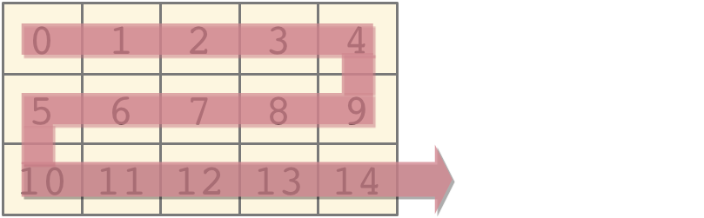
Reduction: Axis
Introduction to Numpy
3/18/13 8:11 AM
Array method reductions take an optional axis parameter that specifies over which axes to reduce axis=None reduces into a single scalar
In [7]: a.sum()
Out[7]: 105
axis=None is the default

Slide 28

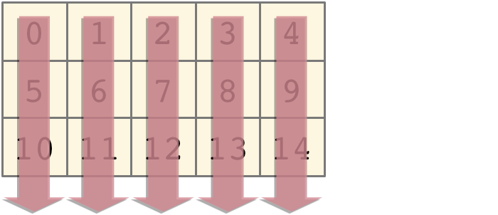

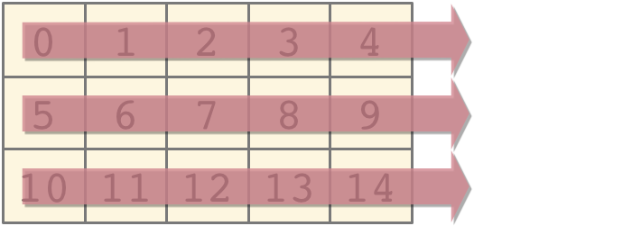
Introduction to Numpy
3/18/13 8:11 AM
axis=0 reduces into the zeroth dimension
In [8]: a.sum(axis=0)
Out[8]: array([15, 18, 21, 24,
27])
axis=0 reduces into the first dimension
In [9]: a.sum(axis=1)
Out[9]: array([10, 35, 60])

Slide 29
Numpy – array creation and use
>>> arr = numpy.arange(10, 20 )
>>> div_by_3 = arr%3 == 0 # comparison produces boolean array
>>> print(div_by_3)
[ False False True False False True False False True False]
>>> print(arr[div_by_3]) # can use boolean lists as indices
[12 15 18]
>>> arr = numpy.arange(10, 20) . reshape((2,5))
[[10 11 12 13 14]
[15 16 17 18 19]]

Slide 30
Numpy – array methods
>>> arr.sum()
145
>>> arr.mean()
14.5
>>> arr.std()
2.8722813232690143
>>> arr.max()
19
>>> arr.min()
10
>>> div_by_3.all()
False
>>> div_by_3.any()
True
>>> div_by_3.sum()
3
>>> div_by_3.nonzero()
(array([2, 5, 8]),)

Slide 31
Numpy – array methods - sorting
>>> arr = numpy.array([4.5, 2.3, 6.7, 1.2, 1.8, 5.5])
>>> arr.sort() # acts on array itself
>>> print(arr)
[ 1.2 1.8 2.3 4.5 5.5 6.7]
>>> x = numpy.array([4.5, 2.3, 6.7, 1.2, 1.8, 5.5])
>>> numpy.sort(x)
array([ 1.2, 1.8, 2.3, 4.5, 5.5, 6.7])
>>> print(x)
[ 4.5 2.3 6.7 1.2 1.8 5.5]
>>> s = x.argsort()
>>> s
array([3, 4, 1, 0, 5, 2])
>>> x[s]
array([ 1.2, 1.8, 2.3, 4.5, 5.5, 6.7])
>>> y[s]
array([ 6.2, 7.8, 2.3, 1.5, 8.5, 4.7])

Slide 32
Numpy – array operations
>>> a = array([[1.0, 2.0], [4.0, 3.0]])
>>> print a
[[ 1. 2.]
[ 3. 4.]]
>>> a.transpose()
array([[ 1., 3.],
[ 2., 4.]])
>>> inv(a)
array([[-2. , 1. ],
[ 1.5, -0.5]])
>>> u = eye(2) # unit 2x2 matrix; "eye" represents "I"
>>> u
array([[ 1., 0.],
[ 0., 1.]])
>>> j = array([[0.0, -1.0], [1.0, 0.0]])
>>> dot (j, j) # matrix product
array([[-1., 0.],
[ 0., -1.]])
Notes:
32

Slide 33
Numpy – statistics
In addition to the mean, var, and std functions, NumPy supplies several other methods for returning statistical features of arrays. The median can be found:
>>> a = np.array([1, 4, 3, 8, 9, 2, 3], float)
>>> np.median(a)
3.0
The correlation coefficient for multiple variables observed at multiple instances can be found for arrays of the form [[x1, x2, …], [y1, y2, …], [z1, z2, …], …] where x, y, z are different observables and the numbers indicate the observation times:
>>> a = np.array([[1, 2, 1, 3], [5, 3, 1, 8]], float)
>>> c = np.corrcoef(a)
>>> c
array([[ 1. , 0.72870505],
[ 0.72870505, 1. ]])
Here the return array c[i,j] gives the correlation coefficient for the ith and jth observables. Similarly, the covariance for data can be found::
>>> np.cov(a)
array([[ 0.91666667, 2.08333333],
[ 2.08333333, 8.91666667]])
Notes:
33

Slide 34
Using arrays wisely
Array operations are implemented in C or Fortran
Optimised algorithms - i.e. fast!
Python loops (i.e. for i in a:…) are much slower
Prefer array operations over loops, especially when speed important
Also produces shorter code, often more readable

Slide 35
Numpy – matrices
For two dimensional arrays NumPy defined a special matrix class in module matrix. Objects are created either with matrix() or mat() or converted from an array with method asmatrix().
>>> import numpy
>>> m = numpy.mat([[1,2],[3,4]])
or
>>> a = numpy.array([[1,2],[3,4]])
>>> m = numpy.mat(a)
or
>>> a = numpy.array([[1,2],[3,4]])
>>> m = numpy.asmatrix(a)
Note that the statement m = mat(a) creates a copy of array 'a'.
Changing values in 'a' will not affect 'm'.
On the other hand, method m = asmatrix(a) returns a new reference to the same data.
Changing values in 'a' will affect matrix 'm'.
https://docs.scipy.org/doc/numpy/reference/generated/numpy.matrix.html
Notes:
35

Slide 36
Numpy – matrices
Array and matrix operations may be quite different!
>>> a = array([[1,2],[3,4]])
>>> m = mat(a) # convert 2-d array to matrix
>>> m = matrix([[1, 2], [3, 4]])
>>> a[0] # result is 1-dimensional
array([1, 2])
>>> m[0] # result is 2-dimensional
matrix([[1, 2]])
>>> a*a # element-by-element multiplication
array([[ 1, 4], [ 9, 16]])
>>> m*m # (algebraic) matrix multiplication
matrix([[ 7, 10], [15, 22]])
>>> a**3 # element-wise power
array([[ 1, 8], [27, 64]])
>>> m**3 # matrix multiplication m*m*m
matrix([[ 37, 54], [ 81, 118]])
>>> m.T # transpose of the matrix
matrix([[1, 3], [2, 4]])
>>> m.H # conjugate transpose (differs from .T for complex matrices)
matrix([[1, 3], [2, 4]])
>>> m.I # inverse matrix
matrix([[-2. , 1. ], [ 1.5, -0.5]])
Notes:
36

Slide 37
Numpy – matrices
Operator *, dot(), and multiply():
  For array, '*' means element-wise multiplication, and the dot() function is used for matrix multiplication.
  For matrix, '*'means matrix multiplication, and the multiply() function is used for element-wise multiplication.
Handling of vectors (rank-1 arrays)
  For array, the vector shapes 1xN, Nx1, and N are all different things. Operations like A[:,1] return a rank-1 array of shape N, not a rank-2 of shape Nx1. Transpose on a rank-1 array does nothing.
  For matrix, rank-1 arrays are always upgraded to 1xN or Nx1 matrices (row or column vectors). A[:,1] returns a rank-2 matrix of shape Nx1.
Handling of higher-rank arrays (rank > 2)
  array objects can have rank > 2.
  matrix objects always have exactly rank 2.
Convenience attributes
  array has a .T attribute, which returns the transpose of the data.
  matrix also has .H, .I, and .A attributes, which return the conjugate transpose, inverse, and asarray() of the matrix, respectively.
Convenience constructor
  The array constructor takes (nested) Python sequences as initializers. As in
  array([[1,2,3],[4,5,6]]).
  The matrix constructor additionally takes a convenient string initializer. As in
  matrix("[1 2 3; 4 5 6]")
Notes:
37

