Slide 1
Deep Learning & TensorFlow with Keras
Based on:

Slide 2
Why Deep Learning?
ImageNet challenge error rates (red line = human performance)

Slide 3
Why Deep Learning?

Slide 4
Neural Model

Slide 5
Neuron a.k.a. Unit

Slide 6
Learning

Slide 7
Stochastic Gradient Descent
Generalization of (Stochastic) Gradient Descent

Slide 8
Stochastic Gradient Descent

Slide 9
Modern Deep Networks
Ingredients:
Rectified Linear Activation function a.k.a. ReLu

Slide 10
Modern Deep Networks
Mini-batches:
Stochastic Gradient Descent (or its evolutions)
Compute gradient over many (50 -100) data points (minibatch) and update.
Shared parameters
Several layer / network-level templates
CNN, RNN, 2vec models, Autoencoders, Generative Adversal Networks (GAN),...
Transfer learning (from one problem to another)

Slide 11
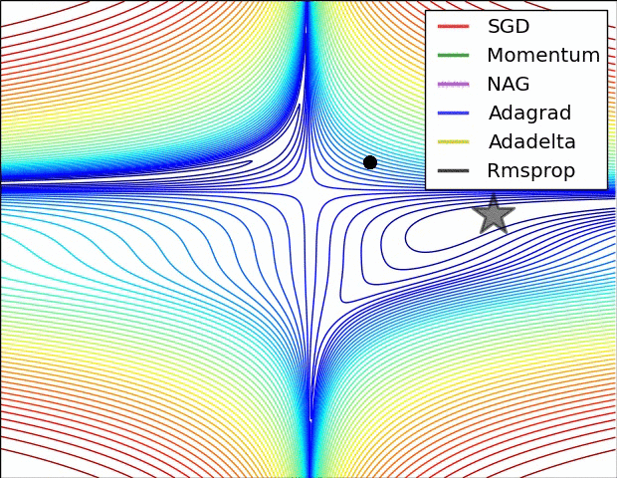
Modern Feedforward Networks
Ingredients:
Adagrad a.k.a. adaptive learning rates
Decrease step size over time
In a factor-wise fashion

Slide 12
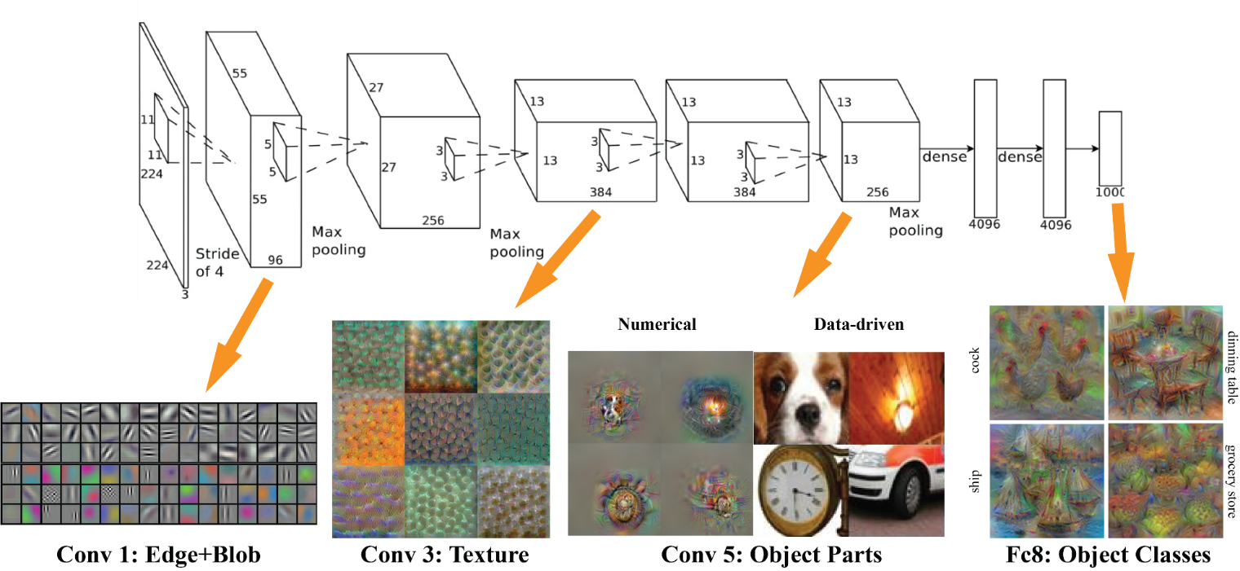
Convolutional deep network
[Fig source: http://vision03.csail.mit.edu/cnn_art/index.html ]

Slide 13
Deep-Learning Package Zoo
Torch
Caffe
Theano (Keras, Lasagne)
CuDNN
Tensorflow
Mxnet
Etc.

Slide 14
Deep-Learning Package Design Choices
Model specification: Configuration file (e.g. Caffe, DistBelief, CNTK) versus programmatic generation (e.g. Torch, Theano, Tensorflow)
For programmatic models, choice of high-level language: Lua (Torch) vs. Python (Theano, Tensorflow) vs others.
We chose to work with python because of rich community and library infrastructure.

Slide 15
What is TensorFlow?
TensorFlow is a deep learning library recently open-sourced by Google.
But what does it actually do?
TensorFlow provides primitives for defining functions on tensors and automatically computing their derivatives.

Slide 16
But what’s a Tensor?
Formally, tensors are multilinear maps from vector spaces to the real numbers ( vector space, and dual space)
A scalar is a tensor (
A vector is a tensor (
A matrix is a tensor (
Common to have fixed basis, so a tensor can be represented as a multidimensional array of numbers.
)
)
)

Slide 17
Why the „Flow“?
Tensorflow constructs a graph of the evaluation G
The nodes in the graph are evaluated upon request (.eval() / session.run() )
TenorFlow can automatically calculate derivates for each of the nodes and therefor we can use SGD easily to optimize w.r.t. Arbitrary error metri

Slide 18
Simple Numpy Recap
In [23]: import numpy as np
In [24]: a = np.zeros((2,2)); b = np.ones((2,2)) In [25]: np.sum(b, axis=1)
Out[25]: array([ 2., 2.])
In [26]: a.shape
Out[26]: (2, 2)
In [27]: np.reshape(a, (1,4))
Out[27]: array([[ 0., 0., 0.,
0.]])

Slide 19
More on Session
soon
Repeat in TensorFlow
More on .eval()
in a few slides
In [31]: import tensorflow as tf
In [32]: tf.InteractiveSession()
In [33]: a = tf.zeros((2,2)); b = tf.ones((2,2))
In [34]: tf.reduce_sum(b, reduction_indices=1).eval() Out[34]: array([ 2., 2.], dtype=float32)
In [35]: a.get_shape()
Out[35]: TensorShape([Dimension(2), Dimension(2)])
TensorShape behaves like a python tuple.
In [36]: tf.reshape(a, (1, 4)).eval()
Out[36]: array([[ 0., 0., 0., 0.]], dtype=float32)

Slide 20
Numpy to TensorFlow Dictionary
Numpy | TensorFlow
a = np.zeros((2,2)); b = np.ones((2,2)) | a = tf.zeros((2,2)), b = tf.ones((2,2))
np.sum(b, axis=1) | tf.reduce_sum(a,reduction_indices=[1])
a.shape | a.get_shape()
np.reshape(a, (1,4)) | tf.reshape(a, (1,4))
b * 5 + 1 | b * 5 + 1
np.dot(a,b) | tf.matmul(a, b)
a[0,0], a[:,0], a[0,:] | a[0,0], a[:,0], a[0,:]

Slide 21
Basic concepts in TF
Constants, Input data (placeholders, feed dictionary)
(trainable) Variables (variable scopes, reuse variables)
Optimizers

Slide 22
TensorFlow requires explicit evaluation!
In [37]: a = np.zeros((2,2))
In [38]: ta = tf.zeros((2,2))
TensorFlow computations define a computation graph that has no numerical value until evaluated!
In [39]: print(a)
[[ 0. 0.]
[ 0. 0.]]
In [40]: print(ta)
Tensor("zeros_1:0", shape=(2, 2), dtype=float32)
In [41]: print(ta.eval())
[[ 0. 0.]
[ 0. 0.]]

Slide 23
TensorFlow Session Object (1)
“A Session object encapsulates the environment in which Tensor objects are evaluated” - TensorFlow Docs
In [20]: a = tf.constant(5.0)
In [21]: b = tf.constant(6.0)
c.eval() is just syntactic sugar for sess.run(c) in the currently active session!
In [22]: c = a * b
In [23]: with tf.Session() as sess:
....:
....:
....: 30.0
30.0
print(sess.run(c)) print(c.eval())

Slide 24
TensorFlow Variables (1)
“When you train a model you use variables to hold and update parameters. Variables are in-memory buffers containing tensors” - TensorFlow Docs.
All tensors we’ve used previously have been constant
tensors, not variables.

Slide 25
TensorFlow Variables (2)
In [32]: W1 = tf.ones((2,2))
In [33]: W2 = tf.Variable(tf.zeros((2,2)), name="weights") In [34]: with tf.Session() as sess:
print(sess.run(W1)) sess.run(tf.initialize_all_variables()) print(sess.run(W2))
....:
Note the initialization step tf. initialize_all_variables()
[[ | 1. | 1.]
[ | 1. | 1.]]
[[ | 0. | 0.]
[ | 0. | 0.]]

Slide 26
Fetching Variable State (1)
In [82]: input1 = tf.constant(3.0) In [83]: input2 = tf.constant(2.0) In [84]: input3 = tf.constant(5.0)
In [85]: intermed = tf.add(input2, input3) In [86]: mul = tf.mul(input1, intermed)
In [87]: with tf.Session() as sess:
Calling sess.run(var) on a tf.Session() object retrieves its value. Can retrieve multiple variables simultaneously with sess.run([var1, var2]) (See Fetches in TF docs)
....:
....:
....:
[21.0, 7.0]
result = sess.run([mul, intermed]) print(result)

Slide 27
Inputting Data
All previous examples have manually defined tensors. How can we input external data into TensorFlow?
Simple solution: Import from Numpy:
In [93]: a = np.zeros((3,3))
In [94]: ta = tf.convert_to_tensor(a) In [95]: with tf.Session() as sess:
....: print(sess.run(ta))
....:
[[ 0. 0. 0.]
[ 0. 0. 0.]
[ 0. 0. 0.]]

Slide 28
Placeholders and Feed Dictionaries (1)
Inputting data with tf.convert_to_tensor() is convenient, but doesn’t scale.
Use tf.placeholder variables (dummy nodes that provide entry points for data to computational graph).
A feed_dict is a python dictionary mapping from tf. placeholder vars (or their names) to data (numpy arrays, lists, etc.).

Slide 29
Placeholders and Feed Dictionaries (2)
In [96]: input1 = tf.placeholder(tf.float32)
Define tf.placeholder
objects for data entry.
In [97]: input2 = tf.placeholder(tf.float32)
In [98]: output = tf.mul(input1, input2)
In [99]: with tf.Session() as sess:
....: print(sess.run([output], feed_dict={input1:[7.], input2:[2.]}))
....:
[array([ 14.], dtype=float32)]
Fetch value of output from computation graph.
Feed data into computation graph.

Slide 30
Placeholders and Feed Dictionaries (3)

Slide 31
Variable Scope (1)
Complicated TensorFlow models can have hundreds of variables.
tf.variable_scope() provides simple name-spacing to avoid clashes.
tf.get_variable() creates/accesses variables from within a variable scope.

Slide 32
Variable Scope (2)
Variable scope is a simple type of namespacing that adds prefixes to variable names within scope
with tf.variable_scope("foo"): with tf.variable_scope("bar"):
v = tf.get_variable("v", [1]) assert v.name == "foo/bar/v:0"

Slide 33
Variable Scope (3)
Variable scopes control variable (re)use
with tf.variable_scope("foo"):
v = tf.get_variable("v", [1]) tf.get_variable_scope().reuse_variables() v1 = tf.get_variable("v", [1])
assert v1 == v

Slide 34
Understanding get_variable (1)
Behavior depends on whether variable reuse enabled
Case 1: reuse set to false
Create and return new variable
with tf.variable_scope("foo"):
v = tf.get_variable("v", [1]) assert v.name == "foo/v:0"

Slide 35
Understanding get_variable (2)
Case 2: Variable reuse set to true
Search for existing variable with given name. Raise
ValueError if none found.
with tf.variable_scope("foo"):
v = tf.get_variable("v", [1])
with tf.variable_scope("foo", reuse=True): v1 = tf.get_variable("v", [1])
assert v1 == v

Slide 36
Ex: Linear Regression in TensorFlow (1)
import numpy as np import seaborn
# Define input data
X_data = np.arange(100, step=.1)
y_data = X_data + 20 * np.sin(X_data/10)
# Plot input data plt.scatter(X_data, y_data)

Slide 37
Ex: Linear Regression in TensorFlow (2)
# Define data size and batch size n_samples = 1000
batch_size = 100
# Tensorflow is finicky about shapes, so resize X_data = np.reshape(X_data, (n_samples,1)) y_data = np.reshape(y_data, (n_samples,1))
# Define placeholders for input
X = tf.placeholder(tf.float32, shape=(batch_size, 1))
y = tf.placeholder(tf.float32, shape=(batch_size, 1))

Slide 38
Ex: Linear Regression in TensorFlow (3)
# Define variables to be learned
with tf.variable_scope("linear-regression"): W = tf.get_variable("weights", (1, 1),
Note reuse=False so these tensors are created anew
initializer=tf.random_normal_initializer()) b = tf.get_variable("bias", (1,),
initializer=tf.constant_initializer(0.0)) y_pred = tf.matmul(X, W) + b
loss = tf.reduce_sum((y - y_pred)**2/n_samples)

Slide 39
Ex: Linear Regression in TensorFlow (4)
# Sample code to run one step of gradient descent In [136]: opt = tf.train.AdamOptimizer()
Note TensorFlow scope is not python scope! Python variable loss is still visible.
In [137]: opt_operation = opt.minimize(loss)
In [138]: with tf.Session() as sess:
.....:
.....:
.....:
sess.run(tf.initialize_all_variables()) sess.run([opt_operation], feed_dict={X: X_data, y: y_data})
But how does this actually work under the hood? Will return to TensorFlow computation graphs and explain.

Slide 40
Ex: Linear Regression in TensorFlow (4)
# Sample code to run full gradient descent: # Define optimizer operation
opt_operation = tf.train.AdamOptimizer().minimize(loss)
with tf.Session() as sess:
# Initialize Variables in graph sess.run(tf.initialize_all_variables()) # Gradient descent loop for 500 steps for _ in range(500):
# Select random minibatch
indices = np.random.choice(n_samples, batch_size) X_batch, y_batch = X_data[indices], y_data[indices] # Do gradient descent step
Let’s do a deeper. graphical dive into this operation
_, loss_val = sess.run([opt_operation, loss], feed_dict={X: X_batch, y: y_batch})

Slide 41
Ex: Linear Regression in TensorFlow (5)

Slide 42
Ex: Linear Regression in TensorFlow (6)
Learned model offers nice fit to data.

Slide 43
Thats it?
So far, rather low-level API described
Not suitable for building complex networks
More generic building blocs needed
Tf.keras
Layers: common types of network layers
Model: train/validate/test automation
Metrics,...
No more session.run(), reuse_variables etc.

Slide 44
Your task
Build a siammese network:
Is the pair of data from the same class?
One-shot classification task
What if a new class emerges?
Re-train model (standard ML) or use similarity of embeddings
Two „towers“ that share parameters and the similarity calculation on top of it
Use tf.keras layers + model

