Slide 1
Recommender Systems - introduction
Ladislav Peška,
Department of Software Engineering,
Charles University in Prague,
Czech Republic

Slide 2
Background, disclaimer

Slide 3
Content:
What are recommender systems?
Why we should love them?
How they work?
Challenges, problems, risks, practical deployment
Discussion
http://www.recommenderbook.net/teaching-material/slides
http://www.ksi.mff.cuni.cz/~peska/vyuka/ndbi021/recsysIntro.pdf
http://www.ksi.mff.cuni.cz/~peska/vyuka/nswi166/

Slide 4
Recommender Systems
You all know them, maybe you just didn’t know that so far…;-)

Slide 5
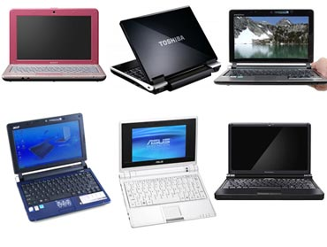
Recommender Systems
Propose relevant items to the right persons at the right time
Machine learning application / subset of Information retrieval
Expose otherwise hard to find, unknown items
Complementary to the catalogues, search engines etc.
„Win-win strategy“
User Feedback
rating, clickstream,
time on page, buys…
Top-K Recommended objects
RECOMMENDER
SYSTEM
User, Object Profiles
Object attributes
(Context)
Time, location,
Possible choices…
Notes:
ML application
Propose few objects
Not necessarily the most similar / relevant
Ultimate goal is to improve key success metrics of the vendor (maximize profit – volumes of sales, user loyalty....)

Slide 6
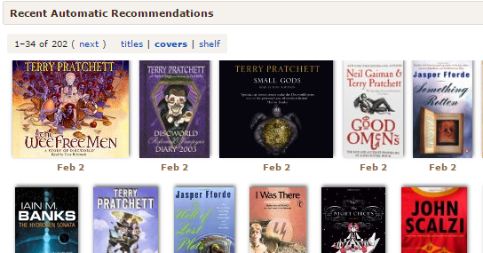
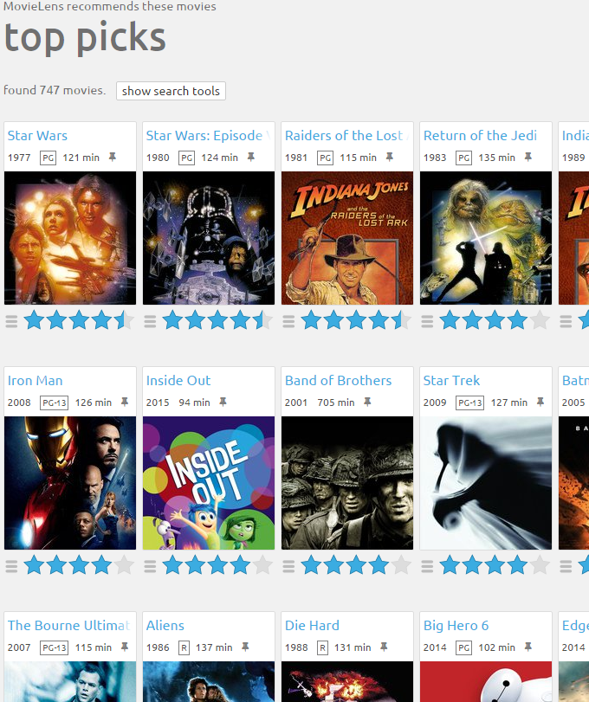
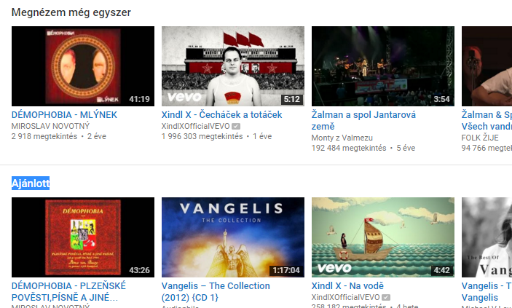
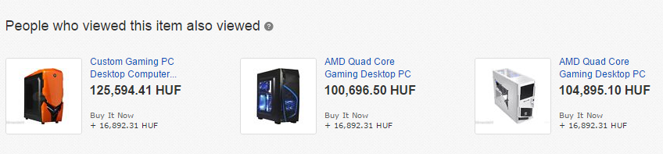
Recommender Systems
are everywhere ☺
- Movies, news, books, e-commerce, web/site-wide search, social networks…
Notes:
ML application
Propose few objects
Not necessarily the most similar / relevant
Ultimate goal is to improve key success metrics of the vendor (maximize profit – volumes of sales, user loyalty....)

Slide 7
How do they work?

Slide 8
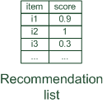

Paradigms of recommender systems
Recommender systems reduce information overload by estimating relevance

Slide 9


Paradigms of recommender systems
Personalized recommendations

Slide 10

Paradigms of recommender systems
Collaborative: "Tell me what's popular among my peers"

Slide 11

Paradigms of recommender systems
Content-based: "Show me more of the same what I've liked"

Slide 12


Paradigms of recommender systems
Knowledge-based: "Tell me what fits based on my needs"

Slide 13
Paradigms of recommender systems
Knowledge-based: "Tell me what fits based on my needs"
Majority of NDBI021 content

Slide 14
Paradigms of recommender systems
Hybrid: combinations of various inputs and/or composition of different mechanism

Slide 15
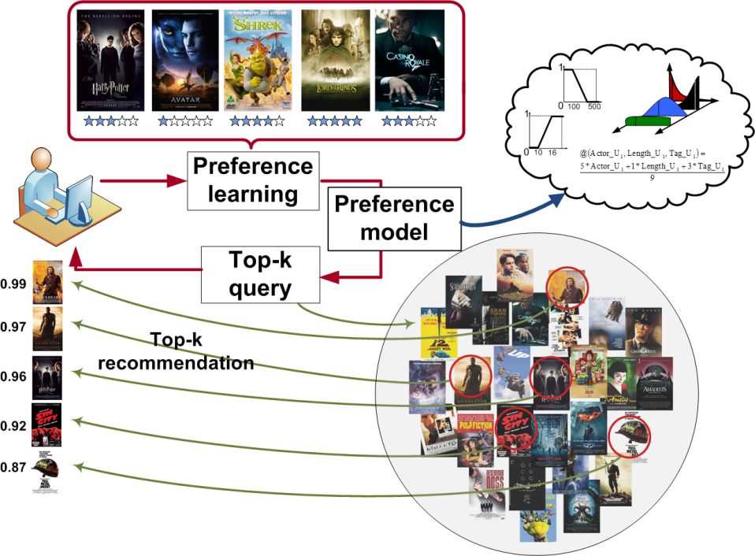
RecSys Lifecycle
Ideal case:
Get feedback from users (+ additional data)
Learn model of user’s
preferences
On demand, provide
recommendations
Real world:
Stream of feedback and demands
Learn on the fly

Slide 16
RecSys „Hello World!“
User-based nearest-neighbor collaborative filtering
  Get most similar users to the current one.
    Cosine similarity / Correlation of known ratings per user
  Aggregate their feedback on not-yet-visited items.
    Average / similarity-weighted average…
  Recommend items with best aggregated feedack.
    Top-k items with highest rating

Slide 17
User Feedback

Slide 18
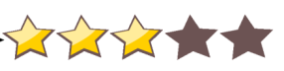

User Feedback
Explicit feedback (ratings)
  Often not enough data (not all users, not all visited objects…)
  Especially problematical in e-commerce (the lack of experience and motivation)
  Quite a good estimator of user’s preference
Implicit feedback (tracking events triggered by the user)
  Noisy, harder to interpret
  Not clear what to observe
  Unbound volumes of feedback

Slide 19
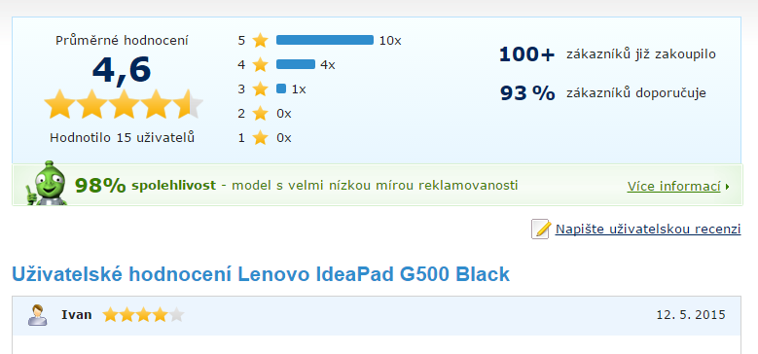
User Feedback

Slide 20
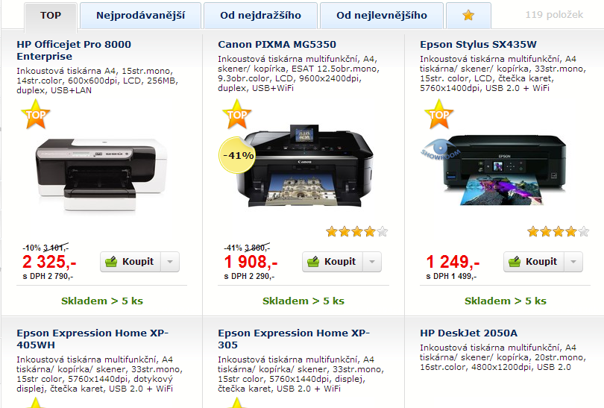
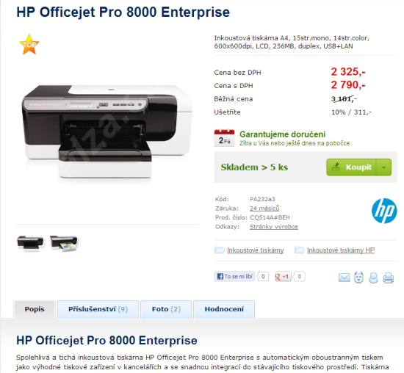
Implicit Feedback in
E-commerce
Categories / search results
List of objects / selections
Searched parameters
Observation of individual objects (visible time, mouseover,…)
Evaluate user preference on the category level
Object’s detail
Clicks count
Mouse events, scrolling, visibility of page segments
Time on page
Purchase / add to basket…
…

Slide 21
From feedback to preference
Explicitní feedback interpretation is quite straightforward
  Normalize ratings w.r.t. individual user (pesimists, optimists)
Implicit feedback is challenging
    Time on page: 120 sec
    Number of visits: 2
    Scrolling distance: 500px
    Mouse distance: 150px
    …
  Current research topic
?
Notes:
Zmínit longtail na čase, scrollování a dalších informacích
Zmínit že některé ukazatele záleží na rozložení stránky (scrolling), množství textu na čase…
Namalovat graf četností

Slide 22
Recommending Algorithms

Slide 23
Recommending Algorithms

Slide 24
DISCLAIMER
Whenever there is a human factor (client, user) in evaluation
…and this THE case of RecSys
  You cannot say, what is right or wrong
    You may just evaluate and iterpret usage statistics or ask users for their opinion
  Algorithms materialize some hypothesis about user’s behavior
    Sometimes, they work, sometimes not
    Never cover all aspects of each user

Slide 25
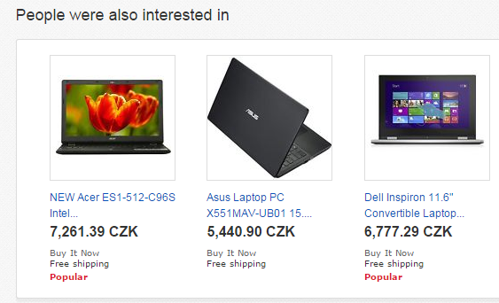
Recommending Algorithms
No personalization
„Most popular“
„People who bought this also bought that“
„Similar objects to this one“
…
Personalized
Similarity of objects
„Content-based“
Similarity of behavior
„Collaborative filtering“
Hybrid, context-based
Session based…

Slide 26
Collaborative Filtering (CF)
The most researched approach to get recommendations
  used by large, commercial sites (Amazon, Netflix, … )
  (mostly) domain independent
Approach
  use the "wisdom of the crowd" to recommend items
Basic assumption and idea
  Users give ratings to catalog items (implicitly or explicitly)
  Customers who had similar tastes in the past, will have similar tastes in the future

Slide 27
Collaborative-filtering algorithms
K-Nearest Neighbors
  Simplest solution, 90’ way of thinking, performance problems, easy implementation
Matrix factorization (latent factor models)
  SOTA before deep learning emerged
Graph based algorithms
  Social networks
Market Basket Analysis
…

Slide 28
Memory-based and model-based approaches
User-based CF (UBCF) is said to be "memory-based"
  the rating matrix is directly used to find neighbors / make predictions
  does not scale for most real-world scenarios
  large e-commerce sites have tens of millions of customers and millions of items, UBCF does not scale even to thousands
Model-based approaches
  based on an offline pre-processing or "model-learning" phase
  at run-time, only the learned model is used to make predictions (fast)
  models are updated / re-trained periodically
  large variety of techniques used
  model-building and updating can be computationally expensive
  item-based CF / matrix factorizations are examples for model-based approaches

Slide 29
Matrix Factorization
Matrix of ratings (implicit feedback) of users on items
Decompose this matrix into latent factors of users and items
  Decomposition should provide similar results on known data
  Define error of this representation (e.g., squared difference between true and expected ratings)
  Use, e.g., stochastic gradient descend to minimize this error
http://www2.research.att.com/~volinsky/papers/ieeecomputer.pdf

Slide 30
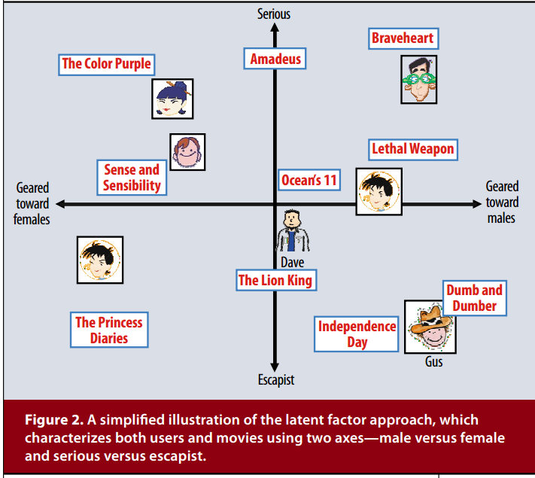
Latent space visualizaton

Slide 31
Matrix Factorization
Matrix factorization is cool, clever algorithm
  Suitable for different domains…
  With many published variants…
So, why to consider something else?
Whhere’s the hook?

Slide 32
Data sparsity problems
Cold start problem
  How to recommend new items? What to recommend to new users?
Straightforward approaches
  Ask/force users to rate a set of items
  Use another method (e.g., content-based, hybrid or simply non-personalized) in the initial phase
  Default voting: assign default values to items that was not rated
  Novelty enhancements: prefer new items in recommendations

Slide 33
Content-based recommendation
While CF – methods do not require any information about the items,
    it might be reasonable to exploit such information; and
    recommend fantasy novels to people who liked fantasy novels in the past
What do we need:
    some information about the available items such as the genre ("content")
    some sort of user profile describing what the user likes (the preferences)
The task:
    learn user preferences
    locate/recommend items that are "similar" to the user preferences
"show me more of the same what I've liked"

Slide 34
Content-based Algorithms
Vector Space Model / Rocchio algorithm
  Shared space of users (a.k.a. query) and objects, w.r.t. content-based attributes
  Recommend items close to the user’s profile
  Often TF-IDF weighting + cosine similarity
Common machine learning
  Decision trees / forests / GBT
  Graph-based algorithms (Linked Data)
  SVM…

Slide 35

What is the "content"?
Most CB-recommendation techniques were applied to recommending text documents.
  Like web pages or newsgroup messages for example.
Content of items can also be represented as text documents.
  With textual descriptions of their basic characteristics.
  Structured: Each item is described by the same set of attributes
  Unstructured: free-text description.
Title | Genre | Author | Type | Price | Keywords
The Night of the Gun | Memoir | David Carr | Paperback | 29.90 | Press and journalism, drug addiction, personal memoirs, New York
The Lace Reader | Fiction, Mystery | Brunonia Barry | Hardcover | 49.90 | American contemporary fiction, detective, historical
Into the Fire | Romance, Suspense | Suzanne Brockmann | Hardcover | 45.90 | American fiction, murder, neo-Nazism

Slide 36
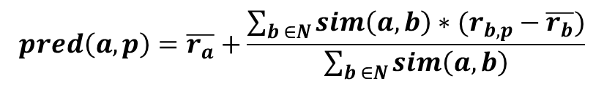
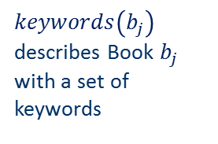
Content representation and item similarities
Item representation
Title | Genre | Author | Type | Price | Keywords
The Night of the Gun | Memoir | David Carr | Paperback | 29.90 | Press and journalism, drug addiction, personal memoirs, New York
The Lace Reader | Fiction, Mystery | Brunonia Barry | Hardcover | 49.90 | American contemporary fiction, detective, historical
Into the Fire | Romance, Suspense | Suzanne Brockmann | Hardcover | 45.90 | American fiction, murder, neo-Nazism
User profile
$keywords\left(b_{j}\right)$ describes Book $b_{j}$ with a set of keywords
Title | Genre | Author | Type | Price | Keywords
… | Fiction | Brunonia, Barry, Ken Follett | Paperback | 25.65 | Detective, murder, New York
Simple approach
  Compute the similarity of an unseen item with the user profile based on the keyword overlap
  Or combine multiple metrics (one per feature)
$$\frac{2 × \left|keywords\left(\left.b_{i}\right)\right.∩keywords\left(b_{j}\right)\right|}{\left|keywords\left(\left.b_{i}\right)\right.\right|+\left|keywords\left(\left.b_{j}\right)\right.\right|}$$
(Dice coefficient)

Slide 37

Term-Frequency - Inverse Document Frequency ($TF−IDF$)
Simple keyword representation has its problems
  in particular when automatically extracted as
    not every word has similar importance
    longer documents have a higher chance to have an overlap with the user profile
Standard measure: TF-IDF
  Encodes text documents in multi-dimensional Euclidian space
    weighted term vector
  TF: Measures, how often a term appears (density in a document)
    assuming that important terms appear more often
    normalization has to be done in order to take document length into account
  IDF: Aims to reduce the weight of terms that appear in all documents

Slide 38
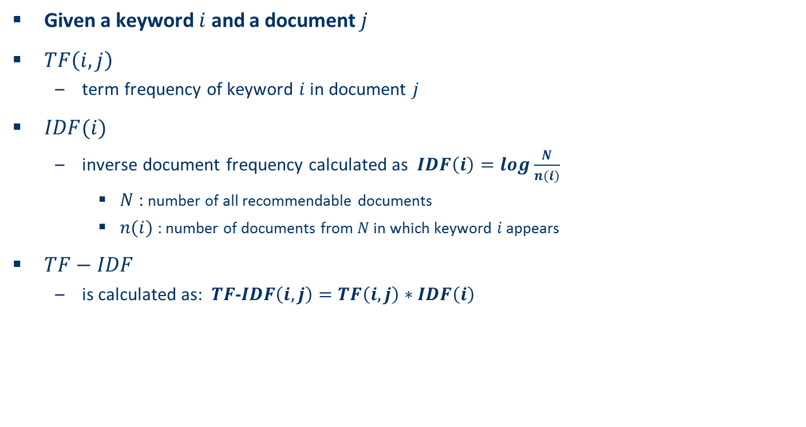
TF-IDF II
Given a keyword $i$ and a document $j$
$TF\left(i,j\right)$
  term frequency of keyword $i$ in document $j$
$IDF(i)$
  inverse document frequency calculated as $IDF\left(i\right)=log\frac{N}{n(i)}$
    $N$ : number of all recommendable documents
    $n(i)$: number of documents from $N$ in which keyword $i$ appears
$TF−IDF$
  is calculated as: $TF$-$IDF\left(i,j\right)=TF\left(i,j\right)∗IDF\left(i\right)$

Slide 39
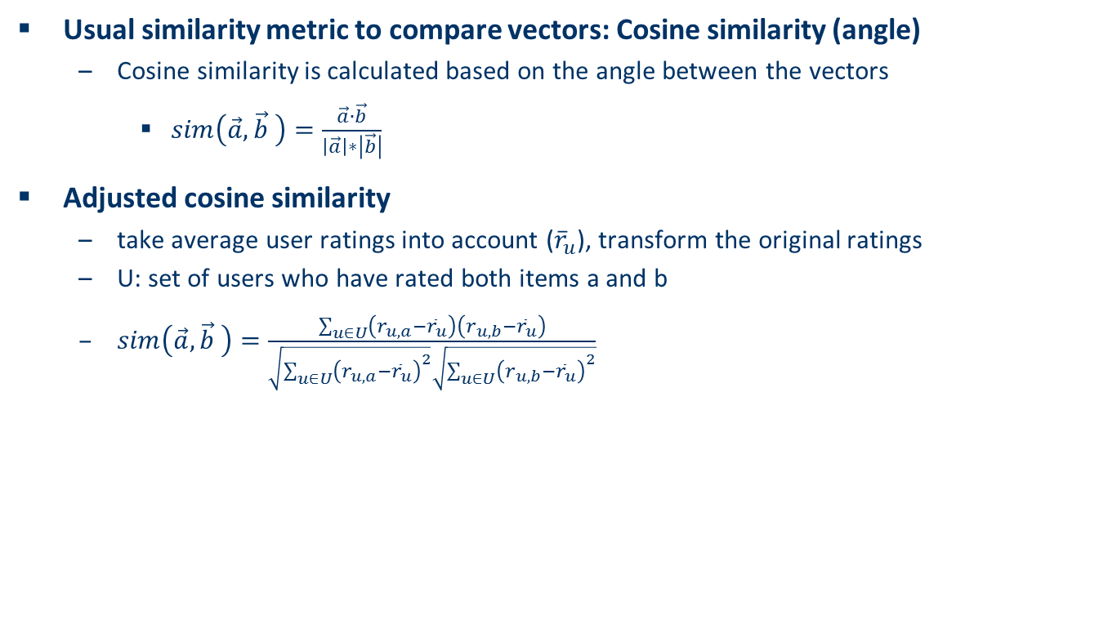
Cosine similarity
Usual similarity metric to compare vectors: Cosine similarity (angle)
  Cosine similarity is calculated based on the angle between the vectors
    $sim\left(\vec{a},\vec{b} \right)=\frac{\vec{a}∙\vec{b}}{\left|\vec{a}\right|∗\left|\vec{b}\right|}$
Adjusted cosine similarity
  take average user ratings into account (${\overline{r}}_{u}$), transform the original ratings
  U: set of users who have rated both items a and b
  $sim\left(\vec{a},\vec{b} \right)=\frac{\sum_{u∈U}{\left(r_{u,a}−{\overline{r}}_{u}\right)}\left(r_{u,b}−{\overline{r}}_{u}\right)}{\sqrt{\sum_{u∈U}{{\left(r_{u,a}−{\overline{r}}_{u}\right)}^{2}}}\sqrt{\sum_{u∈U}{{\left(r_{u,b}−{\overline{r}}_{u}\right)}^{2}}}}$

Slide 40
How to know what to use?
Experiment as much as you can
  If You want to double your success rate, you should double your failure rate.

Slide 41
Experiments
Online
Offline
Production servers
Hard to repeat
Expensive (time + money)
Selected methods
Real metrics
GUI changes etc. can be also evaluated
User studies
Data-based simulation
Easily repeatable
Fast and cheap
Artificial metrics (RMSE, nDCG, diversity…)
Causality problems; Only algorithms can be compared
Success in offline do not imply success in online…
…however the lack of success usually holds.

Slide 42
Conclusions
Recommender systems slowly became standard in web applications.
There is always problem with insufficient data
  Tradeoff between complexity and train-ability
  Multiple pathways to explore
  Domain dependent best practices
Basic algorithms are easy to handle (devil is in the details)
Important research topic (Bc, Mgr, PhD thesis etc.)

Slide 43
What was left for NSWI166 (next winter)
Deep learning
How to present recommendations
Trust, explanations
Session-based recommendations, causality, context
Hybrid algorithms
Practical problems & solutions, libraries, frameworks
And many more☺

Slide 44

Questions?

