Slide 1


NDBI021, Lecture 8
User preferences, 2/1 ZK+Z,
Wed 12:20 – 13:50 S8
Wed 14:00 – 15:30 SW2 (odd weeks)
https://www.ksi.mff.cuni.cz/~peska/vyuka/ndbi021/2022/
https://ksi.mff.cuni.cz

Slide 2
Multi-criteriality in RS
https://ksi.mff.cuni.cz

Slide 3


Tutorial:
Multi-Objective Recommendations
Yong Zheng, Illinois Institute of Technology, USA David (Xuejun) Wang, Morningstar, Inc., USA

Slide 4
Multi-criteriality in RS
Multi-objective optimization: basics
  Pareto front
  Scalarization
  Evolutionary algorithms
  How to select a single solution
Multi-objective Recommender systems
Multi-stakeholder Recommender systems
https://ksi.mff.cuni.cz

Slide 5
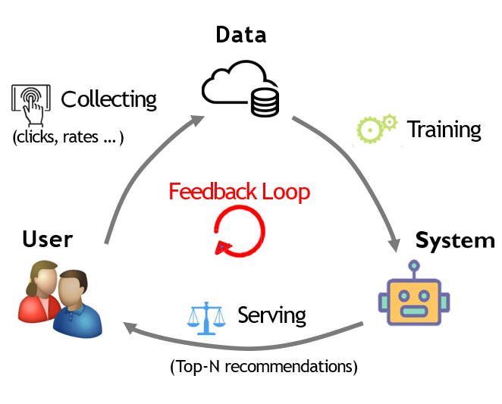
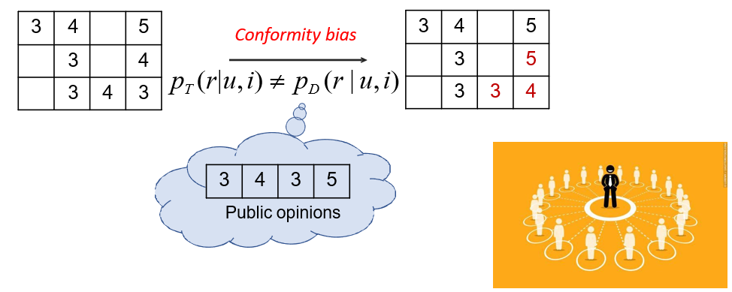
Recap
What is a feedback loop?
What is conformity bias?
https://ksi.mff.cuni.cz

Slide 6
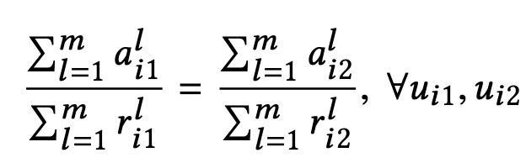
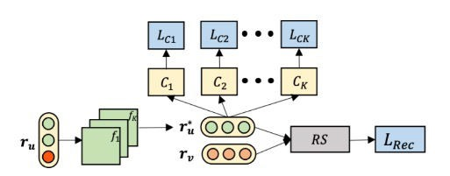
Recap
What is this equation trying to express?
What is causal/counterfactual fairness?
attention
relevance
Discriminator module
Filter module
https://ksi.mff.cuni.cz

Slide 7
Different Types of Recommender Systems
Context- Aware RecSys
Incorporate context info (time, location, etc) into RecSys
Recommend items to a group of users, e.g., group dinning
Group RecSys
Multi-Stakeholder RecSys
Produce recommendations by considering multiple stakeholders, e.g., buyers and sellers on eBay
Multi-Task RecSys
Build joint learning model by considering
multiple tasks, e.g., RecSys + opinion texts
10

Slide 8


Why MOO in RecSys
There is an emerging demand in MOO
  Traditional RecSys
    Example: RecSys balancing multiple metrics, e.g., news
Accuracy
Novelty
Diversity
Coverage

Slide 9


Why MOO in RecSys
There is an emerging demand in MOO
  New Types of RecSys
    Example: Multi-stakeholder RecSys, e.g., marketplace
E-Commerce

Slide 10












RecSys with MOO
Contexts in which we need MOO in RecSys

Slide 11
Contents
Background and Some History
Multi Objective Optimization (MOO)
MOO Solutions
  Scalarization Algorithms
  Multi Objective Evolutionary Algorithms
  Multi-objective Reinforcement Learning
Selection of the best solution in Pareto set

Slide 12

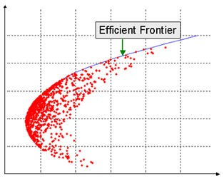

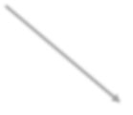






Background and Some History
Multi Objective Optimization in Finance
Financial
Planning
Portfolio Optimization
Expected Return
education
house
retiremen t
Life quality
Risk

Slide 13


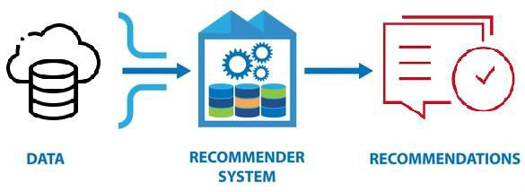
Background and Some History
Multi Metrics in Recommendation Systems
– Goal: Meets user’s need
Objectives:
  Maximize Accuracy
  Maximize Diversity
  Maximize Novelty
Challenge
  Increase Diversity may decease Accurac
  Increase Novelty may decease Accuracy
Accuracy
Diversity
Novelty
y

Slide 14



Background and Some History
Multi Stakeholder Recommendation Systems
– Goal: Meet interests of all stakeholders
Platform Owner
Objectives: Maximize Three Item Utilities
  In respect of End User
  In respect of Provider
  In respect of Platform Owner
Challenge
Item
Provider
End User
– Utilities regarding to three stakeholders
may conflict each other

Slide 15
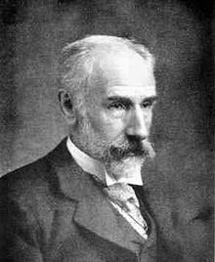
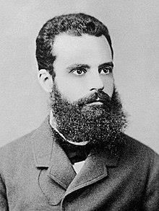
Background and Some History
Francis Ysidro Edgeworth (1845-1926)
– Mathematical Psychics: An Essay on the Application of Mathematics to the Moral Sciences, published in 1881
– “It is required to find a point (𝑥, 𝑦) such that, in whatever direction we take an infinitely small step, 𝑃 and 𝛱 do not increase together, but that, while one increases, the other decreases”
Vilfredo Pareto (1848-1923)
  Manual of Political Economy, published in 1906
  “The optimum allocation of the resources of a society is not attained so long as it is possible to make at least one individual better off in his own estimation while keeping others as well off as before in their own estimation.”

Slide 16
Multi Objective Optimization (MOO)
… Machine Learning perspective

Slide 17
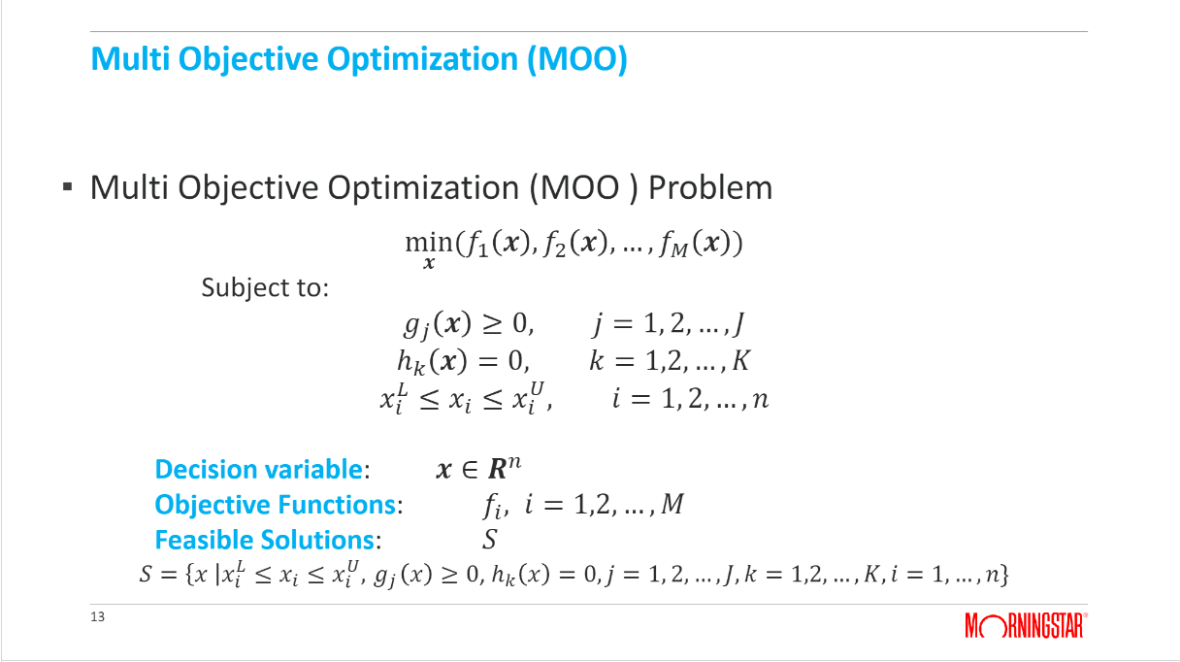
Multi Objective Optimization (MOO)
Objectives
Multi Objective Optimization (MOO ) Problem
min(𝑓₁ 𝒙 , 𝑓₂ 𝒙 , … , 𝑓_{𝑀} 𝒙 )
𝒙
Subject to:
Possible constraints format
𝑔_{𝑗} ℎ_{𝑘}
𝒙 ≥ 0,
𝒙 = 0,
𝑗 = 1, 2, … , 𝐽
𝑘 = 1,2, … , 𝐾
𝑖 = 1, 2, … , 𝑛
𝑥_{𝑖} ≤ 𝑥_{𝑖} ≤ 𝑥_{𝑖} ,
𝐿 𝑈
Decision variable: Objective Functions: Feasible Solutions:
𝒙 ∈ 𝑹^{𝑛}
𝑓_{𝑖} , 𝑖 = 1,2, … , 𝑀
𝑆
𝐿 𝑈
𝑆 = 𝑥 𝑥_{𝑖} ≤ 𝑥_{𝑖} ≤ 𝑥_{𝑖} , 𝑔_{𝑗} 𝑥
≥ 0, ℎ_{𝑘} 𝑥
= 0, 𝑗 = 1, 2, … , 𝐽, 𝑘 = 1,2, … , 𝐾, 𝑖 = 1, … , 𝑛}

Slide 18
Multi Objective Optimization (MOO)
Example: Two Objectives in Recommender Systems
Name | Symbol | Meaning
Decision Variable | 𝑥 | Top N recommendation list
Feasible Solution Set | 𝑆 | All top N recommendation list
First Objective | 𝑓₁(𝑥) | 1 – accuracy
Second Objective | 𝑓₂(𝑥) | 1 – diversity
Find recommendation list that maximize accuracy and diversity
min(𝑓₁, 𝑓₂)
or
min 𝐹(𝑥), where 𝐹 𝑥
𝑥∈𝑆
= (𝑓₁, 𝑓₂)
𝑥∈𝑆

Slide 19
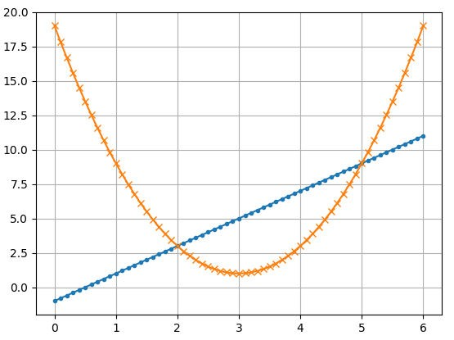

Multi Objective Optimization (MOO)
Special Characters of MOO
  Objectives may be conflict each other
  Cannot determine which solution is better
  Example:
min 𝑓₁, 𝑓₂
𝑥
Where 𝑓₁ 𝑥 = 2 𝑥 − 1 + 1,
𝑓₂ 𝑥 = 2 𝑥 − 3 ² + 1
Subject 𝑥 ∈ [0, 6]

Slide 20
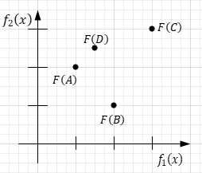
Multi Objective Optimization (MOO)
Dominance Relation
A solution 𝑥 is said to be Dominated by 𝑥∗ if and only if
min 𝑓₁, 𝑓₂
𝑥
_{𝑥}∗
𝑓_{𝑚} ≤ 𝑓_{𝑚} 𝑥
for all 𝑚 = 1,2, … , 𝑀
and there exists at least one 𝑚′ such that:
_{𝑥}∗
𝑓_{𝑚}′ < 𝑓_{𝑚}′ 𝑥
A and B dominate C, D is only dominated by A. A and B: no dominance relationship
D and B: no dominance relationship

Slide 21

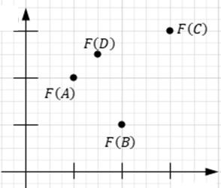




Multi Objective Optimization (MOO)
Non-Dominated Solution (Pareto Optimal Solution)
Not dominated by any other solutions
Solution 𝐴, 𝐵, 𝐸 and 𝐺 are Pareto Optimal
Pareto Optimal Set:
– All 𝑥 such that 𝐹(𝑥) is on curve from 𝐹(𝐸) to 𝐹(𝐺)
Pareto Front:
− All 𝐹(𝑥) on curve from 𝐹(𝐸) to 𝐹(𝐺)
min 𝑓₁, 𝑓₂
𝑥
𝐹(𝐸)

Slide 22
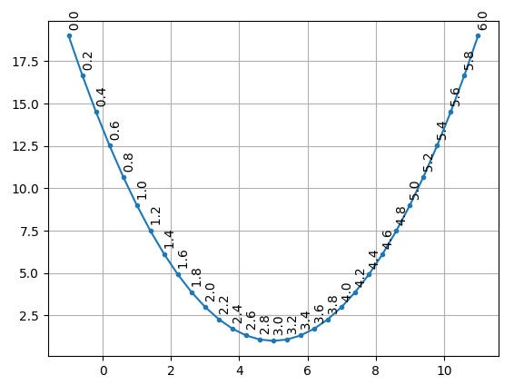
Multi Objective Optimization (MOO)
Example:
min 𝑓₁, 𝑓₂
𝑥
Where 𝑓₁ 𝑥 = 2 𝑥 − 1 + 1,
𝑓₂ 𝑥 = 2 𝑥 − 3 ² + 1
Subject 𝑥 ∈ [0, 6]
Analysis
– Feasible solutions: 𝑆 = 0,6
Pareto Set: {𝑥 | 𝑥 ∈
Pareto Front:
0,3 }
𝑓₁, 𝑓₂
𝑥 ∈ [0, 3]}
Pareto
Front

Slide 23
Multi Objective Optimization (MOO)
Solving Multi Objective Optimization (MOO ) Problem
min 𝐹(𝒙)
𝒙∈𝑆
= (𝑓₁ 𝒙 , 𝑓₂ 𝒙 , … , 𝑓_{𝑀} 𝒙 )
where 𝐹 𝒙
𝒙 ∈ 𝑆
𝑆 is set of all feasible solutions
Outputs
  Find a Non-Dominated Solution
  Find All Non-Dominated Solutions (Pareto Set)
  Find a representative subset of Non-Dominated Solutions

Slide 24

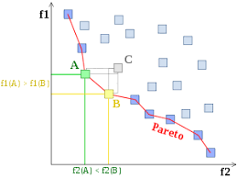

Multi Objective Optimization (MOO)
MOO Decision Making Process
a Priori
Specify
Preference
a Posteriori
Interactive
No DM
MOO
MOO
MOO
MOO
Pareto Optimal Set
Pareto Optimal Set
Single Solution
Single Solution
Pick Single
Solution
Single Solution
20

Slide 25
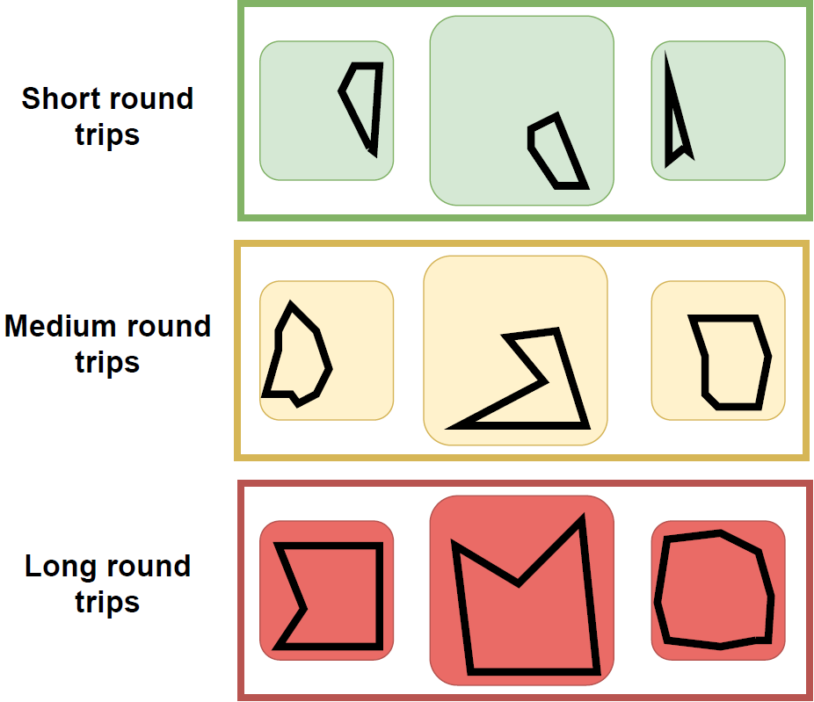
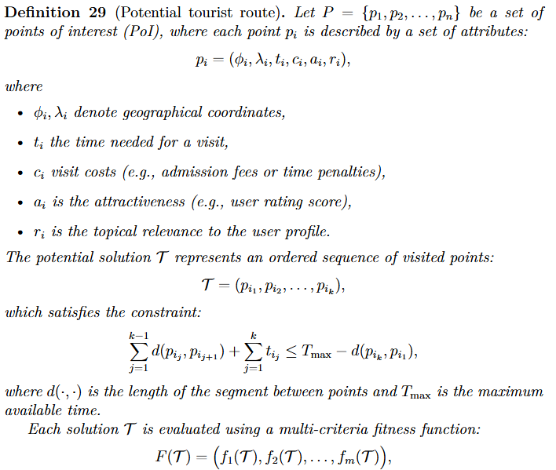
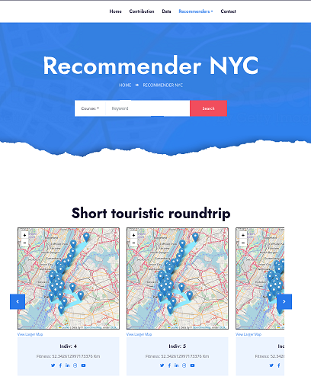
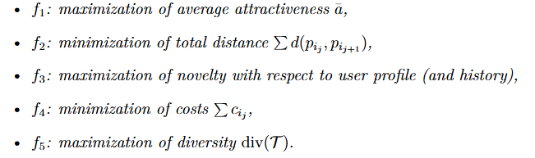
Multi Objective Optimization (MOO)
Example: trip recommendations
20

Slide 26
Multi Objective Optimization (MOO)
Scalarization Algorithms
  Transform multi-objectives into a single objective
  Solve it by single objective optimizer
  Find one Pareto optimal solution in one run
  Find Pareto Set in multiple run
Multi Objective Evolutionary Algorithms (MOEA)
  Follow natural evolution process such as gene evolution, a flock of birds seeking food and other resources, a cooling process of melted crystal, …
  Find multiple Pareto optimal solutions in one run

Slide 27
Multi Objective Optimization (MOO)
Multi Objective Reinforcement Learning
  Classical RL setup, but the reward is multi-modal (corresponding to individual objectives)
  Weights of individual objectives may be supplied up front*, or being learned during the process**
* Ge, Y., Zhao, X., Yu, L., Paul, S., Hu, D., Hsieh, C.-C., Zhang, Y.: Towardpareto efficient fairness-utility trade-off in recommendation through reinforce-ment learning. In WSDM ’22, pp. 316–324. 2022. https://doi.org/10.1145/3488560.3498487
** Yu, Y., Kuang, K., Yang, J., Wang, Z., Jia, K., Lu, W., Yang, H., Wu, F.: Multi-objective meta-return reinforcement learning for sequential recommendation. In Artificial Intelligence, pp.95–111. 2022

Slide 28
Scalarization Algorithms
How to get the job done simply?

Slide 29
Scalarization Algorithms
Weighting Methods
𝜖-Constraint Method
Normal Boundary Intersection (NBI) & Normal Constraint (NC)
Goal Programming
Physical Programming
Lexicographic Method

Slide 30
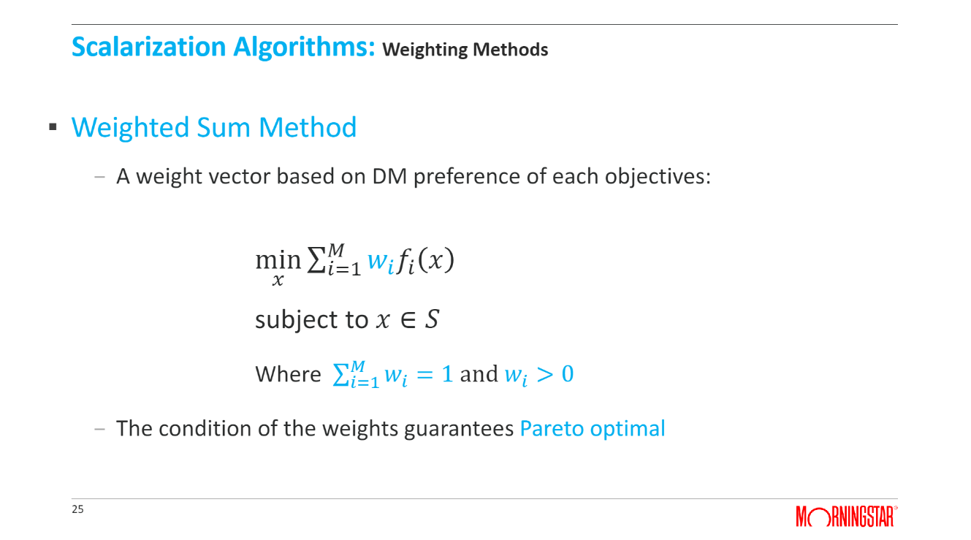
Scalarization Algorithms: Weighting Methods
Weighted Sum Method
– A weight vector based on DM preference of each objectives:
𝑀
min σ_{𝑖=1} 𝑤_{𝑖} 𝑓_{𝑖}
𝑥
𝑥
subject to 𝑥 ∈ 𝑆
Where σ_{𝑖=1} 𝑤_{𝑖} = 1 and 𝑤_{𝑖} > 0
– The condition of the weights guarantees Pareto optimal
𝑀
… other weighting schemes were tested as well

Slide 31
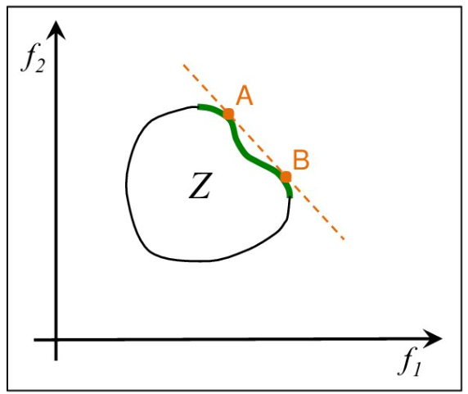
Scalarization Algorithms: Weighted Sum Methods
Example: Two Objective Metrics Recommender Systems
min(𝑓₁, 𝑓₂), 𝑓₁=1 - accuracy, 𝑓₂ =1 - diversity
𝑥∈𝑆
Solve: min(𝑤₁𝑓₁ + 𝑤₂𝑓₂)
𝑥∈𝑆
𝑤₁ + 𝑤₂ = 1, 𝑤, 𝑤₂ > 0
Each
𝑤₁, 𝑤₂
gives one Pareto solution
Question: Can we get all Pareto solutions in this way? Spoiler: NO

Slide 32
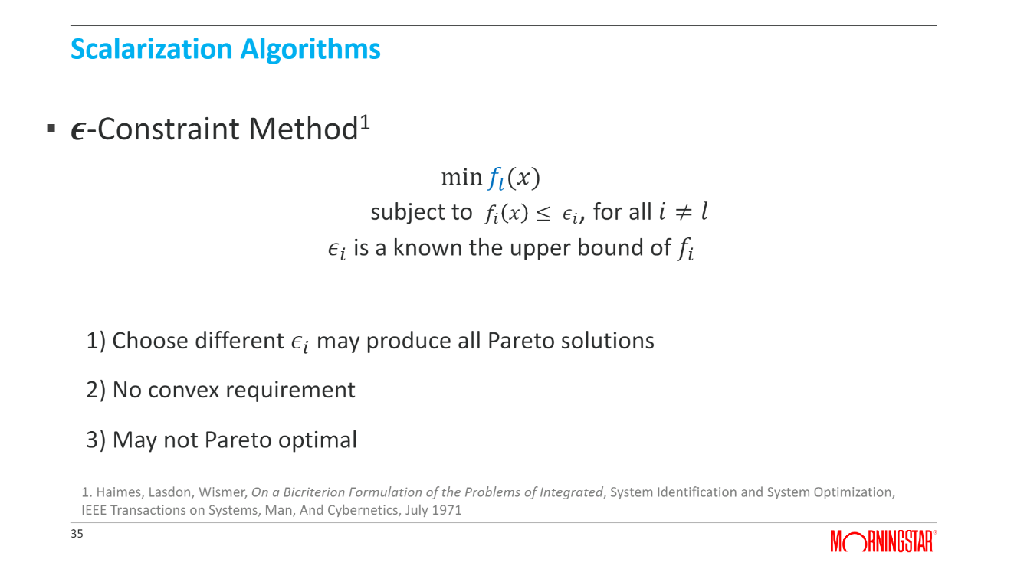
Scalarization Algorithms
𝝐-Constraint Method¹
min 𝑓_{𝑙} (𝑥)
subject to 𝑓_{𝑖} 𝑥 ≤ 𝜖_{𝑖}, for all 𝑖 ≠ 𝑙
𝜖_{𝑖} is a known the upper bound of 𝑓_{𝑖}
  Choose different 𝜖_{𝑖} may produce all Pareto solutions
  No convex requirement
  May not Pareto optimal
1. Haimes, Lasdon, Wismer, On a Bicriterion Formulation of the Problems of Integrated, System Identification and System Optimization,
IEEE Transactions on Systems, Man, And Cybernetics, July 1971
35

Slide 33













Scalarization Algorithms: 𝝐-Constraint Method
A sufficient condition of Pareto optimal¹
– If optimal solution 𝑥∗ is unique
Two objective example
solve
min 𝑓₁(𝑥)
𝑥∈𝑆
subject to 𝑓₂ ≤ 𝜖
Constraint | Unique Solution | Pareto Optimal
_{𝜖}1 | No solution | NA
𝜖², 𝜖³, 𝜖⁴, 𝜖⁵ | Yes | Yes
_{𝜖}6 | No | Not necessary
1. V. Chankong, Y. Haimes, Multiobjective Decision Making, Dover Publication, 1983
36

Slide 34
  Multi Objective Evolutionary Algorithms
Make things more thorough…

Slide 35



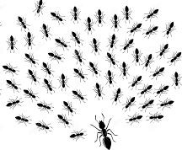
Multi Objective Evolutionary Algorithms
Evolutionary Algorithms inspired by natural evolutionary process:
Particle
Genetic Algorithm (GA)
Swam Optimization (PSO)
Simulated Annealing (SA)
Ant Colony Optimal (ACO)
Martin Pilát: Evoluční algoritmy 1 a 2; Přírodou inspirované algoritmy
NAIL 025, 086, 119

Slide 36






Multi Objective Evolutionary Algorithms : Basic Concepts
Terminologies of Solutions:
  Individual : a feasible solution 𝑥
  Population: a set of individuals
  Parents: selected from Population
  Children: produced from Parents
Population
Evaluation
Variation
Parents
Children

Slide 37

Multi Objective Evolutionary Algorithms : Basic Concepts
Operators of Genetic Algorithm
  Evaluation: measure how ‘good’ each solution is
    assigning fitness value (or order): 𝑧(𝑥)
  Selection: find Parents
    Random process
    Tournament process
  Variation: produce children
Population
Evaluation
𝑧(𝑥)
Crossover
Mutation
– Elitism:
Variation
Parents
Children
– maintain ‘better’ solution in each iteration

Slide 38
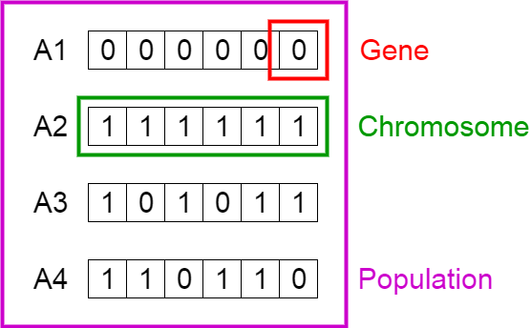
Multi Objective Evolutionary Algorithms : Encoding in Genetic Algorithm
Binary Encoding in Recommender
  Chromosome: a recommendation list (decision variable 𝑥)
  Length of Chromosome = total number of available items
  Each Gene position is corresponding an item
    1: item is in recommender list ,
    0: item is not in recommender list
49

Slide 39
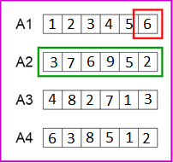
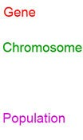
Multi Objective Evolutionary Algorithms : Encoding in Genetic Algorithm
Permutation Encoding in Recommender
  Length of Chromosome = 𝑁 in top N recommendation list
  The value of each Gene: index of an item
    6: the 6th item
    Total 9 available items
– 𝑁 = 6
50

Slide 40

From Single Objective to Multi Objective Evolutionary Algorithms
Solve a MOO problem
  Find non-dominated solutions (Pareto optimal)
Where are multi objective considered? Where are dominance relations applied?
  Fitness value 𝑧 𝑥 evaluation
  Parent selection
Population
Evaluation
𝑧(𝑥)
Variation
– Elitism
Children
Parents

Slide 41
Multi Objective Evolutionary Algorithms:
Major MOO Genetic Algorithm Methods
Method | Fitness Evaluation | Parent Selection | Elitism
VEGA (Schaffer,1985) | Single objective | Probability distribution | Dominance relation
MOGA (Fonseca & Fleming,1993) | Dominance relation | Probability distribution | NA
NSGA (Srinivas and Deb,1994) | Dominance relation | Probability distribution | NA
NSGA-II (Debb, etc., 2002) | Dominance relation | Probability distribution | Dominance relation
NPGA (Horn, etc. ,1994) | No Fitness | Tournament method (dominance relation) | NA
PAES (Knowles and Corne, 1999) | No Fitness | Local search (dominance relation) | Dominance relation
54

Slide 42
Classification of Multi Objective Genetic Algorithms
Dominance relation in Elitism
  VEGA (Schaffer,1985)
Dominance relation in fitness function
  MOGA (Fonseca & Fleming,1993),
  NSGA (Srinivas and Deb,1994) ,
  NSGA-II (Debb, etc., 2002)
No fitness values, but dominance relation in selection process
  NPGA (Horn, etc. ,1994),
  PAES (Knowles and Corne, 1999)

Slide 43
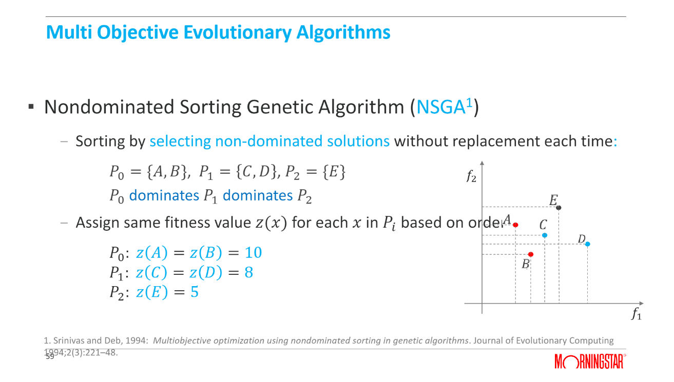
Multi Objective Evolutionary Algorithms
Nondominated Sorting Genetic Algorithm (NSGA¹)
  Sorting by selecting non-dominated solutions without replacement each time:
𝑃₀ = {𝐴, 𝐵}, 𝑃₁ = 𝐶, 𝐷 , 𝑃₂ = {𝐸}
𝑃₀ dominates 𝑃₁ dominates 𝑃₂
  Assign same fitness value 𝑧(𝑥) for each 𝑥 in 𝑃_{𝑖} based on orde
r
𝑃₀: 𝑧 | 𝐴 | = 𝑧 𝐵 | = 10
𝑃₁: 𝑧 | 𝐶 | = 𝑧 𝐷 | = 8
𝑃₂: 𝑧 | 𝐸 | = 5
1. Srinivas and Deb, 1994: Multiobjective optimization using nondominated sorting in genetic algorithms. Journal of Evolutionary Computing
1₅9₉94;2(3):221–48.

Slide 44
Selection of the best solution in Pareto set
In the end, we still need just one solution…

Slide 45
Selection of the best solution in Pareto set
When do we need to produce Pareto set?
  Most MOEA method (A posterior, No DM available)
  Scalarization without DM preference (A posterior, No DM available)
Example: Recommender Systems balancing multiple metrics
  End user (DM) cannot choose from Pareto set
  A single best recommendation list needs to be produced

Slide 46
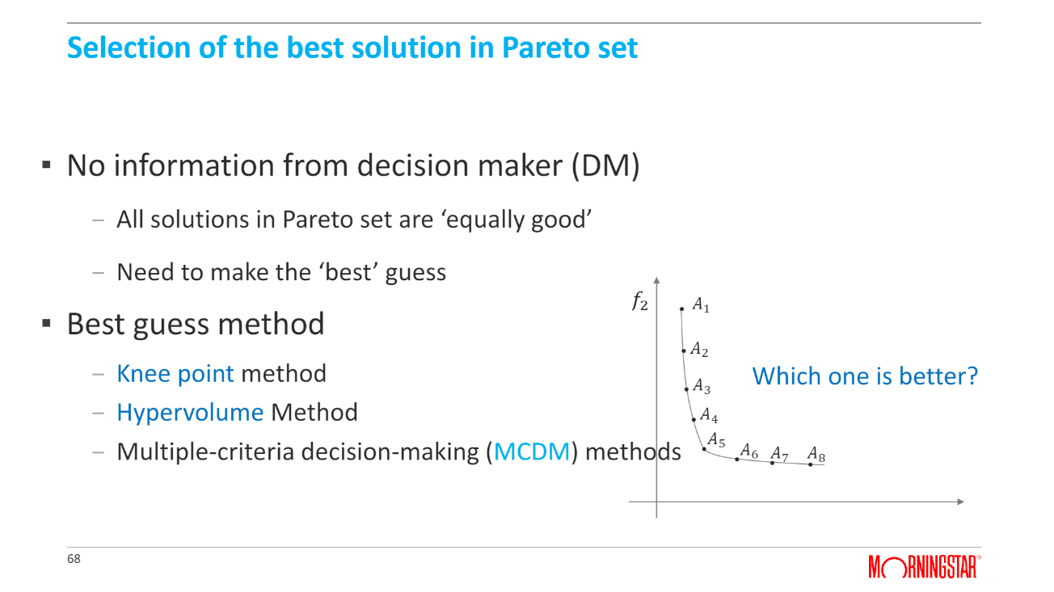
Selection of the best solution in Pareto set
When do we need to produce Pareto set?
  Most MOEA method (A posterior, No DM available)
  Scalarization without DM preference (A posterior, No DM available)
Example: Recommender Systems balancing multi metrics
  End user (DM) cannot choose from Pareto set
  A single best recommendation list needs to be produced

Slide 47
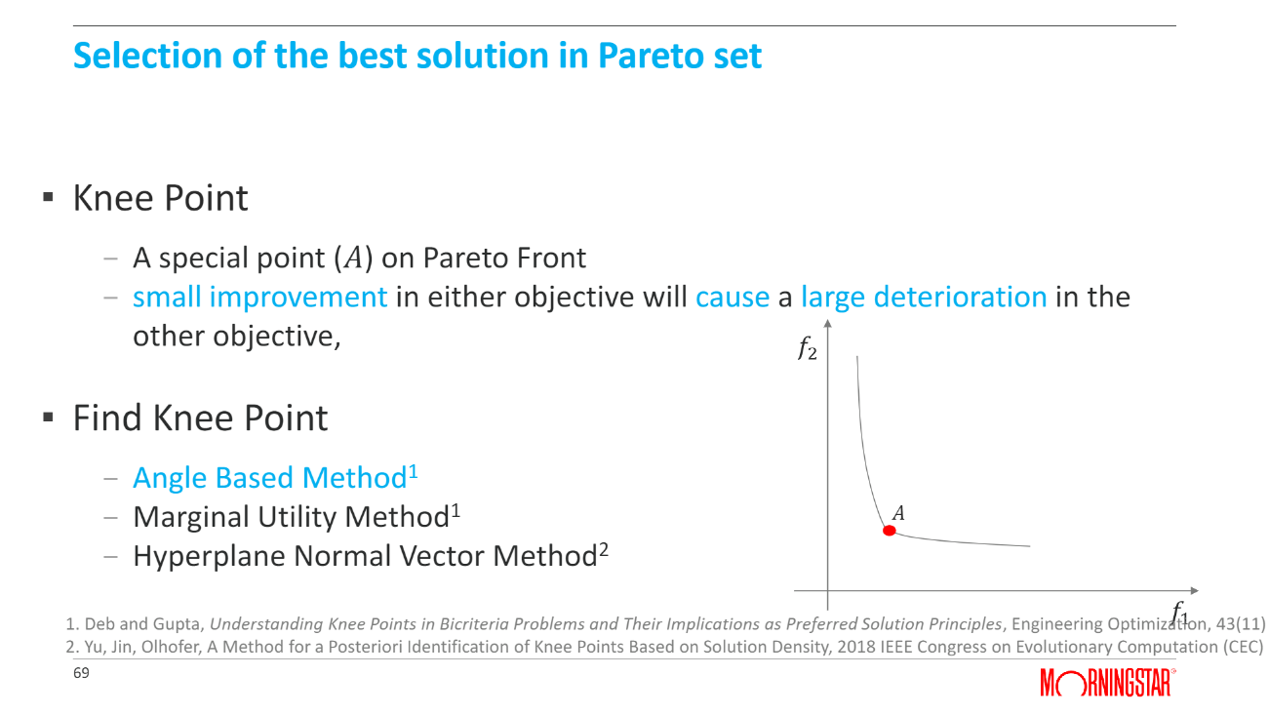
Selection of the best solution in Pareto set
When do we need to produce Pareto set?
  Most MOEA method (A posterior, No DM available)
  Scalarization without DM preference (A posterior, No DM available)
Example: Recommender Systems balancing multi metrics
  End user (DM) cannot choose from Pareto set
  A single best recommendation list needs to be produced

Slide 48









RecSys with MOO
Contexts in which we need MOO in RecSys

Slide 49
RecSys balancing multiple metrics
Why we need MOO in this context
  Relevance or accuracy is not the only focus
    For example, news and music recommendations
      Boring if always recommending the same types of items
      Diversity: try something different
      Novelty: try something never experienced before
    For example, item recommendations in e-commerce
      Co-sales
      Bundle sales

Slide 50
RecSys balancing multiple metrics
Goals
  Improve other metrics at no loss or acceptable loss
on accuracy
  Challenges
    No clear rules to define the “acceptable” loss

Slide 51
RecSys balancing multiple metrics
Case Study 1: Hybrid Recommender
Ribeiro, M. T., Lacerda, A., Veloso, A., & Ziviani, N. (2012). Pareto-efficient hybridization for multi-objective recommender systems. In ACM RecSys 2012.
  Application: balancing accuracy, novelty, diversity
  Recommendation Framework
Step 1
Build multiple recommendation models to predict rating for a user on an item
Step 3
Produce recommendation list by the aggregated rating
Step 2
Fuse predictions by weighted sum
Step 4
Learn the optimal weights (decision variables) by considering
accuracy, novelty, diversity

Slide 52
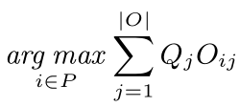
RecSys balancing multiple metrics
Case Study 1: Hybrid Recommender
Ribeiro, M. T., Lacerda, A., Veloso, A., & Ziviani, N. (2012). Pareto-efficient hybridization for multi-objective recommender systems. In ACM RecSys 2012.
  MOEA as the MOO Method
    Consider accuracy, diversity, novelty as objectives
    Use Strength Pareto Evolutionary Algorithm as MOEA optimizer
      Encoding/Decision variables: the weights in the hybrid model
      Output: a Pareto optimal set
    Select the best single solution from Pareto set
      Use a weighted sum on the three objectives
      Try different set of weights (Q_{j}) manually
– Results: balancing multiple metrics

Slide 53
RecSys balancing multiple metrics
Case Study 2: Results-level proportionality
Peska & Dokoupil. (2022). Towards Results-level Proportionality for Multi-objective Recommender Systems. In SIGIR 2022.
  Individual-level MORS:
    Each user may have different needs/wishes w.r.t. objectives (propensities)
      I am in the mood for some exploration
      Please stick to the bestsellers now
    In order to do so, we need to be able to learn user propensities (estimate, or explicitly require)
    Underlying algorithms have to respect the propensities while serving the results.
  Results level proportionality:
    Recommendations are as good as possible w.r.t. each individual objective
    Recommendations maintain the relative ratios between objectives as defined by the users

Slide 54
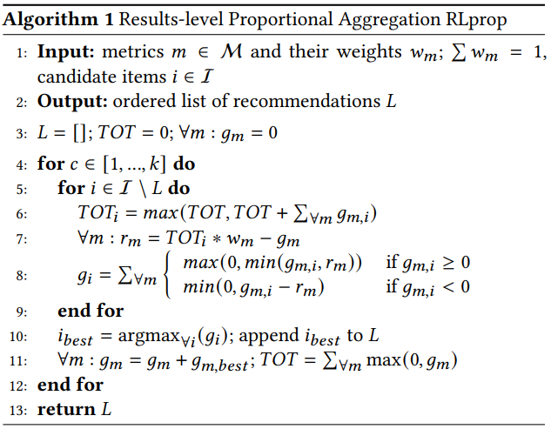
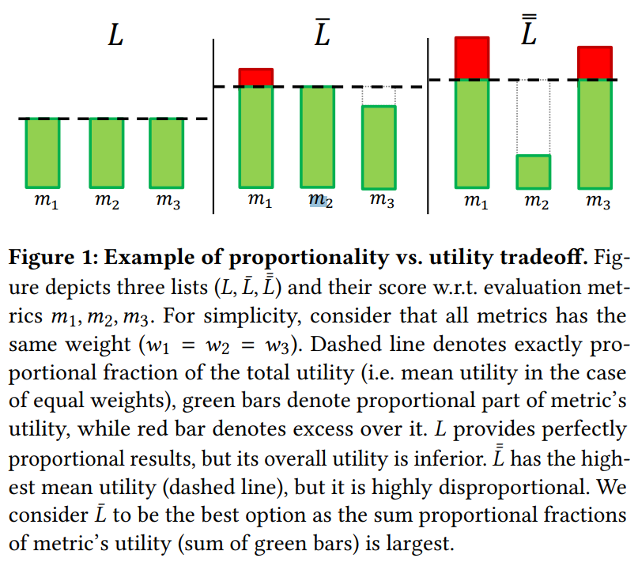
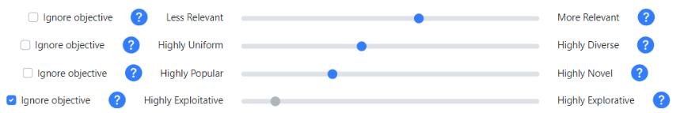
RecSys balancing multiple metrics
Case Study 2: Results-level proportionality
Peska & Dokoupil. (2022). Towards Results-level Proportionality for Multi-objective Recommender Systems. In SIGIR 2022.
  Results-level proportionality itself is multi-objective
    Maximization vs. Proportionalization
    Does it hurt to have more exploration while relevance remains intact?
  RL-prop: incremental greedy procedure
    Inspired by mandates allocation in public elections
    Maintaining a relative fulfillment w.r.t. each objective
    For next candidate selection, marginal gains are „caped“ by how much is particular objective lacking

Slide 55



RecSys with MOO
Contexts in which we need MOO in RecSys

Slide 56












Multi-Stakeholder RecSys
Why we need MOO in this context
– The end user is not the only stakeholder
– RecSys should be built by considering the item utility
from the perspective of different stakeholders

Slide 57
Multi-Stakeholder RecSys
Objective definitions
  It varies from domains to domains
  For each stakeholder, there’s at least one objective
    E-Commerce or Marketplace
      Buyer: user preferences on items, budget
      Seller: profits
      Platform: commission fees
      Delivery company: costs and profits
    Job seeking
      Job seeker: user preferences
      Recruiter: talent requirements
50

Slide 58
Multi-Stakeholder RecSys
Goals
  Deliver item recommendations by balancing the
needs of multiple stakeholders
  With acceptable loss on the consumer side
  Challenges
    Which stakeholders should be considered
    How to define and achieve the “balance”
    No clear rules to define the acceptable loss

Slide 59
Multi-Stakeholder RecSys
Case Studies
  Using scalarization as the MOO method
Lin, X., Chen, H., Pei, C., et al. (2019). A pareto-efficient algorithm for multiple objective optimization in e-commerce recommendation. In ACM RecSys, 2019.
  Using MOEA as the MOO method
Zheng, Y., Ghane, N., & Sabouri, M. (2019). Personalized educational learning with multi-stakeholder optimizations. In Adjunct Publication of the 27th Conference on User Modeling, Adaptation and Personalization (pp. 283-289).

Slide 60

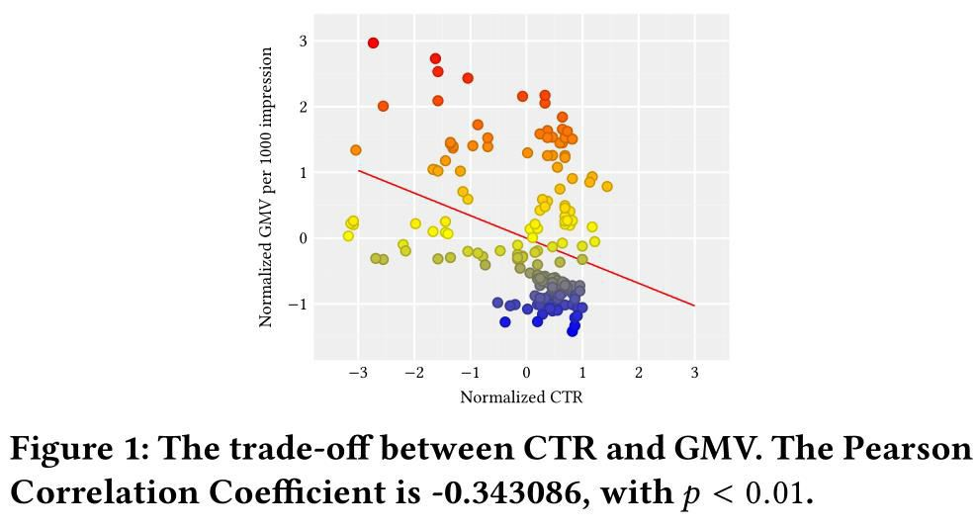
Multi-Stakeholder RecSys
Case Study 1: Using scalarization in E-Commerce
Objectives
  CTR (Click Through Rate)
  GMV (Gross Merchandise Volume)
Lin, X., Chen, H., Pei, C., et al. (2019). A pareto-efficient algorithm for multiple objective optimization in e-commerce recommendation. In ACM RecSys, 2019.

Slide 61


Multi-Stakeholder RecSys
Case Study 1: Using scalarization in E-Commerce
  MOO Method
    Define a loss function for each objective
CTR , i.e., point-wise learning-to-rank
GMV
x: impression, y: clicks, z: purchases
    Use weighted sum as the scalarization
Joint Loss = ω·L_{CTR} + (1 - ω)·L_{GMV}
User loss
Platform loss

Slide 62

Multi-Stakeholder RecSys
Case Study 1: Using scalarization in E-Commerce
  MOO Method
    Use weighted sum as the scalarization
Joint Loss = ω·L_{CTR} + (1 - ω)·L_{GMV}
    Try different weights to get Pareto Set
    Select a single best solution by using Least Misery strategy, i.e.,
minimizing the highest loss function of the objectives

Slide 63
Summary
Tutorial
  Website: https://moorecsys.github.io/
  Slide: https://github.com/moorecsys/moorecsys.github.io
  Supplementary materials:
“Multi-Objective Recommendations: A Tutorial” on
arXiv.org (will be available soon on the github above)

