Slide 1


NDBI021, Lecture 7
User preferences and advanced recommending methods, 2/1 ZK+Z,
https://www.ksi.mff.cuni.cz/~peska/vyuka/ndbi021/
https://youtube.com/playlist?list=PLTYzSYF3EX3BNIVJkMpCE3vUDmUGvhEcy
https://ksi.mff.cuni.cz

Slide 2
Today’s content
Recap
Bias in RS (and search)
Fairness issues and how to address them

Slide 3
Recap

Slide 4
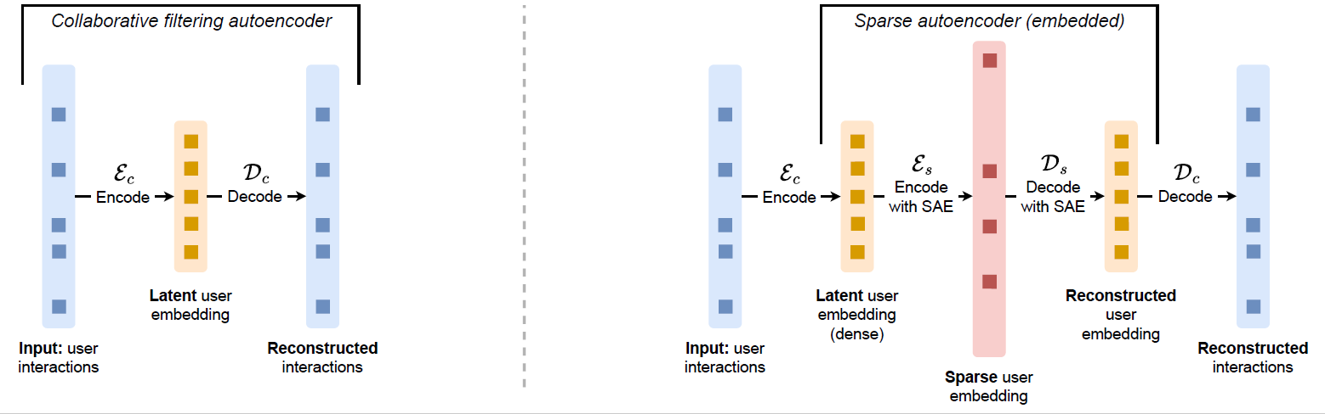
What is an autencoder? What is unique for sparse autoencoders?
Name one topic for the semestral work☺

Slide 5
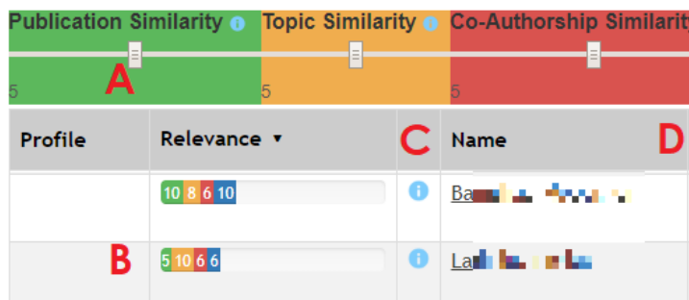
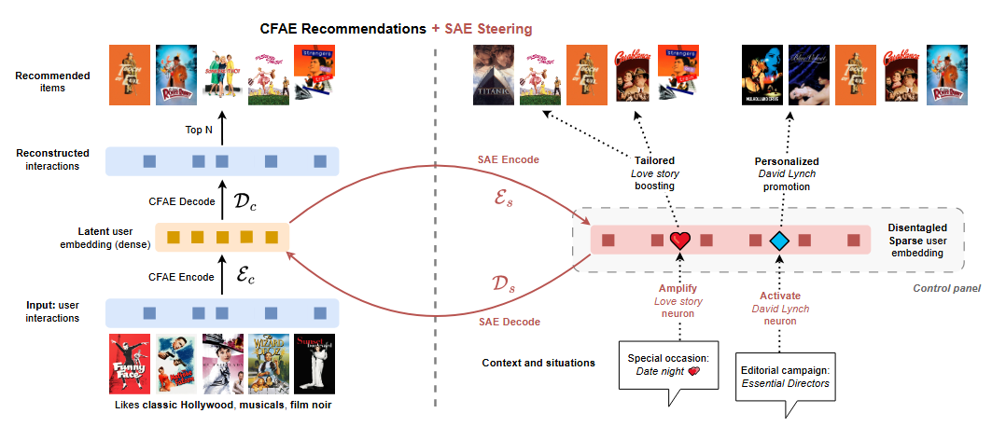
Name some use cases, where recommendation steering is needed?
How can we use SAE to do the steering?

Slide 6
Biases and Fairness issues in RS

Slide 7




Bias Issues and Solutions in Recommender System
Jiawei Chen, Xiang Wang, Fuli Feng, Xiangnan He cjwustc@ustc.edu.cn
slides will be available at: https://github.com/jiawei-chen/RecDebiasing
A literature survey based on this tutorial is available at: https://arxiv.org/pdf/2010.03240.pdf
.

Slide 8

Fairness in Recommender Systems
Tutorial from: https://fairness-tutorial.github.io/

Slide 9



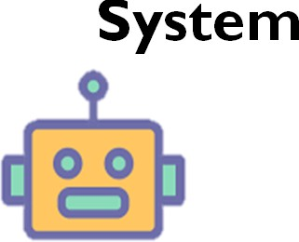


Ecosystem of Recsys
Workflow of RS
  Training: RS is trained/updated on observed user-item interaction data.
  Serving: RS infers user preference over items and exposes top-n items.
  Collecting: User actions on exposed items are merged into the training data.
Forming a Feedback Loop
Data
ollecting
(clicks, rates …)
C
Training
Feedback Loop
User
System
Serving
(Top-N recommendations)
5

Slide 10



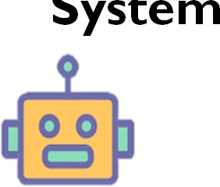

Where Bias Comes?
Bias in data (Collecting):
  Data is observational rather than experimental (i.e., missing-not-at- random)
  Affected by many factors:
    The exposure mechanism
    Public opinions
    Display position
……
  The collected data deviates from user true preference.
Data
Bias in data
User
System
6

Slide 11


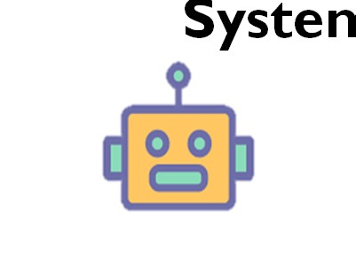

Where Bias Comes?
Bias in results (Serving):
  Unbalanced training data
  Recommendations are in favor of some item groups
  E.g., popularity bias, category- aware unfairness
  Hurting user experience and satisfaction
Data
User
Syste
m
Biases in results
7

Slide 12

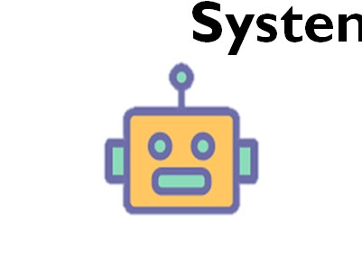
Matthew Effect: Bias + Loop
Biases amplification along the loop:
  Biases would be circled back into the collected data
  Resulting in “Matthew effect” issue: the rich gets richer
  Damaging the ecosystem of RS
Data
Biases in data
User
Bias amplification
Syste
m
Managable through exploration promotion
Biases in results
8

Slide 13


Bias is Evil
  Economic
    Bias affects recommendation accuracy
    Bias hurts user experience, causing the losses of users
    Unfairness incurs the losses of item providers
  Society
    Bias can reinforce discrimination of certain user's groups
    Bias decreases the diversity and intensify the homogenization of users
    Or, reinforce isolation of some subgroups (filter bubbles)
Facebook’s role in Rohingya’s genocide
https://macmillan.yale.edu/sites/default/files/2024-10/Schissler%2C%20Facebook%20%26%20genocide%20110123%20%282%29.pdf
9

Slide 14
What is data bias?
Data bias: The distribution for which the training data is collected is different from the ideal data distribution.
Biases
(Exposure, Position)
Skewed distribution exhibited on training data
𝑃_{T}(𝑢, 𝑖, 𝑟)
Data distribution for testing
𝑃_{D}(𝑢, 𝑖, 𝑟)
14

Slide 15
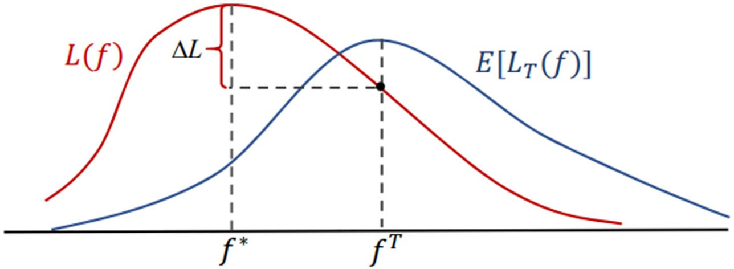




Impact of Data Bias
Data bias causes model training towards wrong direction.
Distributional difference
Risk discrepancy between and .
Suboptimal results.
P_{D}
between and .
p ≠ p
ˆ
E [L ( f )] ≠ L( f )
T
D
P
T
T
True risk.
L( f ) = E_{P (u ,i ) P ( R |u ,i )}[δ ( f (u, i), R_{ui} )]
D D ui
Empirical risk.
L^{ˆ} ( f ) = ¹
∑
(u,i,r_{ui} )∈D_{T}
⎣⎡δ ( f (u, i), r )⎤⎦
T
D
ui
T
15

Slide 16

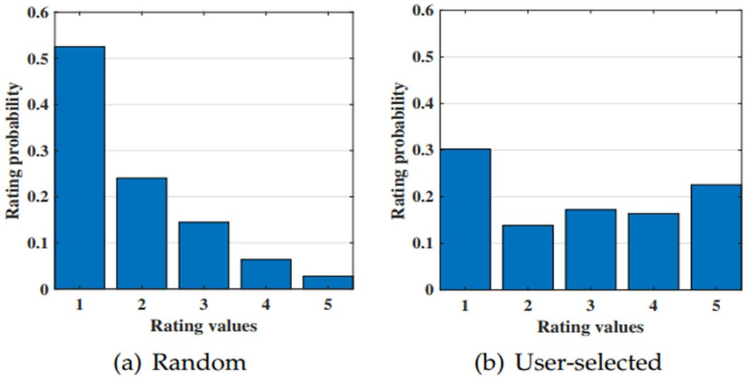
Selection Bias
  Definition: Selection bias happens in explicit feedback data as users are free to choose which items to rate, so that the observed ratings are not a representative sample of all ratings.
Selection bias
p_{T} (u, i) ≠ p_{D} (u, i)
3 | 4 | 2 | 5
1 | 3 | 2 | 5
2 | 3 | 4 | 4
3 | 4 |  | 5
 | 3 |  | 5
 | 3 | 4 | 4
Tobias Schnabel, Adith Swaminathan, Ashudeep Singh, Navin Chandak, and Thorsten Joachims. 2016. Recommendations as Treatments: Debiasing Learning and Evaluation. In ICML.
B. M. Marlin, R. S. Zemel, S. Roweis, and M. Slaney, “Collaborative filtering and the missing at random
assumption,” in UAI, 2007
17

Slide 17


Exposure Bias
Definition: Exposure bias happens in implicit feedback data as users are only exposed to a part of specific items.
Explanation: A user generates behaviors on exposed items, making the observed user‐item distribution deviate from the ideal one p_{D} (u, i) .
1 | 1 | 0 | 1
0 | 1 | 0 | 1
0 | 1 | 1 | 1
Exposure bias
p_{T} (u, i) ≠ p_{D} (u, i)
1 | 1
0 |  | 0
0 | 1 | 1 | 1
18

Slide 18

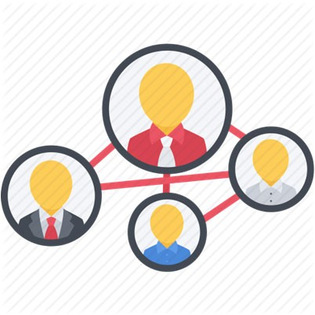

Exposure Bias
Unware
Dislike Implicit feedback
p_{T} (u, i | r = 0) = 0
1 | 1 | 0 | 1
0 | 1 | 0 | 1
0 | 1 | 1 | 1
1 | 1
0 |  | 0
0 | 1 | 1 | 1
1
1
Exposure bias
p_{T} (u, i) ≠ p_{D} (u, i)
1
1
1
Exposure
User
Background
Item
Popularity
Policy of RS
19

Slide 19


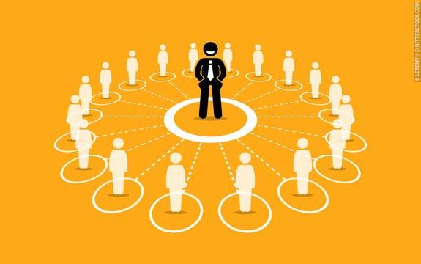
Conformity Bias
  Definition: Conformity bias happens as users tend to behave similarly to the others in a group, even if doing so goes against their own judgment.
Conformity bias
p_{T} (r|u, i) ≠ p_{D} (r | u, i)
3 | 4 |  | 5
 | 3 |  | 4
 | 3 | 4 | 3
3 | 4 |  | 5
 | 3 |  | 5
 | 3 | 3 | 4
3 | 4 | 3 | 5
Public opinions
20

Slide 20
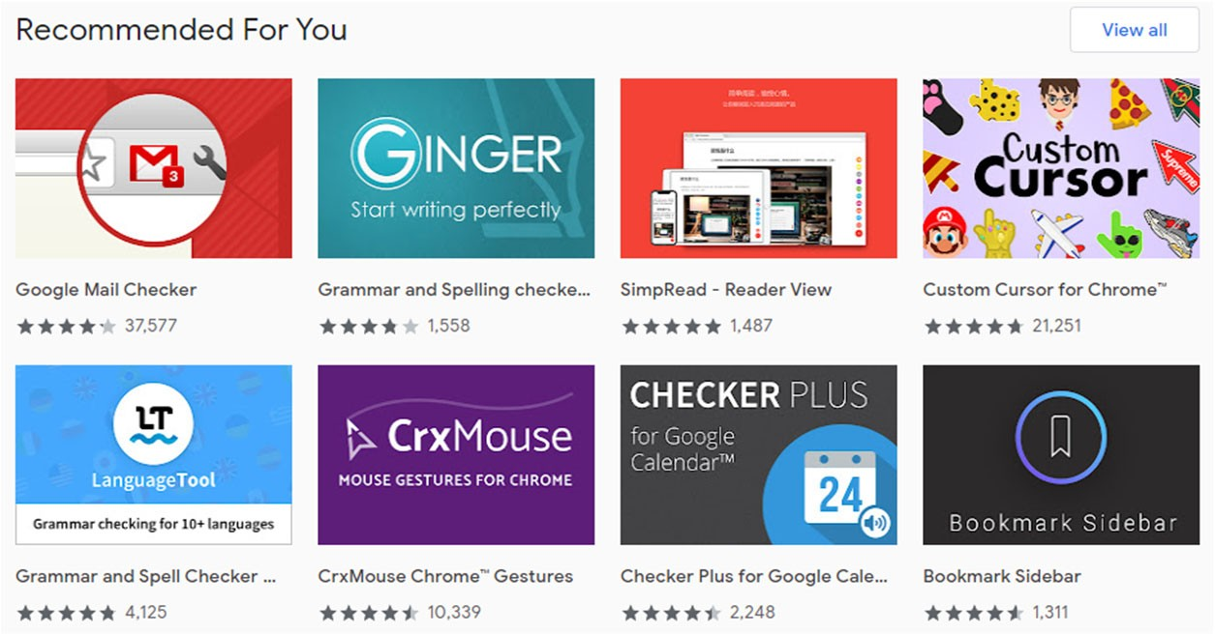
Position Bias (Presentation Bias more generally)
  Definition: Position bias happens as users tend to interact with items in higher position of the recommendation list.
Position bias
1 | 1 | 0 | 1
0 | 1 | 0 | 1
0 | 1 | 1 | 1
1 | 1 | 1
 |  | 1
 |  | 1 | 1
p_{T} (u, i) ≠ p_{D} (u, i)
User exposure will be affected by the position
p_{T} (r | u, i) ≠ p_{D} (r | u, i)
User judgments also will be affected by the position
21
Historically denoted as „search engine bias“

Slide 21
Debiasing Strategies Overview
  Re-weighting
    Giving weights for each instance to re-scale their contributions on model training
  Re-labeling
    Giving a new pseudo-label for the missing or biased data
  Generative Modeling
    Assuming the generation process of data and reduces the biases accordingly
IPS – can be applied for training as well as evaluation
22

Slide 22

Re-weighting Strategies
Basic idea: change data distribution by sample reweighting:
Test data distribution
Biases
Training data distribution
Σ
u,i ∈D_{T}
1
^{𝐿}ipc ⁼
𝛿(𝑟_{ui}, rˆ_{ui})
IPS
𝜌
ui
Mainly addressing the deviation of 𝑝(𝑢, 𝑖)
p_{T} (u, i) ≠ p_{D} (u, i)
Properly defining weights can lead to unbiased estimator of the ideal:
^{L( f ) = E}P (u ,i ) P (r|u ,i )^{[δ (r}ui ^{, rˆ}ui ^{)]}
E[L^{ˆ} ( f )] = E
[δ (r , rˆ )]
D
D
Inverse propensity Scores (IPS)
T
P_{T} (u ,i ) P_{T} (r|u ,i )
ui ui
P_{D} (u, i) ₌ 1
P (u, i)
δ (r , r )]
E[L^{ˆ} ( f )] = E
[
D
ˆ
P_{T} (u, i)
^{ρ}ui
IPS
P_{T} (u ,i ) P_{T} (r|u ,i )
P (u, i)
ui ui
T
23

Slide 23
Fairness/Biases in evaluation
Popularity bias (more popular => much more attention)
Biased historical data (missing not at random) => (unbiased) learning algorithm => biased recommendations
=> biased off-line evaluation (same bias vector => better results)
=> discrepancy between off-line and on-line evaluation
How to evaluate methods fairly?

Slide 24
Fairness in evaluation
Inverse propensity score
Weight results by the inverse to the propensity score
  (probability of being noticed by the user)
  Definitions may vary on available information
    Based on general item’s popularity or similar features
    Based on impressions
    Based on user’s actions within the page

Slide 25
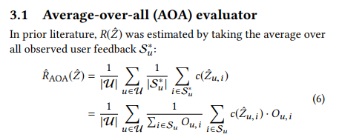
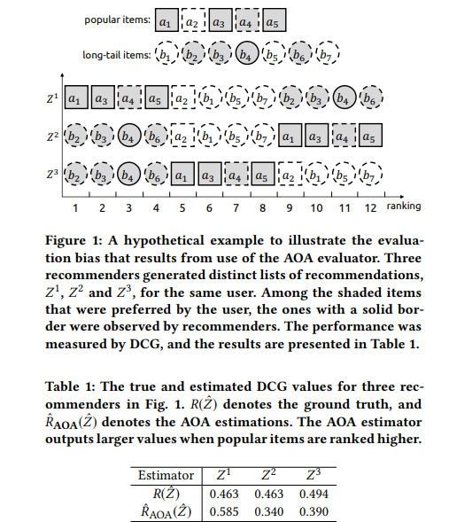
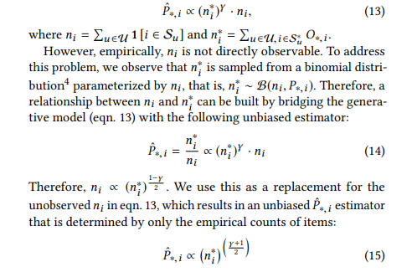
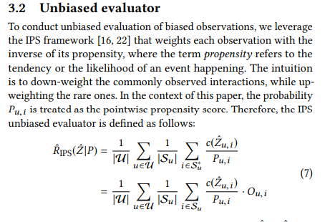
De-biasing Off-line Evaluation
https://dl.acm.org/doi/pdf/10.1145/3240323.3240355
nDCG, AUC, MAP,...
Propensity score

Slide 26
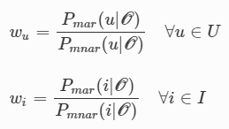


De-biasing Off-line Evaluation
https://link.springer.com/article/10.1007/s10844-021-00651-y
Alternative: sampling from test data to de-bias them
  Based on missing-at-random (MAR) vs. Missing-not-at-random (MNAR)
  Sample from MNAR data to better resemble MAR
  Variants:
    You have some subsample that is MAR (random recommendations, forced rating), sample from MNAR so that posterior probability is similar to MAR. Finding weight w for each user-item pair
    You do not have MAR subsample: assume uniform posterior probability
  Possible disadvantage: not enough data due to sampling
    Sample with repetition
  Possible disadvantage: not enough data from all segments

Slide 27
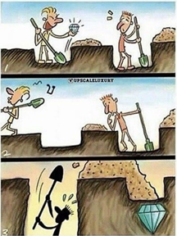
Long vs. short-term evaluation
Exploration vs. Exploitation tradeoff
  …the recommendations gets boring after some time ☹
  Purely exploitational RS: high target values in short-term, but possibly low target values in long-term
  Problematic evaluation
    No exploration in the train data => no way to learn it => no exploration in the test data => Penalization of exploration-oriented RS

Slide 28
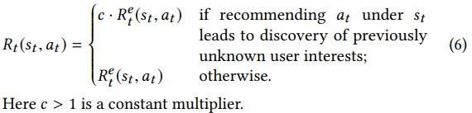
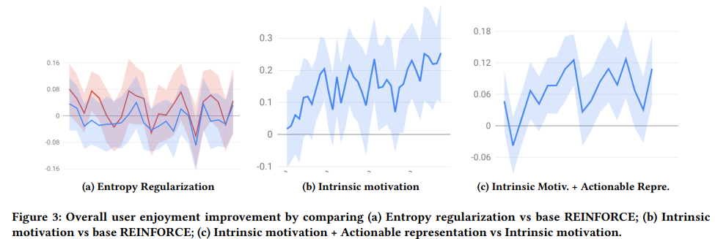
Exploration vs. Exploitation
Values of User Exploration in Recommender Systems https://dl.acm.org/doi/pdf/10.1145/3460231.3474236
  Reinforcement learning based RS (learning through rewards given for each recommendation)
  Reward shaping / Intrinsic motivation (improved reward for relevant items from previously unknown interest clusters)
  Promotes serendipity
  How to transfer this for
  different algorithms?

Slide 29
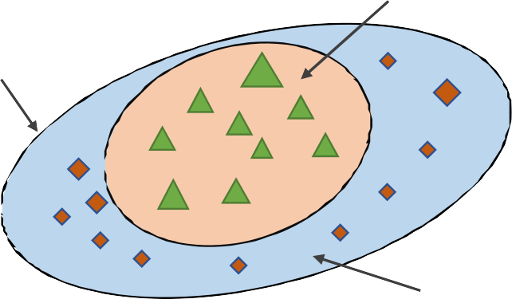




Limitation of Reweighting: Requiring positivity
Just leveraging propensity score is insufficient:
S₁
S : {(u,i, r) : p_{U} (u,i, r) > 0}
S
S :{(u,i, r) : p (u,i, r) > 0, p (u,i, r) = 0}
0 U T
S₁ :{(u,i, r) : p_{U} (u,i, r) > 0, p_{T} (u, i, r) > 0}
: Training data
: Imputed data
S₀
Due to the data bias, training data distribution 𝑃_{T} may only provide the partial data knowledge of the region 𝑆 (𝑆₀ is not included)
IPS cannot handle this situation
Imputing pseudo-data to the region 𝑆₀:
𝐿_{T} = Σ
(u,i)∈D_{T}
_{𝑤} 1
Σ
u∈U,i∈I
_{𝑤} 2
𝛿 𝑟_{ui} , 𝑟_{ui} +
𝛿 𝑚_{ui} , 𝑟_{ui}
ui
ui
26

Slide 30
Debiasing Strategies Overview
  Re-weighting
    Giving weights for each instance to re-scale their contributions on model training
  Re-labeling
    Giving a new pseudo-label for the missing or biased instance
  Generative Modeling
    Assuming the generation process of data and reduces the biases accordingly
27

Slide 31
Re-labeling Strategies
Basic idea: change data distribution by imputing pseudo-labels:
Test data distribution
Biases
Training data distribution
𝐿_{DI} =
Σ 𝛿(𝑟_{ui} \𝑚_{ui}, 𝑟_{ui}) u,i ∈D_{T}∨D_{n}
Re-labeling
Could address the deviation of 𝑝(𝑢, 𝑖) and 𝑝(𝑟|𝑢, 𝑖)
p_{T} (u, i) ≠ p_{D} (u, i)
p_{T} (r | u, i) ≠ p_{D} (r | u, i)
Properly defining pseudo-labels can lead to unbiased estimator of the ideal:
For
p_{T} (r | u, i) ≠ p_{D} (r | u, i)
=
∑
(u ,i,r )∈D_{T}
∑
(u,i,r )∈D_{T}
δ (m_{ui} , rˆ_{ui} ), m_{ui} ~ p_{D} (r | u, i)
^{L}DI
For
p_{T} (u, i) ≠ p_{D} (u, i)
^{L}DI
=
δ (r_{ui} , rˆ_{ui} ) +
∑ ^{δ} (^{m}ui ^{, rˆ}ui )
(u ,i )− D_{T}
28

Slide 32

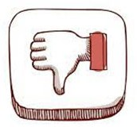
Data imputation for Selection Bias (Relabeling)
True Preference Training data Imputation data
Selection bias Data imputation
p_{T} (u,i) ≠ p_{D} (u,i)
  Relabeling: assigns pseudo-labels for missing data.
3 | 4 | 2 | 5
1 | 3 | 2 | 5
2 | 3 | 4 | 4
3 | 4 |  | 5
 | 3 |  | 5
2 | 3 | 4 | 4
3 | 4 | 2 | 5
2 | 3 | 2 | 5
2 | 3 | 4 | 4
∑
ˆ
( )
arg min
θ
δ r
o&i
, f (u, i | θ ) + Reg(θ )
ui
u ,i
Simple and straightforward.
H. Steck, “Training and testing of recommender systems on data missing not at random,” in KDD, 2010, pp. 713–722.
Sensitive to the imputation strategy. Imputing proper pseudo-labels is more difficult.
X. Wang, R. Zhang, Y. Sun, and J. Qi, “Doubly robust joint learning for recommendation on data missing not at random,” in ICML, 2019, pp. 6638–6647
29

Slide 33
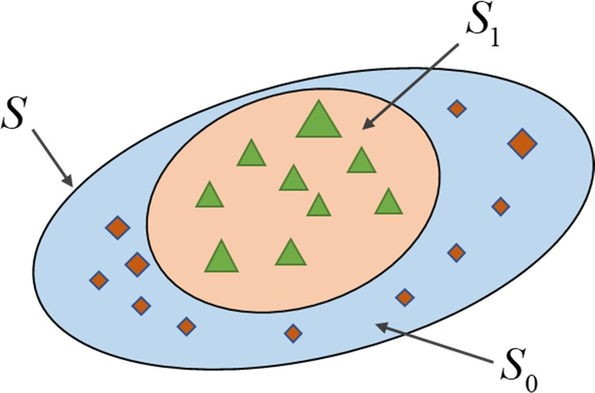


Relabeling+Reweighting
Reweighting:
  Relatively Robust
  High variance; Requires positivity
Relabeling:
  General
  Sensitive to pseudo-labels
𝐿_{T} = Σ
(u,i)∈D_{T}
_{𝑤} 1
Σ
u∈U,i∈I
_{𝑤} 2
𝛿 𝑟_{ui} , 𝑟_{ui} +
𝛿 𝑚_{ui} , 𝑟_{ui}
ui
ui
30

Slide 34


Doubly Robust for Selection Bias (Relabeling+Reweighting)
3 | 4 | 2 | 5
1 | 3 | 2 | 5
2 | 3 | 4 | 4
3 | 4 |  | 5
 | 3
2 | 3 | 4 | 4
Relabeling+ Reweighting
3 | 4 | 2 | 5
2 | 3 | 2 | 4
2 | 3 | 4 | 4
Selection bias
p_{T} (u,i) ≠ p_{D} (u,i)
Doubly Robust: combines IPS and data imputation for robustness.
+ ∑
u∈U ,i∈I
1 O
_{L}ˆ
∑
(u ,i )∈D_{T}
( )
( )
( )
δ r , r
(1− )δ r , m
=
ˆ
ui
ˆ
DR
ρ
ui ui
ρ
ui ui
ui ui
IPS
Imputation
O_{ui} = I[(u, i) ∈ D_{T} ]
Low Variance.
Relatively robust to the propensity score and imputation value.
Requires proper imputation or propensity strategy.
Xiaojie Wang, Rui Zhang, Yu Sun, and Jianzhong Qi. 2019. Doubly robust joint learning for recommendation on
data missing not at random. In ICML.
31

Slide 35
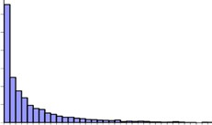
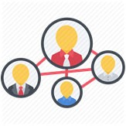

Relabeling+Reweighting for Exposure Bias
1 | 1 |  | 1
 | 1 |  | 1
 | 1 | 1 | 1
1 | 1
 | 1 | 1 | 1
Imputation
+Weighting
1 | 1 | 0 | 0
0 | 0 | 0 | 0
0 | 1 | 1 | 1
Exposure bias
p_{T} (u,i) ≠ p_{D} (u,i)
∑
(u ,i )∈D_{T}
¹ δ (r , rˆ ) + ∑
( )
w δ 0, r
L =
(2)
ˆ
w
ρ
ui ui
ui
ui
ui
u∈U ,i∈I
Imputing zero for unobserved data and downweight their contribution.
_{𝑤} 2
•
reflects how likely the item is exposed to the user.
ui
weighting
Item popularity Social network User community
32

Slide 36
Fairness in Recommender Systems

Slide 37
Fairness in Recommender Systems
Tutorial from: https://fairness-tutorial.github.io/

Slide 38
Fairness issues in RecSys and IR
News recommendation/social networks
  Does the suggested articles close me into some opinion bubble?
    Fairness of the presented opinions on controversary subjects
  Societal polarization and echo chambers are among top current challenges in RS
Job matching & marketplaces
  Am I omitted from the list of possible applicants just because [black / old / female…]
  Is one content provider favored over others?
Finance domain
  Why am I not recommended for loan? Why is my credit score lower/higher?
E-commerce
  Is this product being recommended because it is the best for me or because the provider earns the most from it?
What if these features are learned indirectly?

Slide 39
Fairness in General
Equality of opportunities
  „You should not be disqualified /mistreated based on generic statistics that should not affect the outcome“
    „You will not get the job because you are female“
    What about already biased inputs?
Equality of outcome
  „Submission vs. acceptance ratio for male/female authors should not differ, if they differ, countermeasures should be taken“
    Is this still fair? Are all candidates equally good?
    Someone may be in „higher need“ of getting help vs. someone had been mistreated in the past.
Fairness vs. proportionality

Slide 41
Most of de-biasing techniques is here

Slide 42


Fairness in Machine Learning — Basic tasks
Fairness in Classification
Fairness in Ranking

Slide 43



Fairness in Ranking — Introduction
List-wise definitions for fairness: depend on the entire list of results for a given query
Unsupervised criteria: the average exposure near the top of the ranked list to be equal for different groups [71][72][75]
Supervised criteria: the average exposure for a group to be proportional to the average relevance of that group’s results to the query [65][67]

Slide 44
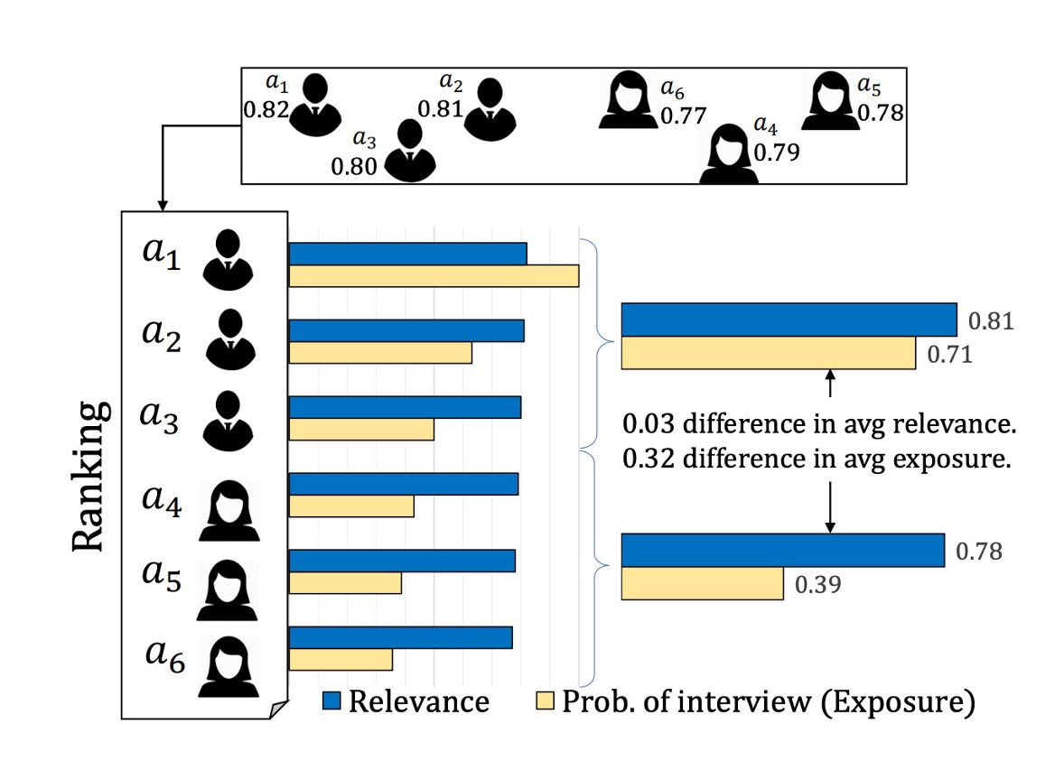
Fairness in Ranking
Fairness Concerns: A conceptual and computational framework that allows the formulation of fairness constraints on rankings in terms of exposure allocation.
Job seeker example: a small difference in relevance can lead to a large difference in exposure (an opportunity) for the group of females.
Reasonable if relevance has direct probabilistic interpretation
Singh, Ashudeep, and Thorsten Joachims. "Fairness of exposure in rankings." SIGKDD’2018.

Slide 45


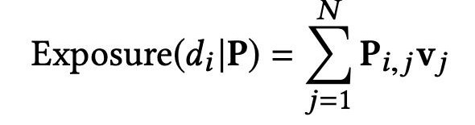
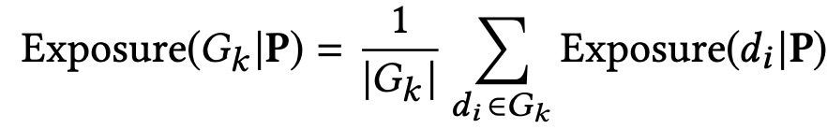

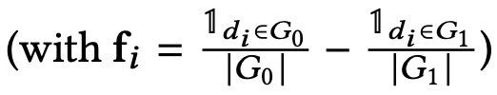
Fairness in Ranking
Method:
Exposure for a document 𝑑_{i} under a probabilistic ranking 𝑃 as:
Demographic Parity Constraints:
31
Singh, Ashudeep, and Thorsten Joachims. "Fairness of exposure in rankings." SIGKDD’2018

Slide 46
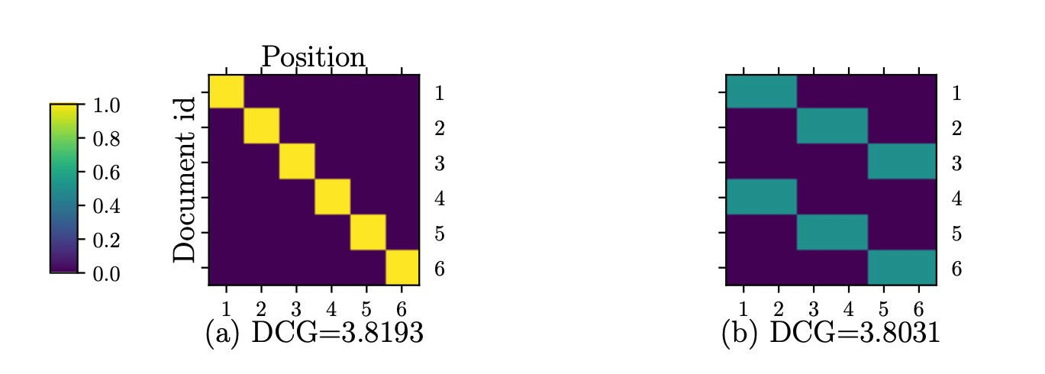
Fairness in Ranking
Figure (a) is optimal unfair ranking that maximizes DCG.
Figure (b)
is optimal fair ranking
under demographic parity.
Compared to the DCG of the unfair ranking, the optimal fair ranking has slightly lower utility with a DCG.
32
Singh, Ashudeep, and Thorsten Joachims. "Fairness of exposure in rankings." SIGKDD’2018

Slide 47
Fairness in Ranking
Based on P_i,j = probability of document i being recommended at position j (for some query q)
- Linear programming
Individual fairness variants can be expressed via f & g vectors
32
Singh, Ashudeep, and Thorsten Joachims. "Fairness of exposure in rankings." SIGKDD’2018

Slide 48
Fairness in Ranking
Based on P_i,j = probability of document i being recommended at position j (for some query q)
- Linear programming
Problem: source data and therefore utility estimations are biased. Classical remedy in online eval: let the algorithm run long enough
Individual fairness variants can be expressed via f & g vectors
32
Singh, Ashudeep, and Thorsten Joachims. "Fairness of exposure in rankings." SIGKDD’2018

Slide 49
NDBI021, Lecture 8
User preferences and advanced recommending methods, 2/1 ZK+Z,
https://www.ksi.mff.cuni.cz/~peska/vyuka/ndbi021/
https://youtube.com/playlist?list=PLTYzSYF3EX3BNIVJkMpCE3vUDmUGvhEcy
https://ksi.mff.cuni.cz

Slide 50
Recap

Slide 51
What is conformity bias?
How does Mathew’s Effect work?
Data
Biases in data
User
Syste
m
Biases in results

Slide 52
What is Inverse Propensity Score?
What kind of fairness is violated in this example?

Slide 53




Fairness in Recommendation — Challenges
More Perspectives
Multiple Models And Goals
Extreme Data Sparsity
Dynamics

Slide 54
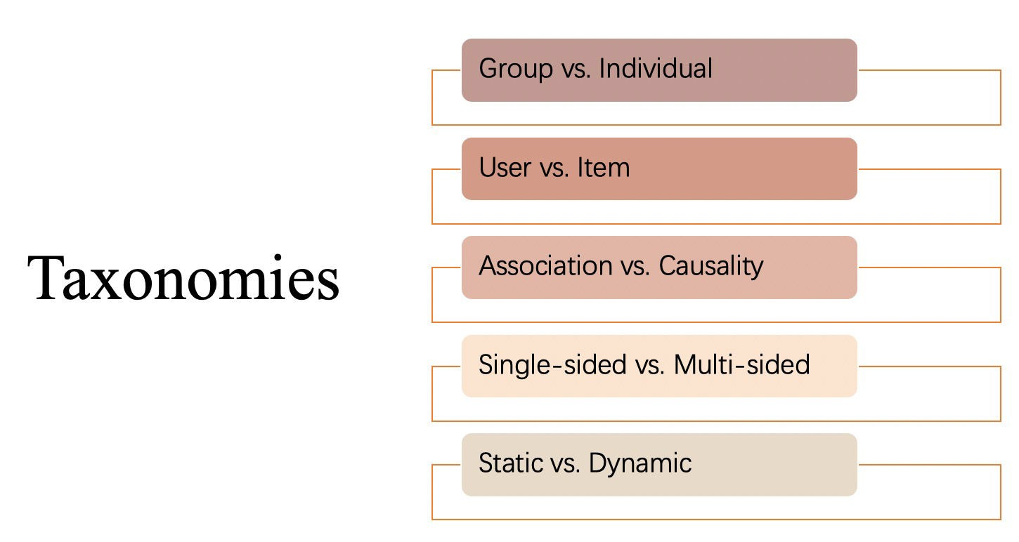

Slide 55




















Group Fairness vs. Individual Fairness
Group fairness requires that the protected groups should be treated similarly to the advantaged group.
Group = Male Advantaged
We need to be fair for both male and female applicants
Group = Female Protected
Require the same acceptance rate for both male and female job applicants

Slide 56

Group Fairness vs. Individual Fairness
Individual fairness requires that the similar individual should be treated similarly.
Image source: https://mitibmwatsonailab.mit.edu/wp-content/uploads/2020/04/Leadspace-GettyImages-598952582.jpg

Slide 57

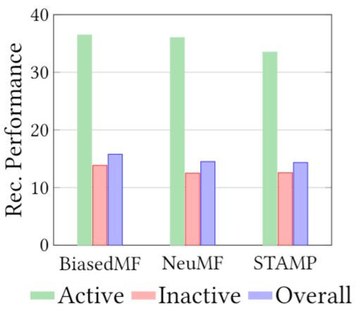



Group Fairness in Recommendation
Fairness concerns: The unfair recommendation quality between user groups with different activity levels, e.g., number of interactions.
Unfairness of current recommender systems:
  Active users only account for a small proportion of users.
  The average recommendation quality on the small group (active) is significantly better than that on the remaining majority of users (inactive) for all baselines.
Ratio between Active and Inactive users
5%
Inactive
Act ive
95%
Li.Y et al. “User-oriented Fairness in Recommendation” WWW’21.

Slide 58





Active vs. Inactive groups
Fairness on user side: Fairness requirements in recommender systems may come from users.
I want a doll
Milk
Ice cream Skirt
… Orange
…
Active
I want a toy car
Ice cream Basketball
Inactive
Recommender System

Slide 59
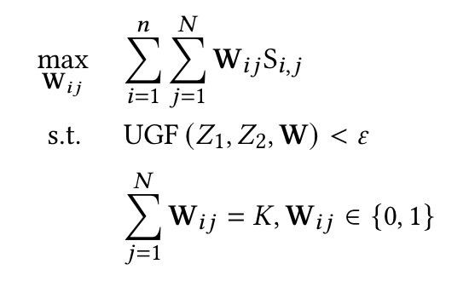
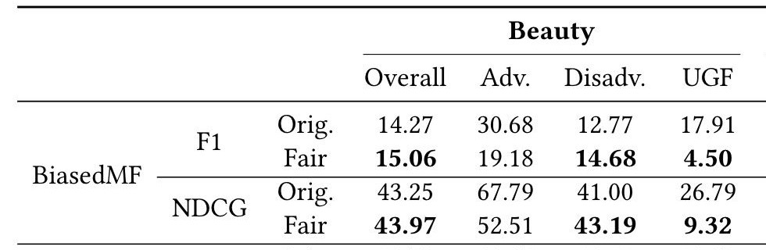
Group Fairness in Recommendation
Fairness-aware Algorithm: A re-ranking method with user-oriented group fairness
Preference of user 𝑖 in terms of item 𝑗
Fairness constraint
constrained on the recommendation lists
generated from any base recommender algorithm.
Top-K list
Experiment
Results:
Improve
fairness;
Improve recommendation quality of overall
and disadvantaged users. However, the performance of advantaged users is reduced to satisfy our fairness requirement.
Improvement of overall accuracy
Disadv. Adv.
Improvement of fairness
Li.Y et al. “User-oriented Fairness in Recommendation” WWW’21.

Slide 60
Group Fairness in Job Recommendation
First we need to know whats important, only then try to optimize / evaluate it
Structured interviews with different stakeholders (seekers, recruiters,…)
Set of qualified candidates (not all applicants) as the basic unit
[then, all remaining applicants should be treated equally]
[is cultural fit a qualification or a sensitive attribute?]
[do not waste candidate’s time – offers they’re not gonna get invited for ultimately]
Size of the pool matters (hundreds candidates vs. few candidates trigger different needs)
[rank-awareness, but only for larger pools – fatigue…
plus you do not need to review 100 profiles to find a receptionist]
[properties of the pool matters (medical nureses are not 50:50 in the population)]
Company-focused fairness
[some companies has broader mission they want to maintain… e.g., supporting young]
Overall result: equal probability of exposure for qualified candidates: Conditional Demographic Disparity
Often, interviewees considered group fairness options.
Mapping Stakeholder Needs to Multi-Sided Fairness in Candidate Recommendation for Algorithmic Hiring; https://dl.acm.org/doi/pdf/10.1145/3705328.3748079

Slide 61
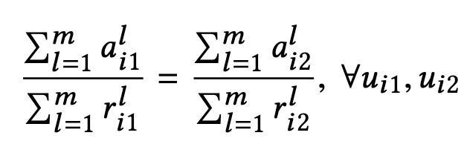
Individual Fairness in Recommendation
Fairness concerns: the position bias which leads to disproportionately: less attention being paid to low-ranked subjects (position bias).
No single ranking can achieve individual attention fairness.
Equity of Amortized Attention: A sequence of rankings {1,2, … 𝑚} offer equity of amortized attention if each subject 𝑢 receives cumulative attention proportional to her cumulative relevance:
attention
relevance
Biega, A. J. et al. “Equity of Attention: Amortizing Individual Fairness in Rankings” SIGIR’18.

Slide 62
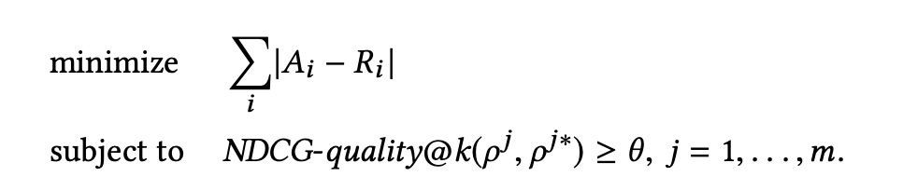
Individual Fairness in Recommendation
Method (Offline optimization):
Fairness (L1 norm over distributions)
Ranking quality
Experiment Results:
  Improving equity of attention is crucial: the discrepancy between the attention received and the deserved attention can be substantial.
  Improving equity of attention can often be done without sacrificing much quality in the rankings.
Integer linear programming (re-ranking) https://en.wikipedia.org/wiki/Integer_programming
Biega, A. J. et al. “Equity of Attention: Amortizing Individual Fairness in Rankings” SIGIR’18.

Slide 63
Associative Fairness vs. Causal Fairness
Find the discrepancy of statistical metrics between individuals or sub-populations.
In binary classification, fairness metrics can be represented by regularizing the classifier's positive or negative rates over different protected groups.

Slide 64

Associative Fairness vs. Causal Fairness
Fairness cannot be well assessed only based on association notions [46-49].
Difference:
  Reason about the causal relations between the protected features and the model outcomes.
  Leverage prior knowledge about the world structure in the form of causal models, help to understand the propagation of variable changes in the system.
https://en.wikipedia.org/wiki/Causal_model

Slide 65


























Counterfactual fairness
Counterfactual fairness is an individual-level causal-based fairness notion. It requires that for any possible individual, the predicted result of the learning system should be the same in the counterfactual world as in the real world.
ADMISSION RATE
Female Male
What if I am a girl, can I get an offer?
Gender = F
Gender = M
GPA = 3.6
SAT = 700
Get Offer!
GPA = 3.6
SAT = 700
Get offer???
Offer
50%
_{50%} Offer
No offer
No offer
Associative Group Fairness
Counterfactual Fairness
59

Slide 66
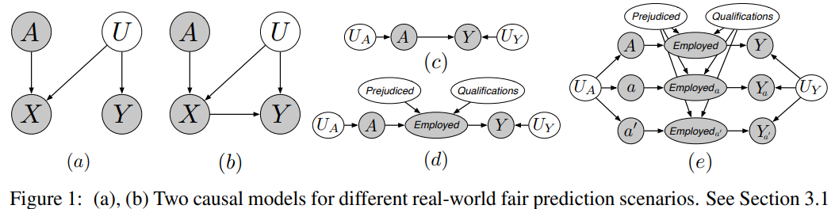
Counterfactual fairness
https://arxiv.org/pdf/1703.06856
Counterfactual fairness is an individual-level causal-based fairness notion. It requires that for any possible individual, the predicted result of the learning system should be the same in the counterfactual world as in the real world.
ADMISSION RATE
Female Male
What if I am a girl, can I get an offer?
Gender = F
Gender = M
GPA = 3.6
SAT = 700
Get Offer!
GPA = 3.6
SAT = 700
Get offer???
Offer
50%
_{50%} Offer
No offer
No offer
Associative Group Fairness
Counterfactual Fairness
Trained rule: 2-year work gap equals no offer
59

Slide 67
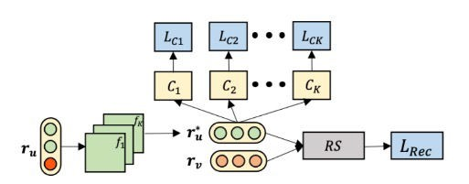
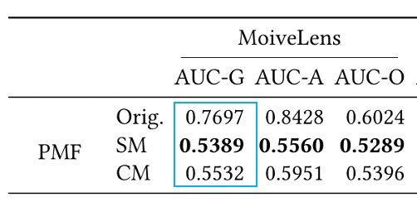
Causal Fairness in Recommendation
Discriminator module
Method: Generate feature independent user embeddings through adversary learning.
  Filter Module: filter the information about sensitive features from user embeddings
  Discriminator module: predict the sensitive features from the learned user embeddings.
Experiment Results:
  Improve fairness
  A little sacrifice on recommendation performance
Filter module
Li. Y et al. “Towards Personalized Fairness based on Causal Notion” SIGIR’21

Slide 68
Fairness in RS, further reading
https://link.springer.com/article/10.1007/s11257-020-09285-1
https://dl.acm.org/doi/pdf/10.1145/3383313.3411545
https://www.sciencedirect.com/science/article/pii/S0306457321001503
https://arxiv.org/abs/1908.06708
https://dl.acm.org/doi/pdf/10.1145/3450614.3461685
https://arxiv.org/abs/2006.05255
https://dl.acm.org/doi/pdf/10.1145/3184558.3186949

