Slide 1


NDBI021, Lecture 5
User preferences and advanced recommending methods, 2/1 ZK+Z,
https://www.ksi.mff.cuni.cz/~peska/vyuka/ndbi021/
https://youtube.com/playlist?list=PLTYzSYF3EX3BNIVJkMpCE3vUDmUGvhEcy
https://ksi.mff.cuni.cz

Slide 2
Today’s content
Recap
From feedback to preferences
Explanations
User Control

Slide 3
Recap

Slide 4
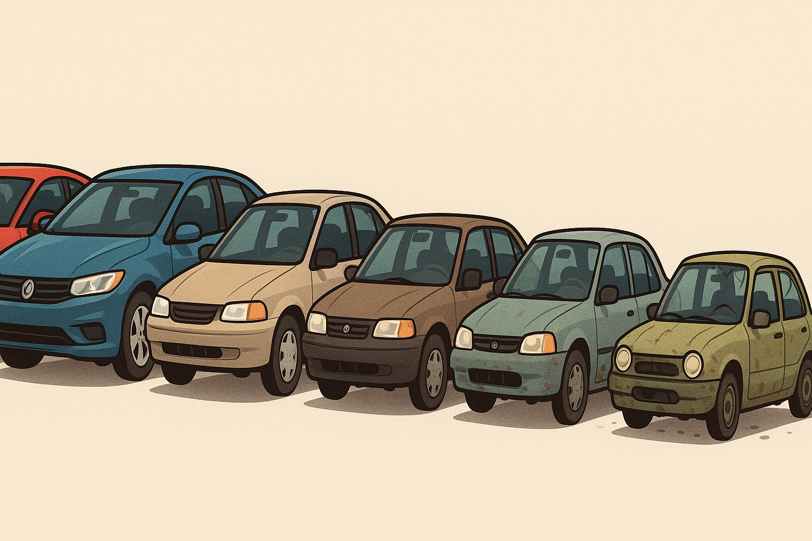
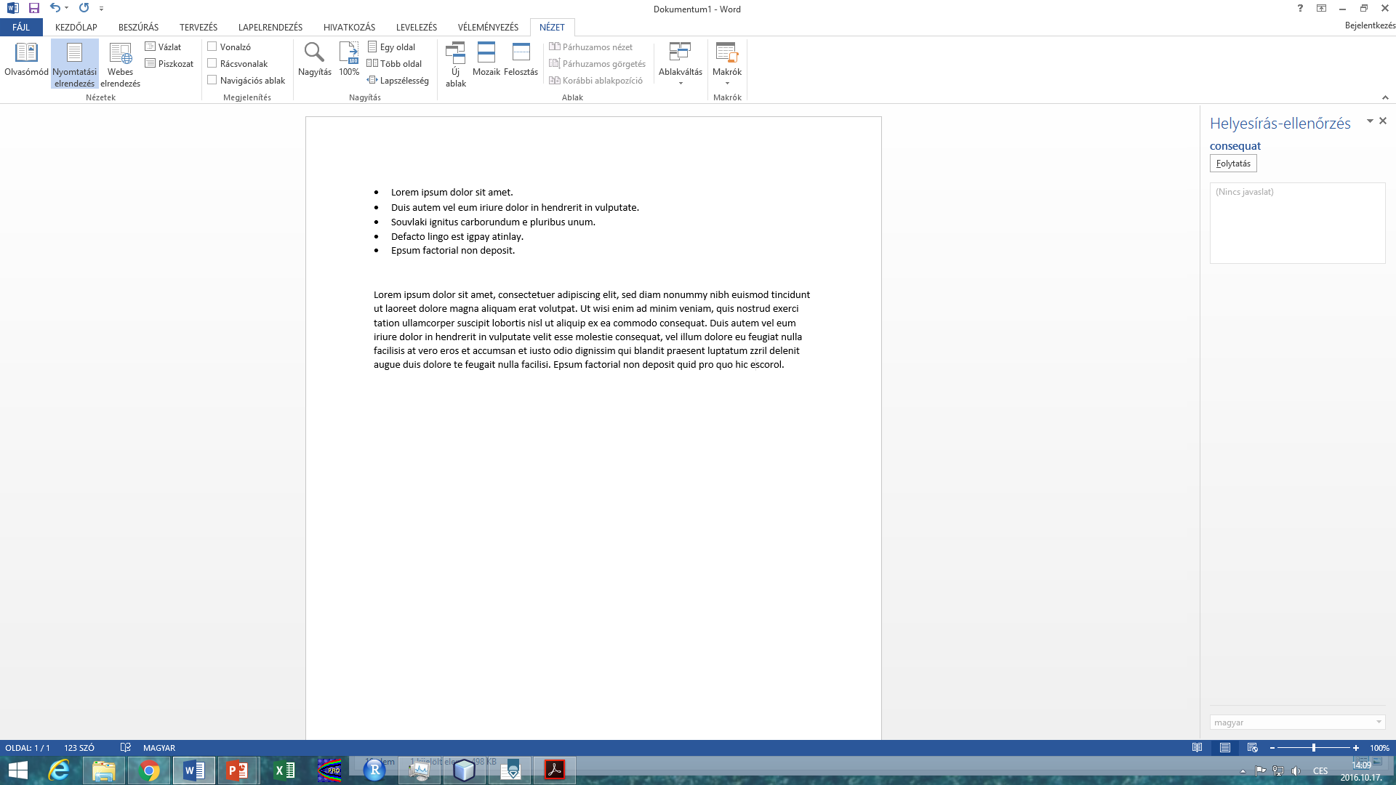
Can you name some examples where you should venture beyond simple numeric feedback indicators?
What are assimilation and contrast effects?

Slide 5
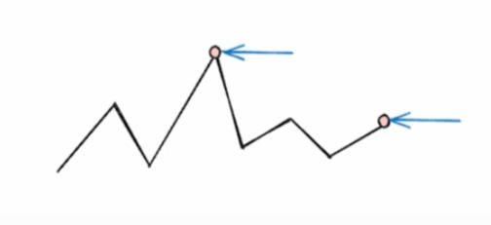
What do you think can represent long-term implicit feedback?

Slide 6
How to model user preferences
What can be expressed & how to express it

Slide 7
How to model user preferences?
What are the targets of the preference mining?
Entity granularity
Who gives the preference (who is the user)?
Group preference, Various confidence in user identification.
What are expected connections among the entities (hypotheses)?
Aggregation methods and fuzzy logic
(Knowledge) Graph-aware recommending algorithms
Does user preference depend on some context/conditions?
Context-aware Recommender Systems
In what way do we allow users to express their preferences?
[Already covered] Explicit/implicit/other feedback

Slide 8
Entity selection & Granularity

Slide 9
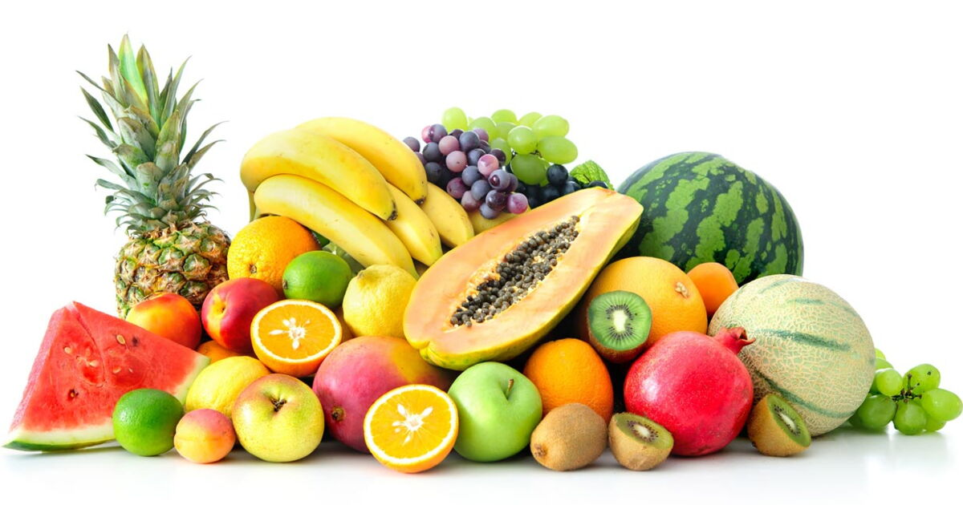
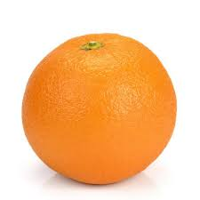
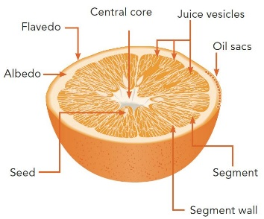
Points to consider in modeling phase
What entities are relevant?
Are they sufficiently recognizeable?
Can we get enough data about them?
How much added value they can give us?
Would it upset our users if they are not allowed to define preferences w.r.t. them?
Why I cannot like the album, only individual songs?
Vs.
Vs.

Slide 10
Points to consider in modeling phase
What (minimal) granularity to use?
Primary target: cooking recipes
Recipes are composed from multiple ingredients (and other attributes)
Ingredients themselves has some attributes (e.g. quantity, type of preparation, quality, category)
0.5kg of ground free-ranged chicken brests -> chicken brests are a type of meat / chicken meat / light meat…
What you might want to be able to express:
Would the user like the recipe more/less if it would be meat-free?
Is it possible that he/she (dis)like chicken brests?
Can you say that the recipe contains too much vegetable?
Does „free-ranged“ affect the perception of chicken breasts?

Slide 11
Points to consider in modeling phase
What would the user be willing to do/say/rate/…?
Users tend not to rate things much
But they are sometimes willing to confirm/reject your beliefs (see later: user steering)
They do browsing, searching, buying etc.

Slide 12
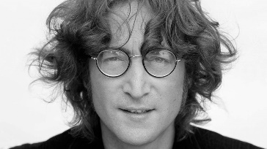
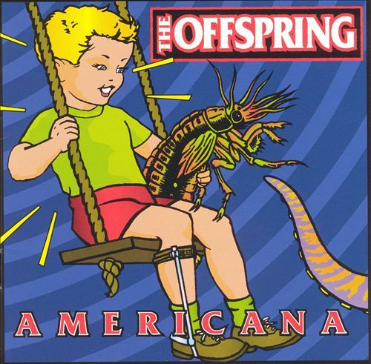
What entities are relevant?
What entities are relevant?
Are they sufficiently independent?
Is the user’s preference towards some recipe a mere aggregation of his/her preference towards its ingredients?
Do you like the song just because it was written by… John Lennon?
How much added value they can give us?
Is it usual that people like Offsprings, but dislike their Americana album?
Who should decide?
Domain expert
Supported by data analysis
If you have some preliminary data:
… and/or continuous testing
… and/or dedicated lab study
Look for both common cases and outliers. Every person is an outlier in some scenario => only solving common cases... Makes everyone angry at some point☺

Slide 13
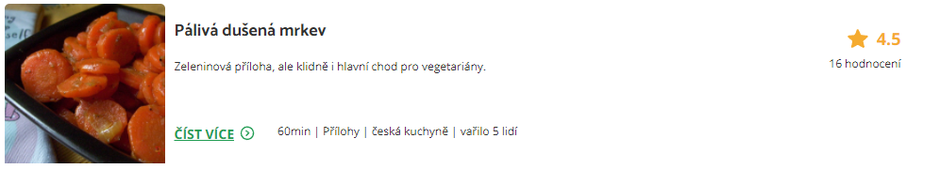

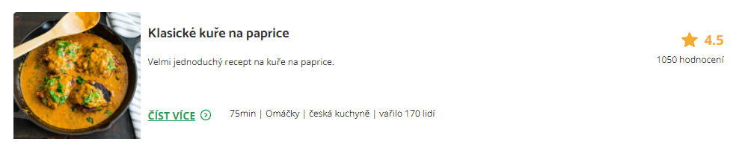

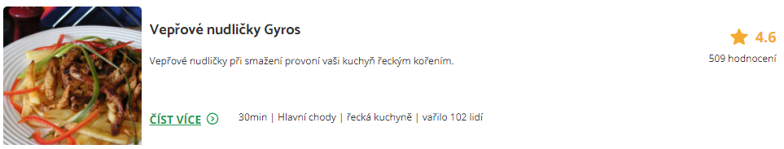
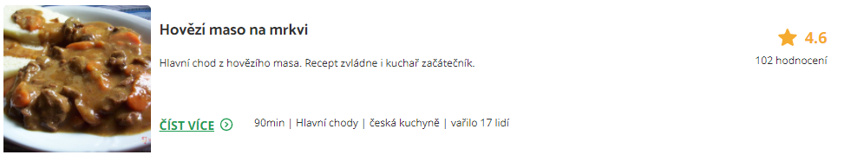
What minimal granularity to chose?
This is the feedback we have
Would the user like this one?

Slide 14

What minimal granularity to chose?
This is the feedback we have
Would he/she like this one?

Slide 15
What minimal granularity to chose?
This is the feedback we have
Would he/she like this one?
Probably not, he/she seems to be a vegetarian

Slide 16
What minimal granularity to chose?
So, the finer granularity the better?

Slide 17

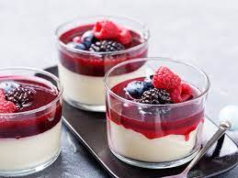
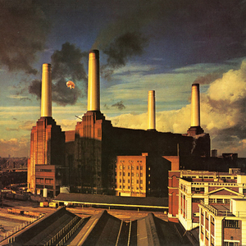
What minimal granularity to chose?
Why do you like Lord of the Rings movie?
What makes panna cotta so delicious?
What is so good on [your favorite artists] songs?

Slide 18
What minimal granularity to chose?
Why do you like Lord of the Rings movie?
What makes Panna cotta so delicious?
What is so good on [your favorite artists] songs?
Is the description discriminative?
Can it be generalized to all other objects sharing the same feature?
Is there something missing in the picture?
If you mentioned multiple features, what is their interplay?
And-like / or-like / additive / amplifying…

Slide 19
What minimal granularity to chose?
Why do you like Lord of the Rings movie?
What makes Panna cotta so delicious?
What is so good on [your favorite artists] songs?
People are generally not very good at describing their reasons thoroughly

Slide 20
What minimal granularity to chose?
Why do you like Lord of the Rings movie?
What makes Panna cotta so delicious?
What is so good on [your favorite artists] songs?
Also, if asked for reasons, people often just gonna justify their emotions
https://start.askwonder.com/insights/want-add-previous-request-made-few-years-ago-want-studies-support-idea-decisions-c22yygpap
https://en.wikipedia.org/wiki/Motivated_reasoning
Ninety percent of human decisions are made based on emotions. Humans use logic to justify their actions to themselves and others
"Common emotional decisions may use some logic, but the main driving force is emotion, which either overrides logic or uses a pseudo-logic to support emotional choices (this is extremely common). Another common use of emotion in the decision is to start with logic and then use emotion in the final choice."

Slide 21
What minimal granularity to chose?
To sum-up
It may be difficult for humans to express their preference on sub-object level
Some hints are possible, but the information is rarely complete
Our data does not have to correspond to the user’s vocabulary
Some features are missing
Some user’s preferences are hard to be transferred to attributes (The movie is too generic)
Quite often, human’s decisions are not driven logically, but emotionally
Any logical clues they give us does not have to be applicable for the next case

Slide 22
What minimal granularity to chose?
Possible solution:
Collect [implicit] feedback on object-level, then infer sub-object preferences
Latent (E.g., attribute-level vector representation, attention models) or explicit (direct preference prediction)
Occasionally ask, whether your inferred preferences are correct [see later: explanations]
E.g. Use latent model, but „guard“ it via regularization to the explicit sub-object one. Iteratively update if you recieve confirmation on your explicit model. https://www.frontiersin.org/articles/10.3389/fdata.2021.778417/full https://dl.acm.org/doi/10.1145/2043932.2043979 [Content-boosted matrix factorization]
Confirmation is often easier than definition + can be done in a less intrusive way
Based on your recipe ratings, we think you are a vegetarian. Is that true? [Yes | NO | No, but I do not eat meat much | Irrelevant] What will happen >>
If you click on Yes, we will promote more vegetarian meals in your future searches. You can always turn this feature off in your user profile.
User controll in RS (https://web-ainf.aau.at/pub/jannach/files/BOOK_CHAPTER_PERSONALIZED_HCI_2019.pdf)

Slide 23
What minimal granularity to chose?
Possible solution:
Use within-page feedback collection to identify most relevant content parts
Then translate this to the sub-object preferences
Inherently noisy, highly visualization-specific
No known usage
Requires detailed feedback collection, but possibly less data points needed

Slide 24
What minimal granularity to chose?
Be careful while generalizing from inferred sub-object preferences
Do you like action movies?
Do you like food with salt?
Do you like movies with David Aston?
Yes, but not all of them
Yes, but not because of this
…who is David Aston?

Slide 25
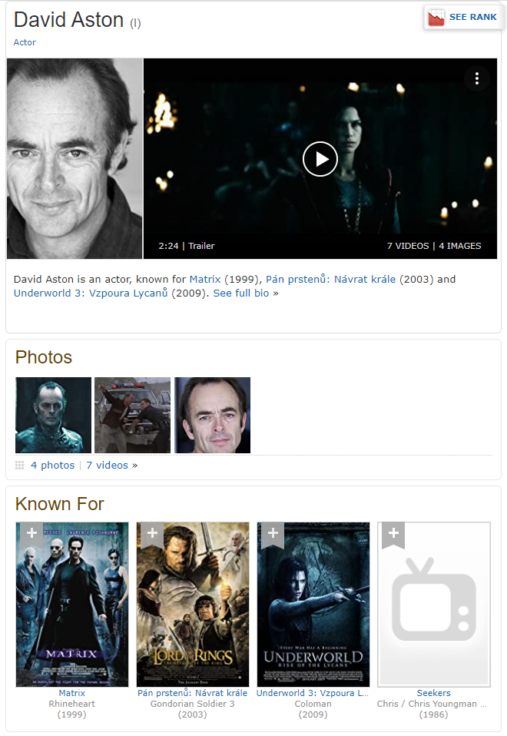
What minimal granularity to chose?
Be careful while generalizing from inferred sub-object preferences
Do you like action movies?
Do you like food with salt?
Do you like movies with David Aston?
Yes, but not all of them
Yes, but not because of this
…who is David Aston?

Slide 26
What minimal granularity to chose?
Be careful while generalizing from inferred sub-object preferences
Yes, but not all of them
Should be fine (other features to clarify), but we need to ask questions correctly
Yes, but not because of this
Loss of trust („the system does not understand what is important“)
Some model of global or per-object feature importance
Only confirm the inferred preference on the important ones
Do not base your decision on the less relevant much

Slide 27
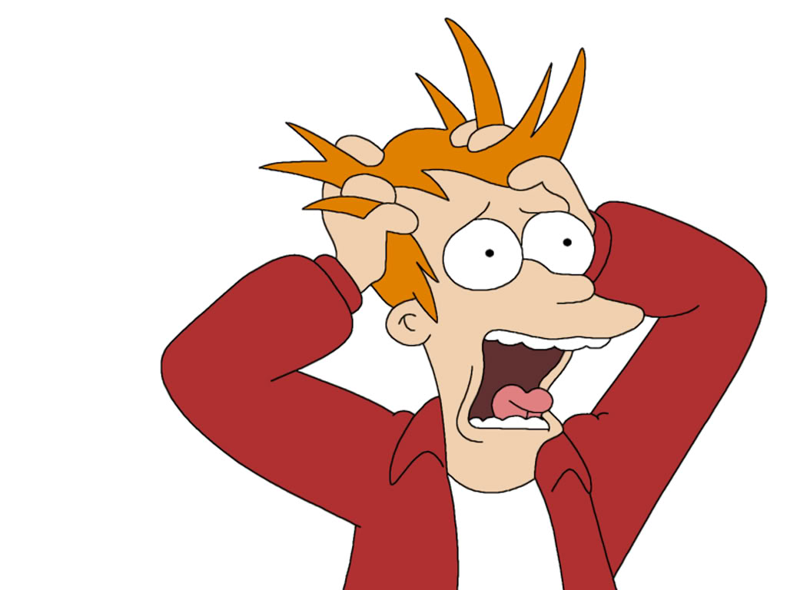
Questions?

Slide 28
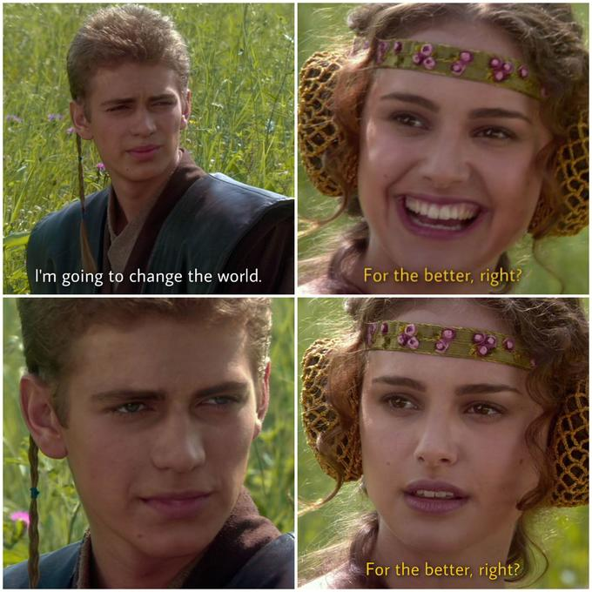
Aggregating multiple indicators
If A=1 and B=1, then A and B is 2, right? … RIGHT?

Slide 29
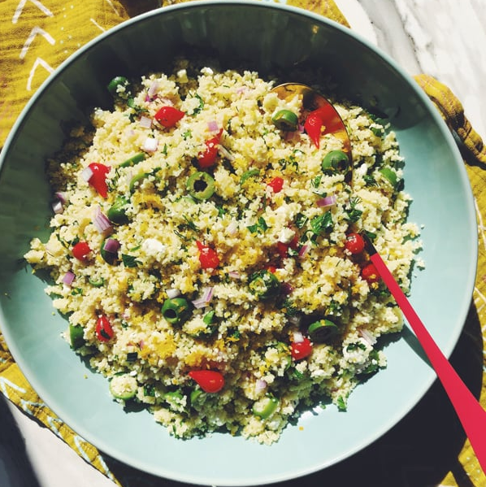
Aggregating User Preferences
Recipes domain:
Suppose you KNOW that the user likes olives, but dislikes cous-cous
Would she like or dislike cous-cous with olives?

Slide 30
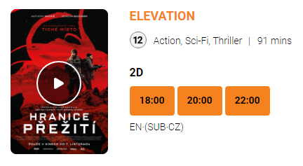
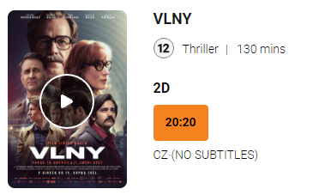
Aggregating User Preferences
Group movie night:
Both Adam and Eva like action sci-fi, but they’re not fond of Czech movies in general
David dislikes sci-fi, but enjoys thrillers, especially Czech ones.
What should they watch tonight?

Slide 31
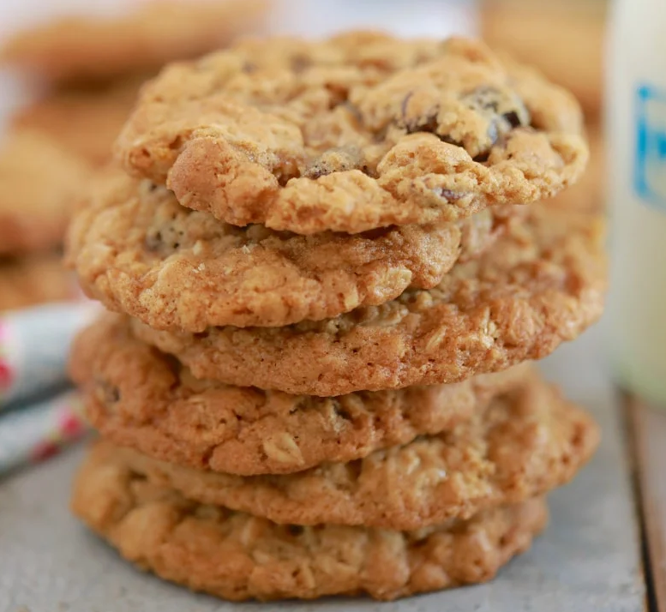
Aggregating User Preferences
More attributes:
This Panna cotta is with strawberries which I love so much, the cream looks delicious and is from my favorite shop – but there is a lot of fat in it as well.
I am not really fond of oat cookies and this one is a bit over-priced, but they are very healthy.
Should I eat something?

Slide 32
Aggregating User Preferences
In different situations people may employ different aggregation of individual preferences
If enough data, we may try to train a model to predict the decision based on partial inputs. However, this might not be always possible.
What simple models of preference aggregations can we use instead?

Slide 33
Aggregating User Preferences
What simple models of preferences aggregations can we use?
Just sum’em up (MEAN)
First good wins (MAX)
I have to be completely satisfied (MIN)

Slide 34
Aggregating User Preferences
What simple models of preferences aggregations can we use?
Just sum’em up (MEAN)
First good wins (MAX)
I have to be completely satisfied (MIN)
Priorities matter (weighted average)

Slide 35
Aggregating User Preferences
What simple models of preferences aggregations can we use?
Just sum’em up (MEAN)
First good wins (MAX)
I have to be completely satisfied (MIN)
Priorities matter (weighted average)
Is that it?

Slide 36
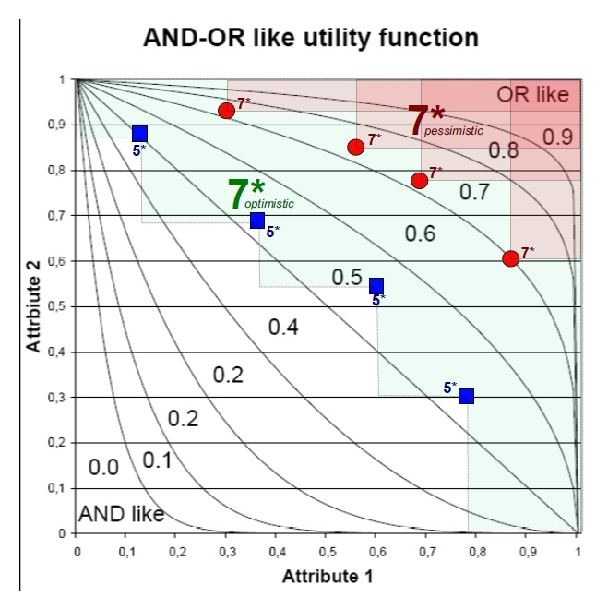
Aggregating User Preferences
What simple models of preferences aggregations can we use?
Just sum’em up (MEAN)
First good wins (MAX)
I have to be completely satisfied (MIN)
Priorities matter (weighted average)
Users’ preference tend to be more forgiving (OR-like) when the item is good and less forgiving (AND-like) when it is not so good

Slide 37
Aggregating User Preferences
What simple models of preferences aggregations can we use?
Just sum’em up (MEAN)
First good wins (MAX)
I have to be completely satisfied (MIN)
Priorities matter (weighted average)
Fuzzy-logic AND, OR, or other connectives (e.g., implications)

Slide 38
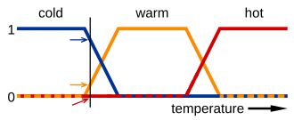
Aggregating User Preferences: Fuzzy logic
What is fuzzy logic: laymen’s view
Extension of classical logic to the full spectrum of truth values between 0 and 1
Has to maintain the laws of Boolean logic (e.g. 0 AND 1 = 0, asociativity, commutativity, monotonity…)
Many proposed variants of logical connectives
Basic (non-parametrized): Lukasiewicz, Goedel, Product
Parametrized (the output depends on a hyperparameter)

Slide 39
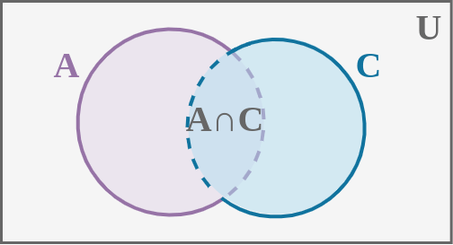
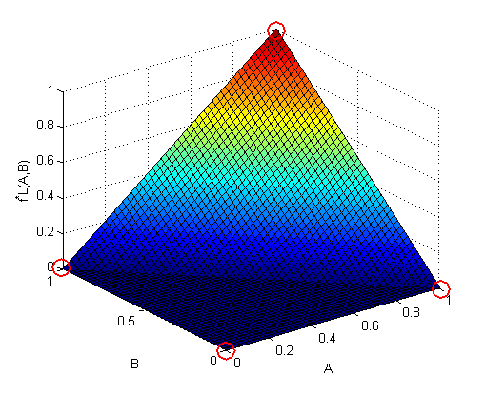
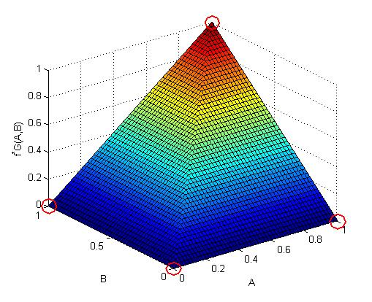
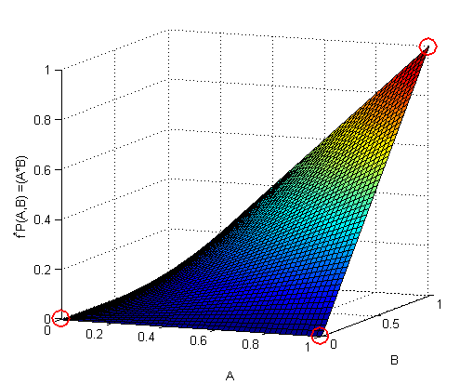
Aggregating User Preferences: Fuzzy logic
Fuzzy-logical AND (T-norms)… phenomenons’ intersection
Lukasiewicz: T_L = max(0, a+b-1) … i.e., minimal possible intersection of two phenomenons
Goedel: T_G = min(a,b) … i.e., full intersection of two phenomenons
Product: T_P = a*b … i.e., assumed intersection of two independent phenomenons

Slide 40
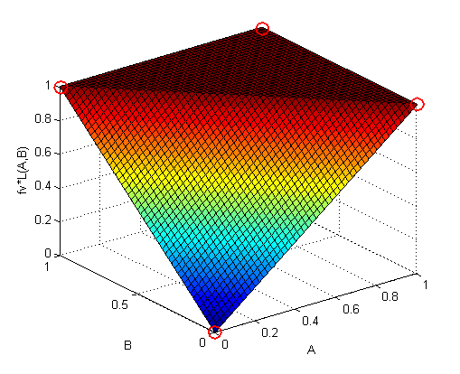
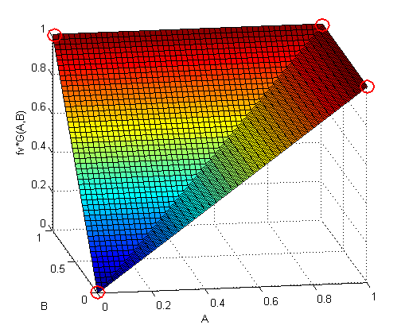
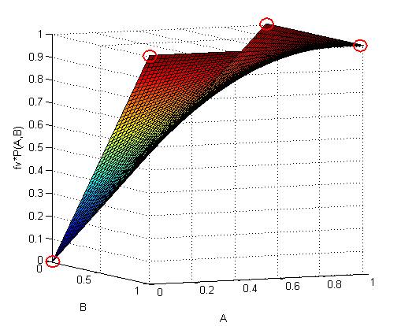
Aggregating User Preferences: Fuzzy logic
Fuzzy-logical OR (T-conorms) … phenomenons’ union
Use deMorgan rules and NOT(x) = 1-x
Lukasiewicz: S_L = min(1, a+b) … i.e., minimal possible intersection of two phenomenons
Goedel: S_G = max(a,b) … i.e., full intersection of two phenomenons
Product: S_P = a+b - a*b … i.e., assumed intersection of two independent phenomenons

Slide 41
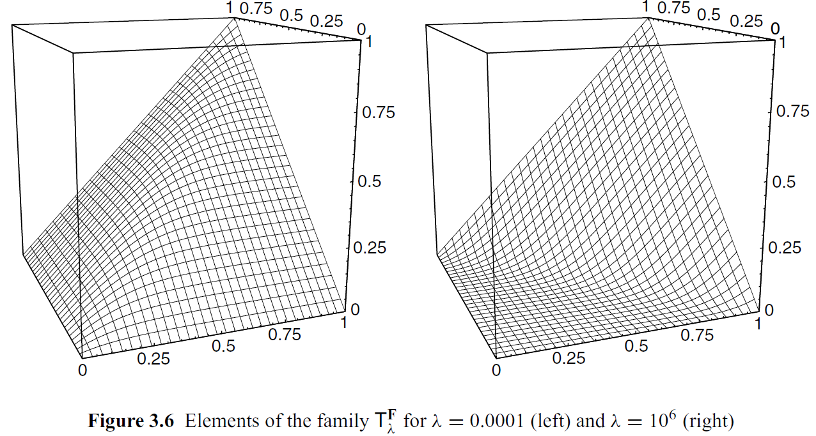
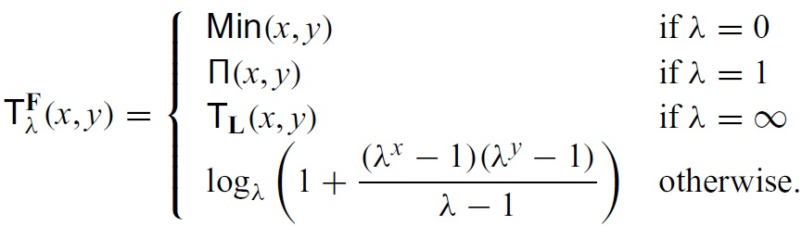
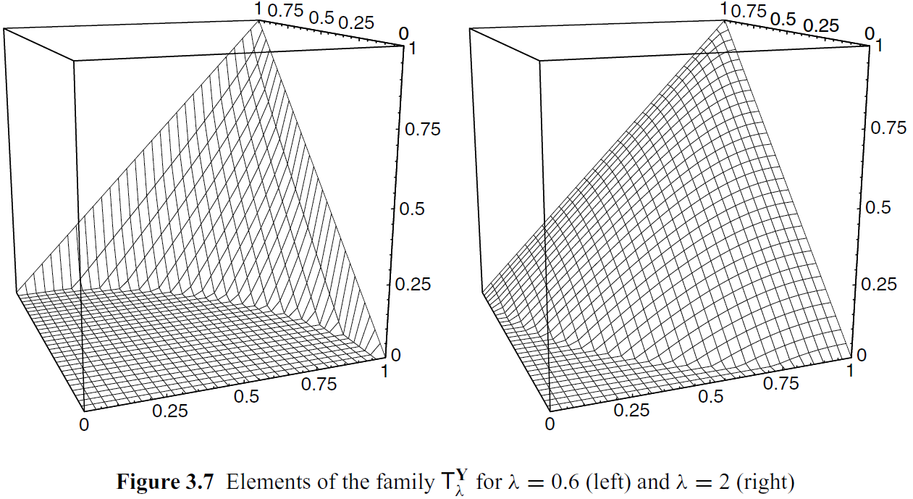
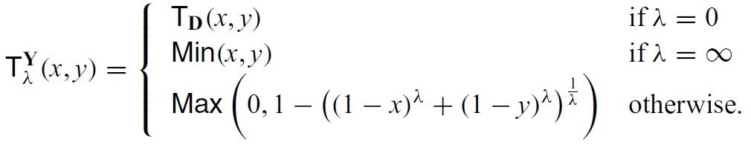
Aggregating User Preferences: Fuzzy logic
Parametrized T-norms
Frank t-norm
Yager t-norm
Grabisch, M., Marichal, J., Mesiar, R., & Pap, E. (2009). Aggregation Functions (Encyclopedia of Mathematics and its Applications). Cambridge: Cambridge University Press.

Slide 42
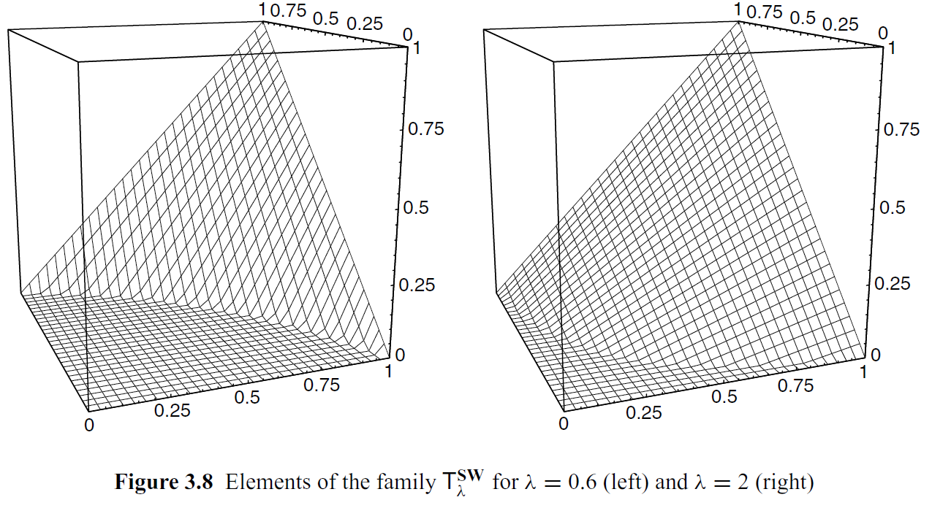
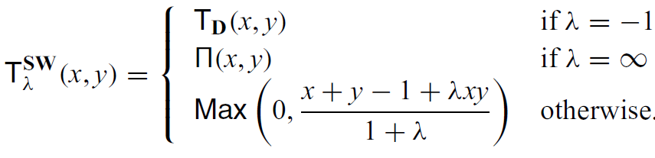
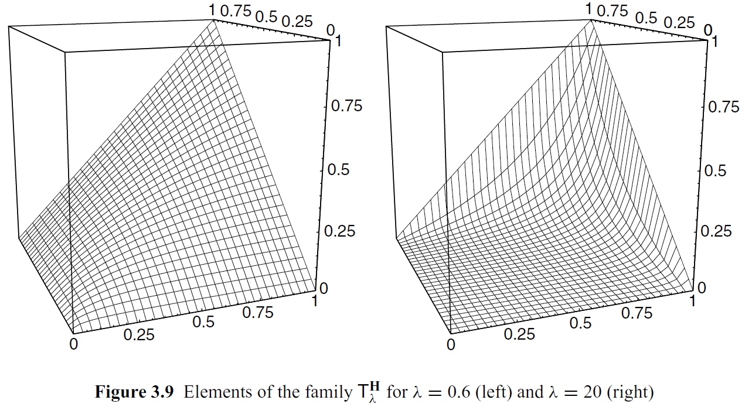
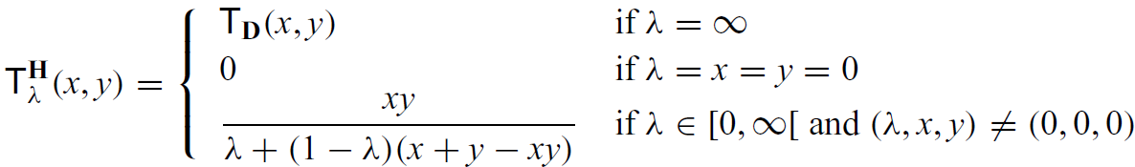
Aggregating User Preferences: Fuzzy logic
Parametrized T-norms
Sugeno-Weber t-norm
Hamacher t-norm
Grabisch, M., Marichal, J., Mesiar, R., & Pap, E. (2009). Aggregation Functions (Encyclopedia of Mathematics and its Applications). Cambridge: Cambridge University Press.

Slide 43
Aggregating User Preferences: Fuzzy logic
Fuzzy logic aggregations
Fills the space between Min – Mean – Max aggregations
Can be tuned/selected with limited data
Nice formalism for faceted search as well
No direct way to incorporate weights for individual objectives

Slide 44
Questions?

Slide 45
Explanations
How to tell the user [whether|that] we did a good job

Slide 46
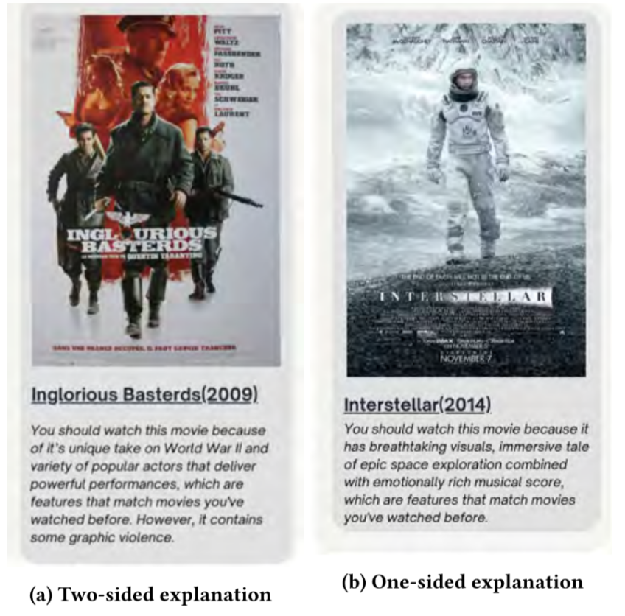
Explanations
Not just what, but also why
Typically personalized to particular user

Slide 47
Explanations - classification
Explaining items vs. Explaining lists vs. Explaining users
Multiple possible roles
Transparency, Validation/Auditing, Persuasiveness, Trustworthiness, Comprehensibility, Education…
Different source data
Metadata, Content itself, Collaborative model
Different output modality
Free text, tags/labels, graphical content
Justification vs. Explanation
Why is the item a good choice vs. Why was the item actually recommended?

Slide 48
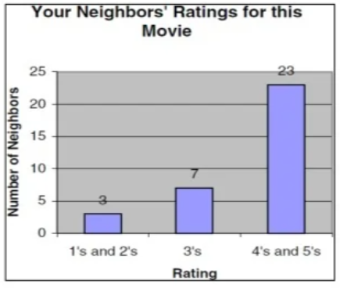
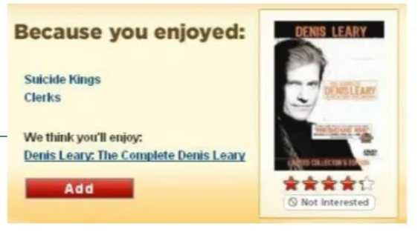
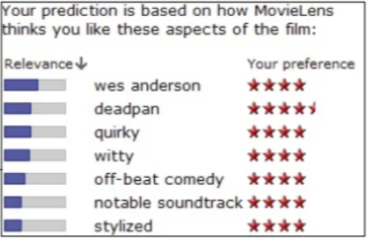
Explanations – early examples
Very often based on basic collaborative algorithms
Tightly coupled with the model’s reasoning
Not really working much, usually
Typically item-wise

Slide 49
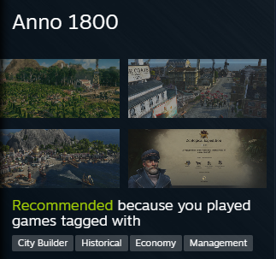



Explanations – more recent examples
Justifications?, item-level
tag-based data & visualizations
Limited expressiveness (why is this city builder a good one?)

Slide 50
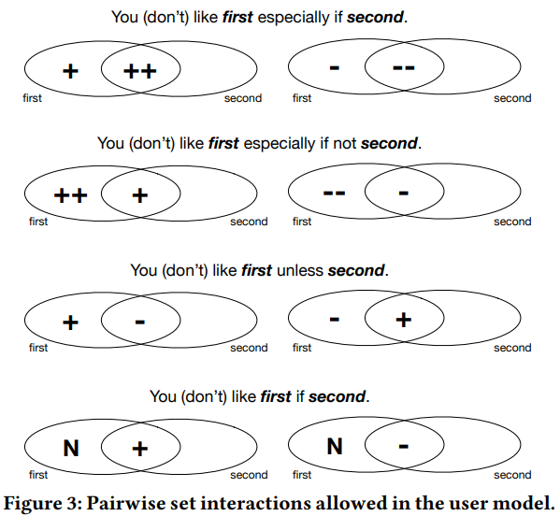
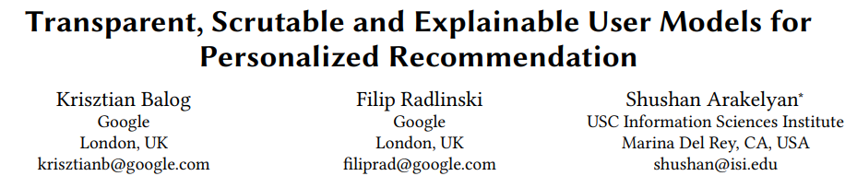
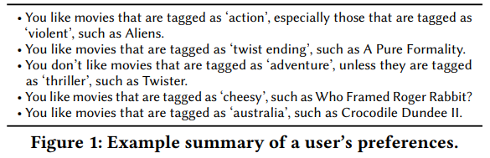
Explanations – list-wise
List-wise / Profile-wise explanations
Tag-based data, set-wise operations
Candidate tags selected w.r.t. coverage and significance
Justifications rather than explanations

Slide 51
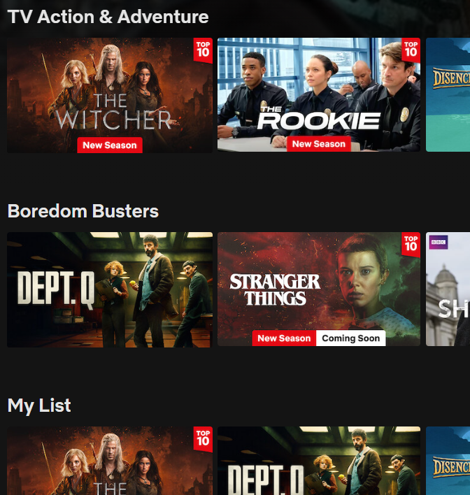
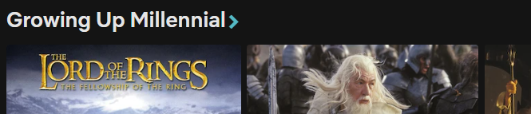
Explanations – more recent
List-wise explanations (labeling)
Actually a 2-step process
First recommend carousels (with labels) then populate them
Alternatively: start with recommendations -> apply clustering -> select cluster labels (beware, many outliers)

Slide 52
NDBI021, Lecture 6
User preferences and advanced recommending methods, 2/1 ZK+Z,
https://www.ksi.mff.cuni.cz/~peska/vyuka/ndbi021/
https://youtube.com/playlist?list=PLTYzSYF3EX3BNIVJkMpCE3vUDmUGvhEcy
https://ksi.mff.cuni.cz

Slide 53
Today’s content
Recap
Explanations, steering
Sparse Autoencoders
Variants of semestral works

Slide 54
Recap

Slide 55
In what way may be weighted average of preferences insufficient?
What may be the problem when asking users about why they liked some item?

Slide 56
What kinds/axes of recommendation explanations can you remember?

Slide 57
Explanations - continued
How to tell the user [whether|that] we did a good job

Slide 58
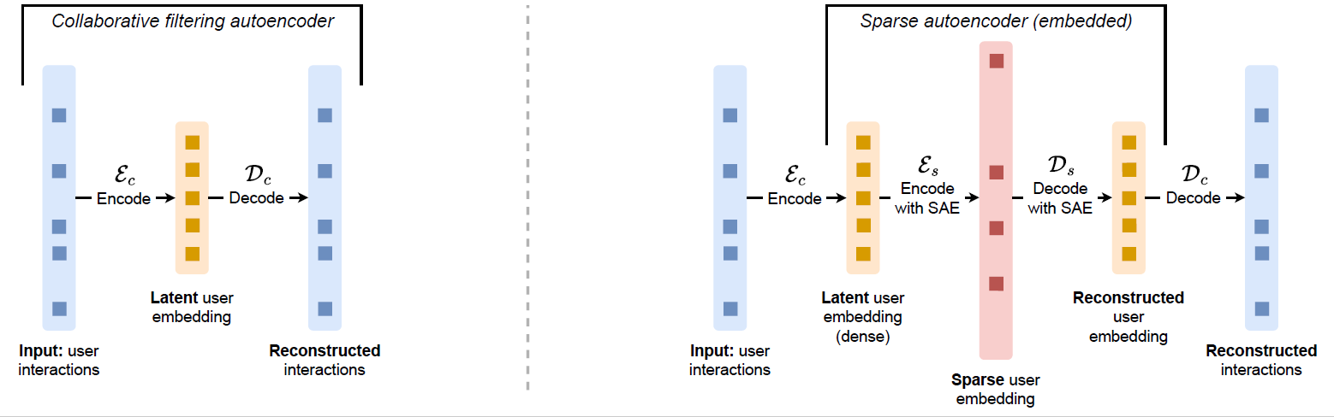
Explanations – more recent examples
Can we provide explanations that actually follow from the model?
Entangled nature of many models based on (dense) latent embeddings
Mechanistic interpretability field (how to explain/audit DL models)
Sparse Autoencoders (SAE)
Large but sparsely activated embedding space (e.g., only keep top-k highest values)
Can be inserted as a hook into any latent embedding (varying performance)

Slide 59
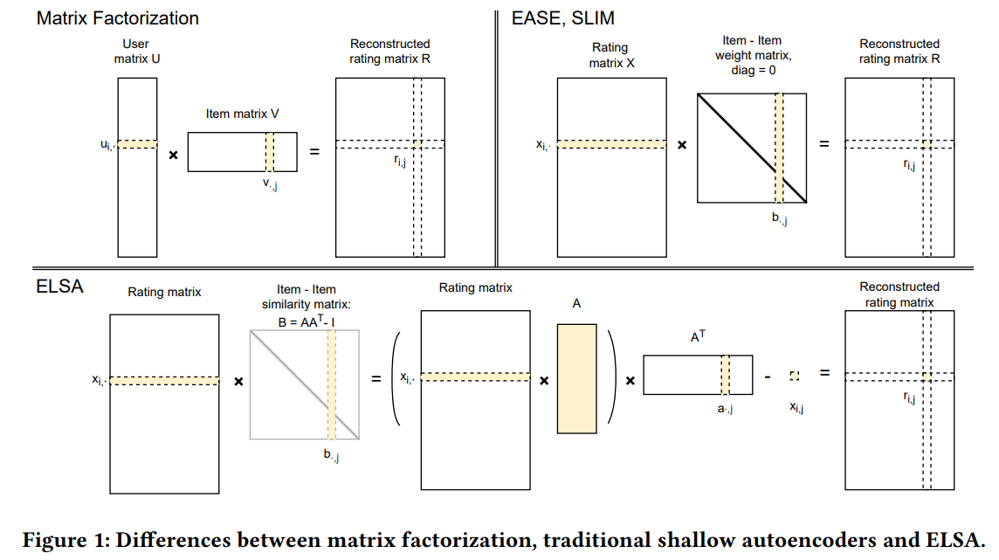



Preliminaries: ELSA linear autoencoder model
ELSA model (low-rank EASE approximation)
- Optimized through gradient descend

Slide 60
Preliminaries: SAE
Various ways to enforce sparsity
L1 regularization loss
Top-k operator, Batch Top-k
Matrioshka model (gradually decreasing sparsity on different neuron segments)
Otherwise classical embedding difference loss + some specialties such as dead neuron prevention

Slide 61

Explanations – SAE
Sparse Autoencoders (SAE)
(mostly) Disentangled nature of the latent embeddings
I.e., each neuron means +/- one thing, we can put labels on them
Different labeling options:
TF-IDF like assignment of tags
LLM based aggregation of items activating particular neuron
…
Direct implication: disclose activated neurons to the user
Similar expressivity as Steam example, but directly related to the actual working of the algorithm
Tereza Beranova, bachelor thesis, Perfume Recommender Systems

Slide 62



Explanations – SAE
Sparse Autoencoders (SAE)
Indirect implication: editorial overlook over the current usage of the system
https://ceur-ws.org/Vol-4056/short1.pdf

Slide 63

Explanations – SAE
Sparse Autoencoders (SAE)
(mostly) Disentangled nature of the latent embeddings
I.e., each neuron means +/- one thing, we can put labels on them
Different labeling options:
TF-IDF like assignment of tags
LLM based aggregation of items activating particular neuron
…
Indirect implication: utilize latent space segmentation for 2D (explained) recommendations
https://compressed-elsa-demo.streamlit.app/demo

Slide 64
Questions?

Slide 65
User / Editorial Steering
How to change recommenders to do a good job?

Slide 66
Recommendation steering
As users, what can we do if the Recommender is not doing a good job?

Slide 67
Recommendation steering
Intentionally provide feedback to move Recommender to a desired direction
Uncertain effect
Requires knowledge of how system works
Browse towards more suitable catalogue area
No permanent effect
Utilize dedicated steering interface
Only limited support in industry so far

Slide 68


Steering interfaces
Conference Navigator system to discover papers & people on a particular conference
Different factors may affect final recommendations
Post-processing the mix through user-exposed sliders
Can be nicely combined with axis-specific explanations

Slide 69


Steering interfaces
Helping users to discover a new music genre, while still considering their profile
Slider to set to what extent displayed tracks should be representative and to what extent they should be similar to the current user profile [spotify semantic features]

Slide 70


Steering interfaces
Balancing accuracy and beyond-accuracy objectives
Users may steer the recommendations on these axes via different UI variants
Follow-up works playing with labels and feedback semantics

Slide 71


Steering interfaces
Content-based boosting
Fixed boost if an item fulfils a user-specified contextual criteria
Good for domains with well-defined and descriptive metadata
Elsewhere metadata might not be enough to describe user’s intent

Slide 72
Steering interfaces
Are we happy?

Slide 73
Steering interfaces
Are we happy?
All steering interfaces realized as post-processing
All steering interfaces worked on top of (coarse-grained) pre-defined axes
Users might need more fine-grained axes to steer towards
We may want to get rid of (possibly expensive) post-processing

Slide 74
Steering interfaces
Are we happy?
All steering interfaces realized as post-processing
All steering interfaces worked on top of (coarse-grained) pre-defined axes
Users might need more fine-grained axes to steer towards
We may want to get rid of (possibly expensive) post-processing
How about using SAEs for steering?

Slide 75

Using SAE for Steering
Define item segments through tag association (can be done as anything else)
Operationalize steering towards segment as follows:
Find which neuron best represents given tag (TF-IDF like score on top of tag-item and item-neuron mappings)
Use original user encodings, but boost the particular neuron by some fixed/relative weight
Results should steer towards what is being represented by that neuron while still reflecting user’s preferences

Slide 76

Using SAE for Steering

Slide 77

Using SAE for Steering

Slide 78
Steering interfaces
Are we happy now? ☺

Slide 79
Steering interfaces
Are we happy now? ☺
The segments (metadata) might not reflect all what users may want to steer to => Different segment labeling (LLMs)
How to disclose the steering option to users?
List of features? Textual prompt?
The neurons might not reflect all what users may want to steer to
They are trained to reflect differences observed in interactional data
But some emerging trends might be missing & not ready for fully conversational approach.

Slide 80
Questions?

