Slide 1


NDBI021, Lecture 4
User preferences and advanced recommending methods, 2/1 ZK+Z,
https://www.ksi.mff.cuni.cz/~peska/vyuka/ndbi021/
https://youtube.com/playlist?list=PLTYzSYF3EX3BNIVJkMpCE3vUDmUGvhEcy
https://ksi.mff.cuni.cz

Slide 2
Today’s content
Recap
User feedback
  Intro
  Preference Elicitation
  Explicit Feedback
  Implicit Feedback
  Non-numeric Feedback
From feedback to preferences

Slide 3
Recap

Slide 4
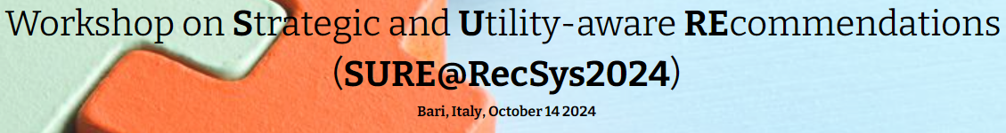
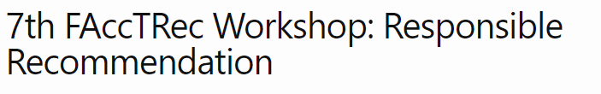
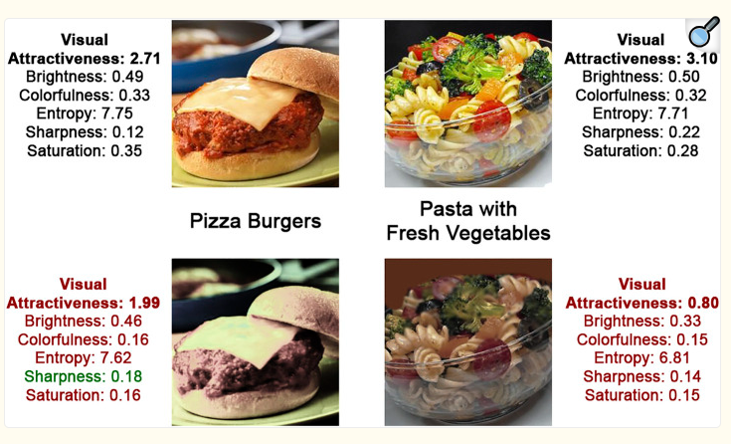



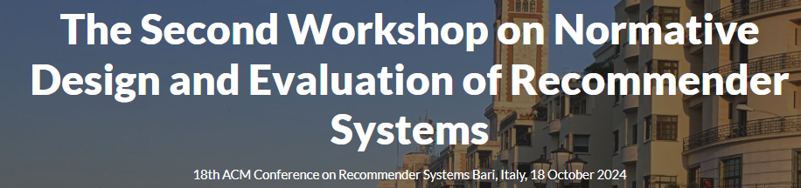

Any open problems in RS you remember?
Why we might need preference elicitation?

Slide 5
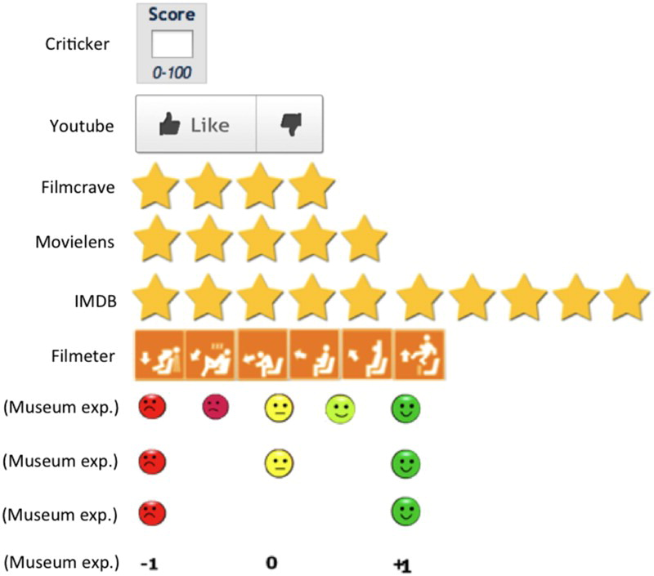
What is explicit feedback?

Slide 6
Explicit feedback (leftovers)
Let the users tell rate you

Slide 7
Explicit feedback: how much inconsistent it can be?
https://xamat.github.io/pubs/xamatriain_umap09.pdf
Netflix dataset, both popular & unpopular movies
Three trials, 5-scale rating + unseen of 100 movies: 1->2 at least one day apart, 2->3 at least 14 days apart, different ordering of items (random -> popular -> random)
Usually, rating differs just by one point; mediocre movies more unstable

Slide 8
Explicit feedback: how much inconsistent it can be?
https://xamat.github.io/pubs/xamatriain_umap09.pdf
Netflix dataset, both popular & unpopular movies
Three trials, 5-scale rating + unseen of 100 movies: 1->2 at least one day apart, 2->3 at least 14 days apart, different ordering of items (R1:random -> R2:popular -> R3:random)
Inconsitencies are more frequent in less popular (less known?) items

Slide 9


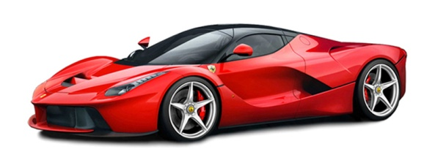
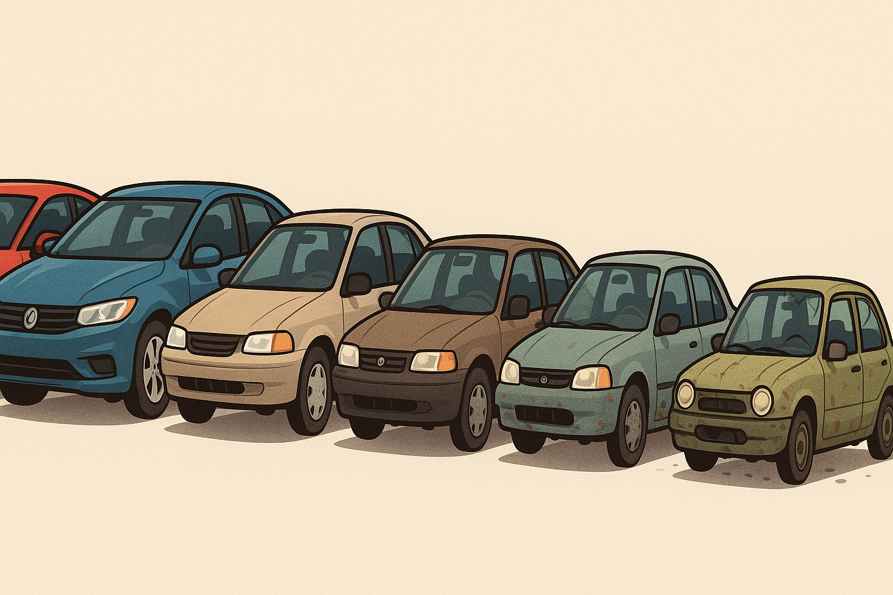
Explicit feedback: how much inconsistent it can be?
Assimilation/Contrast effect on sequence of ratings
  https://psycnet.apa.org/record/2001-01676-002, https://en.wikipedia.org/wiki/Assimilation_and_contrast_effects
  Main findings:
    Contrast: A user is likely to give a lower rating to an item if the preceding one deserved a very high evaluation.
    Assimilation: However, if successive items are comparable in their ratings, the user is likely to assimilate the second item to the preceding one and give the same rating to both

Slide 10
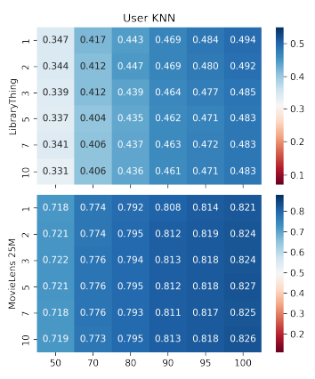
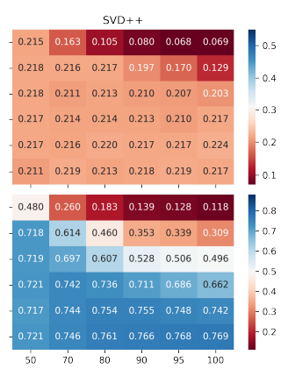
Explicit feedback: does granularity helps?
 Feedback granularity =>  preference understanding =>  recommendations
=>  task complexity =>  feedback volume =>  recommendations
Which phenomenon will have a higher impact?
  Understanding the Temporal Dynamics of Recommendations across Different Rating Scales
  (https://ceur-ws.org/Vol-997/umap2013_lbr_7.pdf)
    Comparing 1-5 star rating scheme with positive-neutral-negative (with explicit conversions)
    Utilizing User kNN algorithm, book dataset, rating prediction task (MAE)
    3-valued feedback result in lower MAE than 5-valued one (surprising)
  The Effect of Feedback Granularity on Recommender Systems
  Performance (https://dl.acm.org/doi/abs/10.1145/3523227.3551479) [our work]
    Movies and books data, more rating granularity (1,2,3,5,7,10) and explicitly
    model the feedback volume decrease
      More granular data may improve the results of some algorithms – but not all
      Even the slightest decrease in the feedback volume has much stronger impact
      on the results than feedback granularity

Slide 11
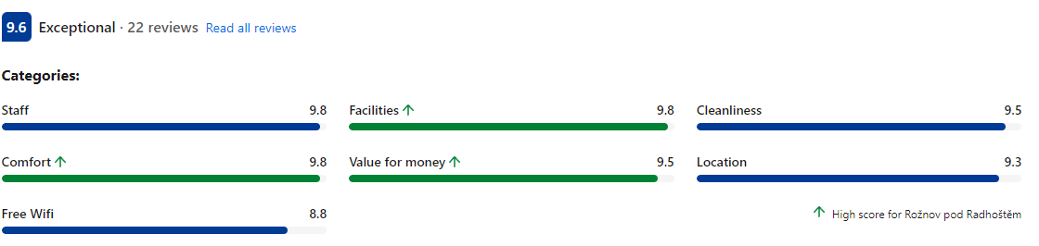
Explicit feedback: other variants
Explicit comparison of items / groups of items
  Never seen outside of preference elicitation models
  And one ancient dating app...
  May be fun for users -> higher engagement... But only for specific use-cases
Explicit rating of item’s attributes
  Multimodal rating
  Not frequent, but relevant for well-defined cases
    Booking.com example
    Might not have a 1:1 map to attributes as defined in items metadata
Writing a review (is it really explicit feedback?)
  Emotion/polarity detection, feature detection
  Details maybe later – if enough time

Slide 12
Explicit feedback
How does the industry feel about that?

Slide 13
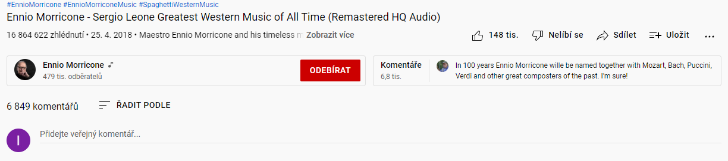


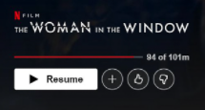







Explicit feedback in industry
Artist, album & track

Slide 14
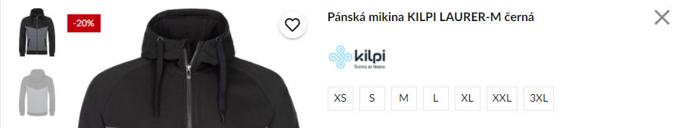
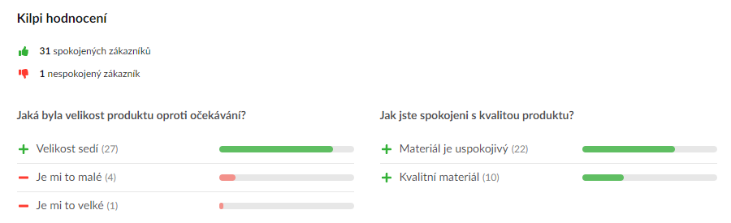


Explicit feedback in industry

Slide 15
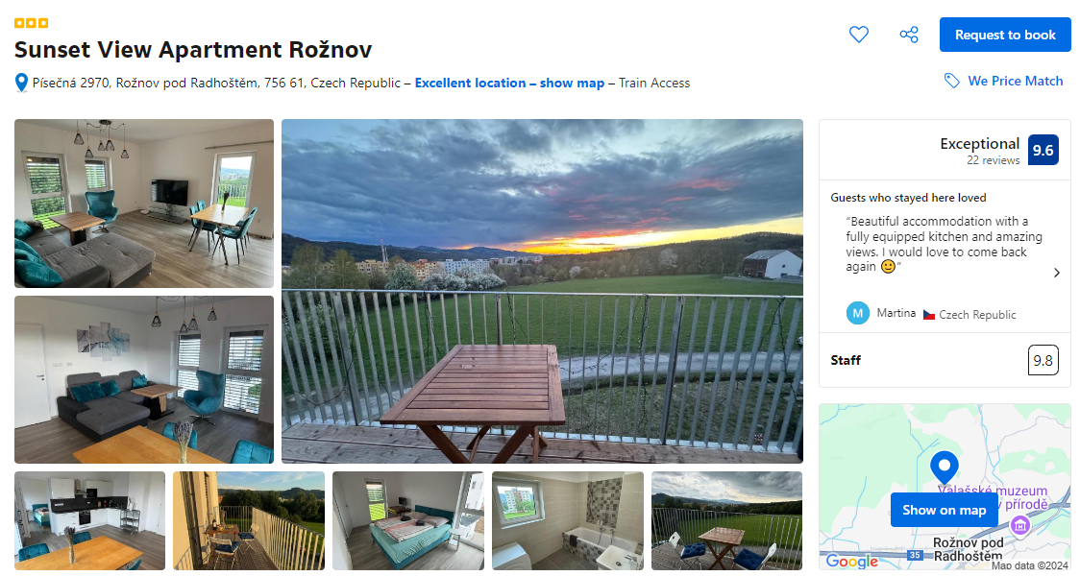
Explicit feedback in industry

Slide 16
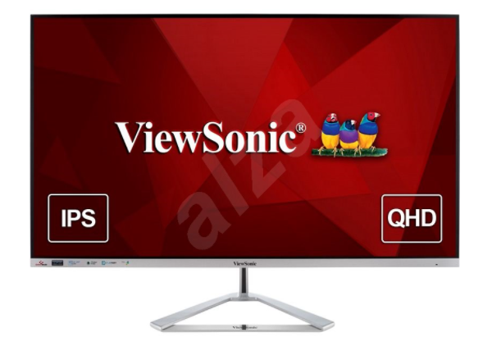
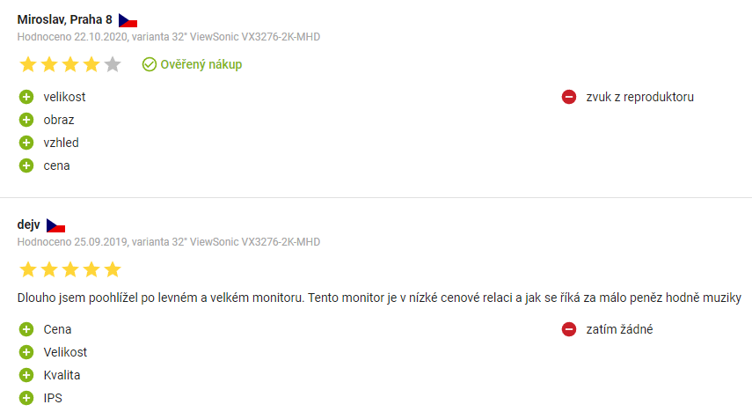
Explicit feedback in industry

Slide 17
Explicit feedback in industry
Some users are sometimes willing to
Provide ratings
  Sometimes aspect-based ratings (mostly pre-defined, widely recognized categories)
    Does not have to correspond to object’s attributes directly
Write review/comment
Explicit / implicit borderline:
  Add object to some list / organize favorite objects / provide tags for them
  Share items
Is this frequent enough so we can infer preferences of individual users?

Slide 18
Implicit feedback
Let the users tell consume (you)

Slide 19
Implicit feedback
Information received unconsciously by simply observing what the user do
Common beliefs
Often, implicit feedback is considered as unary or binary
Even binary feedback is rather noisy (accidental clicks etc.)
It is hard to interpret more refined information
We can receive it in abundant volumes
  Non-intrusive design
Collection points
Server-side (limited expressibility)
Client-side (triggered DOM events)
Beyond (eye-tracking, other biometrics)
  Limited applicability (lab studies)
  Can provide leads on interpretation of the previous two

Slide 20
Implicit feedback
Server-side
  Stream of visited pages
  Asynchronous loading of page content (e.g. more results)
  Proxy for time on page / dwell time (very coarse)
    http://www.hongliangjie.com/publications/recsys2014.pdf (RecSys 2014 best paper)
Not much information available
  But non-intrusive & cannot be turned off or altered easily
  Possible use-case: recommendation as a service, only partially cooperating 3rd-party

Slide 21
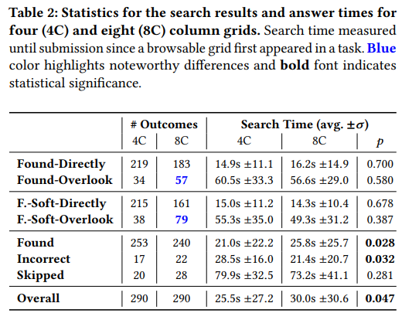
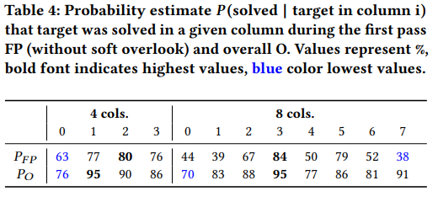
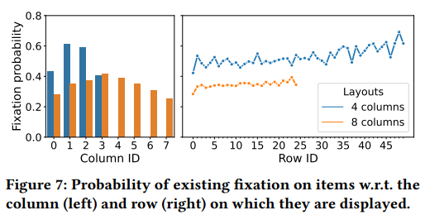

Implicit feedback
Beyond
What, out of the displayed content do users actually perceive?
Eye-tracking studies, sometimes relating other feedback with eye gazes
  Known-Item Search in Video: An Eye Tracking-Based Study, https://dl.acm.org/doi/10.1145/3652583.3658119 [our work]
    Grid of displayed images, either 4 or 8 columns; Marine video frames;
    Where users mostly look?
    Which setting has more overlooks? What is the overlook probability?
    Are users eye-gazes content dependent? To what extent?

Slide 22
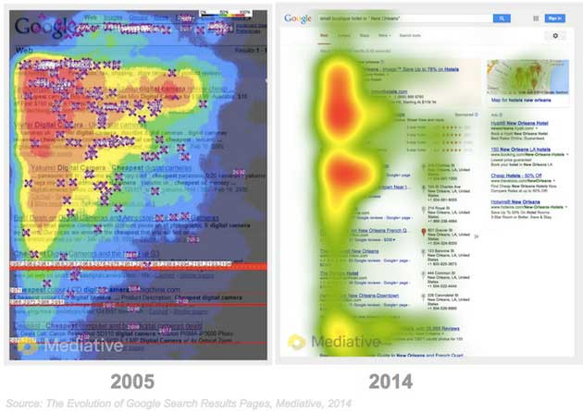
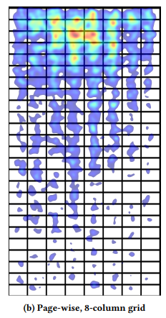
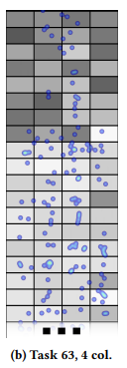
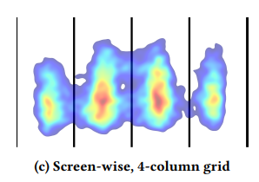
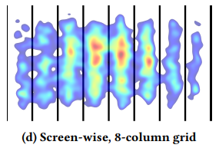
Implicit feedback
Misses on the
first row
Soft dependence on content quality
Expectations: golden triangle
Reality: central pattern

Slide 23
Implicit feedback
Client-side
Any DOM event can be captured, processed and stored…
  But which ones are relevant?
    And also… what is their semantics?

Slide 24
Implicit feedback
Client-side
Any DOM event can be captured, processed and stored…
  But which ones are relevant?
    And also… what is their semantics? Does it differ from explicit feedback?
  What features are we actually building from these events?
  Are collected data dependent on some context?
  How to establish what is a desired behavior and what is not?
Peska, IPIget: The Component for Collecting Implicit User Preference Indicators
https://www.researchgate.net/publication/305495313_IPIget_The_Component_for_Collecting_Implicit_User_Preference_Indicators

Slide 25
What to Collect as Implicit feedback
Not very explored area
Domain dependence (how surprising☺)
Publicly available datasets divert attention from this topic
  Tune the algorithms on what is available in the data
  „The decision on what to collect has already been made“
  Not much work done on how to deal with heterogeneous feedback signals (gradually changing nowadays)
Not many known industry papers with details on implicit feedback collection and its treatment
  Part of their know-how?
However…

Slide 26
What to Collect as Implicit feedback
However… some things are fairly common:
(count of) page visits => object visits
Time on page / dwell time
  Beware to count only while focus is on the page (http://www.hongliangjie.com/publications/recsys2014.pdf)
Objects consumption statistics (playcounts, viewtime, purchase, store in basket,…)
!!! Impressions !!! (what was shown to the user)
  Contextual impressions
  Estimate what was actually perceived by the user

Slide 27
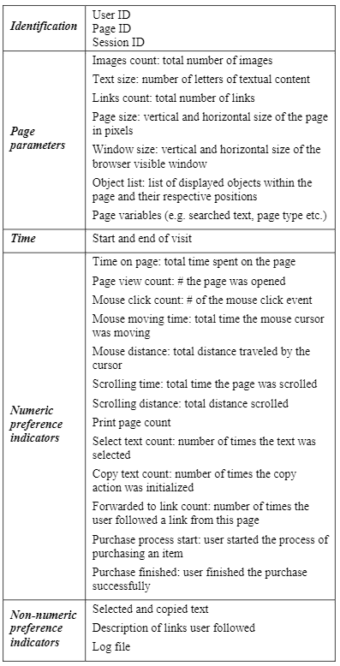
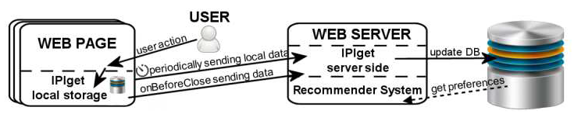
What to Collect as Implicit feedback
Peska, IPIget: The Component for Collecting Implicit User Preference Indicators
https://www.researchgate.net/publication/305495313_IPIget_The_Component_for_Collecting_Implicit_User_Preference_Indicators
Main target: small e-commerce vendors
  Events
    Page visits
    Time pings
    Scrolling
    Mouse position sampling
    Mouse over pre-defined elements
  Other aggregated events: print, search, copy, text selection (not much usable)
  Non-numeric data (searched text, selected text,…)
  Basic page statistics
    Volume of text, images, links
    page dimensions, window dimensions
    position of elements
    Page params (e.g. Catalogue -> menswear -> Trousers…)

Slide 28
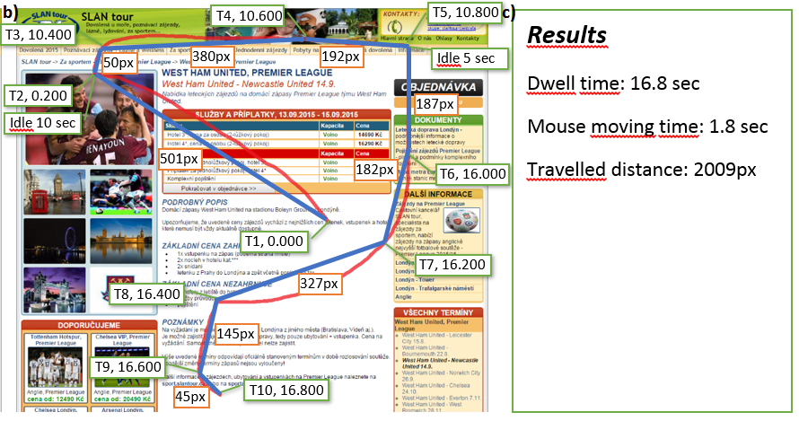
What to Collect as Implicit feedback
Hovering over photos

Slide 29

What to Collect as Implicit feedback
Collect visible area through time (scrolling position + window dimensions)
Store areas where interesting page segments are located
  Items in category page
  Areas focused on item’s features
Calculate visibility => noticeability of individual components
If the item is clicked, it should be more preferred than not-clicked ones with high-enough noticeability
Usually referred to as Visible impressions nowadays
https://link.springer.com/article/10.1007/s13740-016-0061-8

Slide 30
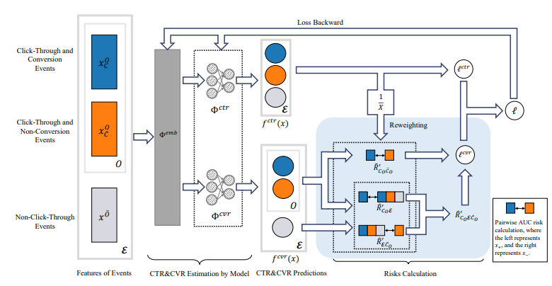


How to interpret numeric implicit feedback?
Assumption: most RS algorithms are tailored to utilize binary/unary feedback
  BPR, EASE, most sequence-aware algorithms…
  Why not to just use simple binary feedback?
  Downside: we might be loosing too much by relying on coarse-grained + sparse information
Assumption: many algorithms are tailored to utilize explicit numerical feedback
  SVD, variants of KNN,…
  Historically, much higher coverage due to MovieLens and similar datasets
  Somehow, translate the multimodal implicit feedback signal to what can be understood as rating. Than use algorithms suitable for explicit feedback.
Assumption: multiple feedback modalities are equally important,
lets jointly predict them
  Click-through rate & post-click conversion rate
  Two-tower design of the multi-task learning model

Slide 31

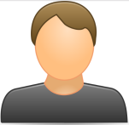
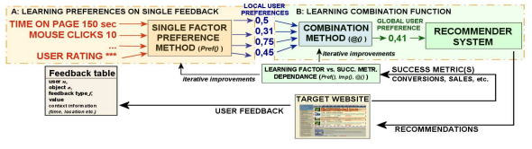
How to interpret numeric implicit feedback
Translate implicit feedback to rating: simple designs
Get graded „rating-like“ output from the combination of multiple feedback types
  Rating-based recommender systems can be used afterwards
The more the better hypothesis
  Normalize data (Time on page vs. Scrolling distance vs. Vol. of visits)
  (shifted) standardization, cummulative distribution
  function, log transformation…
    Try to consiesly define what meaning each value has
  Aggregate per-modality values (wAVG, fuzzy logic,…)
Dwell time: 10s
Scrolling: 100px
Mouse movement:250px
Mean feedback: 0.2
Dwell time: 100s
Scrolling: 200px
Mouse movement:450px
Mean feedback: 0.4

Slide 32
How to interpret numeric implicit feedback
Translate implicit feedback to rating: target feedback modality
  Use other feedback modalities to predict the target one. Use prediction certainty as rating
Use feedback linked with positive/negative preference
  Ratings, purchases: rare, but with clear interpretation
  Train arbitrary ML to predict the above based on other implicit feedback features
    Class probability or any other confidence notion can then work as the rating
    Positive preference indicators are usually very sparse => bootstrap / stratified sampling / weighting
Dwell time: 10s
Scrolling: 100px
Mouse movement:250px
Rating: 0.2
Dwell time: 100s
Scrolling: 200px
Mouse movement:450px
Rating: 0.8
https://www.researchgate.net/publication/283526661_How_to_interpret_implicit_user_feedback,
https://www.ksi.mff.cuni.cz/~peska/wims13.pdf

Slide 33

How to interpret numeric implicit feedback
Combine all implicit feedback features to generate additional „probably positive“ examples
  Use factor analysis to relate additional feedback indicators with the target (binary) purchase
  Then, generate additional positive examples with some confidence value and sample from it
    Sampled items represent additional positive examples to train the model
  Use standard BPR MF to learn user & item factors
    One tweak: use confidence as a power in the loss function
Stream of JS events: mouse motion, keyboard, scroll
+
Stream of JS events: mouse motion, keyboard, scroll
Resolving data sparsity by multi-type auxiliary implicit feedback for recommender systems
https://www.sciencedirect.com/science/article/pii/S0950705117304653

Slide 34
How to interpret numeric implicit feedback
Combine all implicit feedback features to estimated user rating
  Standard recommender systems can be used afterwards
Use feedback linked with positive/negative preference
  Ratings, purchases
  Train ML predictor to predict this based on other implicit feedback features
    Note that positive preference indicators are usually very sparse => bootstrap / stratified sampling / weighting
  Make individual preference estimators per feedback type &
  their aggregator (wAVG, fuzzy logic,…)
    In case of insufficient data or specific model in mind
https://www.researchgate.net/publication/283526661_How_to_interpret_implicit_user_feedback,
https://www.ksi.mff.cuni.cz/~peska/wims13.pdf
Stream of JS events: mouse motion, keyboard, scroll
Active time: 50s
Are we over-complicating things a bit?
Stream of JS events: mouse motion, keyboard, scroll
Active time: 20s

Slide 35
How to interpret numeric implicit feedback
Construct single (complex) implicit feedback based proxy for user preference
  Standard recommender systems can be used afterwards
Active dwell time (my best guess on what a simple feature could work well)
  Time spent on page
  But counted only if some other events are detected in close temporal proximity => user is active
Stream of JS events: mouse motion, keyboard, scroll
Active time: 50s
Stream of JS events: mouse motion, keyboard, scroll
Active time: 20s

Slide 36
How to interpret numeric implicit feedback
Construct single (complex) implicit feedback based proxy for user preference
  Standard recommender systems can be used afterwards
Active dwell time [not confirmed by literature]
  Time spent on page
  But counted only if some other events are detected in close temporal proximity => user is active
Dwell time: 10s
Scrolling: 100px
Mouse movement:250px
Rating: 0.2
Is that all we should do?
Dwell time: 100s
Scrolling: 200px
Mouse movement:450px
Rating: 0.8

Slide 37
How to interpret numeric implicit feedback
Is that all we should do?
Negative Implicit Feedback
Context of User Feedback
Long-term Preference Indicators

Slide 38
Context of user feedback

Slide 39
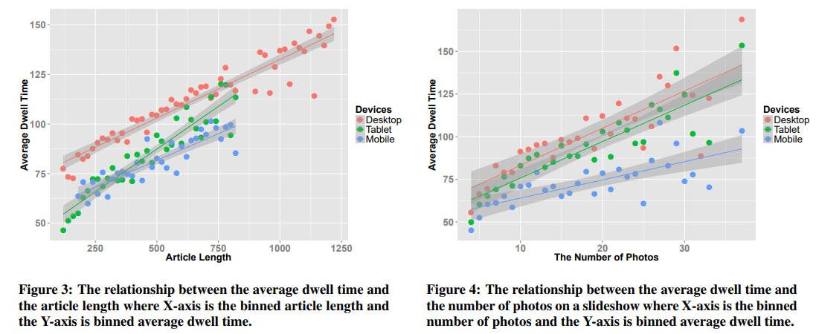
How to interpret numeric implicit feedback
Beyond Clicks: Dwell Time for Personalization, https://dl.acm.org/doi/10.1145/2645710.2645724 [RecSys2014 best paper]
Pages may substantially vary in length, amount of content etc.
  This could affect perceived implicit feedback features
  Leveraging context could be important
Consumption statistics may significantly vary also for different device types

Slide 40



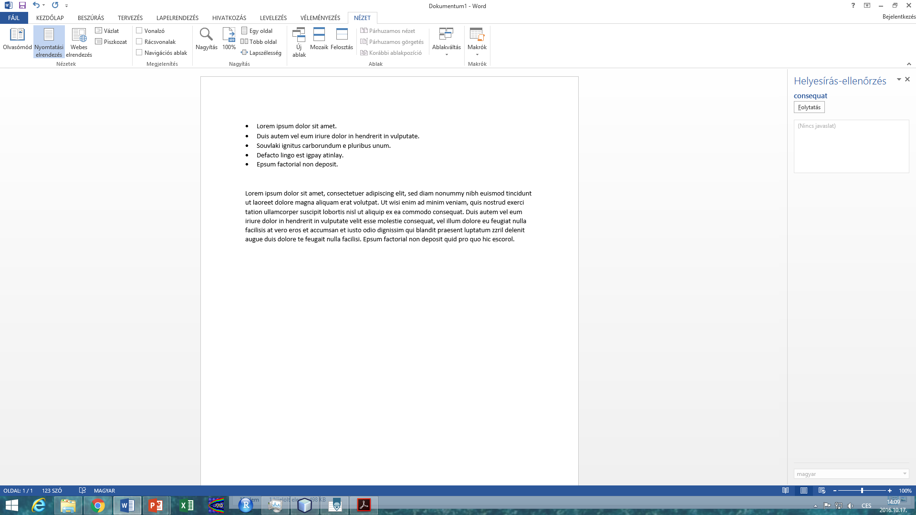
How to interpret numeric implicit feedback
Context of the user
  Location, Mood, Seasonality...
  Can affect user preference (but is out of scope here)
Context of device and page
  Page and browser dimensions
  Page complexity (amount of text, links, images,...)
  Device type
  Datetime
  Can affect percieved values of the user feedback
A
B
http://btw2017.informatik.uni-stuttgart.de/slidesandpapers/E3-16/paper_web.pdf

Slide 41
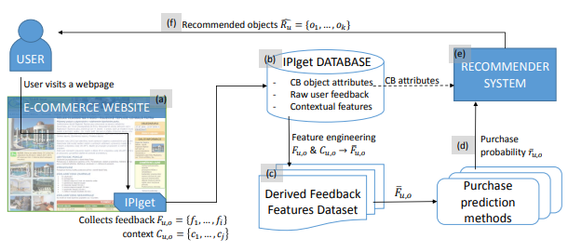

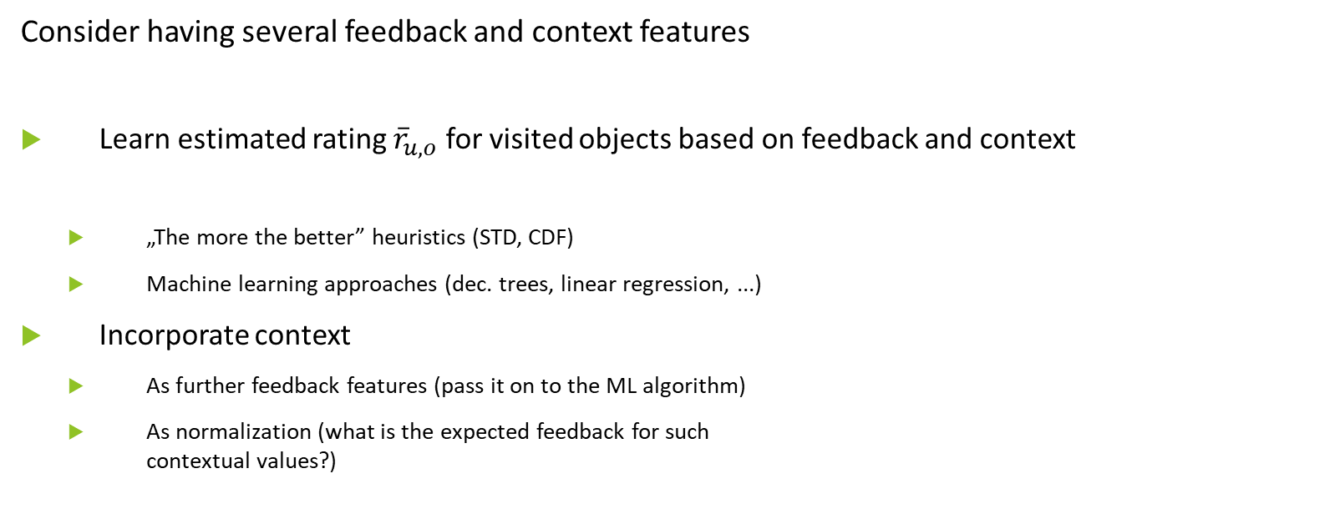
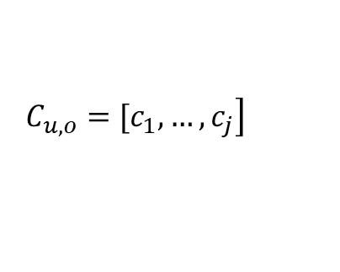
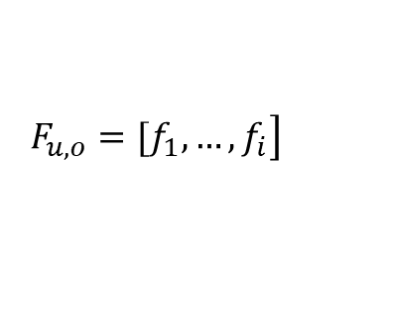
How to interpret numeric implicit feedback
Using the Context of User Feedback in Recommender Systems
https://arxiv.org/pdf/1612.04978.pdf
Consider having several feedback and context features
Learn estimated rating ${\overline{r}}_{u,o}$ for visited objects based on feedback and context
  „The more the better” heuristics (STD, CDF)
  Machine learning approaches (dec. trees, linear regression, ...)
Incorporate context
  As further feedback features (pass it on to the ML algorithm)
  As normalization (what is the expected feedback for such
  contextual values?)
$$\left. F_{u,o}=[f_{1},…,f_{i}\right]$$
$$\left. C_{u,o}=[c_{1},…,c_{j}\right]$$
$$F_{u,o}, C_{u,o}→{\overline{r}}_{u,o}:o∈S$$

Slide 42
Negative preference from implicit feedback
Can my consumption say I don’t like it?

Slide 43
Negative preference from implicit feedback
Object detail level
If more is better… „not-enough“ might mean I do not like it?
  Where is the borderline?
  https://dl.acm.org/doi/10.1145/2479787.2479800 [Our work]
    (below average implies negative – maybe not the best idea, selection bias)
Google Analytics: bounce rate (leaving the page „immediately“ after openning it)
But why?
  Did I waited too long to load page?
  I clicked on it accidentally?
  I found sth. better in the meantime?
  The short description looked good, but it was missleading / did not cover important drawbacks
    Would this transfer into decreased feedback values?
    Maybe, maybe not (Seznam.cz lecture@NSWI166, clickbaits have similar consumption stats)

Slide 44
Negative preference from implicit feedback
The lack of positive feedback on object detail level
https://link.springer.com/content/pdf/10.1007%2F978-3-642-02247-0_47.pdf
  RecSys for jobs
    If the job was openned, but no positive action was recorded
    (applying /saving for later /...), consider it as negative
    Applied to extend user profile similarity (both users disliked similar jobs)
But do we have the full information?
  User could just bookmark the job outside
  User could simply leave interesting offers open
Spiritual followers: multi-armed bandits with delayed feedback
  Positive feedback may come later, but has to come – otherwise considered as negative

Slide 45
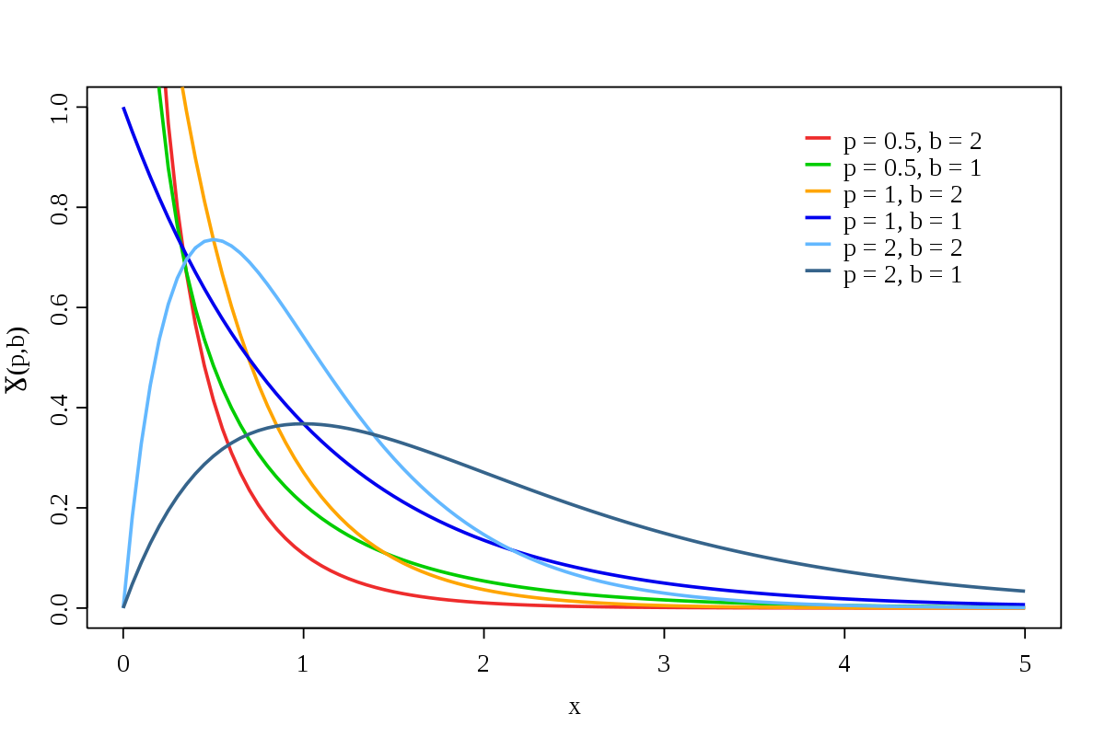
Negative preference from implicit feedback
De-noising binary implicit feedback (SATtisfied /DisSATtisfied click)
  Static (e.g. only count clicks with >30sec click dwell time as positive)
  Context-aware
Modeling Dwell Time to Predict Click-level Satisfaction; https://dl.acm.org/doi/pdf/10.1145/2556195.2556220
  Feedback from search engines, text query
    Query topic, query types / page topic, reading difficulty
  Use click dwell time, known SAT / DSAT labels
  Decision trees: identify relevant context segments [strange]
    Fit Gamma distribution for both SAT, DSAT and each segment
  Predictor based on actual dwell time and SAT / DSAT params.
Dwell time: 40s
Page context
Rating: 1
Dwell time: 100s
Page context
Rating: 0

Slide 46
Negative preference from implicit feedback
De-noising binary implicit feedback (SATtisfied /DisSATtisfied click)
  Context-aware
Denoising Implicit Feedback for Recommendation (https://arxiv.org/pdf/2006.04153.pdf)
  „False-positive interactions are harder to fit in the early stages. According to the theory of robust learning, easy samples are more likely to be the clean ones and fitting the hard samples may hurt the generalization.“
  Discard or reduce weight for train interactions with high initial loss
    Counter-intuitive, but may work☺
  No need for additional types of feedback with this approach
Visited Item
Rating: 0
Visited Item
Rating: 1

Slide 47
Negative preference from implicit feedback
De-noising binary implicit feedback (SATtisfied /DisSATtisfied click)
  Context-aware
Denoising Implicit Feedback for Recommendation (https://arxiv.org/pdf/2006.04153.pdf)
  „False-positive interactions are harder to fit in the early stages. According to the theory of robust learning, easy samples are more likely to be the clean ones and fitting the hard samples may hurt the generalization.“
  Discard or reduce weight for train interactions with high initial loss
    Counter-intuitive, but may work☺
  No need for additional types of feedback with this approach

Slide 48
Negative Preference from category-level feedback
If impressions data are available
If I (repeatedly) ignore an object, I probably dislike it
How many times do I have to ignore it?
  Lien Michiels: it may take time before users get used to the idea of something completely new
    Explorative items may need more time to adopt
    Typically leads to partial downweighting with temporal decay
What is the chance I just missed the item?
  Depending on data quality, we may consider uniform chance, sequential exploration, or more complex patterns
  https://link.springer.com/article/10.1007/s11257-021-09311-w

Slide 49
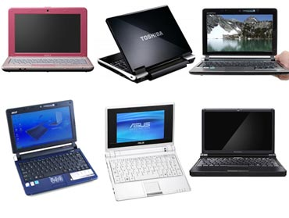
If you have detailed implicit feedback...
Using Implicit Preference Relations to Improve Recommender Systems [our work]
If user selects some objects from the list, we take it as an evidence of his/her positive preference.
  User prefers selected object(s) more, than other displayed & ignored objects
  We can form preference relations: IPR_{rel} (selected obj. > ignored obj.)
  Intensity of the relation based on the level of visibility for both items
    Visibility of clicked item considered as sufficient -> if the visibility of ignored was lower, strength of the relation decreases
In paper, CB extensions for relations (maybe not the best idea)
Contextual BPR might work better
>
>
  https://link.springer.com/article/10.1007/s13740-016-0061-8

Slide 50
Negative Preference from category-level feedback
Gaze Prediction for Recommender Systems, https://dl.acm.org/doi/pdf/10.1145/2959100.2959150
Grid RecSys design (3rows x 8 columns)
  Where would the user look within the page?
  Can we predict the eye gaze based on other feedback?
    Fixation existence + time of fixation
    Position, dwell time, distance to closest existing action
    Fairly usable if a small volume of gaze data exist
Both left-right & top-bottom decrease in fixations
  Contradicting to our own work, but no scrolling included in this experiment
If sufficient dwell time, fixation probability is close to 1 for all positions

Slide 51
Long-term indicators of user preference
Much less frequent events than short-term feedback
-> harder to optimize for, but closer to real goals
(user retention, satisfaction, sustained engagement)
Repeated consumption (re-visits)
Next day/week/month return, inter-session time, users retention
Account lifetime / survival time / Subscription continuation

Slide 52
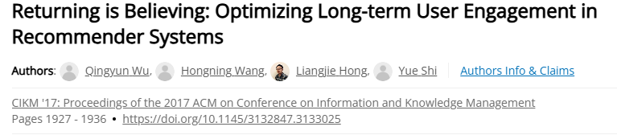
Long-term indicators of user preference
Retention-aware models
Combine immediate value (next item prediction) with retention signals (returning users)

Slide 53
Long-term indicators of user preference
Retention-aware models
Combine immediate value (next item prediction) with retention signals (returning users)

Slide 54
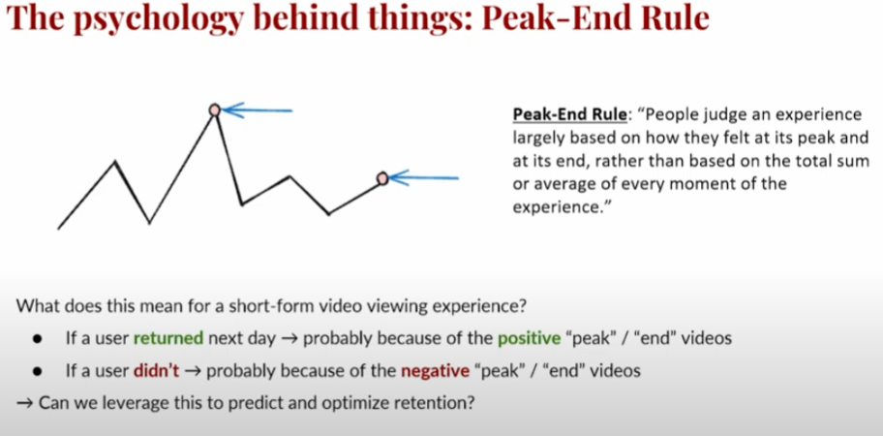
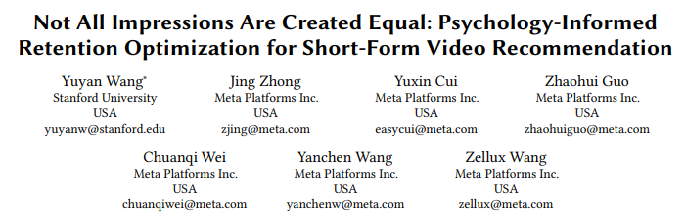
Long-term indicators of user preference
Map short-term signals to long-term ones
RecSys2025 paper: Peak-End rule (users are mostly affected by their feelings during the peak and at the end ) [Meta’s short video reels]
https://www.youtube.com/watch?v=GmJKyl0g_Nc
https://dl.acm.org/doi/pdf/10.1145/3705328.3748122

Slide 55

Questions?

Slide 56
How to model user preferences
What can be expressed & how to express it

Slide 57
How to model user preferences?
What are the targets of the preference mining?
  Entity granularity
Who gives the preference (who is the user)?
  Group preference, Various confidence in user identification.
What are expected connections among the entities (hypotheses)?
  Aggregation methods and fuzzy logic
  (Knowledge) Graph-aware recommending algorithms
Does user preference depend on some context/conditions?
  Context-aware Recommender Systems
In what way do we allow users to express their preferences?
  [Already covered] Explicit/implicit/other feedback

Slide 58
Entity selection & Granularity

Slide 59
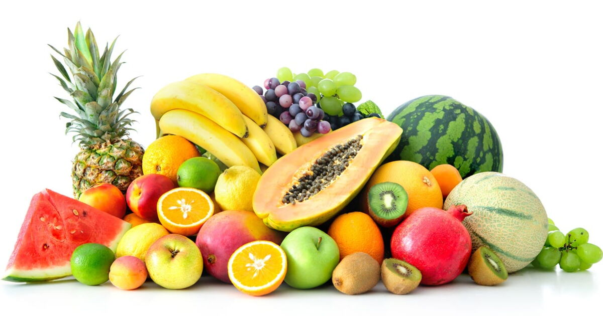
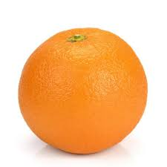
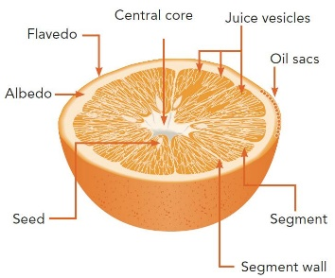
Points to consider in modeling phase
What entities are relevant?
  Are they sufficiently recognizeable?
  Can we get enough data about them?
  How much added value they can give us?
  Would it upset our users if they are not allowed to define preferences w.r.t. them?
    Why I cannot like the album, only individual songs?
Vs.
Vs.

Slide 60
Points to consider in modeling phase
What (minimal) granularity to use?
  Primary target: cooking recipes
    Recipes are composed from multiple ingredients (and other attributes)
      Ingredients themselves has some attributes (e.g. quantity, type of preparation, quality, category)
      0.5kg of ground free-ranged chicken brests -> chicken brests are a type of meat / chicken meat / light meat…
  What you might want to be able to express:
    Would the user like the recipe more/less if it would be meat-free?
    Is it possible that he/she (dis)like chicken brests?
    Can you say that the recipe contains too much vegetable?
    Does „free-ranged“ affect the perception of chicken breasts?

Slide 61
Points to consider in modeling phase
What would the user be willing to do/say/rate/…?
  Users tend not to rate things much
  But they are sometimes willing to confirm/reject your beliefs
  They do browsing, searching, buying etc.

Slide 62


What entities are relevant?
What entities are relevant?
  Are they sufficiently independent?
    Is the user’s preference towards some recipe a mere aggregation of his/her preference towards its ingredients?
    Do you like the song just because it was written by… John Lennon?
  How much added value they can give us?
    Is it usual that people like Offsprings, but dislike their Americana album?
Who should decide?
  Domain expert
  Supported by data analysis
    If you have some preliminary data:
    … and/or continuous testing
    … and/or dedicated lab study
    Look for both common cases and outliers. Every person is an outlier in some scenario => only solving common cases... Makes everyone angry at some point☺

Slide 63






What minimal granularity to chose?
This is the feedback we have
Would the user like this one?

Slide 64

What minimal granularity to chose?
This is the feedback we have
Would he/she like this one?

Slide 65
What minimal granularity to chose?
This is the feedback we have
Would he/she like this one?
Probably not, he/she seems to be a vegetarian

Slide 66
What minimal granularity to chose?
So, the finer granularity the better?

Slide 67

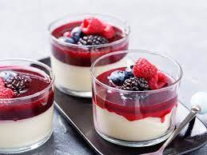
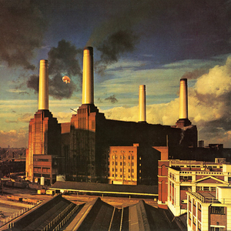
What minimal granularity to chose?
Why do you like Lord of the Rings movie?
What makes panna cotta so delicious?
What is so good on [your favorite artists] songs?

Slide 68
What minimal granularity to chose?
Why do you like Lord of the Rings movie?
What makes Panna cotta so delicious?
What is so good on [your favorite artists] songs?
Is the description discriminative?
  Can it be generalized to all other objects sharing the same feature?
  Is there something missing in the picture?
If you mentioned multiple features, what is their interplay?
  And-like / or-like / additive / amplifying…

Slide 69
What minimal granularity to chose?
Why do you like Lord of the Rings movie?
What makes Panna cotta so delicious?
What is so good on [your favorite artists] songs?
People are generally not very good at describing their reasons thoroughly

Slide 70
What minimal granularity to chose?
Why do you like Lord of the Rings movie?
What makes Panna cotta so delicious?
What is so good on [your favorite artists] songs?
Also, if asked for reasons, people often just gonna justify their emotions
  https://start.askwonder.com/insights/want-add-previous-request-made-few-years-ago-want-studies-support-idea-decisions-c22yygpap
  https://en.wikipedia.org/wiki/Motivated_reasoning
  Ninety percent of human decisions are made based on emotions. Humans use logic to justify their actions to themselves and others
  "Common emotional decisions may use some logic, but the main driving force is emotion, which either overrides logic or uses a pseudo-logic to support emotional choices (this is extremely common). Another common use of emotion in the decision is to start with logic and then use emotion in the final choice."

Slide 71
What minimal granularity to chose?
To sum-up
It may be difficult for humans to express their preference on sub-object level
  Some hints are possible, but the information is rarely complete
Our data does not have to correspond to the user’s vocabulary
  Some features are missing
  Some user’s preferences are hard to be transferred to attributes
  (The movie is too generic)
Quite often, human’s decisions are not driven logically, but emotionally
  Any logical clues they give us does not have to be applicable for the next case

Slide 72
What minimal granularity to chose?
Possible solution:
Collect [implicit] feedback on object-level, then infer sub-object preferences
  Latent (E.g., attribute-level vector representation, attention models) or explicit (direct preference prediction)
  Occasionally ask, whether your explicit preferences are correct
    E.g. Use latent model, but „guard“ it via regularization to the explicit one. Iteratively update if you recieve confirmation on your explicit model.
    https://www.frontiersin.org/articles/10.3389/fdata.2021.778417/full
    https://dl.acm.org/doi/10.1145/2043932.2043979
  Confirmation is often easier than definition + can be done in a less intrusive way
    Based on your recipe ratings, we think you are a vegetarian. Is that true?
    [Yes | NO | No, but I do not eat meat much | Irrelevant] What will happen >>
    If you click on Yes, we will promote more vegetarian meals in your future searches. You can always turn this feature off in your user profile.
  User controll in RS (https://web-ainf.aau.at/pub/jannach/files/BOOK_CHAPTER_PERSONALIZED_HCI_2019.pdf)
Requires rather lot of per-user data to learn this reliably… well, maybe not, see in a few lectures

Slide 73
What minimal granularity to chose?
Possible solution:
Use within-page feedback collection to identify most relevant content parts
  Then translate this to the sub-object preferences
  Inherently noisy, highly visualization-specific
  No known usage
Requires detailed feedback collection, but possibly less data points needed

Slide 74
What minimal granularity to chose?
Be careful while generalizing from inferred sub-object preferences
Do you like action movies?
Do you like food with salt?
Do you like movies with David Aston?
  Yes, but not all of them
  Yes, but not because of this
…who is David Aston?

Slide 75
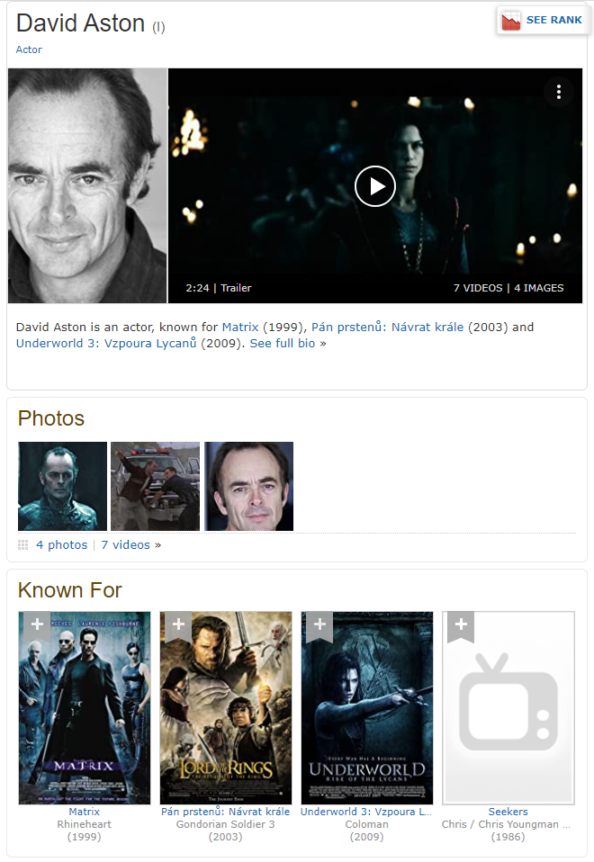
What minimal granularity to chose?
Be careful while generalizing from inferred sub-object preferences
Do you like action movies?
Do you like food with salt?
Do you like movies with David Aston?
  Yes, but not all of them
  Yes, but not because of this
…who is David Aston?

Slide 76
What minimal granularity to chose?
Be careful while generalizing from inferred sub-object preferences
Yes, but not all of them
  Should be fine (other features to clarify), but we need to ask questions correctly
Yes, but not because of this
  Loss of trust („the system does not understand what is important“)
  Some model of global or per-object feature importance
    Only confirm the inferred preference on the important ones
    Do not base your decision on the less relevant much

Slide 77
Questions?

Slide 78
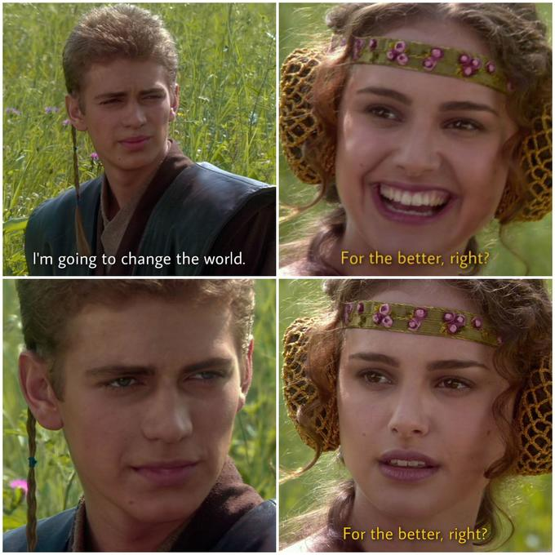
Aggregating multiple indicators
If A=1 and B=1, then A and B is 2, right? … RIGHT?

Slide 79
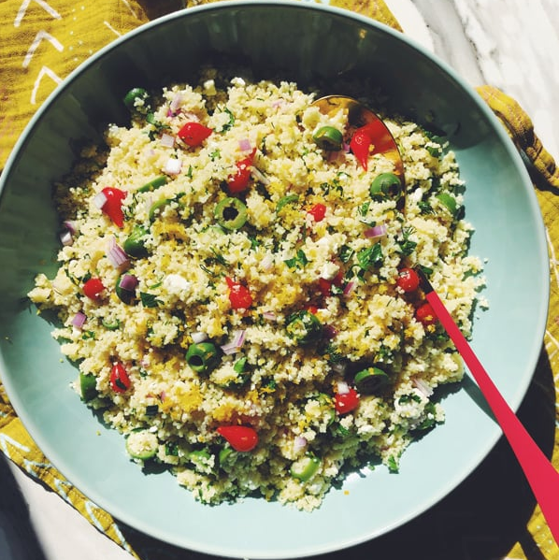
Aggregating User Preferences
Recipes domain:
  Suppose you KNOW that the user likes olives, but dislikes cous-cous
Would she like or dislike cous-cous with olives?

Slide 80


Aggregating User Preferences
Group movie night:
  Both Adam and Eva like action sci-fi, but they’re not fond of Czech movies in general
  David dislikes sci-fi, but enjoys thrillers, especially Czech ones.
What should they watch tonight?

Slide 81

Aggregating User Preferences
More attributes:
  This Panna cotta is with strawberries which I love so much, the cream looks delicious and is from my favorite shop – but there is a lot of fat in it as well.
  I am not really fond of oat cookies and this one is a bit over-priced, but they are very healthy.
Should I eat something?

Slide 82
Aggregating User Preferences
In different situations people may employ different aggregation of individual preferences
If enough data, we may try to train a model to predict the decision based on partial inputs. However, this might not be always possible.
What simple models of preference aggregations can we use instead?

Slide 83
Aggregating User Preferences
What simple models of preferences aggregations can we use?
  Just sum’em up (MEAN)
  First good wins (MAX)
  I have to be completely satisfied (MIN)

Slide 84
Aggregating User Preferences
What simple models of preferences aggregations can we use?
  Just sum’em up (MEAN)
  First good wins (MAX)
  I have to be completely satisfied (MIN)
  Priorities matter (weighted average)

Slide 85
Aggregating User Preferences
What simple models of preferences aggregations can we use?
  Just sum’em up (MEAN)
  First good wins (MAX)
  I have to be completely satisfied (MIN)
  Priorities matter (weighted average)
Is that it?

Slide 86

Aggregating User Preferences
What simple models of preferences aggregations can we use?
  Just sum’em up (MEAN)
  First good wins (MAX)
  I have to be completely satisfied (MIN)
  Priorities matter (weighted average)
Users’ preference tend to be more forgiving (OR-like) when the item is good
and less forgiving (AND-like) when it is not so good

Slide 87
Aggregating User Preferences
What simple models of preferences aggregations can we use?
  Just sum’em up (MEAN)
  First good wins (MAX)
  I have to be completely satisfied (MIN)
  Priorities matter (weighted average)
  Fuzzy-logic AND, OR, or other connectives (e.g., implications)

Slide 88

Aggregating User Preferences: Fuzzy logic
What is fuzzy logic: laymen’s view
  Extension of classical logic to the full spectrum of truth values between 0 and 1
  Has to maintain the laws of Boolean logic (e.g. 0 AND 1 = 0, asociativity, commutativity, monotonity…)
  Many proposed variants of logical connectives
    Basic (non-parametrized): Lukasiewicz, Goedel, Product
    Parametrized (the output depends on a hyperparameter)

Slide 89




Aggregating User Preferences: Fuzzy logic
Fuzzy-logical AND (T-norms)… phenomenons’ intersection
  Lukasiewicz: T_L = max(0, a+b-1) … i.e., minimal possible intersection of two phenomenons
  Goedel: T_G = min(a,b) … i.e., full intersection of two phenomenons
  Product: T_P = a*b … i.e., assumed intersection of two independent phenomenons

Slide 90



Aggregating User Preferences: Fuzzy logic
Fuzzy-logical OR (T-conorms) … phenomenons’ union
Use deMorgan rules and NOT(x) = 1-x
  Lukasiewicz: S_L = min(1, a+b) … i.e., minimal possible intersection of two phenomenons
  Goedel: S_G = max(a,b) … i.e., full intersection of two phenomenons
  Product: S_P = a+b - a*b … i.e., assumed intersection of two independent phenomenons

Slide 91




Aggregating User Preferences: Fuzzy logic
Parametrized T-norms
Frank t-norm
Yager t-norm
Grabisch, M., Marichal, J., Mesiar, R., & Pap, E. (2009). Aggregation Functions (Encyclopedia of Mathematics and its Applications). Cambridge: Cambridge University Press.

Slide 92




Aggregating User Preferences: Fuzzy logic
Parametrized T-norms
Sugeno-Weber t-norm
Hamacher t-norm
Grabisch, M., Marichal, J., Mesiar, R., & Pap, E. (2009). Aggregation Functions (Encyclopedia of Mathematics and its Applications). Cambridge: Cambridge University Press.

Slide 93
Aggregating User Preferences: Fuzzy logic
Fuzzy logic aggregations
  Fills the space between Min – Mean – Max aggregations
  Can be tuned/selected with limited data
  Nice formalism for faceted search as well
  No direct way to incorporate weights for individual objectives

Slide 94
Questions?

