Slide 1


NDBI021, Lecture 2
User preferences and advanced recommending methods, 2/1 ZK+Z,
Tue 14:00 – 15:30 S9
Tue 15:30 – 17:10 S11 (odd weeks)
https://www.ksi.mff.cuni.cz/~peska/vyuka/ndbi021/
https://youtube.com/playlist?list=PLTYzSYF3EX3BNIVJkMpCE3vUDmUGvhEcy
https://ksi.mff.cuni.cz

Slide 2
Today’s content
Continuing RecSys Recap
CF leftovers
Content-based RS
Hybrid RS
Session-based, Context-aware (If enough time)
Evaluation of RecSys
Open problems in RecSys

Slide 3
RecSys Recap - continued

Slide 4
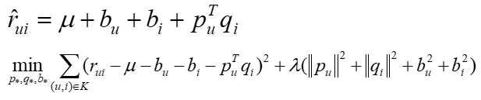

RecSys: collaborative
Collaborative filtering: Matrix Factorization
Lets have a matrix of ratings (or implicit feedback) of users on items: R
Decompose this matrix into latent factors of users and items: U and O
Decomposition should provide similar results on known data
Define error of this representation (e.g., squared difference between true and expected ratings)
Use, e.g., stochastic gradient descend to minimize this error
Why? Assume generalization of the decomposition (estimate ratings of unknown pairs)
http://www2.research.att.com/~volinsky/papers/ieeecomputer.pdf
$$R≈UO^{T}=\underset{n×f}{\underbrace{\left[\begin{matrix}μ_{1}^{T} \\ μ_{2}^{T} \\ ⋮\end{matrix}\right]}}×\underset{f×m}{\underbrace{\left[\begin{matrix}q_{1} & q_{2} & …\end{matrix}\right]}}$$

Slide 5
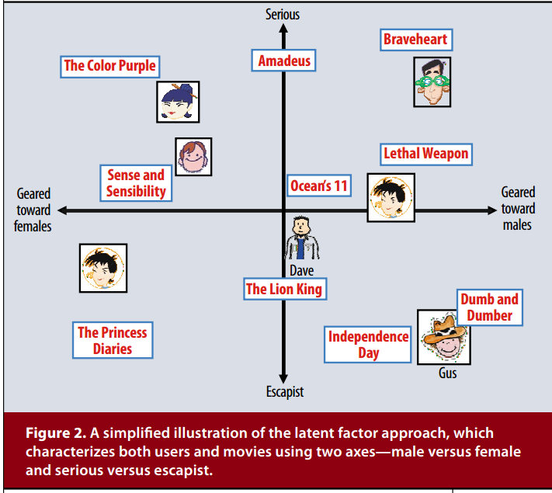
RecSys: collaborative
Collaborative filtering: Matrix Factorization
Assumption: latent factors describe users propensities & items fullfilment of certain descriptive factors behind users preferences.
Entanglement problem
Many variants propsed to date, main differences:
Definition of the objective value
Optimization algorithm
SVD++, BPR MF, ALS,…

Slide 6
RecSys: collaborative
Bayesian Personalized Ranking (BPR) MF
Instead of rating errors, focus on ranking correctness (pairwise)
Triples of user, good and bad object
For these pairs, good object should be rated higher than the bad one (unary feedbak originally, but graded possible)

Slide 7
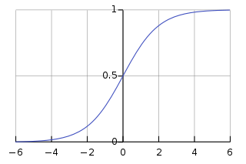
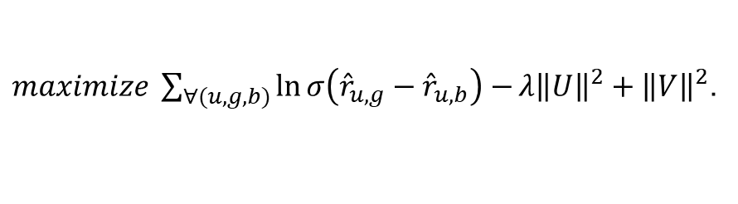


RecSys: collaborative
Matrix factorization/completion
BPR MF¹ optimization
Binary implicit feedback
Train set triples (user, good, bad object)
Maximize distance in rating of good and bad obj.
Stochastic Gradient Descent with individual updates for both user, good object and bad object
¹Rendle et al.: BPR: Bayesian Personalized Ranking from Implicit Feedback, UAI 2009
$$R≈UO^{T}=\underset{n×f}{\underbrace{\left[\begin{matrix}μ_{1}^{T} \\ μ_{2}^{T} \\ ⋮\end{matrix}\right]}}×\underset{f×m}{\underbrace{\left[\begin{matrix}q_{1} & q_{2} & …\end{matrix}\right]}}$$
$${\hat{r}}_{i,j}≔u_{i}×q_{j}$$
Ranking correctness
$maximize \sum_{∀(u,g,b)}{\ln{σ\left({\hat{r}}_{u,g}−{\hat{r}}_{u,b}\right)}−}{λ\left\|U\right\|}^{2}+{\left\|V\right\|}^{2}$.
Regularization
Train set

Slide 8
RecSys: collaborative
Collaborative-filtering: limitations
Bias amplification (oversampling popular items; more on that later)
Discrepancies between true needs and trainable objectives
Inferior performance if the data is lacking
Cold-start problem
User cold-start
Item cold-start

Slide 9






RecSys: Cold-start problem
Which user is closer to the current one?
Considering all existing users
Which object is closer to the current one?
Considering all rated objects

Slide 10


RecSys: Cold-start problem
Which user is closer to the current one?
Considering all existing users
Which object is closer to the current one?
Considering all rated objects

Slide 11

Questions?

Slide 12


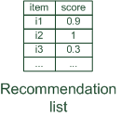




RecSys: content-based
Content-based
Using current user’s preferences and item attributes/metadata/descriptions
No knowledge on the content of items or users
Need to adapt on domain-specific knowledge
Susceptible to trivial recommendations & varying descriptiveness of the content information

Slide 13
RecSys: content-based
Content-based: Item-kNN
Same algorithm, different basis on which to calculate item similarity
Item-based KNN
In: current user u, all items I, items’ data D, hyperparameter k
- Calculate pairwise similarity between all items w.r.t. D, and store it [may be pruned & pre-computed]
- Represent the user through his/her preferred items I_u, retreive k most similar items to all i from I_u
- Aggregate the results item-wise, obtain score vector for all items (zeros for unknown)
Return: list of items with highest score
Suitable similarity method depend on what data we actually have. Working baselines:
- Numeric data: cosine or euclidean distance (watch out for diverse value ranges)
- Nominal data: binarize & Jaccard similarity
- Textual data: TF-IDF, or some pre-trained embedding
- Other multimedia: pre-trained embedding

Slide 14
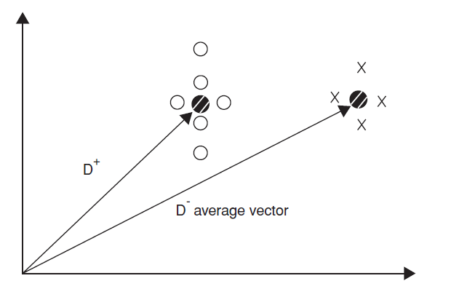
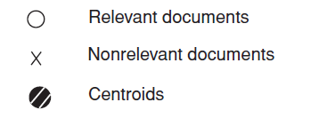

RecSys: content-based
Content-based: Vector Space Model (Rocchio's method)
Originally designed for explicit queries, but can be applied e.g., for conversational RecSys
The system then learns a prototype of relevant/irrelevant documents
Then evaluates candidate items w.r.t. similarity to relevant and dissimilarity to irrelevant prototypes
Item collections D⁺ (liked) and D⁻ (disliked)
Computing modified query Qi+1 from current query Qi with:
α, β, γ used to fine-tune the feedback
α weight for original query
β weight for positive feedback
γ weight for negative feedback
$$Q_{i+1}= α ∗ Q_{i}+ β\left(\frac{1}{\left|D^{+}\right|} \sum_{d^{+}∈D^{+}}{d^{+}}\right)− γ\left(\frac{1}{\left|D^{−}\right|}\sum_{d^{−}∈D^{−}}{d^{−}}\right)$$
Then, use similarity of individual items w.r.t. $Q_{i+1}$to establish recommendations
https://en.wikipedia.org/wiki/Rocchio_algorithm

Slide 15
RecSys: content-based
Content-based RS: limitations
- lack of sufficiently descriptive content (important, but domain specific)
- lack of means to process raw content (nowadays mostly solved through DL)
- varying data quality (nowadays mostly solved through attention mechanism)
- constructing trivial recommendations (a.k.a. overspecialization)

Slide 16

RecSys: Overspecialization
Recommended reading:
What is wrong here?

Slide 17
RecSys: Overspecialization
Recommended reading:
Possibly lacking:
Novelty (w.r.t. user’s currently known interests)
Diversity (of recommended items from each other)
Serendipity (i.e. combination of relevance & surprise for the user)

Slide 18
RecSys: Overspecialization
Recommended reading:
Simple diversity re-ranking: maximal marginal relevance
Select first item by relevance
Select next item by max( alpha*relevance – (1-alpha) * max(similarity to already selected item) )
Not good for too long lists (iterative calculations over increasingly large sets)
https://www.cs.cmu.edu/~jgc/publication/The_Use_MMR_Diversity_Based_LTMIR_1998.pdf (2-page paper, 3500 citations☺)

Slide 19
Questions?

Slide 20


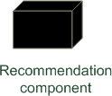
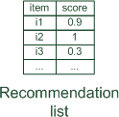


RecSys: Hybrid RS
Hybrid RS
Combining collaborative and content-based principles
Nowadays, most RS in production are some form of a hybrid

Slide 21
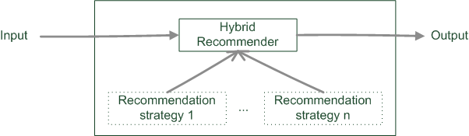
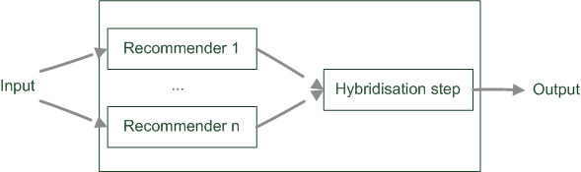
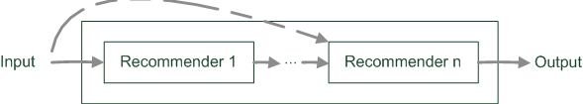
RecSys: Hybrid RS
Hybrid RS: hybridization strategies
Monolithic
(multiple paradigms combined within the algorithm)
Parallel
(hybridization as a post-processing)
Pipelined
(one algorithm feeds another)

Slide 22
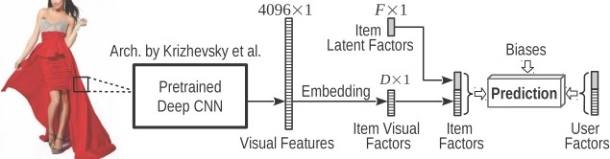
RecSys: Hybrid RS
Hybrid RS: monolithic example: Visual BPR
Latent factor based approach (similar to matrix factorization)
Portion of the item embedding is static
Based on a pre-trained visual feature extractor
Dimensionality reduction to maintain Collaborative vs. Content-based tradeoff
Trained using BPR loss
https://arxiv.org/abs/1510.01784

Slide 23
RecSys: Hybrid RS
Hybrid RS: Parallel approaches
Weighted average
Aggregate output scores of all methods per item, then select top-k
Watch out for different values distribution
Watch out for disproportional results (oversampling algorithms with highest weights)
Switching hybrid
Each time only select output of one algorithm
Item-level or list-level
Rule-based selection
Simple probabilistic selection
Reinforcement learning, e.g., multi-armed bandits

Slide 24
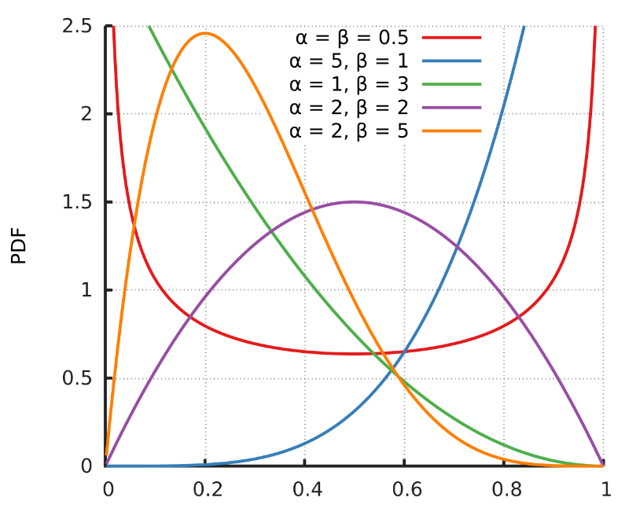
RecSys: Hybrid RS
Hybrid RS: Parallel approaches, example: MAB using Thompson Sampling
Pool of several recommenders R1,…,Rk; for each position, select one Recommender and its best available output
Selection probability correspond to the RS’s past performance, using Thompson Sampling
Random sample from Beta distribution induced by #trials vs. #successes per RS
Select Recommender with highest sampled value
Beta distribution (https://en.wikipedia.org/wiki/Beta_distribution)
Mean value corresponds to the success probablity
Distribution is more compact with more trials
https://dl.acm.org/doi/10.1145/3172944.3172967

Slide 25
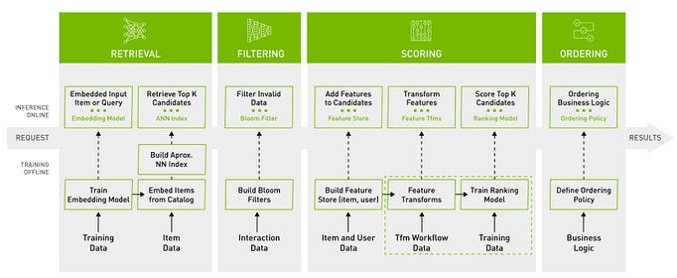
RecSys: Hybrid RS
Hybrid RS: Pipeline approaches
Most used in industrial settings
Quick&simple approaches quickly drill down the volume of candidates
More complex approaches fine-tune the results
Conceptual Pipeline with Merlin. Source: https://developer.nvidia.com/nvidia-merlin

Slide 26
Questions?

Slide 27
RecSys: Session-based
Session-based models
NO explicit notion of the user’s past behavior (i.e., no long-lasting UID)
But the user is represented by his/her recent behavior (recorded during the current session)
Cannot train models using explicit notion of the user
Instead, user can be represented by their behavior sequence, in particular, visited/bought items
General belief: more recent user feedback is more important
Extreme case: item-based RS
Algorithm families
Session-based KNN (find k-nearest sessions, recommend complementary items, https://arxiv.org/pdf/1803.09587.pdf )
Recurrent Neural Networks (https://arxiv.org/abs/1511.06939)
Transformers-based architecture (https://dl.acm.org/doi/abs/10.1145/3556702.3556844)

Slide 28
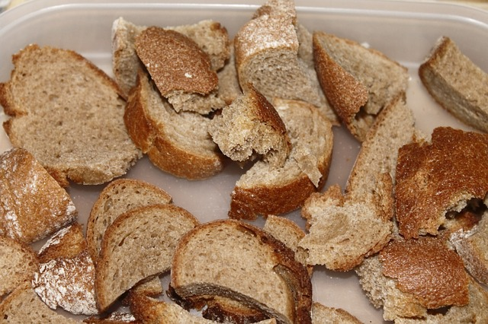
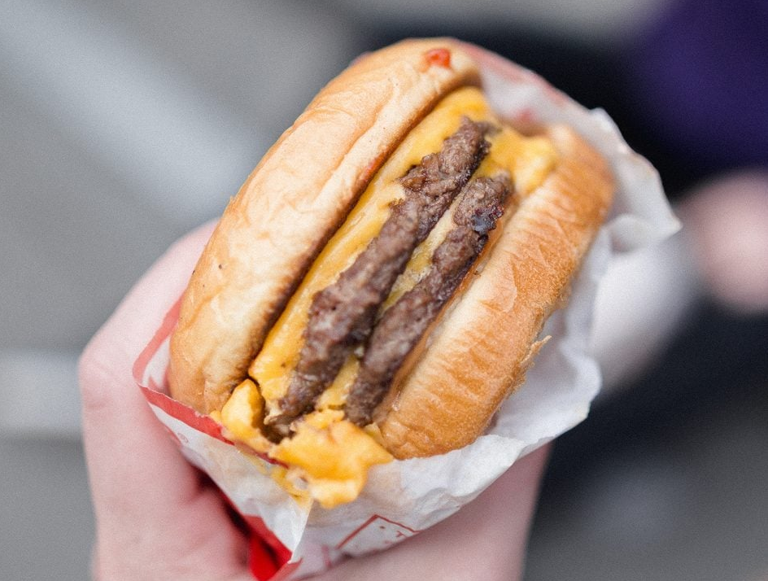





RecSys: Context-aware
Context-awareness
Eating alone vs. With friends vs. On a conference
Usual tase vs. The end of December
While in homepage vs. in headset category

Slide 29
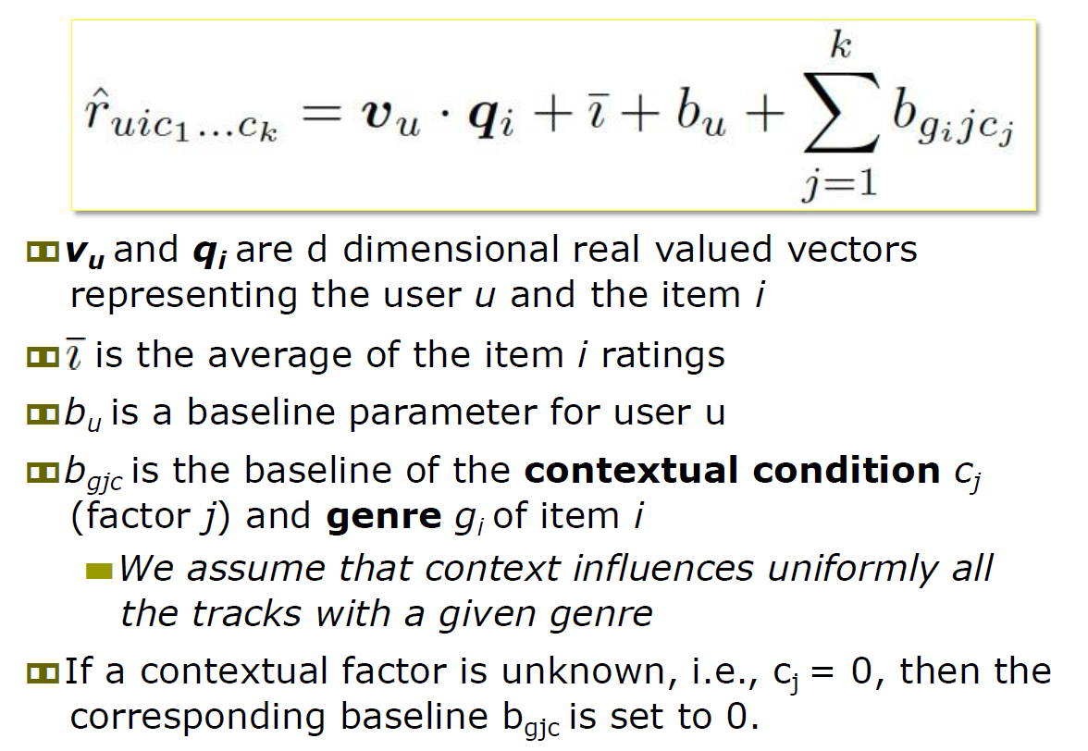
RecSys: Context-aware
Key design choice: which contextual axes and values / granularity to consider?
Context-awareness
Simple method for context incorporation into matrix factorization
Nowadays, more convenient to model through DL

Slide 30
Questions?

Slide 31
RecSys Evaluation If You want to double #successes, double #failures

Slide 32

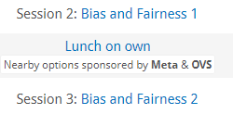

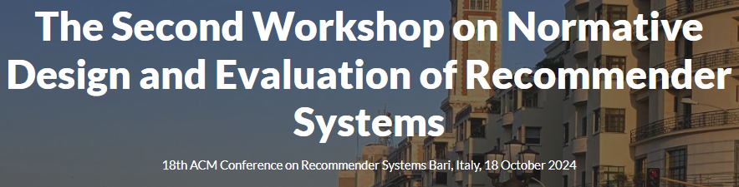



Evaluation settings
Off-line evaluation
Based on historical data
Aiming to predict hidden part of the data
A lot of improvements recently towards de-biasing & multi-criterial evaluation
Lab studies (User Studies)
Expressly created for the purpose of the study
Extraneous variables can be controlled more easily by selecting study participants
Possibility to get more detailed answer from users
But doubts may exist about participants motivated by money or prizes
Participants should behave as they would in a real-world enviroment
Field studies (On-line, A/B testing)
Conducted in an preexisting real-world enviroment
Users are intrinsically motivated to use a system

Slide 33
Online Evaluation: Metrics
Always design evaluation metrics with respect to your target variables (KPIs)
However select something, where the effect is measurable
But be careful about long term effects
More relevance => better KPIs => less exploration => bad recommendations in the future => bad KPIs
Cascade of evaluation metrics
From high to low detectability of changes
From low to high impact on your true target

Slide 34

E-commerce: Online evaluation metrics
Recommending correctness
Visit (once) recommended object (i.e. ignore page layout)
Click-through rate (CTR)
Click on recommended item / Click and do something (do not leave imediatelly)
Conversions rate
Buy recommended item / Recommend -> Click -> Purchase
CVR (conversion of clicked items)
Cross-sale increase
Add to cart -> Recommend -> Add another (recommended) to cart
Returning buyers, viral effect…
Cummulative lifetime user value...
More able to find differences
Better proxy of target variable

Slide 35
„Technical“ metrics
!!Inference time (how fast can we recommend?)!!
Train / re-train / model update time
Can we stay up-to-date? Can we recommend to new users?
Memory/CPU/GPU consumption
How large can we grow with current infrastructure?
Recall on objects
Is portion of your objects ignored? Are there too many low-profit bestsellers?
Ability to predict
Can you calculate recommendations for all users?
For which groups of users are we better than baseline?

Slide 36
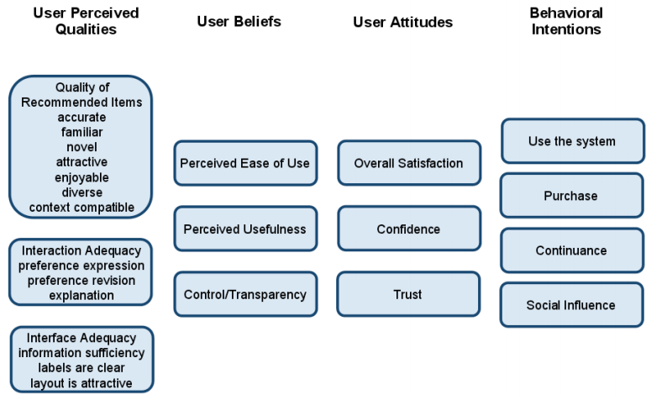
Evaluation in Lab studies
Same metrics as on-line experiments plausible
Questionnaire
Features otherwise harder to detect directly
Helpfulness / Ease of use / Relevance
Trust
Novelty to the user etc.
Physiological response
Eye tracking etc.
Key requirement: study subjects should well approximate behavior of your real users
This may be harder than it seems
Carefully consider what tasks you give to participants
Often, user cold start may be a problem -> preference ellicitation

Slide 37
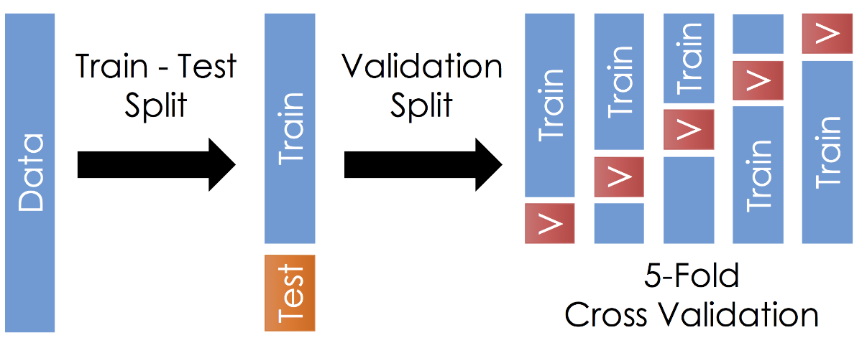
Evaluation in Off-line Settings
Prediction of „correct“ objects
According to some metic / metrics (see later)
Train / Validation / Test split
Random (bootstrap) – in case of sufficiently large datasets
Cross-validation variants
Temporal splits – better than CV for RecSys (causality problems), however lower support in non-recsys audience
Sliding windows for evaluation
Beware of biases in your data
Counterfactual learning / de-biasing
Use impressions if you have them
Simulational studies (replace real users with agents capable of expanding the existing profiles)

Slide 38
Off-line Evaluation Metrics
Relevance/Accuracy of the recommended objects
User visited / rated / purchased… the objects, which the method recommends
nDCG, MAP, Precision@top-k, Recall,…
Rating error metrics
User rated some objects, how large is the prediction error on those? (MAE, RMSE,…)
Novelty
Does the user already know / visited recommended objects?
May be useful in some scenarios, yet recommending previously known items is rather trivial
Other definitions: novel w.r.t. creation time, novel w.r.t. volume of interactions (= not popular)
Diversity
Are all the recommendations similar to each other?
Many variants based on content-based or collaborative data (Intra-List Diversity,...)
Exploration
Are all recommendations similar to a pre-existing user profile?
Coverage, Serendipity, Popularity amplification, ...
Beyond accuracy objectives

Slide 39
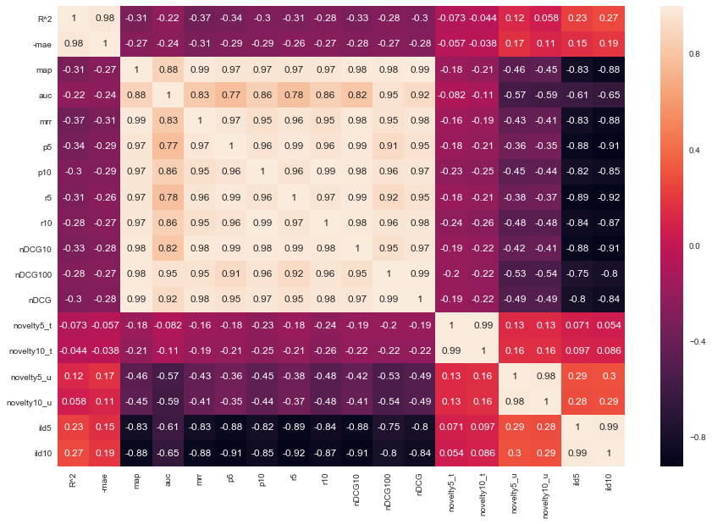
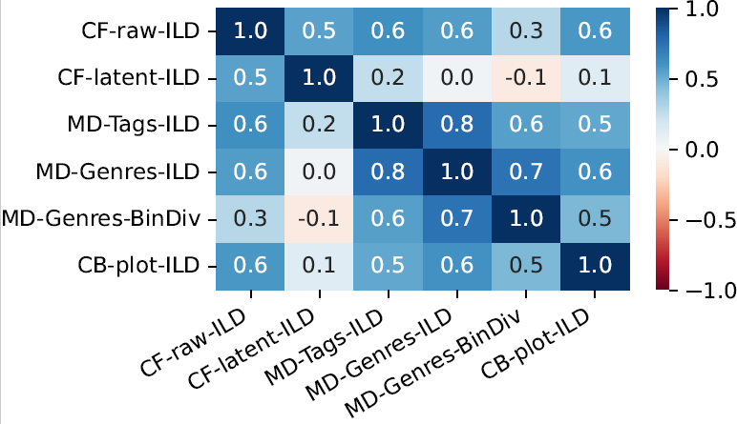
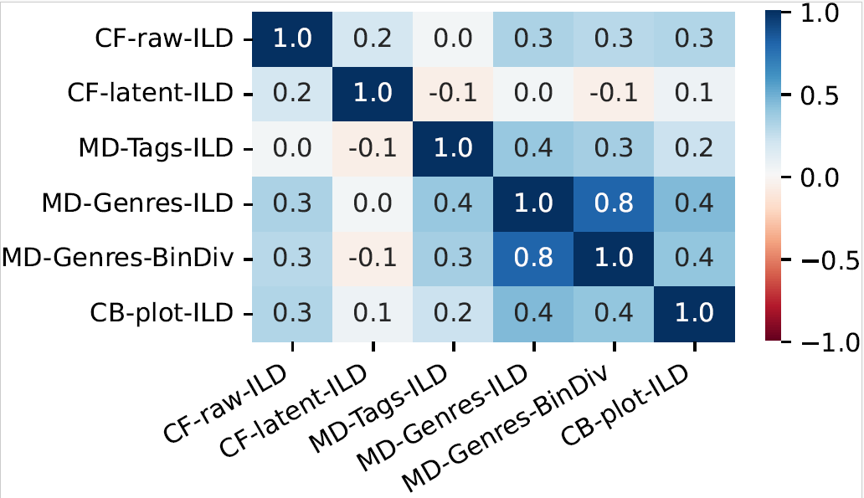
Off-line Evaluation Metrics
Multiple metric types on an e-commerce
Diversity variants on books and moveis

Slide 40
Questions?

Slide 41
RecSys: Open Problems

Slide 42
Rather Solved Problems (incremental updates)
Incorporate raw content -> DL
Combine different input modalities -> DL
Cold start problem -> Hybrid systems with multiple modalities
-> Recent trend: align modalities to supplement each other
Over-specialization -> Pipelined systems / post-processing
Keep the model up-to-date -> EASE, ELSA / session-based

Slide 43

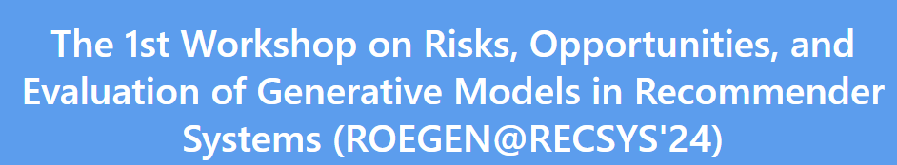
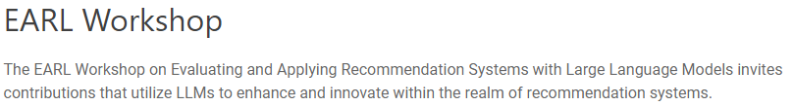

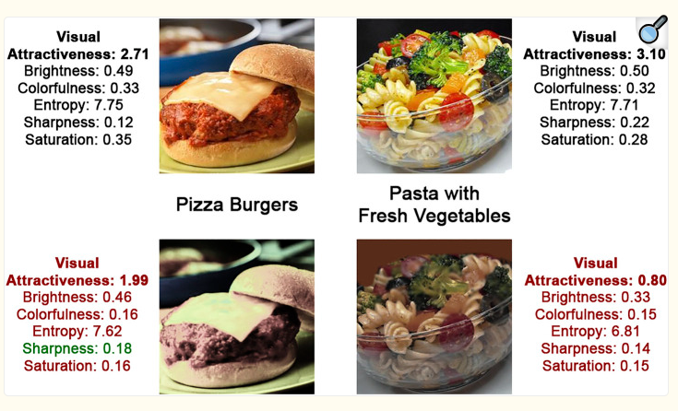

Open Problems
User understanding
How to give RecSys correct inputs?
How to interact with users? (ChatGPT stirred things up)
How to interpret their responses?
How to measure what made the user happy?
How to nudge users towards desired behavior?
Intersection of RecSys, Psychology & other areas

Slide 44
Open Problems
Change of interaction paradigms
Users may gradually expect more freedom when expressing their needs
Conversational RecSys
Recommendations critiquing, user control & steering
Chat-style interactions

Slide 45
Open Problems
Evaluation gap
Good in off-line vs. Good in production
What combination of metrics?
What evaluation protocol?
What data treatment? ...
Off-policy learning and impression-aware datasets improved things, but still far from a solved problem

Slide 46



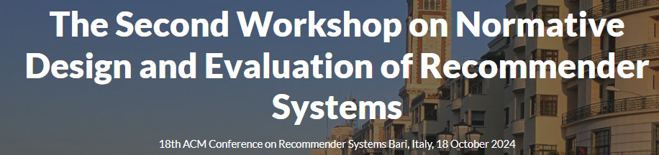


Open Problems
Long-term impact of RecSys
It changes us...
Nudging towards uniformity
Creating bubbles
... (helped to) cause a genocide (at least) once
Spreading missinformation
Amplifying biases
... and can severely hurt you in some use cases (job recommenders, misinformation spreading, ...)

Slide 47


Open Problems
Fairness and multi-stakeholder environment
Its not just me and the system...
Other stakeholders (e.g., content providers) have needs of their own
Often, those needs contradict each other
But how to say what is fair... And who gets to say that?
Norms and regulations
Sometimes, being evil (or turning a blind eye) is too much tempting

Slide 48

Open Problems
Scalability
Sometimes better approaches dealing with previous challenges exist... But are too slow.
Not just time, but model size / train memory is also an issue

Slide 49



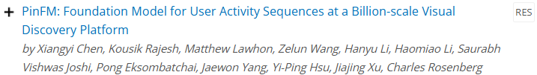
Open Problems
Joint modeling [New at RecSys 2024]
Is search so much different from recommendations?
Could we, perhaps use the same machinery for both?
What are the challenges/obstacles?

Slide 50
Questions?

Slide 51
Three things you found interesting
…
…
…

Slide 52
Five things I find most important
Over-specialization problem
Usage of DL to combine different input modalities
Online vs. Offline
Beware of how you measure diversity
Long-term impact of RS

Slide 53
Next Lecture
User Preferences: intro + variants; preference elicitation

