Slide 1


NDBI021, Lecture 1
User preferences and advanced recommending methods, 2/1 ZK+Z,
Tue 14:00 – 15:30 S9
Tue 15:30 – 17:10 S11 (odd weeks)
https://www.ksi.mff.cuni.cz/~peska/vyuka/ndbi021/
https://youtube.com/playlist?list=PLTYzSYF3EX3BNIVJkMpCE3vUDmUGvhEcy
https://ksi.mff.cuni.cz

Slide 2
Today’s content
Introduction + Motivation
NDBI021 organization
RecSys Recap

Slide 3
Introduction

Slide 4



NDBI021: Motivation
Not about sandbox optimization for artificial tasks
We used exactly the same settings as those other guys, but significantly improved p@10 by 0.005%
How does this even matter for the users?
If that does not matter, what does, then?

Slide 5
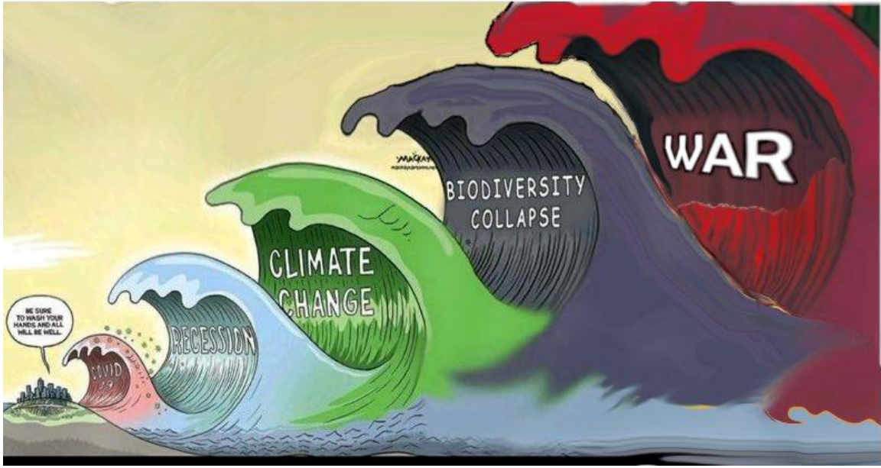
NDBI021: Motivation

Slide 6
NDBI021: Motivation
RMSE is all you need

Slide 7
NDBI021: Motivation
Ranking matter, use nDCG
RMSE is all you need

Slide 8
NDBI021: Motivation
Being accurate is not enough
Ranking matter, use nDCG
RMSE is all you need

Slide 9
NDBI021: Motivation
Full page optimization, carousels,
clickbaits
Being accurate is not enough
Ranking matter, use nDCG
RMSE is all you need

Slide 10
NDBI021: Motivation
Lifetime value
Full page optimization, carousels,
clickbaits
Being accurate is not enough
Ranking matter, use nDCG
RMSE is all you need

Slide 11
NDBI021: Motivation
Lifetime value
Full page optimization, carousels,
clickbaits
Being accurate is not enough
Ranking matter, use nDCG
RMSE is all you need
Did you lost me along the way?

Slide 12
User preference
What is User Preference (UP)?
[IGI-global dictionary] A soft requirement provided by users, in addition to a query, to reflect a wish. It influences the querying process by causing some results to be favored.
Why do we need UP? Where to use them?
How to define/express UP (i.e., user feedback)? How to model UP?
What to do with UP (Recommender systems & beyond)?

Slide 13



Why do we need user preferences?
Information Overload (https://en.wikipedia.org/wiki/Information_overload)
Difficulty to effectively decide when one has too much information (options to choose from)
Filter available information according to user’s preferences
Show only those with a higher likelihood of being relevant
Because it may improve user’s experience => satisfaction, loyalty, consumption…
=> improve target metrics of the content provider
Knowing your users allows you to serve them better => monetize them better

Slide 14
Related concepts
(Implicit / explicit ) user feedback
Typical means of getting raw data for user preferences
Psychological profiling (https://www.researchgate.net/publication/220737365_Towards_User_Psychological_Profile)
High level, but impactful description of humans
E.g. Sufficer vs. Maximizer (https://www.wsj.com/articles/how-you-make-decisions-says-a-lot-about-how-happy-you-are-1412614997 )
Recommender systems
Typical means of utilizing user preferences
Preference Elicitation
How to get (explicit) preferences (mainly) from new users

Slide 15
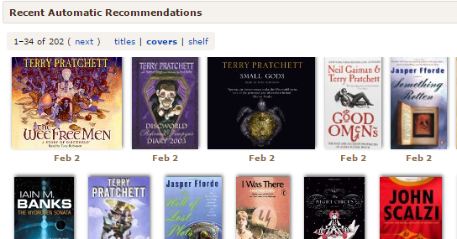
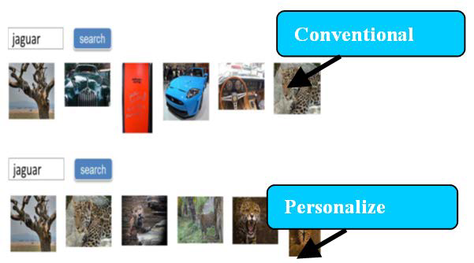
Where to utilize user preferences?
Where & what to do:
Limit ourselves to information retrieval (IR) domain
Recommender systems,
GUI personalizations (https://evergreen.team/articles/ui-and-ux-personalization.html)
Personalized search (https://en.wikipedia.org/wiki/Personalized_search)
…

Slide 16
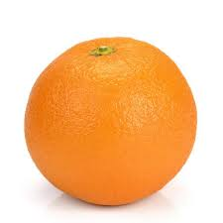
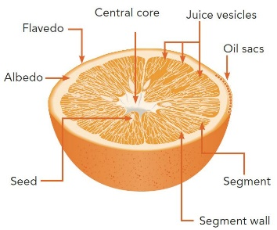

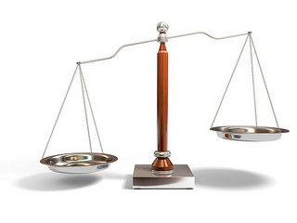
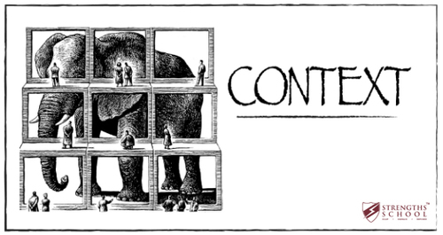
How to model user preferences?
Highly domain / task specific:
What is the task?
What is/are the entity/ies on which preferences can be expressed?
Objects? Their features? Groups of items?... Page layout?
Who gives the preference (who is the user)?
An individual? A group of people? A cookies stored in a browser?
What are expected connections among these entities (hypotheses)?
Some features are more important than others (presumably)
Preference of an object corresponds to an aggregation of its feature’s preferences
Does user preference depend on some context/conditions?
I only watch romantic comedies with my wife…
How to express preferences?
Implicitly? Explicitly? Through text/speech? Sth. else?

Slide 17
What means do we have to express UP?
„Expressing by doing“ (implicit feedback)
Rating/(dis)approving (explicit feedback)
Filtering, searching
Critiquing (especially popular at the age if LLMs)
Explicit comparison (A is better than B)
Writing a review

Slide 18
How to collect user preferences?
Implicit feedback
Server-side (limited expressibility)
Client-side (triggered JS events)
Beyond (eye tracking, other biometrics)
Limited applicability (lab studies)
Can provide leads on interpretation of the previous two
Rating, filtering, comparison, reviews… via designated GUI
How to store e.g. searching / filtering may be a bit tricky…
Questionaires, role playing
Lab studies only (in most cases)
Can provide leads on interpretation of other collection methods

Slide 19
Recommender systems
What are Recommender Systems?
[Wikipedia] A recommender system is a subclass of information filtering system that provides suggestions for items that are most pertinent to a particular user. Recommender systems are particularly useful when an individual needs to choose an item from a potentially overwhelming number of items that a service may offer.
[pertinent: relevant or applicable to a particular matter]
What pertinent/relevant means for users? On what does the relevance depend?
How to learn what is relevant? What data do we need, what algorithms to apply?

Slide 20
Recommender systems
Search Engines
Users know in advance what they want (and are able to specify it)
Explicit query submitted by the user
Evaluation through known „correct“ answers for the query
Recommender Systems
Users do not know what they want (or do not know how to ask for it)
But, typically, can say what is a good suggestion and what is not
RS tries to understand user’s needs through observed behavior (provide suitable results for these needs without being explicitly asked)
„Implicit query“
Personalized Adds
Works extra-site, no prior indication of user’s needs
Often, the basic principle of RecSys (mutual benefits) is violated
Although seemingly the same task, the same methods as for RecSys often do not work

Slide 21
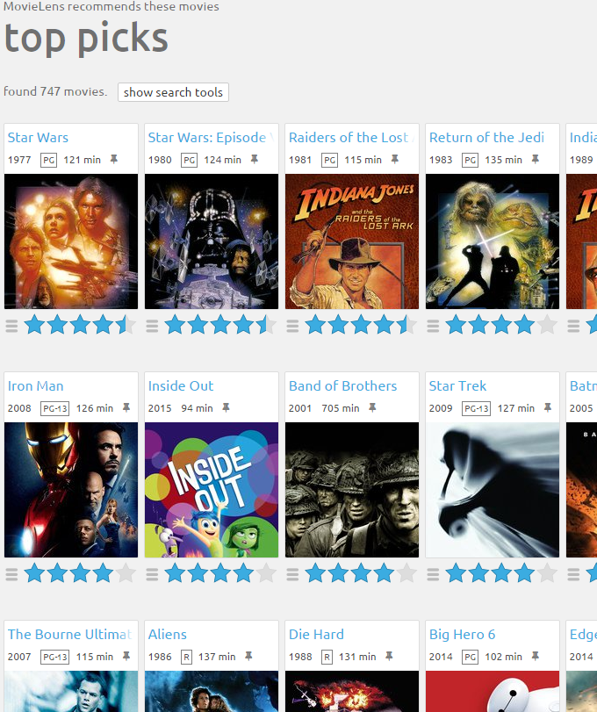
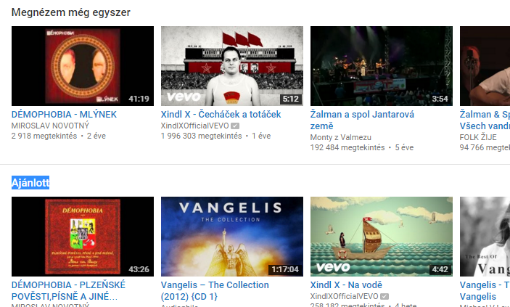
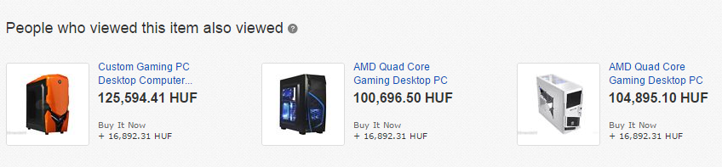
Recommender Systems are everywhere
More and more true every year
- Movies, news, books, e-commerce, web/site-wide search, social networks…
Notes:
ML application
Propose few objects
Not necessarily the most similar / relevant
Ultimate goal is to improve key success metrics of the vendor (maximize profit – volumes of sales, user loyalty....)

Slide 22
Recommender systems
RS seen as a function
Given:
User model (user preferences)
Items (with or without description of item characteristics, relations,…)
Other data (depending on the type of algorithm)
Return:
Items Relevance score / Items ranking / Recommendation page template

Slide 23



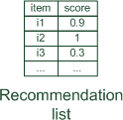




Paradigms of recommender systems

Slide 24
Paradigms of recommender systems
Similarity
User’s Preferences

Slide 25
RecSys „Hello World!“
User-based nearest-neighbor collaborative filtering (UB-kNN)
Get most similar users to the current one.
Cosine similarity / Correlation of known ratings per user
Aggregate their feedback on not-yet-visited items.
Average / similarity-weighted average…
Recommend items with best aggregated feedack.
Top-k items with highest rating

Slide 26

Questions?

Slide 27
NDBI021 Organization

Slide 28
NDBI021: Syllabus
Lectures: 4 blocks
Basics
30.9. Intro + basic RS
07.10. basic RS + open problems + RecSys highlights?
User preferences
14.10. User feedback variants + pre-processing
21.10. User preferences + aggregations
04.11. Advanced concepts, explanations, nudging, user control
Advanced RS concepts
11.11. Fairness, Biases and de-biasing
18.11. Multi-objective, multi-stakeholders
25.11. Group RS
02.12. Dynamic RS, RL, Advanced evaluation concepts
09.12. Scalability, sparse + linear autoencoders [guest lecture]
Domain-specific RS
16.12. Intro + News domain
08.01. Peer recommenders, E-commerce (Fashion), Music

Slide 29
NDBI021: Syllabus
Labs:
Hands on existing resources
Datasets (MovieLens, MIND, GoodBooks, RetailRocket,…)
RecSys Frameworks (EasyStudy, RankSys, Eliot,RecBole, Implicit,…)
Investigation & evaluation of RS / User preferences concepts
Diversification, de-biasing, preference elicitation, explicit feedback,…
Semestral work
TBD, several options: RecSIS, SAE, MORS, preference elicitation
Small teams encouraged
Alternative completion: larger individual research project (let me know if interested)

Slide 30
Main resources
UMAP tracks 2024
Personalized Recommender Systems
Knowledge Graphs, Semantics, Social and Adaptive Web
Intelligent User Interfaces
Personalizing Learning Experiences through User Modeling
Fairness, Transparency, Accountability, and Privacy
Personalization for Persuasive and Behavior Change Systems
Virtual Assistants and Personalized Human-robot Interaction
Research Methods and Reproducibility
UMAP, RecSys, SIGIR conferences
https://www.um.org/umap2024/
https://recsys.acm.org/
https://sigir.org/sigir2024/
UMUAI, ToRS journals
http://www.umuai.org/
https://dl.acm.org/journal/tors
ECIR, IUI, CHI, WWW, FAccT…

Slide 31
RecSys Recap

Slide 32
RecSys: notable algorithm families
Non-personalized & item-based
Session-based models
KNN variants (content-based or collaborative)
Matrix factorization variants
Hybrid models (mostly deep learning nowadays)
Reinforcement learning / multi-armed bandits
Autoencoders

Slide 33
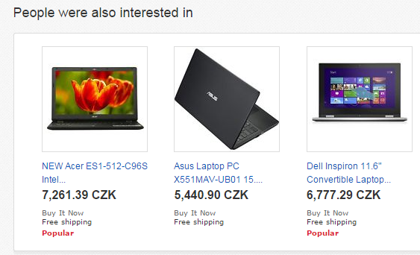
RecSys: non-personalized
Non-personalized
no explicit notion of the current user (i.e., no UID)
recommending based on aggregated data
and (optionally), current page context (item-based RS)
„Most (recently) popular items (in this category)“
„People who bought this also bought that“
„Similar objects to this one“
…
On the borderline between personalized and non-personalized:
frequent pattern matching (market basket analysis)
session-based RS (recommending based on the interactions of the current session

Slide 34


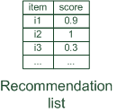

RecSys: collaborative
Collaborative filtering
Using current and other users’ preferences (a.k.a. wisdom of the crowd)
No knowledge on the content of items or users
Easy to use the same algorithms on different domains (same input data)
Susceptible to various biases & data quantity issues (cold-start)

Slide 35
RecSys: collaborative
Collaborative filtering: KNN
Two practically usable variants: user-based and item-based
Different variants for rating prediction and ranking:
Rating prediction (obsolate): for each candidate item, try to predict rating based on nearest neighbors
Ranking (biased): calculate nearest neighbors only once, ignore items for which we have insufficient data
User-based KNN
In: current user u, all users U, preference matrix R, hyperparameter k
- Calculate similarity between u and all other users w.r.t. R, select k closest users to the current one U_k
- Get slice of the matrix R correspodning to U_k users: R_k
- Aggregate the slice item-wise, obtain score vector for all items
Return: list of items with highest score
Item-based KNN
In: current user u, all items I, preference matrix R, hyperparameter k
- Calculate pairwise similarity between all items w.r.t. R, and store it [may be pruned & pre-computed]
- Represent the user through his/her preferred items I_u, retreive k most similar items to all i from I_u
- Aggregate the results item-wise, obtain score vector for all items (zeros for unknown)
Return: list of items with highest score

Slide 36
RecSys: collaborative
Collaborative filtering: KNN
Two practically usable variants: user-based and item-based
Different variants for rating prediction and ranking:
Rating prediction (obsolate): for each candidate item, try to predict rating based on nearest neighbors
Ranking (biased): calculate nearest neighbors only once, ignore items for which we have insufficient data
User-based KNN
In: current user u, all users U, preference matrix R, hyperparameter k
- Calculate similarity between u and all other users w.r.t. R, select k closest users to the current one U_k
- Get slice of the matrix R correspodning to U_k users: R_k
- Aggregate the slice item-wise, obtain score vector for all items
Return: list of items with highest score
Item-based KNN
In: current user u, all items I, preference matrix R, hyperparameter k
- Calculate pairwise similarity between all items w.r.t. R, and store it [may be pruned & pre-computed]
- Represent the user through his/her preferred items I_u, retreive k most similar items to all i from I_u
- Aggregate the results item-wise, obtain score vector for all items (zeros for unknown)
Return: list of items with highest score
Pearson’s correlation / Cosine / jaccard similarity
- beware of handling missing values
Typically, weighted average
- user similarity as weight

Slide 37
RecSys: collaborative
Collaborative filtering: KNN
Two practically usable variants: user-based and item-based
Different variants for rating prediction and ranking:
Rating prediction (obsolate): for each candidate item, try to predict rating based on nearest neighbors
Ranking (biased): calculate nearest neighbors only once, ignore items for which we have insufficient data
User-based KNN
In: current user u, all users U, preference matrix R, hyperparameter k
- Calculate similarity between u and all other users w.r.t. R, select k closest users to the current one U_k
- Get slice of the matrix R correspodning to U_k users: R_k
- Aggregate the slice item-wise, obtain score vector for all items
Return: list of items with highest score
Item-based KNN
In: current user u, all items I, preference matrix R, hyperparameter k
- Calculate pairwise similarity between all items w.r.t. R, and store it [may be pruned & pre-computed]
- Represent the user through his/her preferred items I_u, retreive k most similar items to all i from I_u
- Aggregate the results item-wise, obtain score vector for all items (zeros for unknown)
Return: list of items with highest score
Typically, weighted average
- item similarity as weight
- item rating as weight
Key advantage as long as users fluctuation > items fluctuation (famous 2001 Amazon paper*)
* https://ieeexplore.ieee.org/abstract/document/1167344

Slide 38
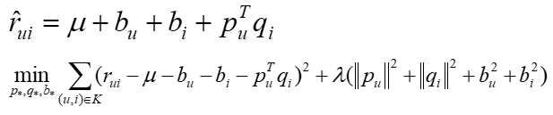

RecSys: collaborative
Collaborative filtering: Matrix Factorization
Lets have a matrix of ratings (or implicit feedback) of users on items: R
Decompose this matrix into latent factors of users and items: U and O
Decomposition should provide similar results on known data
Define error of this representation (e.g., squared difference between true and expected ratings)
Use, e.g., stochastic gradient descend to minimize this error
Why? Assume generalization of the decomposition (estimate ratings of unknown pairs)
http://www2.research.att.com/~volinsky/papers/ieeecomputer.pdf
$$R≈UO^{T}=\underset{n×f}{\underbrace{\left[\begin{matrix}μ_{1}^{T} \\ μ_{2}^{T} \\ ⋮\end{matrix}\right]}}×\underset{f×m}{\underbrace{\left[\begin{matrix}q_{1} & q_{2} & …\end{matrix}\right]}}$$

Slide 39
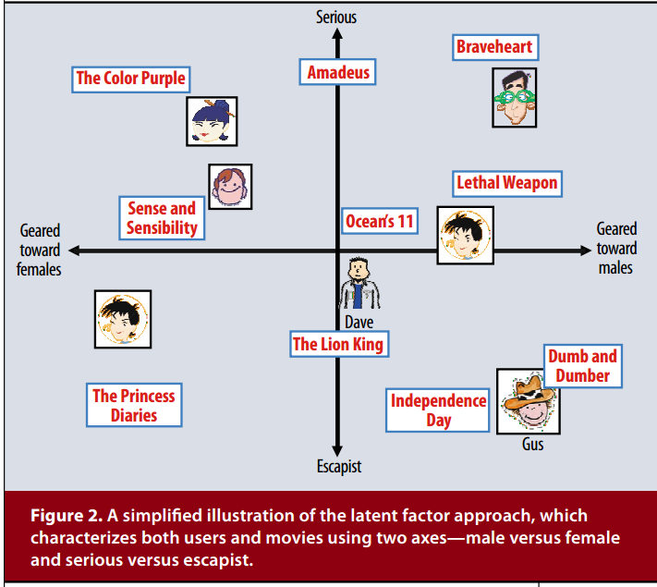
RecSys: collaborative
Collaborative filtering: Matrix Factorization
Assumption: latent factors describe users propensities & items fullfilment of certain descriptive factors behind users preferences.
Entanglement problem
Many variants propsed to date, main differences:
Definition of the objective value
Optimization algorithm
SVD++, BPR MF, ALS,…

Slide 40
RecSys: collaborative
Bayesian Personalized Ranking (BPR) MF
Instead of rating errors, focus on ranking correctness (pairwise)
Triples of user, good and bad object
For these pairs, good object should be rated higher than the bad one (unary feedbak originally, but graded possible)

Slide 41
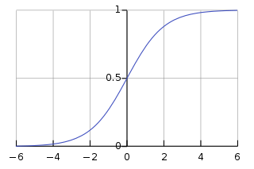
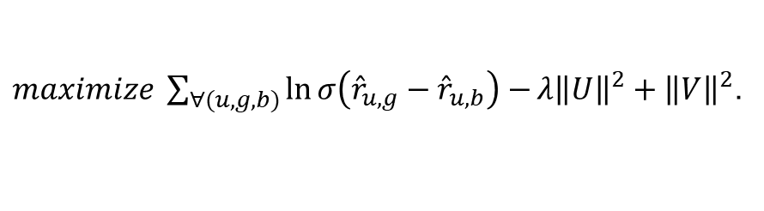


RecSys: collaborative
Matrix factorization/completion
BPR MF¹ optimization
Binary implicit feedback
Train set triples (user, good, bad object)
Maximize distance in rating of good and bad obj.
Stochastic Gradient Descent with individual updates for both user, good object and bad object
¹Rendle et al.: BPR: Bayesian Personalized Ranking from Implicit Feedback, UAI 2009
$$R≈UO^{T}=\underset{n×f}{\underbrace{\left[\begin{matrix}μ_{1}^{T} \\ μ_{2}^{T} \\ ⋮\end{matrix}\right]}}×\underset{f×m}{\underbrace{\left[\begin{matrix}q_{1} & q_{2} & …\end{matrix}\right]}}$$
$${\hat{r}}_{i,j}≔u_{i}×q_{j}$$
Ranking correctness
$maximize \sum_{∀(u,g,b)}{\ln{σ\left({\hat{r}}_{u,g}−{\hat{r}}_{u,b}\right)}−}{λ\left\|U\right\|}^{2}+{\left\|V\right\|}^{2}$.
Regularization
Train set

Slide 42
RecSys: collaborative
Collaborative-filtering: limitations
Bias amplification (oversampling popular items; more on that later)
Inferior performance if the data is lacking
Cold-start problem
User cold-start
Item cold-start

Slide 43

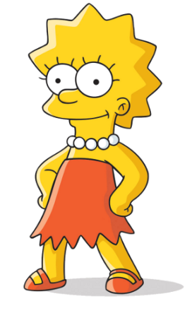




RecSys: Cold-start problem
Which user is closer to the current one?
Considering all existing users
Which object is closer to the current one?
Considering all rated objects

Slide 44


RecSys: Cold-start problem
Which user is closer to the current one?
Considering all existing users
Which object is closer to the current one?
Considering all rated objects

Slide 45
Questions?

Slide 46
Three things you found interesting
…
…
…

Slide 47
Four things I find most important
Look beyond plain numbers while comparing RS
We need preference-based content filtering
Cold-start problem
Intuition behind latent representations

Slide 48
Next Lecture
Continuing with RecSys Recap
Content-based, hybrid, context-aware, session-aware
Evaluation of RecSys
Open problems and challenges

Slide 49
Lab #1
Explicit feedback: experiment #1
Hands-on frameworks for RS

