Slide 1


NDBI021, Lecture 4
User preferences and advanced recommending methods, 2/1 ZK+Z,
Tue 14:00 – 15:30 S11
Tue 15:30 – 17:10 S11 (odd weeks)
https://www.ksi.mff.cuni.cz/~peska/vyuka/ndbi021/
https://youtube.com/playlist?list=PLTYzSYF3EX3BNIVJkMpCE3vUDmUGvhEcy
https://ksi.mff.cuni.cz

Slide 2
Today’s content
Recap
User feedback
  Intro
  Preference Elicitation
  Explicit Feedback
  Implicit Feedback
  Non-numeric Feedback

Slide 3
Recap

Slide 4
Any open problems in RS you remember?
Why we might need preference elicitation?

Slide 5
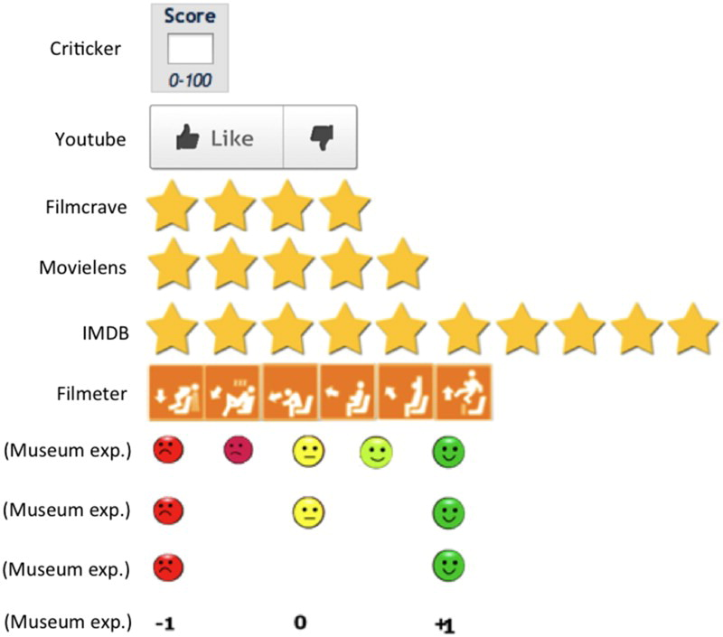
What is explicit feedback?
What do you remember about rating inconsistency issue?

Slide 6
Implicit feedback
User’s actions will speak for themselves…

Slide 7
Implicit feedback
Server-side (limited expressibility)
Client-side (triggered DOM events)
Beyond (eye-tracking, other biometrics)
  Limited applicability (lab studies)
  Can provide leads on interpretation of the previous two

Slide 8
Implicit feedback
Server-side
  Stream of visited pages
  Asynchronous loading of page content (e.g. more results)
  Proxy for time on page / dwell time (very coarse)
    http://www.hongliangjie.com/publications/recsys2014.pdf (RecSys 2014 best paper)
Not much information available
  But non-intrusive & cannot be turned off or altered easily

Slide 9
Implicit feedback
Client-side
Any DOM event can be captured, processed and stored…
  But which ones are relevant?
    And also… what is their semantics? Does it differ from explicit feedback?
  How to interpret implicit feedback?
  Are collected data dependent on some context?
  How to establish negative preference from implicit feedback?
Peska, IPIget: The Component for Collecting Implicit User Preference Indicators
https://www.researchgate.net/publication/305495313_IPIget_The_Component_for_Collecting_Implicit_User_Preference_Indicators

Slide 10
What to Collect as Implicit feedback
Not very explored area
Domain dependence (how surprising☺)
Mostly, academic researchers work with pre-collected datasets
  The decision on what to collect was already done
Not many known industry papers with details on implicit feedback collection
However…

Slide 11
What to Collect as Implicit feedback
Not very explored area
However… common identifiers:
(count of) page visits => object visits
Time on page / dwell time
  Beware to count only while focus is on the page (http://www.hongliangjie.com/publications/recsys2014.pdf)
Objects consumption statistics (playcounts, viewtime, purchase, store in basket,…)
!!! Impressions !!! (what was shown to the user)
  Contextual impressions
  Estimate what was actually perceived by the user

Slide 12
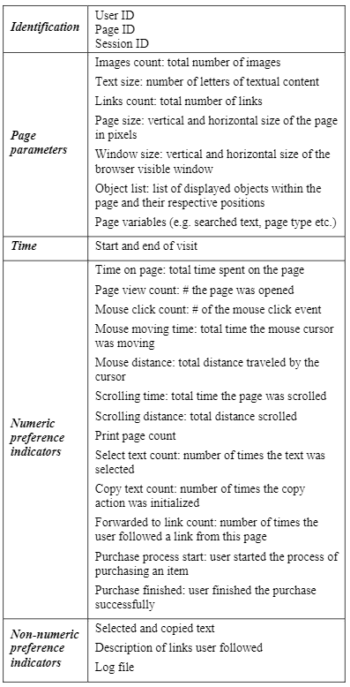
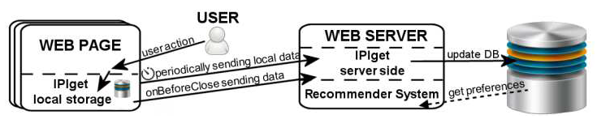
What to Collect as Implicit feedback
Peska, IPIget: The Component for Collecting Implicit User Preference Indicators
https://www.researchgate.net/publication/305495313_IPIget_The_Component_for_Collecting_Implicit_User_Preference_Indicators
Main target: small e-commerce vendors
  Previously mentioned events
  Other aggregated events: print, search, copy, text selection (not much usable)
    Non-numeric data (searched text, selected text,…)
  Context of events
    Scrolling to coordinates
    Mouse position sampling
    Mouse over pre-defined elements
  Basic page statistics
    Volume of text, images, links
    page dimensions, window dimensions
    position of elements
    Page params (e.g. Catalogue -> menswear -> Trousers…)

Slide 13
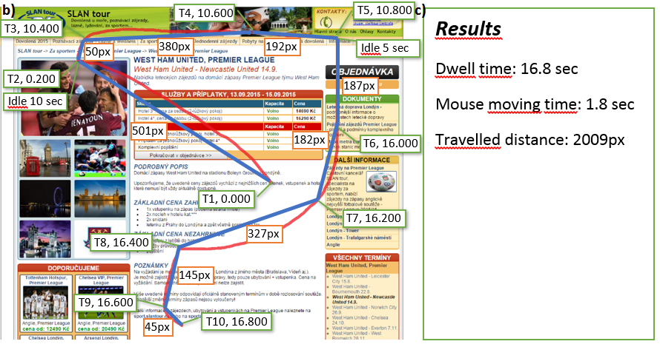
What to Collect as Implicit feedback

Slide 14

What to Collect as Implicit feedback
Collect visible area through time (scrolling position + window dimensions)
Store areas where interesting page segments are located
  Items in category page
  Areas focused on item’s features
Calculate visibility => noticeability of individual components
If the item is clicked, it should be more preferred than not-clicked ones with high-enough noticeability
https://link.springer.com/article/10.1007/s13740-016-0061-8

Slide 15
How to interpret numeric implicit feedback
Tailored RS algorithms to (mostly) binary/unary feedback
  BPR-MF
  EASE
  …
  Downside: we might be loosing too much by relying on coarse-grained information
Apply some pre-processing and then use RS tailored for explicit/multi-valued feedback
  Historically, better coverage
  Tailored to fine-grained preferences

Slide 16

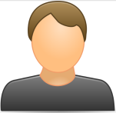
How to interpret numeric implicit feedback
Get graded „rating-like“ output from the combination of multiple feedback types
  Rating-based recommender systems can be used afterwards
The more the better hypothesis
  Normalize data (Time on page vs. Scrolling distance vs. Vol. of visits)
  (shifted) standardization, cummulative distribution function, log transformation
    Make a hypothesis about what particular values mean and then confirm it via user study (or guess blindly...)
Dwell time: 10s
Scrolling: 100px
Mouse movement:250px
Rating: 0.2
Dwell time: 100s
Scrolling: 200px
Mouse movement:450px
Rating: 0.8

Slide 17
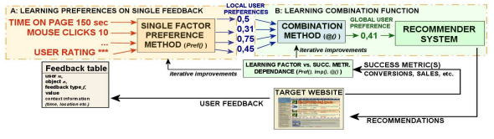
How to interpret numeric implicit feedback
Combine all implicit feedback features to estimated user rating
  Standard recommender systems can be used afterwards
Use feedback linked with positive/negative preference
  Ratings, purchases
  Train ML predictor to predict this based on other implicit feedback features
    Note that positive preference indicators are usually very sparse => bootstrap / stratified sampling / weighting
  Make individual preference estimators per feedback type &
  their aggregator (wAVG, fuzzy logic,…)
    In case of insufficient data or specific model in mind
https://www.researchgate.net/publication/283526661_How_to_interpret_implicit_user_feedback,
https://www.ksi.mff.cuni.cz/~peska/wims13.pdf
Stream of JS events: mouse motion, keyboard, scroll
Rating: 0.2
Stream of JS events: mouse motion, keyboard, scroll
Rating: 0.8

Slide 18
How to interpret numeric implicit feedback
Combine all implicit feedback features to estimated user rating
  Standard recommender systems can be used afterwards
Use feedback linked with positive/negative preference
  Ratings, purchases
  Train ML predictor to predict this based on other implicit feedback features
    Note that positive preference indicators are usually very sparse => bootstrap / stratified sampling / weighting
  Make individual preference estimators per feedback type &
  their aggregator (wAVG, fuzzy logic,…)
    In case of insufficient data or specific model in mind
https://www.researchgate.net/publication/283526661_How_to_interpret_implicit_user_feedback,
https://www.ksi.mff.cuni.cz/~peska/wims13.pdf
Stream of JS events: mouse motion, keyboard, scroll
Active time: 50s
Are we over-complicating things a bit?
Stream of JS events: mouse motion, keyboard, scroll
Active time: 20s

Slide 19
How to interpret numeric implicit feedback
Construct single (complex) implicit feedback based proxy for user preference
  Standard recommender systems can be used afterwards
Active dwell time [not confirmed by literature to the best of my knowledge]
  Time spent on page
  But counted only if some other events are detected in close temporal proximity => user is active
Stream of JS events: mouse motion, keyboard, scroll
Active time: 50s
Stream of JS events: mouse motion, keyboard, scroll
Active time: 20s

Slide 20
How to interpret numeric implicit feedback
Construct single (complex) implicit feedback based proxy for user preference
  Standard recommender systems can be used afterwards
Active dwell time [not confirmed by literature]
  Time spent on page
  But counted only if some other events are detected in close temporal proximity => user is active
Dwell time: 10s
Scrolling: 100px
Mouse movement:250px
Rating: 0.2
Is that all we can do?
Dwell time: 100s
Scrolling: 200px
Mouse movement:450px
Rating: 0.8

Slide 21
How to interpret numeric implicit feedback
Is that all we can do?
Negative Implicit Feedback
  Low values of feedback features on particular object
  Implicit feedback on object’s categories
Context of User Feedback

Slide 22
Context of user feedback

Slide 23
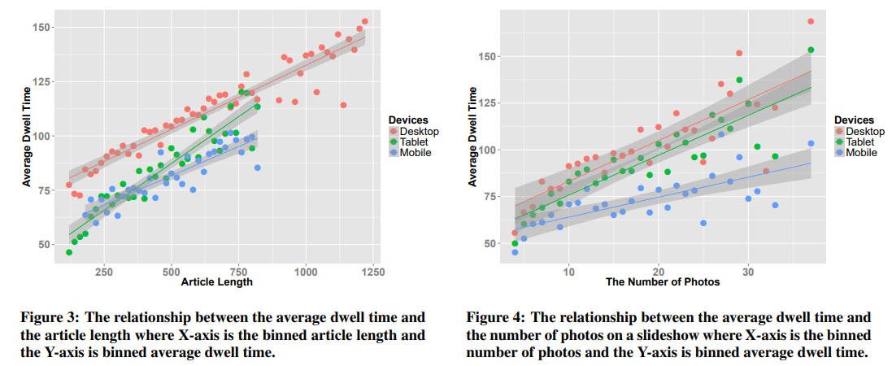
How to interpret numeric implicit feedback
Pages may substantially vary in length, amount of content etc.
  This could affect perceived implicit feedback features
  Leveraging context could be important
Consumption statistics may significantly vary for different device types
  (http://www.hongliangjie.com/publications/recsys2014.pdf)

Slide 24
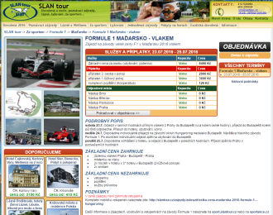

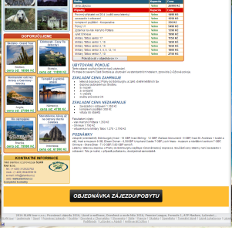
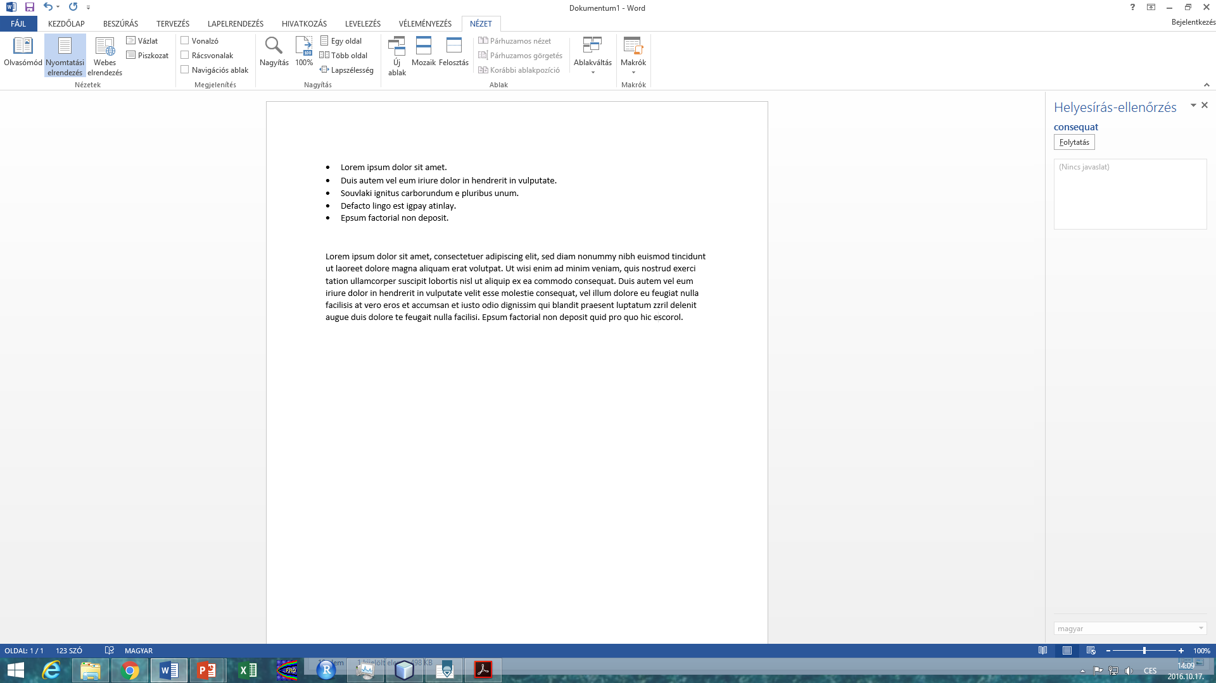
How to interpret numeric implicit feedback
Context of the user
  Location, Mood, Seasonality...
  Can affect user preference
  Out of scope of this paper (and this lecture☺)
Context of device and page
  Page and browser dimensions
  Page complexity (amount of text, links, images,...)
  Device type
  Datetime
  Can affect percieved values of the user feedback
A
B

Slide 25
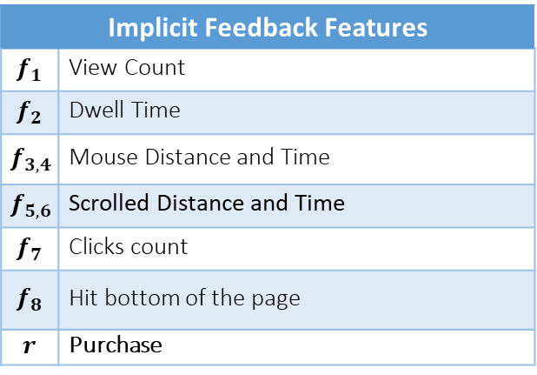
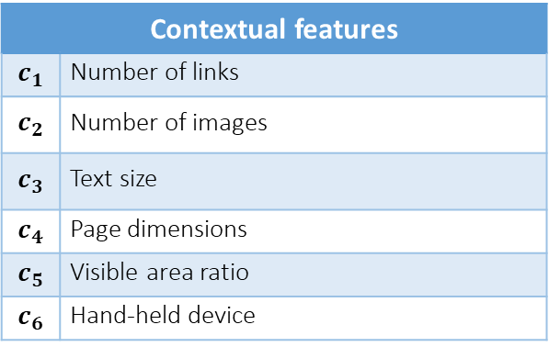
How to interpret numeric implicit feedback
IPIget component for collecting user behavior
Implicit Feedback Features
$$f_{1}$$ | View Count
$$f_{2}$$ | Dwell Time
$$f_{3,4}$$ | Mouse Distance and Time
$$f_{5,6}$$ | Scrolled Distance and Time
$$f_{7}$$ | Clicks count
$$f_{8}$$ | Hit bottom of the page
$$r$$ | Purchase
Contextual features
$$c_{1}$$ | Number of links
$$c_{2}$$ | Number of images
$$c_{3}$$ | Text size
$$c_{4}$$ | Page dimensions
$$c_{5}$$ | Visible area ratio
$$c_{6}$$ | Hand-held device

Slide 26
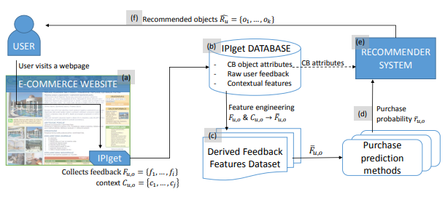

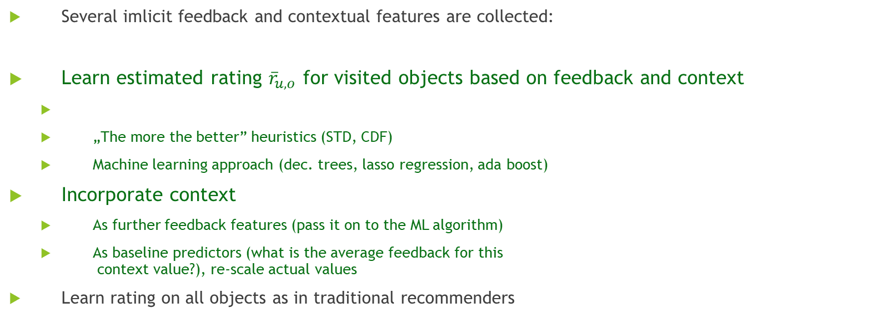
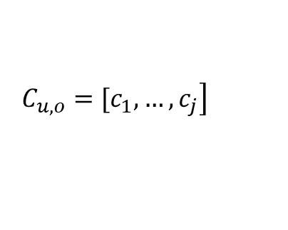

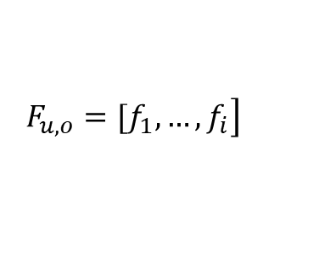
How to interpret numeric implicit feedback
Using the Context of User Feedback in Recommender Systems
https://arxiv.org/pdf/1612.04978.pdf
Several imlicit feedback and contextual features are collected:
Learn estimated rating ${\overline{r}}_{u,o}$ for visited objects based on feedback and context
  „The more the better” heuristics (STD, CDF)
  Machine learning approach (dec. trees, lasso regression, ada boost)
Incorporate context
  As further feedback features (pass it on to the ML algorithm)
  As baseline predictors (what is the average feedback for this
  context value?), re-scale actual values
Learn rating on all objects as in traditional recommenders
$$\left. F_{u,o}=[f_{1},…,f_{i}\right]$$
$$\left. C_{u,o}=[c_{1},…,c_{j}\right]$$
$$F_{u,o}, C_{u,o}→{\overline{r}}_{u,o}:o∈S$$
${{ \overline{R}}_{u}→\hat{r}}_{u,o′}$ $:{ o}^{′}∈O$

Slide 27
Negative preference from implicit feedback
Can my consumption say I dont like it?

Slide 28
Negative preference from implicit feedback
Object detail level
If more is better… „not-enough“ might mean I do not like it?
  Where is the borderline?
  https://dl.acm.org/doi/10.1145/2479787.2479800
    (below average implies negative – maybe not the best idea)
Google Analytics: bounce rate (leaving the page „immediately“ after openning it)
But why?
  Did I waited too long to load page?
  I clicked on it accidentally?
  I found sth. better in the meantime?
  The short description looked good, but it was missleading / did not cover important drawbacks
    Would this transfer into decreased feedback values?
    Maybe, maybe not (Seznam.cz lecture@NSWI166, clickbaits have similar consumption stats)

Slide 29
Negative preference from implicit feedback
The lack of positive feedback on object detail level
https://link.springer.com/content/pdf/10.1007%2F978-3-642-02247-0_47.pdf
  RecSys for jobs
    If the job was openned, but no positive action was recorded (applying /saving for later /...), consider it as negative
Applied to extend user profile similarity (both users disliked similar jobs)
But do we have the full information?
  User could just bookmark the job outside
  User could simply leave interesting offers open

Slide 30
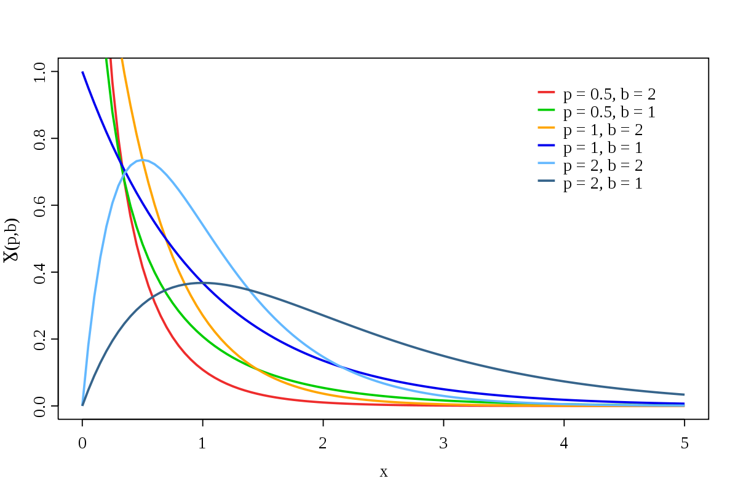
Negative preference from implicit feedback
De-noising binary implicit feedback (SATtisfied /DisSATtisfied click)
  Static (e.g. only count clicks with >30sec click dwell time)
  Context-aware
  Modeling Dwell Time to Predict Click-level Satisfaction
    https://dl.acm.org/doi/pdf/10.1145/2556195.2556220
  Feedback from search engines, text query
    Query topic, query types / page topic, reading difficulty
  Use click dwell time, known SAT / DSAT labels
  Decision trees: identify relevant context segments [strange]
    Fit Gamma distribution for both SAT, DSAT and each segment
  Predictor based on actual dwell time and SAT / DSAT params.
Dwell time: 40s
Page context
Rating: 0
Dwell time: 100s
Page context
Rating: 1

Slide 31
Negative preference from implicit feedback
De-noising binary implicit feedback (SATtisfied /DisSATtisfied click)
  Context-aware
  Denoising Implicit Feedback for Recommendation (https://arxiv.org/pdf/2006.04153.pdf)
    „False-positive interactions are harder to fit in the early stages. According to the theory of robust learning easy samples are more likely to be the clean ones and fitting the hard samples may hurt the generalization.“
    Discard or reduce weight for train interactions with high initial loss
      Counter-intuitive, but may work☺
  No need for additional types of feedback with this approach
Visited Item
Rating: 0
Visited Item
Rating: 1

Slide 32
Neg. Pref. from category-level feedback
List of objects (impressions needed)
If I (repeatedly) ignore an object, I probably dislike it
  How many times do I have to ignore it?
  Could it be that I just did not pay attention for this specific part of the page?
  What is the chance that I changed my mind?
We can consider uniform chance of item being unnoticed
We can consider fixed chance of being unnoticed for certain position
  https://link.springer.com/article/10.1007/s11257-021-09311-w
We can consider that items are evaluated sequentially
  If the item below was clicked, this one is probably observed as well
  TODO: ref [I know there is one, just could not find it]
We can have detailed feedback with objects’ visibility information
  https://link.springer.com/article/10.1007/s13740-016-0061-8

Slide 33
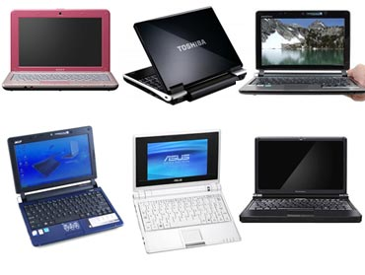
If you have detailed implicit feedback...
If user selects some objects from the list, we take it as an evidence of his/her positive preference.
  User prefers selected object(s) more, than other displayed & ignored objects
  We can form preference relations:
  IPR_{rel} (selected obj. > ignored obj.)
  Intensity of the relation based on the level of visibility for both items
    Visibility of clicked item considered as sufficient -> if the visibility of ignored was lower, strength of the relation decreases
In paper, CB extensions for relations (maybe not the best idea)
>
>
  https://link.springer.com/article/10.1007/s13740-016-0061-8

Slide 34
Neg. Pref. from category-level feedback
https://dl.acm.org/doi/pdf/10.1145/2959100.2959150
  Use eye tracking camera to observe fixations on certain page areas
  Gaze prediction for grid-based user interfaces
    MovieLens, YouTube, Netflix,...
  Where would the user look within the page
  Gaze prediction model
  (eye fixation on grid cell exists + time of eye fixation)
    Position, dwell time, distance to closest existing action
Both left-right & top-bottom decrease clearly apparent
  If sufficient dwell time, fixation probability is close to 1 for all positions
  Note, no scrolling included in the experiment

Slide 35
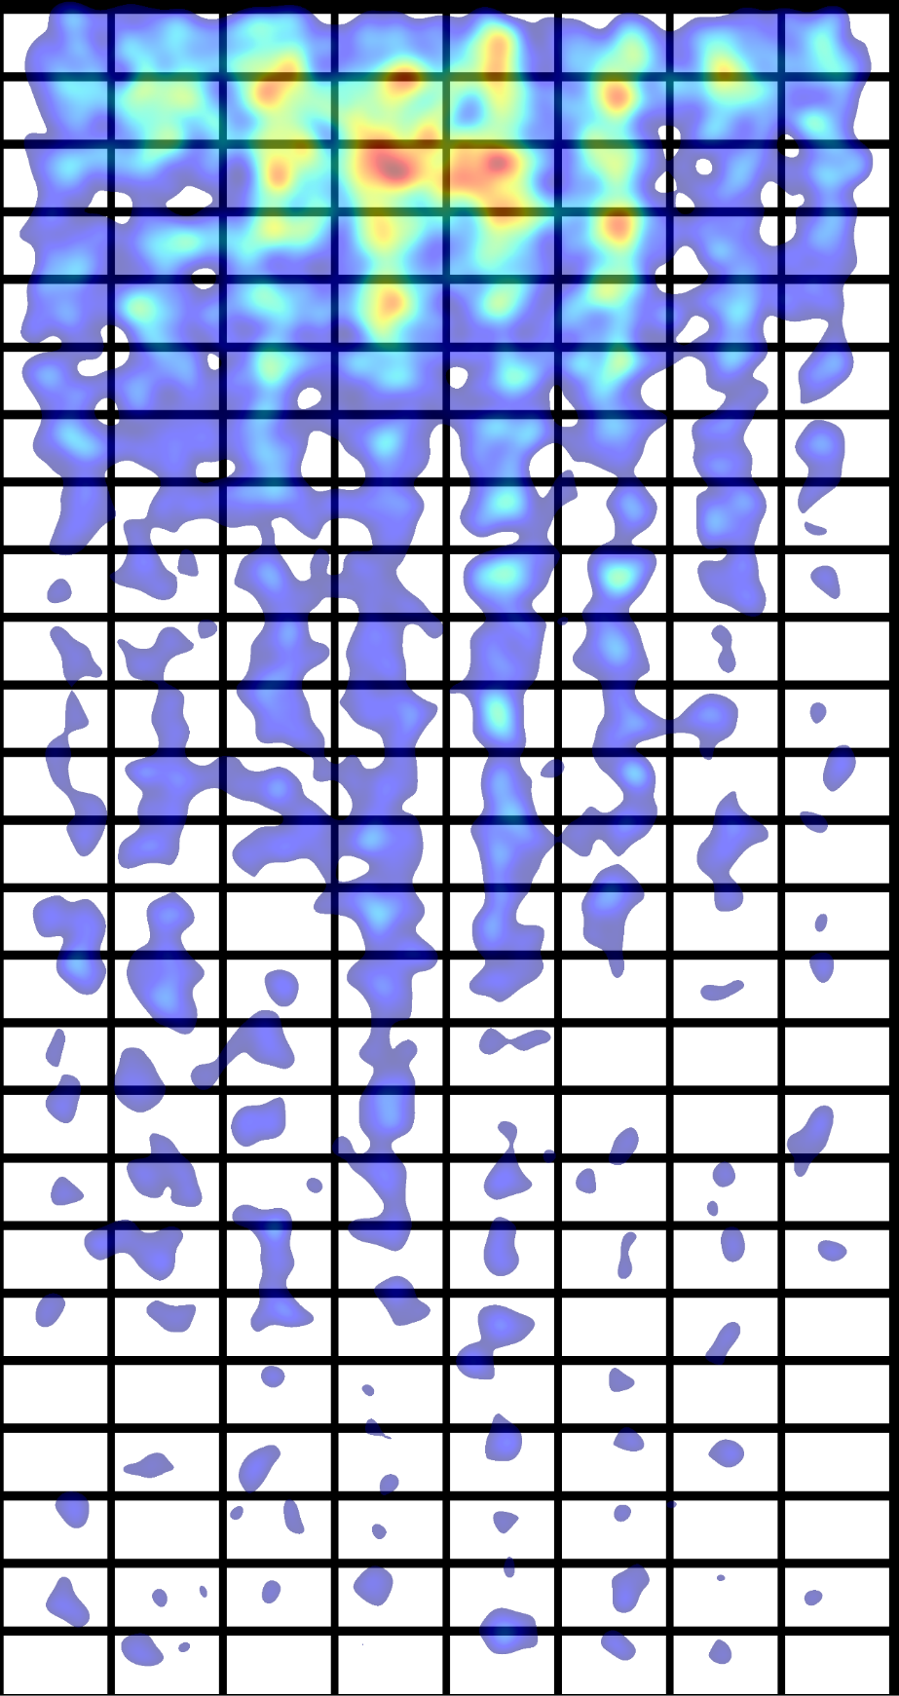
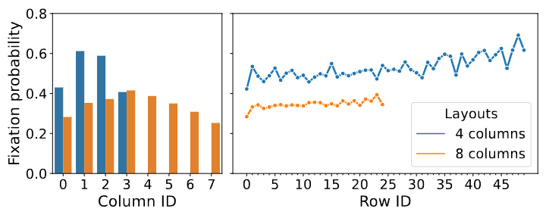
Neg. Pref. from category-level feedback
GUI / domain dependent fixation probabilities:
  Search results for visual query-by-example
  Not yet published (fingers crossed☺)

Slide 36
Implicit Feedback
How does the industry feel about that?

Slide 37
Implicit Feedback
???
How does the industry feel about that?

Slide 38

Questions?

Slide 39
Non-numeric feedback
How reviews improve personalization

Slide 40
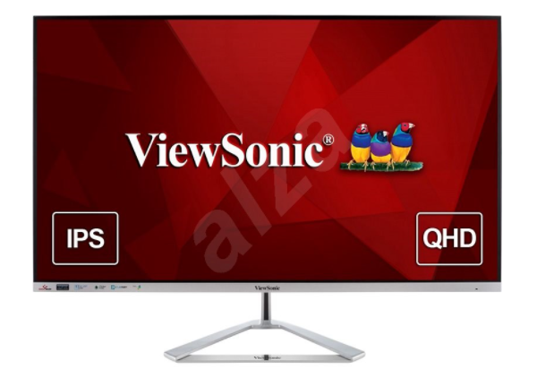
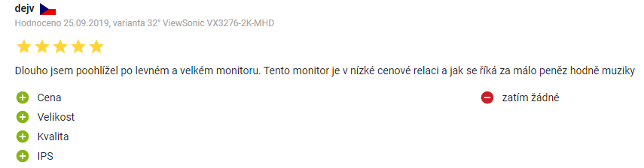
Non-numeric feedback
Textual reviews
Semi-textual reviews

Slide 41
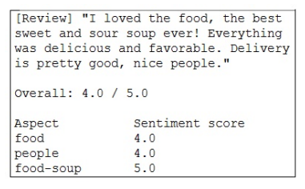
Textual reviews
Main usage:
  Rating prediction from reviews
    Multi-criteria rating prediction => recommendation
  Explanations
How:
  (explicit) Sentiment analysis
    https://dl.acm.org/doi/abs/10.1145/3109859.3109905 (restaurants)
    https://dl.acm.org/doi/10.1007/s11257-015-9157-3 (hotels, fixed aspects)
  Latent Dirichlet Allocation (and related approaches) + post-processing
    https://ieeexplore.ieee.org/abstract/document/8813018

Slide 42
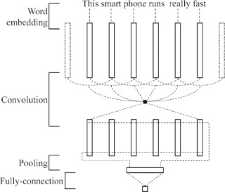
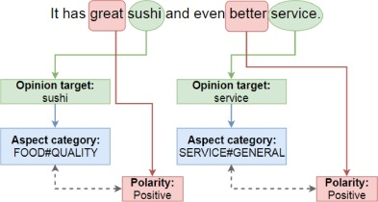
Textual reviews
Deep Learning for Aspect-Based Sentiment Analysis: A Comparative Review (2018) https://www.sciencedirect.com/science/article/pii/S0957417418306456
  CNN, RNN, Recursive NN
Three subtasks of aspect-based sentiment analysis:
Opinion target extraction (OTE),
Aspect category detection (ACD)
Sentiment Polarity (SP),
An example of CNN architecture for aspect category and sentiment polarity. Adapted from Gu, Gu, & Wu (2017) https://doi.org/10.1007/s11063-017-9605-7.
Limitations: fixed list of aspect axes

Slide 43
Textual reviews
Sentiment analysis https://dl.acm.org/doi/abs/10.1145/3109859.3109905
  A Multi-criteria Recommender System Exploiting Aspect-based Sentiment Analysis of Users’ Reviews
    „SABRE“ framework, Output: aspect, sub-aspect, its relevance for reviewer & its sentiment
    https://link.springer.com/chapter/10.1007/978-3-319-46135-9_4
      Aspect modeling as relatively simple frequency analysis – most common nouns [room for improvement]
      Afinn wordlist for sentiment (annotated words representing opinion appears close to the aspect)
      Aspect relevance ~ its relative frequency
      Limitations:
        Minimal granularity = one word (may be not generic enough)
        Fixed word-based sentiment
      Plus points:
        Dynamic list of aspects
    Neighborhood-based recommendation model
      Treat each aspect as independent rating, use multi-dimensional Euclidean distance
      (serialize pairs of item-aspect into a single vector)

Slide 44
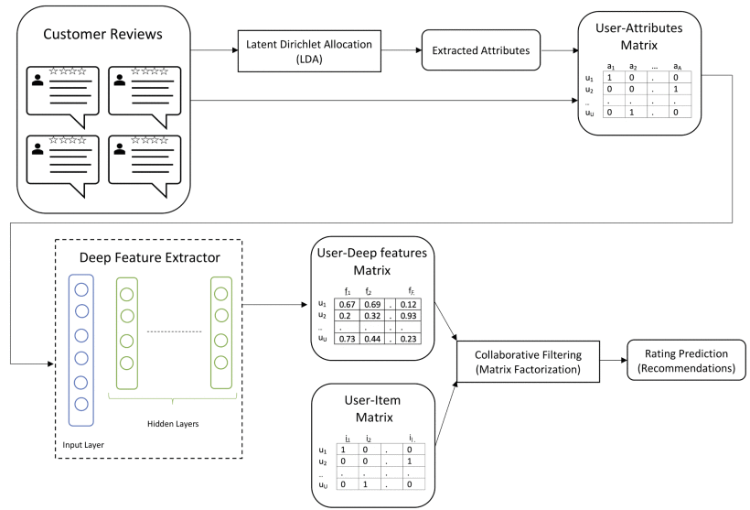
Textual reviews
What if the list of aspects cannot be fixed? Also, multiple words may account for the same aspect.
https://ieeexplore.ieee.org/abstract/document/8813018
Customer Reviews Analysis With Deep Neural Networks for E-Commerce Recommender Systems
  Latent Dirichlet Allocation
    The only interesting part of the
    pipeline
    „What was the review about“?
    Dynamic topic modeling

Slide 45
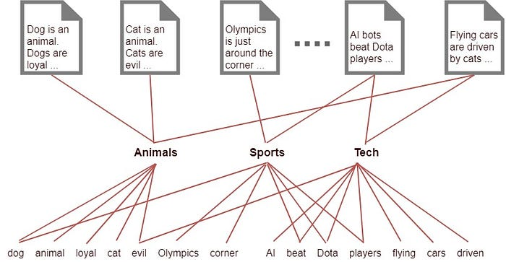
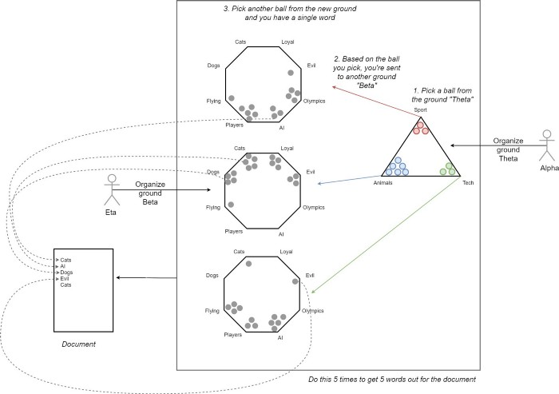
Textual reviews
Latent Dirichlet Allocation (LDA)
https://en.wikipedia.org/wiki/Latent_Dirichlet_allocation ,
https://towardsdatascience.com/light-on-math-machine-learning-intuitive-guide-to-latent-dirichlet-allocation-437c81220158
  Documents; fixed set of latent topics;
    each document is a mixture of topics,
    each topic is characterized as a Dirichlet distribution over words
  Assume generative model for documents
  and then try to reverse-ingeneer the documents with it.
  Several ways to learn, e.g. Variational inference / EM alg.
    https://en.wikipedia.org/wiki/Expectation%E2%80%93maximization_algorithm
    https://en.wikipedia.org/wiki/Variational_Bayesian_methods
  https://en.wikipedia.org/wiki/Kullback%E2%80%93Leibler_divergence

Slide 46
Textual reviews
Latent Dirichlet Allocation (LDA)
https://en.wikipedia.org/wiki/Latent_Dirichlet_allocation ,
https://towardsdatascience.com/light-on-math-machine-learning-intuitive-guide-to-latent-dirichlet-allocation-437c81220158
  Documents; fixed set of latent topics;
    each document is a mixture of topics,
    each topic is characterized as a Dirichlet distribution over words
  Assume generative model for documents
  and then try to reverse-ingeneer the documents with it.
  Several ways to learn, e.g. Variational inference / EM alg.
    https://en.wikipedia.org/wiki/Expectation%E2%80%93maximization_algorithm
    https://en.wikipedia.org/wiki/Variational_Bayesian_methods
  https://en.wikipedia.org/wiki/Kullback%E2%80%93Leibler_divergence

Slide 47
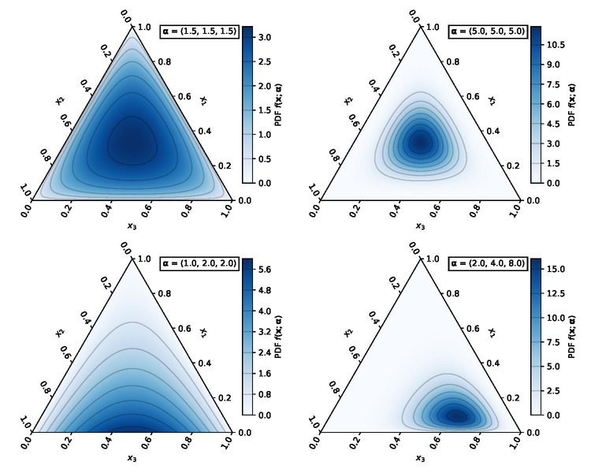
Textual reviews
Dirichlet distribution
  Multi-variate generalization of Beta distribution
  https://en.wikipedia.org/wiki/Dirichlet_distribution

Slide 48
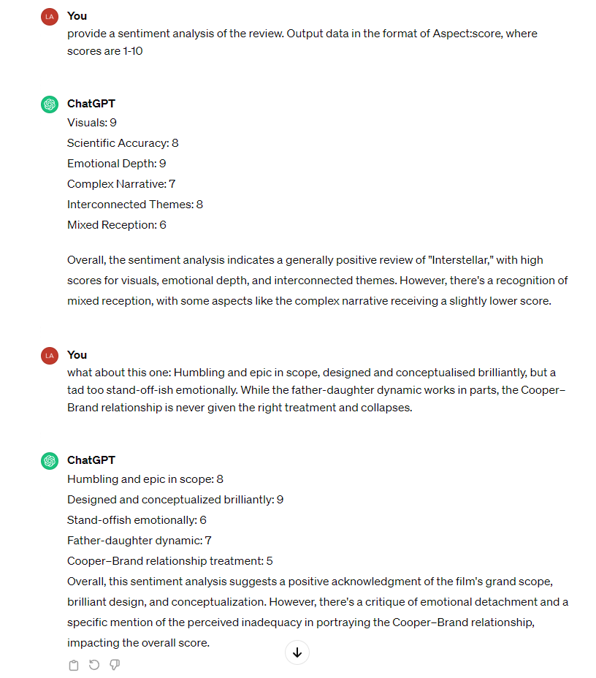
Textual reviews
Leave it on LLMs?
  Hard without a fixed set of aspects

Slide 49
Textual reviews
LDA is a variant of topic modeling algorithms, there are other options, see e.g.:
  https://arxiv.org/pdf/2103.00498.pdf (Topic Modelling Meets Deep Neural Networks: A Survey)
  https://medium.com/data-folks-indonesia/recent-works-in-topic-modeling-56c38da8dfc4
    Attention nets, GANs

Slide 50
Textual reviews
https://dl.acm.org/doi/pdf/10.1145/3412841.3442065
Utilizing Textual Reviews in Latent Factor Models for Recommender Systems
Latent Dirichlet Allocation (LDA); document = all reviews for item
  Use LDA to get item-attributes, use them in matrix factorization
  Joint optimization model for MF based and LDA based parts
  EM procedure for optimization

Slide 51
Textual reviews
http://ceur-ws.org/Vol-2068/exss8.pdf [vision paper]
Explaining Recommendations by Means of User Reviews
  Extract & summarize arguments about products from reviews
  Use them in Personalized explanations
Challenges:
Linguistically analyzing review texts via argument mining
and stance detection.
Identifying important concepts for a target user via an attention-based mechanism.
Deriving an argumentation flow via multiple applications of the attention-based mechanism.
Unifying the linguistic analyses and the attention-based mechanism.
... Just what ChatGPT can do now [beware of fact checks though]

Slide 52
Textual reviews
https://dl.acm.org/doi/pdf/10.1145/3320435.3320457 (2019)
Justifying Recommendations through Aspect-based Sentiment Analysis of Users’ Reviews
Aspoect extraction:
  Part-of-Speech (POS) tagging algorithm (nouns = possible aspects)
  Aspect ranking: relevant+positive & distinguishing
    For each aspect number of sentences + average sentiment + IDF
Sentences containing aspect a
Positive vs negative sentiment
IDF-like weighting

Slide 53
[What generic language models can do]
There are several reasons why you might want to watch Terminator 2: Judgment Day:
Groundbreaking Visual Effects: Terminator 2 was a pioneer in the use of computer-generated imagery (CGI) and special effects. The film features some of the most impressive and realistic visual effects of its time, which still hold up well today.
Iconic Characters: The movie features some of the most memorable characters in sci-fi movie history, including Arnold Schwarzenegger's "Terminator" and Linda Hamilton's "Sarah Connor." Their performances and characterizations have become iconic and have helped define the genre.
Compelling Storyline: The movie has a gripping storyline that keeps you on the edge of your seat. It's a thrilling sci-fi action film that also explores themes such as the nature of humanity and the dangers of technology.
Top-Notch Action Scenes: The movie is packed with exciting action scenes that are expertly choreographed and executed. From car chases to shootouts to hand-to-hand combat, Terminator 2 delivers on the action front.
Cultural Significance: Terminator 2 has had a significant impact on popular culture and has influenced many subsequent movies, TV shows, and video games. If you're a fan of sci-fi or action movies, it's definitely worth watching to see where many of today's tropes and techniques originated.
There are several reasons why you might want to watch Cars 3:
Heartwarming Story: Cars 3 features a heartwarming story that is both inspiring and emotional. The movie explores themes such as friendship, perseverance, and self-discovery, making it a great choice for families and viewers of all ages.
Stunning Animation: As with all Pixar films, Cars 3 boasts stunning animation that brings the characters and world to life. The attention to detail and vibrant colors make the movie a visual treat.
Nostalgia Factor: For fans of the original Cars movie, Cars 3 offers a return to the beloved characters and world of Radiator Springs. The movie pays tribute to the original film while also introducing new characters and storylines.
Strong Voice Cast: Cars 3 features an all-star voice cast, including Owen Wilson, Cristela Alonzo, Armie Hammer, and Chris Cooper. The cast brings the characters to life with their nuanced performances and comedic timing.
Inspirational Messages: Cars 3 delivers inspirational messages about the power of hard work, determination, and the importance of mentorship. These messages make the movie not only entertaining but also educational and inspiring for viewers of all ages.
Overall, Cars 3 is a fun, engaging, and inspiring movie that is perfect for families and fans of Pixar films.

Slide 54
Questions?

Slide 55
Searching and filtering as feedback

Slide 56
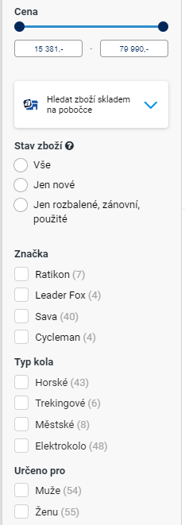

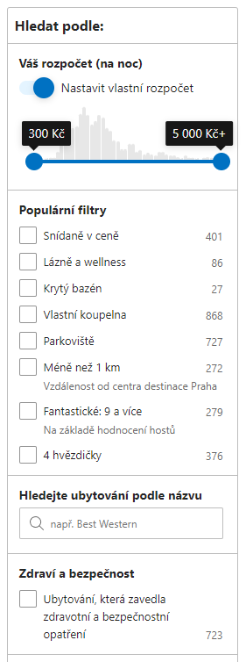
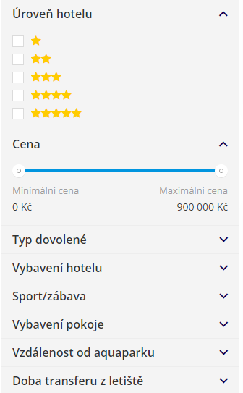
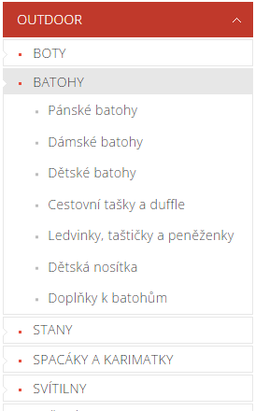
What would the user be willing to do?

Slide 57
What would the user be willing to do?
Most users do:
Filter content manually
  Browse categories
  Apply facet search
    Mostly direct mapping to object’s attributes
  Use fulltext search
  Can be utilized in the construction of attribute-level preferences
    Beware of long-term preferences vs. short-term goals
All users do:
Evaluate & consume content:
  Browse items, open details, read content, play, purchase,…
  Preferences based on implicit feedback

Slide 58
How to utilize searching / querying feedback?
Query refinement
User gives some (textual) query, we recommend him/her query extensions/modifications
Traditional approach: https://link.springer.com/chapter/10.1007/978-3-540-30192-9_58
  Query Recommendation Using Query Logs in Search Engines (2004)
  Queries along with the text of their clicked URLs extracted from the Web log are clustered. This is a preprocessing phase of the algorithm that can be conducted at periodical and regular intervals.
  Given an input query (i.e., a query submitted to the search engine) we first find the cluster to which the input query belongs. Then we compute a rank score for each query in the cluster.
  Finally, the related queries are returned ordered according to their rank score. The rank score of a related query measures its interest and is obtained by combining the following notions:
    Similarity of the Query. [Same words appearing in clicked URIs]
    Support of the Query. This is a measure of how relevant is the query in the cluster. We measure the support of the query as the fraction of the documents returned by the query that captured the attention of users (clicked documents). It is estimated from the query log as well.

Slide 59
How to utilize searching / querying feedback?
Query refinement
Not just similarity, but rather expansion of the query
Diversity of the recommended expansions
Beyond bag-of-words models (NLP, deep learning)
Sequential models (e.g., RNN, multi-armed bandits)
Further readning:
https://link.springer.com/chapter/10.1007/978-3-030-72240-1_54
https://proceedings.mlr.press/v157/puthiya-parambath21a.html
https://dl.acm.org/doi/10.1145/3269206.3271808
In general:
Usable for current information need of the user
Limited applicability for estimating long-term preferences

Slide 60
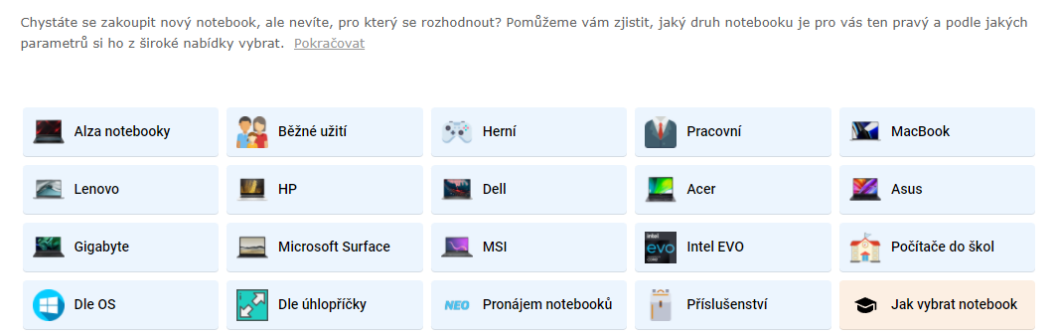
How to utilize searching / querying feedback?
Query refinement
In theory, could be done also based on faceted search logs / category browsing
Not very clear how to present it to the user
  Customized banners such as Alza have?
  Needs additional description generation model

Slide 61
How to utilize faceted search logs / browsed categories?
???

Slide 62
How to utilize faceted search logs / browsed categories?
???
Almost no available literature
  No (to the best of my knowledge) available datasets combining recommendations and facet search logs
    => Largely ignored by academic researchers
  No confirmed info from the industry
So, why should we bother?

Slide 63
How to utilize faceted search logs / browsed categories?
So, why should we bother?
  Depending on the domain (based on the data I have available)
  Visits of objects vs. visits of search / browsing pages are approx. 50:50
    Recommendation-first designs are less informative (users did not filter anything manually), but e.g. E-commerce websites may be highly relevant
    User’s intent can be inferred from the searched / filtered terms & it can be done faster than if only feedback from visited objects is collected
How to distinguish short-term needs vs. long-term preferences?
How to detect interest / preference drift?

Slide 64
How to utilize faceted search logs / browsed categories?
Option #0 just filter the recommendations
  Implicit assumption: User preferences are binary & exactly as stated in the search
    Post-process any recommendations to fulfill searched conditions (or their slightly relaxed versions)
    Use e.g. the last search record to filter recommendations given on particular object (a.k.a. similar objects)

Slide 65
How to utilize faceted search logs / browsed categories?
Option #1 content-based representation for recommender systems
  Model search pages / browsed pages in the same way as visited objects
    Vector representation of object’s attributes
    The same representation for searched terms (leave blank if unknown)
    Alternatively, page is represented as a (weighted) sum of items it displays
  Apply any suitable sequence-based recommender system on such data
  Diploma thesis of Kaan Yos: „Deep Learning For Implicit Feedback-based Recommender Systems“, https://dspace.cuni.cz/handle/20.500.11956/121242
    Limited search data on a travel agency (dates, tour type, accomodation type)
    LSTM, several encoding variants
    Next item recommendations
  Suitable for short-term user needs (sessions)
  Possible extensions: aggregated information from past sessions => latent model for long-term pref. (similar as https://dl.acm.org/doi/10.5555/3367471.3367627)

Slide 66
How to utilize faceted search logs / browsed categories?
Option #1 content-based representation - extension
  Adaptive user modeling with long and short-term preferences for personalized recommendation
    https://dl.acm.org/doi/10.5555/3367471.3367627
    Latent model based on two components: long-term and short-term user preferences
  Short-term: based on LSTM trained on the sequence of user behavior (tweaks with time distance)
  Long-term: assymetric SVD
    users are represented through weighted sum of items they interacted with
    This representation can be modified e.g. to cover searched terms
  Adaptive fusion of long and short term preferences to derive final latent vector for user

Slide 67
How to utilize faceted search logs / browsed categories?
Option #1 content-based representation - extension
  Beware on how to represent search terms
    Different ranges for the same attributes throughout various categories (e.g. Fridge vs. Keyboard)
    Different set of attributes for various categories
    The same value may have a different meaning throughout the time
      „500GB HDD“ now vs. 5 years ago
      „Movies from 2018“ now vs. 3 years ago
  Try to compensate for these biases

Slide 68
How to utilize faceted search logs / browsed categories?
Option #1 content-based representation – explicit model
  Latent vs. Explicit model (previously described is latent)
  Explicit model:
    Distribution on searched values vs. all possible values
    Probably relevant only for a subset of attributes
    What about context (of other searched criteria)
    Be especially aware of biases – category agnostic predictor (use CDF or similar rather than raw data)
    Given other searched terms, try to predict what values would be searched by the user in not-yet-filled facets => use this to rank items / recommend particularly good ones

Slide 69
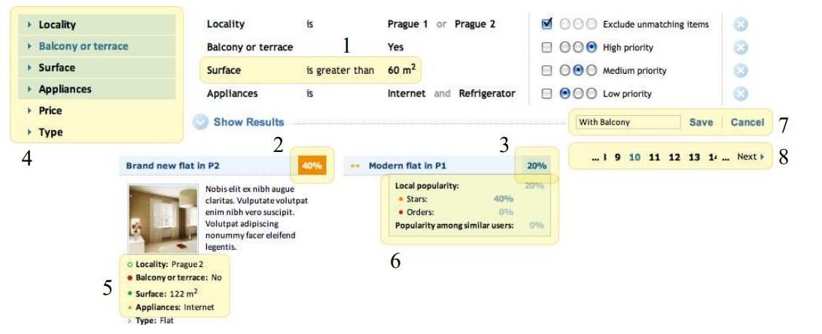
How to utilize faceted search logs / browsed categories?
  Soft & hard constraints / importance of individual constraints
    https://dl.acm.org/doi/pdf/10.1145/3425603
    Diploma thesis of Bronislav Vaclav „Models of user preferences in e-shop environment“ https://dspace.cuni.cz/handle/20.500.11956/30703
!! If all constraints are met,
items are undistinguishable !!

Slide 70
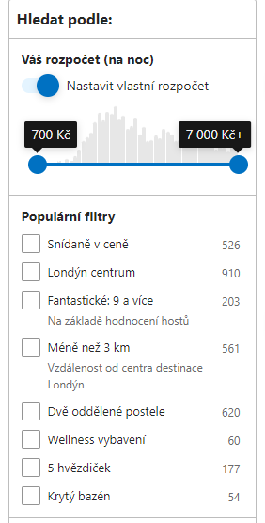
How to utilize faceted search logs / browsed categories?
Option #3 recommend/re-order filtering options
  If there are too many filtering options, the relevant ones might be difficult to find
    Recommend best options for the user
      Nowadays, this is usually done in a non-personalized fashion
    Personalization based on
      Utilization statistics (the more used the higher position – multiarmed bandits, beware of feedback loops – discoverability models)
        Collaborative/contextual model possible in case of insufficient data per user
      Background user preference model & ability to distinguish preferred vs. unpreferred (e.g. Information gain, https://en.wikipedia.org/wiki/Information_gain_in_decision_trees)

Slide 71
Three things you found interesting
…
…
…

