Slide 1


NDBI021, Lecture 3
User preferences and advanced recommending methods, 2/1 ZK+Z,
Tue 14:00 – 15:30 S11
Tue 15:30 – 17:10 S11 (odd weeks)
https://www.ksi.mff.cuni.cz/~peska/vyuka/ndbi021/
https://youtube.com/playlist?list=PLTYzSYF3EX3BNIVJkMpCE3vUDmUGvhEcy
https://ksi.mff.cuni.cz

Slide 2
Today’s content
Recap
Open problems in RecSys
User feedback
  Intro
  Preference Elicitation
  Explicit Feedback
  Implicit Feedback

Slide 3
Recap

Slide 4
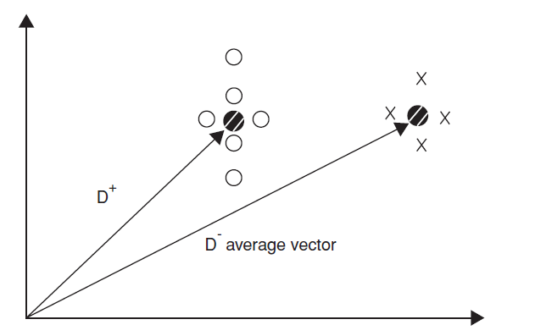
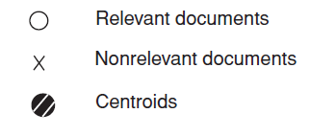

How does Rochio’s method work?
What is wrong here?

Slide 5
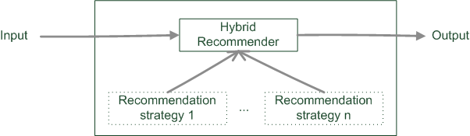
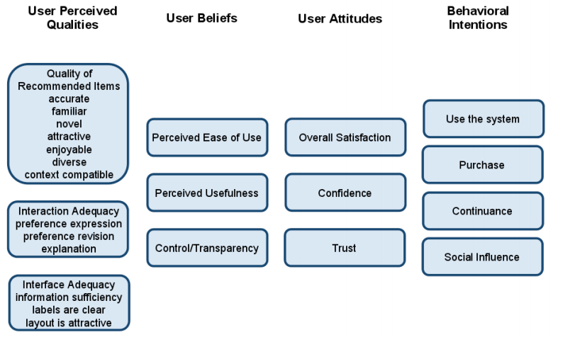
What are the 3 paradigms of hybrid RecSys?
What are the key benefits of user studies over online RS evaluation?

Slide 6
RecSys: Open Problems

Slide 7
Rather Solved Problems (incremental updates)
Incorporate raw content -> DL
Combine different input modalities -> DL
Keep the model up-to-date -> EASE / session-based

Slide 8
Open Problems
User understanding
  How to give RecSys correct inputs?
    How to interact with users? (ChatGPT stirred things up)
    How to interpret their responses?
    How to measure what made the user happy?
    Saying vs. Doing (beware of user studies)

Slide 9
Open Problems
Evaluation gap
  Good in off-line vs. Good in production
    What combination of metrics?
    What evaluation protocol?
    What data treatment? ...

Slide 10
Open Problems
Long-term impact of RecSys
  It changes us...
    Nudging towards uniformity
    Creating bubbles
    Spreading missinformation
    Amplifying biases
    ... and can severely hurt you in some use cases (job recommenders,...)

Slide 11
Open Problems
Fairness and multi-stakeholder environment
  Its not just me and the system...
    Other stakeholders (e.g., content providers) have needs of their own
    Often, those needs contradict each other
    But how to say what is fair... And who gets to say that?

Slide 12
Open Problems
Scalability
  Sometimes better approaches dealing with previous challenges exist... But are too slow.
  Not just time, but model size / train memory is also an issue

Slide 13
USER PREFERENCES

Slide 14
How to express user preferences
Feedback variants for users

Slide 15
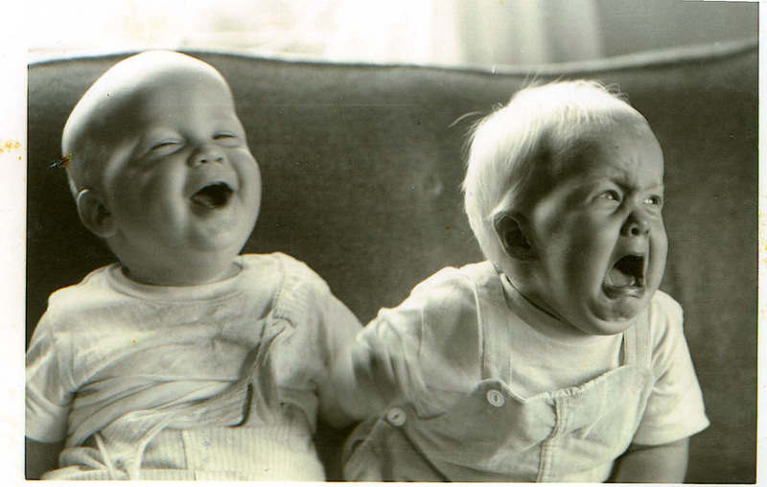
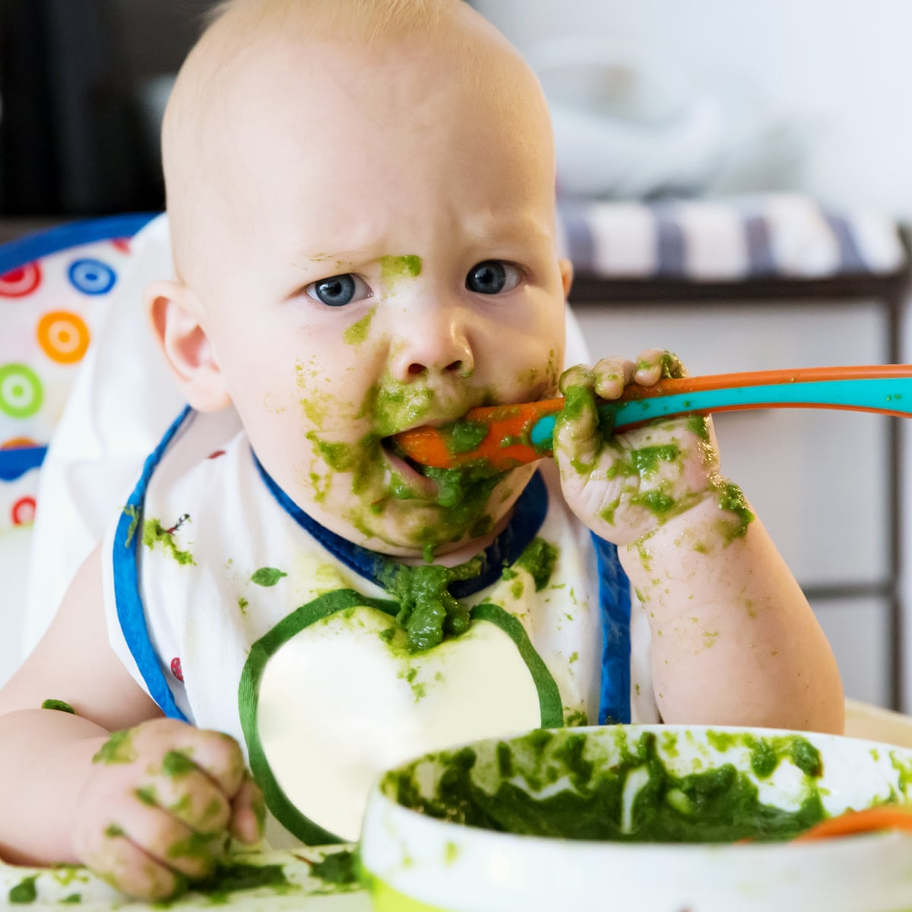

What tools are there to express preferences
Explicit feedback
Searching / filtering
Implicit feednack
Why doing user preference research feels like being a parent?

Slide 16
What tools are there to express preferences
„Expressing by doing“ (implicit feedback)
Rating/(dis)approving (explicit feedback)
  Filtering, searching
  Explicit comparison (A is better than B)
  Critiquing
  Writing a review
Did I forgot anything?

Slide 17
How to collect user preferences?
Rating, filtering, comparison, reviews… via designated GUI
  How to store e.g. searching / filtering may be a bit tricky…
Implicit feedback
  Server-side (limited expressibility)
  Client-side (triggered JS events)
  Beyond (eye tracking, other biometrics)
    Limited applicability (lab studies)
    Can provide leads on interpretation of the previous two
Questionaires, role playing
  Lab studies only (in most cases)
  Can provide leads on interpretation of other collection methods

Slide 18
Preference Elicitation
What to do for a brand new user?

Slide 19
What to do for a brand new user?
Just show them the normal content (using non-personalized RS)
  Wait untill enough feedback is collected; Then switch to personalized treatment.
  Possible problems: biased data
Preference Elicitation
  Preliminary step (before showing the normal content)
  Aimed on gaining initial feedback very quickly and then using personalized treatment
  Possible problems: bounce rate
  Known usage: NetFlix, new account (select 3 out of approx. 20 movies)

Slide 20
Preference Elicitation
[WIKI] Preference elicitation refers to the problem of developing a decision support system capable of generating recommendations to a user, thus assisting in decision making. It is important for such a system to model user's preferences accurately, find hidden preferences and avoid redundancy.
Not really a definition
The process of collecting user preferences to support decision making systems
  Often considered w.r.t. restricted meaning of initial preference elicitation
  Often restricted to explicit feedback, but not exclusively

Slide 21
Preference Elicitation - Requirements
Fast & simple (users have limited patience)
Sufficiently descriptive (personalization is „good enough“ after the elicitation step)
As unbiased as possible (e.g., do not only focus on blockbusters)
Obviously, those requirements contradict each other

Slide 22
Preference Elicitation – Prehistory
Survey of Preference Elicitation Methods
(Chen and Pu, 2004)
Value function elicitation
  Additive independence of preferences
  Preferences of items is a function of it’s features preferences (wAVG)
https://www.researchgate.net/publication/2935925_Survey_of_Preference_Elicitation_Methods

Slide 23
Preference Elicitation – Prehistory
Survey of Preference Elicitation Methods
(Chen and Pu, 2004)
Value function elicitation
  Additive independence of preferences
  Preferences of items is a function of it’s features preferences (wAVG)
Violates „Fast and simple“ requirement

Slide 24
Preference Elicitation - Theory
Constructive Preference Elicitation
  „There exist many types of queries, like lotteries, pairwise or setwise rankings, improvements, which all share the goal of being easy to answer to and as informative as possible.“
    Choice set feedback (pick the best set out of several options)
    Coactive feedback (how to slightly improve a solution? – can be done from implicit feedback)
    https://www.jair.org/index.php/jair/article/view/10939
    Example critiquing (similar to above, but just identify what is wrong)
  „Queries involving comparisons and rankings have come to be predominant in the literature with respect to quantitative evaluations.“
  „Indeed, users are typically more confident in providing qualitative judgments like “I prefer configuration y over y′ ” than in specifying how much they prefer y over y′ (Conitzer, 2009; Carson and Louviere, 2011).“
https://www.frontiersin.org/articles/10.3389/frobt.2017.00071/full

Slide 25
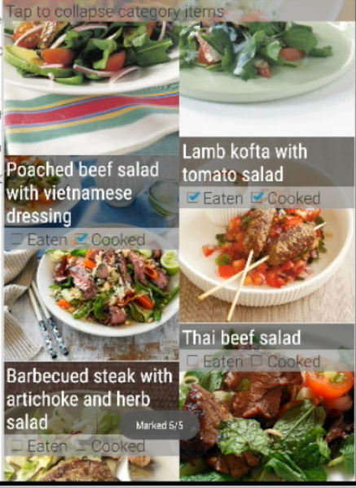
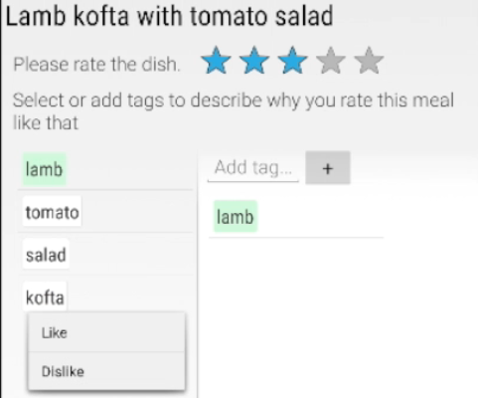
Preference Elicitation – example #1
Health-aware Food Recommender System
  Key question: What was the main cause of your decision?
    Relatively simple tag-based approach
    Still, perhaps too much for realistic use-case
https://dl.acm.org/doi/pdf/10.1145/2792838.2796554, also see video: https://onedrive.live.com/?authkey=%21ALYePnW0fOCHOUQ&cid=60DC0855E37985A6&id=60DC0855E37985A6%2149418&parId=60DC0855E37985A6%2149101&o=OneUp

Slide 26
Preference Elicitation – example #2
Choice-based preference elicitation for collaborative filtering recommender systems
  Set-wise feedback
  Based on latent factors rather than meta-data
    „The basic idea behind our approach is, thus, to use latent item features derived from the rating matrix and request preferences for sets of similar items instead of single items.“
    „Since the number of interaction steps needed should be minimized, we developed a technique based on latent factors to achieve a maximum information gain with each choice.“
https://dl.acm.org/doi/10.1145/2556288.2557069

Slide 27
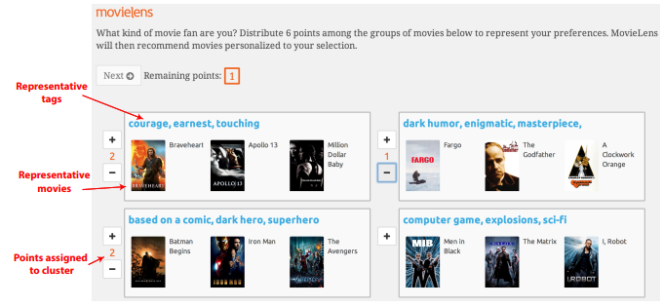
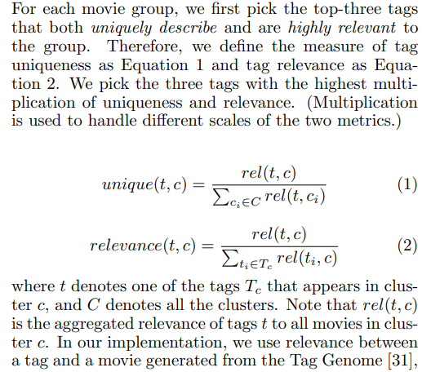
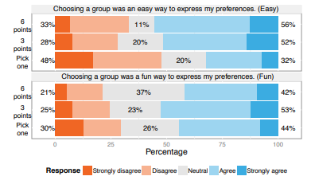
Preference Elicitation - #3
Using Groups of Items for Preference Elicitation
in Recommender Systems
Set-wise feedback, but this time, points assignment
  Utilize clustering to generate groups
  Based only on movie ratings
  For each cluster: select tags, then select best matching movies
  Recommendation step: get avg. ratings of users with similar cluster prefs.
https://dl.acm.org/doi/pdf/10.1145/2675133.2675210

Slide 28
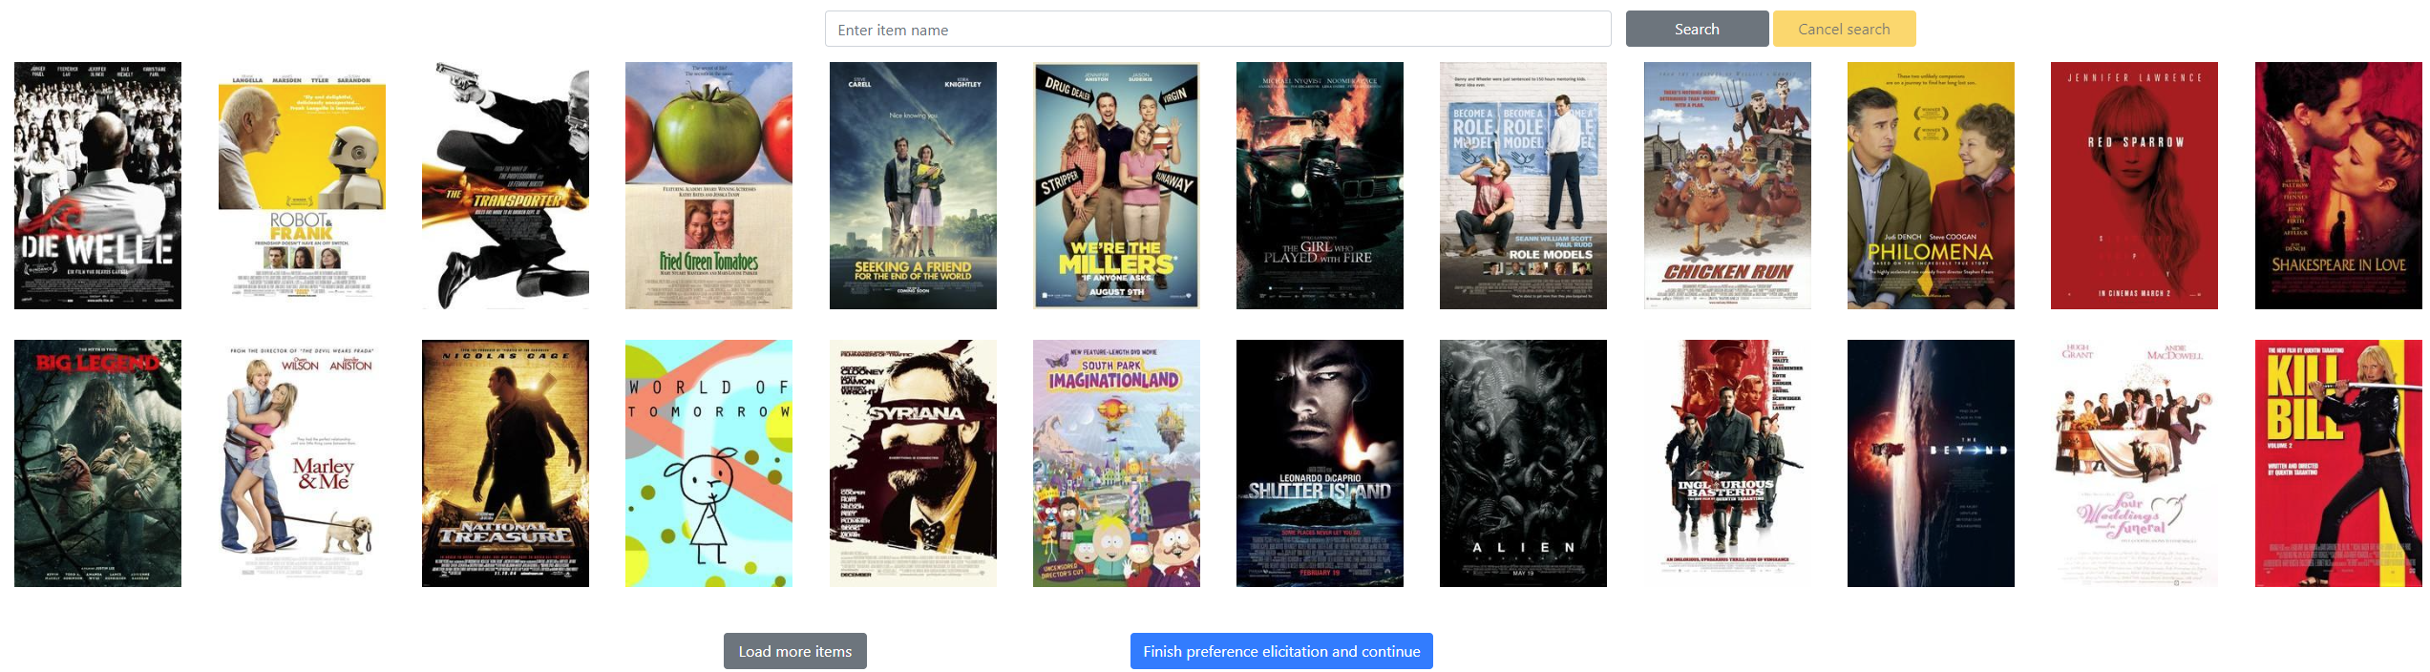
Preference Elicitation – example #4 (our work)
Looks Can Be Deceiving: Linking User-Item Interactions and User’s Propensity Towards Multi-Objective Recommendations
Item-wise, unary feedback (click if you liked)
How to select representative candidates?
  Three criteria, „low“ and „high“ bins for each
    Relevance (w.r.t. average user profile), Novelty (temporal or interactional), Diversity (different from previously selected)
  Sample fixed vol. of items from each bin

Slide 29
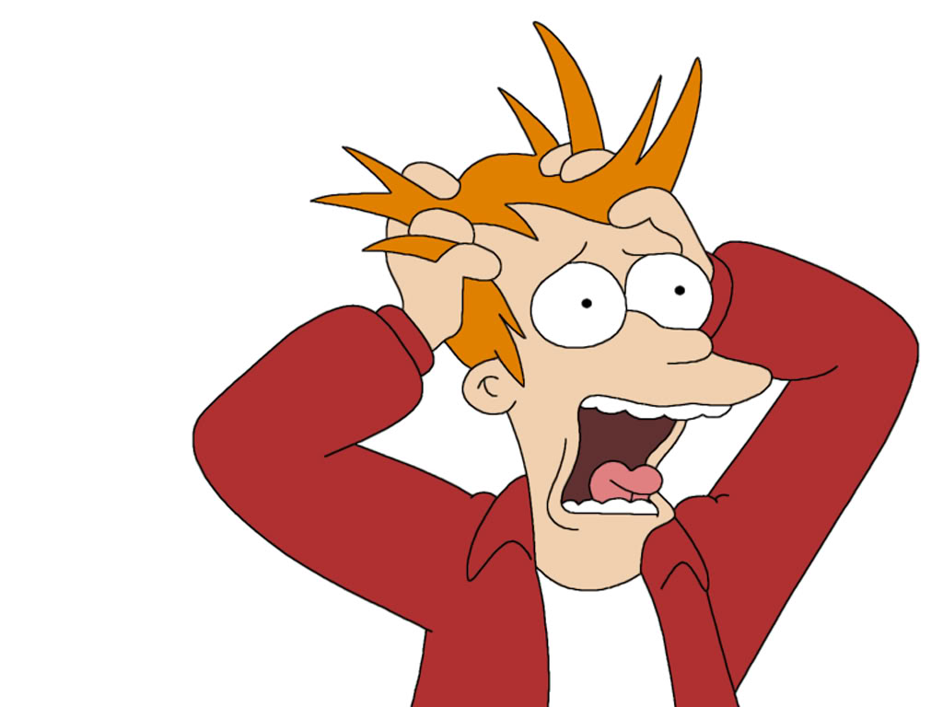
Questions?

Slide 30
Explicit feedback
Let the users to tell you

Slide 31
Explicit feedback
Information given consciously by the user to express his/her preference
  Via dedicated GUI
Rating (likert scale) of objects
  N-ary preference (5 / 10 degrees of preference most common)
  Binary preference (likes – dislikes)
  Unary preference (likes only)
Simple enough? Nothing to research here?
  Well... ☺

Slide 32
Explicit feedback
How scales influence user rating behaviour in recommender systems?
(https://www.tandfonline.com/doi/full/10.1080/0144929X.2017.1322145 )
  Granularity of the rating scale
  Presence/absence of neutral point
  Labeling
How much are the ratings inconsistent for test-retest?
  I like it... I like it not: Evaluating User Ratings Noise in Recommender Systems (https://xamat.github.io/pubs/xamatriain_umap09.pdf )
  Impact of the Number of Response Categories and Anchor Labels on Coefficient Alpha and Test-Retest Reliability (https://journals.sagepub.com/doi/10.1177/0013164404268674 )
Are different rating scales affecting RS performance?
  The Effect of Feedback Granularity on Recommender Systems Performance (https://dl.acm.org/doi/10.1145/3523227.3551479; our work)
    More granular feedback tend to require more effort from users (=> we may receive it in lower quantities)
    Does the more information value justify less quantity? …No, not really.

Slide 33
Explicit feedback: how scale influence behavior?
How rating scale influence user rating behavior?
https://www.tandfonline.com/doi/full/10.1080/0144929X.2017.1322145
  Granularity of the rating scale
    10.1007/s11205-007-9171-x: evaluate happiness on 4, 5, 7 and 11 points likert scale; then re-scale to 11 points: 11-point scale has higher happiness than 4 and 7 (higher scale higher ratings?)
    Other authors did not found such re-scaling issues
    10.1016/S0001-6918(99)00050-5: 2,3,4 point least reliable and least discriminating, wider options preferred (7-10), but 2-4 points quicker to use
      Less granularity imply higher willingness to use?
      Binary/unary schemes less intrusive?
    10.1177/0013164404268674: test-retest scenario; more points (at least 3) imply higher reliability

Slide 34
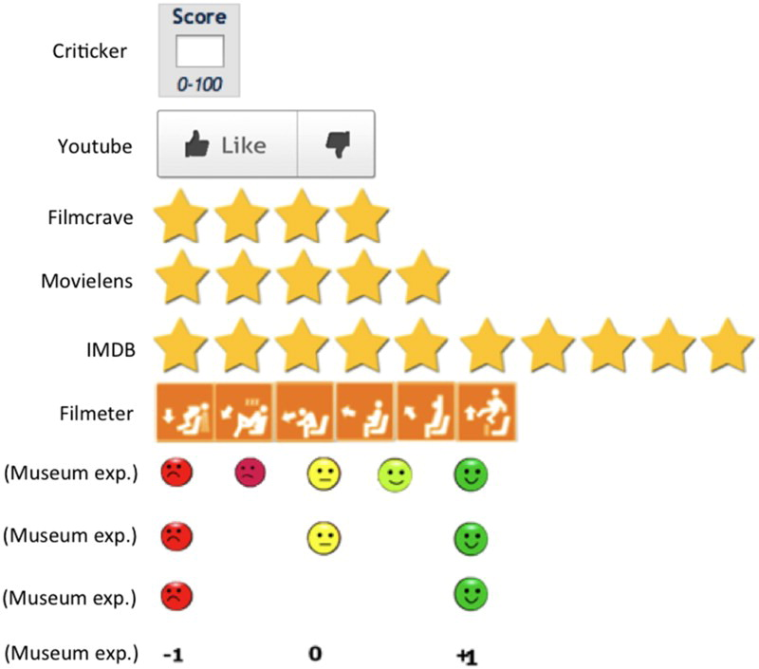
Explicit feedback: how scale influence behavior?
How rating scale influence user rating behavior?
https://www.tandfonline.com/doi/full/10.1080/0144929X.2017.1322145
  Granularity of the rating scale: how different rating scales correlate on real-world services
 |  | Cricketer | Filmeter | FilmCrave | IMDb | MovieLens
Criticker | Pearson Correlation | 1 | 0.791ª | 0.943ª | 0.944ª | 0.946ª
Filmeter | Pearson Correlation | 0.791ª | 1 | 0.783ª | 0.767ª | 0.740ª
FilmCrave | Pearson Correlation | 0.943ª | 0.783ª | 1 | 0.934ª | 0.915ª
IMDb | Pearson Correlation | 0.944ª | 0.767ª | 0.934ª | 1 | 0.933ª
MovieLens | Pearson Correlation | 0.946ª | 0.740ª | 0.915ª | 0.933ª | 1

Slide 35
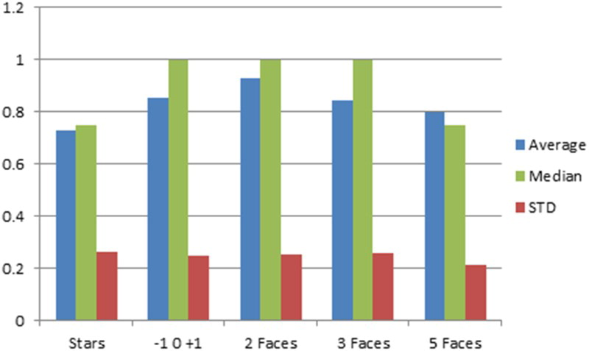
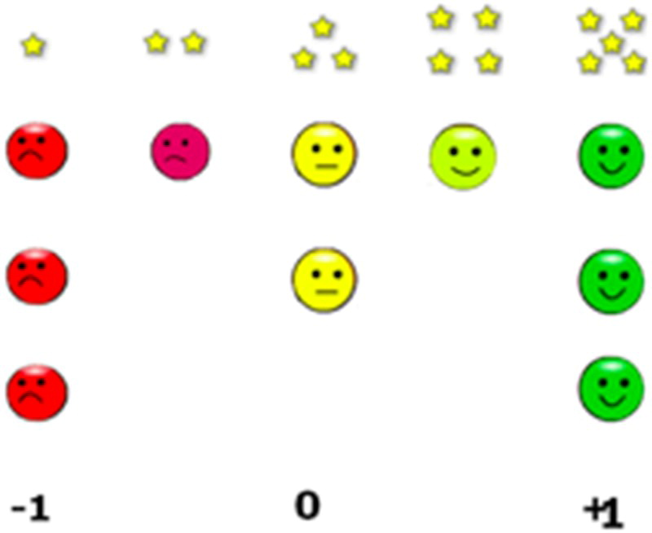
Explicit feedback: how scale influence behavior?
How rating scale influence user rating behavior?
https://www.tandfonline.com/doi/full/10.1080/0144929X.2017.1322145
  Granularity of the rating scale: same site with different rating scales implemented: how the results differ?
  Note the average

Slide 36
Explicit feedback: how scale influence behavior?
How rating scale influence user rating behavior?
https://www.tandfonline.com/doi/full/10.1080/0144929X.2017.1322145
  Neutral point
    https://www.rangevoting.org/MB_V2_N3_Garland.pdf :
      some respondents may choose the midpoint in order to provide a less negative answer, because of a social desirability bias
      rating scales with no midpoint force the real indifferent to make a choice, causing a distortion towards higher or lower answers
    10.1016/j.ijresmar.2010.02.004:
      with neutral points in the rating scale, we have less extreme responses and higher ratings

Slide 37
Explicit feedback: how scale influence behavior?
How rating scale influence user rating behavior?
https://www.tandfonline.com/doi/full/10.1080/0144929X.2017.1322145
  Labels
    http://www.websm.org/uploadi/editor/1368430817Hereshey_1993_The_Biasing_Effects_of_scale_checking.pdf : Ordering of labels could matter
      collected students’ attitudes towards their college
      ‘strongly agree’, ‘agree’, ‘undecided’, ‘disagree’ and ‘strongly disagree’ and opposite order,
      first scale resulted in a significantly greater degree of agreement.
    https://academic.oup.com/poq/article/79/1/145/2330061?login=true :
      Using 11-point likert scale (0 – 10 vs. 10-0), significant bias towards left side
    https://papers.ssrn.com/sol3/papers.cfm?abstract_id=2423064 (label’s value matters)
      If negative labels are used (e.g. -4,.., 4), it is perceived more negatively (vs. 1,...,9)
      -4,.., 4 produces more positive evaluations than 1,...,9

Slide 38
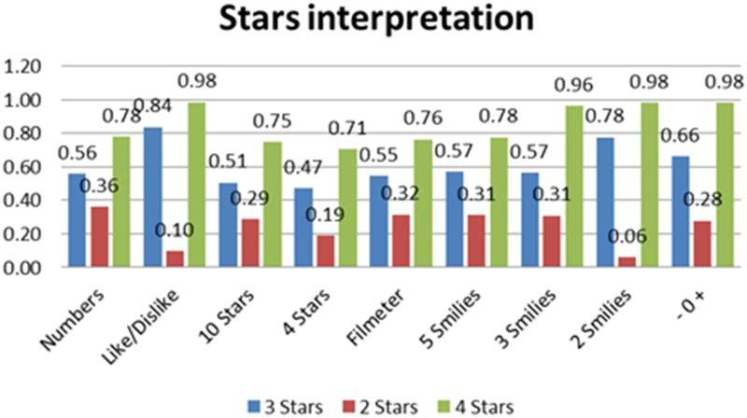
Explicit feedback: how scale influence behavior?
How rating scale influence user rating behavior?
https://www.tandfonline.com/doi/full/10.1080/0144929X.2017.1322145
  You have 2*, 3* and 4* out of five star chart, how will you translate it to other rating schemes
    Translation differs, but there are some similar outcomes

Slide 39
Explicit feedback: how scale influence behavior?
Summary:
  Be very careful while changing GUI or using external feedback data
  It may be difficult to assess where is the border between liked and disliked (and what/how to use it in the user profile)

Slide 40
Explicit feedback: how much inconsistent it can be?
https://xamat.github.io/pubs/xamatriain_umap09.pdf
Netflix dataset, both popular & unpopular movies
Three trials, 5-scale rating + unseen of 100 movies: 1->2 at least one day apart, 2->3 at least 14 days apart, different ordering of items (random -> popular -> random)
Usually, rating differs just by one point; mediocre movies more unstable

Slide 41
Explicit feedback: how much inconsistent it can be?
https://xamat.github.io/pubs/xamatriain_umap09.pdf
Netflix dataset, both popular & unpopular movies
Three trials, 5-scale rating + unseen of 100 movies: 1->2 at least one day apart, 2->3 at least 14 days apart, different ordering of items (random -> popular -> random)
Inconsitencies are more frequent in less popular (less known?) items

Slide 42
Explicit feedback: how much inconsistent it can be?
Assimilation/Contrast effect on sequence of ratings
https://psycnet.apa.org/record/2001-01676-002
https://en.wikipedia.org/wiki/Assimilation_and_contrast_effects
  Main findings:
    A user is likely to give a lower rating to an item if the preceding one deserved a very high evaluation.
    However, if successive items are comparable in their ratings, the user is likely to assimilate the second item to the preceding one and give the same rating to both

Slide 43
Explicit feedback: other variants
Explicit comparison of items / groups of items
  Never seen outside of preference elicitation models
  And one dating app...
  May be fun for users -> higher engagement... But only for specific use-cases
Explicit rating of item’s attributes
  Multimodal rating
  Not frequent, but relevant for well-defined cases
    Booking.com example
    Does not have to 1:1 map to „attributes“ as defined for item
Writing a review (is it really explicit feedback?)
  Emotion/polarity detection, feature detection
  Details maybe later – if enough time

Slide 44
Questions?

Slide 45
Explicit feedback
How does the industry feel about that?

Slide 46
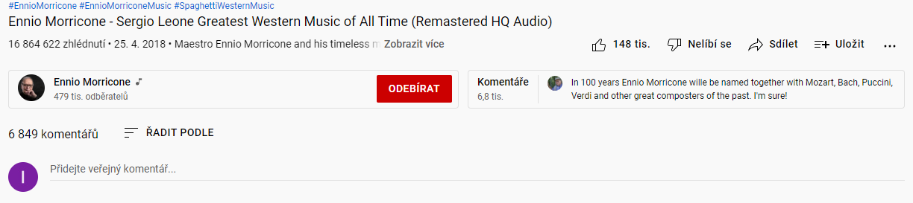


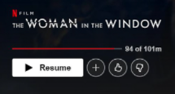







Explicit feedback in industry
Artist, album & track

Slide 47
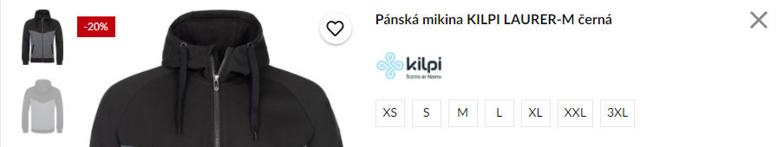
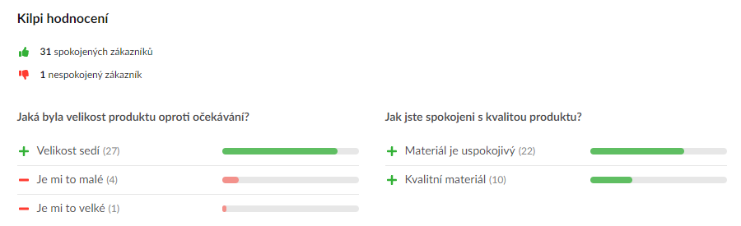


Explicit feedback in industry

Slide 48
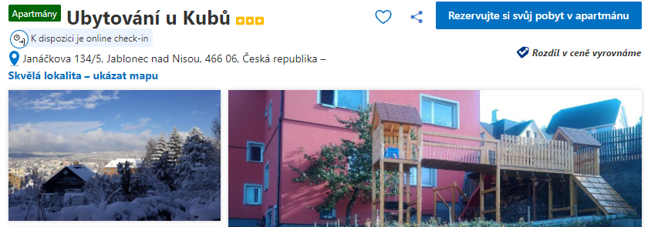
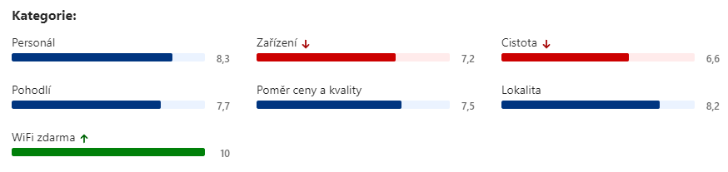
Explicit feedback in industry

Slide 49
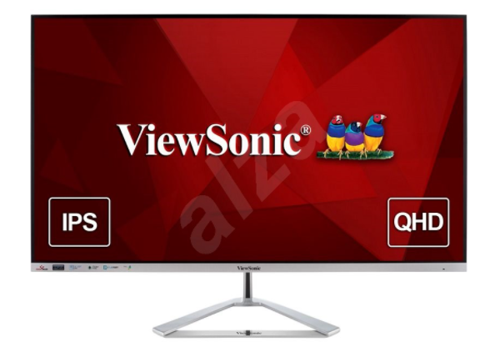
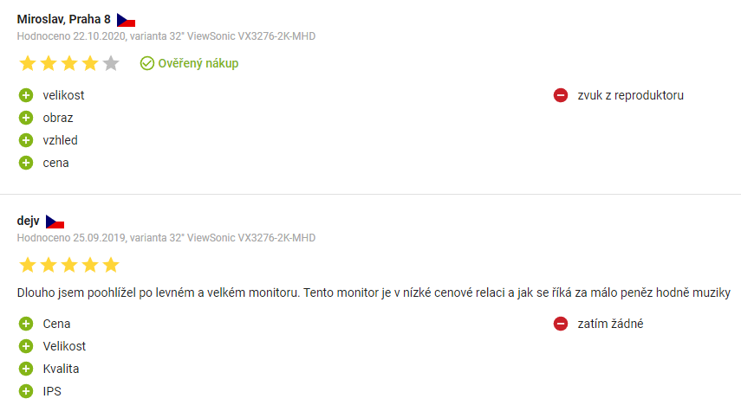
Explicit feedback in industry

Slide 50
Explicit feedback in industry
Some users are sometimes willing to
Provide ratings
  Sometimes aspect-based ratings (mostly pre-defined, widely recognized categories)
    Does not have to correspond to object’s attributes directly
  Write review
Explicit / implicit borderline:
  Add object to some list / organize favorite objects / provide tags for them
  Share items
Is this frequent enough so we can infer preferences of individual users?

Slide 51
Three things you found interesting
…
…
…

