Slide 1
Domain-specific RS
News RS
Notes:
In the next few hours I’m going to teach you about the wonderful world of recommender systems with a focus on news.

Slide 2
Slides (mostly) by Lien Michiels
… and Sanne Vrijenhoek
PhD in Industry (Baekeland) @ Froomle & University of Antwerp
Froomle is a spin-off company of the University of Antwerp founded by prof. Bart Goethals and dr. Koen Verstrepen 6 years ago.
I joined 5 years ago and developed most of our original RecSys stack.
For the past two years I’ve focused on research on news recommender systems
Before my PhD…
NLP @ Prezly
ML @ Sentiance
Masters in Mathematical Engineering at KU Leuven
Normative design of Diversity in RS
Notes:
First, I’ll tell you a little about me and why I’m here talking to you about this

Slide 3
Domain-specific RS: Intro + News RS
Examples of RecSys in Daily Life
News Recommender Systems

Slide 4
[Different] RecSys in Daily Life

Slide 5
News User Needs Model (https://smartocto.com/research/userneeds/)

Slide 6
Can we apply this same framework to ecommerce? 🤔
News User Needs Model (https://smartocto.com/research/userneeds/)

Slide 7
Can we apply this framework to e-commerce?

Slide 8
💡Needs are domain-specific💡
Can we apply this framework to e-commerce?
Notes:
Needs are domain-specific. It doesn’t make sense for Spotify to do “complete the look/vibe” recommendations.
Nor does it make sense to do “discover weekly” recommendations in news or e-commerce.

Slide 9
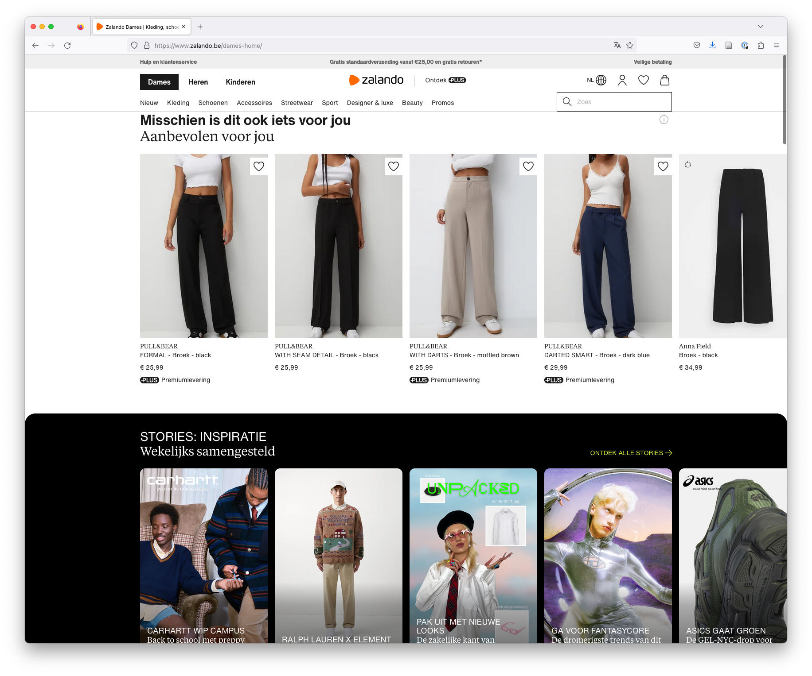
Notes:
Yet another difference between theory and practice is this…

Slide 10
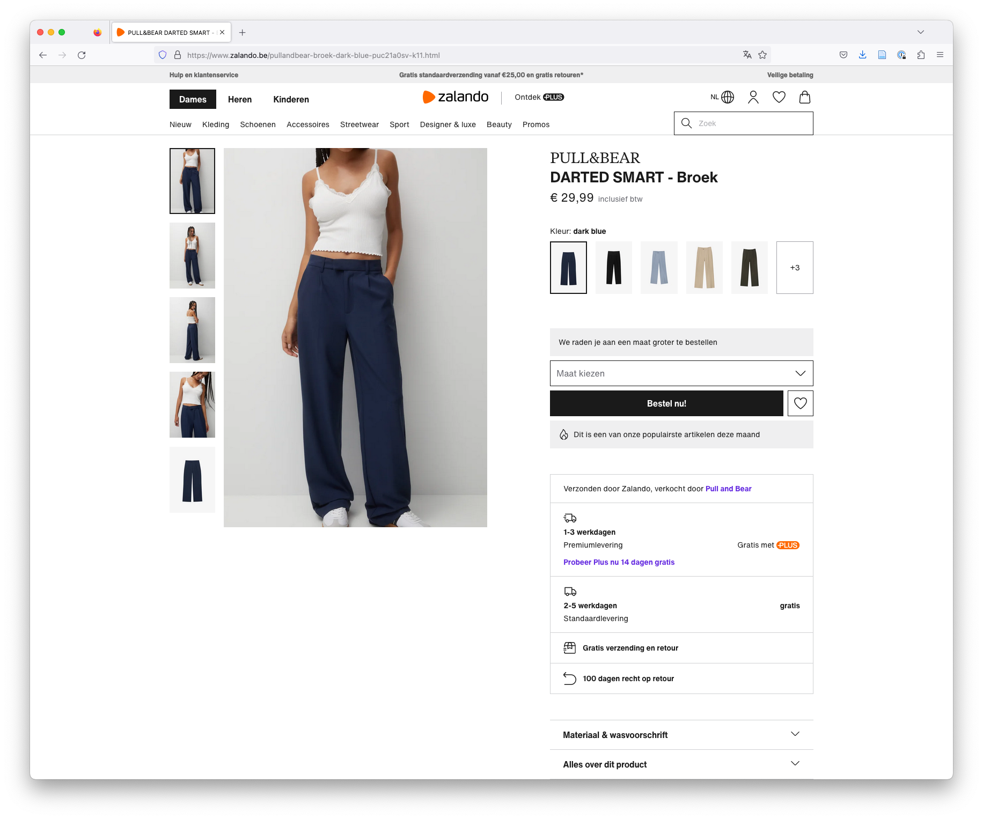

Slide 11
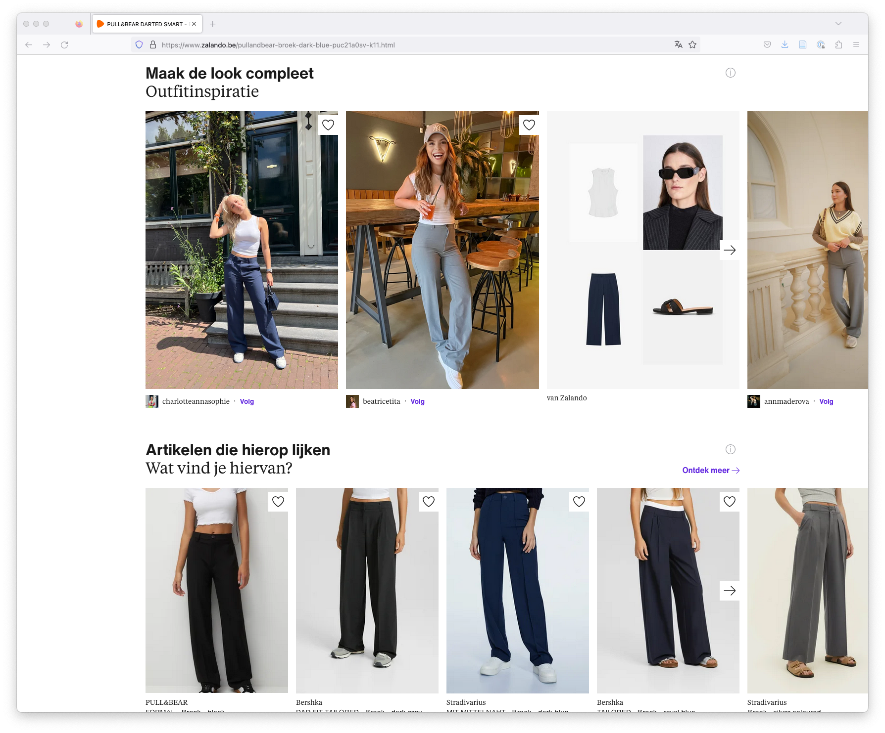

Slide 12
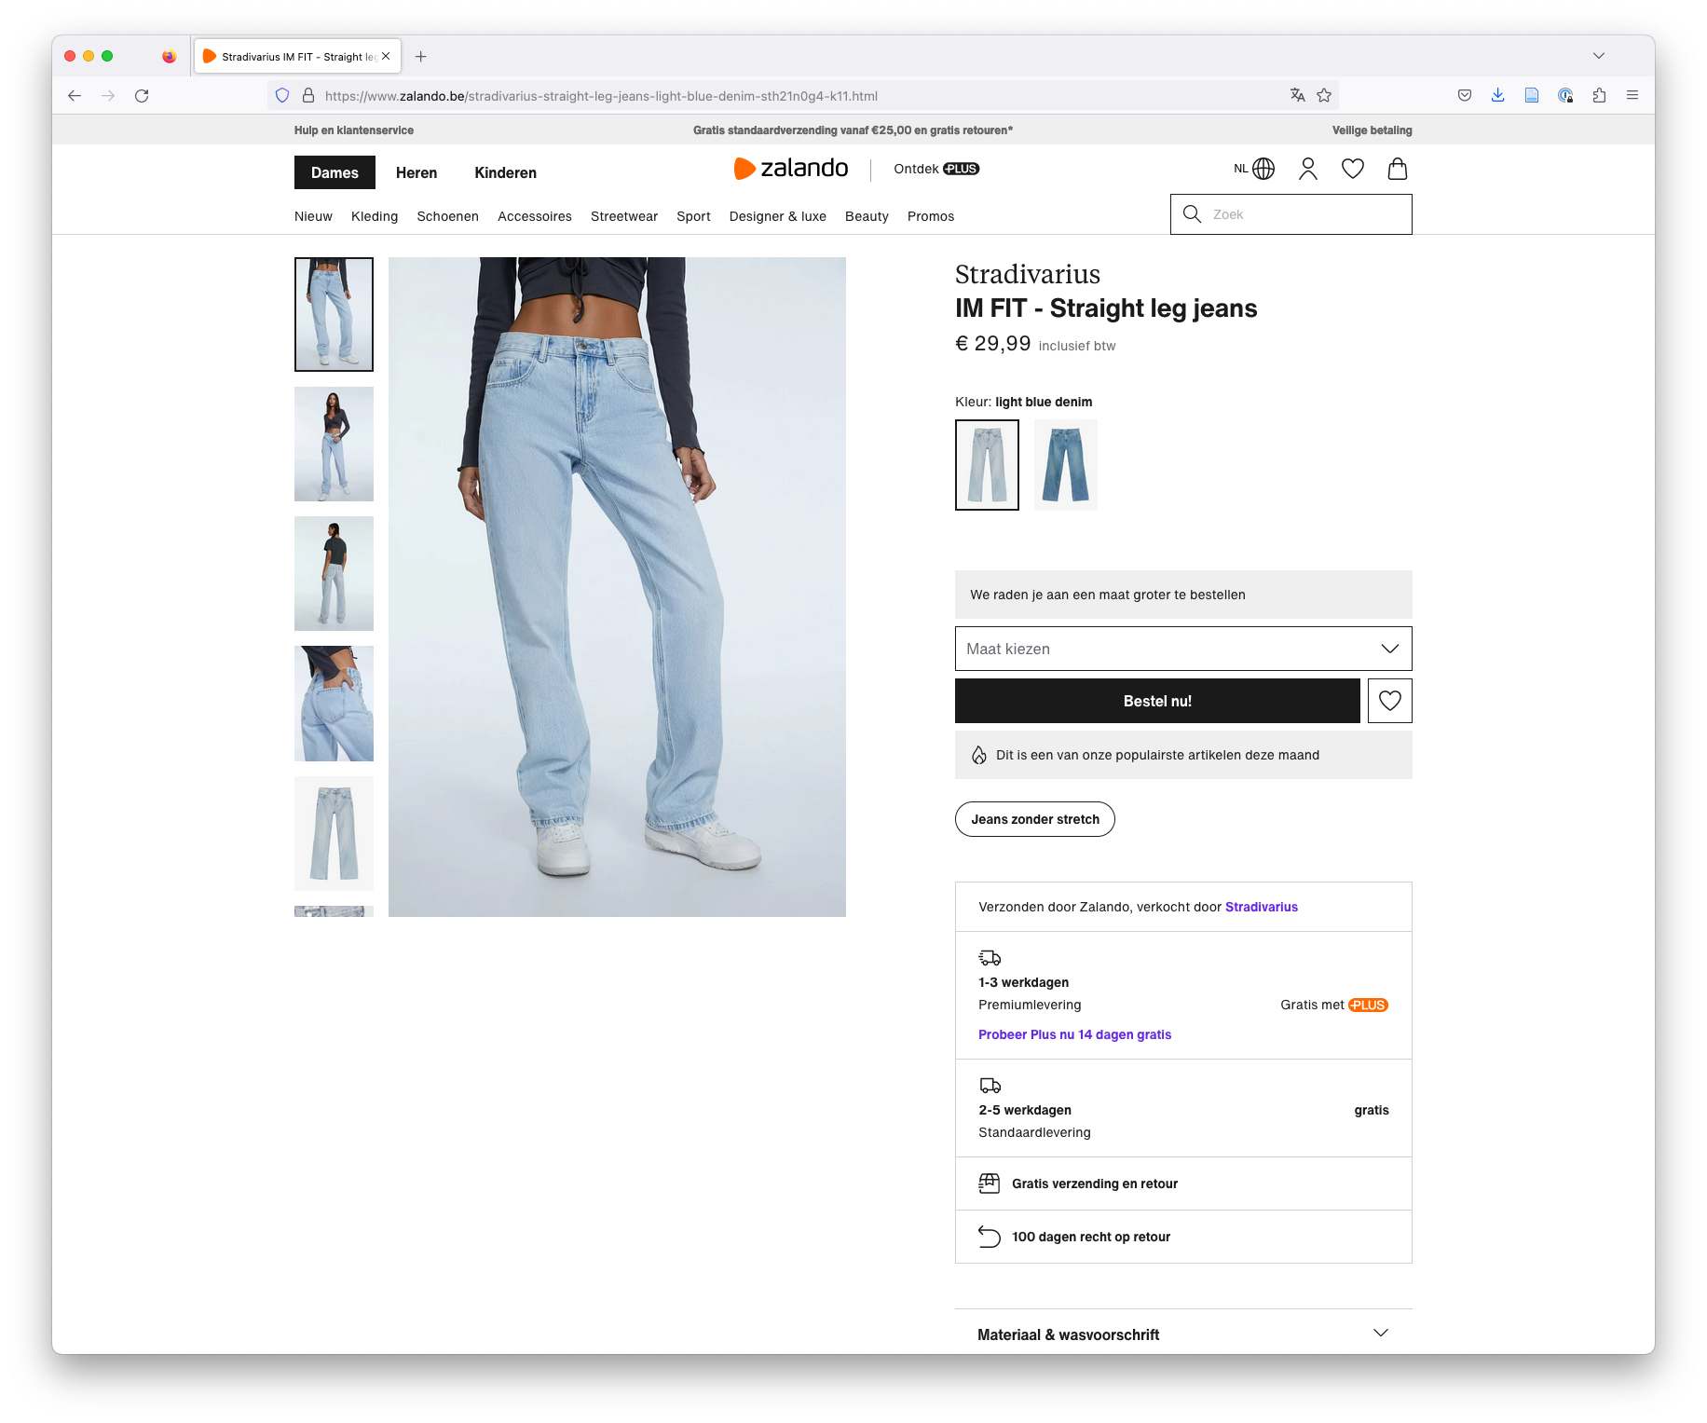

Slide 13
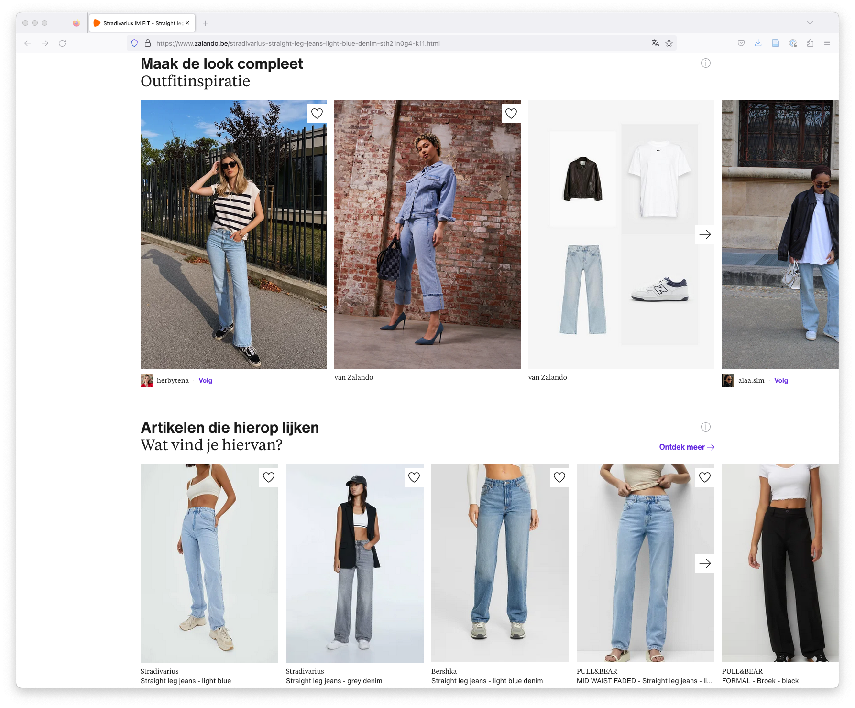

Slide 14
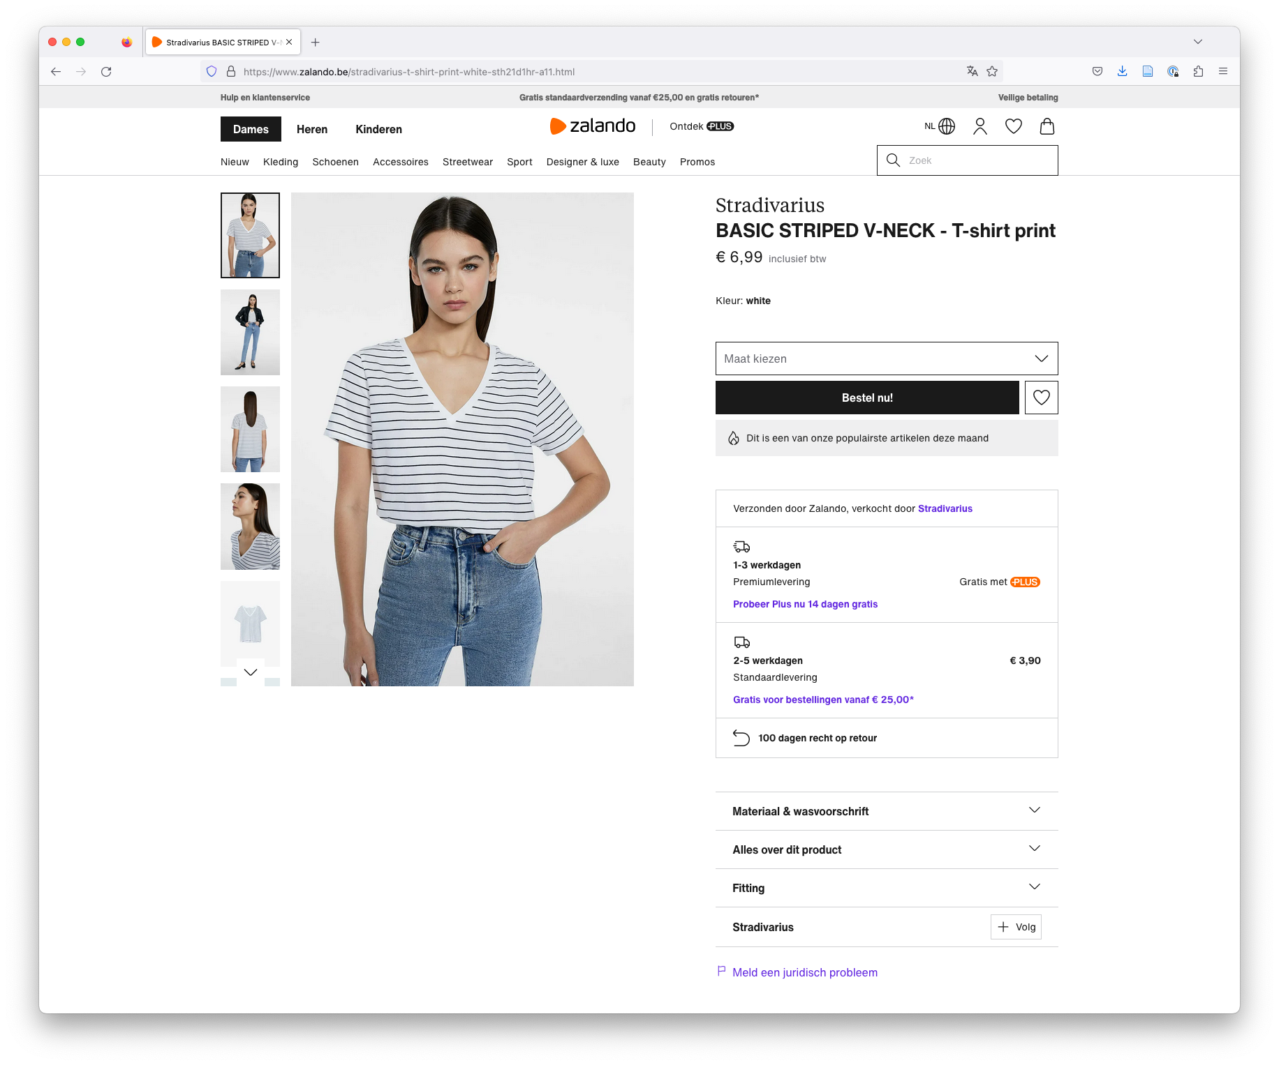

Slide 15
In Top-N recommendation, we assume recommendations are made once

Slide 16
… but in reality we make a lot of recommendations

Slide 17
Can we always show the same “best items”? 🤔

Slide 18
Can we always show the same “best items”? 🤔

Slide 19
💡If we show “the best five items” too often… Users get annoyed that recommendations are not “fresh”💡

Slide 20
How often should we show an item
💡If we replace “good items” too soon…
We run out of “good” items quickly💡

Slide 21
How often should we show an item? 🤔

Slide 22
💡“Impression discounting” adds a discount to item scores proportional to how often it was exposed in the last XX recommendations💡
(https://www.froomle.ai/resource/news-impression-discounting-stop-showing-the-same-article-over-and-over-again)
Notes:
Impression discounting is essentially adding a “discount” to the score for every time a user was exposed to it in their last 100 recommendations. This makes sure users will always see fresh items.

Slide 23
… 💡but unexpected items take longer to convert to a click💡
Notes:
Any guesses why?

Slide 24
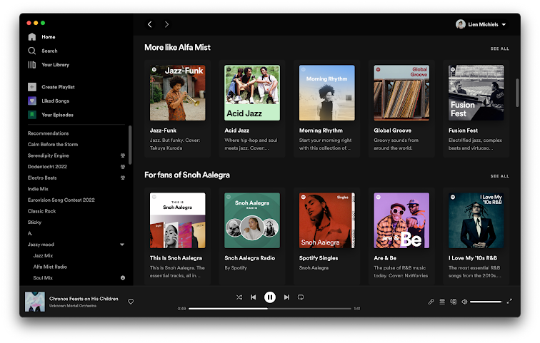
Music Recommender System
Notes:
Spotify, but also Apple Music, Pandora, Tidal, Deezer

Slide 25
Algorithmic and Curated Recommendation
Notes:
Editorial recommend

Slide 26
Editorial Recommendation
Notes:
Playlists made by editors - I once made a visit to the Spotify hq in Stockholm before they got really big, in 2016. They were already big, but far from where they are today
And they had a whole hall
With people who spent their days creating and curating playlists
It was quite impressive

Slide 27
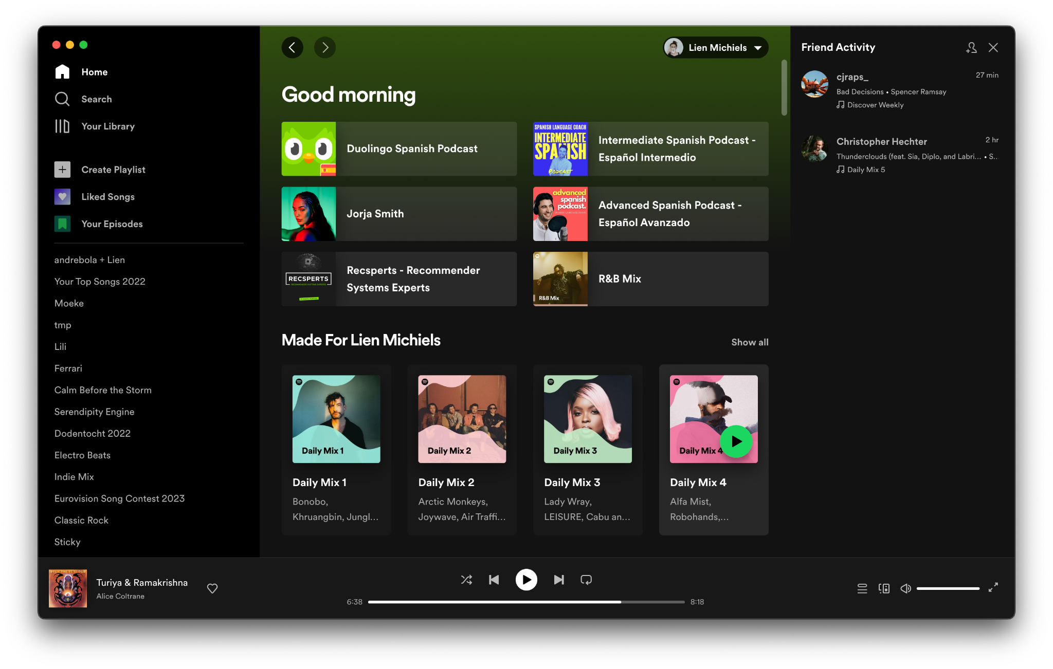
Social Recommendation
Notes:
Spotify, but also Apple Music, Pandora, Tidal, Deezer

Slide 28
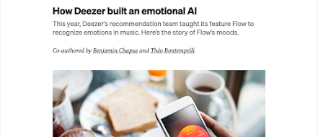
Challenges in Music Recommendation?
Fairness
Towards artists, e.g. Are we discriminating against female or black artists?
Towards non-mainstream music, e.g. Are we bad at recommending classical music because it’s not as popular as pop music?
Freshness
People like to listen to the same music over and over, but sometimes they like something new
Mood
Tastes in music are highly influenced by mood

Slide 29
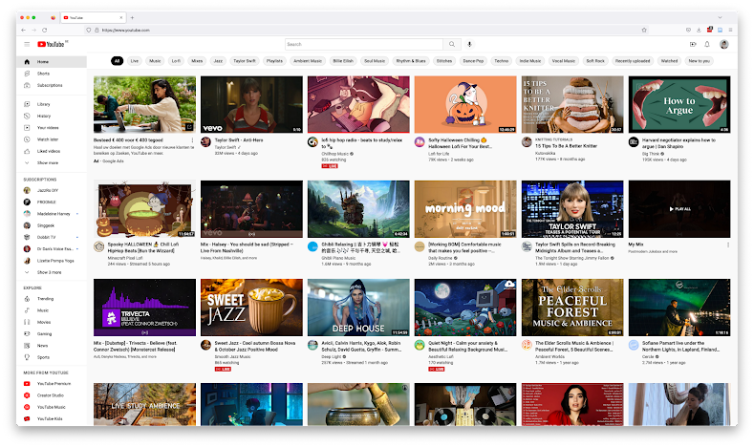
User-Generated Content Recommender System
Notes:
YouTube

Slide 30
Challenges in User-Generated Content Recommendation?
Misinformation & Hate Speech
We cannot control what content users upload and we want to avoid amplifying harmful content
Freshness
People expect the same, yet different (similar to music)
Calibration
People have more than one interest, and we don’t want one to dominate the others.
Notes:
What is hate speech?
What is misinformation?

Slide 31
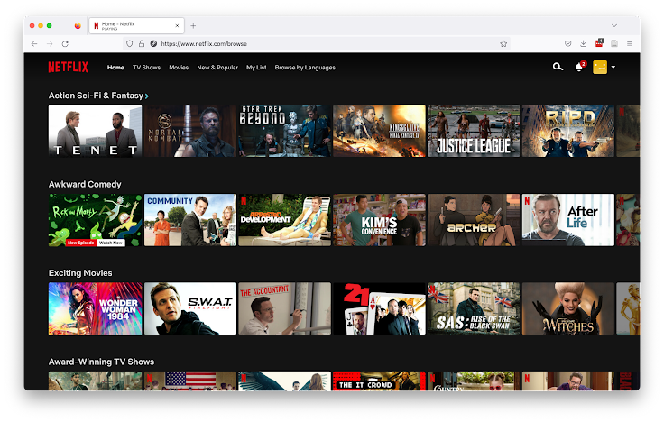
Video Recommender System
Notes:
Netflix, but also Disney+, StreamZ, VTM Go, Amazon Prime, …

Slide 32
Challenges in Video Recommendation?
Order
Most shows, but also movies (e.g. Star Wars) should be watched in a certain order
Fairness
Towards other languages than English
Towards content made by smaller studios
Calibration
People have more than one interest, and we don’t want one to dominate the others
Long-Term User Engagement (Subscriptions)
How can we optimize the recommender system for long-term engagement (and subscriptions)

Slide 33
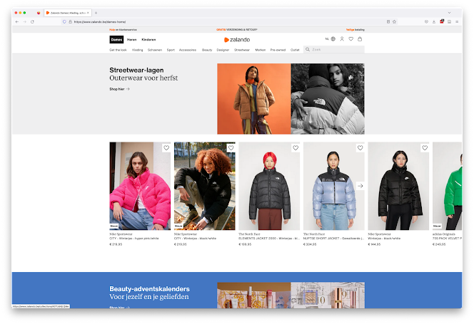
Fashion Recommender System
Notes:
Zalando, ZEB, About You, Asos, H&M, …

Slide 34
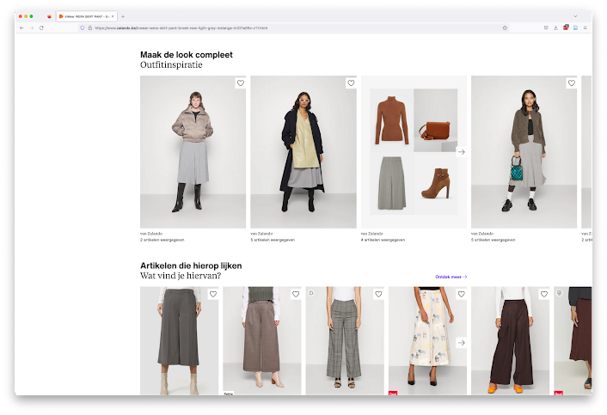
Fashion Recommender System

Slide 35
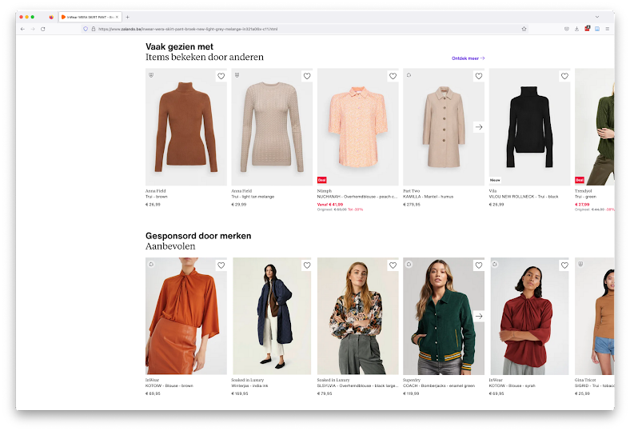
Fashion Recommender System

Slide 36
Challenges in Fashion Recommendation?
Outfit Creation
Clothes are worn together as part of an outfit, but outfit creation is more of an art-form than a science
Choice Overwhelm
Sometimes showing the user five very similar red shirts may backfire because of choice overwhelm
From Clicks to Purchases
Purchase data is incredibly sparse while pageviews are plenty, but we want to make sales (and maximize profits)

Slide 37
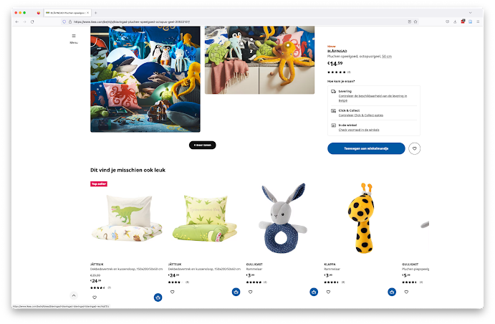
E-commerce Recommender System
Notes:
Other e-commerce sites also use RecSys
IKEA and Amazon.

Slide 38
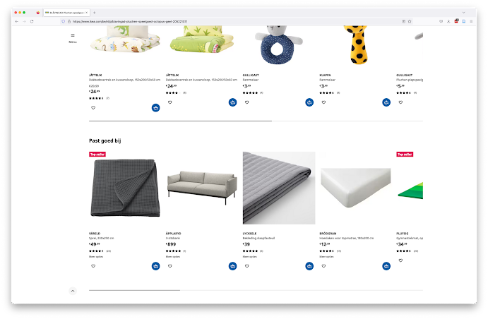
E-commerce Recommender System
Notes:
Recommendations aren’t always good (:

Slide 39
Challenges in E-commerce Recommendation?
Customer Intent
Users often have a specific purchase goal in mind, but how can we identify it?
Giant Item Catalogs and User Bases
Lead to scaling issues
Re-purchasability
Most people need only one Playstation 5, but might like several games

Slide 40
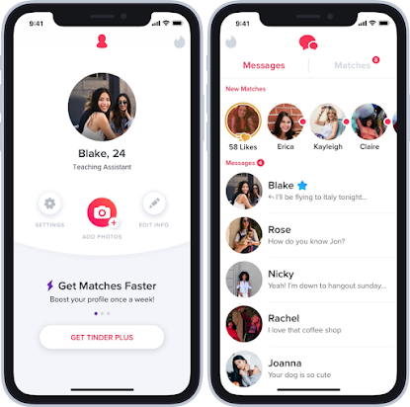
People Recommender System
Notes:
Tinder, Bumble, Grindr, Hinge, Match.com (the list goes on I think, I’m not exactly an expert)

Slide 41
Challenges in People Recommendation?
Mutual Interest
People recommendation is not just a ranking problem, it is a matching problem
Fairness
Towards users of the platform, so that everyone has equal opportunity
Towards users of a certain sexual orientation
Towards users of a certain ethnicity
Towards users of minority genders
Negative Feedback
How do we deal with a swipe left?
Inverse positivity: solving user goal imply terminate the app usage

Slide 42
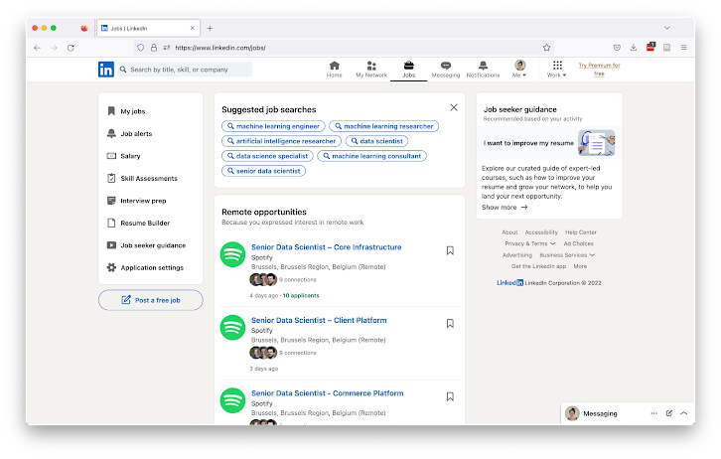
Job Recommender System
Notes:
LinkedIn, but also Indeed, Jobat, VDAB

Slide 43
Challenges in Job Recommendation?
Fairness
Towards users of a certain ethnicity
Towards users of a certain gender
Towards users with unusual career paths or career gaps
Matching Problem
The user not only needs to like the job, the employer needs to like the applicant
Job Understanding
Recommending the wrong dress is not so bad, recommending the wrong job can be

Slide 44
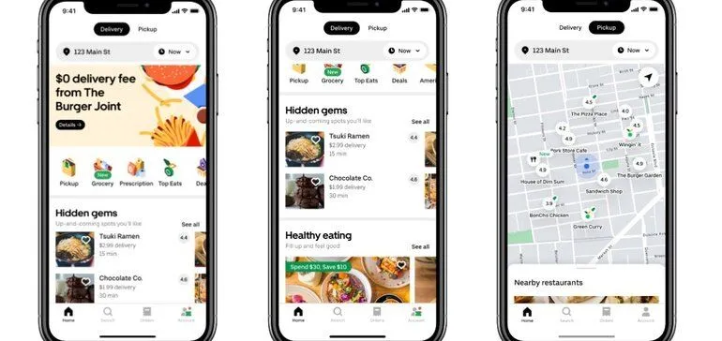
Restaurant Recommender System
Notes:
Food Delivery Apps, like Uber Eats, but also Takeaway.com, Deliveroo

Slide 45
Challenges in Restaurant Recommendation?
Load Balancing
If you send all the customers to the same restaurants, they will soon not be able to fill orders
And restaurants that don’t get enough orders will leave your platform
Similar issue with several-piece-only sale sites (i.e., bazos.cz)

Slide 46
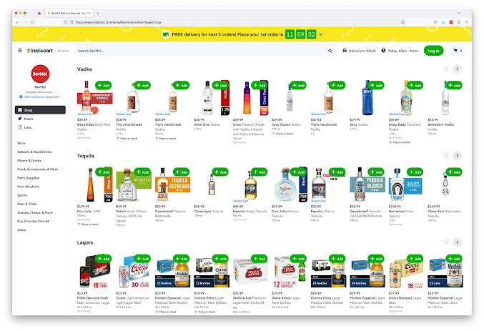
Grocery Recommender System
Notes:
Grocery shopping, like InstaCart in the US but also Collect&Go closer to home :-)

Slide 47
Challenges in Grocery Recommendation?
Purchasing Frequency
I don’t need toilet paper every week, but I do buy bananas every week
Health
(How) Should we nudge users towards healthier food choices?
Near Duplicates
You don’t want to recommend Coca-Cola bottles in four different sizes
Baskets to recipes
What people normally have at home?

Slide 48
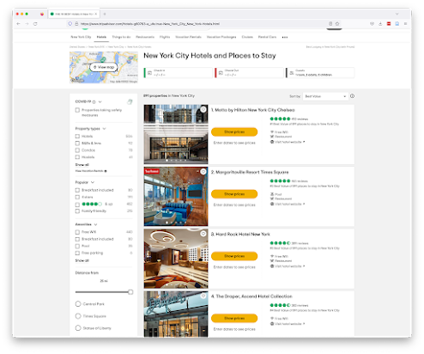
Location (POI) Recommender System

Slide 49
Challenges in Location (POI) Recommendation?
Distance
What is walking/cycling distance depends on the user
Different location types allows for different travel times
Item Availability
Because you don’t own the locations you recommend, you can never be sure they are up-to-date (e.g. opening hours) or still available

Slide 50
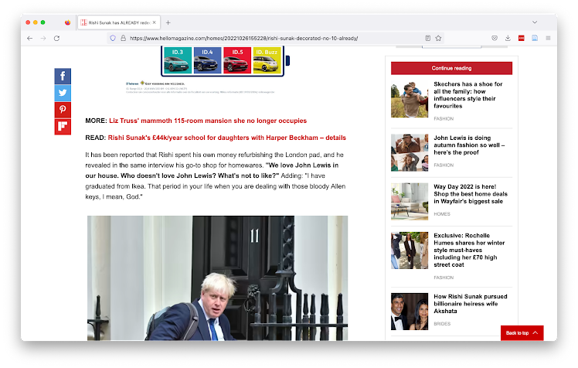
News Recommender Systems

Slide 52
News Recommender Systems

Slide 53
News Recommender Systems

Slide 54
News Recommender Systems

Slide 55
Editors & Journalists
Business, Investors
Product Managers
& Data Scientists
Policy-makers
Many Stakeholders
Users

Slide 56
Editors & Journalists
Business, Investors
Product Managers
& Data Scientists
… but the business usually wins…
Policy-makers
Many Stakeholders
Users

Slide 57
Different tasks at different places => different recommenders
Notes:
We’re going to look at a number of recommendation use cases together, and then try to figure out which of the techniques I talked about you would use
Try first to think in terms of user needs: What does a user expect?
Then try to translate that to concepts you’ve learned here today.

Slide 58
Continue Reading

Slide 59
Articles most related to what you are reading now
Content-based, based on tags or article text
or
Collaborative filtering + Business Rules that restrict to the same category
Continue Reading

Slide 60
Recommended for You

Slide 61
General Interest News
Popularity
Top-3/5/10 Interests of the User
Collaborative filtering + Business logic that enforces that article recommendations have different topics
Recommended for You - Homepage

Slide 62
Push Notification

Slide 63
Breaking News
Content-based (because cold start)
Or, editorial picks (handcrafted)
Push Notification

Slide 64
Newsletter

Slide 65
Hidden Gems/Niche Interests
Hybrid (content + collaborative)
Discount popularity
Editor’s Pick
Recommendation from a
very narrow selection of articles
Newsletter

Slide 66
Why use a News RecSys?

Slide 67
Opportunities
Competition with social media & aggregators
Who also personalize
Longer engagement on the site
Sells more advertisements
May convert users to paid subscribers
Increased engagement with hidden gems
There is only so much space on a page, and so many articles

Slide 68
Challenges in News Recommendation

Slide 69
Technical Challenges in News Recommendation
Frequent Catalog Updates
New articles are published all the time
Interest Decay
Interest in an article decays quickly

Slide 70
Model Training Services
Tracking API
User Interaction Data Store
Item Data Store
Recommendations API
Recommendation Server
Recommendation Models
How are recommendations made?

Slide 71
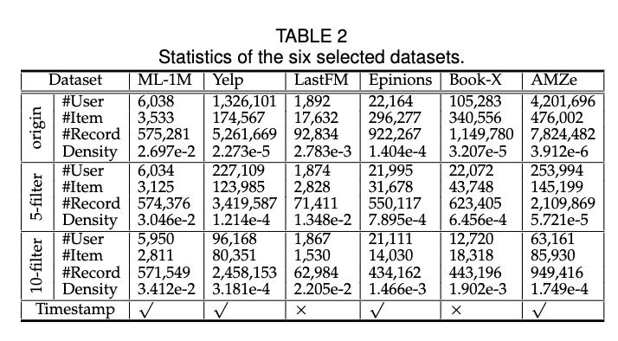
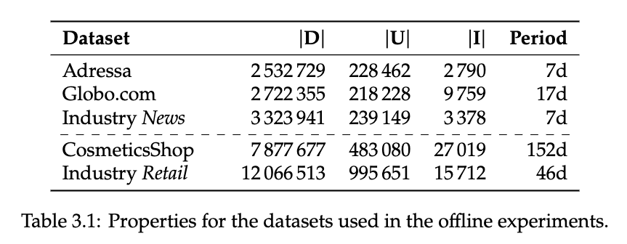
Data streem speed

Slide 72
Model Training Service

Slide 73
Model Training Services
Tracking API
User Interaction Data Store
Item Data Store
Recommendations API
Recommendation Server
Recommendation Models
Models are retrained “periodically”

Slide 74
Model Training Services
Tracking API
User Interaction Data Store
Item Data Store
So how often is “periodically”?🤔
Recommendations API
Recommendation Server
Recommendation Models
Models are retrained “periodically”

Slide 75
Model Training Services
Tracking API
User Interaction Data Store
Item Data Store
So how often is “periodically”?🤔
… it depends 🙃
Recommendations API
Recommendation Server
Recommendation Models
Models are retrained “periodically”

Slide 76
How often does your choice of music change?🤔

Slide 77
How often does your choice of music change?🤔
… it doesn’t
Notes:
Although I do tend to get a bit more melancholy in winter

Slide 78
How often does your choice of music change?🤔
… unless your favorite artist releases a new album 😍
Notes:
Although I do tend to get a bit more melancholy in winter

Slide 79
How often does your choice of clothes change?🤔

Slide 80
How often does your choice of clothes change?🤔
… depends how trendy you are 🙃

Slide 81
How often does your choice of clothes change?🤔
… but at least every season🌷☀️🍂❄️
Notes:
It’s very important to train

Slide 82
Model Training Services
Tracking API
User Interaction Data Store
Item Data Store
The frequency of model updates depends on how frequently behavior or the catalog shifts.
Recommendations API
Recommendation Server
Recommendation Models
Models are retrained “periodically”

Slide 83
In news, articles typically live for only 48h 😨
Reading behavior shifts hourly 😱

Slide 84
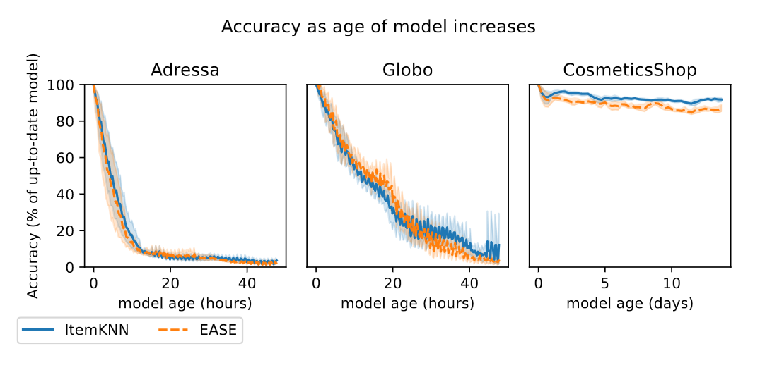
From “Scheduling on a Budget: Avoiding Stale Recommendations with Timely Updates” by Verachtert et al., 2022

Slide 85
Model is stale
From “Scheduling on a Budget: Avoiding Stale Recommendations with Timely Updates” by Verachtert et al., 2022

Slide 86
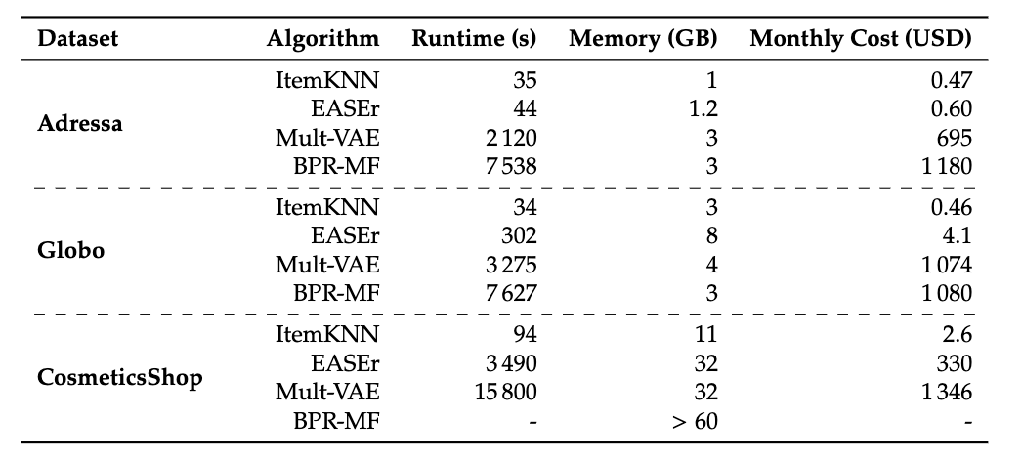
From “Scheduling on a Budget: Avoiding Stale Recommendations with Timely Updates” by Verachtert et al., 2022

Slide 87
💡Training a model takes time 😥💡
… therefore all* models are out of date 🙃
*Except truly incremental models, but as far as I know, these are not in use due to other issues we will get into later.
From “Scheduling on a Budget: Avoiding Stale Recommendations with Timely Updates” by Verachtert et al., 2022

Slide 88
≈2 hours
≈2 hours
From “Scheduling on a Budget: Avoiding Stale Recommendations with Timely Updates” by Verachtert et al., 2022

Slide 89
What happens if we use these models for a news RecSys? 🤔
From “Scheduling on a Budget: Avoiding Stale Recommendations with Timely Updates” by Verachtert et al., 2022

Slide 90
What happens if we use these models for a news RecSys? 🤔
From “Scheduling on a Budget: Avoiding Stale Recommendations with Timely Updates” by Verachtert et al., 2022

Slide 91
Unless… 🧐
We can cut down the time by using less training data
From “Scheduling on a Budget: Avoiding Stale Recommendations with Timely Updates” by Verachtert et al., 2022

Slide 92
Model Training Services
Tracking API
User Interaction Data Store
Item Data Store
… So how much data should we use to train models?🤔
Recommendations API
Recommendation Server
Recommendation Models
Models are retrained “periodically”

Slide 93
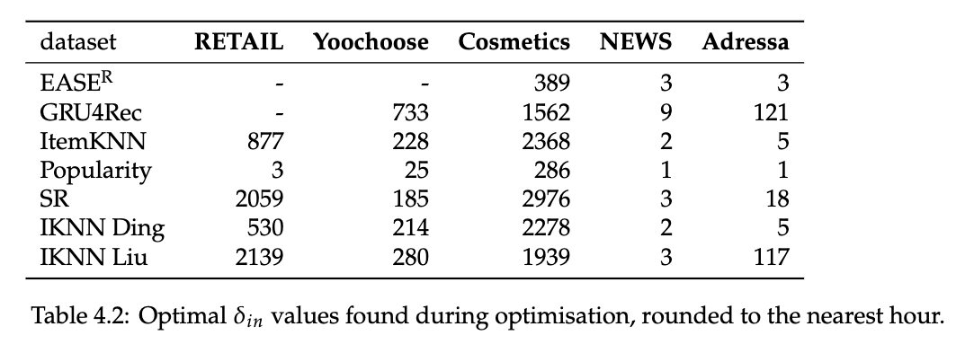
From “Are We Forgetting Something? Correctly Evaluate a Recommender System With an Optimal Training Window” by Verachtert et al., 2022

Slide 94
💡The optimal amount of training data depends on the domain💡
From “Are We Forgetting Something? Correctly Evaluate a Recommender System With an Optimal Training Window” by Verachtert et al., 2022

Slide 95
From “Are We Forgetting Something? Correctly Evaluate a Recommender System With an Optimal Training Window” by Verachtert et al., 2022

Slide 96
💡The optimal amount of training data also depends on the algorithm💡
From “Are We Forgetting Something? Correctly Evaluate a Recommender System With an Optimal Training Window” by Verachtert et al., 2022

Slide 97
🏆
🏆
From “Are We Forgetting Something? Correctly Evaluate a Recommender System With an Optimal Training Window” by Verachtert et al., 2022

Slide 98
💡If you use the optimal amount of training data, simpler algorithms suddenly win 🏆💡
🏆
🏆
From “Are We Forgetting Something? Correctly Evaluate a Recommender System With an Optimal Training Window” by Verachtert et al., 2022

Slide 99
From “Scheduling on a Budget: Avoiding Stale Recommendations with Timely Updates” by Verachtert et al., 2022

Slide 100
💡Training a model costs 💰💡
From “Scheduling on a Budget: Avoiding Stale Recommendations with Timely Updates” by Verachtert et al., 2022

Slide 101
💡More complex models cost more 💰💰💰💡
From “Scheduling on a Budget: Avoiding Stale Recommendations with Timely Updates” by Verachtert et al., 2022

Slide 102
… so are they worth it?🤔
From “Scheduling on a Budget: Avoiding Stale Recommendations with Timely Updates” by Verachtert et al., 2022

Slide 103
… so are they worth it?🤔
🫣Usually no…🤫
unless you are Spotify/Netflix
From “Scheduling on a Budget: Avoiding Stale Recommendations with Timely Updates” by Verachtert et al., 2022

Slide 104
💡When and how often a model should be trained is an important design decision💡
💡… and cost should not be ignored💡

Slide 105
Policy Challenges in News Recommendation
Filter Bubbles/Diversity
News publishers have a mission/responsibility to inform readers by providing news that is diverse

Slide 106
Filter bubbles by Lien:
A technological filter bubble is a decrease in the diversity of a user’s recommendations over time, in any dimension of diversity, resulting from the choices made by different recommendation stakeholders.

Slide 107
HOW SHOULD WE MEASURE FILTER BUBBLES IN ONLINE NEWS?
Currently under submission.
Notes:
Bubbly people
FairUMAP

Slide 108
WHY SHOULD WE MEASURE FILTER BUBBLES IN ONLINE NEWS?
Notes:
Bubbly people
FairUMAP

Slide 109
EDITORS
POLICY-MAKERS
USERS
are concerned that filter bubbles will take away their brand DNA
worry that filter bubbles would harm the democratic process
want to be exposed to diverse news

Slide 110
How CAN We Measure Filter Bubbles?
Simulated Users
Real Users
Simulation Study
Controlled User Study
Simulated Env.
MORE REALISTIC
Audit Study
Field Experiment
Real Env.
Observational Study
MORE REALISTIC

Slide 111
WHAT SHOULD WE MEASURE as FILTER BUBBLES IN ONLINE NEWS?
Notes:
Bubbly people
FairUMAP

Slide 112
WHAT SHOULD WE MEASURE as FILTER BUBBLES IN ONLINE NEWS?
Notes:
Bubbly people
FairUMAP

Slide 113
WHAT SHOULD WE MEASURE as FILTER BUBBLES IN ONLINE NEWS?
Notes:
Bubbly people
FairUMAP

Slide 114
WHAT SHOULD WE MEASURE as FILTER BUBBLES IN ONLINE NEWS?
Notes:
Bubbly people
FairUMAP

Slide 115
WHAT SHOULD WE MEASURE as FILTER BUBBLES IN ONLINE NEWS?
Notes:
Bubbly people
FairUMAP

Slide 116
WHAT SHOULD WE MEASURE as FILTER BUBBLES IN ONLINE NEWS?
Notes:
Bubbly people
FairUMAP

Slide 117
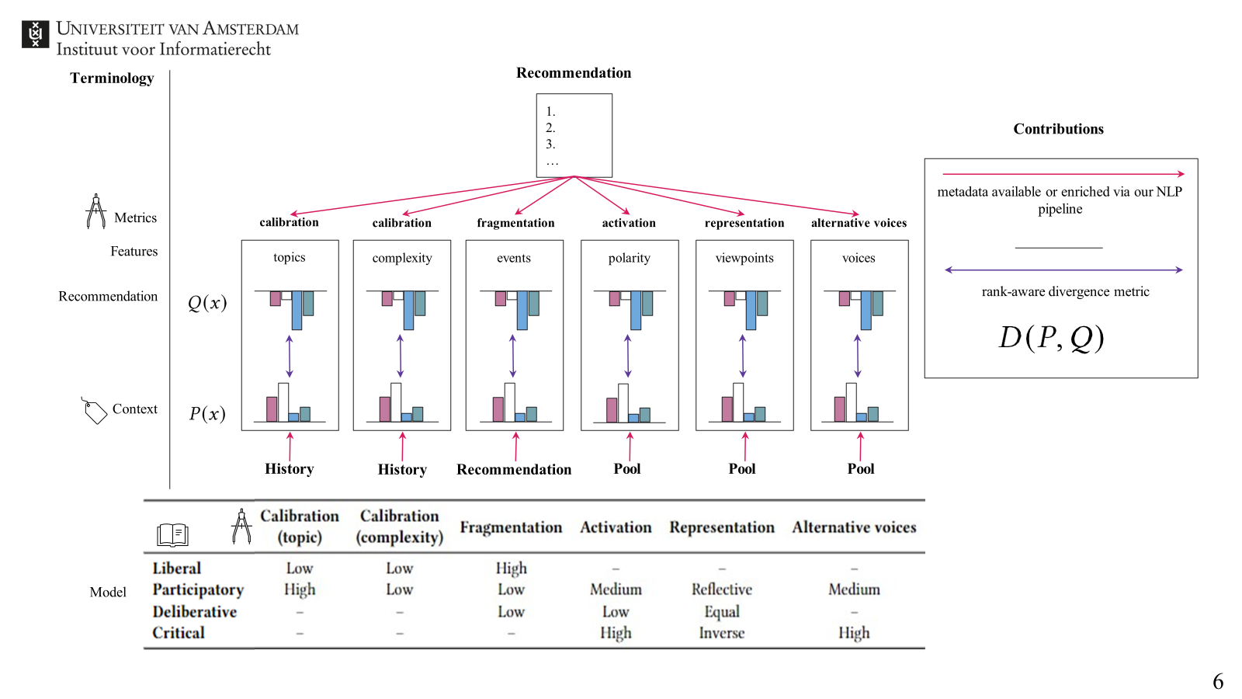
WHAT SHOULD WE MEASURE as FILTER BUBBLES IN ONLINE NEWS?
Notes:
Bubbly people
FairUMAP

Slide 118
WHAT SHOULD WE MEASURE as FILTER BUBBLES IN ONLINE NEWS?
Notes:
Bubbly people
FairUMAP

Slide 119
Editorial Challenges in News Recommendation
Brand DNA
Editors provide value by curating relevant news
Long-Term User Engagement (Subscriptions)
What we want is for users to buy subscriptions, but how do recommendations contribute to that?

Slide 120
User Challenges in News Recommendation
Niche/Hyperlocal Content
E.g. opera, stock market, regional sports matches
Choice Overwhelm

Slide 121
Q&A

