Slide 1
NDBI021, Lecture 9
User preferences, 2/1 ZK+Z,
Wed 12:20 – 13:50 S8
Wed 14:00 – 15:30 SW2 (odd weeks)
https://www.ksi.mff.cuni.cz/~peska/vyuka/ndbi021/2022/
https://ksi.mff.cuni.cz

Slide 2
Dynamic RS
https://ksi.mff.cuni.cz

Slide 3
Dynamic RS
Many RS algorithms consider a static setting of a RS
Static set of train data
Static set of items and users
Static set of „queries“ that need to be answered (a.k.a. test set)
Static preferences of users
In reality, all this is dynamic and changes over time
Thought experiment: what could go wrong with a matrix factorization?

Slide 4
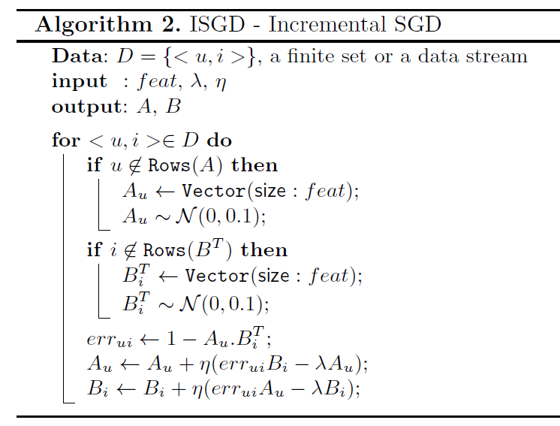
Dynamic RS: partial training for matrix factorizations
Partial SGD-like updates when new data arrives
Can run more than just one iteration
Can re-play some of older data as well to increase accuracy
Most probably you need higher learning rates
How to properly evaluate this?
How often would normally be the other model re-trained?
João Vinagre, Alípio Mário Jorge & João Gama: Fast Incremental Matrix Factorization for Recommendation with Positive-Only Feedback

Slide 5
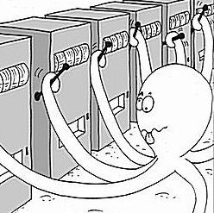
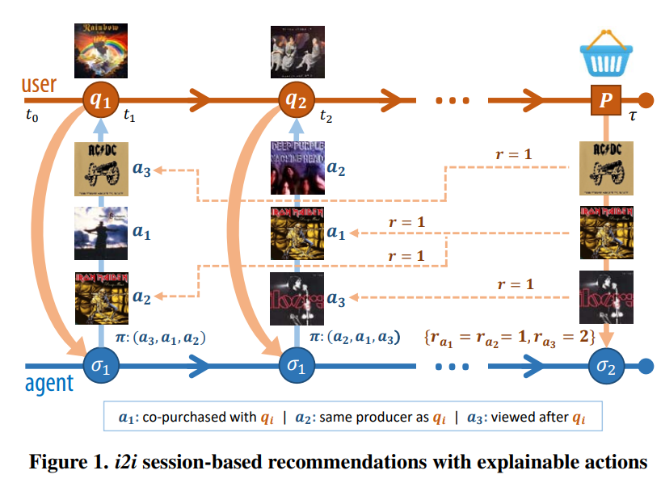
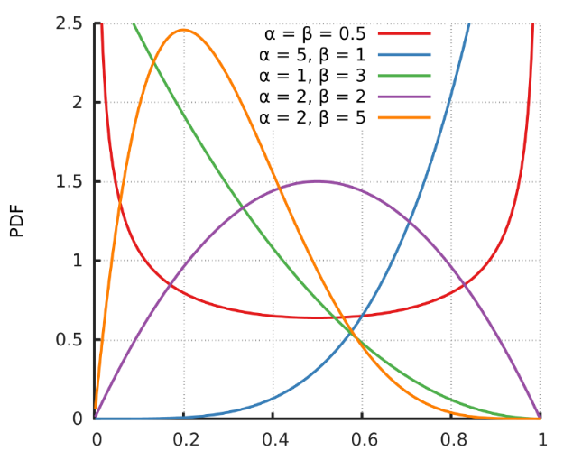
Dynamic RS: multi-armed bandits: TS
Use MAB to select which Recommender performs the best
Each Recommender starts with the same probability of being selected
This is dynamically being adjusted as we gain more rewards
Thompson Sampling
Beta distribution w.r.t. #successes, #missess
Rewards attribution problem with delayed rewards
Non-stationary behavior of arms -> partitioning into sub-components
IDF for attribute-like links
Edge weight for behavioral links
Broden et al.: Ensemble Recommendations via Thompson Sampling: an Experimental Study within e-Commerce

Slide 6
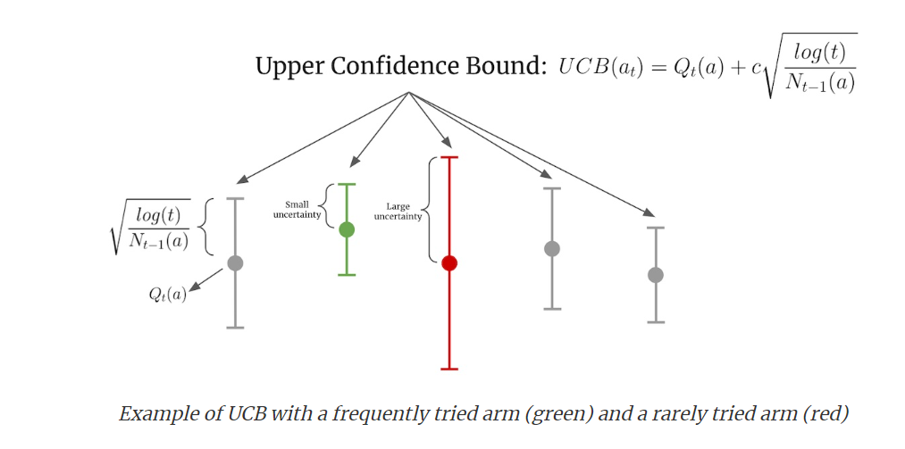
Dynamic RS: multi-armed bandits: other strategies
Epsilon-greedy
Select current best with epsilon prob. Select at random with 1-epsilon prob.
Upper Confidence Bound (UCB)
Confidence given by the volume of trials (N_t)
Slight decrease over time (log(t))
Hyperparameter c
What about non-stationarity?
https://eugeneyan.com/writing/bandits/

Slide 7
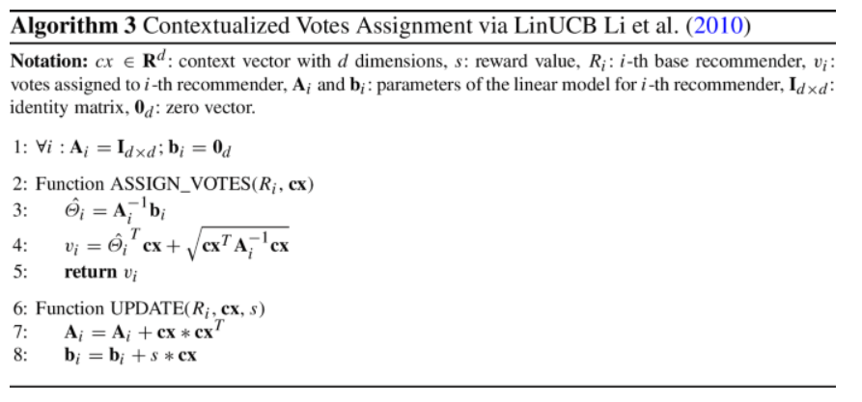
Dynamic RS: LinearUCB
LinearUCB: reward estimates depend on some parameters (a.k.a. state)
E.g., current context of the user
If the state is represented with nominal values => sub-component strategy from Broden
What if we need to incorporate numerical (unbound) values?
Assume linear impact of the state on rewards + independence of individual state dimensions
We used it in https://link.springer.com/article/10.1007/s11257-021-09311-w i n slightly altered way to assign votes for a variant of mandates allocation strategy.
Curse of dimensionality? What about more complex relationships?
Li et al. A contextual-bandit approach to personalized news article recommendation

Slide 8
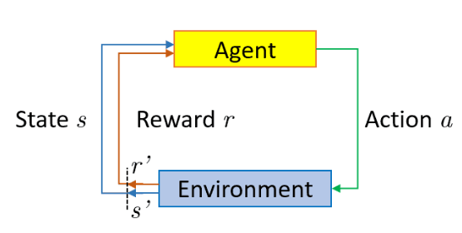
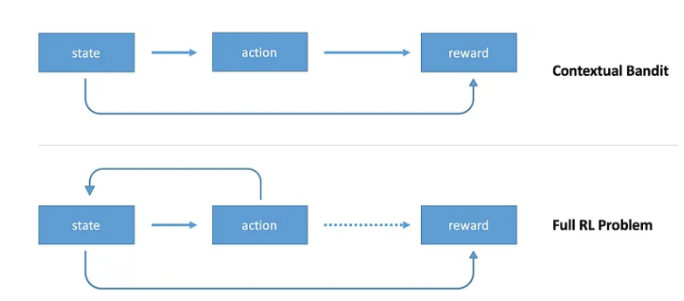
Dynamic RS: Reinforcement learning
Bandits are a subclass of reinforcement learning approach
On top of what CX bandits do, full RL algorithms update state as a result of an action
https://towardsdatascience.com/contextual-bandits-and-reinforcement-learning-6bdfeaece72a

Slide 9
Dynamic RS: Reinforcement learning
Based on Bellman equation
Basic approach: Q-learning (literally, table of states and actions)
„Expected long-term reward for a given action is equal to the immediate reward from the current action combined with the expected reward from the best future action taken at the following state.“
Q(s,a) = r + γ(max(Q(s’,a’)) (in reality, we keep the current value adjusted w.r.t. some learning rate „This says that the Q-value for a given state (s) and action (a) should represent the current reward (r) plus the maximum discounted (γ) future reward expected according to our own table for the next state (s’) we would end up in. “
Q-learning not scalable if we have more states or actions
https://en.wikipedia.org/wiki/Bellman_equation
https://medium.com/emergent-future/simple-reinforcement-learning-with-tensorflow-part-0-q-learning-with-tables-and-neural-networks-d195264329d0

Slide 10
Dynamic RS: Reinforcement learning
Based on Bellman equation
Deep Q-learning (use neural network as a function approximator)
States as one-hot-encoding (input)
Actions as output nodes (estimated reward)
Backpropagation w.r.t. real vs. Estimated Q values: Loss = ∑(Q-target - Q)²
Experience replay
Freezing target networks
Exploration of actions (not always the best predicted one: epsilon-greedy)
https://en.wikipedia.org/wiki/Bellman_equation
https://www.baeldung.com/cs/q-learning-vs-deep-q-learning-vs-deep-q-network
https://medium.com/emergent-future/simple-reinforcement-learning-with-tensorflow-part-0-q-learning-with-tables-and-neural-networks-d195264329d0

Slide 11
Dynamic RS: Reinforcement learning
Based on Bellman equation
Deep Q-learning (use neural network as a function approximator)
States as one-hot-encoding (input)
Actions as output nodes (estimated reward)
Backpropagation w.r.t. real vs. Estimated Q values: Loss = ∑(Q-target - Q)²
Experience replay
Freezing target networks
Exploration of actions (not always the best predicted one: epsilon-greedy)
RecSys tutorial on RL: https://www.youtube.com/watch?v=qJysTu1Xl5U
Survey paper: https://www.sciencedirect.com/science/article/pii/S0950705123000850
https://en.wikipedia.org/wiki/Bellman_equation
https://www.baeldung.com/cs/q-learning-vs-deep-q-learning-vs-deep-q-network
https://medium.com/emergent-future/simple-reinforcement-learning-with-tensorflow-part-0-q-learning-with-tables-and-neural-networks-d195264329d0

