Slide 1


NDBI021, Lecture 8
User preferences, 2/1 ZK+Z,
Wed 12:20 – 13:50 S8
Wed 14:00 – 15:30 SW2 (odd weeks)
https://www.ksi.mff.cuni.cz/~peska/vyuka/ndbi021/2022/
https://ksi.mff.cuni.cz

Slide 2
Lecture 8 (bits and pieces)
Semestral work
Group Recommender Systems
Dynamic Recommender Systems
https://ksi.mff.cuni.cz

Slide 3


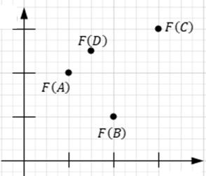




Recap
What stakeholders can you think of, e.g., at Spotify?
What is a Pareto Front?
min 𝑓₁, 𝑓₂
𝑥
𝐹(𝐸)
https://ksi.mff.cuni.cz

Slide 4
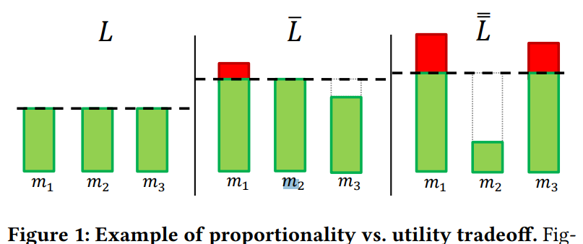













Recap
Which of the lists would you prefer?
How epsilon-constraint method works?
https://ksi.mff.cuni.cz

Slide 5
Semestral work
Serendipity is the key… but what is serendipity?

Slide 6
Group Recommender Systems

Slide 7
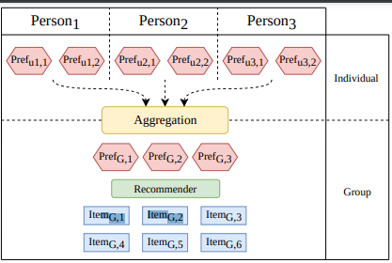
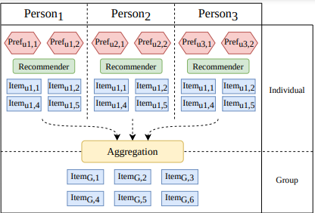
Group RS
Group Recommendation: recommend items to groups of users whose preferences can be different from each other.
It is assumed, that the group will „consume“ the recommendation together
Can differentiate in whether a single best decision has to be made, or a stream of decisions is plausible (background music)

Slide 8
Group Recommendation: two worlds
Group Choice prediction
  Two types of source data: individual preferences and group choices
  Sometimes consider volatile group composition
  Leadership identification
  Often lead to deep-learning approaches in preference aggregation
Fairness of Group Recommendations
  Typically, only individual preferences available
  How to create a recommendation that – to some extent – respect everyones’ preferences?
  Often lead to recommendation aggregation algorithms
Often not reliable

Slide 9
Fairness in Group Recommendation
Fairness Concerns: maximize the satisfaction of each group member while minimizing the unfairness (the imbalance of user utilities inside the group) between them.
Why not just aggregate individual preferences of users?
  Possible unfairness for individuals with minority opinion
Xiao, Lin, et al. "Fairness-aware group recommendation with pareto-efficiency." Recsys’17

Slide 10
Group RS
Two main classes of approaches:
  Item-wise (utility of each item is evaluated independently from all others)
  List-wise (utility is evaluated for the whole list)
    In most cases, the list is constructed incrementally
    You can focus on ranking-aware fairness, i.e., each head of the list of recommendations should be as fair as possible

Slide 11
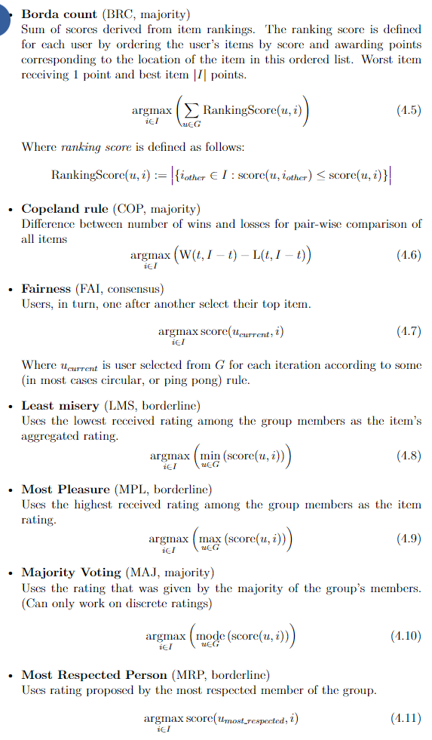
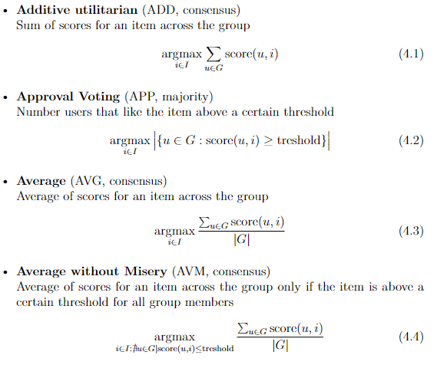
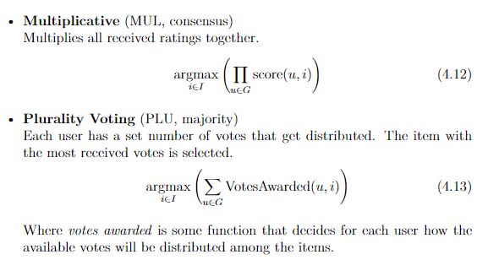
Item-based Group RS
https://pro.unibz.it/projects/schoolrecsys17/JudithMasthoff.pdf

Slide 12
Fairness in Group Recommendation
Item-based fairness in group RS
  Faster
  Still high chance of unfairness
    Question: is it true in reality?
=> List-wise fairness in group RS
Xiao, Lin, et al. "Fairness-aware group recommendation with pareto-efficiency." Recsys’17

Slide 13
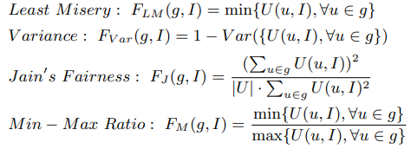
Fairness in Group Recommendation
Method:
  The Social Welfare (𝑆𝑊(𝑔, 𝐼)): overall utility of all users
  inside the group 𝑔 given a group recommendation I.
– The Fairness (𝐹(𝑔, 𝐼)): a function of 𝑈(𝑢, 𝐼), ∀𝑢 ∈ 𝑔, ∀𝐼.
  Multi-Objective Optimization:
  NP-Hard (again) -> scalarization + greedy or
  integer programming solvers
Experiment Results: The results indicate that
considering fairness can improve the quality
of group recommendation.
Xiao, Lin, et al. "Fairness-aware group recommendation with pareto-efficiency." Recsys’17

Slide 14
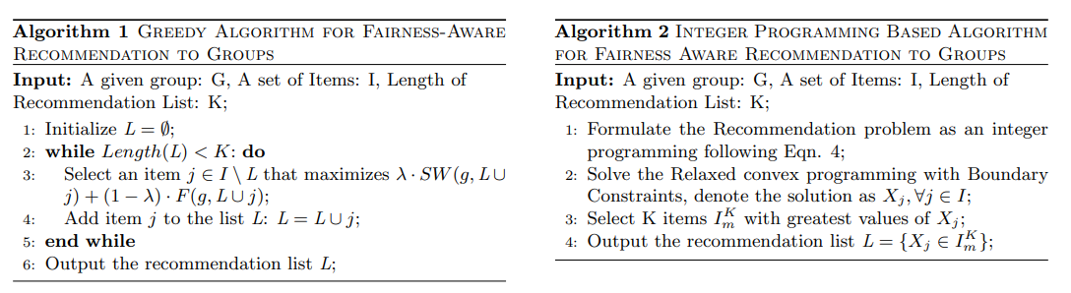
Fairness in Group Recommendation
Xiao, Lin, et al. "Fairness-aware group recommendation with pareto-efficiency." Recsys’17

Slide 15
Fairness in Group Recommendation
Possible issues:
Fairness metrics above did not consider ranking
Yet, user’s attention is unevenly distributed
Are fairness and utility two separable things?

Slide 16
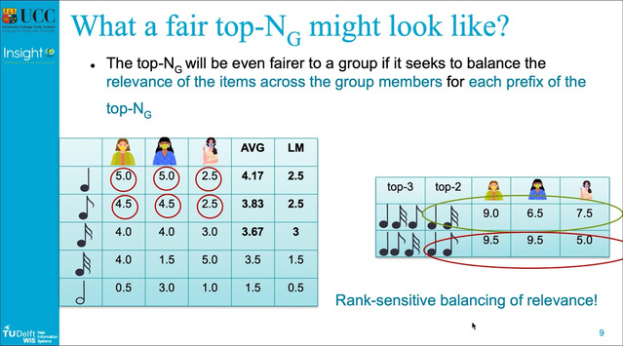
Fairness in Group Recommendation
Possible issues:
Ranking aware fairness
  Nice feature: optimizing just one metric comprising both utility and fairness
Greedy construction algorithm GFAR
https://slideslive.com/38934807/ensuring-fairness-in-group-recommendations-by-ranksensitive-balancing-of-relevance?ref=speaker-41949
https://dl.acm.org/doi/10.1145/3383313.3412232

Slide 17
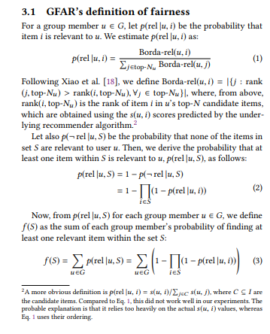
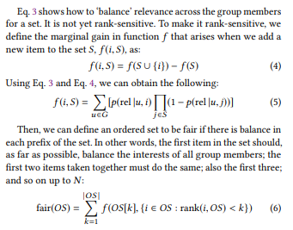
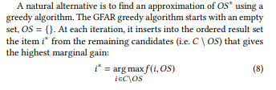
Fairness in Group Recommendation
Drastic decrease of relevance w.r.t. order of items
Finding one item per user is sufficient

Slide 18
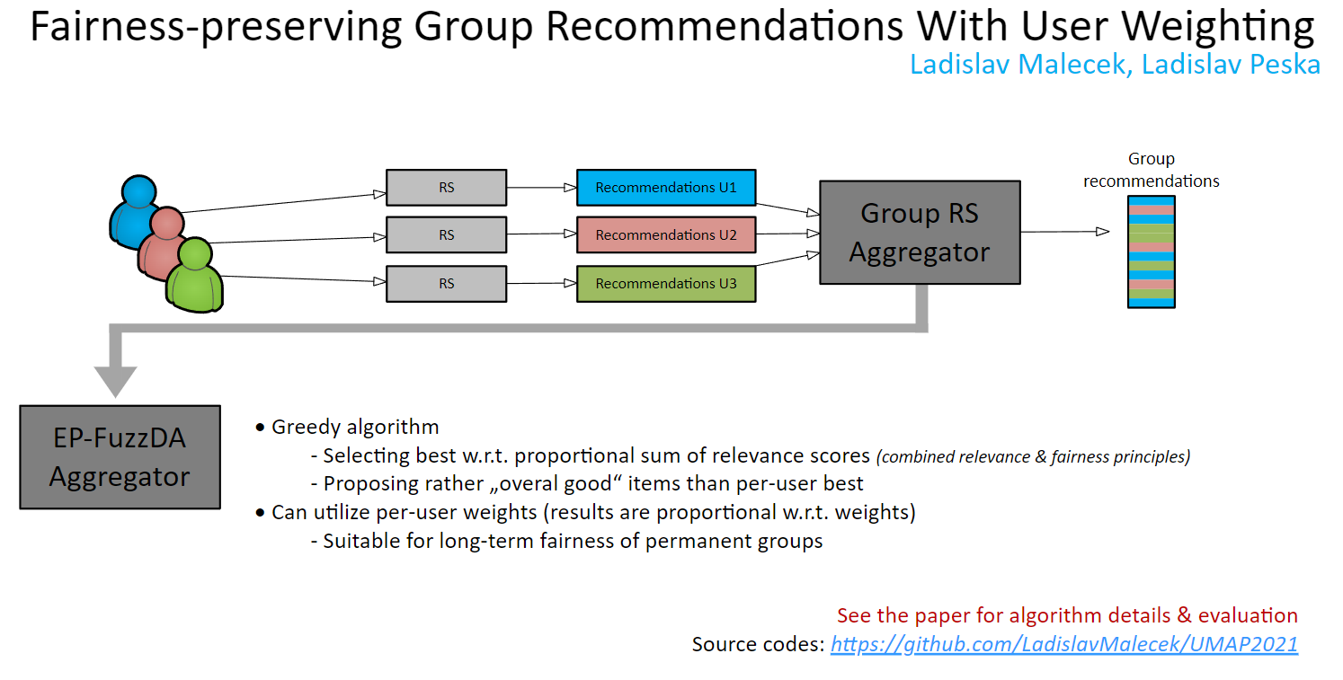
Fairness in Group Recommendation

Slide 19
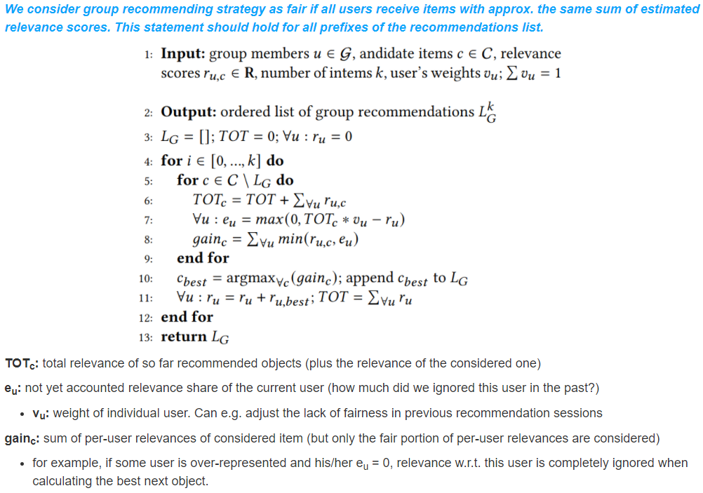
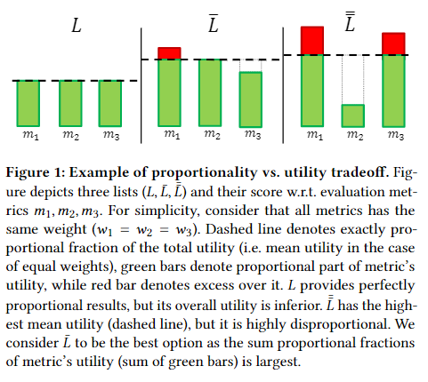
Fairness in Group Recommendation

Slide 20
Fairness in Group Recommendation
GFAR
Dilemma: recommend „per-user best“, or
average items „not bad“ for everyone?
EP-FuzzDA

Slide 21
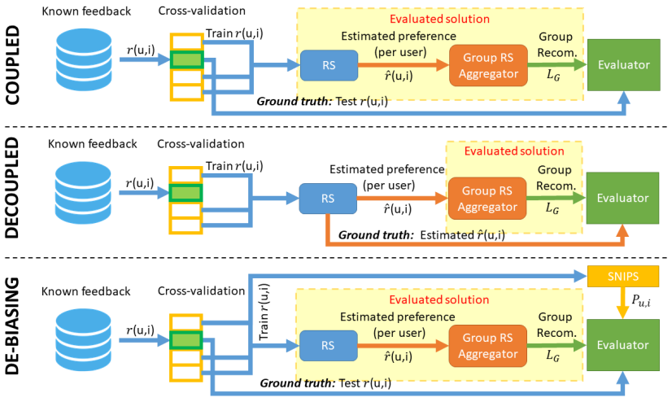
Biases in metrics
GFAR vs. EP-FuzzDA
  Coupled evaluation picks up biases of the RS and underlying data (popularity bias)
    Favors per-user best
  Decoupled evaluation depends on estimated ratings (their absolute differences)
    Lower values / higher score differences favor „best-per-user“ algorithms
    Higher values / smaller differences may favor algorithms seeking items best in average

Slide 22
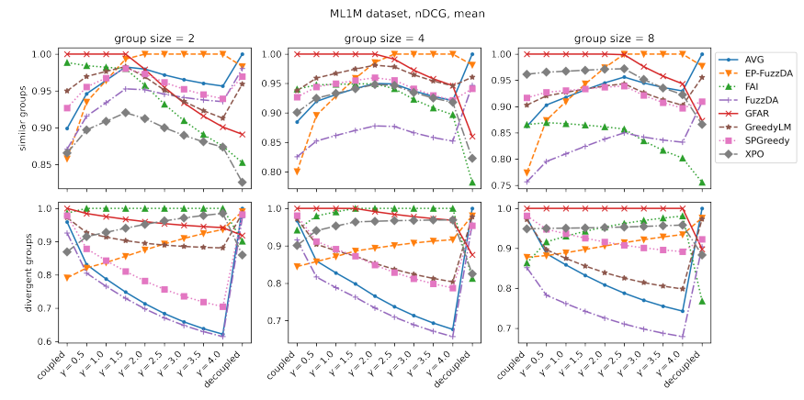
Biases in metrics
Results depend on the de-biasing intensity

Slide 23
Dynamic RS
https://ksi.mff.cuni.cz

Slide 24
Dynamic RS
Many RS algorithms consider a static setting of a RS
  Static set of train data
  Static set of items and users
  Static set of „queries“ that need to be answered (a.k.a. test set)
  Static preferences of users
In reality, all this is dynamic and changes over time
  Thought experiment: what could go wrong with a matrix factorization?

Slide 25
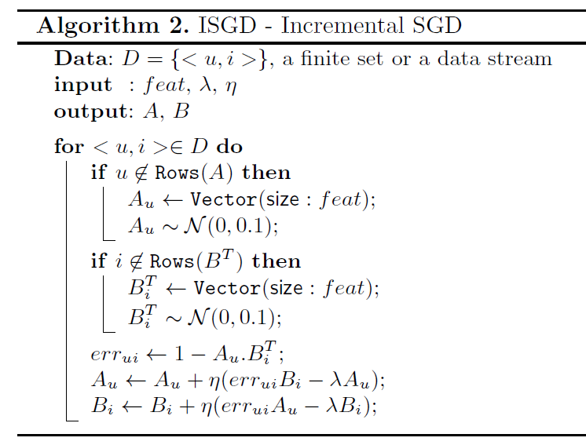
Dynamic RS: partial training for matrix factorizations
Partial SGD-like updates when new data arrives
  Can run more than just one iteration
  Can re-play some of older data as well to increase accuracy
  Most probably you need higher learning rates
How to properly evaluate this?
How often would normally be the other model re-trained?
João Vinagre, Alípio Mário Jorge & João Gama: Fast Incremental Matrix Factorization for Recommendation with Positive-Only Feedback

Slide 26
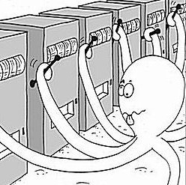
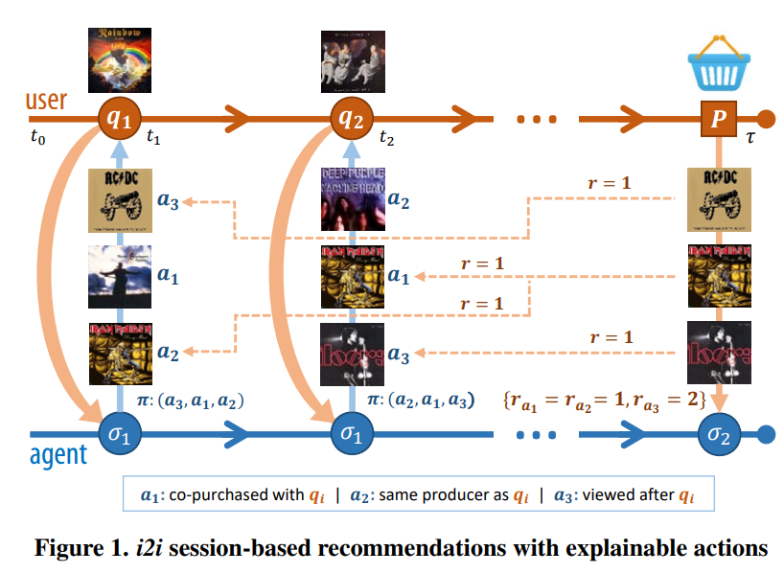
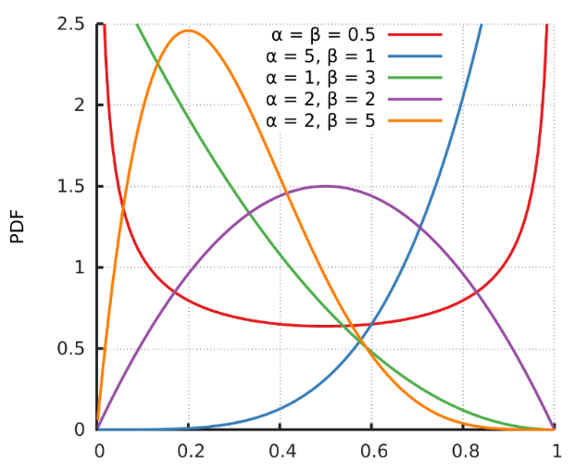
Dynamic RS: multi-armed bandits: TS
Use MAB to select which Recommender performs the best
  Each Recommender starts with the same probability of being selected
  This is dynamically being adjusted as we gain more rewards
    Thompson Sampling
    Beta distribution w.r.t. #successes, #missess
  Rewards attribution problem with delayed rewards
  Non-stationary behavior of arms -> partitioning into sub-components
    IDF for attribute-like links (assume same performance for similarly popular items)
    Edge weight for behavioral links
Broden et al.: Ensemble Recommendations via Thompson Sampling: an Experimental Study within e-Commerce

Slide 27
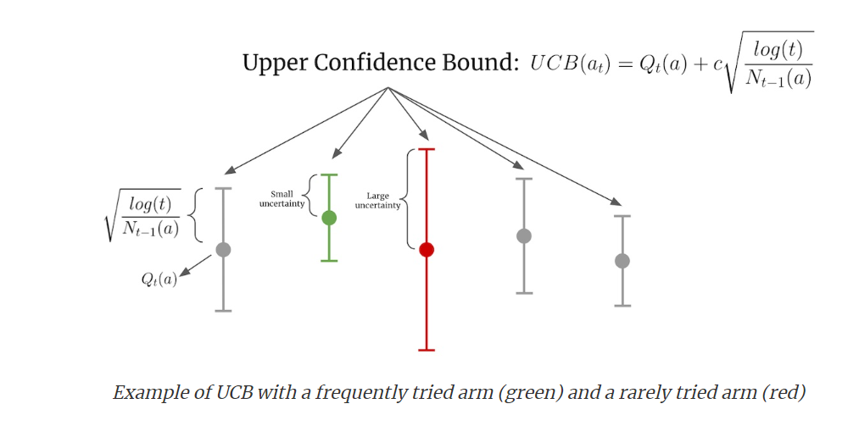
Dynamic RS: multi-armed bandits: other strategies
Epsilon-greedy
  Select current best with epsilon prob. Select at random with 1-epsilon prob.
Upper Confidence Bound (UCB)
  Confidence given by the volume of trials (N_t)
  Slight decrease over time (log(t))
  Hyperparameter c
What about non-stationarity?
https://eugeneyan.com/writing/bandits/

Slide 28
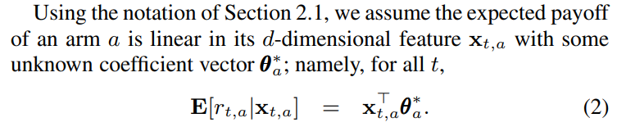
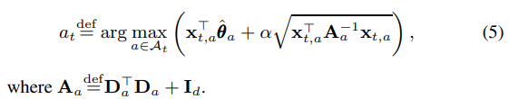

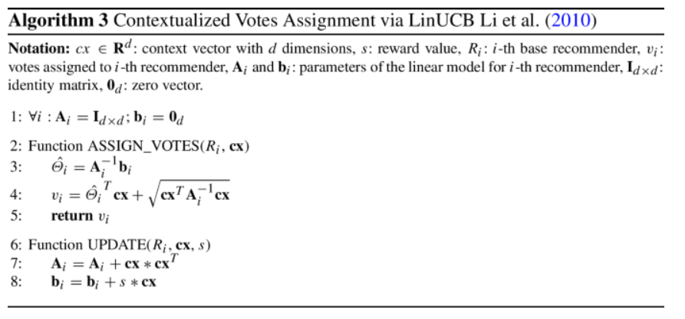
Dynamic RS: LinearUCB
LinearUCB: reward estimates depend on some parameters (a.k.a. state)
  E.g., current context of the user
  If the state is represented with nominal values => sub-component strategy from Broden
  What if we need to incorporate numerical (unbound) values?
    Assume linear impact of the state on rewards + independence of individual state dimensions
  We used it in https://link.springer.com/article/10.1007/s11257-021-09311-w in
  slightly altered way to assign votes for a variant of mandates allocation strategy.
Curse of dimensionality?
What about more complex relationships?
Li et al. A contextual-bandit approach to personalized news article recommendation

Slide 29
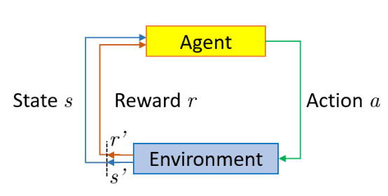

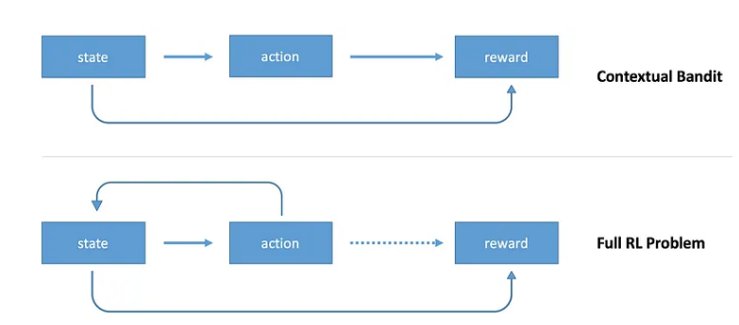
Dynamic RS: Reinforcement learning
Bandits are a subclass of reinforcement learning approach
  On top of what CX bandits do, full RL algorithms update state as a result of an action
https://towardsdatascience.com/contextual-bandits-and-reinforcement-learning-6bdfeaece72a

Slide 30
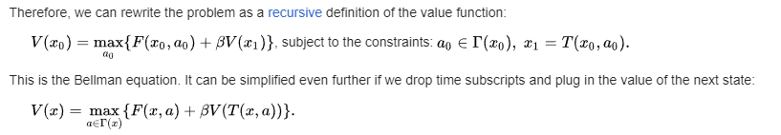
Dynamic RS: Reinforcement learning
Based on Bellman equation
  Basic approach: Q-learning (literally, table of states and actions)
    „Expected long-term reward for a given action is equal to the immediate reward from the current action combined with the expected reward from the best future action taken at the following state.“
    Q(s,a) = r + γ(max(Q(s’,a’)) (in reality, we keep the current value adjusted w.r.t. some learning rate
    „This says that the Q-value for a given state (s) and action (a) should represent the current reward (r) plus the maximum discounted (γ) future reward expected according to our own table for the next state (s’) we would end up in. “
  Q-learning not scalable if we have more states or actions
https://en.wikipedia.org/wiki/Bellman_equation
https://medium.com/emergent-future/simple-reinforcement-learning-with-tensorflow-part-0-q-learning-with-tables-and-neural-networks-d195264329d0

Slide 31
Dynamic RS: Reinforcement learning
Based on Bellman equation
  Deep Q-learning (use neural network as a function approximator)
    States as one-hot-encoding (input)
    Actions as output nodes (estimated reward)
    Backpropagation w.r.t. real vs. Estimated Q values: Loss = ∑(Q-target - Q)²
      Experience replay
      Freezing target networks
      Exploration of actions (not always the best predicted one: epsilon-greedy)
https://en.wikipedia.org/wiki/Bellman_equation
https://www.baeldung.com/cs/q-learning-vs-deep-q-learning-vs-deep-q-network
https://medium.com/emergent-future/simple-reinforcement-learning-with-tensorflow-part-0-q-learning-with-tables-and-neural-networks-d195264329d0

Slide 32
Dynamic RS: Reinforcement learning
Based on Bellman equation
  Deep Q-learning (use neural network as a function approximator)
    States as one-hot-encoding (input)
    Actions as output nodes (estimated reward)
    Backpropagation w.r.t. real vs. Estimated Q values: Loss = ∑(Q-target - Q)²
      Experience replay
      Freezing target networks
      Exploration of actions (not always the best predicted one: epsilon-greedy)
RecSys tutorial on RL: https://www.youtube.com/watch?v=qJysTu1Xl5U
Survey paper: https://www.sciencedirect.com/science/article/pii/S0950705123000850
https://en.wikipedia.org/wiki/Bellman_equation
https://www.baeldung.com/cs/q-learning-vs-deep-q-learning-vs-deep-q-network
https://medium.com/emergent-future/simple-reinforcement-learning-with-tensorflow-part-0-q-learning-with-tables-and-neural-networks-d195264329d0

