Slide 1


NDBI021, Lecture 5
User preferences and advanced recommending methods, 2/1 ZK+Z,
https://www.ksi.mff.cuni.cz/~peska/vyuka/ndbi021/
https://youtube.com/playlist?list=PLTYzSYF3EX3BNIVJkMpCE3vUDmUGvhEcy
https://ksi.mff.cuni.cz

Slide 2
Today’s content
User feedback
  Non-numeric feedback
User preference
  Challenges
  Entity selection and Granularity
  Aggregations

Slide 3
Recap

Slide 4
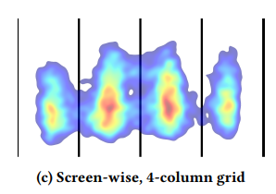

What is „beyond“ client-side feedback?
What are impressions? Why do we need them?

Slide 5
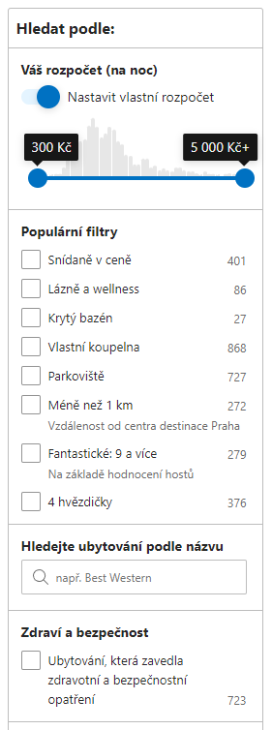
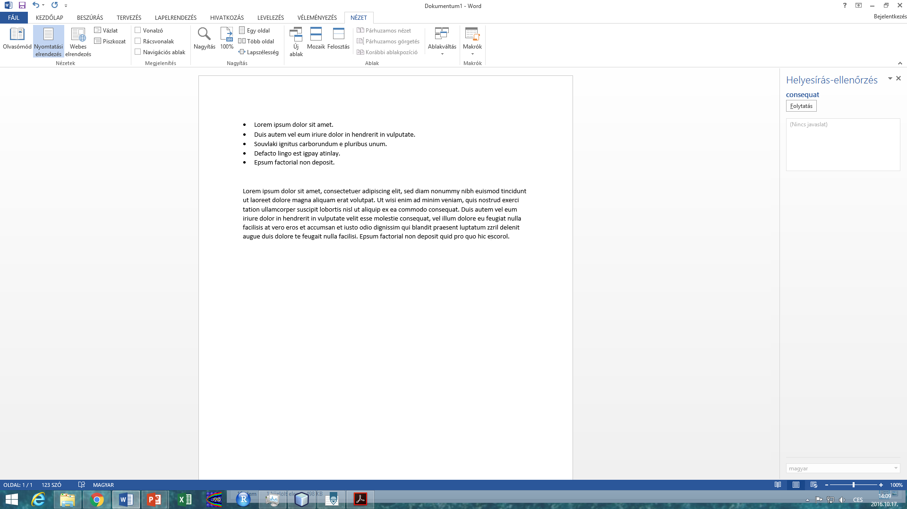
Should we interpret numerical feedback as context-free?
How would you utilize seaching/browsing feedback?

Slide 6
Textual feedback
How reviews improve personalization

Slide 7
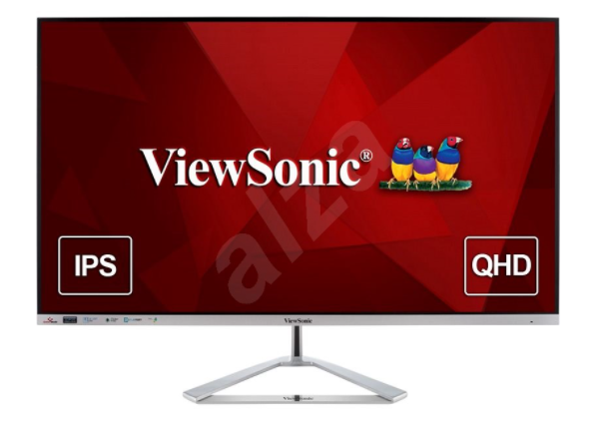
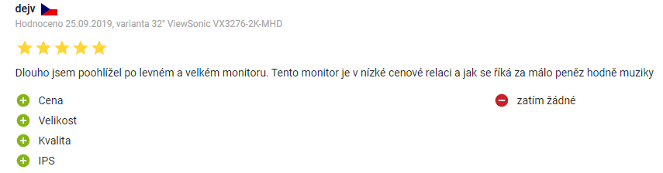
Non-numeric feedback
Textual reviews
Semi-textual reviews

Slide 8
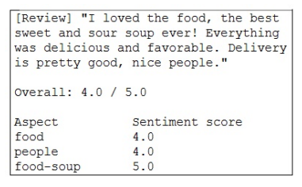
Textual reviews
Main usage:
  Rating prediction from reviews
    Multi-criteria rating prediction => recommendation
  Explanations
How:
  (explicit) Sentiment analysis
    https://dl.acm.org/doi/abs/10.1145/3109859.3109905 (restaurants)
    https://dl.acm.org/doi/10.1007/s11257-015-9157-3 (hotels, fixed aspects)
  Latent Dirichlet Allocation (and related approaches) + post-processing
    https://ieeexplore.ieee.org/abstract/document/8813018

Slide 9
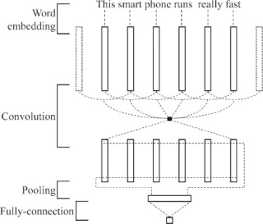
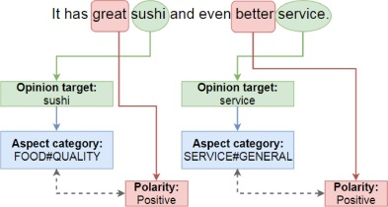
Textual reviews
Deep Learning for Aspect-Based Sentiment Analysis: A Comparative Review (2018) https://www.sciencedirect.com/science/article/pii/S0957417418306456
  CNN, RNN, Recursive NN
Three subtasks of aspect-based sentiment analysis:
Opinion target extraction (OTE),
Aspect category detection (ACD)
Sentiment Polarity (SP),
An example of CNN architecture for aspect category and sentiment polarity. Adapted from Gu, Gu, & Wu (2017) https://doi.org/10.1007/s11063-017-9605-7.
Limitations: fixed list of aspect axes

Slide 10
Textual reviews
Sentiment analysis (pre-LLM) https://dl.acm.org/doi/abs/10.1145/3109859.3109905
  A Multi-criteria Recommender System Exploiting Aspect-based Sentiment Analysis of Users’ Reviews
    „SABRE“ framework, Output: aspect, sub-aspect, its relevance for reviewer & its sentiment
    https://link.springer.com/chapter/10.1007/978-3-319-46135-9_4
      Aspect modeling as relatively simple frequency analysis – most common nouns [room for improvement]
      Afinn wordlist for sentiment (annotated words representing opinion appears close to the aspect)
      Aspect relevance ~ its relative frequency
      Limitations:
        Minimal granularity = one word (may be not generic enough)
        Fixed word-based sentiment
      Plus points:
        Dynamic list of aspects
    Neighborhood-based recommendation model
      Treat each aspect as independent rating, use multi-dimensional Euclidean distance
      (serialize pairs of item-aspect into a single vector)

Slide 11
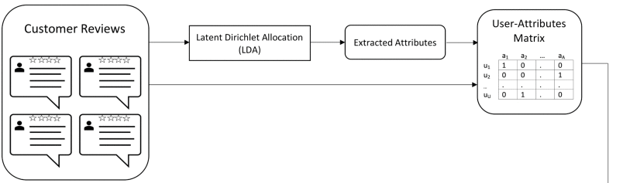
Textual reviews
What if the list of aspects cannot be fixed? Also, multiple words may account for the same aspect.
https://ieeexplore.ieee.org/abstract/document/8813018
Customer Reviews Analysis With Deep Neural Networks for E-Commerce Recommender Systems
  Latent Dirichlet Allocation
    The only interesting part of the pipeline
    „What was the review about“?
    Dynamic topic modeling
…

Slide 12
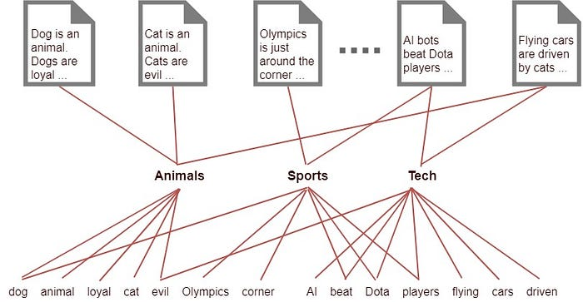
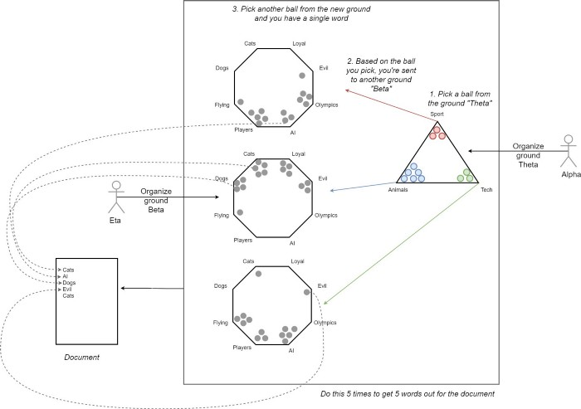
Textual reviews
Latent Dirichlet Allocation (LDA)
https://en.wikipedia.org/wiki/Latent_Dirichlet_allocation ,
https://towardsdatascience.com/light-on-math-machine-learning-intuitive-guide-to-latent-dirichlet-allocation-437c81220158
  Documents; fixed set of latent topics;
    each document is a mixture of topics,
    each topic is characterized as a Dirichlet distribution over words
  Assume generative model for documents
  and then try to reverse-ingeneer the documents with it.
  Several ways to learn, e.g. Variational inference / EM alg.
    https://en.wikipedia.org/wiki/Expectation%E2%80%93maximization_algorithm
    https://en.wikipedia.org/wiki/Variational_Bayesian_methods
  https://en.wikipedia.org/wiki/Kullback%E2%80%93Leibler_divergence

Slide 13
Textual reviews
Latent Dirichlet Allocation (LDA)
https://en.wikipedia.org/wiki/Latent_Dirichlet_allocation ,
https://towardsdatascience.com/light-on-math-machine-learning-intuitive-guide-to-latent-dirichlet-allocation-437c81220158
  Documents; fixed set of latent topics;
    each document is a mixture of topics,
    each topic is characterized as a Dirichlet distribution over words
  Assume generative model for documents
  and then try to reverse-ingeneer the documents with it.
  Several ways to learn, e.g. Variational inference / EM alg.
    https://en.wikipedia.org/wiki/Expectation%E2%80%93maximization_algorithm
    https://en.wikipedia.org/wiki/Variational_Bayesian_methods
  https://en.wikipedia.org/wiki/Kullback%E2%80%93Leibler_divergence

Slide 14
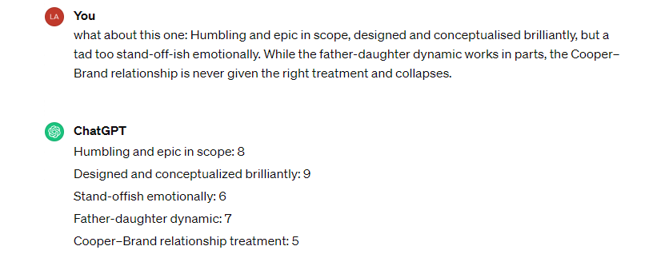
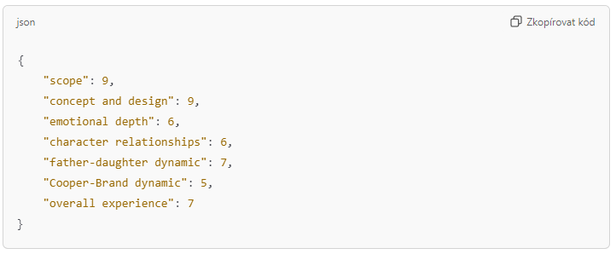
Textual reviews
Leave it on LLMs?
  [2022] Hard without a fixed set of aspects
  [2024] Seemingly better
    But still, some aspects lack generalization capability
  Pre-defined set of aspects would probably work better
2022
2024

Slide 15
Textual reviews: explanations
https://dl.acm.org/doi/pdf/10.1145/3320435.3320457 (2019)
Justifying Recommendations through Aspect-based Sentiment Analysis of Users’ Reviews
Aspect extraction:
  Part-of-Speech (POS) tagging algorithm (nouns = possible aspects)
  Aspect ranking: relevant+positive & distinguishing
    For each aspect number of sentences + average sentiment + IDF
Sentences containing aspect a
Positive vs negative sentiment
IDF-like weighting

Slide 16
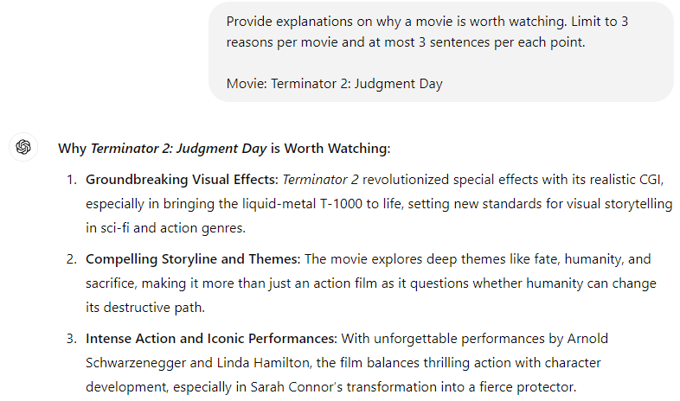
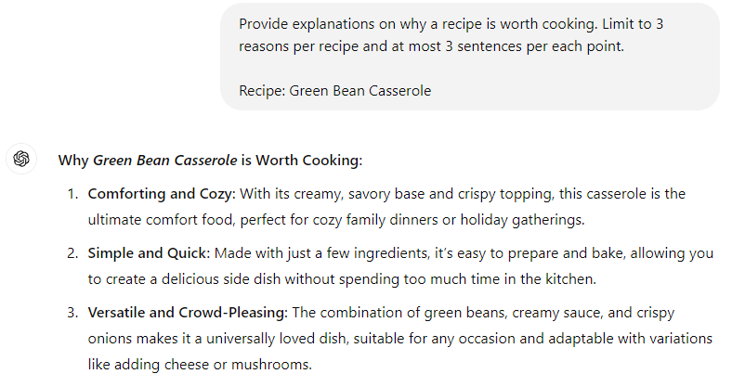
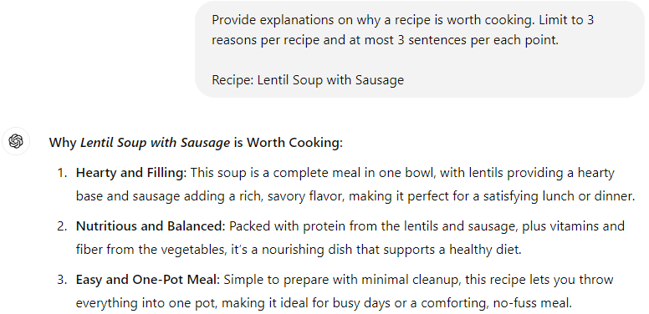
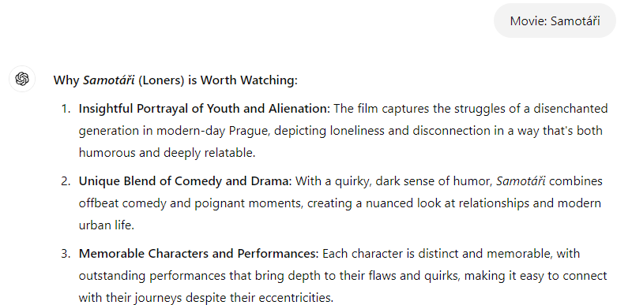
LLM-generated Explanations
Inherent limitation: domain knowledge
Gets better over time
New item issue

Slide 17

Questions?

Slide 18
How to model user preferences
What can be expressed & how to express it

Slide 19
How to model user preferences?
What are the targets of the preference mining?
  Entity granularity
Who gives the preference (who is the user)?
  Group preference, Various confidence in user identification.
What are expected connections among the entities (hypotheses)?
  Aggregation methods and fuzzy logic
  (Knowledge) Graph-aware recommending algorithms
Does user preference depend on some context/conditions?
  Context-aware Recommender Systems
In what way do we allow users to express their preferences?
  [Already covered] Explicit/implicit/other feedback

Slide 20
How to model UP [some use-cases]
Simple movies recommendation:
Task: help to discover what to watch tonight
How to use UP: Collaborative recommendation of movies
  E.g. Select users similar to the current one, recommend what other users liked but the current one does not know.
(Food) Recipes recommendation:
Task: help to decide what to cook
  How to use UP: personalized searching
    Searching for recipes matching desired ingredients + users preferences
  How to use UP: front-page recommendation
    E.g. recommend recipes from user’s favorite ingredients, similar (not too similar) to the ones liked in the past

Slide 21
How to model UP [some use-cases]
Group music recommendation:
Task: create a background music playlist for an evening with friends
  On top of Youtube / Spotify or similar service
How to utilize it: fairness-aware playlist construction
  (Endless) sequence of tracks, representing interests of all group members

Slide 22
Entity selection & Granularity

Slide 23
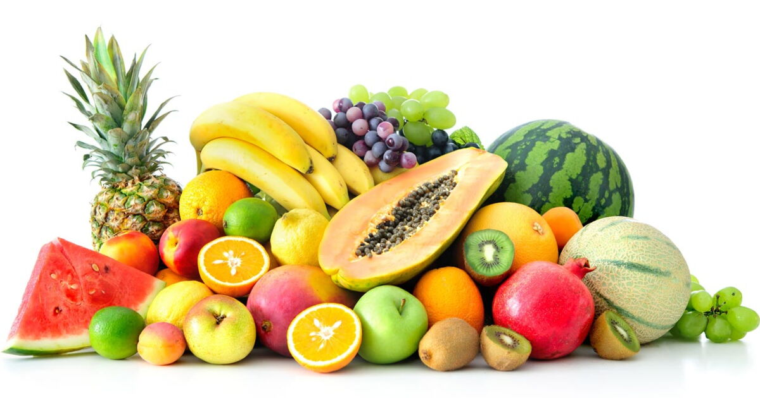
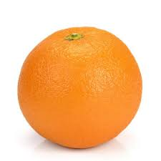
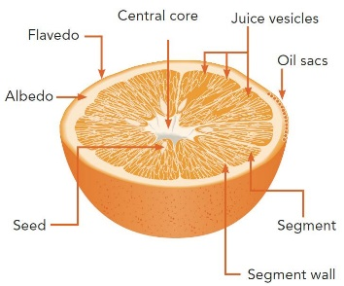
Points to consider in modeling phase
What entities are relevant?
  Are they sufficiently recognizeable?
  Can we get enough data about them?
  How much added value they can give us?
  Would it upset our users if they are not allowed to define preferences w.r.t. them?
    Why I cannot like the album, only individual songs?
Vs.
Vs.

Slide 24
Points to consider in modeling phase
What (minimal) granularity to use?
  Primary target: cooking recipes
    Recipes are composed from multiple ingredients (and other attributes)
      Ingredients themselves has some attributes (e.g. quantity, type of preparation, quality, category)
      0.5kg of ground free-ranged chicken brests -> chicken brests are a type of meat / chicken meat / light meat…
  What you might want to be able to express:
    Would the user like the recipe more/less if it would be meat-free?
    Is it possible that he/she (dis)like chicken brests?
    Can you say that the recipe contains too much vegetable?
    Is it even possible to rate the recipe based on ingredients?

Slide 25
Points to consider in modeling phase
What would the user be willing to do/say/rate/…?
  Users tend not to rate things much
  But they are sometimes willing to confirm/reject your beliefs
  They do browsing, searching, buying etc.

Slide 26
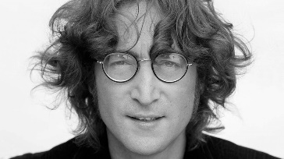
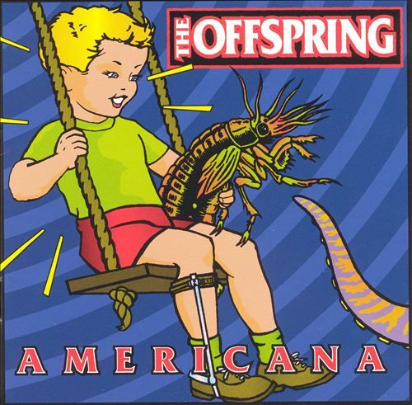
What entities are relevant?
What entities are relevant?
  Are they sufficiently independent?
    Is the user’s preference towards some recipe a mere aggregation of his/her preference towards its ingredients?
    Do you like the song just because it was written by… John Lennon?
  How much added value they can give us?
    Is it usual that people like Offsprings, but dislike their Americana album?
Who should decide?
  Domain expert
  Supported by data analysis
    If you have some preliminary data:
    … and/or continuous testing
    … and/or dedicated lab study
    Look for both common cases and outliers. Every person is an outlier in some scenario => only solving common cases... Not good☺

Slide 27
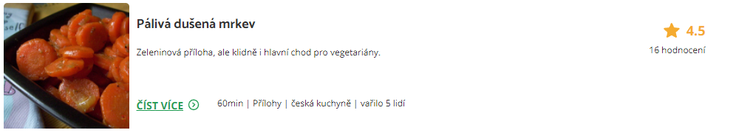



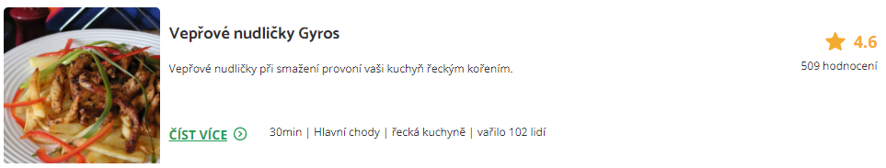

What minimal granularity to chose?
This is the feedback we have
Would the user like this one?

Slide 28

What minimal granularity to chose?
This is the feedback we have
Would he/she like this one?

Slide 29
What minimal granularity to chose?
This is the feedback we have
Would he/she like this one?
Probably not, he/she seems to be a vegetarian

Slide 30
What minimal granularity to chose?
So, the finer granularity the better?

Slide 31

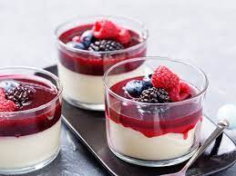
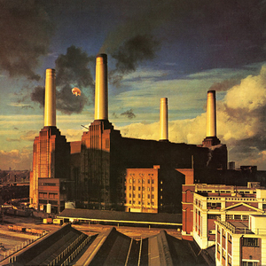
What minimal granularity to chose?
Why do you like Lord of the Rings movie?
What makes panna cotta so delicious?
What is so good on [your favorite artists] songs?

Slide 32
What minimal granularity to chose?
Why do you like Lord of the Rings movie?
What makes Panna cotta so delicious?
What is so good on [your favorite artists] songs?
Is the description discriminative?
  Can it be generalized to all other objects sharing the same feature?
  Is there something missing in the picture?
If you mentioned multiple features, what is their interplay?
  And-like / or-like / additive / amplifying…

Slide 33
What minimal granularity to chose?
Why do you like Lord of the Rings movie?
What makes Panna cotta so delicious?
What is so good on [your favorite artists] songs?
Do we have data for your choices?
  How much meaningful are our attributes?
  How much variety do we have?
  (Hard to define) how much information is missing?

Slide 34
What minimal granularity to chose?
Why do you like Lord of the Rings movie?
What makes Panna cotta so delicious?
What is so good on [your favorite artists] songs?
Also, are this the actual reasons, or just you justifying your emotions?
  https://start.askwonder.com/insights/want-add-previous-request-made-few-years-ago-want-studies-support-idea-decisions-c22yygpap
  https://en.wikipedia.org/wiki/Motivated_reasoning
  Ninety percent of human decisions are made based on emotions. Humans use logic to justify their actions to themselves and others
  "Common emotional decisions may use some logic, but the main driving force is emotion, which either overrides logic or uses a pseudo-logic to support emotional choices (this is extremely common). Another common use of emotion in the decision is to start with logic and then use emotion in the final choice."

Slide 35
What minimal granularity to chose?
To sum-up
It may be difficult for humans to express their preference on sub-object level
  Some hints are possible, but the information is rarely complete
Our data does not have to correspond to the user’s vocabulary
  Some features are missing
  Some user’s preferences are hard to be transferred to attributes
  (The movie is too generic)
Quite often, human’s decisions are not driven logically, but emotionally
  Any logical clues they give us does not have to be applicable for the next case

Slide 36
What minimal granularity to chose?
Possible solution:
Collect [implicit] feedback on object-level, then infer sub-object preferences
  Latent (e.g., attribute-level vector representation) or explicit (direct preference prediction)
  Occasionally ask, whether your explicit preferences are correct
    E.g. Use latent model, but „guard“ it via regularization to the explicit one. Iteratively update if you recieve confirmation on your explicit model.
    https://www.frontiersin.org/articles/10.3389/fdata.2021.778417/full
    https://dl.acm.org/doi/10.1145/2043932.2043979
  Confirmation is often easier than definition + can be done in a less intrusive way
    Based on your recipe ratings, we think you are a vegetarian. Is that true?
    [Yes | NO | No, but I do not eat meat much | Irrelevant] What will happen >>
    If you click on Yes, we will promote more vegetarian meals in your future searches. You can always turn this feature off in your user profile.
  User controll in RS (https://web-ainf.aau.at/pub/jannach/files/BOOK_CHAPTER_PERSONALIZED_HCI_2019.pdf)
Requires rather lot of per-user data to learn this reliably

Slide 37
What minimal granularity to chose?
Possible solution:
Use within-page feedback collection to identify most relevant content parts
  Then translate this to the sub-object preferences
  Inherently noisy, highly visualization-specific
  No known usage
Requires detailed feedback collection, but possibly less data points needed

Slide 38
What minimal granularity to chose?
Be careful while generalizing from inferred sub-object preferences
Do you like action movies?
Do you like food with salt?
Do you like movies with David Aston?
  Yes, but not all of them
  Yes, but not because of this
…who is David Aston?

Slide 39
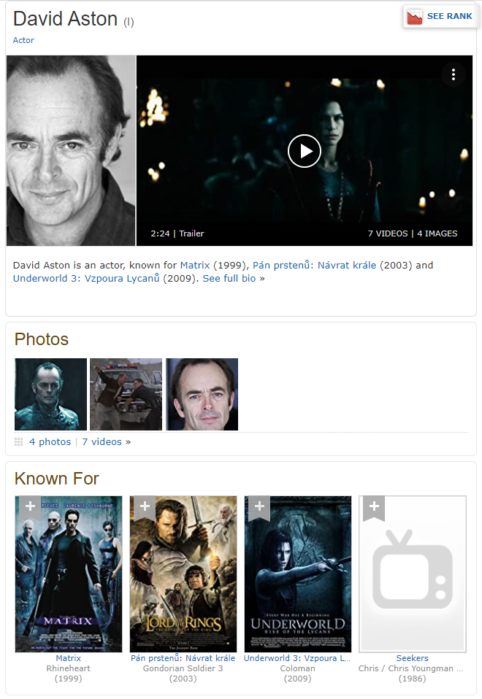
What minimal granularity to chose?
Be careful while generalizing from inferred sub-object preferences
Do you like action movies?
Do you like food with salt?
Do you like movies with David Aston?
  Yes, but not all of them
  Yes, but not because of this
…who is David Aston?

Slide 40
What minimal granularity to chose?
Be careful while generalizing from inferred sub-object preferences
Yes, but not all of them
  Should be fine (other features to clarify), but we need to ask questions correctly
Yes, but not because of this
  Loss of trust („the system does not understand what is important“)
  Some model of global or per-object feature importance
    Only confirm the inferred preference on the important ones
    Do not base your decision on the less relevant much

Slide 41
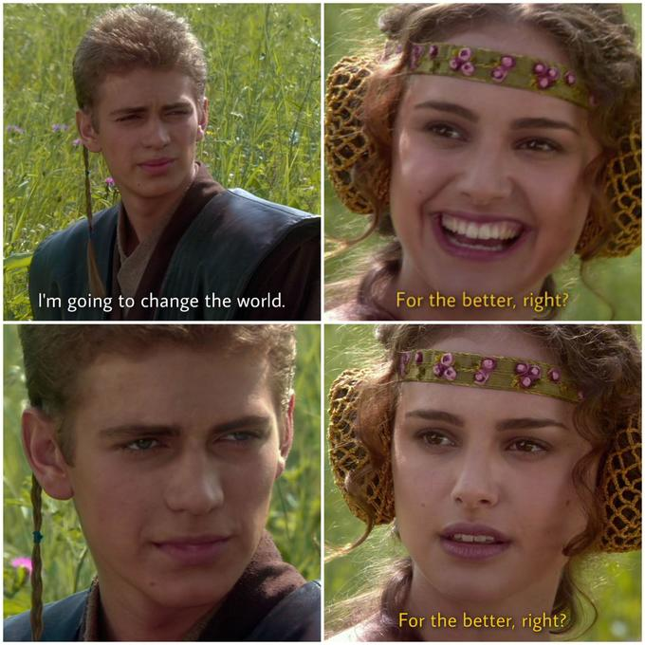
Aggregating multiple indicators
If A=1 and B=1, then A and B is 2, right? … RIGHT?

Slide 42
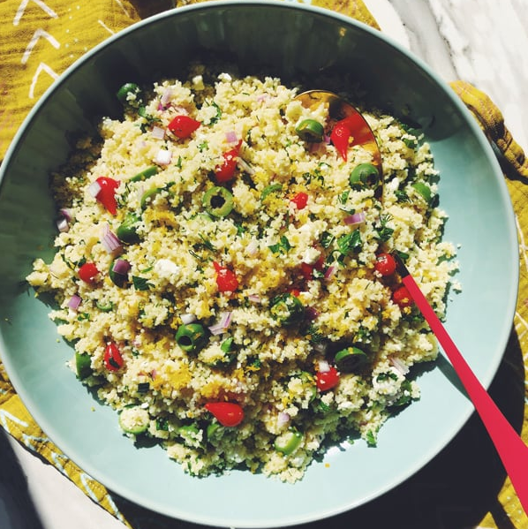
Aggregating User Preferences
Recipes domain:
  Suppose you KNOW that the user likes olives, but dislikes cous-cous
Would she like or dislike cous-cous with olives?

Slide 43
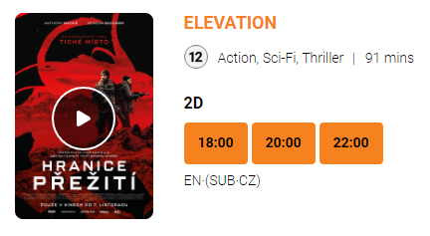
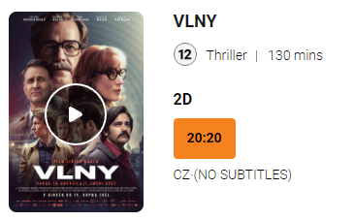
Aggregating User Preferences
Group movie night:
  Both Adam and Eva like action sci-fi, but they’re not fond of Czech movies in general
  David dislikes sci-fi, but enjoys thrillers, especially Czech ones.
What should they watch tonight?

Slide 44
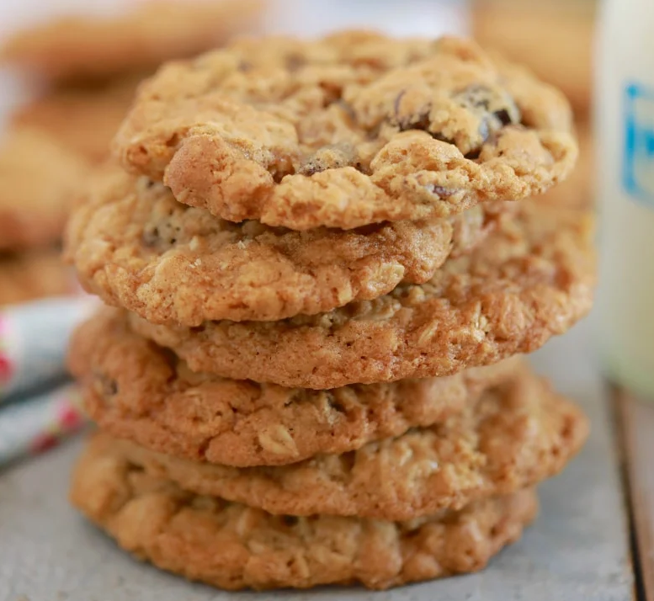
Aggregating User Preferences
More attributes:
  This Panna cotta is with strawberries which I love so much, the cream looks delicious and is from my favorite shop – but there is a lot fat in it as well.
  I am not really fond of oat cookies and this one is a bit over-priced, but they are very healthy.
Should I eat something?

Slide 45
Aggregating User Preferences
In different situations people may employ different aggregation of individual preferences
If enough data, we may try to train a model to predict the decision based on partial imputs. However, this might not be always possible.
What simple models of preferences aggregations can we use instead?

Slide 46
Aggregating User Preferences
What simple models of preferences aggregations can we use?
  Just sum’em up (MEAN)
  First good wins (MAX)
  I have to be completely satisfied (MIN)

Slide 47
Aggregating User Preferences
What simple models of preferences aggregations can we use?
  Just sum’em up (MEAN)
  First good wins (MAX)
  I have to be completely satisfied (MIN)
  Priorities matter (weighted average)

Slide 48
Aggregating User Preferences
What simple models of preferences aggregations can we use?
  Just sum’em up (MEAN)
  First good wins (MAX)
  I have to be completely satisfied (MIN)
  Priorities matter (weighted average)
Is that it?

Slide 49
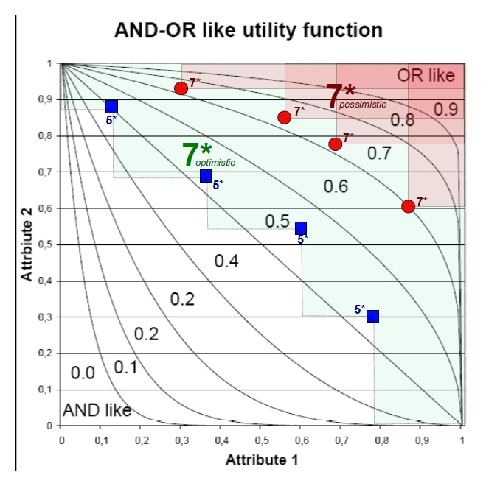
Aggregating User Preferences
What simple models of preferences aggregations can we use?
  Just sum’em up (MEAN)
  First good wins (MAX)
  I have to be completely satisfied (MIN)
  Priorities matter (weighted average)
Users’ preference tend to be more forgiving (OR-like) when the item is good
and less forgiving (AND-like) when it is not so good

Slide 50
Aggregating User Preferences
What simple models of preferences aggregations can we use?
  Just sum’em up (MEAN)
  First good wins (MAX)
  I have to be completely satisfied (MIN)
  Priorities matter (weighted average)
  Fuzzy-logic AND, OR, or other connectives (e.g., implications)

Slide 51
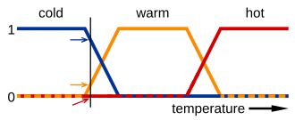
Aggregating User Preferences: Fuzzy logic
What is fuzzy logic: laymen’s view
  Extension of classical logic to the full spectrum of truth values between 0 and 1
  Has to maintain the laws of Boolean logic (e.g. 0 AND 1 = 0, asociativity, commutativity, monotonity…)
  Many proposed variants of logical connectives
    Basic (non-parametrized): Lukasiewicz, Goedel, Product
    Parametrized (the output depends on a hyperparameter)

Slide 52
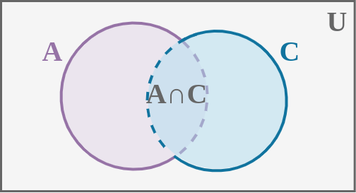
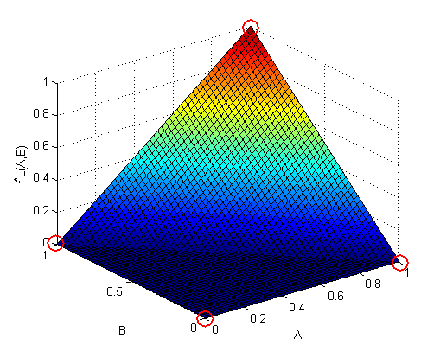
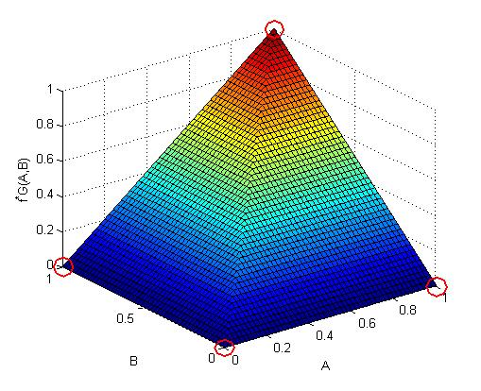
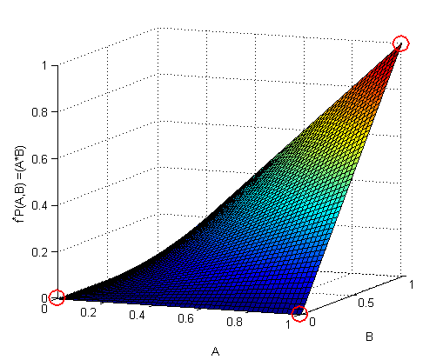
Aggregating User Preferences: Fuzzy logic
Fuzzy-logical AND (T-norms)… phenomenons’ intersection
  Lukasiewicz: T_L = max(0, a+b-1) … i.e., minimal possible intersection of two phenomenons
  Goedel: T_G = min(a,b) … i.e., full intersection of two phenomenons
  Product: T_P = a*b … i.e., assumed intersection of two independent phenomenons

Slide 53
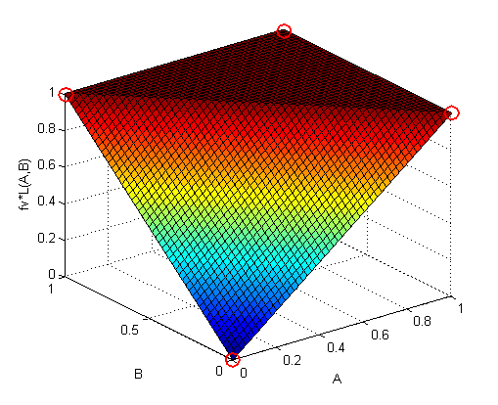
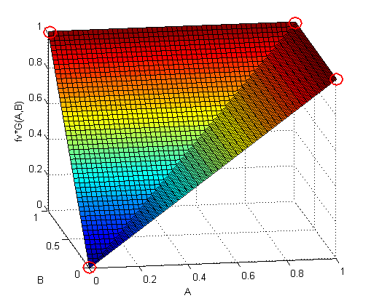
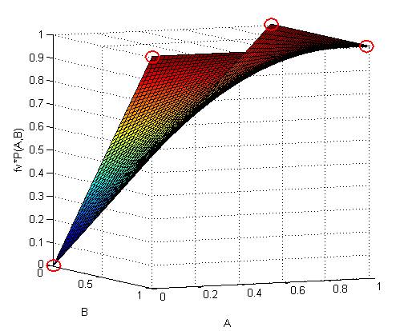
Aggregating User Preferences: Fuzzy logic
Fuzzy-logical OR (T-conorms) … phenomenons’ union
Use deMorgan rules and NOT(x) = 1-x
  Lukasiewicz: S_L = min(1, a+b) … i.e., minimal possible intersection of two phenomenons
  Goedel: S_G = max(a,b) … i.e., full intersection of two phenomenons
  Product: S_P = a+b - a*b … i.e., assumed intersection of two independent phenomenons

Slide 54
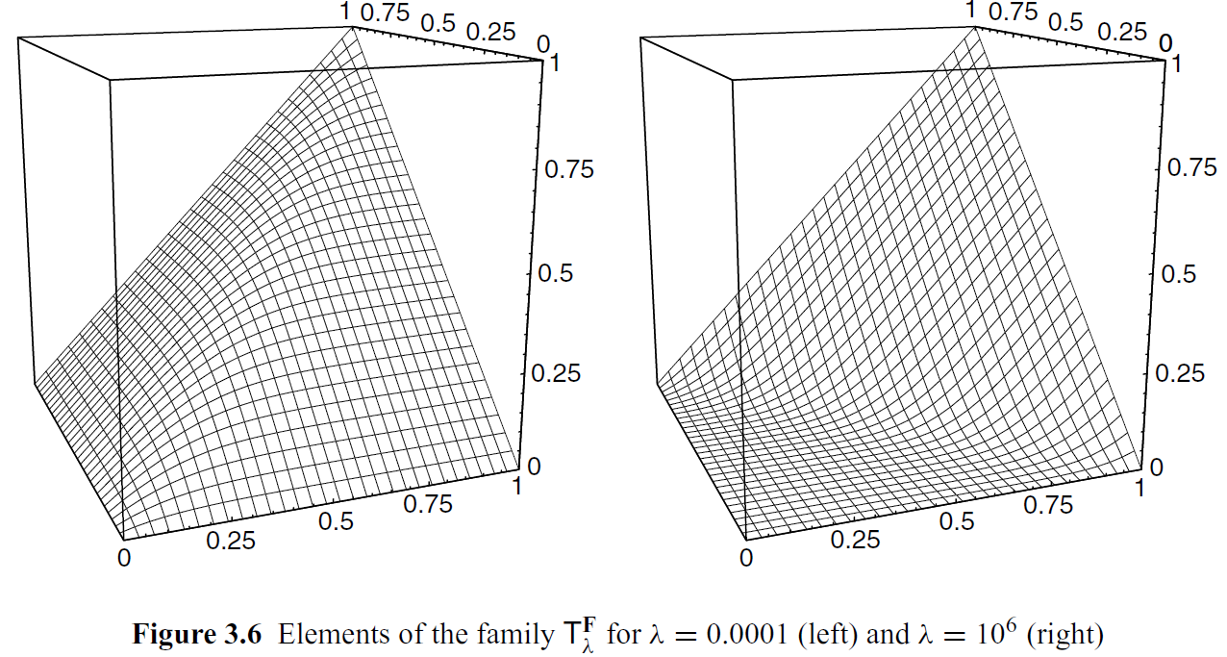
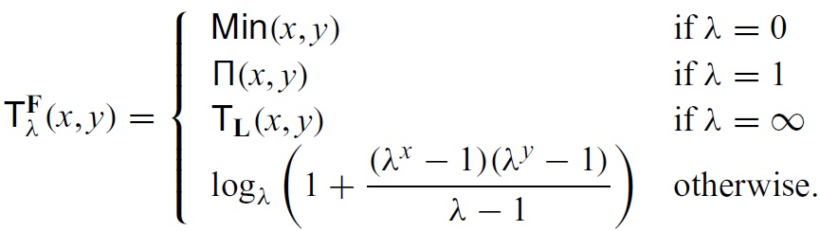
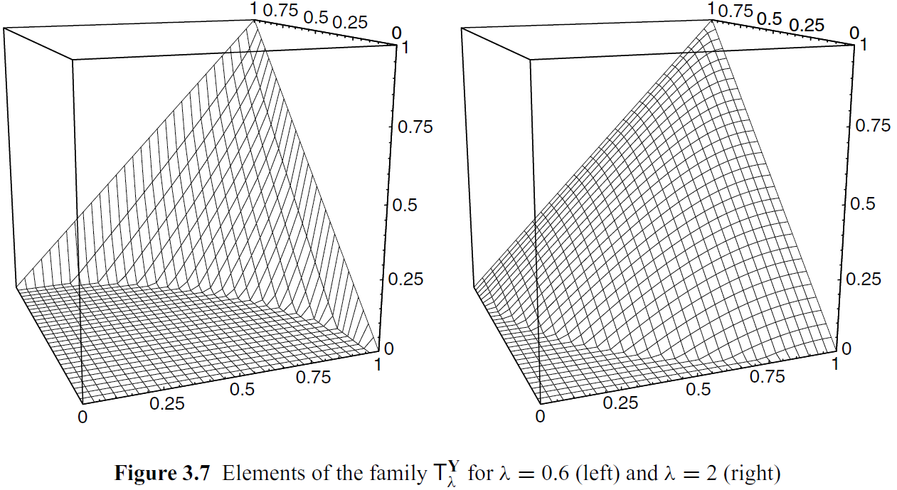
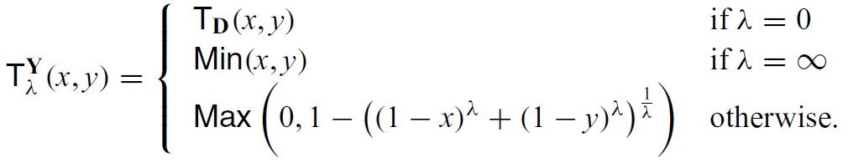
Aggregating User Preferences: Fuzzy logic
Parametrized T-norms
Frank t-norm
Yager t-norm
Grabisch, M., Marichal, J., Mesiar, R., & Pap, E. (2009). Aggregation Functions (Encyclopedia of Mathematics and its Applications). Cambridge: Cambridge University Press.

Slide 55
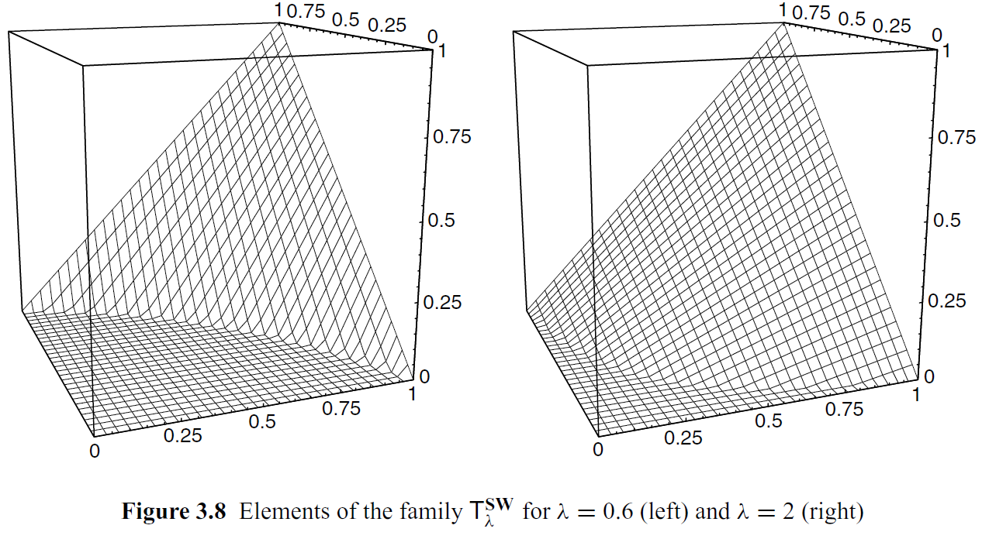
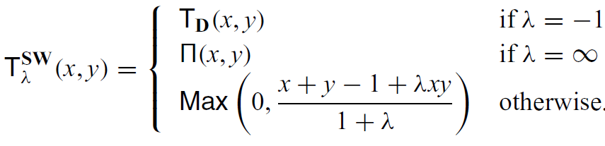
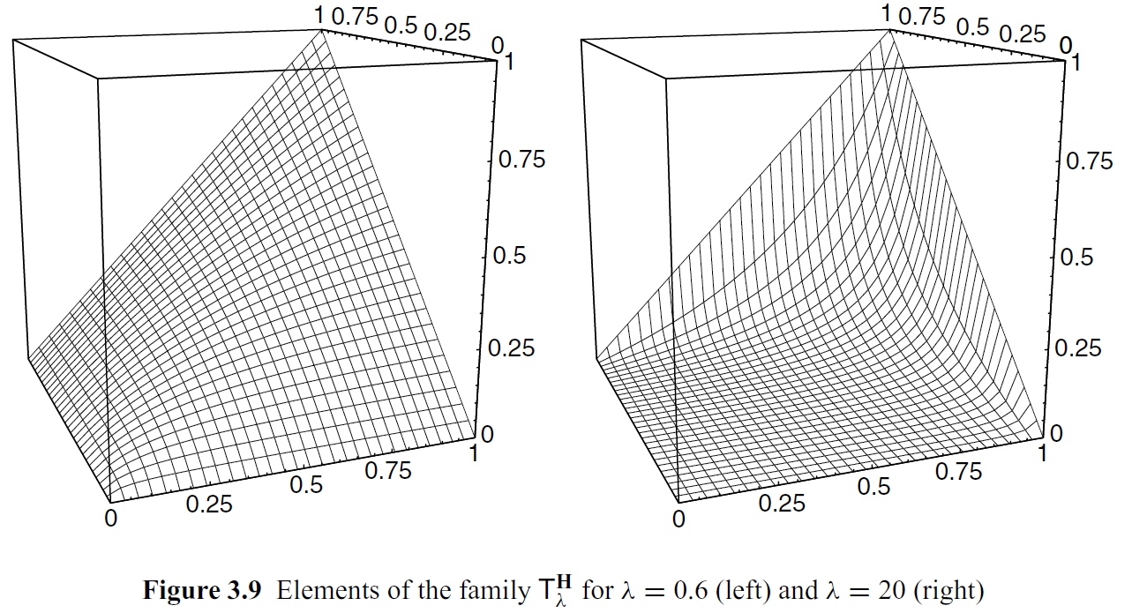
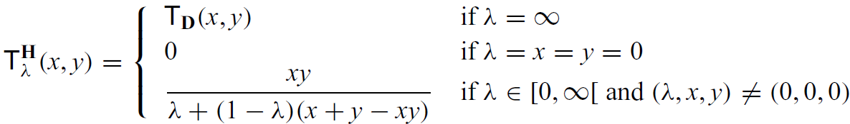
Aggregating User Preferences: Fuzzy logic
Parametrized T-norms
Sugeno-Weber t-norm
Hamacher t-norm
Grabisch, M., Marichal, J., Mesiar, R., & Pap, E. (2009). Aggregation Functions (Encyclopedia of Mathematics and its Applications). Cambridge: Cambridge University Press.

Slide 56
Aggregating User Preferences: Fuzzy logic
Fuzzy logic aggregations
  Fills the space between Min – Mean – Max aggregations
  Can be tuned/selected with limited data
  Nice formalism for faceted search as well
  No direct way to incorporate weights for individual objectives

Slide 57
Questions?

Slide 58
Three things you found interesting
…
…
…

