Slide 1
NDBI021, Lecture 11
User preferences, 2/1 ZK+Z,
https://www.ksi.mff.cuni.cz/~peska/vyuka/ndbi021
https://ksi.mff.cuni.cz

Slide 2
Lecture 11: Domain-specific RS
Exams: dates & times
News RS
Reciprocal RS
Music RS – if enough time
RS in Fashion (E-commerce) – if enough time
Semestral work
https://ksi.mff.cuni.cz

Slide 3
Exams: dates & times
Exams: possible dates
13. or 14.1.
22.1.
27.1.
When do you prefer within 3.2. – 12.2.
What do you prefer?
https://ksi.mff.cuni.cz

Slide 4
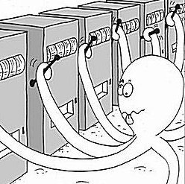
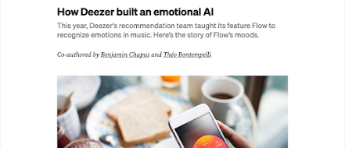
Recap
What is the difference between multi-armed and contextual bandits?
Which specific challenges of Music RS do you remember
https://ksi.mff.cuni.cz

Slide 5
News Recommender Systems

Slide 6
News Recommender Systems

Slide 7
News Recommender Systems

Slide 8
Editors & Journalists
Business, Investors
Product Managers
& Data Scientists
Policy-makers
Many Stakeholders
Users

Slide 9
Editors & Journalists
Business, Investors
Product Managers
& Data Scientists
… but the business usually wins…
Policy-makers
Many Stakeholders
Users

Slide 10
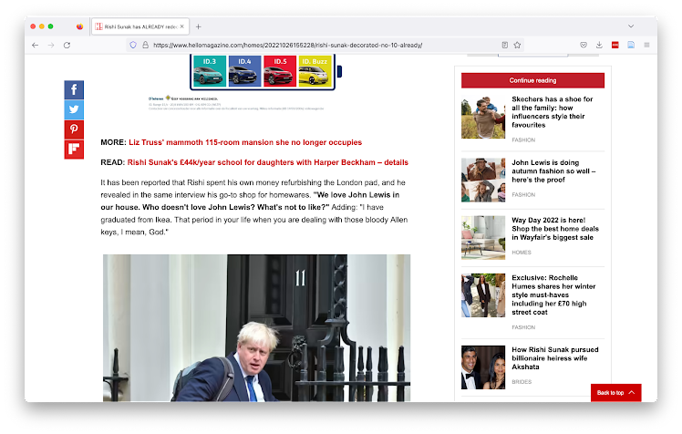
Different tasks at different places => different recommenders
Notes:
We’re going to look at a number of recommendation use cases together, and then try to figure out which of the techniques I talked about you would use
Try first to think in terms of user needs: What does a user expect?
Then try to translate that to concepts you’ve learned here today.

Slide 11
Continue Reading

Slide 12
Articles most related to what you are reading now
Content-based, based on tags or article text
or
Collaborative filtering + Business Rules that restrict to the same category
Continue Reading

Slide 13
Recommended for You

Slide 14
General Interest News
Popularity
Top-3/5/10 Interests of the User
Collaborative filtering + Business logic that enforces that article recommendations have different topics
Recommended for You - Homepage

Slide 15
Push Notification

Slide 16
Breaking News
Content-based (because cold start)
Or, editorial picks (handcrafted)
Push Notification

Slide 17
Newsletter

Slide 18
Hidden Gems/Niche Interests
Hybrid (content + collaborative)
Discount popularity
Editor’s Pick
Recommendation from a
very narrow selection of articles
Newsletter

Slide 19
Why use a News RecSys?

Slide 20
Opportunities
Competition with social media & aggregators
Who also personalize
Longer engagement on the site
Sells more advertisements
May convert users to paid subscribers
Increased engagement with hidden gems
There is only so much space on a page, and so many articles

Slide 21
Challenges in News Recommendation

Slide 22
Technical Challenges in News Recommendation
Frequent Catalog Updates
New articles are published all the time
Interest Decay
Interest in an article decays quickly

Slide 23
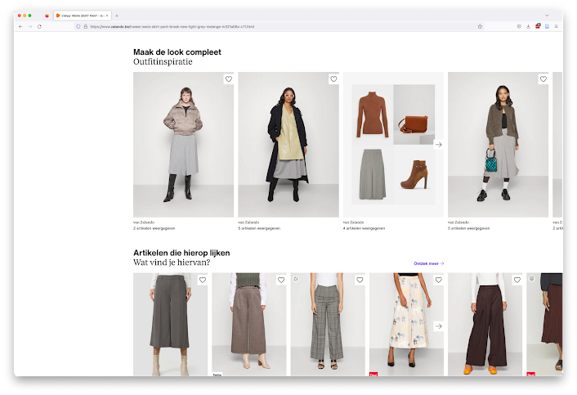
Model Training Services
Tracking API
User Interaction Data Store
Item Data Store
Recommendations API
Recommendation Server
Recommendation Models
How are recommendations made?

Slide 24
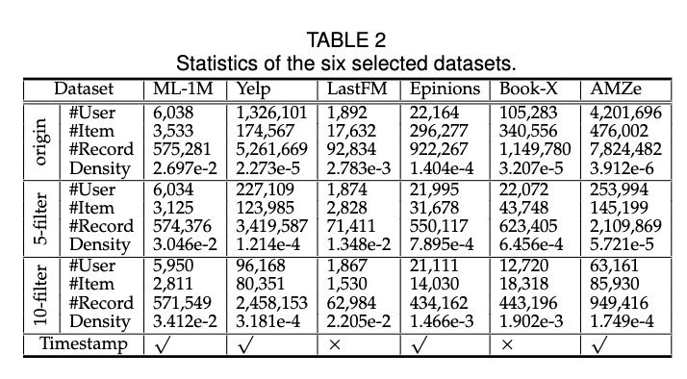
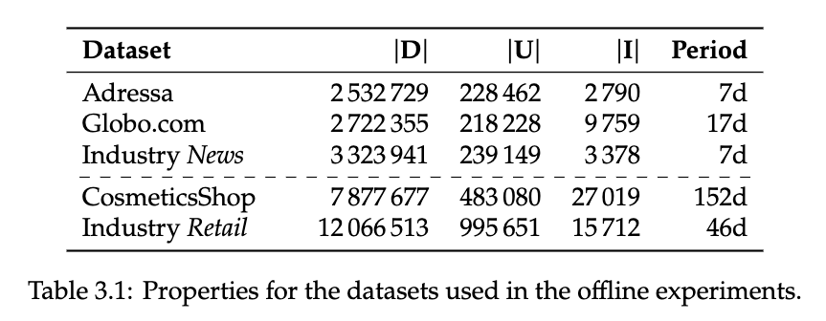
Data streem speed

Slide 25
Model Training Service

Slide 26
Model Training Services
Tracking API
User Interaction Data Store
Item Data Store
Recommendations API
Recommendation Server
Recommendation Models
Models are retrained “periodically”

Slide 27
Model Training Services
Tracking API
User Interaction Data Store
Item Data Store
So how often is “periodically”?
Recommendations API
Recommendation Server
Recommendation Models
Models are retrained “periodically”

Slide 28
Model Training Services
Tracking API
User Interaction Data Store
Item Data Store
So how often is “periodically”?… it depends 🙃
Recommendations API
Recommendation Server
Recommendation Models
Models are retrained “periodically”

Slide 29
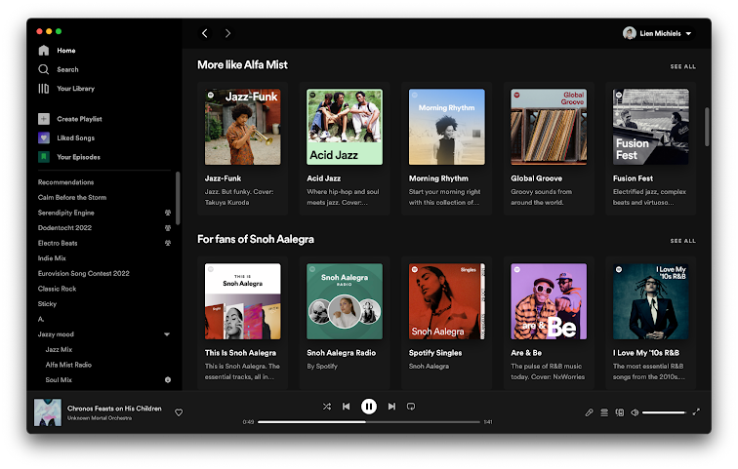
How often does your choice of music change?

Slide 30
How often does your choice of music change?
… it doesn’t
Notes:
Although I do tend to get a bit more melancholy in winter

Slide 31
How often does your choice of music change?… unless your favorite artist releases a new album 😍
Notes:
Although I do tend to get a bit more melancholy in winter

Slide 32
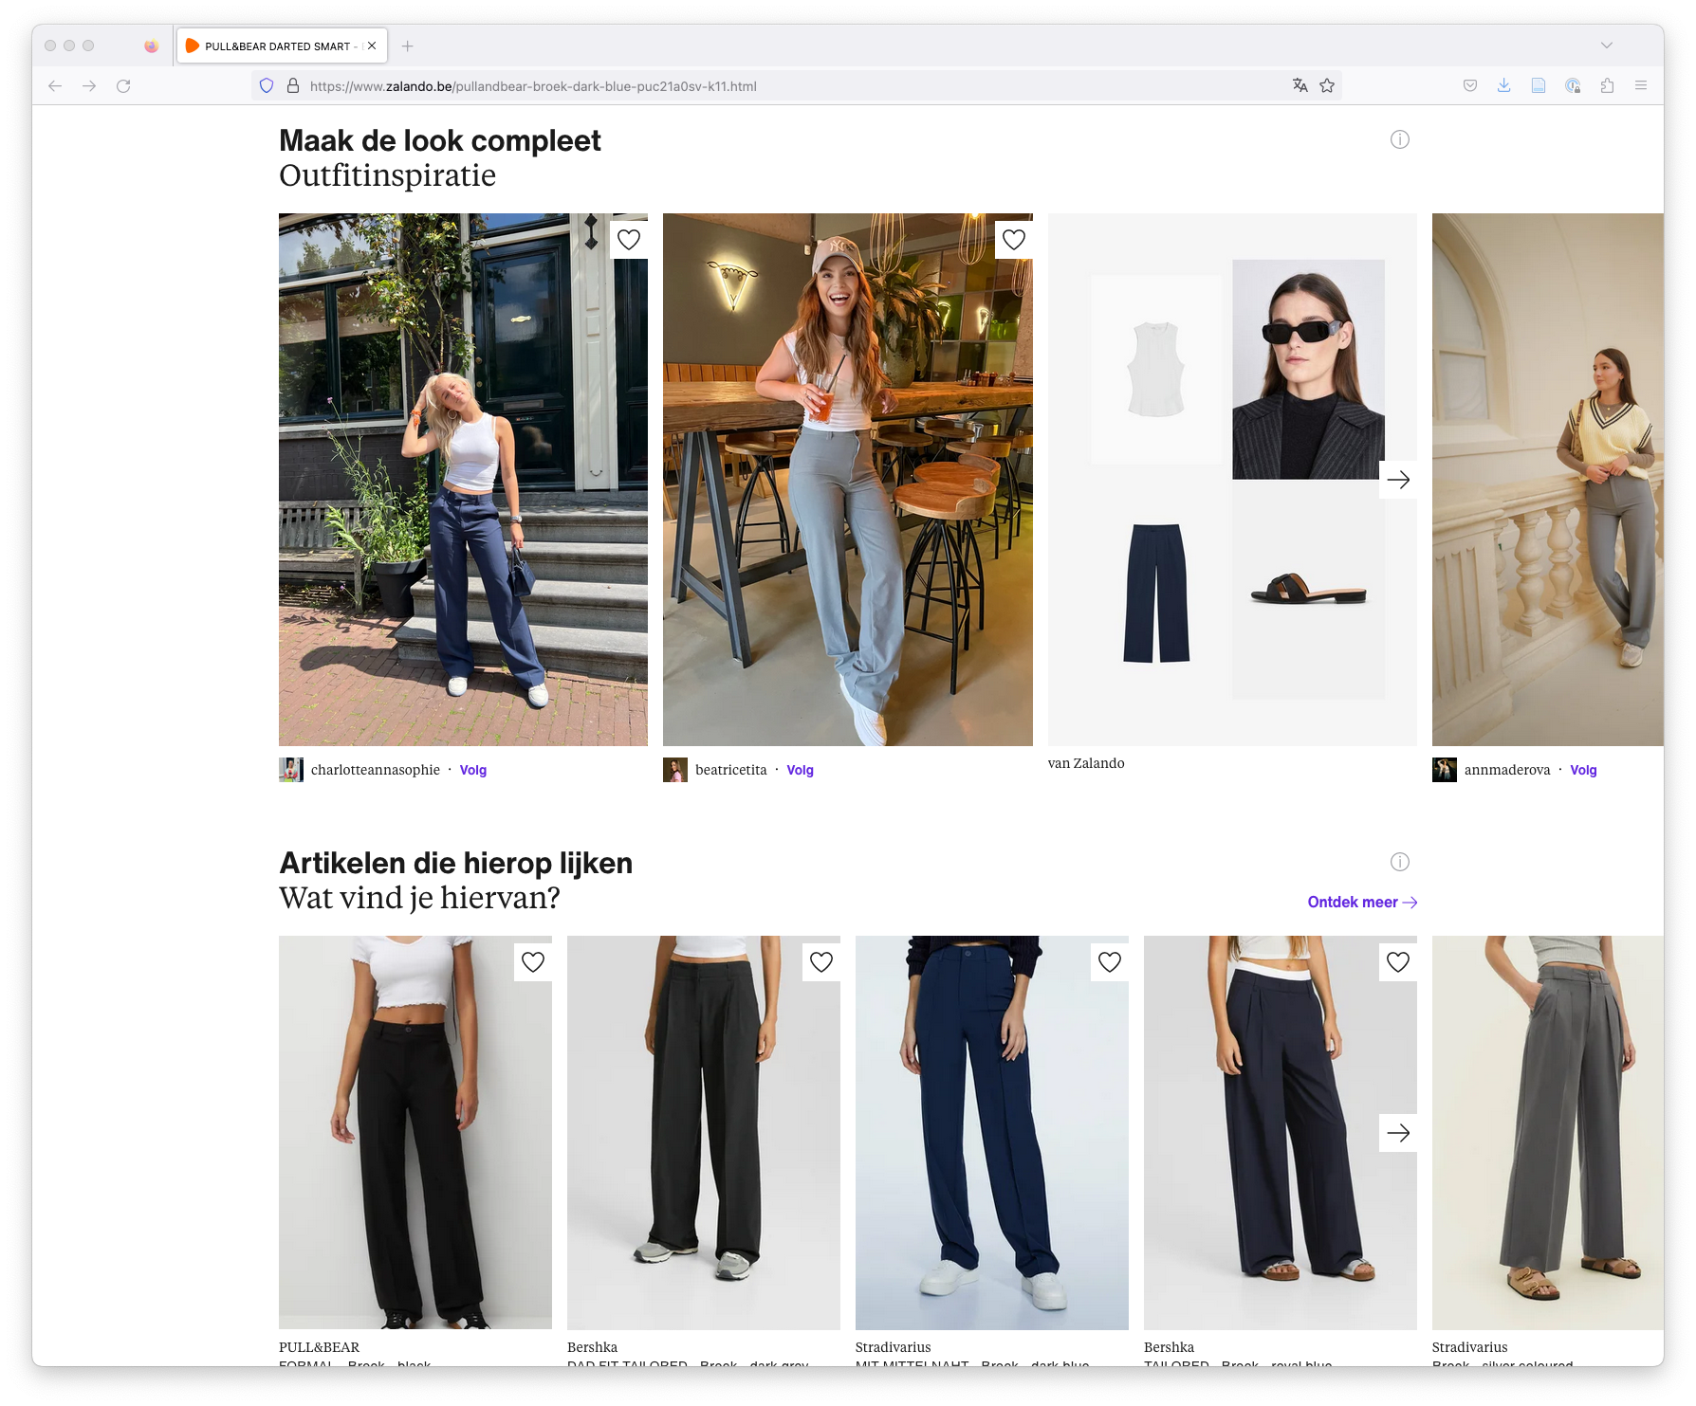
How often does your choice of clothes change?

Slide 33
How often does your choice of clothes change?
… depends how trendy you are 🙃

Slide 34
How often does your choice of clothes change?
… but at least every season🌷☀🍂❄
Notes:
It’s very important to train

Slide 35
Model Training Services
Tracking API
User Interaction Data Store
Item Data Store
The frequency of model updates depends on how frequently behavior or the catalog shifts.
Recommendations API
Recommendation Server
Recommendation Models
Models are retrained “periodically”

Slide 36
In news, articles typically live for only 48h 😨
Reading behavior shifts hourly 😱

Slide 37
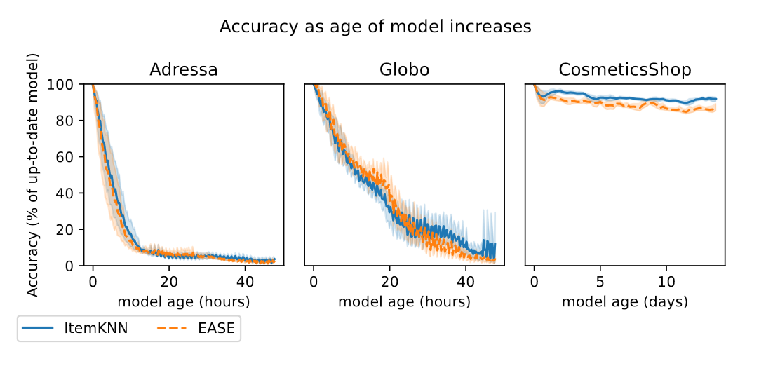
From “Scheduling on a Budget: Avoiding Stale Recommendations with Timely Updates” by Verachtert et al., 2022

Slide 38
Model is stale
From “Scheduling on a Budget: Avoiding Stale Recommendations with Timely Updates” by Verachtert et al., 2022

Slide 39
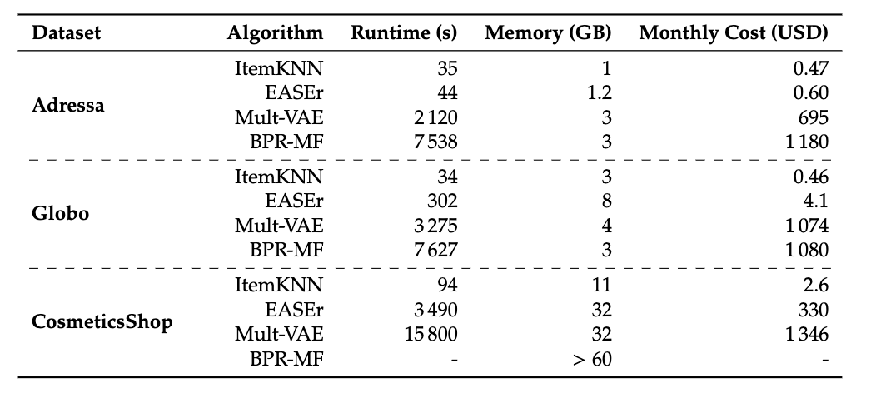
From “Scheduling on a Budget: Avoiding Stale Recommendations with Timely Updates” by Verachtert et al., 2022

Slide 40
💡Training a model takes time 😥💡
… therefore all* models are out of date 🙃
*Except truly incremental models, but as far as I know, these are not in use due to other issues we will get into later.
From “Scheduling on a Budget: Avoiding Stale Recommendations with Timely Updates” by Verachtert et al., 2022

Slide 41
≈2 hours
≈2 hours
From “Scheduling on a Budget: Avoiding Stale Recommendations with Timely Updates” by Verachtert et al., 2022

Slide 42
What happens if we use these models for a news RecSys?
From “Scheduling on a Budget: Avoiding Stale Recommendations with Timely Updates” by Verachtert et al., 2022

Slide 43
What happens if we use these models for a news RecSys? 🤔
From “Scheduling on a Budget: Avoiding Stale Recommendations with Timely Updates” by Verachtert et al., 2022

Slide 44
Unless…
We can cut down the time by using less training data
From “Scheduling on a Budget: Avoiding Stale Recommendations with Timely Updates” by Verachtert et al., 2022

Slide 45
Model Training Services
Tracking API
User Interaction Data Store
Item Data Store
… So how much data should we use to train models?
Recommendations API
Recommendation Server
Recommendation Models
Models are retrained “periodically”

Slide 46
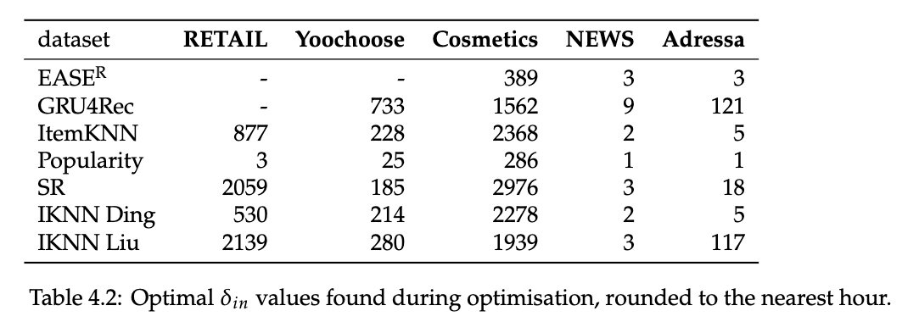
From “Are We Forgetting Something? Correctly Evaluate a Recommender System With an Optimal Training Window” by Verachtert et al., 2022

Slide 47
💡The optimal amount of training data depends on the domain💡
From “Are We Forgetting Something? Correctly Evaluate a Recommender System With an Optimal Training Window” by Verachtert et al., 2022

Slide 48
From “Are We Forgetting Something? Correctly Evaluate a Recommender System With an Optimal Training Window” by Verachtert et al., 2022

Slide 49
💡The optimal amount of training data also depends on the algorithm💡
From “Are We Forgetting Something? Correctly Evaluate a Recommender System With an Optimal Training Window” by Verachtert et al., 2022

Slide 50
🏆
🏆
From “Are We Forgetting Something? Correctly Evaluate a Recommender System With an Optimal Training Window” by Verachtert et al., 2022

Slide 51
💡If you use the optimal amount of training data, simpler algorithms suddenly win 🏆💡
🏆
🏆
From “Are We Forgetting Something? Correctly Evaluate a Recommender System With an Optimal Training Window” by Verachtert et al., 2022

Slide 52
From “Scheduling on a Budget: Avoiding Stale Recommendations with Timely Updates” by Verachtert et al., 2022

Slide 53
💡Training a model costs 💰💡
From “Scheduling on a Budget: Avoiding Stale Recommendations with Timely Updates” by Verachtert et al., 2022

Slide 54
💡More complex models cost more 💰💰💰💡
From “Scheduling on a Budget: Avoiding Stale Recommendations with Timely Updates” by Verachtert et al., 2022

Slide 55
… so are they worth it?
From “Scheduling on a Budget: Avoiding Stale Recommendations with Timely Updates” by Verachtert et al., 2022

Slide 56
… so are they worth it?
Usually not…
unless you are Spotify/Netflix
From “Scheduling on a Budget: Avoiding Stale Recommendations with Timely Updates” by Verachtert et al., 2022

Slide 57
💡When and how often a model should be trained is an important design decision💡
💡… and cost should not be ignored💡

Slide 58
Policy Challenges in News Recommendation
Filter Bubbles/Diversity
News publishers have a mission/responsibility to inform readers by providing news that is diverse

Slide 59
Filter bubbles by Lien:
A technological filter bubble is a decrease in the diversity of a user’s recommendations over time, in any dimension of diversity, resulting from the choices made by different recommendation stakeholders.

Slide 60
HOW SHOULD WE MEASURE FILTER BUBBLES IN ONLINE NEWS?
Currently under submission.
Notes:
Bubbly people
FairUMAP

Slide 61
WHY SHOULD WE MEASURE FILTER BUBBLES IN ONLINE NEWS?
Notes:
Bubbly people
FairUMAP

Slide 62
EDITORS
POLICY-MAKERS
USERS
are concerned that filter bubbles will take away their brand DNA
worry that filter bubbles would harm the democratic process
want to be exposed to diverse news

Slide 63
How CAN We Measure Filter Bubbles?
Simulated Users
Real Users
Simulation Study
Controlled User Study
Simulated Env.
MORE REALISTIC
Audit Study
Field Experiment
Real Env.
Observational Study
MORE REALISTIC

Slide 64
WHAT SHOULD WE MEASURE as FILTER BUBBLES IN ONLINE NEWS?
Notes:
Bubbly people
FairUMAP

Slide 65
WHAT SHOULD WE MEASURE as FILTER BUBBLES IN ONLINE NEWS?
Notes:
Bubbly people
FairUMAP

Slide 66
WHAT SHOULD WE MEASURE as FILTER BUBBLES IN ONLINE NEWS?
Notes:
Bubbly people
FairUMAP

Slide 67
WHAT SHOULD WE MEASURE as FILTER BUBBLES IN ONLINE NEWS?
Notes:
Bubbly people
FairUMAP

Slide 68
WHAT SHOULD WE MEASURE as FILTER BUBBLES IN ONLINE NEWS?
Notes:
Bubbly people
FairUMAP

Slide 69
WHAT SHOULD WE MEASURE as FILTER BUBBLES IN ONLINE NEWS?
Notes:
Bubbly people
FairUMAP

Slide 70
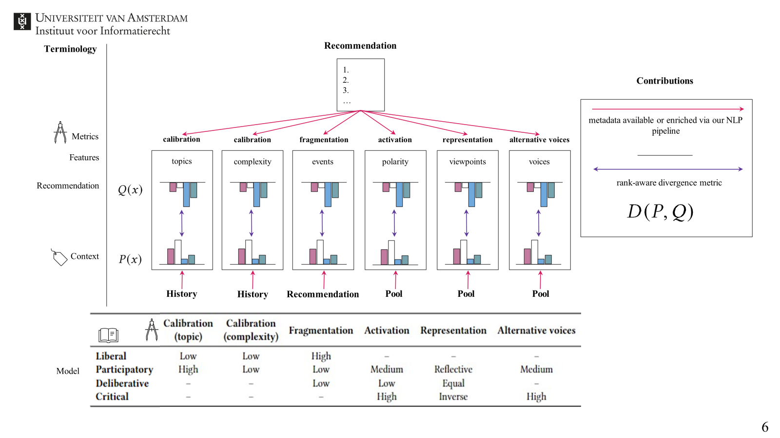
WHAT SHOULD WE MEASURE as FILTER BUBBLES IN ONLINE NEWS?
Notes:
Bubbly people
FairUMAP

Slide 71
WHAT SHOULD WE MEASURE as FILTER BUBBLES IN ONLINE NEWS?
Notes:
Bubbly people
FairUMAP

Slide 72
Editorial Challenges in News Recommendation
Brand DNA
Editors provide value by curating relevant news
Long-Term User Engagement (Subscriptions)
What we want is for users to buy subscriptions, but how do recommendations contribute to that?

Slide 73
User Challenges in News Recommendation
Niche/Hyperlocal Content
E.g. opera, stock market, regional sports matches
Choice Overwhelm

Slide 74
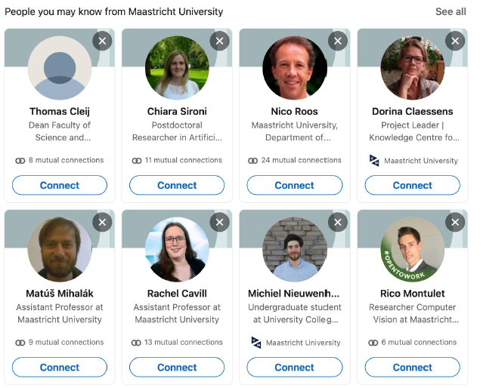
People Recommender Systems
Slides partially based on Maastricht RecSys course by Nava Tintarev and Francesco Barile
https://ksi.mff.cuni.cz

Slide 85
Can lead to FoFoF (friend of a friend of a frined) type recommendations, considering the weak ties (B->A->C)

Slide 87
Recommend courses/mentors to follow…
… or recommend people to team up with

Slide 88
Recommend courses/mentors to follow…
… or recommend people to team up with
Socio-demographic links performed the best

Slide 90
People Recommender Systems: Online Dating
Slides partially based on Maastricht RecSys course by Nava Tintarev and Francesco Barile
https://ksi.mff.cuni.cz

Slide 91
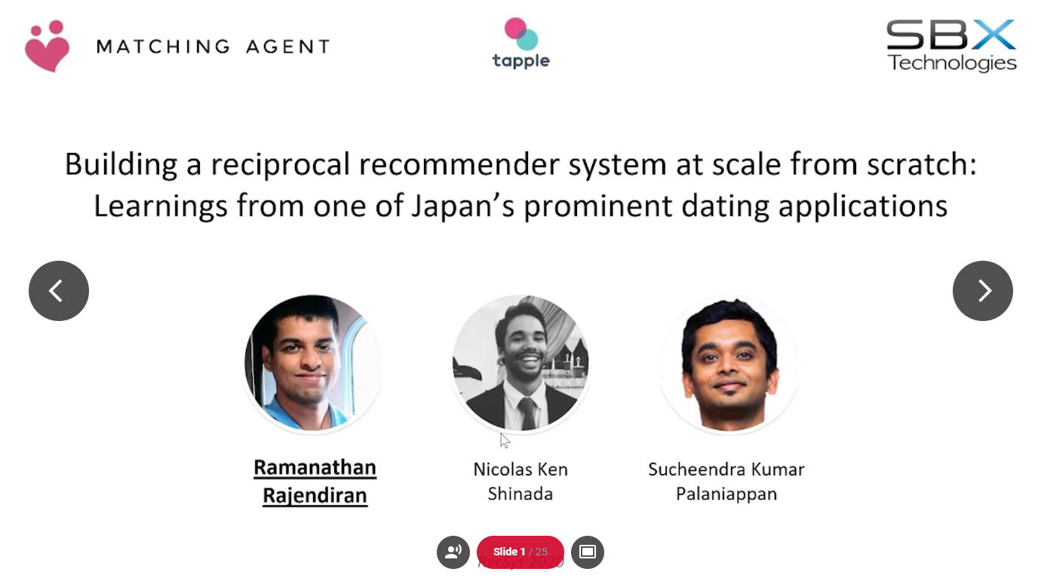
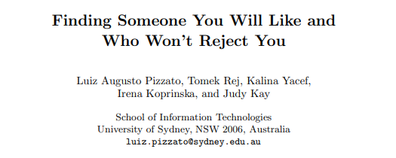
Reciprocal RS in Online Dating

Slide 92
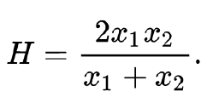
Finding Someone You Will Like and Who Won’t Reject You (UMAP 2011)
Modeling both Likes and Dislikes
Costly „bad“ recommendations – i.e., initiate contact but rejected
Likes: send invitation / response positively
Attribute-oriented CB recommender (it was over a decade ago:-/)
Checking compatibility of „liked“ attributes C_pos(A,B)
Harmonic mean for C_pos(A,B) and C_pos(B,A)
Penalizes high differences in compatibilities
Dislikes: ignoring invite
Otherwise, same approach
Unified model: C(A,B) = (1 + C_pos(A,B) – C_neg(A,B))/2
Finding Someone You Will Like and Who Won’t Reject You, UMAP 2011

Slide 93
Other insights (2016)
Large disballance
Possible CB links to exploit
Design of Reciprocal Recommendation Systems for Online Dating: https://web.cs.ucla.edu/~yzsun/papers/snam2016.pdf

Slide 99
Notes:
Recently active users re-ranking!

Slide 100
Notes:
De-popularization
Recently active users
Recently registered users

Slide 101
Notes:
New users: pseudo embeddings based on similar metadata of other users
Metadata: e.g., location

Slide 102
Notes:
Pre-compute recommendations for faster query-time responses

Slide 103
Notes:
Different treatment of existing (key-value pair storage of precomputed recs) vs. Cold-start users (running inference server)

Slide 107
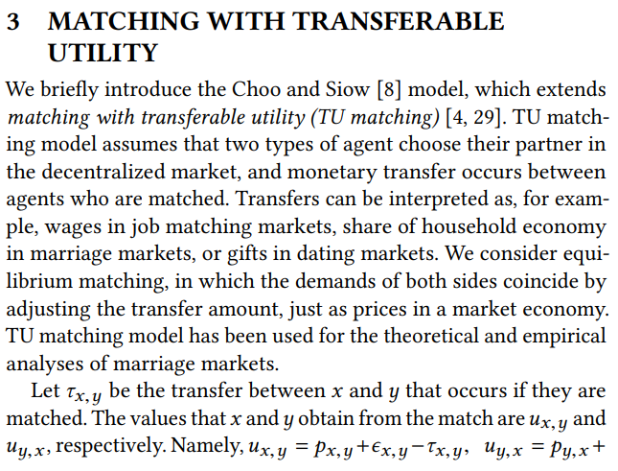
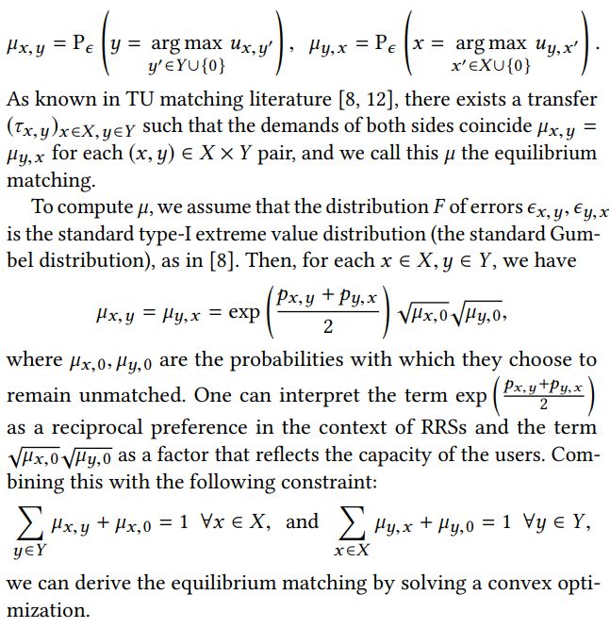
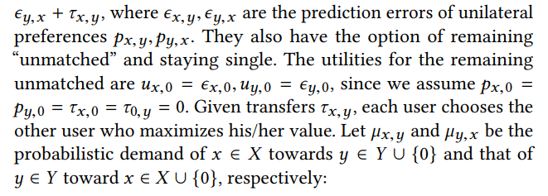
Notes:
TU: sort of a cost one have to pay to receive a match…
Aiming to maximize overal utility of the system
Work on top of probabilistic distributions – I assume hten there is time for sampling
Jointly consider reciprocal preference and the capacity of users

Slide 108
People Recommender Systems: Job Recommender Systems
Slides partially based on Maastricht RecSys course by Nava Tintarev and Francesco Barile
https://ksi.mff.cuni.cz

Slide 109
Job Recommender Systems (RecSys in HR)
RecSys Workshop at 2021 – 24
Overall, challenging topic
Reciprocal RS, but with different stakeholders
Recruiters
Job seekers
Main sources of knowledge
Interactional data (the usual)
CV (content-representation of „users“)
Job description (content-representation of „items“)
Dual task (whom do we recommend to?)
Location importance

Slide 111
Effectiveness of job title based embeddings (2021)
Recommend candidates to jobs
Latent model (users = job postings, items = job seekers), several variants
Represent items as an embedding of ther CV, User as embed of their description
Represent items through historical interaction with users (average embeddings)
Represent users through historical interaction with items (average embeddings)
Embeddings:
Pre-trained Word2Vec
Self-trained Word2Vec
Self-trained Doc2Vec
Data:
Job title only
Job appetizer / resume texts

Slide 112
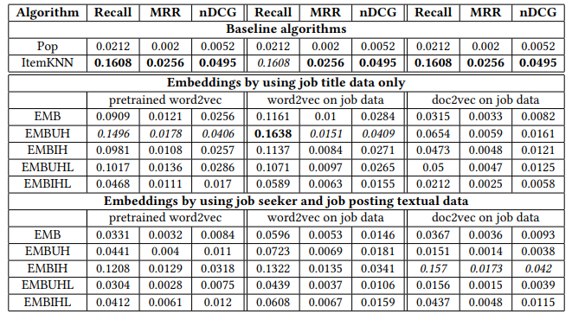
Effectiveness of job title based embeddings (2021)
Results:
If enough interactional data, ItemKNN outperforms all embeddings :-/
But not in cold-start
Job title-based embeds outperformed whole resume-based ones.
Mismatch in writing style?
Self-trained improved over pre-trained

Slide 113
Follow-up: An Exploration of Sentence-Pair Classification for Algorithmic Recruiting (2023)
Maybe, 2vec models are not versatile enough
Different „language style“ of resume and job postings (semantic gap)
What if we use a good language model to learn the properties of this semantic gap?
Use next-sentence-prediction feature of BERT and tune it to map resumes from job postings

Slide 114
An Exploration of Sentence-Pair Classification for Algorithmic Recruiting (2023)
Approaches classification:

Slide 115
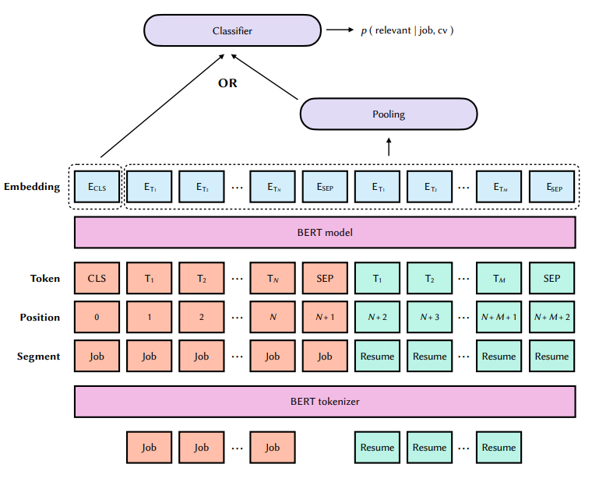
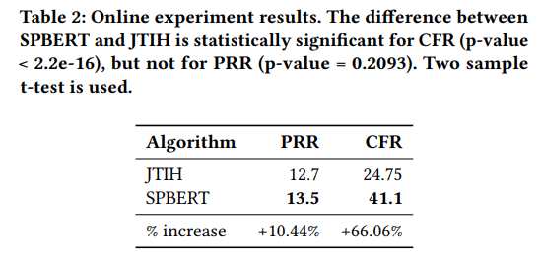
An Exploration of Sentence-Pair Classification for Algorithmic Recruiting (2023)
SPBERT

Slide 117
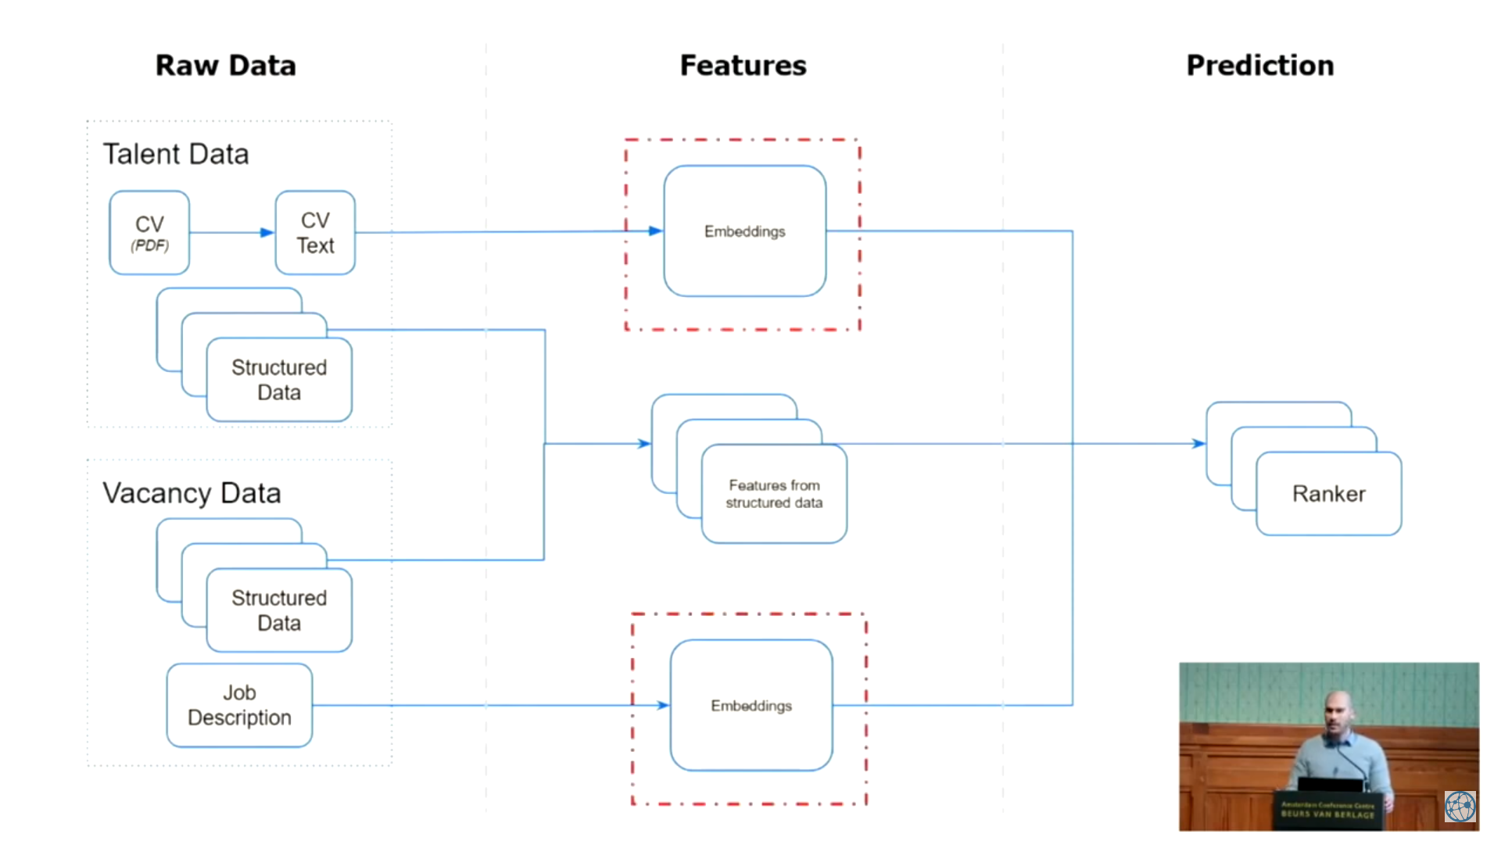

Slide 118
Notes:
CV is noisy, but job description is more consistent
English CV but Dutch job descriptions
Positive signal: any kind of interaction from recruiter to person
Negative: absence of thereof

Slide 119
Notes:
TF-IDF: even larger dimensions did not help
Supervised: feed to random forest

Slide 120
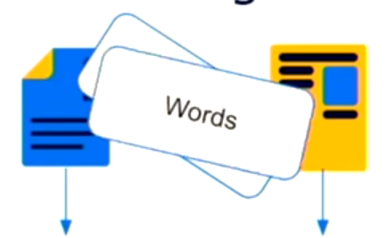
Notes:
Siamese network => pooling layer => cosine similarity

Slide 122
Notes:
Unsupervised distributions basically did not learn anything
Having softmax hurt the performance, but can be remedied by adding random forest

Slide 123
Notes:
Finetuning also help to distinguish different language for descriptions… maybe language agnostic networks next?

Slide 124
Career Path Prediction using Resume Representation Learning and Skill-based Matching (2023)
Provide people with the next career steps at the right time
Career path prediction task:
given a career history: sequence of experiences (𝑒𝑥1 , 𝑒𝑥2 , … , 𝑒𝑥𝑁 −1) each having a title, description and their ESCO occupation labels (𝑜𝑐𝑐1 , 𝑜𝑐𝑐2 , … , 𝑜𝑐𝑐𝑁 −1),
predict the ESCO occupation label 𝑜𝑐𝑐𝑁 of the held-out next experience.
European Skills, Competences, Qualifications and Occupations (ESCO) ontology
Not focus on specific job, but rather a generic job class
Internal job mobility
Research obstacles due to data privacy

Slide 125
Career Path Prediction using Resume Representation Learning and Skill-based Matching (2023)

Slide 126
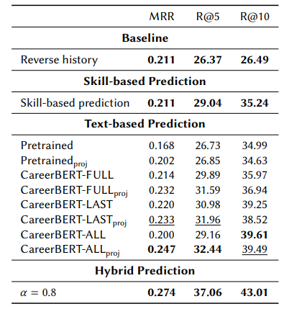
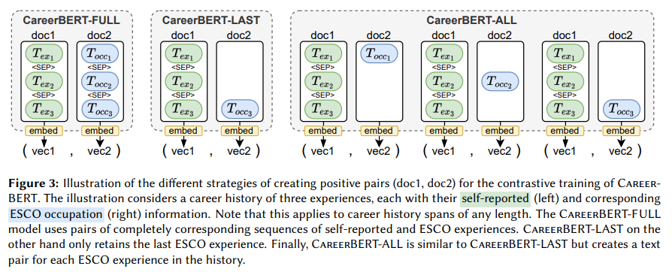
Career Path Prediction using Resume Representation Learning and Skill-based Matching (2023)
Approach:
Skill-based prediction (part of ESCO ontology)
Description-based prediction (embedding + mapping)
Notes:
Contrastive learning
Then, linear transformation between embeddings of previous experience and current job posting

Slide 127
Music RecSys
https://ksi.mff.cuni.cz

Slide 128
RecSys in Music
Additional topics:
How Age Influences Musical Preferences
Local effects, microgenres
Negative feedback difficulty
Fairness of performance w.r.t. popularity (Popularity Degradation Bias)
Fairness, biases & multi-stakeholders in general

Slide 129
Playlist Continuation Problem
https://ksi.mff.cuni.cz

Slide 130
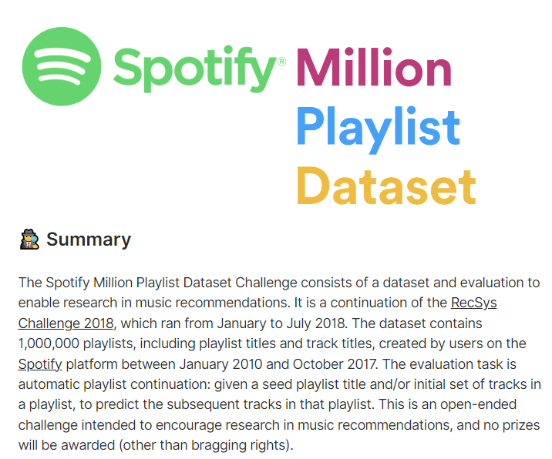
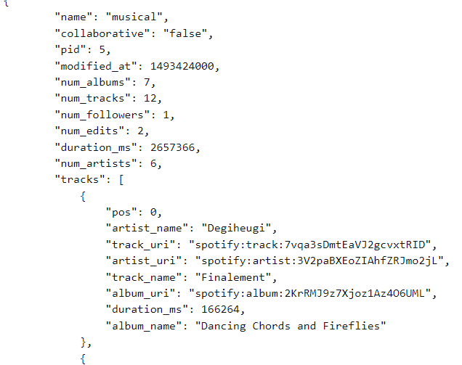
Playlist continuation
2018 RecSys Challenge by Spotify
Re-issued 2020 as an ongoing challenge
Data: Spotify’s Million Playlist Dataset
Title
Subset of songs in the playlist
Various sparsity magnitude
Recall at track and artists level
https://www.aicrowd.com/challenges/spotify-million-playlist-dataset-challenge

Slide 131
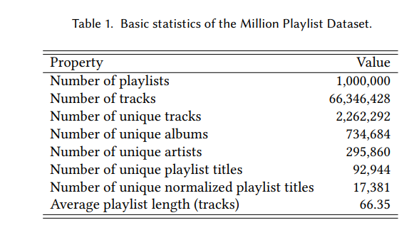
Playlist continuation
2018 RecSys Challenge by Spotify
Re-issued 2020 as an ongoing challenge
Data: Spotify’s Million Playlist Dataset
Title
Subset of songs in the playlist
Various sparsity magnitude
Recall at track and artists level
https://www.aicrowd.com/challenges/spotify-million-playlist-dataset-challenge

Slide 132
Playlist continuation
What would you use?
https://www.aicrowd.com/challenges/spotify-million-playlist-dataset-challenge

Slide 133
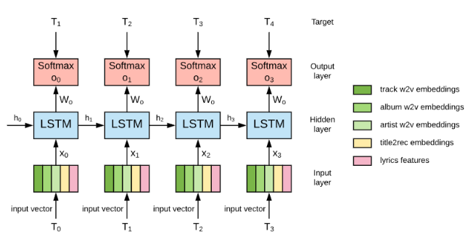
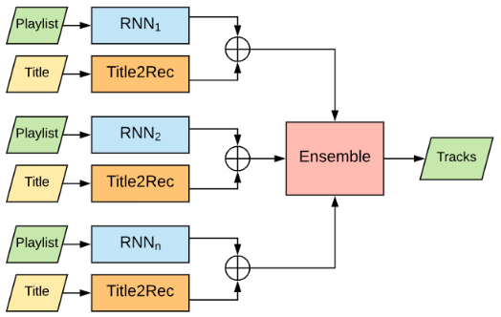
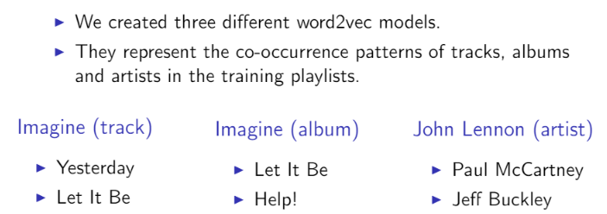
Playlist continuation
Typical solutions: neural networks, mostly RNN

Slide 134
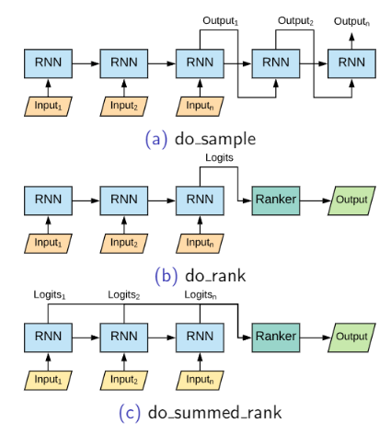
Playlist continuation
Typical solutions: neural networks, mostly RNN
We evaluated in a controlled setting all the strategies for generating the recommended tracks described in Section 3.3. We observed that, independently from other hyper-parameters, the technique called do_summed_rank systematically achieved better results than the other ones in all the metrics considered.

Slide 135
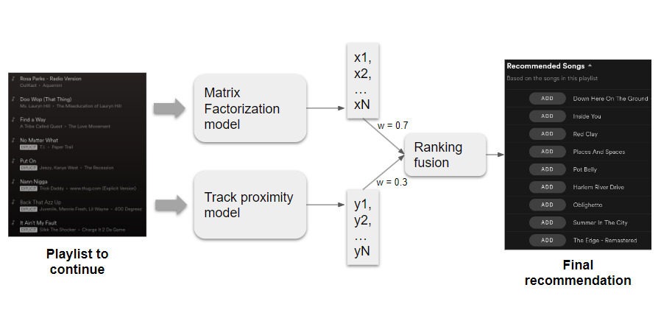
Playlist continuation
Automatic playlist continuation using a hybrid recommender system combining features from text and audio
Typical solutions: matrix factorization

Slide 136
Playlist continuation
Automatic playlist continuation using a hybrid recommender system combining features from text and audio
High-level semantic features
Genre classifcation
- normalized titles (one-hot encoded)

Slide 137
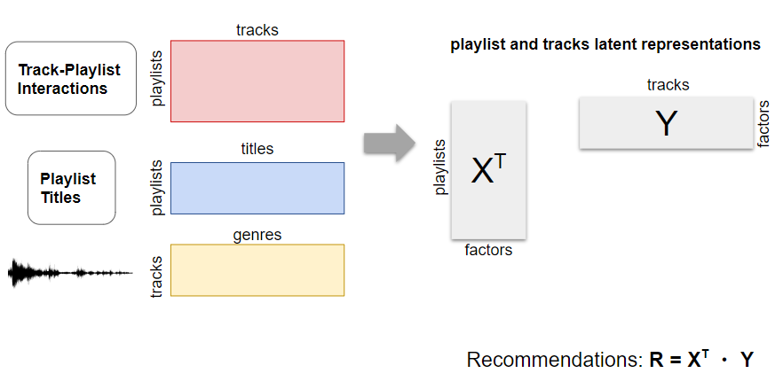
Playlist continuation
Automatic playlist continuation using a hybrid recommender system combining features from text and audio

Slide 138
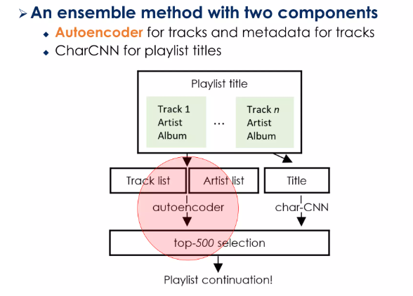
Playlist continuation
Typical solutions: autoencoders
Utilize metadata as additional one-hot-encoded values
Dropout & hide whole input categories

Slide 139
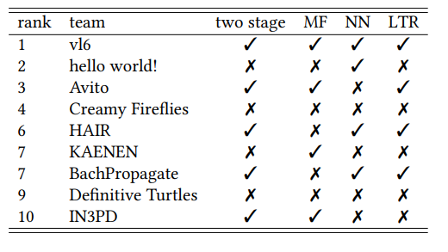
Playlist continuation
Results
Pipelined processing
Ensemble models
Matrix factorization over RNN
Autoencoders plausible
Some solutions with KNN as well
(Personalized) popularity works
Only minor effect of CB features overall

Slide 140
Exploration + Explanations
https://ksi.mff.cuni.cz

Slide 141
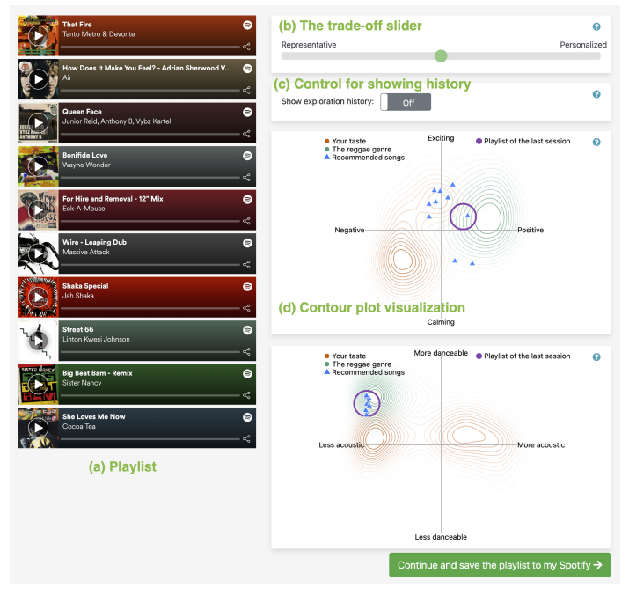
Music exploration

Slide 142
Music exploration: SpotifyGraph

Slide 143
Music exploration: SpotifyExplained

Slide 144
E-Commerce: Fashion
https://ksi.mff.cuni.cz

Slide 145
RecSys Challenge 2022: Dressipi
Not so interesting data to work with (e.g., no images)
Multi-stage approaches + Ensemble of multiple methods
Simple retrieval (ItemKNN, SKNN, 2vec, popularity, transformers4rec,…)

Slide 146
FashionXRecSys workshop 2018-23
Size recommendation
Automated meta-data extraction (virtual try-ons)
Detect visual incompatibility (inverse outfits?)
Automation of visualizations

Slide 147
FashionXRecSys workshop 2018-23
Enabling Hyper Personalisation: Automated Ad Creative Generation and Ranking for Fashion E-Commerce

Slide 148
Outfit Recommendation Problem
Several slightly different definitions of the problem
Given the set of items, are they a good outfit?
Is the pair of items compatible?
Having several items in an outfit, how to complete it with another clothing type?
Having a pre-owned wardrobe, how to combine stuff I already have?
However, they all lead to the same/similar solutions…

Slide 149
Outfit Recommendation
Polyvore dataset of outfits
20K outfits (train-test-validation splits)
Several pre-defined tasks (fill-in the blank)

Slide 150
Outfit Recommendation: Wardrobe
1. Model Training
Use the outfit descriptions to extract only the images that match articles of clothing in our definition of an "outfit."
Optional: Train an autoencoder model for each type of clothing
Predict embeddings for each input image.
Train a multi-input CNN to predict the likes for each outfit.
2. Outfit Recommendation
Input end user wardrobe and predict the embedding for each image.
Generate „all“ possible combinations of outfits
Score each possible outfit using the CNN.
Create „three“ clusters of outfits based on the embeddings
Return the outfits with the top score per cluster
https://blog.dataiku.com/outfit-recommendation-system

Slide 151
Outfit Recommendation: Wardrobe
Tops, Bottoms, and Shoes: Building Capsule Wardrobes via Cross-Attention Tensor Network
- Local and global compatibility
http://yusanlin.com/files/papers/recsys21_tensornet.pdf

Slide 152
Outfit Recommendation: Transitivity
Complementary-Similarity Learning using Quadruplet Network
https://research.zalando.com/fashionxrecsys/workshop-files/presentations/session3-paper2.pdf

