Slide 1


NDBI021, Lecture 10
User preferences, 2/1 ZK+Z,
https://www.ksi.mff.cuni.cz/~peska/vyuka/ndbi021
https://ksi.mff.cuni.cz

Slide 2
Lecture 10 Dynamic RS, Domain-specific
Dynamic Recomender Systems
Domain specific RS
  Intro, challenges in several domains
  News RS
https://ksi.mff.cuni.cz

Slide 3
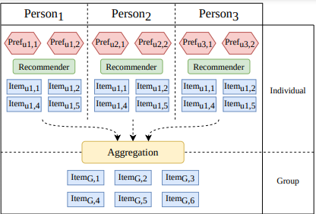
Recap
What are group recommender systems?
Can you recall at least 2 item-wise
aggregation strategies?
https://ksi.mff.cuni.cz

Slide 4
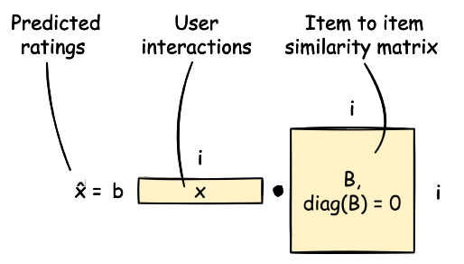
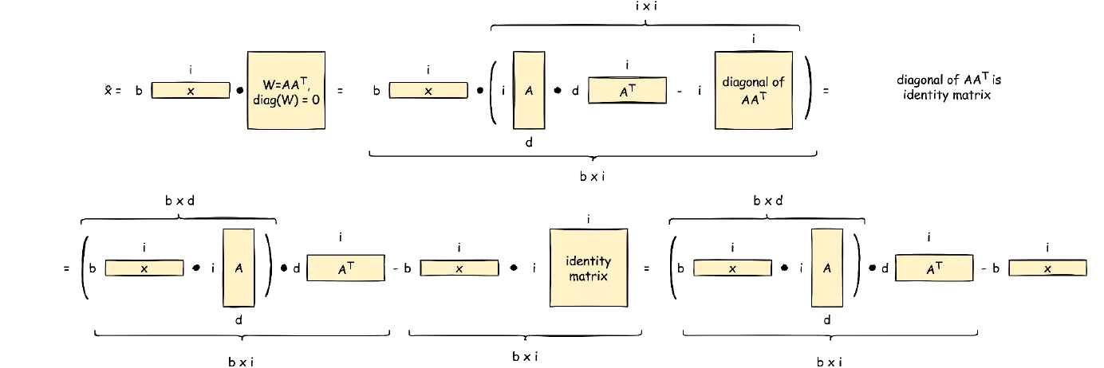
Recap
What is EASE, what is its main limitation?
How does ELSA resolve the EASE limitation?
https://ksi.mff.cuni.cz

Slide 5
Semestral work
Any questions / comments / unclear points?

Slide 6
Dynamic RS
https://ksi.mff.cuni.cz

Slide 7
Dynamic RS
Many RS algorithms consider a static setting of a RS
  Static set of train data
  Static set of items and users
  Static set of „queries“ that need to be answered (a.k.a. test set)
  Static preferences of users
In reality, all this is dynamic and changes over time
  Thought experiment: what could go wrong with a matrix factorization?

Slide 8
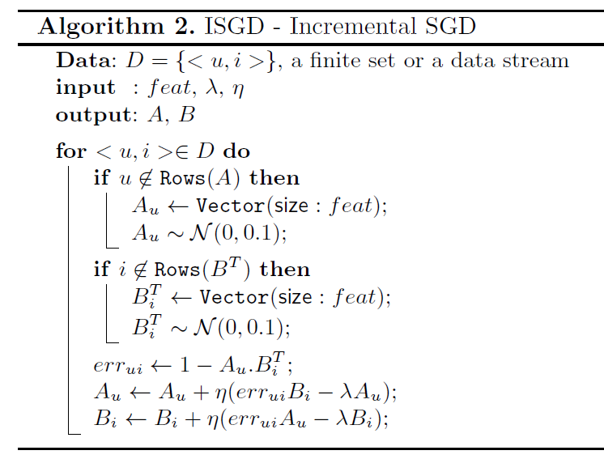
Dynamic RS: partial training for matrix factorizations
Partial SGD-like updates when new data arrives
  Can run more than just one iteration
  Can re-play some of older data as well to increase accuracy
  Most probably you need higher learning rates
How to properly evaluate this?
How often would normally be the other model re-trained?
João Vinagre, Alípio Mário Jorge & João Gama: Fast Incremental Matrix Factorization for Recommendation with Positive-Only Feedback

Slide 9
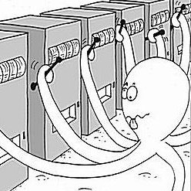
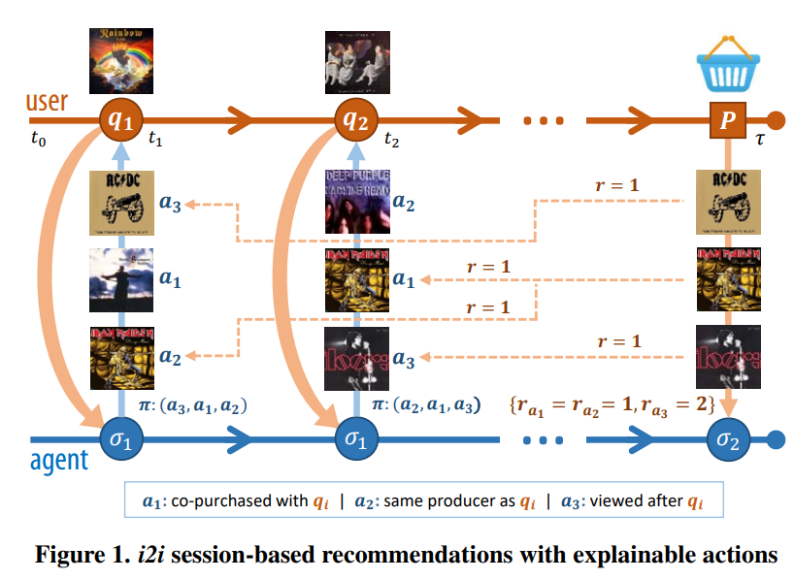
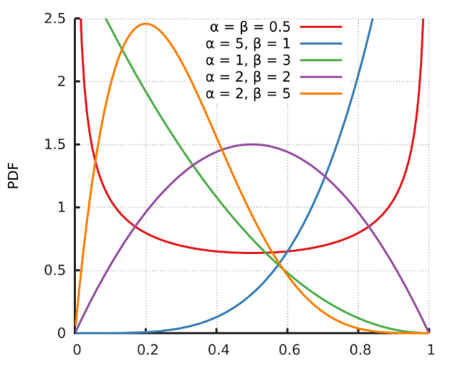
Dynamic RS: multi-armed bandits: TS
Use MAB to select which Recommender performs the best
  Each Recommender starts with the same probability of being selected
  This is dynamically being adjusted as we gain more rewards
    Thompson Sampling
    Beta distribution w.r.t. #successes, #missess
  Rewards attribution problem with delayed rewards
  Non-stationary behavior of arms -> partitioning into sub-components
    Simple recommenders based e.g. on edges in user-item-attribute graphs
    IDF for attribute-like links (assume same performance for similarly popular items)
Broden et al.: Ensemble Recommendations via Thompson Sampling: an Experimental Study within e-Commerce

Slide 10
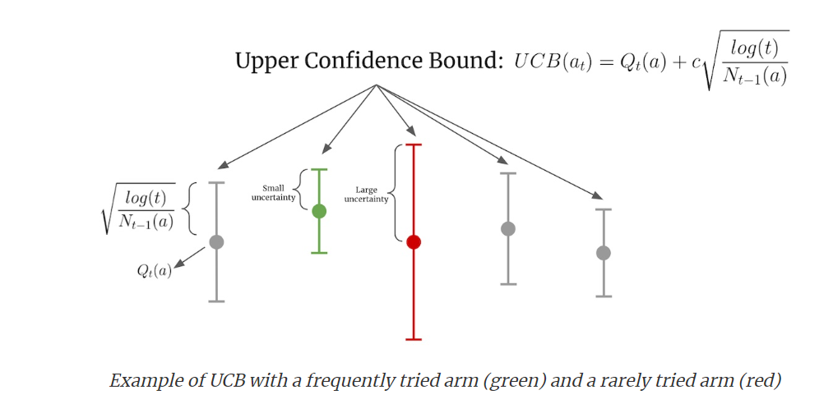
Dynamic RS: multi-armed bandits: other strategies
Epsilon-greedy
  Select current best with epsilon prob. Select at random with 1-epsilon prob.
Upper Confidence Bound (UCB)
  Confidence given by the volume of trials (N_t)
  Slight decrease over time (log(t))
  Hyperparameter c
What about non-stationarity?
https://eugeneyan.com/writing/bandits/

Slide 11
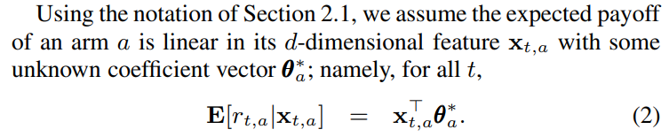
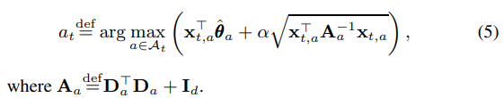

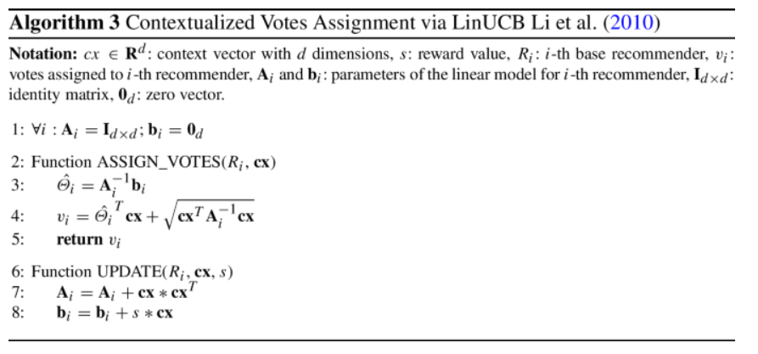
Dynamic RS: LinearUCB
LinearUCB: reward estimates depend on some parameters (a.k.a. state)
  E.g., current context of the user
  If the state is represented with nominal values => sub-component strategy from Broden
  What if we need to incorporate numerical (unbound) values?
    Assume linear impact of the state on rewards + independence of individual state dimensions
  We used it in https://link.springer.com/article/10.1007/s11257-021-09311-w in
  slightly altered way to assign votes for a variant of mandates allocation strategy.
What about more complex relationships?
Li et al. A contextual-bandit approach to personalized news article recommendation

Slide 12
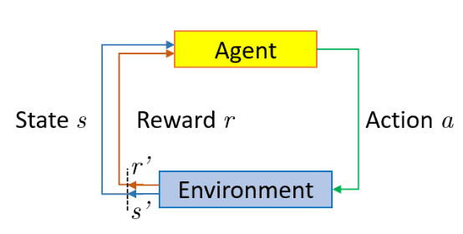

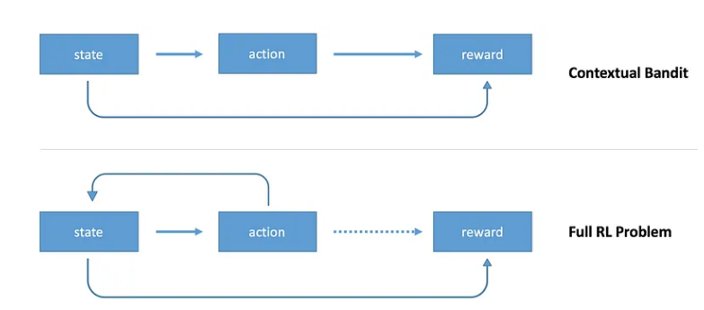
Dynamic RS: Reinforcement learning
Bandits are a subclass of reinforcement learning approach
  On top of what CX bandits do, full RL algorithms update state as a result of an action
https://towardsdatascience.com/contextual-bandits-and-reinforcement-learning-6bdfeaece72a

Slide 13
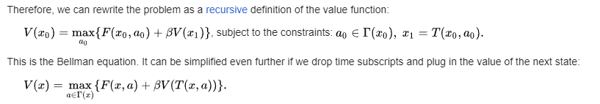
Dynamic RS: Reinforcement learning
Based on Bellman equation
  Basic approach: Q-learning (literally, table of states and actions)
    „Expected long-term reward for a given action is equal to the immediate reward from the current action combined with the expected reward from the best future action taken at the following state.“
    Q(s,a) = r + γ(max(Q(s’,a’)) (in reality, we keep the current value adjusted w.r.t. some learning rate
    „This says that the Q-value for a given state (s) and action (a) should represent the current reward (r) plus the maximum discounted (γ) future reward expected according to our own table for the next state (s’) we would end up in. “
  Q-learning not scalable if we have more states or actions
https://en.wikipedia.org/wiki/Bellman_equation
https://medium.com/emergent-future/simple-reinforcement-learning-with-tensorflow-part-0-q-learning-with-tables-and-neural-networks-d195264329d0

Slide 14
Dynamic RS: Reinforcement learning
Based on Bellman equation
  Deep Q-learning (use neural network as a function approximator)
    States as one-hot-encoding (input)
    Actions as output nodes (estimated reward)
    Backpropagation w.r.t. real vs. Estimated Q values: Loss = ∑(Q-target - Q)²
      Experience replay
      Freezing target networks
      Exploration of actions (not always the best predicted one: epsilon-greedy)
https://en.wikipedia.org/wiki/Bellman_equation
https://www.baeldung.com/cs/q-learning-vs-deep-q-learning-vs-deep-q-network
https://medium.com/emergent-future/simple-reinforcement-learning-with-tensorflow-part-0-q-learning-with-tables-and-neural-networks-d195264329d0

Slide 15
Dynamic RS: Reinforcement learning
Based on Bellman equation
  Deep Q-learning (use neural network as a function approximator)
    States as one-hot-encoding (input)
    Actions as output nodes (estimated reward)
    Backpropagation w.r.t. real vs. Estimated Q values: Loss = ∑(Q-target - Q)²
      Experience replay
      Freezing target networks
      Exploration of actions (not always the best predicted one: epsilon-greedy)
RecSys tutorial on RL: https://www.youtube.com/watch?v=qJysTu1Xl5U
Survey paper: https://www.sciencedirect.com/science/article/pii/S0950705123000850
https://en.wikipedia.org/wiki/Bellman_equation
https://www.baeldung.com/cs/q-learning-vs-deep-q-learning-vs-deep-q-network
https://medium.com/emergent-future/simple-reinforcement-learning-with-tensorflow-part-0-q-learning-with-tables-and-neural-networks-d195264329d0

Slide 16
Domain-specific RS
https://ksi.mff.cuni.cz

Slide 17


Slides (mostly) by Lien Michiels
… and Sanne Vrijenhoek
PhD in Industry (Baekeland) @ Froomle & University of Antwerp
  Froomle is a spin-off company of the University of Antwerp founded by prof. Bart Goethals and dr. Koen Verstrepen 6 years ago.
  I joined 5 years ago and developed most of our original RecSys stack.
  For the past two years I’ve focused on research on news recommender systems
Before my PhD…
  NLP @ Prezly
  ML @ Sentiance
  Masters in Mathematical Engineering at KU Leuven
Normative design of Diversity in RS
Notes:
First, I’ll tell you a little about me and why I’m here talking to you about this

Slide 18
Domain-specific RS: Intro + News RS
Examples of RecSys in Daily Life
News Recommender Systems

Slide 19

[Different] RecSys in Daily Life

Slide 20
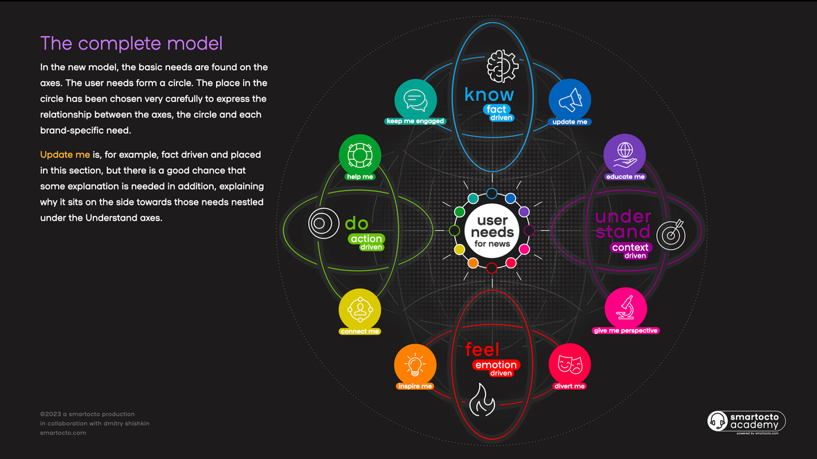
News User Needs Model (https://smartocto.com/research/userneeds/)

Slide 21
Can we apply this same framework to ecommerce? 🤔
News User Needs Model (https://smartocto.com/research/userneeds/)

Slide 22
Can we apply this framework to e-commerce?

Slide 23
💡Needs are domain-specific💡
Can we apply this framework to e-commerce?
Notes:
Needs are domain-specific. It doesn’t make sense for Spotify to do “complete the look/vibe” recommendations.
Nor does it make sense to do “discover weekly” recommendations in news or e-commerce.

Slide 24
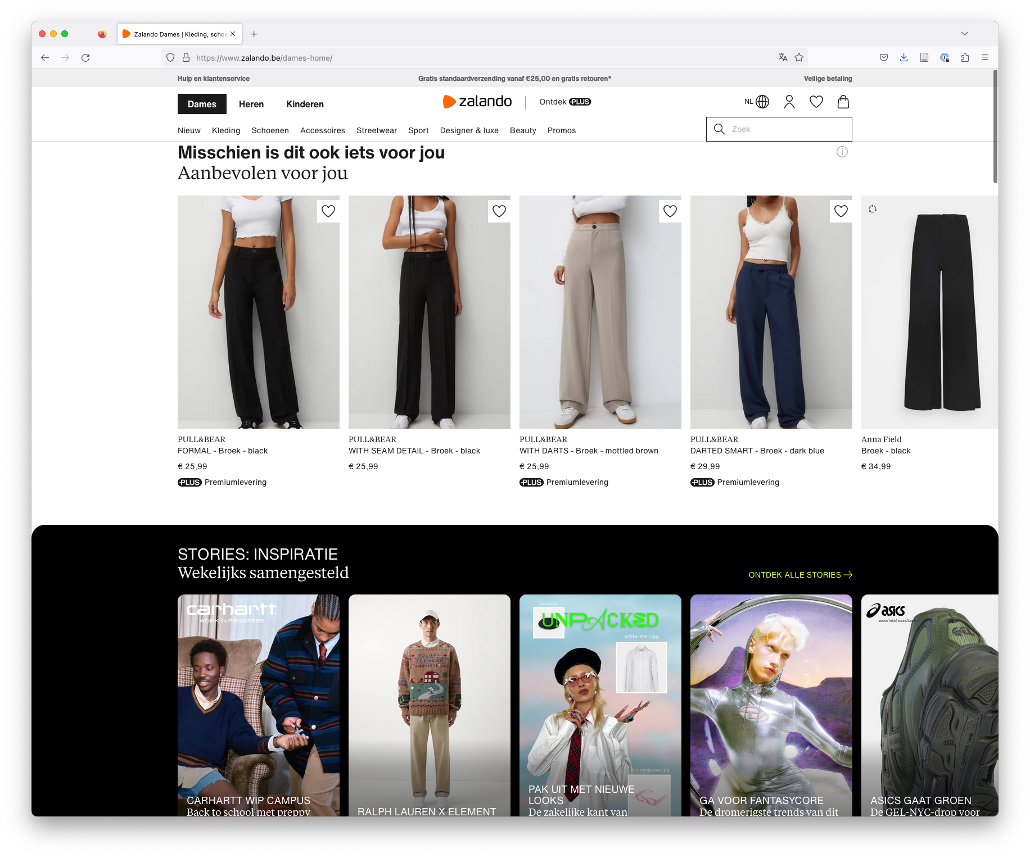
Notes:
Yet another difference between theory and practice is this…

Slide 25
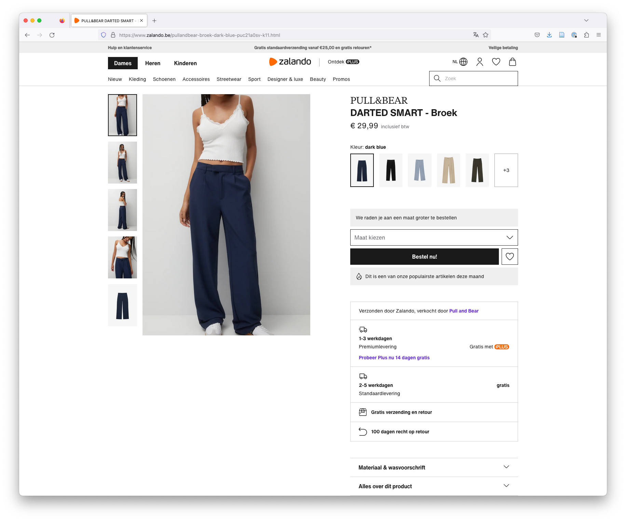

Slide 26


Slide 27
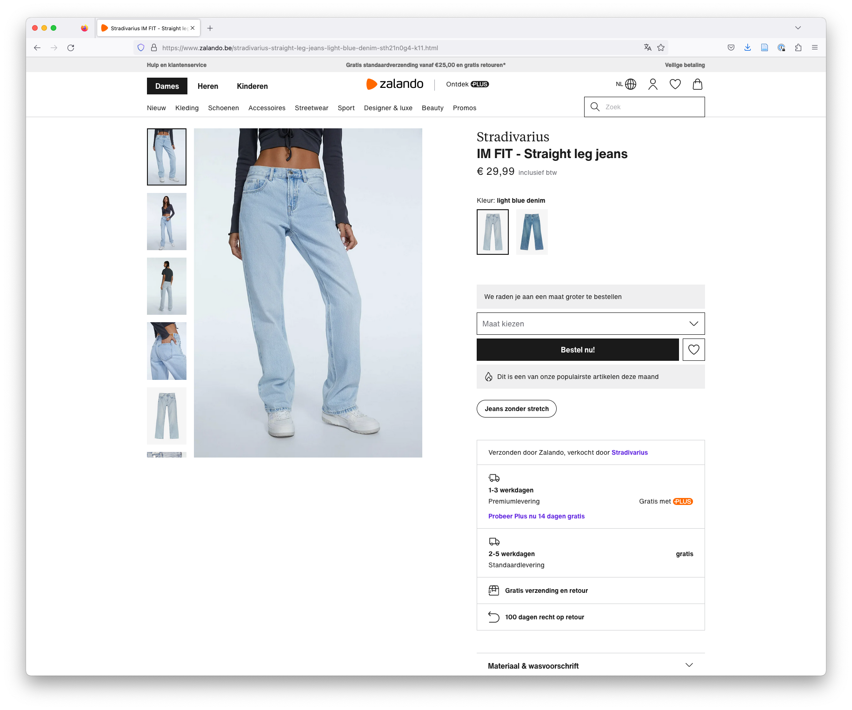

Slide 28
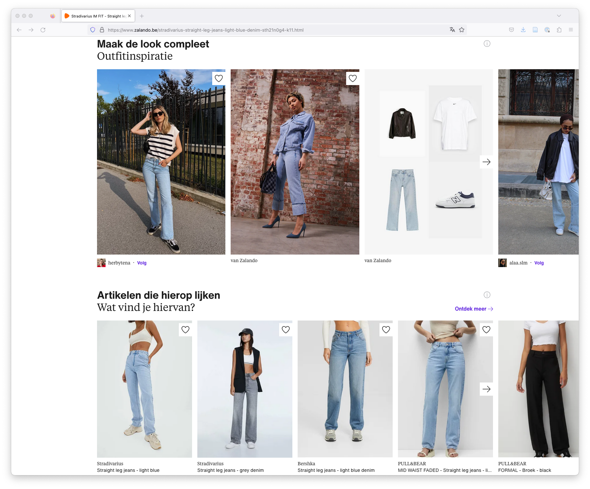

Slide 29
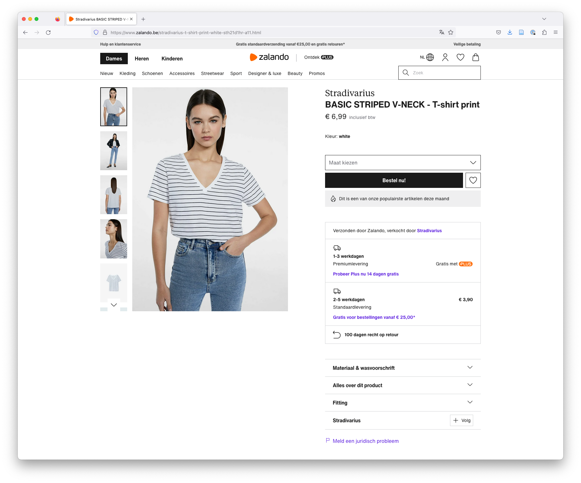

Slide 30
In Top-N recommendation, we assume recommendations are made once

Slide 31
… but in reality we make a lot of different recommendations

Slide 32
Can we always show the same “best items”?

Slide 33
Can we always show the same “best items”?

Slide 34
💡If we show “the best five items” too often… Users get annoyed that recommendations are not “fresh”💡

Slide 35
How often should we show an item
💡If we replace “good items” too soon…
We run out of “good” items quickly💡

Slide 36
How often should we show an item?

Slide 37
💡“Impression discounting” adds a discount to item scores proportional to how often it was exposed in the last XX recommendations💡
(https://www.froomle.ai/resource/news-impression-discounting-stop-showing-the-same-article-over-and-over-again)
Notes:
Impression discounting is essentially adding a “discount” to the score for every time a user was exposed to it in their last 100 recommendations. This makes sure users will always see fresh items.

Slide 38
… 💡but unexpected items take longer to convert to a click💡
Notes:
Any guesses why?

Slide 39
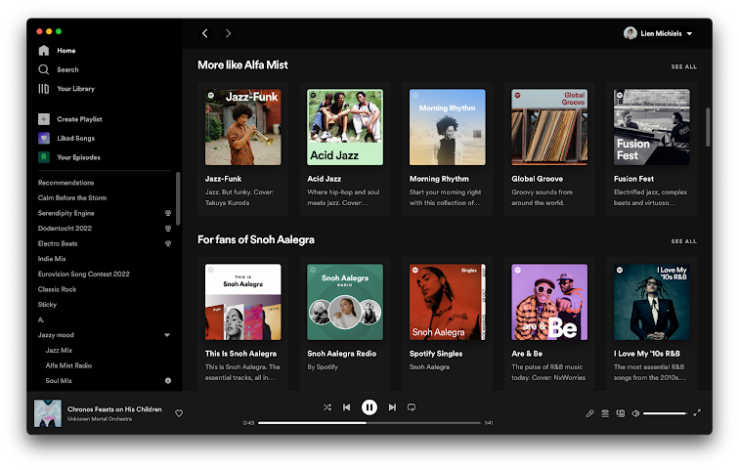
Music Recommender System
Notes:
Spotify, but also Apple Music, Pandora, Tidal, Deezer

Slide 40
Algorithmic and Curated Recommendation
Notes:
Editorial recommend

Slide 41
Editorial Recommendation
Notes:
Playlists made by editors - I once made a visit to the Spotify hq in Stockholm before they got really big, in 2016. They were already big, but far from where they are today
And they had a whole hall
With people who spent their days creating and curating playlists
It was quite impressive

Slide 42
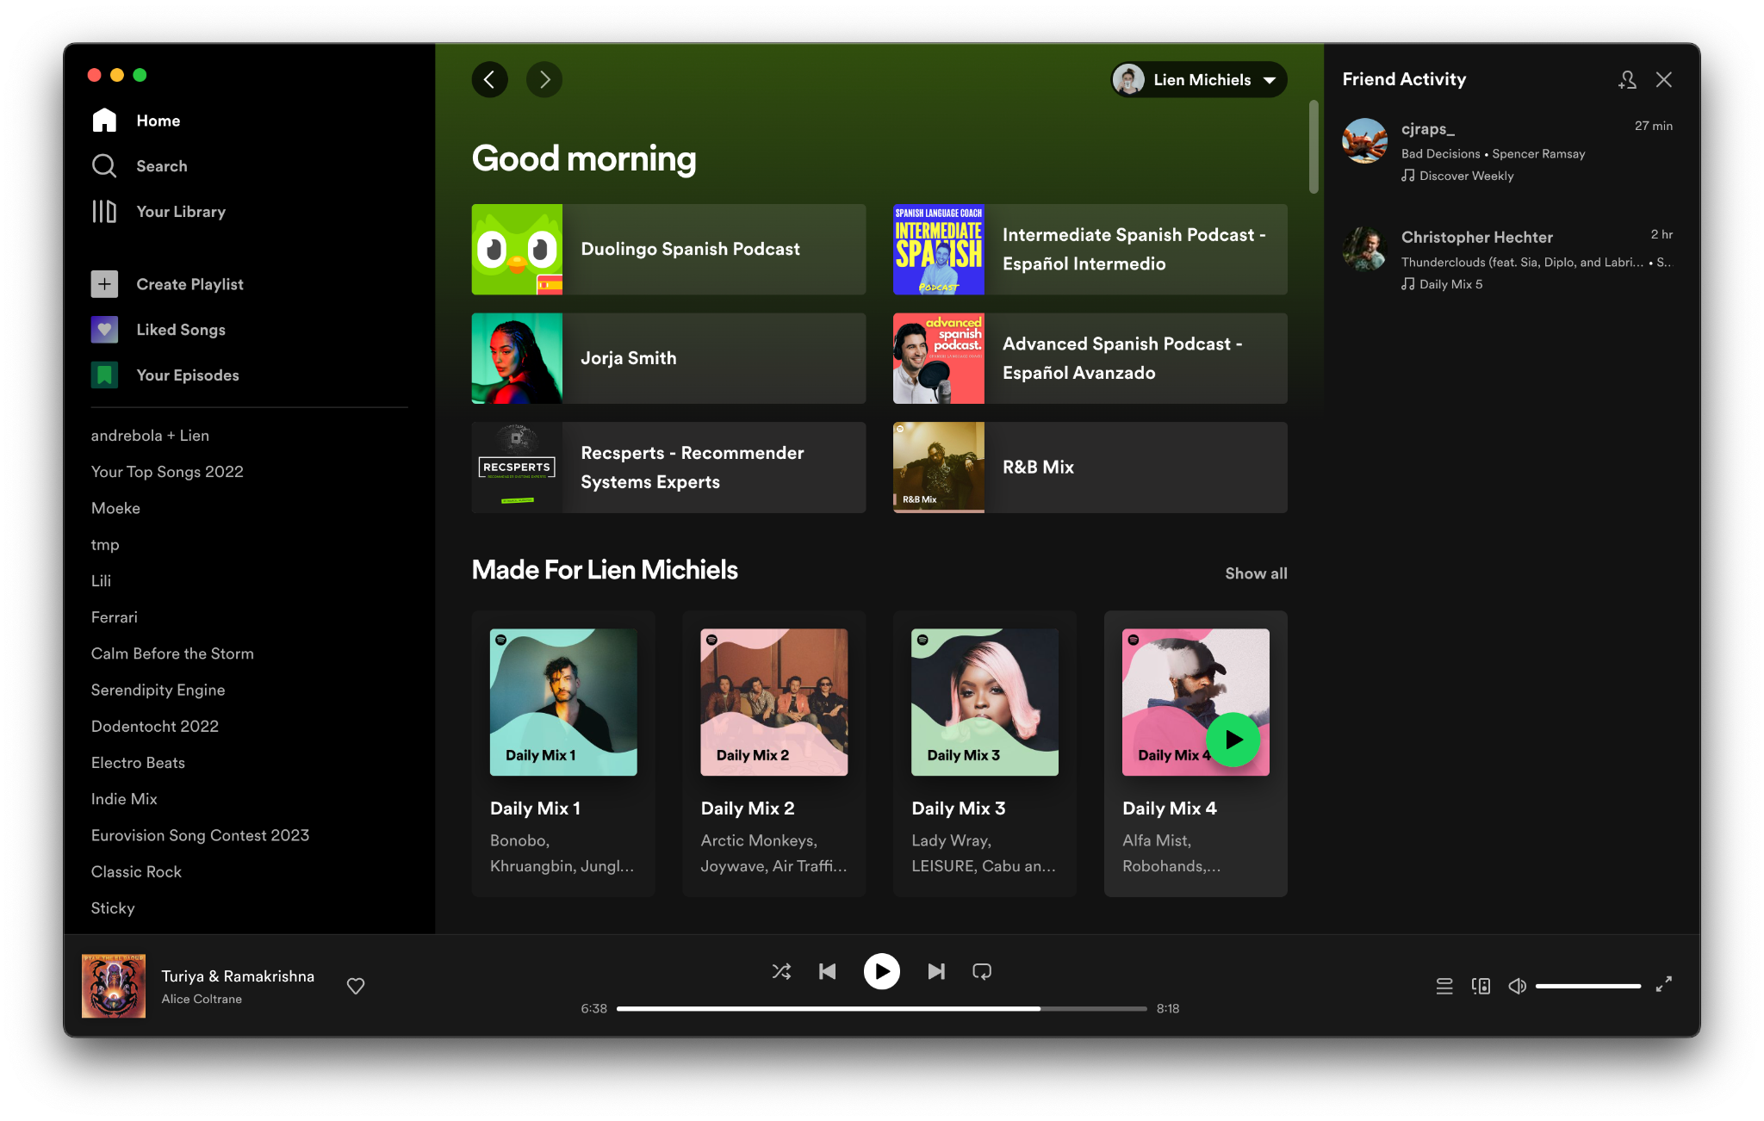
Social Recommendation
Notes:
Spotify, but also Apple Music, Pandora, Tidal, Deezer

Slide 43
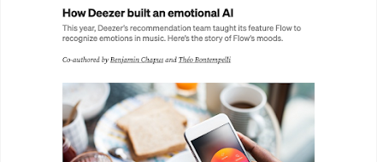
Challenges in Music Recommendation?
Fairness
  Towards artists, e.g. Are we discriminating against female or black artists?
  Towards non-mainstream music, e.g. Are we bad at recommending classical music because it’s not as popular as pop music?
Freshness
  People like to listen to the same music over and over,
  but sometimes they like something new
Mood
  Tastes in music are highly influenced by mood

Slide 44
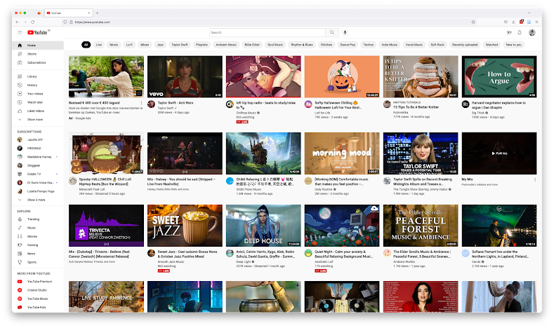
User-Generated Content Recommender System
Notes:
YouTube

Slide 45
Challenges in User-Generated Content Recommendation?
Misinformation & Hate Speech
  We cannot control what content users upload and we want to avoid amplifying harmful content
Freshness
  People expect the same, yet different (similar to music)
Calibration
  People have more than one interest, and we don’t want one to dominate the others.
Notes:
What is hate speech?
What is misinformation?

Slide 46
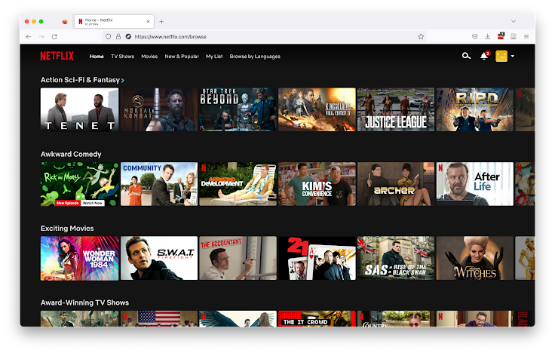
Video Recommender System
Notes:
Netflix, but also Disney+, StreamZ, VTM Go, Amazon Prime, …

Slide 47
Challenges in Video Recommendation?
Order
  Most shows, but also movies (e.g. Star Wars) should be watched in a certain order
Fairness
  Towards other languages than English
  Towards content made by smaller studios
Calibration
  People have more than one interest, and we don’t want one to dominate the others
Long-Term User Engagement (Subscriptions)
  How can we optimize the recommender system for long-term engagement (and subscriptions)

Slide 48
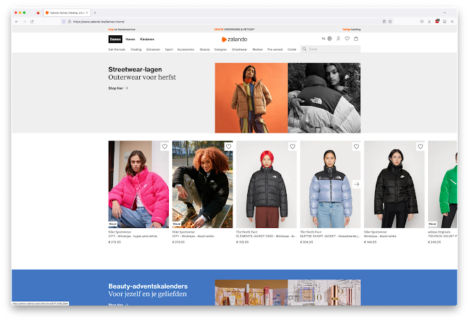
Fashion Recommender System
Notes:
Zalando, ZEB, About You, Asos, H&M, …

Slide 49
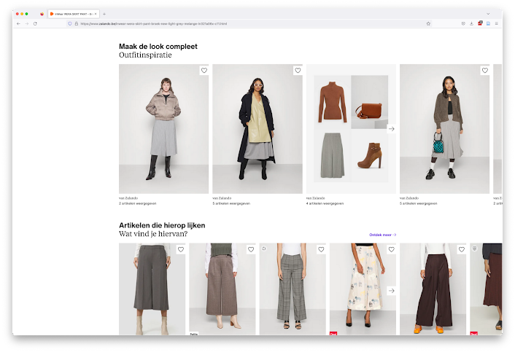
Fashion Recommender System

Slide 50
Challenges in Fashion Recommendation?
Outfit Creation
  Clothes are worn together as part of an outfit, but outfit creation is more of an art-form than a science
Choice Overwhelm
  Sometimes showing the user five very similar red shirts may backfire because of choice overwhelm
From Clicks to Purchases
  Purchase data is incredibly sparse while pageviews are plenty, but we want to make sales (and maximize profits)

Slide 51
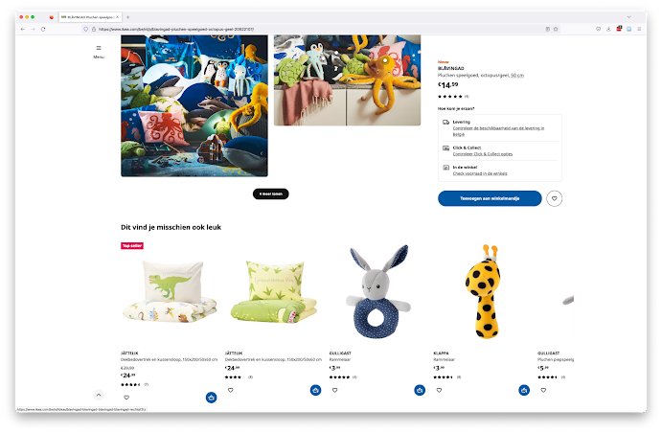
E-commerce Recommender System
Notes:
Other e-commerce sites also use RecSys
IKEA and Amazon.

Slide 52
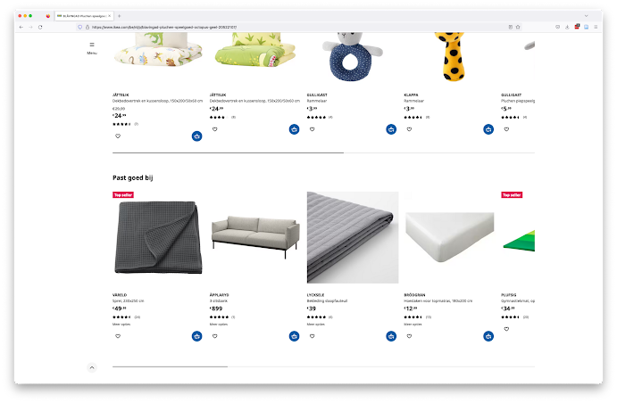

E-commerce Recommender System
Notes:
Recommendations aren’t always good (:

Slide 53
Challenges in E-commerce Recommendation?
Customer Intent
  Users often have a specific purchase goal in mind, but how can we identify it?
Giant Item Catalogs and User Bases
  Lead to scaling issues
Re-purchasability
  Most people need only one Playstation 5, but might like several games

Slide 54
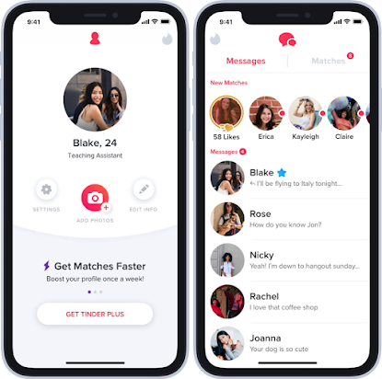
People Recommender System
Notes:
Tinder, Bumble, Grindr, Hinge, Match.com (the list goes on I think, I’m not exactly an expert)

Slide 55
Challenges in People Recommendation?
Mutual Interest
  People recommendation is not just a ranking problem, it is a matching problem
Fairness
  Towards users of the platform, so that everyone has equal opportunity
  Towards users of a certain sexual orientation
  Towards users of a certain ethnicity
  Towards users of minority genders
Negative Feedback
  How do we deal with a swipe left?
  Inverse positivity: solving user goal imply terminate the app usage

Slide 56
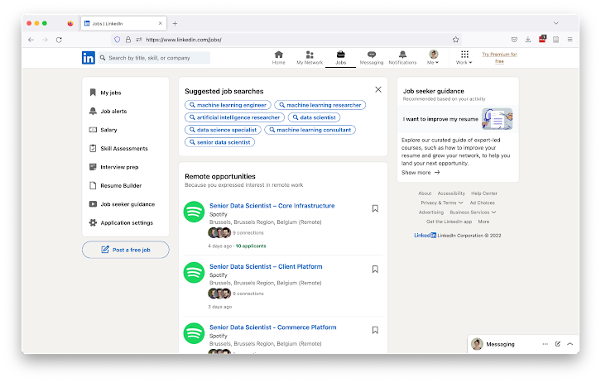
Job Recommender System
Notes:
LinkedIn, but also Indeed, Jobat, VDAB

Slide 57
Challenges in Job Recommendation?
Fairness
  Towards users of a certain ethnicity
  Towards users of a certain gender
  Towards users with unusual career paths or career gaps
Matching Problem
  The user not only needs to like the job, the employer needs to like the applicant
Job Understanding
  Recommending the wrong dress is not so bad, recommending the wrong job can be

Slide 58
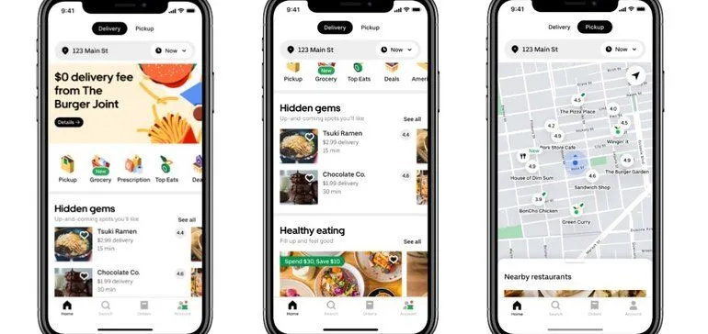
Restaurant Recommender System
Notes:
Food Delivery Apps, like Uber Eats, but also Takeaway.com, Deliveroo

Slide 59
Challenges in Restaurant Recommendation?
Load Balancing
  If you send all the customers to the same restaurants, they will soon not be able to fill orders
  And restaurants that don’t get enough orders will leave your platform
Similar issue with several-piece-only sale sites (i.e., bazos.cz)

Slide 60
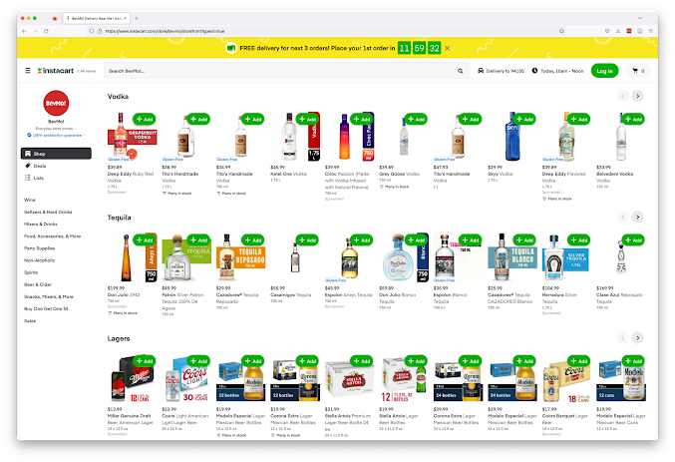
Grocery Recommender System
Notes:
Grocery shopping, like InstaCart in the US but also Collect&Go closer to home :-)

Slide 61
Challenges in Grocery Recommendation?
Purchasing Frequency
  I don’t need toilet paper every week, but I do buy bananas every week
Health
  (How) Should we nudge users towards healthier food choices?
Near Duplicates
  You don’t want to recommend Coca-Cola bottles in four different sizes
Baskets to recipes
  What people normally have at home?

Slide 62
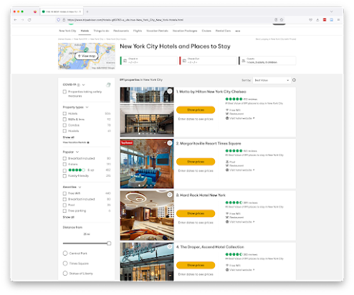
Location (POI) Recommender System

Slide 63
Challenges in Location (POI) Recommendation?
Distance
  What is walking/cycling distance depends on the user
  Different location types allows for different travel times
Item Availability
  Because you don’t own the locations you recommend, you can never be sure they are up-to-date (e.g. opening hours) or still available

Slide 64
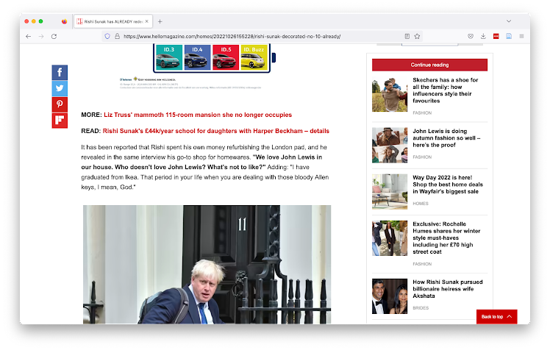
News Recommender Systems

Slide 65

News Recommender Systems

Slide 66
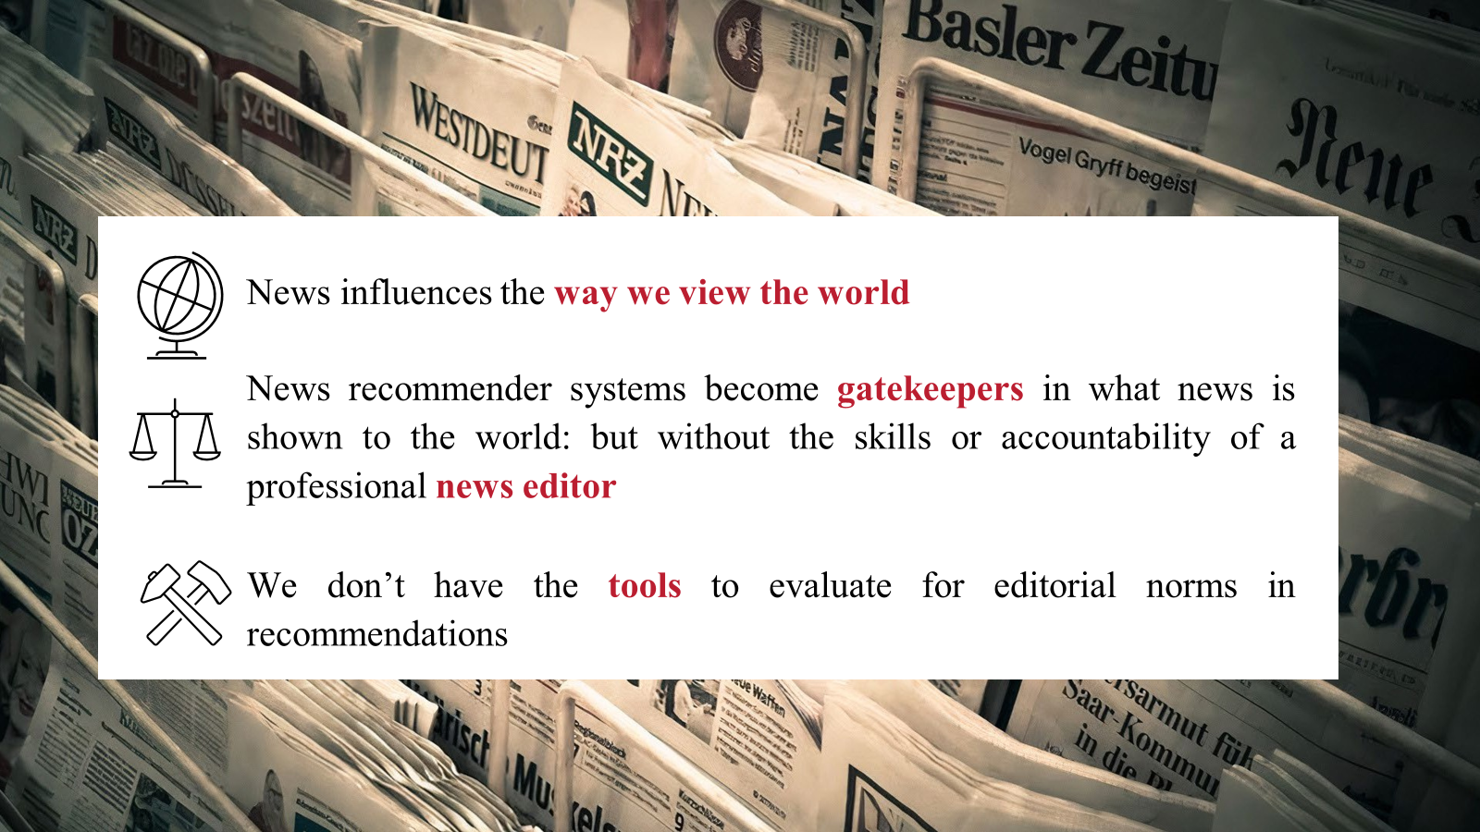
News Recommender Systems

Slide 67
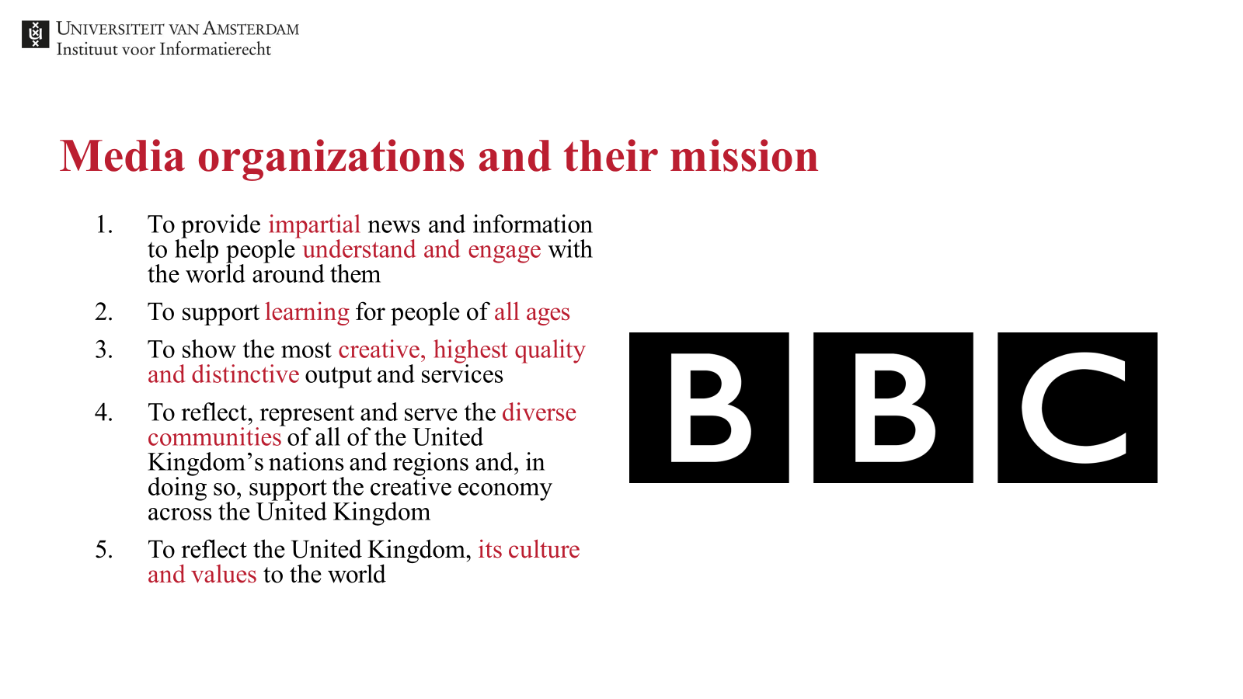
News Recommender Systems

Slide 68

Editors & Journalists
Business, Investors
Product Managers
& Data Scientists
Policy-makers
Many Stakeholders
Users

Slide 69
Editors & Journalists
Business, Investors
Product Managers
& Data Scientists
… but the business usually wins…
Policy-makers
Many Stakeholders
Users

Slide 70

Different tasks at different places => different recommenders
Notes:
We’re going to look at a number of recommendation use cases together, and then try to figure out which of the techniques I talked about you would use
Try first to think in terms of user needs: What does a user expect?
Then try to translate that to concepts you’ve learned here today.

Slide 71
Continue Reading

Slide 72
Articles most related to what you are reading now
Content-based, based on tags or article text
or
Collaborative filtering + Business Rules that restrict to the same category
Continue Reading

Slide 73
Recommended for You

Slide 74
General Interest News
Popularity
Top-3/5/10 Interests of the User
Collaborative filtering + Business logic that enforces that article recommendations have different topics
Recommended for You - Homepage

Slide 75

Push Notification

Slide 76
Breaking News
Content-based (because cold start)
Or, editorial picks (handcrafted)
Push Notification

Slide 77

Newsletter

Slide 78
Hidden Gems/Niche Interests
Hybrid (content + collaborative)
Discount popularity
Editor’s Pick
Recommendation from a
very narrow selection of articles
Newsletter

Slide 79
Why use a News RecSys?

Slide 80
Opportunities
Competition with social media & aggregators
  Who also personalize
Longer engagement on the site
  Sells more advertisements
  May convert users to paid subscribers
Increased engagement with hidden gems
  There is only so much space on a page, and so many articles

Slide 81
Challenges in News Recommendation

Slide 82
Technical Challenges in News Recommendation
Frequent Catalog Updates
  New articles are published all the time
Interest Decay
  Interest in an article decays quickly

Slide 83







Model Training Services
Tracking API
User Interaction Data Store
Item Data Store
Recommendations API
Recommendation Server
Recommendation Models
How are recommendations made?

Slide 84
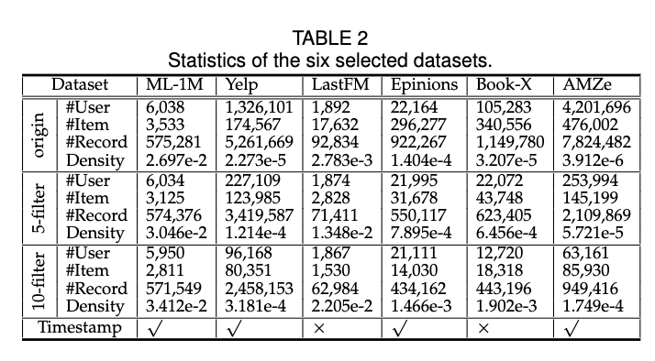
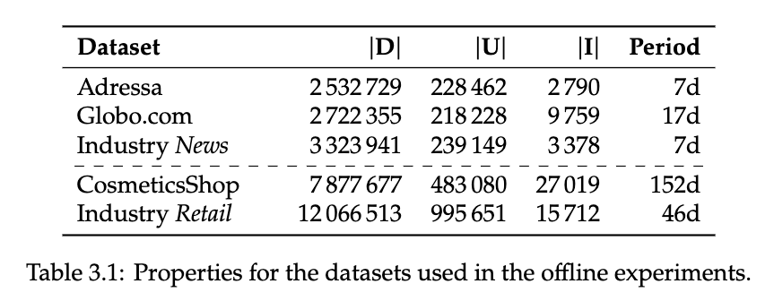
Data streem speed

Slide 85
Model Training Service

Slide 86
Model Training Services
Tracking API
User Interaction Data Store
Item Data Store
Recommendations API
Recommendation Server
Recommendation Models
Models are retrained “periodically”

Slide 87
Model Training Services
Tracking API
User Interaction Data Store
Item Data Store
So how often is “periodically”?
Recommendations API
Recommendation Server
Recommendation Models
Models are retrained “periodically”

Slide 88
Model Training Services
Tracking API
User Interaction Data Store
Item Data Store
So how often is “periodically”?… it depends 🙃
Recommendations API
Recommendation Server
Recommendation Models
Models are retrained “periodically”

Slide 89
How often does your choice of music change?

Slide 90
How often does your choice of music change?
… it doesn’t
Notes:
Although I do tend to get a bit more melancholy in winter

Slide 91
How often does your choice of music change?… unless your favorite artist releases a new album 😍
Notes:
Although I do tend to get a bit more melancholy in winter

Slide 92
How often does your choice of clothes change?

Slide 93
How often does your choice of clothes change?
… depends how trendy you are 🙃

Slide 94
How often does your choice of clothes change?
… but at least every season🌷☀🍂❄
Notes:
It’s very important to train

Slide 95
Model Training Services
Tracking API
User Interaction Data Store
Item Data Store
The frequency of model updates depends on how frequently behavior or the catalog shifts.
Recommendations API
Recommendation Server
Recommendation Models
Models are retrained “periodically”

Slide 96
In news, articles typically live for only 48h 😨
Reading behavior shifts hourly 😱

Slide 97
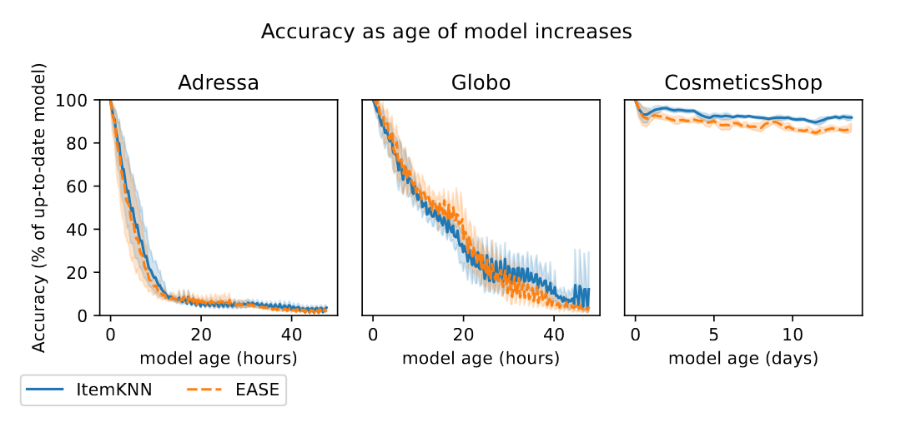
From “Scheduling on a Budget: Avoiding Stale Recommendations with Timely Updates” by Verachtert et al., 2022

Slide 98
Model is stale
From “Scheduling on a Budget: Avoiding Stale Recommendations with Timely Updates” by Verachtert et al., 2022

Slide 99
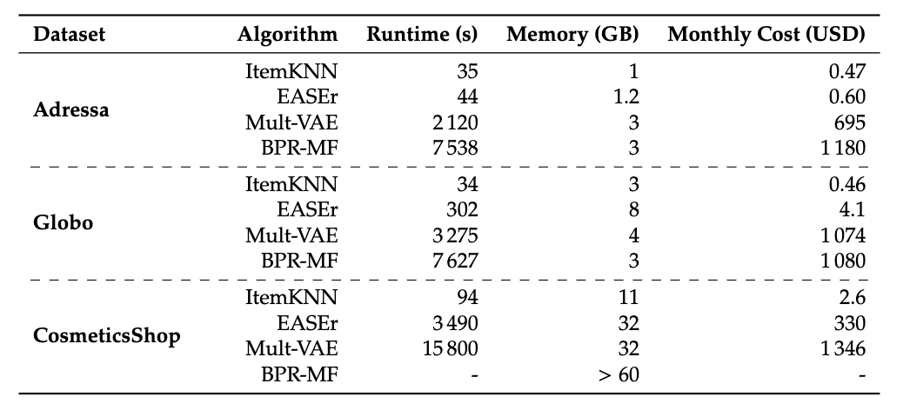
From “Scheduling on a Budget: Avoiding Stale Recommendations with Timely Updates” by Verachtert et al., 2022

Slide 100
💡Training a model takes time 😥💡
… therefore all* models are out of date 🙃
*Except truly incremental models, but as far as I know, these are not in use due to other issues we will get into later.
From “Scheduling on a Budget: Avoiding Stale Recommendations with Timely Updates” by Verachtert et al., 2022

Slide 101
≈2 hours
≈2 hours
From “Scheduling on a Budget: Avoiding Stale Recommendations with Timely Updates” by Verachtert et al., 2022

Slide 102
What happens if we use these models for a news RecSys?
From “Scheduling on a Budget: Avoiding Stale Recommendations with Timely Updates” by Verachtert et al., 2022

Slide 103
What happens if we use these models for a news RecSys? 🤔
From “Scheduling on a Budget: Avoiding Stale Recommendations with Timely Updates” by Verachtert et al., 2022

Slide 104
Unless…
We can cut down the time by using less training data
From “Scheduling on a Budget: Avoiding Stale Recommendations with Timely Updates” by Verachtert et al., 2022

Slide 105
Model Training Services
Tracking API
User Interaction Data Store
Item Data Store
… So how much data should we use to train models?
Recommendations API
Recommendation Server
Recommendation Models
Models are retrained “periodically”

Slide 106
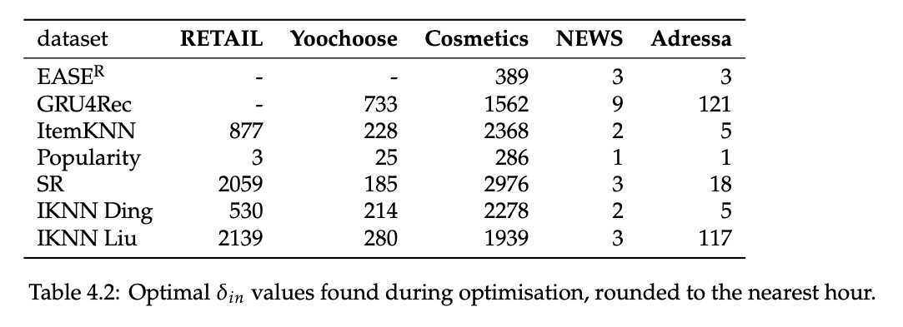
From “Are We Forgetting Something? Correctly Evaluate a Recommender System With an Optimal Training Window” by Verachtert et al., 2022

Slide 107
💡The optimal amount of training data depends on the domain💡
From “Are We Forgetting Something? Correctly Evaluate a Recommender System With an Optimal Training Window” by Verachtert et al., 2022

Slide 108
From “Are We Forgetting Something? Correctly Evaluate a Recommender System With an Optimal Training Window” by Verachtert et al., 2022

Slide 109
💡The optimal amount of training data also depends on the algorithm💡
From “Are We Forgetting Something? Correctly Evaluate a Recommender System With an Optimal Training Window” by Verachtert et al., 2022

Slide 110
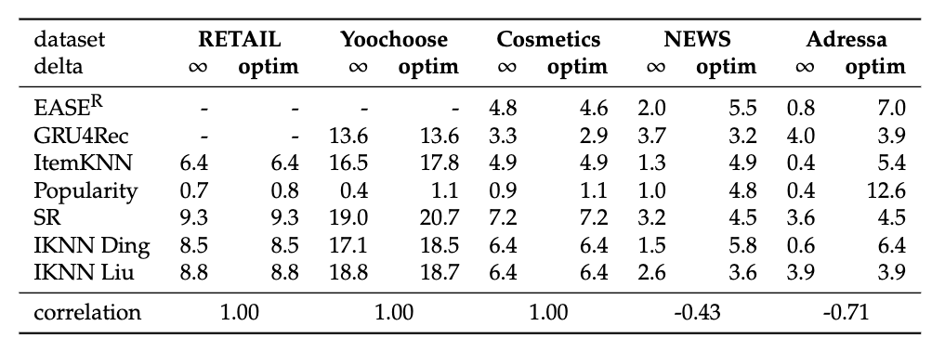
🏆
🏆
From “Are We Forgetting Something? Correctly Evaluate a Recommender System With an Optimal Training Window” by Verachtert et al., 2022

Slide 111
💡If you use the optimal amount of training data, simpler algorithms suddenly win 🏆💡
🏆
🏆
From “Are We Forgetting Something? Correctly Evaluate a Recommender System With an Optimal Training Window” by Verachtert et al., 2022

Slide 112
From “Scheduling on a Budget: Avoiding Stale Recommendations with Timely Updates” by Verachtert et al., 2022

Slide 113
💡Training a model costs 💰💡
From “Scheduling on a Budget: Avoiding Stale Recommendations with Timely Updates” by Verachtert et al., 2022

Slide 114
💡More complex models cost more 💰💰💰💡
From “Scheduling on a Budget: Avoiding Stale Recommendations with Timely Updates” by Verachtert et al., 2022

Slide 115
… so are they worth it?
From “Scheduling on a Budget: Avoiding Stale Recommendations with Timely Updates” by Verachtert et al., 2022

Slide 116
… so are they worth it?
Usually not…
unless you are Spotify/Netflix
From “Scheduling on a Budget: Avoiding Stale Recommendations with Timely Updates” by Verachtert et al., 2022

Slide 117
💡When and how often a model should be trained is an important design decision💡
💡… and cost should not be ignored💡

Slide 118
Policy Challenges in News Recommendation
Filter Bubbles/Diversity
  News publishers have a mission/responsibility to inform readers by providing news that is diverse

Slide 119
Filter bubbles by Lien:
A technological filter bubble is a decrease in the diversity of a user’s recommendations over time, in any dimension of diversity, resulting from the choices made by different recommendation stakeholders.

Slide 120
HOW SHOULD WE MEASURE FILTER BUBBLES IN ONLINE NEWS?
Currently under submission.
Notes:
Bubbly people
FairUMAP

Slide 121
WHY SHOULD WE MEASURE FILTER BUBBLES IN ONLINE NEWS?
Notes:
Bubbly people
FairUMAP

Slide 122
EDITORS
POLICY-MAKERS
USERS
are concerned that filter bubbles will take away their brand DNA
worry that filter bubbles would harm the democratic process
want to be exposed to diverse news

Slide 123
How CAN We Measure Filter Bubbles?
Simulated Users
Real Users
Simulation Study
Controlled User Study
Simulated Env.
MORE REALISTIC
Audit Study
Field Experiment
Real Env.
Observational Study
MORE REALISTIC

Slide 124
WHAT SHOULD WE MEASURE as FILTER BUBBLES IN ONLINE NEWS?
Notes:
Bubbly people
FairUMAP

Slide 125
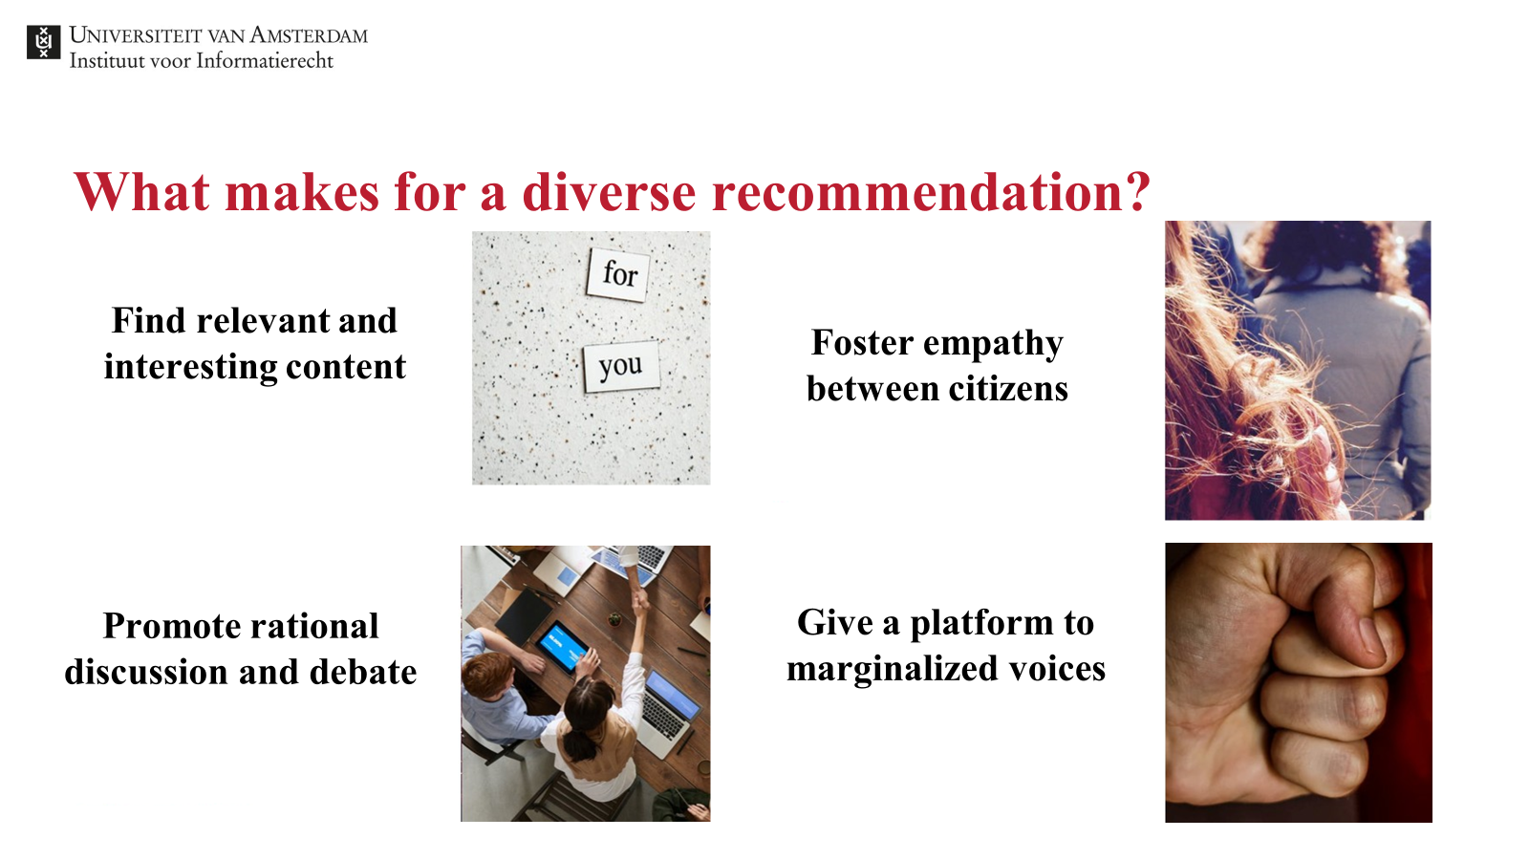
WHAT SHOULD WE MEASURE as FILTER BUBBLES IN ONLINE NEWS?
Notes:
Bubbly people
FairUMAP

Slide 126
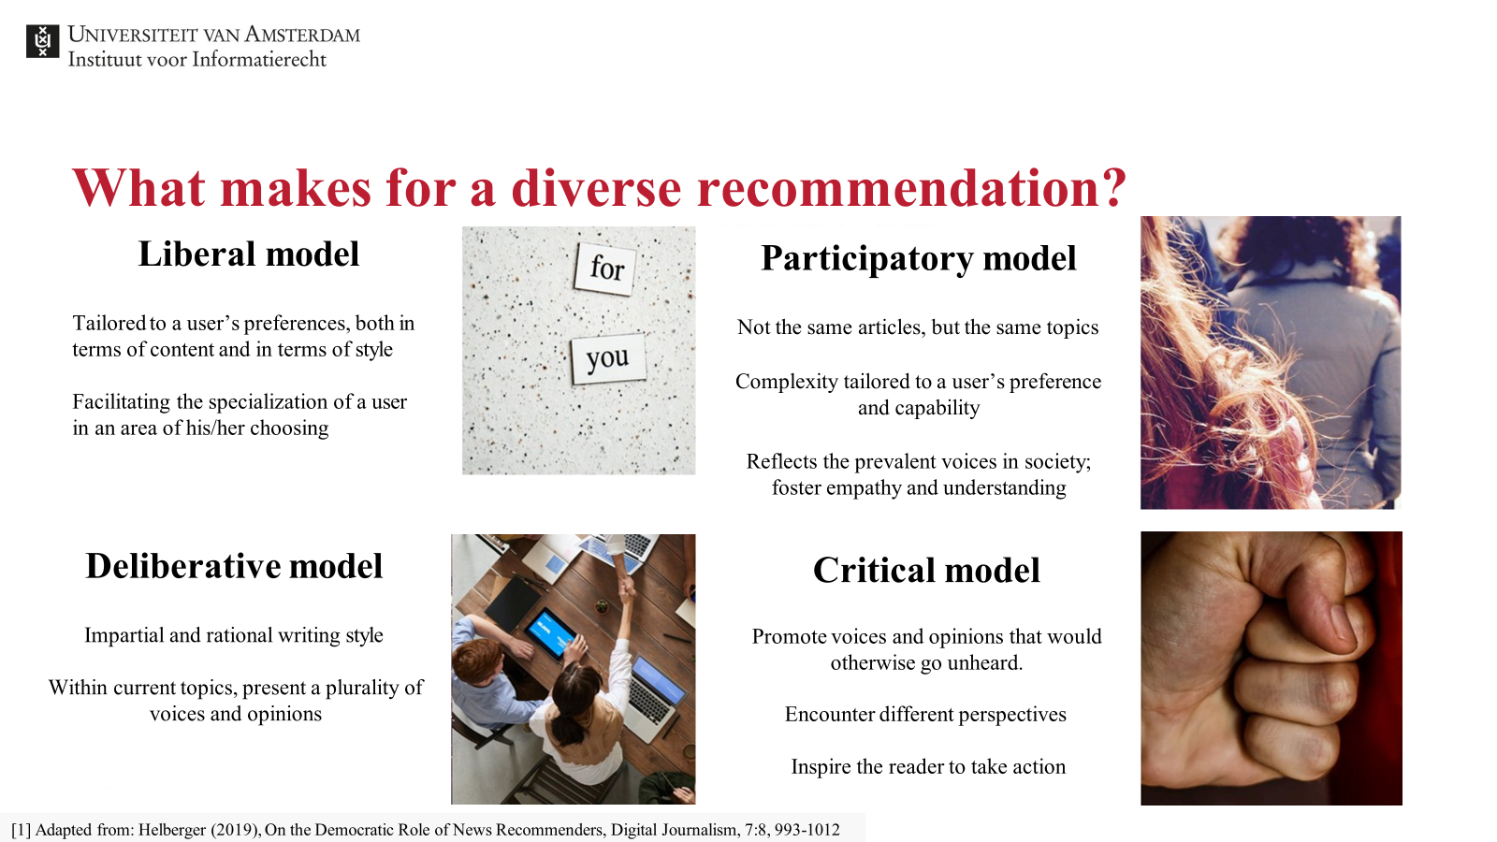
WHAT SHOULD WE MEASURE as FILTER BUBBLES IN ONLINE NEWS?
Notes:
Bubbly people
FairUMAP

Slide 127
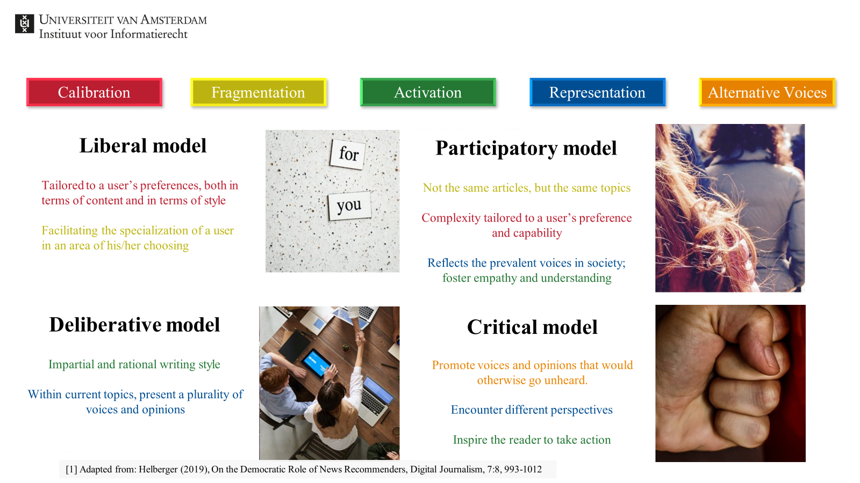
WHAT SHOULD WE MEASURE as FILTER BUBBLES IN ONLINE NEWS?
Notes:
Bubbly people
FairUMAP

Slide 128
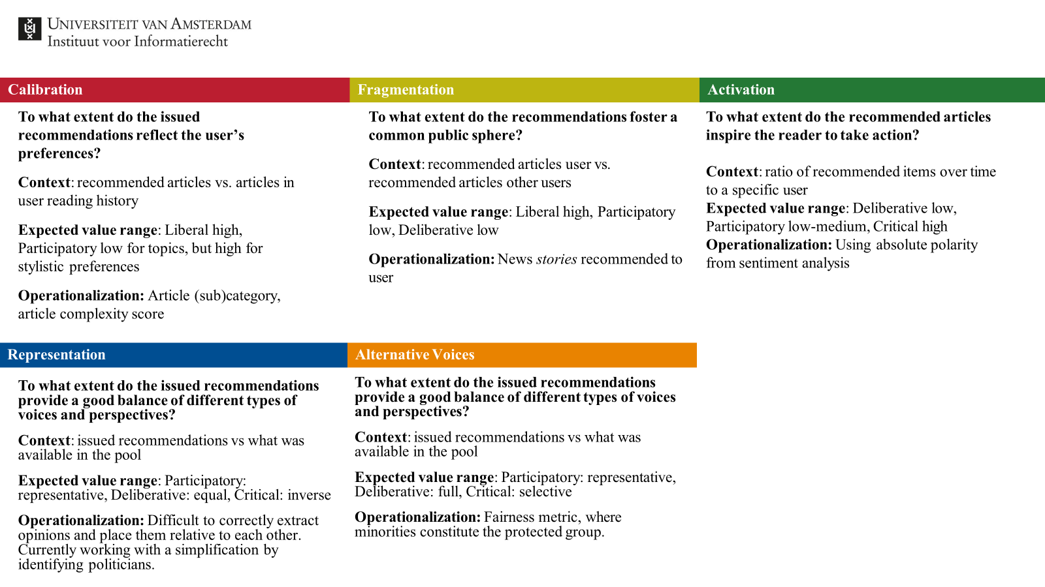
WHAT SHOULD WE MEASURE as FILTER BUBBLES IN ONLINE NEWS?
Notes:
Bubbly people
FairUMAP

Slide 129
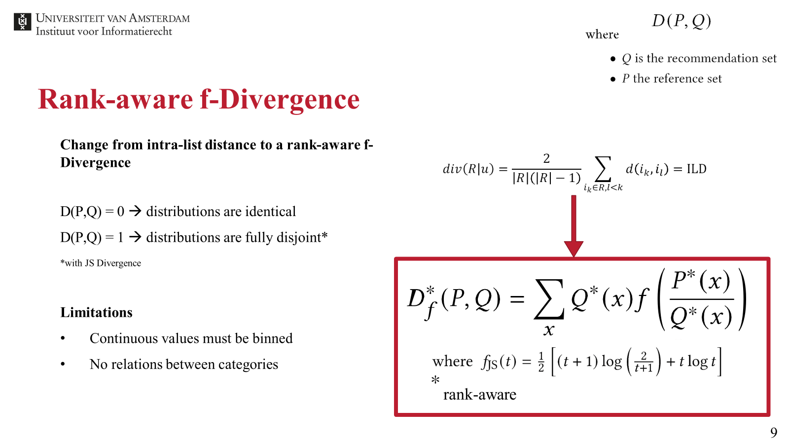
WHAT SHOULD WE MEASURE as FILTER BUBBLES IN ONLINE NEWS?
Notes:
Bubbly people
FairUMAP

Slide 130
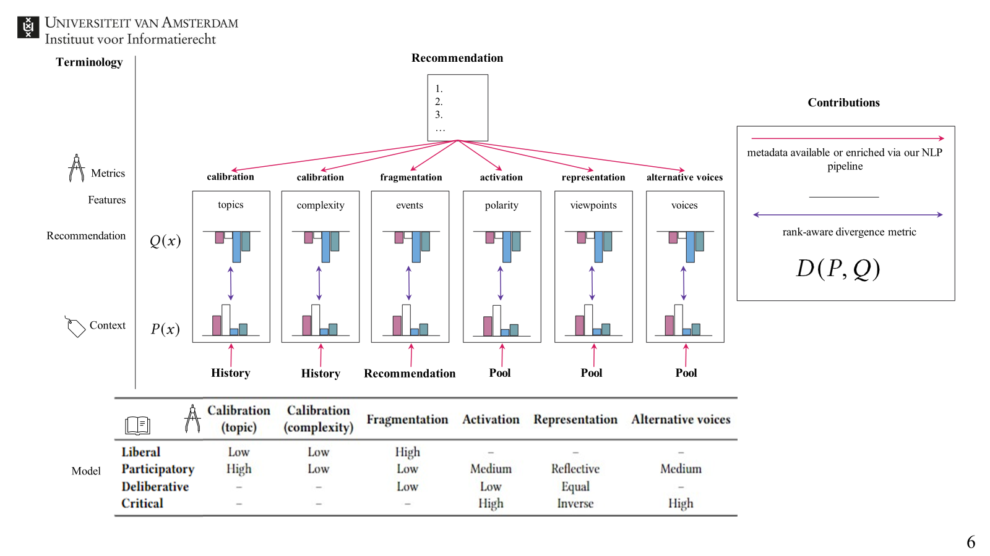
WHAT SHOULD WE MEASURE as FILTER BUBBLES IN ONLINE NEWS?
Notes:
Bubbly people
FairUMAP

Slide 131
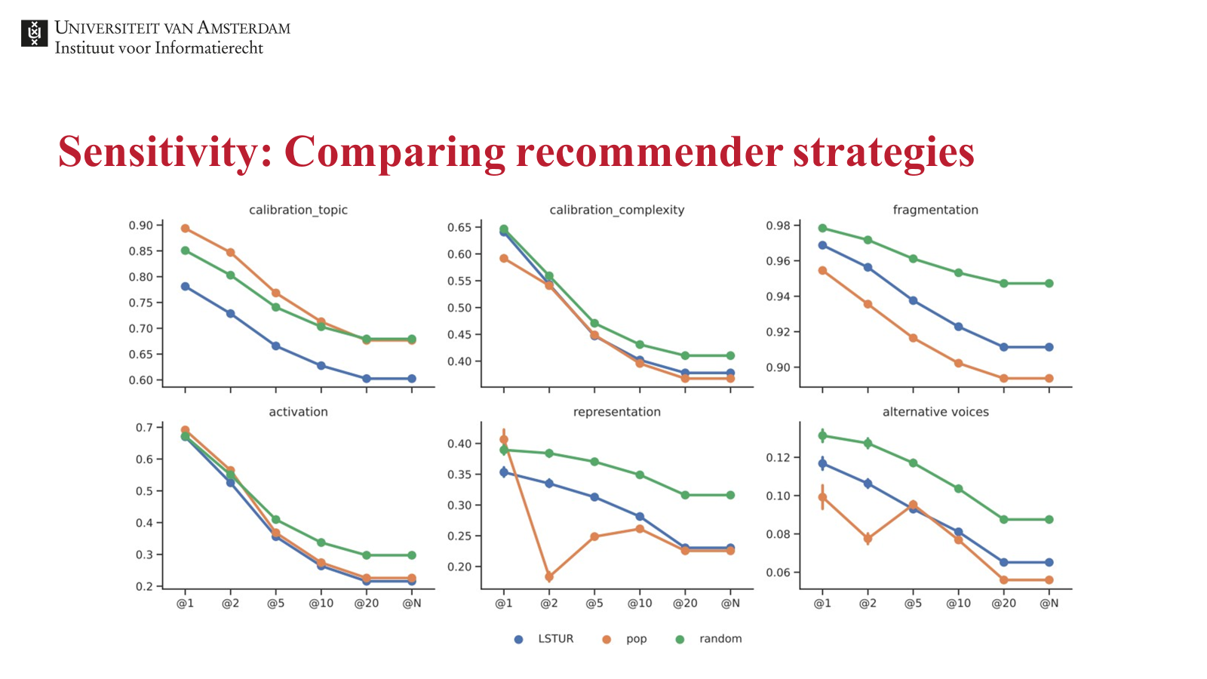
WHAT SHOULD WE MEASURE as FILTER BUBBLES IN ONLINE NEWS?
Notes:
Bubbly people
FairUMAP

Slide 132
Editorial Challenges in News Recommendation
Brand DNA
  Editors provide value by curating relevant news
Long-Term User Engagement (Subscriptions)
  What we want is for users to buy subscriptions, but how do recommendations contribute to that?

Slide 133
User Challenges in News Recommendation
Niche/Hyperlocal Content
  E.g. opera, stock market, regional sports matches
Choice Overwhelm

Slide 134
Q&A

