Slide 1
Short repetition of NSWI 166 (winter)
NDBI021 User Preferences Lecture 1
Peter Vojtáš

Slide 2
Linear Monotone Preference Model-LMPM
Decathlon – “single user” IAAF rules order athletes
Disciplines A₁,…, A₁₀; domains D₁,…, D₁₀; ideal (field / track)
A_{i} point function f_{i} : D_{i} → N makes results commeasurable
Winner - overall IAAF achievement is obtained via sum Σ{f_{i} (athleteID . A_{i}): i = 1, …, 10}
Retail, e-shop – set of users U, LMPM^{u} orders items
Attributes A₁,…, A_{m}; domains D₁,…, D_{m}; ideal points can be for each user different
Degree of preference for A_{i} and user u∈U f_{i}^{u}: D_{i} → [0, 1] – hardly made commeasurable in response time
Winner, top-k, overall degree of preference - aggregation r^{f,t}(objectID) = t^{u}{f_{i}^{u} (objectID . A_{i}): i = 1, …, m}
Here t^{u}: [0, 1]^{m} → [0, 1], t^{u}(0,…,0) = 0, t^{u}(1,…,1) = 1, t^{u} monotone(linear) - preserves Pareto ordering,

Slide 3
D₂
Let us describe steps leading to calculation of preference degree of item B (for user u), we first describe mapping DC-data cube to PC-preference cube
Assume degree of preference f_{i}^{u}: D_{i} → [0, 1] (for an user u∈U),
Object with objectID = B has attribute values B.A₁ = b₁ and B.A₂ = b₂, sometimes we write B=(b₁, b₂).
Attribute preference degrees f_{j}^{u}(B.A_{j}) = b_{j}^{u} and corresponding point in preference cube is B^{u} = (b₁^{u}, b₂^{u})
other points analogically
Data cube -
User interface
C
E
D
b₂
B
f₂^{u}
x₂
D₁
1
b₂^{u}
0
b₁
Preference
cube
0
f₁^{u}
B^{u}
b₁^{u}
1
x₁

Slide 4
D₂
Note, that point B^{u} has 4 coimages B, B’, B’’, B’’’
Degree of preference for user u∈U are given by f₁^{u} and f₂^{u} .
Object with objectID = B has attribute values B.A₁ = b₁ and B.A₂ = b₂, sometimes we write B=(b₁, b₂).
For B, D, E attribute preference degrees the corresponding points in preference cube are B^{u}, D^{u}, E^{u},
Note that B^{u} and D^{u} are incomparable in Pareto order and E^{u} is dominated by both B^{u} and D^{u},
DC - UI
C
E
B’’
B’’’
D
b₂
B’
B
f₂^{u}
x₂
D₁
1
b₁^{u}
0
b₁
PC
0
E^{u}
D^{u}
f₁^{u}
B^{u}
b₁^{u}
1
x₁

Slide 5
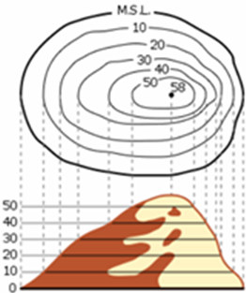
To get global preference degree of items we need aggregation functions. It is a function [0,1]²→[0,1]
t(x₁, x₂) = w₁*x₁ + w₂*x₂ , where w₁, w₂ ≥ 0 are attribute weights with w₁+ w₂ =1
Graph of t is a 3D object. Intuition behind display of aggregation function are contour lines (e.g. cl_{1/3} , cl_{2/3}) for users u, resp. u
Note, that on the preference cube diagonal corresponding contour line of preference degree y∈[0,1] intersect the diagonal at point (y, y) , because
w₁*x + w₂*x = y gives
x*(w₁ + w₂)= y, i.e., x = y
D₂
x₂
½
0
D₁
1
0
cl_{1/3}
¹/₃
½
½
²/₃
cl_{2/3}
Ideal, top
1
x₁

Slide 6
D₂
How does it work together?
Vector of attribute preferences f=[f₁, …, f_{m}] and aggregation t define a user u_{f,t} = u
Overall preference of user u_{f,t} is given by r^{f,t}:O→[0,1] , for object oid given by r^{f,t}(oid) =
t ([f_{i} (oid.A_{i}) : i = 1, …, m])
Depict contour line (i.e. items of same preference degree) in DC-data cube is a little bit trickier (depending on position of ideal points and/or intervals)
C
E
A
D
b₂
B
f₂^{u}
x₂
D₁
1
b₂^{u}
0
b₁
C^{u}
0
E^{u}
D^{u}
r^{f,t}(E)
f₁^{u}
B^{u}
b₁^{u}
1
x₁

Slide 7
D₂
Preference model of user u_{f,t} on data cube
Function R^{f,t}: ΠD_{i} →[0,1] R^{f,t}(a₁, …, a_{m}) = t ([f_{i} (a_{i}) : i = 1, …, m])
Ordering on data cube(a₁, …, a_{m}) ≥^{f,t} (b₁, …, b_{m}) iff R^{f,t}(a₁, …, a_{m}) ≥ R^{f,t}(b₁, …, b_{m}) Odering can be vizualized as contour lines on ΠD_{i}
For better understanding are different contour lines (of same t) in colors
User u_{f,t} , preference of user u_{f,t} , R^{f,t}: ΠD_{i} →[0,1]
R^{f,t}(a₁, …, a_{m}) = t ([f_{i} (a_{i}) : i = 1, …, m])
(a) ≥^{f,t} (b) iff R^{f,t}(a) ≥R^{f,t}(b)
C
E
D
ideal
b₂
B
f₂^{u}
x₂
D₁
1
b₁^{u}
0
b₁
C^{u}
0
E^{u}
D^{u}
f₁^{u}
B^{u}
b₁^{u}
1
ideal
x₁

Slide 8
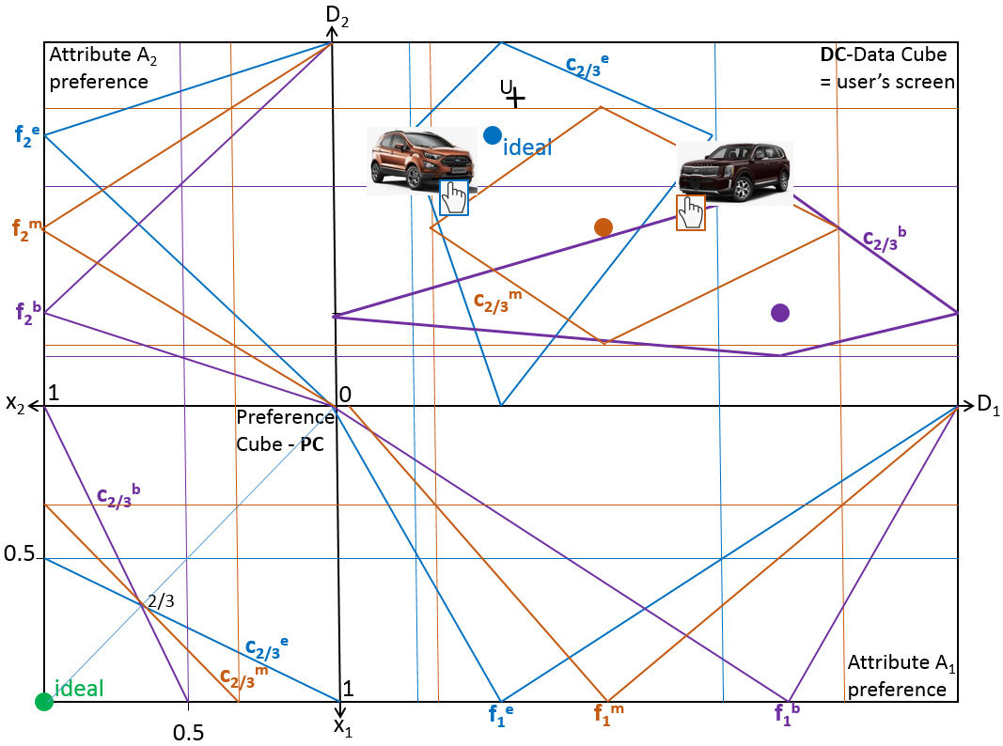
Prepare “geometric” mockup, lab Tue March 21

Slide 9
D₂
Two users u and u
Preference scale L = [0, 1]
C
ideal
E
Data
cube
A
D
ideal
B
x₂
D₁
1
0
a₁
d₁
0
Preference
cube
1
ideal
x₁

Slide 10
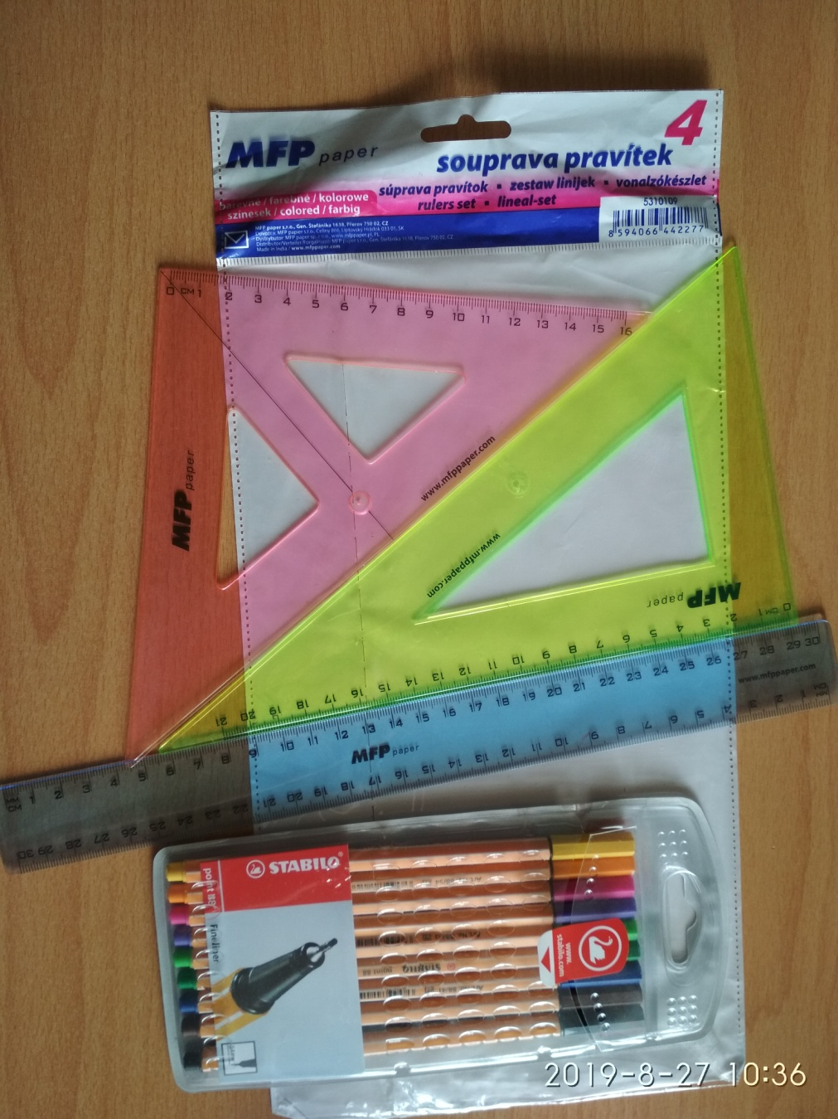
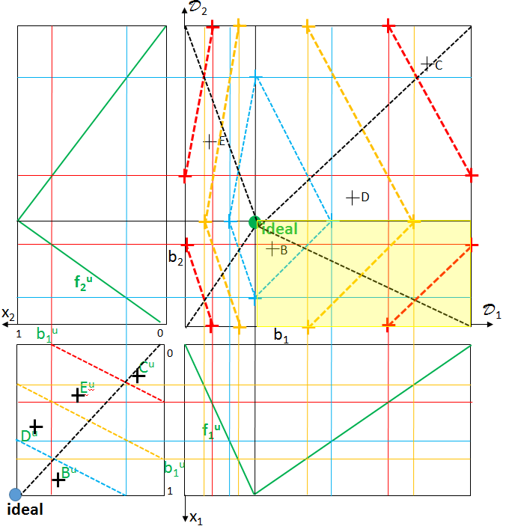
No coding, simulation using drawing tools

Slide 11
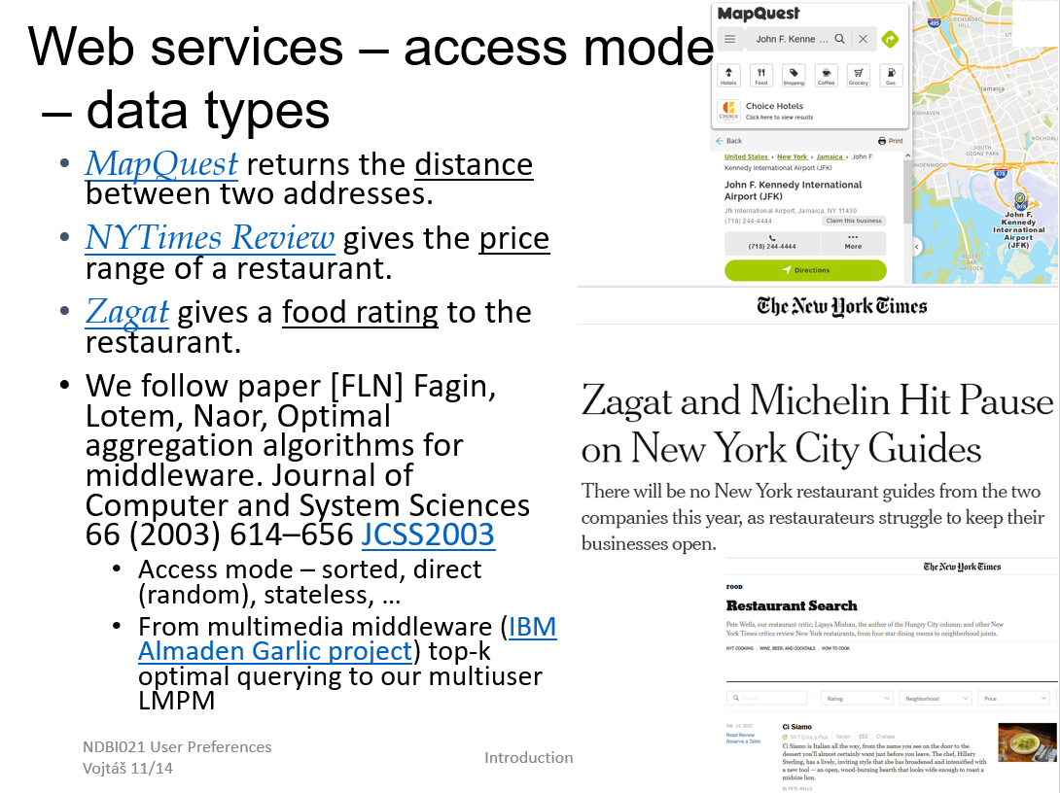
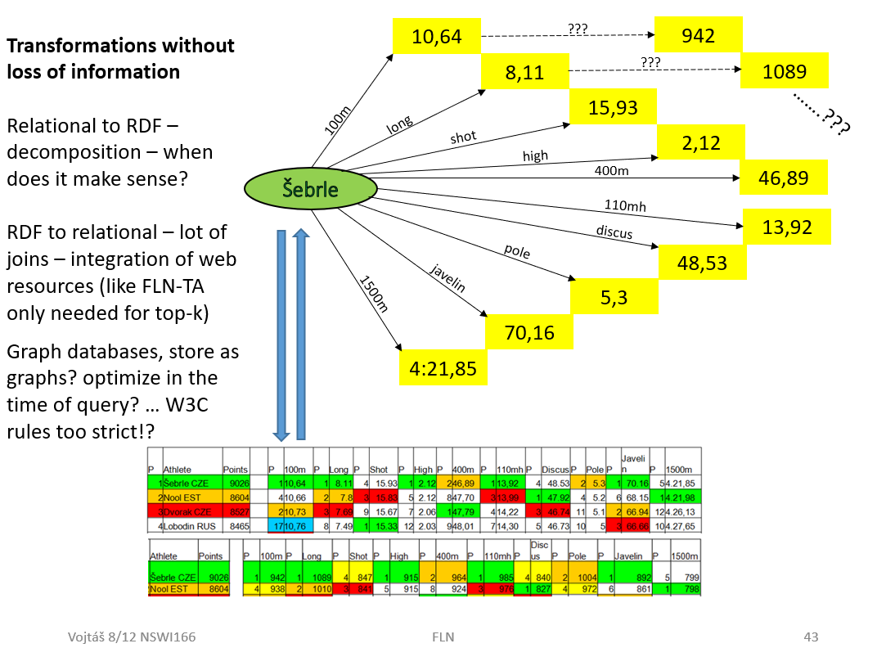
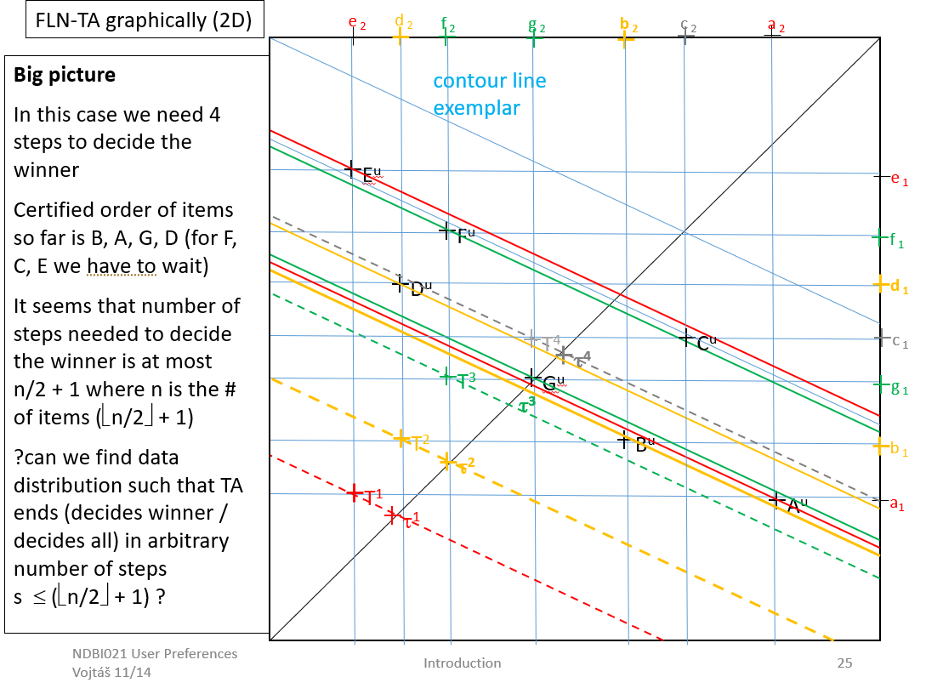
Yet another NSWI166 content, back to NDBI021

