Slide 1
NSWI166 Introduction to recommender systems and user preferences
Prostřední třetinu Peter Vojtáš, KSI MFF UK
první a poslední třetinu Láďa Peška, KSI MFF UK
7/12 Learn user preferences as a FLN-LMPM
(from Fagin-Lotem-Naor class of models)

Slide 2

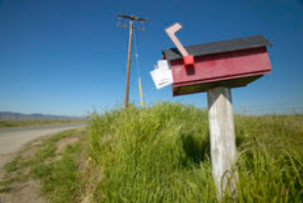


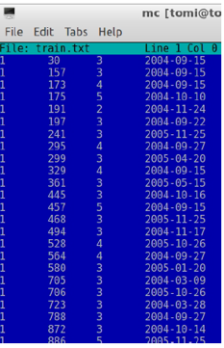
Old system - new one - streaming
Netflix
competition

Slide 3
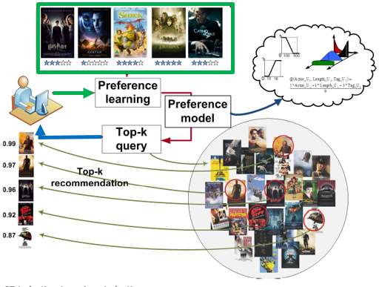
User’s preference learning
Preference learning = generalization of our observation of user = estimation of his/her future acts – what is a good recommendation (user/retailer)
We have
User behavior
Would like to
have an
LMPM user model
to compute top-k
for recommendation
What is our goal?

Slide 4
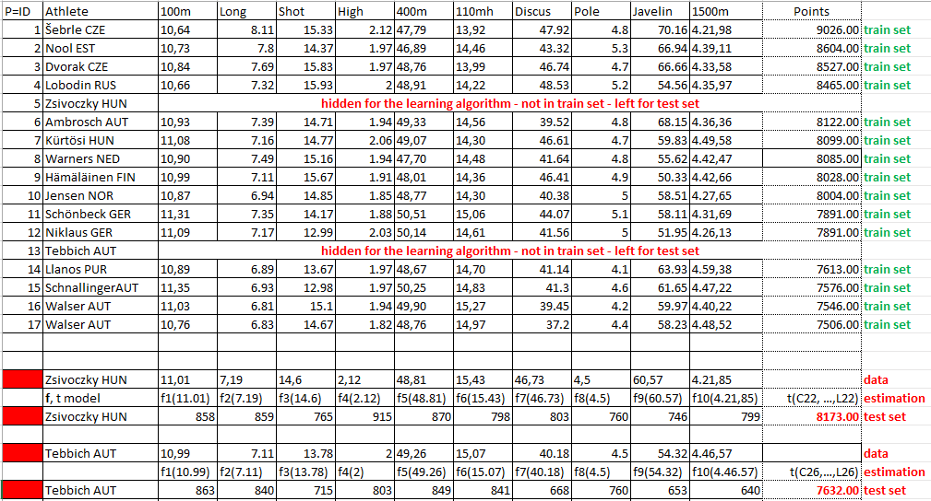
Note the difference: induction/deduction + test
Deduction = querying, search, input offline ordered
Induction = learning, estimating, generalizing, …

Slide 5
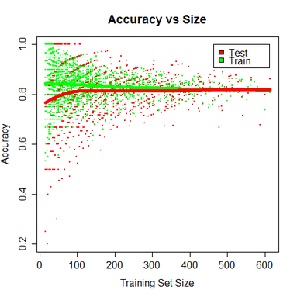
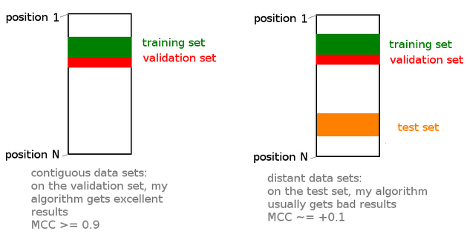
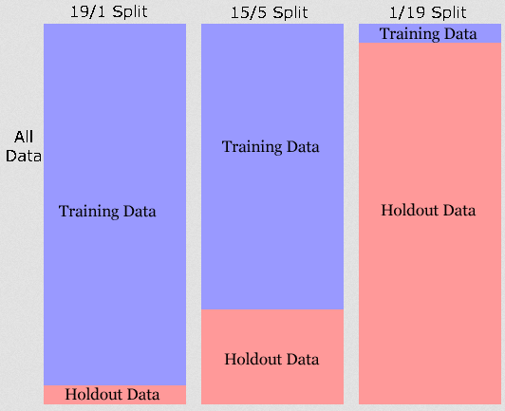
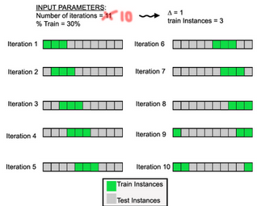
Learning from train data, testing (Google images)
What is the
conclusion?

Slide 6
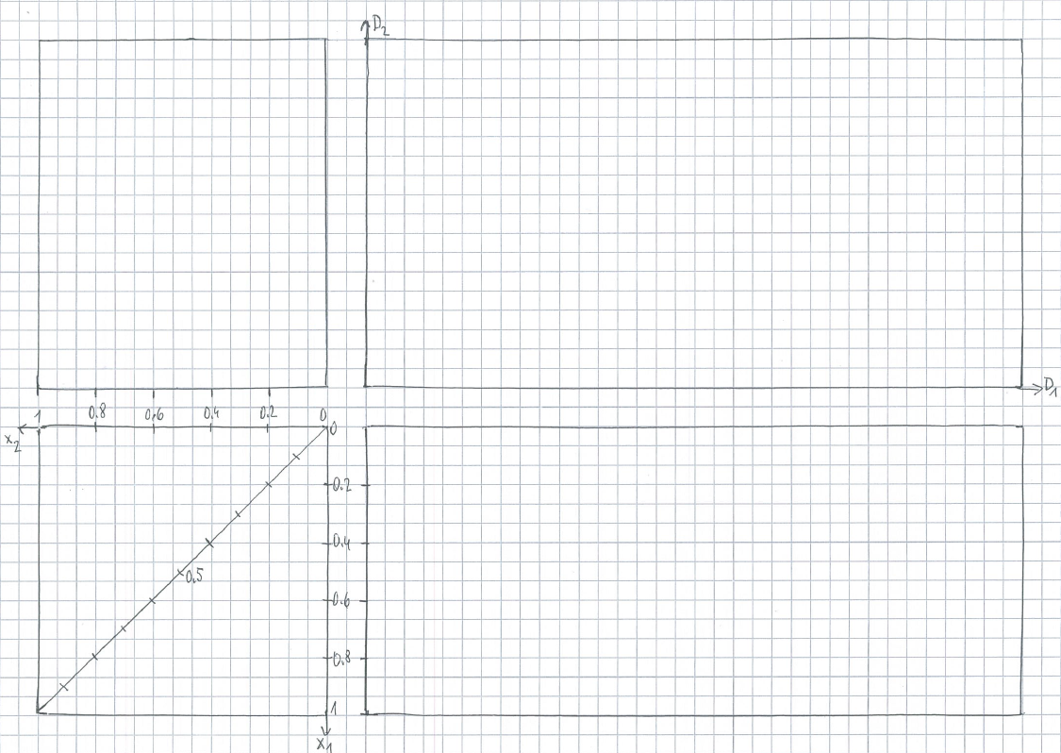
In the beginning we know only overall preferences r^{u} of an item, and item’s attributes
X .5
A .3
B .3
?
Y .5
D .5
E .7
Z .6
F .7
C .4
?
?

Slide 7
Learning the LMPM model
from data generated by an LMPM model
so, we know for sure data are from an LMPM model
We know that shape of attribute preferences are “hill”
We chose aggregation contour line
We start generating data from PC, in order to have “good” numeric values of overall preference – points are on contour lines with decimal values
Selecting attribute preferences, we have starting data

Slide 8
1. generate PC points, several in same contour line (t can be chosen arbitrarily) + use squared underlining to by able to depict r^{u} , r^{ft} and after learning r^{u} , r^{ft} ,
t
B
D
C
A
Y
E
X
Z
F

Slide 9
1. Choose f₁, f₂ (arbitrarily hill like) the inverse in DC. These are our observations (one of four possibilities)
A .3
C .4
D .5
E .7
F .7
B .3
A .3
X .5
X .5
B .3
Y .5
Y .5
D .5
f₂
Z .6
E .7
Z .6
F .7
C .4
B
D
C
A
Y
E
X
Z
F
f₁

Slide 10
2. Forget t, f₁, f₂ and we start in DC – these are our observations
A .3
B .3
C .4
D .5
E .7
F .7
A .3
X .5
X .5
B .3
Y .5
Y .5
D .5
Z .6
E .7
Z .6
F .7
C .4

Slide 11
3. 3. First step of our computation – projections –– only necessary lines
A .3
B .3
C .4
D .5
E .7
F .7
A .3
X .5
A .3
X .5
X .5
B .3
B .3
Y .5
Y .5
Y .5
D .5
D .5
Z .6
E .7
E .7
F .7
C .4
F .7
C .4
Z .6
Z .6
B .3
A .3
C .4
Y .5
X .5
D .5
Z .6
E .7
F .7

Slide 12
Learning the LMPM model – from data generated by an LMPM model
We have single user preference data generated from a LMPM model (given f₁, f₂, t and calculated r^{ft})
Learning starts projecting of points in DC to preference space [0,1]xD_{i}
To learn f₁, f₂, we will specify two learning methods
  m₁ takes 2nd and 3rd biggest values and their center of mass is the estimated ideal point in the respective domain (ties case by case)
  m₂ tries to separate about half of data from 0 by lines from max/min at zero, their intersection domain coordinate is the estimated ideal point
To learn t we use the fact that in training there are always two pairs of items with same preference degree
  a₁ takes the pair with smaller preference and using f₁, f₂ maps them to PC and we expect that they define estimated contour line
  a₂ method does the same the pair with bigger preference
So, there are 4 methods in total.

Slide 13
Learning the LMPM model
For each m_{i}a_{j} methods we use a 1/3 split of data to training and testing in c₁, c₂, c₃ iterations of learning – hence there will be in total 12 experiments m_{i}a_{j}c_{k} calculating r^{ft}.
Each of these 12 experiments evaluates error measure on test set. Metric used is sum of absolute values of differences between r^{ft} and r^{ft} degree on test set. So, we have 24 graphical “calculations”
Better is the method which has smaller sum of split errors (and consequently smaller average of errors)

Slide 14
C1 split

Slide 15
C1 TRAIN M1 A1
A .3
B .3
C .4
D .5
E .7
F .7
X .5
A .3
X .5
X .5
B .3
Y .5
Y .5
Y .5
D .5
D .5
Z .6
E .7
E .7
F .7
F .7
C .4
Z .6
Z .6
D .5
Y .5
Y .5
X .5
D .5
X .5
Z .6
E .7
F .7

Slide 16
C1 TEST M1 A1
A .3
B .3
C .4
D .5
E .7
F .7
X .5
A .3
X .5
B .3
Y .5
Y .5
D .5
Z .6
E .7
Z .6
F .7
C .4
B .3
C .4
A .3

Slide 17
C1 TRAIN M1 A2
A .3
B .3
C .4
D .5
E .7
F .7
X .5
A .3
X .5
X .5
B .3
Y .5
Y .5
Y .5
D .5
D .5
Z .6
E .7
E .7
F .7
F .7
C .4
Z .6
Z .6
Y .5
X .5
D .5
E .7
Z .6
E .7
F .7
F .7

Slide 18
C1 TEST M1 A2
A .3
B .3
C .4
D .5
E .7
F .7
X .5
A .3
X .5
B .3
Y .5
Y .5
D .5
Z .6
E .7
Z .6
F .7
C .4
B .3
C .4
A .3

Slide 19
C1 TRAIN M2 A1
A .3
B .3
C .4
E .7
F .7
X .5
A .3
X .5
X .5
B .3
Y .5
Y .5
Y .5
D .5
D .5
Z .6
E .7
E .7
F .7
F .7
C .4
Z .6
Z .6
Y .5
D .5
Y .5
X .5
D .5
Z .6
X .5
E .7
F .7

Slide 20
C1 TEST M2 A1
A .3
B .3
C .4
D .5
E .7
F .7
X .5
A .3
X .5
B .3
Y .5
Y .5
D .5
Z .6
E .7
Z .6
F .7
C .4
B .3
C .4
A .3

Slide 21
C1 TRAIN M2 A2
A .3
B .3
C .4
D .5
E .7
F .7
X .5
A .3
X .5
X .5
B .3
Y .5
Y .5
Y .5
D .5
D .5
Z .6
E .7
E .7
F .7
F .7
C .4
Z .6
Z .6
E .7
Y .5
X .5
D .5
Z .6
E .7
F .7
F .7

Slide 22
C1 TEST M2 A2
A .3
B .3
C .4
D .5
E .7
F .7
X .5
A .3
X .5
B .3
Y .5
Y .5
D .5
Z .6
E .7
Z .6
F .7
C .4
B .3
C .4
A .3

Slide 23
Experiment evaluation
sum of error measures (3 points in test set) of split c1,
M1 A1
M1 A2
M2 A1
M2 A2

Slide 24
C2 split

Slide 25
C2 train M1 A1
A .3
B .3
C .4
D .5
E .7
F .7
A .3
X .5
A .3
X .5
X .5
B .3
B .3
Y .5
Y .5
Y .5
D .5
Z .6
E .7
Z .6
C .4
Z .6
F .7
C .4
B .3
B .3
A .3
A .3
C .4
Y .5
X .5
Z .6

Slide 26
C2 test M1 A1
A .3
B .3
C .4
D .5
E .7
F .7
X .5
A .3
X .5
B .3
Y .5
Y .5
D .5
Z .6
E .7
Z .6
F .7
C .4
D .5
E .7
F .7

Slide 27
C2 train M1 A2
A .3
B .3
C .4
D .5
E .7
F .7
A .3
X .5
A .3
X .5
X .5
B .3
B .3
Y .5
Y .5
Y .5
D .5
Z .6
E .7
Z .6
C .4
Z .6
F .7
C .4
B .3
A .3
Y .5
C .4
Y .5
X .5
Z .6
X .5

Slide 28
C2 test M1 A2
A .3
B .3
C .4
D .5
E .7
F .7
X .5
A .3
X .5
B .3
Y .5
Y .5
D .5
Z .6
E .7
Z .6
F .7
C .4
D .5
E .7
F .7

Slide 29
C2 train M2 A1
A .3
B .3
C .4
D .5
E .7
F .7
A .3
X .5
A .3
X .5
X .5
B .3
B .3
Y .5
Y .5
Y .5
D .5
Z .6
E .7
Z .6
C .4
Z .6
F .7
C .4
B .3
A .3
B .3
A .3
C .4
Y .5
X .5
Z .6

Slide 30
C2 test M2 A1
A .3
B .3
C .4
D .5
E .7
F .7
X .5
A .3
X .5
B .3
Y .5
Y .5
D .5
Z .6
E .7
Z .6
F .7
C .4
D .5
E .7
F .7

Slide 31
C2 train M2 A2
A .3
B .3
C .4
D .5
E .7
F .7
A .3
X .5
A .3
X .5
X .5
B .3
B .3
Y .5
Y .5
Y .5
D .5
Z .6
E .7
Z .6
C .4
Z .6
F .7
C .4
B .3
A .3
Y .5
C .4
Y .5
X .5
X .5
Z .6

Slide 32
C2 test M2 A2
A .3
B .3
C .4
D .5
E .7
F .7
X .5
A .3
X .5
B .3
Y .5
Y .5
D .5
Z .6
E .7
Z .6
F .7
C .4
D .5
E .7
F .7

Slide 33
Experiment evaluation
sum of error measures of splits c1, c2,
M1 A1
M1 A2
M2 A1
M2 A2

Slide 34
C3 split

Slide 35
C3 train M1 A1
A .3
B .3
C .4
D .5
E .7
F .7
A .3
X .5
A .3
X .5
B .3
B .3
Y .5
Y .5
D .5
D .5
Z .6
E .7
E .7
F .7
C .4
Z .6
F .7
C .4
B .3
B .3
A .3
C .4
A .3
D .5
E .7
F .7

Slide 36
C3 test M1 A1
A .3
B .3
C .4
D .5
E .7
F .7
X .5
A .3
X .5
B .3
Y .5
Y .5
D .5
Z .6
E .7
Z .6
F .7
C .4
Y .5
Z .6
X .5

Slide 37
C3 train M1 A2
A .3
B .3
C .4
D .5
E .7
F .7
A .3
X .5
A .3
X .5
B .3
B .3
Y .5
Y .5
D .5
D .5
Z .6
E .7
E .7
F .7
C .4
Z .6
F .7
C .4
B .3
A .3
E .7
C .4
D .5
E .7
F .7
F .7

Slide 38
C3 test M1 A2
A .3
B .3
C .4
D .5
E .7
F .7
X .5
A .3
X .5
B .3
Y .5
Y .5
D .5
Z .6
E .7
Z .6
F .7
C .4
Y .5
Z .6
X .5

Slide 39
C3 train M2 A1
A .3
B .3
C .4
D .5
E .7
F .7
A .3
X .5
A .3
X .5
B .3
B .3
Y .5
Y .5
D .5
D .5
Z .6
E .7
E .7
F .7
C .4
Z .6
F .7
C .4
B .3
B .3
A .3
C .4
A .3
D .5
E .7
F .7

Slide 40
C3 test M2 A1
A .3
B .3
C .4
D .5
E .7
F .7
X .5
A .3
X .5
B .3
Y .5
Y .5
D .5
Z .6
E .7
Z .6
F .7
C .4
Y .5
Z .6
X .5

Slide 41
C3 train M2 A2
A .3
B .3
C .4
D .5
E .7
F .7
A .3
X .5
A .3
X .5
B .3
B .3
Y .5
Y .5
D .5
D .5
Z .6
E .7
E .7
F .7
C .4
Z .6
F .7
C .4
B .3
A .3
C .4
E .7
D .5
E .7
F .7
F .7

Slide 42
C3 test M2 A2
A .3
B .3
C .4
D .5
E .7
F .7
X .5
A .3
X .5
B .3
Y .5
Y .5
D .5
Z .6
E .7
Z .6
F .7
C .4
Y .5
Z .6
X .5

Slide 43
Experiment evaluation
sum of error measures of splits c1, c2, c3
M2+A2 is the winner (tightly followed by M2A1, then M1A1 and far away last M1A2)
M1 A1
M1 A2
M2 A1
M2 A2

Slide 44
Experiment evaluation
sum of error measures of splits c1, c2, c3
M2+A2 is the winner (tightly followed by M2A1, then M1A1 and far away last M1A2)
In general A1 is little bit better than A2, and M2 is better than M1
M1
M2
A1
A2
M1 A1
M1 A2
M2 A1
M2 A2

Slide 45
Lessons learned 1?
Are these synthetic data representative?
  Experience/practice on different data distribution shows that estimated aggregation need not have nonnegative weights (contour line direction goes from SW to NE)
  We did not specify graphical algorithm for valley/hill
We do not use information from DC, only from 1D projections – we lose information on mutual interplay of large preference in one attribute with other – there is a need for further algorithms
Error at highly preferred objects (recommended) is more important than that of low preferred
  This can be measured by some classification metric
When designing a graphical algorithm, we (as humans with global parallel visual perception) are tempted to “guess” the right solution – please erase “green” info

Slide 46
Jak dochází ke „sporu“ v PC
A
Y
B
X
B
B
X
A
Y
Y
A
A
Y
Y
A
X
B
B
X
A
X
A
Y
B
B

Slide 47
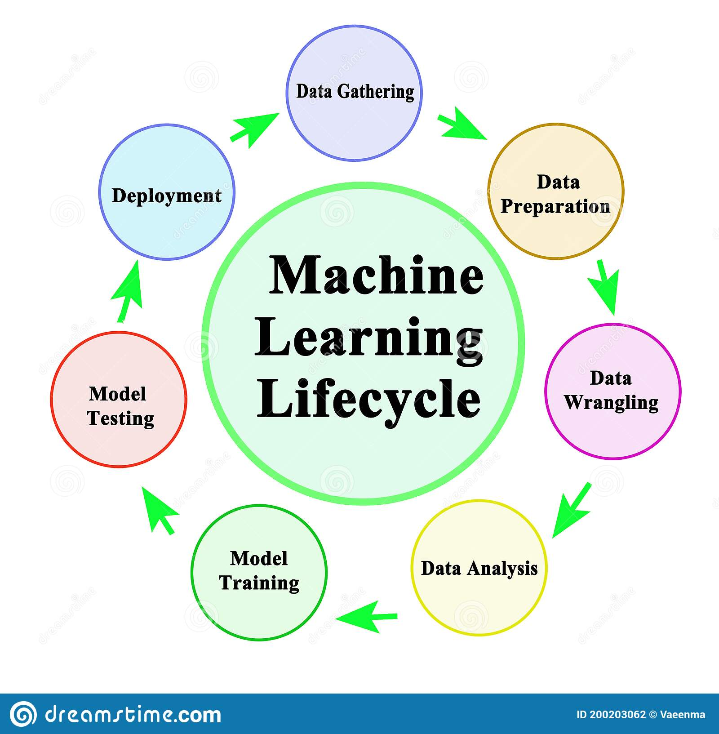
Machine learning – data mining - …
Teacher – labeling
  Supervised
  Unsupervised
How much do I know about items
  Content based
  Collaborative
  Hybrid
How much do I know about user
  Demographic data
  Historical data
  Anonymous users
Domain specific (leisure, frequency, … )
For more see lectures of Ladislav Peska

Slide 48
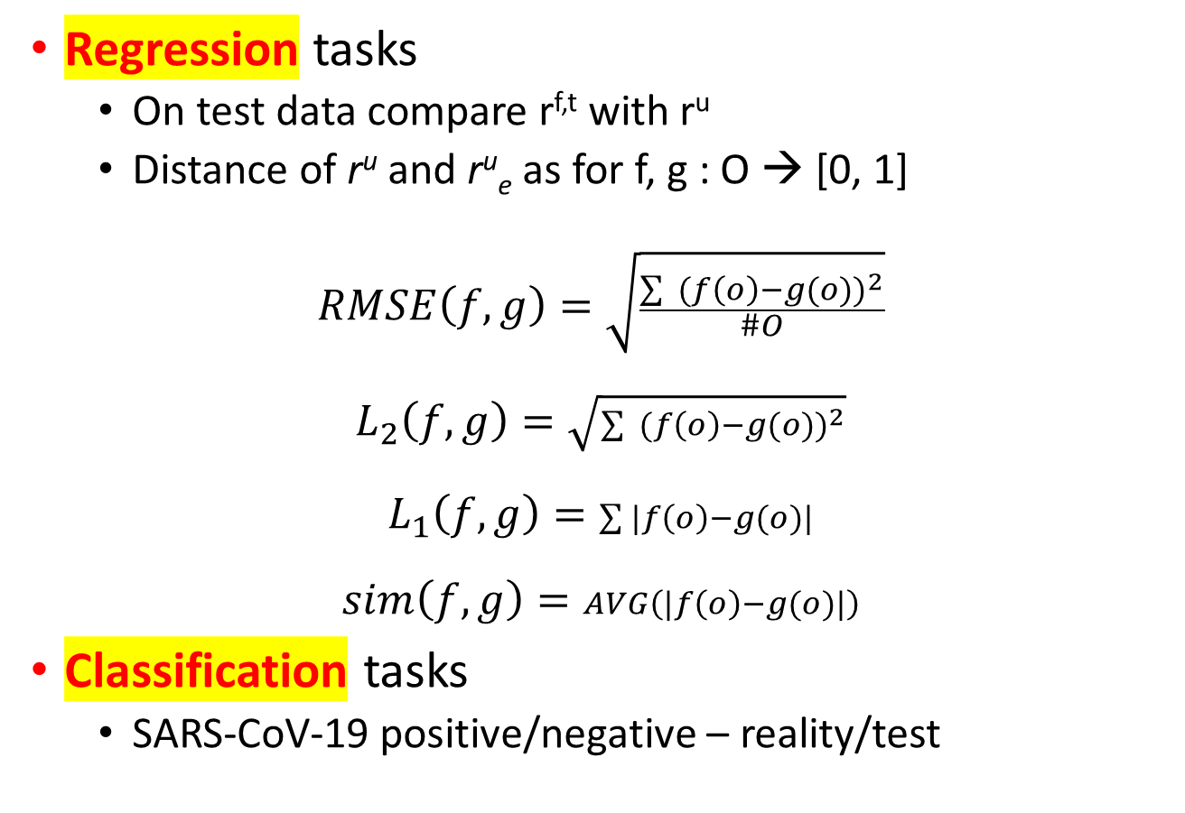
Evaluation metrics influences all
Regression tasks
  On test data compare r^{f,t} with r^{u}
  Distance of r^{u} and r^{u}_{e} as for f, g : O → [0, 1]
$$RMSE\left(f,g\right)=\sqrt{\frac{\sum{ {(f\left(o\right)−g(o))}^{2}}}{\#O}}$$
$$L_{2}\left(f,g\right)=\sqrt{\sum{ {(f\left(o\right)−g(o))}^{2}}}$$
$$L_{1}\left(f,g\right)=\sum{|f\left(o\right)−g(o)|}$$
$$sim\left(f,g\right)=AVG\left(|f\left(o\right)−g(o)|\right)$$
Classification tasks
  SARS-CoV-19 positive/negative – reality/test

Slide 49
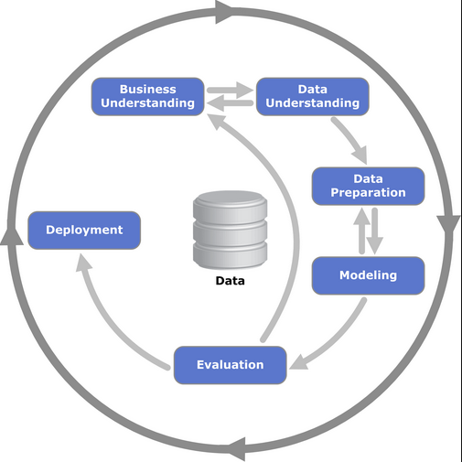
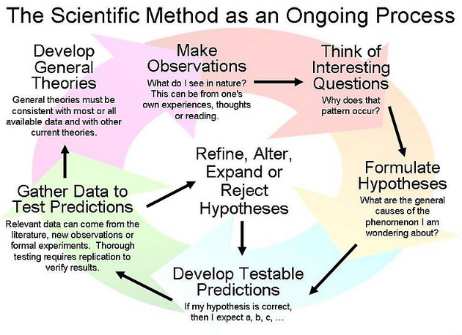
Recall - scientific method
Physical nature is unique
Users’ nature not unique
Scientific method
  Observation/Research
  Hypothesis
  Prediction
  Experimentation
  Conclusion
Current solutions
Components
Context
?forgot something?
11
11
11

Slide 50
CRISP-DM Cross Industry
Standard Process for
Data Mining
Scientific method
physics, biology, chemistry
medicine, pharmaceutics
Sociology, psychology
Improve algorithm
The whole process
r^{u} : V^{u}→ [0,1]
Deploy, online A/B test
Based on train data
Find f,t and user u^{f,t}
On test data compare
r^{f,t} with r^{u}
11
11
Deploy, online A/B test
r^{u} : V^{u}→ [0,1]
11
Improve algorithm
User is an
LMPM user?
Clusters of users?
Content matters?
On test data compare
r^{f,t} with r^{u}
Based on train data
Find f,t and user u^{f,t}

Slide 51
Metric – regression, order, business
Classical
  RMSE, ABS, AVG, L^{p} , …
  Pearson , ...
  … on all objects, top-k,
Order matters
  nDCG, Kendall, Average position of best object,
  1-hit, Next -1, 1st hit, …
  Again parametrize wrt k in top-k
What are business relevant metric? dynamic, session, ..
  E.g. for Netflix it is loyalty ((no)content, explicit rating, user identified by registration)
  For recommendation based on implicit user behavior, no registration, ...
  Epidemic / pandemic (test PCR/Ag, has virus, is contagious, has symptoms, needs hospital treatment, serious, ... (dead))

Slide 52
Deduction – induction – abduction – analogy …
Measures of success, mathematics, statistics, computer science, industry, customers, economy …
Hypothesis should be refutable
The International Congress of Logic, Methodology and Philosophy of Science and Technology (CLMPST)
Strategic planning
Where is the value
  Innovation, patent, know-how ownership
  Investment
  Assembly – Montagewerk – montovna
  Final product – added value

Slide 53
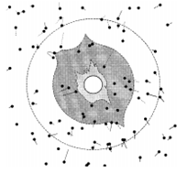
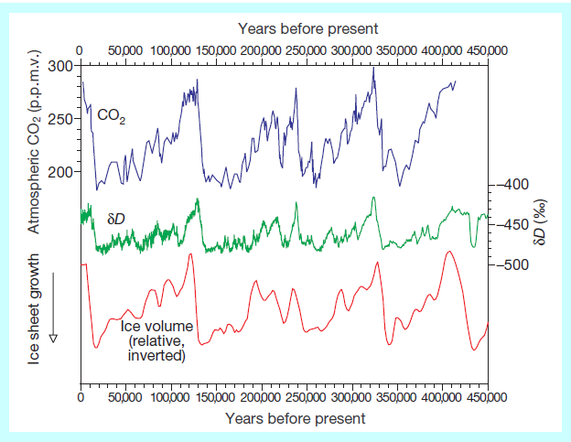
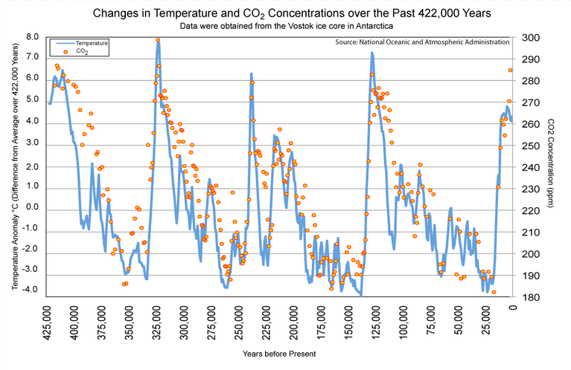
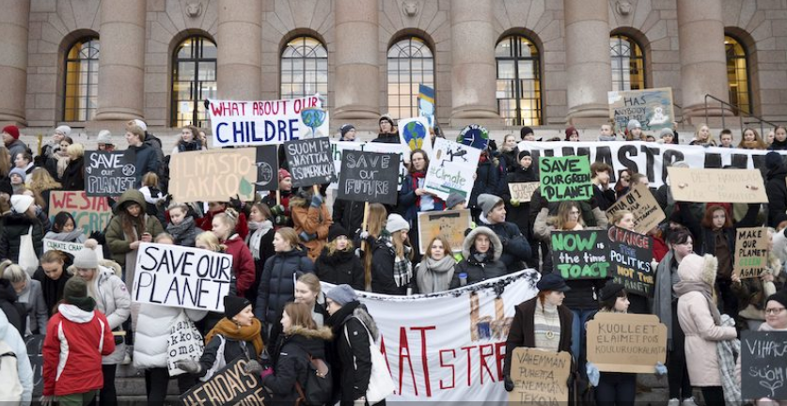
Measure, compute(simulate), media, politics
Eddington confirms Einstein’s theory of relativity - data - 1919 eclipse
Effect of human activity on climate change insignificant
The most viable hypotheses for the cause of glacial/interglacial CO2 change involve ... by biological production
Peter Coles:... But the media don't seem to like representing science the way it actually is, ... They prefer instead to portray scientists as priests, laying down the law ...
Change in star position during the eclipse

