Slide 1


NDBI021, Lecture 5
User preferences, 2/1 ZK+Z,
Wed 12:20 – 13:50 S8
Wed 14:00 – 15:30 SW2 (odd weeks)
https://www.ksi.mff.cuni.cz/~peska/vyuka/ndbi021/2022/
https://ksi.mff.cuni.cz

Slide 2
Recommender Systems: recap

Slide 3



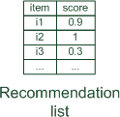




Paradigms of recommender systems

Slide 4
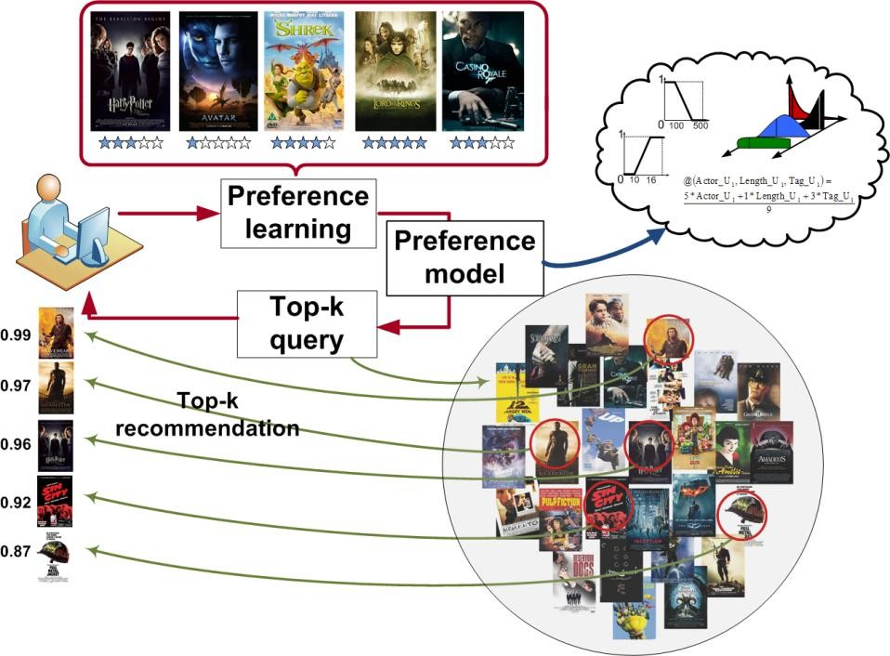
Lifecycle of Recommender Systems
Get User Feedback
Learn internal model
Upon demand, recommend objects
The process is asynchronous by nature
Most recent usually most relevant
Dynamic nature of the process seriously complicate things
  Partial re-train / model updates
  Long-term vs short-term (context), preference drift
  Repeated consumption & recommendation

Slide 5
Basic algorithms
Non-personalized & item-based & session-based models
KNN variants
Matrix factorizations
  Content-aware factorization methods
Reinforced learning / multi-armed bandits

Slide 6
Basic evaluation
On-line / off-line / lab studies
Accuracy-based metrics (Recall, nDCG, MAP,…)
„Beyond accuracy“ (diversity, novelty, coverage, fairness, popularity bias…)
„Technical“ (time complexity, scalability, ability to predict for all…)

Slide 7
Fairness in Recommender Systems

Slide 8

Fairness in Recommender Systems
Tutorial from: https://fairness-tutorial.github.io/

Slide 9
Fairness issues in RecSys and IR
News recommendation/social networks
  Does the suggested articles close me into some opinion bubble?
    Fairness of the presented opinions on controversary subjects
Job matching & marketplaces
  Am I omitted from the list of possible applicants just because [black/old/female…]
  Is one content provider favored over others?
Finance domain
  Why am I not recommended for loan? Why is my credit score lower/higher?
E-commerce
  Is this product being recommended because it is the best for me… or because the provider earns the most from it?
What if these features are learned indirectly?

Slide 10
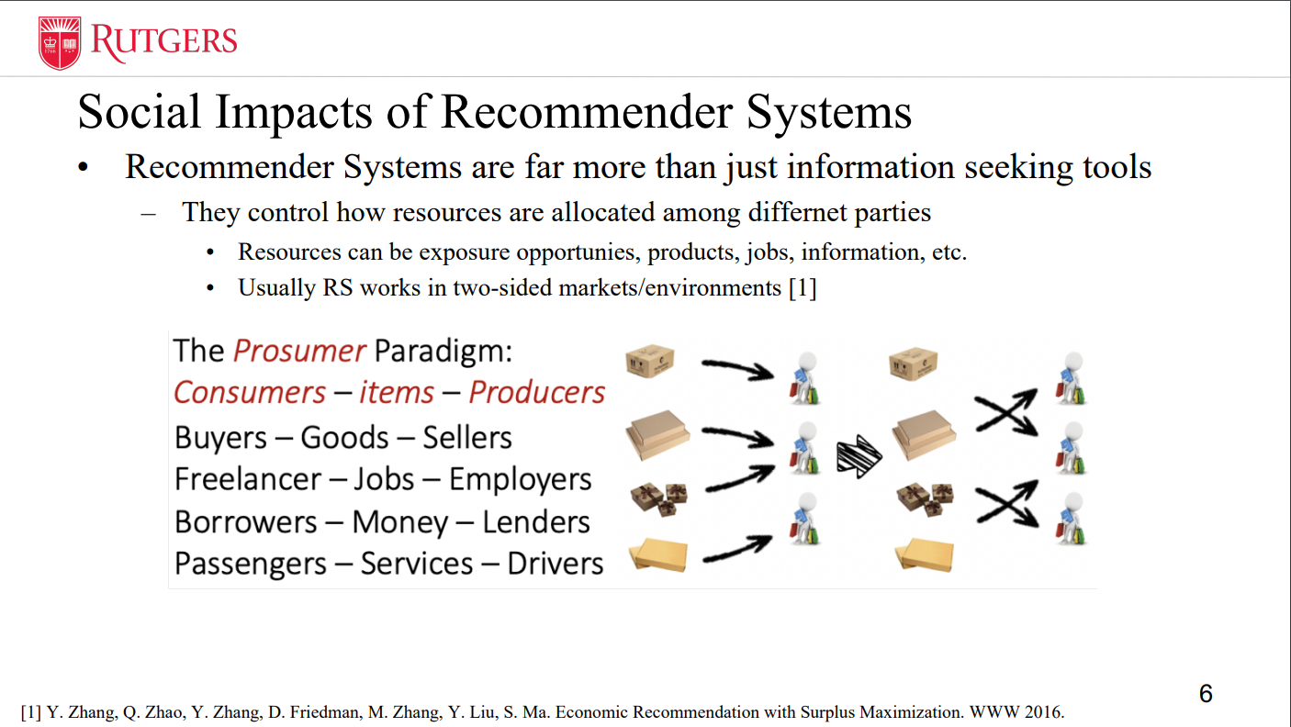

Slide 11
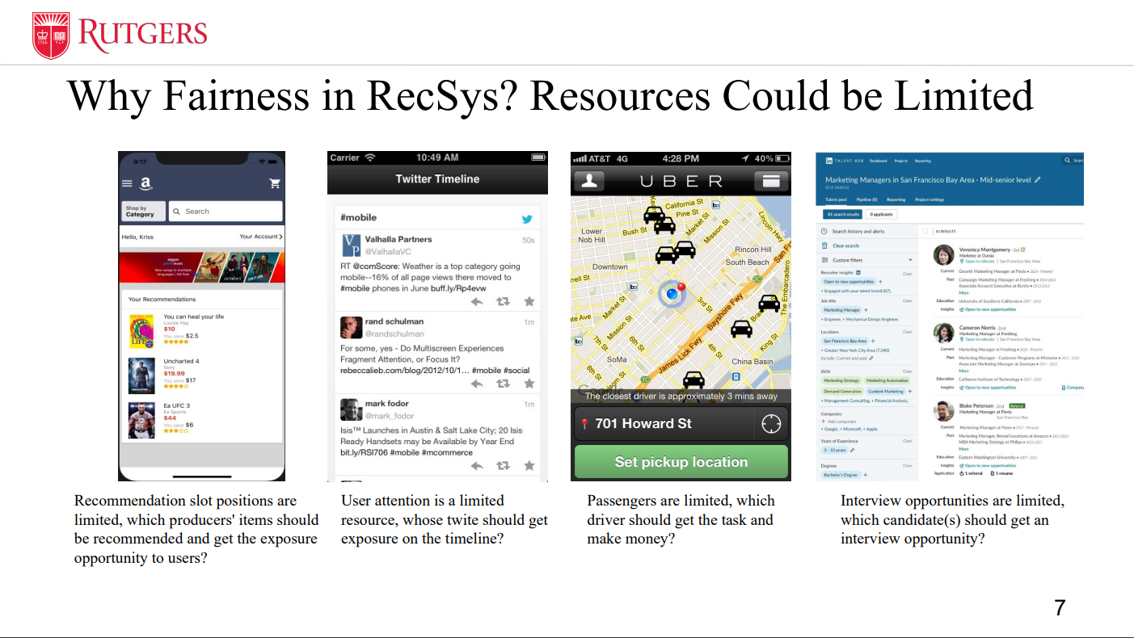

Slide 12
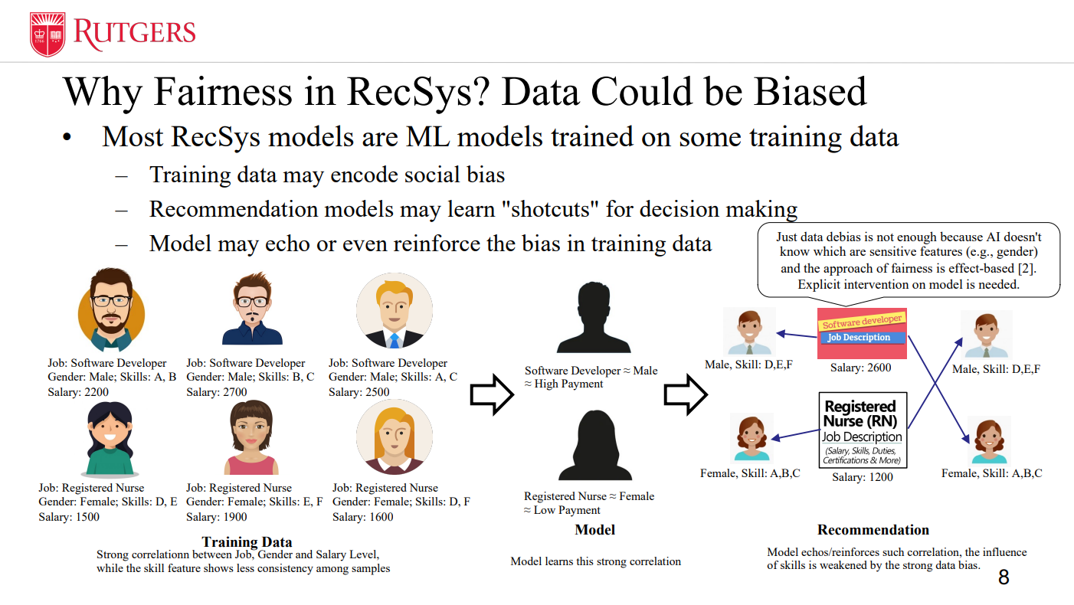

Slide 13
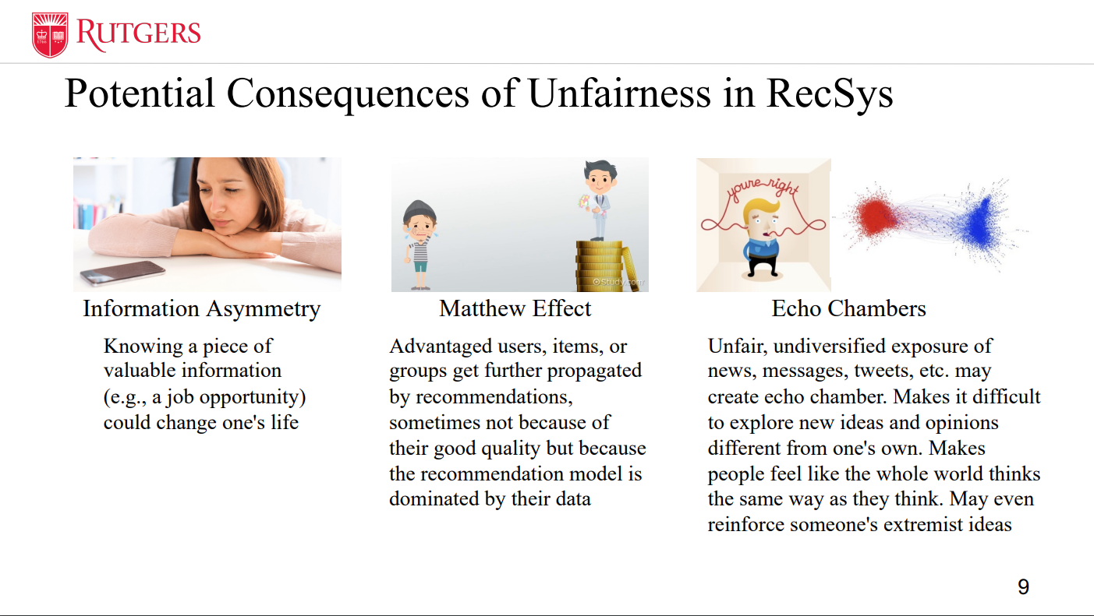

Slide 14
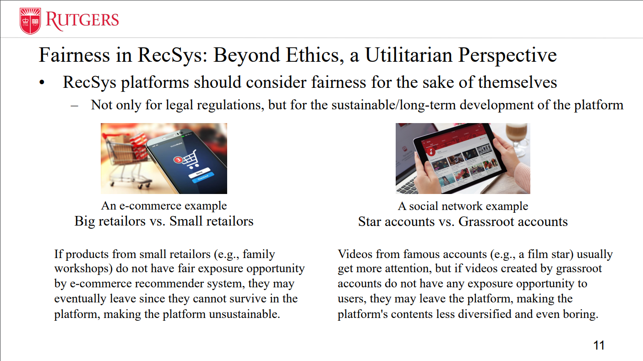

Slide 15
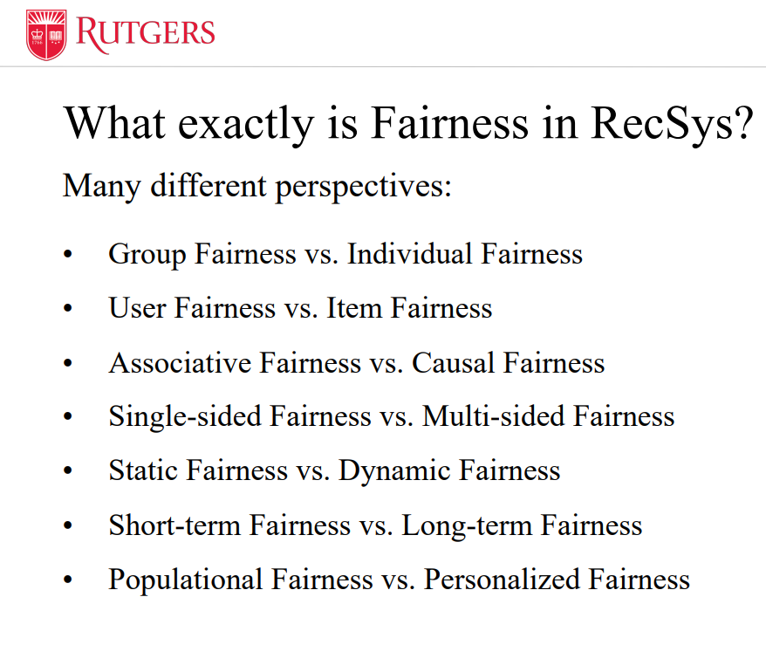
Fairness in RecSys
User-wise fairness
  Does the system work for me as good as for others?
Fairness w.r.t. (sensitive) user groups
  Are some groups being discriminated?
Item-wise / content provider-wise fairness
Multi-objective optimization
  a.k.a. fairness for multiple metrics

Slide 16
Fairness in General
Equality of opportunities
  „You should not be disqualified /mistreated based on generic statistics that should not affect the outcome“
    „You will not get the job because you are female“
    What about already biased inputs?
Equality of outcome
  „Submission vs. acceptance ratio for male/female authors should not differ, if they differ, countermeasures should be taken“
    Is this still fair?
    Someone may be in „higher need“ of getting help vs. Someone had been mistreated in the past.
Fairness vs. proportionality

Slide 17
More on biases in RS soon...

Slide 19
Statistical parity
Multi-valued y -> compare distributions (e.g., KL divergence, https://en.wikipedia.org/wiki/Kullback%E2%80%93Leibler_divergence)

Slide 20


Fairness in Machine Learning — Basic tasks
Fairness in Classification
Fairness in Ranking

Slide 21
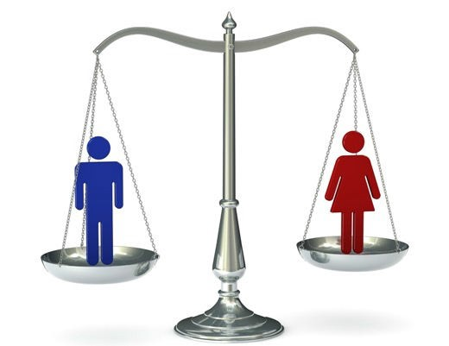
Fairness in Classification — Introduction
Objective: Avoid unethical interference of protected attributes into the decision-making process.
Binary Classification: Fairness metrics can be expressed by rate constraints to regularize the classifier’s positive or negative rates over different protected groups.
Statistical parity:
𝑃 𝑌" = 1 𝑍 = 0 = 𝑃 𝑌" = 1 𝑍 = 1
Equality of Opportunity:
𝑃 𝑌" = 1 𝑍 = 0, 𝑌 = 1 = 𝑃 𝑌" = 1 𝑍 = 1, 𝑌 = 1
…

Slide 22



Fairness in Classification — Method
Pre-processing: [3][4][5][6]…
In-processing: [7][8][9][10]…
Post-processing: [11][12][13]…
Pros:
The transformed dataset can be used to train any downstream algorithm.
Cons:
Unpredictable loss in accuracy;
May not remove unfairness on the test data.
Pros:
Good performance;
May higher flexibility for the trade-off.
Cons:
A non-convex optimization problem and not guarantee optimality.
Pros:
No need to modify classifier;
Relatively good performance especially fairness measures.
Cons:
Cannot be used in cases where sensitive feature information is unavailable.

Slide 23
Hard to optimize directly (complex P)
Distance to decision boundary
Mean value of protected attribute

Slide 24



Fairness in Ranking — Introduction
List-wise definitions for fairness: depend on the entire list of results for a given query
Unsupervised criteria: the average exposure near the top of the ranked list to be equal for different groups [71][72][75]
Supervised criteria: the average exposure for a group to be proportional to the average relevance of that group’s results to the query [65][67]

Slide 25
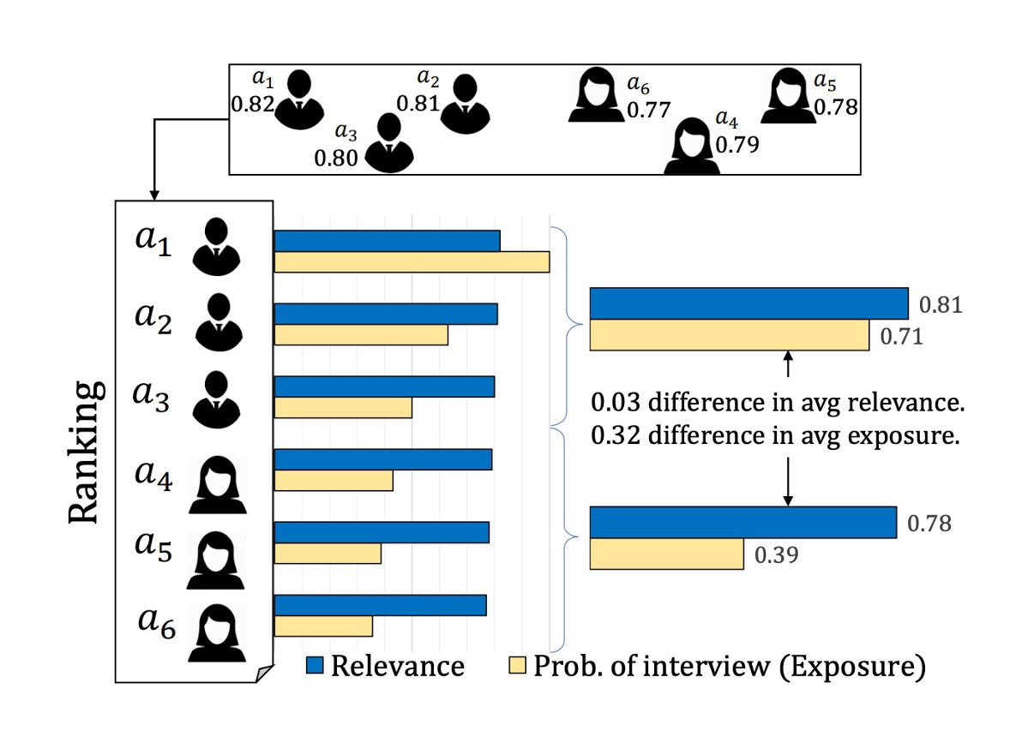
Fairness in Ranking
Fairness Concerns: A conceptual and computational framework that allows the formulation of fairness constraints on rankings in terms of exposure allocation.
Job seeker example: a small difference in relevance can lead to a large difference in exposure (an opportunity) for the group of females.
Reasonable if relevance has direct probabilistic interpretation
Minor differences might be arbitrary, or a result of a previous bias
Singh, Ashudeep, and Thorsten Joachims. "Fairness of exposure in rankings." SIGKDD’2018.

Slide 26


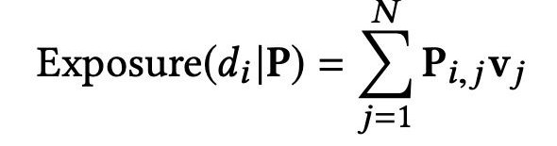
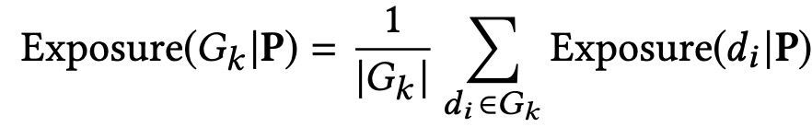

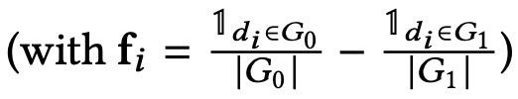
Fairness in Ranking
Method:
Exposure for a document 𝑑! under a probabilistic ranking 𝑃 as:
Demographic Parity Constraints:
31
Singh, Ashudeep, and Thorsten Joachims. "Fairness of exposure in rankings." SIGKDD’2018

Slide 27
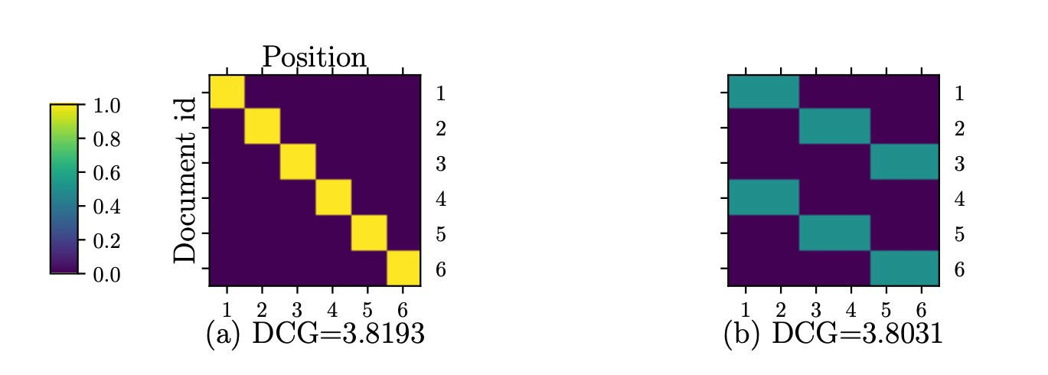
Fairness in Ranking
Figure (a) is optimal unfair ranking that maximizes DCG.
Figure (b)
is optimal fair ranking
under demographic parity.
Compared to the DCG of the unfair ranking, the optimal fair ranking has slightly lower utility with a DCG.
32
Singh, Ashudeep, and Thorsten Joachims. "Fairness of exposure in rankings." SIGKDD’2018

Slide 28
Fairness in Ranking
Based on P_i,j = probability of document i being recommended at position j (for some query q)
- Linear programming
Individual fairness variants can be expressed via f & g vectors
32
Singh, Ashudeep, and Thorsten Joachims. "Fairness of exposure in rankings." SIGKDD’2018

Slide 29




Fairness in Recommendation — Challenges
More Perspectives
Multiple Models And Goals
Extreme Data Sparsity
Dynamics

Slide 30
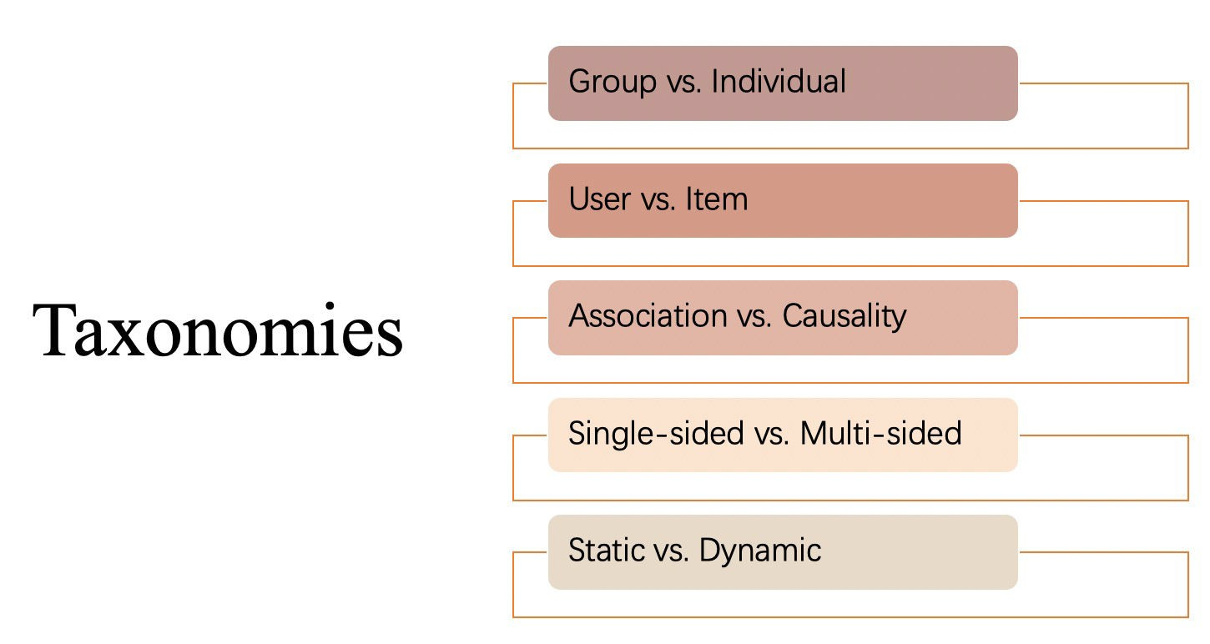

Slide 31




















Group Fairness vs. Individual Fairness
Group fairness requires that the protected groups should be treated similarly to the advantaged group.
Group = Male Advantaged
We need to be fair for both male and female applicants
Group = Female Protected
Require the same acceptance rate for both male and female job applicants

Slide 32

Group Fairness vs. Individual Fairness
Individual fairness requires that the similar individual should be treated similarly.
Image source: https://mitibmwatsonailab.mit.edu/wp-content/uploads/2020/04/Leadspace-GettyImages-598952582.jpg

Slide 33

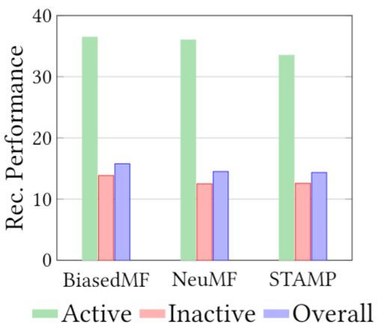



Group Fairness in Recommendation
Fairness concerns: The unfair recommendation quality between user groups with different activity levels, e.g., number of interactions.
Unfairness of current recommender systems:
  Active users only account for a small proportion of users.
  The average recommendation quality on the small group (active) is significantly better than that on the remaining majority of users (inactive) for all baselines.
Ratio between Active and Inactive users
5%
Inactive
Act ive
95%
Li.Y et al. “User-oriented Fairness in Recommendation” WWW’21.

Slide 34





Active vs. Inactive groups
Fairness on user side: Fairness requirements in recommender systems may come from users.
I want a doll
Milk
Ice cream Skirt
… Orange
…
Active
I want a toy car
Ice cream Basketball
Inactive
Recommender System

Slide 35
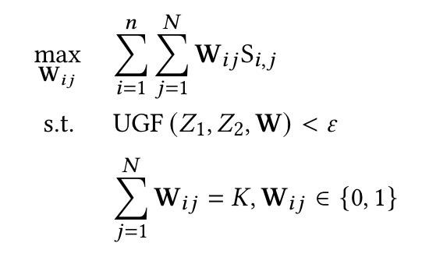
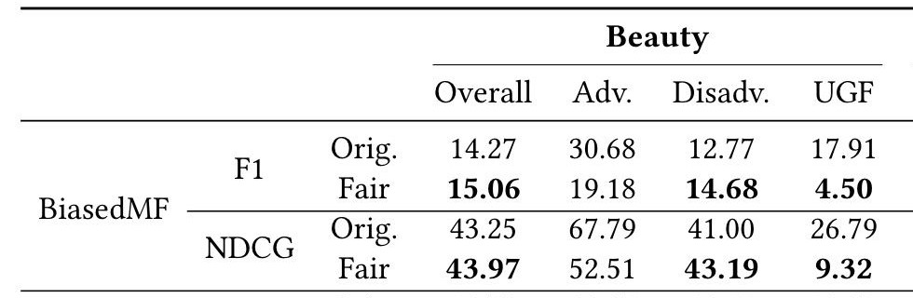
Group Fairness in Recommendation
Fairness-aware Algorithm: A re-ranking method with user-oriented group fairness
Preference of user 𝑖 in terms of item 𝑗
Fairness constraint
constrained on the recommendation lists
generated from any base recommender algorithm.
Top-K list
Experiment
Results:
Improve
fairness;
Improve recommendation quality of overall
and disadvantaged users. However, the performance of advantaged users is reduced to satisfy our fairness requirement.
Improvement of overall accuracy
Disadv. Adv.
Improvement of fairness
Li.Y et al. “User-oriented Fairness in Recommendation” WWW’21.

Slide 36
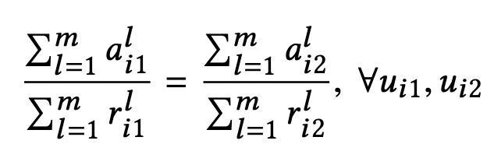
Individual Fairness in Recommendation
Fairness concerns: the position bias which leads to disproportionately: less attention being paid to low-ranked subjects (position bias).
No single ranking can achieve individual attention fairness.
Equity of Amortized Attention: A sequence of rankings {1,2, … 𝑚} offer equity of amortized attention if each subject 𝑢 receives cumulative attention proportional to her cumulative relevance:
attention
relevance
Biega, A. J. et al. “Equity of Attention: Amortizing Individual Fairness in Rankings” SIGIR’18.

Slide 37
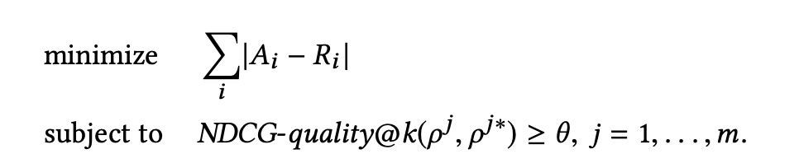
Individual Fairness in Recommendation
Method (Offline optimization):
Fairness (L1 norm over distributions)
Ranking quality
Experiment Results:
  Improving equity of attention is crucial: the discrepancy between the attention received and the deserved attention can be substantial.
  Improving equity of attention can often be done without sacrificing much quality in the rankings.
Integer linear programming (re-ranking) https://en.wikipedia.org/wiki/Integer_programming
Biega, A. J. et al. “Equity of Attention: Amortizing Individual Fairness in Rankings” SIGIR’18.

Slide 38
Associative Fairness vs. Causal Fairness
Find the discrepancy of statistical metrics between individuals or sub-populations.
In binary classification, fairness metrics can be represented by regularizing the classifier's positive or negative rates over different protected groups.

Slide 39

Associative Fairness vs. Causal Fairness
Fairness cannot be well assessed only based on association notions [46-49].
Difference:
  Reason about the causal relations between the protected features and the model outcomes.
  Leverage prior knowledge about the world structure in the form of causal models, help to understand the propagation of variable changes in the system.
https://en.wikipedia.org/wiki/Causal_model

Slide 40


























Counterfactual fairness
Counterfactual fairness is an individual-level causal-based fairness notion. It requires that for any possible individual, the predicted result of the learning system should be the same in the counterfactual world as in the real world.
ADMISSION RATE
Female Male
What if I am a girl, can I get an offer?
Gender = F
Gender = M
GPA = 3.6
SAT = 700
Get Offer!
GPA = 3.6
SAT = 700
Get offer???
Offer
50%
_{50%} Offer
No offer
No offer
Associative Group Fairness
Counterfactual Fairness
59

Slide 41
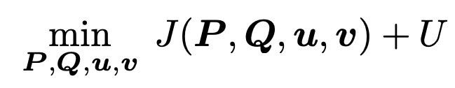
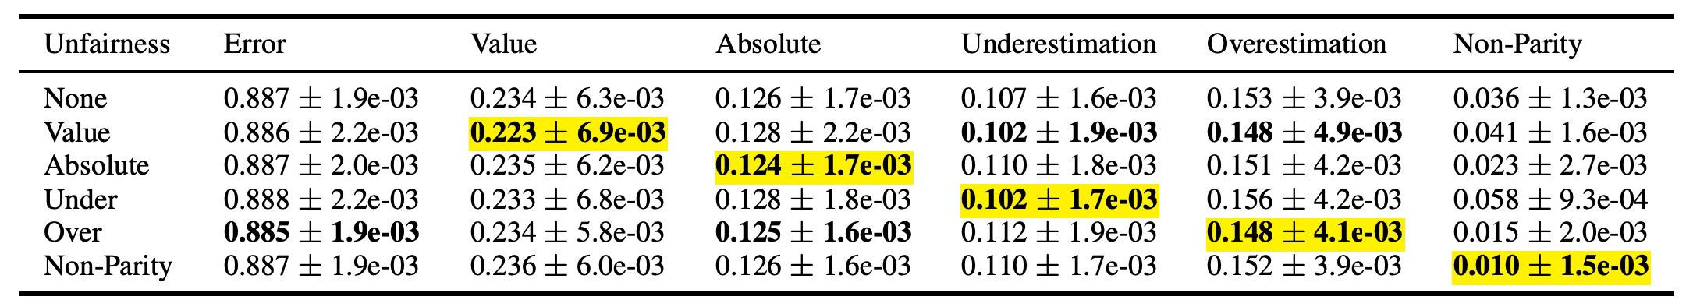
Associative Fairness in Recommendation
Method:
Loss for recommender model Fairness constraint
Experiment Results: the experiments on synthetic and real data show that minimization of these forms of unfairness is possible with no significant increase in reconstruction error.
61
Yao, Sirui, and Bert Huang. “Beyond Parity: Fairness Objectives for Collaborative Filtering” NIPS’17

Slide 42
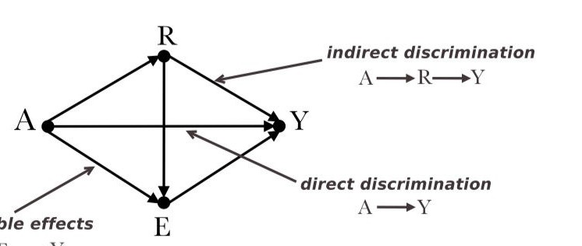
Causal Fairness in Recommendation
Fairness Concerns: Counterfactual fairness for users in recommendations.
Definition: A recommender model is counterfactually fair if for any possible user
𝑢 with features 𝑋 = 𝑥 and 𝑍 = 𝑧, for all 𝐿, and for any value 𝑧’ attainable by 𝑍:
Top-N recommendation list for user 𝑢 with sensitive features 𝑧
Insensitive features
Sensitive features
Li. Y et al. “Towards Personalized Fairness based on Causal Notion” SIGIR’21

Slide 43
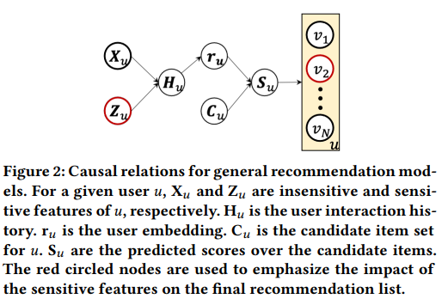
Causal Fairness in Recommendation
Fairness Concerns: Counterfactual fairness for users in recommendations.
Li. Y et al. “Towards Personalized Fairness based on Causal Notion” SIGIR’21

Slide 44
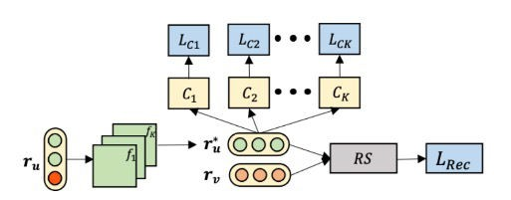
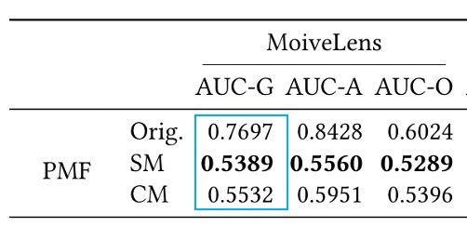
Causal Fairness in Recommendation
Discriminator module
Method: Generate feature independent user embeddings through adversary learning.
  Filter Module: filter the information about sensitive features from user embeddings
  Discriminator module: predict the sensitive features from the learned user embeddings.
Experiment Results:
  Improve fairness
  A little sacrifice on recommendation performance
Filter module
Li. Y et al. “Towards Personalized Fairness based on Causal Notion” SIGIR’21

Slide 45
Group Recommender Systems

Slide 46
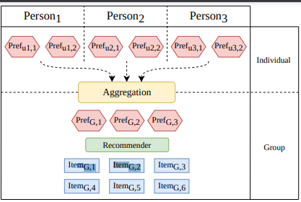
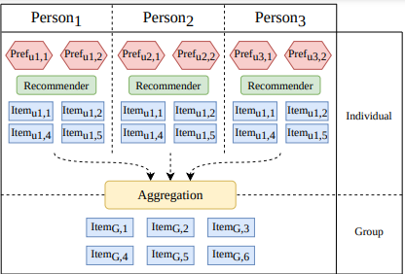
Group RS
Two main classes of approaches:
  Item-wise (utility of each item is evaluated independently from all others)
  List-wise (utility is evaluated for the whole list)
    In most cases, the list is constructed incrementally
    You can focus on ranking-aware fairness, i.e., each head of the list of recommendations should be as fair as possible

Slide 47
Fairness in Group Recommendation
Group Recommendation: recommend items to groups of users whose preferences can be different from each other.
Fairness Concerns: maximize the satisfaction of each group member while minimizing the unfairness (the imbalance of user utilities inside the group) between them.
Why not just aggregate individual preferences of users?
  Possible unfairness for individuals with minority opinion
Xiao, Lin, et al. "Fairness-aware group recommendation with pareto-efficiency." Recsys’17

Slide 48
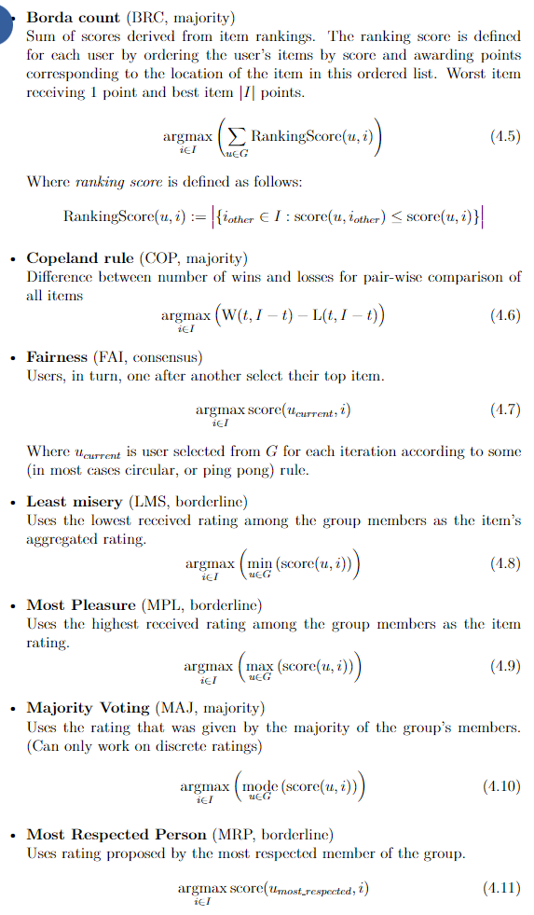
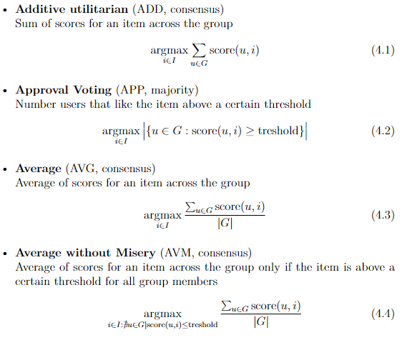
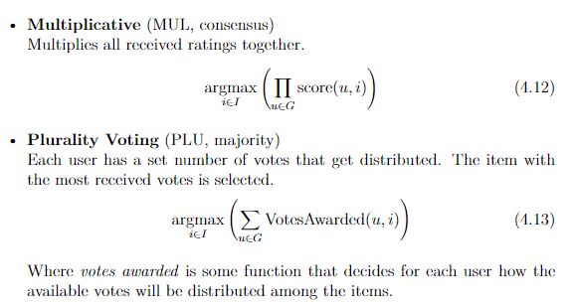
Item-based Group RS
https://pro.unibz.it/projects/schoolrecsys17/JudithMasthoff.pdf

Slide 49
Fairness in Group Recommendation
Item-based group RS
  Faster
  Still high chance of unfairness
Xiao, Lin, et al. "Fairness-aware group recommendation with pareto-efficiency." Recsys’17

Slide 50
Fairness in Group Recommendation
Method:
  The Social Welfare (𝑆𝑊(𝑔, 𝐼)): overall utility of all users inside the group 𝑔 given a group recommendation I.
– The Fairness (𝐹(𝑔, 𝐼)): a function of 𝑈(𝑢, 𝐼), ∀𝑢 ∈ 𝑔, ∀𝐼.
  Multi-Objective Optimization:
Experiment Results: The results indicate that considering fairness can improve the quality of group recommendation.
Xiao, Lin, et al. "Fairness-aware group recommendation with pareto-efficiency." Recsys’17

Slide 51
Fairness in Group Recommendation
Possible issues:
Fairness metrics does not consider ranking
User’s attention is unevenly distributed

Slide 52
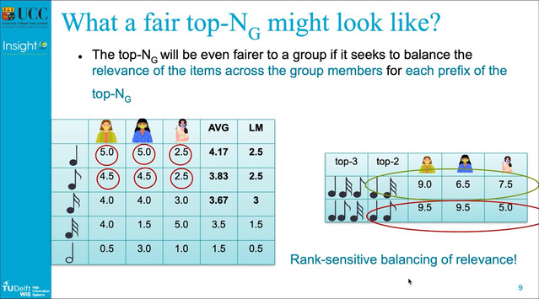
Fairness in Group Recommendation
Possible issues:
Ranking aware fairness
  Nice feature: optimizing just one metric comprising both utility and fairness
Greedy construction algorithm GFAR
https://slideslive.com/38934807/ensuring-fairness-in-group-recommendations-by-ranksensitive-balancing-of-relevance?ref=speaker-41949
https://dl.acm.org/doi/10.1145/3383313.3412232

Slide 53
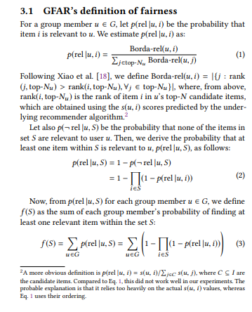
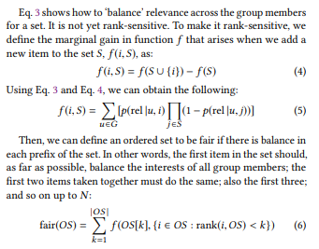
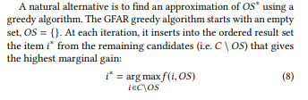
Fairness in Group Recommendation
Drastic decrease of relevance w.r.t. order of items
Finding one item per user is sufficient

Slide 54
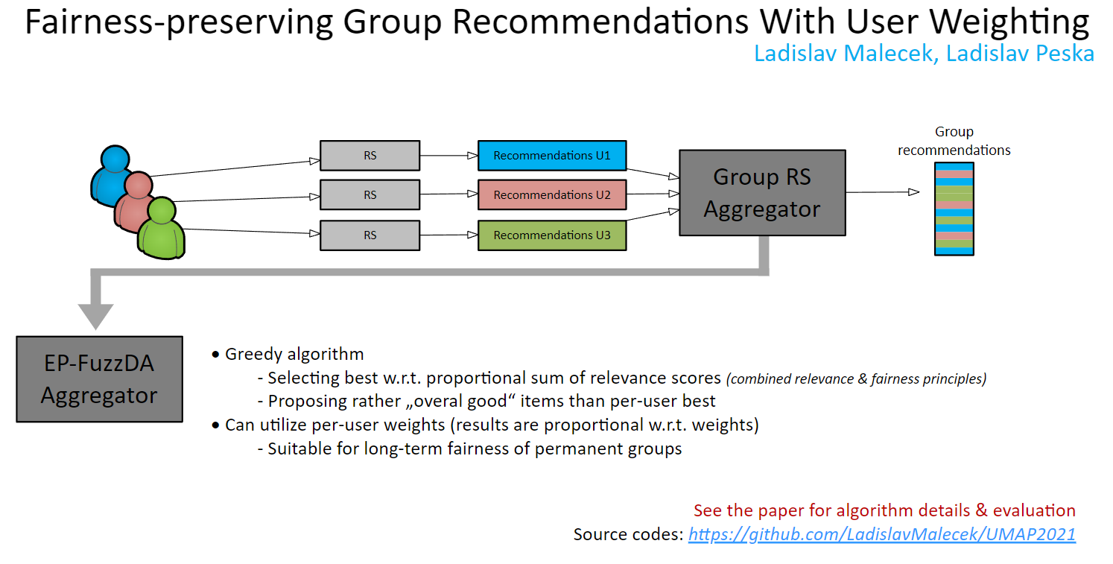
Fairness in Group Recommendation

Slide 55
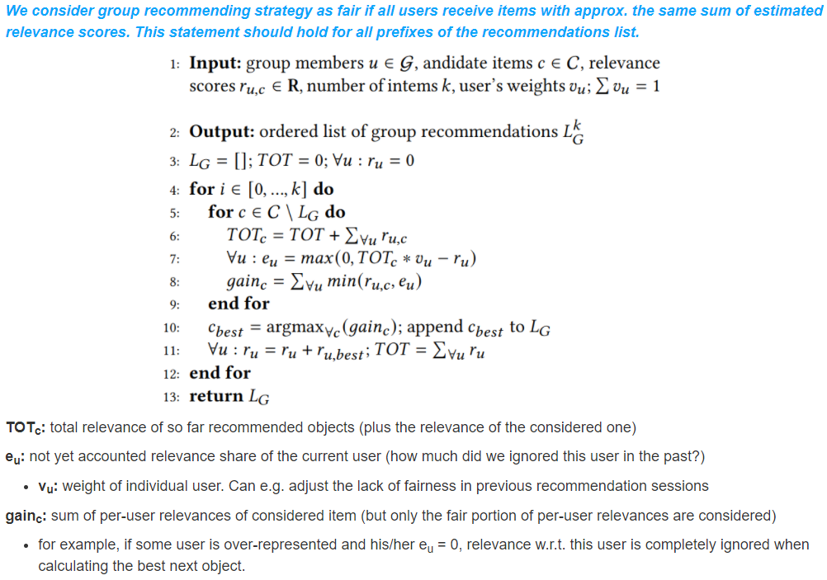
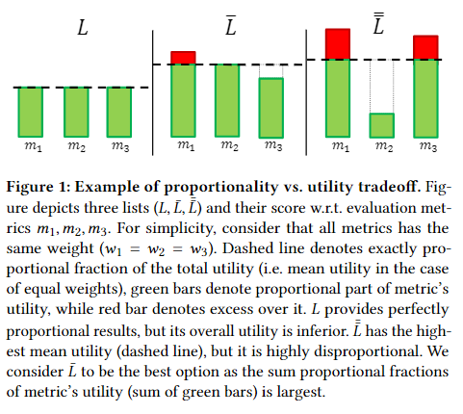
Fairness in Group Recommendation

Slide 56
Fairness in evaluation
Popularity bias (more popular => much more attention)
Biased historical data (missing not at random) => (unbiased) learning algorithm => biased recommendations
=> biased off-line evaluation (same bias vector => better results)
=> discrepancy between off-line and on-line evaluation
How to evaluate methods fairly?

Slide 57
Fairness in evaluation
Inverse propensity score
Weight results by the inverse to the propensity score
  (probability of being noticed by the user)
  Definitions may vary on available information
    Based on general item’s popularity
    Based on recommended positions
    Based on user’s actions within the page

Slide 58
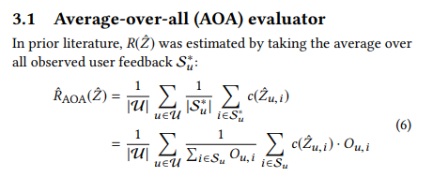
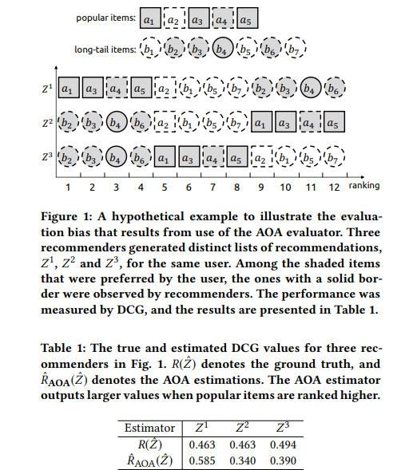
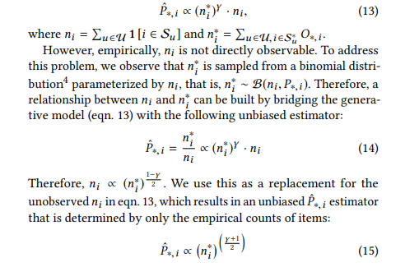
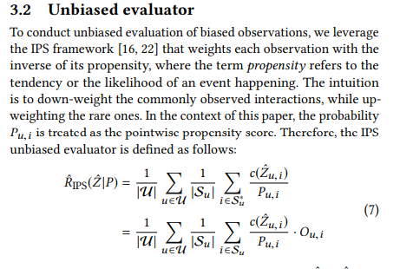
De-biasing Off-line Evaluation
https://dl.acm.org/doi/pdf/10.1145/3240323.3240355
nDCG, AUC, MAP,...
Propensity score

Slide 59
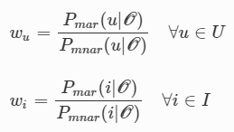


De-biasing Off-line Evaluation
https://link.springer.com/article/10.1007/s10844-021-00651-y
Alternative: sampling from test data to de-bias them
  Based on missing-at-random (MAR) vs. Missing-not-at-random (MNAR)
  Sample from MNAR data to better resemble MAR
  Variants:
    You have some subsample that is MAR (random recommendations, forced rating), sample from MNAR so that posterior probability is similar to MAR. Finding weight w for each user-item pair
    You do not have MAR subsample: assume uniform posterior probability
  Possible disadvantage: not enough data due to sampling
    Sample with repetition
  Possible disadvantage: not enough data from all segments

Slide 60
Fairness in RS, further reading
https://link.springer.com/article/10.1007/s11257-020-09285-1
https://dl.acm.org/doi/pdf/10.1145/3383313.3411545
https://www.sciencedirect.com/science/article/pii/S0306457321001503
https://arxiv.org/abs/1908.06708
https://dl.acm.org/doi/pdf/10.1145/3450614.3461685
https://arxiv.org/abs/2006.05255
https://dl.acm.org/doi/pdf/10.1145/3184558.3186949

