Slide 1


NDBI021, Lecture 4
User preferences, 2/1 ZK+Z,
Wed 12:20 – 13:50 S8
Wed 14:00 – 15:30 SW2 (odd weeks)
https://www.ksi.mff.cuni.cz/~peska/vyuka/ndbi021/2022/
https://ksi.mff.cuni.cz

Slide 2
How to express user preferences
Feedback variants for users

Slide 3
Non-numeric feedback
How reviews improve personalization

Slide 4

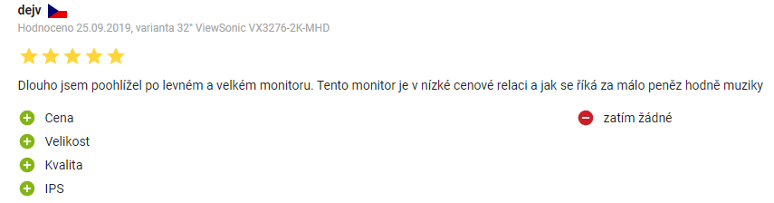
Non-numeric feedback
Textual reviews
Semi-textual reviews

Slide 5
Textual reviews
Main usage:
  Rating prediction from reviews
    Multi-criteria rating prediction => recommendation
  Explanations
How:
  (explicit) Sentiment analysis
    https://dl.acm.org/doi/abs/10.1145/3109859.3109905 (restaurants)
    https://dl.acm.org/doi/10.1007/s11257-015-9157-3 (hotels, fixed aspects)
  Latent Dirichlet Allocation (and related approaches) + post-processing
    https://ieeexplore.ieee.org/abstract/document/8813018

Slide 6
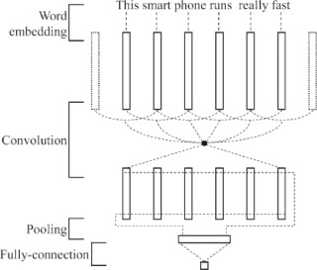
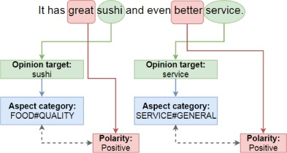
Textual reviews
Deep Learning for Aspect-Based Sentiment Analysis: A Comparative Review (2018) https://www.sciencedirect.com/science/article/pii/S0957417418306456
  CNN, RNN, Recursive NN
Three subtasks of aspect-based sentiment analysis:
Opinion target extraction (OTE),
Aspect category detection (ACD)
Sentiment Polarity (SP),
An example of CNN architecture for aspect category and sentiment polarity. Adapted from Gu, Gu, & Wu (2017) https://doi.org/10.1007/s11063-017-9605-7.
Limitations: fixed list of aspect axes

Slide 7
Textual reviews
Sentiment analysis https://dl.acm.org/doi/abs/10.1145/3109859.3109905
  A Multi-criteria Recommender System Exploiting Aspect-based Sentiment Analysis of Users’ Reviews
    „SABRE“ framework, Output: aspect, sub-aspect, its relevance for reviewer & its sentiment
    https://link.springer.com/chapter/10.1007/978-3-319-46135-9_4
      Aspect modeling as relatively simple frequency analysis – most common nouns [room for improvement]
      Afinn wordlist for sentiment (annotated words representing opinion appears close to the aspect)
      Aspect relevance ~ its relative frequency
      Limitations:
        Minimal granularity = one word (may be not generic enough)
        Fixed word-based sentiment
      Plus points:
        Dynamic list of aspects
    Neighborhood-based recommendation model
      Treat each aspect as independent rating, use multi-dimensional Euclidean distance
      (serialize pairs of item-aspect into a single vector)

Slide 8
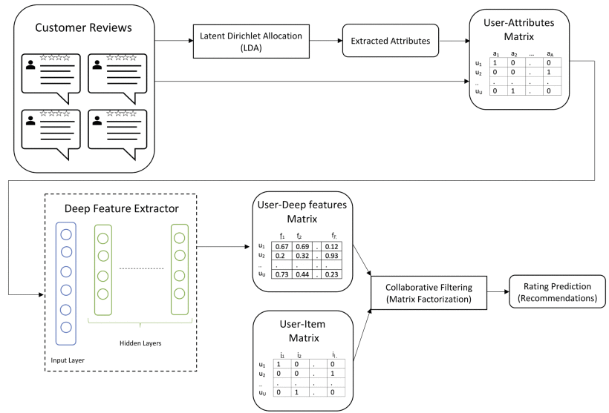
Textual reviews
What if the list of aspects cannot be fixed? Also, multiple words may account for the same aspect.
https://ieeexplore.ieee.org/abstract/document/8813018
Customer Reviews Analysis With Deep Neural Networks for E-Commerce Recommender Systems
  Latent Dirichlet Allocation
    The only interesting part of the
    pipeline
    „What was the review about“?
    Dynamic topic modeling

Slide 9
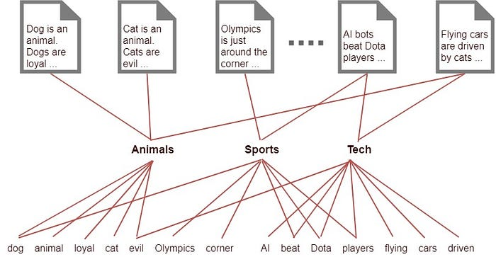
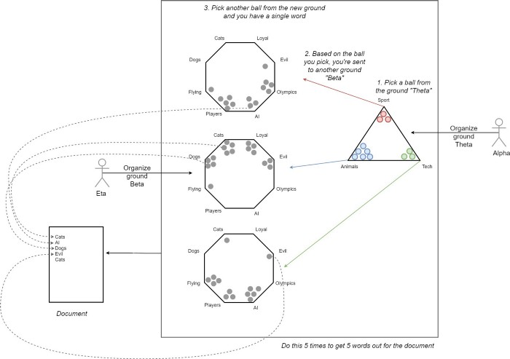
Textual reviews
Latent Dirichlet Allocation (LDA)
https://en.wikipedia.org/wiki/Latent_Dirichlet_allocation ,
https://towardsdatascience.com/light-on-math-machine-learning-intuitive-guide-to-latent-dirichlet-allocation-437c81220158
  Documents; fixed set of latent topics;
    each document is a mixture of topics,
    each topic is characterized as a Dirichlet distribution over words
  Assume generative model for documents
  and then try to reverse-ingeneer the documents with it.
  Several ways to learn, e.g. Variational inference / EM alg.
    https://en.wikipedia.org/wiki/Expectation%E2%80%93maximization_algorithm
    https://en.wikipedia.org/wiki/Variational_Bayesian_methods
  https://en.wikipedia.org/wiki/Kullback%E2%80%93Leibler_divergence

Slide 10
Textual reviews
Latent Dirichlet Allocation (LDA)
https://en.wikipedia.org/wiki/Latent_Dirichlet_allocation ,
https://towardsdatascience.com/light-on-math-machine-learning-intuitive-guide-to-latent-dirichlet-allocation-437c81220158
  Documents; fixed set of latent topics;
    each document is a mixture of topics,
    each topic is characterized as a Dirichlet distribution over words
  Assume generative model for documents
  and then try to reverse-ingeneer the documents with it.
  Several ways to learn, e.g. Variational inference / EM alg.
    https://en.wikipedia.org/wiki/Expectation%E2%80%93maximization_algorithm
    https://en.wikipedia.org/wiki/Variational_Bayesian_methods
  https://en.wikipedia.org/wiki/Kullback%E2%80%93Leibler_divergence

Slide 11
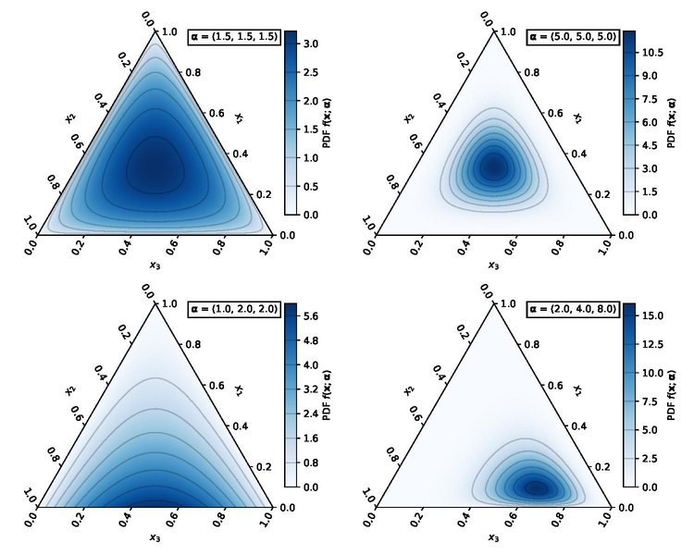
Textual reviews
Dirichlet distribution
  Multi-variate generalization of Beta distribution
  https://en.wikipedia.org/wiki/Dirichlet_distribution

Slide 12
Textual reviews
LDA is a variant of topic modeling algorithms, there are other options, see e.g.:
  https://arxiv.org/pdf/2103.00498.pdf (Topic Modelling Meets Deep Neural Networks: A Survey)
  https://medium.com/data-folks-indonesia/recent-works-in-topic-modeling-56c38da8dfc4
    Attention nets, GANs

Slide 13
Textual reviews
https://dl.acm.org/doi/pdf/10.1145/3412841.3442065
Utilizing Textual Reviews in Latent Factor Models for Recommender Systems
Latent Dirichlet Allocation (LDA); document = all reviews for item
  Use LDA to get item-attributes, use them in matrix factorization
  Joint optimization model for MF based and LDA based parts
  EM procedure for optimization

Slide 14
Textual reviews
http://ceur-ws.org/Vol-2068/exss8.pdf [vision paper]
Explaining Recommendations by Means of User Reviews
  Extract & summarize arguments about products from reviews
  Use them in Personalized explanations
Challenges:
Linguistically analyzing review texts via argument mining
and stance detection.
Identifying important concepts for a target user via an attention-based mechanism.
Deriving an argumentation flow via multiple applications of the attention-based mechanism.
Unifying the linguistic analyses and the attention-based mechanism.
... Just what ChatGPT can do now [beware of fact checks though]

Slide 15
[What generic language models can do]
There are several reasons why you might want to watch Terminator 2: Judgment Day:
Groundbreaking Visual Effects: Terminator 2 was a pioneer in the use of computer-generated imagery (CGI) and special effects. The film features some of the most impressive and realistic visual effects of its time, which still hold up well today.
Iconic Characters: The movie features some of the most memorable characters in sci-fi movie history, including Arnold Schwarzenegger's "Terminator" and Linda Hamilton's "Sarah Connor." Their performances and characterizations have become iconic and have helped define the genre.
Compelling Storyline: The movie has a gripping storyline that keeps you on the edge of your seat. It's a thrilling sci-fi action film that also explores themes such as the nature of humanity and the dangers of technology.
Top-Notch Action Scenes: The movie is packed with exciting action scenes that are expertly choreographed and executed. From car chases to shootouts to hand-to-hand combat, Terminator 2 delivers on the action front.
Cultural Significance: Terminator 2 has had a significant impact on popular culture and has influenced many subsequent movies, TV shows, and video games. If you're a fan of sci-fi or action movies, it's definitely worth watching to see where many of today's tropes and techniques originated.
There are several reasons why you might want to watch Cars 3:
Heartwarming Story: Cars 3 features a heartwarming story that is both inspiring and emotional. The movie explores themes such as friendship, perseverance, and self-discovery, making it a great choice for families and viewers of all ages.
Stunning Animation: As with all Pixar films, Cars 3 boasts stunning animation that brings the characters and world to life. The attention to detail and vibrant colors make the movie a visual treat.
Nostalgia Factor: For fans of the original Cars movie, Cars 3 offers a return to the beloved characters and world of Radiator Springs. The movie pays tribute to the original film while also introducing new characters and storylines.
Strong Voice Cast: Cars 3 features an all-star voice cast, including Owen Wilson, Cristela Alonzo, Armie Hammer, and Chris Cooper. The cast brings the characters to life with their nuanced performances and comedic timing.
Inspirational Messages: Cars 3 delivers inspirational messages about the power of hard work, determination, and the importance of mentorship. These messages make the movie not only entertaining but also educational and inspiring for viewers of all ages.
Overall, Cars 3 is a fun, engaging, and inspiring movie that is perfect for families and fans of Pixar films.

Slide 16
Textual reviews
https://dl.acm.org/doi/pdf/10.1145/3320435.3320457 (2019)
Justifying Recommendations through Aspect-based Sentiment Analysis of Users’ Reviews
Aspoect extraction:
  Part-of-Speech (POS) tagging algorithm (nouns = possible aspects)
  Aspect ranking: relevant+positive & distinguishing
    For each aspect number of sentences + average sentiment + IDF
Sentences containing aspect a
Positive vs negative sentiment
IDF-like weighting

Slide 17
Searching and filtering as feedback

Slide 18
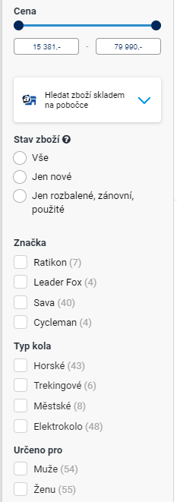

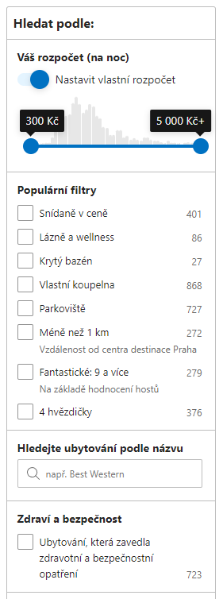
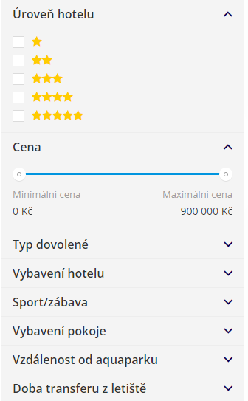
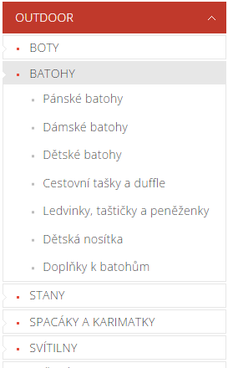
What would the user be willing to do?

Slide 19
What would the user be willing to do?
Most users do:
Filter content manually
  Browse categories
  Apply facet search
    Mostly direct mapping to object’s attributes
  Use fulltext search
  Can be utilized in the construction of attribute-level preferences
    Beware of long-term preferences vs. short-term goals
All users do:
Evaluate & consume content:
  Browse items, open details, read content, play, purchase,…
  Preferences based on implicit feedback

Slide 20
How to utilize searching / querying feedback?
Query refinement
User gives some (textual) query, we recommend him/her query extensions/modifications
Traditional approach: https://link.springer.com/chapter/10.1007/978-3-540-30192-9_58
  Query Recommendation Using Query Logs in Search Engines (2004)
  Queries along with the text of their clicked URLs extracted from the Web log are clustered. This is a preprocessing phase of the algorithm that can be conducted at periodical and regular intervals.
  Given an input query (i.e., a query submitted to the search engine) we first find the cluster to which the input query belongs. Then we compute a rank score for each query in the cluster.
  Finally, the related queries are returned ordered according to their rank score. The rank score of a related query measures its interest and is obtained by combining the following notions:
    Similarity of the Query. [Same words appearing in clicked URIs]
    Support of the Query. This is a measure of how relevant is the query in the cluster. We measure the support of the query as the fraction of the documents returned by the query that captured the attention of users (clicked documents). It is estimated from the query log as well.

Slide 21
How to utilize searching / querying feedback?
Query refinement
Not just similarity, but rather expansion of the query
Diversity of the recommended expansions
Beyond bag-of-words models (NLP, deep learning)
Sequential models (e.g., RNN, multi-armed bandits)
Further readning:
https://link.springer.com/chapter/10.1007/978-3-030-72240-1_54
https://proceedings.mlr.press/v157/puthiya-parambath21a.html
https://dl.acm.org/doi/10.1145/3269206.3271808
In general:
Usable for current information need of the user
Limited applicability for estimating long-term preferences

Slide 22
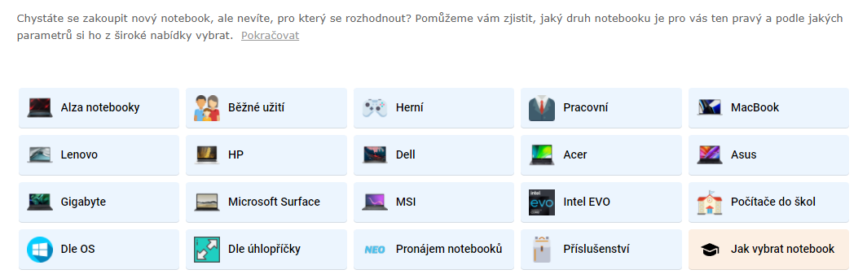
How to utilize searching / querying feedback?
Query refinement
In theory, could be done also based on faceted search logs / category browsing
Not very clear how to present it to the user
  Customized banners such as Alza have?
  Needs additional description generation model => but then, why not to search simply by keywords?

Slide 23
How to utilize faceted search logs / browsed categories?
???

Slide 24
How to utilize faceted search logs / browsed categories?
???
Almost no available literature
  No (to the best of my knowledge) available datasets combining recommendations and facet search logs
    => Largely ignored by academic researchers
  No confirmed info from the industry
So, why should we bother?

Slide 25
How to utilize faceted search logs / browsed categories?
So, why should we bother?
  Depending on the domain (based on the data I have available)
  Visits of objects vs. visits of search / browsing pages are approx. 50:50
    Recommendation-first designs are less informative (users did not filter anything manually), but e.g. E-commerce websites may be highly relevant
    User’s intent can be inferred from the searched / filtered terms & it can be done faster than if only feedback from visited objects is collected
How to distinguish short-term needs vs. long-term preferences?
How to detect interest / preference drift?

Slide 26
How to utilize faceted search logs / browsed categories?
Option #0 just filter the recommendations
  Implicit assumption: User preferences are binary & exactly as stated in the search
    Post-process any recommendations to fulfill searched conditions (or their slightly relaxed versions)
    Use e.g. the last search record to filter recommendations given on particular object (a.k.a. similar objects)

Slide 27
How to utilize faceted search logs / browsed categories?
Option #1 content-based representation for recommender systems
  Model search pages / browsed pages in the same way as visited objects
    Vector representation of object’s attributes
    The same representation for searched terms (leave blank if unknown)
    Alternatively, page is represented as a (weighted) sum of items it displays
  Apply any suitable sequence-based recommender system on such data
  Diploma thesis of Kaan Yos: „Deep Learning For Implicit Feedback-based Recommender Systems“, https://dspace.cuni.cz/handle/20.500.11956/121242
    Limited search data on a travel agency (dates, tour type, accomodation type)
    LSTM, several encoding variants
    Next item recommendations
  Suitable for short-term user needs (sessions)
  Possible extensions: aggregated information from past sessions => latent model for long-term pref. (similar as https://dl.acm.org/doi/10.5555/3367471.3367627)

Slide 28
How to utilize faceted search logs / browsed categories?
Option #1 content-based representation - extension
  Adaptive user modeling with long and short-term preferences for personalized recommendation
    https://dl.acm.org/doi/10.5555/3367471.3367627
    Latent model based on two components: long-term and short-term user preferences
  Short-term: based on LSTM trained on the sequence of user behavior (tweaks with time distance)
  Long-term: assymetric SVD
    users are represented through weighted sum of items they interacted with
    This representation can be modified e.g. to cover searched terms
  Adaptive fusion of long and short term preferences to derive final latent vector for user

Slide 29
How to utilize faceted search logs / browsed categories?
Option #1 content-based representation - extension
  Beware on how to represent search terms
    Different ranges for the same attributes throughout various categories (e.g. Fridge vs. Keyboard)
    Different set of attributes for various categories
    The same value may have a different meaning throughout the time
      „500GB HDD“ now vs. 5 years ago
      „Movies from 2018“ now vs. 3 years ago
  Try to compensate for these biases

Slide 30
How to utilize faceted search logs / browsed categories?
Option #1 content-based representation – explicit model
  Latent vs. Explicit model (previously described is latent)
  Explicit model:
    Distribution on searched values vs. all possible values
    Probably relevant only for a subset of attributes
    What about context (of other searched criteria)
    Be especially aware of biases – category agnostic predictor (use CDF or similar rather than raw data)
    Given other searched terms, try to predict what values would be searched by the user in not-yet-filled facets => use this to rank items / recommend particularly good ones

Slide 31
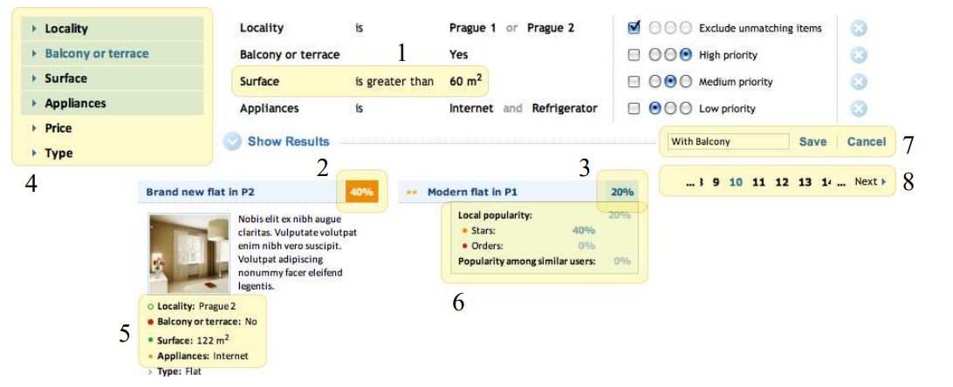
How to utilize faceted search logs / browsed categories?
  Soft & hard constraints / importance of individual constraints
    https://dl.acm.org/doi/pdf/10.1145/3425603
    Diploma thesis of Bronislav Vaclav „Models of user preferences in e-shop environment“ https://dspace.cuni.cz/handle/20.500.11956/30703
!! If all constraints are met,
items are undistinguishable !!

Slide 32
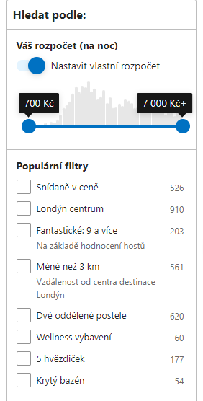
How to utilize faceted search logs / browsed categories?
Option #3 recommend/re-order filtering options
  If there are too many filtering options, the relevant ones might be difficult to find
    Recommend best options for the user
      Nowadays, this is usually done in a non-personalized fashion
    Personalization based on
      Utilization statistics (the more used the higher position – multiarmed bandits, beware of feedback loops – discoverability models)
        Collaborative/contextual model possible in case of insufficient data per user
      Background user preference model & ability to distinguish preferred vs. unpreferred (e.g. Information gain, https://en.wikipedia.org/wiki/Information_gain_in_decision_trees)

Slide 33
Models of User Preferences: summary

