Slide 1


NDBI021, Lecture 3
User preferences, 2/1 ZK+Z,
Tue 14:00 – 15:30 S7
Tue 15:30 – 17:10 S7 (starting 2nd week)
https://www.ksi.mff.cuni.cz/~peska/vyuka/ndbi021/2023/
https://youtube.com/playlist?list=PLTYzSYF3EX3BNIVJkMpCE3vUDmUGvhEcy
https://ksi.mff.cuni.cz

Slide 2
How to express user preferences
Feedback variants for users

Slide 3
Implicit feedback
User’s actions will speak for themselves…

Slide 4
Implicit feedback
Server-side (limited expressibility)
Client-side (triggered JS events)
Beyond (eye tracking, other biometrics)
  Limited applicability (lab studies)
  Can provide leads on interpretation of the previous two

Slide 5
Implicit feedback
Server-side
  Stream of visited pages
  Asynchronous loading of page content (e.g. more results)
  Proxy for time on page / dwell time (very coarse)
    http://www.hongliangjie.com/publications/recsys2014.pdf (RecSys 2014 best paper)
Not much information available
  But non-intrusive & cannot be turned off or altered easily

Slide 6
Implicit feedback
Client-side
Any JS event can be captured, processed and stored…
  But which ones are relevant?
    And also… what is their semantics? Does it differ from explicit feedback?
  How to interpret implicit feedback?
  How to establish negative preference from implicit feedback?
Peska, IPIget: The Component for Collecting Implicit User Preference Indicators
https://www.researchgate.net/publication/305495313_IPIget_The_Component_for_Collecting_Implicit_User_Preference_Indicators

Slide 7
What to Collect as Implicit feedback
Not very explored area
Domain dependence (how surprising☺)
Mostly, academic researchers work with pre-collected datasets
  The decision on what to collect was already done
Not many known industry papers with details on implicit feedback collection
However…

Slide 8
What to Collect as Implicit feedback
Not very explored area
However… common identifiers (cummulative feedback):
(count of) page visits => object visits
Time on page / dwell time
  Beware to count only while focus is on the page (http://www.hongliangjie.com/publications/recsys2014.pdf)
Objects consumption statistics (playcounts, viewtime, purchase, add to basket,…)
!!! Impressions !!! (what was shown to the user)

Slide 9
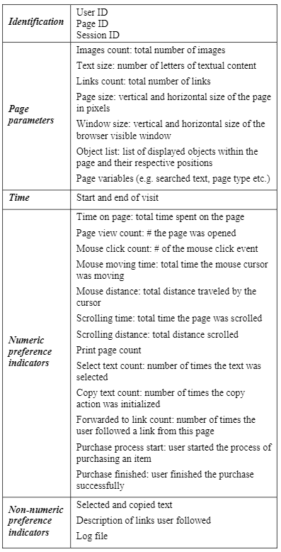
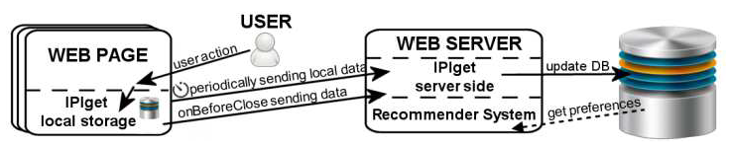
What to Collect as Implicit feedback
Peska, IPIget: The Component for Collecting Implicit User Preference Indicators
https://www.researchgate.net/publication/305495313_IPIget_The_Component_for_Collecting_Implicit_User_Preference_Indicators
Main target: small e-commerce vendors
  Previously mentioned events
  Other aggregated events: print, search, copy, text selection (not much usable)
    Non-numeric data (searched text, selected text,…)
  Context of events
    Scrolling to coordinates
    Mouse position sampling
    Mouse over pre-defined elements
  Basic page statistics
    Vol. Of text, images, links
    page dimensions, window dimensions
    position of elements
    Page params (e.g. Catalogue hierarchy,…)

Slide 10
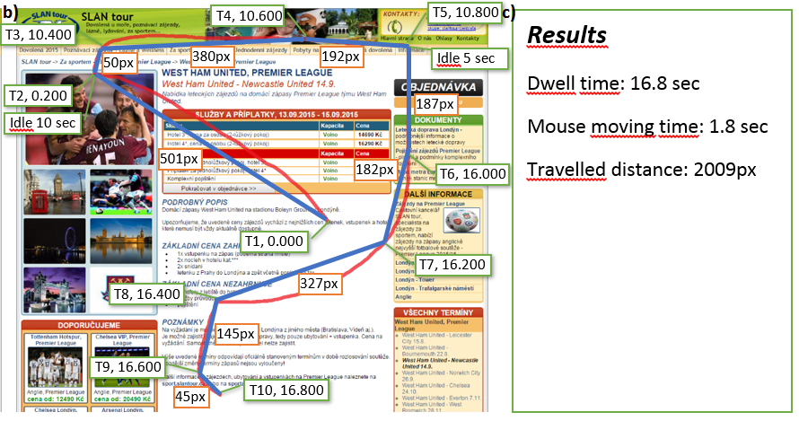
What to Collect as Implicit feedback

Slide 11

What to Collect as Implicit feedback
Collect visible area through time (scrolling position + window dimensions)
Store areas covered with page components
  Items in category page
  Areas focused on item’s features
Calculate visibility => noticeability of individual components
If the item is clicked, it should be more preferred than not-clicked ones with high-enough noticeability
https://link.springer.com/article/10.1007/s13740-016-0061-8

Slide 12
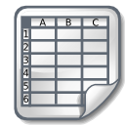
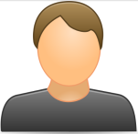
How to interpret numeric implicit feedback
Combine all implicit feedback features to estimated user rating
  Standard recommender systems can be used afterwards
The more the better hypothesis
  Normalize data (Time on page vs. Scrolling distance vs. Vol. of visits)
  (shifted) standardization, cummulative distribution function, log transformation
    Make a hypothesis about what particular values mean and then confirm it via user study
Dwell time: 10s
Scrolling: 100px
Mouse movement:250px
Rating: 0.2
Dwell time: 100s
Scrolling: 200px
Mouse movement:450px
Rating: 0.8

Slide 13
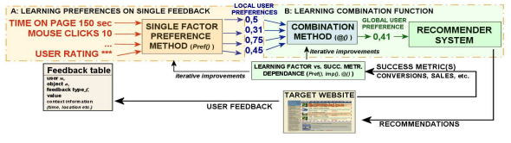
How to interpret numeric implicit feedback
Combine all implicit feedback features to estimated user rating
  Standard recommender systems can be used afterwards
Use feedback linked with positive/negative preference
  Ratings, purchases
  Train ML predictor to predict this based on other implicit feedback features
    Note that positive preference indicators are usually very sparse => stratified sampling / weighting
  Make individual preference estimators per feedback type &
  their aggregator (wAVG, fuzzy logic,…)
    In case of insufficient data or specific model in mind
https://www.researchgate.net/publication/283526661_How_to_interpret_implicit_user_feedback,
https://www.ksi.mff.cuni.cz/~peska/wims13.pdf
Stream of JS events: mouse motion, keyboard, scroll
Rating: 0.2
Stream of JS events: mouse motion, keyboard, scroll
Rating: 0.8

Slide 14
How to interpret numeric implicit feedback
Construct single (complex) implicit feedback based proxy for user preference
  Standard recommender systems can be used afterwards
Active dwell time [not confirmed by literature]
  Time spent on page
  But counted only if some other events are detected in close temporal proximity => user is active
Dwell time: 10s
Scrolling: 100px
Mouse movement:250px
Active time: 10s
Dwell time: 100s
Scrolling: 200px
Mouse movement:450px
Active time: 20s

Slide 15
How to interpret numeric implicit feedback
Construct single (complex) implicit feedback based proxy for user preference
  Standard recommender systems can be used afterwards
Active dwell time [not confirmed by literature]
  Time spent on page
  But counted only if some other events are detected in close temporal proximity => user is active
Dwell time: 10s
Scrolling: 100px
Mouse movement:250px
Rating: 0.2
Is that all we can do?
Dwell time: 100s
Scrolling: 200px
Mouse movement:450px
Rating: 0.8

Slide 16
How to interpret numeric implicit feedback
Is that all we can do?
Negative Implicit Feedback
  Low values of feedback features on particular object
  Implicit feedback on object’s categories
Context of User Feedback
  Same values may have different meanings

Slide 17
Context of user feedback

Slide 18


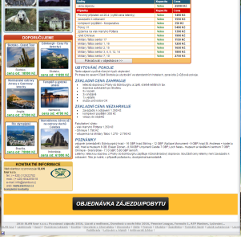
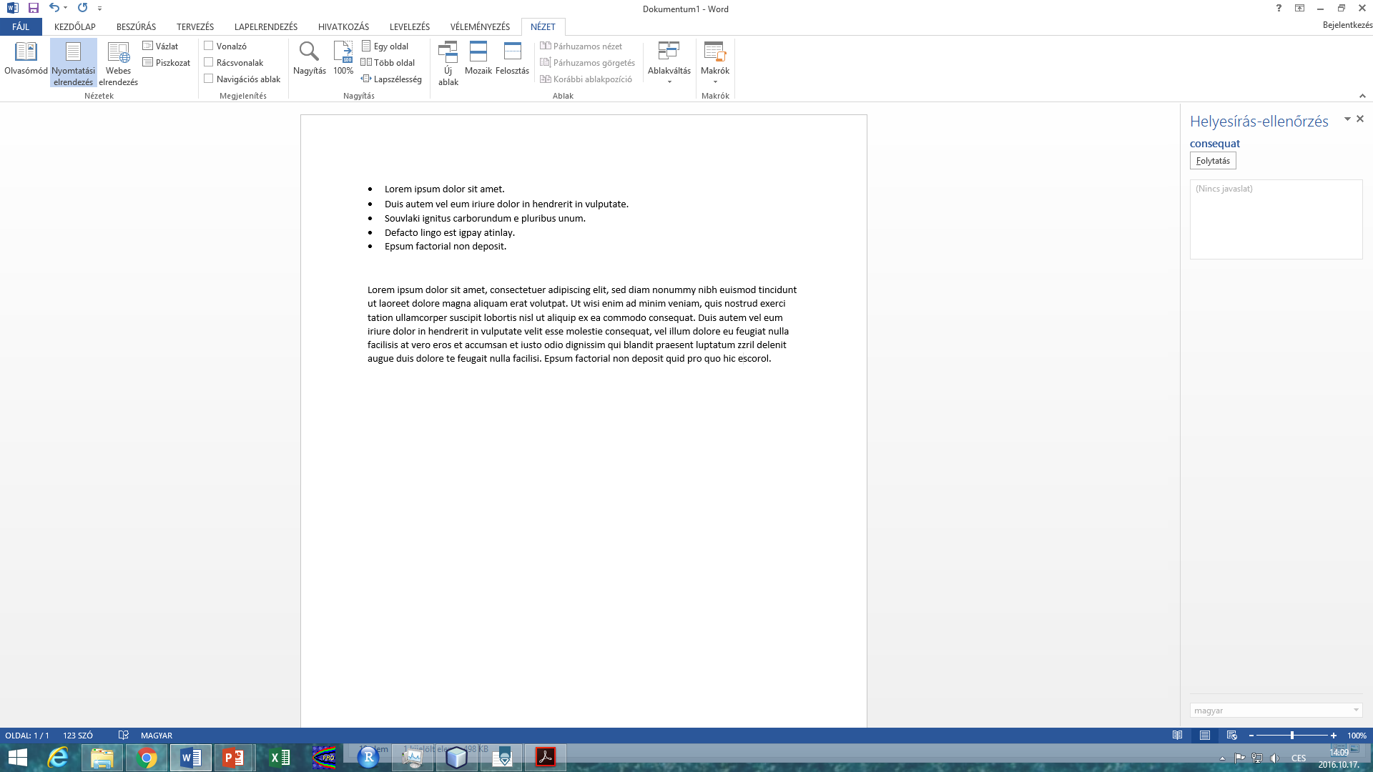
How to interpret numeric implicit feedback
Context of the user
  Location, Mood, Seasonality...
  Can affect user preference
  Out of scope of this paper (and this lecture☺)
Context of device and page
  Page and browser dimensions
  Page complexity (amount of text, links, images,..., https://aclanthology.org/N04-1025.pdf)
  Device type
  Datetime
  Can affect percieved values of the user feedback
A
B

Slide 19
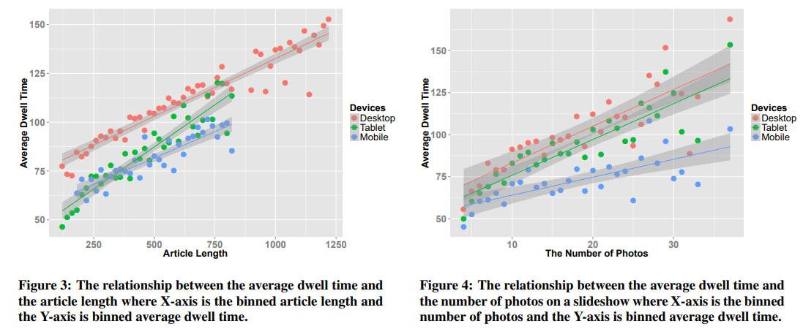
How to interpret numeric implicit feedback
Pages may substantially vary in length, amount of content etc.
  This could affect perceived implicit feedback features
  Leveraging context could be important
Consumption statistics may significantly vary for different device types
  (http://www.hongliangjie.com/publications/recsys2014.pdf)

Slide 20
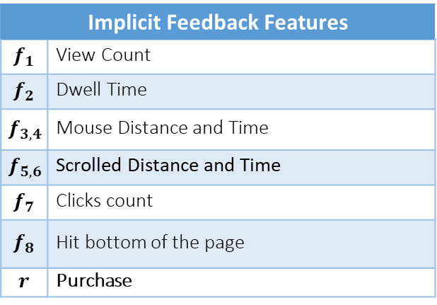
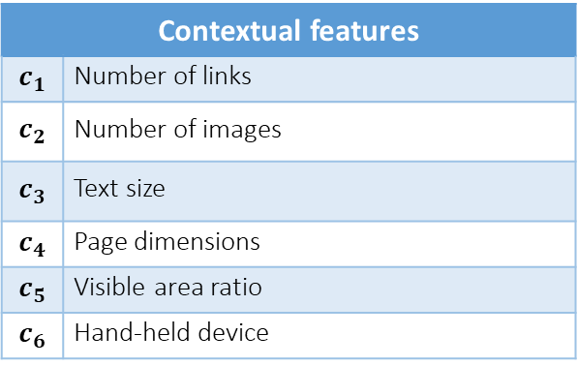
How to interpret numeric implicit feedback
IPIget component for collecting user behavior
Implicit Feedback Features
$$f_{1}$$ | View Count
$$f_{2}$$ | Dwell Time
$$f_{3,4}$$ | Mouse Distance and Time
$$f_{5,6}$$ | Scrolled Distance and Time
$$f_{7}$$ | Clicks count
$$f_{8}$$ | Hit bottom of the page
$$r$$ | Purchase
Contextual features
$$c_{1}$$ | Number of links
$$c_{2}$$ | Number of images
$$c_{3}$$ | Text size
$$c_{4}$$ | Page dimensions
$$c_{5}$$ | Visible area ratio
$$c_{6}$$ | Hand-held device

Slide 21
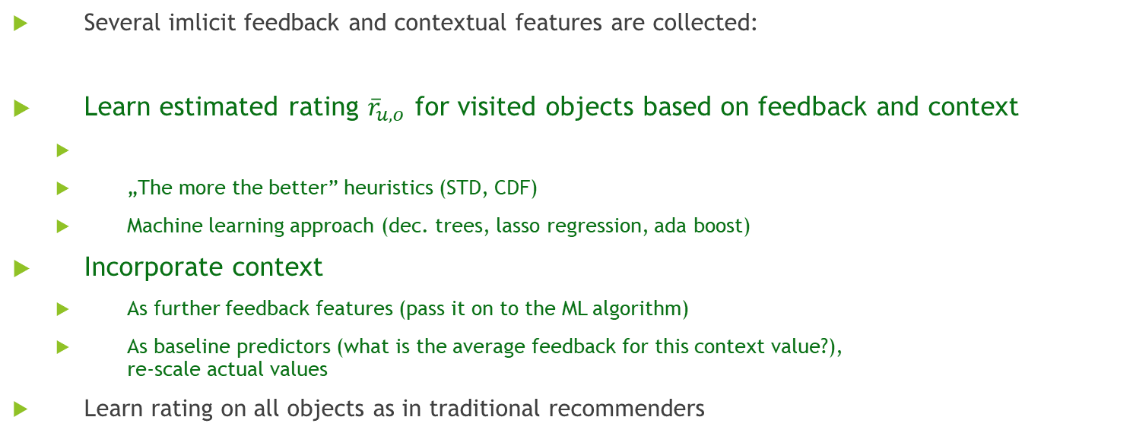

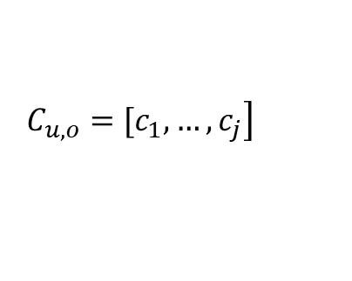

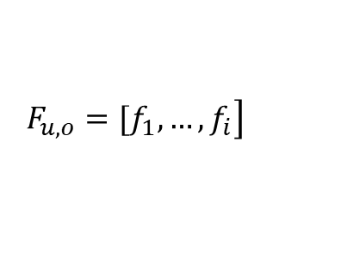
How to interpret numeric implicit feedback
Our approach
Several imlicit feedback and contextual features are collected:
Learn estimated rating ${\overline{r}}_{u,o}$ for visited objects based on feedback and context
  „The more the better” heuristics (STD, CDF)
  Machine learning approach (dec. trees, lasso regression, ada boost)
Incorporate context
  As further feedback features (pass it on to the ML algorithm)
  As baseline predictors (what is the average feedback for this context value?),
  re-scale actual values
Learn rating on all objects as in traditional recommenders
$$\left. F_{u,o}=[f_{1},…,f_{i}\right]$$
$$\left. C_{u,o}=[c_{1},…,c_{j}\right]$$
$$F_{u,o}, C_{u,o}→{\overline{r}}_{u,o}:o∈S$$
${{ \overline{R}}_{u}→\hat{r}}_{u,o′}$ $:{ o}^{′}∈O$
https://arxiv.org/pdf/1612.04978.pdf
https://dl.gi.de/handle/20.500.12116/916
http://www.hongliangjie.com/publications/recsys2014.pdf

Slide 22
Negative preference from implicit feedback
Can my consumption say I dont like it?

Slide 23
Negative preference from implicit feedback
Object detail level
If more is better… „not-enough“ might mean I do not like it?
  Where is the borderline?
  https://dl.acm.org/doi/10.1145/2479787.2479800
    (below average implies negative – maybe not the best idea)
Google Analytics: bounce rate (leaving the page immediately after openning it)
But why?
  Did I waited too long to load page?
  I clicked on it accidentally?
  I found sth. better in the meantime?
  The short description looked good, but it was missleading / did not cover important drawbacks
    Would this transfer into decreased feedback values?

Slide 24
Negative preference from implicit feedback
The lack of positive feedback on object detail level
https://link.springer.com/content/pdf/10.1007%2F978-3-642-02247-0_47.pdf
  RecSys for jobs
    If the job was openned, but no positive action was recorded (applying /saving for later /...), consider it as negative
Applied to extend user profile similarity (both users disliked similar jobs)
But do we have the full information?
  User could just bookmark the job outside
  User could simply leave interesting offers open

Slide 25
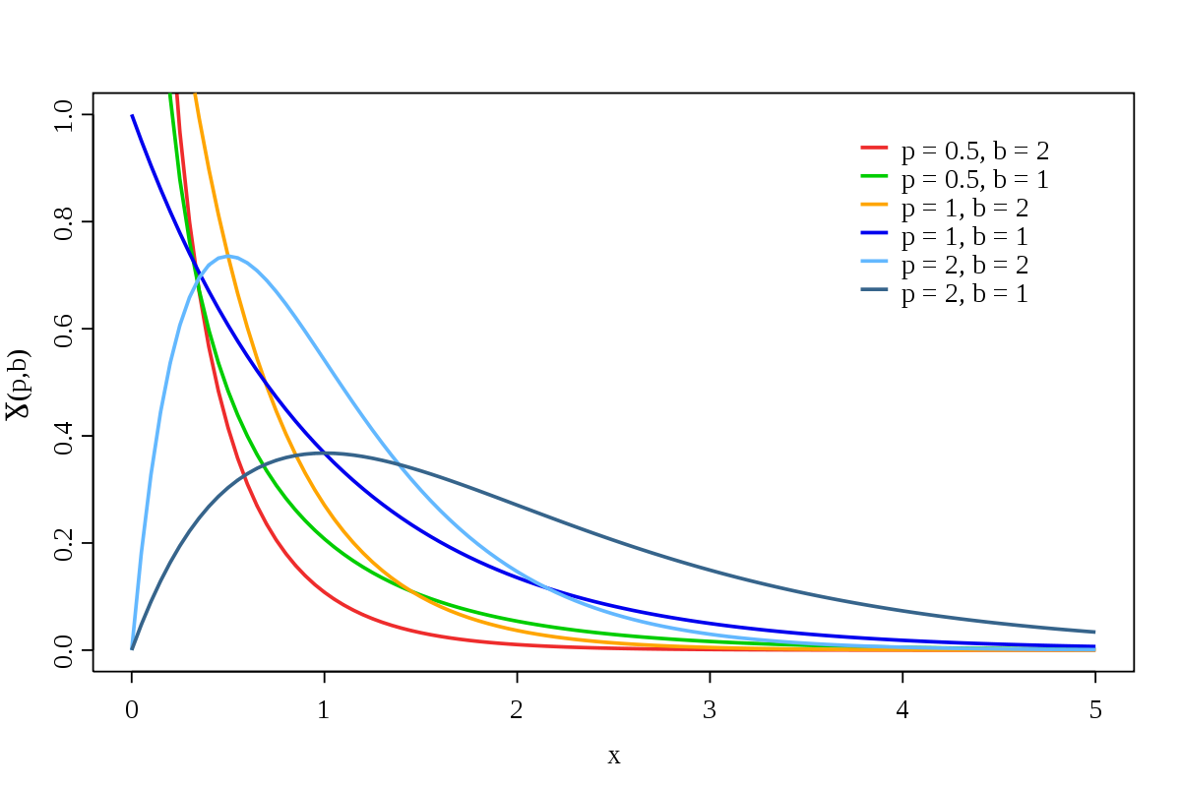
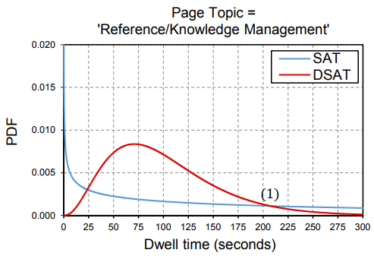
Negative preference from implicit feedback
De-noising binary implicit feedback (SATtisfied /DisSATtisfied click)
  Static (e.g. only count clicks with >30sec click dwell time)
  Context-aware
  https://dl.acm.org/doi/pdf/10.1145/2556195.2556220
  Feedback from search engines, text query
    Query topic, query types / page topic, reading difficulty
  Use click dwell time, known SAT / DSAT labels
  Decision trees: identify relevant context segments
    Fit Gamma distribution for both SAT, DSAT and each segment
  Predictor based on actual dwell time and SAT / DSAT params for specific context segment.
Dwell time: 40s
Page context
Rating: 0
Dwell time: 100s
Page context
Rating: 1

Slide 26
Negative preference from implicit feedback
De-noising binary implicit feedback (SATtisfied /DisSATtisfied click)
  https://arxiv.org/pdf/2006.04153.pdf
    „False-positive interactions are harder to fit in the early stages. According to the theory of robust learning easy samples are more likely to be the clean ones and fitting the hard samples may hurt the generalization.“
    Discard or reduce weight for train interactions with high initial loss
  No need for additional types of feedback with this approach
Dwell time: 40s
Page context
Rating: 0
Dwell time: 100s
Page context
Rating: 1

Slide 27
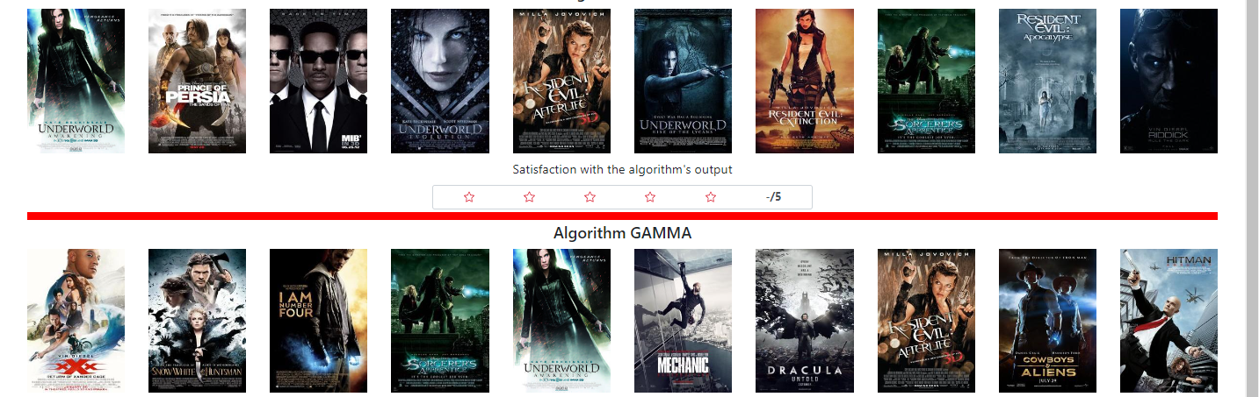
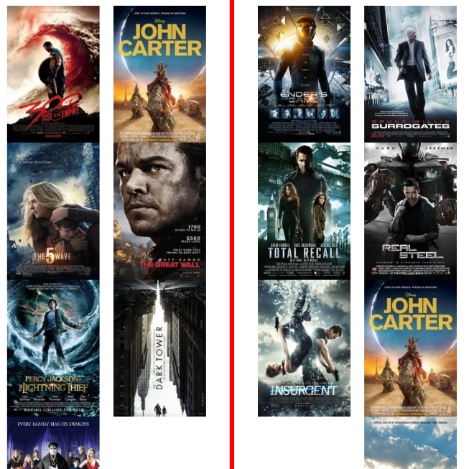
Neg. Pref. from category-level feedback
List of objects (impressions needed)
If I (repeatedly) ignore it, I probably dislike it
  How many times do I have to ignore it?
  Could it be that I just did not pay attention for this specific part of the page?
  What is the chance that I changed my mind?
We can consider uniform chance of item being unnoticed
We can consider fixed chance of being unnoticed for certain position
  https://link.springer.com/article/10.1007/s11257-021-09311-w
We can consider that items are evaluated sequentially
  If the item below was clicked, this one is probably observed as well
  TODO: ref [I know there is one, just could not find it]
We can have detailed feedback with objects’ visibility information
  https://link.springer.com/article/10.1007/s13740-016-0061-8
Vs.

Slide 28
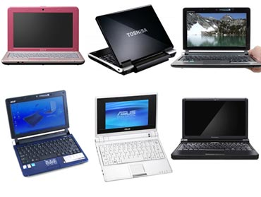
If you have detailed implicit feedback...
If user selects some objects from the list, we take it as an evidence of his/her positive preference.
  User prefers selected object(s) more, than other displayed & ignored objects
  We can form preference relations:
  IPR_{rel} (selected obj. > ignored obj.)
  Intensity of the relation based on the level of visibility for both items
    Visibility of clicked item considered as sufficient -> if the visibility of ignored was lower, strength of the relation decreases
In paper, CB extensions for relations (maybe not the best idea)
>
>
  https://link.springer.com/article/10.1007/s13740-016-0061-8

Slide 29
Neg. Pref. from category-level feedback
https://dl.acm.org/doi/pdf/10.1145/2959100.2959150
  Use eye tracking camera to observe fixations on certain page areas
  Gaze prediction for grid-based user interfaces
    MovieLens, YouTube, Netflix,...
  Where would the user look within the page
  Gaze prediction model
  (eye fixation on grid cell exists + time of eye fixation)
    Position, dwell time, distance to closest existing action
Both left-right & top-bottom decrease clearly apparent
  If sufficient dwell time, fixation probability is close to 1 for all positions
  Note, no scrolling included in the experiment

Slide 30
Implicit Feedback
How does the industry feel about that?

Slide 31
Implicit Feedback
???
How does the industry feel about that?

Slide 32
Non-numeric feedback
How reviews improve personalization

Slide 33
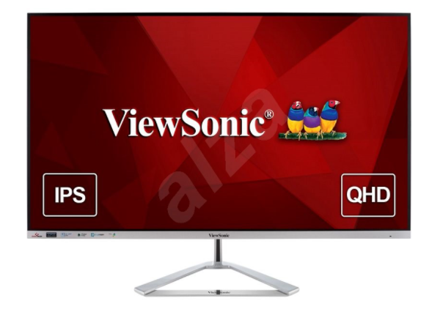
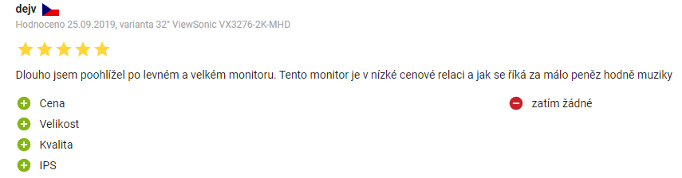
Non-numeric feedback
Textual reviews
Semi-textual reviews

Slide 34
Textual reviews
Main usage:
  Rating prediction from reviews
    Multi-criteria rating prediction
  Explanations
How:
  (explicit) Sentiment analysis
    https://dl.acm.org/doi/abs/10.1145/3109859.3109905 (restaurants)
    https://dl.acm.org/doi/10.1007/s11257-015-9157-3 (hotels, fixed aspects)
  Latent Dirichlet Allocation (and related approaches)
    https://ieeexplore.ieee.org/abstract/document/8813018

Slide 35
Textual reviews
Sentiment analysis https://dl.acm.org/doi/abs/10.1145/3109859.3109905
  A Multi-criteria Recommender System Exploiting Aspect-based Sentiment Analysis of Users’ Reviews
    „SABRE“ framework, Output: aspect, sub-aspect, its relevance for review & its sentiment
    https://link.springer.com/chapter/10.1007/978-3-319-46135-9_4
      Aspect modeling as relatively simple frequency analysis – most common nouns [room for improvement]
      Afinn wordlist for sentiment (annotated words) / DL model for sentiment prediction
    Neighborhood-based recommendation model
      Treat each aspect as independent rating, use multi-dimensional euclidean distance
      (serialize pairs of item-aspect into a single vector)

Slide 36
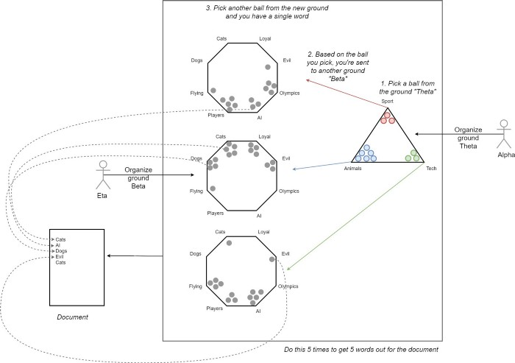
Textual reviews
https://ieeexplore.ieee.org/abstract/document/8813018
Customer Reviews Analysis With Deep Neural Networks for E-Commerce Recommender Systems
  Latent Dirichlet Allocation (LDA, https://en.wikipedia.org/wiki/Latent_Dirichlet_allocation , https://towardsdatascience.com/light-on-math-machine-learning-intuitive-guide-to-latent-dirichlet-allocation-437c81220158 )
    Documents; fixed set of latent topics; each document is a mixture of topics, each topic is characterized as a distribution over words
    Assume generative model for documents
    and then try to reverse-ingeneer it
    Several ways to learn, e.g. Variational inference

Slide 37
Textual reviews
https://ieeexplore.ieee.org/abstract/document/8813018
Customer Reviews Analysis With Deep Neural Networks for E-Commerce Recommender Systems
  Latent Dirichlet Allocation (LDA) on all user reviews
  Get binary user-attribute matrix (sparse)
  -> DL [maybe redundant] for dense vector
  -> Nearest neighbor model for rating prediction
  (user-user similarities)

Slide 38
Textual reviews
https://dl.acm.org/doi/pdf/10.1145/3412841.3442065
Utilizing Textual Reviews in Latent Factor Models for Recommender Systems
Latent Dirichlet Allocation (LDA); document = all reviews for item
  Use LDA to get item-attributes, use them in matrix factorization
  Joint optimization model for MF based and LDA based parts
  EM procedure for optimization

Slide 39
Textual reviews
http://ceur-ws.org/Vol-2068/exss8.pdf [vision paper]
Explaining Recommendations by Means of User Reviews
  Extract & summarize arguments about products from reviews
  Use them in Personalized explanations
Challenges:
Linguistically analyzing review texts via argument mining and stance detection.
Identifying important concepts for a target user via an attention-based mechanism.
Deriving an argumentation flow via multiple applications of the attention-based mechanism.
Unifying the linguistic analyses and the attention-based mechanism.

Slide 40
Searching and filtering as feedback

Slide 41
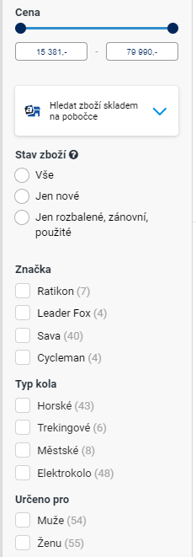

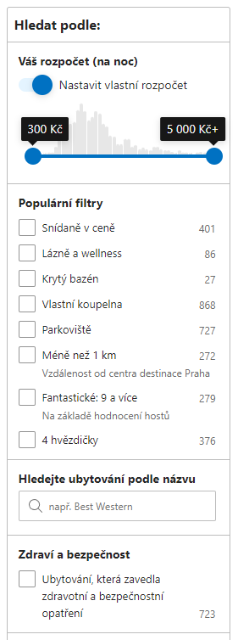
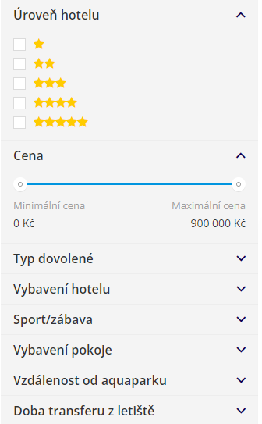
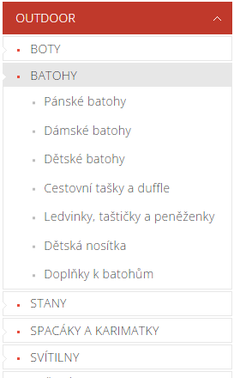
What would the user be willing to do?

Slide 42
What would the user be willing to do?
Most users do:
Filter content manually
  Browse categories
  Apply facet search
    Mostly direct mapping to object’s attributes
  Use fulltext search
  Can be utilized in the construction of attribute-level preferences
    Beware of long-term preferences vs. short-term goals
All users do:
Evaluate & consume content:
  Browse items, open details, read content, play, purchase,…
  Preferences based on implicit feedback

Slide 43
How to model UP
Tenative solutions for show-cases

Slide 44
How to model UP
Simple movies recommendation:
Task: discover what to watch tonight
How to use UP: Collaborative recommendation of movies
Basic model of UP:
Preferences on movies (rating, watching)
  If insufficient data: openning movie details, top search results
Enhancements:
Learned (confirmed) preferences towards genres (multiple confirmation, enough data)
Learned (confirmed) preferences towards other named entities (actor, director)
List-wise preferences (Y was selected from results of XYWZ)
  Remember impressions, not just usage

Slide 45
How to model UP
(Food) Recipes recommendation:
Task: help to decide what to cook
  How to use UP: personalized searching, front-page recommendation
Basic model of UP:
Preferences on recipes (likes, add to list, reading sufficiently long)
Preferences on ingredients (search count, contained in prefered recipes, confirmation?)
  Ingredients granularity?
Enhancements:
Learned preferences towards tags & attributes
  Verify on a well-known subset of users (RecSys OPS)
Best out of similar choices
  Which goulash does the user prefer? Would that say something more generic about him/her?
Should we allow users to further refine recommendations?
  Faceted recommendations (https://www.researchgate.net/publication/301321425_FeRoSA_A_Faceted_Recommendation_System_for_Scientific_Articles)

Slide 46
How to model UP
Group music recommendation:
Task: create a background music playlist for an evening with friends
How to utilize it: fairness-aware playlist construction
Individual preference
  Track -> Album -> Artist (playcount, play from search, likes)
  Maybe, preferred sequences (low-level audio analysis, but probably not for individual users)
Group preferences
  Playlist modifications

Slide 47
Preference Elicitation

Slide 48
Preference Elicitation
[WIKI] Preference elicitation refers to the problem of developing a decision support system capable of generating recommendations to a user, thus assisting in decision making. It is important for such a system to model user's preferences accurately, find hidden preferences and avoid redundancy.
Not really a definition
The process of collecting user preferences to support decision making systems
  Often considered w.r.t. restricted meaning of initial preference elicitation
  Usually restricted to explicit feedback
Traditional methods (2004):
https://citeseerx.ist.psu.edu/viewdoc/download?doi=10.1.1.319.8057&rep=rep1&type=pdf

Slide 49
Preference Elicitation
Additive independence of preferences
  Preferences of items is a function of it’s features preferences (wAVG)

Slide 50
Preference Elicitation
Additive independence of preferences
Similar as LMPM – only value functions does not have to be linear

Slide 51
Preference Elicitation
Knowledge-based RS with preference elicitation
  Start either with known example
  Or initial search

Slide 52
Preference Elicitation
Choice-based preference elicitation for collaborative filtering recommender systems
https://dl.acm.org/doi/10.1145/2556288.2557069
  Not based on meta-data, but latent factors
    „The basic idea behind our approach is, thus, to use latent item features derived from the rating matrix and request preferences for sets of similar items instead of single items.“
    „Since the number of interaction steps needed should be minimized, we developed a technique based on latent factors to achieve a maximum information gain with each choice.“

Slide 53
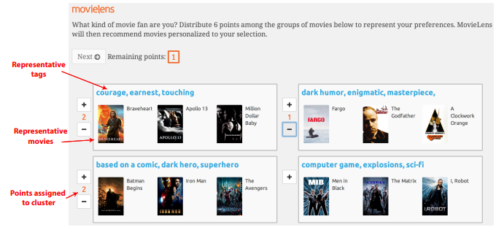
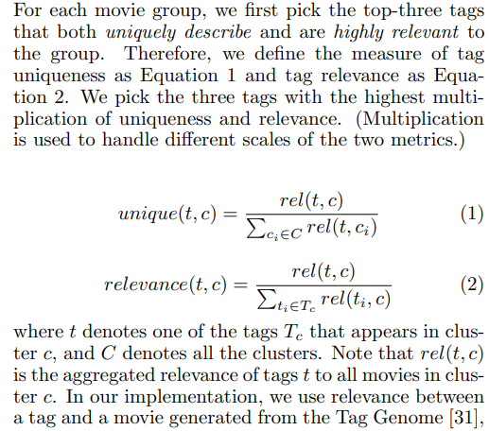
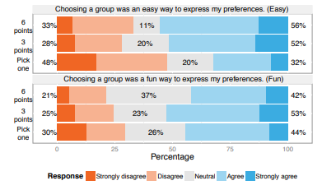
Preference Elicitation
Using Groups of Items for Preference Elicitation
in Recommender Systems
https://dl.acm.org/doi/pdf/10.1145/2675133.2675210
New users can begin by expressing their preferences for groups of items
  Utilize clustering to generate groups
  Based only on movie ratings
  For each cluster: select tags, then select best matching movies
  Get avg. ratings of users with similar cluster prefs.

Slide 54
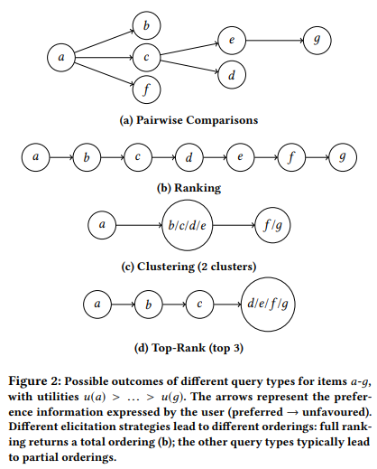
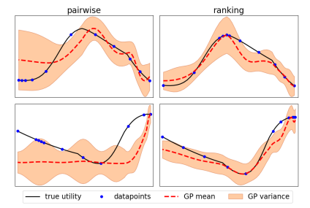
Preference Elicitation
Ordered Preference Elicitation Strategies for Supporting Multi-Objective Decision Making
https://arxiv.org/pdf/1802.07606.pdf
Utilize full ranking of items
  User starts with two items, then iteratively place one more item at each step
  How to select what to ask?
    Gaussian process (model mean and variance for each datapoint)
    (https://ebonilla.github.io/gaussianprocesses/, https://github.com/chariff/GPro )
    Expected improvement acquisition function (https://www.csd.uwo.ca/~dlizotte/publications/lizotte_phd_thesis.pdf)

Slide 55
Preference Elicitation
https://dl.acm.org/doi/pdf/10.1145/2792838.2796554 (Healthy recipes recommendation)
  What was the main cause of your decision?
    Video: https://onedrive.live.com/?authkey=%21ALYePnW0fOCHOUQ&cid=60DC0855E37985A6&id=60DC0855E37985A6%2149418&parId=60DC0855E37985A6%2149101&o=OneUp
    Relatively simple tag-based approach

Slide 56
Preference Elicitation
https://www.frontiersin.org/articles/10.3389/frobt.2017.00071/full (Constructive pref. Elicitation)
  There exist many types of queries, like lotteries, pairwise or setwise rankings, improvements, which all share the goal of being easy to answer to and as informative as possible.
    Choice set feedback
    Coactive feedback (how to slightly improve a solution? – can be done from implicit feedback)
    https://www.jair.org/index.php/jair/article/view/10939
    Example critiquing
  Queries involving comparisons and rankings have come to be predominant in the literature with respect to quantitative evaluations.
  Indeed, users are typically more confident in providing qualitative judgments like “I prefer configuration y over y′” than in specifying how much they prefer y over y′ (Conitzer, 2009; Carson and Louviere, 2011).

