Slide 1


NDBI021, Lecture 2
User preferences, 2/1 ZK+Z,
Tue 14:00 – 15:30 S7
Tue 15:30 – 17:10 S7 (starting 2nd week)
https://www.ksi.mff.cuni.cz/~peska/vyuka/ndbi021/2023/
https://youtube.com/playlist?list=PLTYzSYF3EX3BNIVJkMpCE3vUDmUGvhEcy
https://ksi.mff.cuni.cz

Slide 2
How to express user preferences
Feedback variants for users

Slide 3
What tools are there to express preferences
„Expressing by doing“ (implicit feedback)
Rating/(dis)approving (explicit feedback)
Filtering, searching
Explicit comparison (A is better than B)
Critiquing
Writing a review
Did I forgot anything?

Slide 4
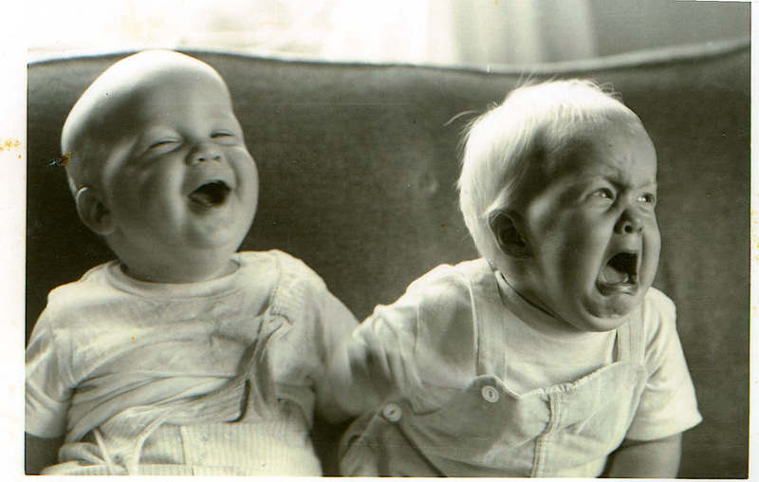
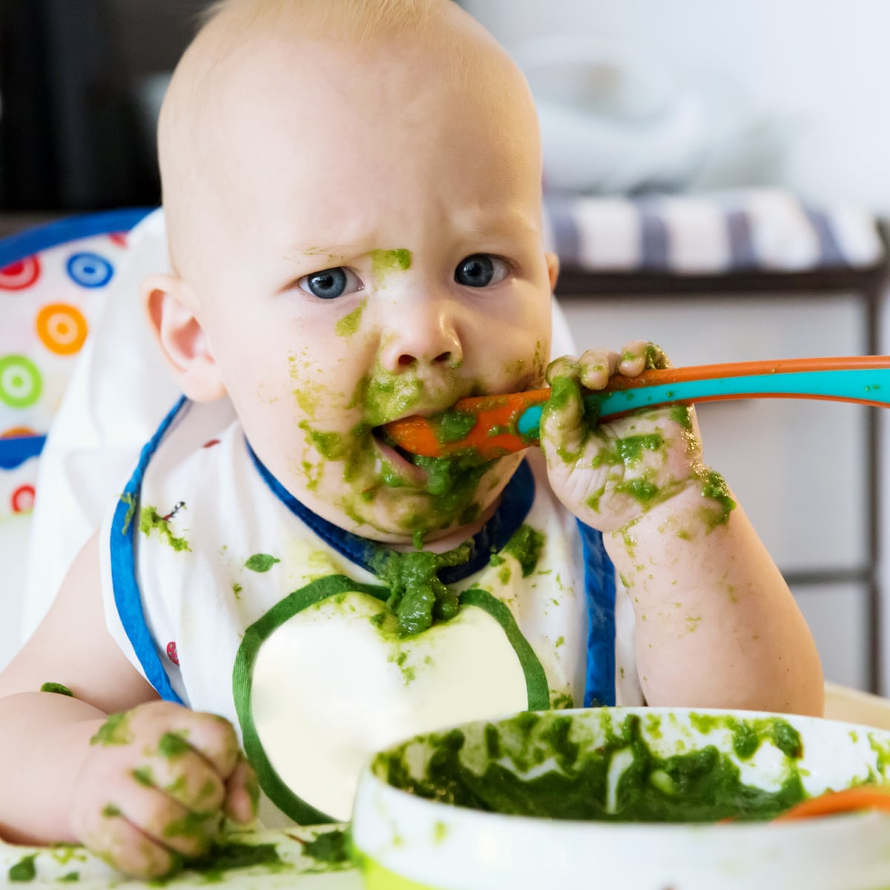

What tools are there to express preferences
Explicit feedback
Searching / filtering
Implicit feednack
Why doing user preference research feels like being a parent?

Slide 5
How to collect user preferences?
Rating, filtering, comparison, reviews… via designated GUI
  How to store e.g. searching / filtering may be a bit tricky…
Implicit feedback
  Server-side (limited expressibility)
  Client-side (triggered JS events)
  Beyond (eye tracking, other biometrics)
    Limited applicability (lab studies)
    Can provide leads on interpretation of the previous two
Questionaires, role playing
  Lab studies only (in most cases)
  Can provide leads on interpretation of other collection methods

Slide 6
Explicit feedback
Let the users to tell you

Slide 7
Explicit feedback
Information given consciously by the user to express his/her preference
  Via dedicated GUI
Rating (likert scale) of objects
  N-ary preference (5 / 10 degrees of preference most common, sometimes pref. slider)
  Binary preference (likes – dislikes)
  Unary preference (likes only)
Comparative preferences (very rare)
  A is better than B
Simple enough? Nothing to research here?
  Well... ☺

Slide 8
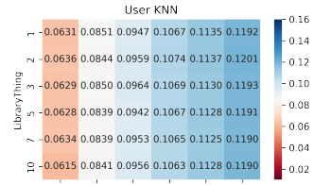
Explicit feedback
How rating scale influence user’s rating behavior?
https://www.tandfonline.com/doi/full/10.1080/0144929X.2017.1322145
  Granularity of the rating scale
  Presence/absence of neutral point
  Labeling
How much are the ratings inconsistent for test-retest?
  https://xamat.github.io/pubs/xamatriain_umap09.pdf
  https://journals.sagepub.com/doi/10.1177/0013164404268674
Are different rating scales affecting RS performance?
  Not much research until recently
  http://ceur-ws.org/Vol-997/umap2013_lbr_7.pdf
    It seems that 3-point likert scale has smaller MAE than 5-point scale
    But what about scaling effect?
  https://dl.acm.org/doi/10.1145/3523227.3551479 (our work)
    Lower granularity may decrease performance of RS, but much less than lower feedback volumes

Slide 9
Explicit feedback: how scale influence behavior?
How rating scale influence user rating behavior?
https://www.tandfonline.com/doi/full/10.1080/0144929X.2017.1322145
  Granularity of the rating scale
    10.1007/s11205-007-9171-x: evaluate happiness on 4, 5, 7 and 11 points likert scale; then re-scale to 11 points: 11-point scale has higher happiness than 4 and 7 (higher scale higher ratings?)
    Other authors did not found such re-scaling issues
    10.1016/S0001-6918(99)00050-5: 2,3,4 point least reliable and least discriminating, wider options preferred (7-10), but 2-4 points quicker to use
      Less granularity imply higher willingness to use?
      Binary/unary schemes less intrusive?
    10.1177/0013164404268674: test-retest scenario; more granular response (at least 3) imply higher reliability

Slide 10
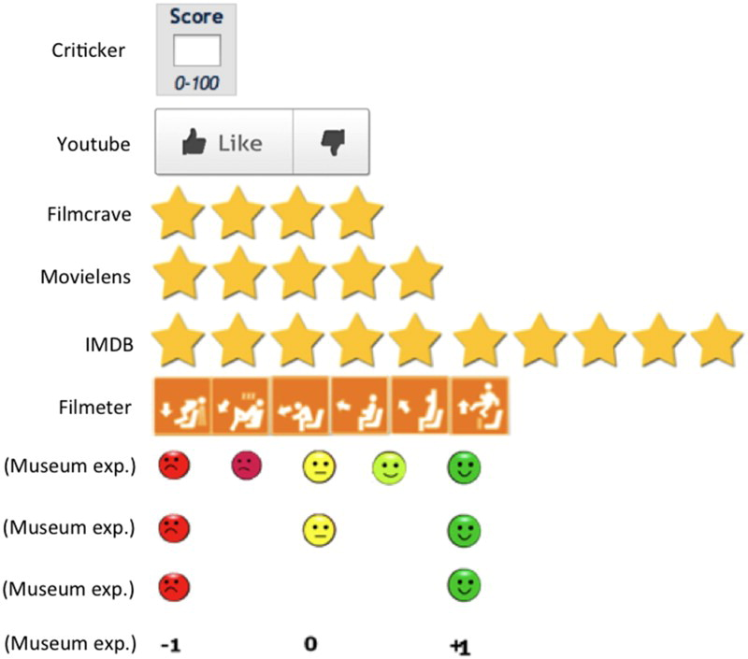
Explicit feedback: how scale influence behavior?
How rating scale influence user rating behavior?
https://www.tandfonline.com/doi/full/10.1080/0144929X.2017.1322145
  Granularity of the rating scale: how different rating scales correlate on real-world services
 |  | Cricketer | Filmeter | FilmCrave | IMDb | MovieLens
Criticker | Pearson Correlation | 1 | 0.791ª | 0.943ª | 0.944ª | 0.946ª
Filmeter | Pearson Correlation | 0.791ª | 1 | 0.783ª | 0.767ª | 0.740ª
FilmCrave | Pearson Correlation | 0.943ª | 0.783ª | 1 | 0.934ª | 0.915ª
IMDb | Pearson Correlation | 0.944ª | 0.767ª | 0.934ª | 1 | 0.933ª
MovieLens | Pearson Correlation | 0.946ª | 0.740ª | 0.915ª | 0.933ª | 1

Slide 11
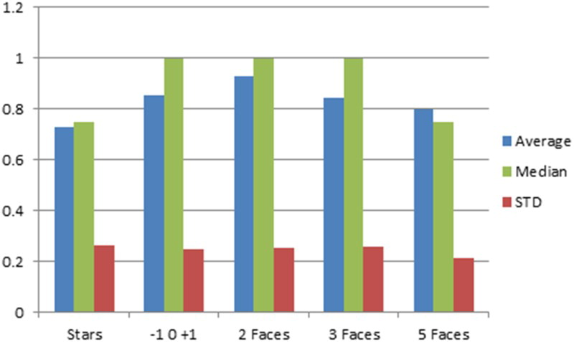
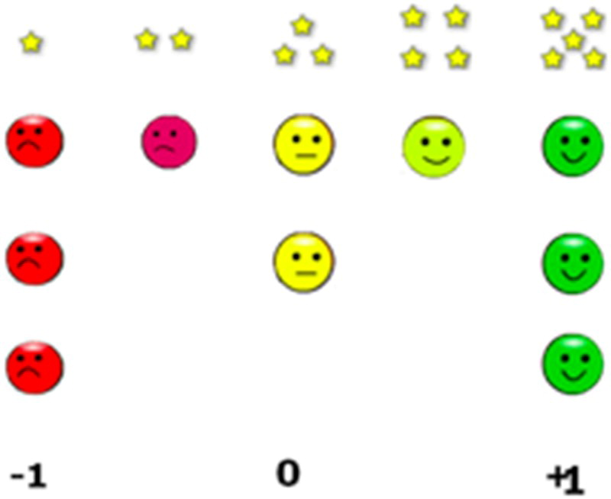
Explicit feedback: how scale influence behavior?
How rating scale influence user rating behavior?
https://www.tandfonline.com/doi/full/10.1080/0144929X.2017.1322145
  Granularity of the rating scale: same site with different rating scales implemented: how the results differ?
  Note the average

Slide 12
Explicit feedback: how scale influence behavior?
How rating scale influence user rating behavior?
https://www.tandfonline.com/doi/full/10.1080/0144929X.2017.1322145
  Neutral point
    https://www.rangevoting.org/MB_V2_N3_Garland.pdf :
      some respondents may choose the midpoint in order to provide a less negative answer, because of a social desirability bias
      rating scales with no midpoint force the real indifferent to make a choice, causing a distortion towards higher or lower answers
    10.1016/j.ijresmar.2010.02.004:
      with neutral points in the rating scale, we will have less extreme responses and higher ratings

Slide 13
Explicit feedback: how scale influence behavior?
How rating scale influence user rating behavior?
https://www.tandfonline.com/doi/full/10.1080/0144929X.2017.1322145
  Labels
    http://www.websm.org/uploadi/editor/1368430817Hereshey_1993_The_Biasing_Effects_of_scale_checking.pdf : Ordering of labels could matter
      collected students’ attitudes towards their college
      ‘strongly agree’, ‘agree’, ‘undecided’, ‘disagree’ and ‘strongly disagree’ and opposite order,
      first scale resulted in a significantly greater degree of agreement.
      Presentation bias / primacy effect?
    https://academic.oup.com/poq/article/79/1/145/2330061?login=true :
      Using 11-point likert scale (0 – 10 vs. 10-0), significant bias towards left side
    https://papers.ssrn.com/sol3/papers.cfm?abstract_id=2423064 (label’s value matters)
      If negative labels are used (e.g. -4,.., 4), it is perceived more negatively (vs. 1,...,9)
      -4,.., 4 produces more positive evaluations than 1,...,9

Slide 14
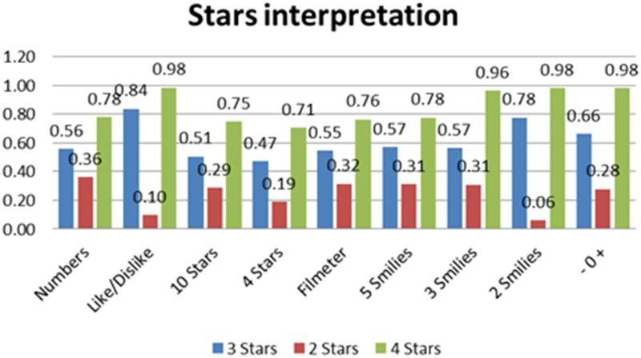
Explicit feedback: how scale influence behavior?
How rating scale influence user rating behavior?
https://www.tandfonline.com/doi/full/10.1080/0144929X.2017.1322145
  You have 2*, 3* and 4* out of five star chart, how will you translate it to other rating schemes
    Translation differs, but there are some similar outcomes

Slide 15
Explicit feedback: how scale influence behavior?
Summary:
  Be very careful while changing GUI or using external feedback data
    Some transformation may be necessary

Slide 16
Explicit feedback: how much inconsistent it can be?
https://xamat.github.io/pubs/xamatriain_umap09.pdf
Netflix dataset, both popular & unpopular movies
Three trials, 5-scale rating + unseen of 100 movies: 1->2 at least one day apart, 2->3 at least 14 days apart, different ordering of items (random -> popular -> random)
Usually, rating differs just by one point; mediocre movies more unstable

Slide 17
Explicit feedback: how much inconsistent it can be?
Assimilation/Contrast effect on sequence of ratings
https://psycnet.apa.org/record/2001-01676-002
https://en.wikipedia.org/wiki/Assimilation_and_contrast_effects
  Main findings:
    a user is likely to give a lower rating to an item if the preceding one deserved a very high evaluation.
    However, if successive items are comparable in their ratings, the user is likely to assimilate the second item to the preceding one and give the same rating to both

Slide 18
Explicit feedback: how much inconsistent it can be?
Summary:
  Test robustness of your models against small rating variations (as they may be slightly unstable)

Slide 19
Explicit feedback: other variants
Explicit comparison of items / groups of items
  Never seen outside of preference elicitation models
  And one dating app...
  May be fun for users -> higher engagement... But only for specific use-cases
Explicit rating of item’s attributes
  Multimodal rating
  Not frequent, but relevant for well-defined cases
    Booking.com example
    Does not have to map to „attributes“ as defined for item
Writing a review (is it really explicit feedback?)
  Emotion/polarity detection, feature detection
  Details maybe later – if enough time

Slide 20
Explicit feedback
How does the industry feel about that?

Slide 21
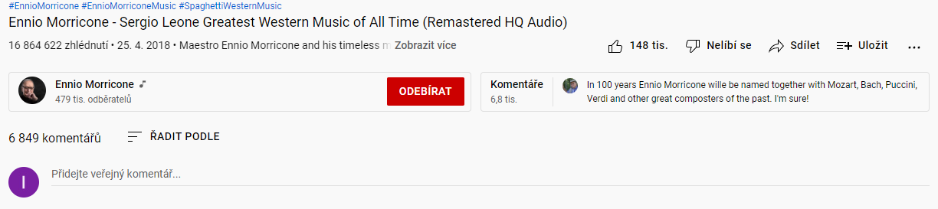
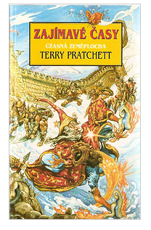
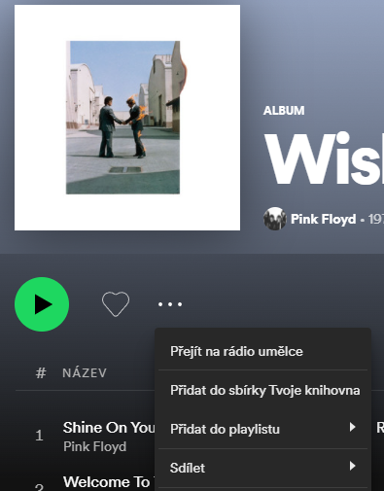
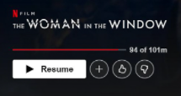







Explicit feedback in industry
Artist, album & track

Slide 22
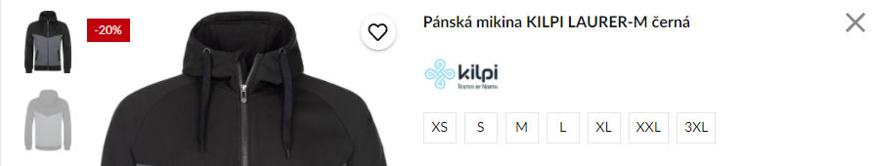
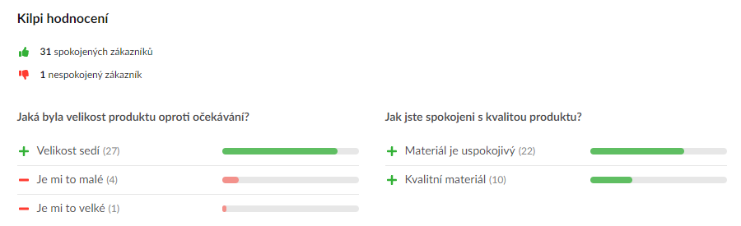


Explicit feedback in industry

Slide 23
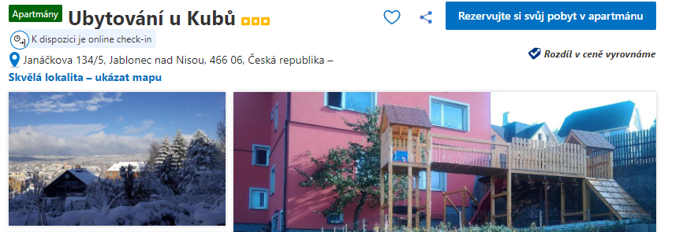
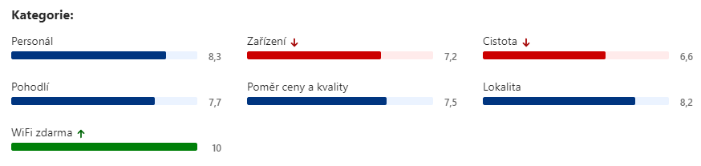
Explicit feedback in industry

Slide 24
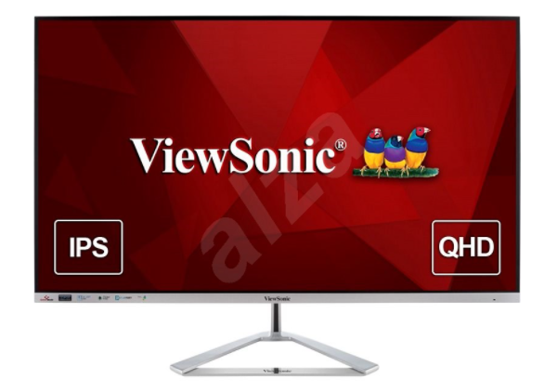
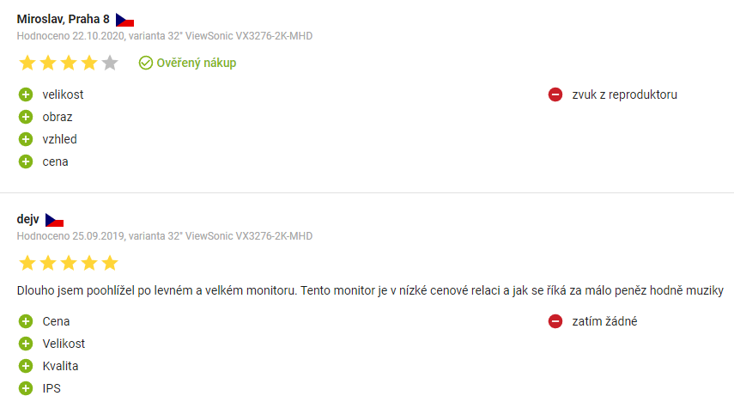
Explicit feedback in industry

Slide 25
Explicit feedback in industry
Some users are sometimes willing to
Provide ratings
  Sometimes aspect-based ratings (mostly pre-defined, widely recognized categories)
    Does not have to correspond to object’s attributes directly
  Write review
Explicit / implicit borderline:
  Add object to some list / organize favorite objects / provide tags for them
  Share items
Is this frequent enough so we can infer preferences of individual users?

