Slide 1


NDBI021, Lecture 1
User preferences, 2/1 ZK+Z,
Tue 14:00 – 15:30 S7
Tue 15:30 – 17:10 S7 (starting 2nd week)
https://www.ksi.mff.cuni.cz/~peska/vyuka/ndbi021/2023/
https://youtube.com/playlist?list=PLTYzSYF3EX3BNIVJkMpCE3vUDmUGvhEcy
https://ksi.mff.cuni.cz

Slide 2
NDBI021: User preferences
Lectures
User preferences (cca 8 lectures: 4x LP + 4x PV)
Advanced topics from recommender systems (cca 5 lectures: LP)
Labs
Paper reports
  Cooperation on current research projects
Coding, analysis & results presentation

Slide 3
NDBI021: User preferences
Syllabus
User preferences
  Introduction, motivation, challenges and use-cases of user preferences
  Modelling / expressing user preferences, types of user feedback, LMPM
  Learning user preferences, feedback interpretation, aggregating preferences & fuzzy logic
  Applications for user preferences, recommender systems, personalized search, challange-response framework
Advanced topics from recommender systems
  Fairness and proportionality in recommender systems
  Multicriterial optimization & evaluation in recommender systems
  Dynamic recommender systems: multi-armed bandits & reinforcement learning
  Unbiased evaluation, inverse propensity, feedback loops problem
  Deep learning for heterogeneous recommender systems

Slide 4



NDBI021: User preferences
Disclaimer
  Not about sandbox models
We used exactly the same settings as those other guys, but significantly improved p@10 by 0.05%

Slide 5
User preference
What is User Preference?
[IGI-global dictionary] A soft requirement provided by users, in addition to a query, to reflect a wish. It influences the querying process by causing some results to be favored.
  Why/where to utilize user preferences (UP)?
  How to define/express UP? How to model UP?
  How to learn UP / interpret user’s feedback?
  What to do with UP?

Slide 6
Related concepts
(Implicit / explicit ) user feedback
  Typical means of getting user preferences
Psychological profiling (https://www.researchgate.net/publication/220737365_Towards_User_Psychological_Profile )
  E.g. Sufficer vs. Maximizer (https://www.wsj.com/articles/how-you-make-decisions-says-a-lot-about-how-happy-you-are-1412614997 )
  Related area of user profiling
Recommender systems
  Typical means of utilizing user preferences
Preference Elicitation
  How to get (explicit) preferences (mainly) from new users

Slide 7
Additional resources
UMAP tracks 2022
Personalized Recommender Systems
Adaptive Hypermedia, Semantic, and Social Web
Intelligent User Interfaces
Technology-Enhanced Adaptive Learning
Fairness, Transparency, Accountability, and Privacy
Personalization for Persuasive and Behavior Change Systems
Virtual Assistants and Personalized Human-robot Interaction
Research Methods and Reproducibility
UMAP konference
  https://www.um.org/umap2023/
UMUAI journal
  http://www.umuai.org/
RecSys, SIGIR, ECIR, IUI, CHI…
  https://sigir.org/sigir2022/, https://recsys.acm.org/

Slide 8
Recommender Systems: recap
a.k.a. If you don’t know it, get into it☺

Slide 9



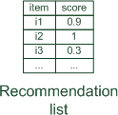
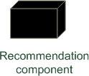



Paradigms of recommender systems

Slide 10
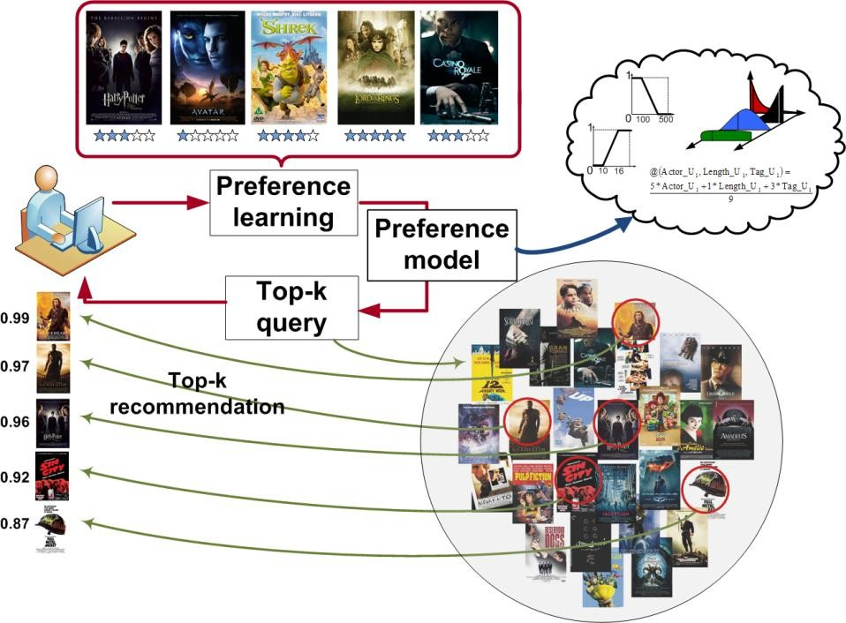
Lifecycle of Recommender Systems
Get User Feedback
Learn internal model
Upon demand, recommend objects
The process is asynchronous by nature
Most recent usually most relevant
Dynamic nature of the process seriously complicate things
  Partial re-train / model updates
  Long-term vs short-term (context), preference drift
  Repeated consumption & recommendation

Slide 11
Basic algorithms
Non-personalized & item-based & session-based models
KNN variants
Matrix factorizations
  Content-aware factorization methods
Reinforced learning / multi-armed bandits
Deep learning architectures

Slide 12
Basic evaluation
On-line / off-line / lab studies
Accuracy-based metrics (Recall, nDCG, MAP,…)
„Beyond accuracy“ (diversity, novelty, coverage, fairness, popularity bias…)
„Technical“ (time complexity, scalability, ability to predict for all…)

Slide 13
User preferences: intro
a.k.a tons of questions and a few answers

Slide 14



Why / where to utilize user preferences?
Why:
Information Overload (https://en.wikipedia.org/wiki/Information_overload)
  Difficulty to effectively decide when one has too much information (options to choose from)
  Filter available information according to user’s preferences
Because it may improve user’s experience => satisfaction, loyalty, consumption…
  => improve target metrics of the content provider
  Knowing your users allows you to serve them better => monetize them better

Slide 15
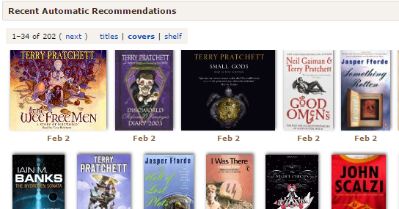
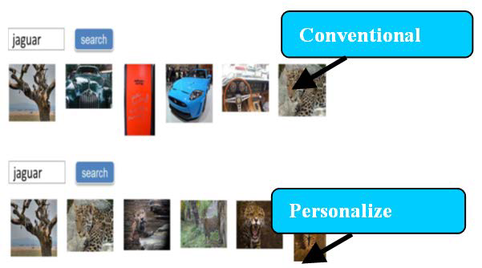
Why/where to utilize user preferences?
Where & what to do:
Limit ourselves to information retrieval (IR) domain
  Within IR, it may be relevant throughout various domains
  Recommender systems,
  GUI personalizations (https://evergreen.team/articles/ui-and-ux-personalization.html)
  Personalized search (https://en.wikipedia.org/wiki/Personalized_search)
  …
Know what you want to achieve (task is important)

Slide 16
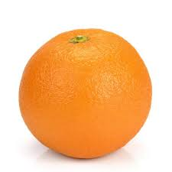
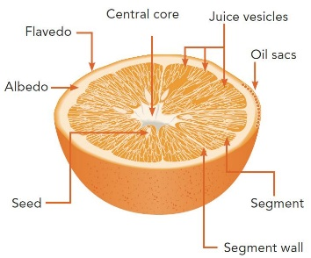

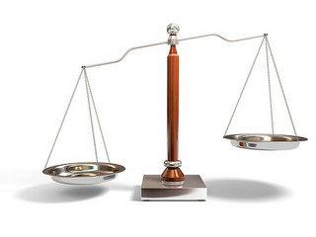
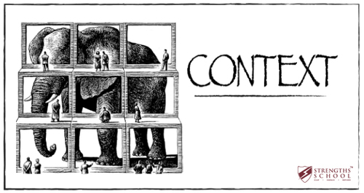
How to define user preference model?
Highly domain / task specific:
What is the task?
  What is/are the entity/ies on which preferences can be expressed?
    Objects? Their features? Groups of items?... Page layout?
  Who gives the preference (who is the user)?
    An individual? A group of people? A cookies stored in a browser?
  What are expected connections among these entities (hypotheses)?
    Some features are more important than others (presumably)
    Preference of an object corresponds to an aggregation of its feature’s preferences)
  Does user preference depend on some context/conditions?
    I only watch romantic comedies with my wife…
How to express preferences?
  Implicitly? Explicitly? A combination of both? Sth. else?

Slide 17
What tools does the user have (to express preferences)?
„Expressing by doing“ (implicit feedback)
Rating/(dis)approving (explicit feedback)
Filtering, searching
Explicit comparison (A is better than B)
Writing a review
Did I forgot anything?

Slide 18
How to collect user preferences?
Rating, filtering, comparison, reviews… via designated GUI
  How to store e.g. searching / filtering may be a bit tricky…
Implicit feedback
  Server-side (limited expressibility)
  Client-side (triggered JS events)
  Beyond (eye tracking, other biometrics)
    Limited applicability (lab studies)
    Can provide leads on interpretation of the previous two
Questionaires, role playing
  Lab studies only (in most cases)
  Can provide leads on interpretation of other collection methods

Slide 19
What to do with user preferences?
(Again) task specific
Apply it in recommender systems
  Most prominent use-case
  Recommend objects to interact with
  Subcase: construct streams of objects (music, learning,…)
Modified search engine
  Results re-ranking
Modified page composition
  Prepend most interesting categories
  Re-order / hide / show some widgets based on utilization,…

Slide 20
How to model user preferences
What can be expressed & how to express it

Slide 21
How to model user preferences?
What is/are the entity/ies on which preferences can be expressed?
Who gives the preference (who is the user)?
What are expected connections among these entities (hypotheses)?
Does user preference depend on some context/conditions?
In what way do we allow users to express their preferences?

Slide 22
How to model UP [some use-cases]
Simple movies recommendation:
Task: help to discover what to watch tonight
  How to use UP: Collaborative recommendation of movies
    E.g. Select users similar to the current one, recommend what other users liked but the current one does not know.
(Food) Recipes recommendation:
Task: help to decide what to cook
  How to use UP: personalized searching
    Searching for recipes matching desired ingredients + users preferences
  How to use UP: front-page recommendation
    E.g. recommend recipes from user’s favorite ingredients, similar (not too similar) to the ones liked in the past

Slide 23
How to model UP [some use-cases]
Group music recommendation:
Task: create a background music playlist for an evening with friends
  On top of Youtube / Spotify or similar service
How to utilize it: fairness-aware playlist construction
  (Endless) sequence of tracks, representing interests of all group members

Slide 24
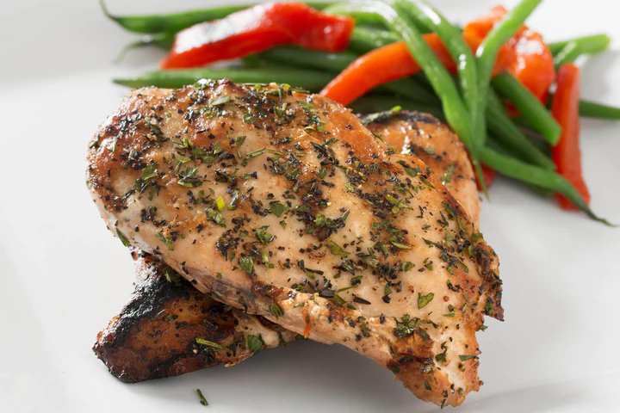
Points to consider in modeling phase
What entities are relevant?
  Are they sufficiently independent? Can we get enough data about them?
  How much added value they can give us? Would it upset our users if they are not allowed to prefer them?
What (minimal) granularity to use?
  Primary target: cooking recipes
    Recipes are composed from multiple ingredients (and other attributes)
      Ingredients themselves has some attributes (e.g. quantity, type of preparation, quality, category)
      0.5kg of ground free-ranged chicken brests -> chicken brests are a type of meat / chicken meat / light meat…
  Would the user like the recipe more/less if it would be meat-free?
  Is it possible that he/she (dis)like chicken brests?
  Can you say that the recipe contains too much meat?
  Is it even possible to rate the recipe based on ingredients?
What would the user be willing to do/say/rate/…?
  Users tend not to rate things much
  But they are sometimes willing to confirm/reject your beliefs
  They do browsing, searching, buying etc.

Slide 25
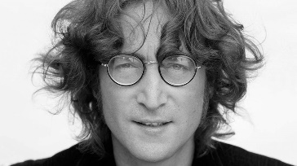

What entities are relevant?
What entities are relevant?
  Are they sufficiently independent?
    Is the user’s preference towards some recipe a mere aggregation of his/her preference towards its ingredients?
    Do you like the song just because it was written by… John Lennon?
  How much added value they can give us?
    Is it usual that people like Offsprings, but dislike their Americana album?
Who should decide?
  Domain expert
  Supported by data analysis
    If you have some preliminary data:
    … and/or continuous testing
    … and/or dedicated lab study
    Look for both common cases and outliers. If every person is an outlier in some scenario & you only solve common cases... Not good☺

Slide 26
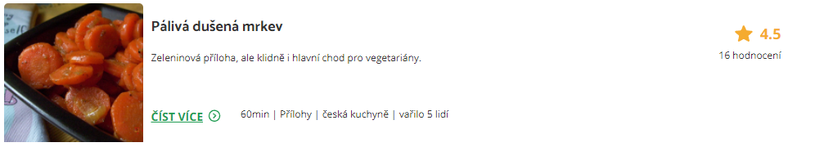



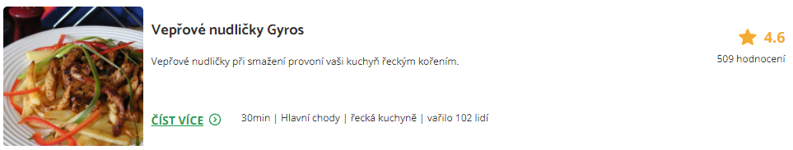
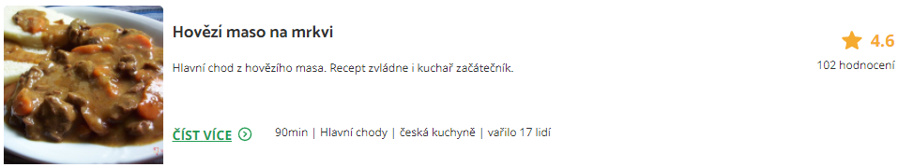
What minimal granularity to chose?
This is the feedback we have
Would he/she like this one?

Slide 27

What minimal granularity to chose?
This is the feedback we have
Would he/she like this one?

Slide 28
What minimal granularity to chose?
This is the feedback we have
Would he/she like this one?
Probably not, he/she seems to be a vegetarian

Slide 29
What minimal granularity to chose?
So, the finer granularity the better?

Slide 30

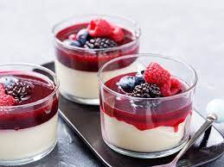
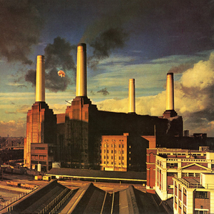
What minimal granularity to chose?
Why do you like Lord of the Rings movie?
What makes panna cotta so delicious?
What is so good on [your favorite artists] songs?

Slide 31
What minimal granularity to chose?
Why do you like Lord of the Rings movie?
What makes Panna cotta so delicious?
What is so good on [your favorite artists] songs?
Is the description discriminative?
  Can it be generalized to all other objects sharing the same feature?
  Is there something missing in the picture?
If you mentioned multiple features, what is their interplay?
  And-like / or-like / additive / amplifying…

Slide 32
What minimal granularity to chose?
Why do you like Lord of the Rings movie?
What makes Panna cotta so delicious?
What is so good on [your favorite artists] songs?
Do we have data for your choices?
  How much meaningful are our attributes?
  How much variety do we have?
  (Hard to define) how much information is missing?

Slide 33
What minimal granularity to chose?
Why do you like Lord of the Rings movie?
What makes Panna cotta so delicious?
What is so good on [your favorite artists] songs?
Also, are this the actual reasons, or just you justifying your emotions?
  https://start.askwonder.com/insights/want-add-previous-request-made-few-years-ago-want-studies-support-idea-decisions-c22yygpap
  https://en.wikipedia.org/wiki/Motivated_reasoning
  Ninety percent of human decisions are made based on emotions. Humans use logic to justify their actions to themselves and others
  "Common emotional decisions may use some logic, but the main driving force is emotion, which either overrides logic or uses a pseudo-logic to support emotional choices (this is extremely common). Another common use of emotion in the decision is to start with logic and then use emotion in the final choice."

Slide 34
What minimal granularity to chose?
To sum-up
It may be difficult for humans to express their preference on sub-object level
  Some hints are possible, but the information is rarely complete
Our data does not have to correspond to the user’s vocabulary
  Some features are missing
  Some user’s preferences are hard to be transferred to attributes
  (The movie is too generic)
Quite often, human’s decisions are not driven logically, but emotionally
  Any logical clues they give us does not have to be applicable for the next case

Slide 35
What minimal granularity to chose?
One possible solution:
Collect feedback on object-level, infer sub-object preferences
  Latent or explicit
  Occasionally ask, whether your explicit preferences are correct
    E.g. Use latent model, but „guard“ it via regularization to the explicit one. Iteratively update if you recieve confirmation on your explicit model. Or mixed latent + explicit model.
    https://www.frontiersin.org/articles/10.3389/fdata.2021.778417/full
    https://dl.acm.org/doi/10.1145/2043932.2043979
  Confirmation is often easier than definition + can be done in a less intrusive way
    Based on your recipe ratings, we think you are a vegetarian. Is that true?
    [Yes | NO | No, but I do not eat meat much | Irrelevant] What will happen >>
    If you click on Yes, we will promote more vegetarian meals in your future searches. You can always turn this feature off in your user profile.
  User controll in RS (https://web-ainf.aau.at/pub/jannach/files/BOOK_CHAPTER_PERSONALIZED_HCI_2019.pdf)
Requires rather lot of per-user data to learn this reliably

Slide 36
What minimal granularity to chose?
Be careful while generalizing from inferred sub-object preferences
Do you like action movies?
Do you like food with salt?
Do you like movies with David Aston?
  Yes, but not all of them
  Yes, but not because of this
…who is David Aston?

Slide 37
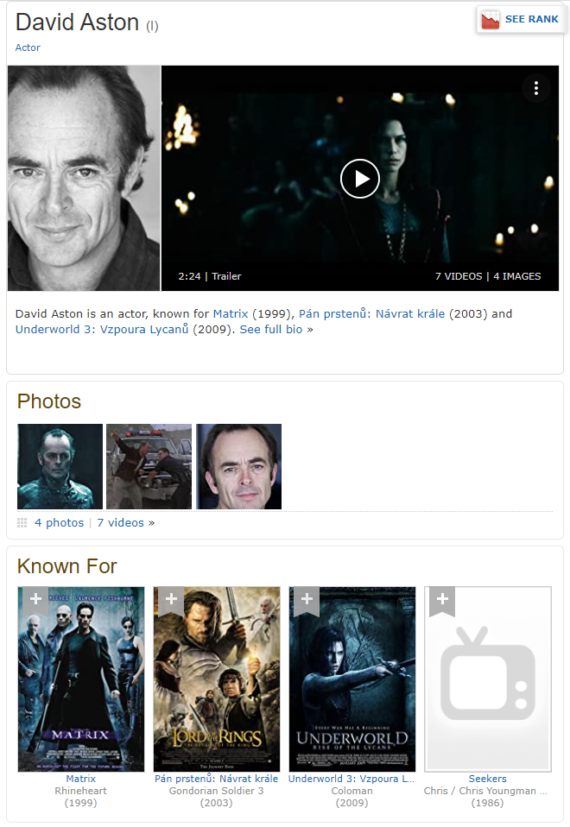
What minimal granularity to chose?
Be careful while generalizing from inferred sub-object preferences
Do you like action movies?
Do you like food with salt?
Do you like movies with David Aston?
  Yes, but not all of them
  Yes, but not because of this
…who is David Aston?

Slide 38
What minimal granularity to chose?
Be careful while generalizing from inferred sub-object preferences
Yes, but not all of them
  Should be fine (other features to clarify), but we need to ask questions correctly
Yes, but not because of this
  Loss of trust („the system does not understand what is important“)
  Some model of global or per-object feature importance
    Only confirm the inferred preference on the important ones
    Do not base your decision on the less relevant much

Slide 39
What would the user be willing to do?
How does the industry feel about that?

Slide 40
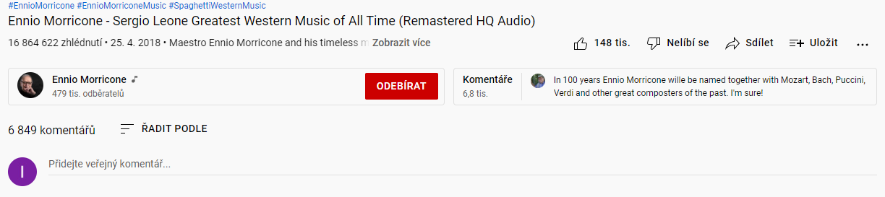
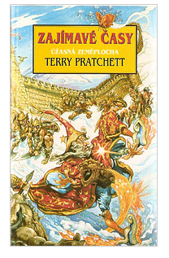
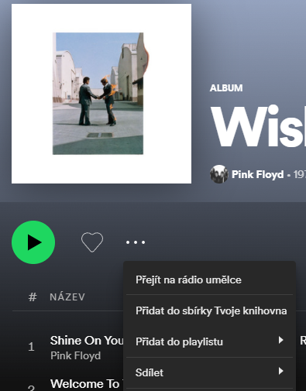
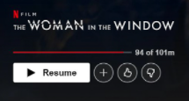







What would the user be willing to do?
Artist, album & track

Slide 41
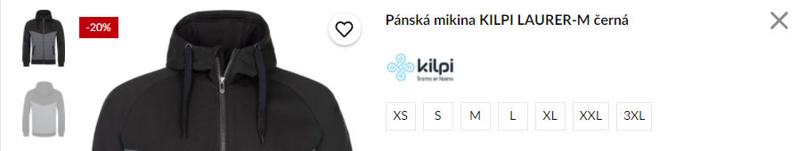
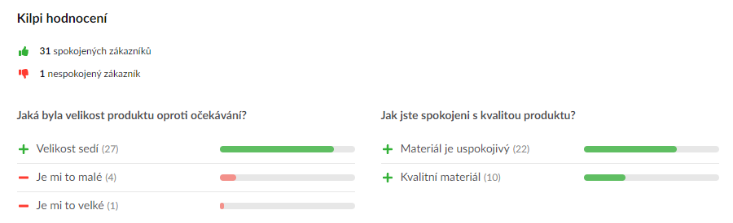


What would the user be willing to do?

Slide 42
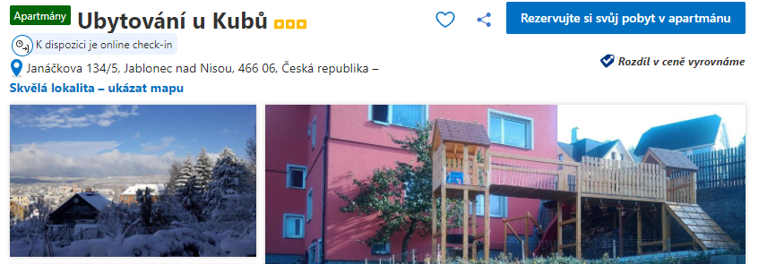
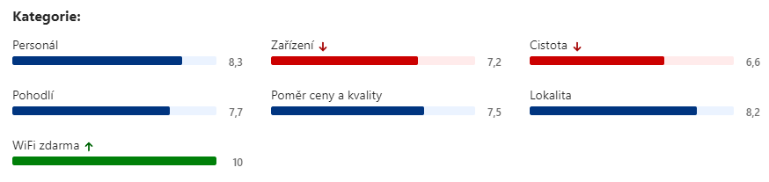
What would the user be willing to do?

Slide 43
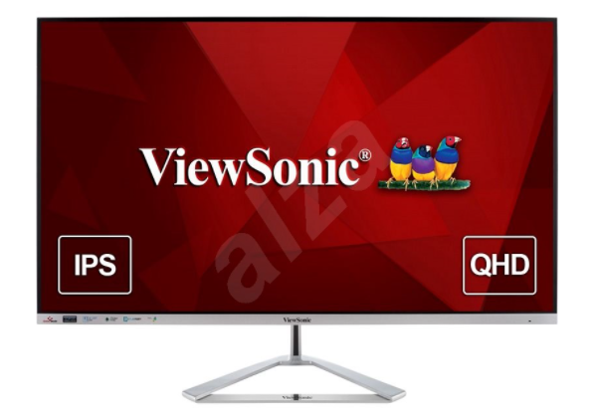
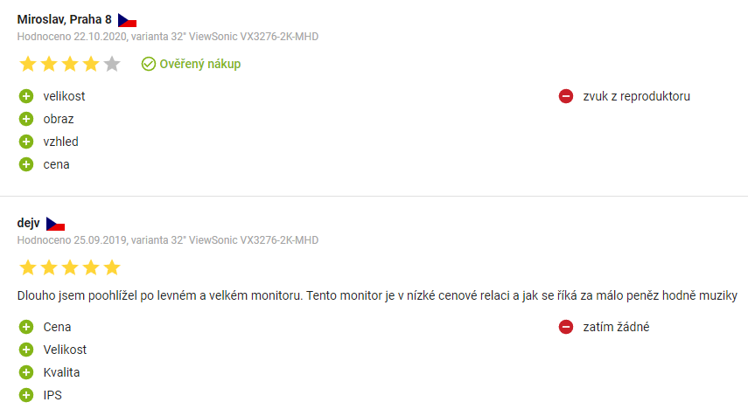
What would the user be willing to do?

Slide 44
What would the user be willing to do?
Some users are sometimes willing to
Provide ratings
  Sometimes aspect-based ratings (mostly pre-defined, widely recognized categories)
    Does not have to correspond to object’s attributes directly
  Write review
Add object to some list / organize favorite objects / provide tags for them
Share items
Is this frequent enough so we can infer preferences of individual users?

Slide 45
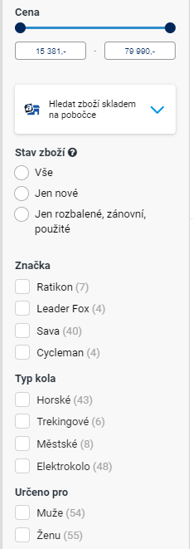

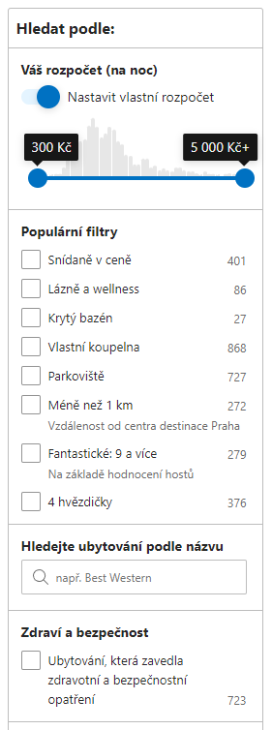
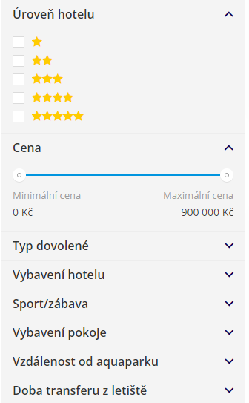
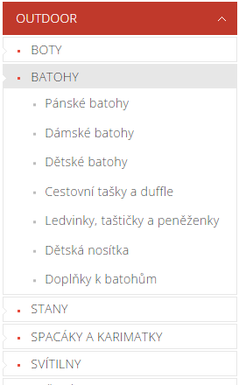
What would the user be willing to do?

Slide 46
What would the user be willing to do?
Most users do:
Filter content manually
  Browse categories
  Apply facet search
    Mostly direct mapping to object’s attributes
  Use fulltext search
  Can be utilized in the construction of attribute-level preferences
    Beware of long-term preferences vs. short-term goals
All users do:
Evaluate & consume content:
  Browse items, open details, read content, play, purchase,…
  Preferences based on implicit feedback

Slide 47
How to model UP
Simple movies recommendation:
Task: discover what to watch tonight
How to use UP: Collaborative recommendation of movies
Basic model of UP:
Preferences on movies (rating, watching)
  If insufficient data: openning movie details, top search results
Enhancements:
Learned (confirmed) preferences towards genres (multiple confirmation, enough data)
Learned (confirmed) preferences towards other named entities (actor, director)
List-wise preferences (Y was selected from results of XYWZ)
  Remember impressions, not just usage

Slide 48
How to model UP
(Food) Recipes recommendation:
Task: help to decide what to cook
  How to use UP: personalized searching, front-page recommendation
Basic model of UP:
Preferences on recipes (likes, add to list, reading sufficiently long)
Preferences on ingredients (search count, contained in prefered recipes, confirmation?)
  Ingredients granularity?
Enhancements:
Learned preferences towards tags & attributes
  Verify on a well-known subset of users (RecSys OPS)
Best out of similar choices
  Which goulash does the user prefer? Would that say something more generic about him/her?
Should we allow users to further refine recommendations?
  Faceted recommendations (https://www.researchgate.net/publication/301321425_FeRoSA_A_Faceted_Recommendation_System_for_Scientific_Articles)

Slide 49
How to model UP
Group music recommendation:
Task: create a background music playlist for an evening with friends
How to utilize it: fairness-aware playlist construction
Individual preference
  Track -> Album -> Artist (playcount, play from search, likes)
  Maybe, preferred sequences (low-level audio analysis, but probably not for individual users)
Group preferences
  Playlist modifications

Slide 50
Preference Elicitation

Slide 51
Preference Elicitation
[WIKI] Preference elicitation refers to the problem of developing a decision support system capable of generating recommendations to a user, thus assisting in decision making. It is important for such a system to model user's preferences accurately, find hidden preferences and avoid redundancy.
Not really a definition
The process of collecting user preferences to support decision making systems
  Often considered w.r.t. restricted meaning of initial preference elicitation
  Usually restricted to explicit feedback
Traditional methods (2004):
https://citeseerx.ist.psu.edu/viewdoc/download?doi=10.1.1.319.8057&rep=rep1&type=pdf

Slide 52
Preference Elicitation
Additive independence of preferences
  Preferences of items is a function of it’s features preferences (wAVG)

Slide 53
Preference Elicitation
Additive independence of preferences
Similar as LMPM – only value functions does not have to be linear

Slide 54
Preference Elicitation
Knowledge-based RS with preference elicitation
  Start either with known example
  Or initial search
https://citeseerx.ist.psu.edu/document?repid=rep1&type=pdf&doi=c0d04f0e00f2204d356234b58fb7368df835d376

Slide 55
Preference Elicitation
https://www.frontiersin.org/articles/10.3389/frobt.2017.00071/full (Constructive pref. Elicitation)
  There exist many types of queries, like lotteries, pairwise or setwise rankings, improvements, which all share the goal of being easy to answer to and as informative as possible.
    Choice set feedback
    Coactive feedback (how to slightly improve a solution?
      can be done from implicit feedback to some extent (search refinements)
      https://www.jair.org/index.php/jair/article/view/10939
    Example critiquing
  Queries involving comparisons and rankings have come to be predominant in the literature with respect to quantitative evaluations.
  Indeed, users are typically more confident in providing qualitative judgments like “I prefer configuration y over y′” than in specifying how much they prefer y over y′ (Conitzer, 2009; Carson and Louviere, 2011).

Slide 56
Preference Elicitation
https://dl.acm.org/doi/pdf/10.1145/2792838.2796554 (Healthy recipes recommendation)
  What was the main cause of your decision? (collecting attribute-level preferences)
    Video: https://onedrive.live.com/?authkey=%21ALYePnW0fOCHOUQ&cid=60DC0855E37985A6&id=60DC0855E37985A6%2149418&parId=60DC0855E37985A6%2149101&o=OneUp
    Relatively simple tag-based approach

Slide 57
Preference Elicitation
Choice-based preference elicitation for collaborative filtering recommender systems
https://dl.acm.org/doi/10.1145/2556288.2557069
  Not based on meta-data, but latent factors
    „The basic idea behind our approach is, thus, to use latent item features derived from the rating matrix and request preferences for sets of similar items instead of single items.“
    „Since the number of interaction steps needed should be minimized, we developed a technique based on latent factors to achieve a maximum information gain with each choice.“

Slide 58
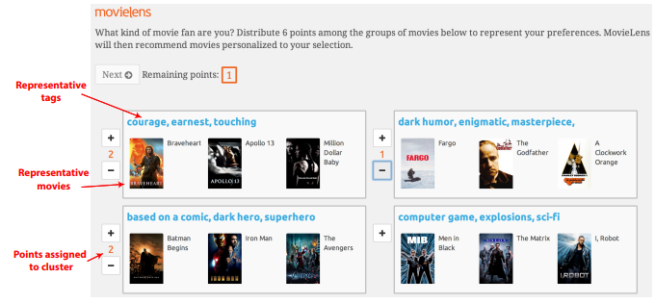
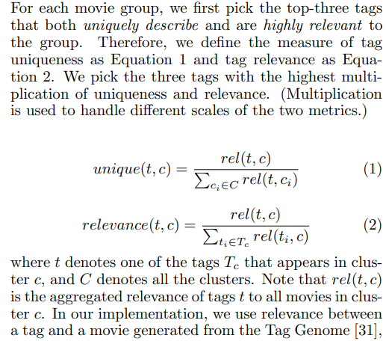
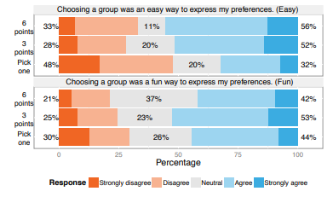
Preference Elicitation
Using Groups of Items for Preference Elicitation
in Recommender Systems
https://dl.acm.org/doi/pdf/10.1145/2675133.2675210
New users can begin by expressing their preferences for groups of items
  Utilize clustering to generate groups
  Based only on movie ratings
  For each cluster: select tags, then select best matching movies
  Get avg. ratings of users with similar cluster prefs.

