Slide 1
NDBI021 User preferences representation +
One third / one quarter in the middle of the semester
Peter Vojtáš
remaining parts Láďa Peška

Slide 2
Content
What is reality/context, our perception, goals, our expectation, reality and outcome of our action
SE, soft skills, Lean startup, design thinking, mockup
Repetition NSWI166, Decathlon commensurability, geometric visualization (close ~ similar), mockup
More general model, more dimensional data and still linear drawing
LMPM in 4D – strength, weakness
More shapes of attribute preferences
Some 3D models in geometric perspective
Next aggregation, learning, reality to model reduce
https://www.ksi.mff.cuni.cz/%7Epeska/vyuka/nswi166/2021_slides/NSWI166-05-RepresentLMPM.pdf

Slide 3
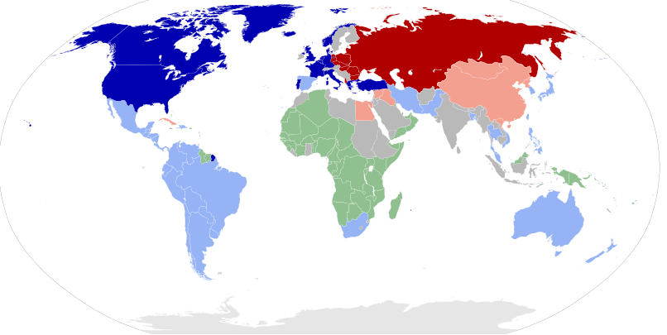
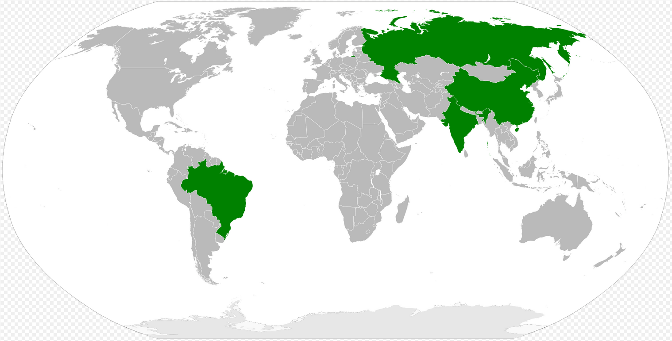
What is reality? What is our perception, goal? We can not change reality, let’s change our action! Am I the driver or am I being driven?
1950’s – 60’s
Currently

Slide 4
Setting goals and achieving them
Goals of customer x goals of seller ?
Does customer know what he/she is looking for?
What are goals of seller/producer?
Is a win-win strategy possible?

Slide 5
Expectations and reality – basis for a formal model
Challenge-Response Framework in lecture No. 4
My expectations challenge, goal my expectations outcome
Real world challenge, goal real world process outcome
IT model challenge, goal my action outcome

Slide 6
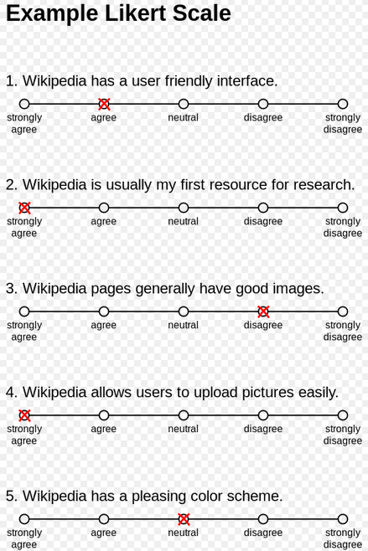
T-shape education in IT, do we need psychology,…?
Broad knowledge – I know I am not expert in these – to be able to ask and communicate
Law, economy, marketing soft skills empathy communication skills
Management concepts, Domain knowledge sociology, psychology, conflict management
IT - more and more about the people
and for the people
Quality – natural language (good, better, best, bad, worse, worst) - linear
we sense visual stimuli – e.g., depth and motion – step-wise, linear
psychology Likert’s scale, also linear
we will represent ordering by numbers
To be able to construct, implement, deploy
Deep in at least one programming language
Deep in at least one system
Deep in at least one IT discipline

Slide 7
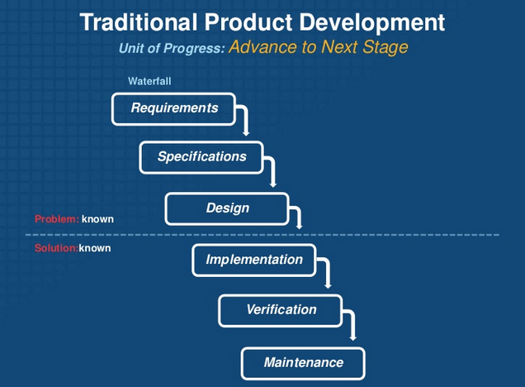
Software development methodologies
Lean Startup Meets Design Thinking

Slide 8
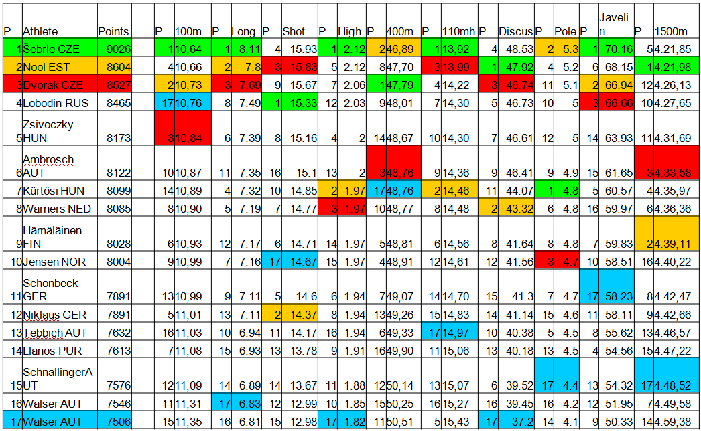
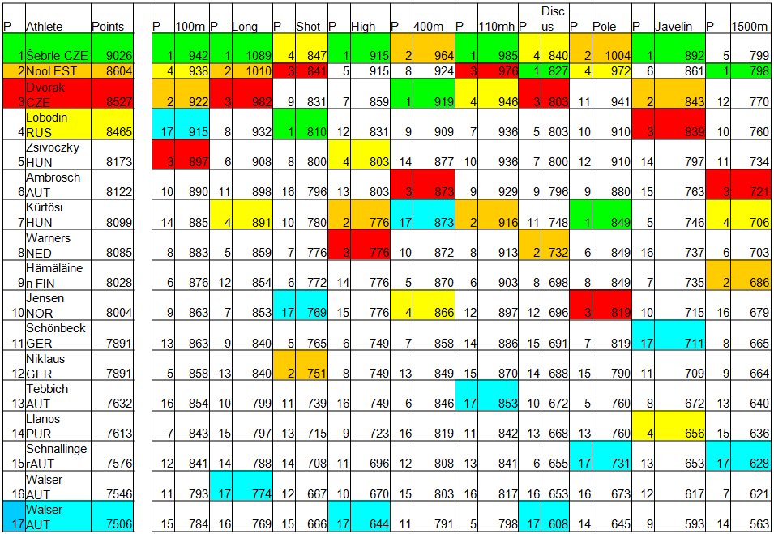
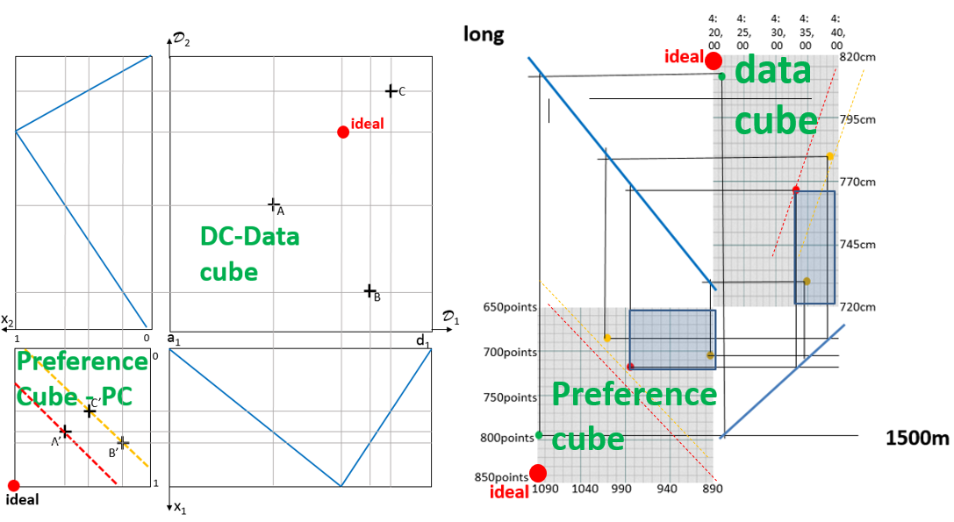
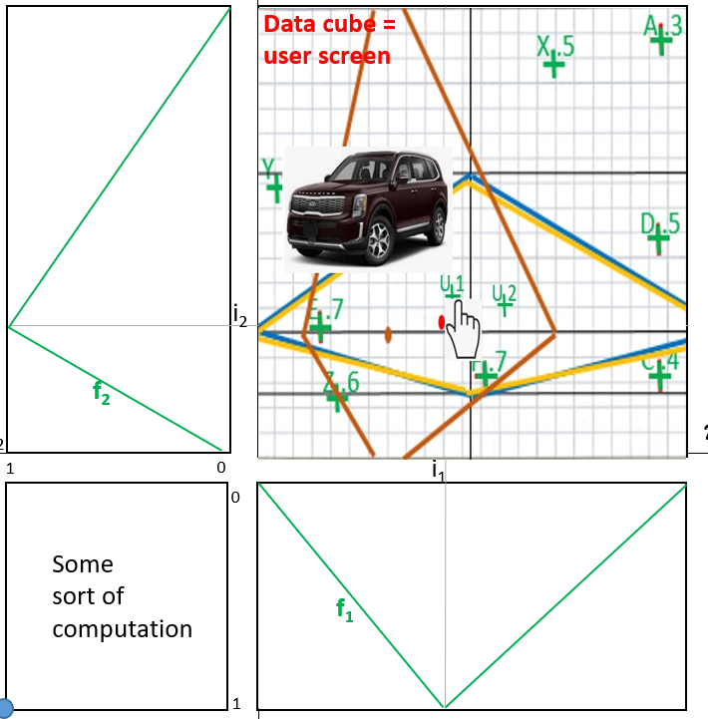
Decathlon commeasurable, geometry, mockup
→ short NSWI166 repetition

Slide 9
$$\frac{2∗\frac{x_{1}+x_{2}}{2}+3∗\frac{2∗x_{3}+x_{4}}{3}}{5}= \frac{2∗y_{1,2}+3∗y_{3,4}}{5}=z$$
Back from repetition - 4dim framework
0
D₂,D₄
d_{1,2}
Two 2D-DC
4D-PC
d_{3,4}
DC_{1,2}
1
1
DC_{3,4}
x₂
x₄
D₁
D₃
4d-ideal
1
PC_{1,2}
0
We have a 4dim preference model, decomposed to two 2dim (red, blue) ones with 2dim-DCs and 2dim-PCs. Diagonals are parallelly shifted and separated to 4dim aggregation (green)
PC_{3,4}
d_{1,2}
d_{3,4}
1
2d-ideal
x₁,x₃

Slide 10
$$\frac{2∗\frac{x_{1}+x_{2}}{2}+3∗\frac{2∗x_{3}+x_{4}}{3}}{5}= \frac{2∗y_{1,2}+3∗y_{3,4}}{5}=z$$
Two 2D-DC → 4D-PC
0
D₂,D₄
d_{1,2}
d_{3,4}
DC_{1,2}
y_{1,2}
y_{3,4}
y_{3,4}
DC_{3,4}
A
A
1
1
A
z
x₂
x₄
D₁
D₃
4d-ideal
1
0
To compute the overall preference of an item A with user’s four attribute preferences, aggregations. Partial preferences on 2D-PC diagonals are shifted to 4D-PC resulting in z
A
A
1
2d-ideal
x₁,x₃

Slide 11
Starting with 4dim
$$\frac{2∗\frac{x_{1}+x_{2}}{2}+3∗\frac{2∗x_{3}+x_{4}}{3}}{5}= \frac{2∗y_{1,2}+3∗y_{3,4}}{5}=z$$
4 dim deduction – easy part
We know the whole model
DC → PC it is easy to graphical calculate an item overall preference
4 dim from PC → DC
Calculate contour lines graphically is the same as ask query:
“which items are preferred more than ...”
It is a little bit more involved as 4 dim contour lines are 3dim hyper cubes
Induction will be challenging
Because FLN-LMPM model needs to know each attribute preference separately, and
And our graphics (on paper) is 2 dimensional ...

Slide 12
$$\frac{2∗\frac{x_{1}+x_{2}}{2}+3∗\frac{2∗x_{3}+x_{4}}{3}}{5}= \frac{2∗y_{1,2}+3∗y_{3,4}}{5}=z$$
4D-PC point on 0.8-4d cl to pairs of 2d cl’s, step 1
L
0
D₂,D₄
R
y_{1,2}
y_{3,4}
L
R
d
1
1
4Dcl0.6
d
D
4Dcl0.8
D₁
D₃
x₂
x₄
4d-ideal
1
0
4D point D has in 2x2D-PC sources product of 2Dcl0.6 and 2Dcl0.9, (2*.6+3*.9)/5 ≈ .8 (up to drawing error). Arbitrary combination of 2D-PC points d, d maps to D, ∞ sources on 2x2D-PC
d
2Dcl0.6
2d-ideal
d
1
2Dcl0.9
x₁,x₃

Slide 13
$$\frac{2∗\frac{x_{1}+x_{2}}{2}+3∗\frac{2∗x_{3}+x_{4}}{3}}{5}= \frac{2∗y_{1,2}+3∗y_{3,4}}{5}=z$$
4D-PC point on 0.8-4d cl to pairs of 2d cl’s, step 2
L
0
D₂,D₄
R
y_{1,2}
y_{3,4}
L
R
d
1
C
1
2Dcl0.9
B
A
4Dcl0.6
d
D
2Dcl0.6
4Dcl0.8
D₁
D₃
x₂
x₄
4d-ideal
1
0
Let’s see, where are sources of arbitrary combination of 2D-PC points d, d. These are arbitrary combination of 2D-DC points d, d from corresponding contour lines (images overlap)
d
2Dcl0.6
2d-ideal
d
1
2Dcl0.9
x₁,x₃

Slide 14
$$\frac{2∗\frac{x_{1}+x_{2}}{2}+3∗\frac{2∗x_{3}+x_{4}}{3}}{5}= \frac{2∗y_{1,2}+3∗y_{3,4}}{5}=z$$
0.6-4d cl to a system of pairs of 2d cl’s, step 1
L
0
D₂,D₄
R
L
y_{3,4}
L
R
d
1
C
1
B
A
4Dcl0.6
R
d
D
L
4Dcl0.8
D₁
D₃
x₂
x₄
R
4d-ideal
L
1
0
Let us see how dominating D behaves in 4D and in 2D
Take A incomparable, B tight, C clearly dominated
Let’s see dominatedness in 2D, both PC and DC. Let’s start with A (solid lines)
d
R
L
2d-ideal
d
1
R
x₁,x₃

Slide 15
$$\frac{2∗\frac{x_{1}+x_{2}}{2}+3∗\frac{2∗x_{3}+x_{4}}{3}}{5}= \frac{2∗y_{1,2}+3∗y_{3,4}}{5}=z$$
0.6-4d cl to a system of pairs of 2d cl’s, step 2
L
0
D₂,D₄
R
L
y_{3,4}
R
L
R
d
1
C
1
B
A
4Dcl0.6
d
D
4Dcl0.8
L
x₂
x₄
R
D₁
D₃
4d-ideal
1
0
L
We continue with point B
And square dot lines in 2D-PC (both red and blue) and
In 2D-DC (same coding)
Arrows in DC denote
Area of data points bigger
than contour line
L
d
R
R
2d-ideal
d
1
x₁,x₃

Slide 16
$$\frac{2∗\frac{x_{1}+x_{2}}{2}+3∗\frac{2∗x_{3}+x_{4}}{3}}{5}= \frac{2∗y_{1,2}+3∗y_{3,4}}{5}=z$$
0.6-4d cl to a system of pairs of 2d cl’s, step 3
L
0
D₂,D₄
R
R
L
y_{3,4}
L
R
d
1
C
1
L
B
A
R
4Dcl0.6
d
D
4Dcl0.8
D₁
D₃
x₂
x₄
L
4d-ideal
1
0
Finally for point C and round dot coding.
Attribute preferences are
“one sided”, hence there are single sources when
Moving from 2D-PC to 2D-DC, watch monotony
d
R
L
2d-ideal
d
1
R
x₁,x₃

Slide 17
$$\frac{2∗\frac{x_{1}+x_{2}}{2}+3∗\frac{2∗x_{3}+x_{4}}{3}}{5}= \frac{2∗y_{1,2}+3∗y_{3,4}}{5}=z$$
0.6-4d cl to a system of pairs of 2d cl’s, step 4
L
0
D₂,D₄
R
R
L
y_{3,4}
L
R
d
1
C
1
L
B
A
R
4Dcl0.6
d
D
D
4Dcl0.8
D₁
D₃
x₂
x₄
L
4d-ideal
1
0
Dominating and dominated areas in 4D become inclusions between pairs of
areas above contour lines -
Both areas must be in inclusion. See also D’s cl’s in
light red and light blue
d
R
L
2d-ideal
d
1
R
x₁,x₃

Slide 18
$$\frac{2∗\frac{x_{1}+x_{2}}{2}+3∗\frac{2∗x_{3}+x_{4}}{3}}{5}= \frac{2∗y_{1,2}+3∗y_{3,4}}{5}=z$$
4d points easy to depict&compute
L
D₂,D₄
R
L
R
d .8
d
D
x₂
x₄
D₁
D₃
This is a template for you future solutions
4D points have coordinates multiples of 0.1 and 4D contour lines are also multiples of 0.1.
d
d
x₁,x₃

Slide 19
$$\frac{2∗\frac{x_{1}+x_{2}}{2}+3∗\frac{2∗x_{3}+x_{4}}{3}}{5}= \frac{2∗y_{1,2}+3∗y_{3,4}}{5}=z$$
To compare with
4d cube
L
0000
D₂,D₄
R
L
R
D .8
1100
0011
D .8
D
x₂
x₄
D₁
D₃
1111
Again, a template to help
you in constructions
4D-PC has corners denoted with value of variables x₁, x₃ , x₂ , x₄ , as preparation for next slide with another
Visualization of 4D cube
D
D
D
x₁,x₃

Slide 20
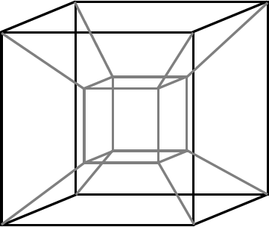
To compare with
4d cube
0.2/0.8 contour line in 4D is a 3D
hypercube, here only intersections
with 4D-cube faces are depicted
0111
d₁₂¹
0011
B
1011
0000
A
d₁₂⁰
0010
1110
0.2
D
d₃₄⁰
C
d₃₄⁰
d₃₄¹
x₃
1100
0011
D
x₂
d₁₂⁰
x₁
C
1000
x₄
1101
d₃₄¹
0.8
B
A
d₁₂¹
x₂
x₄
0001
1001
1111
1
0
d₃₄
Each visualization has some
advantages and disadvantages,
please comment
d₁₂
1
x₁,x₃

Slide 21
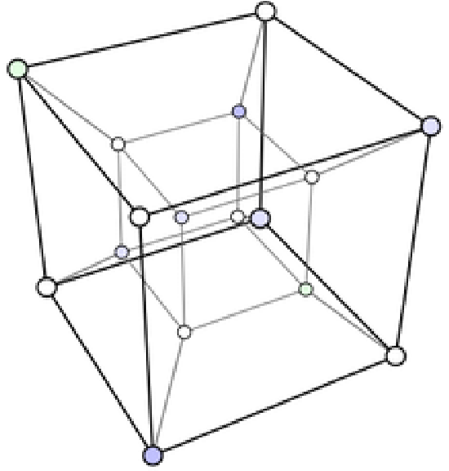
Another view of 4d cube
construct all as in previous slide
0000
d₁₂⁰
D
0.2
C
d₃₄⁰
x₃
x₂
1100
0011
x₁
d₃₄¹
0.8
B
A
d₁₂¹
x₄
x₂
x₄
0
1111
1
d₃₄
d₁₂
What is preserved? What not? Parallelism, ratio of distances? ...
1
x₁,x₃

Slide 22
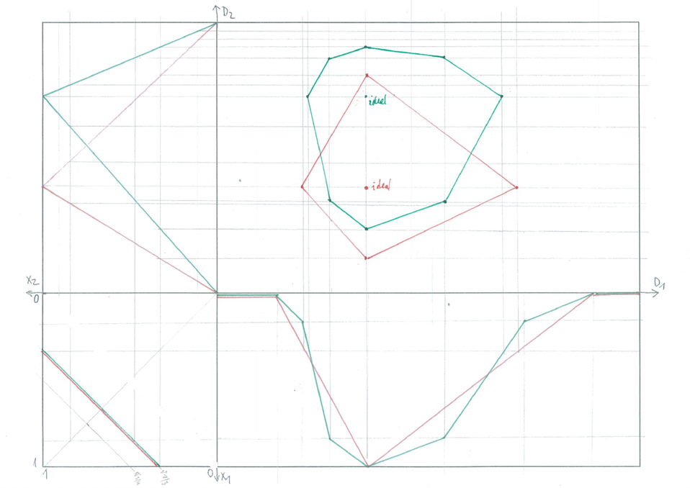
Partially linear approximations of preferences
f₂^{u}
We proceed similarly
as before from PC to
DC, just – we must
be considering each
linear part of f₁^{u}
separately
f₁^{u}

Slide 23
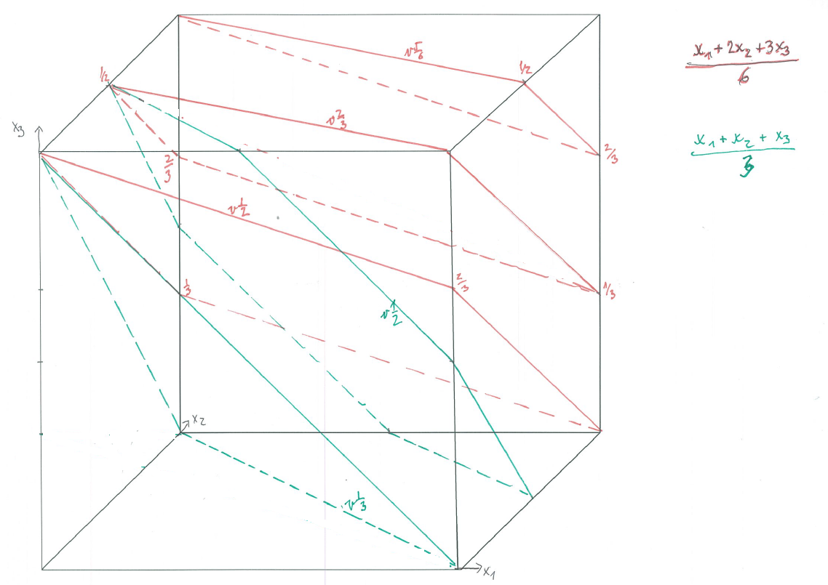
Preference cube in 3D with contour surface wrt different aggregations
Calculate each
aggregation in all corner points – we obtain the “height above the sea level” of respective contour plane. Then find remaining intersection with edges of the cube and use the assumption that contour planes are parallel in parallel projection

Slide 24
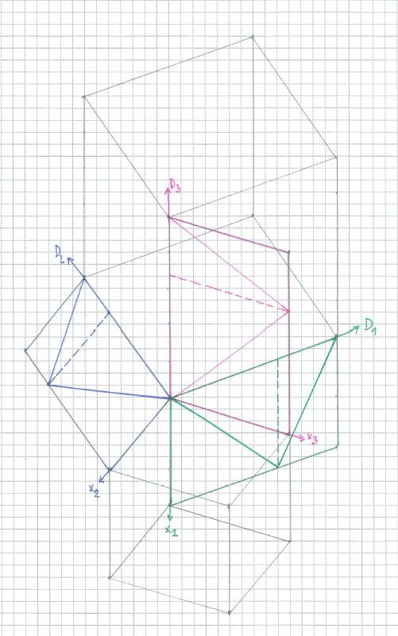
3D-DC-PC
DC
Let’s try to visualize a
3D LMPM model
PC

Slide 25
3D-DC-PC
DC
Consider 3D LMPM in parallel projection .
First observe DC, each
domain denoted with different color.

Slide 26
3D-DC-PC
DC
Continue with 3D LMPM in parallel projection .
We would like to depict PC, nevertheless, to be able to visualize transformations from DC→PC and PC→DC, we must design it simultaneously with attribute preferences.
First observe DC, each
domain denoted with different color.
PC

Slide 27
3D-DC-PC
DC
Continue with 3D LMPM in parallel projection .
We would like to depict the ideal point.
In the PC it is easy.
Using ideal points in each dimension and using assumption of parallel imaging we can find the DC ideal point
3d-DC-ideal
PC
3d-PC-ideal

Slide 28
3D-DC-PC
Continue with 3D LMPM in parallel projection .
Having a point in PC let’s try to find corresponding points in DC (in fact there are 8 of them, let’s depict one)
Point must be given with preference degree in each attribute (else there are many points with same visual position). Then on the preference function find (one) attribute value with this preference degree, having attribute coordinates construct the point in DC
DC
PC

Slide 29
Conclusions
We discussed What is reality, our perception, goals, our expectation, reality and outcome of our action, T-shape view, psychology scales, SW development
We recalled NSWI166, Decathlon commensurability, geometric UI, homework – geometric mockup
We developed more general, more dimensional data and still linear drawing
LMPM in 4D – DC₄ to PC₄ it is OK, from PC₄ to DC₄ it is ambiguous
More shapes of attribute preferences requires patience
In 3D we have contour planes, 3D LMPM model is more involved, in parallel geometric perspective is straightforward

Slide 30
Questions?
Comments?

Slide 31
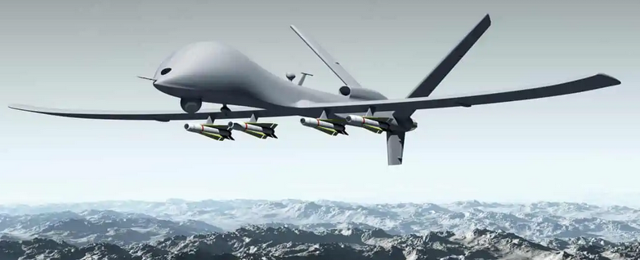
Humans in the Loop: The Design of AI Systems

Slide 32
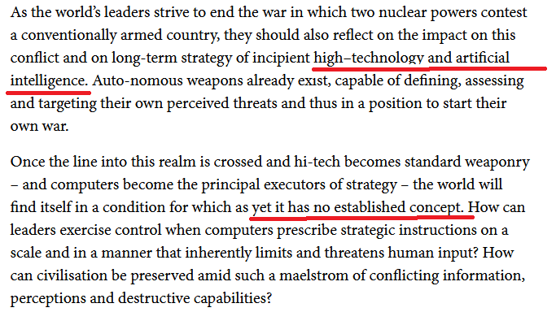
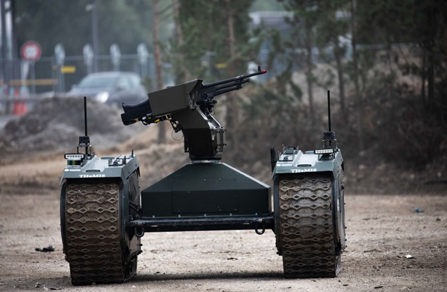
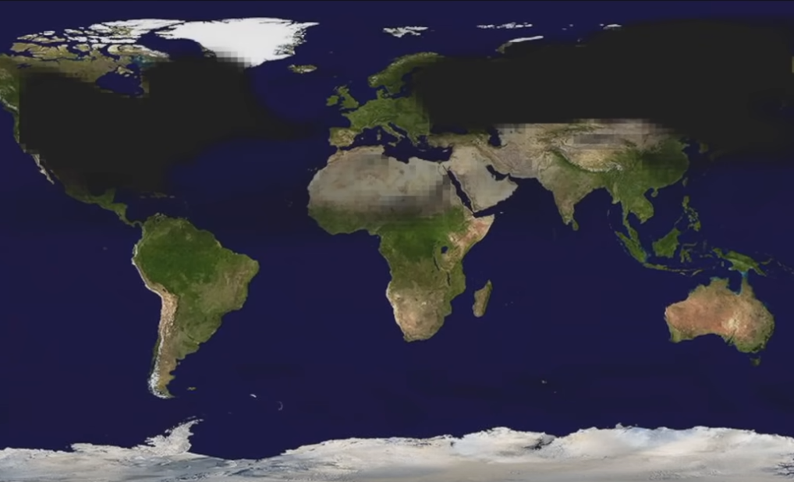
WW1
WW3
Nuclear Dilemma in the Age of the Intelligent Bomb
‘Catalytic nuclear war’ in the age of artificial intelligence
& autonomy: Emerging military technology and escalation
risk between nuclear-armed states

Slide 33
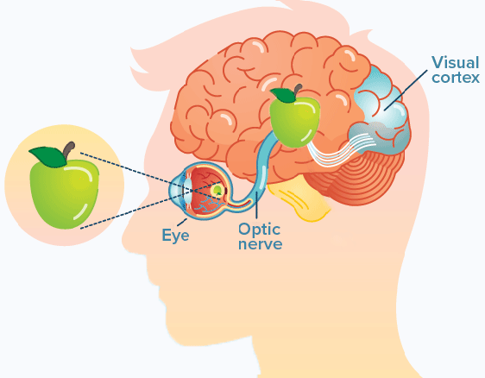
User preferences – human in the loop/in the center
Human-in-the-loop or HITL is defined as a model that requires human interaction. Requires – assumes – serves human need
Human interaction – reaction triggered by senses, observation, use-case, task, expectation, situation …
reaction physical, reaction mental, psychical, sociological
1.2 million retinal ganglion cells
photoreceptor cell convert light
(visible electromagnet radiation)
into biological signals
~ 120 million rods (tyčinky,černobílé,92)
~ 6 million cones (čípky,barevné, 4.6))
Each human optic nerve contains
~ 770,000 - 1.7 million nerve fibers

